Slide 1
Updated sensitivities and comparisons of DA and tune working point scans
S.M.Liuzzo, ESRF, Grenoble

Slide 2
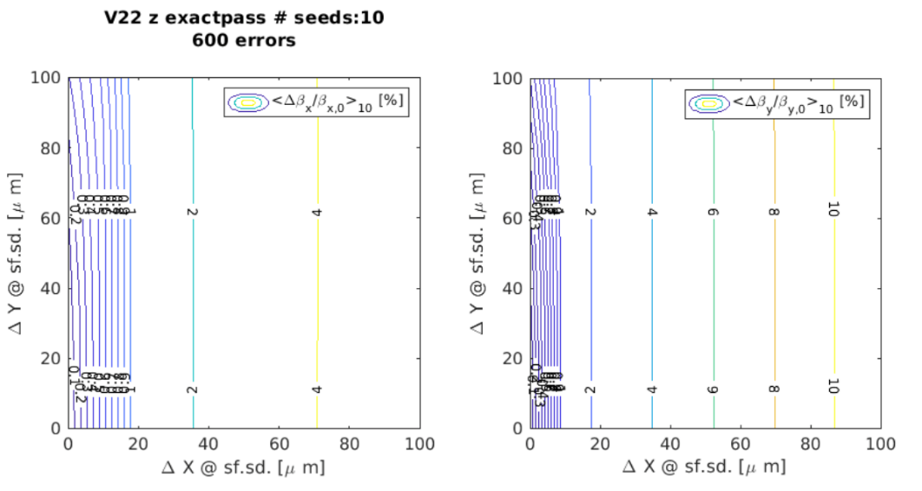
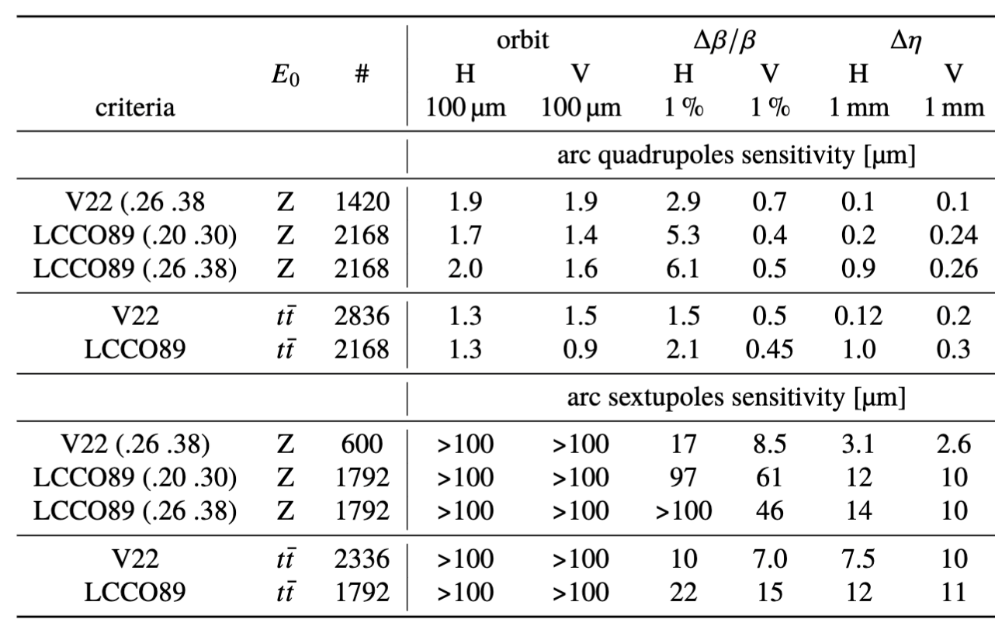
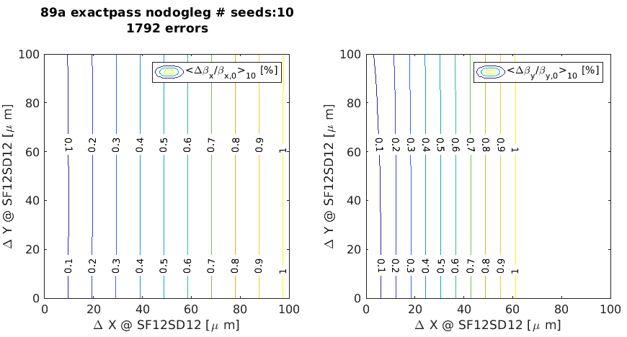
Arc alignment sensitivities
LCCO is less sensitive to errors (larger errors provide the same optics distortion)
This is still the case for LCCO at the same tune of V22 (.26 .38)

Slide 3
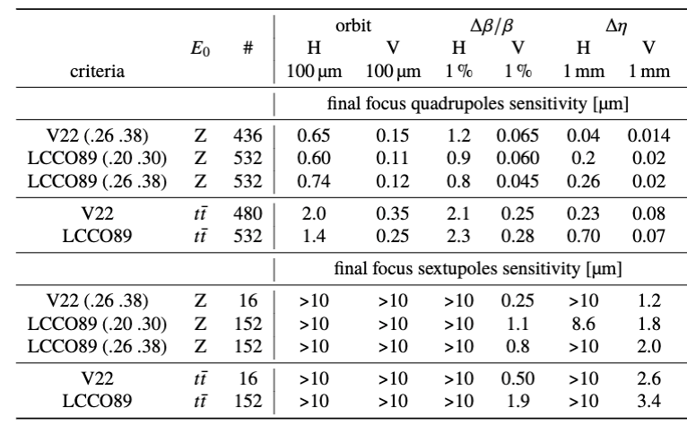
Final FocUs alignment sensitivity
Better for V22
Better for LCCO
~4x better for LCCO
Orbit in FF sextupoles has to be maintained at this level during operation

Slide 4
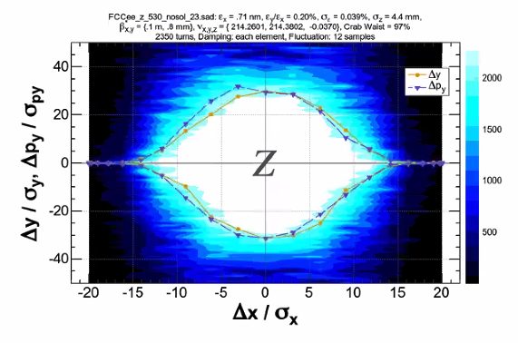
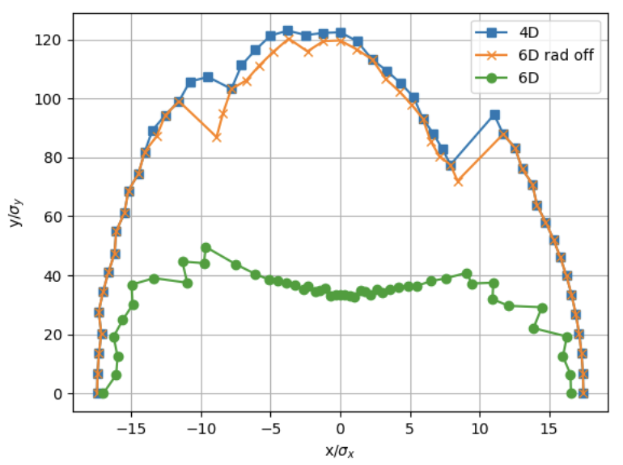
Comparison of AT and SAD DA computations for V22
fluctuation == quantum diffusion in AT not included
SAD
AT
K.Oide
Radiation in all elements, exact integrators, 2350 turns, Ey/Ex = 0.2%
damping at each element in AT is assumed as Radiation at each element.

Slide 5
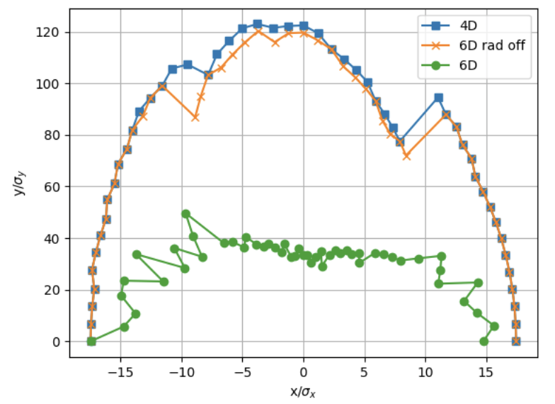
Comparison of AT and SAD DA computations for V22
fluctuation == quantum diffusion in AT included
SAD
AT
1 SEED
K.Oide
Radiation in all elements, exact integrators, 2350 turns, Ey/Ex = 0.2%
damping at each element in AT is assumed as Radiation at each element.

Slide 6
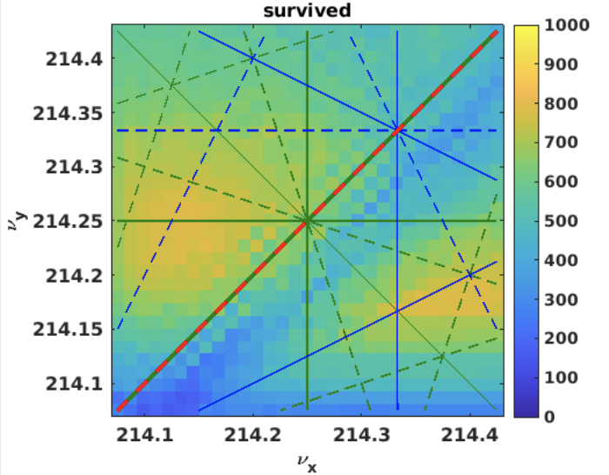
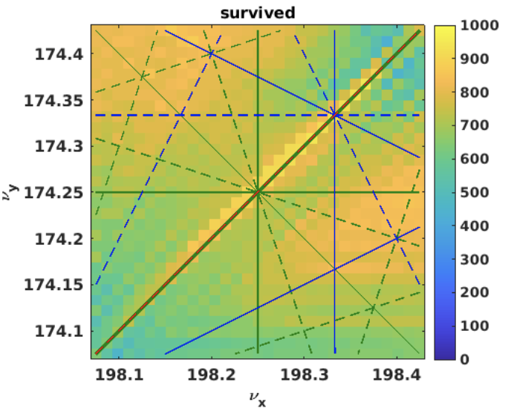
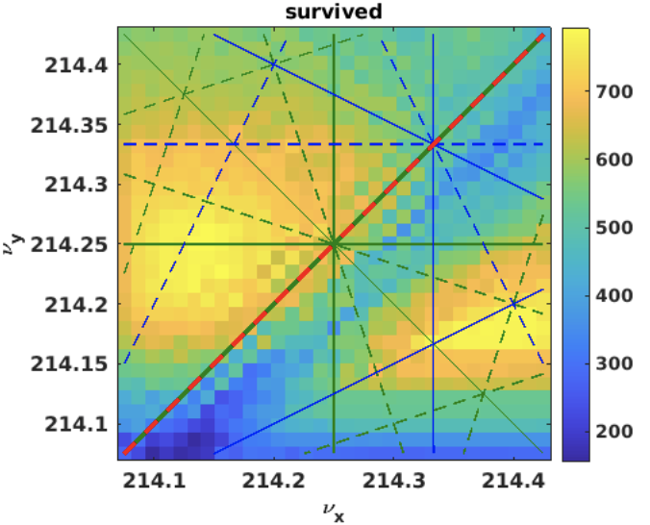
Stability about Tune working point
Track a 3D grid of 1000 particles of size: 20σ_{x} x 20σ_{y} x 0.002 δp/p for 512 turns for different tunes.
Tune varied using ARC quadrupoles. Chromaticity corrected to initial value after tune change.
Small (10 nm) random errors added to all elements, no corrections (to emphasize resonance lines).
V22
LCCO89
Lattice WP
Lattice WP
Operation WP
Operation WP

Slide 7
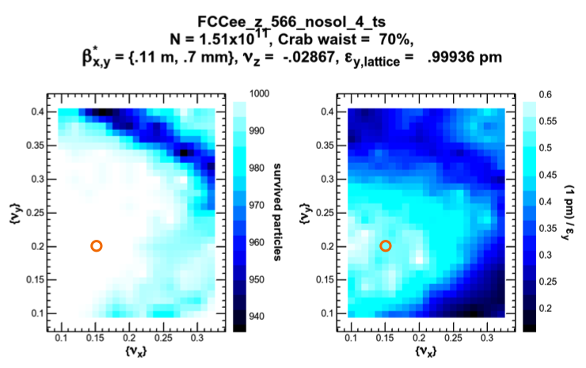
Tune working point scan for V22
SAD
AT
Track a 3D grid of 1000 particles of size: 20σ_{x} x 20σ_{y} x 0.002 δp/p for 512 turns for different tunes.
Tune varied using ARC quadrupoles. Chromaticity corrected to initial value after tune change.
Small (10 nm) random errors added to all elements (to emphasize resonance lines).
K.Oide

Slide 8
Tune working point scan for V22
SAD
AT
Track a 3D grid of 1000 particles of size: 20σ_{x} x 20σ_{y} x 0.002 δp/p for 512 turns for different tunes.
Tune varied using ARC quadrupoles. Chromaticity corrected to initial value after tune change.
Small (10 nm) random errors added to all elements (to emphasize resonance lines).
K.Oide

Slide 9
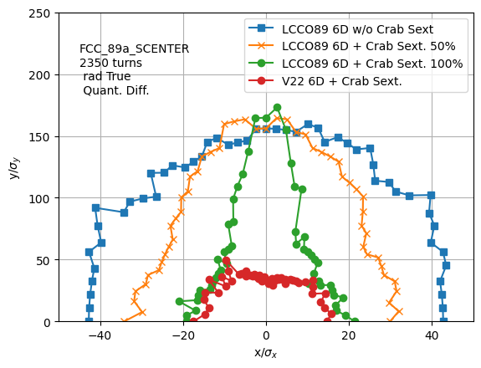
Dynamic aperture at Straight section
Crab 100% = 80% of geometric value
FOLLOW UP on DA optimization with Crab Sext. for LCCO optics
Commissioning
Tuning with progressive increase of Crab sextupoles.
Final configuration for Luminosity production.

Slide 10
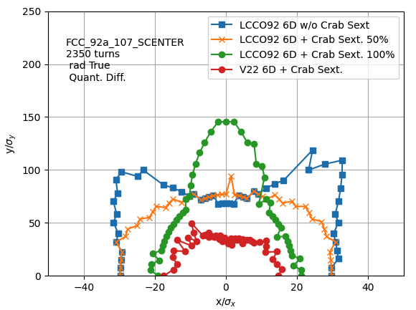
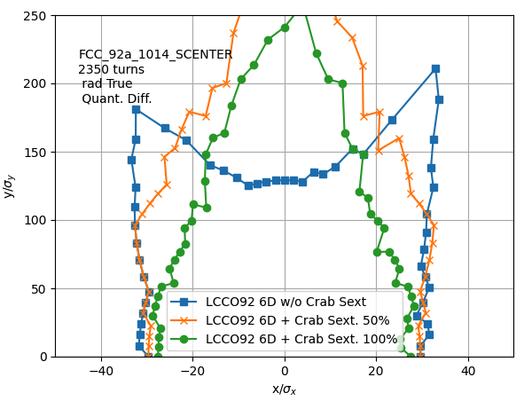
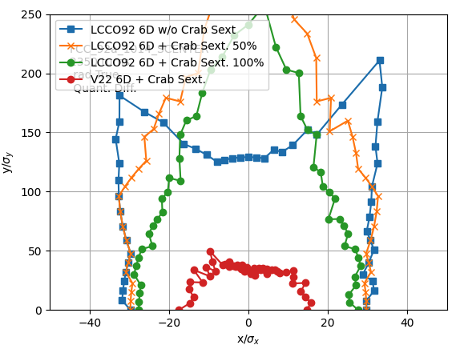
Up to date IP beta* and corresponding Relaxed optics LCCO92
updated β*
β∗_{h}=10cm, β∗_{v}=0.7mm
Relaxed β*
β∗_{h}=10cm, β∗_{v}=1.4mm
β∗_{h}=10cm, β∗_{v}=0.7mm give DA larger in Hor. and Ver. with respect to β∗_{h}=15cm, β∗_{v}=0.8mm
Decapoles optimized ONLY for “CRAB Sext. 100%” (80% of geometric value)

