Slide 1
SuperKEKB Status
- a few of the slides presented by Y. Ohnishi at last week’s STCF workshop
Frank Zimmermann
FCC-ee Optics Design Meeting #178, 25 January 2024

Slide 2
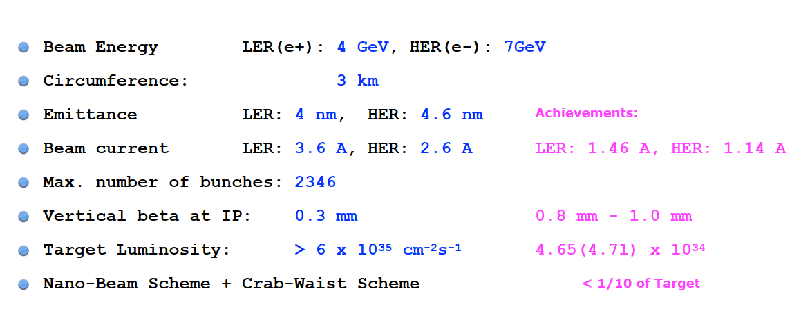

Slide 3
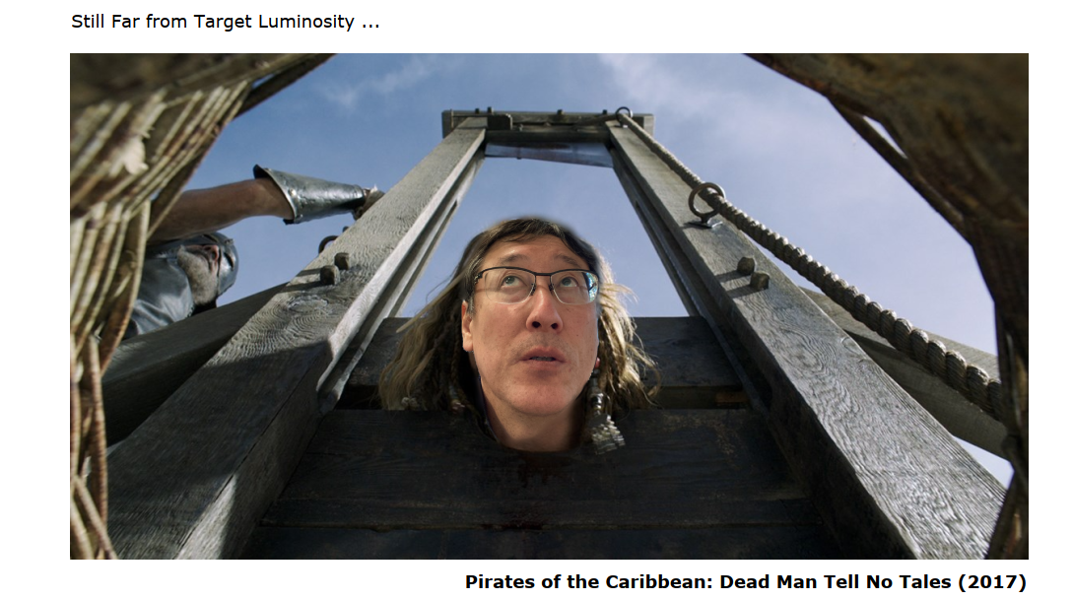

Slide 4
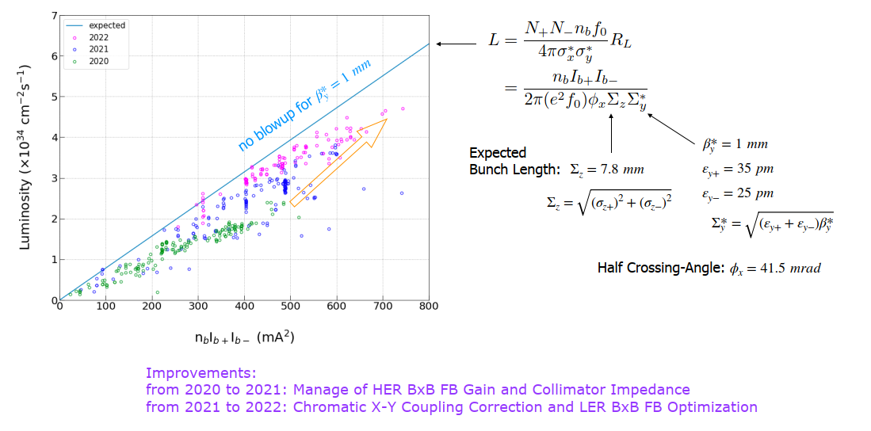

Slide 5
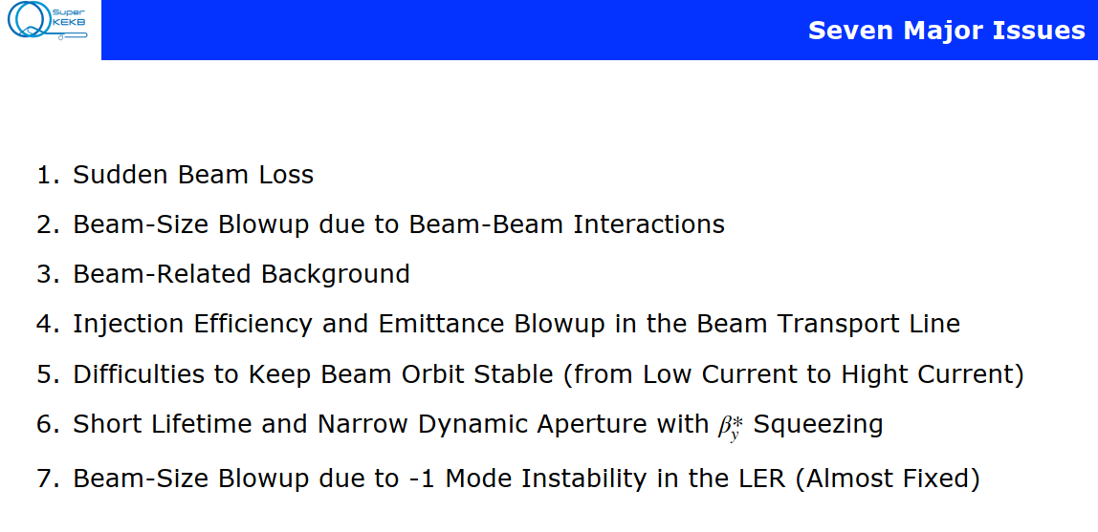

Slide 6
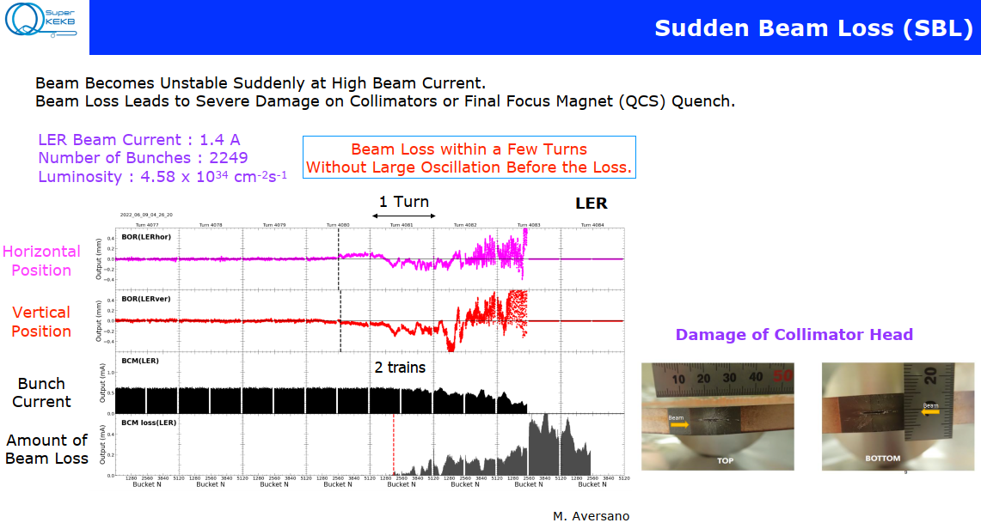

Slide 7
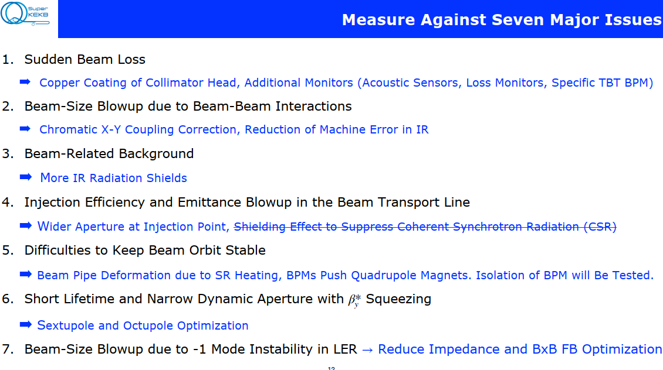

Slide 8
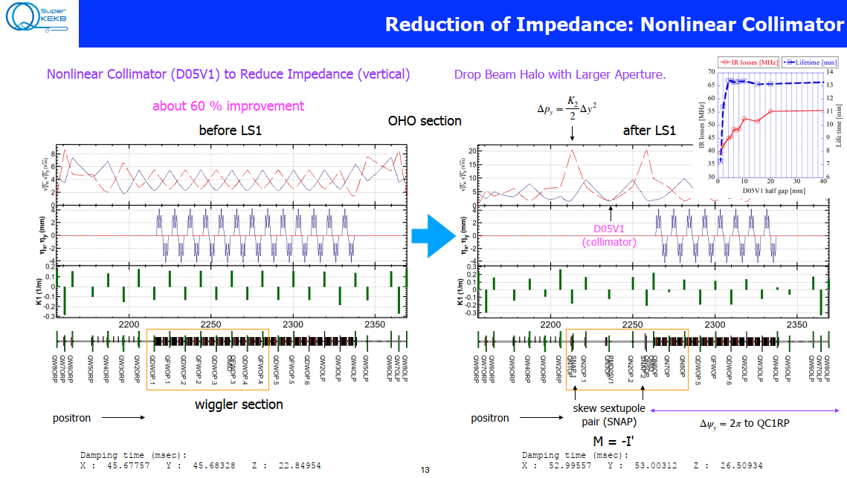

Slide 9
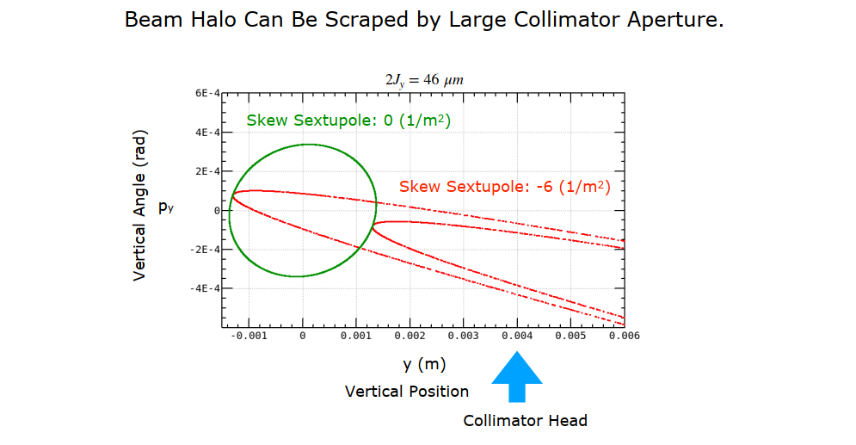

Slide 10
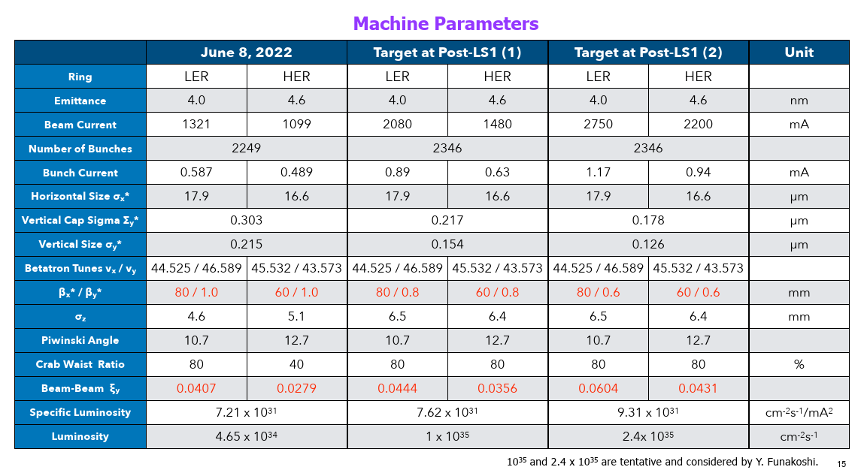

Slide 11
