Slide 1

SM18 Vertical/Horizontal Test Setup
LHC Crab Cavity Engineering Meeting
Session: Cavity Cryostat Testing & Integration in SM18
A. Benoit, O. Brunner, J. Chambrillon, E. Jensen, K. Liao , P. Maesen
BE/RF at CERN

Slide 2
OUTLINE
CAVITY PREPARATION AND ASSEMBLY AT CERN
- EXISTING ASSEMBLY AREA AND CLEAN ROOMS
- CLEANROOM LAYOUT (Existing facility in SM18)
- CLEANROOM LAYOUT (Updated)
- HIGH PRESSURE RINSING (HPR) AND ULTRA PURE WATER PRODUCTION
RF TEST FACILITES
- NEW RF CRYO INFRASTRUCTURE AT SM18
- RF POWER ZONE
- AVAILABILITY FOR CRAB CAVITY
- RF CONTROL ROOM
DIAGNOSTIC SYSTEMS
- OSCILLATING SUPERLEAK TRANSDUCER AND TEMPERATURE MAPING
- OPTICAL INSPECTION
CONCLUSIONS

Slide 3
CAVITY PREPARATION AND ASSEMBLY AT CERN

Slide 4
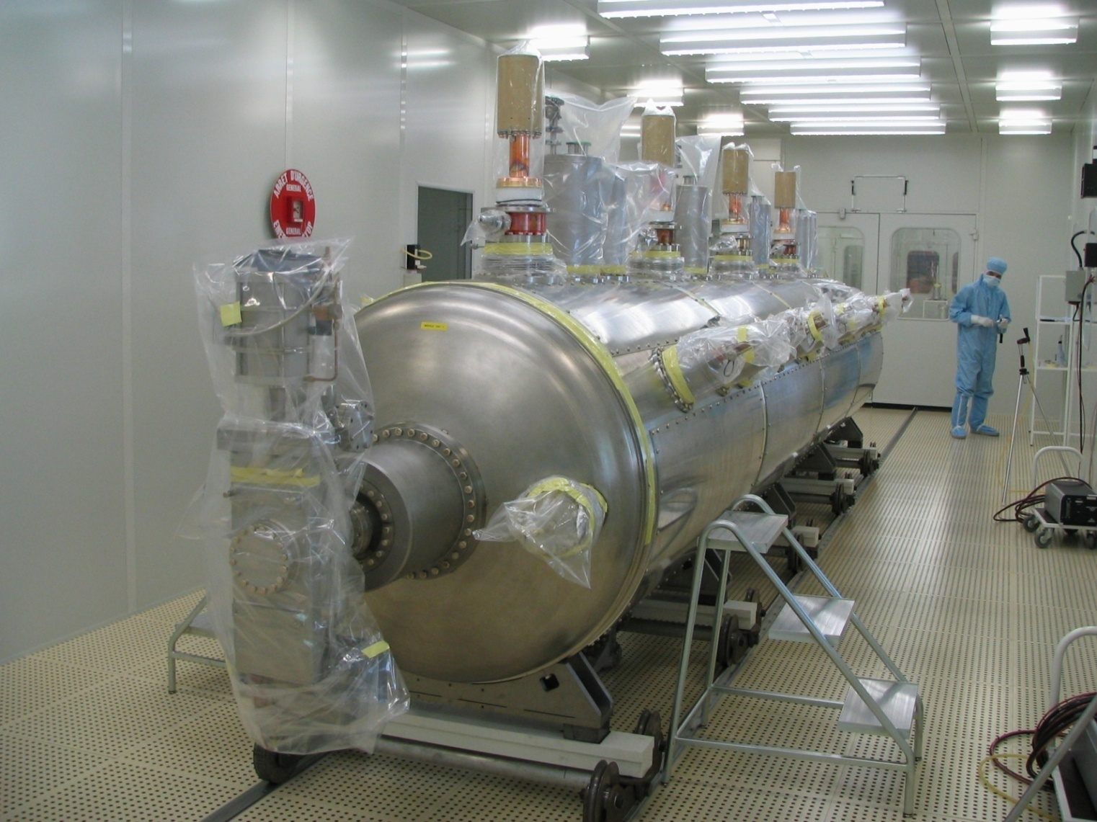
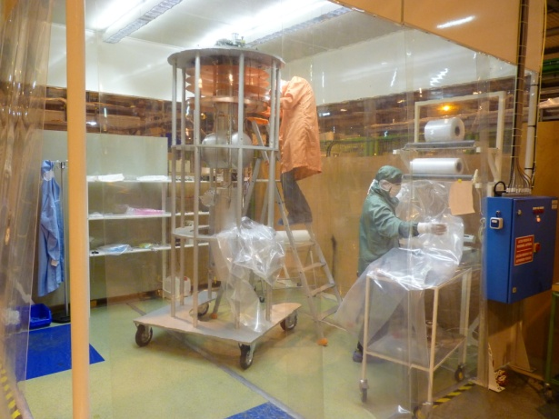
EXISTING ASSEMBLY AREA AND CLEAN ROOMS
  Building 252:
      - Low pressure ultra pure water rinsing (max 10 bars)
      - Two clean room ISO 5
    SM18:
    - Assembly area ≈ 120 m²
    - “Baldaquin”: ISO 5 clean room (for tall items such as HIE ISOLDE cavities, main couplers)
    - Two 13 meters long clean rooms (ISO 7, ISO 4)
    Well adapted for crab cavities preparation
    and assembly

Slide 5
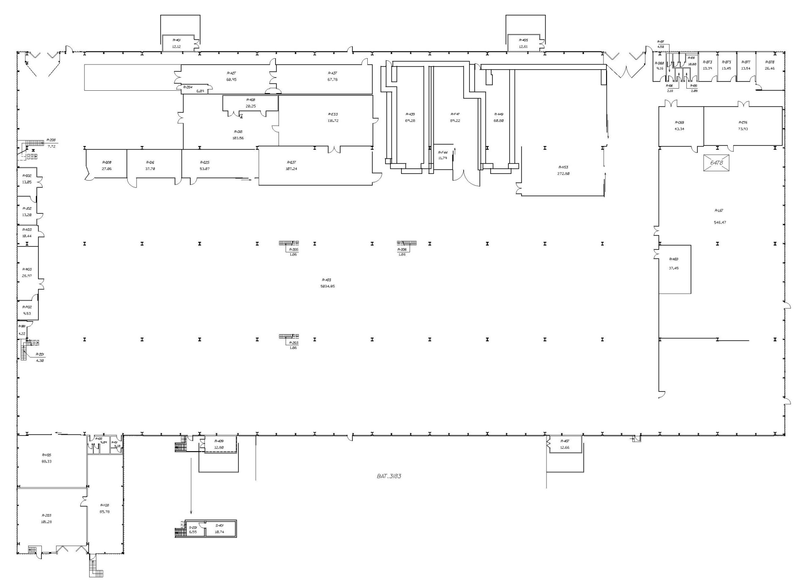
CLEANROOM LAYOUT (Existing facility in SM18)
Cleanroom facility
RF facilities
Cryogenic
Magnet
SM18, plan

Slide 6
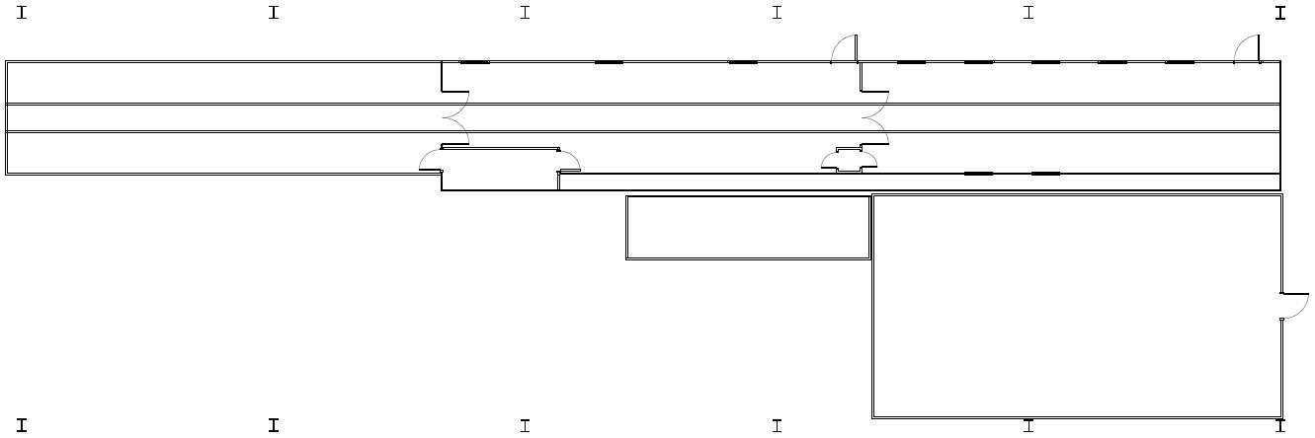
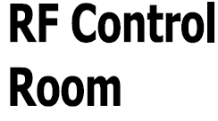
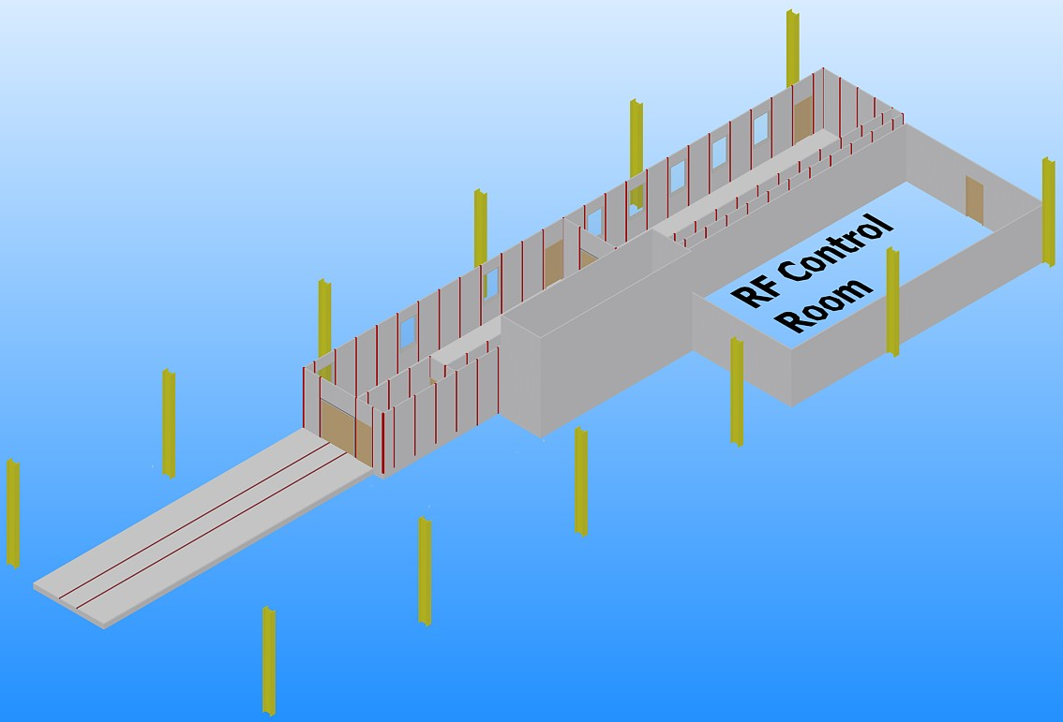
CLEANROOM LAYOUT (Actual)
ISO 7
ISO 4
Air Box
ISO 14644-1 | FS 209
4 | 10
5 | 100
7 | 10 000
Built in 1991.
Goals :
  Increase cleanliness.
  Create a rinsing room.
  Get ride of the Air Box to gain space.

Slide 7
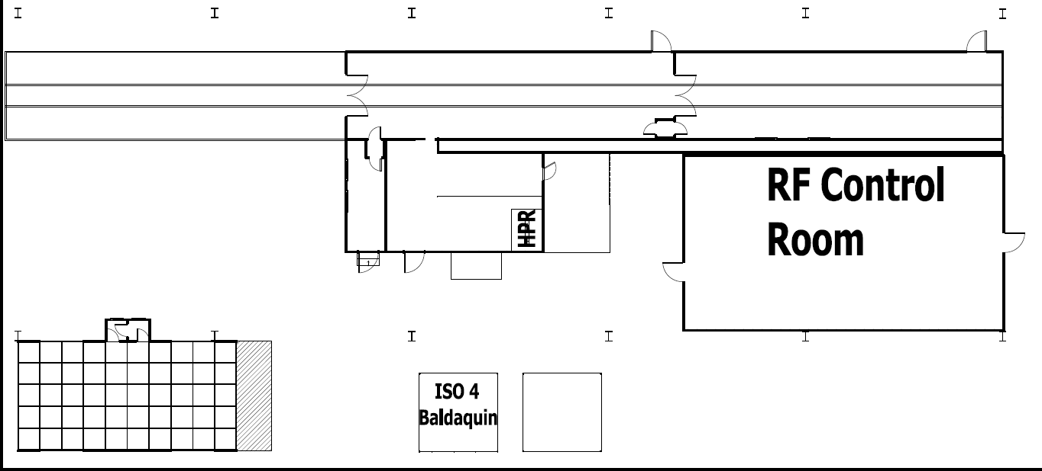
CLEANROOM LAYOUT (Updated)
ISO 5
ISO 4
ISO 5
ISO 4
Optical
Inspection
Extension of the rinsing room
Creation of a preparing room outside of the facility

Slide 8
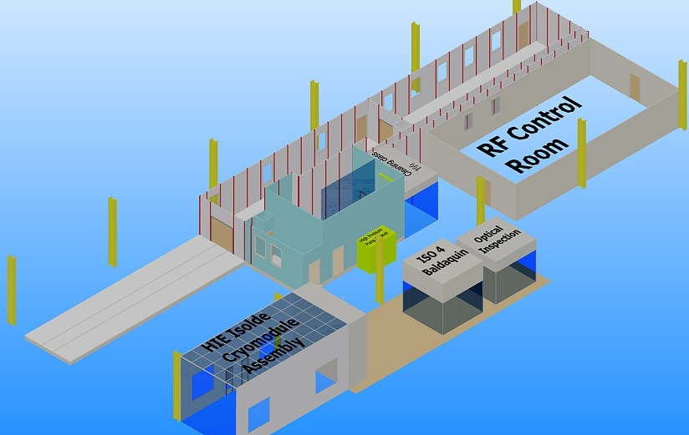
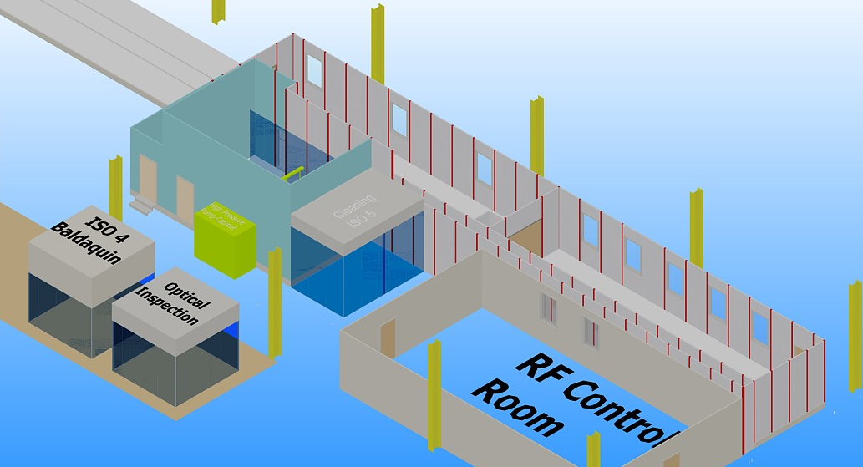
CLEANROOM LAYOUT (Updated)
Refurbishment of the filtering system with Fan Filter Unit (FFU).
Rinsing room extended to 4.5m high to held the HPR.
Preparing room based on softwall design.

Slide 9
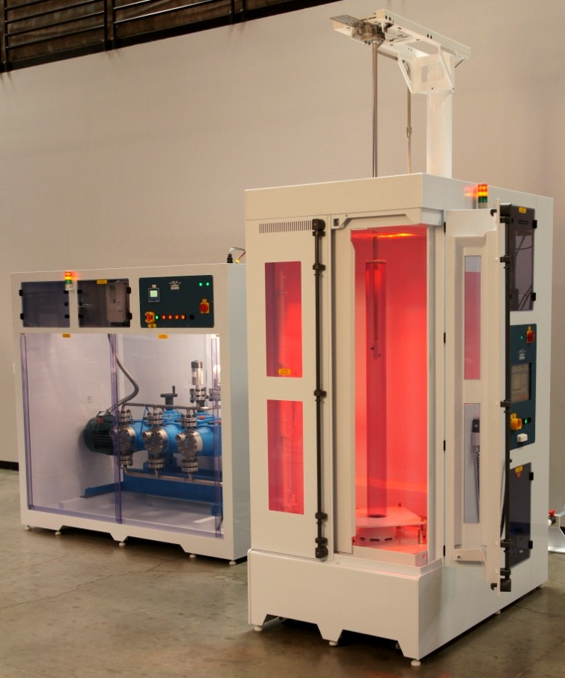
HIGH PRESSURE RINSING (HPR)
HPR from SPEC (US)
HP pump (140 bar, 1.1 m³/h)
@ 3 stages to prevent vibration
Rinsing cabinet with top wand
design (needed in SM18)
Cabinet should shall have a pass
trough design => load/unload from
different class cleanrooms
Drying of the cavity by blowing hot N₂
Rinsing nozzle to be designed

Slide 10
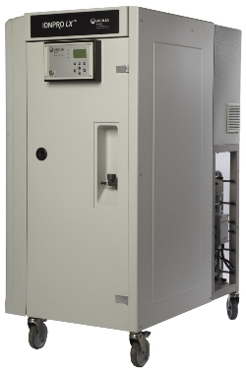
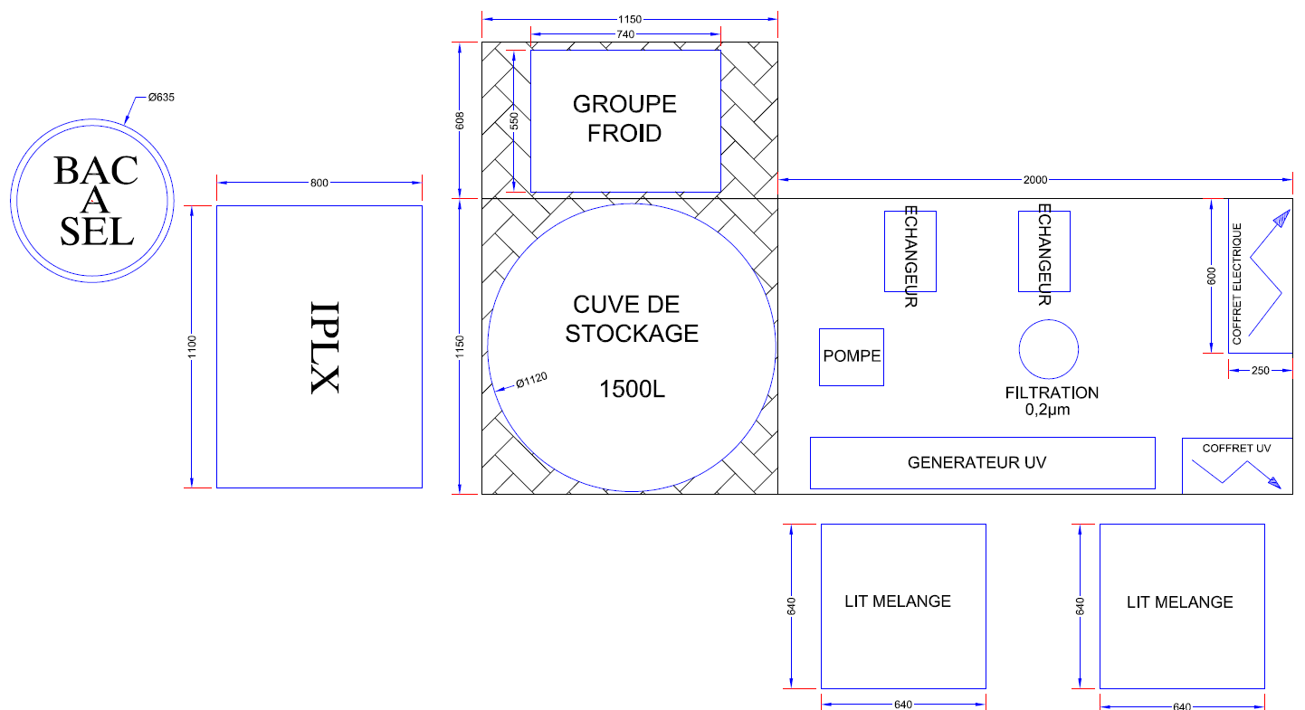
ULTRA PURE WATER PRODUCTION
Pre-design of the installation
Production capacity of 1 m³/h
UV lamp (185 nm) to prevent bacteria growing and
decrease Total Organic Carbone (TOC):
  C_{X}H_{Y}O_{Z} -> CO₂ + H₂0 -> H₂CO₃ -> H⁺ + HCO³⁻
HCO³⁻ absorbed by
polishing resin.
Need to cool down
the recirculation
water due to the
temperature in
SM18

Slide 11
RF TEST FACILITES

Slide 12
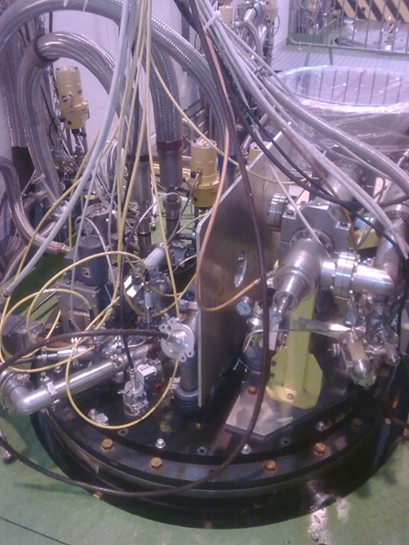
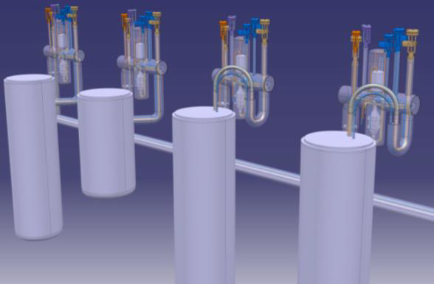
NEW RF CRYO INFRASTRUCTURE AT SM18
The new cryo line is under replacement (hardware and process)
available in march 2013
Vertical test stands
2 cryostats for measurement at 4.5K
- 1 long (4m) for spare LHC cavities
- 1 short (2.4m) for HIE-ISOLDE
2 new cryostats for measurement at 2K
- 1 Long (h= 4m) for Crab (400 MHz) and SPL (704 MHz) cavities
- 1 short cryostat (2.5m)
New cryostat for 2K measurement
- Welded connection
- Integrated pumping
- Active screening
- Earth magnetic field compensation

Slide 13
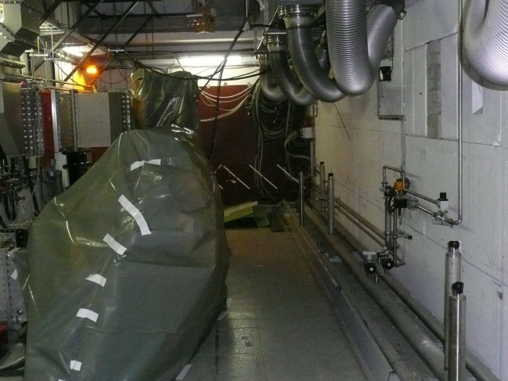
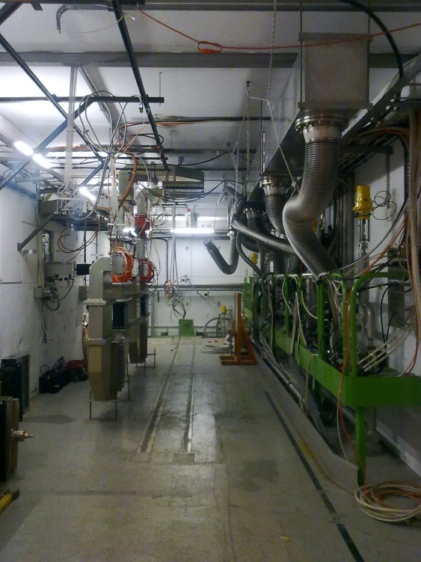
NEW RF CRYO INFRASTRUCTURE AT SM18
Horizontal test stands
Bunker A:
      - Linac 4 RF structure tests: -> end 2012
        Makes use of the existing 352 MHz power system & rad. safe bunker
      - SPL: 2013
        704 MHz RF power system will replace the 352 MHz system
4.5K and 2K measurement
Hard cryogenic connection
Bunker B:
- LHC
        Spare cryo modules tests, development of LLRF electronics & control tool
        - HIE-ISOLDE cryo modules (end of 2013)
      4.5K and 2K measurement
      Flexible cryogenic connection
CCDTL
Dismantling old lines

Slide 14
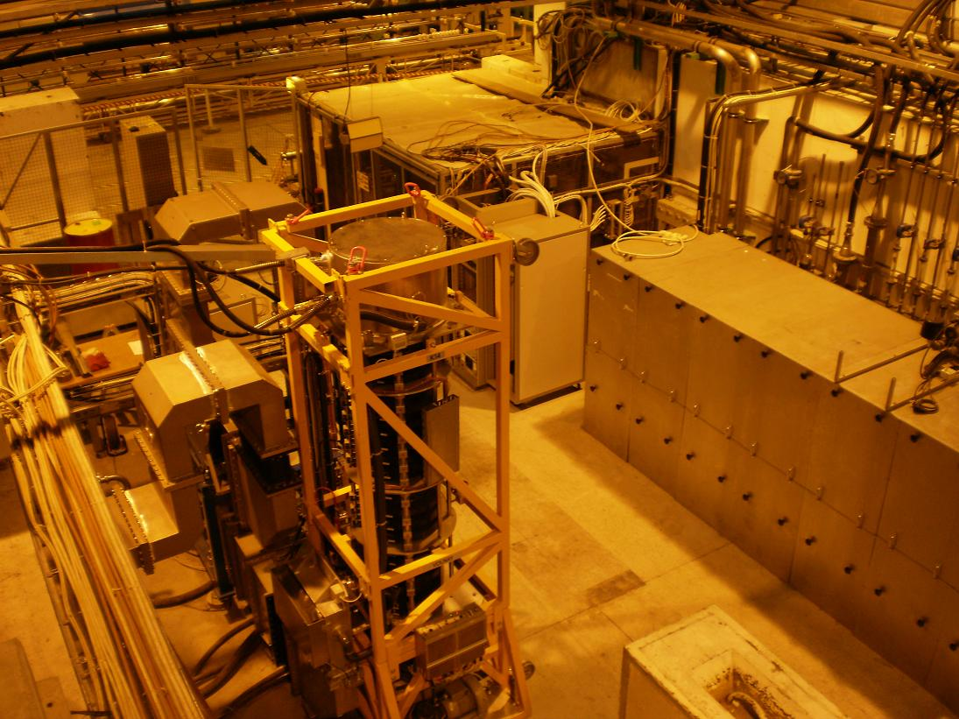
RF POWER ZONE
    Equipped with:
      Demineralized cooling water
      100 kV, 40 A power converter
      400 MHz, 300 kW CW LHC power system
      352 MHz, 1.2 MW pulsed power system (1.6ms/2Hz)
        - Later a 704 MHz pulsed power system will be installed (1.6 ms / 50 Hz)
    Very crowded area:
        Cannot be significantly extended (unfortunately)
        Installation of additional power source + associated power distribution system
        to be studied in details…but look rather complicated!

Slide 15
AVAILABILITY FOR CRAB CAVITY
Cavity tests:
Possible (we did a first test in November)
Need to improve the cavity support on the insert (under study for the next test)
Cryo-module tests:
    Power source is ok (400 MHz, 300 KW) , difficulty for 400 MHz at 2K
    Bunker B: need of adaption for the cryo connection for 2K (flexible to hard)
    Bunker A: need to install a new power distribution
Complicated (no space), we have to study this in detail, and manage with the other projects
One additional cost is to be expected

Slide 16
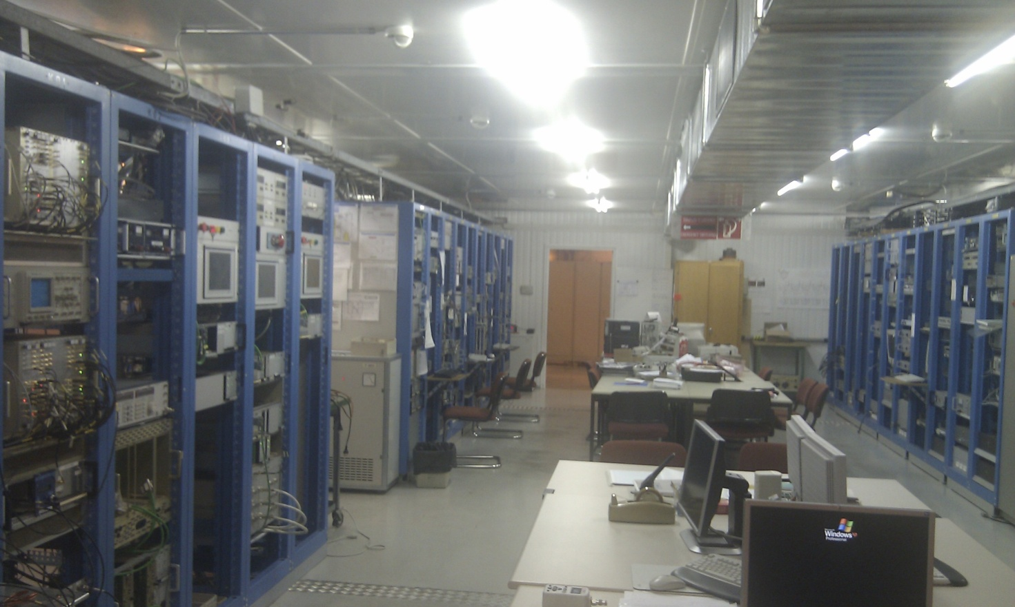
RF CONTROL ROOM
    Common control room for:
      Each vertical cryostats
      Each RF bunkers
        - Complete LHC LLRF system

Slide 17
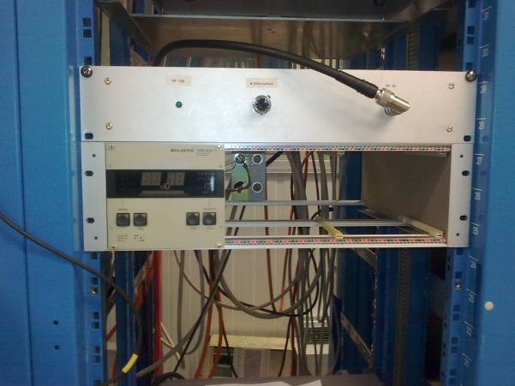
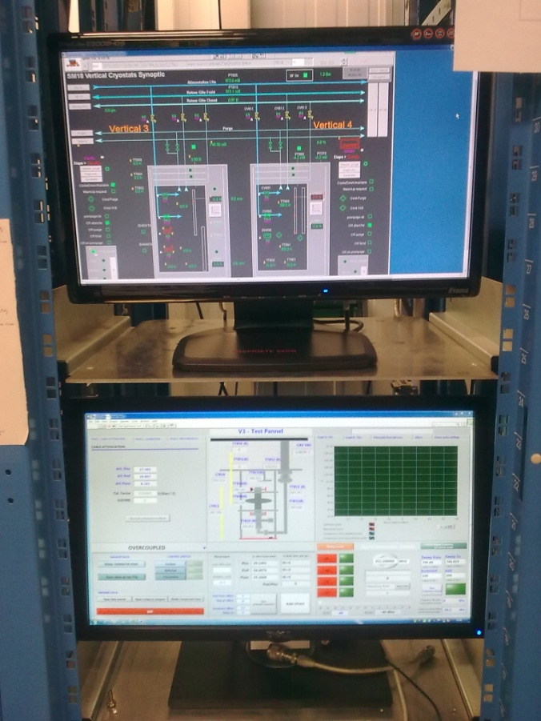
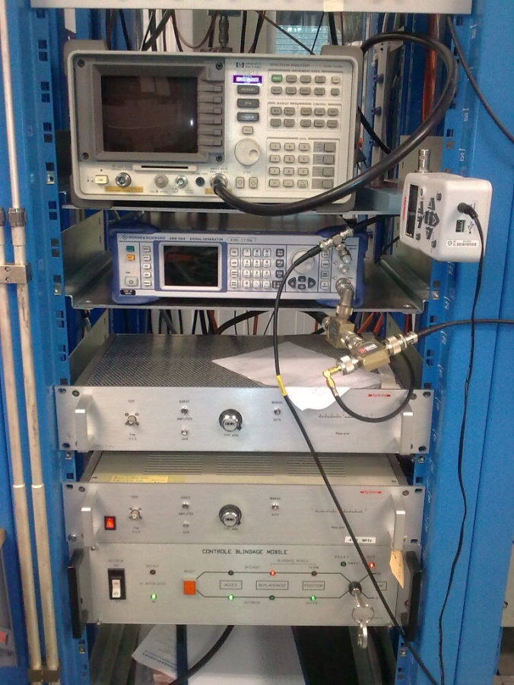
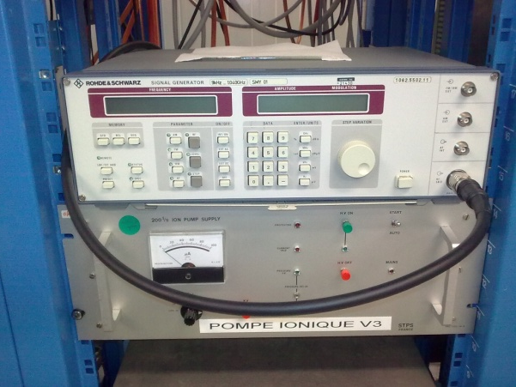
RF CONTROL RACK FOR VERTICAL TEST STAND

Slide 18
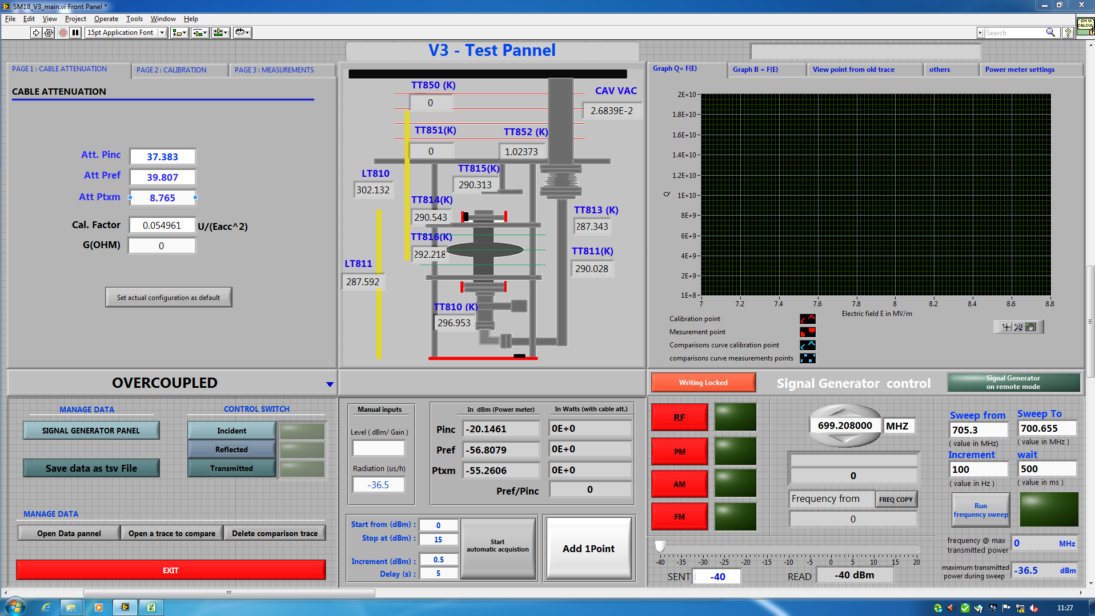
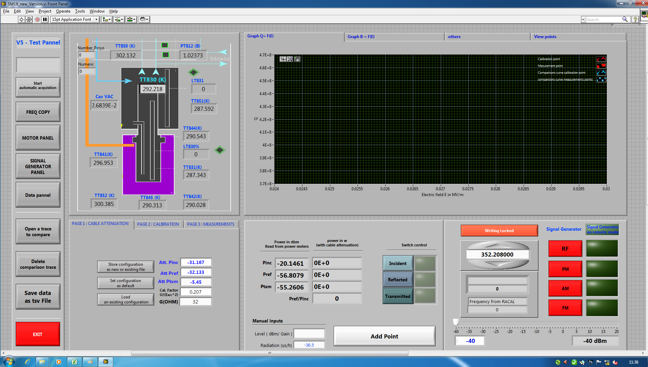
TEST CONTROL PANEL PROGRAM
Improvement: automatic control of the PLL, τ measurement
Labview Program by A. Benoit BE/RF
18

Slide 19
DIAGNOSTIC SYSTEMS

Slide 20
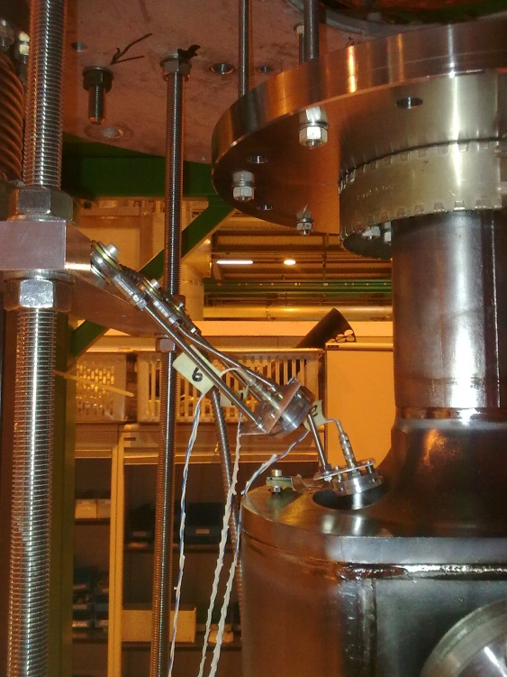
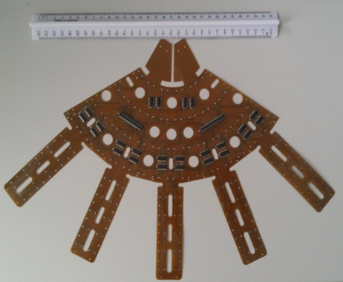
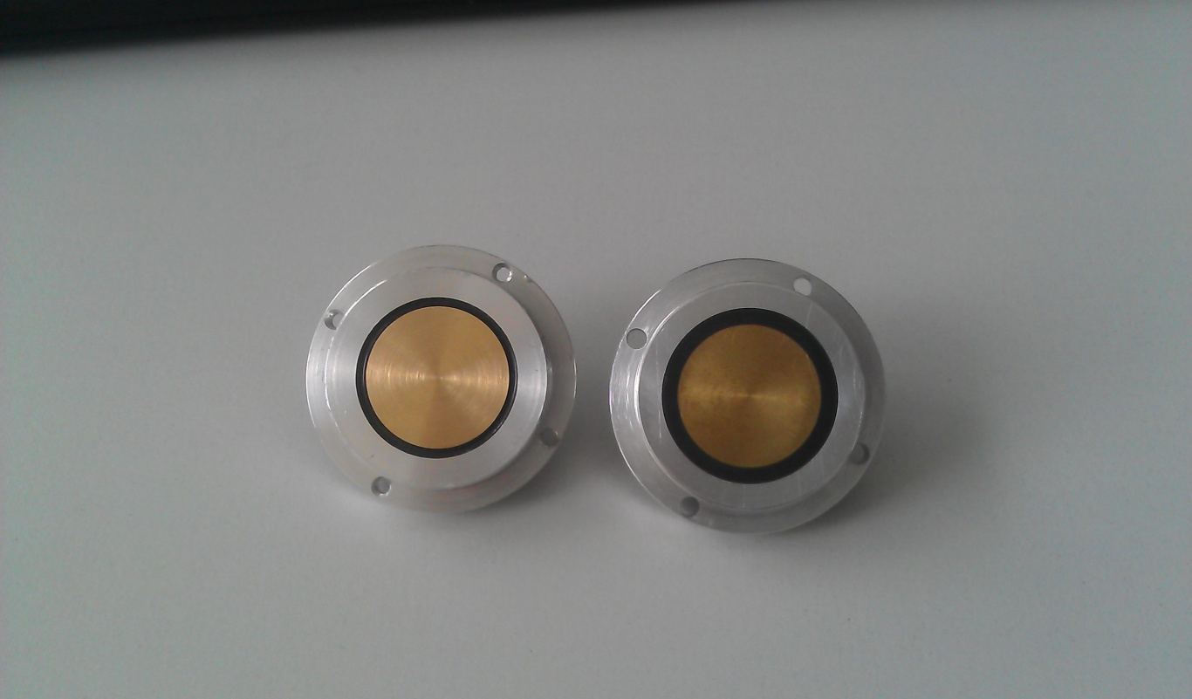
OSCILLATING SUPERLEAK TRANSDUCER AND TEMPERATURE MAPING
OSTs installed around the 4 rods
Temperature mapping for elliptical cavity : Using Allen-Bradley resistors temperature sensor (K.Liao)
can be adapted for crab cavity
Localized hot spot (default) with 2nd sound propagation in He superfluid method
Ref: K. Liao BE/RF

Slide 21
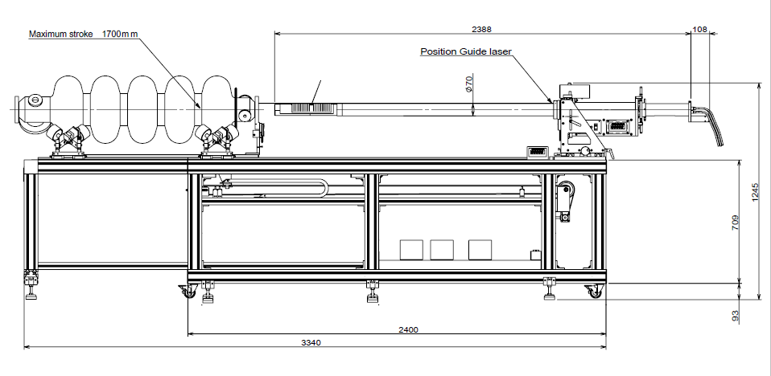
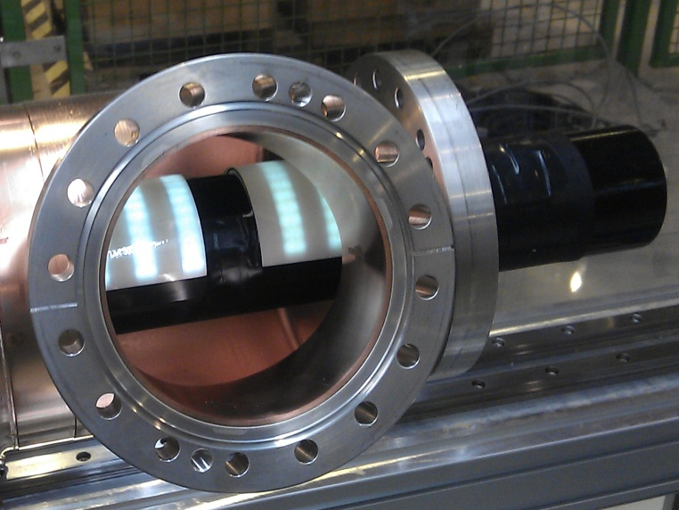
OPTICAL INSPECTION
Camera:
3488 x 2616 pix
@ 2.5 ips
Cavity can:
  Slide
  Rotate
Camera can:
  Rotate over 180°
We have to study how can we adapt it for the crab cavity inspection (support, diameter 70 mm)
Ref: J.Chambrillon BE/RF

Slide 22
CONCLUSIONS
      Preparation and assembly:
        - Clean room upgrade for high performance cavity at SM18
        - New HPR
      Diagnostic systems:
        - OST
        - Temperature mapping
        - Optical inspection
      Low power tests:
        - Four vertical cryostats (2 K & 4.5 K)
        - New RF cryo line
      High power tests:
        - Two bunkers
          - Bunker A (4.5K): LHC, HIE ISOLDE
          - Bunker B (2 K): Linac4, SPL
        - High power area:
          - 352 & 400 MHz high power sources available
Difficult @ 400 MHz or/and 2 K need adaptation for the cryo connections or need to install a new power distribution line over cost

