Slide 1
Overall Planning & HiLumi Meeting Highlights
E. Jensen/CERN

Slide 2
Reminder: What we planned in July 2010
obsolete

Slide 3
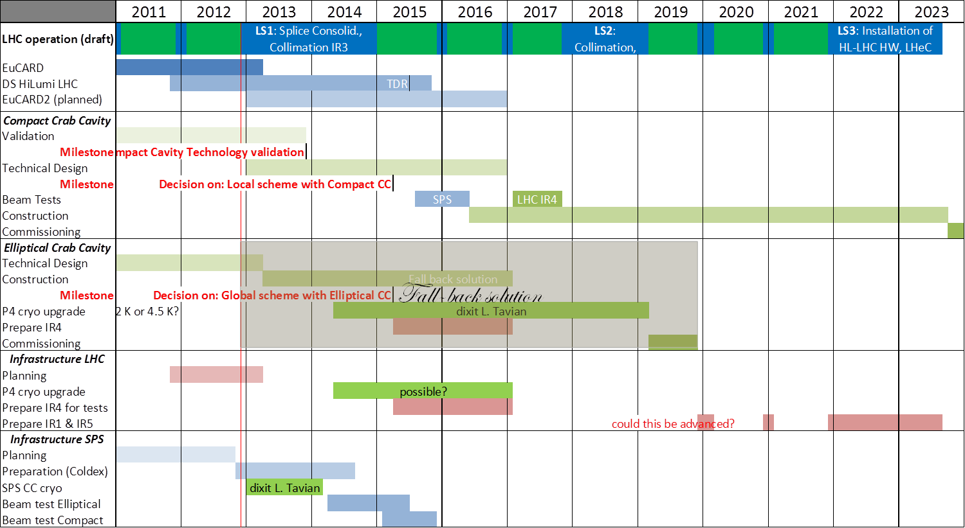
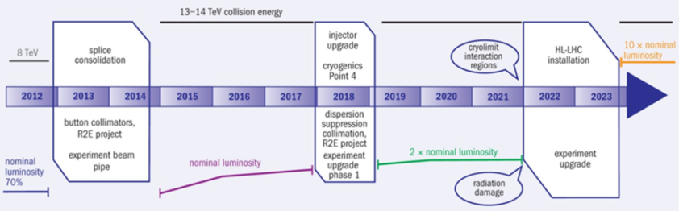
Present overall planning (Dec 2012)
L. Rossi: Frascati 2012

Slide 4
Overall planning – critical decisions (in reverse order)
Crab Cavities to be installed in LHC during LS3 (2022/23)
Major preparations IP1/IP5 during LS2 (2018)
CC must be tested in SPS/BA4 before LS2 (2016/17?)
What exactly is the scope of SPS test?
We have to respect certain constraints of the SPS, but not be dominated by them!
Does a test in LHC/P4 add something? What will we not know by then that would justify the P4 test?
Preparation SPS during LS1 (2013/14)

Slide 5
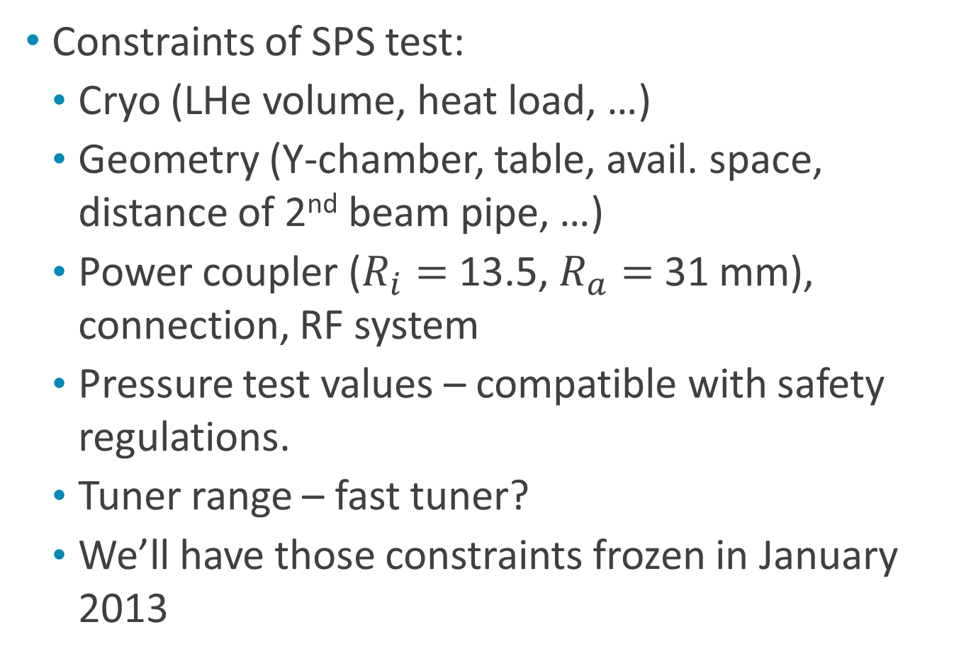
Imminent decisions (focus on SPS test)
Constraints of SPS test:
Cryo (LHe volume, heat load, …)
Geometry (Y-chamber, table, avail. space, distance of 2nd beam pipe, …)
Power coupler ($R_{i}=$ 13.5, $R_{a}=$ 31 mm), connection, RF system
Pressure test values – compatible with safety regulations.
Tuner range – fast tuner?
We’ll have those constraints frozen in January 2013

Slide 6

News from Frascati:
2nd Joint HiLumi LHC-LARP Annual Meeting, 14-19 November, 2012, INFN Frascati
https://indico.cern.ch/conferenceDisplay.py?confId=183635
The parallel sessions on Crab Cavities can be considered “CC-12” Workshop.
https://indico.cern.ch/conferenceDisplay.py?confId=136807

Slide 7
Reminder - Required kick voltage
Design kick: 10 MV /side /IP /beam – this is reached with 3 cavities. Our reference numbers!
Needed for full compensation: 11.8 MV … 13.4 MV; this could be reduced to 8.2 MV with new Q7+ .
Our reference remains 10 MV – the above is possible mitigation – but is this the overall optimum (cost!)?
Let’s see the prototype cavity performance and adapt design parameters then if needed. Keep engineering margin!
Even with reduced voltage, we should stay with 3 cavities (to reduce impact of single cavity trip)

Slide 8
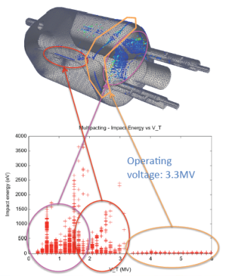
All 3 designs:
Common numerical tools used for comparative studies: HOMs, MP (ACE3P, Z. Li), n-pole (HFSS, M. Navarro-Tapia)
HOM damping: suppression below (demanding) CM18 numbers achieved – also thanks to newly designed coaxial high-pass filters and hook-shaped couplers.
MP simulations indicate:
MP at low fields is “soft” – can be conditioned;
MP at high fields has low impact energy.
Z. Li

Slide 9
Getting ready for SPS tests
SPS test is a must (LHC no best-bed!)
Goal: Confirm that cavity can be made invisible; it would allow to try out operational scenarios. SPS beam may be too noisy to test additional noise injected from CCs.
Schedule: Prepare during LS1 (RF power, cryo) – install cavities X-mas break 2015/16 – perform tests in 2016
R. Calaga, A. Macpherson

Slide 10
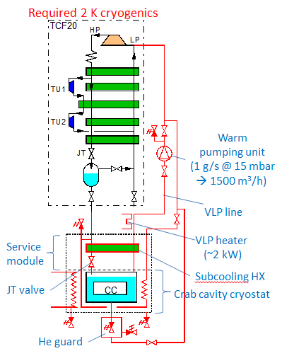
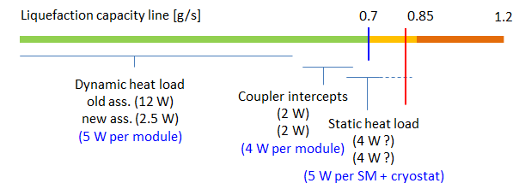
Cryo preparation for SPS tests
Existing TCF20 should do, but liquefaction test must be done before 15-Jun-2013.
Dynamic heat load assumed: 2.5 W/module.
Upgrade to 2 K during LS1.
K. Brodzinski

Slide 11
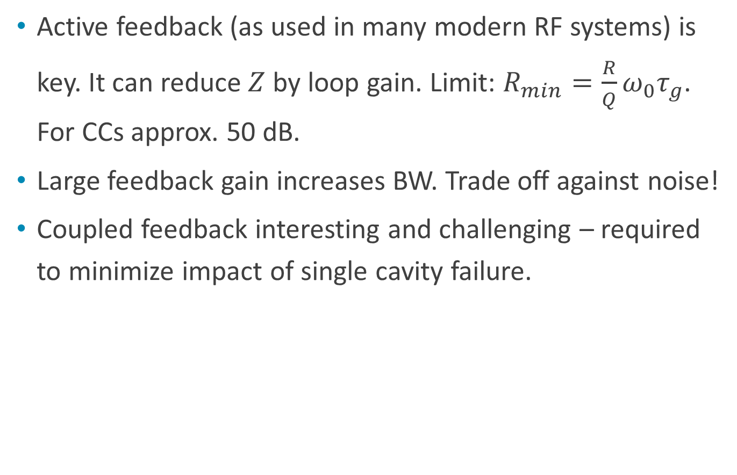
LLRF
Active feedback (as used in many modern RF systems) is key. It can reduce $Z$ by loop gain. Limit: $R_{min}=\frac{R}{Q}ω_{0}τ_{g}$. For CCs approx. 50 dB.
Large feedback gain increases BW. Trade off against noise!
Coupled feedback interesting and challenging – required to minimize impact of single cavity failure.
P. Baudrenghien

Slide 12
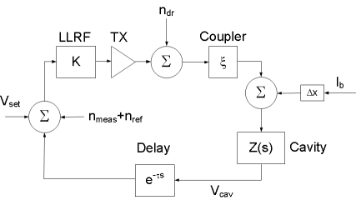
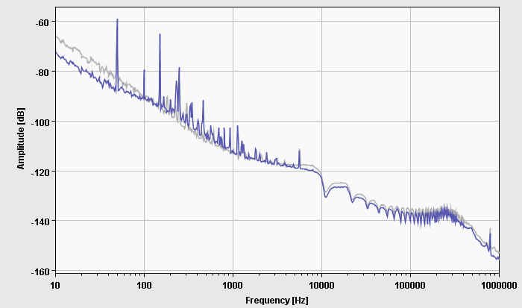
RF Noise
Different noise sources have different spectra;
1st betatron SB 3 kHz off – dominated by TX noise.
Tetrode/IOT advantageous..
Scaling from ACS: expected 0.01 ° rms ϕ noise @ 400 MHz. This looks OK.
Idea for noise measurement: excite on betatron SB.

Slide 13
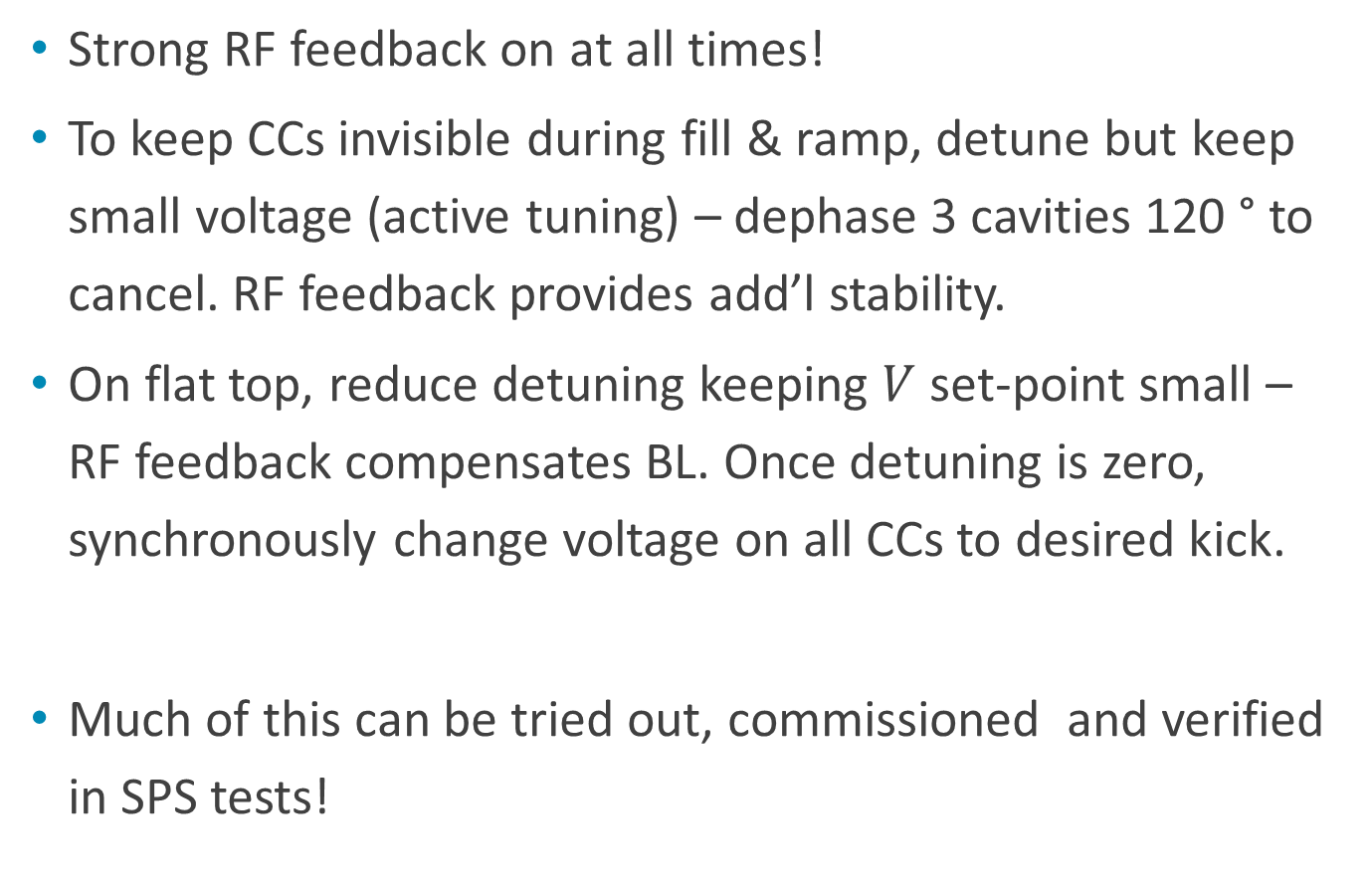
Operational scenario revisited
Strong RF feedback on at all times!
To keep CCs invisible during fill & ramp, detune but keep small voltage (active tuning) – dephase 3 cavities 120 ° to cancel. RF feedback provides add’l stability.
On flat top, reduce detuning keeping $V$set-point small – RF feedback compensates BL. Once detuning is zero, synchronously change voltage on all CCs to desired kick.
Much of this can be tried out, commissioned and verified in SPS tests!

Slide 14

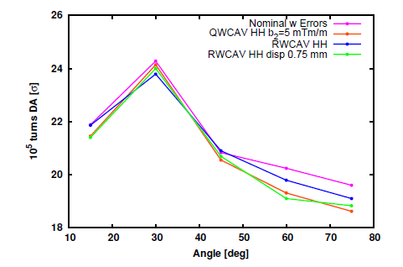
n-pole errors
For the first time, SixTrack simulations could study the effect of n-pole errors on beam. Results can give also tolerable misalignments:
These studies were done with older versions of the cavities.
n-pole fields with latest versions of cavities indicate globally even smaller errors.
J. Barranco, M. Navarro-Tapia

Slide 15
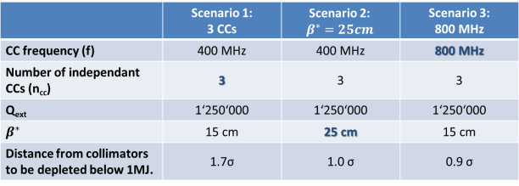
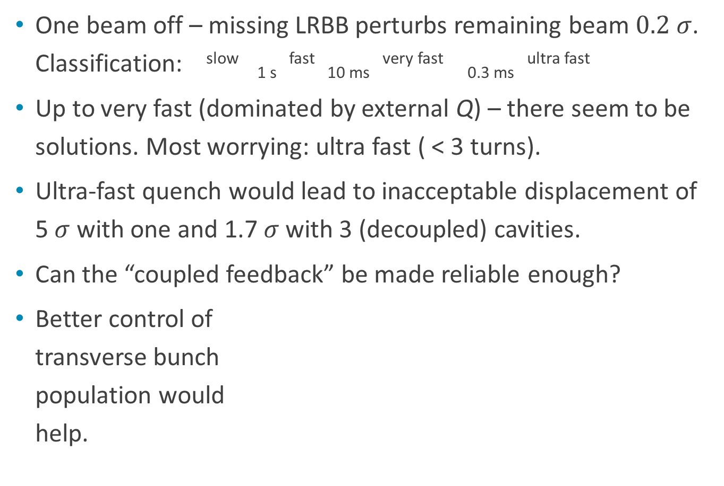
Machine Protection
One beam off – missing LRBB perturbs remaining beam $0.2 σ$. Classification: ^{slow} _{1 s} ^{fast} _{10 ms} ^{very fast} _{0.3 ms} ^{ultra fast}
Up to very fast (dominated by external Q) – there seem to be solutions. Most worrying: ultra fast ( < 3 turns).
Ultra-fast quench would lead to inacceptable displacement of 5 $σ$ with one and 1.7 $σ$ with 3 (decoupled) cavities.
Can the “coupled feedback” be made reliable enough?
Better control of transverse bunch population would help.
T. Baer, B.Y. Rendón

Slide 16
Frascati Discussions/brain storming
Lots of productive/critical discussion throughout – this was really a “work”-shop. (pretty much like this one!)
What instrumentation do we need for CCs – head-tail monitors, streak camera to measure remaining non-closure? What instrumentation do we need to make the SPS test a success?
We need fast BLMs for MP (diamond?)
We still need better understanding of possible (ultra) fast failure modes – cavity tests and in particular SPS tests will help this understanding.

Slide 17
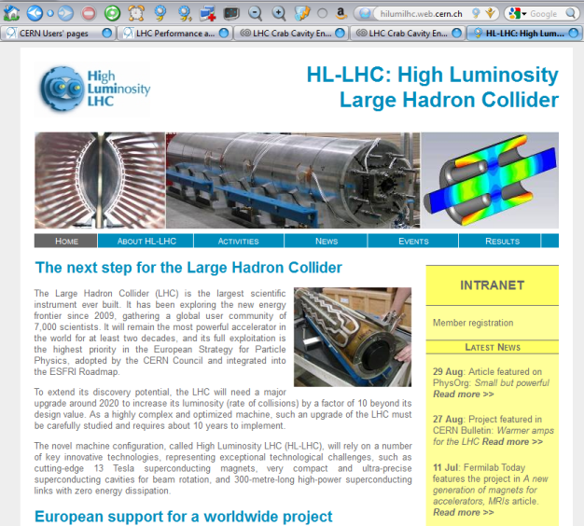
HL-LHC – HiLumi LHC
Definition:
HL-LHC: the overall project for Luminosity upgrade
HiLumi LHC: FP7 Design Study, co-financed by EU, Grant Agreement 284404

Slide 18
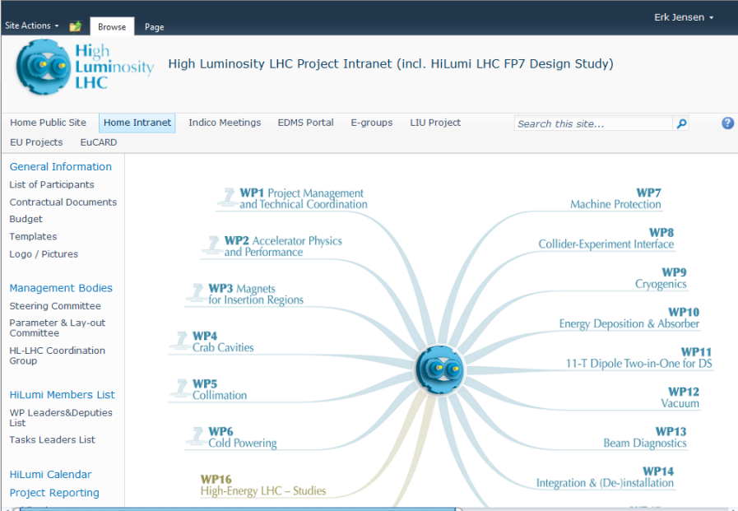
HiLumi Intranet: https://espace.cern.ch/HiLumi/default.aspx

Slide 19
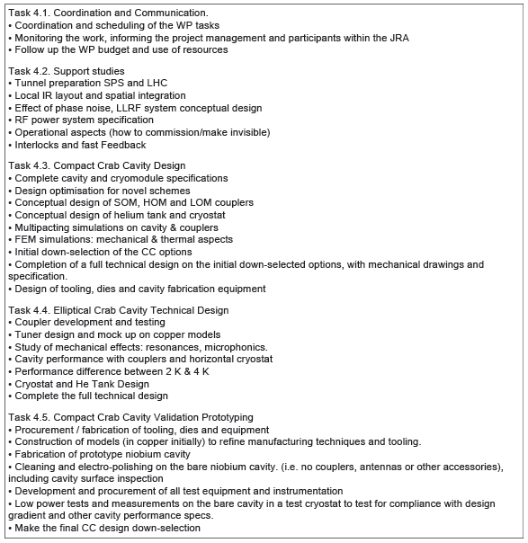
HiLumi Description (excerpt)
HiLumi LHC started 1-Dec-2011
to run 48 months (until Nov. 2015)
Beneficiaries: CERN, CEA, CNRS, STFC, ULANC;
Associated partners: KEK, BNL, FNAL, LBNL, ODU, SLAC (US-LARP).
Tasks (see right) now revised to adapt to planning and needs (Task 4.4 to disappear).
Please register to allow use of Sharepoint site! This will allow coordination and communication!
I uploaded the “Intermediate Activity Report” there.

Slide 20
Thank you very much!

