Slide 1
Helium vessel / tuner odu-slac rf dipole cavity
LHC Crab Cavity Engineering Meeting – FNAL
13-14 December, 2012

Slide 2
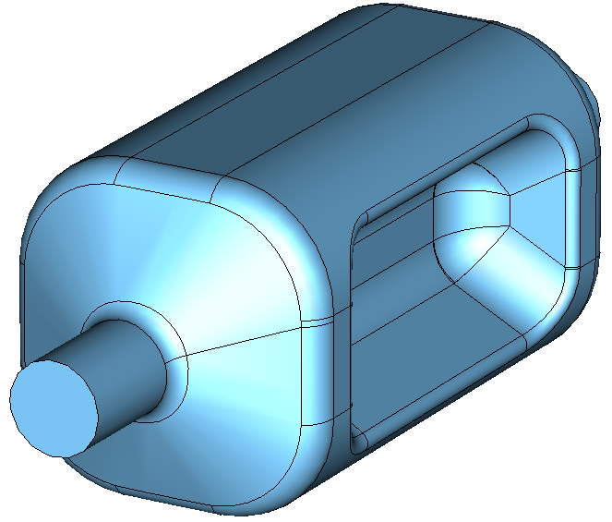
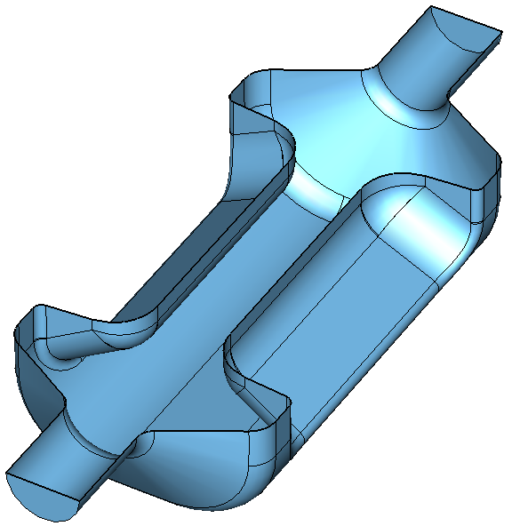
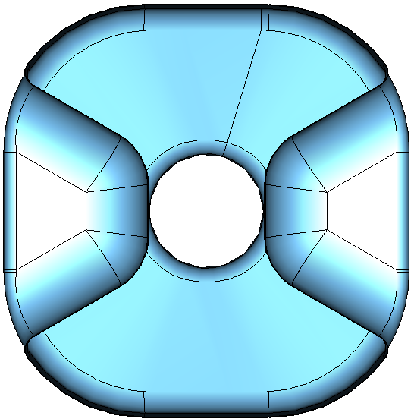
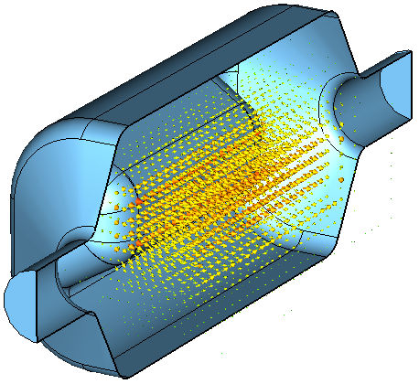
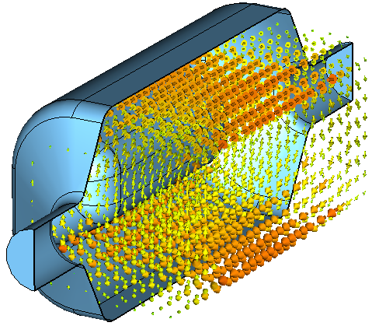
400 MHz RF-Dipole Cavity
60 cm
35 cm
<150 mm
42 mm
194 mm
29 cm
E Field
H Field

Slide 3
Cryostat Design Consideration
Environment
  Space constraints
  Temperature, pressure, relief system
  Typical Cavity/He vessel design condition
  At room temperature, 2-2.5 bar external to cavity, internal to He vessel
  At cryo temperature, 4-5 bar external to cavity, internal to He vessel
Safety code if applicable
  ASME Boiler and Pressure Vessel (BPV) Code
  Allowable stress the lesser of 2/3 Yield or Tensile/3.5
  ASME B31.3 Process Piping Code
Material properties
  Recent test results of Nb samples (RRR>250) at Jlab show a wide variation (RT).
  Modulus: 7.65-16.7 10⁶ psi (53-115 GPa)
  Yield strength: 7-12 ksi (48-83 MPa)
  Tensile strength: 24-30 ksi (165-207 MPa)

Slide 4
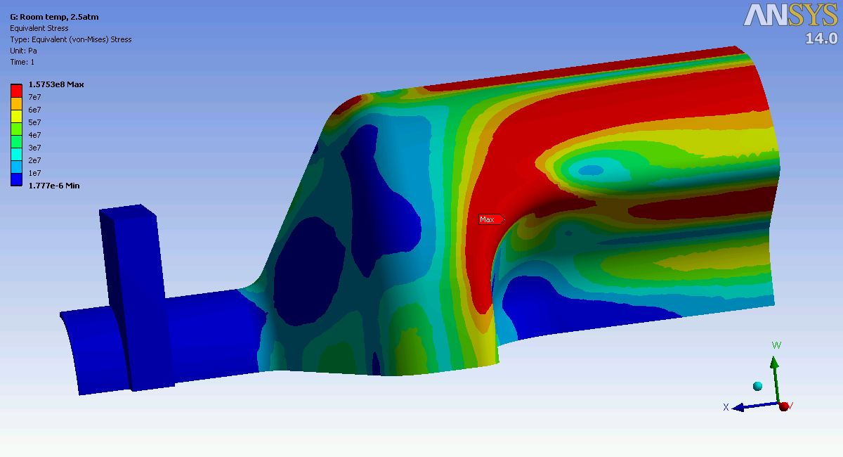
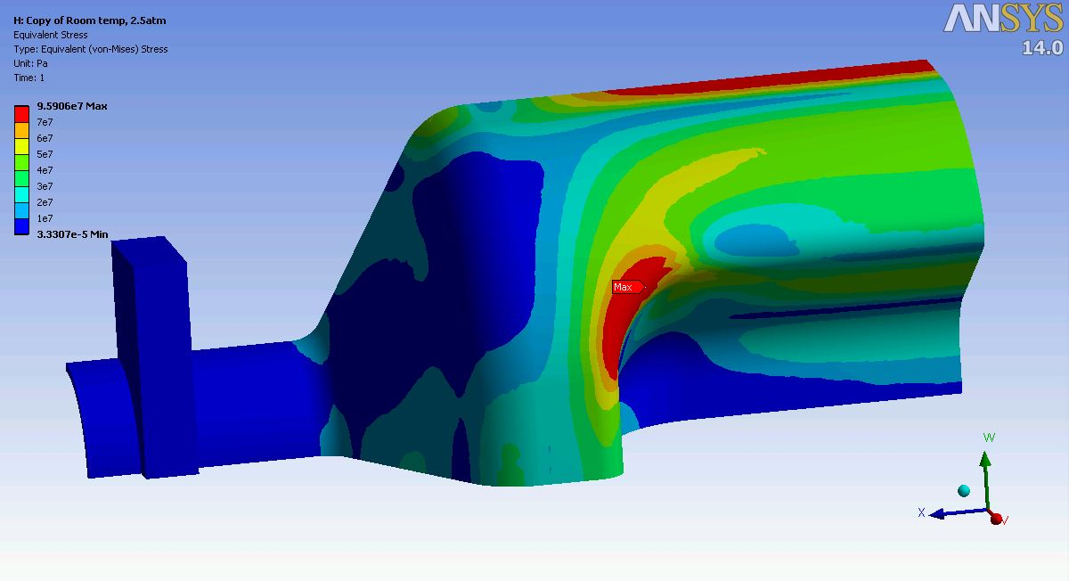

Cavity Mechanical Strength-Warm
Worst case during cool down
Room temperature Nb property, 2.5 atm external pressure
Modulus 55 GPa, Poisson’s ratio 0.38, Density 8.58 g/cm³, Yield strength 69 MPa
Beam pipe tab fixed, gravity ignored to use symmetry
Red region is above the yield strength of the Nb plate as received state.
The strength after cold working (forming) is not measured.
3mm thickness
4mm thickness
(Pa)
Yield strength
(69 MPa)
BPV code allowable strength
(46 MPa)

Slide 5
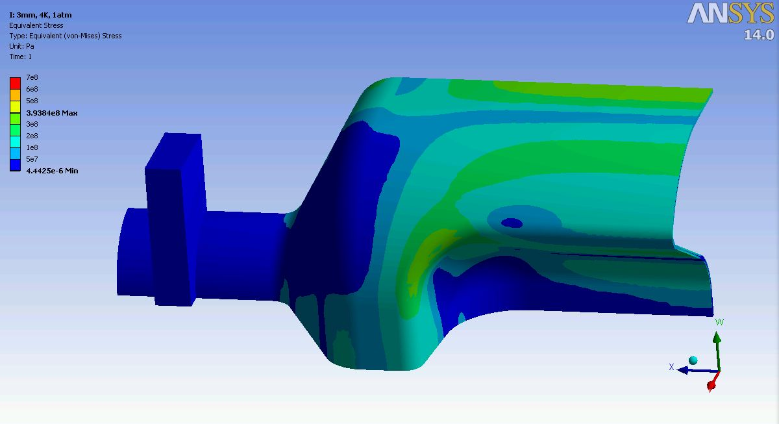
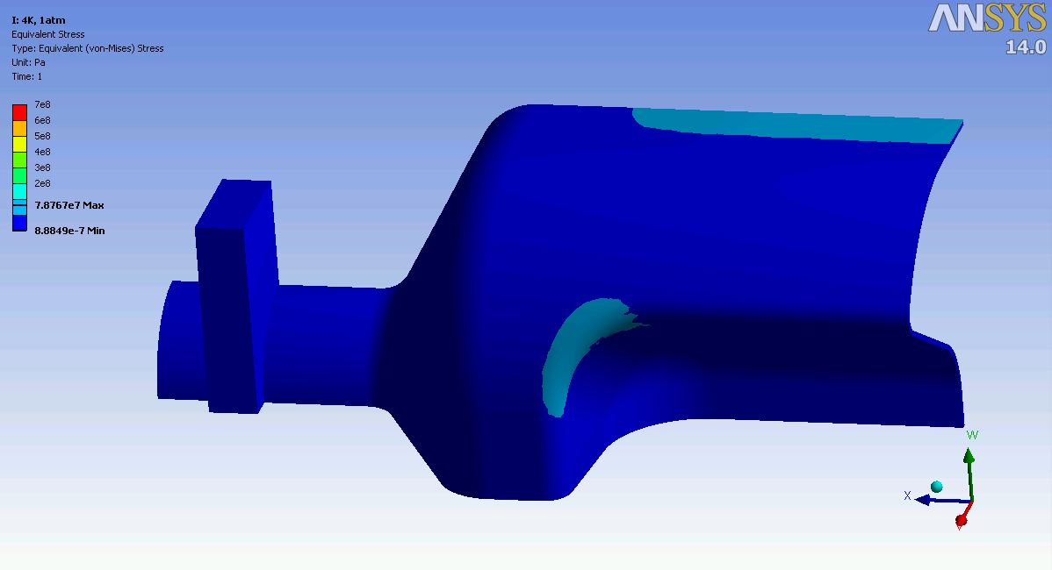

Cavity Mechanical Strength-Cold
Worst case during operation
Cryo temperature Nb property, 5 bar external pressure
Modulus 123 GPa, Poisson’s ratio 0.38, Density 8.58 g/cm³, Yield strength 577 MPa
3mm thickness
At 2K the external pressure at normal operation is less than 30 torr.
There is enough margin to accommodate the tuning load at normal operation.
3mm thickness will be still studied.
5 atm pressure
1 atm pressure-4K Normal operation
(Pa)
Yield strength (577MPa)
BPV code allowable strength (385MPa)

Slide 6
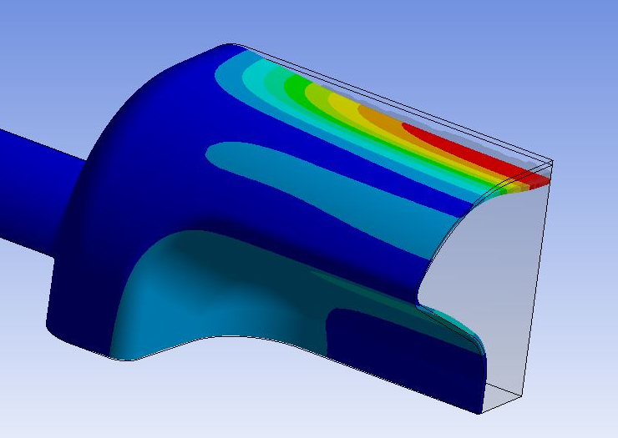
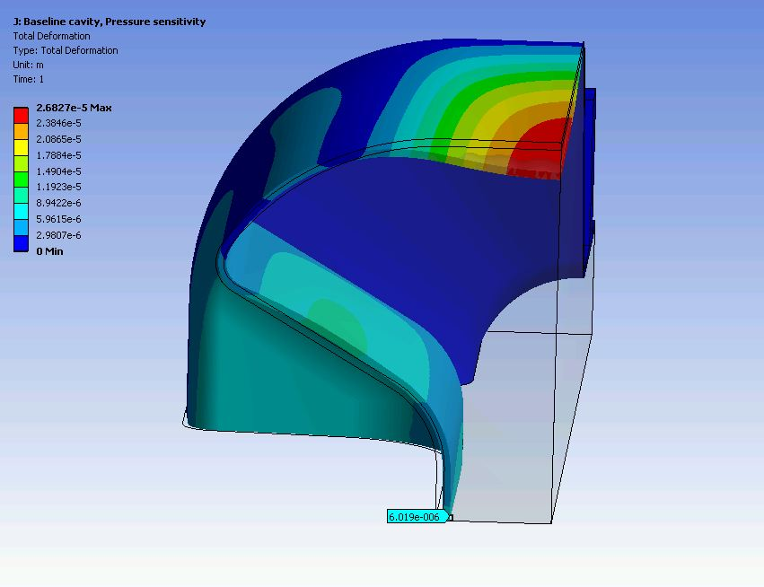
Pressure Sensitivity
3mm uniform thickness
Cryo Nb property
Pressure sensitivity 235 Hz/torr
Largest deformation on top surface (high magnetic field area) observed.
The most effective location of counter deformation – deform the surface with high electric field accordingly by targetted pressure or force.
Additional deformation of side surface helps to reduce the pressure sensitivity.
Make a cavity with different thickness – thicker top surface and thinner side surface?
Optimize thickness after LFD is combined.
Top surface
Side surface
Deformation under 30 torr and additional force on side surface

Slide 7
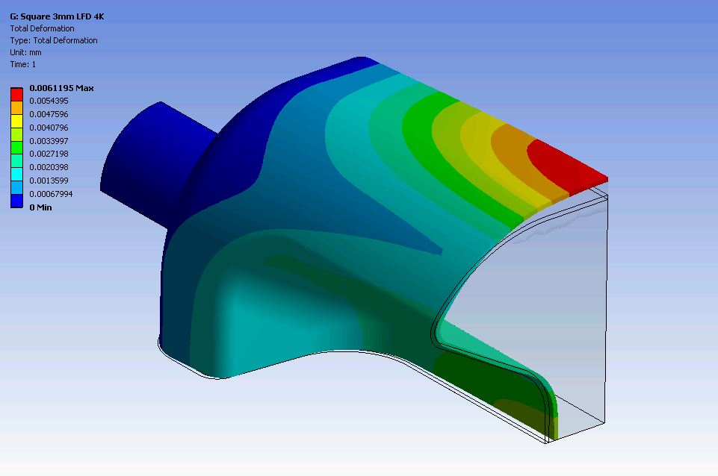
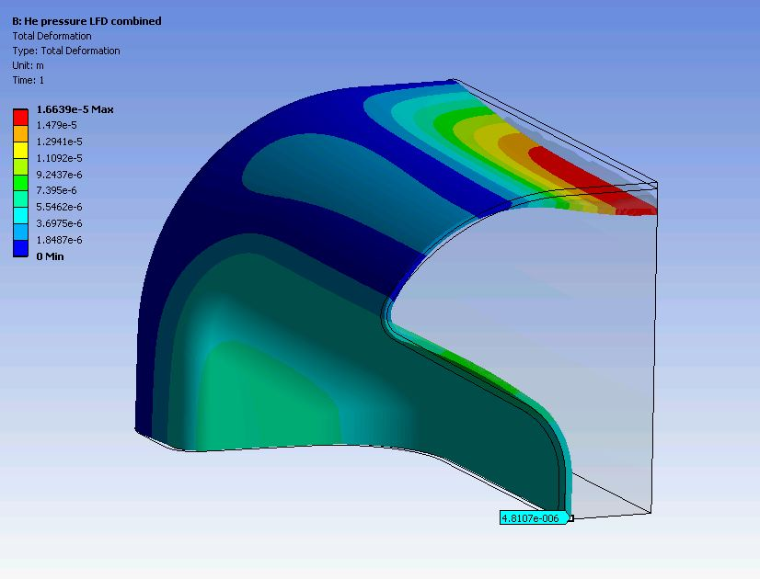
Lorentz Force Detuning
LFD effect alone
3mm uniform thickness
Cryo Nb property
LFD coefficient -195 Hz/(MV/m)², total shift -12.6kHz at 3MV transverse voltage
Surface with high magnetic field deformation 6 μm outward due to radiation pressure
Side surface 3 μm deformation inward
LFD under 2K nominal He pressure 23 torr
LFD -4.5kHz, coefficient -69
Total shift decreases to -3.7kHz with 4mm thick cavity.
Still stiffening is required.
Careful selection of the stiffener location since it also affect the pressure sensitivity in the area.
Deformation under Lorentz force only
Deformation under Lorentz force and He pressure

Slide 8
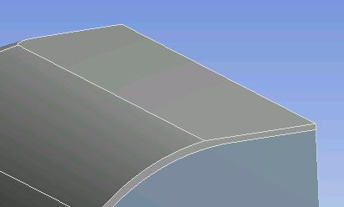
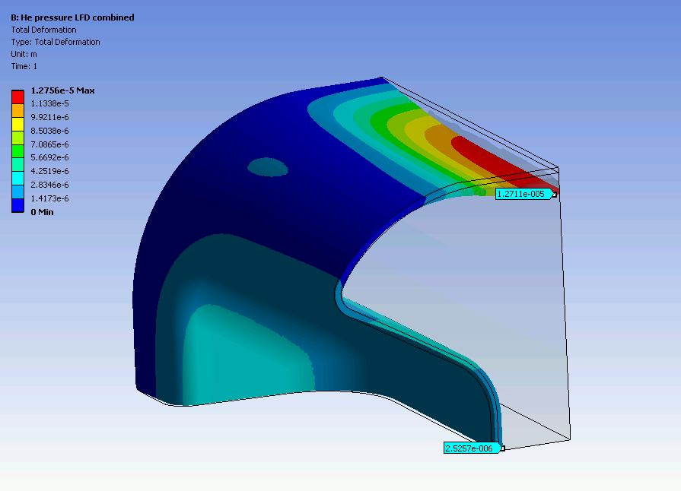
Lorentz Force Detuning
Cavity Improvement
Stiffener on top surface make LFD worse, also no space
The largest deformation is not simply the largest contribution of frequency shift. Balance between cavity deformation by the He pressure and Lorentz force is important.
New Cavity Model
4mm uniform thickness, but the top surface is shaved to 3mm.
LFD under 2K nominal He pressure, total shift 550Hz, k_{L} 8.5 Hz/(MV/m)²
Geometry Detail
Deformation

Slide 9
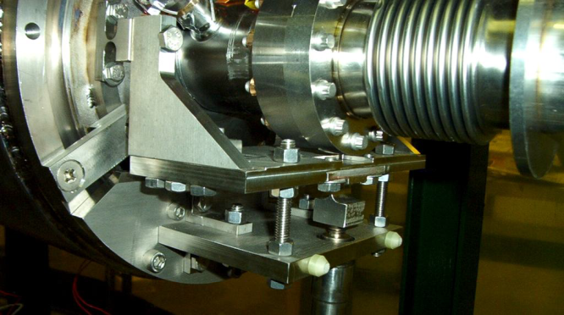
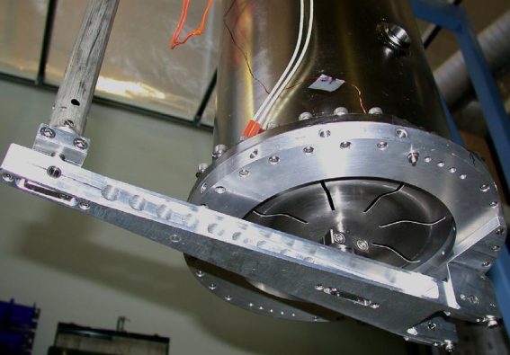
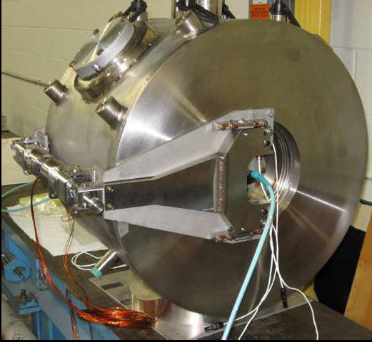
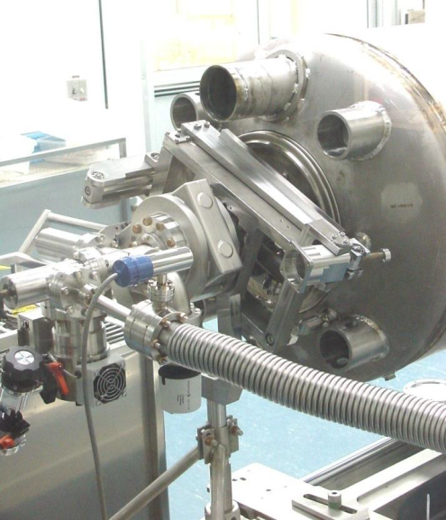
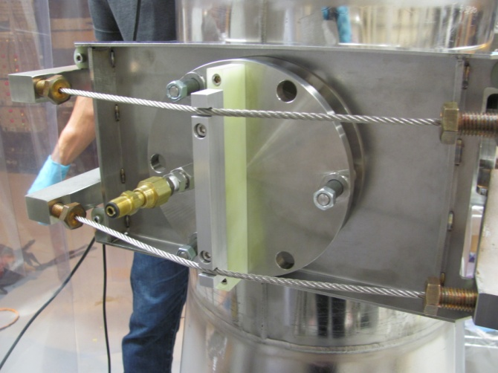
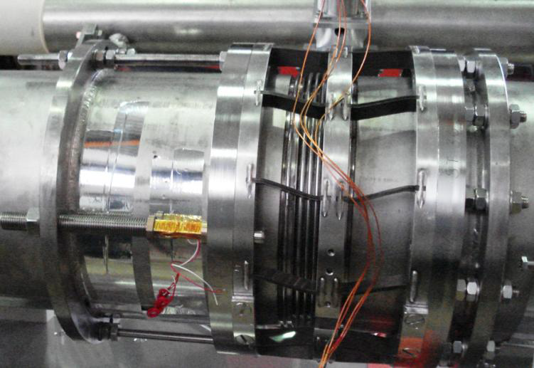
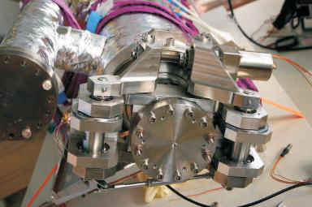
Tuning Options-Existing
ISAC II QWR TRIUMF
RIA
SSR1
ANL
SNS
Saclay II Cam/Lever
Coaxial Blade Tuner
Courtesy of J. Matalevich/JLAB

Slide 10
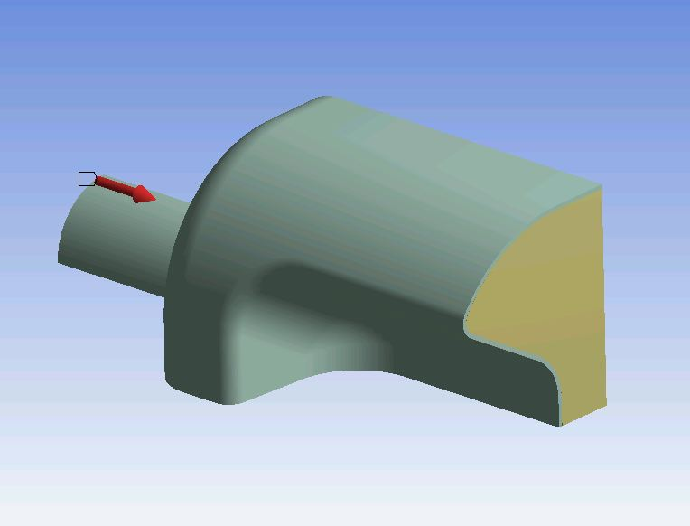
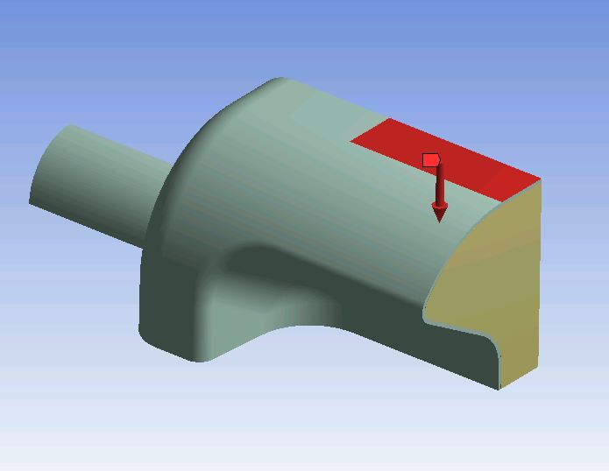
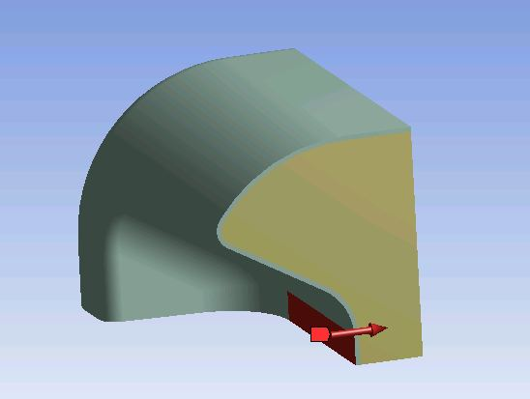
Tuning Sensitivity
Longitudinal displacement
1.14 kHz/ μm
Sensitive but finer stepper motor can achieve the resolution.
Pneumatic drive also applicable
Applied force on outer conductor
-1.4kHz/N
Applied force on inner conductor
-0.9kHz/N

Slide 11
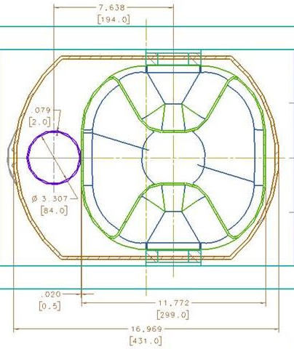
Space Constraints
What is the allowable stress of the cavity?
Something has to be between the cavity and the adjacent beam line?
Adjacent beam pipe inside He vessel (i.e., pressure vessel)
Is the beam pipe thickness 2mm adequate against BPV code?
Yes, safety factor 5
Courtesy of Shaun A Gregory

Slide 12
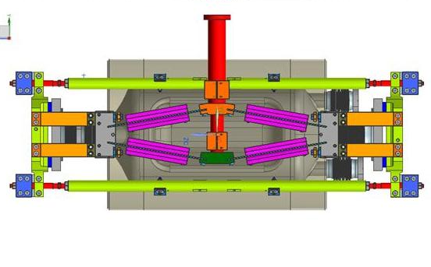
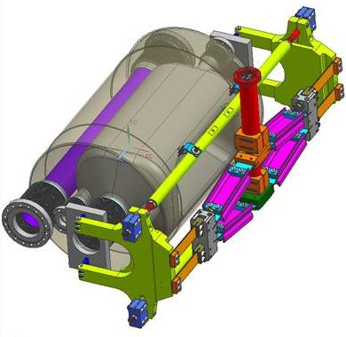
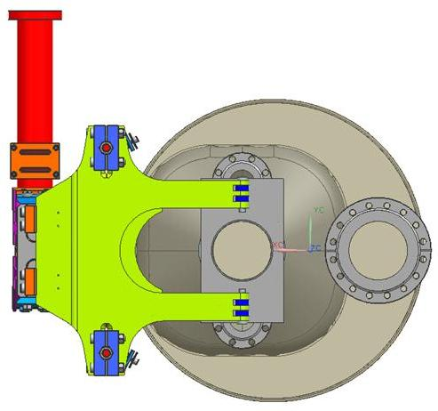
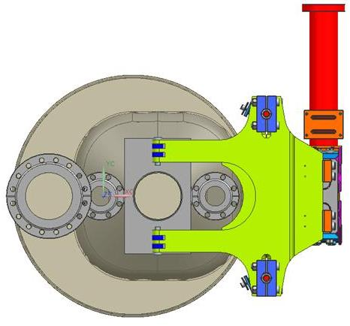
Cryostat Concept 1
Mechanical tuner JLAB design
Comparable size
Stepper motor driven
Courtesy of Shaun A Gregory

Slide 13
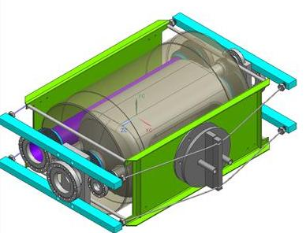
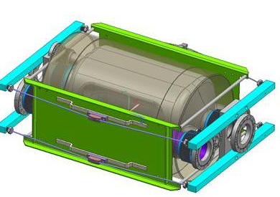
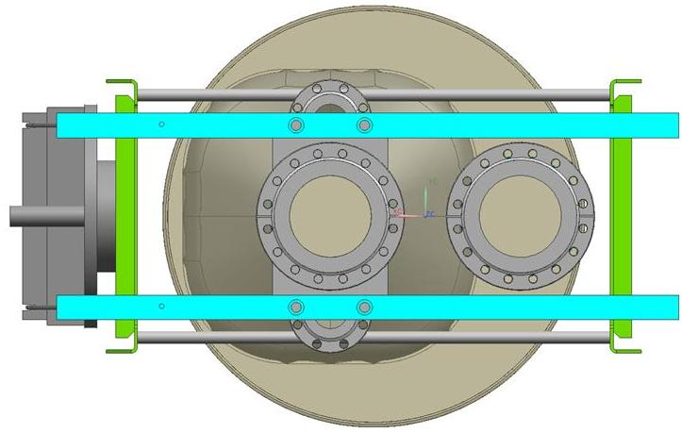
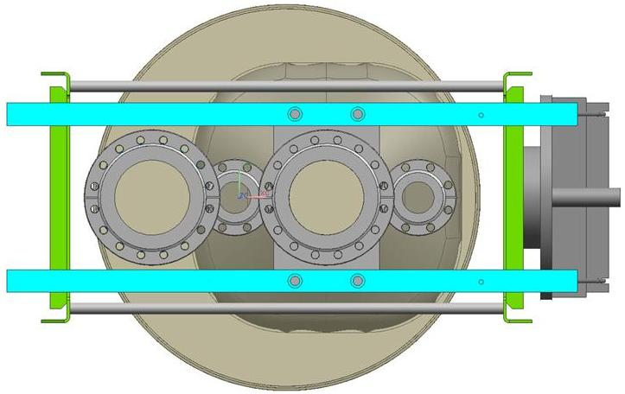
Cryostat Concept 2
Pneumatic tuner ANL design
Helium pressure actuates bellows
Requires simple parts
Courtesy of Shaun A Gregory

Slide 14
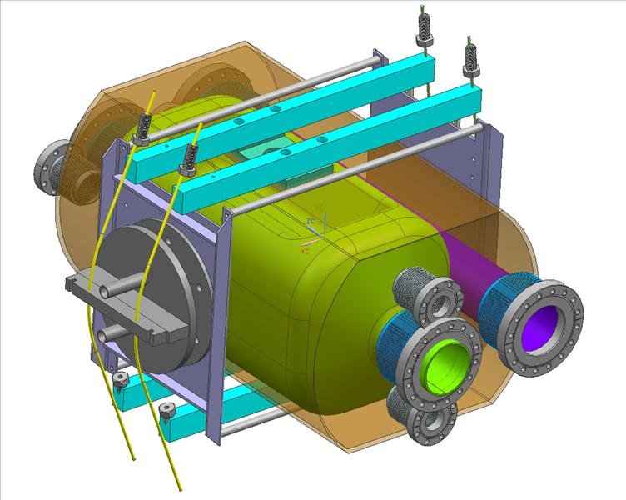
Cryostat Concept 3
Pneumatic tuner ANL design
Deforms cavity outer surfaces
Requires two different designs due to cavity rotation
Courtesy of Shaun A Gregory

Slide 15
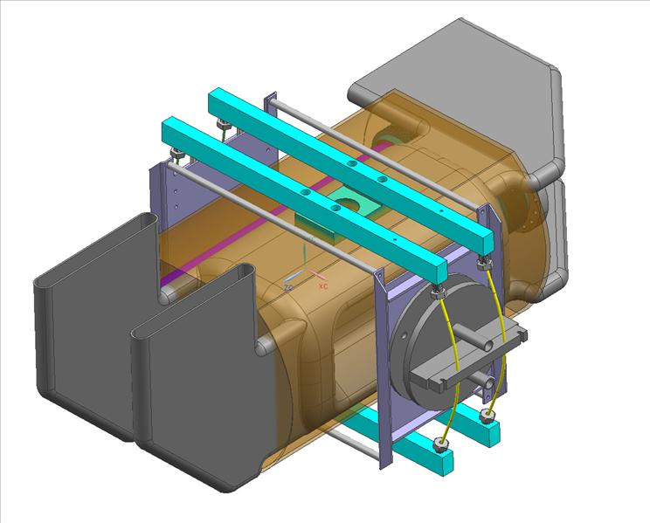
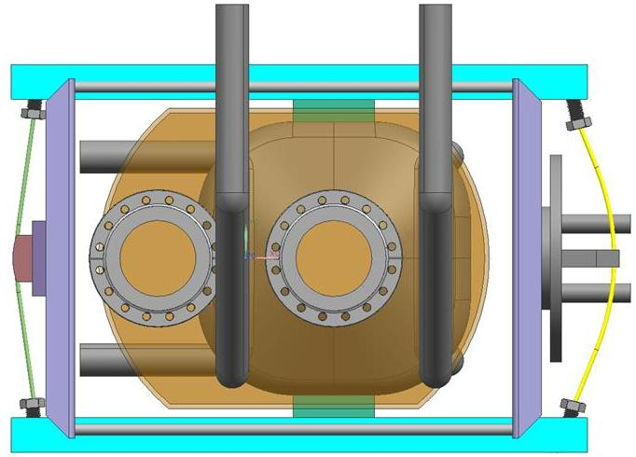
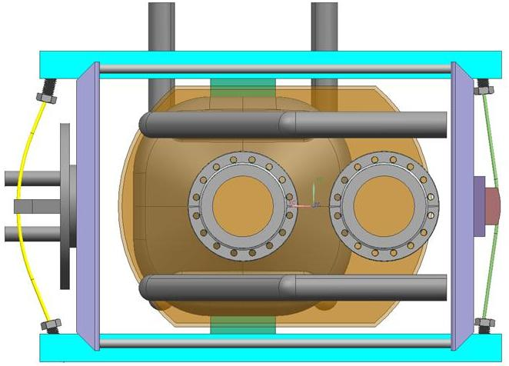
Cryostat Concept 4
Wave guide cavity
Courtesy of Shaun A Gregory

Slide 16
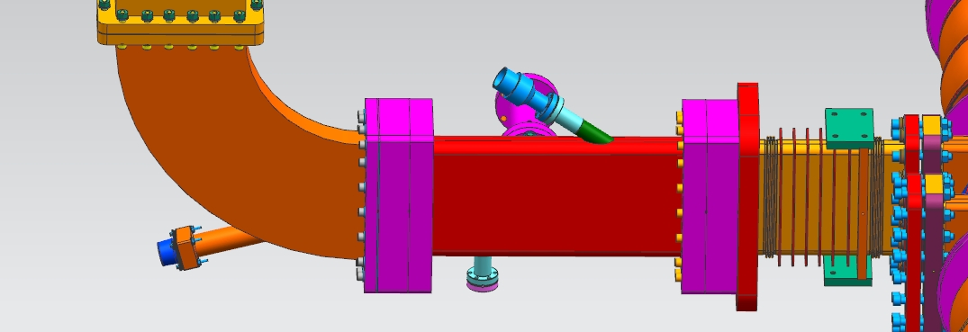
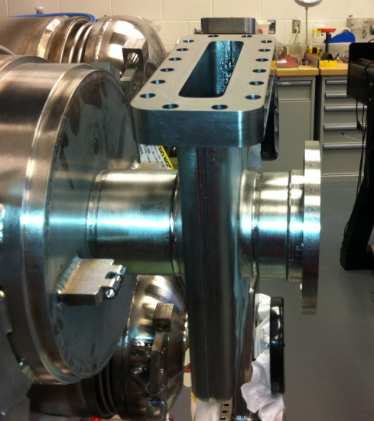
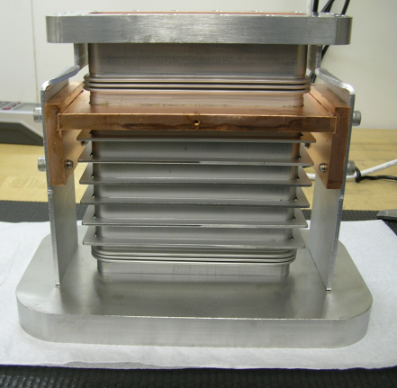
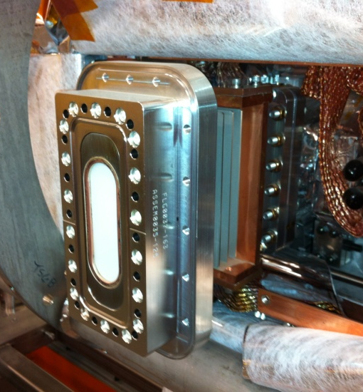
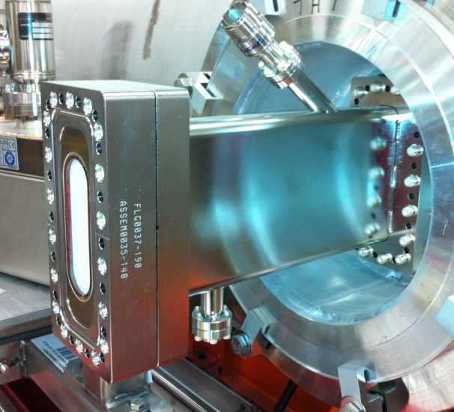
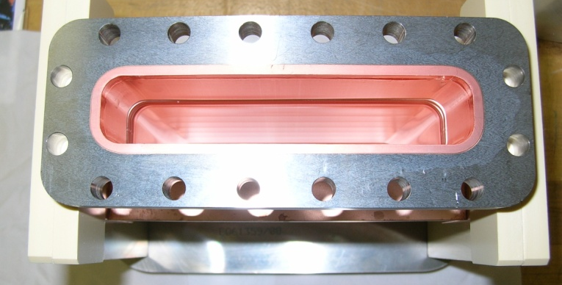
Speaking of Wave Guide
Niobium FPC
Wave guide installed
Wave guide spool installed
Cold wave guide

Slide 17
Future Plan
Finalize cavity design
  Understanding accurate requirements
  Power coupler
Integrated system study
  More complete layout
  Fast tuner
Fabrication outline

