Slide 1
4 Rod Crab cavity Status
G. Burt on behalf of 4RCC collaboration

Slide 2
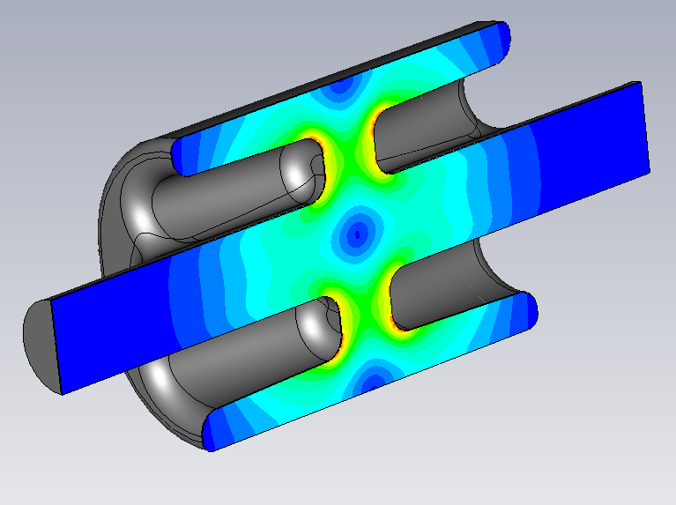
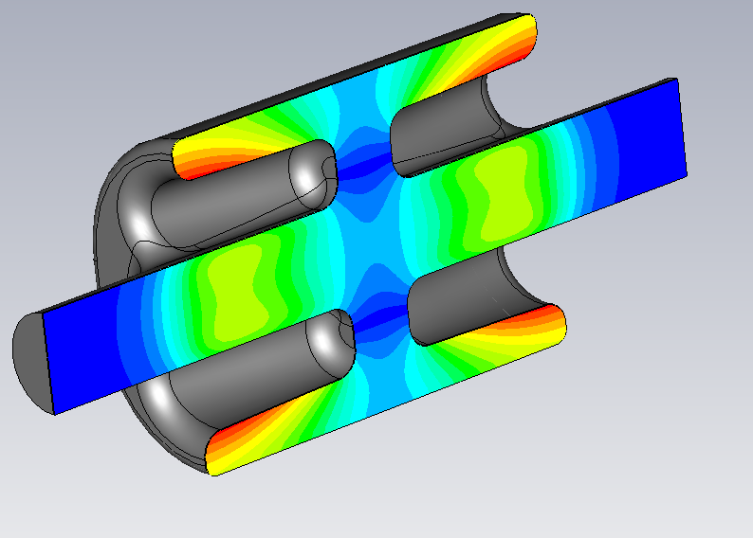
Cavity Shape
Cavity fitted LHC scenario (84 mm aperture compact transverse size) and has tolerable fields at the design gradient.
Removal of voltage variation.
Emax @3MV | 32.0 MV/m
Bmax @3MV | 60.5 mT
Transverse R/Q | 915 Ohms
R_{T}/Q=(V(a)²/wU)*(c/ωa)²

Slide 3
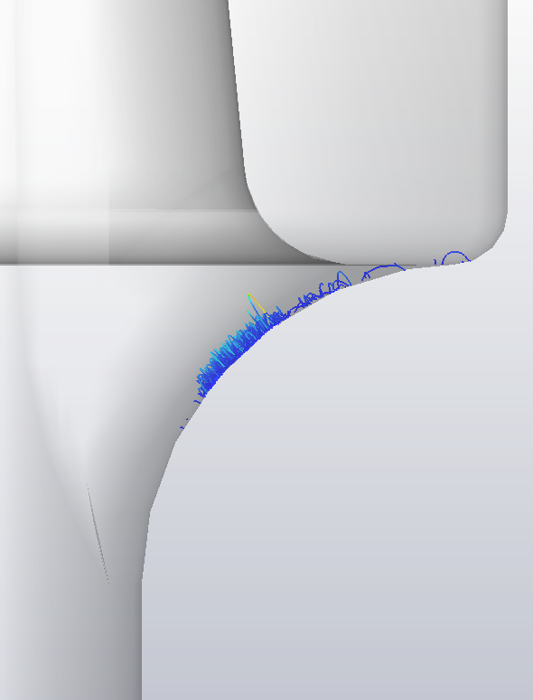
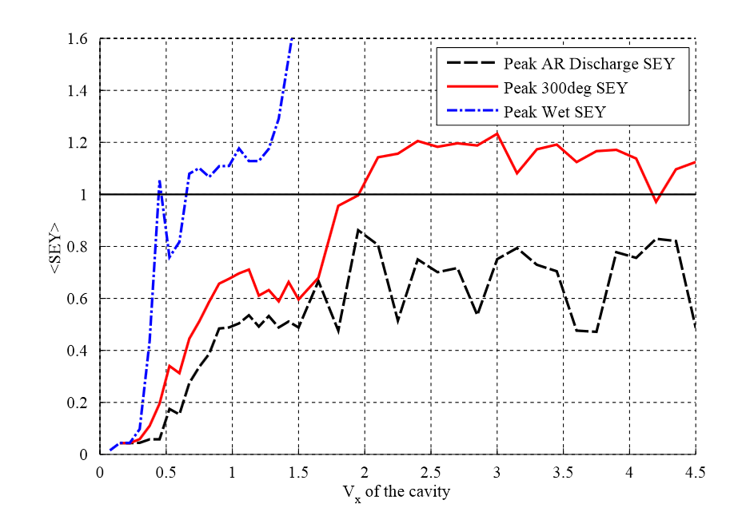
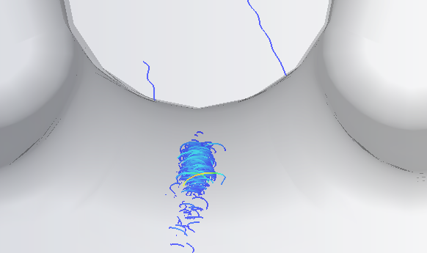
Multipactor
Multipactor on the beam pipe was found on the beam pipe at ~2 MV.
Same type of multipacting was seen on KEKB crab cavity.
Studies with processed surface SEY shows it can be processed through

Slide 4
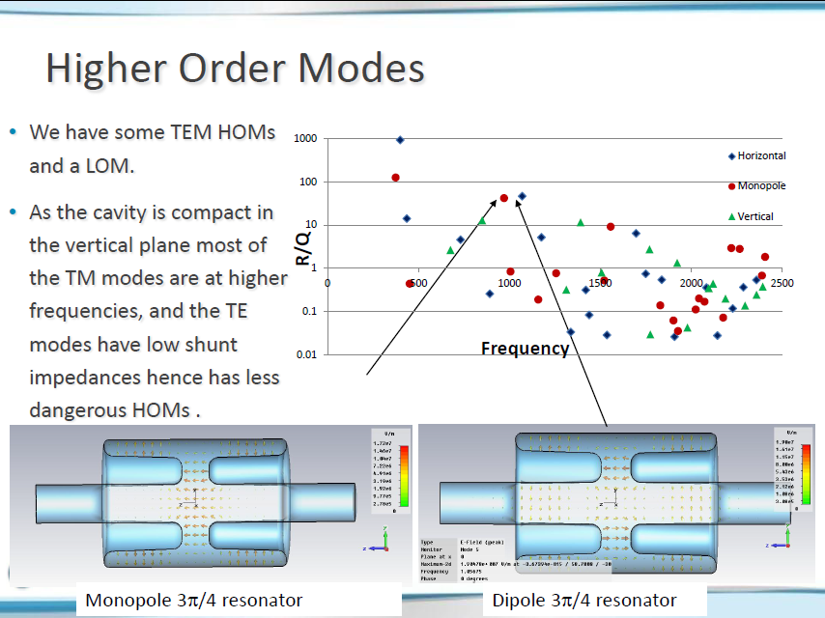

Slide 5
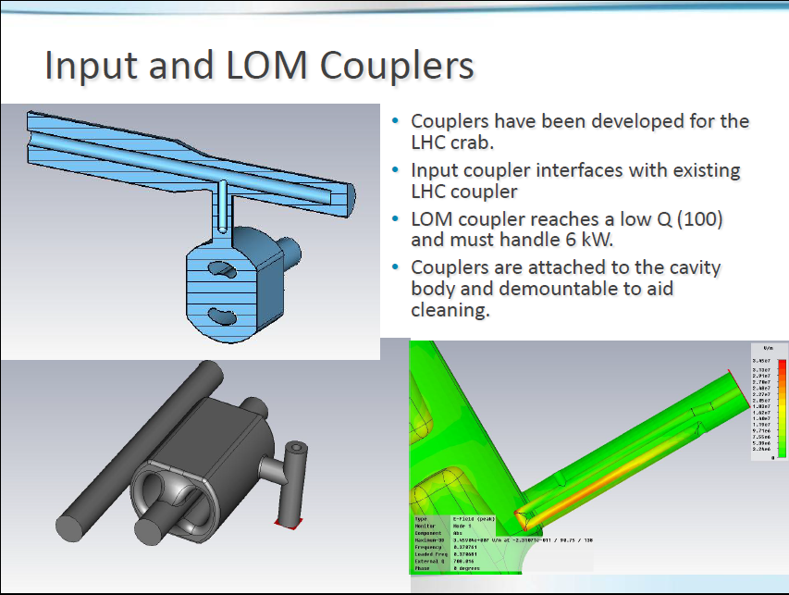

Slide 6
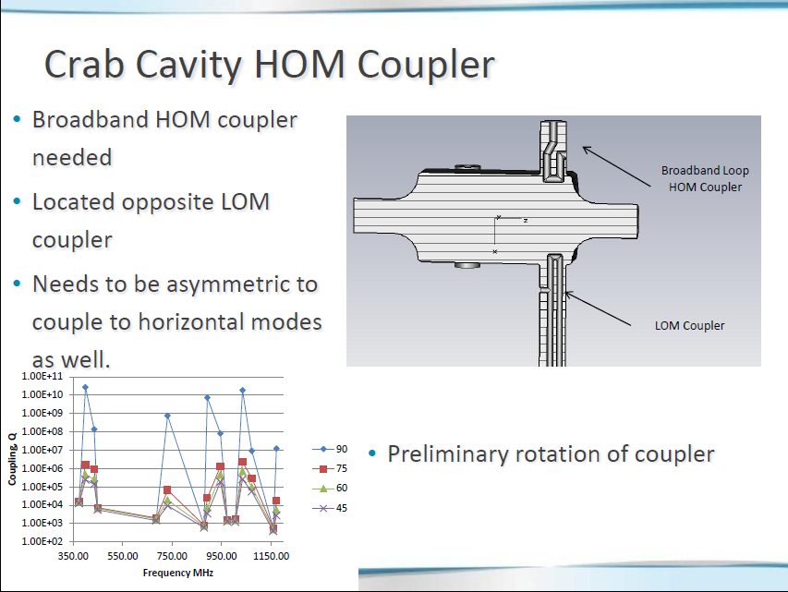

Slide 7
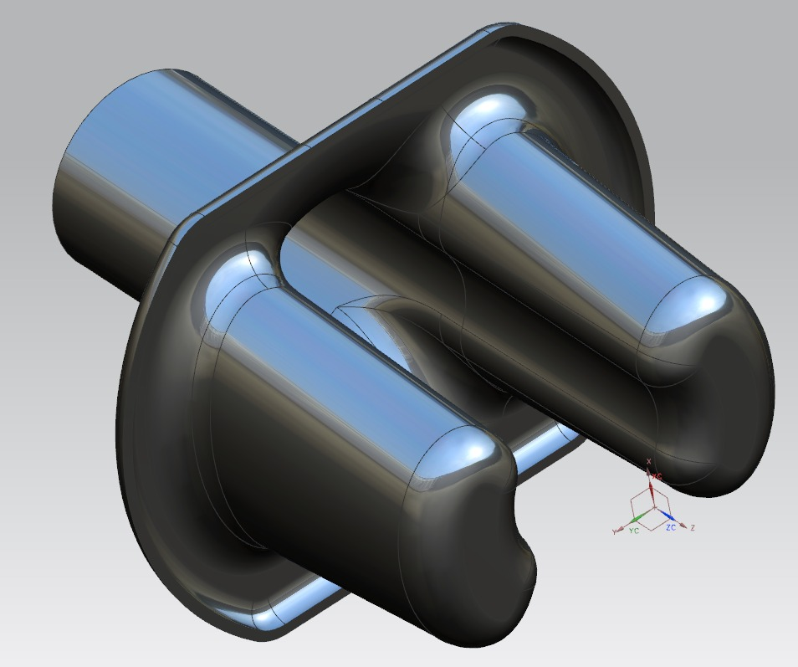
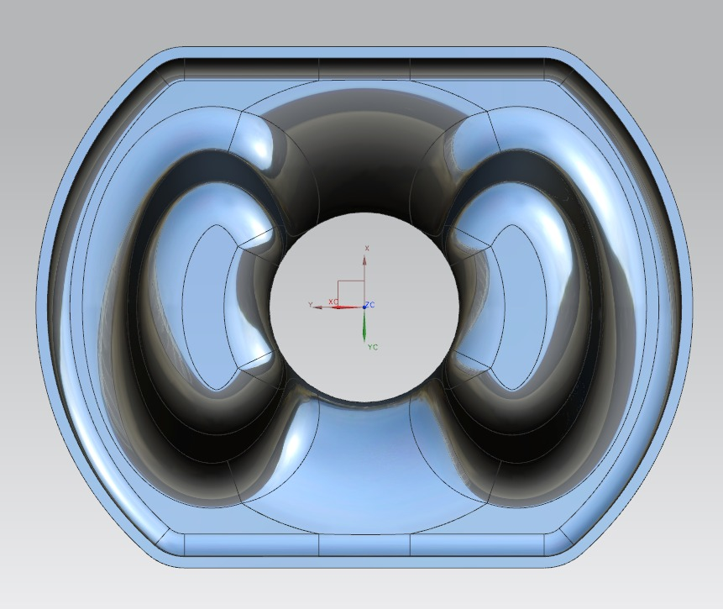
1. Conventional fabrication, ideal RF design
Fabricate from multiple pressed sections (multiple dies)
Multiple multi-axis e-beam welds (esp. rod to end plate joint)
May be possible but weld development needed.
Almost parallel weld
E-beam weld line of sight

Slide 8
2. Machine end plates and rods from solid
Consider to make major parts from solid
  Wire EDM pre-forms from ingot
  Machine all surfaces
  Add beam pipes and can
This allows any material thickness or even a variable thickness. Also stiffeners can easily be added.
This will also allow fine detail to be added to avoid multipactor (like the ridges suggested by SLAC for the 800 MHz elliptical cavity)
However a substantial lump of Nb ingot is required (£50k worth)

Slide 9
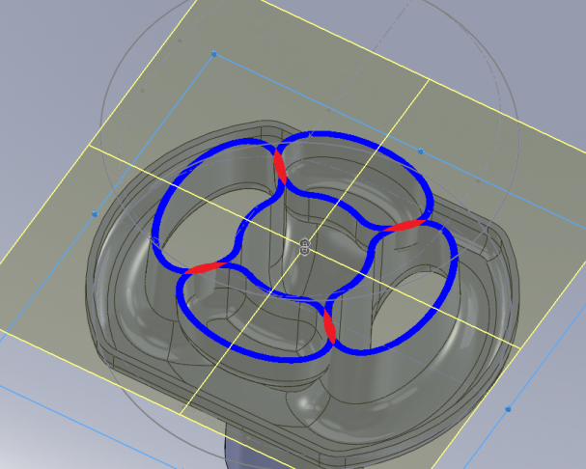
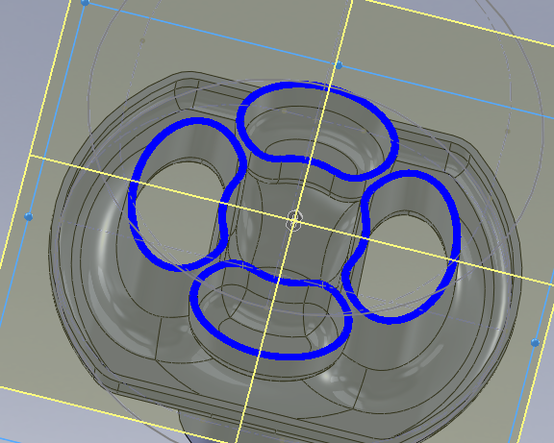
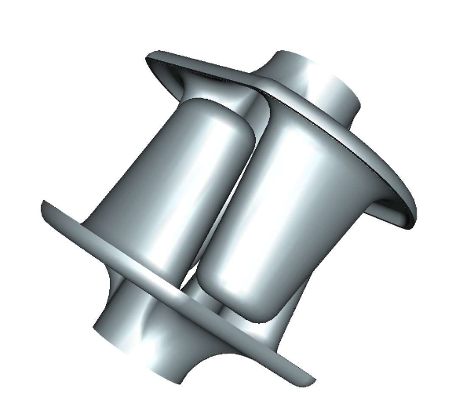
Alternative fab, slightly modified RF design
Rod profile can be reduced to allow both base plates to be wire etched from a single block of niobium.
This saves the amount of Nb required by 20%.
Clearance of 2mm between both rods to allow wire EDM.

Slide 10
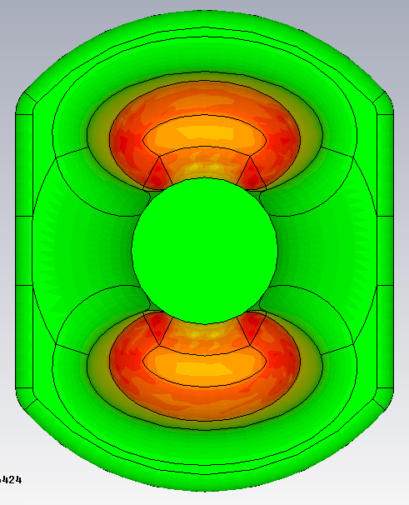

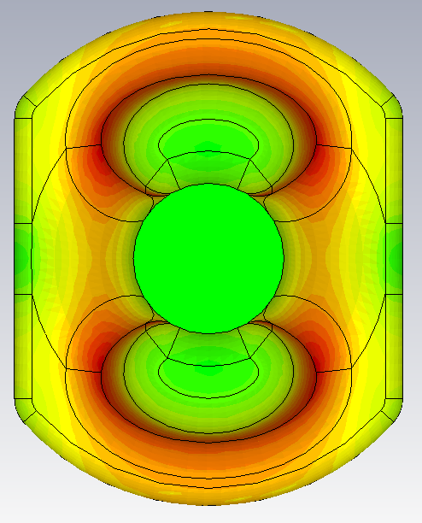
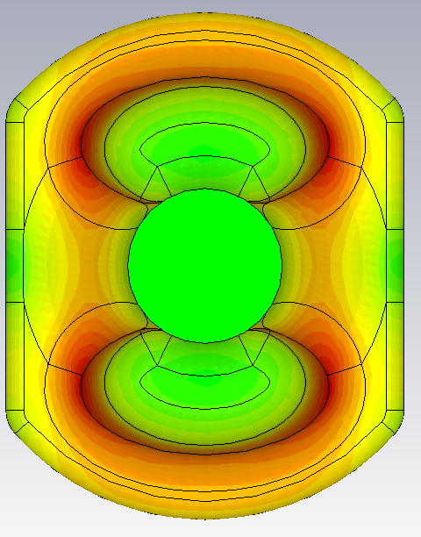
Modified Rod Shape
Reduced tip size leads to a 10% increase in peak surface electric field.
E Abs
 | Original design | Reduced profile
Emax @3MV | 32.0 MV/m | 35.9 MV/m
Bmax @3MV | 60.5 mT | 60.1 mT
Transverse R/Q | 915 Ohms | 963 Ohms
B Abs
Original
Reduced profile

Slide 11
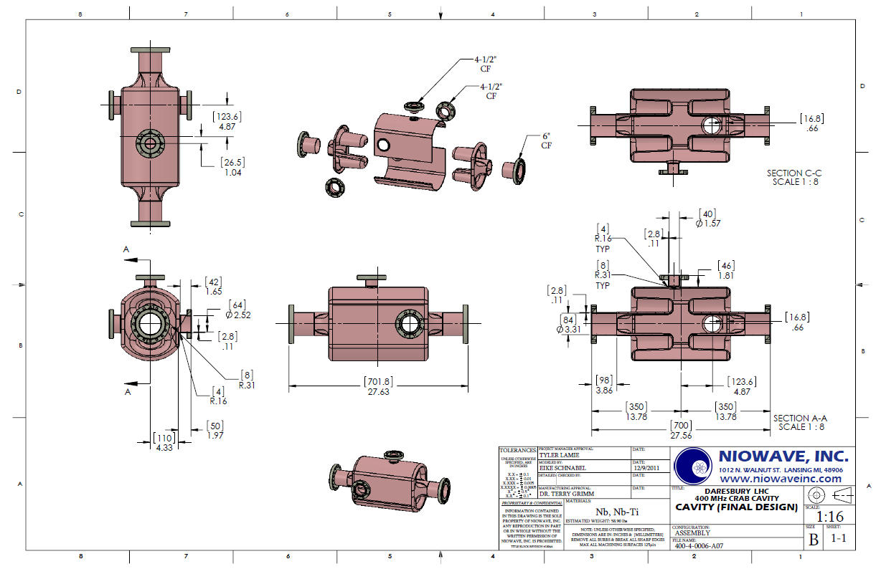
Mechanical Design

Slide 12
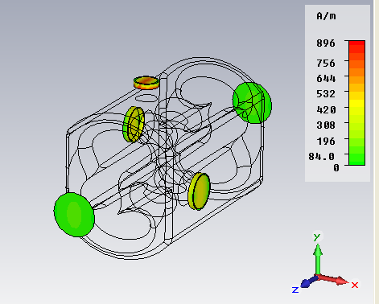
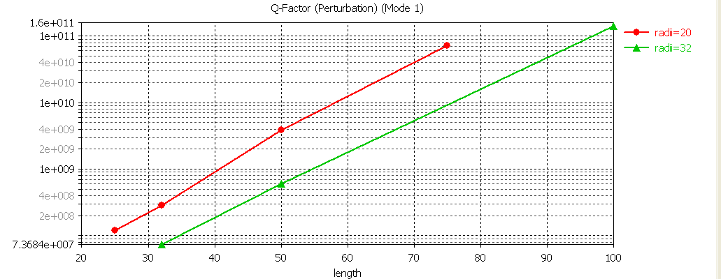
Additional heating on the ports
The lengths of each port has to be carefully chosen to avoid excessive additional losses at the flanges which will make it impossible to measure the Qo of the cavity when testing
50 mm is sufficient for our cavity

Slide 13
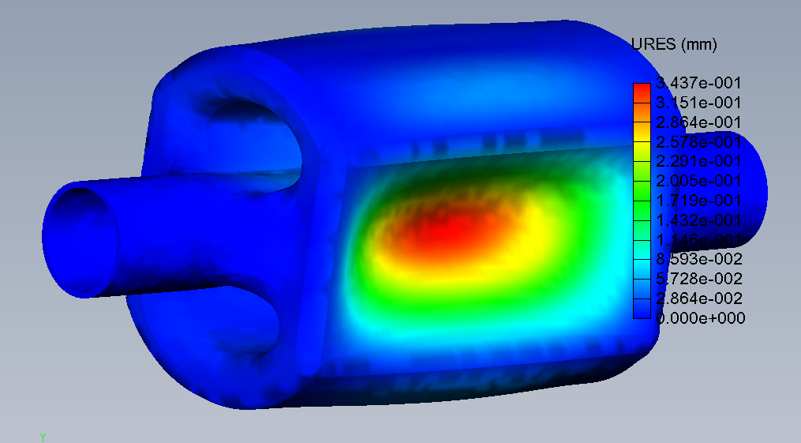
Pressure sensitivity
The outer can needs a thickness of at least 3 mm in order to minimise the pressure sensitivity to below 100 Hz/Torr.
This is a relatively small dependance and is due to the fact that the frequency is dependant on the cavity length and the cavity is quite stiff to longitudinal pressure.

Slide 14
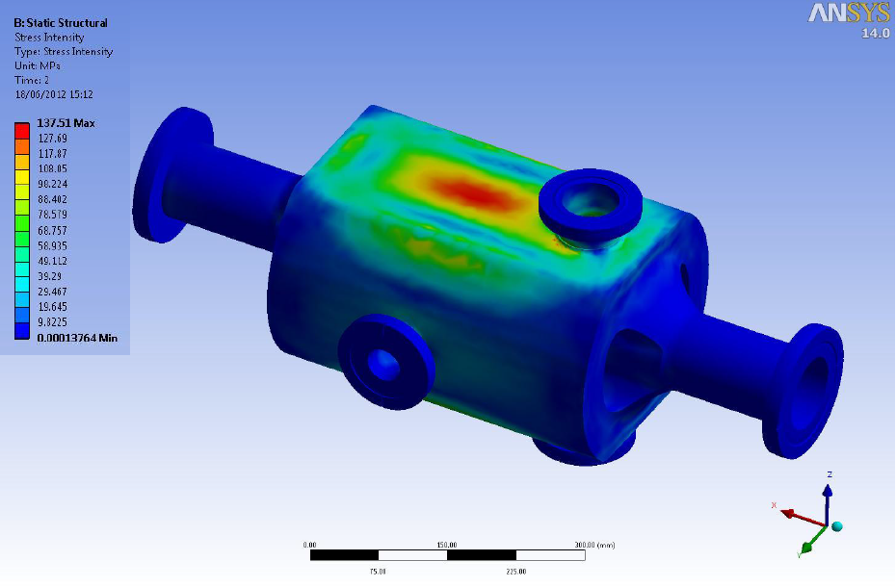
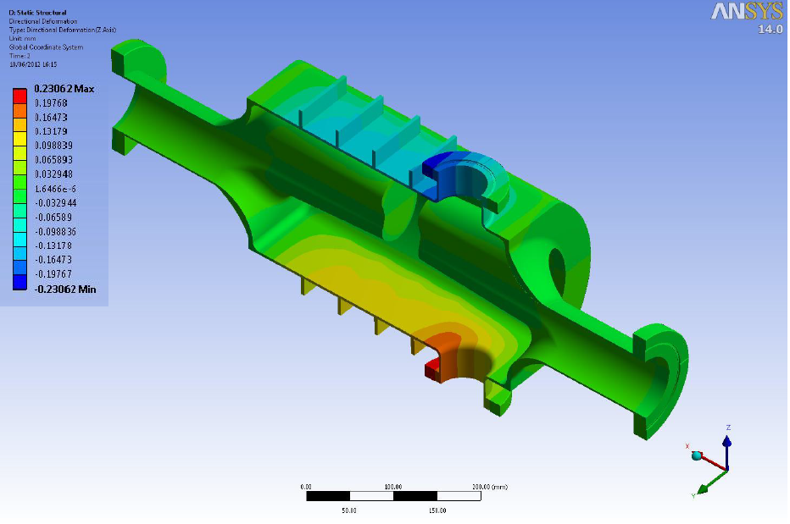
Stiffening Ribs
The stress on the outer can exceeds the 70 Mpa yield strength of Nb at room temp with 2 bar pressure.
Stiffening ribs were added to the cavity to reduce the stress to tolerable levels.

Slide 15
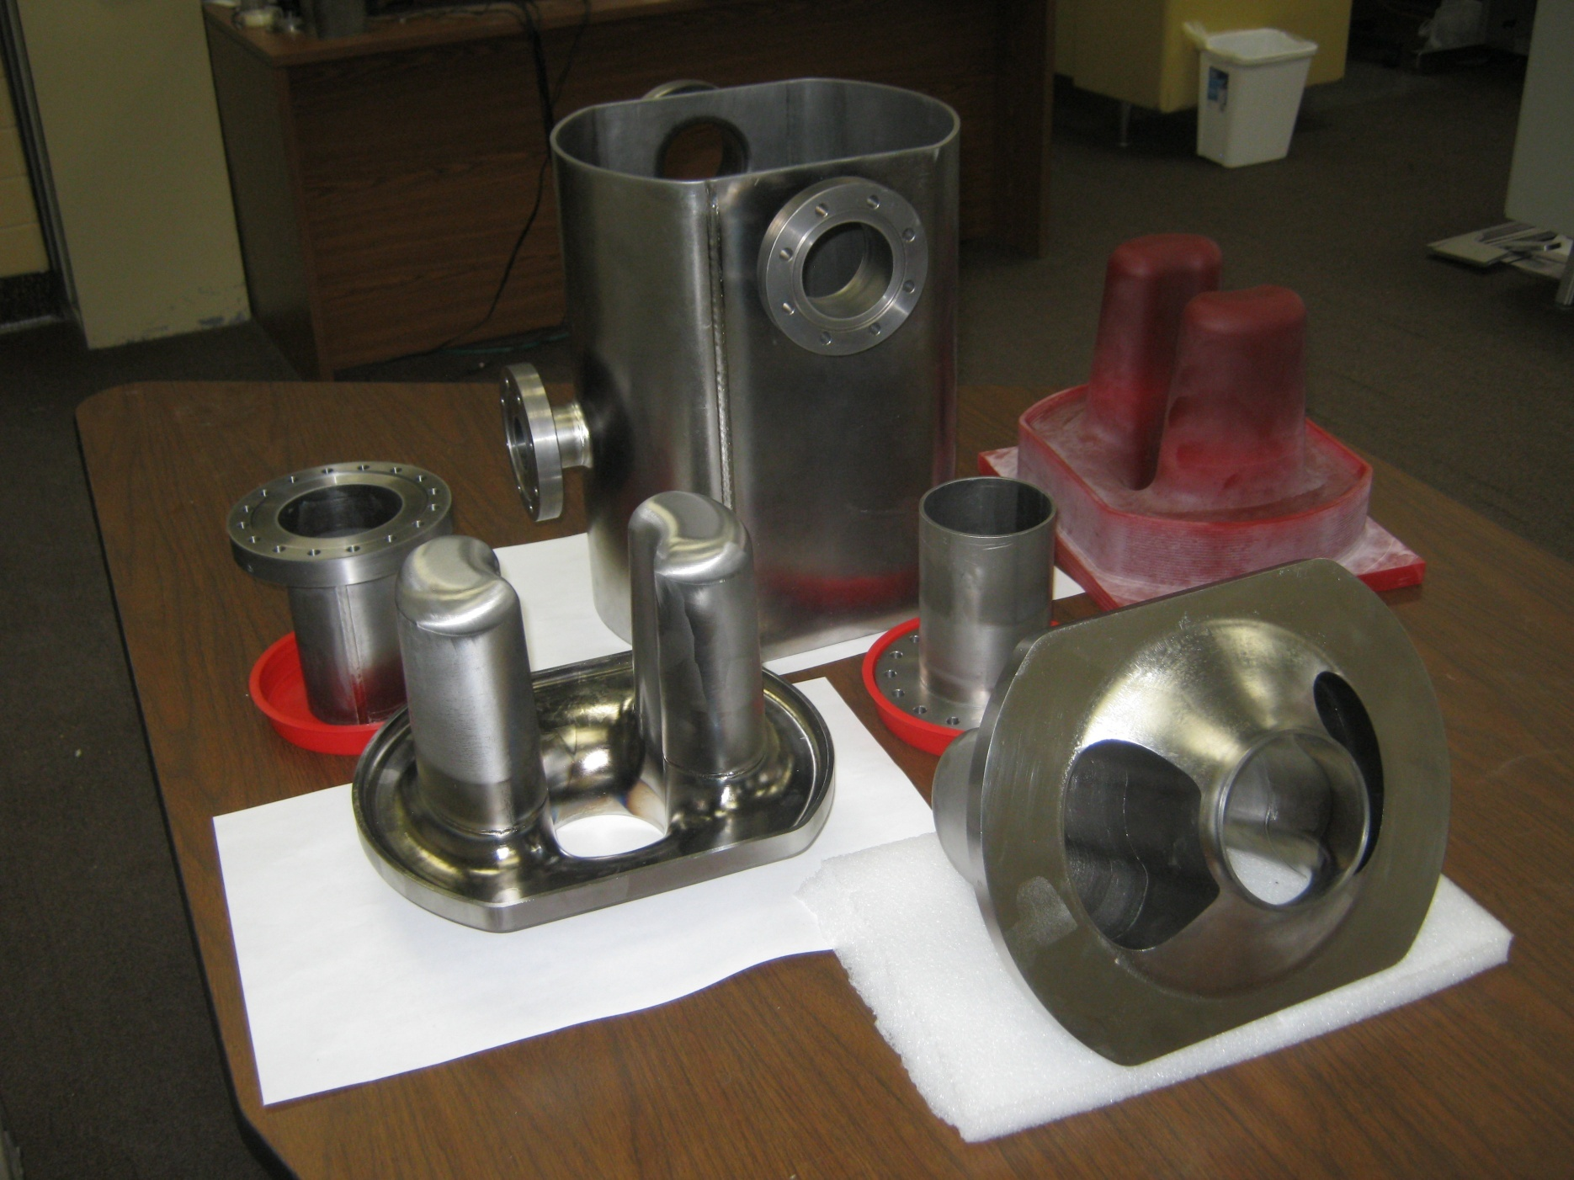
Parts after trimming and final polishing

Slide 16
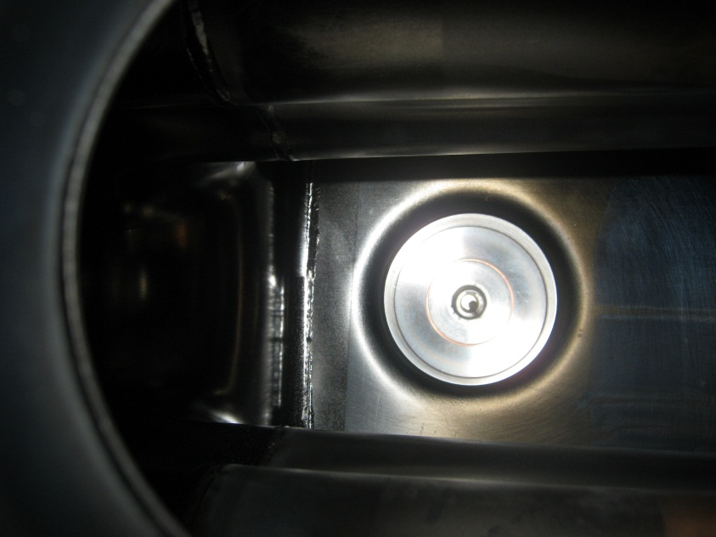
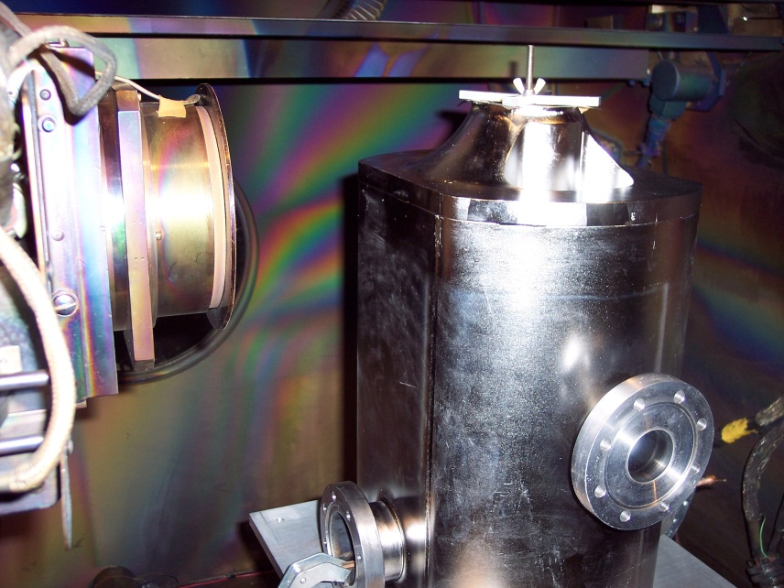
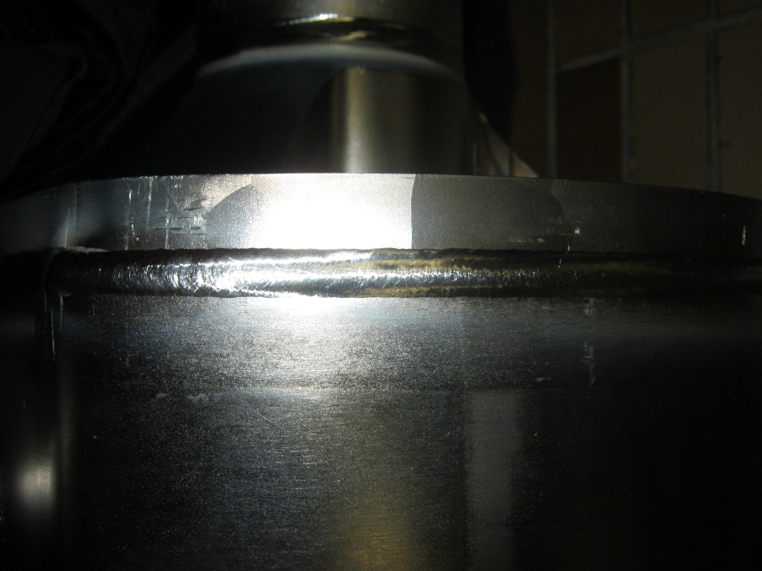
Cavity Welding
All components inspected for surface imperfections prior to etch.
20 micron etch on all weld joints.
Weld Chamber pumped down to 3.7x10⁻⁵ torr before welding.
Surface temperature of all welded components below 160ºF when chamber opened.
All weld seems visually inspected before removing components from chamber.
Post weld cavity leak check performed using copper gaskets, and conflat blanks.
No detectable leaks found (minimum detectable leak of 1.0x10⁻¹⁰ torr ℓ/s)

Slide 17
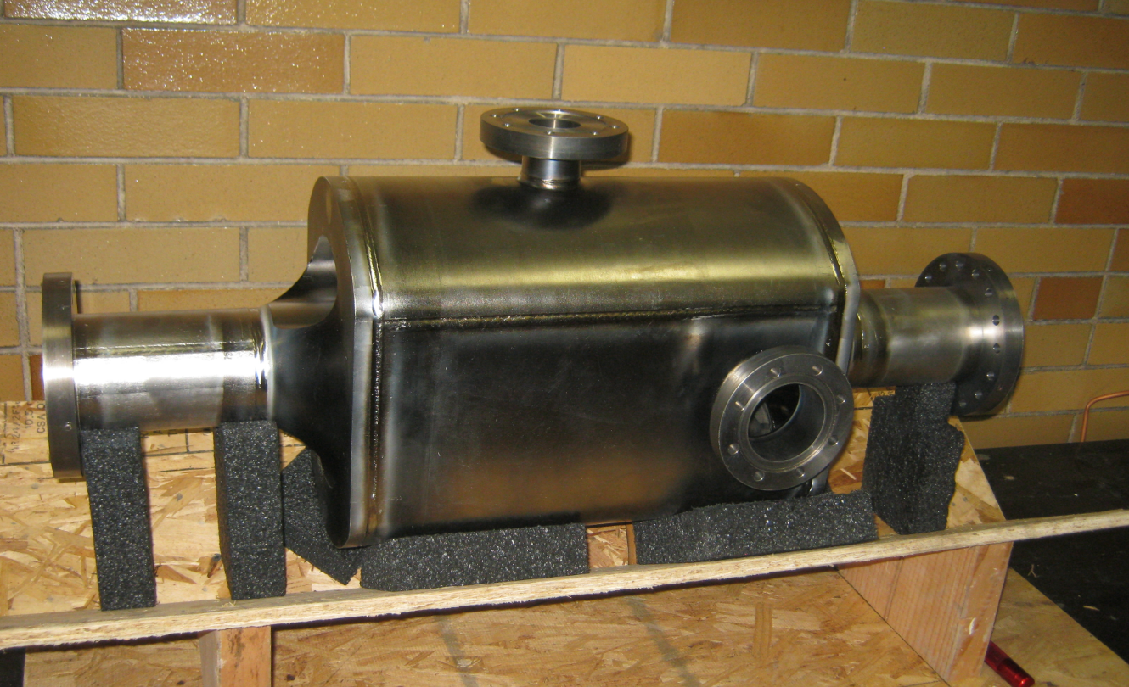

4 Rod prototype built
NIOWAVE

Slide 18
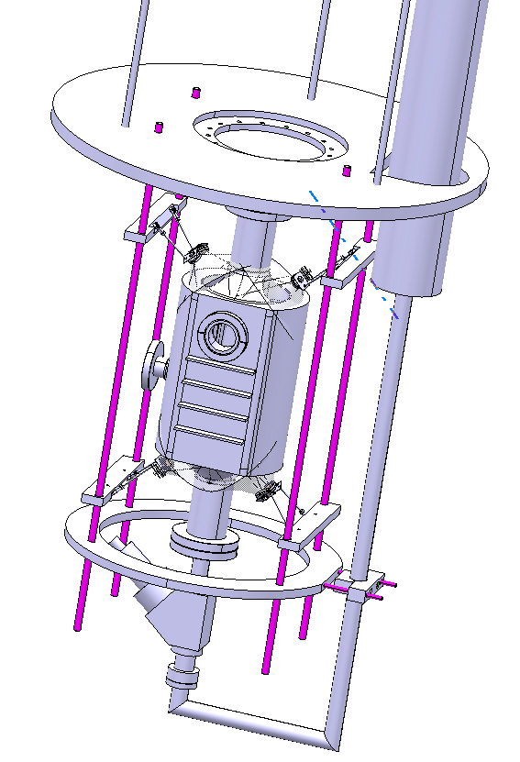
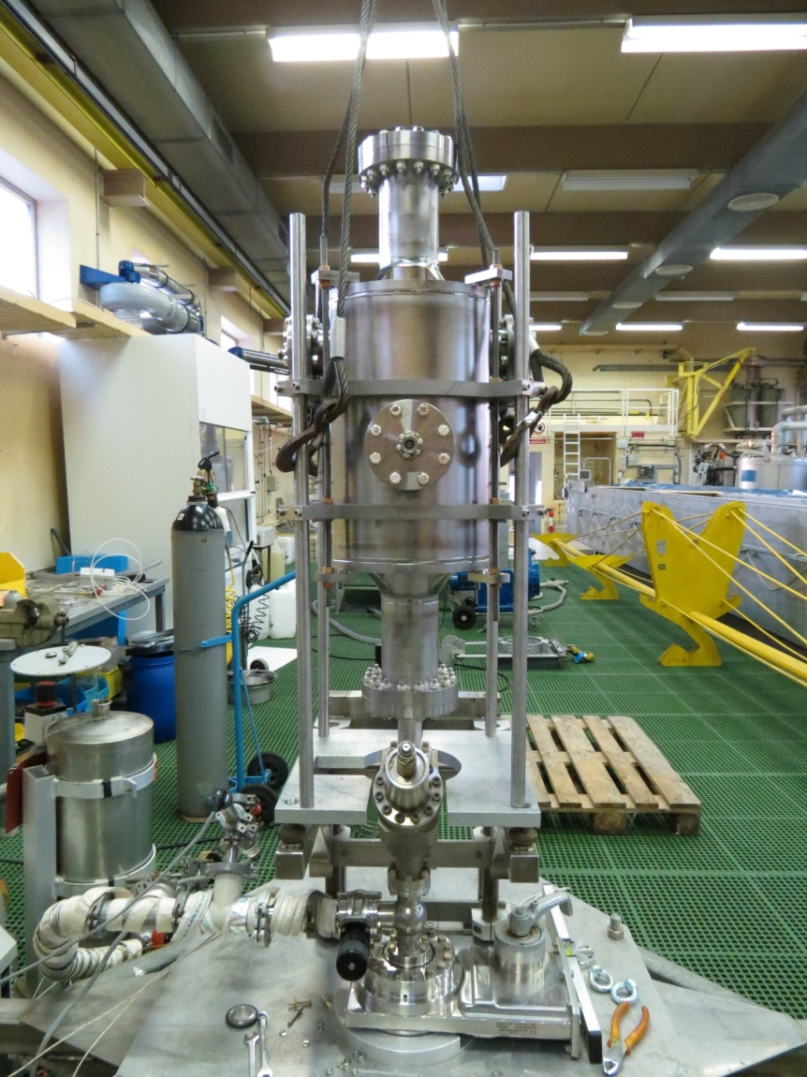
Tests at CERN SM18
The cavity was prepared for vertical testing mid-November at CERN in SM18.

Slide 19
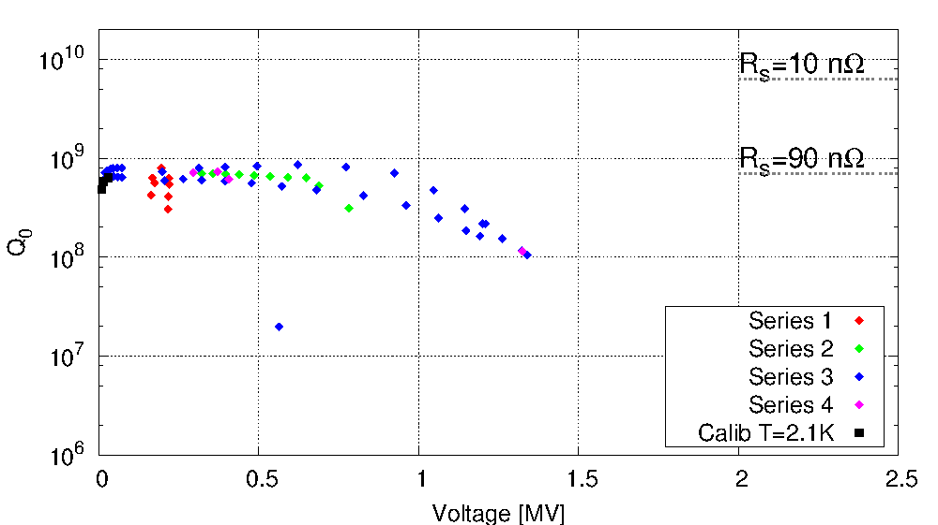
1st test results (preliminary)
Low Q probably due to incomplete cleaning.
Helium processing due to leak?

Slide 20

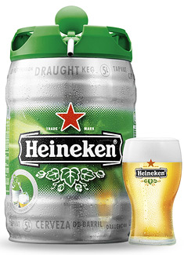
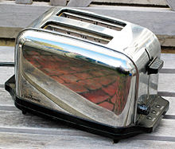
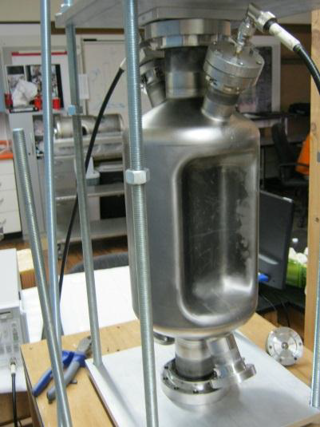
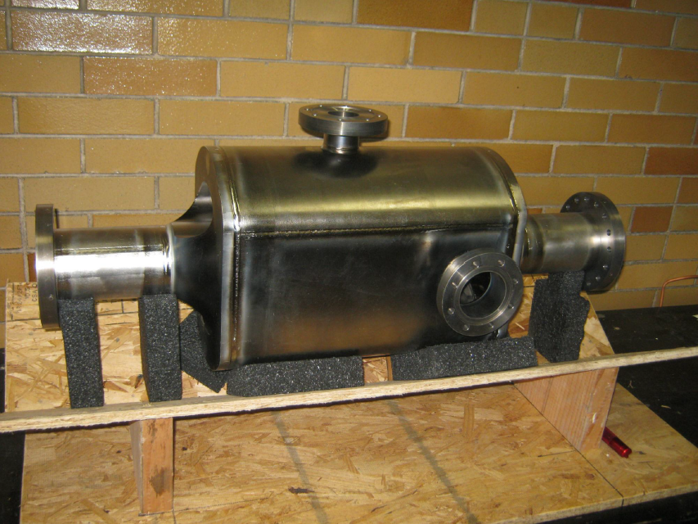
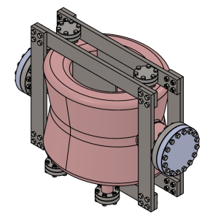
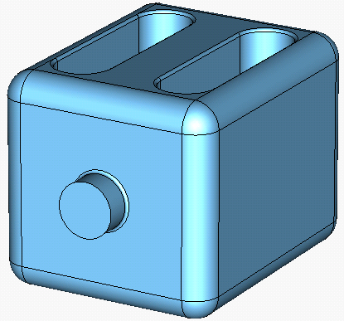
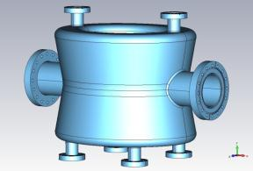
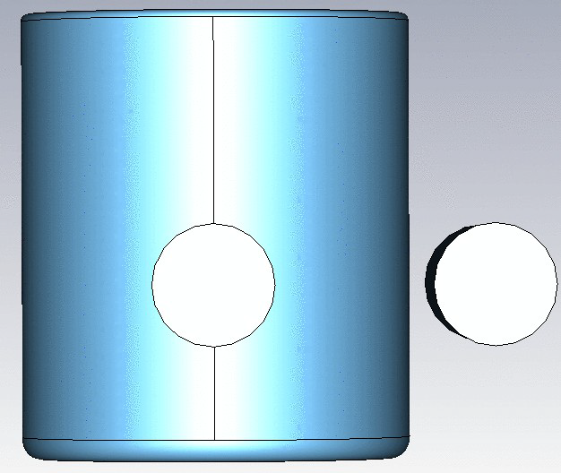
We now have lots of LHC crab prototypes

