Slide 1
DRD6 Collaboration Meeting
History, Status and Next Steps for setting up DRD Collaborations
Thomas Bergauer
9 April 2024

Slide 2

European Strategy on Particle Physics
http://europeanstrategy.cern
Continuous process driven by the community
First defined 2006
Update 2013 brought us HL-LHC decision
Update 2020 brought us decisions for post-HL-LHC times:
  Europe, together with its international partners, should investigate the technical and financial feasibility of a future hadron collider at CERN with a centre-of-mass energy of at least 100 TeV and with an electron-positron Higgs and electroweak factory as a possible first stage.
  Detector R&D programmes and associated infrastructures should be supported at CERN, national institutes, laboratories and universities. Synergies between the needs of different scientific fields and industry should be identified and exploited to boost efficiency in the development process and increase opportunities for more technology transfer benefiting society at large. [... The community should define a global detector R&D roadmap that should be used to support proposals at the European and national levels..
  Successful completion of High-Luminosity LHC must remain key focus
Update 2026 on the horizon with input proposals by spring 2025
http://dx.doi.org/10.17181/CERN.JSC6.W89E

Slide 3

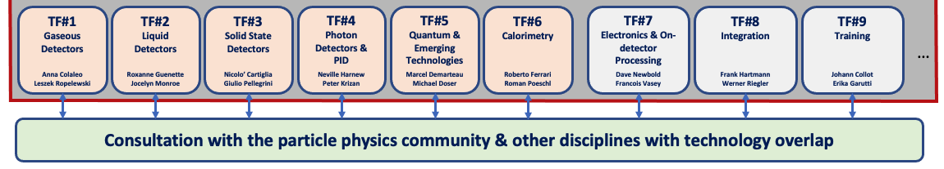
ECFA Detector Roadmap
European Committee for Future Accelerators (ECFA) released in 2021 a full document (200 pages) and synopsis (~10 pages) based on a community-driven effort
The full document can be referenced as DOI: 10.17181/CERN.XDPL.W2EX
Overview of future facilities (EIC, ILC, CLIC, FCC-ee/hh, Muon collider) or major upgrades (ALICE, Belle-II, LHC-b,…) and their timelines
Ten “General Strategic Recommendations” (full list in backup slides)
Nine Technology domains with Task Forces areas
  The most urgent R&D topics in each domain identified as Detector R&D Themes (DRDTs)

Slide 4
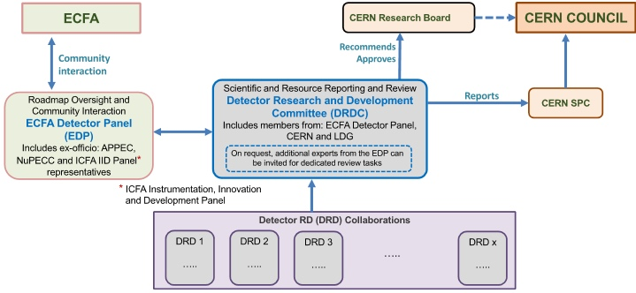
Roadmap implementation plan
Approved by CERN SPC and Council in fall 2022 (CERN/SPC/1190 ; CERN/3679)
CERN will host DRD collaborations
  Interaction between DRD collaborations and committees through DRDC
  Interface to ECFA via ECFA Detector panel: https://ecfa-dp.desy.de
Distinction between reviewing body (DRDC) and advising body (EDP)
EDP also provides input to the next Strategy update

Slide 5
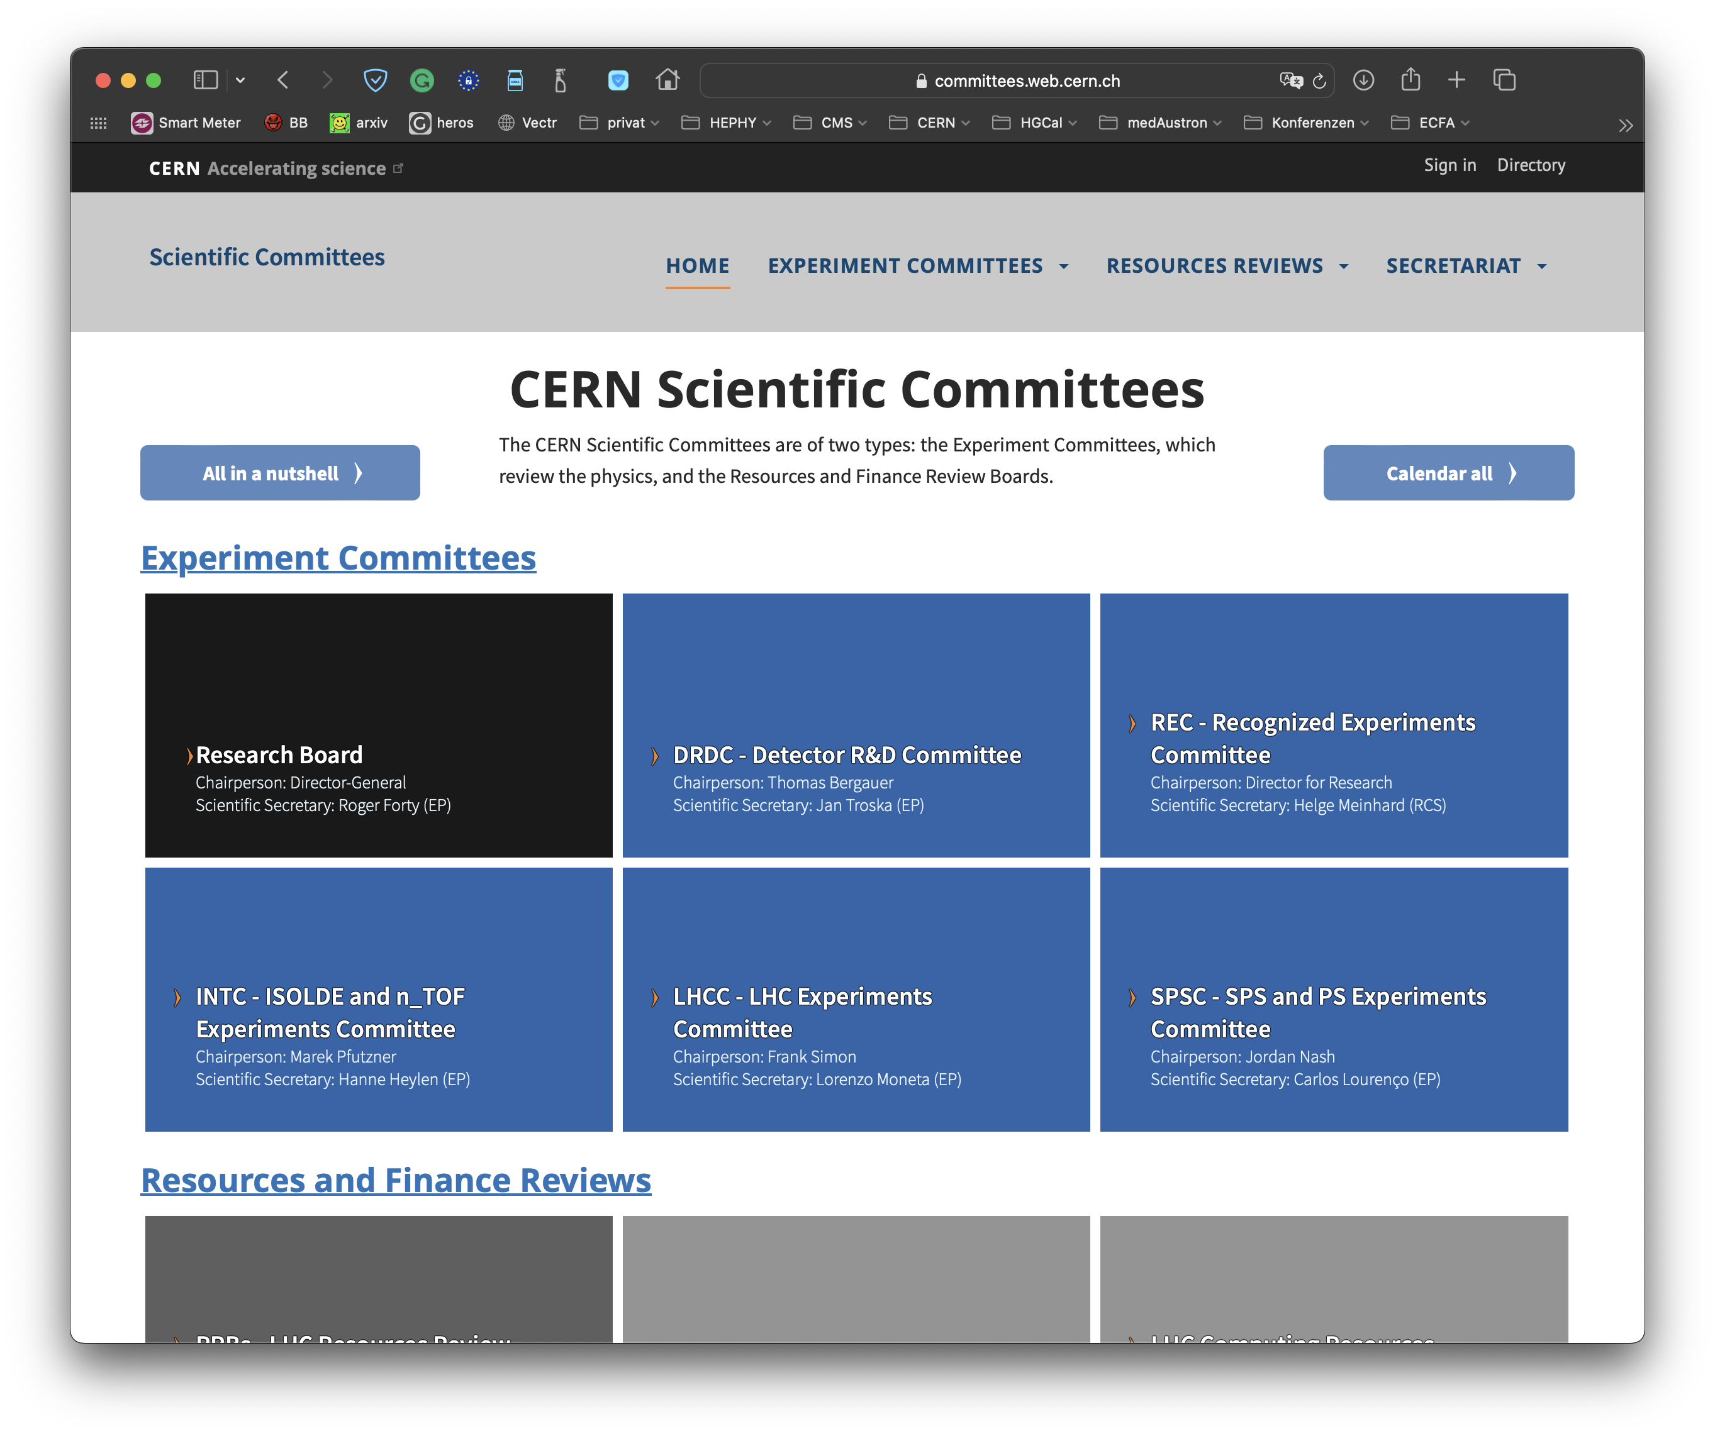
DRD Committee (DRDC)
Detector R&D Committee is a new committee on the same level as SPSC and LHCC
  Established autumn 2023 following ECFA Detector Roadmap Process
  http://committees.web.cern.ch/drdc
Mandate of DRDC:
  Reviews DRD proposals and suggests recommendations to CERN Research Board
  Requests annual status reports of running DRD collaborations and conducts reviews of their progress

Slide 6
DRDC and ECFA EDP
Detector R&D Committee (DRDC):
  “Reviewing body”
  Monitoring milestones and deliverables
  Embedded in “CERN hierarchy”,
  reporting to RB
ECFA Detector Panel (EDP):
  “Advising body”, full mandate to be found here
  Started to organize “DRD Managers Forum” recently
    Organizing exchange across different DRDs
    Define common terminology
    Heritage from “full panel” meetings during proposal preparation
  Providing input to European Strategy for Particle Physics Update 2026
    Input proposals until 31 March 2025, “Granada” style meeting summer 2025

Slide 7
From ECFA Task forces to DRD collaborations
Chapters convenors (Task Force) from ECFA Roadmap became part of Proposal Writing Teams for new DRD collaborations
Collected input from the communities in open meetings happening in the beginning of 2023
Summer 2023: Submission deadline of DRD proposals
  The DRDC (DRD Committee) was appointed at the same time only
  Review of first DRD proposals by DRDC in autumn 2023
  Intense phase of work as also DRDC mandate and tasks had to be defined first
Approval of first DRD collaborations in December 2023 RB
Once approved, DRD collaborations started in 2024
  Collaborations have kick-off meetings, elect management positions,…
  Setting up MoU and collecting signatures from Funding Agencies
Q1/2023
Community input by open meetings
End 07/23
Submission of proposals to DRDC
Fall 2023
Review by CERN DRDC, assisted by ECFA EDP
End 2023
Approval, then:
2024
MoU negotiations and signature collection
Collaboration starts
2024ff
annual status reports and monitoring to DRDC

Slide 8
MoU Template
CERN provides templates for the Memorandum of Understanding
  To be in agreement with CERN’s General Conditions for the execution of experiments, legal service, KT office
  Should be almost identical for all DRD collaborations
Main MoU (previously called “lightweight”) is the only one which is physically/electronically signed by each institution; Contains: Obligations of CERN as host laboratory, industrial involvements, common fund, definitions:
  Working Groups shall reflect the internal structure of the Collaboration. They are expected to be long-lasting
  Work Units shall reflect time-limited resource-loaded activities with clearly defined objectives and deliverables
Annexes: everything that can change over time
  Does not necessarily need a physical signature by funding
  agencies, but agreement/vote at finance committee meeting
  (with representatives of funding agencies)
Status: First draft of MoU Template is available
for CERN-internal review (legal service, DRC,…)
Annex 1: Collaborating Institutions and their Contact Persons
Annex 2: Funding Agencies and their Representatives
Annex 3: Organisational Structure of the Collaboration
Annex 4: Financial Participation of the Funding Agencies
Annex 5: Working Groups
Annex 6: Work Packages and their sub-units (“work units”)
Annex 7: Background IP
Annex 8: CERN General Conditions Applicable to Experiments

Slide 9
Resources Board
Collaboration Board as (scientific and technical) representation of collaborating institutions
Resources Board as a representation of funding agencies
  Definition of a Funding agency:
    Collaborating institutions themselves, if they have the authority for the committed funds
    or a body acting on behalf of one or several institutions in the conclusion of the MoU (e.g. INFN)
Creation (and termination?) of working groups and work packages require approval by CB and RB
  No funding agency involved must object
There have been suggestions that the RB meetings of all DRD collaborations should happen in a common way, similar to what happens for LHC RRB
  Common plenary session for all four LHC experiments, then more detailed individual meetings for each of the four over two days.

Slide 10
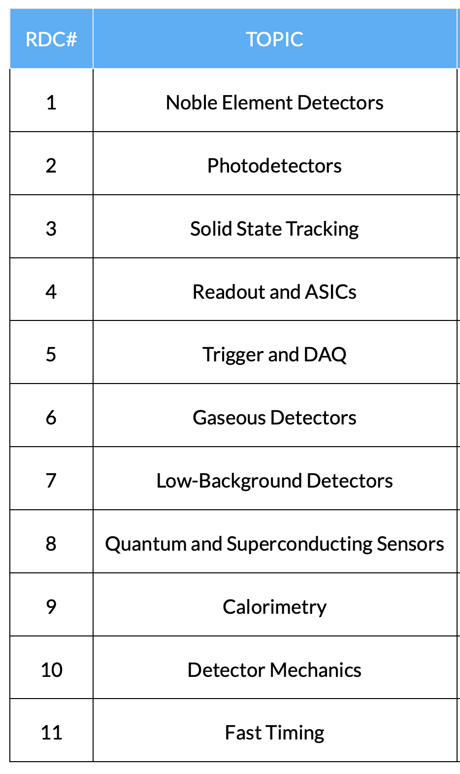
Status in the US
Result from US Snowmass process: recommendation to create Detector R&D collaborations in the US
  Organized by CPAD (Coordinating Panel for Advanced Detectors) of the APS/DPF
    DRDC member Petra Merkel (FNAL) was CPAD co-chair until recently
    Now Jonathan Asaadi (Texas) involved in DRD2
  They created 11 RDCs (R&D Collaborations) and appointed coordinators (see https://cpad-dpf.org/?page_id=1549)
    Calorimetry coordinators: Marina Artuso, Minfang Yeh
  Recently started to reach out to the community and work on detailed planning at CPAD workshop 7-10 Nov 2023
DRD collaborations are open for US participation
  no concurrency, but synergy
  Overlap to DRDs through people/groups involved in both and liaisons

Slide 11

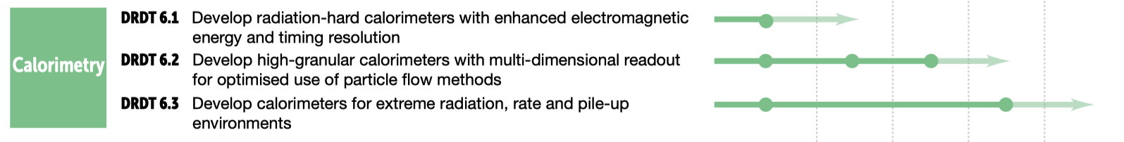
R&D Topics in ECFA Roadmap
The most urgent R&D topics in each Task Force area are identified by Detector Readiness Matrix
Detector R&D Themes (DRDTs) were formulated as high-level deliverables

Slide 12
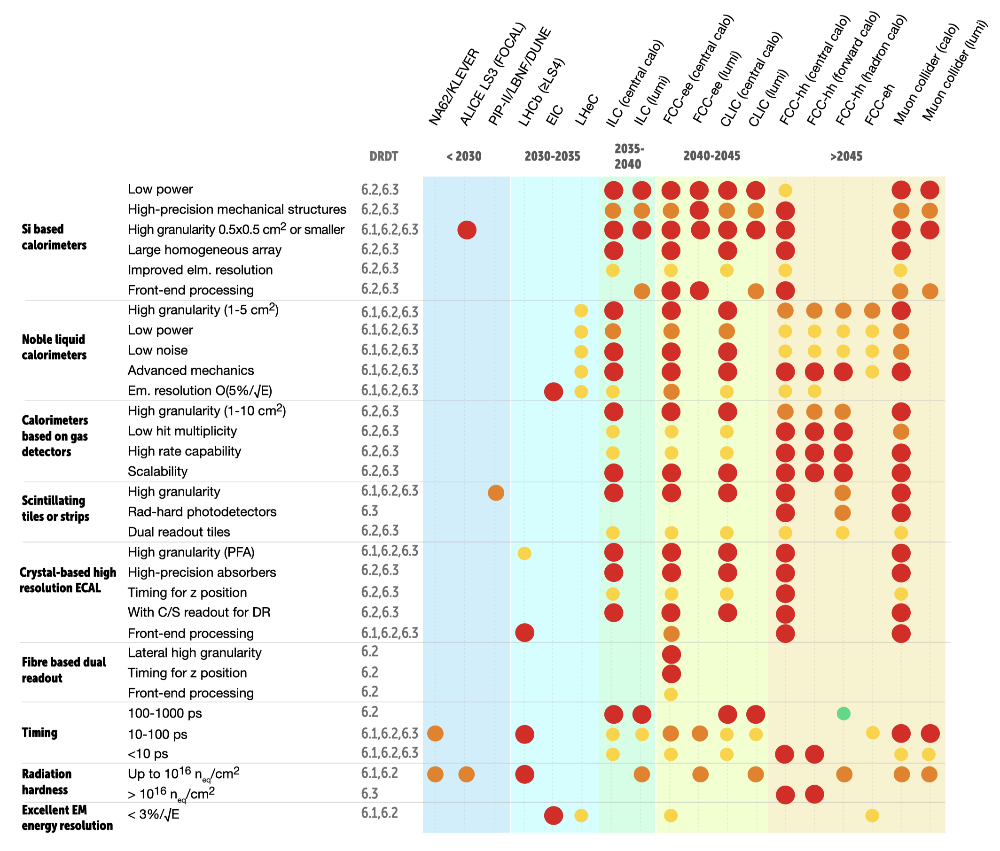

Detector Readiness Matrix
Looks like no short-term deliverables exist
  Many goals for ILC and FCC-ee
DRD6 proposal has several deliverables and milestones within next three years
  Necessary to track progress by DRDC

Slide 13
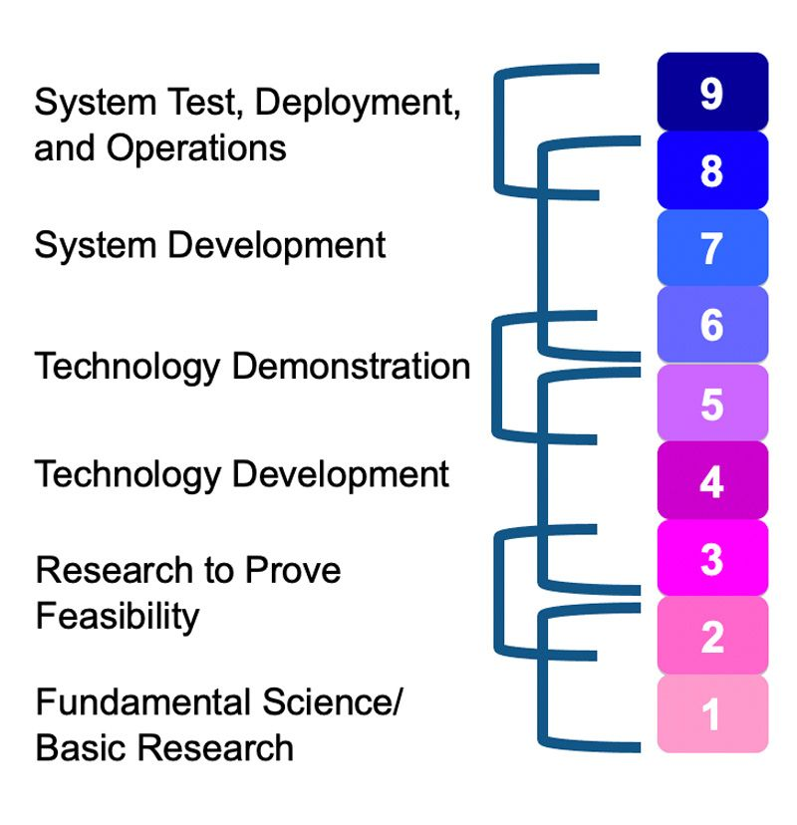
Strategic R&D
Strategic R&D bridges the gap between the idea (“blue sky research”, TRL 1-3) and the deployment and use in a HEP experiment (TRL 8-9)
Detector R&D Collaboration should address TRLs from 3 to 7, before experiment-specific engineering takes over
Covers the development and maturing of technologies, e.g.
  Iterating different options
  Improving radiation hardness
  Scaling up detector area, number of layers,..
Backed up by strategic funding, agreed with funding agencies
Technology Readiness Levels (TRLs) 1-9:
Method for estimating the maturity of technologies
Experiments
Strategic
Blue Sky
Didier Contardo

Slide 14
Blue Sky R&D
Blue Sky R&D is basic research where "real-world" applications are not immediately apparent.
  Covers very low Technology readiness levels
  Starting point of development
EU-funded programs play an important role in enabling and supporting generic R&Ds in Europe: AIDA/2020/innova, ATTRACT, ERC grants (Three in silicon community ^{*)}!)
  Not existing in the US to this extent
  Successor to AIDAinnova planned.
Common fund of RD50/RD51 was used to fund “common projects” which can be seen as blue sky
  RD50 rules: minimum 3 institutes; financial contribution is doubled by RD50
  MoU has a paragraph about common fund; can or cannot be used by DRD collaborations, but allows to start collecting money by simple CB vote, without having formal update of MoU
^{*)} Cartiglia, Sola, Iacobucci

Slide 15
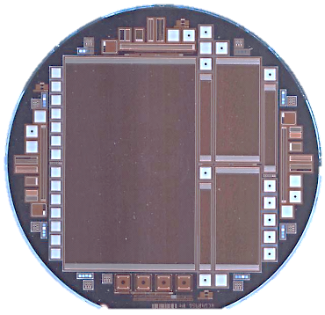
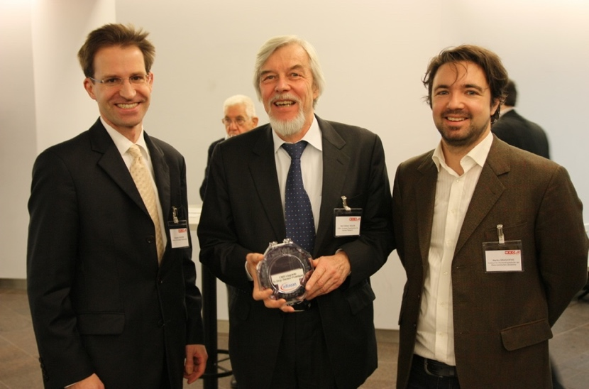
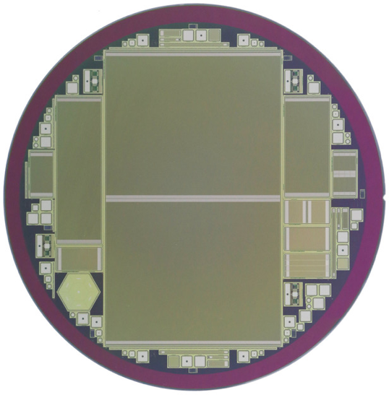
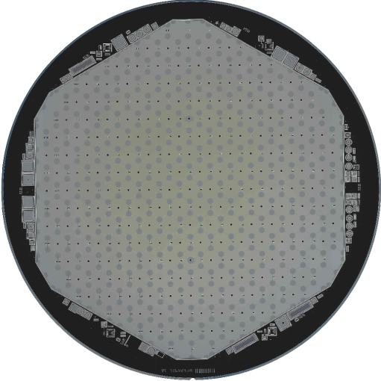
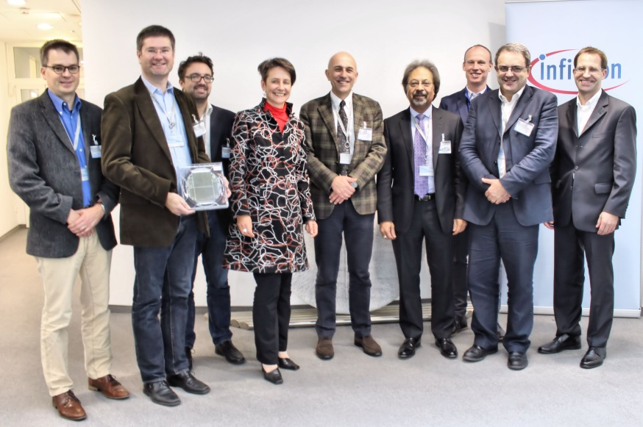
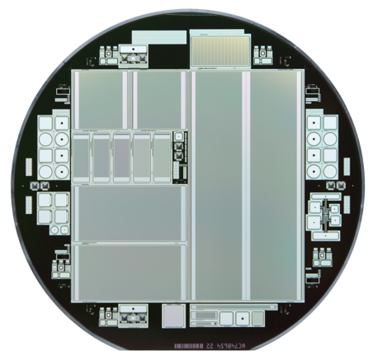
Example for the need of strategic R&D
My group worked for almost a decade with European semiconductor industry to find a “second source” for
large-area planar Si sensors (targeting Phase-II Upgrades)
Attracted a lot of attention
Pushed HPK into developing 8” process
→ now being used for CMS HGCal
Milestones:
  2009: re-produce 6” p-on-n strip sensors
  2015: First AC-coupled strip sensors on 8” wafers
  2016/17: production of first 8” hexagonal HGCal sensors
  2018: program stopped due to economic reasons
Reason for termination of program before series production:
O(10) more wafer runs (~150k€ each) would have been necessary to mature the technology
Strategic R&D funding for R&D costs → reduction of series production costs
6“ p-on-n
Wafer:
Former CERN DG R. Heuer with Infineon manager and HEPHY staff
8” p-type
strips
8” CMS HGCal
prototypes
6” CMS PS-S
prototypes
Infineon CEO together with HEPHY and CERN representatives
9 April 2024
DRDC Update at DRD6 Collaboration Meeting
15

Slide 16
Detector R&D collaborations
Highlights of organization and structure

Slide 17
Status DRD Collaborations
Gaseous Detectors (DRD1) [ex RD51]
Liquid Detectors (DRD2)
Photodetectors & Particle ID (DRD4)
Calorimetry (DRD6)
Semiconductor Detectors (DRD3) [ex RD50, RD42,..]
Quantum Sensors (DRD5)
Electronics (DRD7)
Integration (DRD8)
Fully Approved for an initial period of 3 years by CERN Research Board in December 2023
Reports at open session of DRDC meeting: https://indico.cern.ch/event/1356910/
Full Proposals in CERN CDS
Conditionally approved
Full proposals submitted last week for review
Both aim for approval in June
Full Proposal to be written
by the end of this year
Letter of Intent submitted

Slide 18
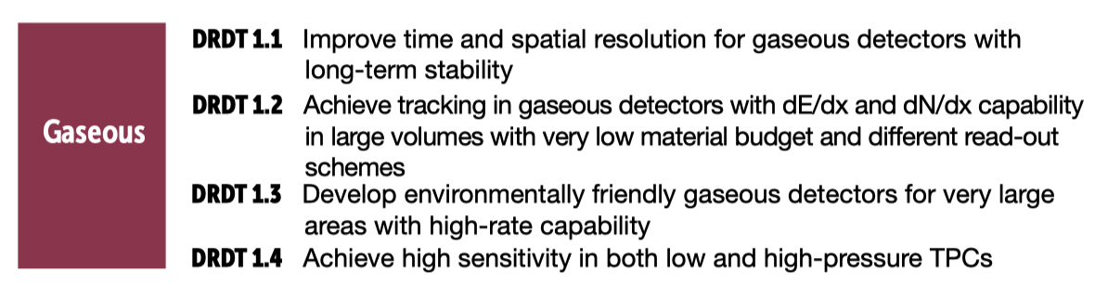
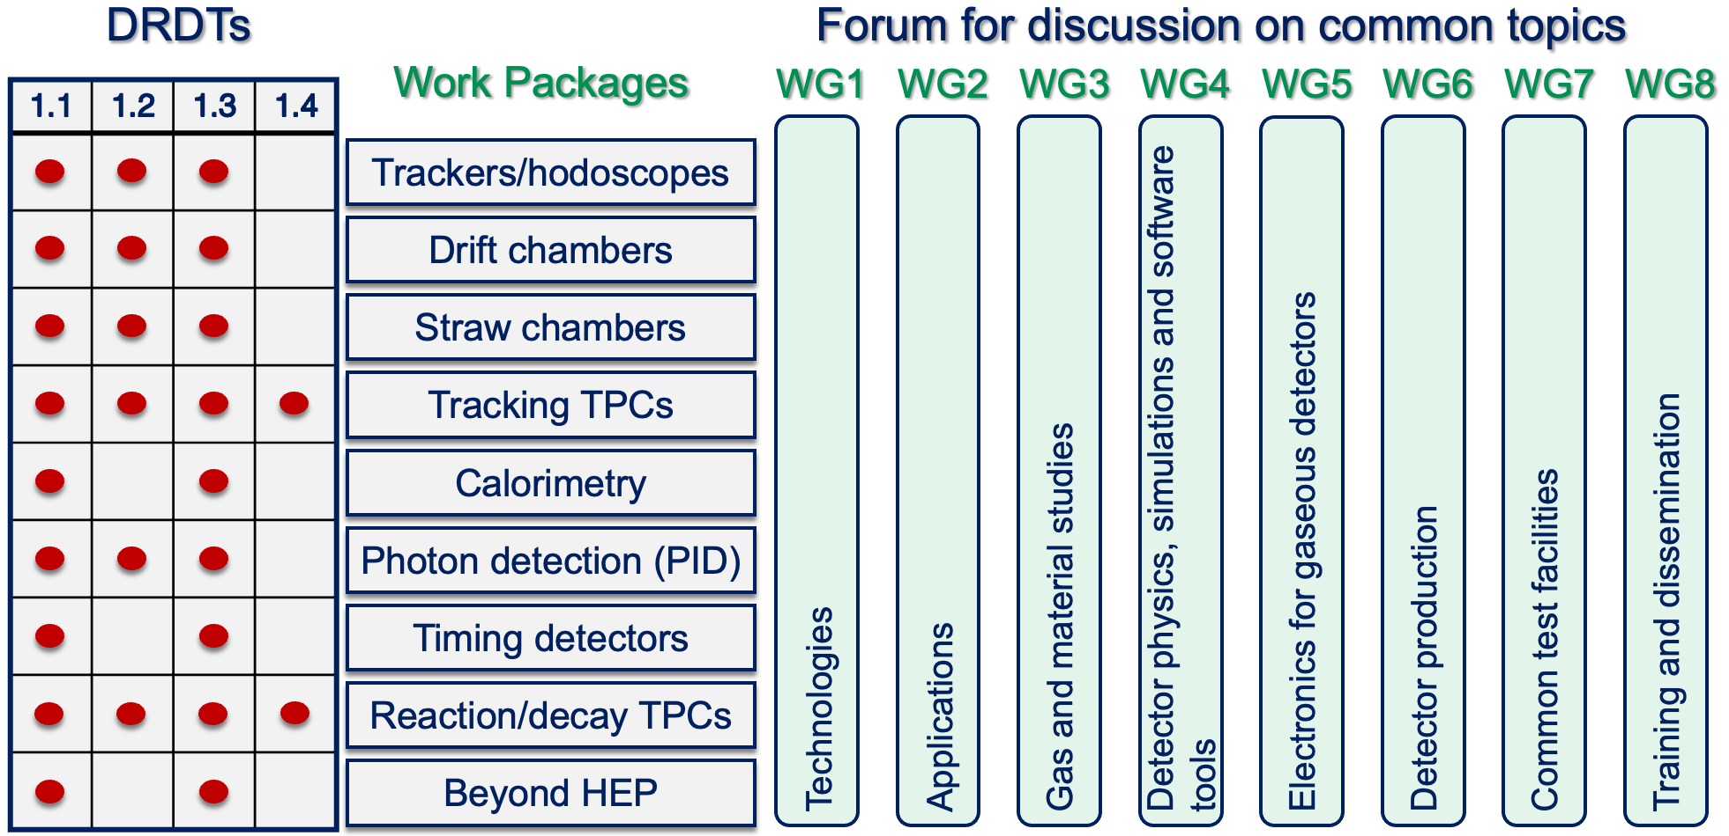
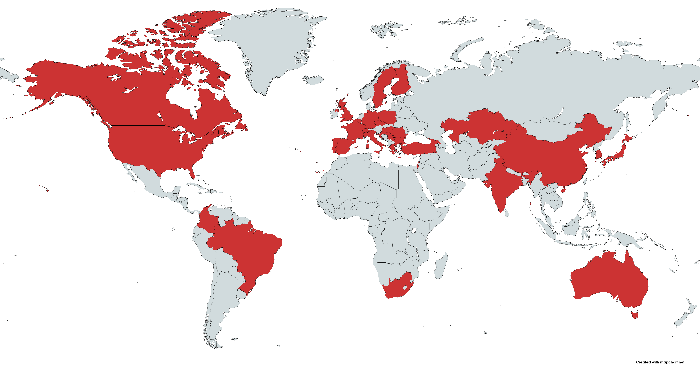
DRD1: Gaseous Detectors
Organized in
  Working Groups: serving as the backbone of R&D
  Work Packages: will reflect the DRDTs,
  and Common Projects (blue sky) financed by fixed yearly fee (Common Fund)
Large community of 161 institutes, 700 members, 33 countries
Anticipated budget: 3 MCHF/y existing, additional 3 MCHF/y requested, 270/100 FTE
Elections Mid-December resulted in CB board chair : Anna Colaleo;
Spokespersons : Eraldo Oliveri, Maxim Titov
A collaboration website exists: https://drd1.web.cern.ch
Collaboration meetings: 29.1. to 2.2.2024: link, 2nd Collaboration Meeting June 17-21;
3rd Collaboration Meeting December (tbc) + regular WG meetings
Started to work on MoU based on RD51 MoU, and started discussion with CERN
Requested six weeks of beamtime at CERN SPS

Slide 19
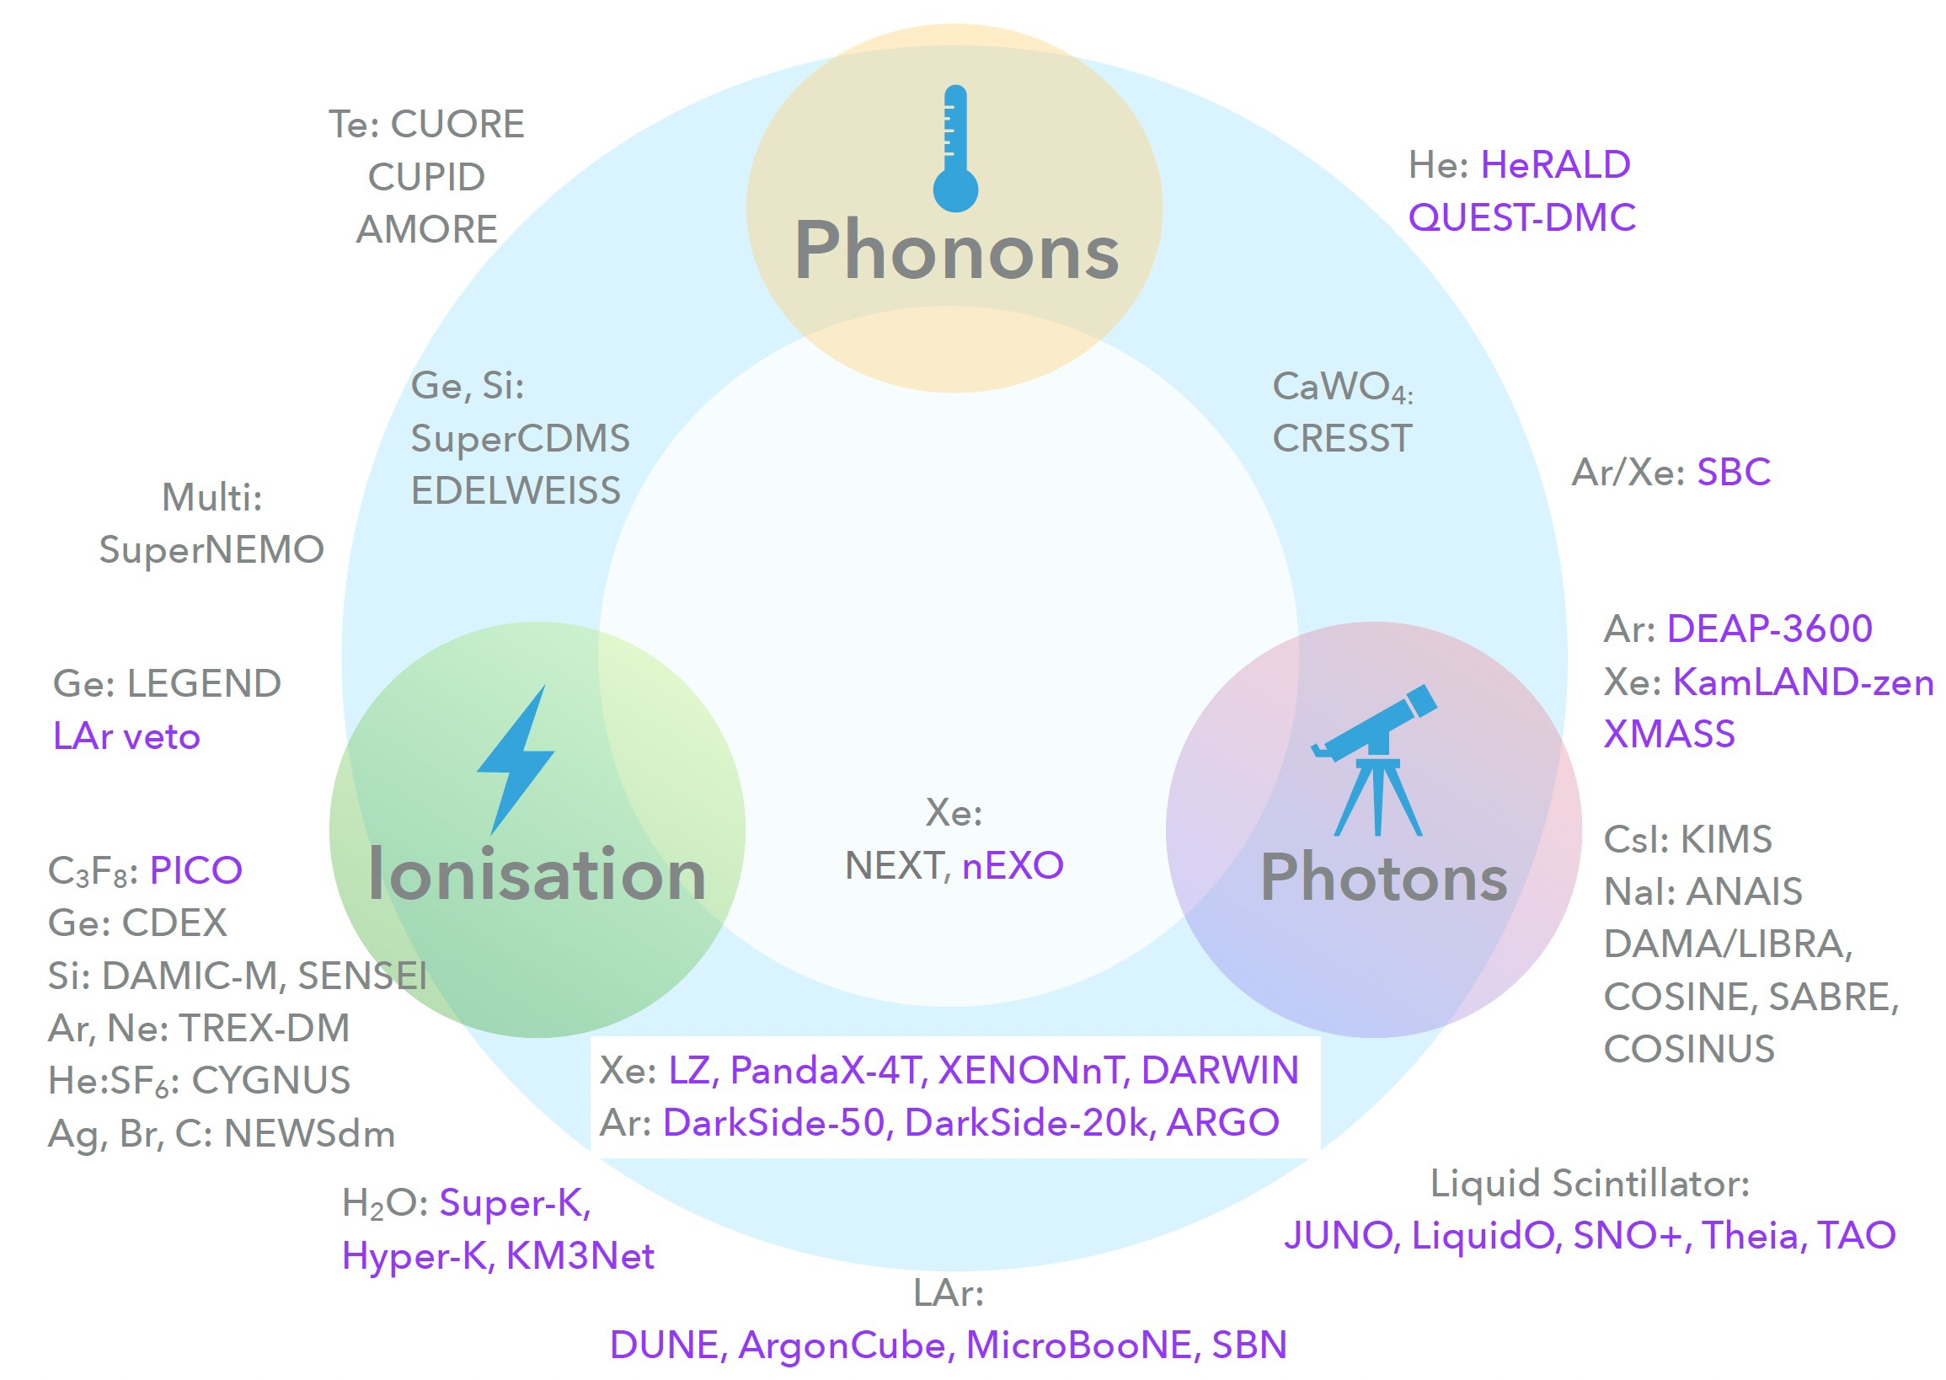
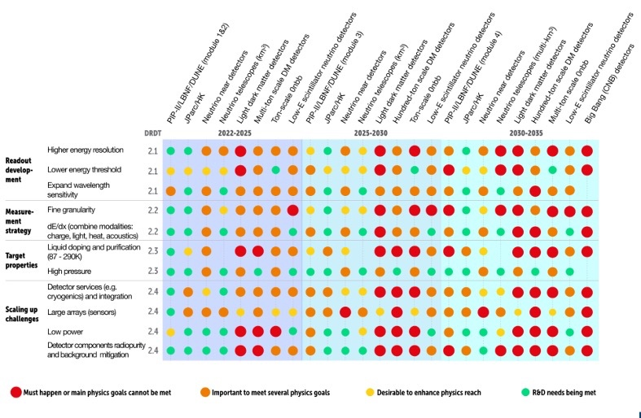
DRD2: Liquid detectors
Covers Dark Matter and Neutrino experiments, accelerator and non-accelerator-based
Several large-scale and many small-scale experiments running or foreseen with liquid detectors
Technology: Noble Liquids (e.g. DUNE), Water Cherenkov (e.g. Super/Hyper-K) and Liquid Scintillator with light and ionization readout
Underground Dark Matter Experiments – small and rare signals R&D for multi-ton scale noble liquids:
  Target doping and purification
  Detector components radiopurity and background mitigation
Feb. 5-7, ’24: inaugural DRD2 Collaboration Meeting at CERN https://indico.cern.ch/event/1367848/
  Exciting scientiﬁc programme! 156 participants, 91 contributed talks, from 71 institutes ,in 15 countries
  Governance working group plan for deﬁnition of Collaboration Board (CB) and call for CB chair nominations
CB Board chair election 1 March 2024 resulted in CB board chair W. Bonivento
[ECFA roadmap, Modified from L.Baudis]
Note: Developments in this field are rapid and it is not possible today to reasonably estimate the dates for projects requiring longer-term R&D

Slide 20
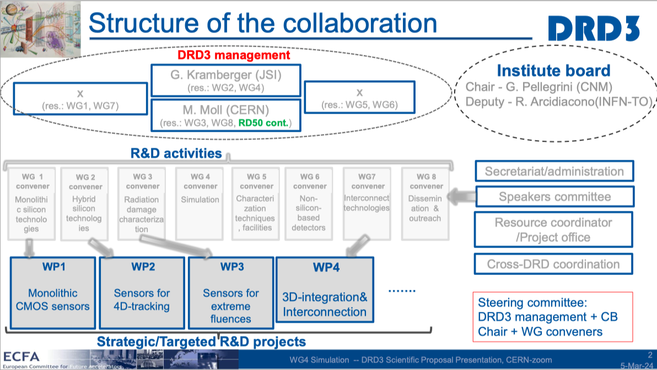
DRD3: Semiconductor Detectors
DRD3 benefits from existing RD50 collaboration
  Extended by diamonds (RD42) and 3D integration
  Large interest in CMOS (DMAPS) sensors
Large Collaboration: 132 institutes,
28 countries, ~900 interested people,
  ∼ 70% are from Europe, 15% from North America,
  Compare: RD50: 65 institutes and 434 members
Budget:
  ~5 MCHF/y (existing), ~8 MCHF/y (requested)
  327 FTE (existing), 170 FTE (requested)
CB Board chair elected: Giulio Pellegrini (CNM Spain),
deputy Roberta Arcidiacono (INFN Torino) nominated
Spokesperson elected: Gregor Kramberger (JSI Slovenia)
Main work is planned to be performed in Working Groups, WP not yet well integrated, but they plan to call for WP projects

Slide 21
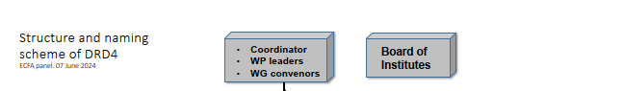
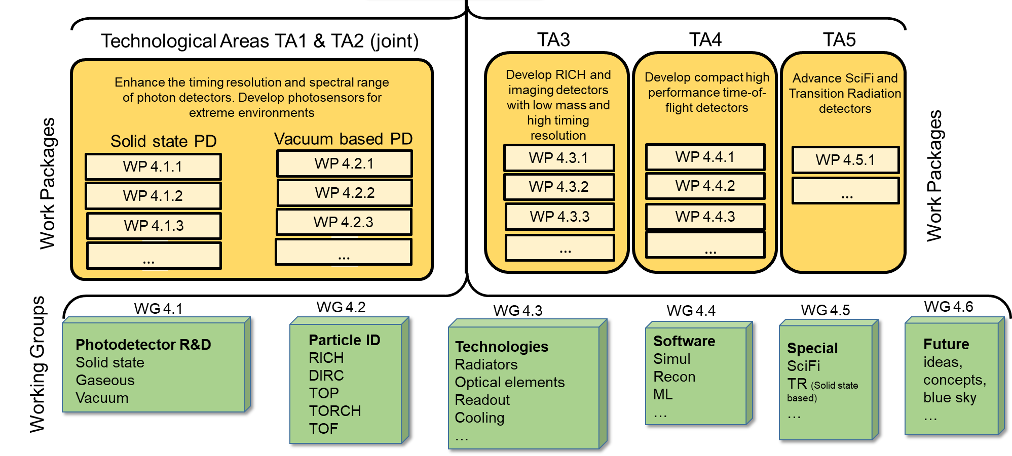
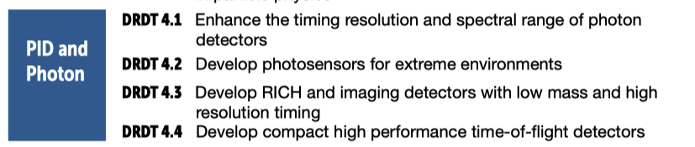
DRD4: Photodetectors & Particle ID
Developments on PMTs, MCP-PMTs, SiPMs, APD, HPD, quantum devices, SciFi,
  Challenges for example for SiPMs: rad hard, dark rate, timing
Applications in Ring Imaging Cherenkov Detectors (RICH), Time-of-Flight (ToF), TRD
Connection to almost every other DRD collab. (gas, Silicon, Calo, electronics, SiPM at cryogenic temp.)
Collaboration: 74 institutes from 19 countries, 7 (semi-) industrial partners
DRD4 constitutional meeting happened at CERN (23-24 January): https://indico.cern.ch/event/1349233/
  CB board chair: Guy Wilkinson
  Spokespersons: Massimiliano Fiorini
  Most WP/WG chairs were elected as well

Slide 22
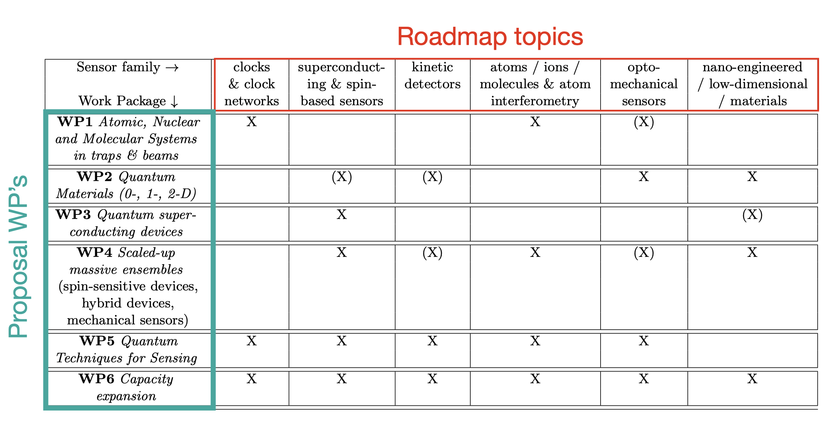
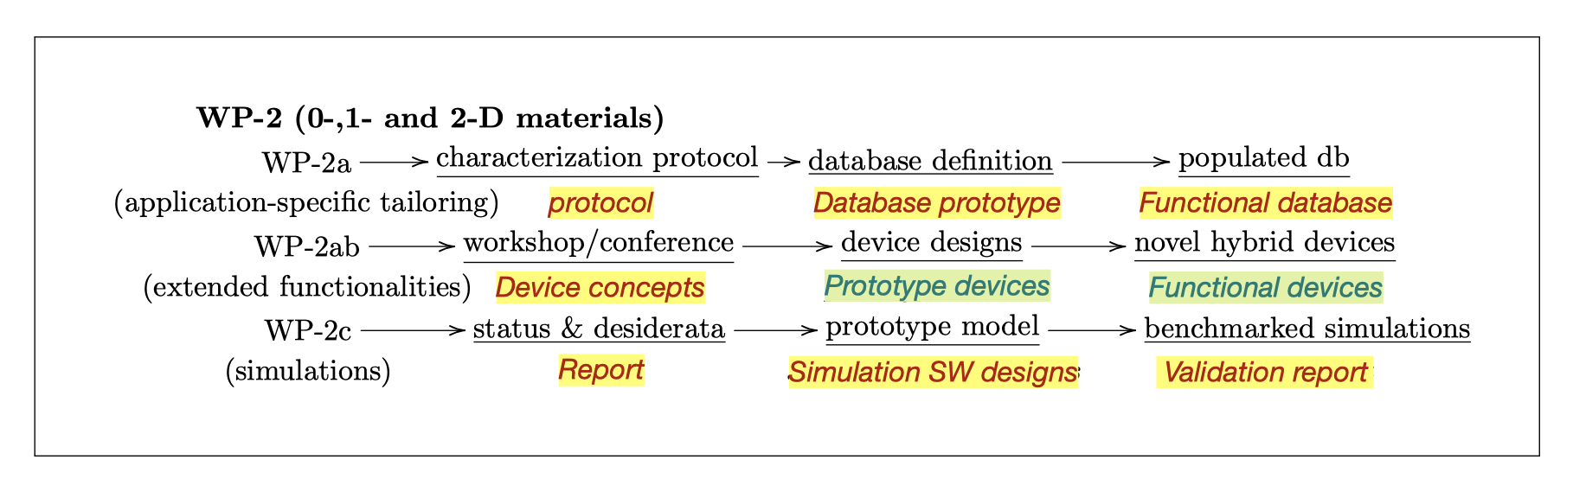
DRD5: Quantum Sensors
Quantum Technologies are a rapidly emerging area of technology development to study fundamental physics
  development of HEP detectors on the long term
Full proposal developed in the last year
  Effort driven by Michael Doser (CERN) and Marcel Demarteau (Oak Ridge)
  Two community workshops [link]
Re-structured the Roadmap topics into WPs
  Many reports and documents as deliverables, but this is in the nature of this proposal (early TRL)
Draft proposal was submitted to DRDC end of February 2024 and sent to interested institutions; 67 signed up within two weeks
  Aim to be approved in June

Slide 23
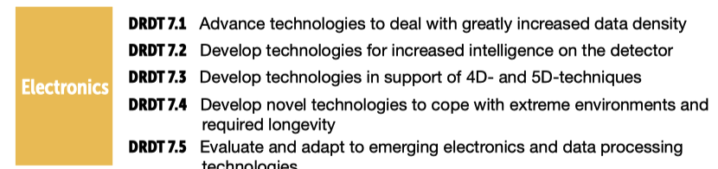
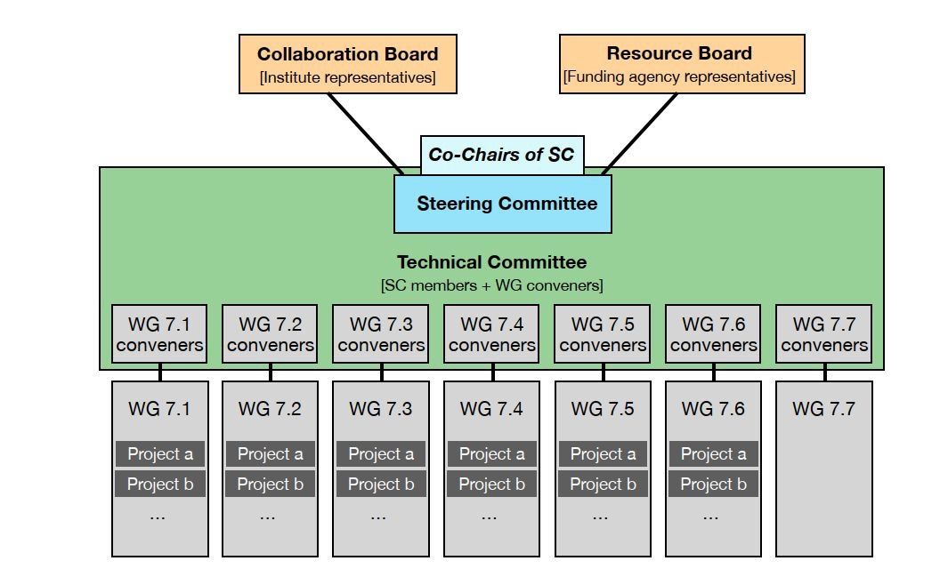
DRD7: Electronics
Full proposal received by 29 February 2024; aiming approval in June 2024
Objectives: Carry out strategic R&D in electronics, fulﬁlling DRDTs, Coordinate cross-European access to technologies, tools and knowledge, Interface with other DRDs
Organization:
  19 countries, 68 institutes
  Somehow CERN-centric at present, e.g. 9/19 WG conveners
  1st workshop happened in March, 2nd workshop 25-27 September 2023
WG 7.6 Complex imaging ASICs and technologies
WG 7.7. Transversal Tools and Technologies

Slide 24
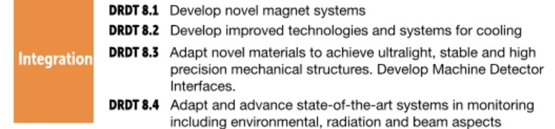
DRD8: Integration
Initial TF convenors did not continue as proposal preparation team
New proponents had to be searched for, which were found by the group around the “Forum on Tracker Mechanics” workshop organizers
Community survey replied that there is an interest in going forward
Community Meeting on December 6, 2023
LoI received by end of February 2024 with
the aim to write a full proposal by
the end of this year
  LoI does not cover all DRDTs, as they are quite diverse
  Focus on vertex detector mechanics and cooling
  22 institutes in 7 countries, 32 FTE at the moment

Slide 25
Summary
Instrumentation must not the limiting factor to meeting the needs of the long-term European particle physics program
New Detector R&D (DRD) collaborations are currently being set up following ECFA Detector roadmap to pave the way for the next decades.
  Collaborations are CERN-hosted
We are on good track, having the first DRD collaborations already starting up, and the others following soon
Next steps of the collaborations: completing organization structure, electing and endorsing convenors, re-defining deliverables, MoU writing, getting financial commitments from funding agencies

Slide 26
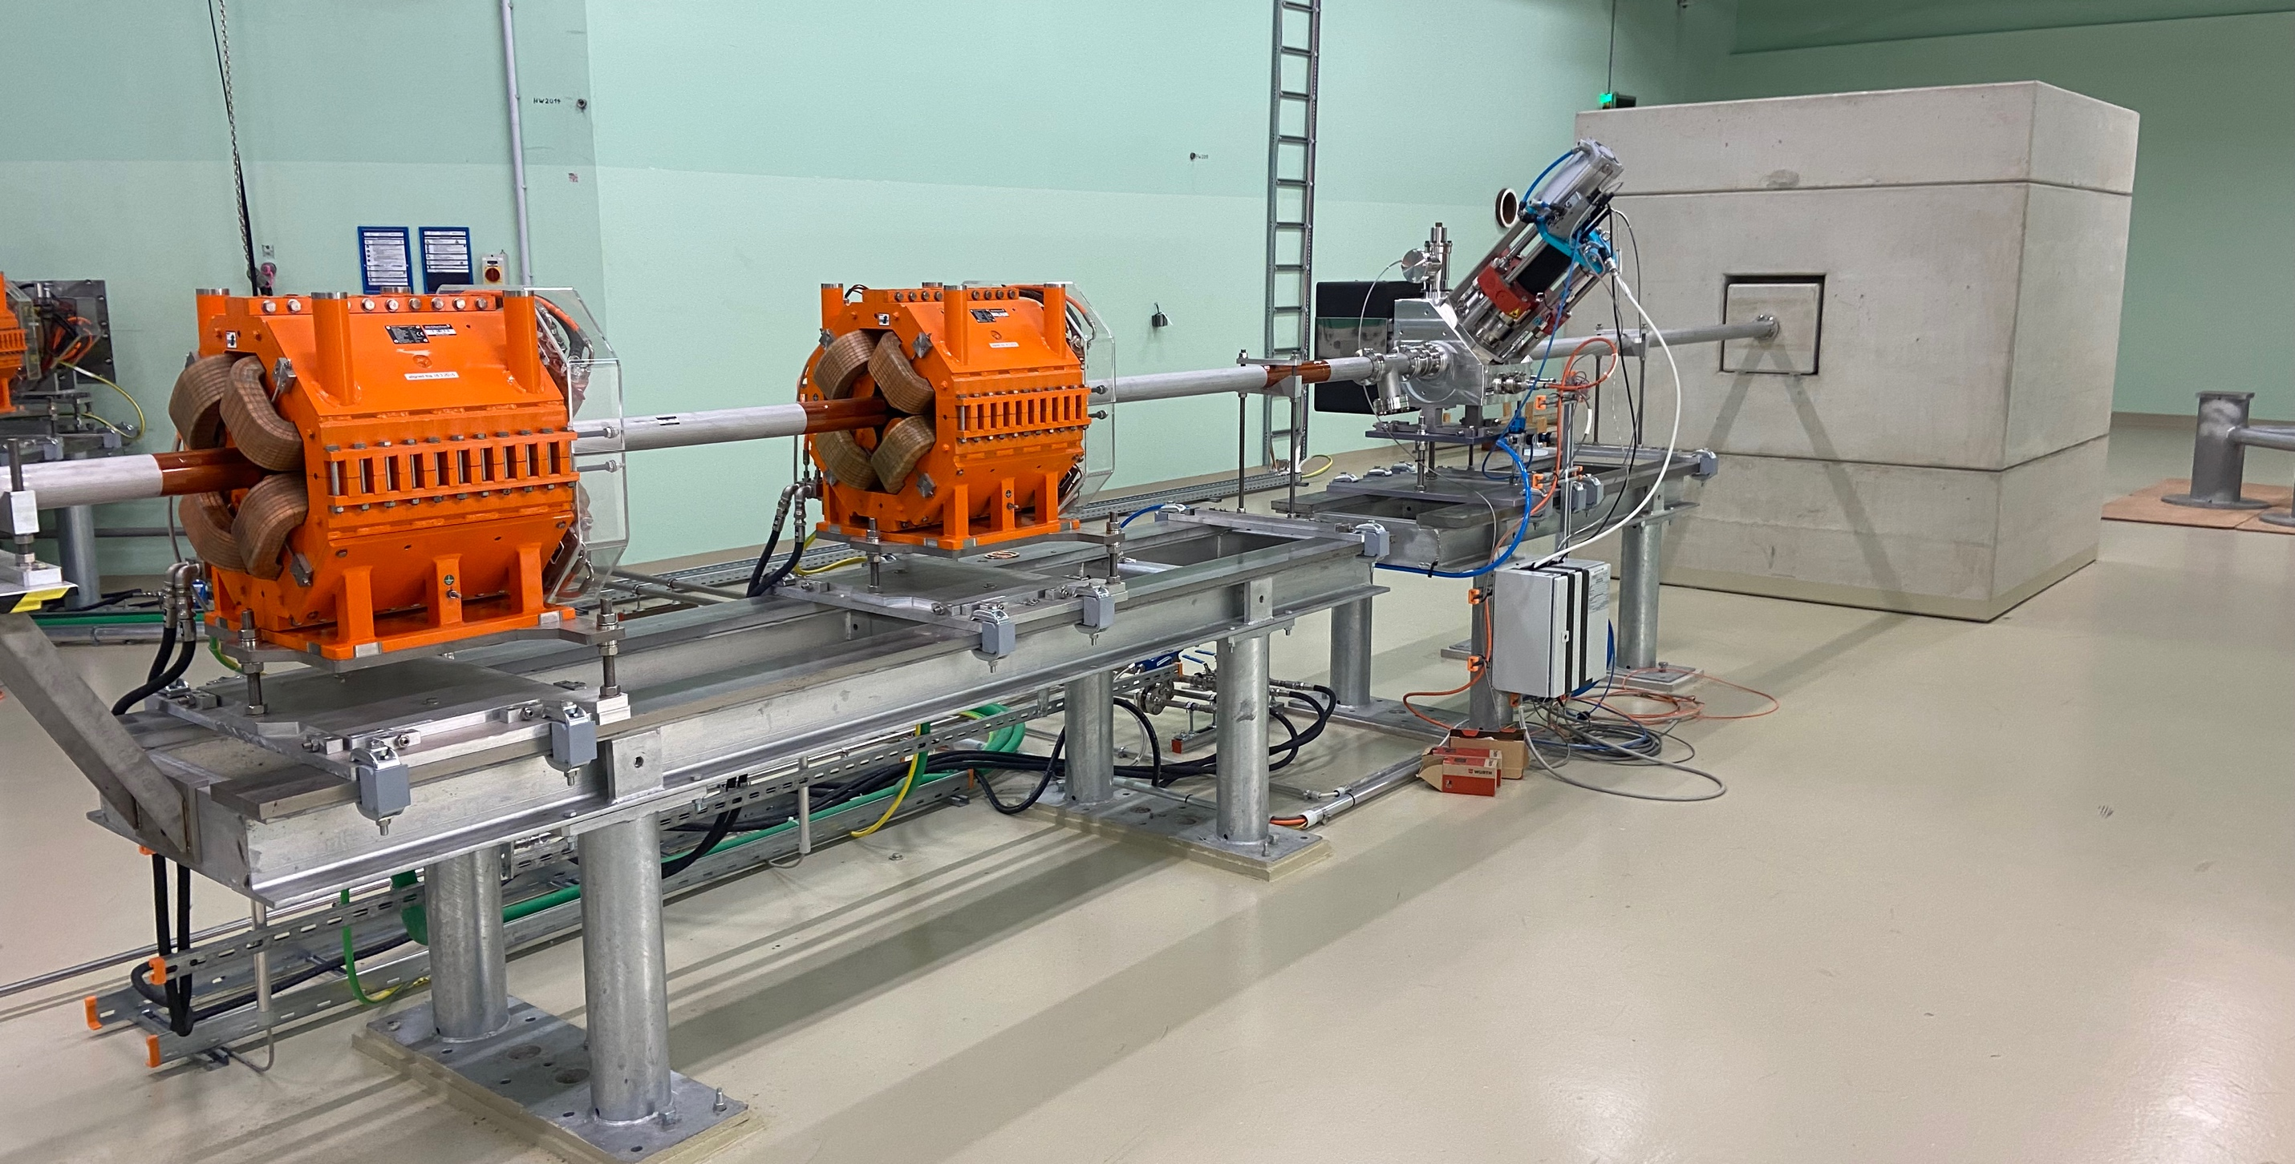
The End.
Beam dump at MedAustron accelerator
The end of each unused particle

Slide 27
General Strategic Recommendations
The General Strategic Recommendations (GSR) topics are:
GSR 1: Supporting R&D facilities (test beams, large-scale generic prototyping and irradiation)
GSR 2: Engineering support for detector R&D
GSR 3: Specific software for instrumentation
GSR 4: International coordination and organisation of R&D activities
GSR 5: Distributed R&D activities with centralised facilities
GSR 6: Establish long-term strategic funding programmes
GSR 7: “Blue-sky” R&D
GSR 8: Attract, nurture, recognise and sustain the careers of R&D experts
GSR 9: Industrial partnerships
GSR 10: Open Science

Slide 28
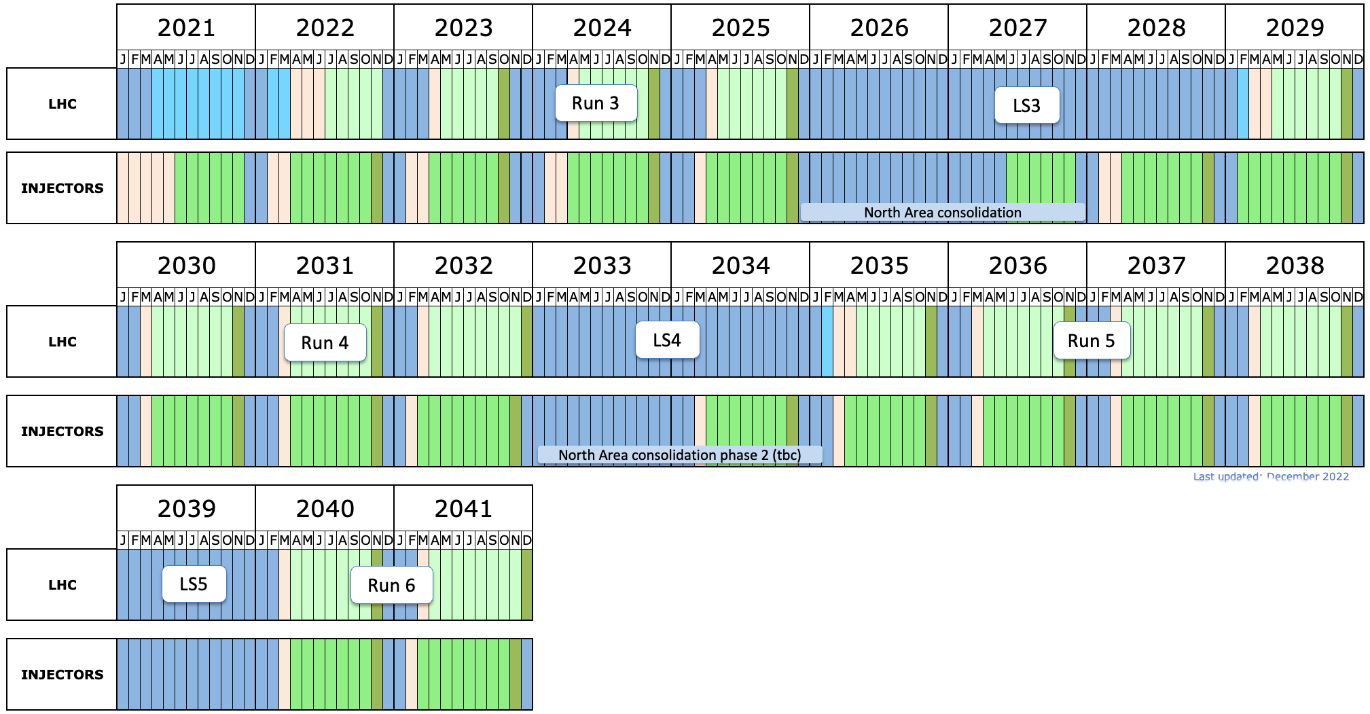
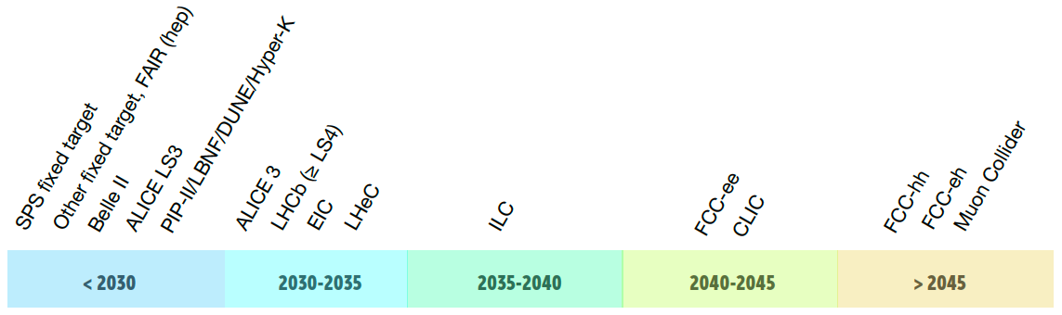


Future Large Experiments
(HL-)LHC timeline:
Five Time periods defined
LHC LS3
LHC LS4

Slide 29
Broad timelines for future HEP Projects
Didier Contardo
Belle-II VTX
2y
3y
2029
entering dedicated engineering with R&D tails in DRDs
EIC
2y
6y
2032
ALICE-3/LHCb-II
3y
2y
6y
2034
only consideration at this stage (not documented)
CMS Phase-III
6y
2y
3y
CEPC
3y
9y
2036
ILC
6y
3y
9y
assuming 2040 physics start
FCC-ee /CLIC/MC
12y
3y
9y
2048
2024

Slide 30
Committee Members
ECFA Detector Panel (EDP):
Detector R&D Committee (DRDC):
Co-chairs: Phil Allport (Birmingham), Didier Contardo (Lyon)
Scientific secretary: Doris Eckstein (DESY)
Gaseous Detectors: Silvia Dalla Torre (Torino)
Liquid Detectors: Inés Gil Botella (CIEMAT)
Solid State Detectors: Doris Eckstein, Phil Allport
PID & Photon Detectors: Roger Forty (CERN)
Quantum and emerging Technologies.: Steven Hoekstra (Groningen)
Calorimetry: Laurent Serin (IJCLab)
Electronics: Valerio Re (Bergamo)
Ex Officio: ECFA Chair (Paris Sphicas), ICFA Detector Panel (Ian Shipsey), DRDC chair (Thomas Bergauer), APPEC & NuPECC observers
Thomas Bergauer (HEPHY Vienna), Chairperson
Jan Troska (CERN), scientific secretary
Stan Bentvelsen (NIKHEF; LDG contact)
Shikma Bressler (Weizmann)
Dimitry Budker (Mainz)
Roger Forty (CERN; RB contact)
Claudia Gemme (INFN and U. Genoa)
Inés Gil Botella (CIEMAT)
Petra Merkel (Fermilab; US contact)
Mark Pesaresi (Imperial College)
Laurent Serin (IJCLab)
Ex-officio: P. Allport, D. Contardo (EDP)
Names in bold in both committees

