Slide 1
Exploiting Cherenkov in Calorimetry
Nural Akchurin
TTU

Slide 2
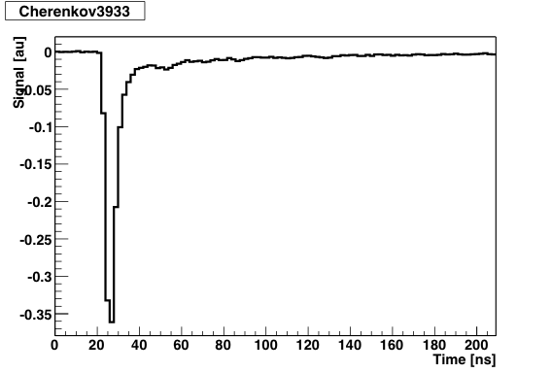
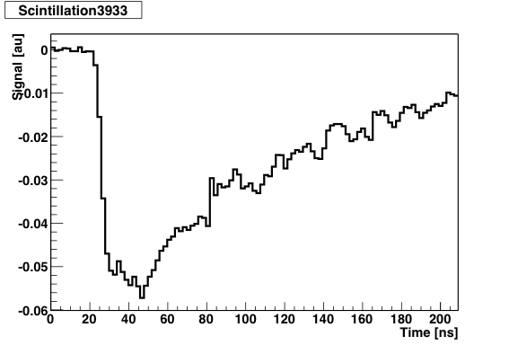
Start with an Example : BSO
Six distinct features distinguish Cherenkov radiation from scintillation:
  Directionality (Cherenkov cone, θ_{c}=cos⁻¹ (1/βn(λ), vs isotropic emission)
  Emission/wavelength spectrum (1/λ² vs scintillator specific)
  Cherenkov threshold (T=(γ-1)mc², for n=2 electrons:~80 keV, protons: ~140 MeV)
  Timing (Prompt vs ~several ns)
  Polarization (linearly polarized vs unpolarized)
  Cherenkov light is feeble (scintillation is often not)

Slide 3

How (EM) Many Cherenkov Photons? (I)
We need realistic light yield estimates in order to set the scale for the calorimeter performance:
Critical values are the following:
  500 eV/cm in the form of Cherenkov photons
  Consider photon energy range from 1.7 eV to 3.0 eV
  160 to 250 Cherenkov photons are produced per cm
  Minimally ionizing particle loses 4.5 MeV/cm in quartz

Slide 4
How (EM) Many Cherenkov Photons? (II)
Take 1 GeV electron/gamma shower in a block of quartz:
  Assume tracks as a collection of MIPs
  (1,000 MeV/4.5 MeV/cm) = 222 cm total track length
  (222 cm)(~200 photons/cm) = 44,000 Cherenkov photons per GeV
  Not all charged particles are above the Cherenkov threshold (T=190 keV)
  Cuts down to ~70%, i.e. 31,000 photons
There are three other major factors if quartz fiber calorimeter is considered:
  Packing fraction: ~1% by volume
  Fiber trapping efficiency: typically ~1% (depending on fiber 0.5 to 3%)
  Detection of these photons by a bi-alkaline PMT results in ~20% signal
  Therefore, we are left with ~0.62 p.e. per GeV
  Examples: CMS HF (copper) = 0.53 p.e./GeV; CMS HF (steel) = 0.25 p.e./GeV

Slide 5
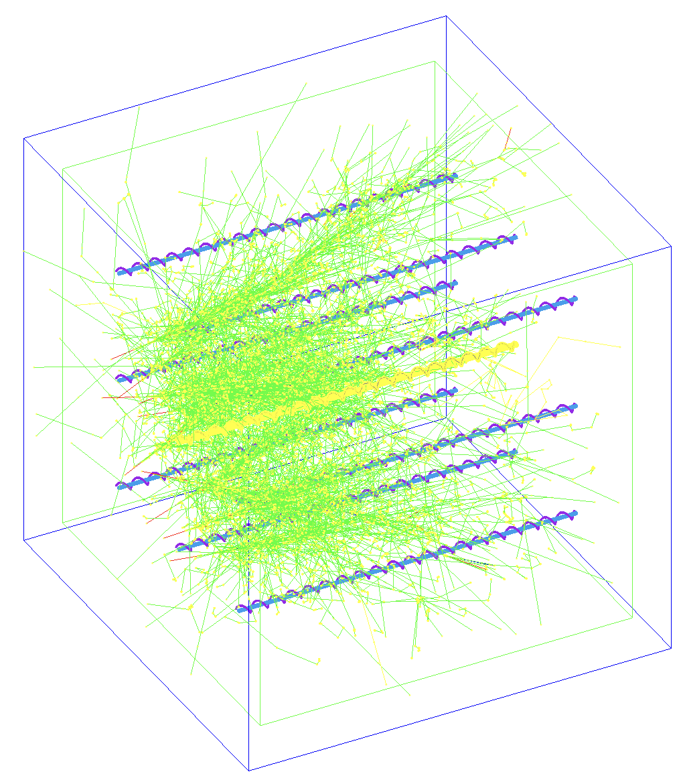
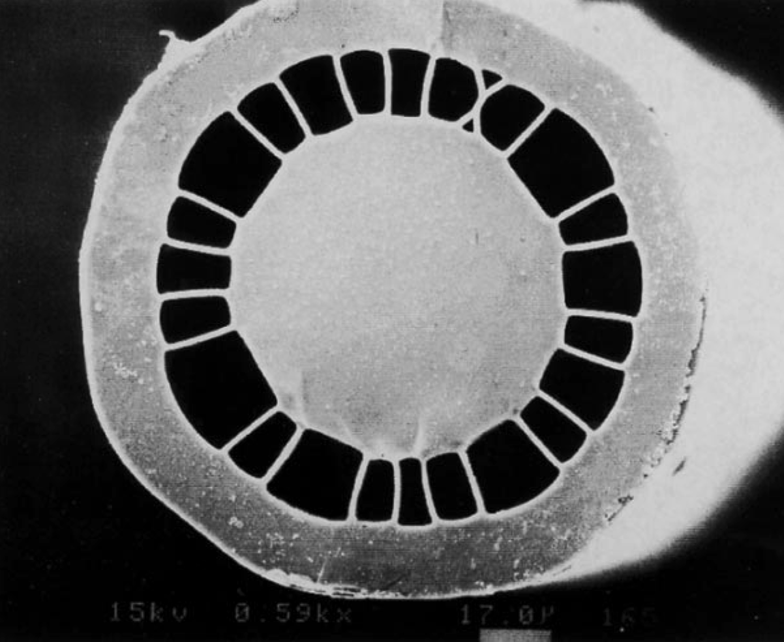


QQ, QP, Plastic, and Air-clad Fibers
Optical fiber is an electromagnetic waveguide and light propagation through this waveguide is complex but can be solved for exactly. Depending on the refractive indices of the core and clad material and the geometry, the relevant features for calorimetry can be optimized. CMS HF hosts QP fibers.
If the radiation damage were not an issue, the choice of fiber
would be easy.
 | QQ | QP | Plastic | Air-clad
NA | 0.22 | 0.37 | 0.55 | ~0.9
n_{core} | 1.46 | 1.46 | 1.5 | 1.46
f_{trap} | 0.57% | 1.61% | 3.36% | 9.5%
Plastic (PS) NA = 0.72 but suffers from short attenuation length (λ_{att} ~ 3 m)

Slide 6
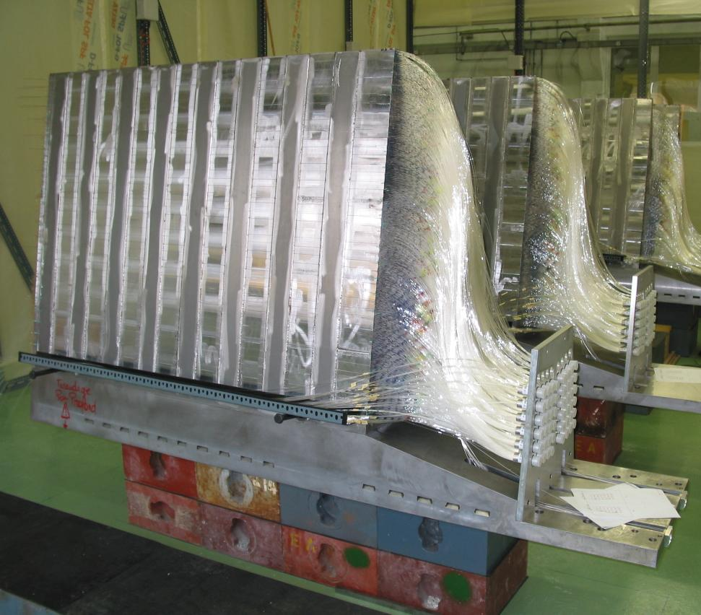
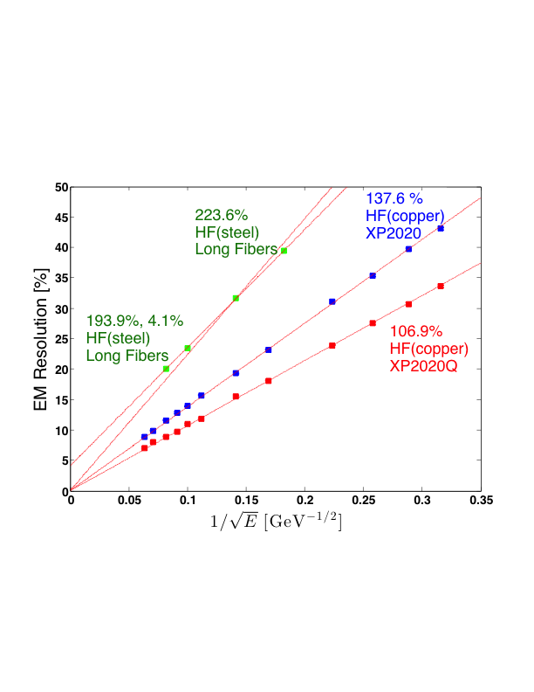
QQ, QP and Plastic Fibers and EM Energy Resolution - I
EM energy resolution is essentially scales with 1/sqrt{E}, thus it is dominated by Poisson photoelectron statistics in quartz fiber calorimeters
The constant term arises from non-uniformities in packing fractions (see CMS HF(steel), when summed linearly, it is ~4%)
At 100 GeV, practically achievable energy resolutions range 10% to 23% with quartz fibers alone

Slide 7
QQ, QP and Plastic Fibers and EM Energy Resolution - II
Calorimeter | Fiber | Packing | Fiber-to-fiber dist (mm) | Fiber core dia (um) | Light yield (p.e./GeV)
CMS HF(copper) | QQ | 1.5% | 2.3 | 300 | 0.53
CMS HF(steel-L) | QP | 0.57% | ~7.1 | 600 | 0.25
DREAM | QP | 12.6% | ~4 | 600 | 8
 | P | 12.6% | ~4 | 600 | 18
Scaling approximately holds (ignore other contributions for now). For example,
  CMS HF(copper) to DREAM QP: (12.6/1.5)(1.61/0.57)(0.53)=12 vs 8
  CMS HF(steel-L) to DREAM QP: (12.6/0.57)(0.25)=6 vs 8

Slide 8
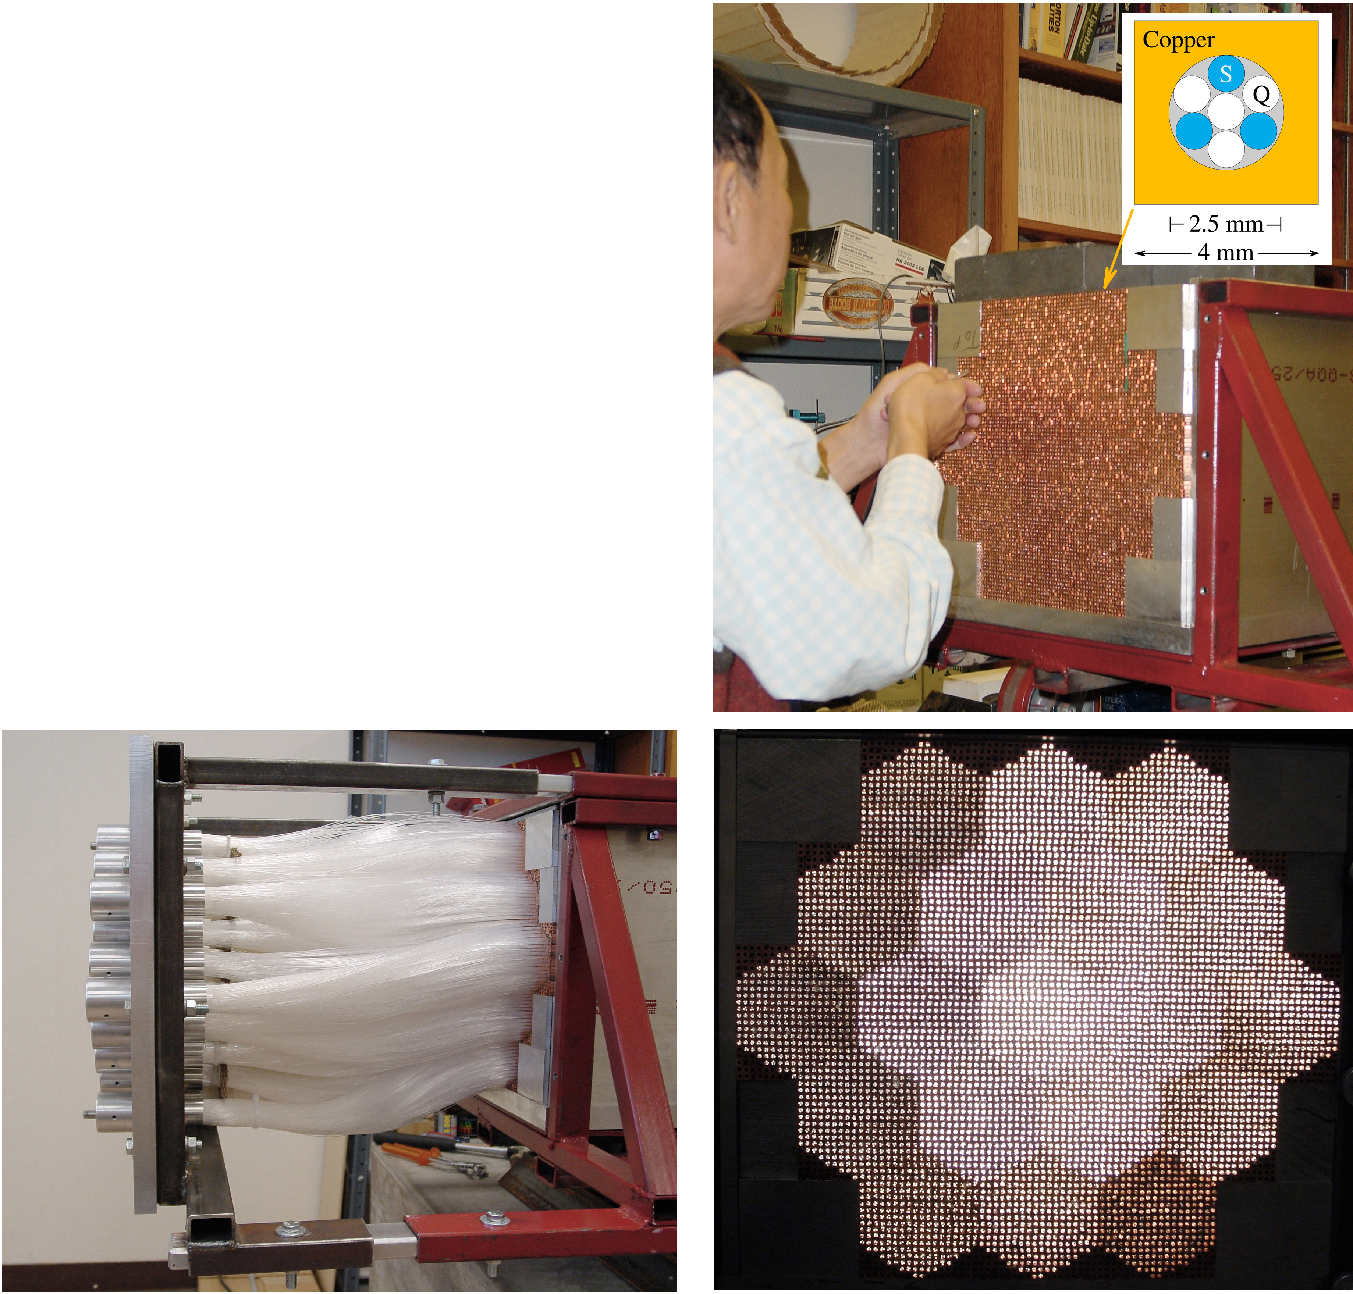
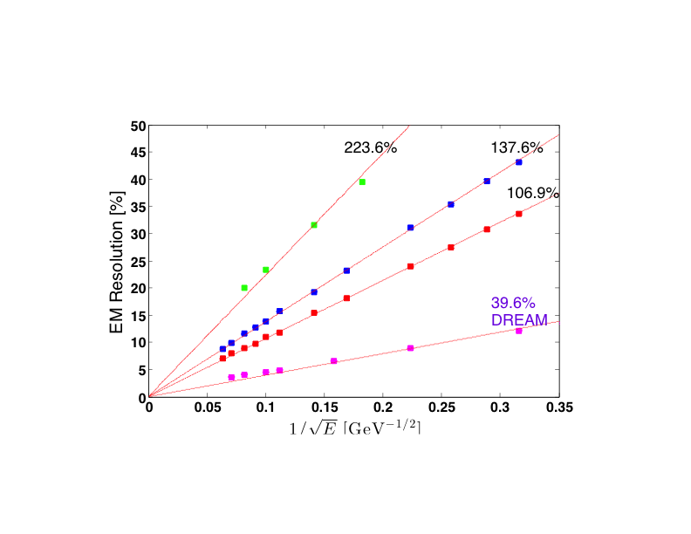
QQ, QP and Plastic Fibers and EM Energy Resolution - III
40%/sqrt{E} EM resolution is clearly achievable with Cherenkov photons and can be further improved (perhaps 15-20%/sqrt{E}) in several ways:
  Improve NA or f_{trap} (~2x) [new optical structures…]
  Improve QE (~2x) [SiPMs vs PMTs …]
  Increase packing fraction (see RD52 prototypes)
  Improve sampling frequency

Slide 9

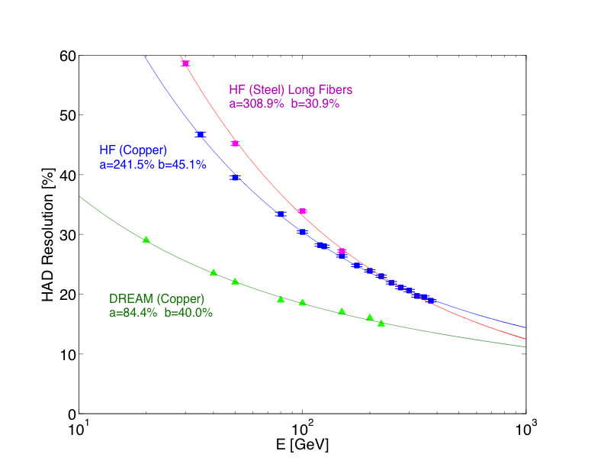
Quartz Fiber/Cherenkov Hadronic Energy Resolution
For illustration purposes, assume c = -0.18-19 and E_{o}= 0.7 GeV
Hadronic energy resolution of highly non-compensating calorimeters behaves significantly differently than typical scintillation-based calorimeters
At high energies (~1 TeV), most quartz Cherenkov calorimeters will perform similarly but at low energies, the situation is more complicated

Slide 10
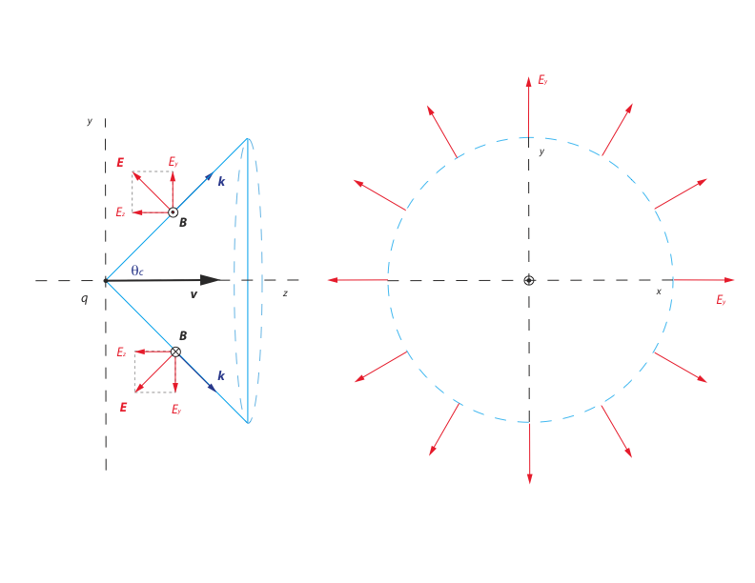
Cherenkov Radiation and Polarization - I

Slide 11

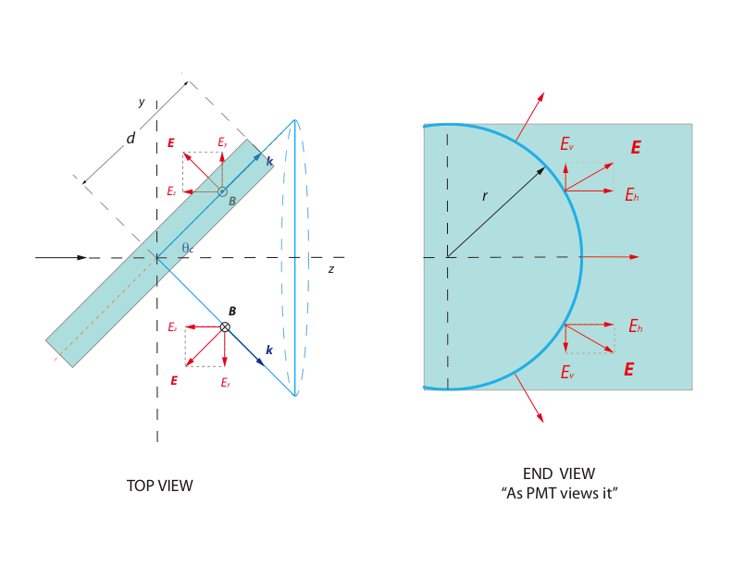
Cherenkov Radiation and Polarization - II

Slide 12
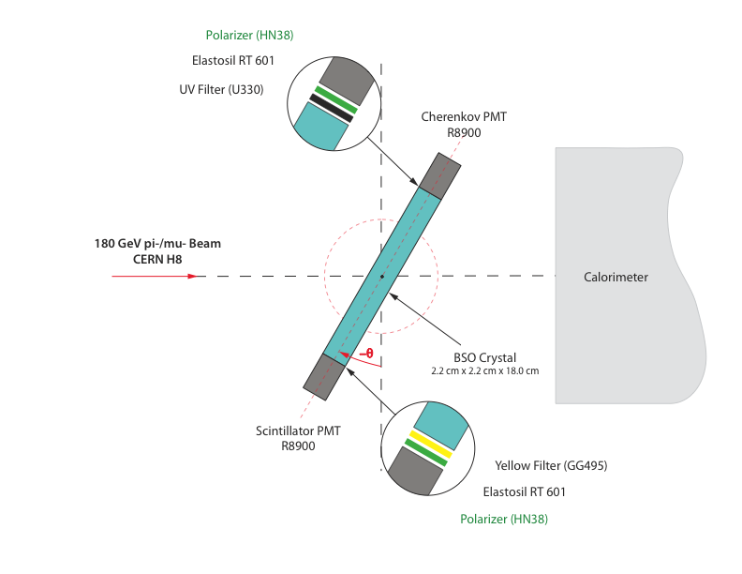


Measuring Cherenkov Polarization in Three Steps
Setup 0 : No polarizer
Setup 1 : Favorable
Setup 2 : Unfavorable
Setup 0 : No polarizer
Setup 1 : Favorable
Setup 2 : Favorable

Slide 13
BSO (Bi₄Si₃O₁₂) Crystal - I
 | BSO | BGO | PWO
Density (g/cm³) | 6.80 | 7.13 | 8.28
Radiation length (mm) | 11.5 | 11.2 | 8.9
Decay time (ns) | ~100 | ~300 | ~10
Peak emission (nm) | 480 | 480 | 410-500
Relative light output | 0.04 | 0.1 | 0.01
Refractive index | 2.06 | 2.15 | 2.20
Cherenkov angle (º) | 61 | 62 | 63
Any transparent medium with a refractive index will generate Cherenkov light when a relativistic charged particle traverses it. BSO crystal is used as an example because the spectral characteristics proved convenient.

Slide 14
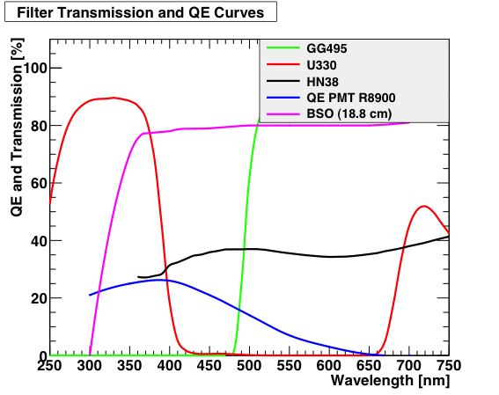
BSO (Bi₄Si₃O₁₂) Crystal - II

Slide 15
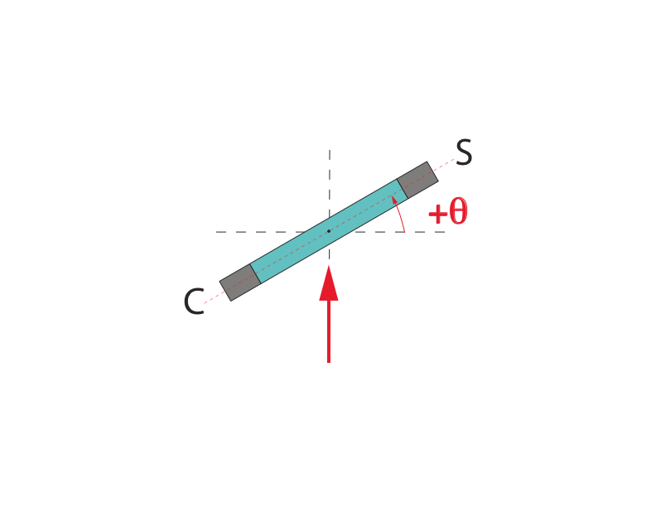
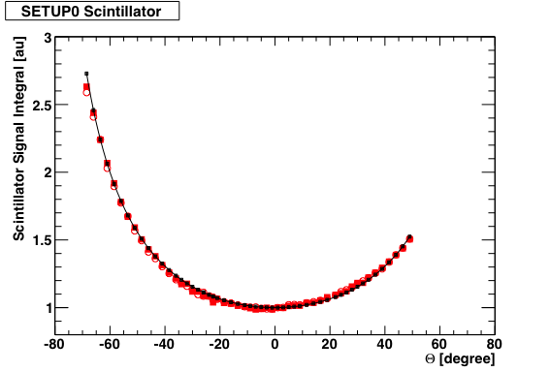
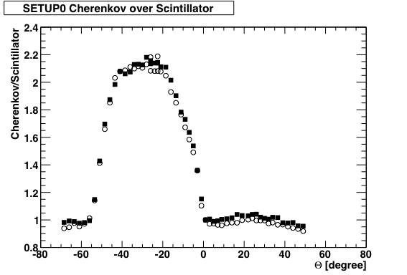
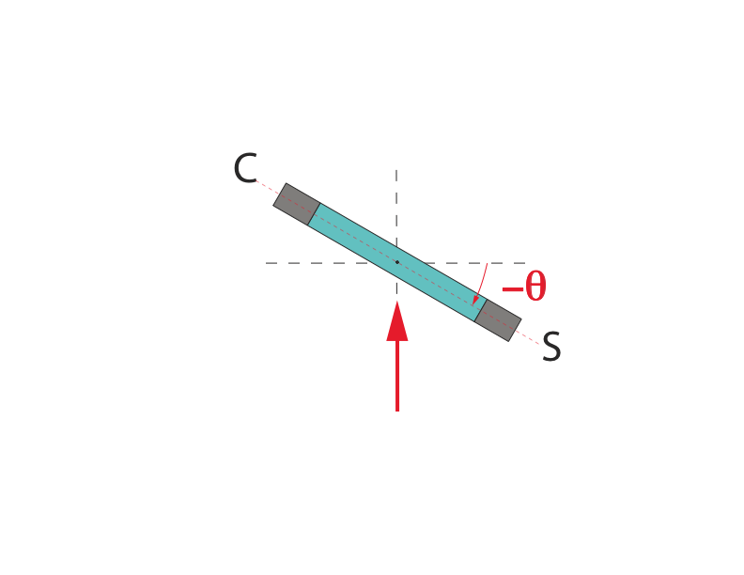
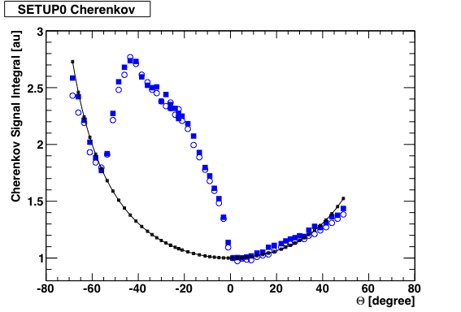
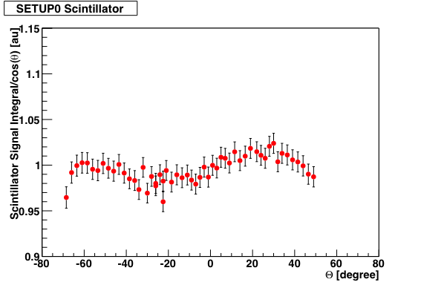
Setup 0 : No Polarizers
C/S
Open symbols = muon
Filled symbols = pion
--------- = 1/cos(θ)

Slide 16
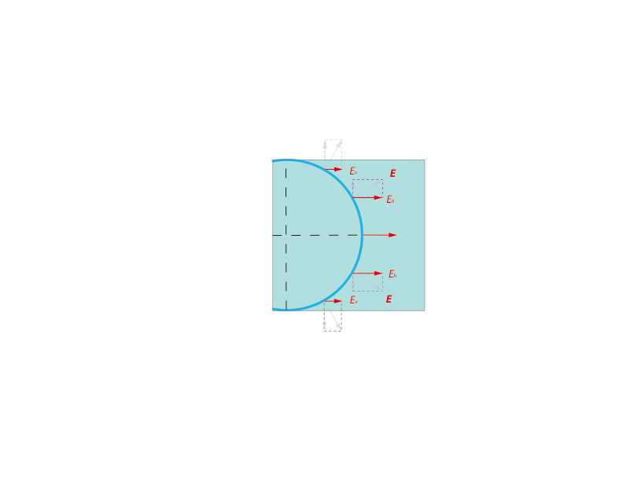
Setup 1 : Favorable Polarization Selection
The polarizers at both Cherenkov and scintillation side are oriented such that the horizontal components are transmitted as shown on the right.
The vertical components are
blocked.

Slide 17
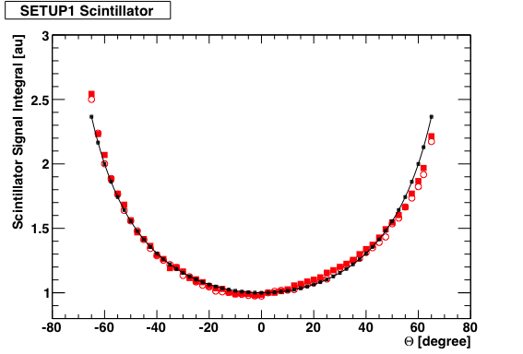
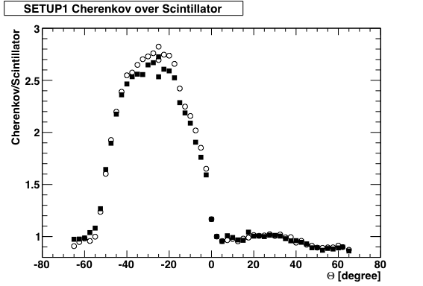
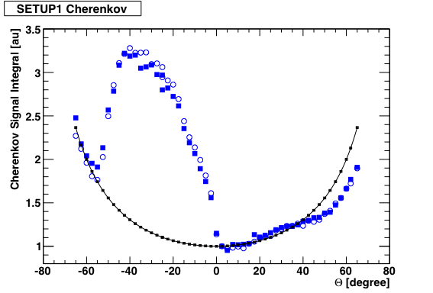
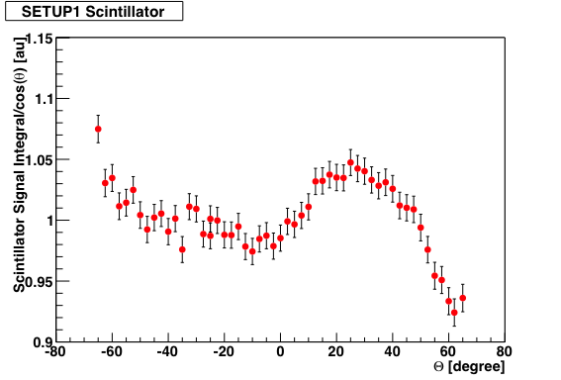
Setup 1 : C (Favorable) & S (Favorable)
C/S
Open symbols = muon
Filled symbols = pion
--------- = 1/cos(θ)

Slide 18
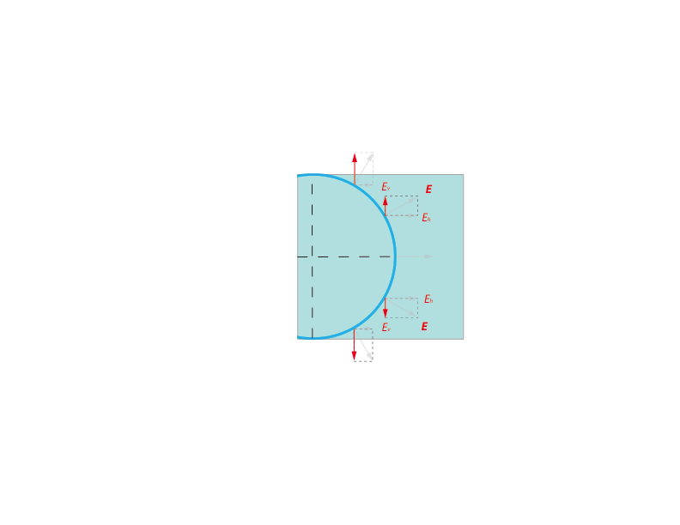
Setup 2 : Unfavorable Polarization Selection
The polarizer at Cherenkov side is oriented such that the vertical components are transmitted which on average add to zero as shown on the right.
The horizontal components are blocked.

Slide 19
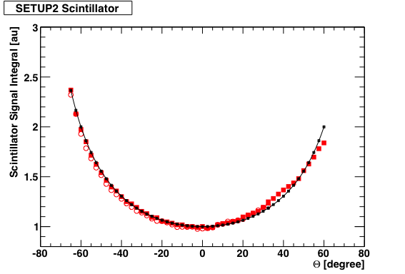
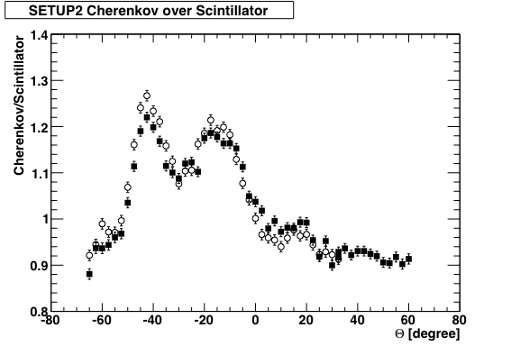
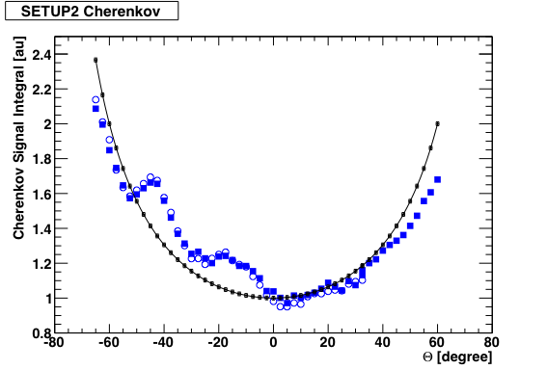
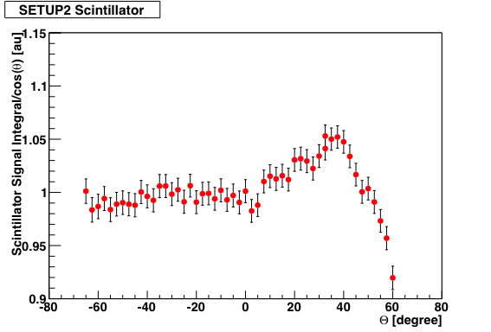
Setup 2 : C (Unfavorable) & S (Favorable)
C/S
Open symbols = muon
Filled symbols = pion
--------- = 1/cos(θ)

Slide 20

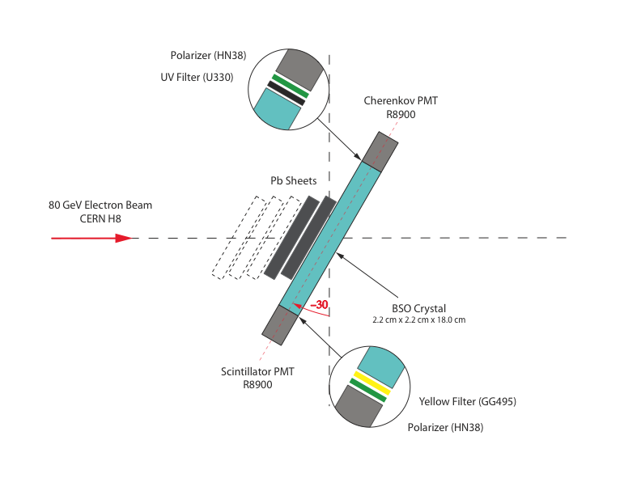

Polarization Profile in EM Showers

Slide 21
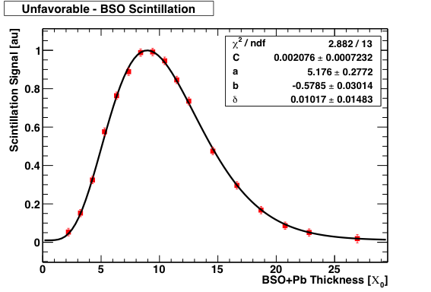
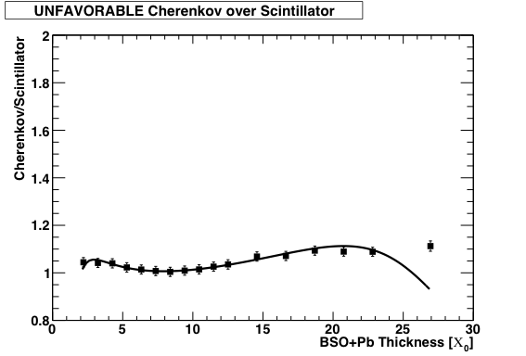
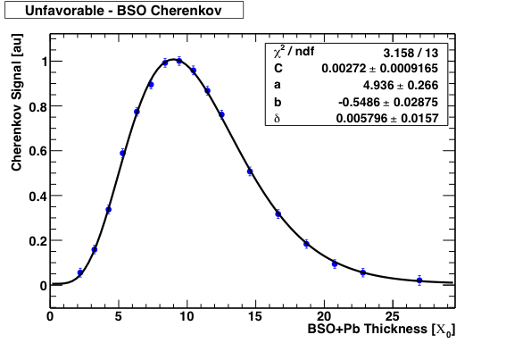
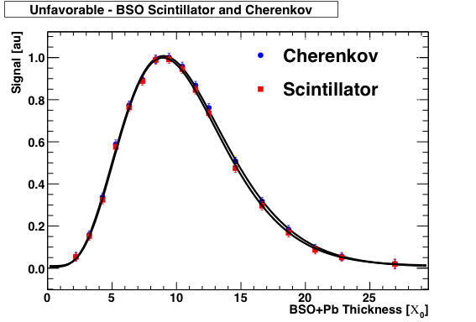
Unfavorable Polarizer Orientation
C/S

Slide 22
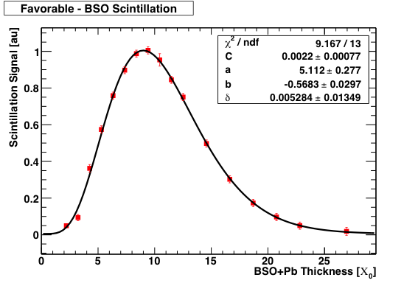
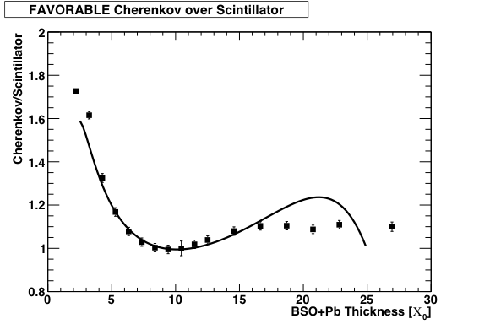
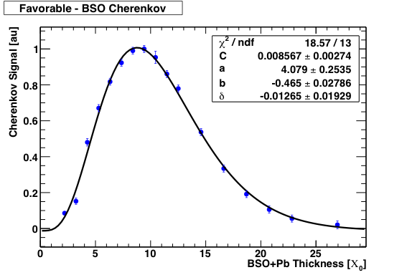
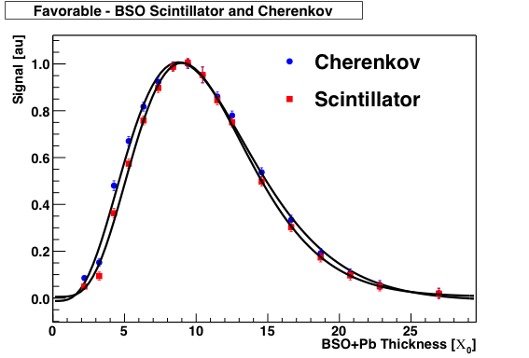
Favorable Polarizer Orientation
C/S

Slide 23
Longitudinal Cherenkov Polarization Profile
 | a | b
Favorable (Sci) | 5.11 ± 0.28 | 0.568 ± 0.029
Favorable (Che) | 4.08 ± 0.25 | 0.465 ± 0.028
Unfavorable (Sci) | 5.18 ± 0.28 | 0.579 ± 0.030
Unfavorable (Che) | 4.94 ± 0.27 | 0.549 ± 0.029
Polarization of Cherenkov light in the earlier stages of the em shower development (<7 X_{o}) is preserved and the effect is relatively large
After the shower maximum, as expected Cherenkov polarization has no unique orientation
This aspect of Cherenkov radiation maybe useful in different applications in calorimetry if polarization can be measured per event, etc.

Slide 24
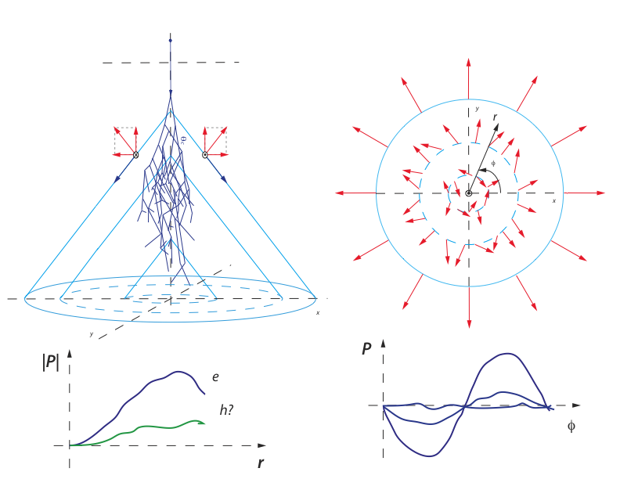
A Possible Application – Air Calorimeter Example ?
It may be possible to perform this measurement in fully sampling large media (e.g. air, ice, big crystals). The polarization component of Cherenkov light adds another (independent) feature that is worth exploring. This approach will enable us to measure the early part of the shower and effectively longitudinally segment the early part of the shower (by polarization).

Slide 25
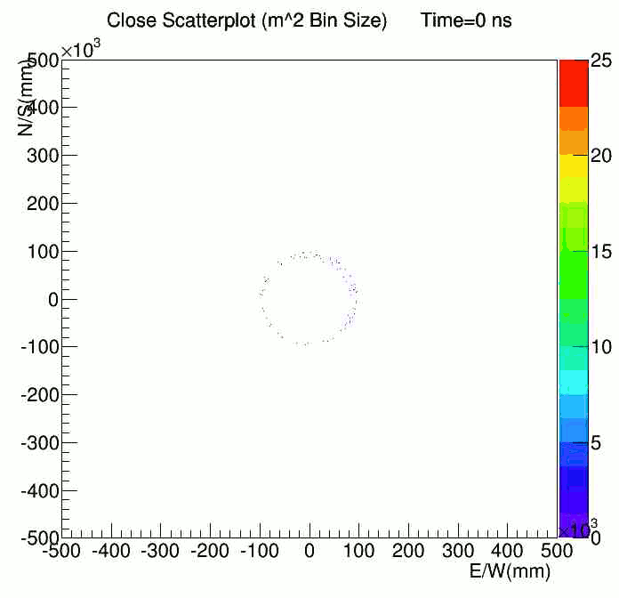

Slide 26
Flipped Cherenkov Radiation - I
“Normal” Cherenkov
“Flipped” Cherenkov
In normal Cherenkov radiation, the real part of the refractive index is positive (n=2 above, θ~60º, e.g. BSO) and the group and phase velocities of the wave coincide
If the refractive index is negative (LHM), the Cherenkov angle (θ~115º above) is large and the photons and charged particles go in opposite directions. In such dispersive media, the phase and group velocities are different (n=c/(ω/k)= -sqrt(μ_{r}ε_{r}) ~ -2.38) and n_{g}=c/(dω/dk)~6.57 and the energy flows with the group velocity
ϕ satisfies the condition tan(180-ϕ)=[(n/n_{g})sinθ cosθ]/[1-(n/n_{g})cos²θ]

Slide 27
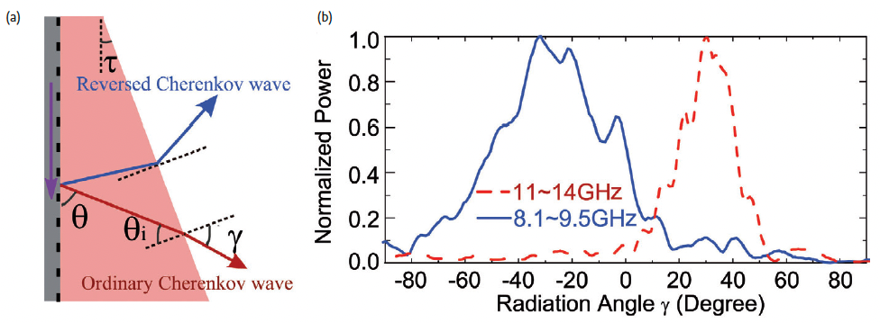
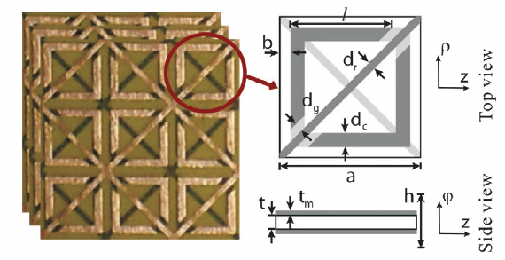
Flipped Cherenkov Radiation - II
S. Xi et al PRL 103 194801 (2009)
H. Chen et al Materials Today 14 1-2 (2011)
The effect is demonstrated in microwaves (~8-12 GHz) with metamaterials where the feature size is measured in mm (much smaller than the wavelength). In the optical region where Cherenkov photons are more abundant and potentially useful in HEP, the feature size needs to be in nm
If such metamaterials are realized, flipped Cherenkov effect might prove useful for calorimetry (readout upstream)

Slide 28
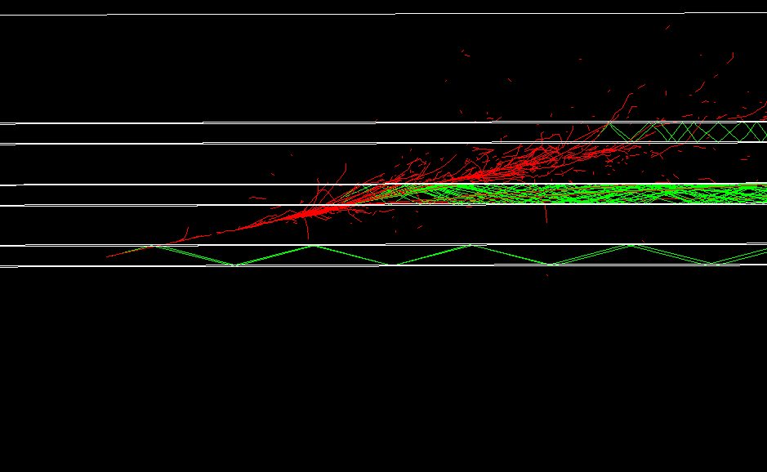
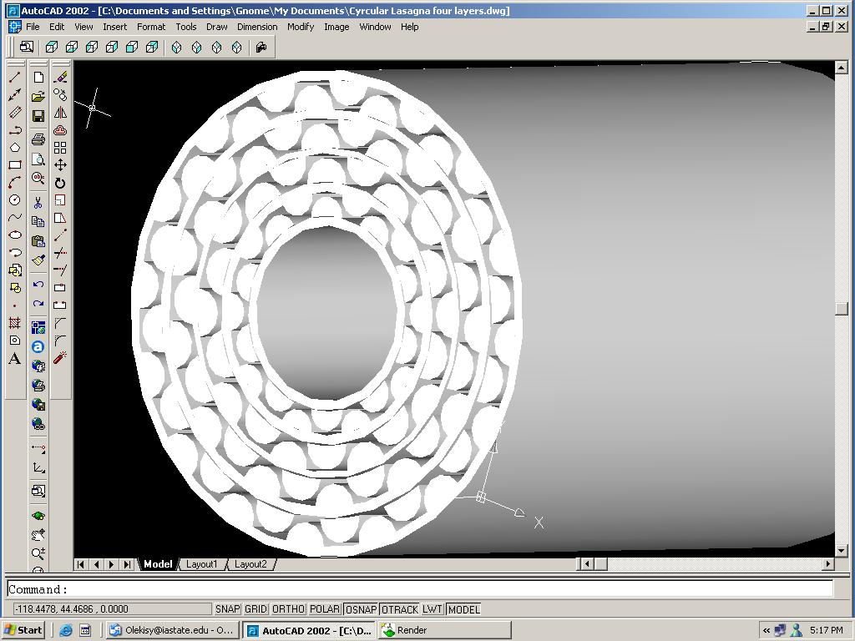
Cherenkov Light in Gas
O. Atramentov et al ALCW (2003)
Index of refraction for gasses is in general small n=1+δ (δ~10⁻³). Example: δ_{C4H8}=0.00258. This has the following consequences:
  Cherenkov angle is small: sin θ_{c} ~ sqrt(2δ) ~ 0.05 which means particles and light come out of the detector at the ~same time and time spread is small
  The Cherenkov threshold is high: E_{th} ~ m_{e}/sqrt{2δ} ~ 11.2 MeV which means decay products from radioactivation do not generate signal/noise
If high quality (>95%?) reflective surfaces can be made (a few meters long) for UV+VIS, a calorimeter based on gas Cherenkov would be very radiation hard (indestructible?)

Slide 29
Longitudinal Segmentation with Timing
Fibers generate and efficiently transport fast Cherenkov radiation. With appropriate timing (sampling), it may be possible to effectively segment the calorimeter in depth
Fibers
L₁
L₂
Signal time = L₁/c + L₂/(c/n),
(c/n) = velocity of light in fiber (n~1.45)
~20 cm/ns or ~1 cm/50 ps
There is significant savings in channel count (and calibration) as one fiber represents many channels along the depth of calorimeter.

Slide 30
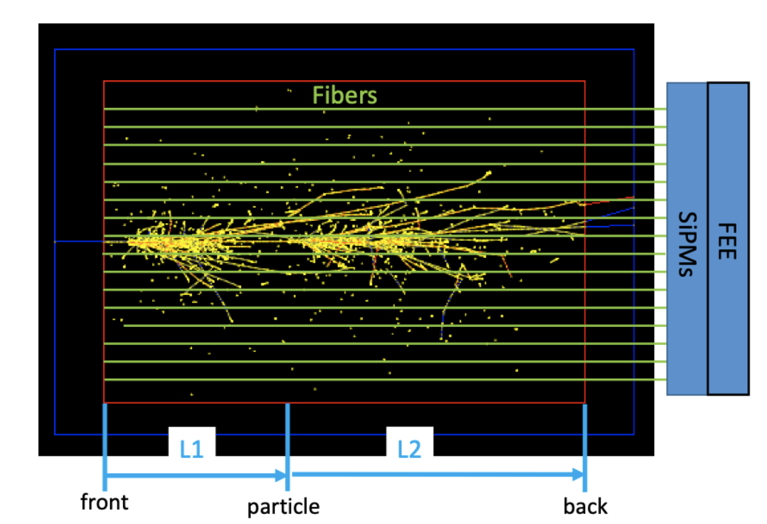
Simulations/Estimates with Cherenkov Photons
Average Space Profile
Average Time Profile
0.05 ns
(1 cm)
0.2 ns
(4 cm)
1 ns
(20 cm)
50 GeV π⁺ in 1.2 cm x 1.2 cm tower

Slide 31
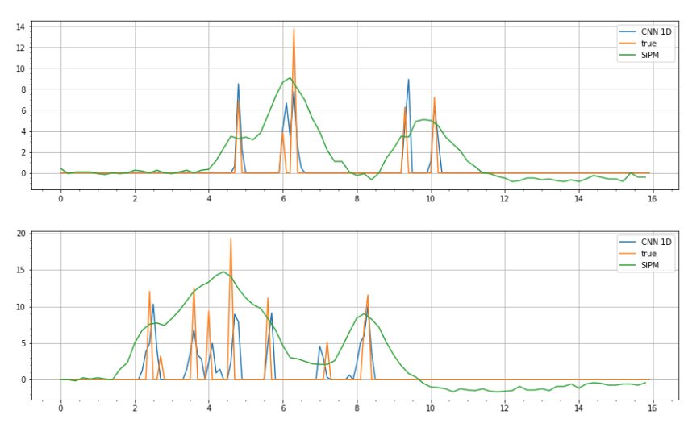
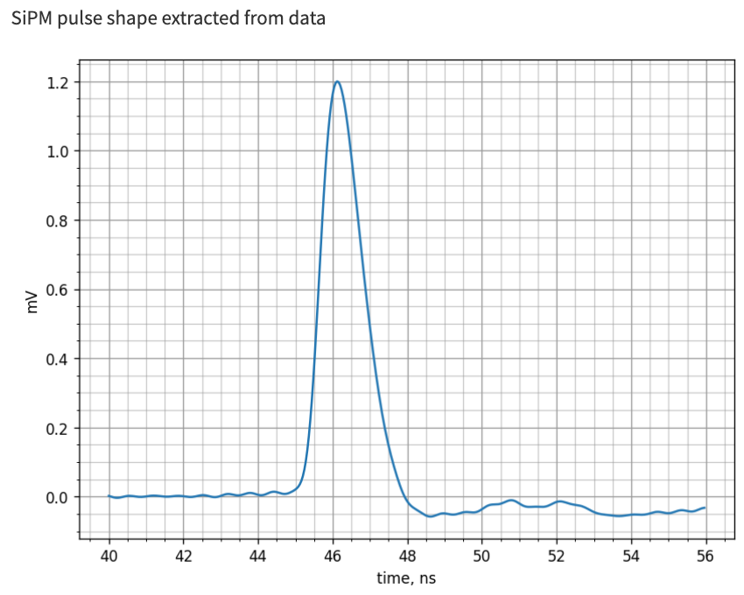
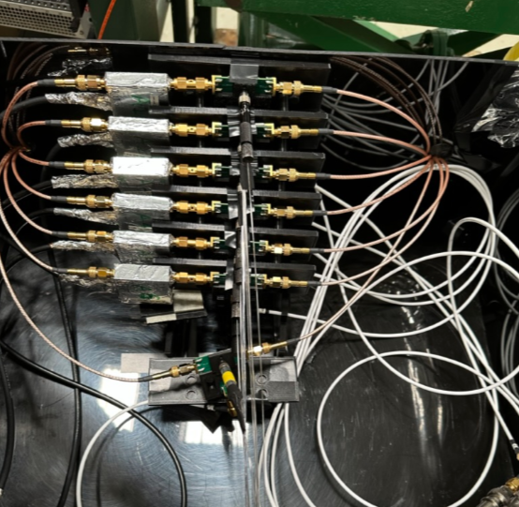
Deconvolution of Cherenkov Pulse Train with CNN
Single Cherenkov photon SiPM pulse obtained in 2023 beam test
Fast Output
Standard Output
It seems possible to deconvolve overlapping SiPM (Cherenkov) pulses to reveal the true distribution of shower components using CNN:
  Green: Convoluted SiPM pulse train
  Blue: Deconvoluted SiPM pulse train
  Orange: True pulse train
7 SiPMs
Amplifiers
Readout Box
Fibers

Slide 32
Conclusions
Cherenkov radiation is rich in interesting features, and many can be exploited for calorimetry
  Polarization adds another interesting one but need to figure out how to take advantage of it for HEP calorimetry
  Fast signals lend themselves for effective longitudinal segmentation, and better energy and timing resolution
  Metamaterials might open new possibilities in calorimetry

