Slide 1
Highly compact calorimeter, electromagnetic forward section
Adrian Irles
Yan Benhammou
DRD6 Collaboration meeting

Slide 2
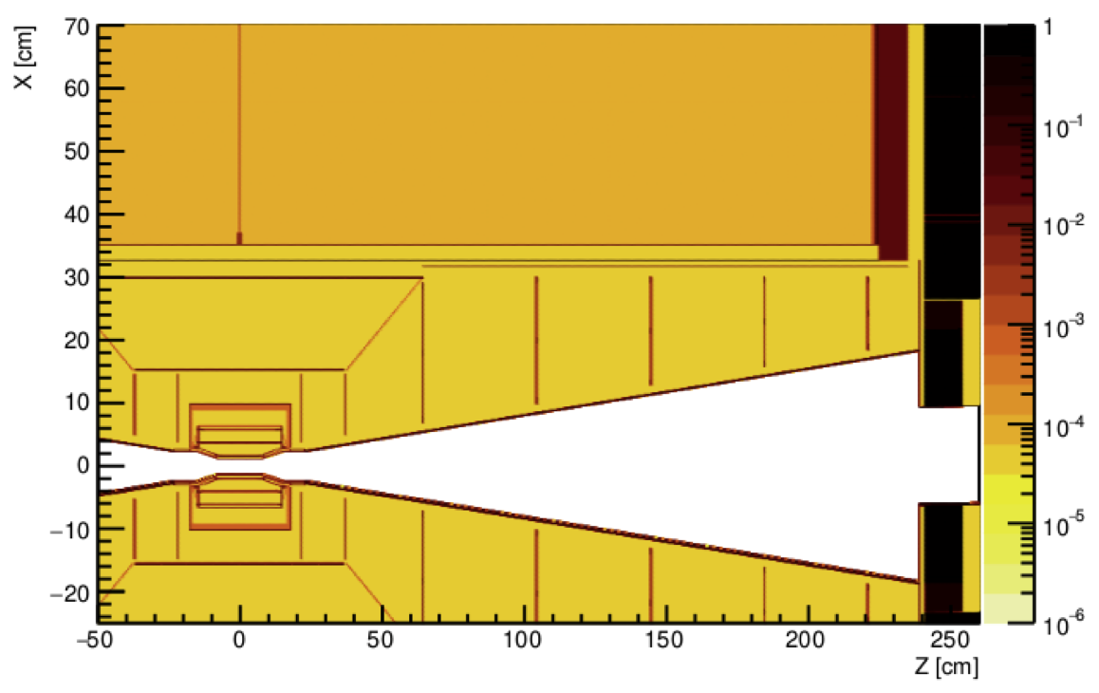
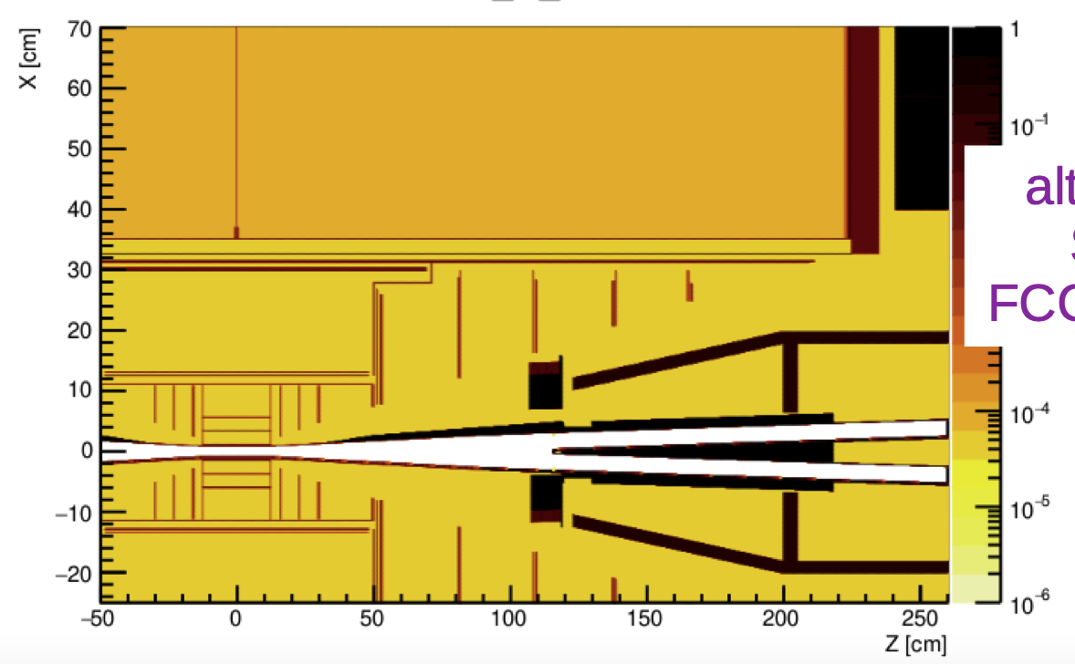
Need for compact calorimeter
1 mm between W layers
Compact calorimeter is interesting in :
  Linear/circular/asymetric collider to measure the luminosity
  In LUXE, to measure the number of positrons and their energy spectrum in the e- laser interaction

Slide 3
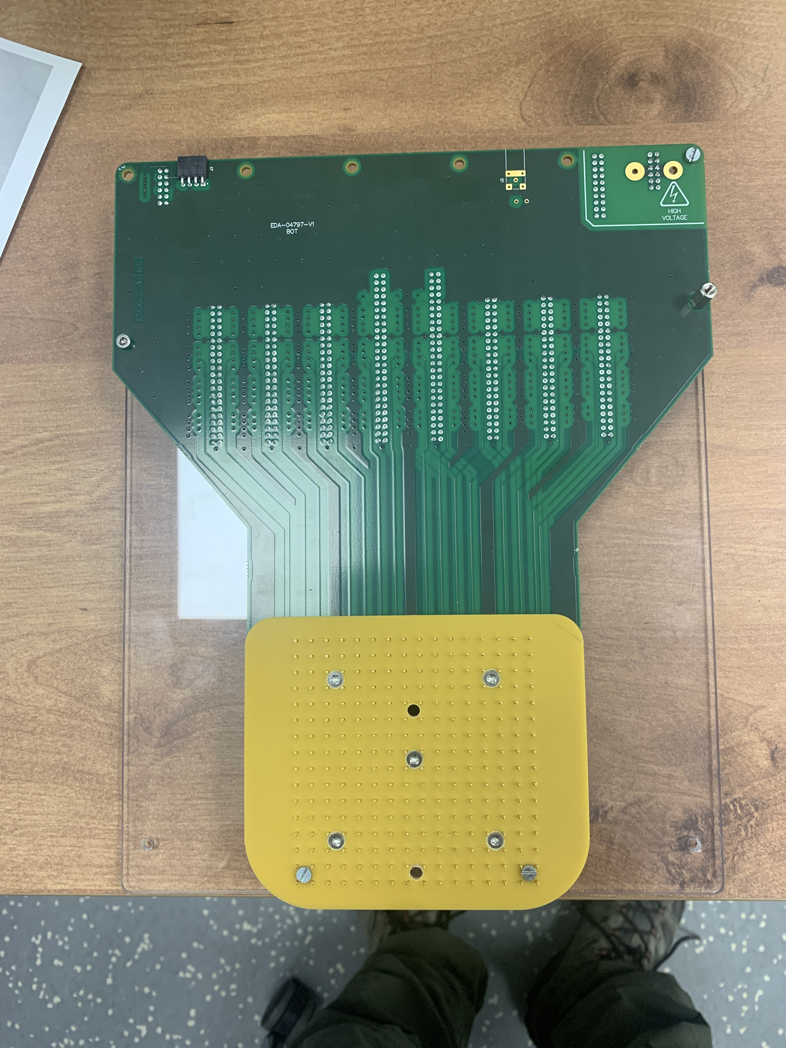
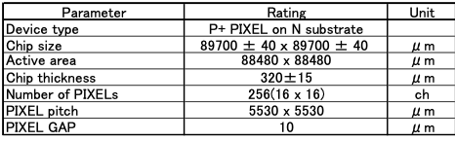
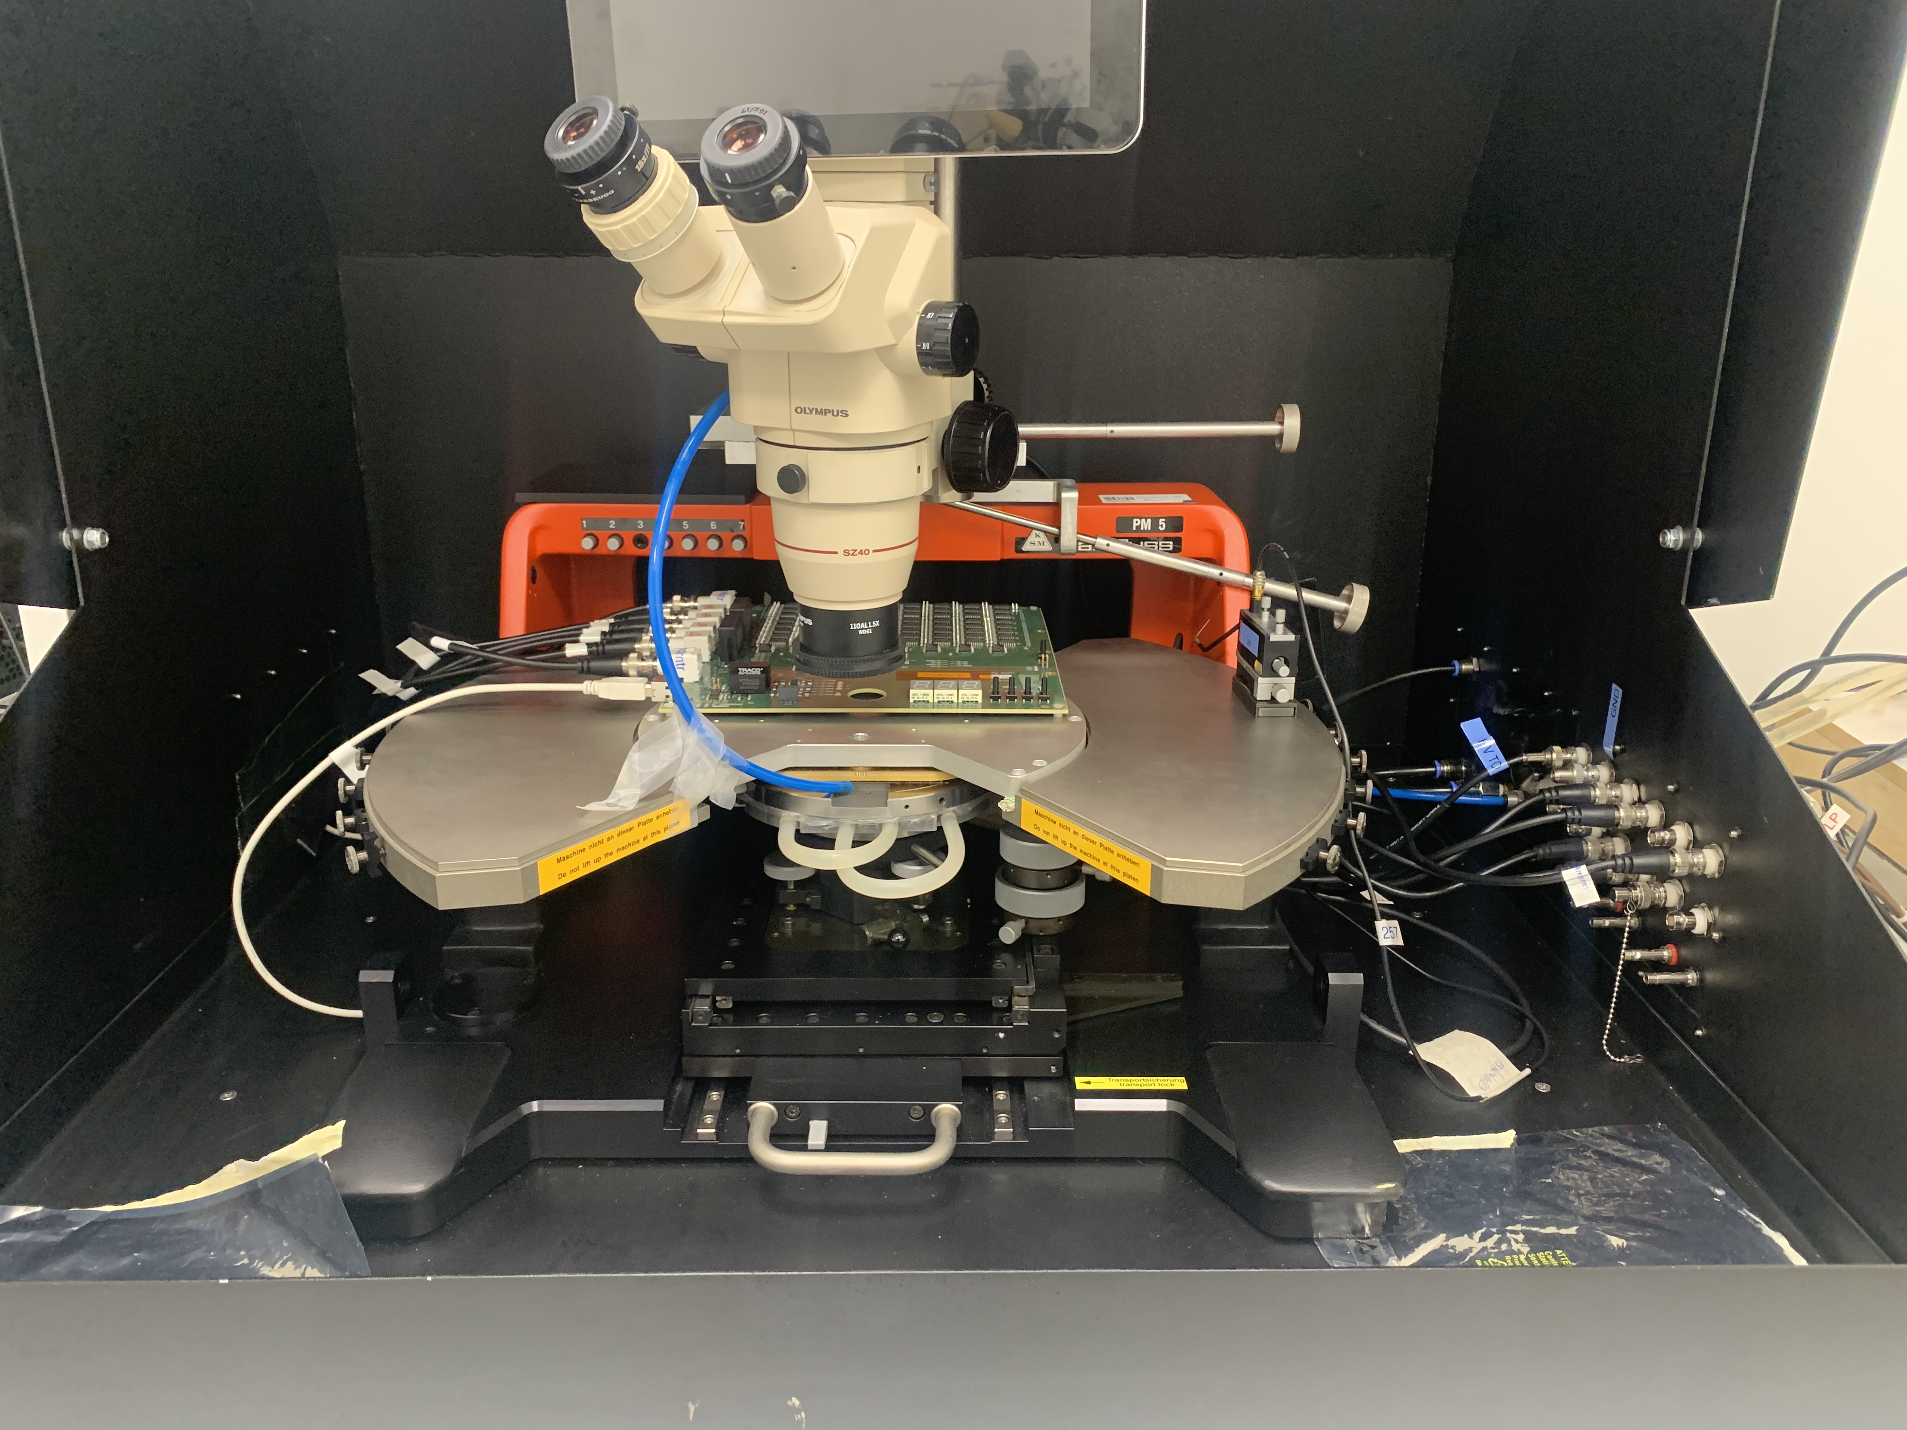
Sensors and probe station
90 CALICE sensors received from Hamamatsu. 320 um thickness, 16x16 pads (5.5x5.5 mm2)
Labeled and stored in dry cabinet with membrane boxes

Slide 4
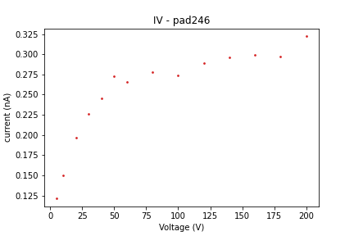
IV measurement
Checked the influence of different parameters: delay between measurements, delay between voltage change,…
System tuned
Up to now, 45 x 256 pads measured
with current plateau

Slide 5

CV measurement - Depletion voltage
It is possible to extract the depletion voltage from the CV measurement; the capacitance can be modelized by:
$C_{g}=A\frac{ε_{Si}ε_{0}}{w}= \left\{\begin{aligned}A\sqrt{\frac{ε_{Si}ε_{0}eN_{d}}{2V} } for V< V_{d}, A:pad area Nd :number of donor, V bias voltage \\ A\frac{ε_{Si}ε_{0}}{w_{m}} for V>Vd, w_{m} max. depletion width\end{aligned}\right.$
So if we take the log of Cg, we should obtain two lines. The intersection of these lines is giving the depletion voltage
ln C
Intersection point: depletion voltage
ln V

Slide 6

Donor density
It is possible to determine the donor density using the formula :
$$\frac{1}{C^{2}}= \frac{2}{εeN_{d}A^{2}}V$$
Where N_{d} is the donor density and A is the pad area
1/C² [1/pF²]
This is compatible with the values found with lumical sensor
Voltage [V]

Slide 7
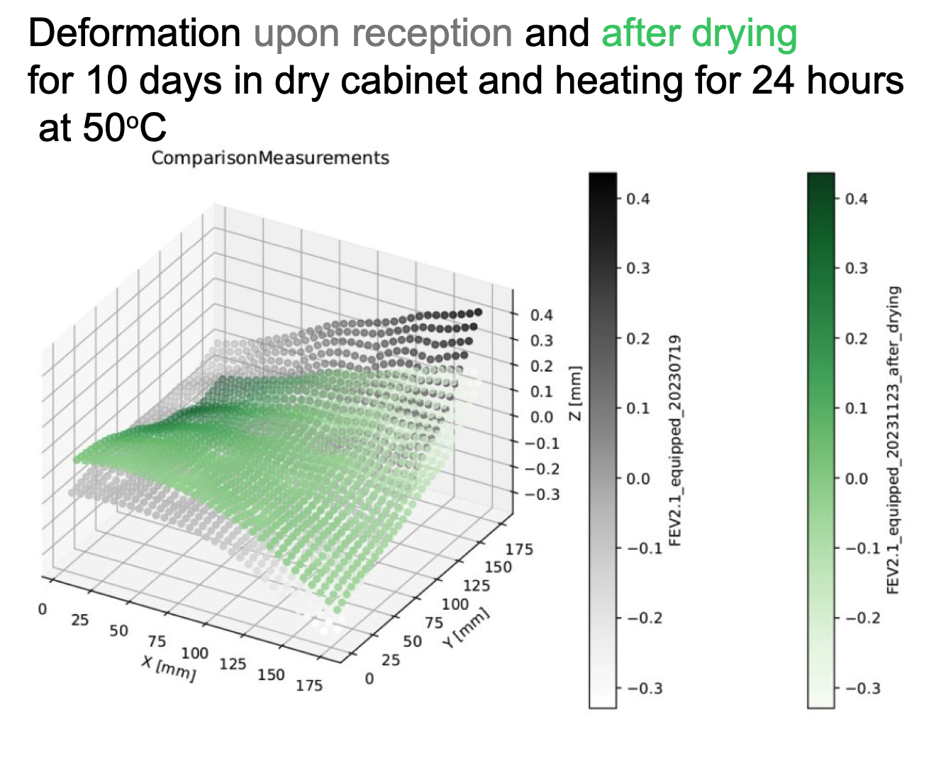
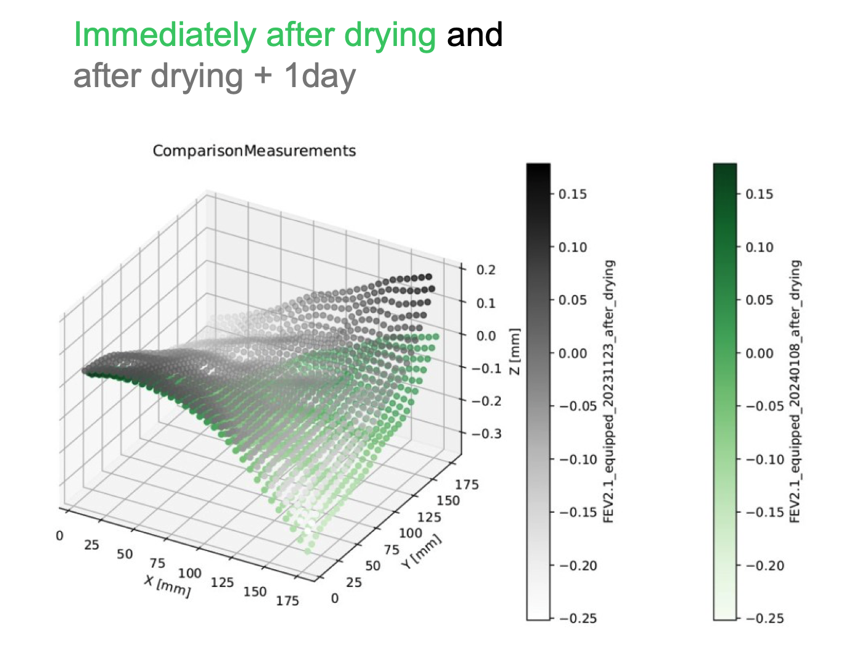
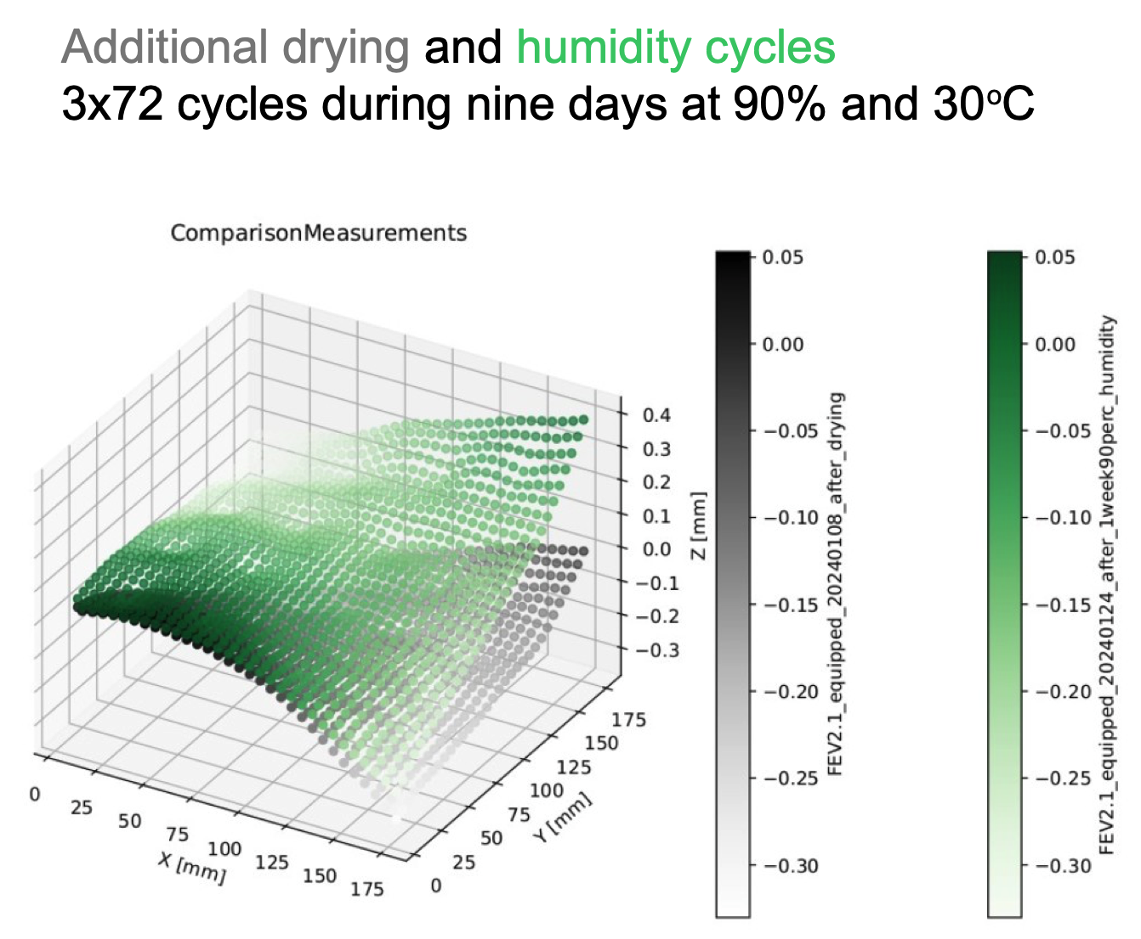
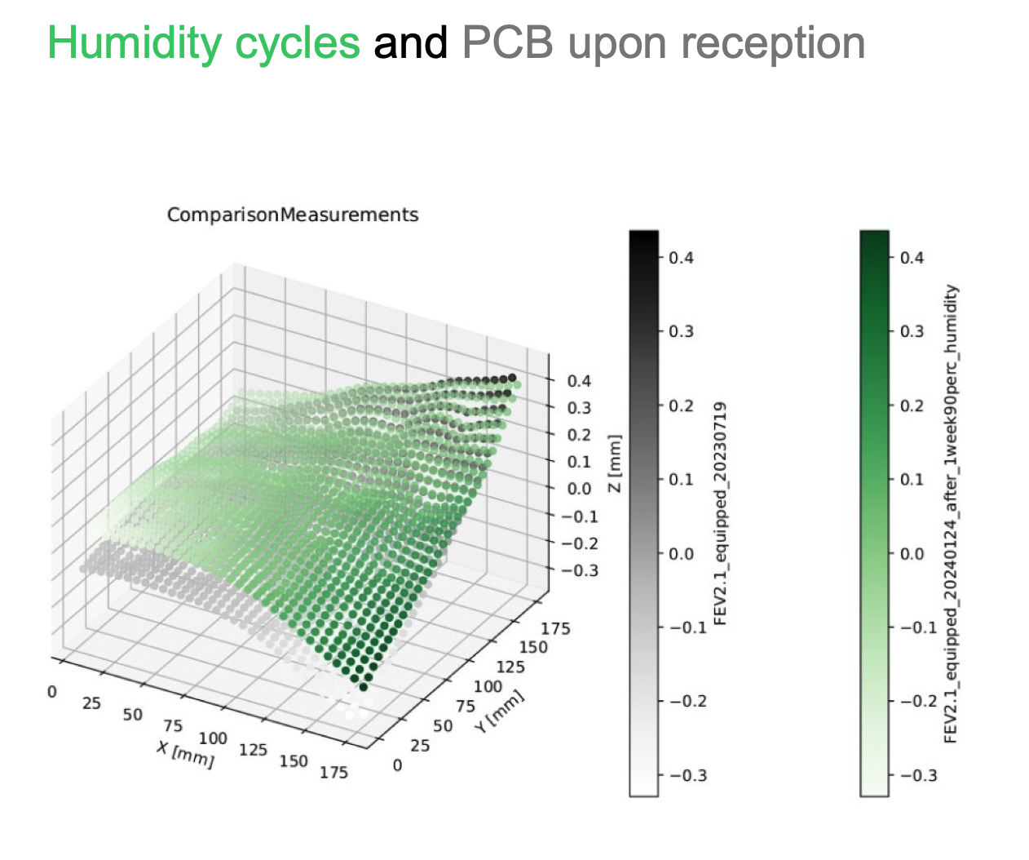
IFIC
All the sensors will be sent to IFIC to be glued to a flexible PCB
Several challenges in conductive gluing/hybridization procedure are shared between SiWECAL and the highly compact calo
IFIC is leading the R&D studies on gluing/hybridization
  R&D on rigid PCB hybridization in collaboration with IJCLab

Slide 8
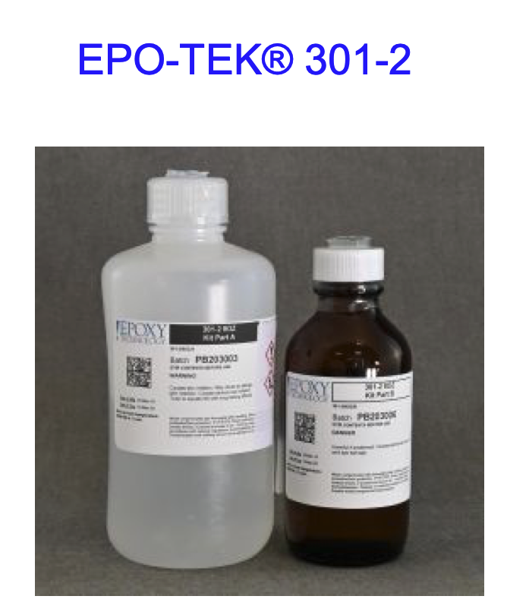
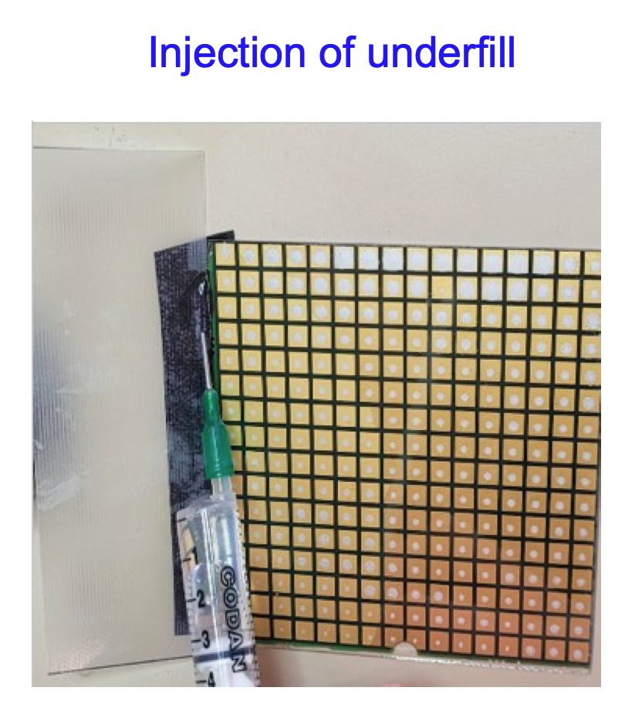
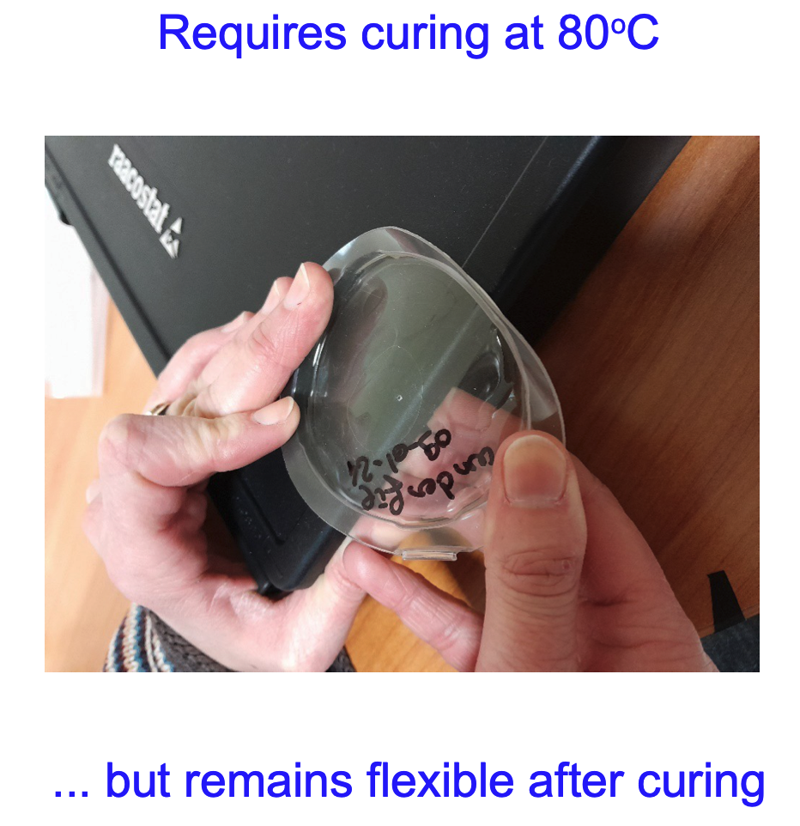
Hybridisation - underfill
Requieres re-curing at 80 C
A. Thiebault, A. Gallas+ Mechanics Department of IJCLab

Slide 9
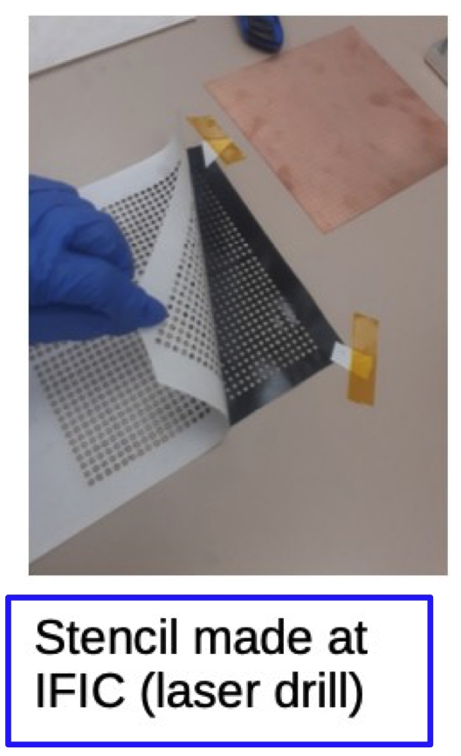
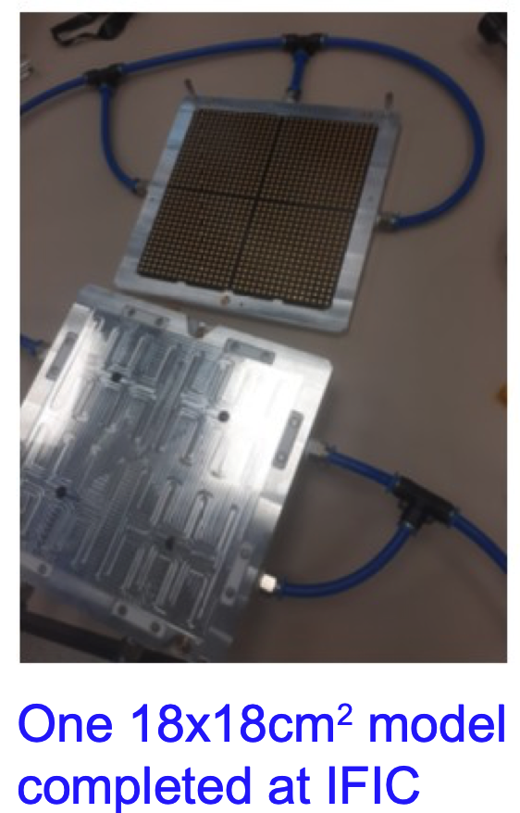
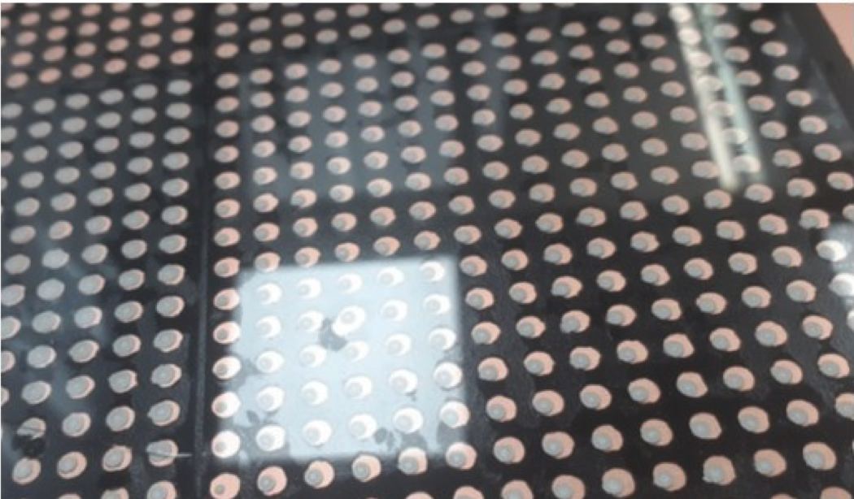
Hybridisation: double side tape
Perforated stencil of thin 250um double tape 3M VHB 5907F

Slide 10
conclusion
TAU :
  We have a working setup to characterize silicon sensors, including analysis and storage : we can test two sensors a day
  All the pads of the tested sensors have a plateau in the IV plot
  Using the CV measurement, it is possible to extract the depletion voltage and the donor density. These extracted values are compatible with expectations
  Design of flexible PCB
IFIC :
  R&D on rigid PCB deformation
  Study of different technologies to glue the sensor to the PCB
  Creation of a IV-CV measurement facility (probe station)
Good synergy between the two institutes to optimize the testing and gluing of the sensors to the PCB

Slide 11
Thanks

