Slide 1




Getting More from Hadron Calorimeters
DRD6 Collaboration Meeting,
CERN - April 10, 2024
Tommaso Dorigo
INFN, Sezione di Padova
Lulea University of Technology
Universal Scientific Education and Research Network

Slide 2
Contents
1. The challenging future of HEP
2. Differential optimization of experimental design
3. Ideas for future calorimetry

Slide 3

1 – A Challenging Future
The 2020 update of the European Strategy for Particle Physics (EUSUPP) encourages feasibility studies for new large, long-term projects which will once again push our technological skills to their limits.

Slide 4
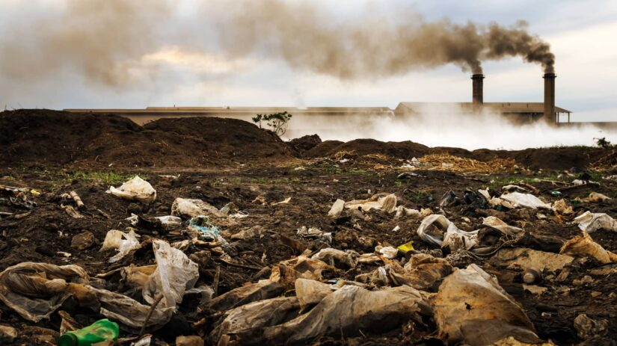
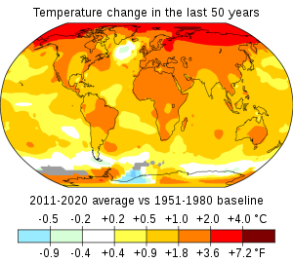
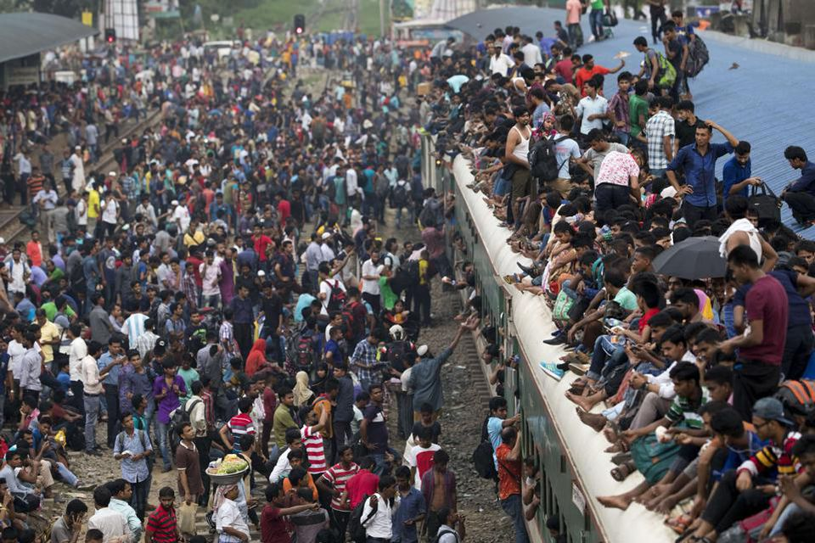
But humanity faces unprecedented global challenges
Resources must be devoted to seek solutions through applied science innovations
rather than investing in fundamental research.

Slide 5

Ensuring the maximum exploitation of any resources spent on fundamental research is a moral imperative
Ensuring the maximum exploitation of any resources spent on fundamental research is a moral imperative

Slide 6
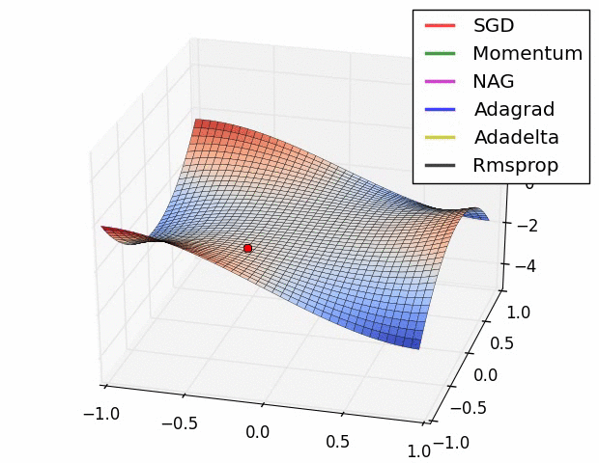
2 – Differentiable Optimization of Experiment Design and the MODE Project

Slide 7
Outstanding Problems in Fundamental Science
Formulating new theories of Nature
Extracting sufficient statistics from high-D data
Ensuring complete control of our type-1 error rates
Explore higher energy / higher intensity frontiers, ensuring we do not miss new physics
The above are all data analysis tasks. Looking forward, we must look into our design problems, as time from blueprint to commissioning is O(20) years!
In market-driven human activities, co-design of hardware and software is already happening. In HEP we still haven’t started doing it systematically
Nowadays we are doing all of that with deep learning

Slide 8
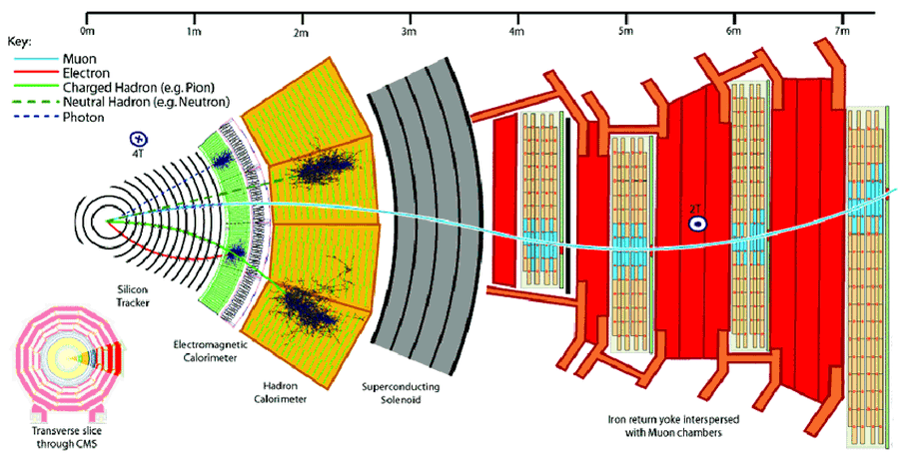
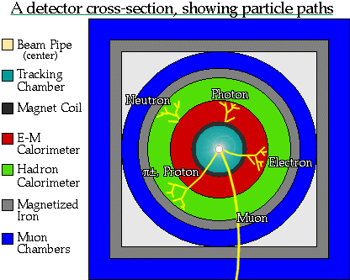
Toward End-to-End Optimization:
The Status Quo in HEP
In the past 50+ years the design of new particle detectors leveraged cutting-edge technologies,
yet a few crucial underlying global paradigms of experimental design have remained mostly unchallenged across decades:
“Track first, destroy later”
Redundancy and robustness of detection systems
Symmetrical layouts
→ No guarantee of optimality!
Those choices do not directly maximize a high-level utility function, such as the highest discovery reach for a physical process, or measurement precision
Above: a present-day detector (CMS)
Below: a 30-years-old detector for LEP

Slide 9
Toward End-to-End Optimization:
The Status Quo in HEP
In the past 50+ years the design of new particle detectors leveraged cutting-edge technologies,
yet a few crucial underlying global paradigms of experimental design have remained mostly unchallenged across decades:
“Track first, destroy later”
Redundancy and robustness of detection systems
Symmetrical layouts
→ No guarantee of optimality!
Those choices do not directly maximize a high-level utility function, such as the highest discovery reach for a physical process, or measurement precision
Above: a present-day detector (CMS)
Below: a 30-years-old detector for LEP
Above: a present-day detector (CMS)
Below: a 30-years-old detector for LEP

Slide 10
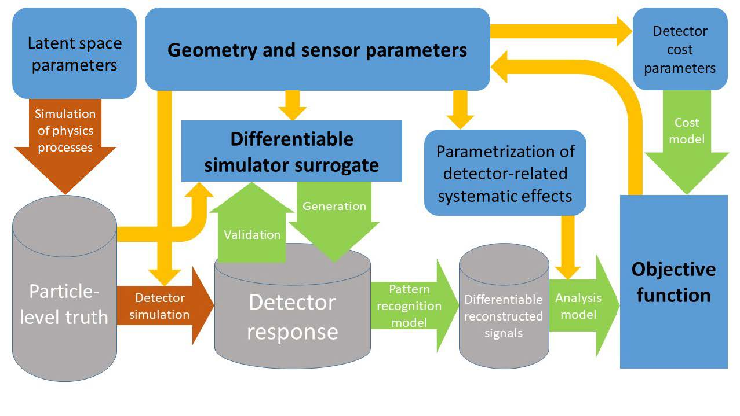
Putting a Pipeline Together
If the simulation can be bypassed by a differentiable surrogate, we remove the stochasticity of the physics and strongly simplify the problem
θ
c
ν
x
z or S
ζ = R(z)
L=NN(ζ)

Slide 11
Putting a Pipeline Together / 2
The model must
include a model of the absolute state-of-the-art (or even extrapolated future performance!) of reconstruction and inference to avoid any misalignment

Slide 12
Putting a Pipeline Together / 3
Backpropagation of the gradient of the objective function then allows to find optimal parameters θ → obtain end-to-end optimality of the instrument

Slide 13













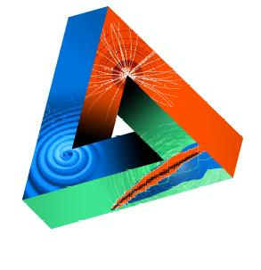

















Machine-Learning Optimized Design of Experiments
MODE Collaboration
https://mode-collaboration.github.io
M. Aehle¹⁷, A. G. Baydin⁵, A. Belias¹⁰, A. Boldyrev⁴, K. Cranmer⁸, P. de Castro Manzano¹, Z. Daher², T. Dorigo^{1,14,21,26}, C. Delaere², D. Derkach⁴, J. Donini^{3,26}, P. Elmer¹⁸, F. Fanzago¹, S. Gami²⁷, N.R. Gauger¹⁷, A. Giammanco^{2,26}, C. Glaser¹¹, L. Heinrich¹², R. Keidel¹⁷, J. Kieseler²², C. Krause²⁸, L. Kusch¹⁷, M. Lagrange², M. Lamparth¹², A. Lee²⁵, M. Liwicki²¹, G. Louppe⁶, L. Layer¹, L. Masserano²⁵, F. Nardi^{3,14}, P. Martinez Ruiz del Arbol⁹, F. Ratnikov⁴, R. Roussel²⁰, T. Samui²⁴, F. Sandin²¹, P. Stowell¹⁵, G. Strong¹, M. Tosi^{1,14}, A. Ustyuzhanin⁴, S. Vallecorsa⁷, X.C. Vidal²³, P. Vischia^{13,26}, G. Watts¹⁹, H. Zaraket¹⁶
Sponsored by
1 INFN, Italy
2 Université Catholique de Louvain, Belgium
3 Université Clermont Auvergne, France
4 Laboratory for big data analysis of the HSE, Russia
5 University of Oxford, UK
6 Université de Liege, Belgium
7 CERN, Switzerland
8 New York University, USA
9 IFCA, Spain
10 GSI, Germany
11 Uppsala Universitet, Sweden
12 TU Munchen, Germany
13 Universidad de Oviedo and ICTEA, Spain
14 Università di Padova, Italy
15 Durham University, UK
16 Lebanese University, Lebanon
17 Kaiserslautern-Landau University, Germany
18 Princeton University, USA
19 University of Washington, USA
20 SLAC, USA
21 Lulea University of Technology, Sweden
22 Karlsruhe Institute of Technology, Germany
23 Universidad de Santiago de Compostela, Spain
24 IISER Kolkata, India
25 Carnegie-Mellon University, USA
26 Universal Scientific Education and Research Network
27 NISER, India
28 HEPHY OeAW, Austria
JENAS

Slide 14
Active Projects: a Pot-Pourri
The target of MODE is to design a scalable, versatile architecture that can provide end-to-end optimization of particle detectors, proving it on a number of different applications
  Idea: if we “solve” a few problems we may construct a library of solutions and exploit the universality of the underlying architecture and its modularity, re-using modeling efforts
  Initial study cases:
  MUonE detector → completed and published
  LHCb EM calorimeter optimization → preliminary results out
  Muon tomography detector optimization → preliminary results out, submitted to journal
  Muon collider EM calorimeter → in progress
  Optimization of detectors for air Cherenkov showers (SWGO) → Preliminary results out, ongoing
  Hybrid calorimeter design integrating tracking layers → started
  plus many more envisioned

Slide 15
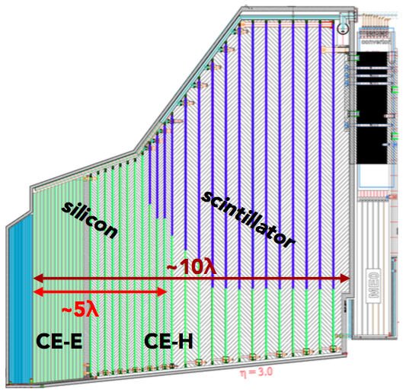
3 – Optimization of Future Calorimeters
Below: the HGCAL calorimeter for the CMS upgrade

Slide 16
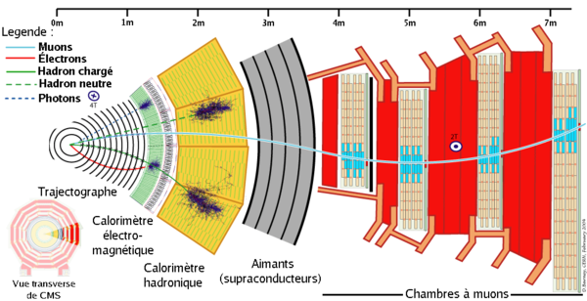
A necessary question: Hybridization
In an impending AI revolution, the design of calorimeters is crying to be rethought.
Standard setup in particle detectors: lightweight tracker → dense calorimeter
Why abrupt change of density?
«Because nuclear interactions…»
Density
Tracker EM HAD
calorimeter
Distance from center

Slide 17
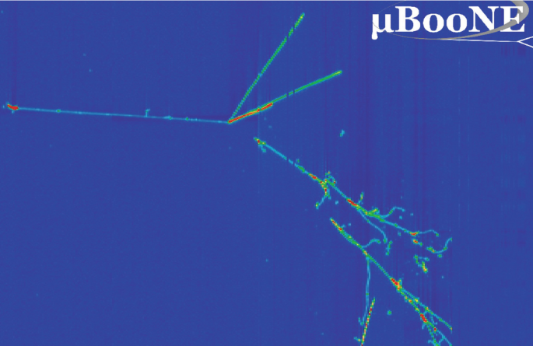
A necessary question:
Hybridization / 2
Regardless of the extractability of particle-ID information from the patterns of energy depositions, the design of calorimeters is crying to be rethought.
Standard setup in particle detectors: lightweight tracker → dense calorimeter
Why abrupt change of density?
Historically: allow measurement of charged particle parameters undisturbed by nuclear interactions
But today/tomorrow we (will) have AI reconstruction...
Plan: Investigate coupled system of tracker and calorimeter, slowly vary density in z from step function to smoother transition, study effect on extractable information
Requires high-perf. reconstruction of nuclear interactions in pattern recognition step
Likely (almost guaranteed) to discover new ways / overcome standing paradigm
Above: a totally out of context neutrino
interaction. Behold the enormous amount
of information a single interaction bears!
Why abrupt change of density?
«Because nuclear interactions…»

Slide 18
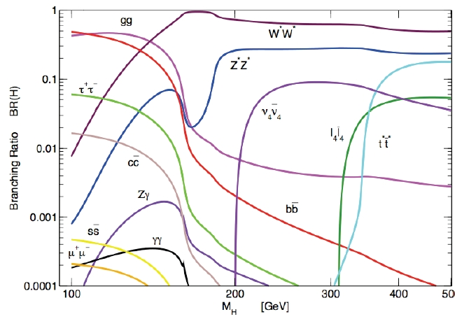
Asking for More to Calorimeters: Particle ID
Charged pions, kaons, and protons constitute the bulk of the hadrons flowing into a hadron calorimeter
Being able to distinguish them would bring in very large gains:
to flavour tagging (killer app: H→ss at a future collider, where you need to tag the fast kaon from s hadronization)
to energy reconstruction (improved through particle flow techniques)
to boosted-jet tagging (from improved inner structure reconstruction of jet cores)
and more

Slide 19
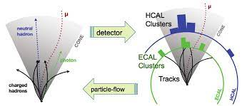
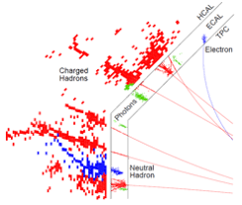
Asking for More to Calorimeters: Particle ID
Charged pions, kaons, and protons constitute the bulk of the hadrons flowing into a hadron calorimeter
Being able to distinguish them would bring in very large gains:
to flavour tagging (killer app: H→ss at a future collider, where you need to tag the fast kaon from s hadronization)
to energy reconstruction (improved through particle flow techniques)
to boosted-jet tagging (from improved inner structure reconstruction of jet cores)
and more

Slide 20
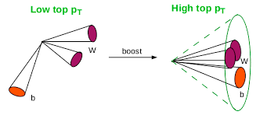
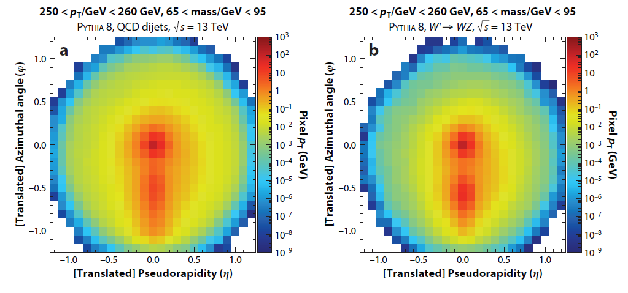
Asking for More to Calorimeters: Particle ID
Charged pions, kaons, and protons constitute the bulk of the hadrons flowing into a hadron calorimeter
Being able to distinguish them would bring in very large gains:
to flavour tagging (killer app: H→ss at a future collider, where you need to tag the fast kaon from s hadronization)
to energy reconstruction (improved through particle flow techniques)
to boosted-jet tagging (from improved inner structure reconstruction of jet cores)
and more

Slide 21

Asking for More to Calorimeters: Particle ID
Charged pions, kaons, and protons constitute the bulk of the hadrons flowing into a hadron calorimeter
Being able to distinguish them would bring in very large gains:
to flavour tagging (killer app: H→ss at a future collider, where you need to tag the fast kaon from s hadronization)
to energy reconstruction (improved through particle flow techniques)
to boosted-jet tagging (from improved inner structure reconstruction of jet cores)
and more
But can it be done?

Slide 22

What Information Are We After?
1 10 100 1000 10000 → s^{0.5} (GeV)

Slide 23
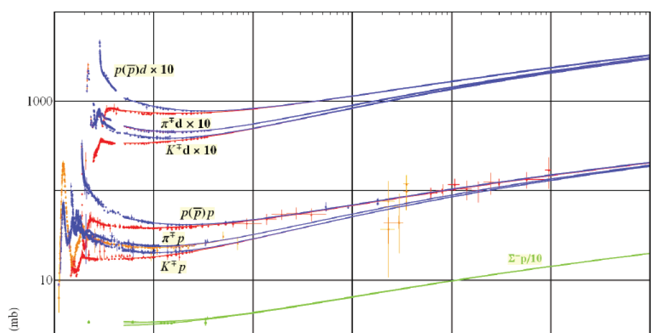
What Information Are We After?
Physical facts:
Protons are larger than pions and kaons, in fact the nuclear interaction cross sections of protons, pions, kaons are significantly different
  Harder to exploit than it looks,
  but it can be done
Ionization power is also different (we only used this in tracking so far)
  → if we have sufficient granularity we can single out the ionization of each particle, at least away from the bulk of the shower
Kaons contain one unit of strangeness, pions (and protons) do not
  → the daughters in nuclear collisions are different
1 10 100 1000 10000 → s^{0.5} (GeV)

Slide 24
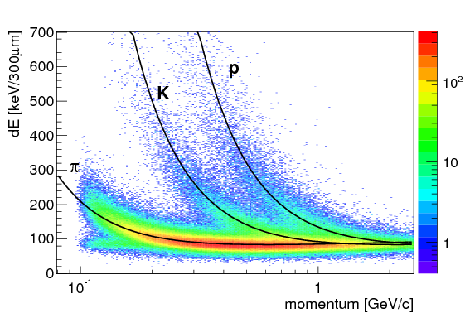

What Information Are We After?
Physical facts:
Protons are larger than pions and kaons, in fact the nuclear interaction cross sections of protons, pions, kaons are significantly different
  this should be «easy» to exploit
Ionization power is also different (we only used this in tracking so far)
  if we have sufficient granularity we can single out the ionization of each particle, at least away from the bulk of the shower
  This information can then be used by ML tools
Kaons contain one unit of strangeness, pions (and protons) do not
  → the daughters in nuclear collisions are different

Slide 25
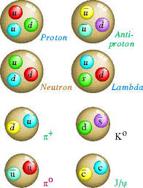
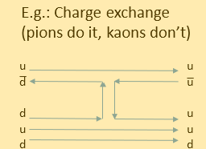
What Information Are We After?
Physical facts:
Protons are larger than pions and kaons, in fact the nuclear interaction cross sections of protons, pions, kaons are significantly different
  this should be «easy» to exploit
Ionization power is also different (we only used this in tracking so far)
  → if we have sufficient granularity we can single out the ionization of each particle, at least away from the bulk of the shower
Kaons contain one unit of strangeness, pions (and protons) do not
  → the daughters in nuclear collisions are different
E.g.: Charge exchange
(pions do it, kaons don’t)

Slide 26
Research Questions and a Money Plot
(1) What are the ultimate particle ID capabilities of a granular hadron calorimeter, assuming no limit on size Δx of readout cells?
(2) How does particle ID capability degrade as Δx is increased, and for what value Δx_{crit} does it get lost in conceivable setups?
(3) By how much would that information improve the performance of hadronic jet reconstruction in specific benchmarks of interest (e.g., H->bb, H→ss)?
(4) How much further gain is possible by exploiting timing information?
Q
p/π
(1)
K/π
p/K
(2)
Δx
Δx_{crit}
Δx_{crit}

Slide 27
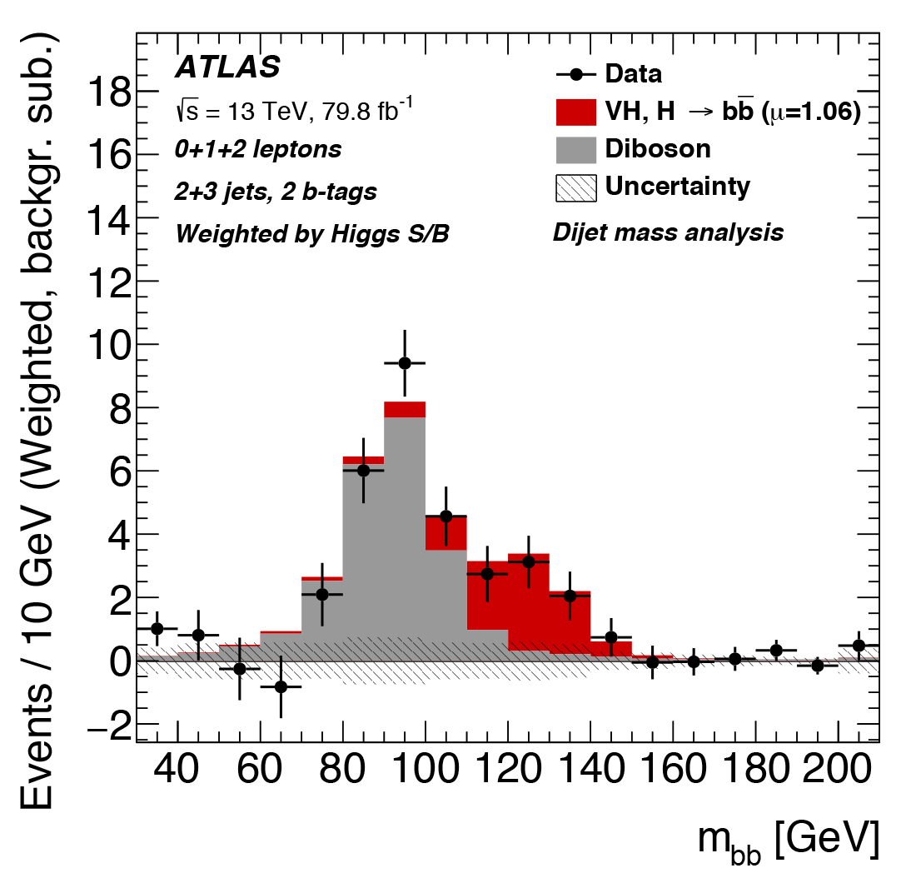
Research Questions / 2
(1) What are the ultimate particle ID capabilities of a granular hadron calorimeter, assuming no limit on size Δx of readout cells?
(2) How does particle ID capability degrade as Δx is increased, and for what value Δx_{crit} does it get lost in conceivable setups?
(3) By how much would that information improve the performance of hadronic jet reconstruction in specific benchmarks of interest (e.g., H->bb, H→ss)?
(4) How much further gain is possible by exploiting timing information?
(3)

Slide 28

Research Questions: timing
(1) What are the ultimate particle ID capabilities of a granular hadron calorimeter, assuming no limit on size Δx of readout cells?
(2) How does particle ID capability degrade as Δx is increased, and for what value Δx_{crit} does it get lost in conceivable setups?
(3) By how much would that information improve the performance of hadronic jet reconstruction in specific benchmarks of interest (e.g., H->bb, H→ss)?
(4) How much further gain is possible by exploiting timing information?

Slide 29
But can we afford mm-size cells?
Costly/unfeasible to have multi-million cell calorimeters. But is it also overkill, or are we limiting ourselves?
Also, in hadron colliders we strive for highest possible collision rate,
which has three implications:
1 - Cannot afford to save all data
  Not a real issue, most collisions are un-interesting… but still a limitation
2 - Pileup complicates pattern recognition
  LHC challenged to retain performance as luminosity increases
3 - Have trouble using highest-granularity subdetectors for online selection
  Using pixel detectors inside ATLAS/CMS for triggering purposes is problematic

Slide 30
A new, far-fetched idea
Introduce fast online preprocessing of light signals by nanophotonic devices embedded in the detector
→ exploit timing structure
→ transmit to back end higher-level primitives
→ enable smarter triggering
→ improve information extraction

Slide 31
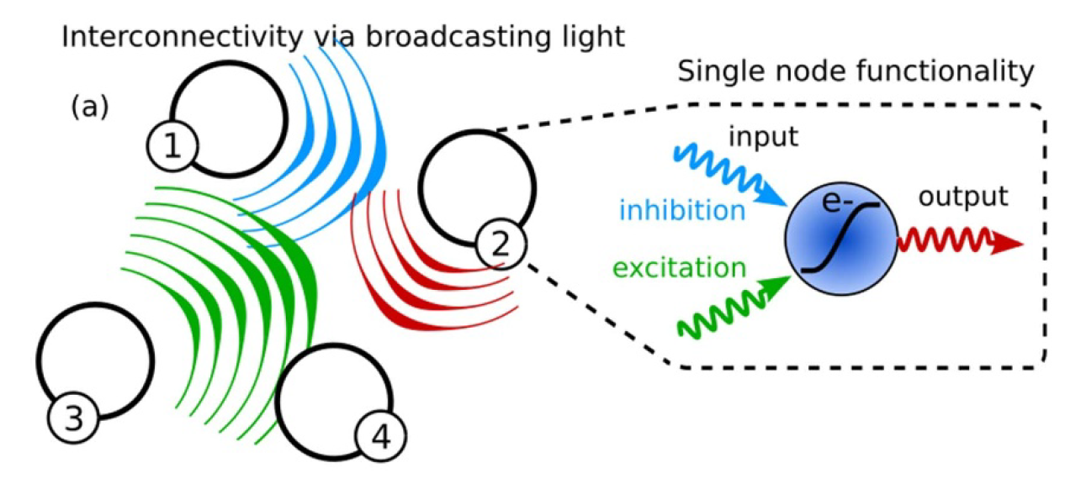
Timing with Neuromorphic Computing
Recent developments in nanophotonics: can use arrays of nanowires (light receivers/emitters) in micrometric substrates
→ create neuromorphic network encoding and exploiting time structure of photon signals from scintillation/Cherenkov

Slide 32
Timing with Neuromorphic Computing
Recent developments in nanophotonics: can use light receivers/emitters in micrometric substrates
→ may create neuromorphic network encoding and exploiting time structure of photon signals from scintillation/Cherenkov
An avalanche of disruptive advancements:
No transduction (PMT gone) – photons are the signal AND the computation tokens
On-site fast computing
Ultra-high energy efficiency
Natural exploitation of time structure

Slide 33
An AI problem to solve (if the rest works)
10x10 matrix of light-sensitive receivers
Consider a small element of scintillating material in a calorimeter
(e.g., few cm³)
Block of transparent scintillating crystal
Particle trajectories

Slide 34
An AI problem to solve (if the rest works)
The space-time structure of photon emission contains information on the processes locally taking place in the cubelet
Light emission sites

Slide 35
Spike time-encoded information flows to neurons
Photon arrival front at interface provide for automatic (but not trivial) encoding
→ May try using a neuromorphic network to reconstruct the topology of interactions– or simply compress information into useful summaries, given detected photons emitted along the path and their arrival times
Reflective side (increase yield of detectable photons)

Slide 36
An invitation
Within MODE we created a group that is looking into these matters:
Particle ID information extraction from high-granularity data
End-to-end modeling via differentiable programming, for optimization
Exploitation of neuromorphic computing to reconstruct space-time patterns
Readout and processing with nanowires
Institutions involved:
INFN, Padova (Dorigo), RPTU (Gauger), LTU (Sandin), Lund (Mikkelsen), CMU (Lee)
Projects seeking funding: several
If you would like to participate, you are more than welcome!

Slide 37

A Workshop
On September 23-25 we will hold the fourth MODE workshop in Valencia (Spain)
Please consider coming / presenting plans for detector design optimization there! https://indico.cern.ch/event/1380163/overview

Slide 38
Summary
After the paradigm shift of 2012 (AlexNet, Higgs discovery) it is not reasonable any longer to do complex multidimensional inference without machine learning tools
The next paradigm shift enabled by AI is the assistance of properly interfaced tools in design of complex systems
We can do more with calorimeters tomorrow, provided that we ensure that extractable information is suitably generated
Some bold new ideas need to be investigated by considering the issue as an end-to-end optimization problem

Slide 39
Thank you for your time!

Slide 40
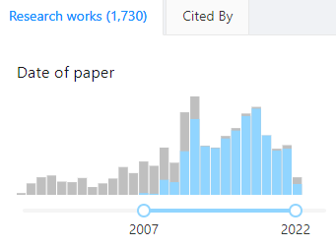
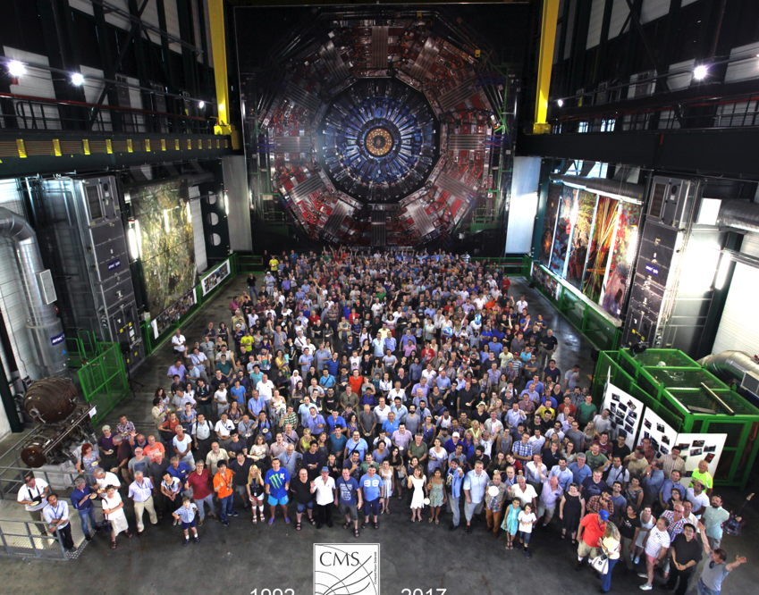
Optimal for What?
Over 1000 publications
The reason why detectors are complex is not only that the studied physics is complex: Science is a demanding job. Physicists want to study everything and do it better than their predecessors
CMS has over 4000 members, who use the data for a LARGE number of different measurements and searches...
So, what does it mean for a detector to be optimal?
What loss function do we aim to minimize?
Does it make sense to speak of an experiment-wide utility function?
Above: publication time of 1125 articles by the CMS collaboration (in blue).
Below: a small fraction of the CMS members

Slide 41
Optimal for What?
Over 1000 publications
The reason why detectors are complex is not only that the studied physics is complex: Science is a demanding job. Physicists want to study everything and do it better than their predecessors
CMS has over 4000 members, who use the data for a LARGE number of different measurements and searches...
So, what does it mean for a detector to be optimal?
What loss function do we aim to minimize?
Does it make sense to speak of an experiment-wide utility function?
Above: publication time of 1125 articles by the CMS collaboration (in blue).
Below: a small fraction of the CMS members

Slide 42
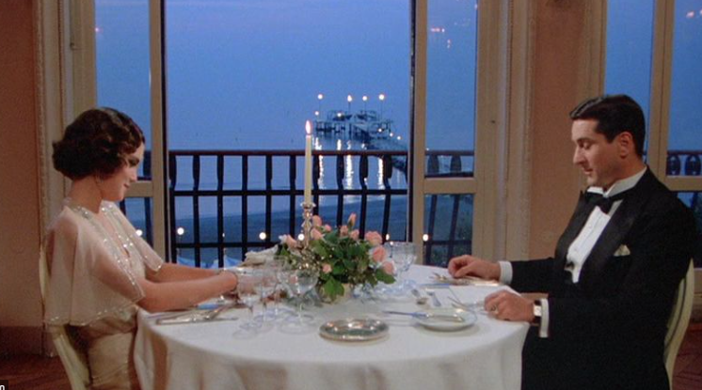

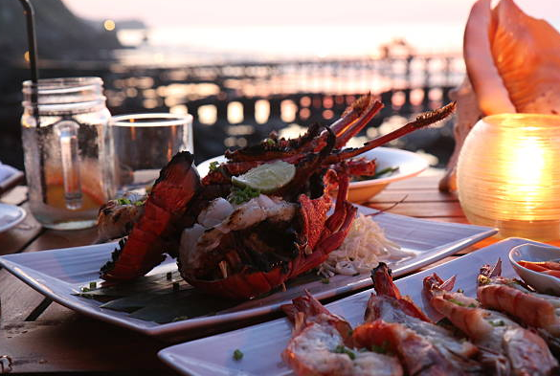
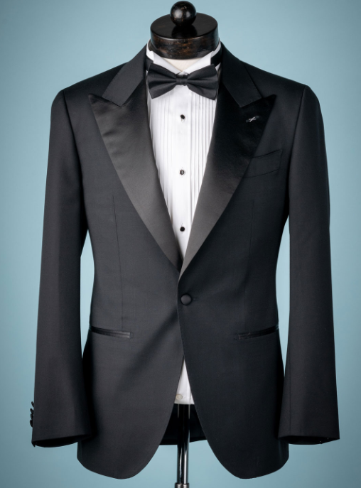
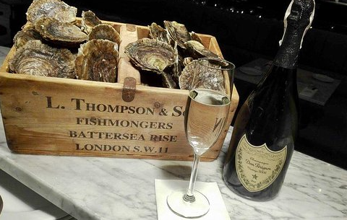



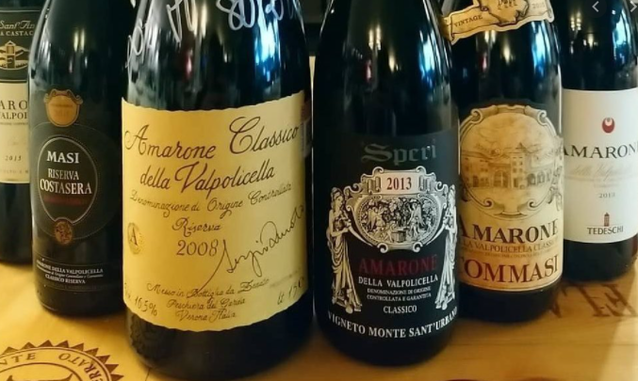
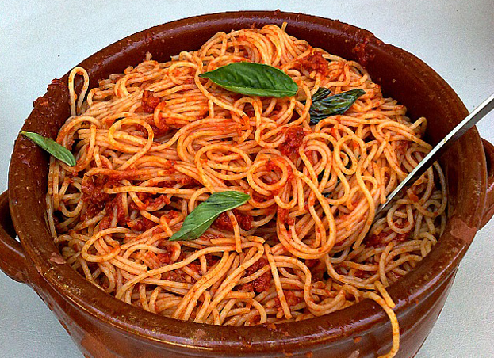
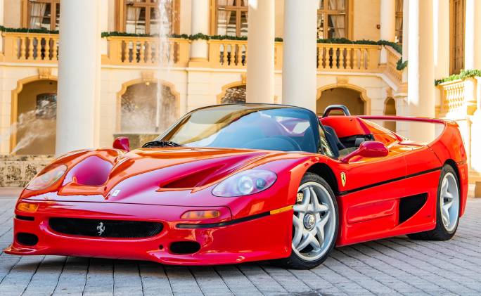

Recipe for a Perfect Dinner
We are not alien to confidently taking complex decisions in a multi-objective space. We actually do it routinely...
Of course, we are not deterred by knowing that the exact form of our optimization target is arbitrary

Slide 43
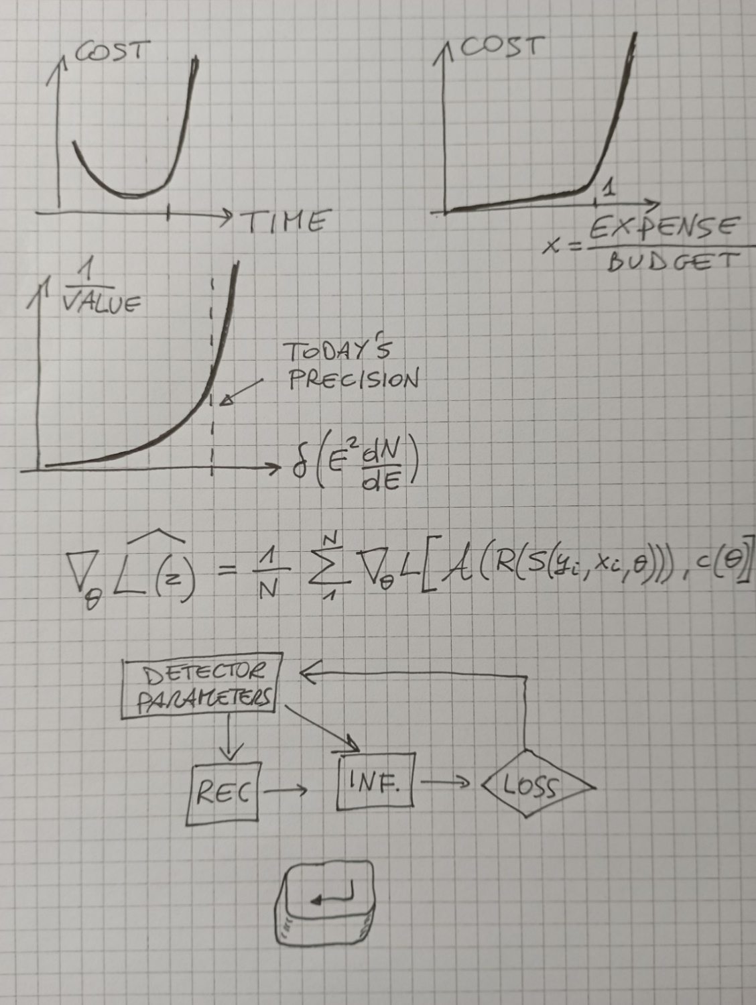
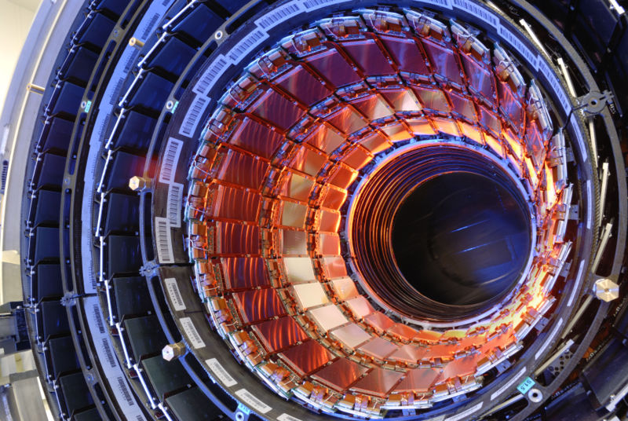
Recipe for a Perfect Detector
1, 2
Assess your total budget and time-to-completion
Model as a steep function the cost of overriding budget or time
Assess the scientific impact of each achievable scientific results
Create a differentiable model of the geometry, the components, the information-extraction procedures, and the utility function
Construct a pipeline with those modules, enabling backpropagation and gradient descent functionality
Let the chain rule of differential calculus do the hard work for you
3
4
5
We will discuss this in more detail below, with a couple of examples – but will first discuss the scale of our problems
6

Slide 44
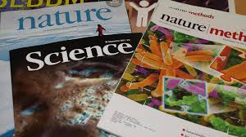
Recipe for a Perfect Detector
1, 2
Assess your total budget and time-to-completion
Model as a steep function the cost of overriding budget or time
Assess the scientific impact of each achievable scientific results
Create a differentiable model of the geometry, the components, the information-extraction procedures, and the utility function
Construct a pipeline with those modules, enabling backpropagation and gradient descent functionality
Let the chain rule of differential calculus do the hard work for you
3
4
5
We will discuss this in more detail below, with a couple of examples – but will first discuss the scale of our problems
6

Slide 45

Recipe for a Perfect Detector
1, 2
Assess your total budget and time-to-completion
Model as a steep function the cost of overriding budget or time
Assess the scientific impact of each achievable scientific results
Create a differentiable model of the geometry, the components, the information-extraction procedures, and the utility function
Construct a pipeline with those modules, enabling backpropagation and gradient descent functionality
Let the chain rule of differential calculus do the hard work for you
3
$$\frac{∂}{∂x}$$
4
5
We will discuss this in more detail below, with a couple of examples – but will first discuss the scale of our problems
6

Slide 46
Recipe for a Perfect Detector
1, 2
Assess your total budget and time-to-completion
Model as a steep function the cost of overriding budget or time
Assess the scientific impact of each achievable scientific results
Create a differentiable model of the geometry, the components, the information-extraction procedures, and the utility function
Construct a pipeline with those modules, enabling backpropagation and gradient descent functionality
Let the chain rule of differential calculus do the hard work for you
3
4
5
We will discuss this in more detail below, with a couple of examples – but will first discuss the scale of our problems
6

