Slide 1
TAU report

Slide 2
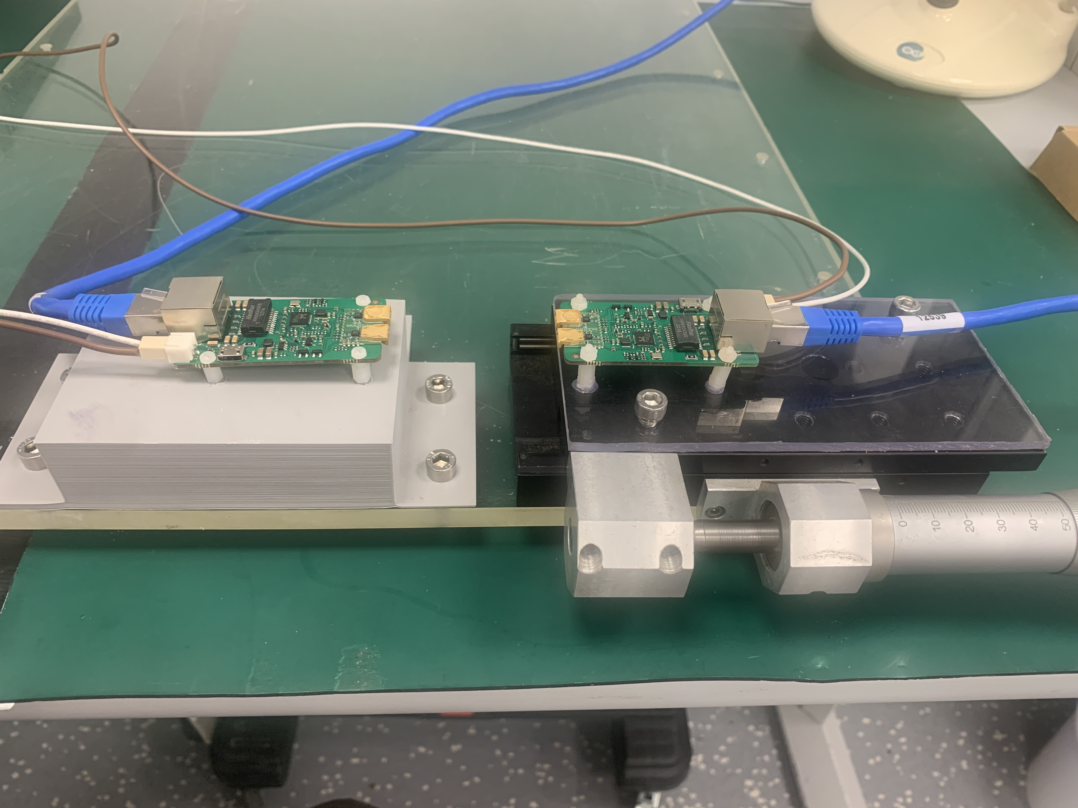
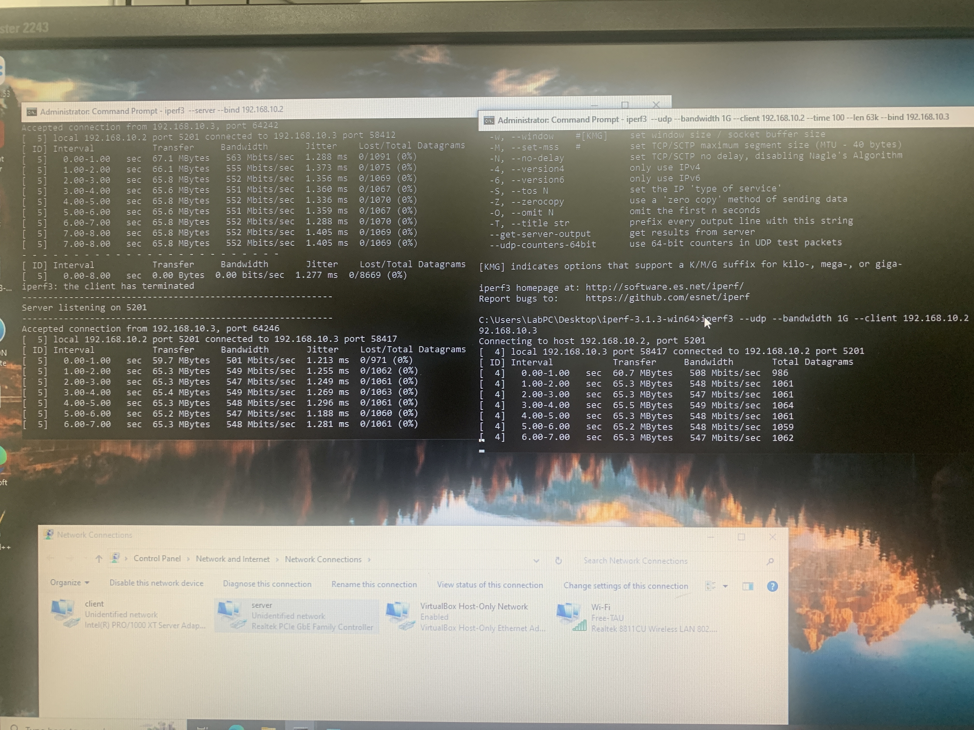
Wireless data
6 SK202 purchased and arrived at TAU
Setup installed to start basic study
Soft (iperf3) installed and running
First basic tests done
Started to look in the code to modify it
Maybe we need to have technical meetings to coordinate the efforts?

Slide 3
Wireless power
Discussion with TAU laser experts to understand which laser led and PV cell to purchase

Slide 4
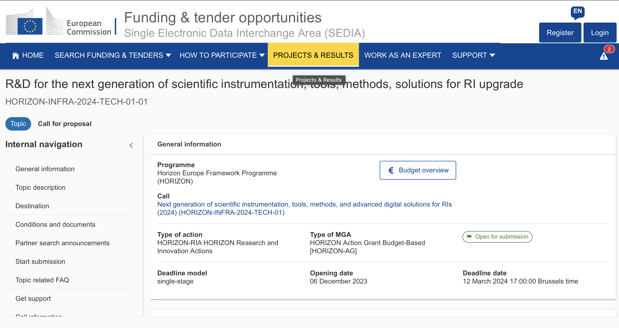
grants
Grant requested to Israel Science Fundation
Discussion started to submit proposal German Israel grant

