Slide 1
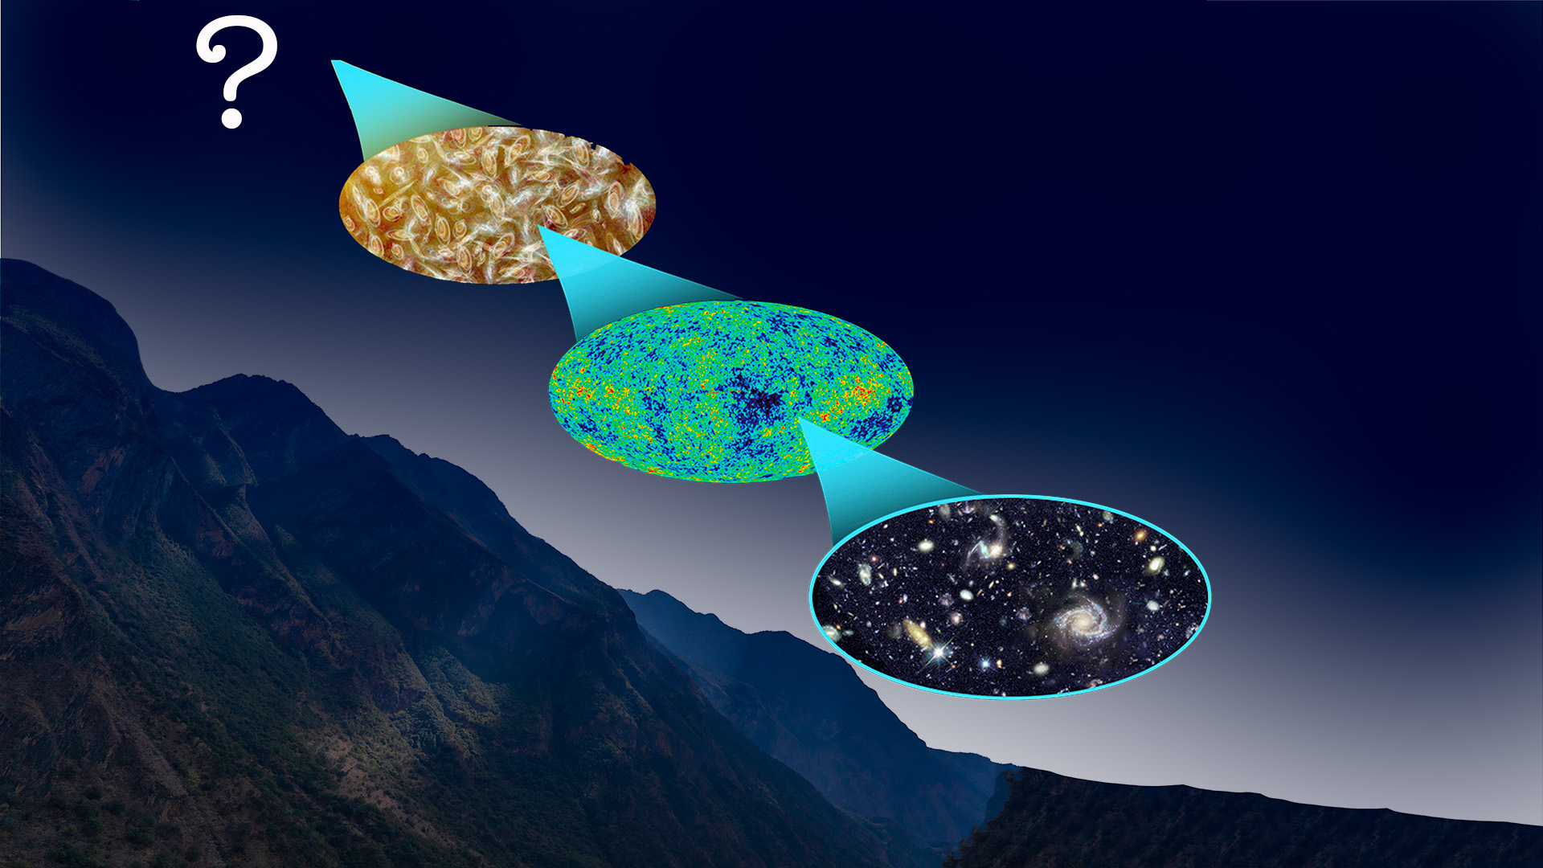

Double weak decay searches in the
PandaX-4T experiment
Shaobo Wang (王少博)
（shaobo.wang@sjtu.edu.cn）
2024-12-12
On behalf of PandaX collaboration
Shanghai Jiao Tong University, China

Slide 2
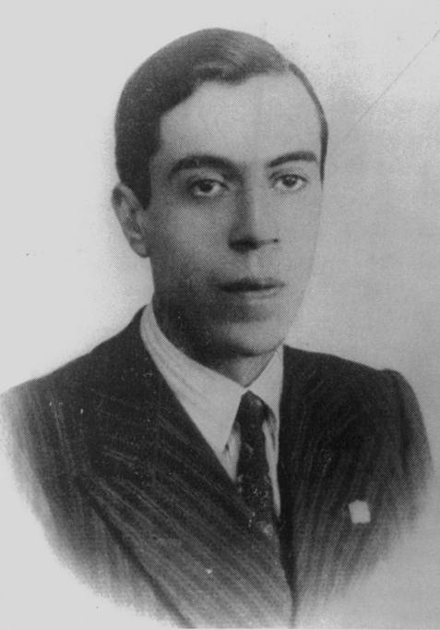
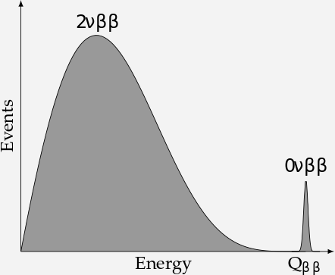
Neutrinos are Dirac or Majorana?
Double Beta Decay (2𝜈𝛽𝛽 )
Neutrinoless Double Beta Decay (0𝜈𝛽𝛽 )
Majorana neutrino may be an important link in connecting to matter-antimatter asymmetry in our universe

Slide 3
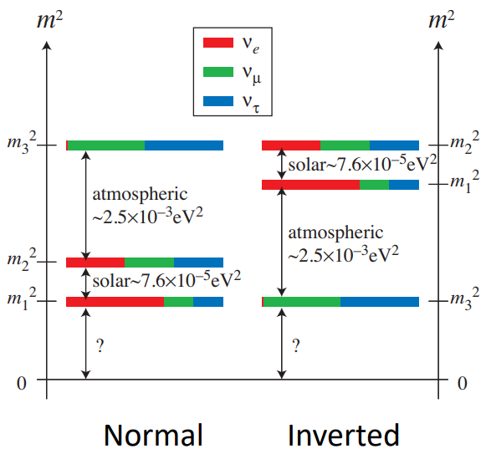
0𝜈𝛽𝛽 : Golden channel for Majorana neutrino searches
Majorana or Dirac
Lepton number violation
Measures effective Majorana mass: relate 0𝜈𝛽𝛽 to the neutrino oscillation physics
Phase space factor
Current Experiments
Nuclear matrix element
Effective Majorana neutrino mass:

Slide 4
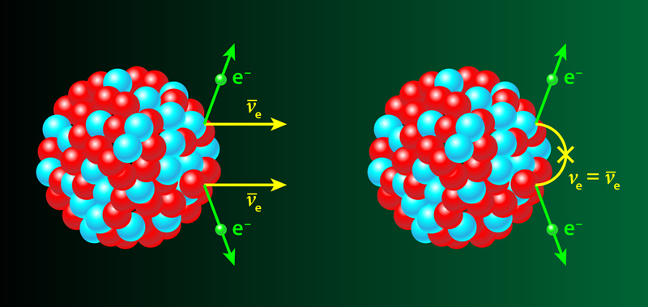
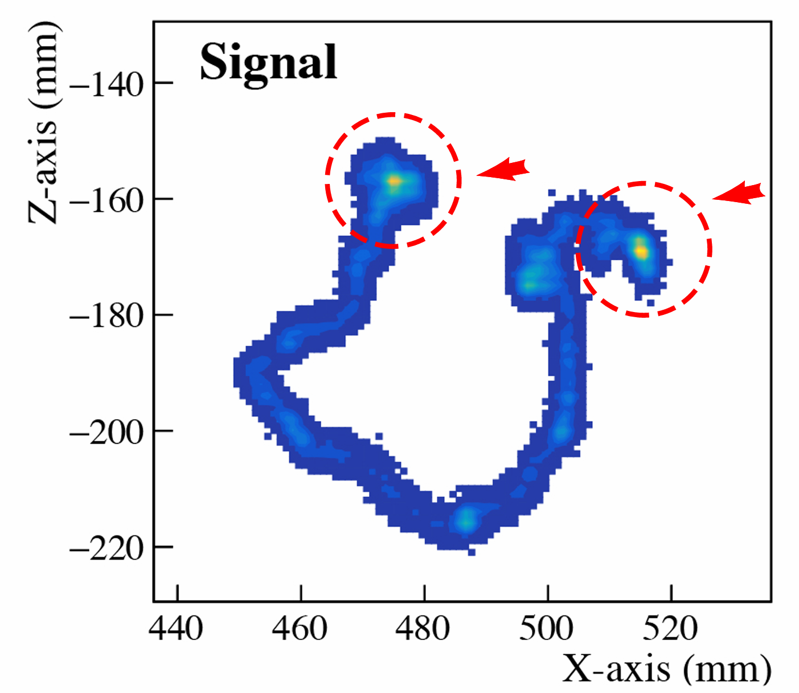
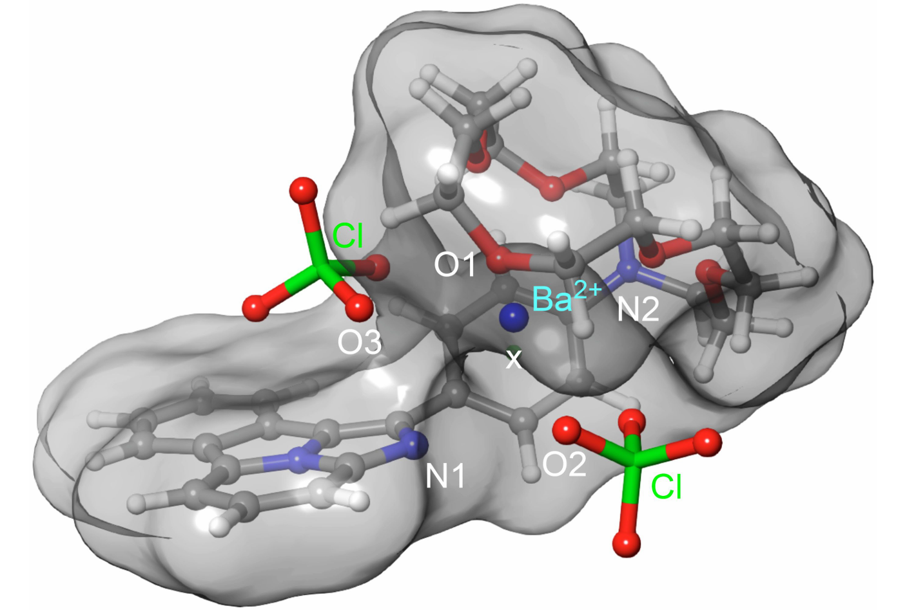

Experimental Searches
$$^{136}Xe→ ^{136}Ba+2e^{−}+?ν$$
Detect the electron
  Summed energy
  Trajectories
Detect the daughter nuclei
  Geochemical and radiochemical
  Imaging

Slide 5
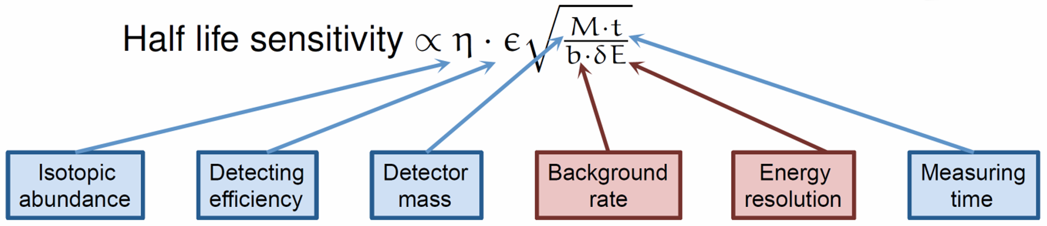
Half-life sensitivity from experiments
Small signals: Fewer than 1 event/year for ton-scale experiments
Number of signals over fluctuation of background for possible observation
Extreme requirements for detector performance and background control

Slide 6
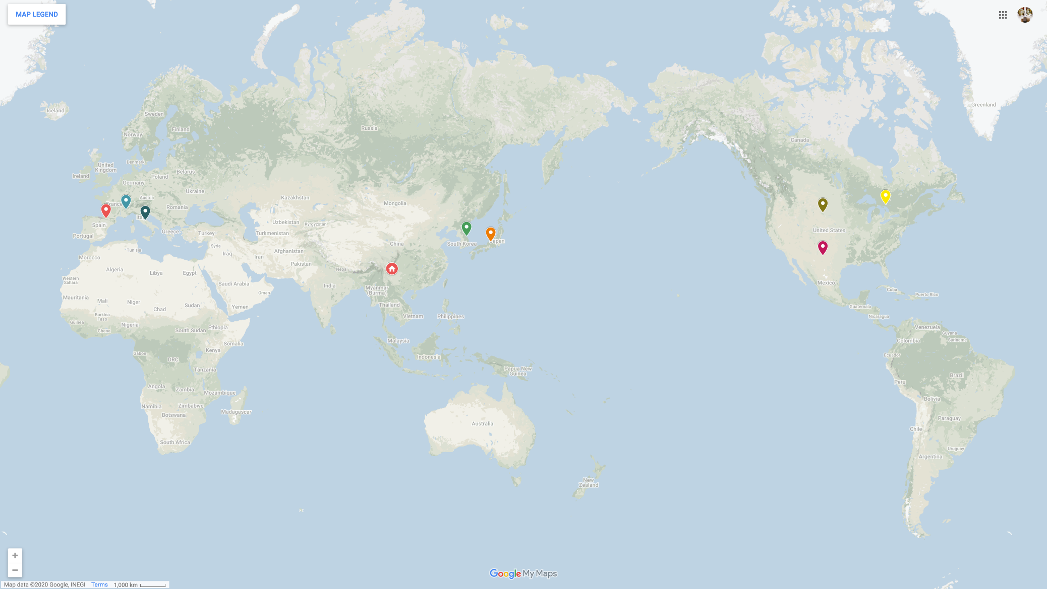
0𝜈𝛽𝛽 experiments
CJPL
PandaX, CDEX
CUPID-China, NvDEX
Y2L
AMoRE
Kamioka
KamLAND-Zen
CANDLES
CUORE (2024)
¹³⁰TeO₂, T_{1/2}>3.8×10²⁵ yr
GERDA (2020)
⁷⁶Ge, T_{1/2}>1.8×10²⁶ yr
Kamland-Zen (2024)
¹³⁶Xe, T_{1/2}>3.8 ×10²⁶ yr
LNGS
CUORE
GERDA
LEGEND
SNOLAB
SNO+
(nEXO)
Canfranc
NEXT
Modane
SuperNEMO
WIPP
EXO-200
SURF
Majorana

Slide 7
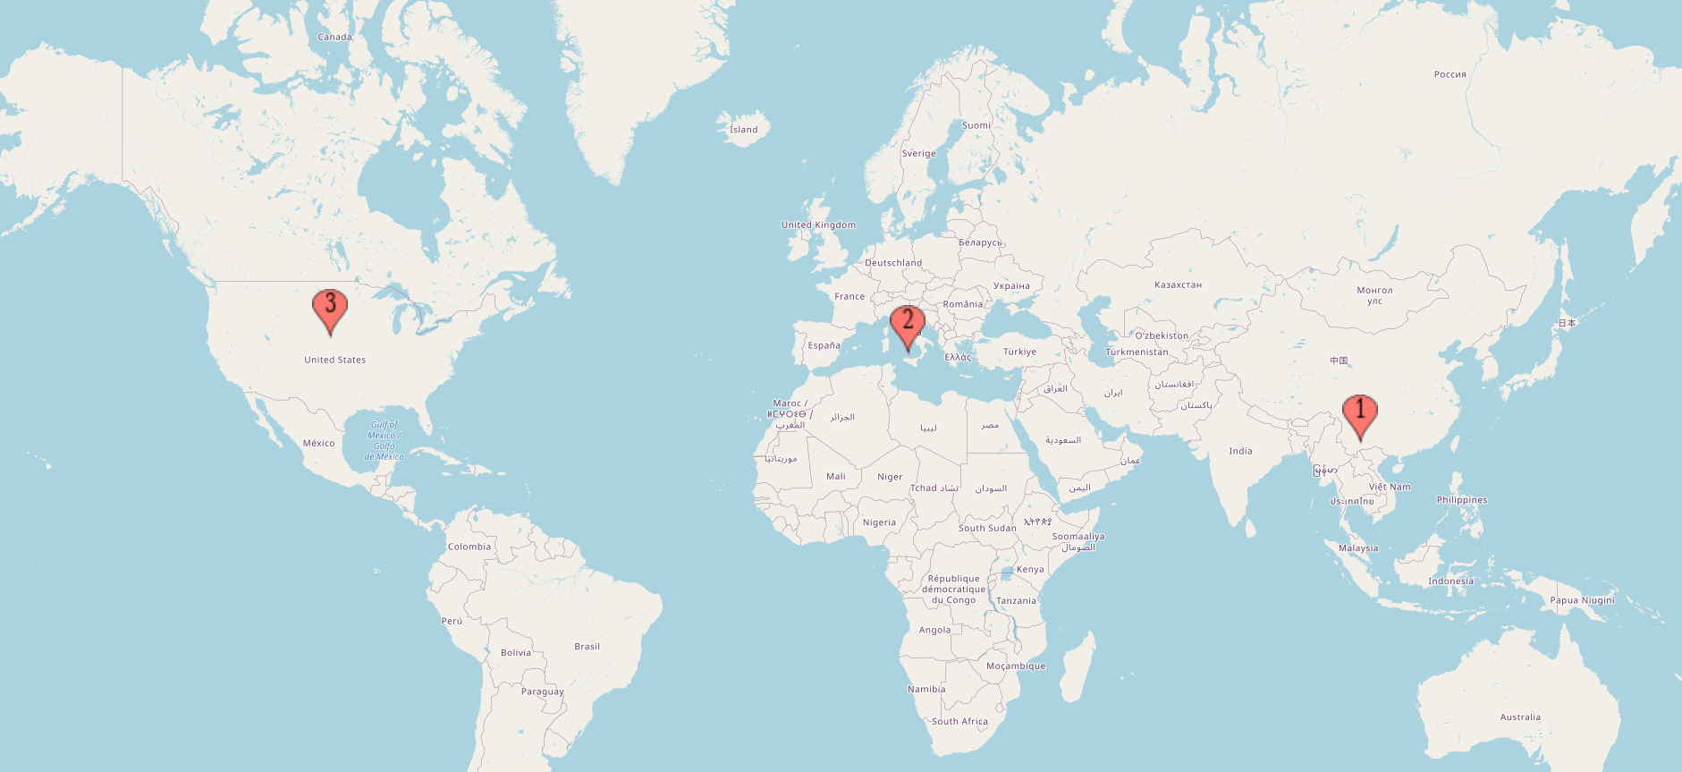
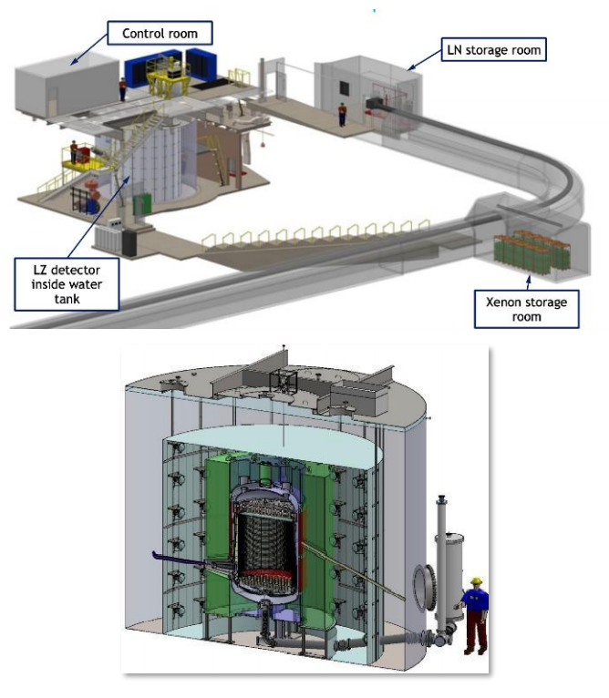
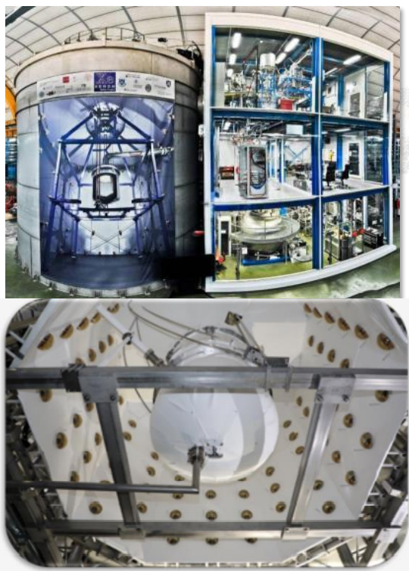
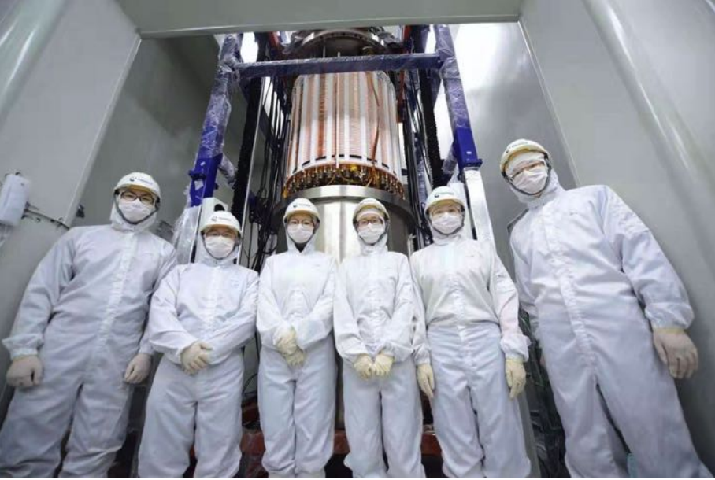
The big three xenon DM experiments
Multi-ton natural xenon experiments for DM search
LZ
XENON
PandaX

Slide 8
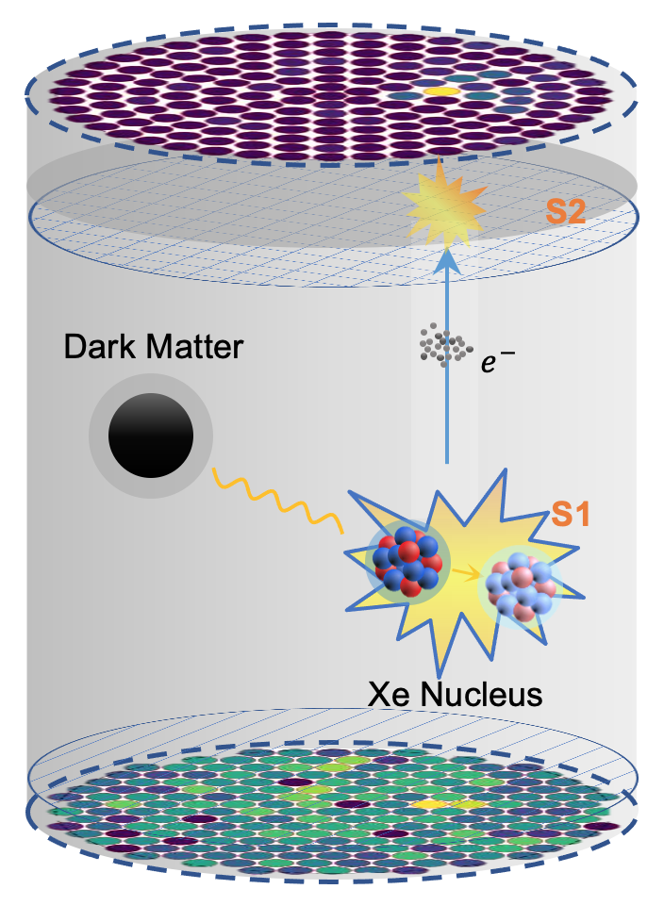
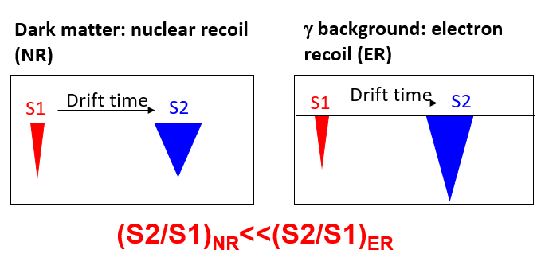
PandaX: Particle and Astrophysical Xenon Observatory
PandaX: Particle and Astrophysical Xenon Observatory
  Incoming DM scattering off xenon atom (nucleus or electrons)
TPC: paired scintillation (S1) and ionization (S2) signals
  Precise energy measurement
  3D position reconstruction
  Discrimination between nuclear recoil and electron recoil signals
Dual-phase xenon TPC

Slide 9
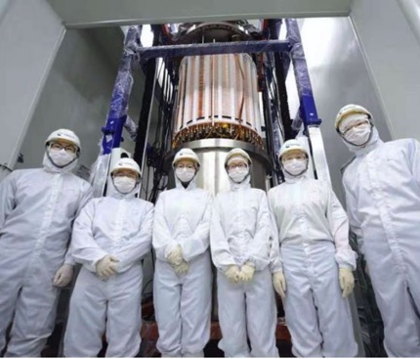
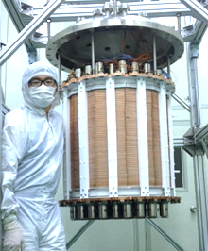
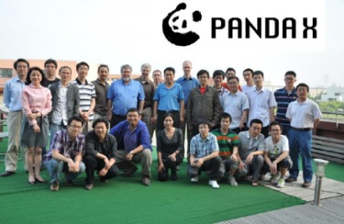
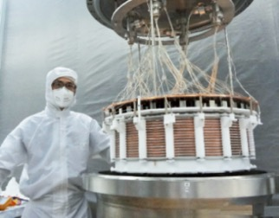
PandaX Detectors
Increasing the detector sensitive target volume
Lowering radioactive background
PandaX-4T
(3.7 tonne)
PandaX-II 580kg
PandaX-I 120kg
PandaX start
2009
2010-2014
2015-2019
2020-

Slide 10
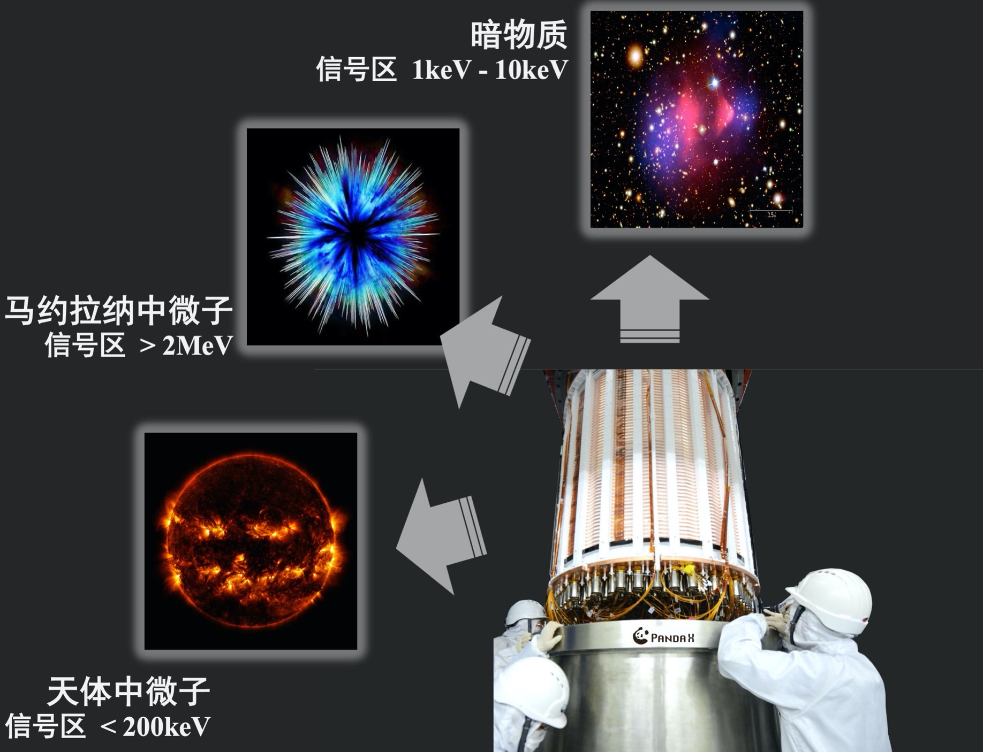
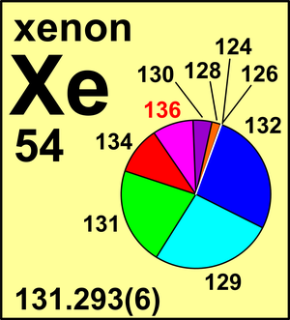
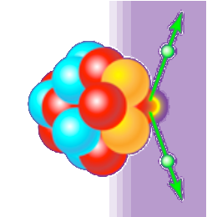
PandaX-4T experiment
Dark Matter
1 keV – 10 keV
Third generation of the PandaX experiments located at CJPL-II
A multi-ton dual phase xenon TPC at CJPL
  Dual-phase Xe TPC: 1.2 m (D) ×1.2 m (H)
  Sensitive volume: 3.7 ton LXe
  Total volume: 5.6 ton LXe
Commissioned since late 2020
Run 0 (∼ 95 d)+Run 1 (∼ 154 d)
Majorana neutrino
> 2 MeV
Astrophysics neutrino < 300 keV

Slide 11
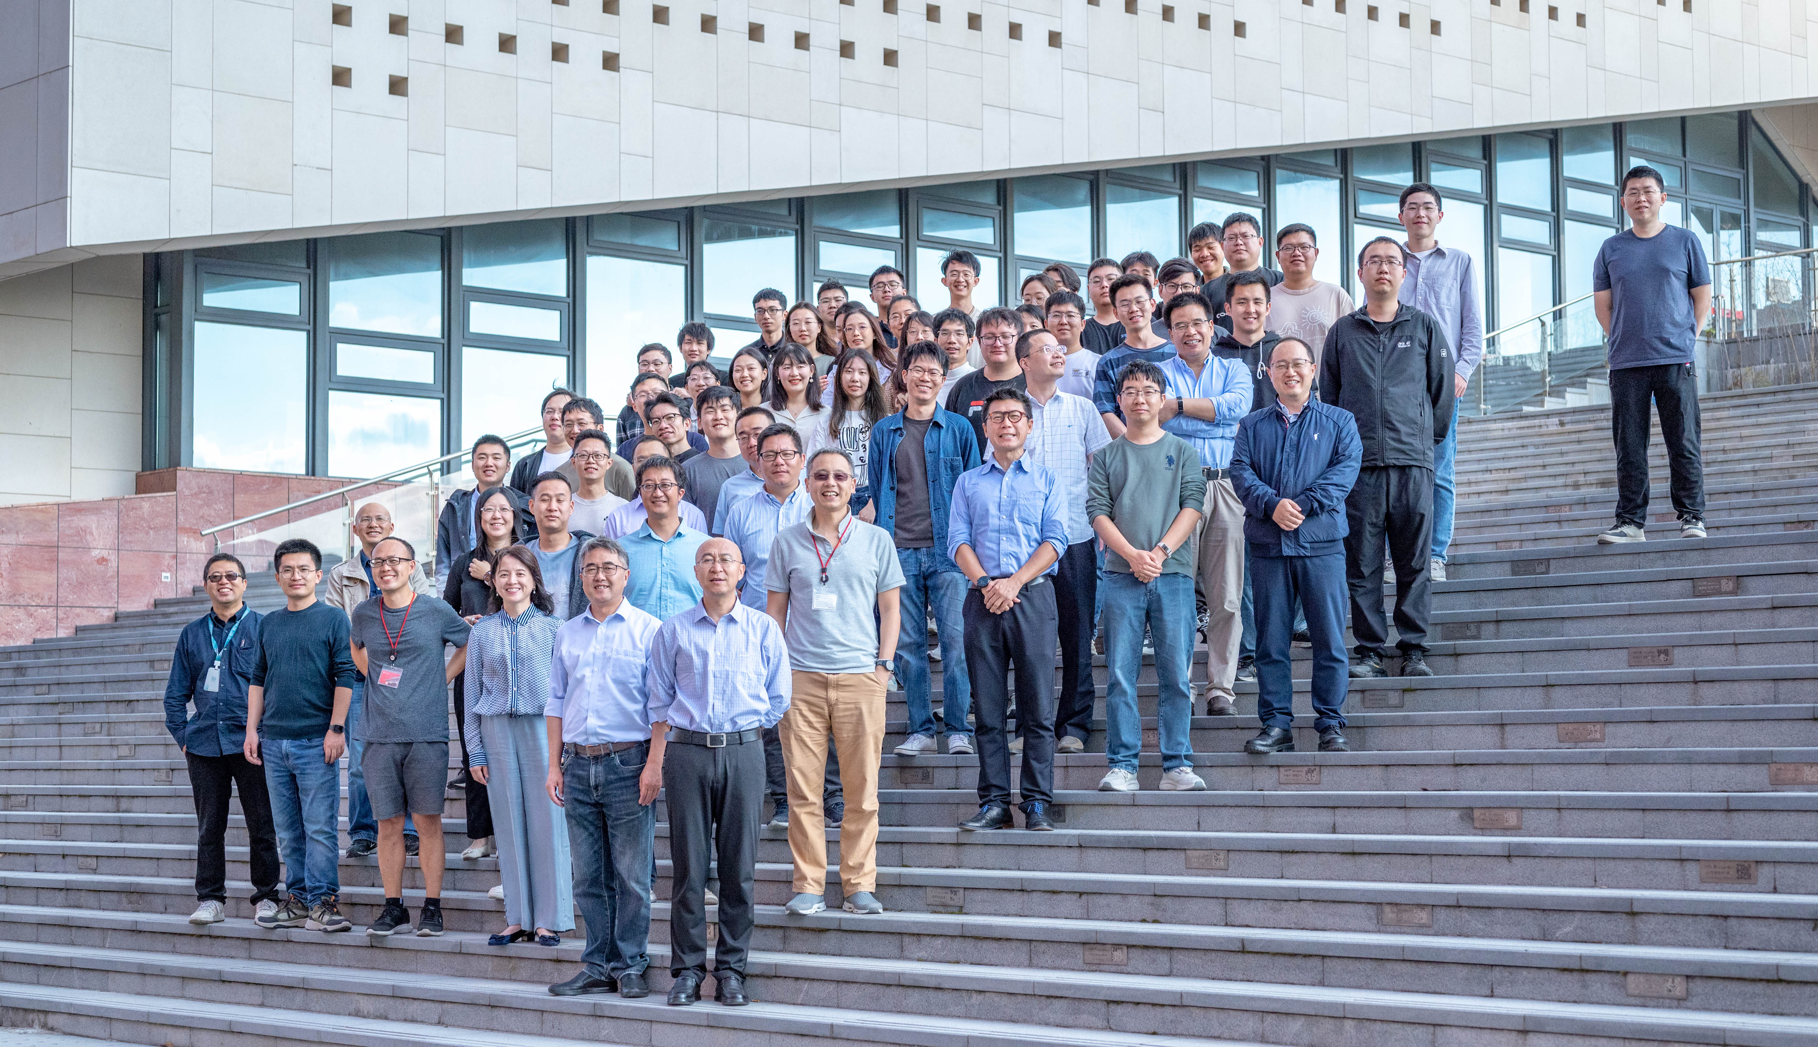

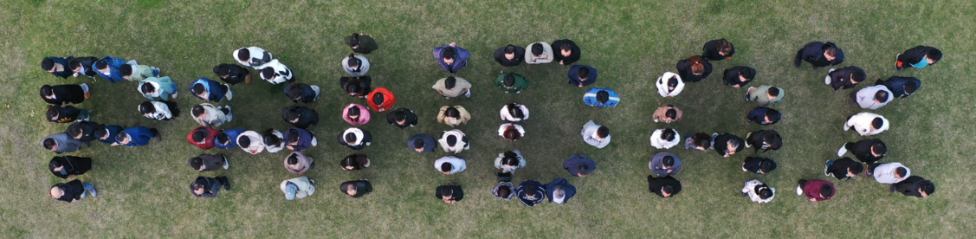
15 institutions and ~100 members

Slide 12
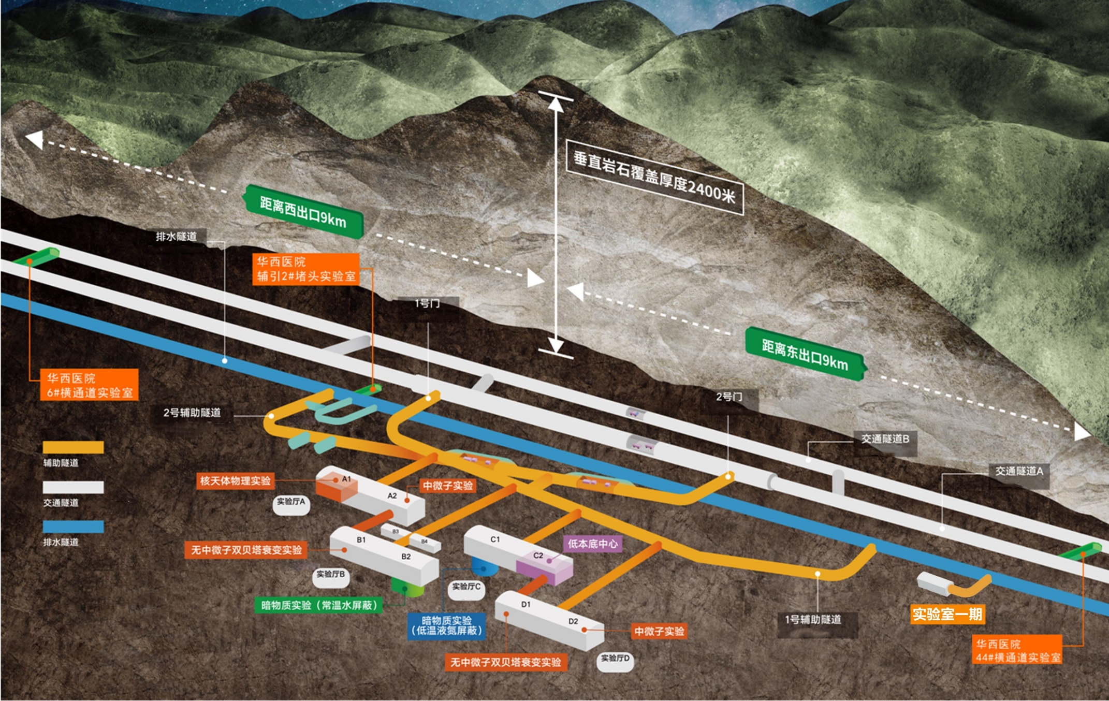
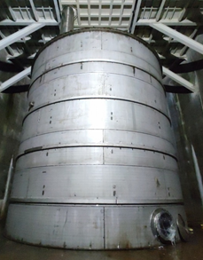
PandaX-4T @ CJPL-II B2

Slide 13

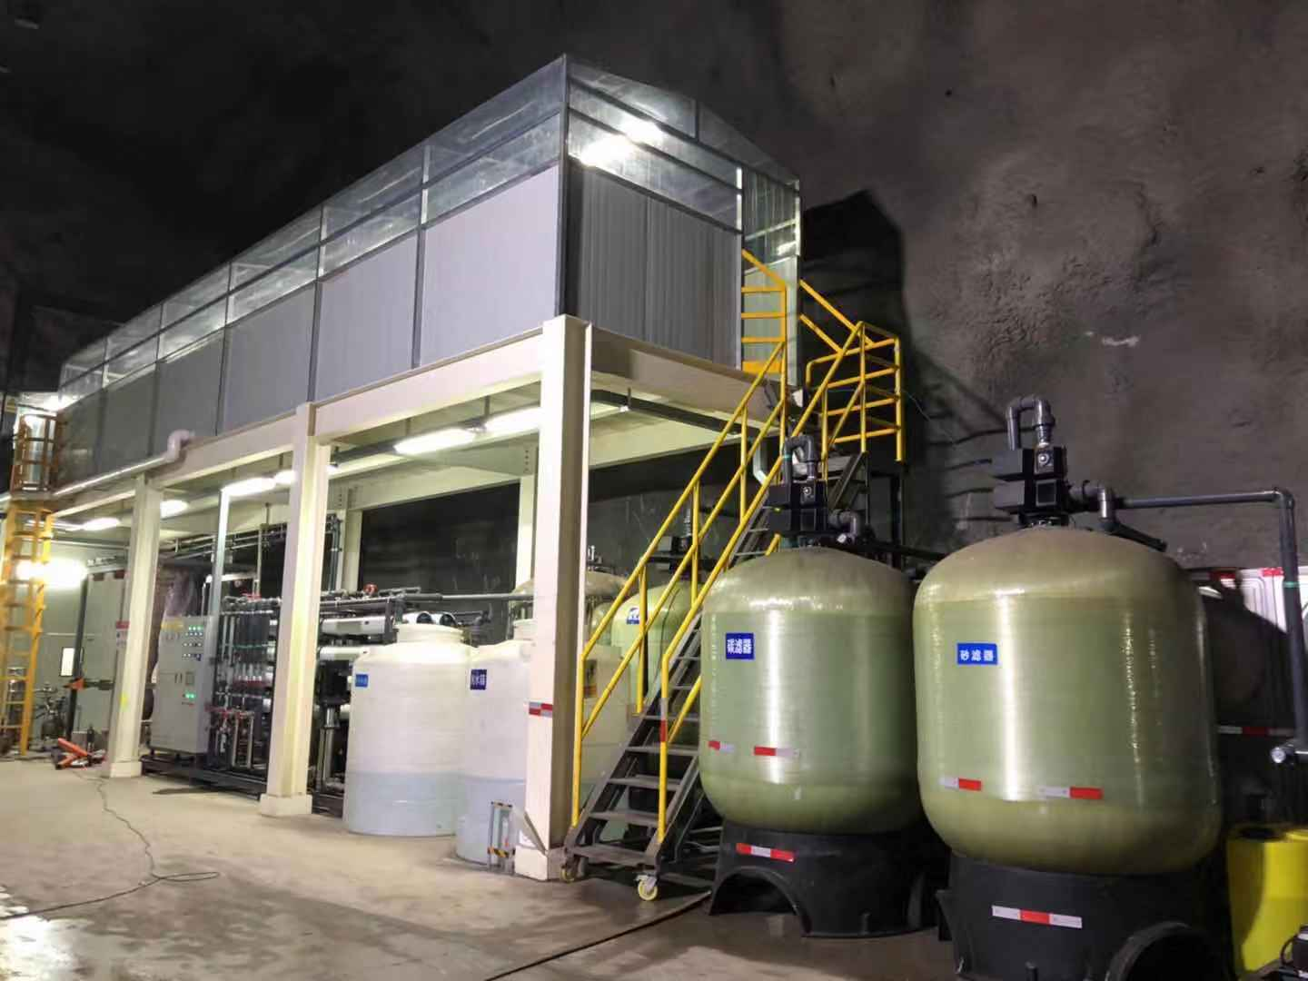
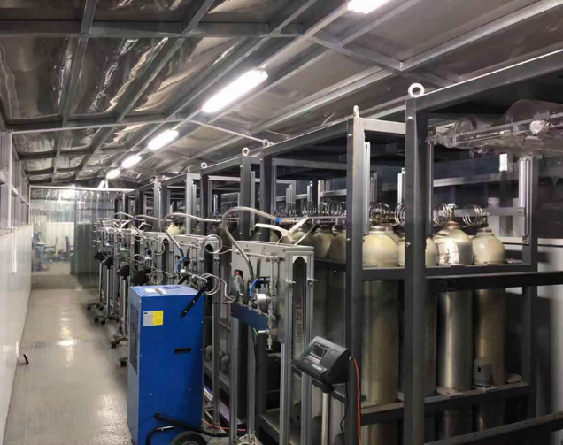
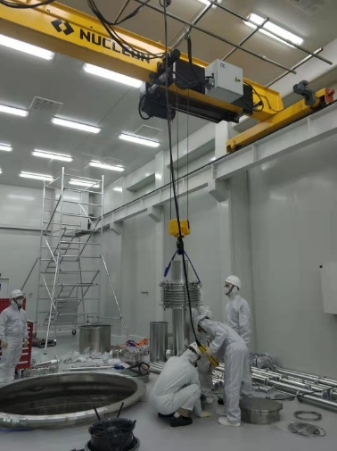
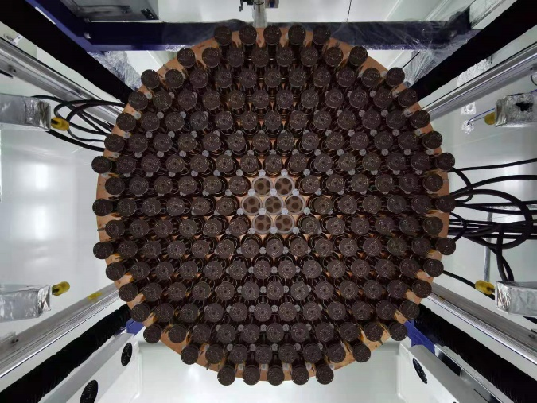
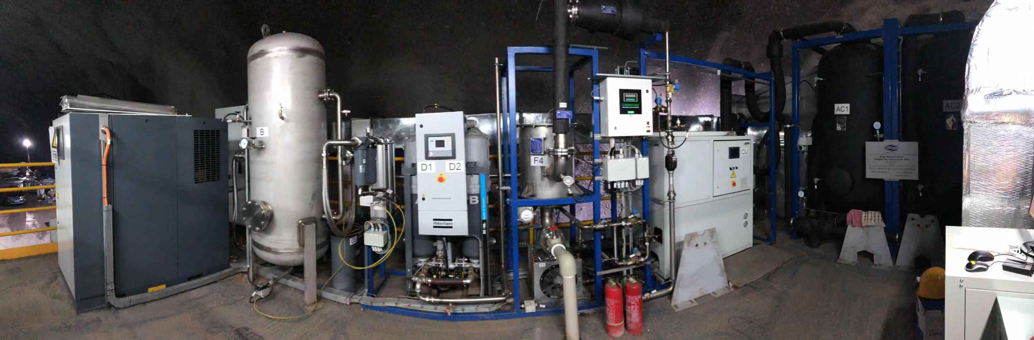
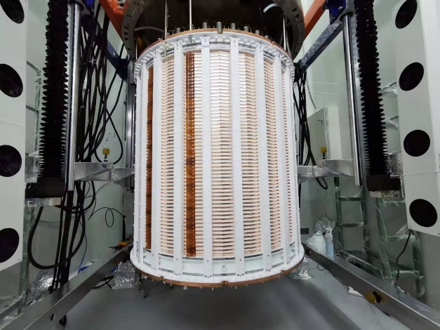
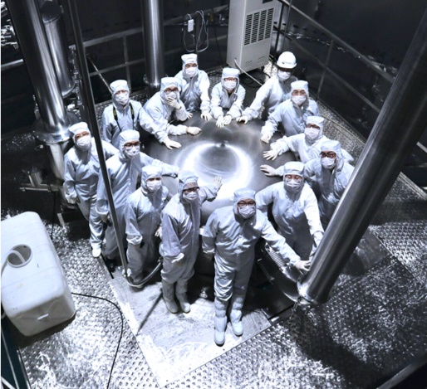
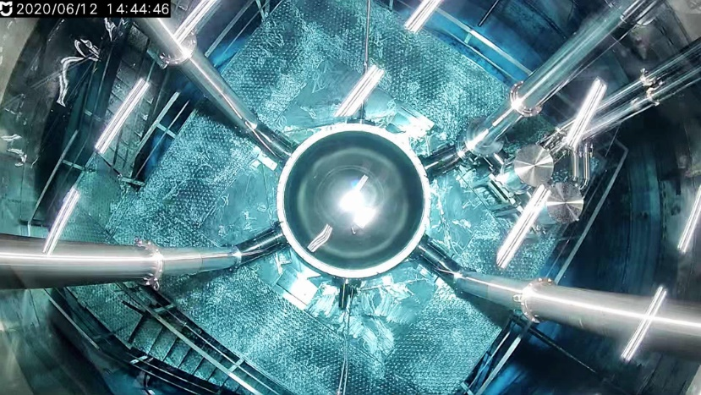
PandaX-4T @ CJPL-II B2

Slide 14
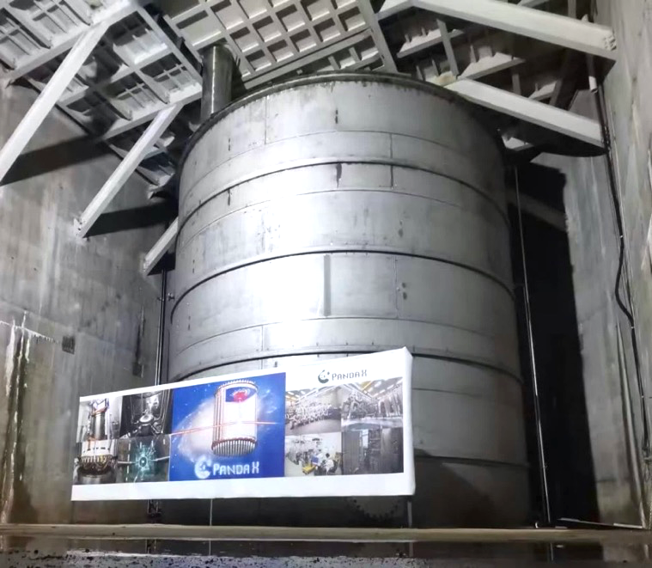
PandaX-4T Physics Run
2020/11 – 2021/04 | Commissioning (Run 0) 95 days
2021/07 – 2021/10 | Tritium removal xenon distillation, gas flushing, etc.
2021/11 – 2022/05 | Physics run (Run 1) 164 days
2022/09 – 2023/12 | CJPL B2 hall construction xenon recuperation, detector upgrade
Current Status | Run2 physics data-taking

Slide 15
Multiple physics in a wide energy range
 | Sub-keV | 1 keV | 10 keV | 100 keV | 1 MeV | 10 MeV
Xe-136 (~9%)
Xe-134 (~10%)
Xe-124 (~0.1%)
Xe all isotopes
2νββ / 0νββ
2νββ / 0νββ
2νECEC
⁸B solar ν and light DM
WIMP and other DM models
solar pp ν
This talk

Slide 16
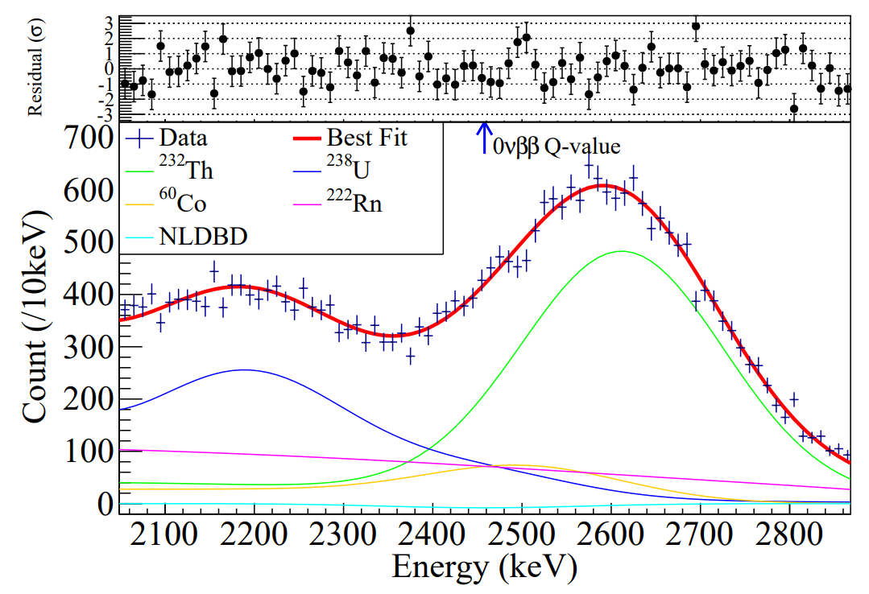
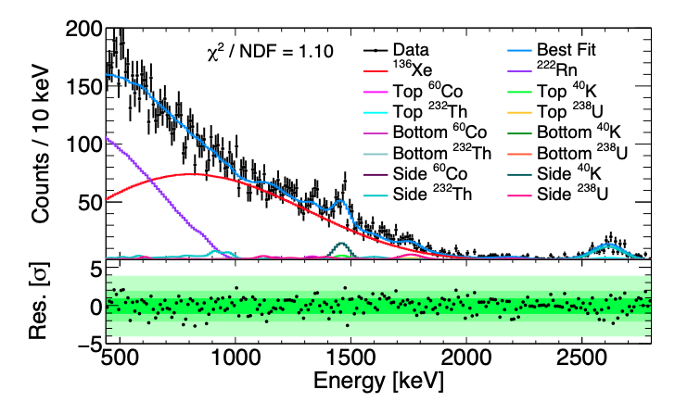
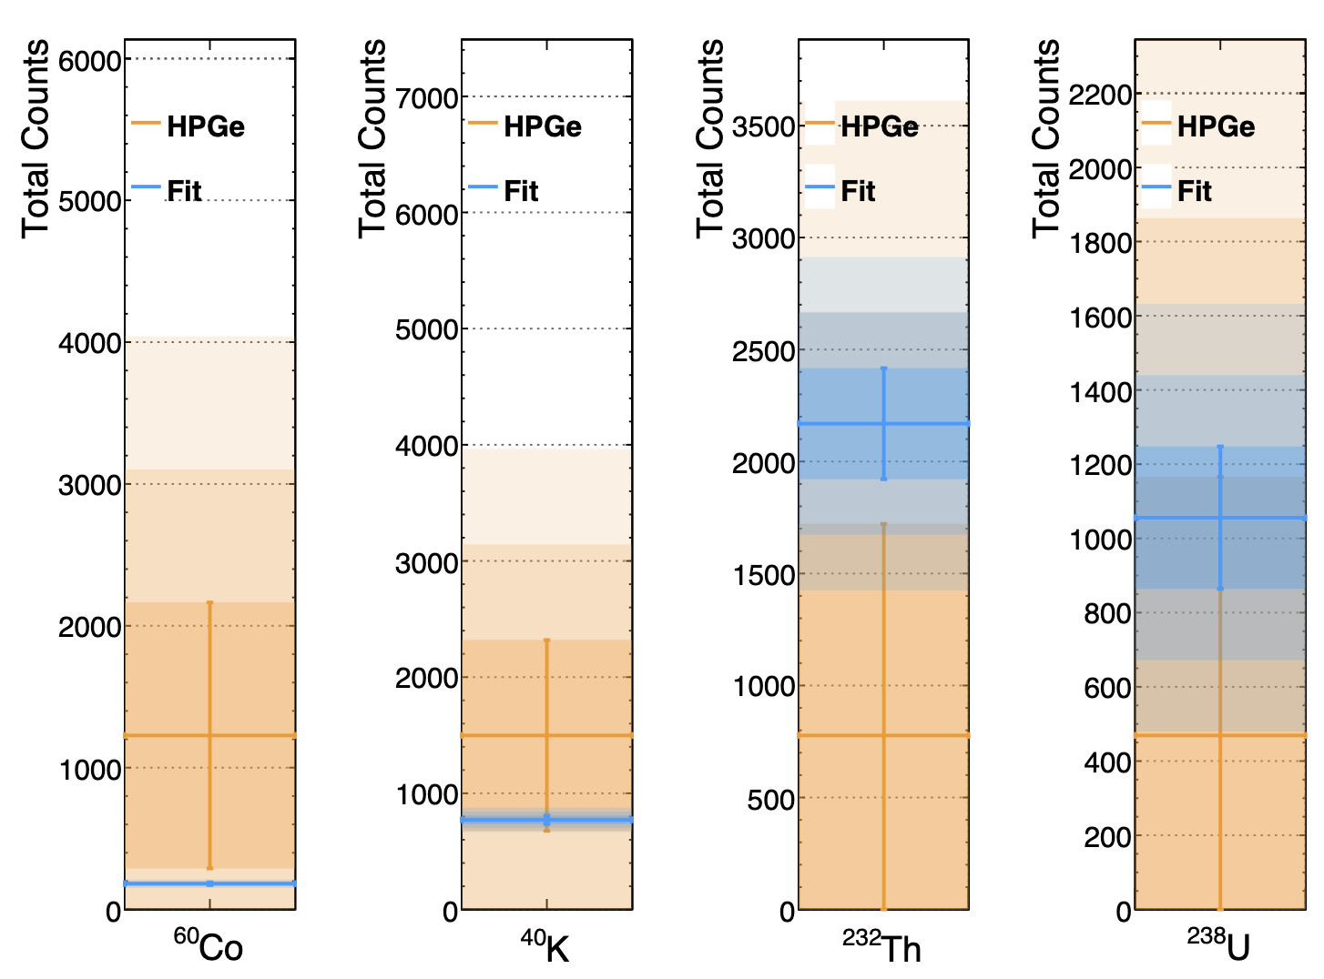

¹³⁶Xe 0𝜈𝛽𝛽 search in PandaX experiment
$$^{136}Xe→ ^{136}Ba+2e^{−}+?ν$$
¹³⁶Xe 0𝜈𝛽𝛽 search by PandaX-II:
580kg natural xenon+403.1 day DM data
First ¹³⁶Xe 0𝜈𝛽𝛽 search from a DM detector (2.4×10²³yr)
Verified feasibility and potential of DM detector for 0𝜈𝛽𝛽 search
PandaX: CPC 43, 113001 (2019)
PandaX: Research 2022 (2022) 9798721
¹³⁶Xe 2𝜈𝛽𝛽 half-life measured by PandaX-4T: 2.27 ± 0.03(stat.) ± 0.10(syst.) × 10²¹ yr
Comparable precision with leading results
First such measurement from a DM detector with natural xenon
440 keV – 2800 keV range is the widest ROI
Material, “Side” category

Slide 17
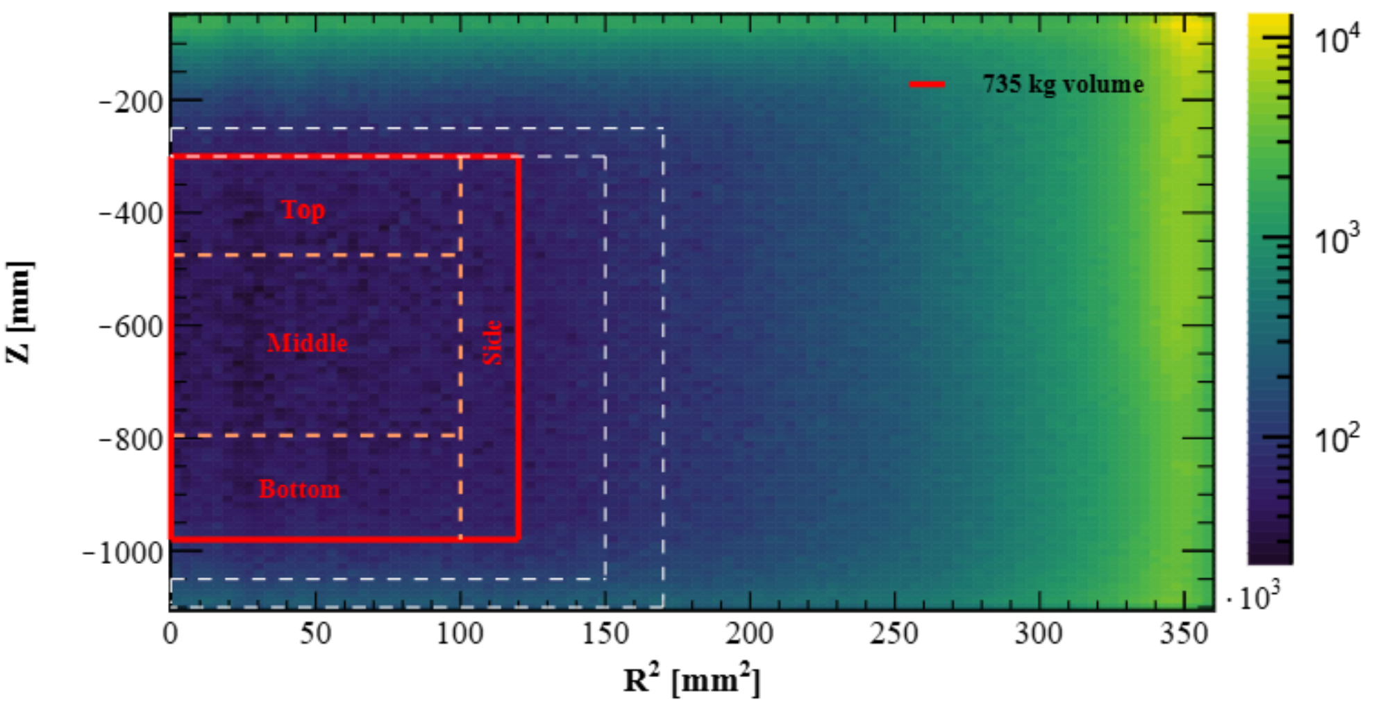
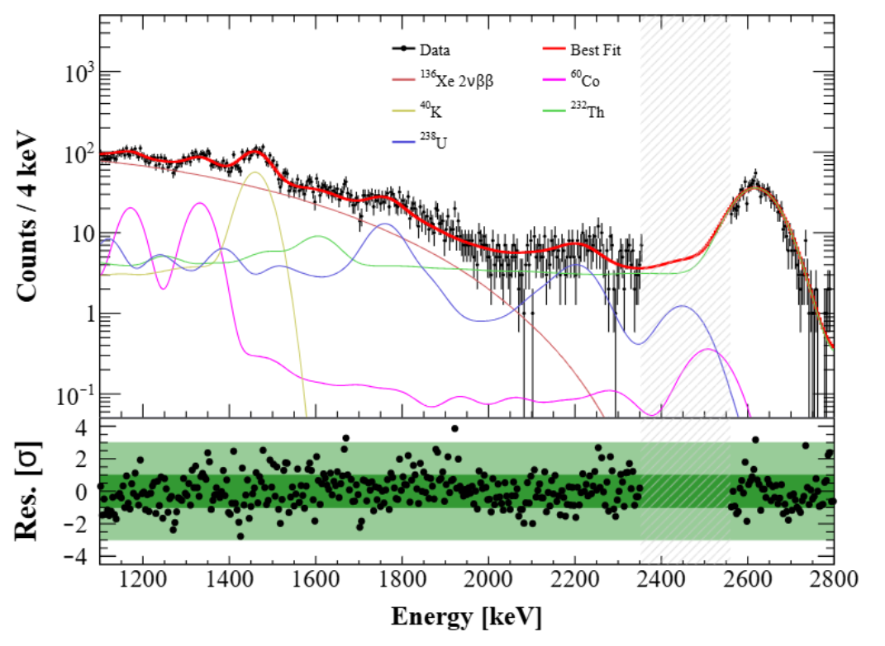
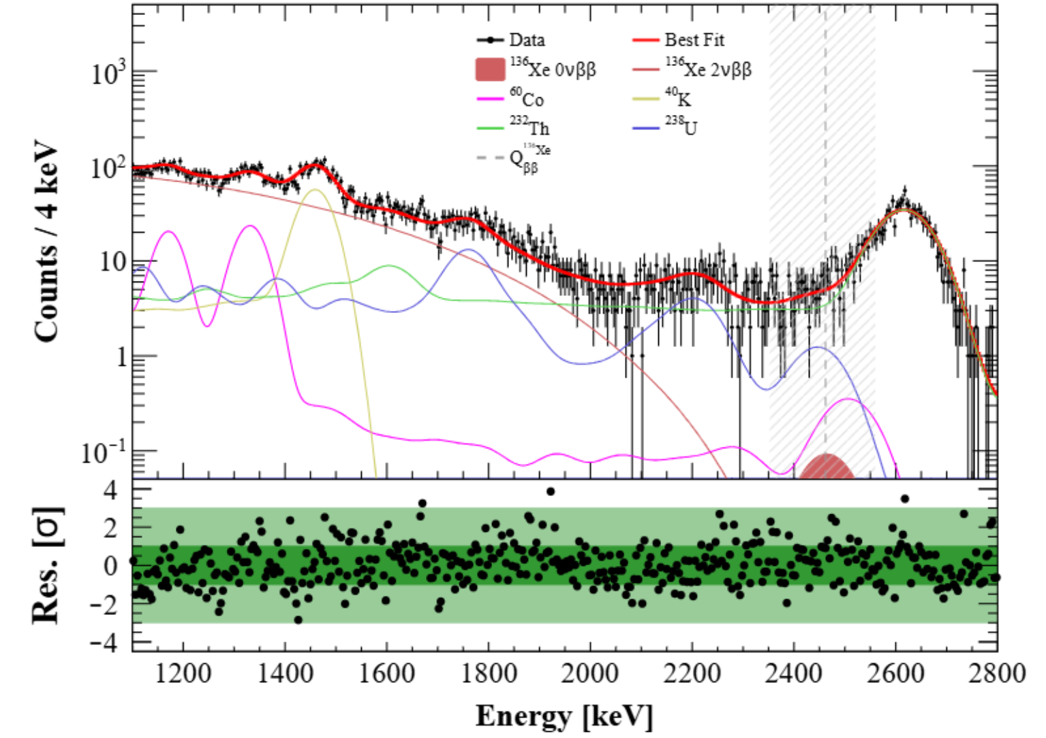
¹³⁶Xe 0𝜈𝛽𝛽 search in PandaX-4T
Run0+Run1 (~250 days’ data) blind analysis
735 kg FV in the center
The region outside the FV for detector response study
Unblind fitted counts 14±55 ton⁻¹ yr⁻¹ , lower limit (preliminary): >2.1×10²⁴ yr @90% CL
preliminary
Blinded
Unblinding
preliminary
preliminary
Unblind fitted result is consistent with the projected sensitivity within 1.1 σ

Slide 18
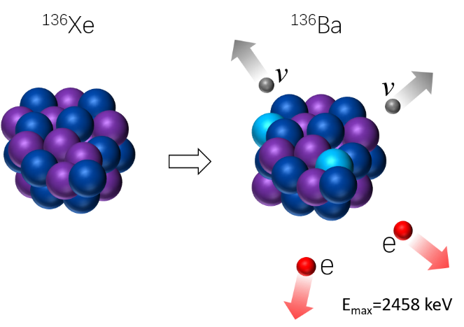

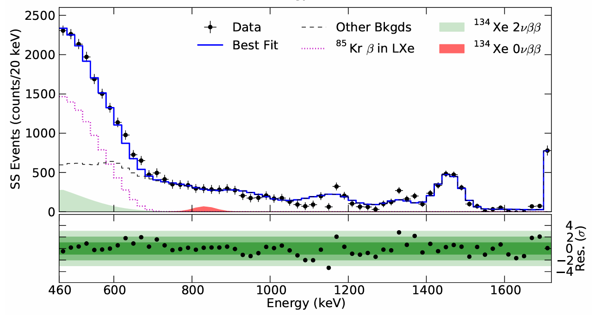

¹³⁴Xe 2𝜈𝛽𝛽 and 0𝜈𝛽𝛽
¹³⁴Xe
¹³⁴Ba
Double beta decay of ¹³⁴Xe into ¹³⁴Ba:
Q-value is 825.8±0.9 keV
Half-life from theoretical predictions: ~10²⁴ yr
Best experiment limits from EXO-200 with 29.6 kg∙𝑦𝑟 data of ¹³⁴Xe :
  $T_{1/2}^{2νββ}>8.7∙1020 yr$ at 90% CL
  $T_{1/2}^{0νββ}>1.1∙1023 yr$ at 90% CL
Isotopic composition in EXO-200 : 80.7% ¹³⁶ Xe and 19.1% ¹³⁴Xe
Energy spectrum: ROI between 460 keV and 740 keV for 2𝜈𝛽𝛽, energy resolution 𝜎/𝐸=3.56% @825.8 𝑘𝑒𝑉
E_{max}=825.8 keV
Phys.Rev.D 96 (2017) 9, 092001

Slide 19
¹³⁴Xe 2𝜈𝛽𝛽 and 0𝜈𝛽𝛽 search in PandaX-4T
PandaX-4T: more ¹³⁴Xe; much less ¹³⁶Xe; wider energy range; self shielding effect; potential discovery
 | ¹³⁴Xe mass | ¹³⁶Xe abundance | Analysis threshold | Live Time
PandaX-4T | 68.7 kg | 8.9% | 200 keV | 94.9 days
EXO-200 | 18.1 kg | 81% | 470 keV | 600 days
470 keV
200 keV

Slide 20
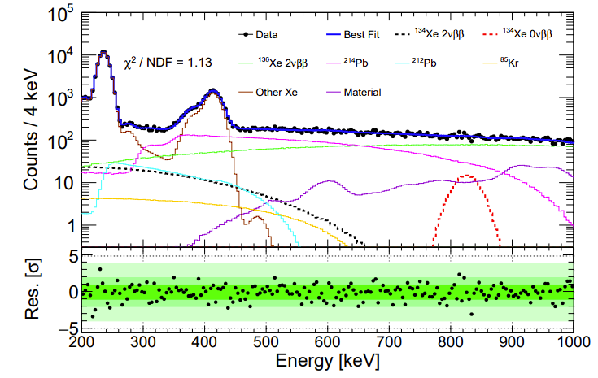
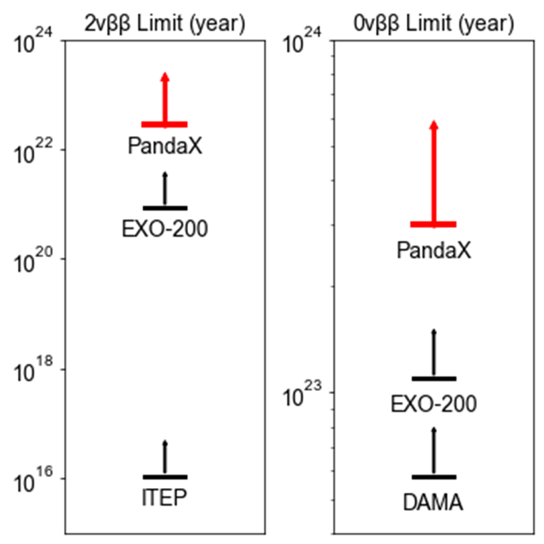
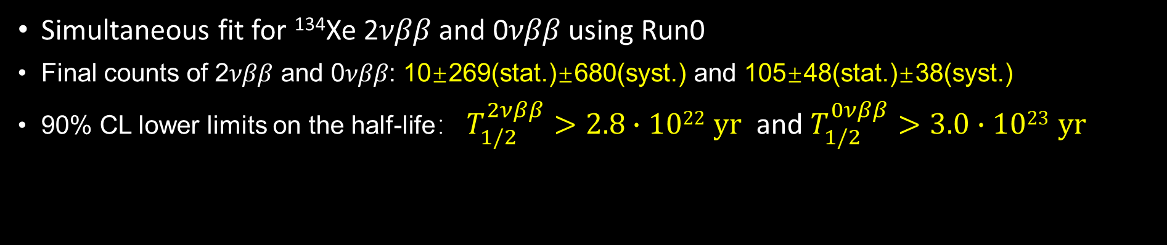
¹³⁴Xe half-life limits @ PandaX-4T
Simultaneous fit for ¹³⁴Xe 2𝜈𝛽𝛽 and 0𝜈𝛽𝛽 using Run0
Final counts of 2𝜈𝛽𝛽 and 0𝜈𝛽𝛽: 10±269(stat.)±680(syst.) and 105±48(stat.)±38(syst.)
90% CL lower limits on the half-life： $T_{1/2}^{2νββ}>2.8∙1022 yr$ and $T_{1/2}^{0νββ}>3.0∙1023 yr$
PandaX: Phys.Rev.Lett. 132 (2024) 15, 152502

Slide 21
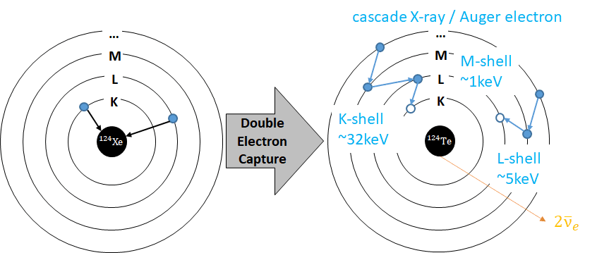
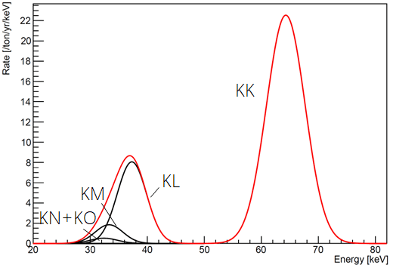
¹²⁴Xe 2νECEC half-life measurement
2ν/0ν ECEC
  Q = 2857 keV
  Auger electron & X-ray cascades SS events
2νECEC is a 2nd order weak process, with a longest measured half-life so far
XENONnT: T_{1/2} = (1.18 ± 0.13_{stat} ± 0.14_{sys}) × 10²² yr
[PRL 129, 161805 (2022)]
LZ: T_{1/2} = (1.09 ± 0.14_{stat} ± 0.05_{sys}) × 10²² yr
[ ArXiv: 2408.17391 (2024)]

Slide 22
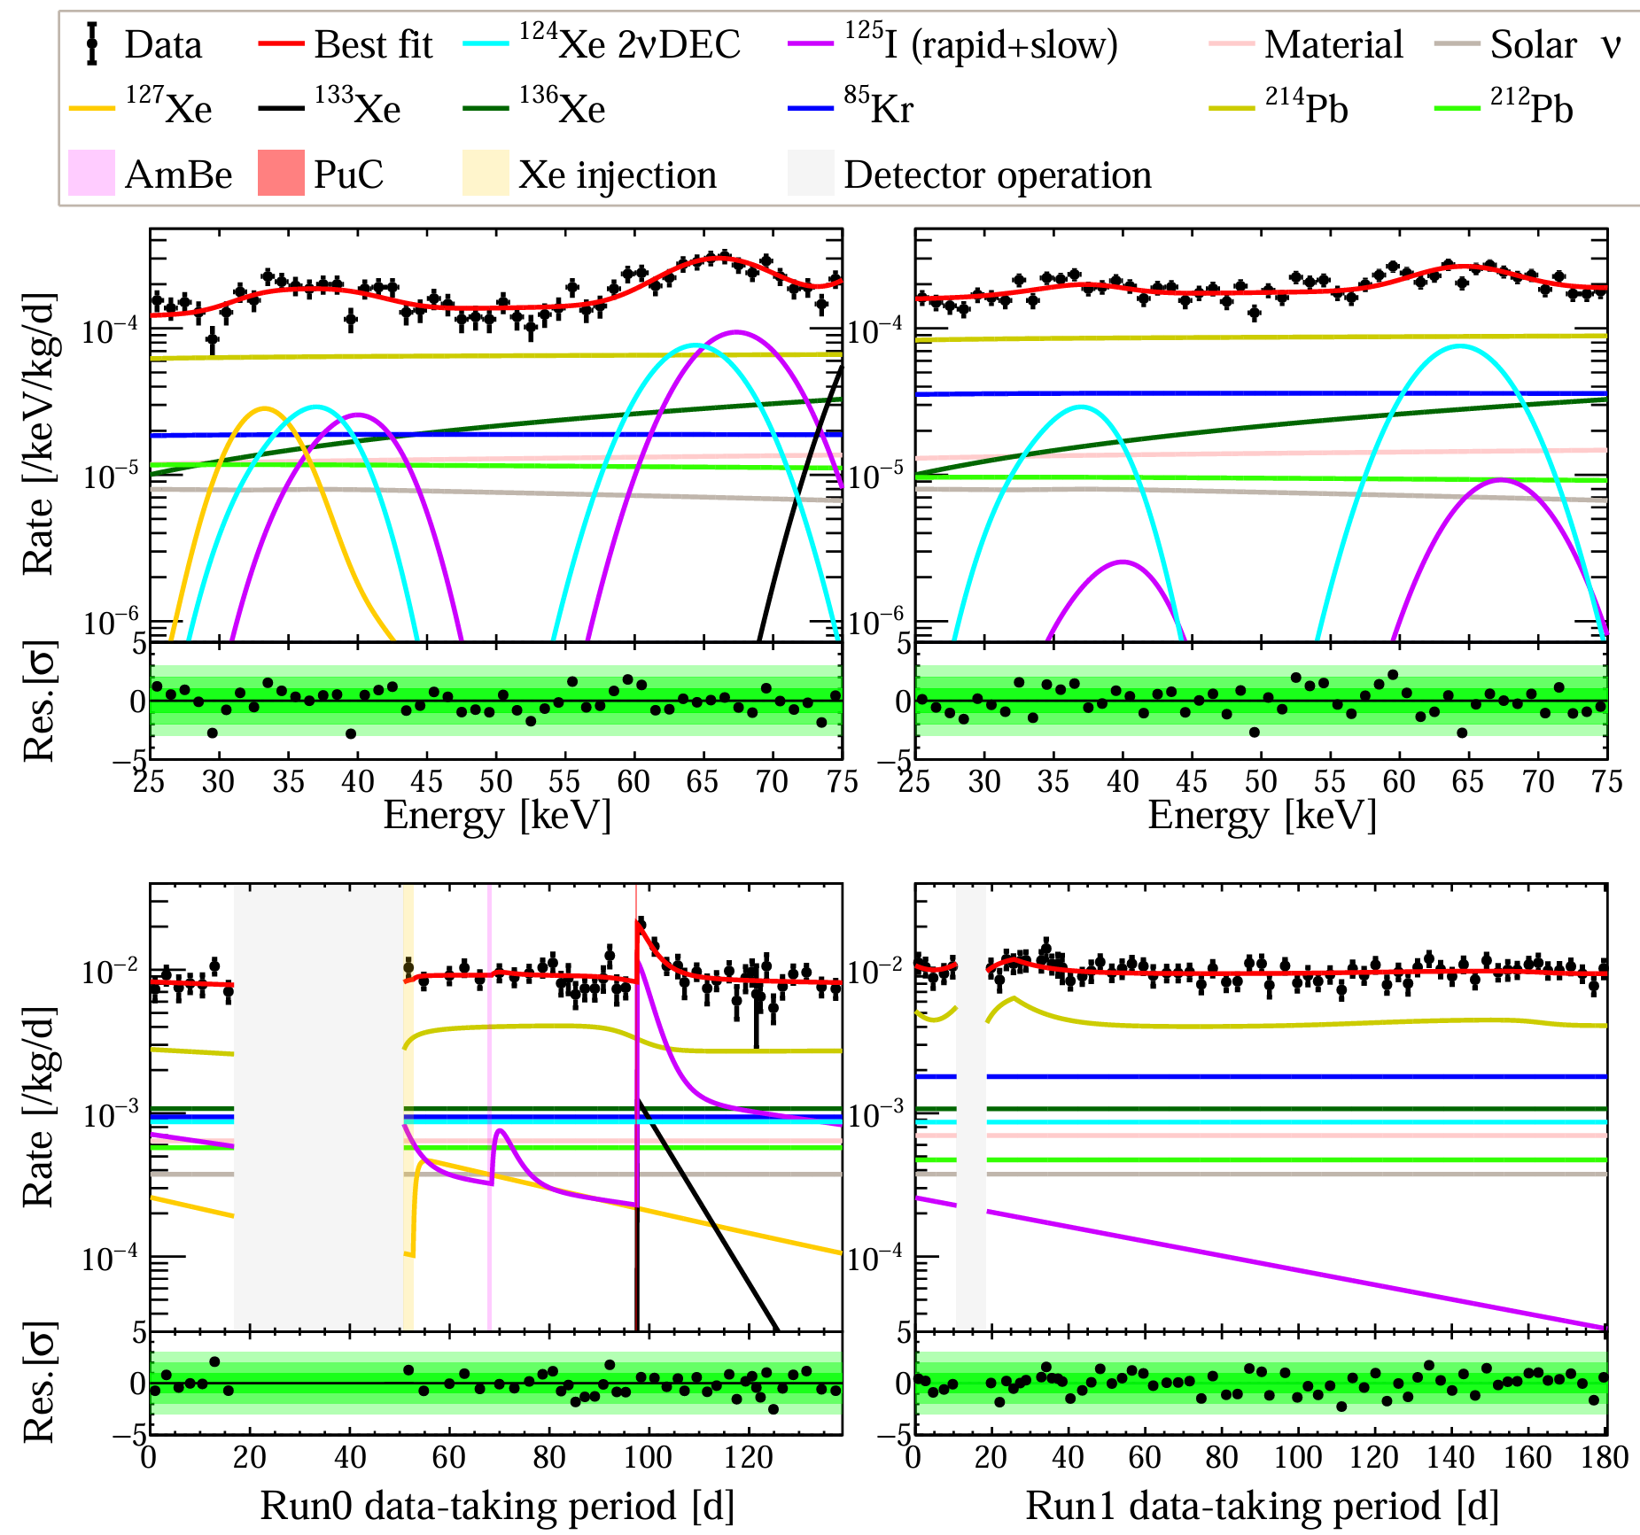

Energy spectrum + time evolution likelihood fit
Unbinned 2D fit to Run0+Run1 data in parameter space of (energy, time)
Measurement on ¹²⁴Xe 2νECEC half-life: 1.03 ± 0.15(stat.) ± 0.06(syst.) × 10²² yr
1.03 ± 0.15(stat.) ± 0.06(syst.) × 10²² yr
PandaX: arXiv 2411.14355 (2024)

Slide 23


Future plan: PandaX-xT
  “Ultimate”liquid xenon experiment, 43-tonne liquid xenon active target
  Projected sensitivity of ¹³⁶Xe 0𝜈𝛽𝛽: > 10²⁷ yr
PandaX: Sci.China Phys.Mech.Astron. 68 (2025) 2, 221011

Slide 24

Summary
PandaX-4T has extended the energy range from keV to MeV, and therefore extended the physics reach from dark matter to double weak decays
¹³⁶Xe 2𝜈𝛽𝛽 half-life is precisely measured (2.27 ± 0.03(stat.) ± 0.10(syst.) × 10²¹ yr) for the first time by a natural xenon detector
Limits for ¹³⁴Xe 2𝜈𝛽𝛽 and 0𝜈𝛽𝛽 with 17.9 kg·yr exposure : $T_{1/2}^{2νββ}>2.8∙1022 yr$ and $T_{1/2}^{0νββ}>3.0∙1023 yr$ at 90% CL
¹²⁴Xe 2𝜈ECEC half-life measurement: 1.03 ± 0.15(stat.) ± 0.06(syst.) × 10²² yr
Preliminary result of ¹³⁶Xe 0𝜈𝛽𝛽: $T_{1/2}^{0νββ}$>2.1×10²⁴ yr
PandaX-xT is under R&D
Thanks！

Slide 25

Systematic uncertainties
  Contributions from target mass, efficiency, energy reconstruction and background are included in the likelihood function as Gaussian constraint
  Contributions from bin size and energy scale of energy spectrum are evaluated independently
 | Sources | 2𝜈𝛽𝛽 [counts] | 0𝜈𝛽𝛽 [counts]
Statistical |  | 269 | 48
 | Target mass | - | -
 | Efficiency | 119 | 10
 | Energy resolution | - | -
Systematic | Background | 521 | 19
 | Bin size | 85 | 13
 | Energy scale | 410 | 28
 | Total | 680 | 38

Slide 26


Position reconstruction improvement with desaturation
Position reconstruction based on PAF (photon acceptance function) methods developed in DM analysis
Reconstruction at MeV energy range is significantly improved with desaturation
Removed the band structure in R² distribution

