Slide 1
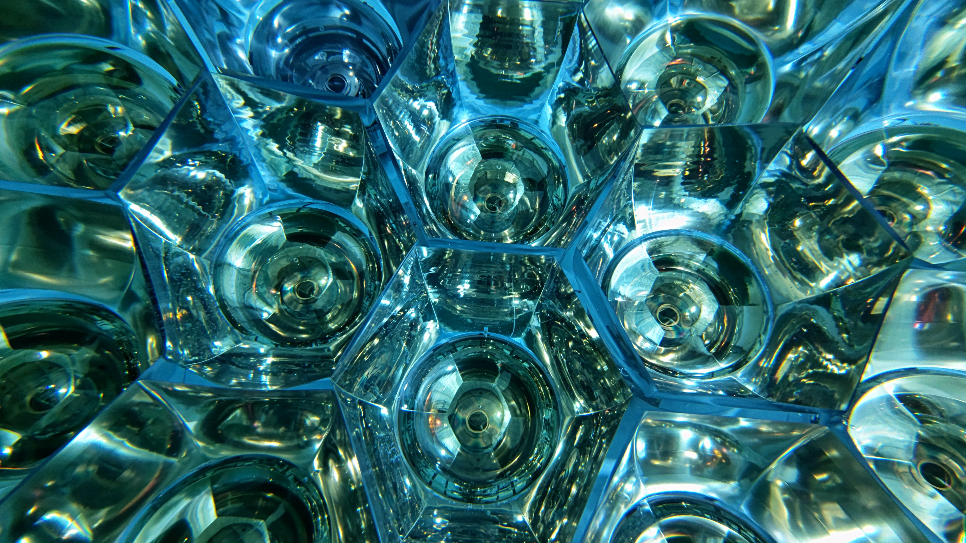
Development of calibration method and performance evaluation for KamLAND2 prototype detector
NuDM-2024
Research Center for Neutrino Science, Tohoku University
Jun Nakane

Slide 2
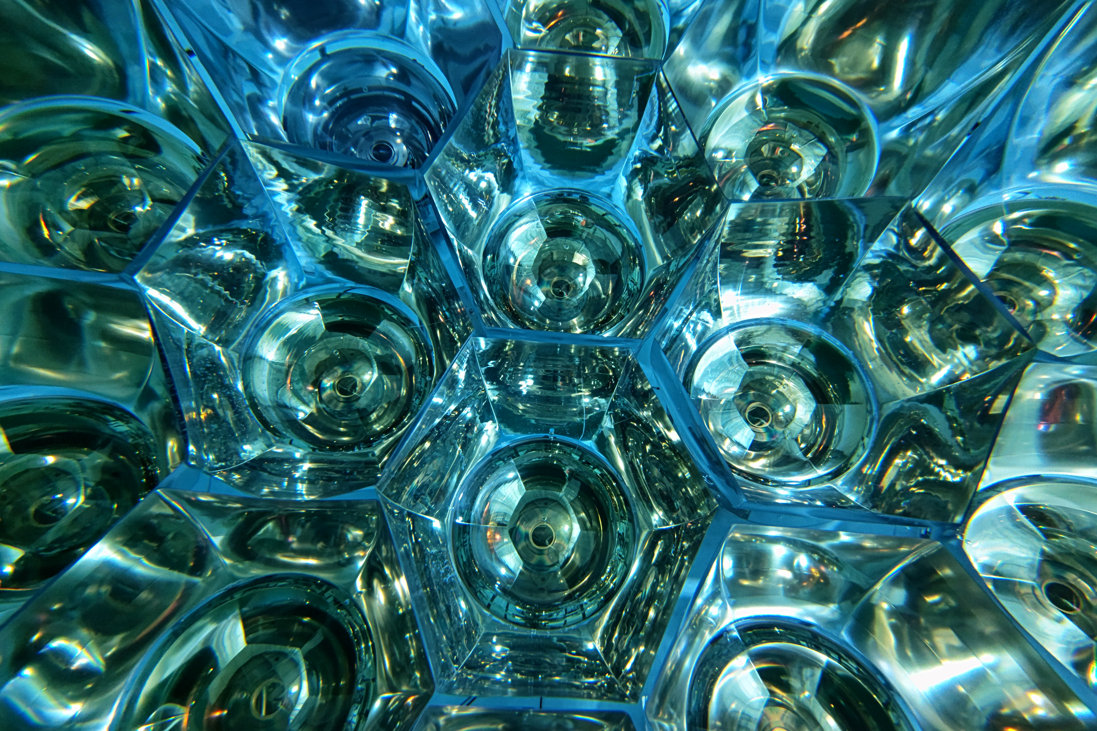
CONTENTS
Motivation
KamLAND2 Prototype Detector
Evaluation of Light Collection Performance of Mirrors
Evaluation of Prototype Detector Total Observed Phototns
Summary
Notes:
The contents of this presentation are as follows

Slide 3
CONTENTS
Motivation
KamLAND2 Prototype Detector
Evaluation of Light Collection Performance of Mirrors
Evaluation of Prototype Detector Total Observed Photons
Summary
Notes:
First, let me talk about the motivation for my research.

Slide 4
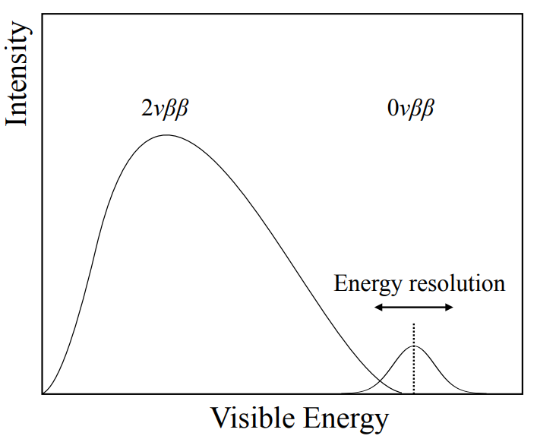
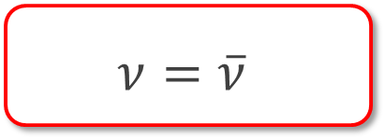

Neutrino-less double beta decay ($0νββ$)
Majorana nature of neutrinos Key component of small neutrino mass matter dominant universe
Neutrino-less double beta decay ($0νββ$)
・ $0νββ$ happens only if $ν$ is Majorana particle.
= verifying the Majorana neutrino
・ Requirements for detector: peak search around the Q-value High light emission & light yield background reduction
→ KamLAND is a suitable detector
Majorana particle
$$ν=\overline{ν}$$
Q
Notes:
Neutrinos may be Majorana particles, meaning they are their own antiparticles. Due to their unique nature, Majorana particles are considered a key component to understanding the small neutrino mass and the matter-dominated universe.
Neutrinoless double-beta decay (0νββ) happens only if neutrino is Majorana particle, so this is the only way to verify this property. A detector searching for 0νββ must meet the following requirements. KamLAND is a suitable detector for these.

Slide 5

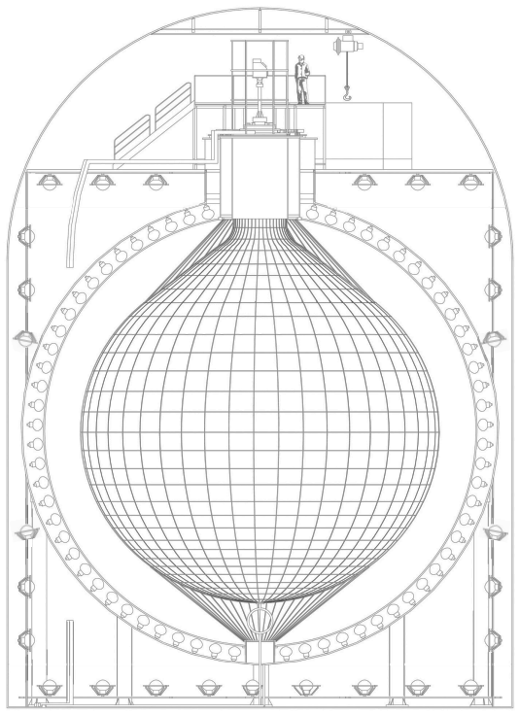
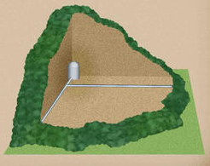
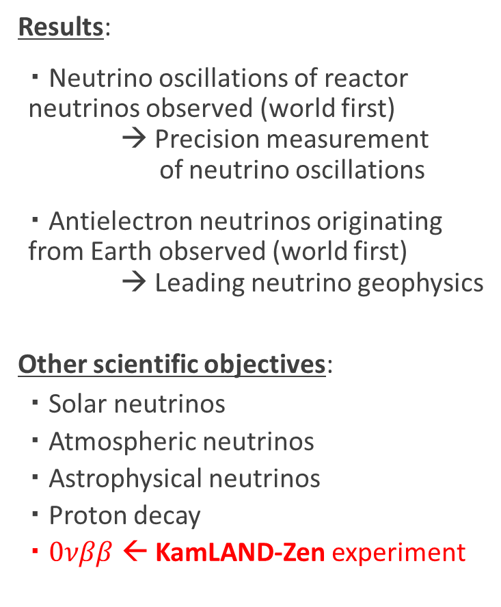
KamLAND
KamLAND: The Kamioka Liquid-scintillator Anti-Neutrino Detector
Advantage: Extremely low-radioactivity + Large & high-sensitivity → Ideal detector for rare decay search!
Results:
・ Neutrino oscillations of reactor neutrinos observed (world first) → Precision measurement of neutrino oscillations
・ Antielectron neutrinos originating from Earth observed (world first) → Leading neutrino geophysics
Other scientific objectives:
・ Solar neutrinos
・ Atmospheric neutrinos
・ Astrophysical neutrinos
・ Proton decay
・ $0νββ$ ← KamLAND-Zen experiment
@Kamioka
PMTs
1,879
LS
1,000 [t]
1000 [m]
13 [m]
Notes:
KamLAND is located 1,000 meters underground in a mountain in Kamioka, Japan. This inner detector contains about 1,000 tons of purified liquid scintillator and is equipped with about 2,000 PMTs. The advantages of this detector include extremely low background radiation due to the surrounding rock and the purification of the LS, as well as its high sensitivity enabled by its large LS volume. Therefore, KamLAND is an ideal detector for rare decay search.
Indeed, the KamLAND experiment has achieved various results and had scientific objectives. Among these, this presentation will focus on the KamLAND-Zen experiment, which aims to search for 0νββ.

Slide 6
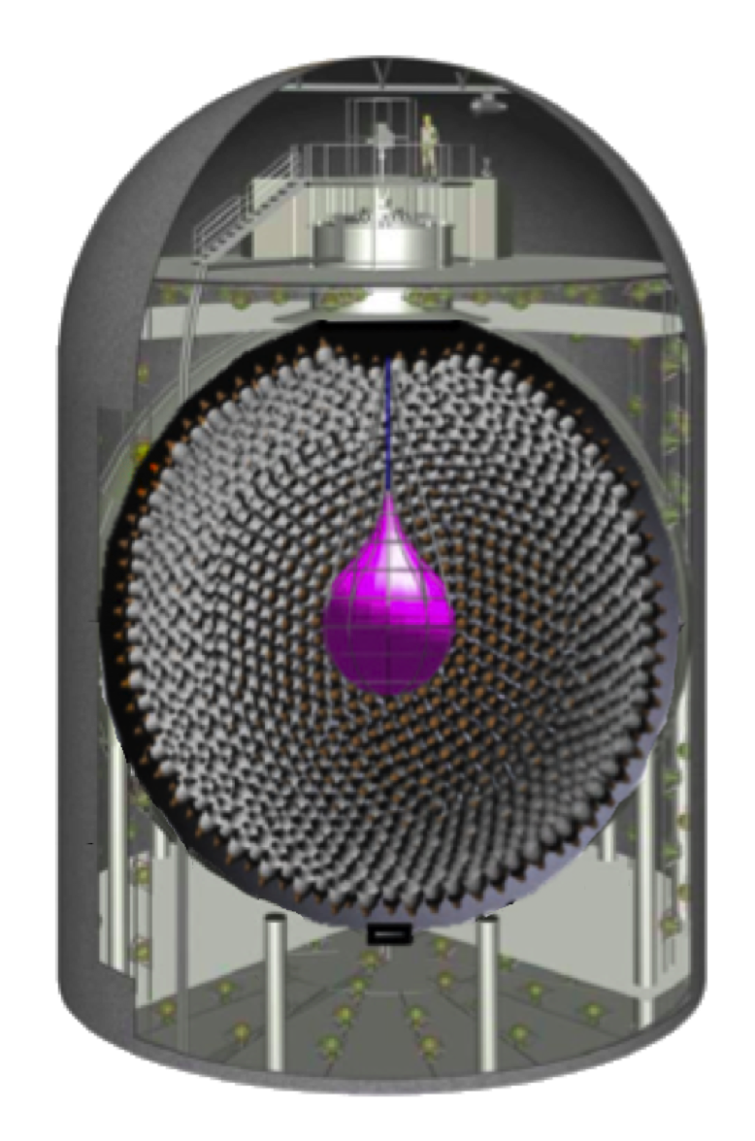
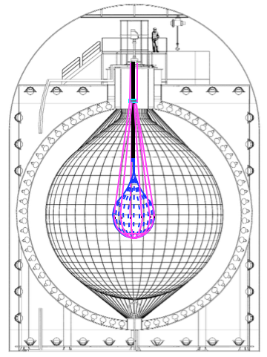

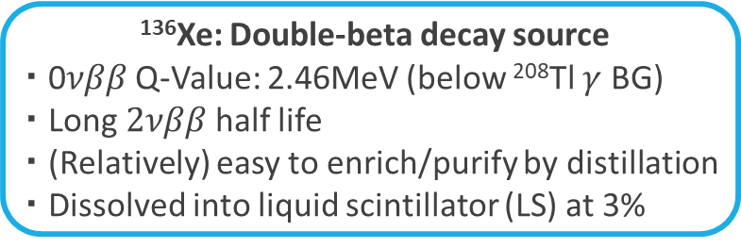

KamLAND-Zen Experiment
KamLAND-Zen = ¹³⁶Xe + KamLAND Zero-neutrino double-beta decay search
KamLAND-Zen 400 (Xe: $\text{320}\text{\sim }\text{380}\text{ [}\text{kg}\text{]}$) KamLAND-zen 800 (Xe: $745±\text{3 [}\text{kg}\text{]}$) KamLAND2-Zen (Xe: $\sim 1,000\text{ [}\text{kg}\text{]}$)
$T_{1/2}^{0ν}>0.9×{10}^{26} [yesrs]$ $T_{1/2}^{0ν}>3.8×{10}^{26} [yesrs]$ Toward $T_{1/2}^{0ν}=2.0×{10}^{27} \left[yesrs\right]$
$\left\langle m_{ββ}\right\rangle <61−165 meV$ $\left\langle m_{ββ}\right\rangle <28−122 meV$ Toward $\left\langle m_{ββ}\right\rangle =20 meV$
Phys. Rev. Lett. 117, 082503 (2016) Phys. Rev. Lett. 130, 051801 (2023)
・Calculate the lower limit of the half-life of $0νββ$ from the observation time and the amount of Xe
・Calculate the upper limit of the effective Majorana mass from the half-life ${\left(T_{1/2}^{0ν}\right)}^{−1}=G^{0ν}{\left|M^{0ν}\right|}^{2}{\left\langle m_{ββ}\right\rangle }^{2}$ $G^{0ν }$ : Phase space factor ${\left|M^{0ν}\right|}^{2}$: Nuclear matric element (NME)
¹³⁶Xe: Double-beta decay source
・ 0𝜈𝛽𝛽 Q-Value: 2.46MeV (below ²⁰⁸Tl $γ$ BG)
・ Long $2νββ$ half life
・ (Relatively) easy to enrich/purify by distillation
・ Dissolved into liquid scintillator (LS) at 3%
Increase in Xe
Now
Upgrading!
Notes:
The KamLAND-Zen experiment involves adding LS dissolved with xenon (a double-beta decay nucleus) to the KamLAND detector to search for 0νββ. This experiment has set the world’s most stringent limits on the 0νββ half-life and effective Majorana mass by increasing the amount of xenon. Currently, to achieve significantly improved sensitivity, the KamLAND detector is being upgraded to the KamLAND2 detector.

Slide 7
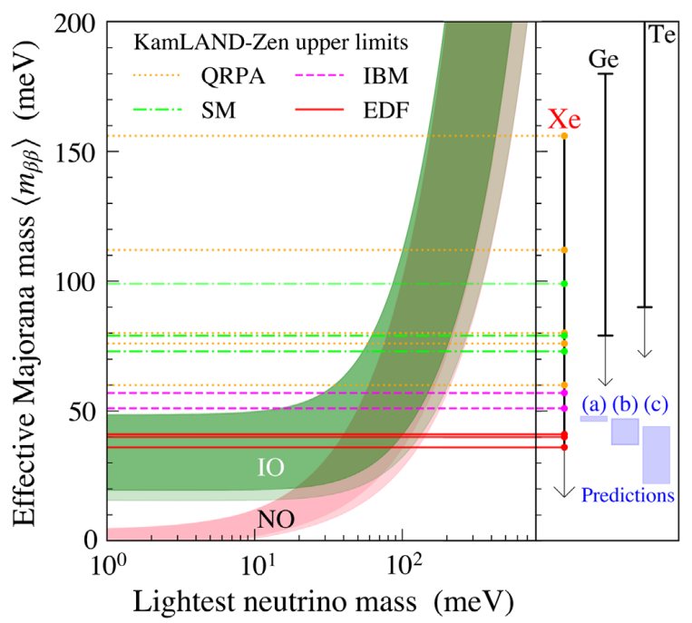
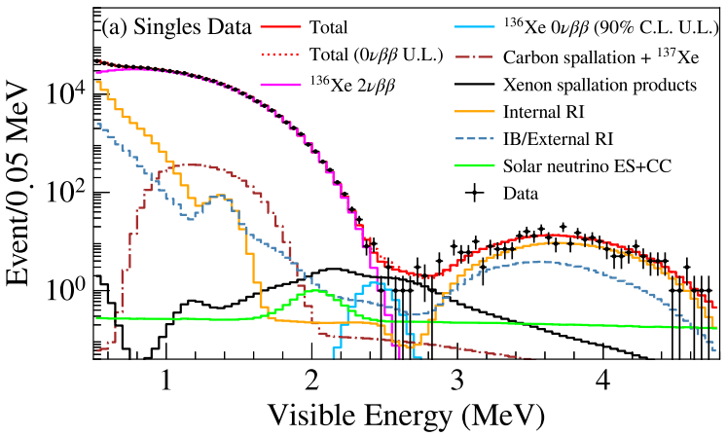



KamLAND-Zen Experiment
KamLAND-Zen 400 + 800
Current results: First in the world to reach IO band $\left({ T_{1/2}^{0ν} > 2.3×{10}^{26} year (90\%C.L.) \atop \left\langle m_{ββ}\right\rangle < 36−156 meV }\right)$
KamLAND2-Zen (Future plan)
Target sensitivity: Covering most of IO $\left(T_{1/2}^{0ν}>2.0×{10}^{27} year \left(\left\langle m_{ββ}\right\rangle \sim 20 meV\right)\right)$
Main backgrounds of $0νββ$
$2νββ$ ・ Can only be separated by improving energy resolution ・ Reduction target: 1/100
Long-lived spallation products ・ Can be reduced by improving energy & vertex resolution
⇒ Aiming to increase the number of observed photons! to improve energy resolution
Searched
Target
$$2νββ$$
Long-lived spallation products
$$0νββ$$
Notes:
Based on the results of KamLAND-Zen 400 and 800, the upper limit of the effective Majorana mass reached the inverted ordering region for the first time in the world. The KamLAND2-Zen experiment aims to increase the target sensitivity by 10 times to explore almost the entire IO region.
Two major background sources need to be reduced for 0νββ, and my research focuses on one of them: 2νββ. This background can only be separated by improving energy resolution. Thus, I aimed to increase the number of observed photons to improve energy resolution and reduce the 2νββ background by a factor of 100.

Slide 8
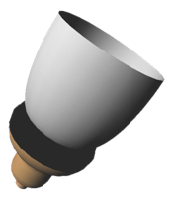
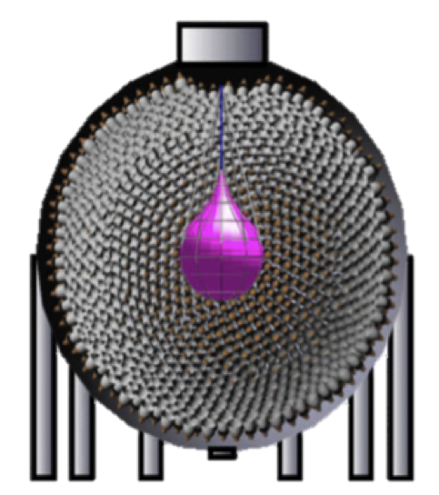


Upgrade KamLAND2-Zen
Upgrade contents
・ Increase in light yield
High quantum efficiency PMT (HQE-PMT) (x1.9)
Light-collecting Winston cone mirror (x1.8)
High light-yield liquid scintillator (New-LS) (x1.4)
・ State-of-the-art read-out electronics: MoGURA2
RFSoC powered data acquisition
Huge buffer for SN-burst detection
・ Increase in ${}_{}^{136}{Xe}$: $745\text{kg}$ → $\sim 1,000\text{kg}$
Target of KamLAND2-Zen
・ 5x increased effective light yield
→ energy resolution $σ$: $4\%→ <2.5\%$ ($E=2.5 MeV$) $2νββ$ BG reduction by the order of 2
➔ Test with prototype detector
・ $\sim 100\%$ spallation neutron detection
・ More efficient L.L. tagging
・ More exposure
Notes:
To achieve the target sensitivity, KamLAND2-Zen involves several upgrades. Among these, these three upgrades are related to increasing the number of observed photons. These upgrades collectively aim to achieve a fivefold improvement in effective light yield. As a result, the energy resolution is expected to improve from 4% to below 2.5%, reducing the 2νββ background by the orders of 2. My research tested these new devices using a prototype detector and evaluated their actual performance.

Slide 9
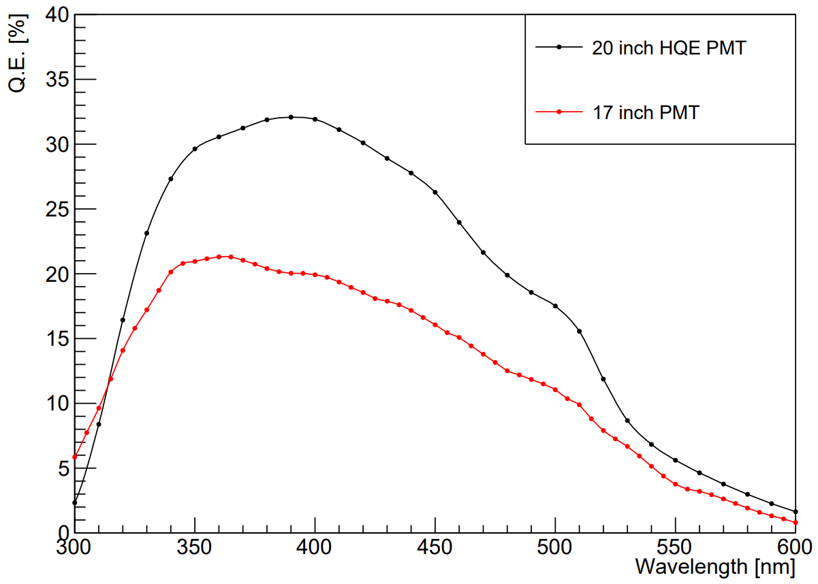
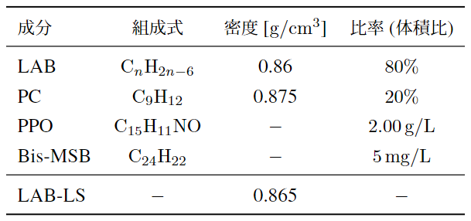
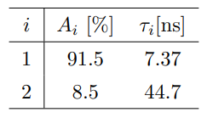
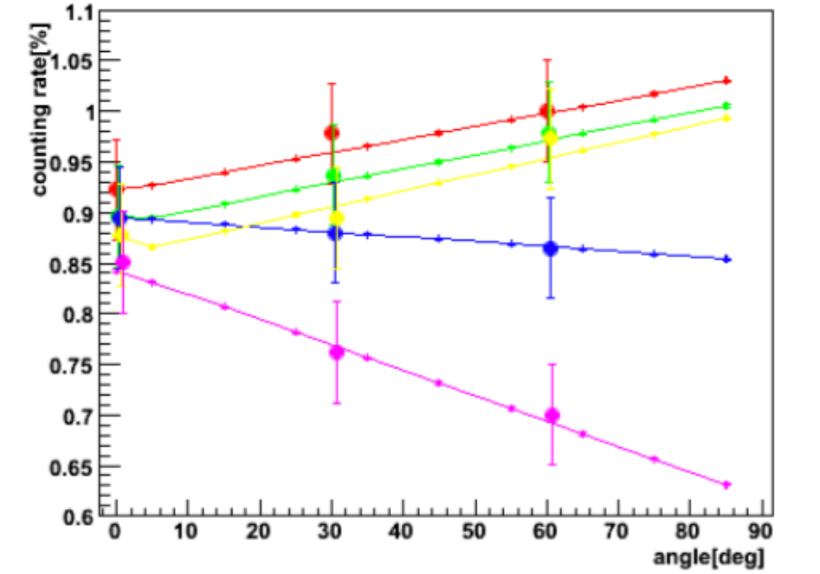
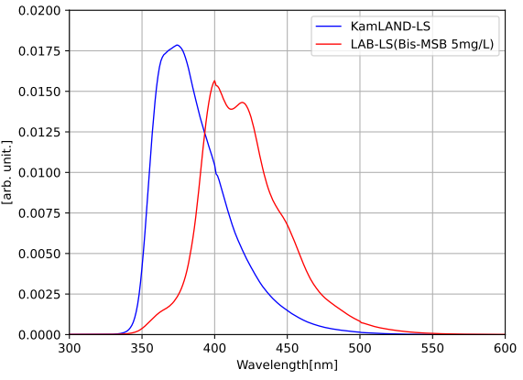
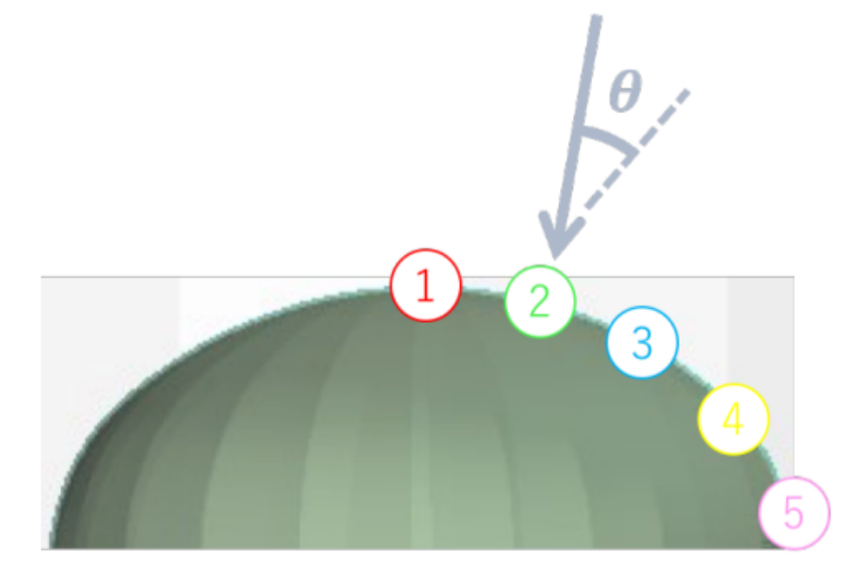
Upgrade contents
Optical properties registered in the simulation ( : Emission wavelength of New-LS)
New-LS (candidate)
Light yield: x1.365 (Compared to conventional)
Composition:
Emission time constant :
Emission spectrum:
HQE-PMT
Quantum efficiency:
Incident position and angle dependency:
HQE-PMT
17inch PMT
Components
Formula
Density [g/cm³]
Volume ratio
New
Notes:
The optical properties of the new devices have been measured as follows:
The new LS achieves a light yield 1.365 times higher than conventional.
The quantum efficiency of the HQE-PMT is 1.5 times higher than conventional.

Slide 10
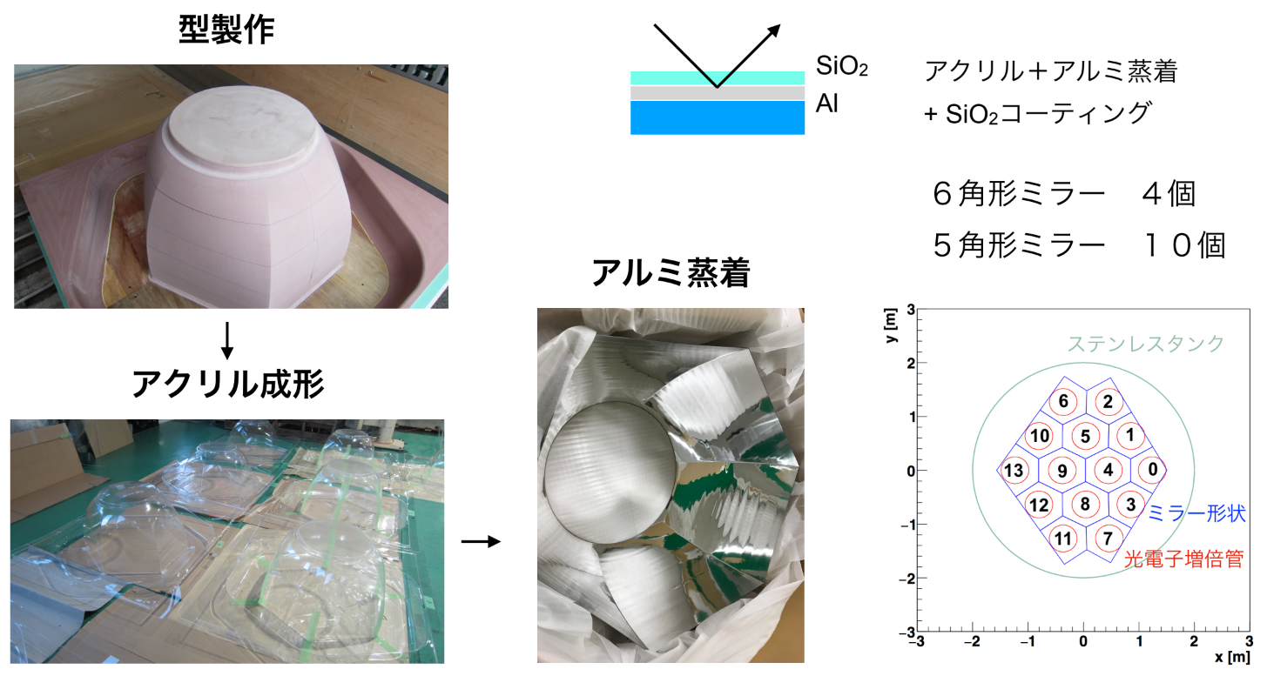
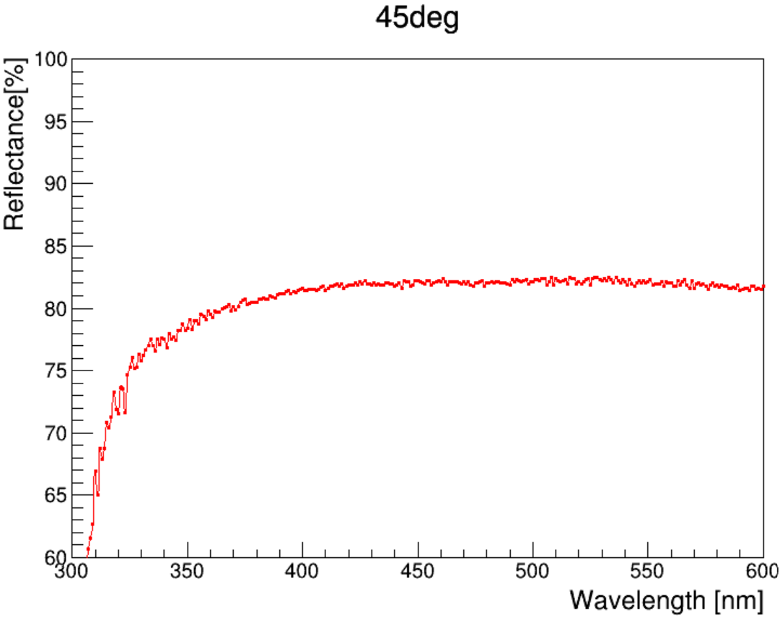
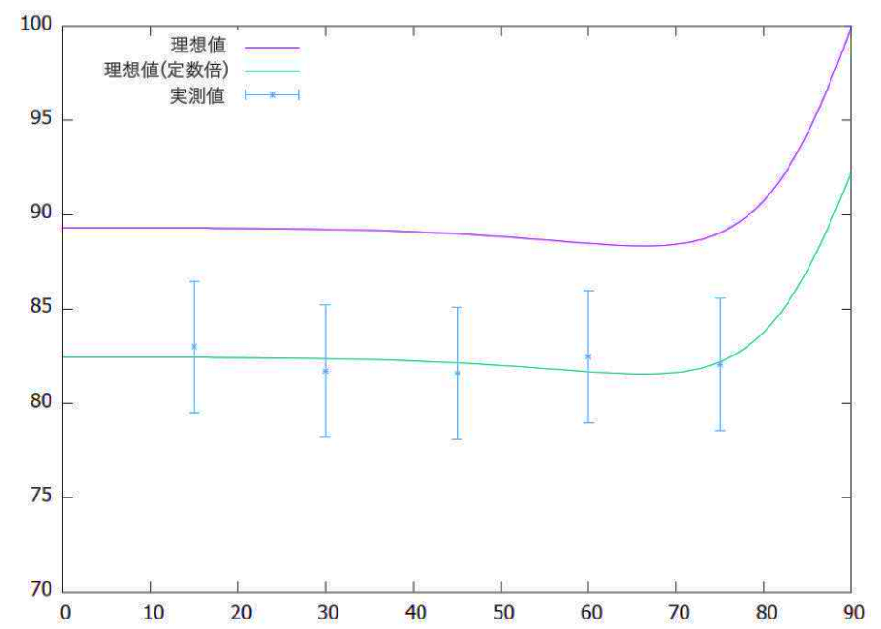
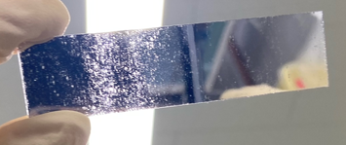

Upgrade contents
Optical properties registered in the simulation ( : Emission wavelength of New-LS)
Light-collecting mirror
Reflectace:
Long-term stability:
20 days at 41℃ (≒ 6 months at 10℃ (usage environment)) In pure water : Reduction in reflectance In LS : Stable
3 months at 20℃ (≒ 6 months at 10℃, by contractor) In pure water : Stable
Top coat
Al – Acrylic
boundary surface
Acrylic plate + Al deposition + acrylic resin
Registered value
Predicted value
Measured value
Incident angle
Measured value @ 45°
Notes:
The reflectivity of the light-collection mirrors exceeds 80%.

Slide 11
CONTENTS
Motivation
KamLAND2 Prototype Detector
Evaluation of Light Collection Performance of Mirrors
Evaluation of Prototype Detector Total Observed Photons
Summary
Notes:
In this section, I will discuss the method of performance evaluation using the prototype detector and provide an overview of the constructed this detector.

Slide 12
Flow of performance evaluation
Measurement Simulation (Geant4)
KamLAND
Prototype detector
KamLAND-Zen 800
Light yield x??
KamLAND2-Zen
Actual measurement with the prototype detector
KamLAND-Zen 800
Light yield x5
KamLAND2-Zen
Reproduce
the prototype detector
Apply
Compare
Notes:
In the KamLAND-Zen experiment, measurements are conducted alongside simulations tuned to match these measurements. While it has been simulated that KamLAND2-Zen will achieve five times the light yield of KamLAND-Zen, I wanted to verify this by evaluating the actual performance. To do so, I tuned the simulation similarly to these and compared this with measurements using the prototype detector. This allowed me to predict the performance of KamLAND2-Zen.

Slide 13
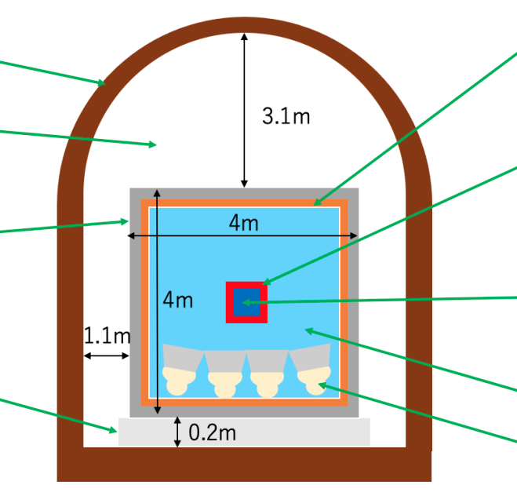

Flow of performance evaluation
Compare
Measurement Simulation
Actual measurement with the prototype detector
1. Light yield w/ or w/o mirrors
→ Evaluate the collecting performance
3. Measure Compton edge by ${}_{}^{137}{Cs} \& {}_{}^{60}{Co}$
→ Evaluate the observed photons
Reproduce the prototype detector with Geant4
Register the values ​​measured
in individual studies for the composition and optical properties of the materials
Simulation to reproduce
the actual measurement
Scintillation ball
measurement
Radiation source
measurement
Notes:
The comparison method using the prototype detector was as follows:
First, during the construction process, I performed single photoelectron measurements using the scintillation ball both with and without light-collection mirrors. By comparing the results, I evaluated the light-collection performance of the mirrors. I calibrated the PMT gains through the similarly measurements. In addition, I conducted radiation source measurements using cesium and cobalt, measuring the Compton edges of gamma rays emitted by these sources. I simulated the expected observational data to reproduce these measurements by setting up the simulation under the same conditions. Finally, I compared the simulated data with the actual measured data to evaluate the number of observed photons.

Slide 14
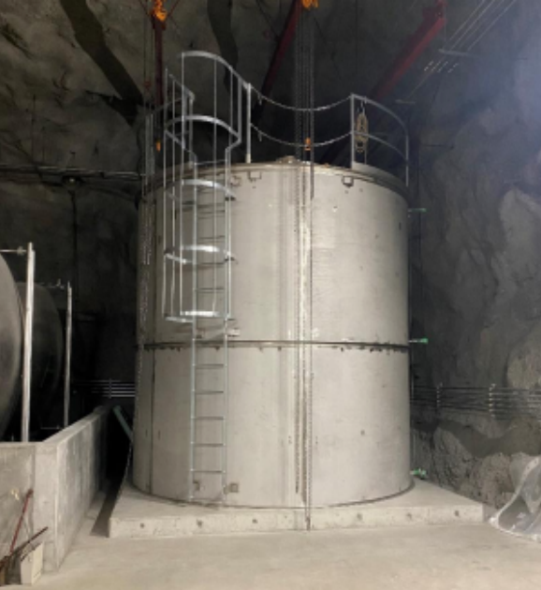
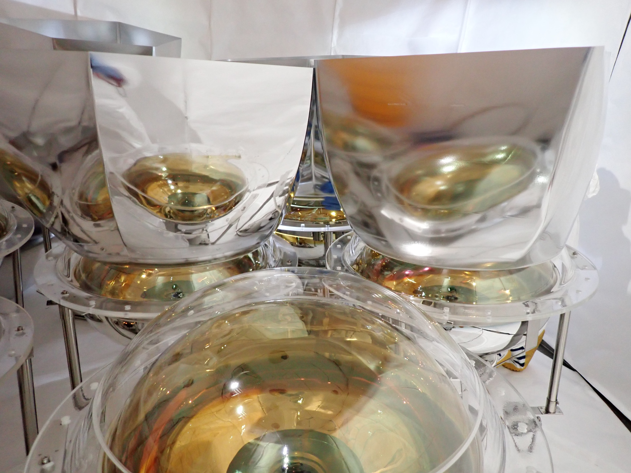
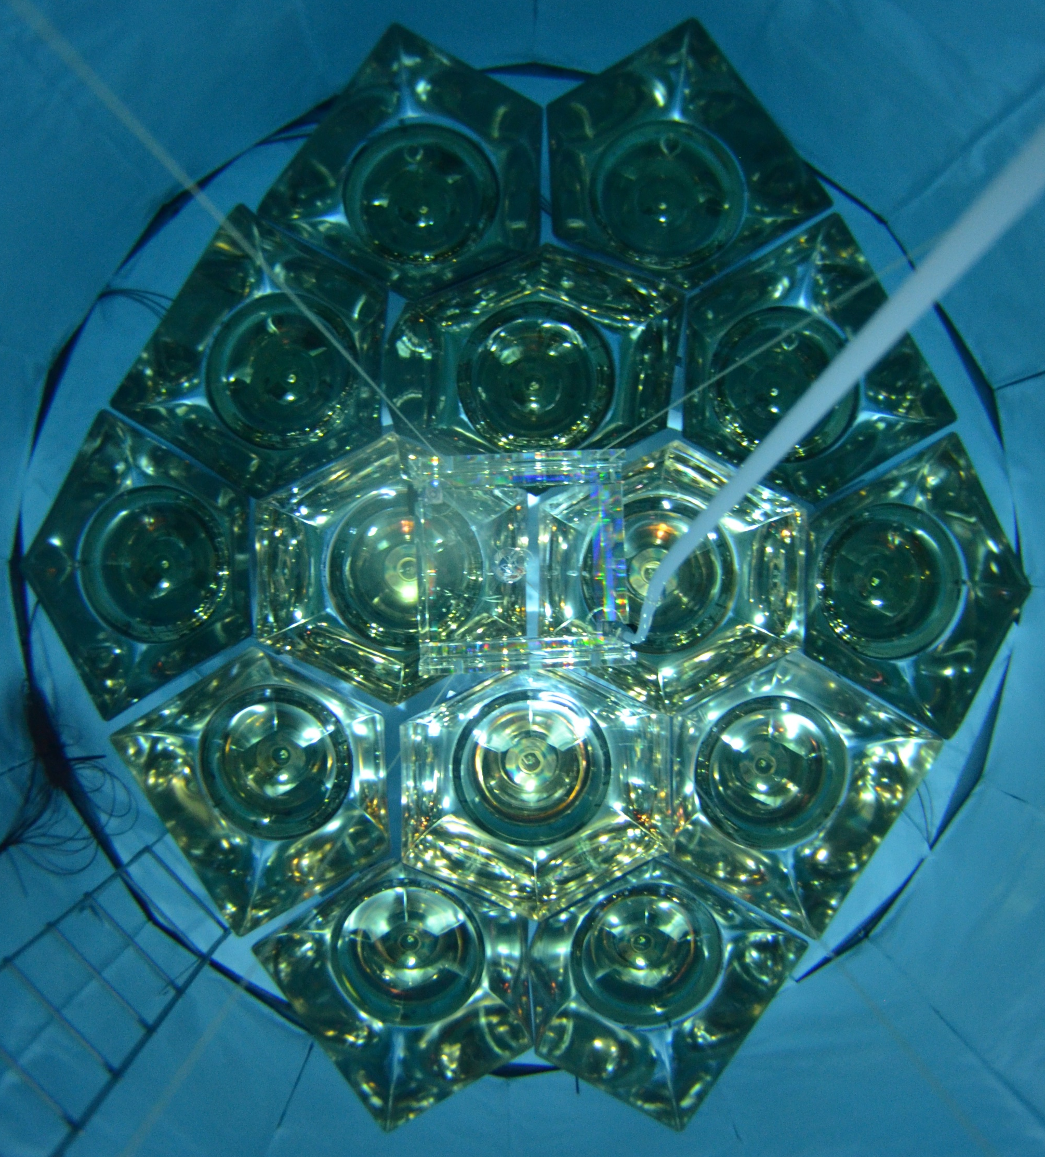
Construction: timeline
Mirror
2021/11 Construct stainless steel tank
2021/12 Clean inside of the detector Install: Tyvek sheet, 7 HQE-PMTs Construct measurement hut
2022/2 manufacture light-collecting mirrors
2022/7 Install: 7 mirrors
2022/8 Replace defective PMT Install: 5 HQE-PMTs, 5 mirrors
2022/10 Install: 2 HQE-PMTs, 2 mirrors
2022/11 Inject pure water
2022/12 Prepare New-LS Install: New-LS
2024/1 Dismantle
Acrylic base
Notes:
The construction of the prototype detector was carried out in several stages over one year, and measurements were conducted continuously for another year.

Slide 15
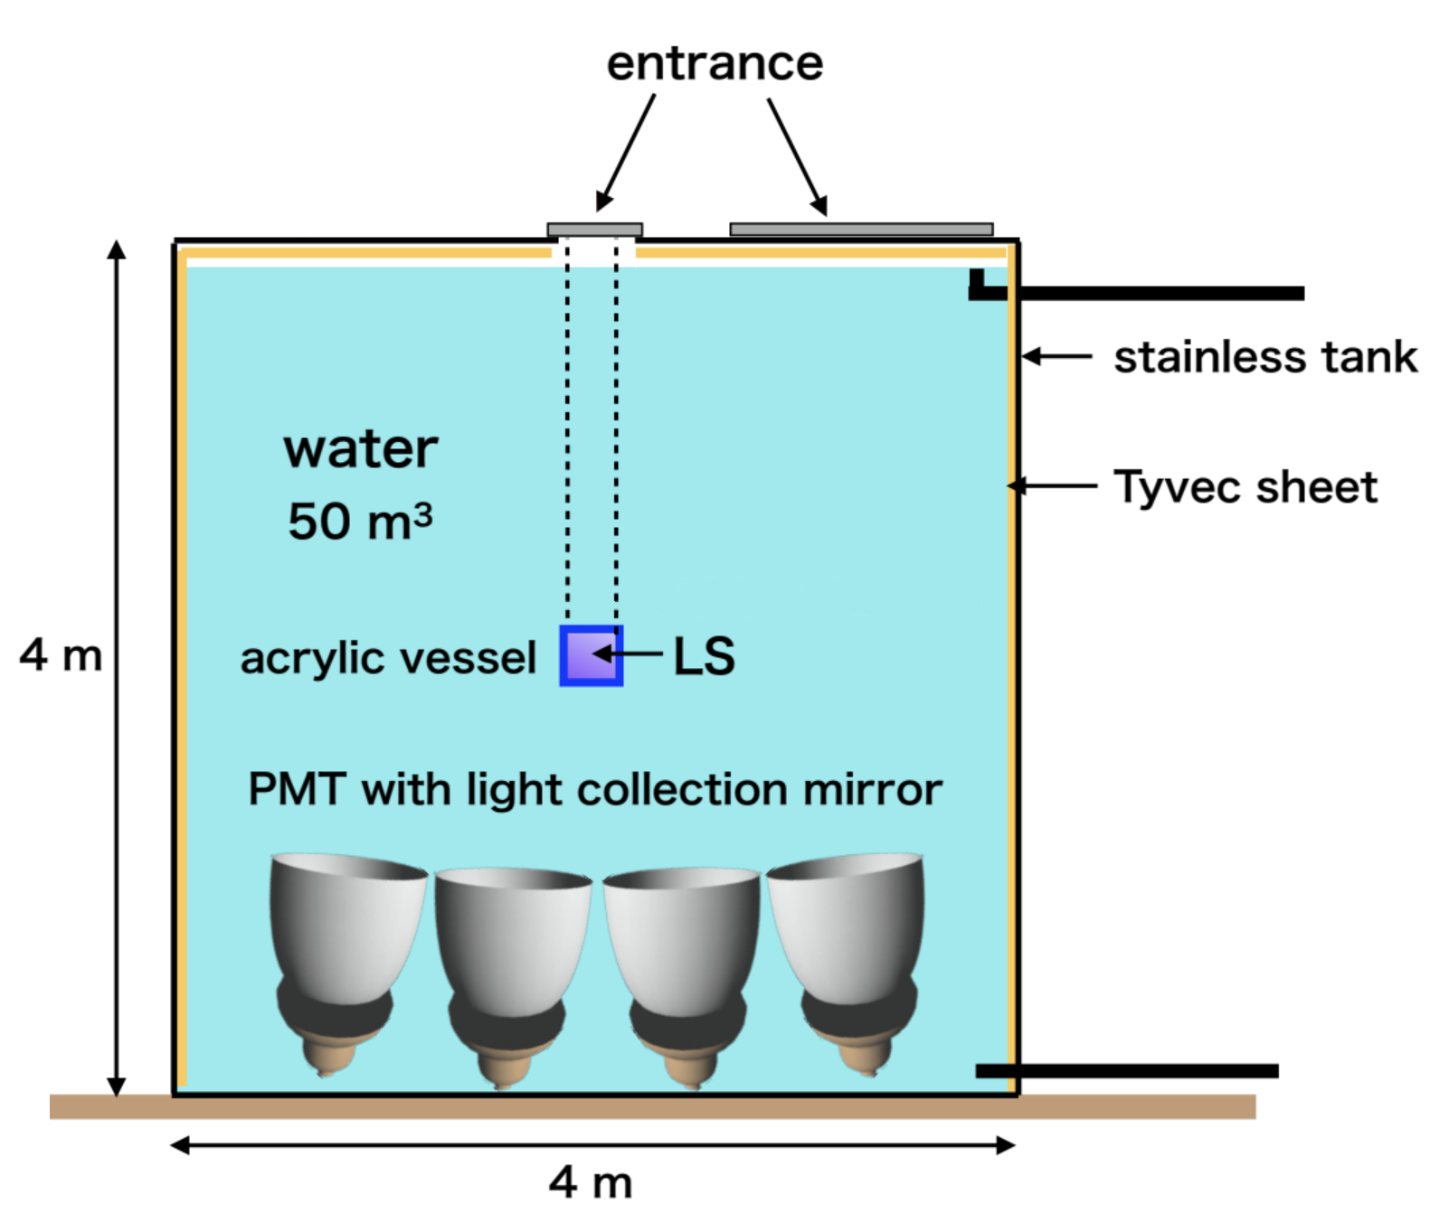
KamLAND2-Zen vs Prototype detector
Shape
Size
Inside
PMTs, Mirrors
Emission point ↔ PMT
Buffer
LS container
LS volume
KamLAND2-Zen
Spherical
18 [m] in diameter
Black sheet
1879
7～11 [m]
Buffer oil (BO)
Nylon balloon
1x10⁶ [kg]
Prototype detector
Cylindrical
4 [m] in diameter & 4 [m] in height
Tyvek sheet
14
1～2 [m]
Pure water
Acrylic vessel
23 [kg]
Notes:
The comparison between the prototype detector and KamLAND2-Zen can be summarized as follows:
The two major differences are the reflective sheets attached to the inner walls and the distance between the light emission position in the liquid scintillator and the PMTs.
The KamLAND2 detector uses low-reflectivity black sheets to avoid interference from reflected light during analysis. On the other hand, the prototype detector uses high-reflectivity Tyvek sheets to maximize photon detection. This is necessary to improve energy resolution, which is critical for evaluating the thorium concentration in new LS, another goal of the prototype detector.

Slide 16
CONTENTS
Motivation
KamLAND2 Prototype Detector
Evaluation of Light Collection Performance of Mirrors
Evaluation of Prototype Detector Total Observed Photons
Summary
Notes:
Next, let me discuss the evaluation results of the light-collection performance of the mirrors.

Slide 17
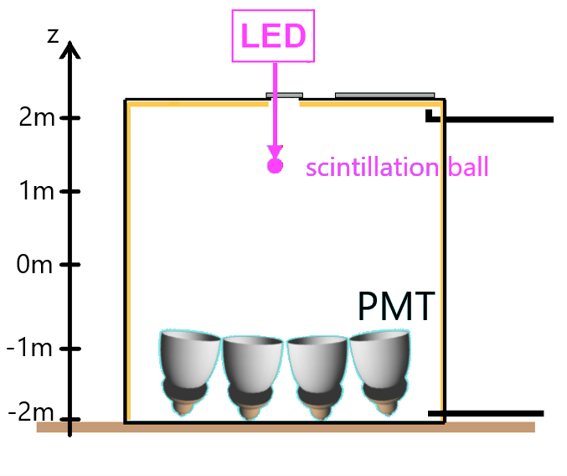
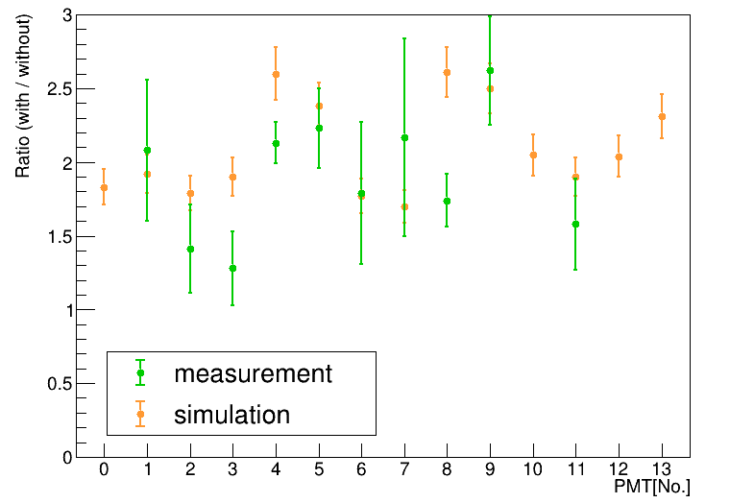


Light collection performance
Light collection performance: $\frac{Effective light yield w/ mirror: λ_{w/} }{Effective light yield w/o mirror: λ_{w/o}}$
*Evaluate only the central 4 PMTs (No.4,5,8,9) Reproduce the angle of incidence of 2-Zen
Performance results: x1.7～2.6
➔ Introducing collecting mirrors to the KamLAND2-Zen increases the effective light yield!!
*Evaluate the ratio with simulation
$\left(\begin{matrix}Average of measurement=x2.06±0.10 \\ Average of simulation =x2.52±0.09 \\ → Ratio =0. 82±0.07\end{matrix}\right)$
➔ The performance did not reach the expected level
Measurement
(Simulation)
Notes:
The light-collection performance of the mirrors was evaluated as the ratio of effective light yield with and without the mirrors for each PMT. In the KamLAND2-Zen experiment, considering the incidence angle of photons emitted inside the mini-balloon onto the mirrors, only the central mirrors in the prototype detector accurately reproduce this incidence angle. Therefore, this study focused on evaluating the performance of only the four central mirrors.
The evaluation results showed that the light-collection performance ranged from 1.7 to 2.6 times. However, when compared to the simulations, the measured performance was about 80% of the expected value. Despite this, we were able to experimentally demonstrate that introducing light-collection mirrors into the KamLAND2-Zen increases its effective light yield.

Slide 18
CONTENTS
Motivation
KamLAND2 Prototype Detector
Evaluation of Light Collection Performance of Mirrors
Evaluation of Prototype Detector Total Observed Photons
Summary
Notes:
Finally, I will discuss the performance evaluation results of the prototype detector.

Slide 19
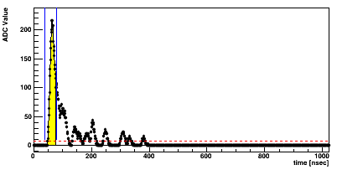
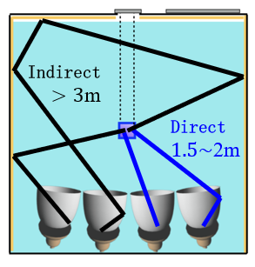
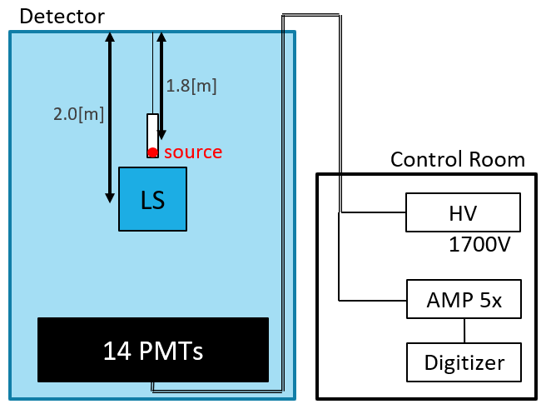
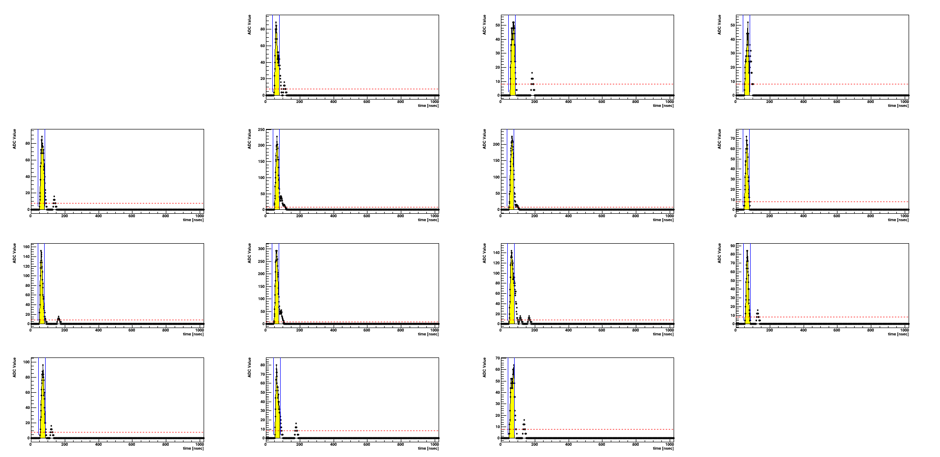
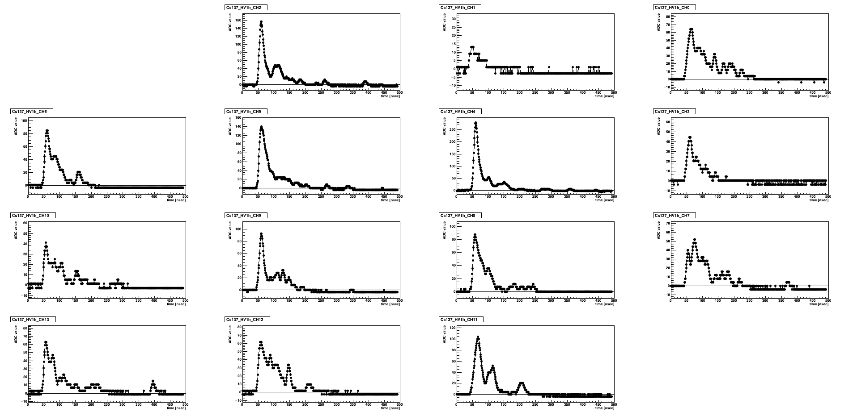



Total observed photons of the prototype detector
Radiation source measurement Selection of direct light signal
Light emitter: New LS (By Radiation source)
Position: On the central axis, $z=20 [cm]$
Intensity: $∼1000 [p.e.]$
Frequency: $100 [Hz]$
PMT signal (self trigger) x14
$t$: Elapsed time
amp: x5
threshold : 16ch (≃ 4 [p.e.])
Reproduce the waveform
Interval of integration:
$t−10\left[ns\right]∼t+25[ns]$
(Contamination of indirect signal: 8.2%)
Direct +
indirect light
Direct light
In Water
PMT No.5
$$t$$
Notes:
I used data from six radiation source measurements conducted about every two months. During these measurements, gamma-ray-induced scintillation light from the New LS was observed by all PMTs. The signals obtained using this circuit correspond to this waveforms. On the other hand, the simulation was used to select signals from direct light because the reflectivity of the Tyvek sheet and the transmittance of pure water, which are not part of the evaluation, significantly affect indirect light. Based on this simulation, the interval of integration for direct light signals was set to 35 ns.

Slide 20
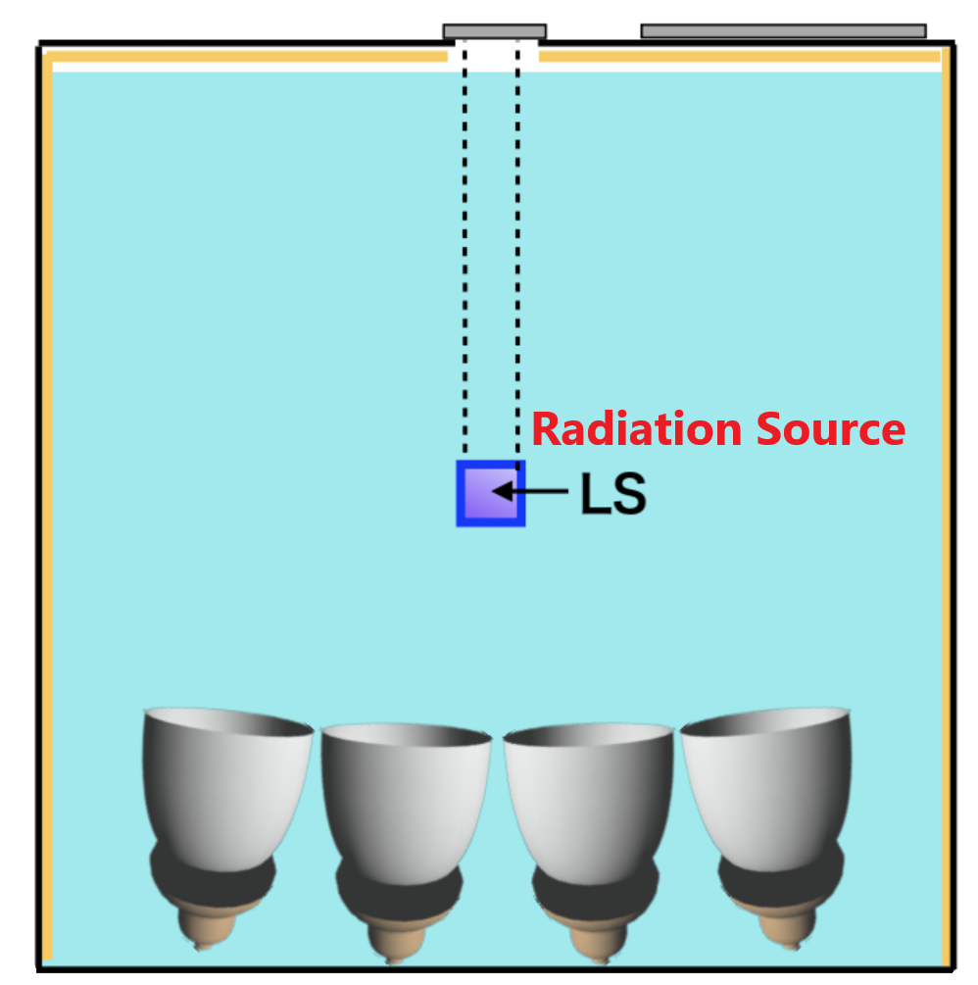
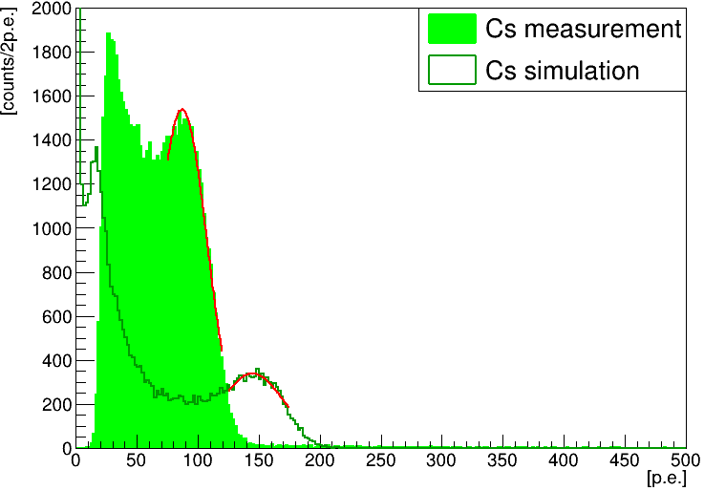
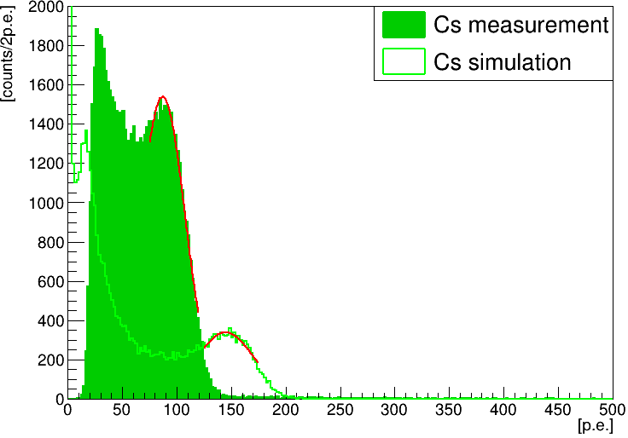





Total observed photons of the prototype detector
Radiation source measurement
Interval of integration
Each event of each PMT signal
$\left(I [ch]\right)=\sum_{t_{PMT}−10 [ns]}^{t_{PMT}+25 [ns]}{(ADC [ch])}$
Number of photons of each PMT:
$q \left[p.e.\right]=\left(I \left[ch\right]\right)/(1p.e. gain value [ch])$
Total photons of all PMT:
$Q \left[p.e.\right]=\sum_{0}^{13}{q \left[p.e.\right]}$
Total observed photons:
Mean value of the peak of the total photon distribution
Compare measurement and simulation
+
Evaluate stability for one year (six measurements)
$$t$$
Total photons distribution
$${}_{}^{137}{Cs}$$
Measurement
Simulation
$${}_{}^{60}{Co}$$
Measurement
Simulation
Notes:
Using this integration range determined from the simulation, the total photon count was calculated as follows. The mean value of the peak in the distribution was defined as the total observed photons. The results were compared between the measurements and the simulation, and the trends across the six measurements were analyzed to evaluate performance and stability.

Slide 21




Total observed photons of the prototype detector
Compare the measured and simulated total observed photons
Result: Measured results were about 40% lower (both ${}_{}^{137}{Cs} \& {}_{}^{60}{Co}$) Cause of the lower result: ・The actual performance of the mirrors is lower than the simulation ($\sim −20\%$) ・Indirect light signal is contaminate into the selected direct light signal ($\sim 8\%$) ・Uncertain Q.E. of HQE-PMT ($\sim 10\%$) ・Detector problems during construction & operation (→ Next page)
Evaluate the long-term stability
Result: Very stable for one year within error
⇒ The observed photons will be maintained with KamLAND2-Zen!!
$$−40\%$$
$$−40\%$$
Notes:
The summarized results of the total observed photons are shown in the graph on the left. Comparing the measurements with the simulation, the measured results were about 40% lower than the simulation. Possible reasons for this result are under consideration, and further detailed simulations are necessary to investigate the cause.
On the other hand, the long-term stability of the total observed photons was very stable. This result indicates that KamLAND2-Zen, which is planned for long-term operation, can maintain its light yield over time.

Slide 22







Detector problems during construction & operation
Initial defects or failures of 3 HQE-PMTs Causes: Peeling of the photocathode, Resistance value decrease → The root cause is under investigation by the manufacturer
PMTs floating due to buoyancy (After water injection) Effect: Contact with acrylic base → May damage the surrounding PMTs and become a fatal problem Need to review the method of fixing the PMT
Contact and deformation of the mirrors (After water injection) Causes: Distortion of tank bottom plate → Need to change the material of the opening
➔
Peeling of Al from the mirrors (After water injection) Causes: Erosion by pure water ( LS resistance test passed) → May deteriorate further with long-term use Need for careful LS resistance test
↓ Sheet mirror
Notes:
Lastly, I will talk about the problems encountered during the construction and operation of the prototype detector. Regarding the PMTs, some PMTs failed, and misalignment of PMT fixtures was observed. For the light-collection mirrors, neighboring mirrors were found to be in contact and deformed, and some mirrors showed spot-like peeling of aluminum coating. These issues could become more significant in the KamLAND2-Zen experiment, so further research and improvements are necessary to address each of them.

Slide 23
CONTENTS
Motivation
KamLAND2 Prototype Detector
Evaluation of Light Collection Performance of Mirrors
Evaluation of Prototype Detector Total Observed Photons
Summary
Notes:
まず、本研究の背景についてお話します。

Slide 24
Summary
KamLAND2-Zen : Aiming for 5x the observed photons by HQE-PMT(x1.9)、Light collecting mirror(x1.8)、New-LS(x1.4)
The performance of the collecting mirror: x1.7～2.6
The performance of the prototype detector (HQE-PMT + mirror + LAB-LS): Very stable for one year
⇒ The observed photons will increase & be maintained with KamLAND2-Zen
Now… We are investigating and studying problems with the prototype detector and making improvements for KamLAND2-Zen
Construction &
1 year operation maintenance
Test with prototype detector
Notes:
In summary, the KamLAND2-Zen experiment, planned as a next-generation experiment, aims to achieve a fivefold increase in effective light yield by introducing HQE-PMTs, light-collection mirrors, and New LS. To evaluate these upgrades, a prototype detector was constructed, operated for one year, and their devises was tested.
As a result, the light-collection mirrors alone were shown to increase the observed light yield by 1.7 to 2.6 times. Additionally, the prototype detector demonstrated highly stable light yield for one year.
These results indicate that KamLAND2-Zen will be able to achieve both an increase in observed light yield and maintain its stability over time.

