Slide 1
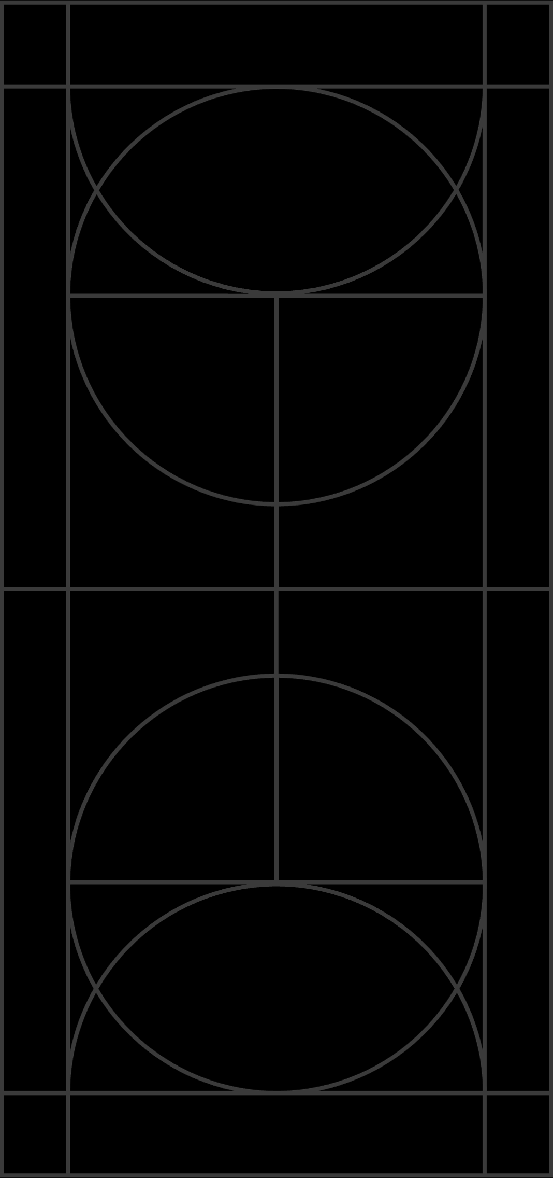




International Conference on Neutrinos and Dark Matter (NuDM 2024)

Slide 2
Welcome to NuDM-2024
We are delighted to welcome you to the 3rd International Conference on Neutrinos and Dark Matter (NuDM-2024), jointly organized by the Journal of Progress in High Energy Physics (PHEP), Andromeda Publishing (UK), and Zewail City of Science and Technology.
Building on the success of NDM-2020 and NuDM-2022, this conference provides a platform for sharing cutting-edge research and exchanging insights on neutrinos and dark matter.
Thank you for joining us—your presence enriches this event, and we look forward to an inspiring and memorable NuDM-2024!

Slide 3
Goals of NuDM-2024
Presenting Advances in Research: To showcase recent theoretical, experimental, and observational developments in the fields of neutrinos and dark matter.
Encouraging Scientific Exchange: To provide a platform for researchers to share findings, discuss methodologies, and address challenges in advancing our understanding of these fundamental topics.

Slide 4
Current Program Overview
47 Talks: A balanced mix of invited and contributed presentations, evenly divided between theory and experiment.
Plenary Sessions Only: All talks are delivered in a single-track format, with no parallel sessions.
Daily Schedule:
  Sessions run from 9:00 AM to 5:00 PM.
  Coffee break: 11:00–11:30 AM.
  Lunch break: 1:30–3:00 PM.
Conference Dinner:
  Scheduled aboard the Revier Nile on Friday, December 13.
  Buses depart from the hotel at 4:00 PM.
  On this day, there will be an extended coffee break, and lunch will not be served at the hotel.

Slide 5
Looking Ahead: NuDM-2026
Future Plans: Preparations for the 4th International Conference on Neutrinos and Dark Matter (NuDM-2026) are underway.
Invitation to Host: If your institute is interested in hosting NuDM-2026, we encourage you to express your interest.
Discussion Opportunity: Please connect with the Andromeda Executive Director to explore the hosting process and discuss details.
Let’s continue shaping the future of neutrino and dark matter research together!

Slide 6
Thank you

