Slide 1
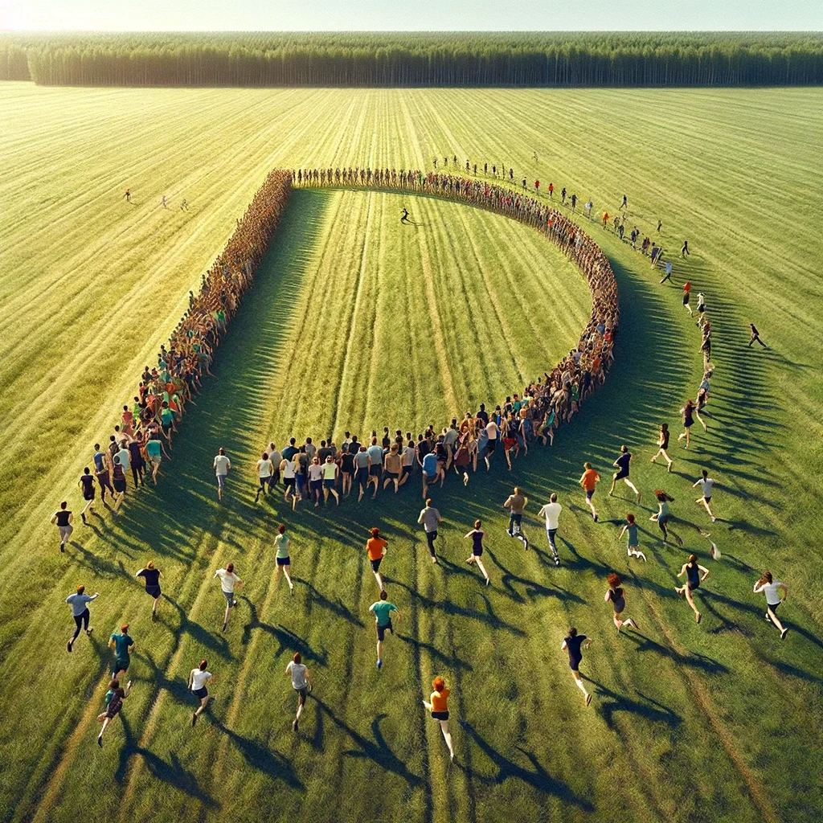

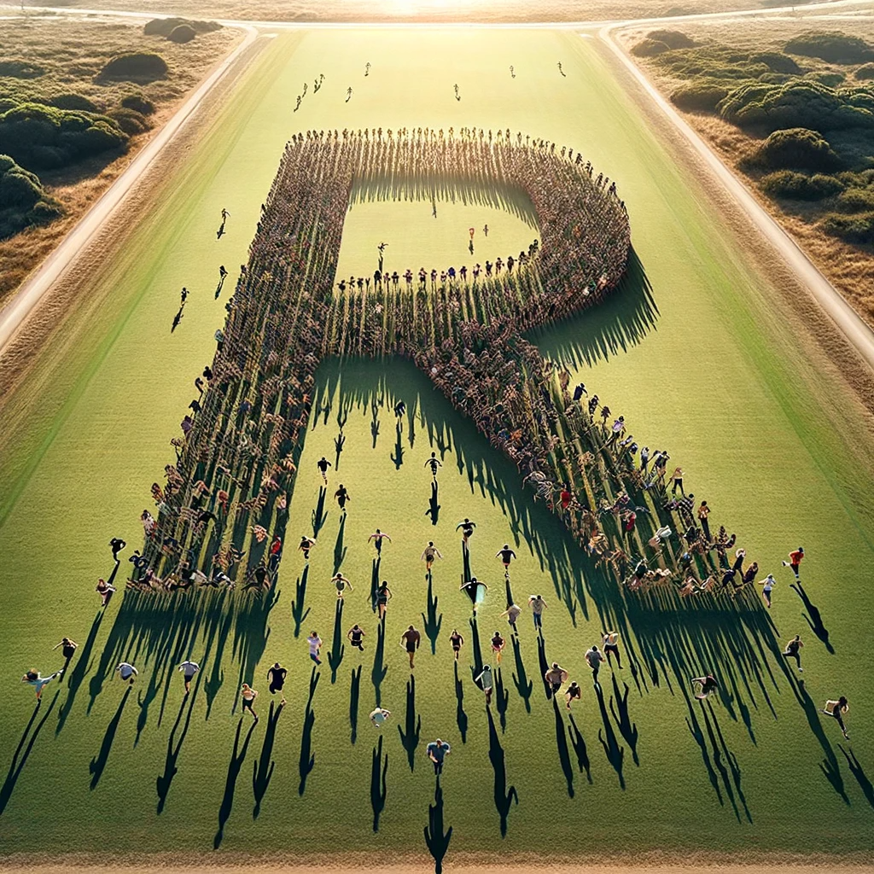
DRD3 Kick-off Meeting
First gathering of the DRD3 collaboration

Slide 2
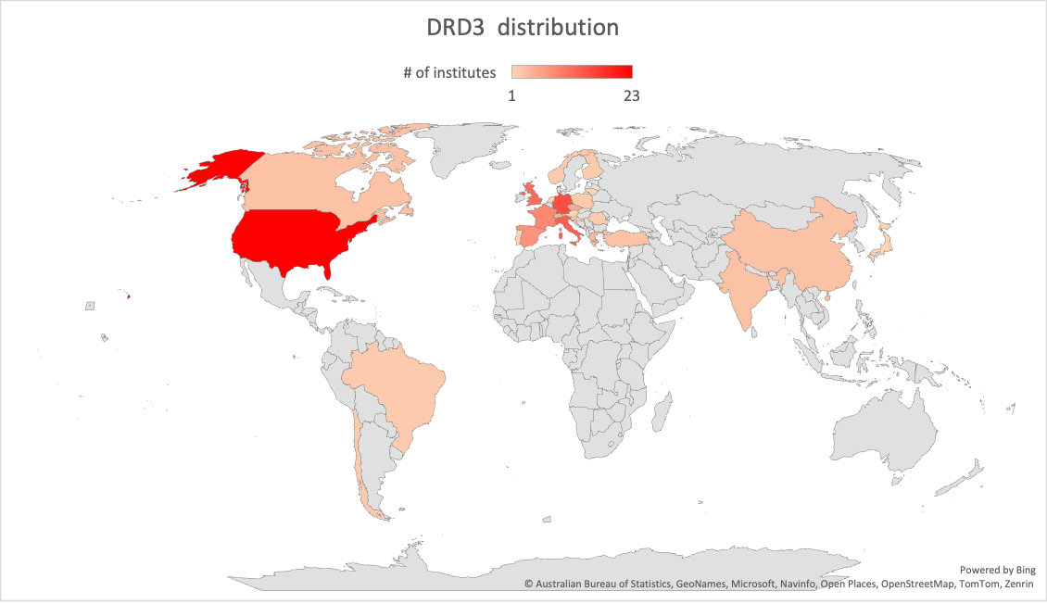
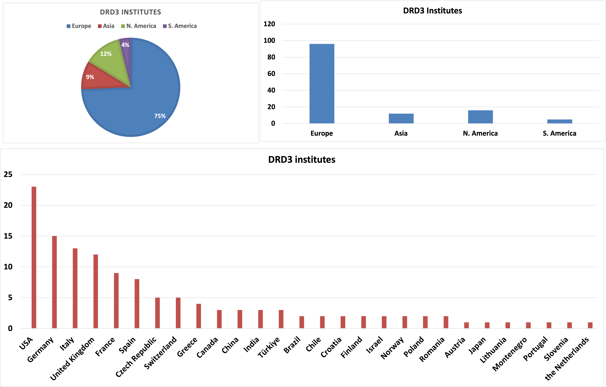
The DRD3 collaboration
The size of the collaboration is changing rapidly.
As of today:
502 people have subscribed to the CERN DRD3 member egroup
132 Institutes have subscribed to the CERN DRD3 institute egroup.

Slide 3
DRD3 Scientific Organization
The DRD3 is based on 3 pillars:
4 Work Packages
8 Working groups
Common projects
The Work Packages | The Working Groups | The common projects
address the need of the strategic R&D objectives | link together activities broadly focused on the same scientific goals | Foster blue-sky R&D and collaboration among groups
”Resource loaded” by funding agencies to achieve specific goals |  | Annual Common fund and group contributions to specific projects
Details in the DRD3 proposal, linked in agenda

Slide 4
DRD3 Scientific Organization
Working groups
WG 1
Monolithic
CMOS sensors
WG 2
Hybrid
silicon sensors
WG 3
Radiation damage
and extreme
fluence
WG 4
Simulations
WG 5
Characterization
Techniques,
facilities
WG 6
Wide bandgap and
Innovative sensor
material
WG 7
Interconnect
and
device fabrication
WG 8
Dissemination
and
outreach
Work packages
Common projects
WP 1
CMOS Sensors
WP 2
Sensors for 4D tracking
DRD3 approval
WP 3
Sensors for extreme fluences
WP 4
A demonstrator
of 3D integration
CP1
…
CPn

Slide 5
The DRD3 Organigramme
The DRD3 is a large collaboration
many positions to be filled in the next few months
Spokesperson
CB Chair
Administration
Resource Manager
Various committees
(conference,…, )
WG conveners
WP conveners

Slide 6
The DRD3 Organigramme
The DRD3 is a large collaboration
many positions to be filled in the next few months
Spokesperson
CB Chair
if requested by CB chair/spokesperson,
the DRD3 writing team will act as advisory board for the next few months
Administration
Resource Manager
Various committees
(conference,…, )
WG conveners
WP conveners

Slide 7
DRDC conditional approval
The DRD3 has been conditionally approved by the DRDC:
“The Research Board preliminarily approved DRD3 so that work towards establishing the collaboration can progress, on condition that the new collaboration structure be established in a timely fashion following the guidelines provided by the DRDC, and the new management appointed.
Approval of DRD3 will be reviewed at the next Research Board meeting in March 2024, on the basis of an updated proposal.”

Slide 8
DRD3 timeline
Following the DRDC suggestions, we have now an accelerated schedule to appoint the CB chair and the spokesperson
Request of nomination for the CB chair | 15/12/23
Select 4-5 candidates for the CB chair |  | 6/1/24
First online workshop |  |  | 22/1/24
Election of the CB chair |  |  |  | 29/1/24
Begin Spokesperson search |  |  |  |  | 30/1/24
Workshop online (presentation candidate Spokespersons + scientific presentations) |  |  |  |  |  | 26/2/24
Election of the Spokesperson |  |  |  |  |  |  | 01/3/24
CB Chair + Spokesperson @ DRDC |  |  |  |  |  |  |  | 4/3/24
First in person workshop at CERN |  |  |  |  |  |  |  |  | 17/6/24

Slide 9
The next steps
CB Chair election
Spokesperson election
Prepare for the March meeting
March 4th meeting with the DRDC
If approved:
Start filling the various positions
Start the process leading to 5 MoUs:
  ”Light MoU” (without financial commitments besides the common funds) governs the DRD3 collaboration. The DRDC will provide help with this step
  “Resource loaded” MoUs govern the 4 strategic work packages

Slide 10
How to vote for the CB chair
Voting
We are using the INDICO anonymous survey for voting.
The access to the vote is restricted by the CB-voting egroup (mailing list) that holds one person per institute
The test run of the voting system resulted in 87 test votes (out of 132 eligible voters)
The link will be distributed to the CB-voting egroup after the meeting.
In case of problems: contact Michael.Moll@cern.ch
Election committee (if required):
  To check with Michael the status of the elections and the correctness of the process
  Requirement: Needs to be and institute representative

Slide 11
How to be a member of DRD3
Institutes request to join the DRD3
The conditions to be a DRD3 member is to pay the annual common fee (~ 2-3 kCHF/year, to be decided)
It is expected that members contribute to DRD3 by being active in working groups and/or work packages
Signing of the MoU (light or resource loaded) it is not mandatory
The participation in a working group does not require any additional commitment besides being an active member of the community.
The participation in a work package requires additional commitments (either funds, FTE, services, in-kind…). These funds (or else) are assigned by the funding agencies to their respective groups to achieve the strategic goals of the WPs.

Slide 12
CB chair election
Presentation of the 3 candidates
The vote (by the institutes representatives) will start after the meeting and close at noon (CERN time), January 24th.
If a candidate has obtained more than 50% of the vote, (s)he is elected. If not, the candidate with the lowest number of votes is eliminated, and a second round of voting will be started, 25-26 of January
CB chair election result by January 29th

