Slide 1
Recent updates of the run 2b diagnostics
Collette Pakuza on behalf of AWAKE BI
AWAKE Collaboration Meeting, Liverpool, 11-13 March 2024

Slide 2
For Run 2B
The teams of BI and AWAKE continue to:
Support the existing systems
Respond to your needs
Develop operational systems and conduct R&D

Slide 3

For Run 2B
The teams of BI and AWAKE continue to:
Support the existing systems

Slide 4
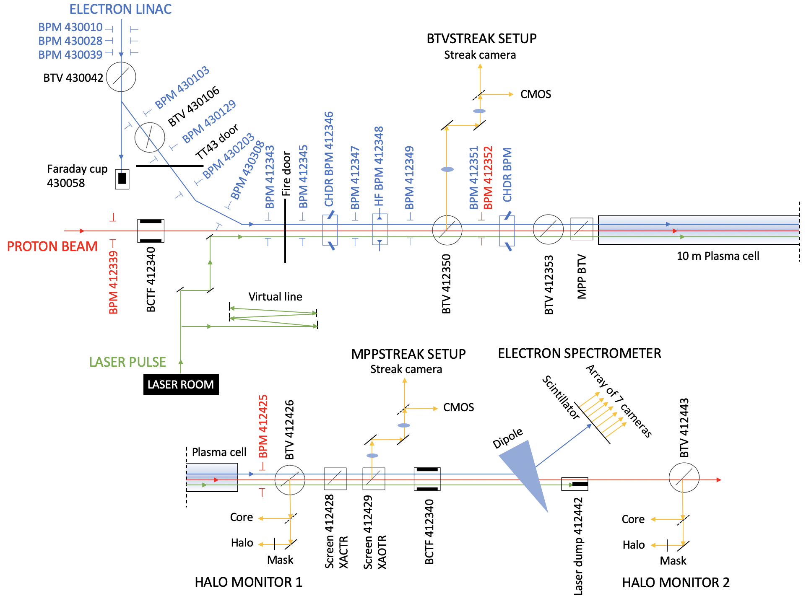

Overview of existing systems
Position:
  Electrons:
    7x 40 mm ID TRIUMF stripline eBPMs in the e-line
    5x 60 mm ID TRIUMF stripline eBPMs in the common line
    2 ChDR and 1 HF BPM
  Protons:
    Total 21 pBPMs from SPS extraction with 2 in the common line

Slide 5
Overview of existing systems (2)
Profile:
  2 BTVs in the e-line, several BTVs and screens downstream the merge point
Electron spectrometer
Intensity:
  Faraday cup
  2 CTs
Needs SW, a lot of motors and cameras, support

Slide 6
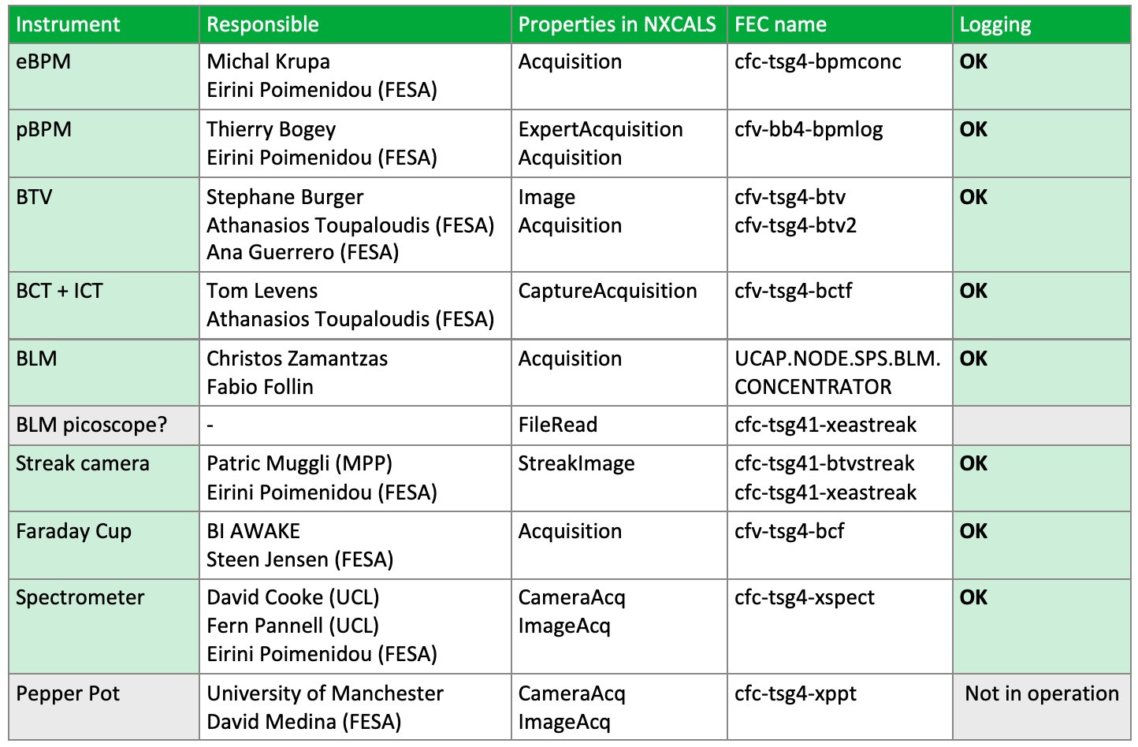
Overview of existing systems (3)
A large team of people dedicated to maintaining the systems for a smooth operation during the runs

Slide 7

For Run 2B
The teams of BI and AWAKE continue to:
Respond to your needs

Slide 8
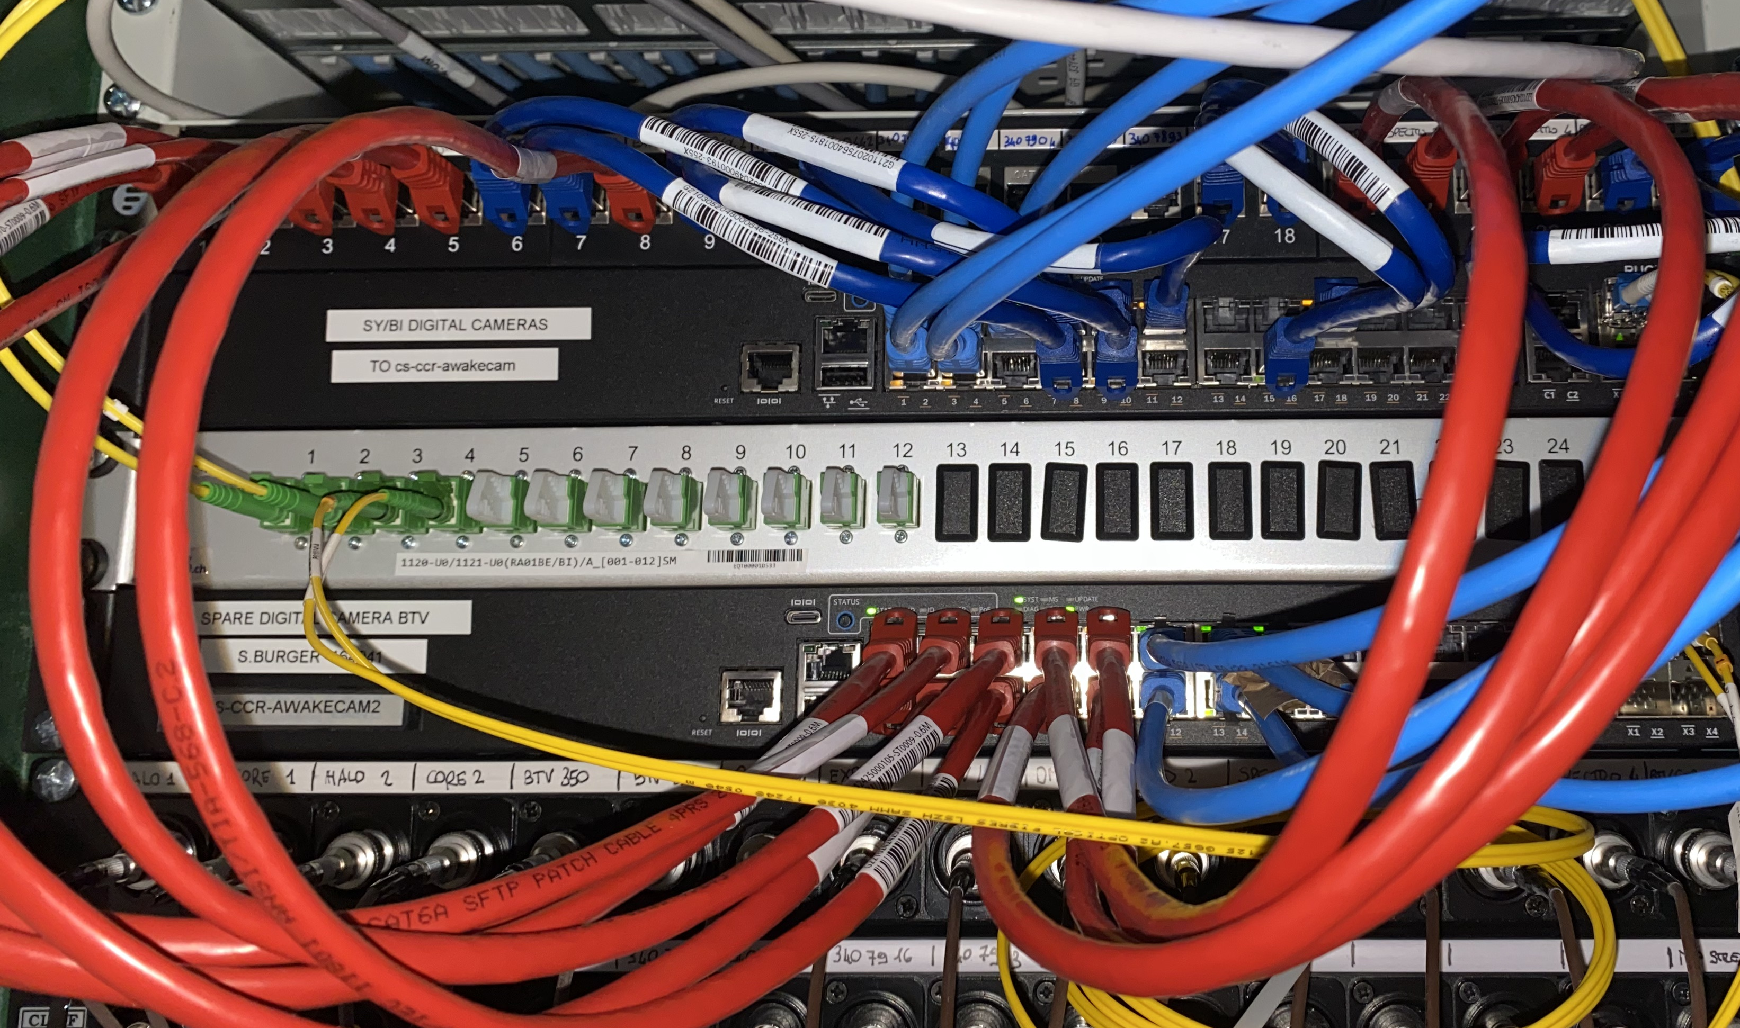
Digital cameras
Fibre link
Total of 37 cameras in use at present
Divided onto 3 servers each having 24 slots
14/24, 15/24 beam line cameras:
  BTVs, Halo monitors
  Other screens and service cameras
8/24 laser cameras:
  Laser diagnostics
  Laser virtual line
Frame loss issues in the past due to high network load
Mitigated by using ~half the free slots and delaying the time at which half of the cameras send the data
Camera
PoE switch
Server

Slide 9
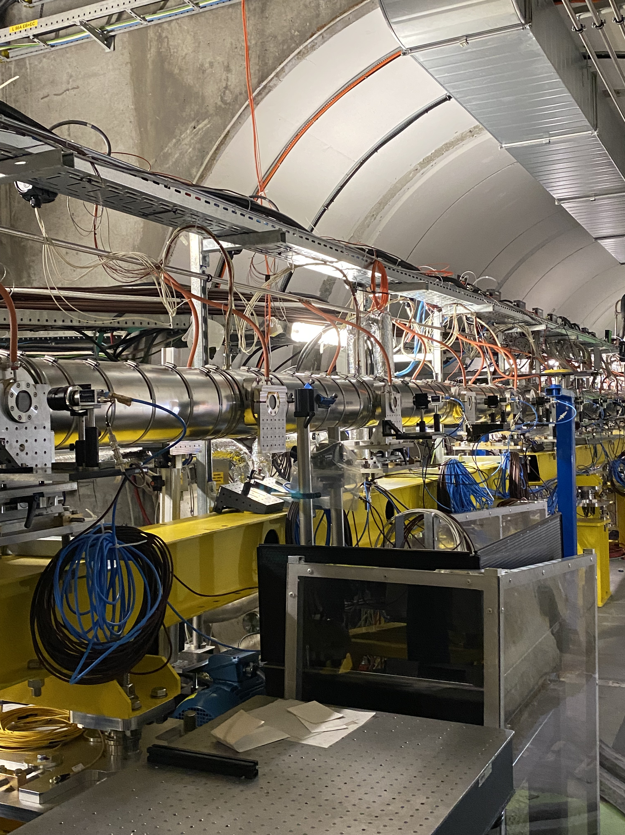
Digital cameras (2)
Viewports
10 plasma cameras installed for the last run
For viewing plasma light
Operation on SPS extraction went well on current servers
Decided not to install additional server

Slide 10
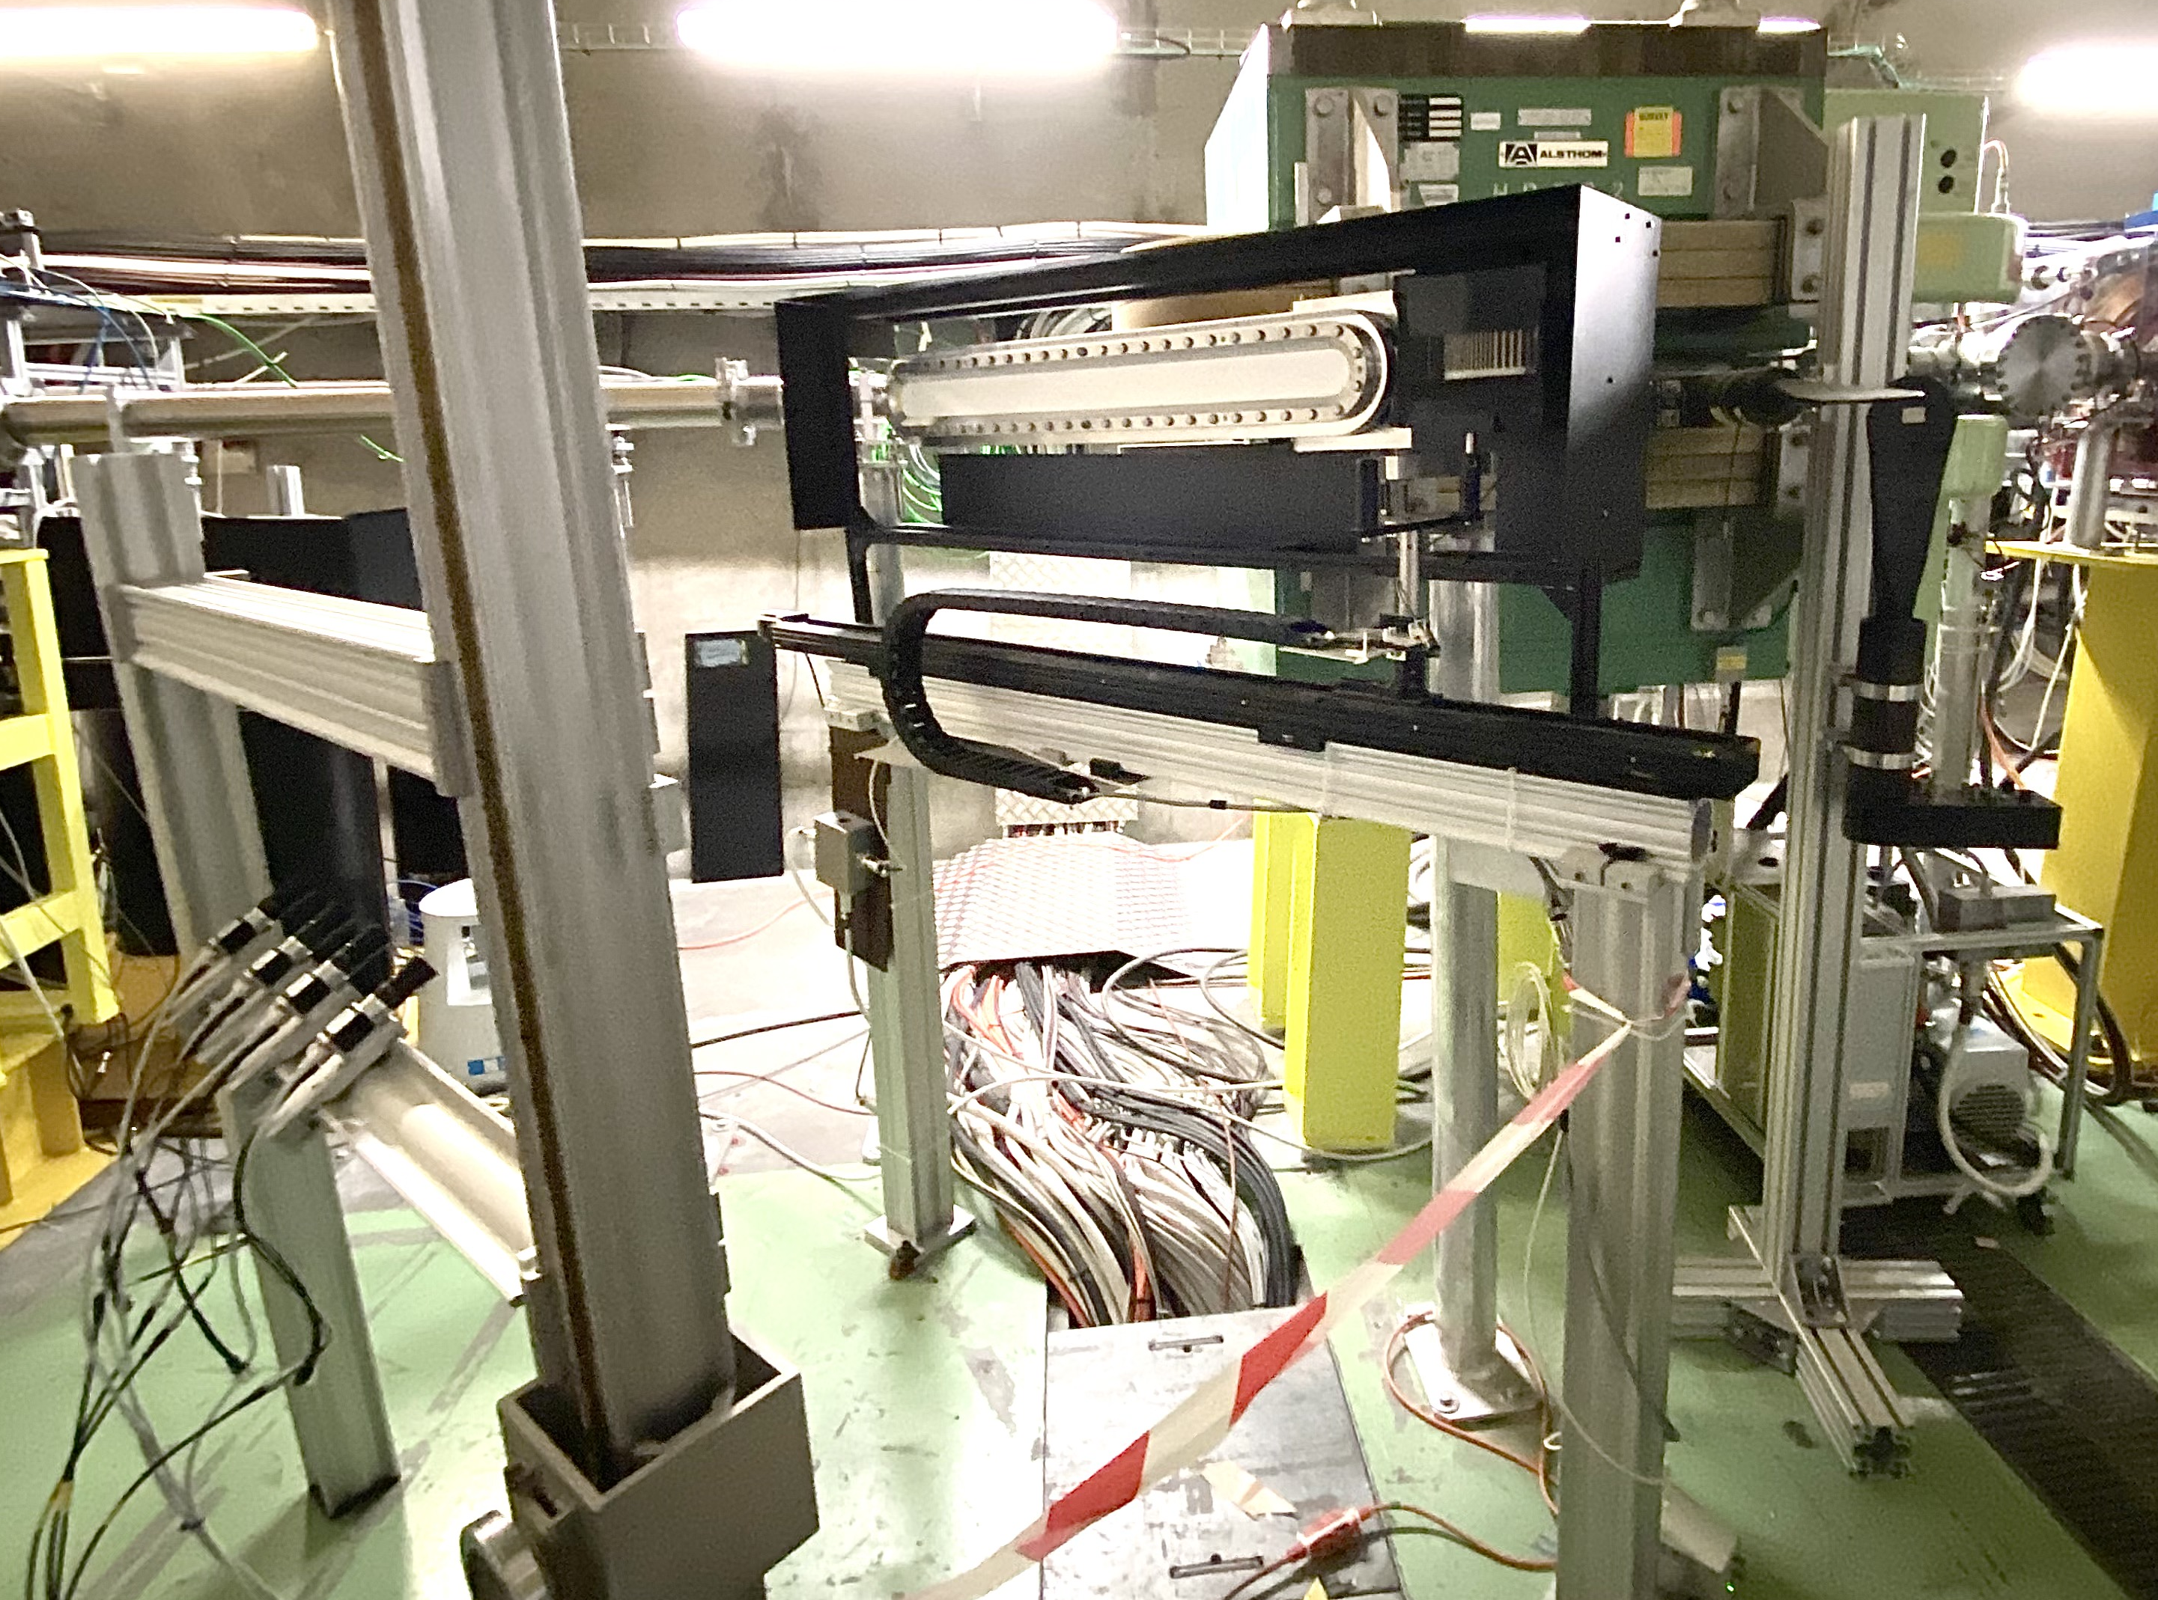
Digital cameras (3)
3 cameras will be added to the spectrometer camera array as part of the upgrade, see Fern’s talk
Connected to the free slots of current server
Plus one high-resolution camera close to the scintillator screen hung from above
If triggered at ≤ 1 Hz, should have no BW issues
Preparations are ongoing such as support construction, procurement of equipment etc.
Should be tested before the start of the run

Slide 11

For Run 2B
The teams of BI and AWAKE continue to:
Develop operational systems and conduct R&D

Slide 12
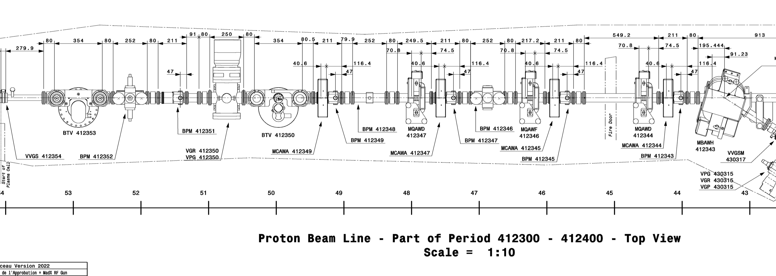
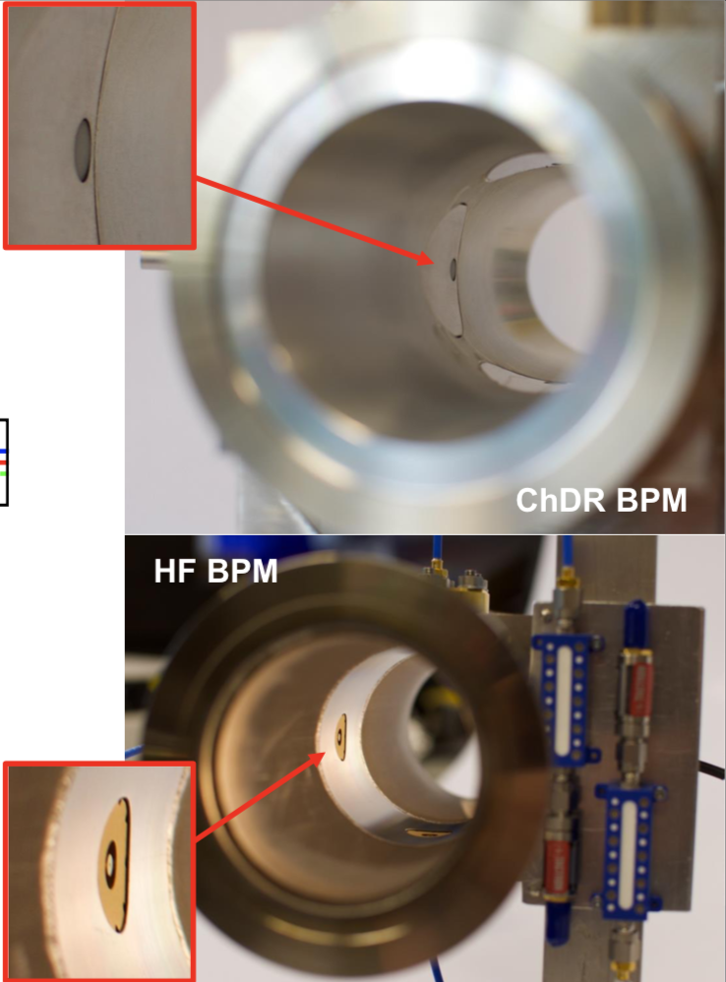
BPMs
Two ChDR BPMs in the common line before plasma cell, one is connected to the scope for R&D (Beth)
The other connected to the electronics developed by TRIUMF
End of last year, one additional digitiser and LO was installed in order to compare data from HF BPM (DESY conical buttons) and ChDR BPM with the same readout system
ChDR BPM
HF BPM
ChDR BPM
Plasma
cell
Beam

Slide 13
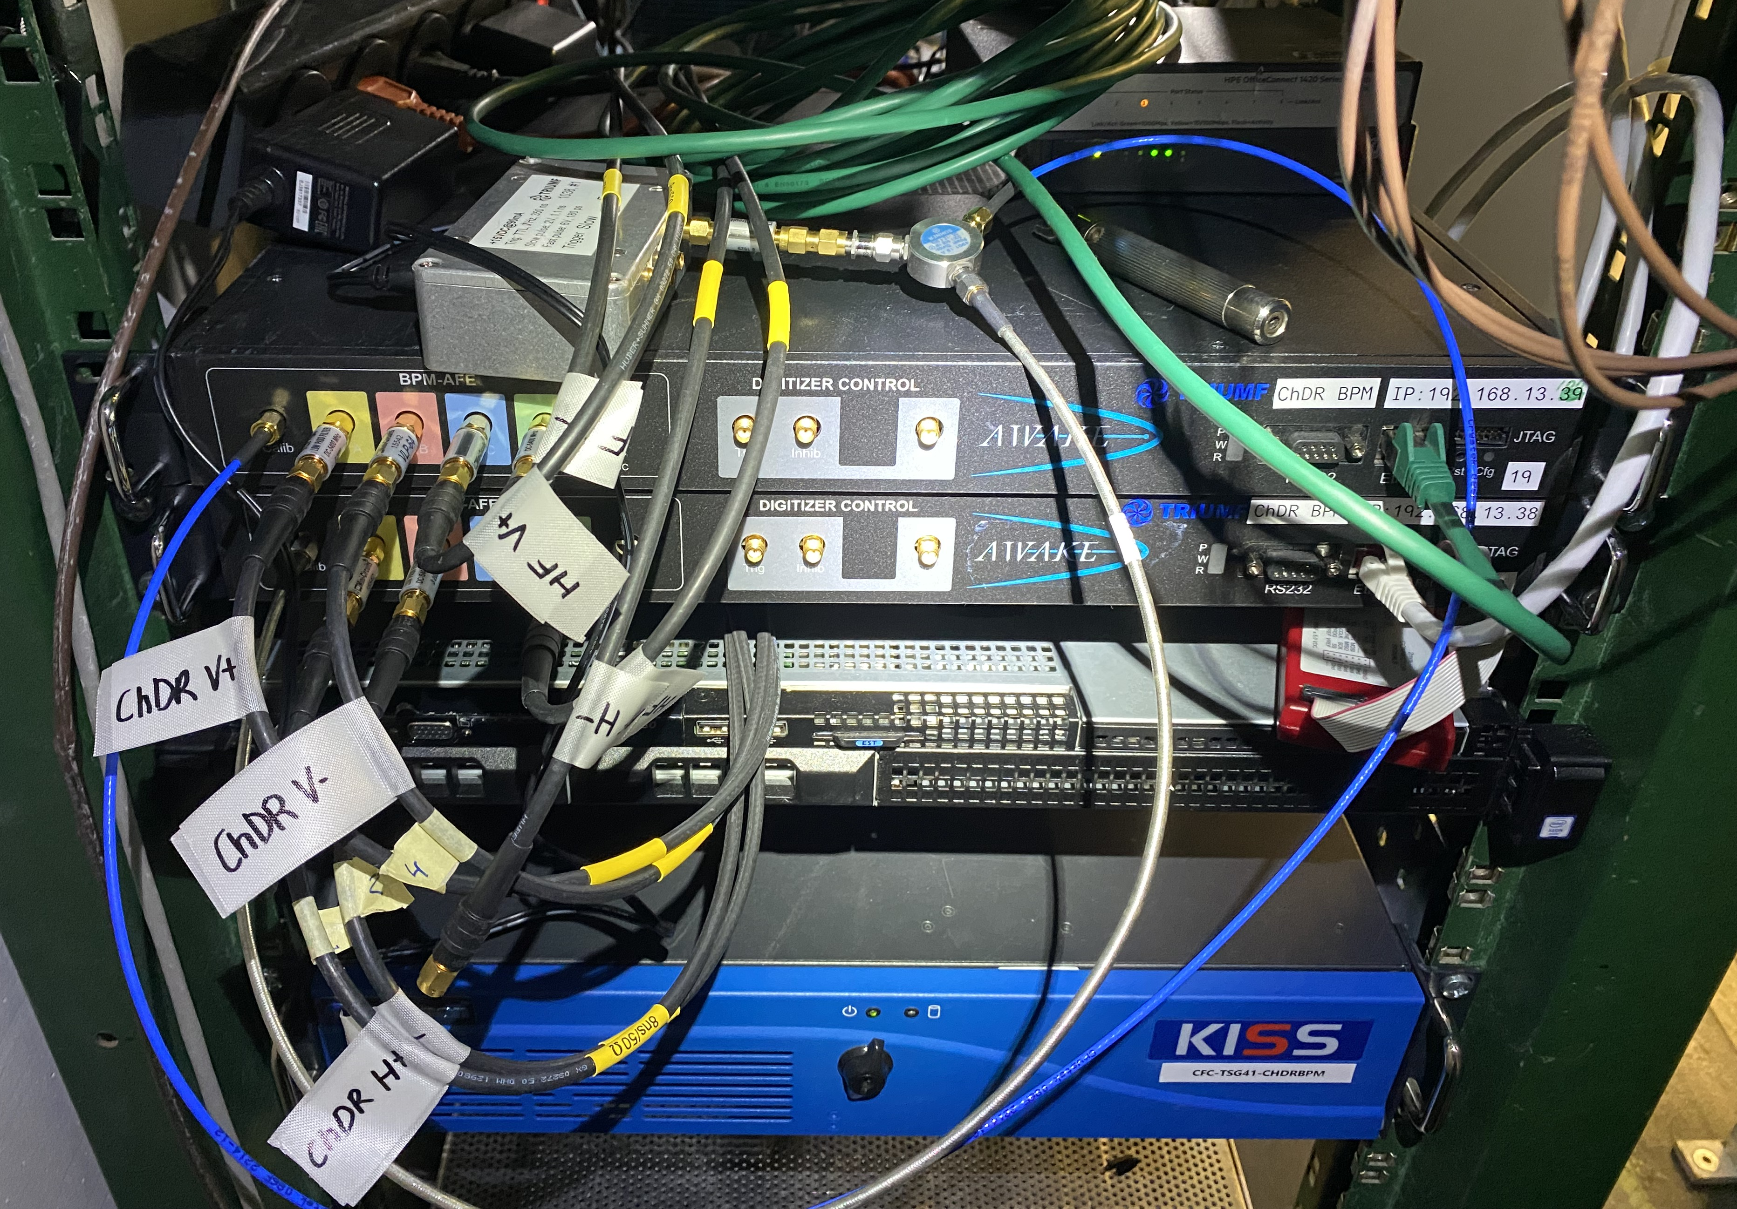
BPMs (2)
Calibration of the digitiser non-trivial and missing components/knowledge
Last run: the horizontal plane of ChDR BPM and HF BPM was connected to one calibrated digitiser, see Beth’s talk for the results
Since then, removed the digitisers out of the tunnel to 867
Fixed broken connector on the first digitiser and now in the process of calibrating
Done by using home-made TRIUMF pulser and programmable variable attenuator to feed each channel, scanning through the attenuation to get the non-linear response of the diodes
Last week, received the programmable variable attenuator
In contact with Shengli, designer of the electronics module
Hope to have ready by 22 March to coordinate with crane
Plans for this year: continuous logging of both ChDR BPM and HF BPM during runs, possible dedicated R&D with electrons outside of the runs

Slide 14
Conclusions
BI continue to support and maintain the beam instruments at AWAKE
The additional cameras from last run are operating well on the existing server, 4 more will be added for the spectrometer upgrade
Ongoing R&D on the ChDR and HF BPMs, data should be recorded with proton and electron beams in the upcoming runs

Slide 15
AWAKE BI meetings
Monthly BI meetings https://indico.cern.ch/event/1373952/
Join egroup ‘awake-instrumentation’ (egroups.cern.ch)

Slide 16
Thank you for your attention!

