Slide 1



Progress update on emittance diagnostics for Run 2c
Catherine Swain, Joseph Wolfenden, Debdeep Ghosal, Carsten Welsch
12/03/2024

Slide 2

Overview
Overview of emittance diagnostics
Setup of experiments at CLEAR – Oct 2023
Preliminary images and analysis
Next steps
Integration ideas at AWAKE
C. Swain (catherine.swain@liverpool.ac.uk)
AWAKE collaboration 12/03/2024
1

Slide 3
Emittance diagnostics
Optical versions of slit/pinhole scans and pepper-pot
Two methods under investigation:
  DMD – Digital Micro-mirror Device
  MLA – Micro Lens Array
Initial testing with transition radiation (OTR)
  Thin screens can be used with minimal impact on >1GeV beams
  Future tests planned with non-invasive OSR
C. Swain (catherine.swain@liverpool.ac.uk)
AWAKE collaboration 12/03/2024
2

Slide 4
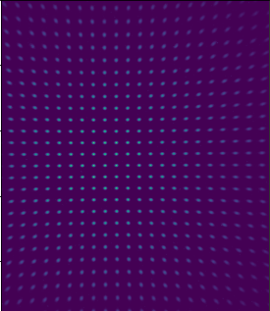
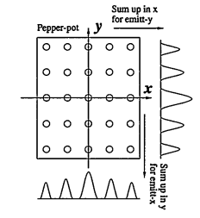
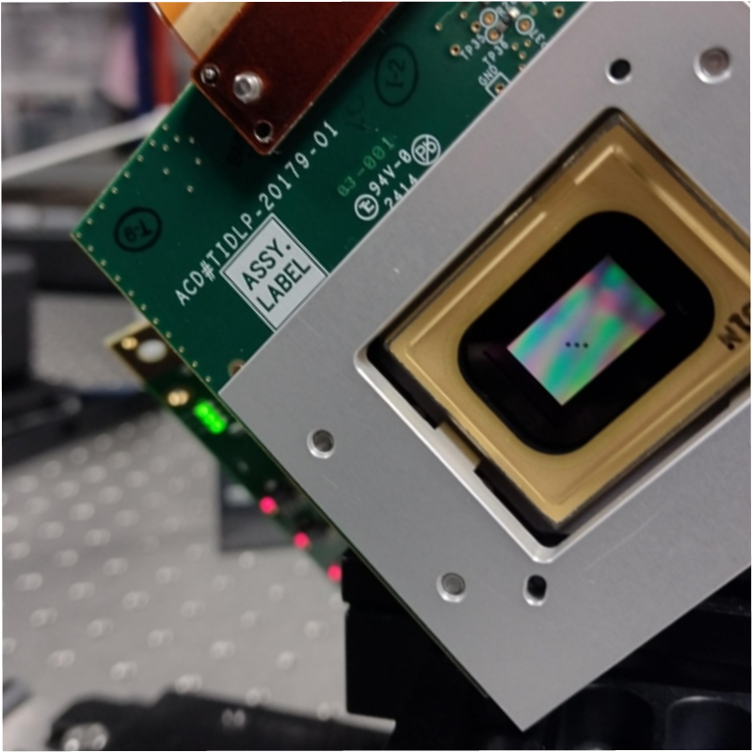
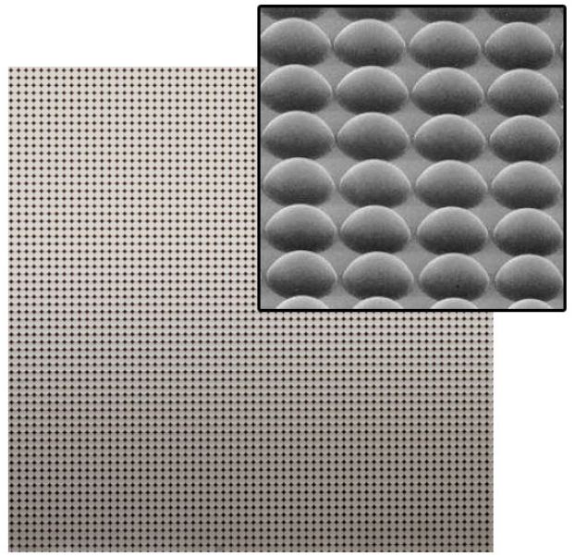

Pepperpot emittance measurements
Screen
Mask
j^{th} beamlet intensity
n_{j}
OTR
Beam
σ_{j}
Beamlets
x_{j}
[1]
[2]
[1]
[2]https://www.thorlabs.com/newgrouppage9.cfm?objectgroup_id=2861
[1] M. Zhang, "Emittance Formula for Slits and Pepper-pot Measurement", FERMILAB-TM-1988, Oct. 1996
C. Swain (catherine.swain@liverpool.ac.uk)
AWAKE collaboration 12/03/2024
3
Notes:
Targeting 10 GeV beams, pepperpot mks will be difficult to manufacture
High res, multi shot phase space mapping, single shot, fixed resolution emittance

Slide 5

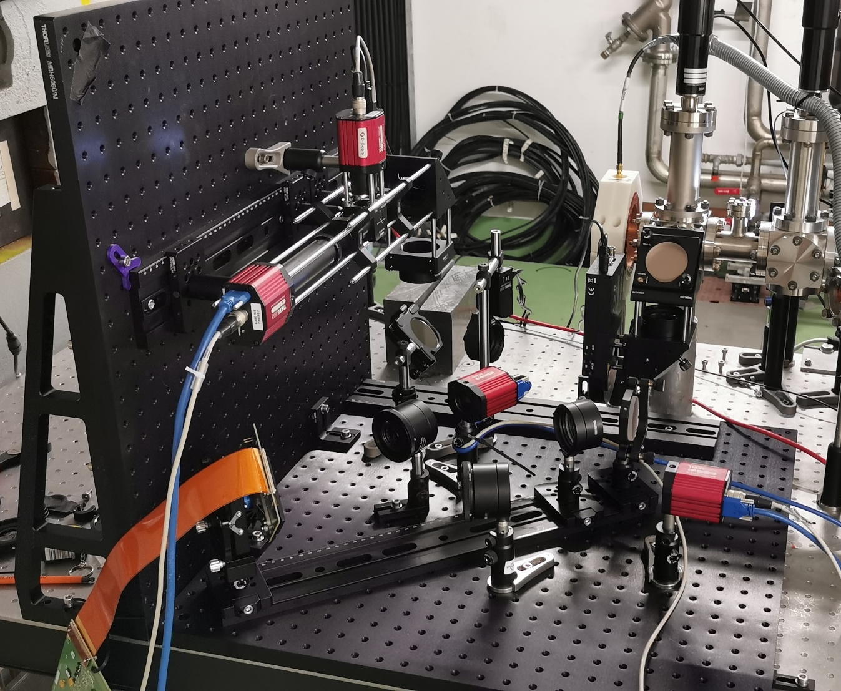
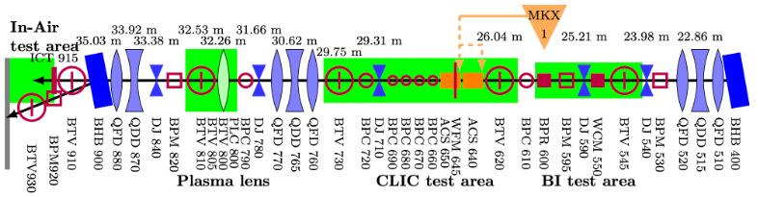
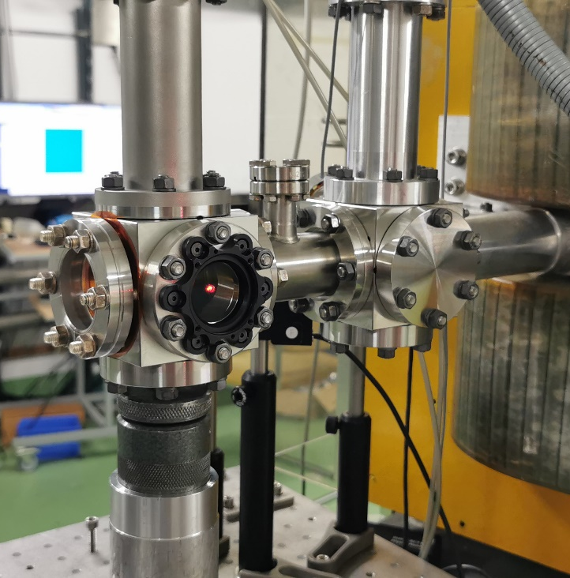
Experimental setup
MLA
DMD
C. Swain (catherine.swain@liverpool.ac.uk)
AWAKE collaboration 12/03/2024
4

Slide 6
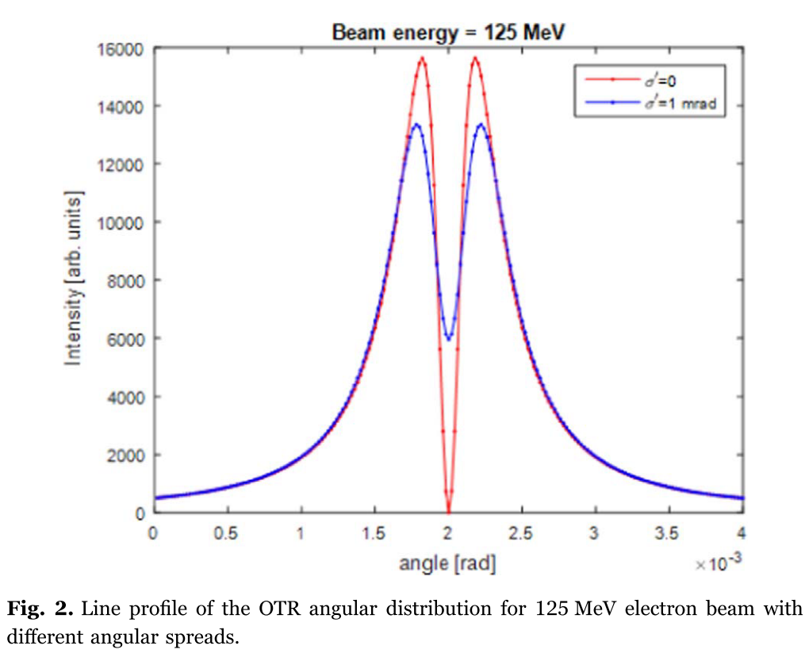
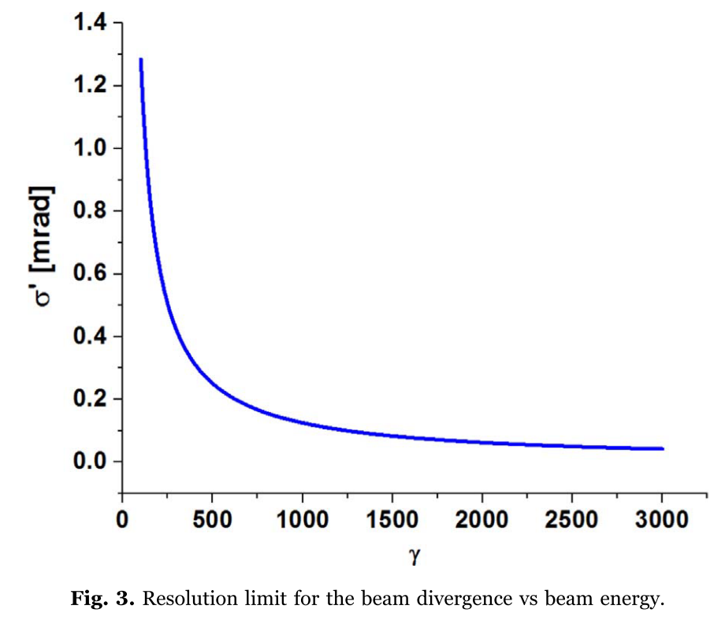

Measurements at CLEAR
$$ε_{x}^{2}=\left\langle x^{2}\right\rangle \left\langle {x′}^{2}\right\rangle −{\left\langle xx′\right\rangle }^{2}$$
Quadrupole
Triplet/Doublet
BTV
OTR
[3]
C. Swain (catherine.swain@liverpool.ac.uk)
AWAKE collaboration 12/03/2024
5
Notes:
Study divergence resolution by reducing correlation term
Estimate div with 910 and screen
No measurements at the low resolution limit because of the beam stability issues

Slide 7

















Measurements at CLEAR
$$ε_{x}^{2}=\left\langle x^{2}\right\rangle \left\langle {x′}^{2}\right\rangle −{\left\langle xx′\right\rangle }^{2}$$
$$ε_{}^{}$$
$$ε_{}^{}$$
$$ε_{}^{}$$
$$ε_{}^{}$$
$$ε_{}^{}$$
$$ε_{}^{}$$
$$σ^{2}$$
$$ε_{}^{}$$
$$ε_{}^{}$$
$$ε_{}^{}$$
$$ε_{}^{}$$
$$ε_{}^{}$$
$$ε_{}^{}$$
$$ε_{}^{}$$
$$ε_{}^{}$$
$$ε_{}^{}$$
$$ε_{}^{}$$
I
Quadrupole
Triplet/Doublet
BTV
OTR
C. Swain (catherine.swain@liverpool.ac.uk)
AWAKE collaboration 12/03/2024
6

Slide 8
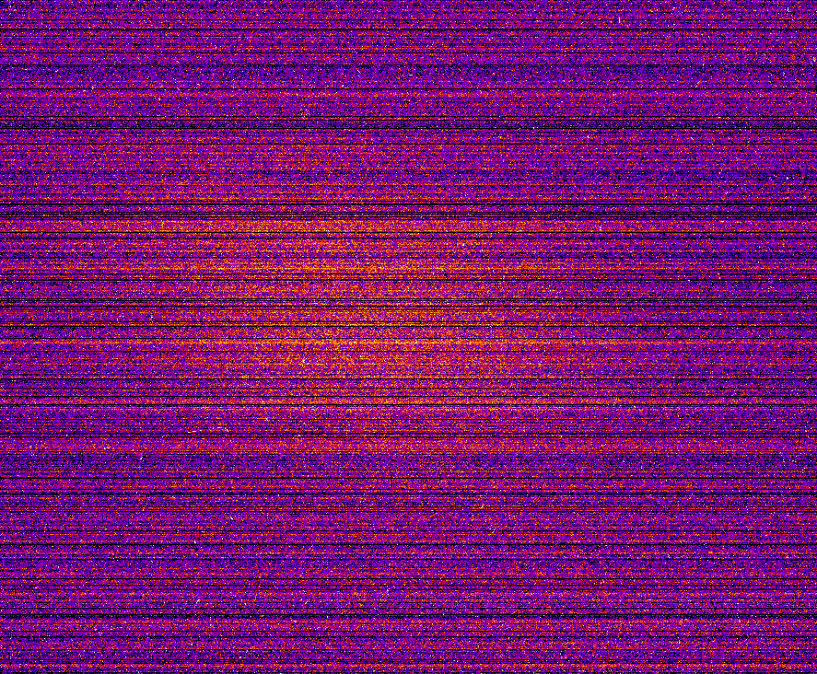
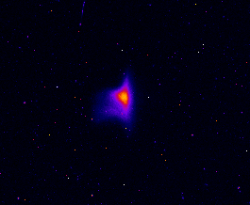
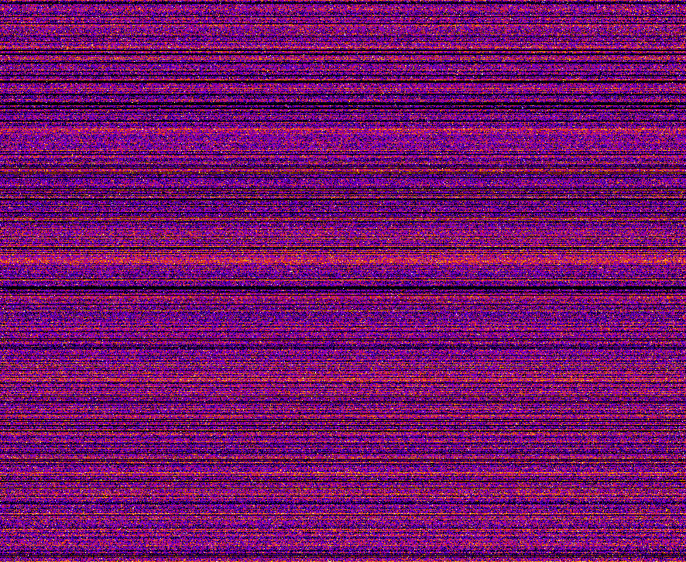
Preliminary images - DMD
3 bunches – 700 pC 204 MeV
22 bunches – 4 nC 204 MeV
Spatial
Angular
J. Wolfenden (joseph.wolfenden@cockcroft.ac.uk)
13th AWAKE Instrumentation meeting 18/10/2023
C. Swain (catherine.swain@liverpool.ac.uk)
AWAKE collaboration 12/03/2024
7
Notes:
All images are from sCMOS, no intensified cameras

Slide 9
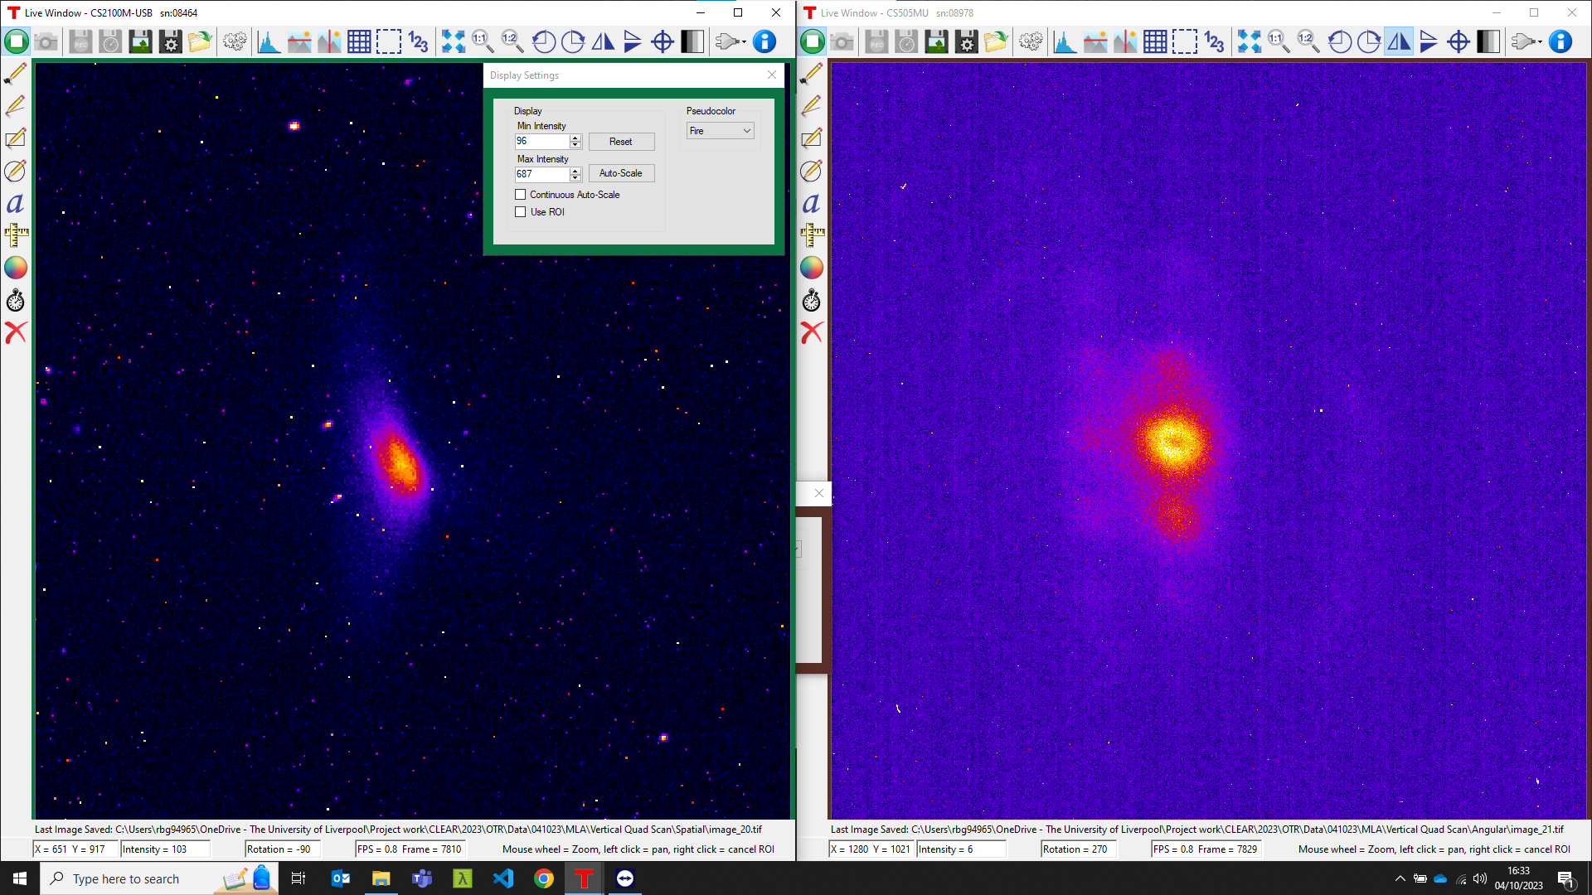
Preliminary images - MLA
3 bunches – 700 pC 204 MeV
Spatial
Angular
C. Swain (catherine.swain@liverpool.ac.uk)
AWAKE collaboration 12/03/2024
8
Notes:
We also have single shot images, they just don’t look as good so they’re not shown here

Slide 10
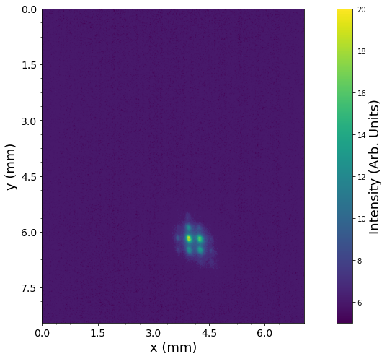
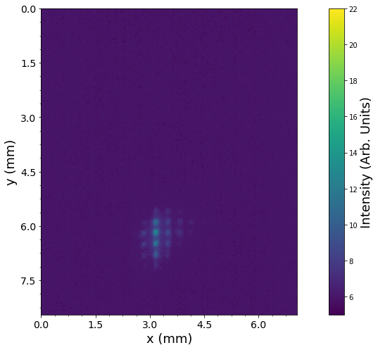
MLA single shot emittance
C. Swain (catherine.swain@liverpool.ac.uk)
AWAKE collaboration 12/03/2024
9

Slide 11
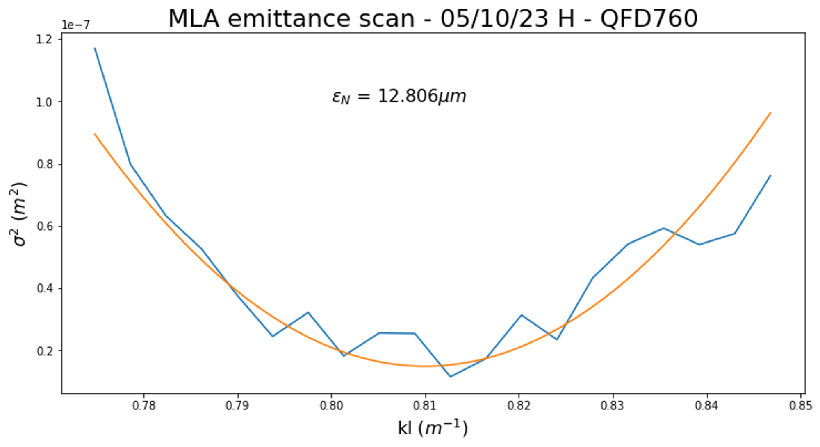
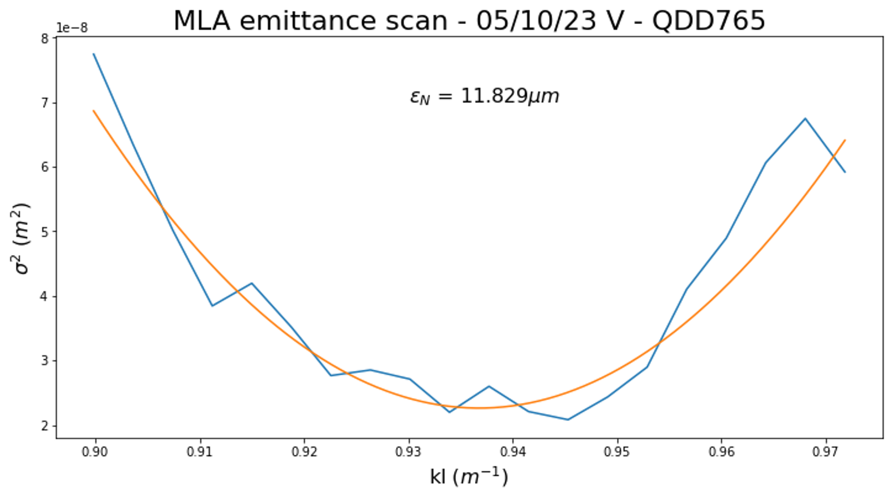
MLA quad scans
C. Swain (catherine.swain@liverpool.ac.uk)
AWAKE collaboration 12/03/2024
10
Notes:
They don’t look as smooth (and we have no errors) as these scans are taken single shot, instead of by averaging images. This is so we can compare each point to the single-shot angular images

Slide 12
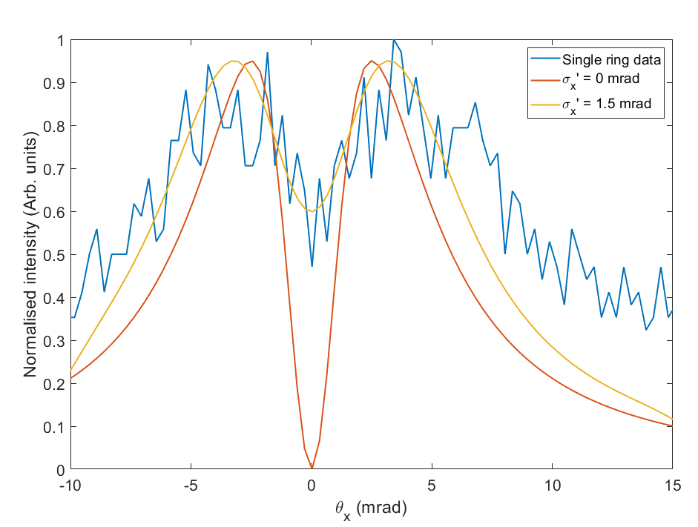
Single-shot emittance
[1]
C. Swain (catherine.swain@liverpool.ac.uk)
AWAKE collaboration 12/03/2024
11

Slide 13
Next steps and outlook
Finish analysis of MLA data and quantify resolution and operation range
Identified improvements to DMD system – need implementing and testing in lab
Return to CLEAR to test DMD improvements – Q2
Return to CLEAR to test MLA improvements and operation with OSR – Q4
Testing systems at CLARA FEBE
Application of ML and MLE-ML model to betatron radiation diagnostic (UCLA and UoM)
C. Swain (catherine.swain@liverpool.ac.uk)
AWAKE collaboration 12/03/2024
12
Notes:
From Debdeep: Implementing and testing with SRW to simulate synchrotron spectra for a shorter CLEAR-like beamline (i.e. if dipole-BHB400 would have been used, which is much upstream in the beamline)- the simulation seems working at the moment. Next will be- modifying the code for a more complex entire CLEAR beamline (i.e. using the dipole-900 which is further downstream) and considering all the optical components like- extra quadrupole magnets, corrector magnets, dipole magnets etc.) and calculate the synchrotron radiation spectrum (spectral intensity etc.) and the electric field wavefront propagation.
E spread – we will simulate and test higher andwill include in paper

Slide 14
Next steps and outlook
Possible integration scenarios
Pre-plasma
  OTR off existing/planned screens
    DMD or MLA, depending on requirements
  OSR from dipole in e⁻ beam line (virtual diagnostic)
    Viewport from within the dipole or an off-axis screen to extract downstream
Post-plasma
  OTR on common beamline will not work given p⁺/e⁻ intensity difference
    Beam separation (for HEP applications?)
  OSR from spectrometer dipole?
    Again, any dipoles in potential separation optics could be used
  Would require MLA or future single-shot version of DMD
C. Swain (catherine.swain@liverpool.ac.uk)
AWAKE collaboration 12/03/2024
13
Notes:
Will need physics model to go alongside, but this would be good to add to the proton beam diagnostics for monitoring the SSM during the next beam time. No more invasive than any other screen based diagnostic, and simple to set up and get in situ. We could use the cameras from the DMD setup currently at AWAKE
From Joe: this would work with OTR, but our preference would be OSR, which we plan to demonstrate this year. There are two OSR areas from the two dipoles, which I mentioned in the collaboration meeting last year in Sweden. OTR type measurements could be tested this year on the test beam line which Stefano has suggested, but the OTR post-acceleration would need the electron and protons to be separated. OTR measurements of the proton beam could be useful for SSM measurements - this would need input from Patric - we have data from CLEAR comparing broadband an filtered data which could feed into this.

Slide 15
Thanks for listening,
any questions?
C. Swain (catherine.swain@liverpool.ac.uk)
AWAKE collaboration 12/03/2024
Notes:
Betatron: Initial idea is- using PyWarpX, to calculate betatron radiation generated by the motion of an electron beam in a magnetic field., use those generated datasets to train an ML model and a hybrid MLE-ML model to predict the beam spot size correctly. (training part of the ML model is ongoing currently)
Then perform the same for the case of a proton beam and compare the betatron spectra for them.
Final idea would be: investigating the case of an electron beam following the proton beam to observe the radiation effects more effectively

