Slide 1


Getting ready for Run 2c
Eloïse Guran, CERN
AWAKE Collaboration meeting
11-13 March 2024

Slide 2
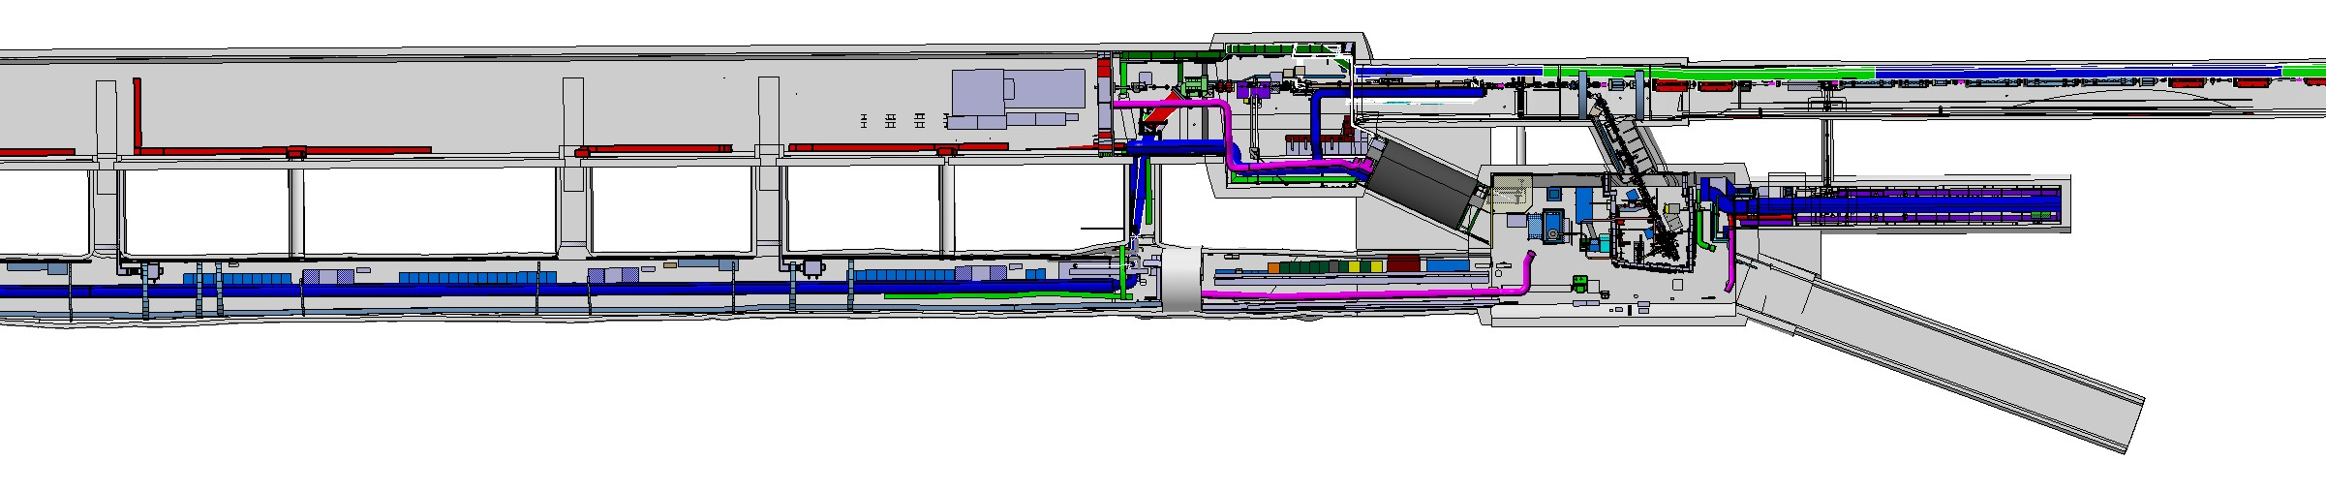
Getting to run 2c
Ans’ talk
CNGS area – to be dismantled
Run1
&
Run2ab
TSG45
TSG44
TSG43
TSG42
AWAKE CNGS Area Dismantling is before & during LS3 (2025-2026)
Run2c Integration/installation/commissioning is during LS3 (2026-2028)
Laser beam compressor 2
Spectrometer
2 Plasma Cells
Laser beam compressor 1
Run2c
2 WDL Chiller Units
2 Electron Sources
UV laser room
Klystrons

Slide 3
Getting to run 2c
Step 2: CNGS dismantling
Step 1: dismantling of run 2b
Run1
TSG45
TSG44
TSG43
TSG42
AWAKE CNGS Area Dismantling is before & during LS3 (2025-2026)
Run2c Integration/installation/commissioning is during LS3 (2026-2028)
Laser beam compressor 2
Spectrometer
2 Plasma Cells
Laser beam compressor 1
Run2
Step 3: Run2c installation
2 WDL Chiller Units
2 Electron Sources
UV laser room
Klystrons

Slide 4
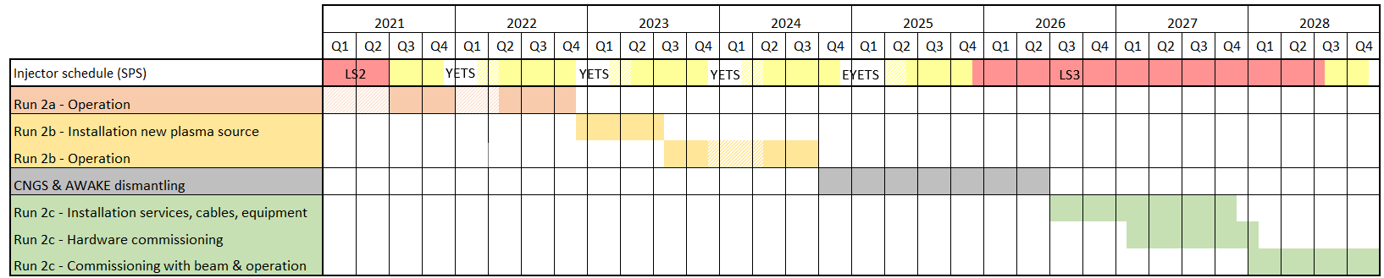
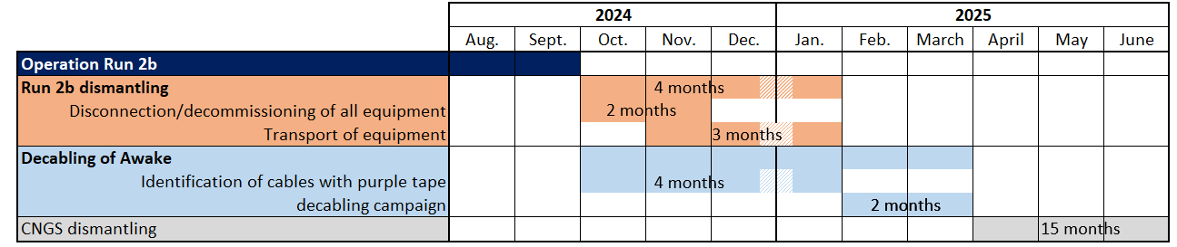
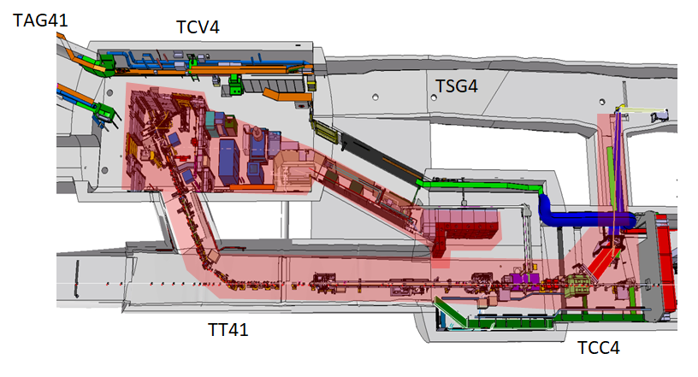
Timeline for AWAKE dismantling & decabling
Step 1
End of Awake operations: September 2024
Run 2b dismantling: 2months of decommissioning + 3 months of transport
Decabling: ~2 months of works
Decabling = all cables linked to a dismantled equipment + obsolete cables

Slide 5
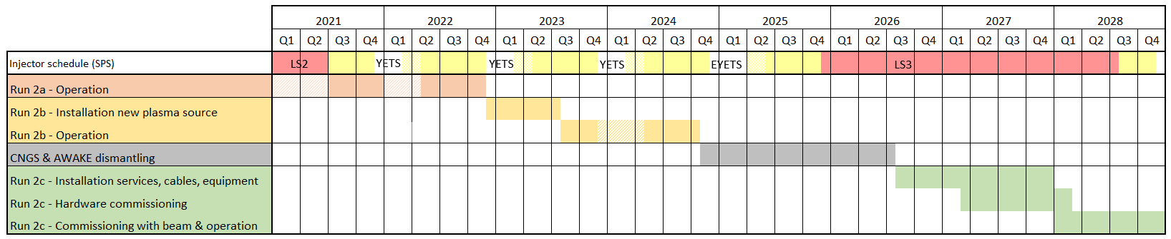
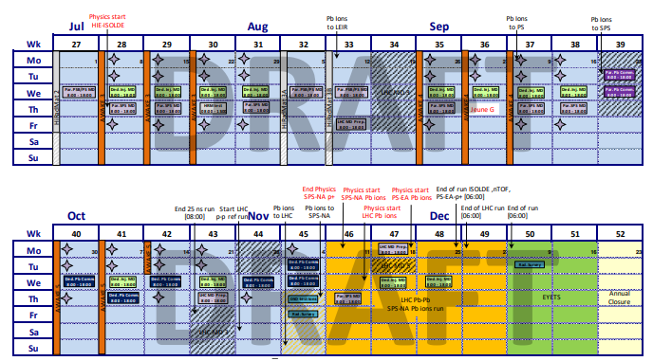
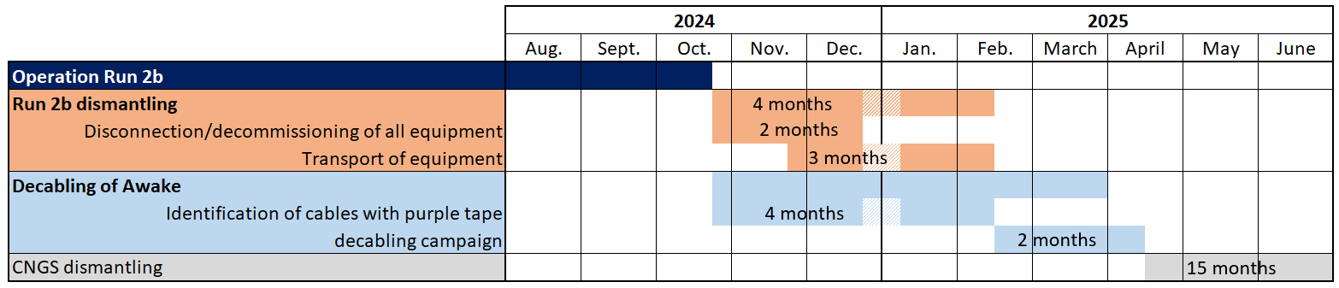
Timeline for AWAKE dismantling & decabling
Step 1
DRAFT
End of Awake operations: October 2024
Run 2b dismantling: 2months of decommissioning + 3 months of transport
Decabling: ~2 months of works
If the 2 additional weeks of beam approved → ~1month shift

Slide 6
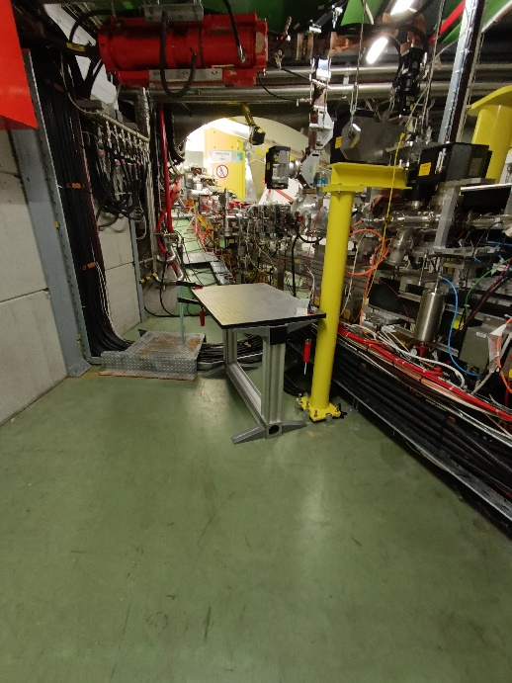
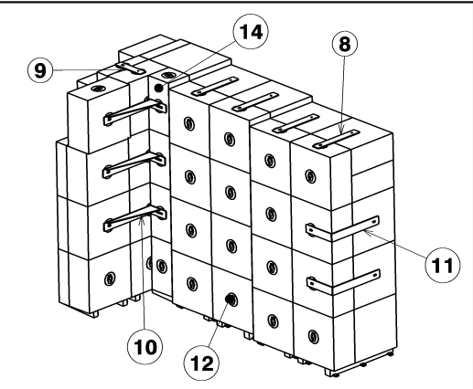
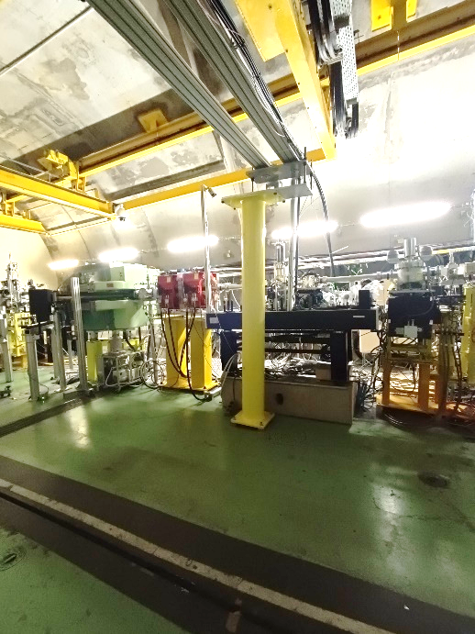
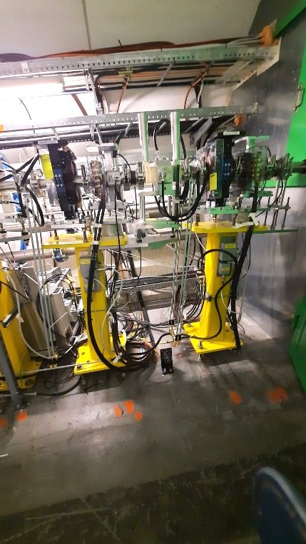
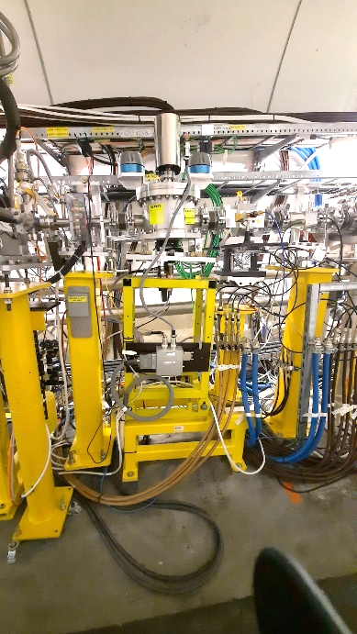
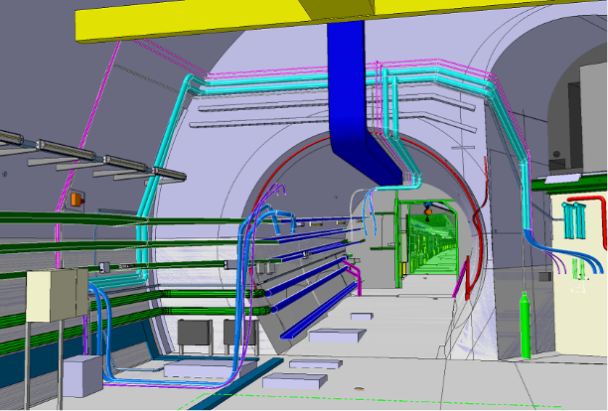
Run 2b dismantling
Step 1
Estimated:
15T of equipment
  11 racks
  8 optical tables
  17 BTVs + 6 BPMs
  28 magnets
  RF gun + klystron + waveguides
  Plasma source
  ~20 girders
50T of shielding blocks (~90blocks)

Slide 7
Dismantling sequence for transport
1. Klystron area (klystron + racks)
2. Bunker structure :
a. doors
b. shielding blocks
5. Streak room
a. walls & doors
b. optical table
c. 2 racks
d. 2nd optical table
4. Dismantling of sector door
6. Optical line
a. Horizontal support
b. Vertical structures (x2)
3. Items inside the bunker :
a. electron injector assembly
b. etc
7. TCC4 shielding
8. Spectrometer structure
9. Electron line
10. TCC4 equipment area

Slide 8
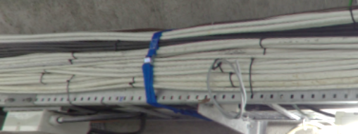
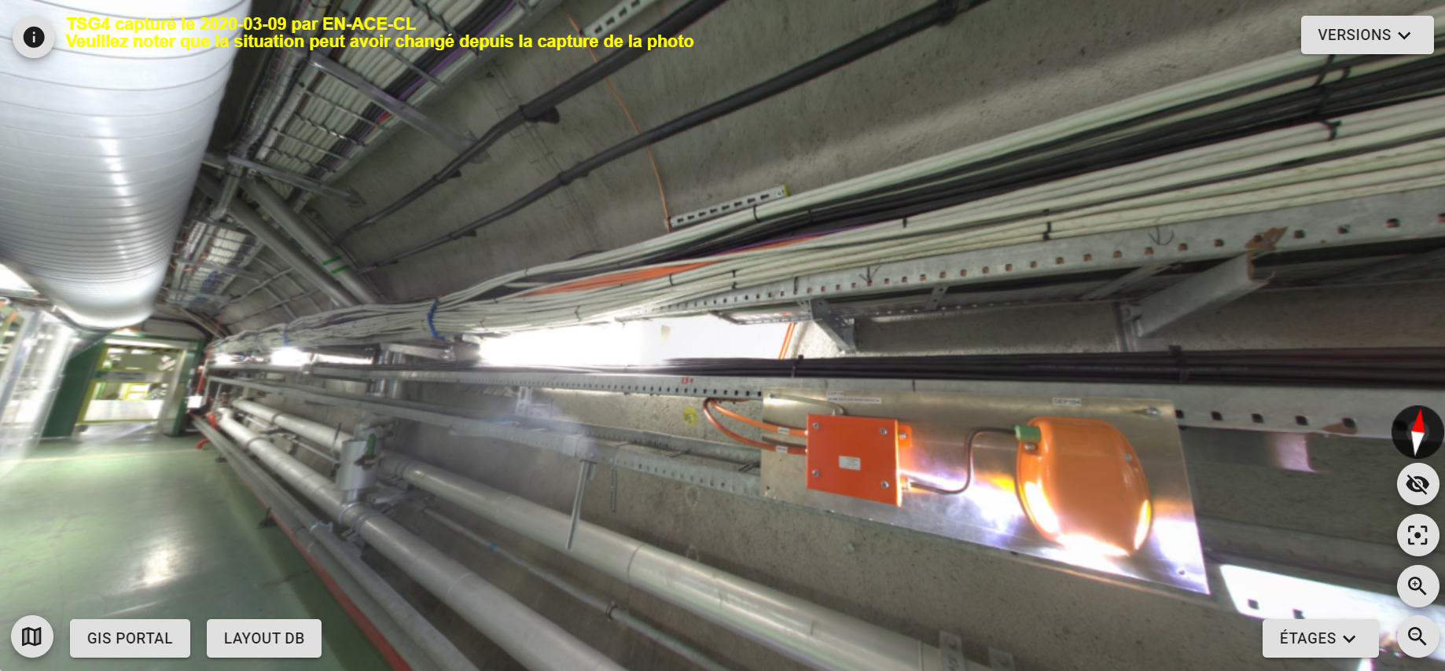
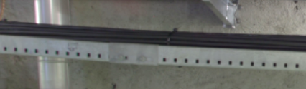
Motivation for decabling
Step 1
Cable trays in Awake are 400% full
Main goal of decabling: ensure a clean infrastructure for future cables needed for run2c

Slide 9
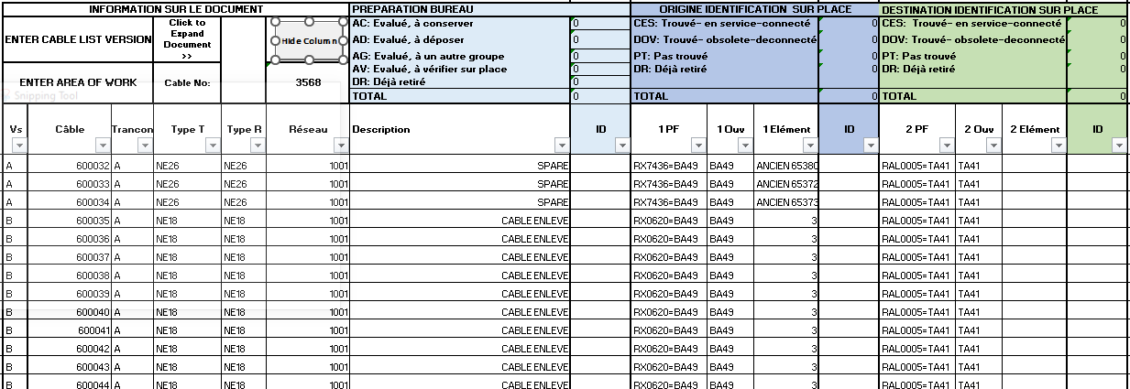
Decabling process
Step 1
Important steps to take before the summer
List of cables (given by EN-EL)
Pre-identification at the office
Finding the cables on-site + identifying with yellow tape
Final list of cables to give back to EN-EL
Preparation of lockout document
Validation of lockout
Decabling campaign
February 2024
March 2024
March/April 2024
May/June 2024
Summer 2024
December 2024 /January 2025
February & March 2025
Input received
NEXT STEP
Two main documents of work :
the cable list (DEC): it states clearly which cable should be removed or not
  approved on edms by all equipment owners
the lockout document: it states which equipment/racks are going to be locked out
  approved on edms by equipment owners, group and department leaders
Example of cable list

Slide 10
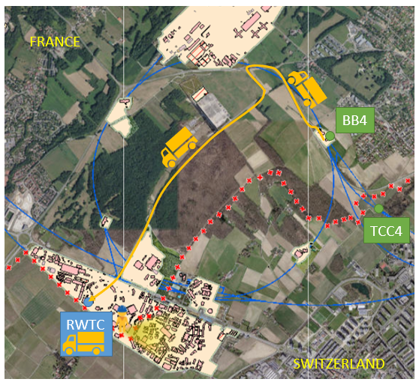
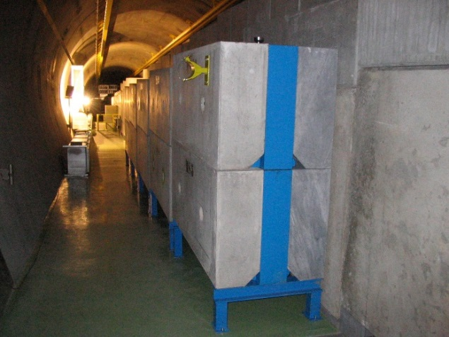
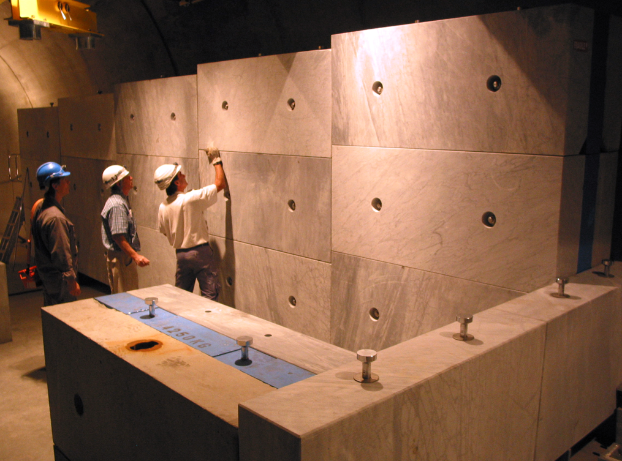
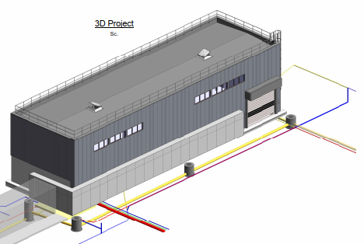
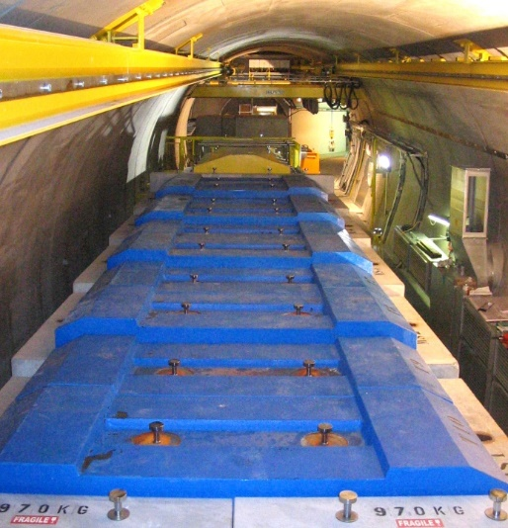
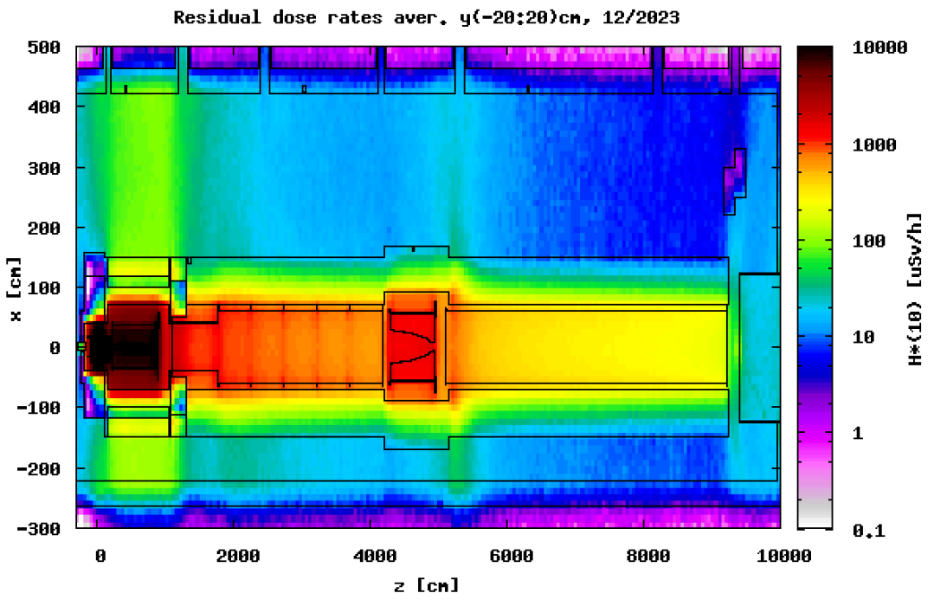
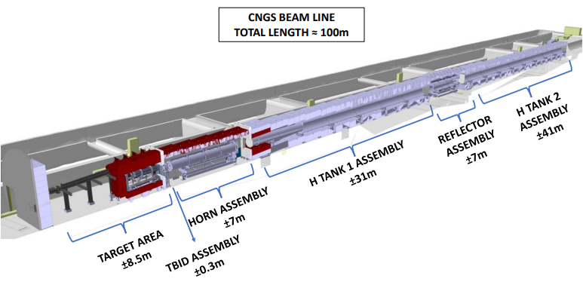
CNGS dismantling
Ans’ talk
Step 2

Slide 11
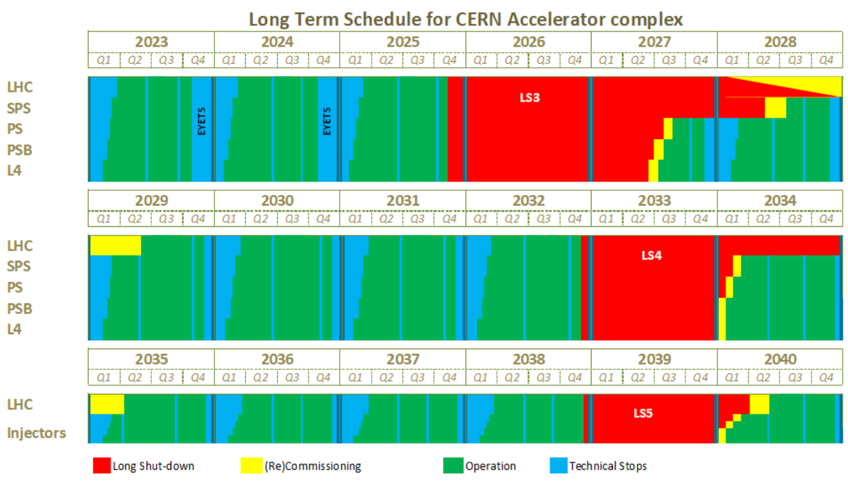
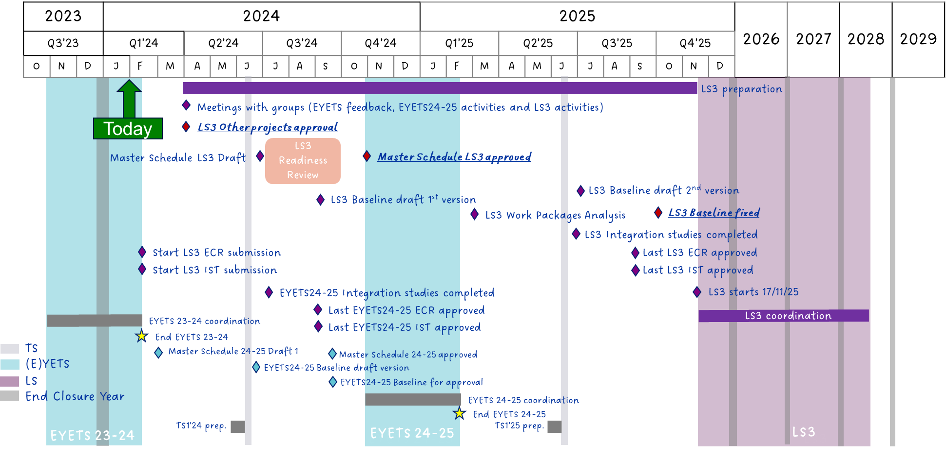

Run 2c installation
Step 3
Installing run 2c during LS3 brings some constraints:
  Availability of resources
  Respect deadlines linked to LS3 even though the project is not yet approved
For AWAKE, next milestones:
  PLAN activities by 31.03.2024
  Cabling request by 15.04.2024
  Electrical network request by 15.04.2024
  Review of run2c schedule for June 2024
Run2b operation
Run2b dismantling
CNGS dismantling
Run 2c installation

Slide 12
General Awake roadmap
2023 | 2024 |  |  |  |  |  |  |  |  |  |  |  | 2025
Dec. | Jan. | Feb. | March | April | May | June | July | Aug. | Sept. | Oct. | Nov. | Dec. | Jan. | Feb. | March
Inventory of equipment
Establish sequence for dismantling
Decommissioning
Transport out
Run 2b dismantling
Listing cables for decabling
Pre-identification of cables
Preparation of lockout document
Identification of cables (purple tape)
Decabling
Decabling
Input Awake activities in PLAN
Cabling requests
Draft schedule
LS3 readiness review
EL network request
Review installation planning
Run2c preparation
Review integration layout of run2c
12

Slide 13
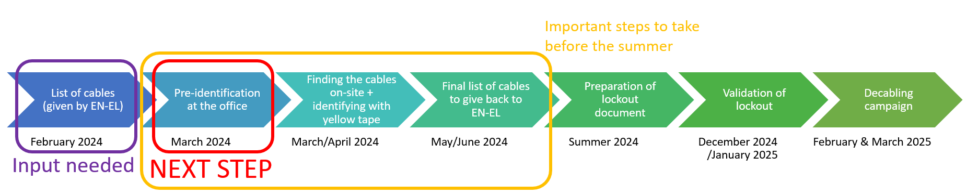
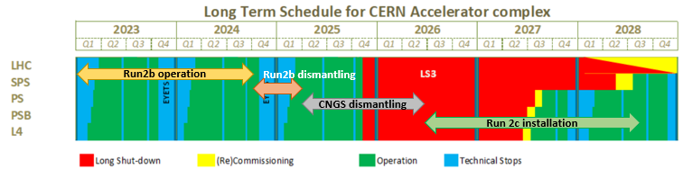
Summary
3 Main steps towards run 2c readiness:
Step 1: AWAKE run 2b dismantling & decabling
  Takes place from October 2024 to January 2025
  Decabling : Pre-identification of cable list
Step 2: CNGS dismantling
Step 3: new installation → Next milestones to prepare the path for run 2c:
  Before 31.03.2024
    Enter your activity in PLAN
  Before 15.04.2024
    Send cabling request
    Send request for new electrical network
  For June 2024
    Review run 2c installation schedule

Slide 14
Back up slides

Slide 15
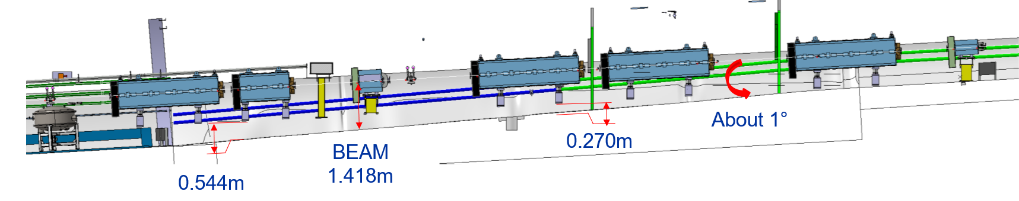
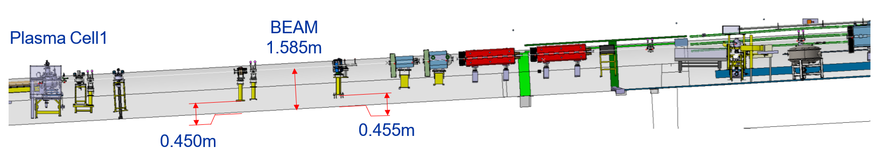
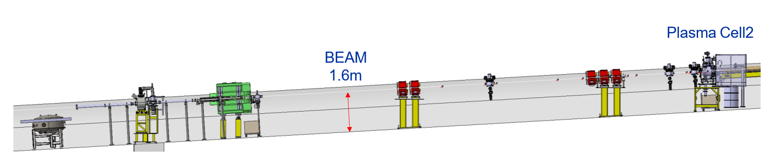
Girders re-usability
All girders currently in use from QTLF.412208 to plasma cell will need an adaptation to be re-used for run 2c.
QTLF412208
QTLF412200

Slide 16
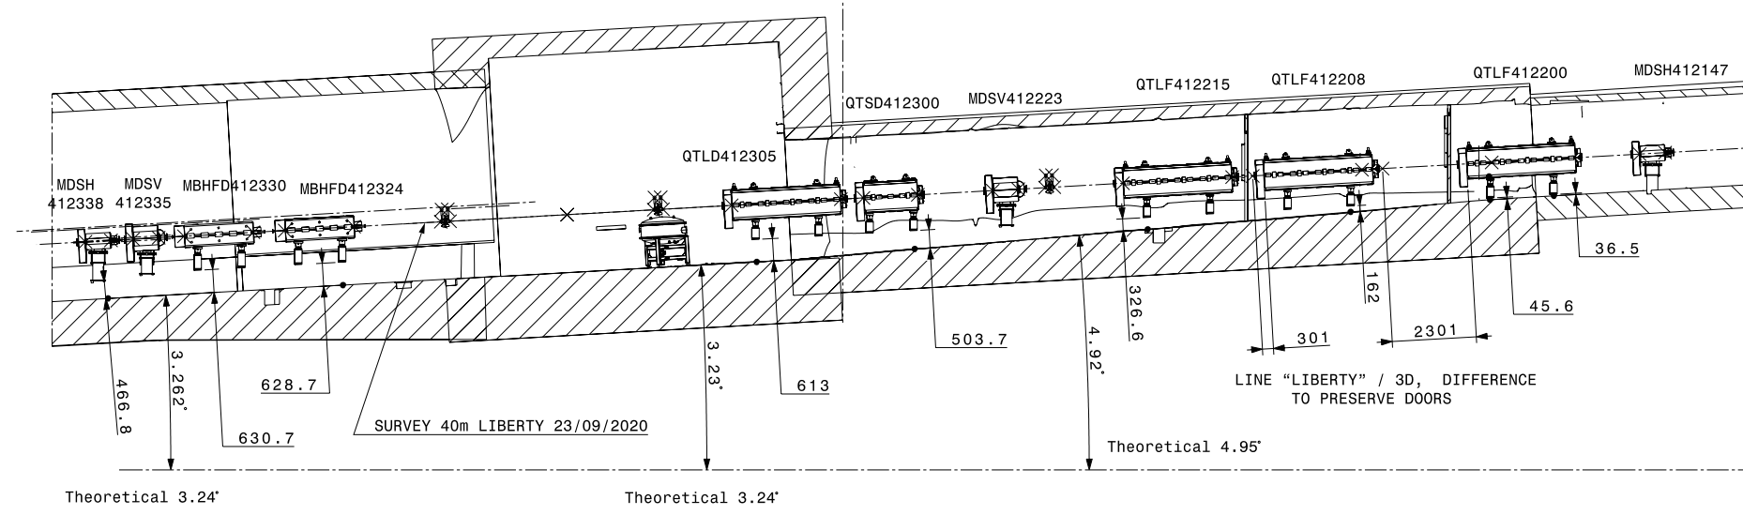
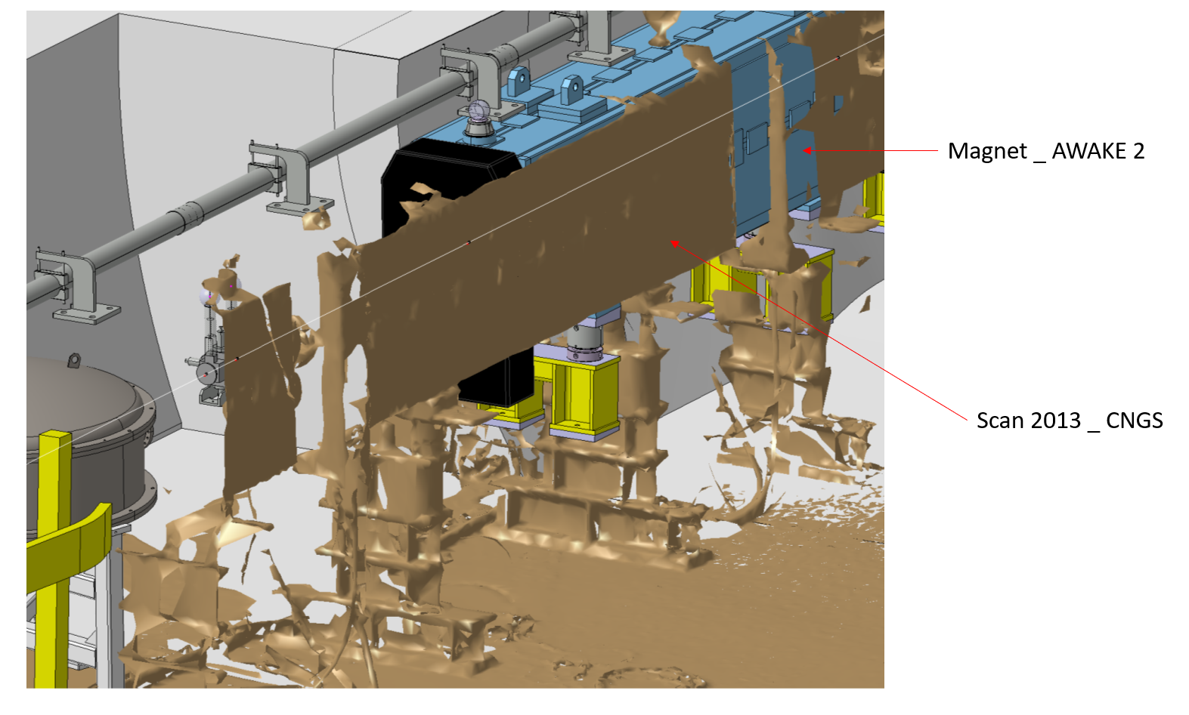
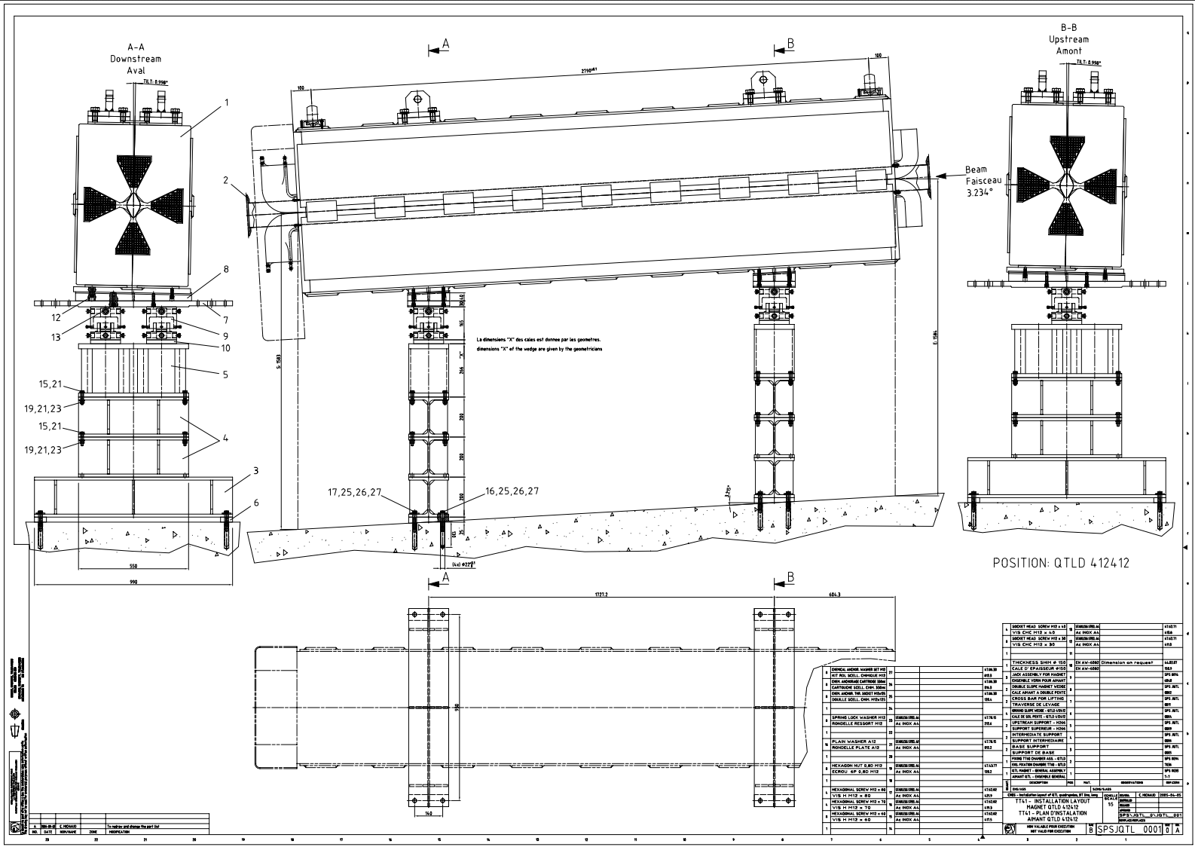
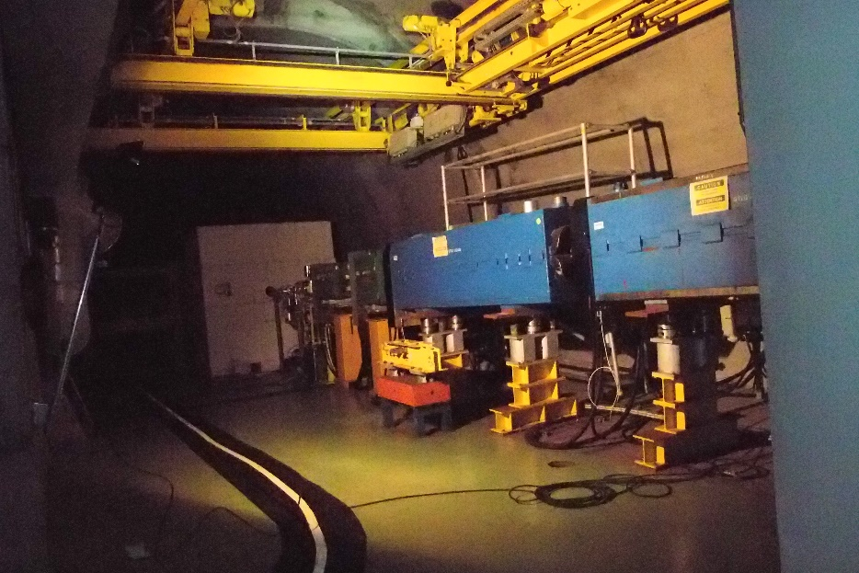
Girders re-usability
Missing height ranges from 162mm to 613mm.

Slide 17
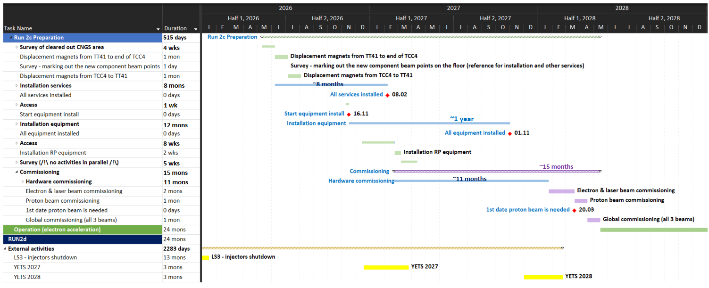
AWAKE run 2c installation schedule
As presented in the CSR of 2021
To be updated

