Slide 1




11-13 March 2024
AWAKE Collaboration meeting, University of Liverpool, Liverpool, UK
Betatron radiation in AWAKE Run 2 and beyond
H. Saberi, G. Xia, J. Mcgunigal, L. Liang, J. Farmer, A. Pukhov, D. Ghosal and C. Welsch
Department of Physics and Astronomy, University of Manchester, Manchester M13 9PL, UK
Cockcroft Institute, Warrington, WA4 4AD, United Kingdom
CERN, 1211 Geneva, Switzerland
Max Planck Institute for Physics, 80805 Munich, Germany
Heinrich Heine University Düsseldorf, 40225 Düsseldorf, Germany
University of Liverpool, Liverpool, UK

Slide 2
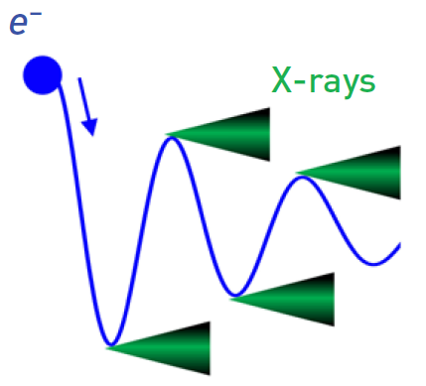
Betatron radiation
Plasma accelerators exhibit very strong accelerating and focusing fields.
The wiggling electrons emit radiation known as betatron radiation.
Advanced X-ray photon source for imaging applications.
BR is of interest for non-invasive beam diagnostic
  LWFA in several labs
  PWFA at FACET experiment
  AWAKE

Slide 3
Betatron radiation in AWAKE Run 2
Notes:
Image by freepik

Slide 4
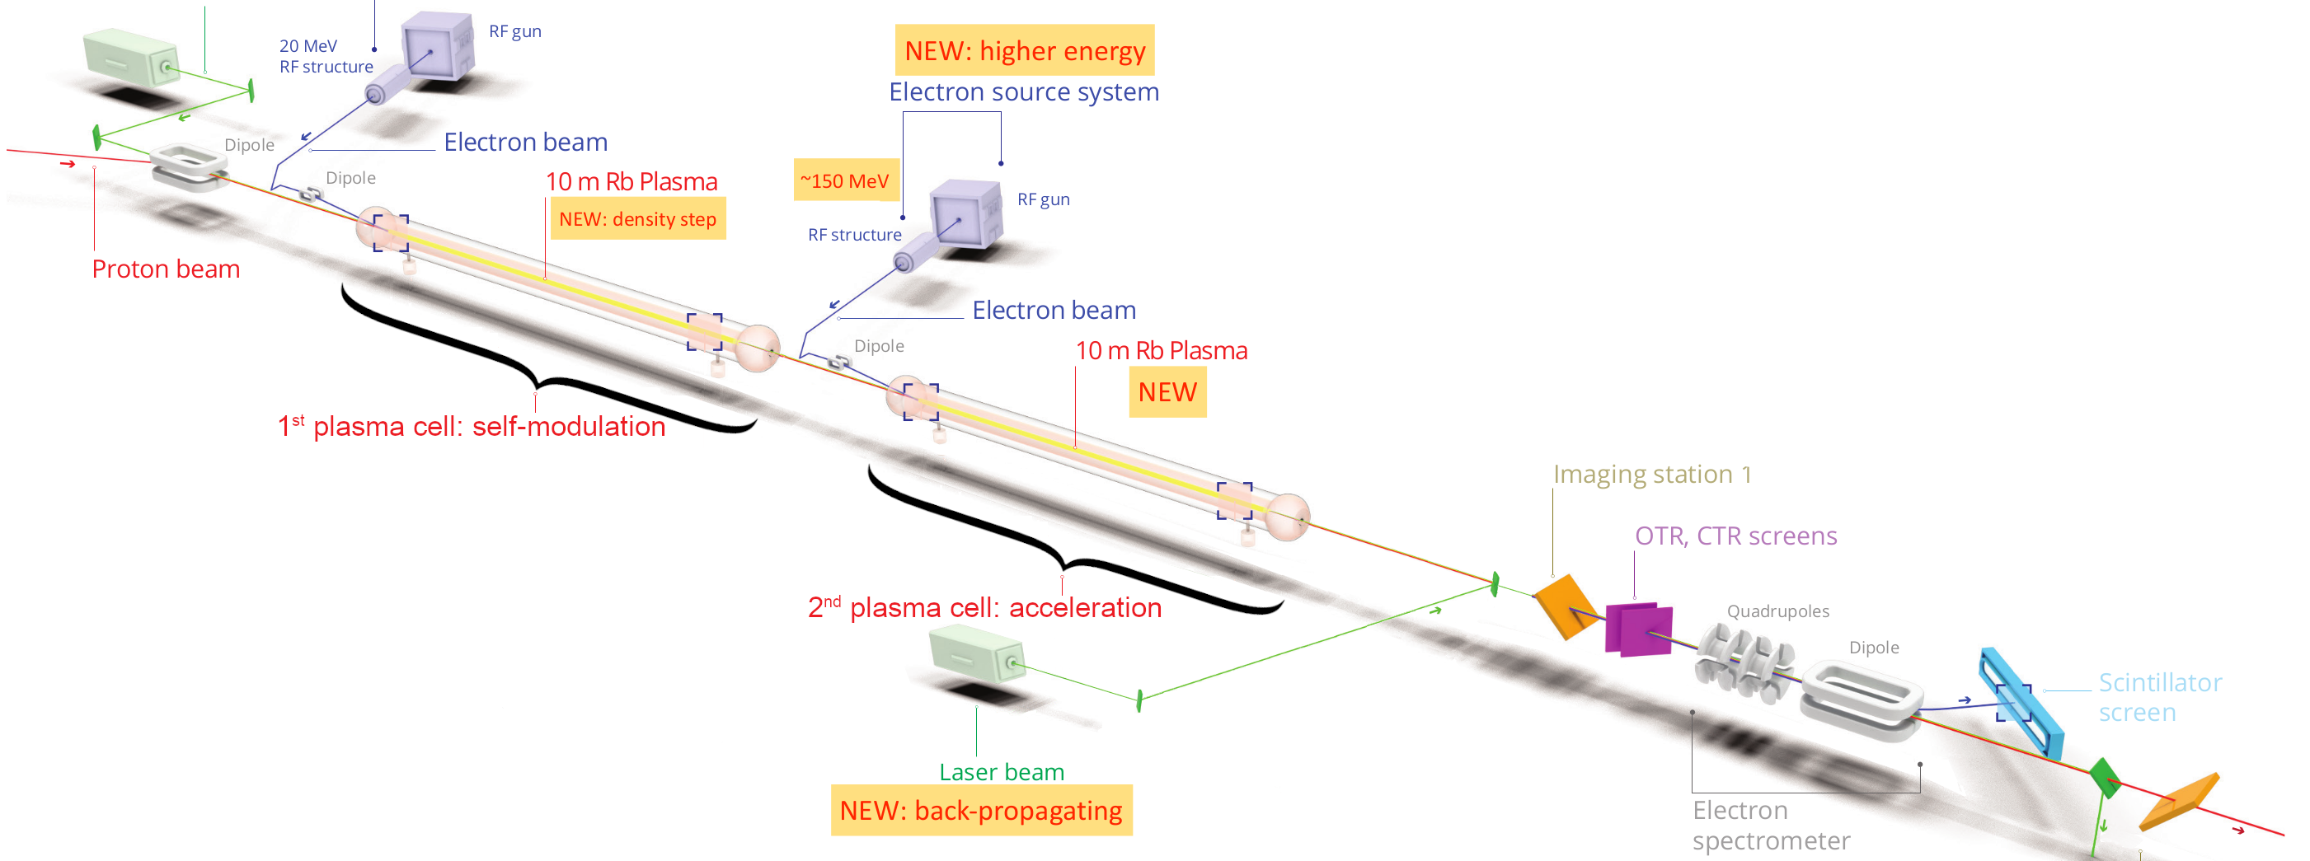

Sources of BR
Witness electron beam
Seeding electron beam
Proton beam (~meV)
Protons may oscillate in their wakefields, emitting betatron radiation.
Maximum critical energy of a single proton is estimated: 73 meV

Slide 5
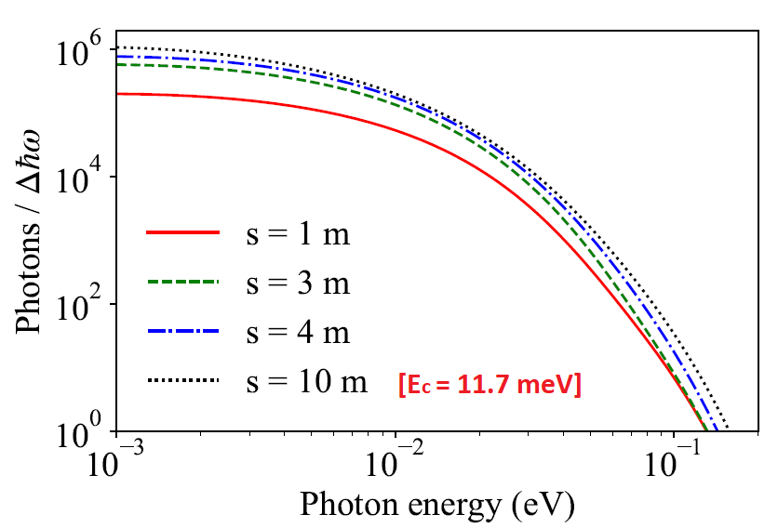
Sources of BR
Witness electron beam
Seeding electron beam (meV)
Proton beam (~meV)
L. Liang- et al, J Plasma Phys. 89, 965890301(2023)

Slide 6
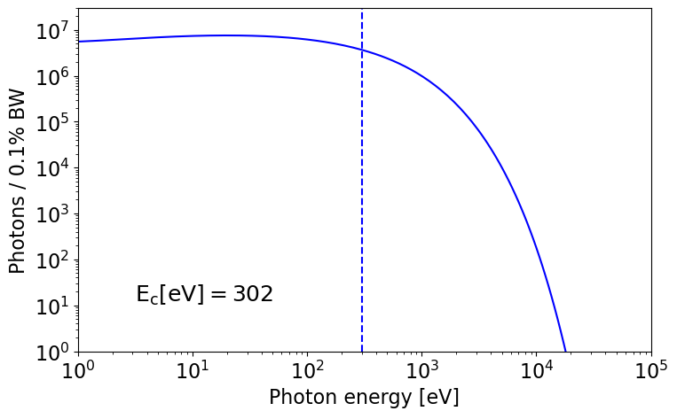
Sources of BR
Witness electron beam (~keV)
Seeding electron beam (meV)
Proton beam (~meV)

Slide 7

Sources of BR
Witness electron beam (~keV)
Seeding electron beam (meV)
Proton beam (~meV)
Due to its practicality, the witness beam radiation is regarded as AWAKE betatron radiation.

Slide 8
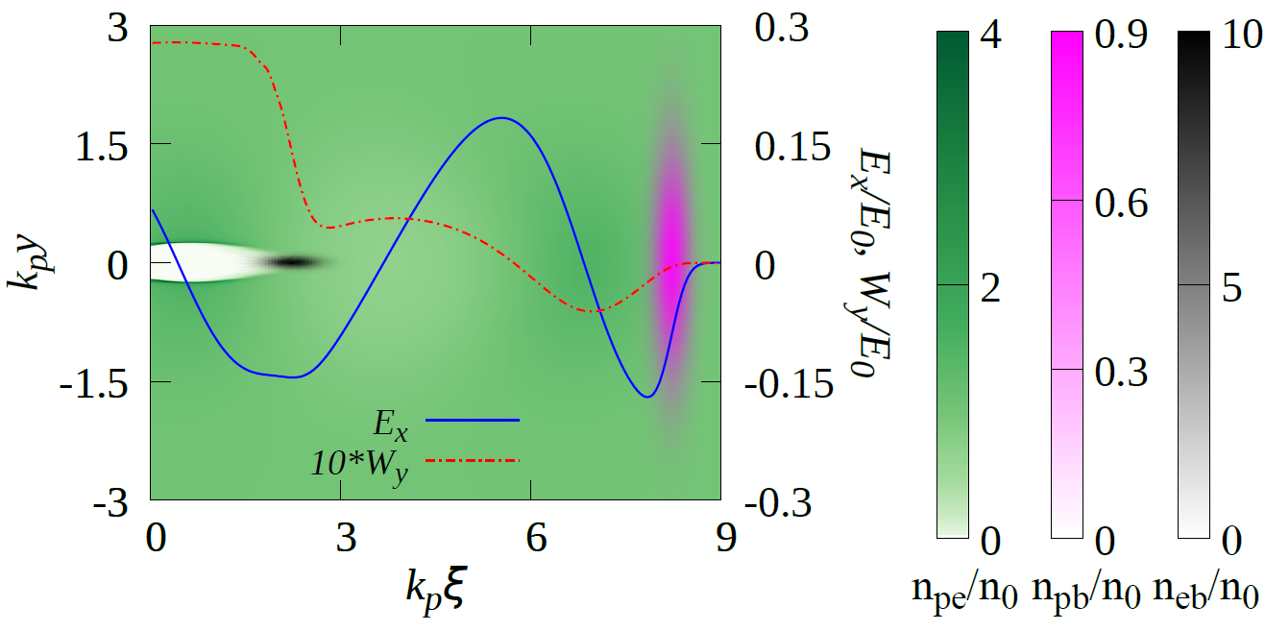
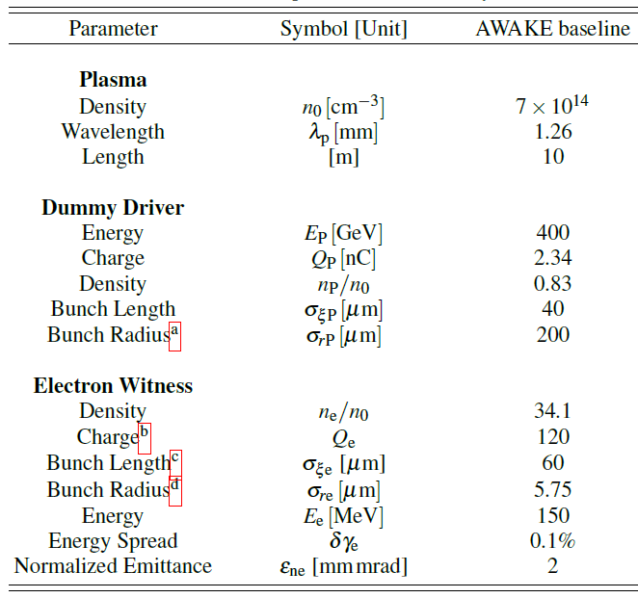
PIC simulation
QV3D PIC code
  Build-in module to calculate synchrotron radiation
Simulation model (V. Olsen et al, PRAB 2018)
  Uses a dummy driver such that it replicates the wakefield of real proton driver
AWAKE Run 2 baseline parameters.

Slide 9
Characteristics of AWAKE betatron radiation
High energy radiation in the UV to X-ray range.
Highly collimated radiation: focused into a narrow angle (~ mrad).
Short pulse duration on the order of ~100 fs.
Total photon numbers ~ 1E9.

Slide 10
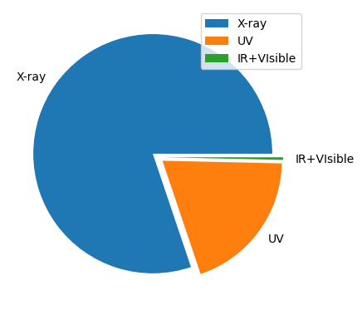
Photon | Energy range
X-ray | > 124 eV
UV | 3.1-124 eV
Others | < 3.1 eV
Distribution of Photon Frequencies Across the Total Spectrum

Slide 11
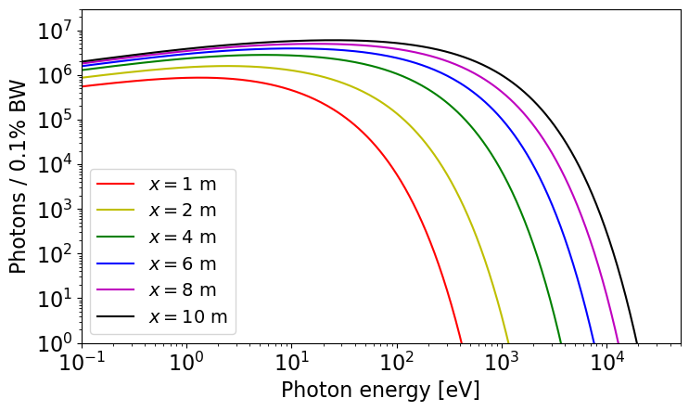
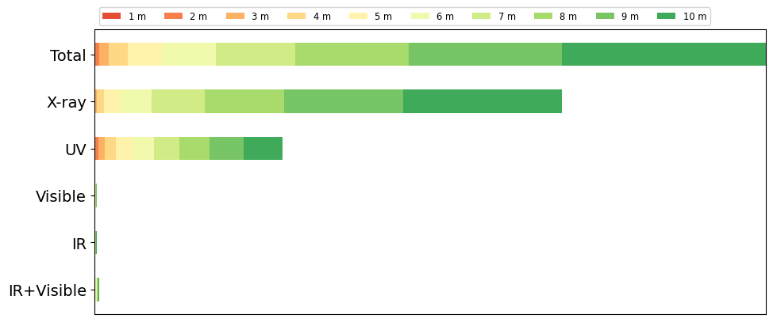
Radiation along the plasma cell

Slide 12
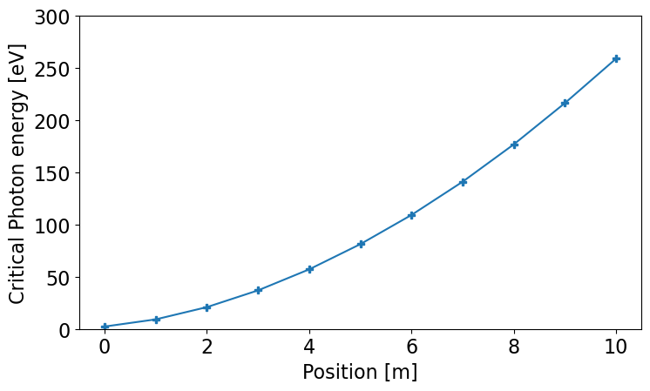
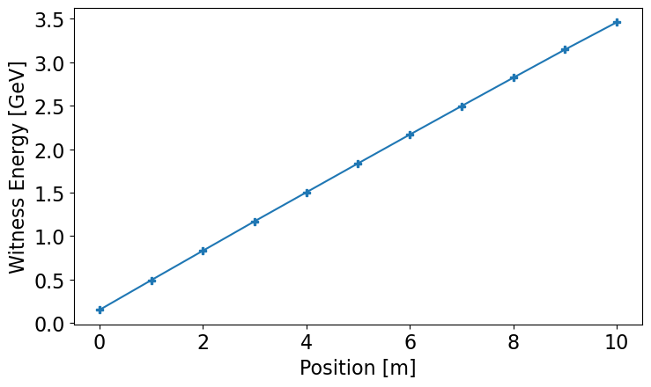
Along the plasma cell

Slide 13
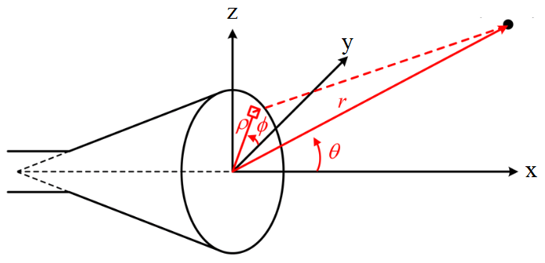
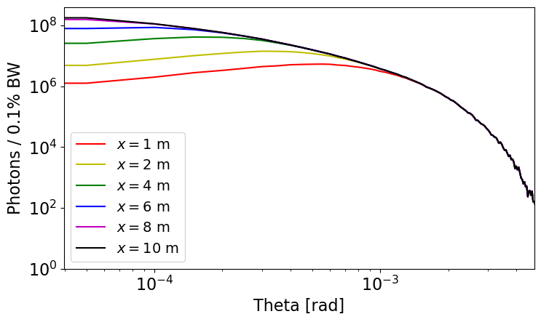
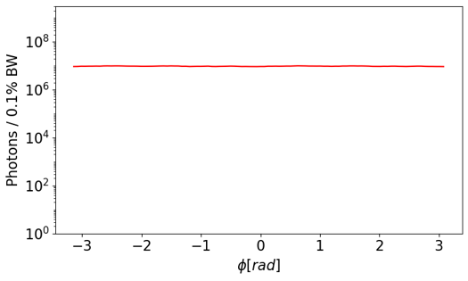
Radiation spatial distribution
Photons are inside a small angle: < few mrad
Most photons below 1 mrad
Photons emitted within 8-10 meters of the plasma cell exhibit divergence within 0.1 mrad.
Photons are distributed with azimuthal symmetry.

Slide 14
Betatron diagnostic:
In experiment
Notes:
Image by freepik

Slide 15
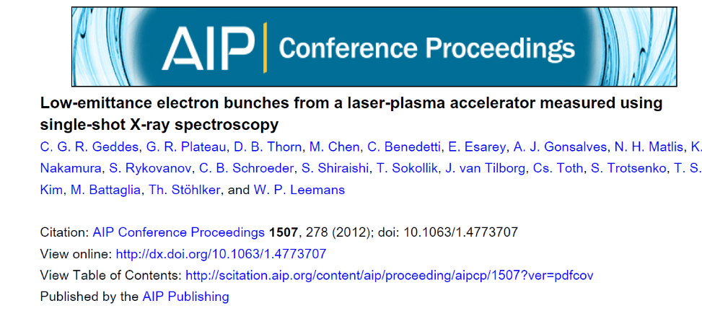
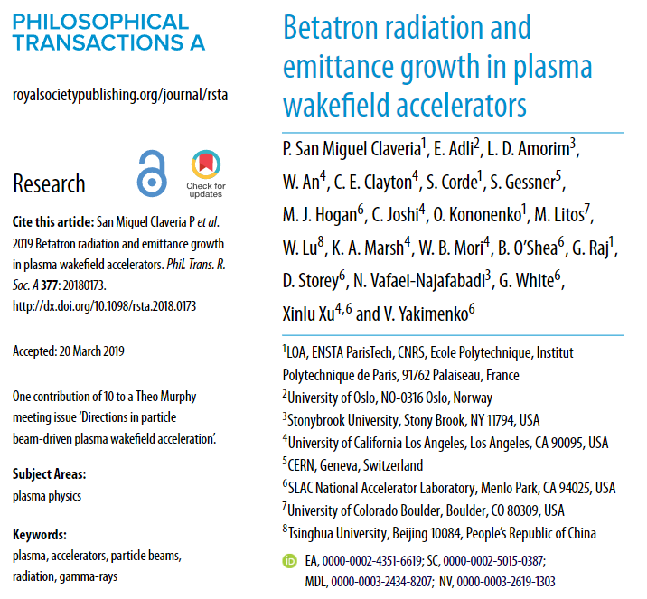
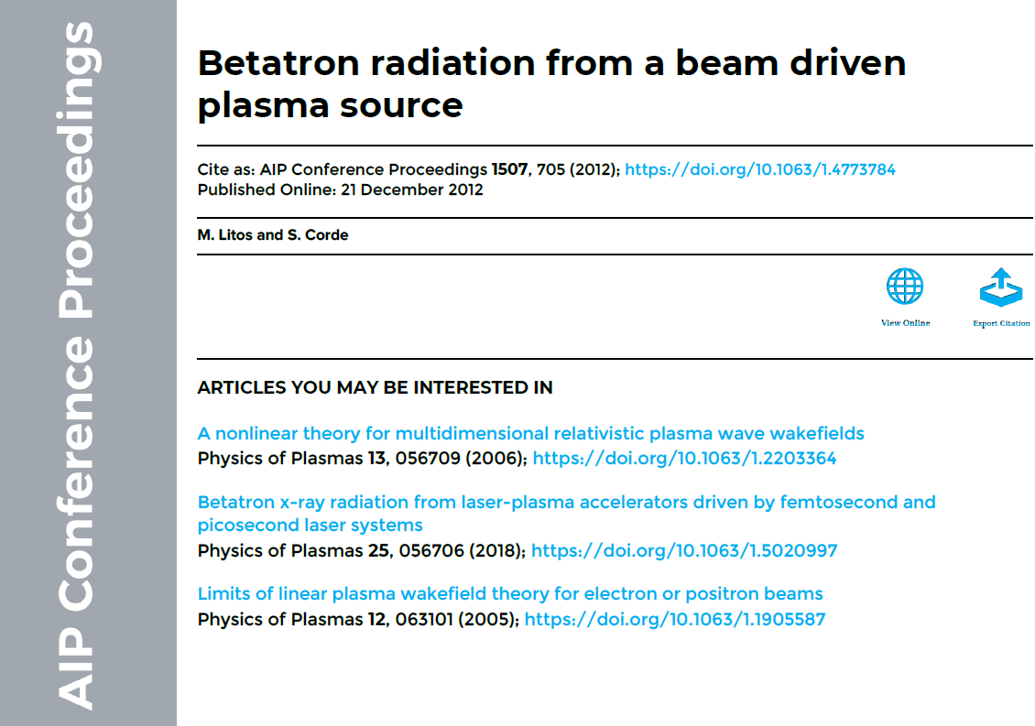
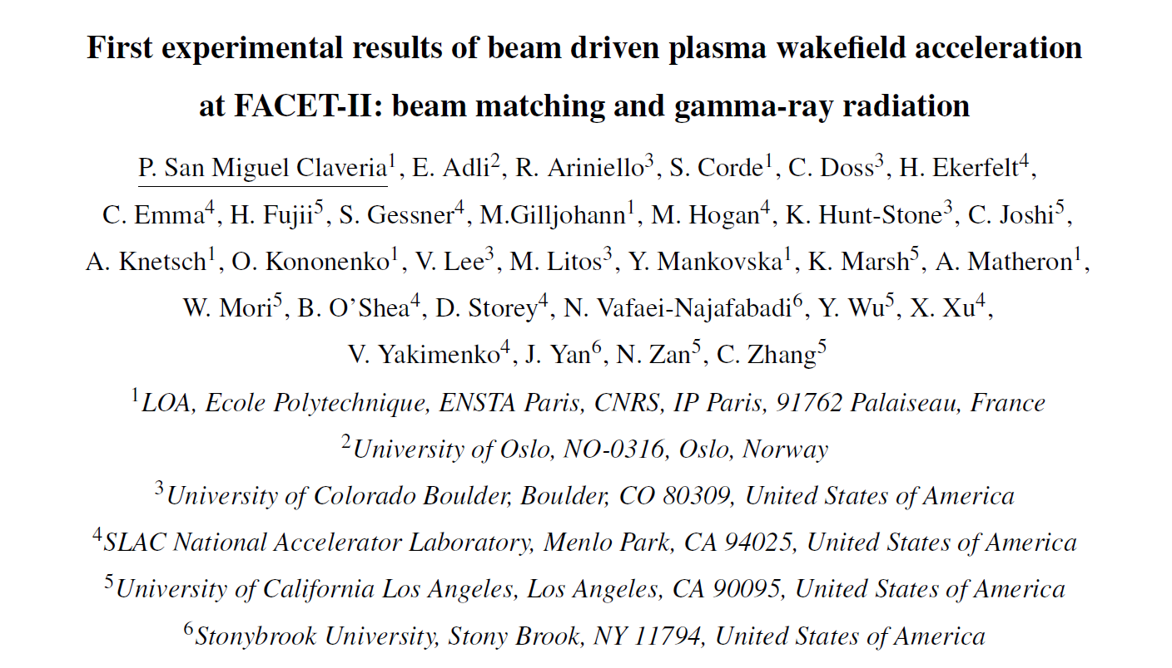
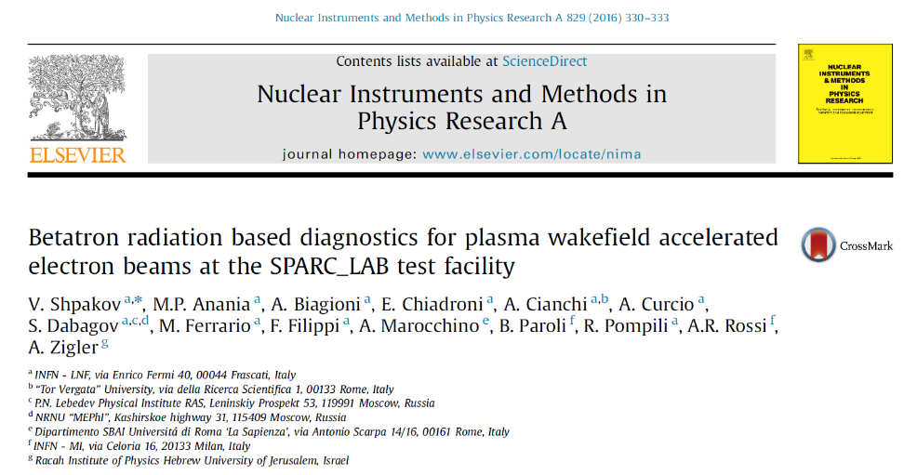
Research and application of Betatron diagnostics in BELLA, FACET, SPARC_LAB …

Slide 16
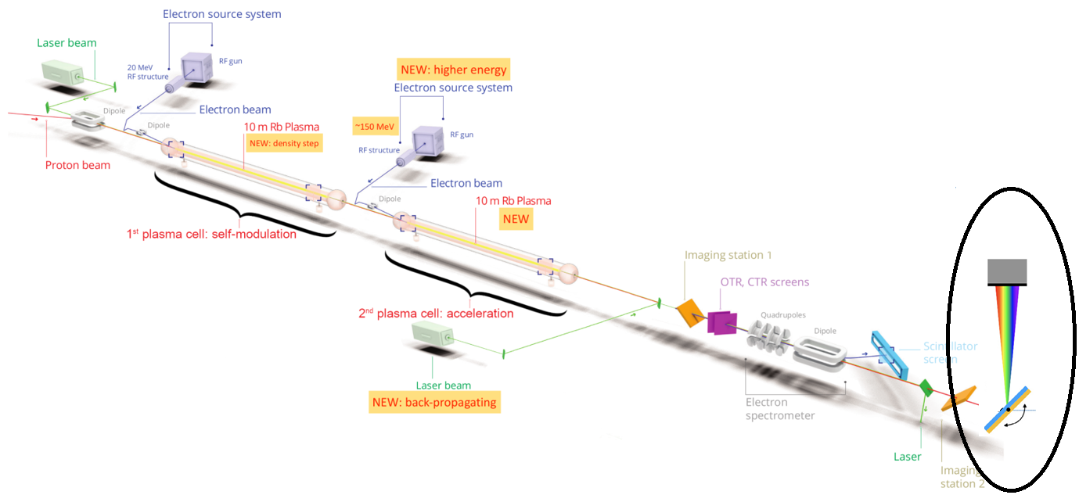
Propose betatron diagnostics in AWAKE
Diagnose injection misalignment (e.g., beam phase-matching; beam off-axis injection)
  L. Liang- et al, ‘Characteristics of betatron radiation in AWAKE Run 2 experiment’ J Plasma Phys. 89, 965890301(2023)
Experimental proposal for betatron spectroscopy in AWAKE
  B. Williamson, et al. NIMA 971, 64076 (2020)

Slide 17
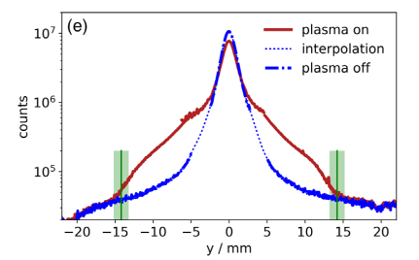
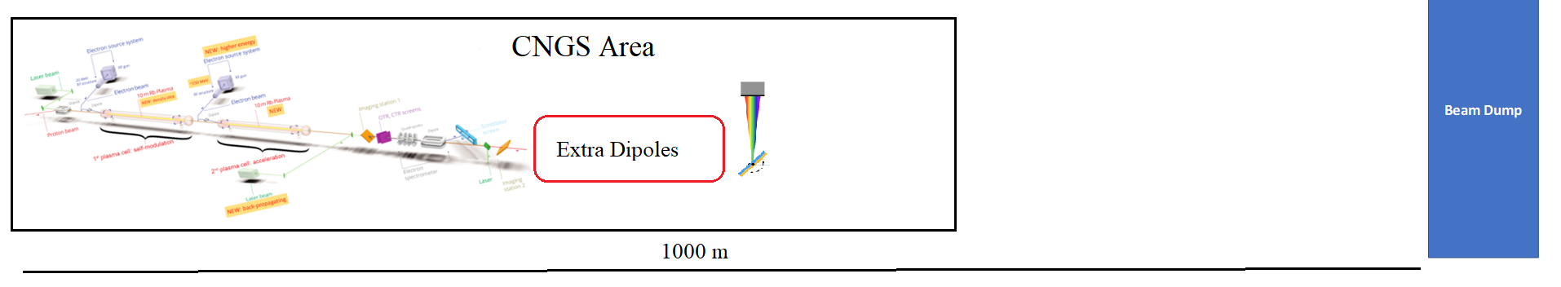

M. Turner (AWAKE Collaboration), PRL 122, 054801 (2019)
The proton beam diverges to a radius of 15 mm after traveling 10 meters beyond the plasma cell.
In case of CNGS dismantling, there would be room to divert the proton beam.
Three dipoles, similar to the Run1 spectrometer, may be necessary to deflect the proton beam by more than 15 mm over a distance of 10 meters.

Slide 18
X-ray detector
The primary radiation will be in the X-ray spectrum.
Various types of X-ray detectors exist, encompassing gas detectors etc.
Based on factors such as spectral coverage, energy resolution, spatial resolution, sensitivity, and price, we can select a suitable X-ray detector for procurement in the future.

Slide 19
Betatron radiation beyond AWAKE Run 2
Notes:
Image by freepik

Slide 20
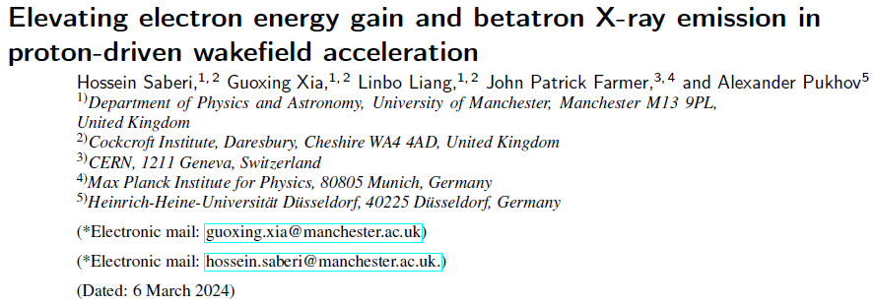
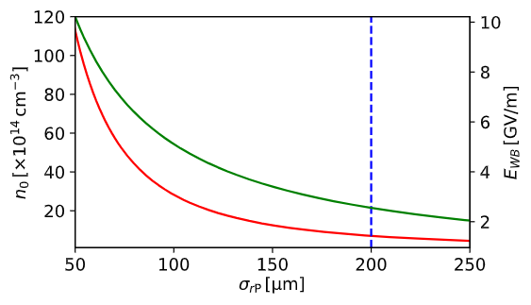

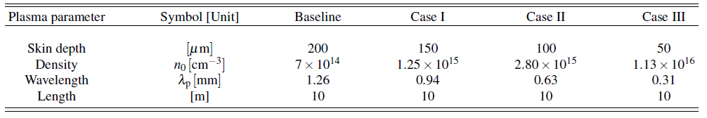
What if we utilize higher plasma densities?

Slide 21
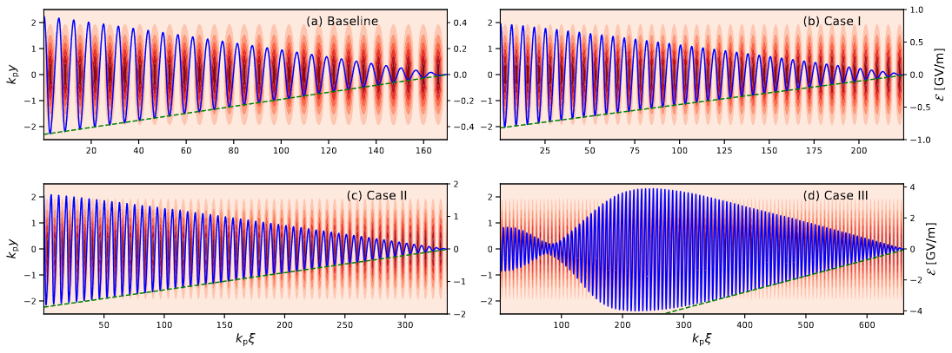
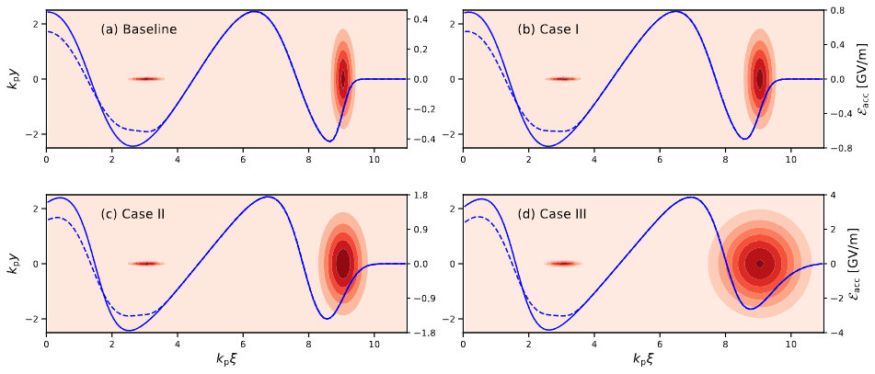
Step 1. Calculate the peak wakefield by considering a fixed current and length of periodic train of bunches
Step 2. Study witness beam acceleration and radiation within the toy model simulation

Slide 22
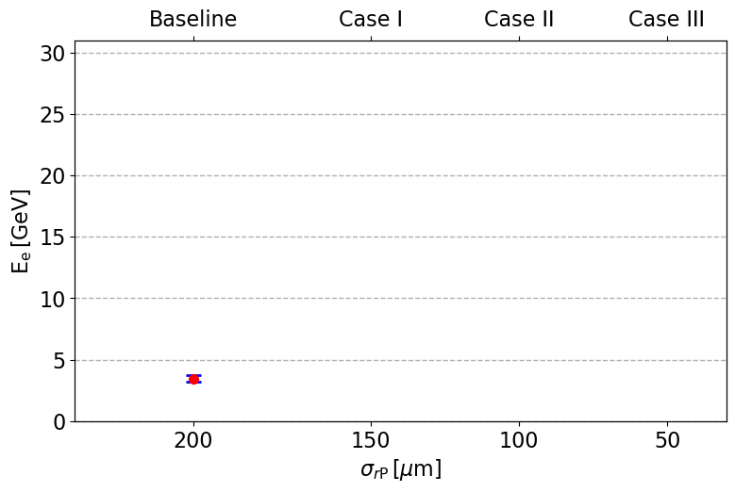
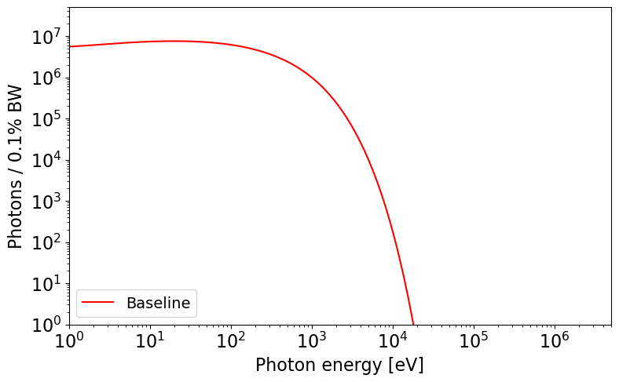

Slide 23
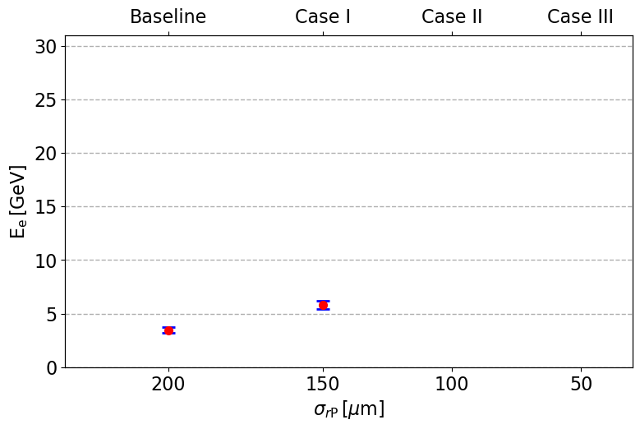
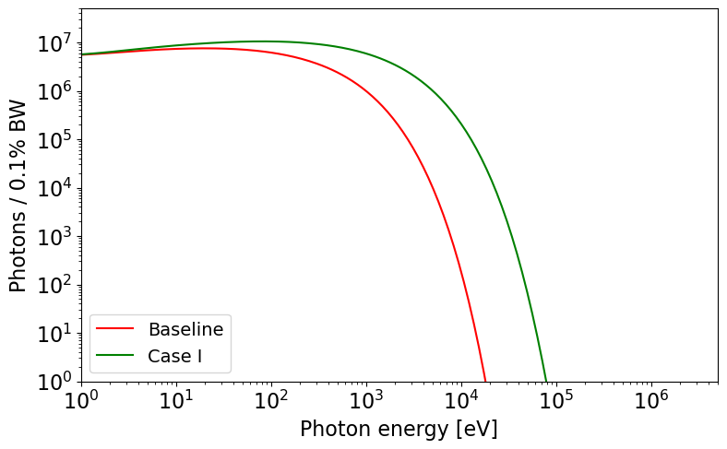

Slide 24
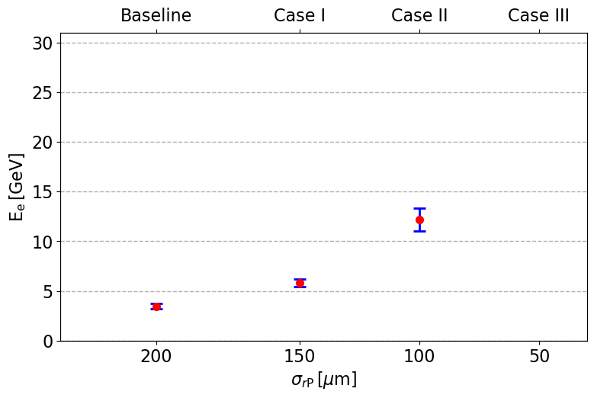
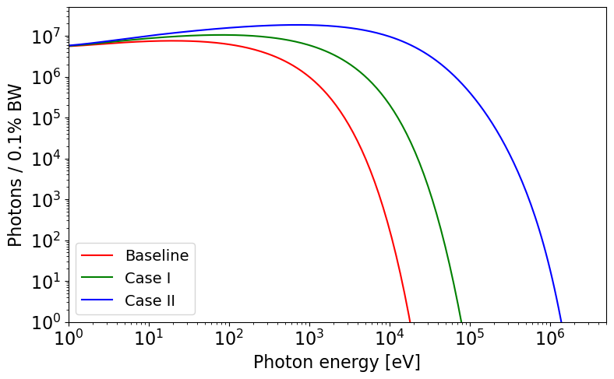

Slide 25
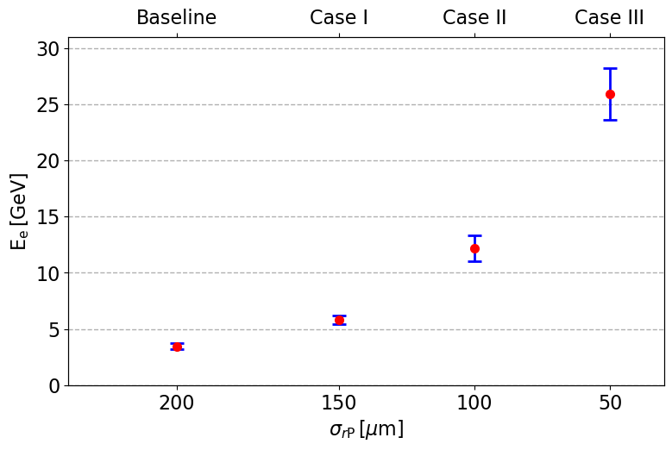
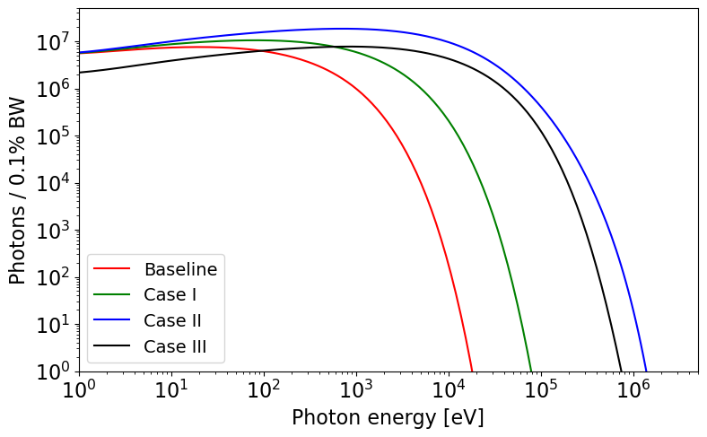

Slide 26
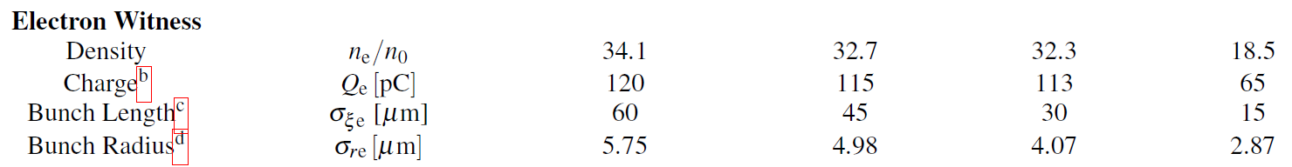
We may seek the unexpected pattern in Case III in its lower charge and radius which has root in non-linear effects of wakefield decay.

Slide 27
Conclusion
Notes:
Image by freepik

Slide 28
Summary
Explore betatron radiation characteristics in-depth.
Propose potential applications of betatron diagnostics at AWAKE.
Conduct a preliminary design study for betatron spectroscopy at AWAKE, addressing associated concerns.
Perform a simulation study on utilizing a shorter proton beam driver and consequently higher plasma density.

Slide 29
Moving Forward: The Next Step
Develop the models for electron beam reconstruction from the radiation.
Conduct a detailed study on experimental design, including potential procurement of necessary tools.
Initiate collaborations with laboratories such as CLARA, CLEAR, and SPARC_LAB for preliminary testing.
Ultimately, construct and deploy diagnostics applications for the AWAKE Run 2c.

Slide 30
Backup slides
Notes:
Image by freepik

Slide 31
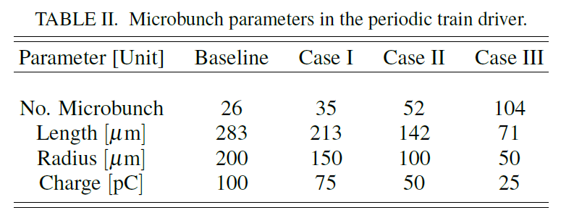


Periodic train driver
For all scenarios, we consider a non-evolving beam comprising 1.62e10 particles, with a length of 65.6 mm, organized as a periodic train of microbunches.
This periodic train driver has a period of plasma wavelength.

Slide 32
Sources of BR
Witness electron beam
Seeding electron beam
Proton beam
Background plasma electrons

Slide 33
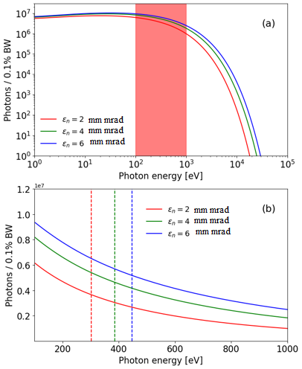
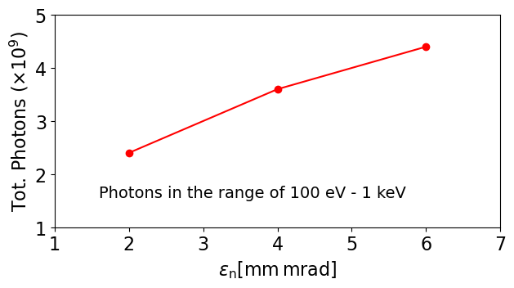
Beam emittance and the radiation spectrum

