Slide 1
AWAKE Collaboration Meeting
Photocathode Performance and Production Reliability
Ralf Erik ROSSEL
Wednesday, 13.03.2024

Slide 2
Content Outline
AWAKE Photocathode Performance 2021 to 2024
CERN Photoemission Laboratory Setup
Photocathode Production Process and Analysis
R&D, Future Work, and Outlook

Slide 3
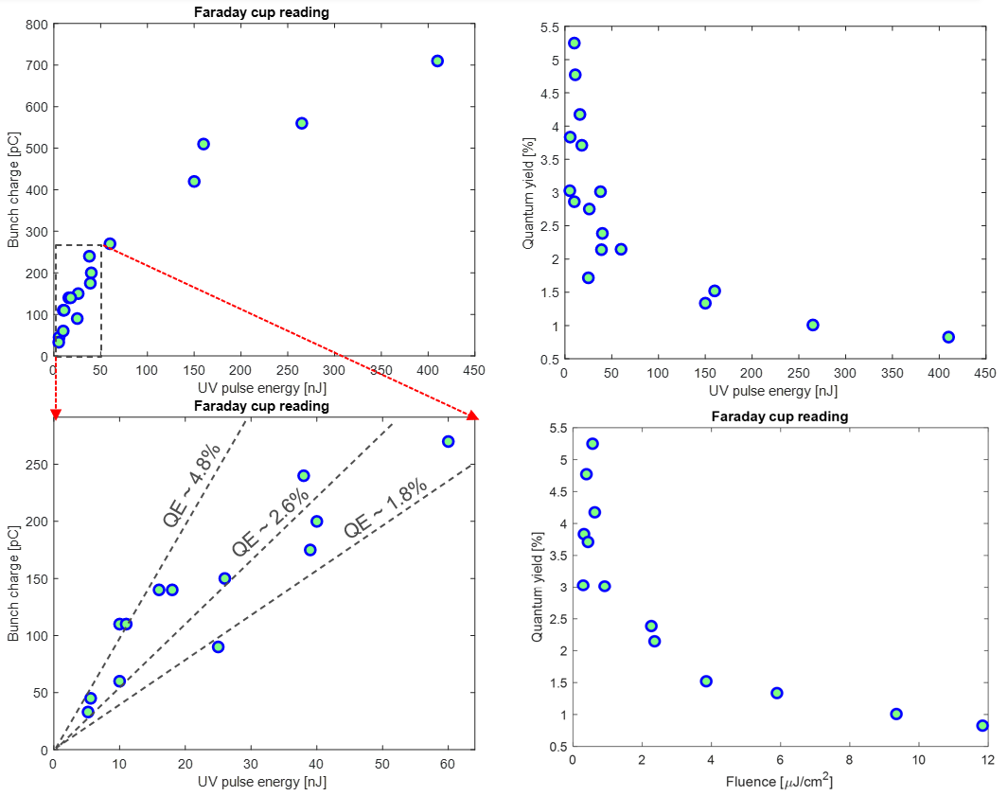
AWAKE Photocathode Performance 2021 and 2022
2021: Photocathode reached end of life, replaced with new high-QE photocathode
2022: High-QE photocathode replaced after vacuum incident in winter 22 / 23

Slide 4
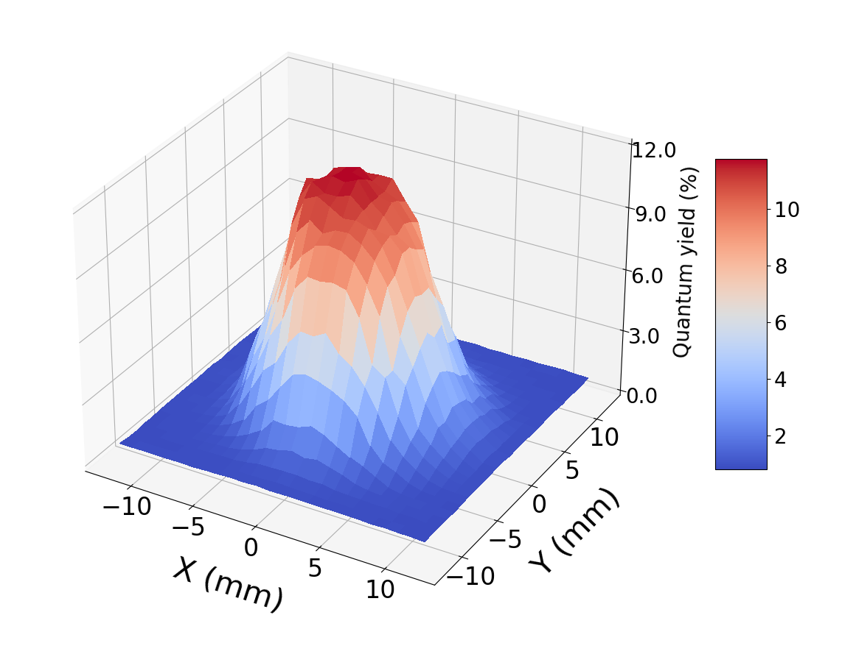
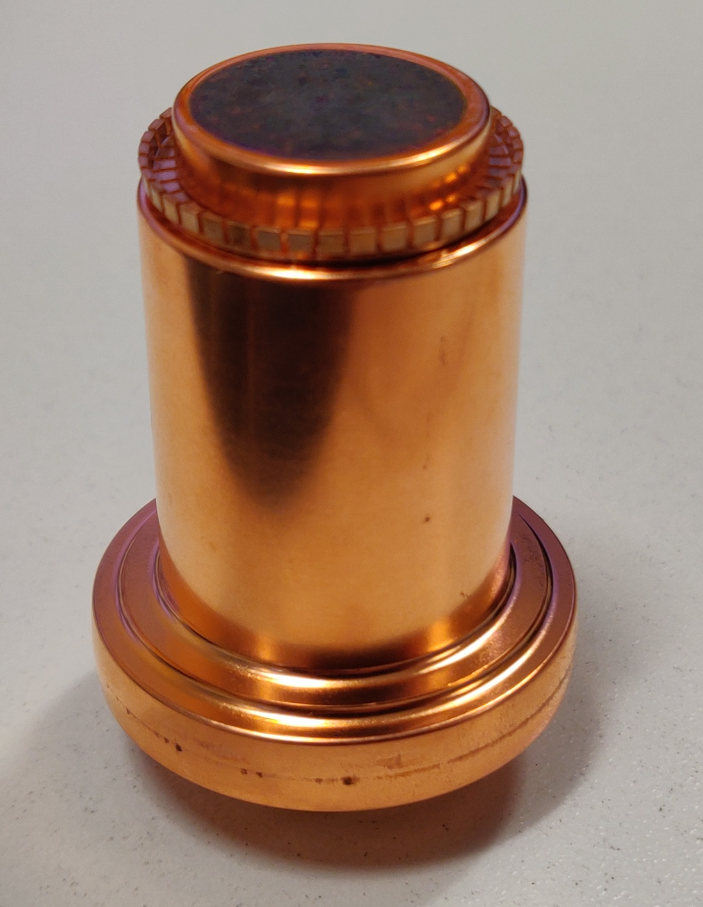
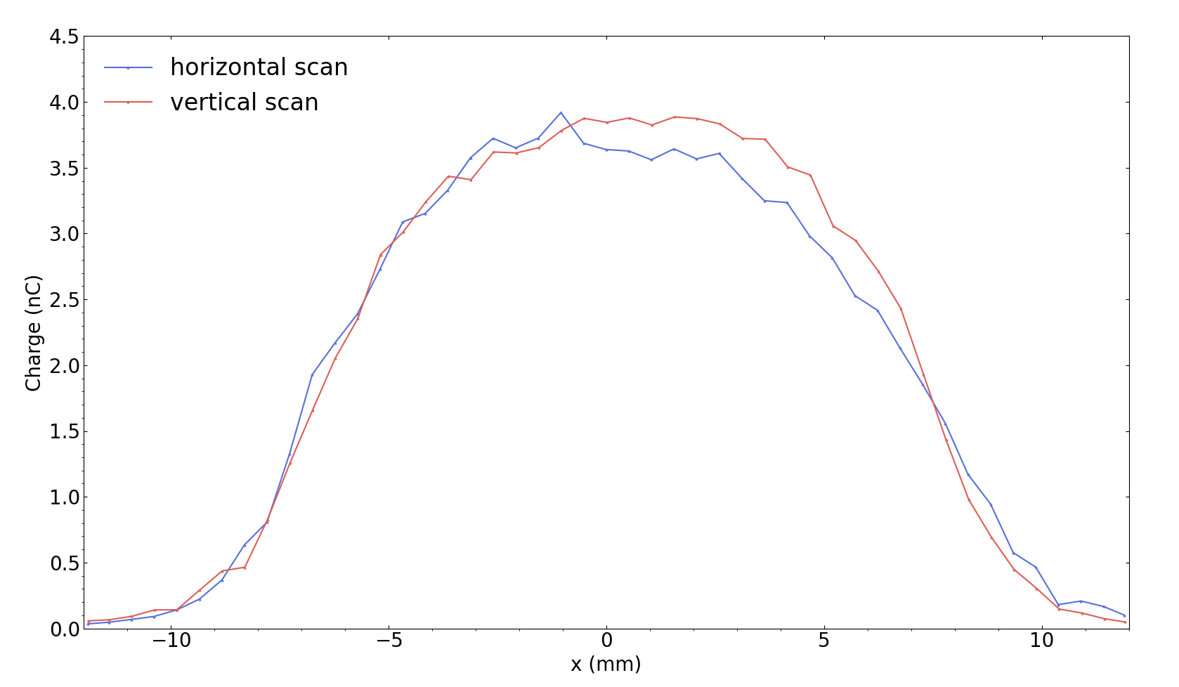
Photocathode #229 Installed at AWAKE in May 2023
Fabrication Results in CERN Photoemission Laboratory
Measured around 12% quantum yield in the Photoemission Lab in 2022
Stored since production in static UHV transport vessel docked to RF gun

Slide 5
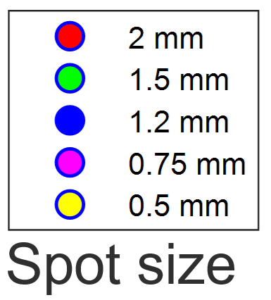
AWAKE Photocathode Performance 2023
Quantum Yield
Photoemission Lab estimate was 12%
Charge Production
Up to 300 pC with
smallest laser spot size
Saturation
Saturation fluence
occurs around 5 µJ/cm²
>15%
at AWAKE
Spot size
Spot size

Slide 6
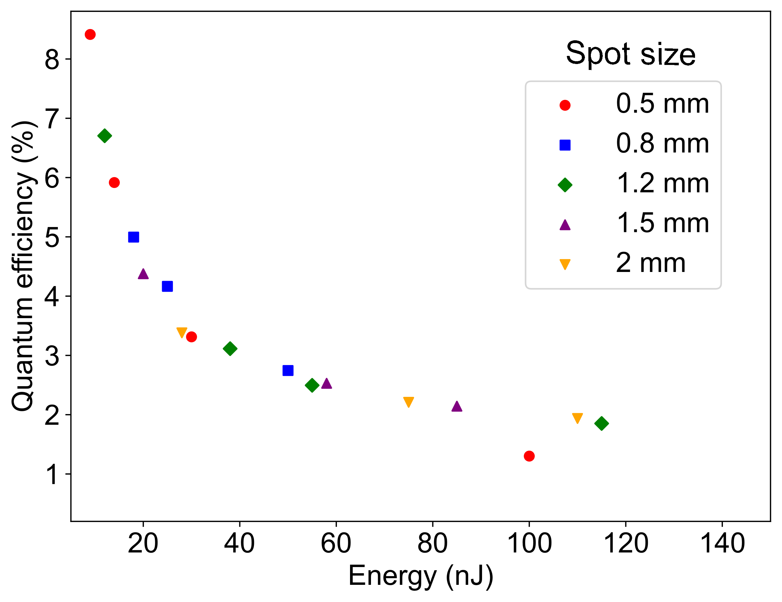
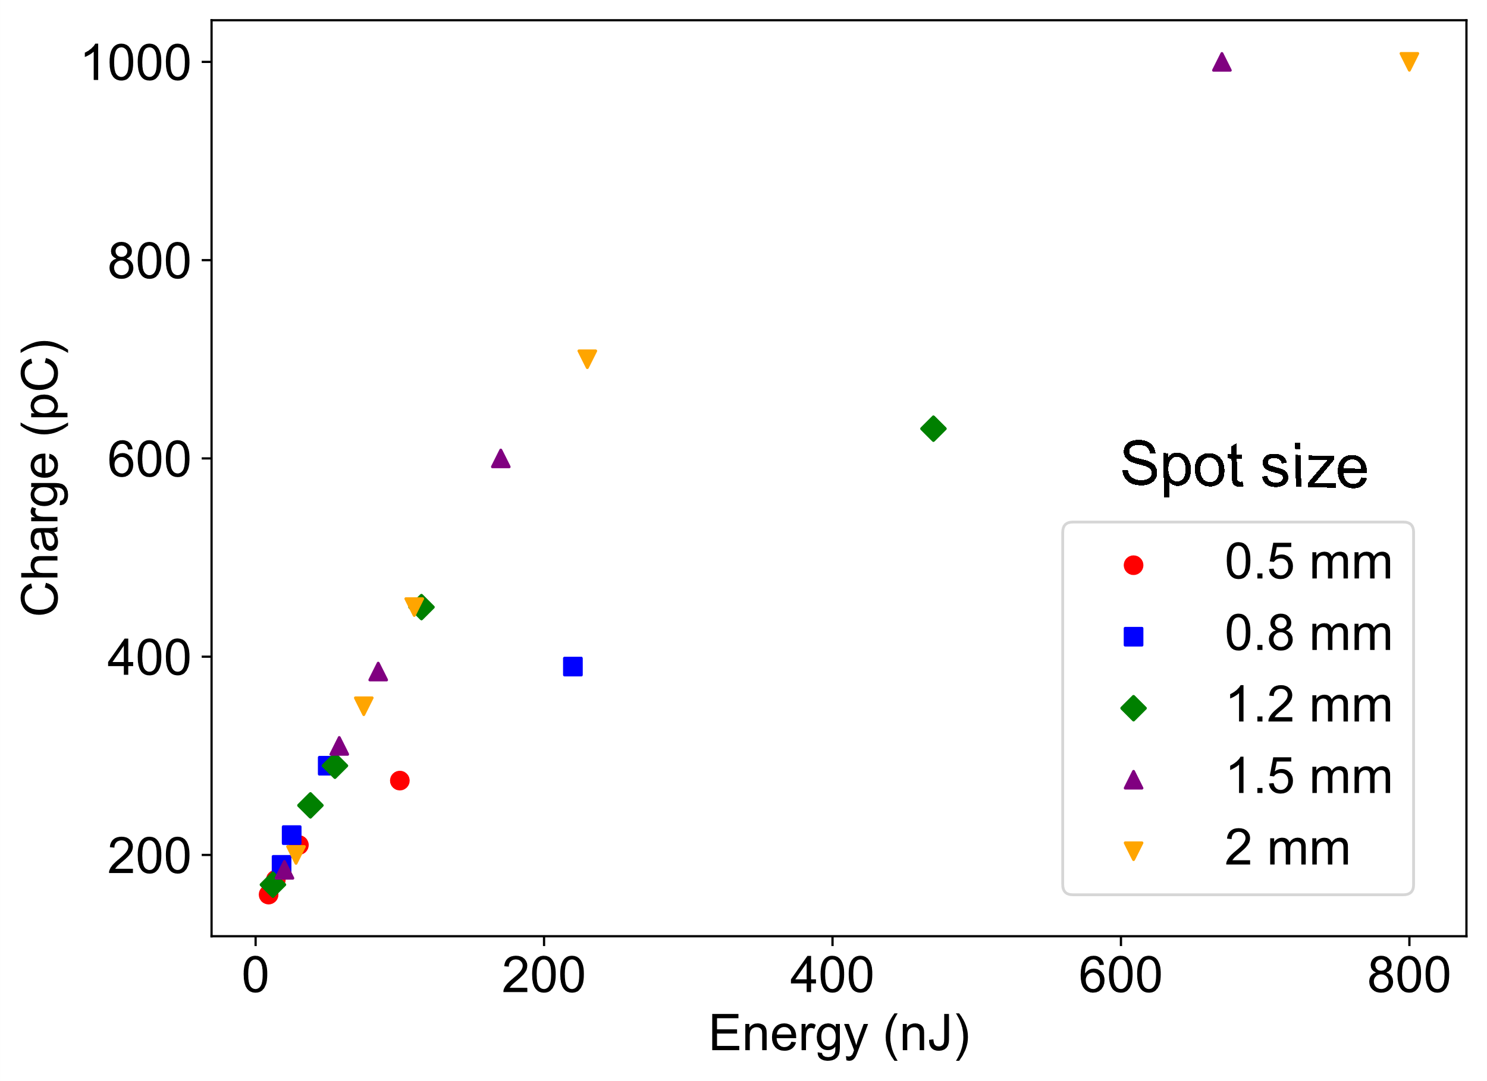
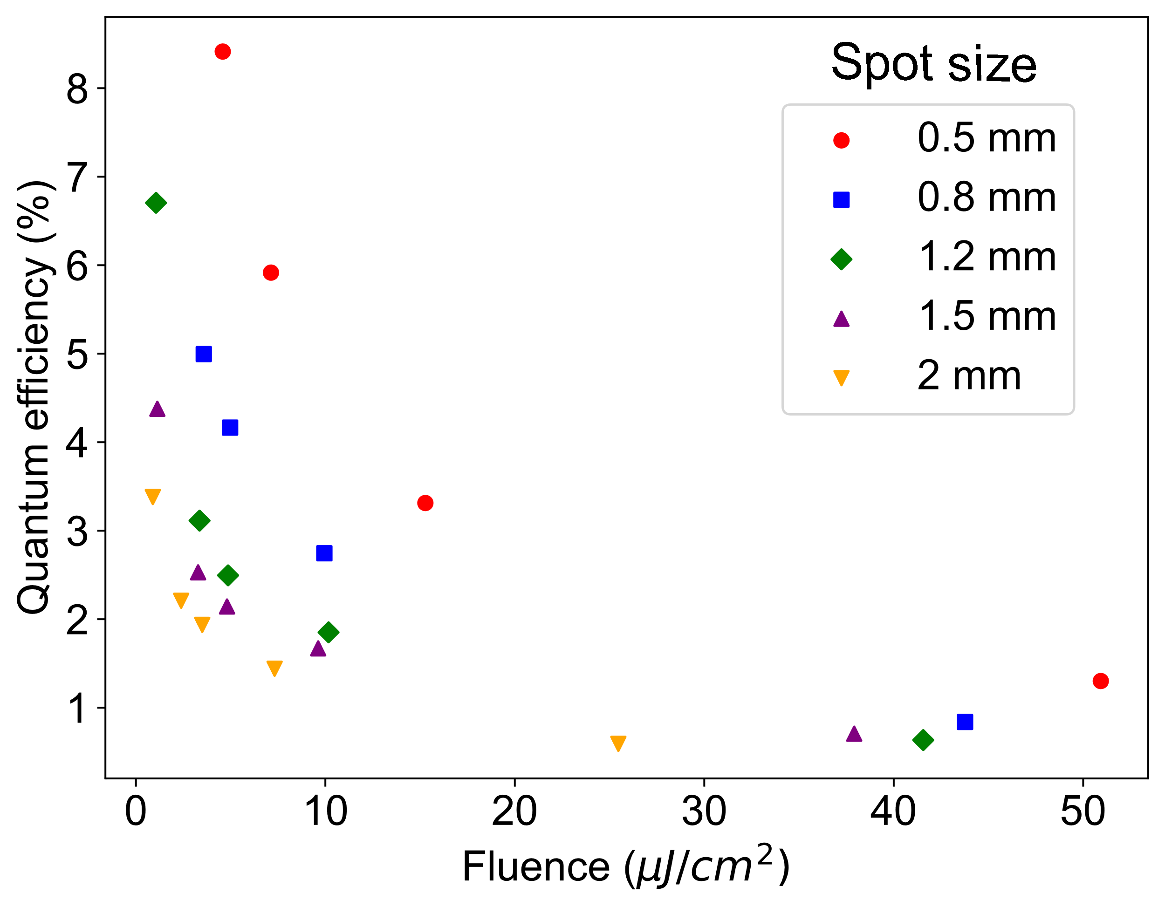
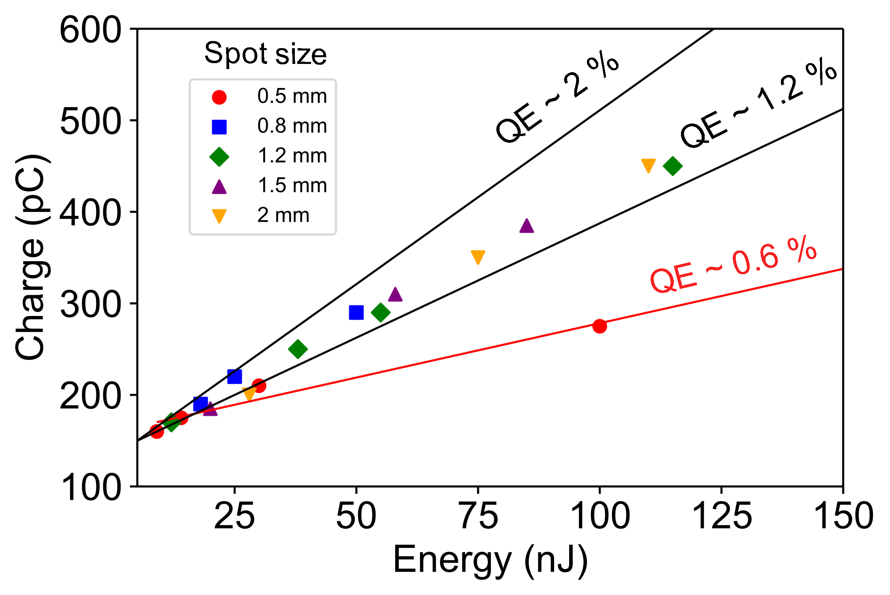
AWAKE Photocathode Performance 2024
Quantum Yield
Measured to around 8% after a year of operation
Charge Production
Above 250 pC with
smallest laser spot size
Saturation
Saturation fluence
occurs around 4 µJ/cm²

Slide 7
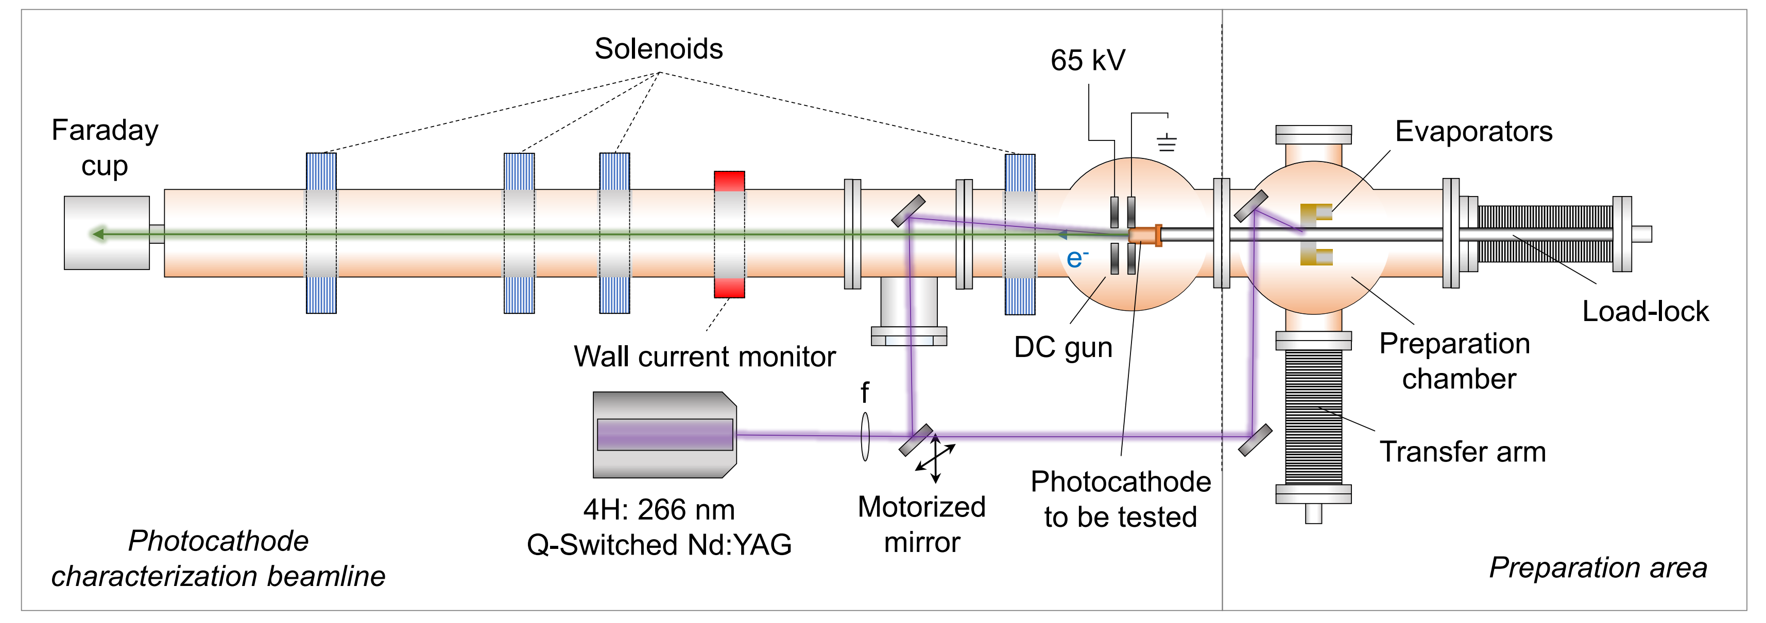
CERN Photoemission Laboratory Setup

Slide 8
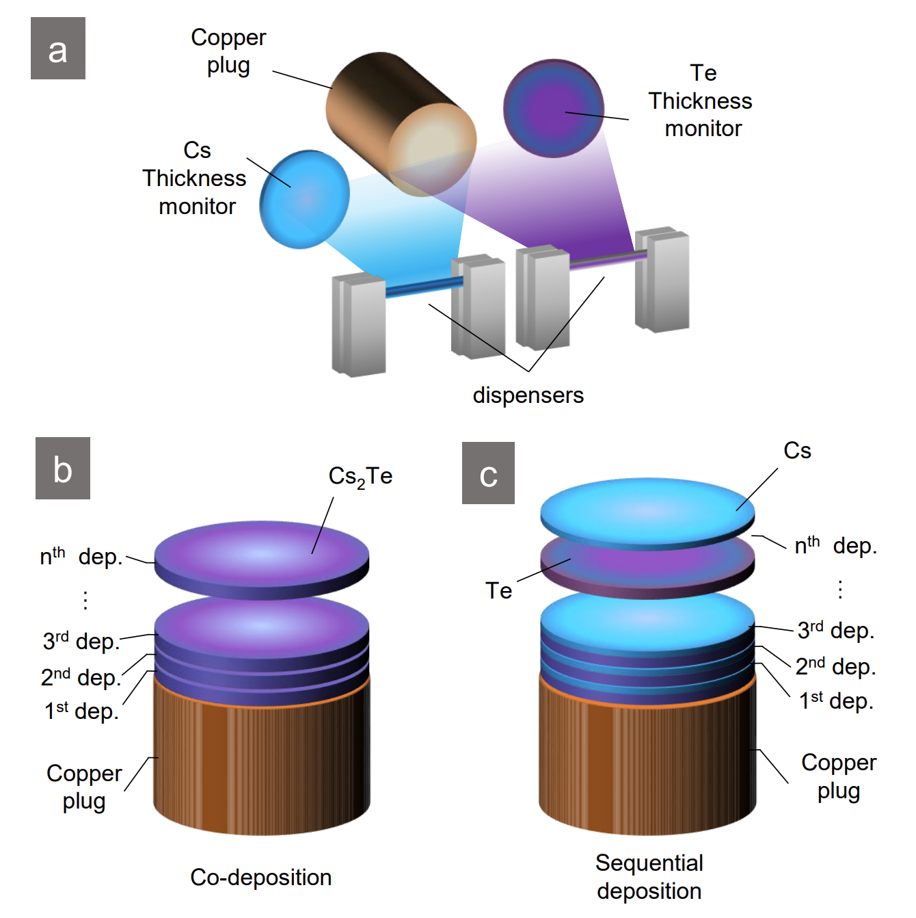
Photocathode
Production Process
a Cesium and tellurium layer applied to copper substrate ‘plug’ via physical vapor deposition (PVD) process
b Monitored co-deposition of Cs and Te is performed in the Photoemission Lab for AWAKE photocathodes
c Sequential deposition of Cs and Te is performed in situ at the CLEAR facility
Related publication (2024-02-08) by M. Martinez Calderon et al.:
https://link.aps.org/doi/10.1103/PhysRevAccelBeams.27.023401

Slide 9
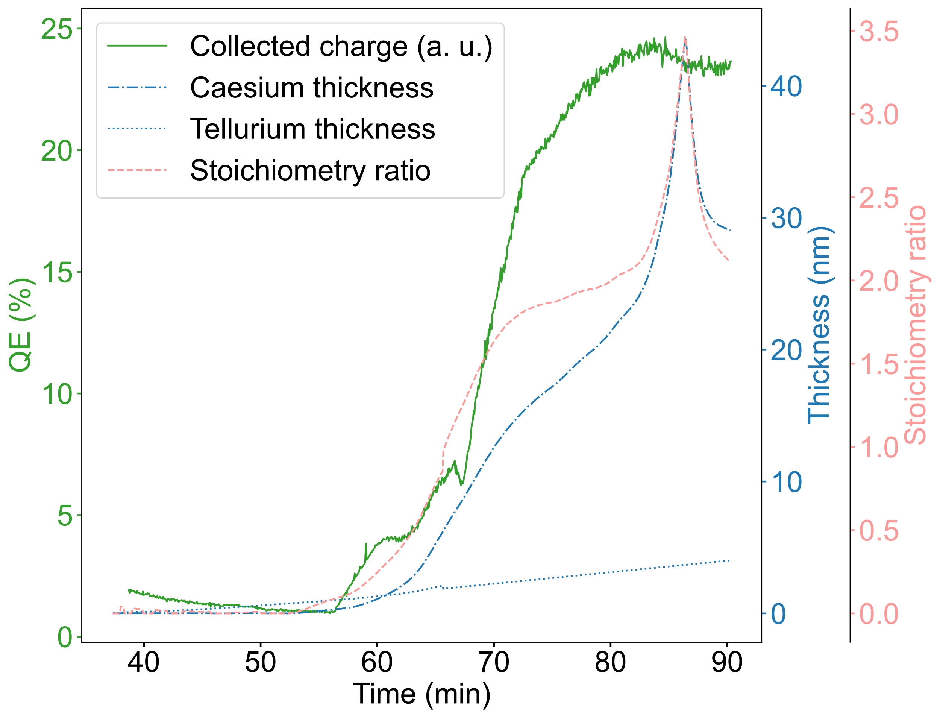
Photocathode
Production Analysis
Production parameters
yielding highest QE
Data analysis of high-QE Cs₂Te photocathode #217 produced at the
Photoemission Lab and installed at AWAKE in 2021 / 2022
PVD process time spent at stoichiometric ratio around 2.0 is significant
Need to compare and relate to historical production parameters of other photocathodes

Slide 10
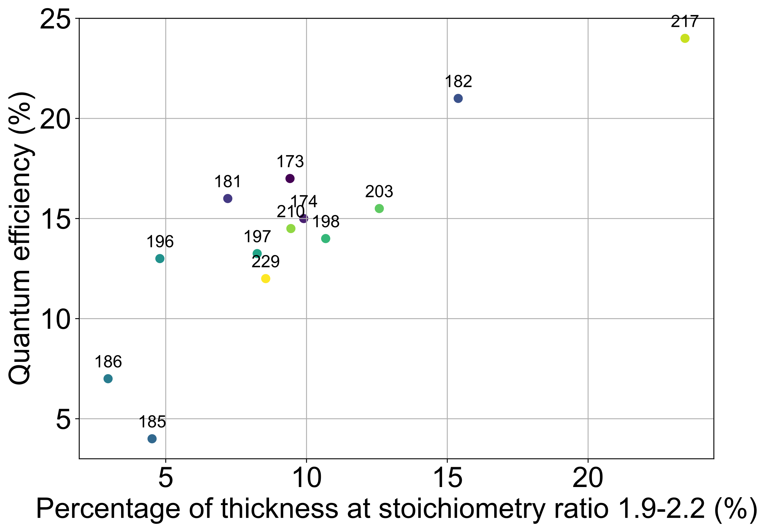
Photocathode
Production Analysis
Production parameter and QE relation for other photocathodes
Data analysis of 13 Cs₂Te photocathodes produced during 12 years at the Photoemission Lab
Successive narrowing of the stoichiometric ratio ‘window’ to gain insights to optimal Cs₂Te layer thickness
Analysis points to options for process reliability improvements and process recipe automation

Slide 11
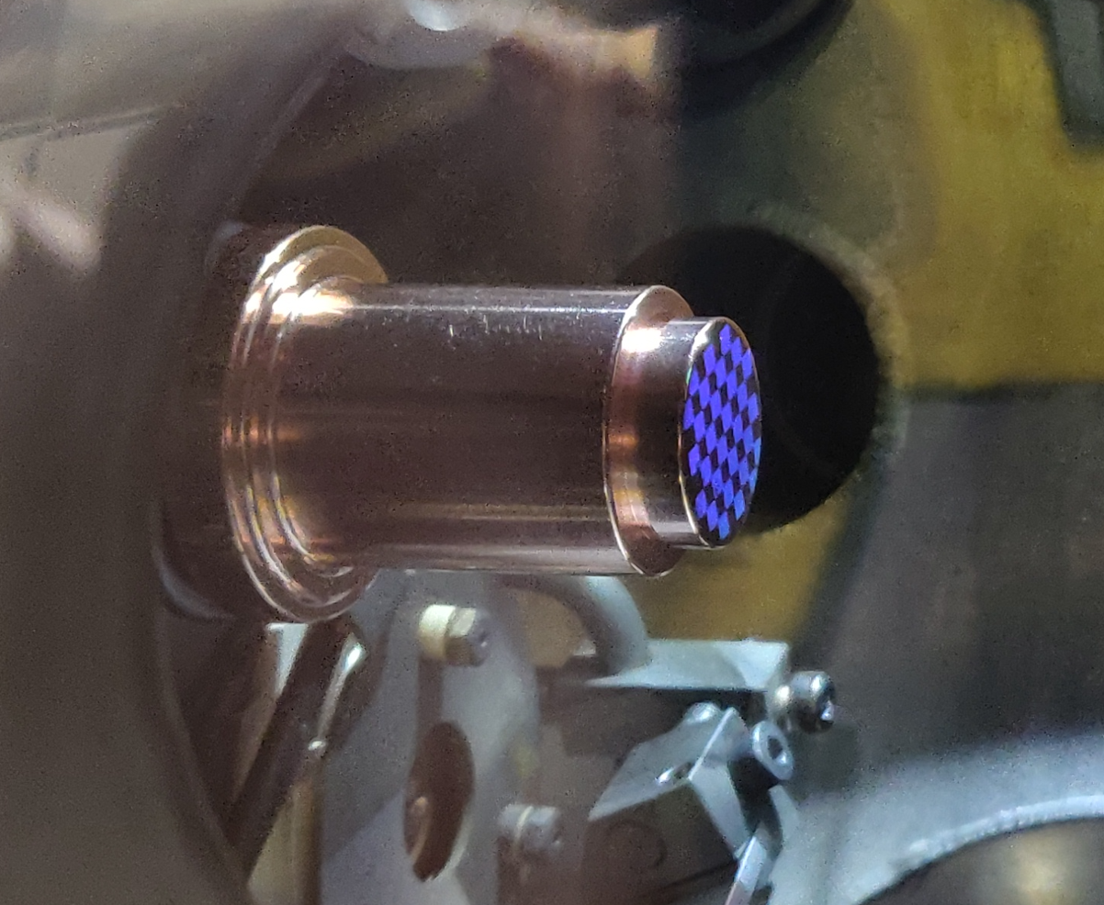
R&D, Future Work and Outlook
Nanoplasmonic Photocathodes
Manufacture nanostructured photocathode surface
Reduce vacuum requirements for photocathodes and investigate expected lifetime
Compromise on achievable quantum efficiency
Require reliable emittance measurements
Related publication (2023-10-17) by M. Martinez Calderon et al.:
https://doi.org/10.1515/nanoph-2023-0552

Slide 12
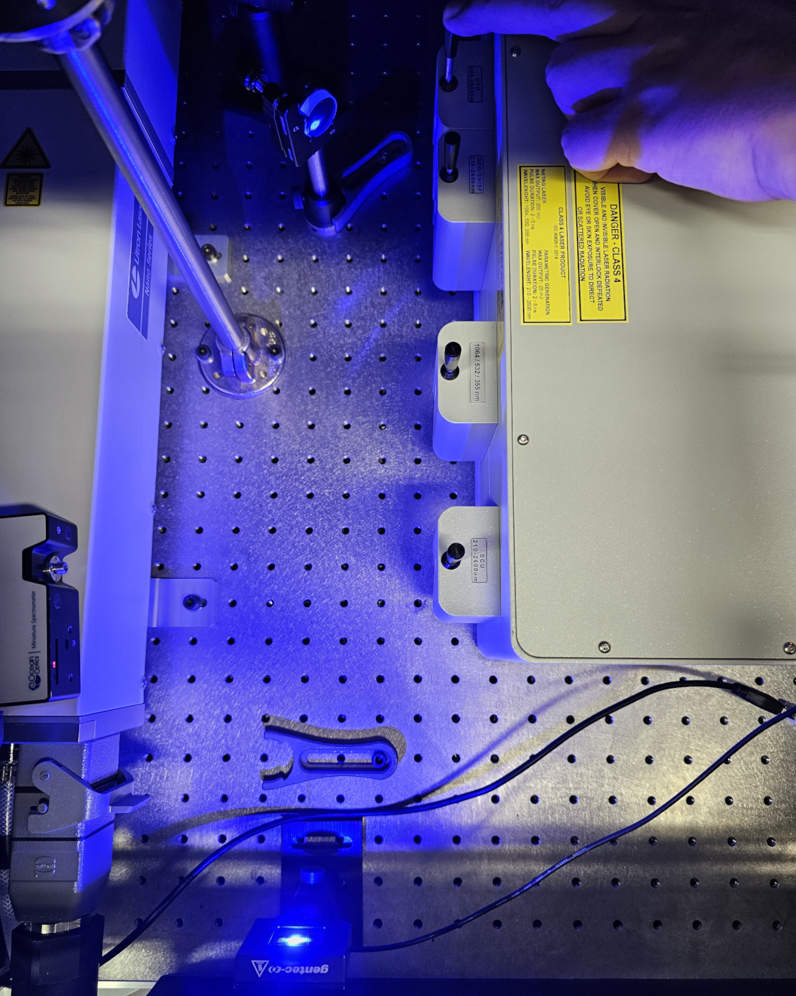
R&D, Future Work and Outlook
Photometric Deposition Layer Measurements
Frequency tunable optical parametric oscillator (OPO) laser installed in Photoemission Lab
Perform work function measurements for different photocathode production strategies and deposition layers e.g. for ‚rejuvenated‘ photocathodes

Slide 13
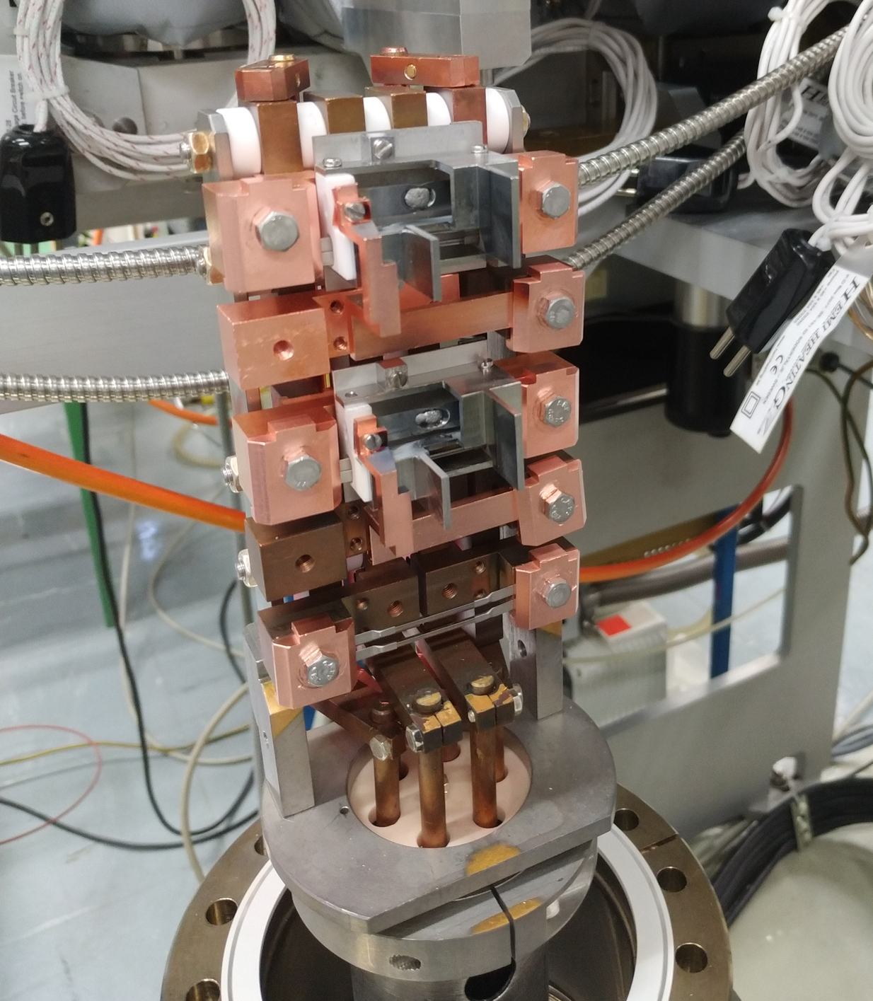
R&D, Future Work and Outlook
Photocathode Production Reliability Upgrades
Production setup maintenance and dispenser renewal
Automation of production process in accordance with recent data analysis results
Potential installation of Transverse Energy Spread Spectrometer (TESS), collaborating with Daresbury Laboratory

Slide 14
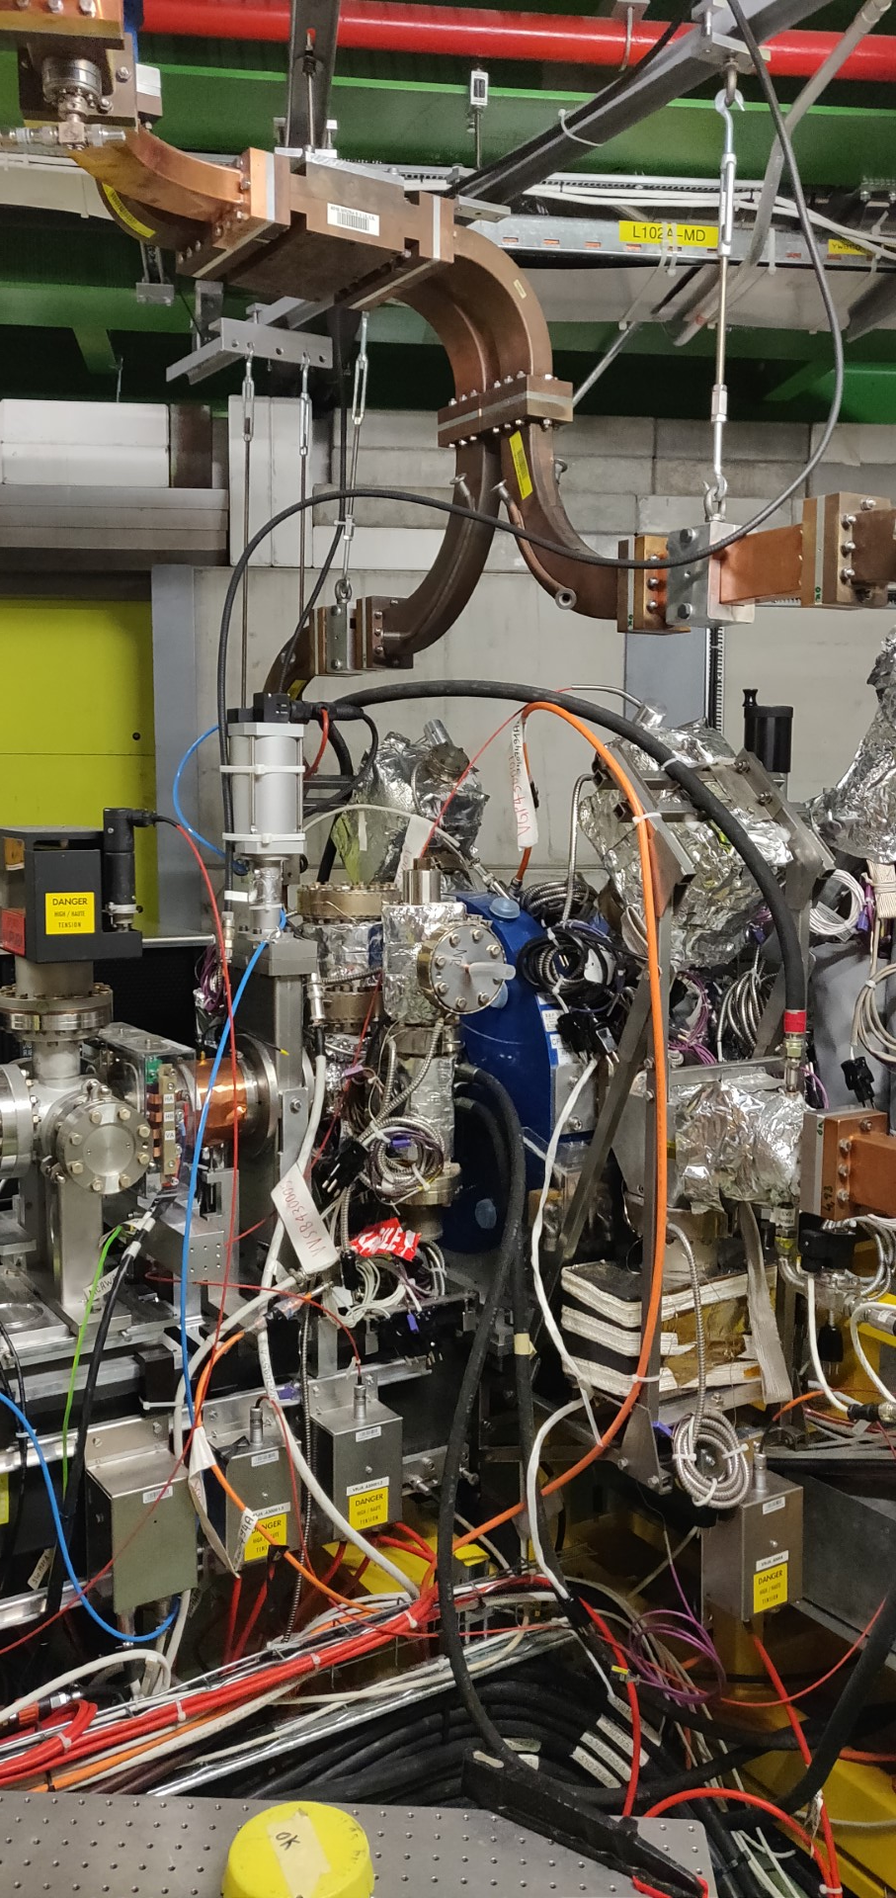
R&D, Future Work and Outlook
CTF2 Commissioning (AWAKE Run 2c Preparation)
Installation of AWAKE photocathode exchange load-lock system at CTF2 during the CNGS clean-up project
Use of CTF2 as test platform for photocathodes produced with improved production methods

Slide 15
Thank you for your attention.
Special thanks to
Eric CHEVALLAY, Eduardo GRANADOS, Miguel MARTINEZ CALDERON, Vittorio BENCINI, Palma KATONA, and Cyril BERNERD for additional material and data, as well as to SY-STI, SY-RF, TE-VSC, and other groups for their continued support.

Slide 16
Additional Detail Slides

Slide 17
Photocathode Performance Comparison and Conclusion
Parameter | 2021 | 2022 | 2023 | 2024
QE | 5.5% (used) | 25% | 15% | 8%
Saturated QE | 1.8% | 5% | 4% | 2.5%
Saturation fluence | 4 µJ/cm² | 2.5 µJ/cm² | 5 µJ/cm² | 4 µJ/cm²
Spare photocathode (#229) was installed in the RF gun after restoring UHV (baking was needed)
Replicated applied pressure, seems reliable (RF gun was still in tune)
Photocathode survived exposure to 10^-9 mbar during a week
QE measurement in agreement with photocathode production measurements at Photoemission Lab
Maximum charge for smallest emittance is about 300 pC.

Slide 18
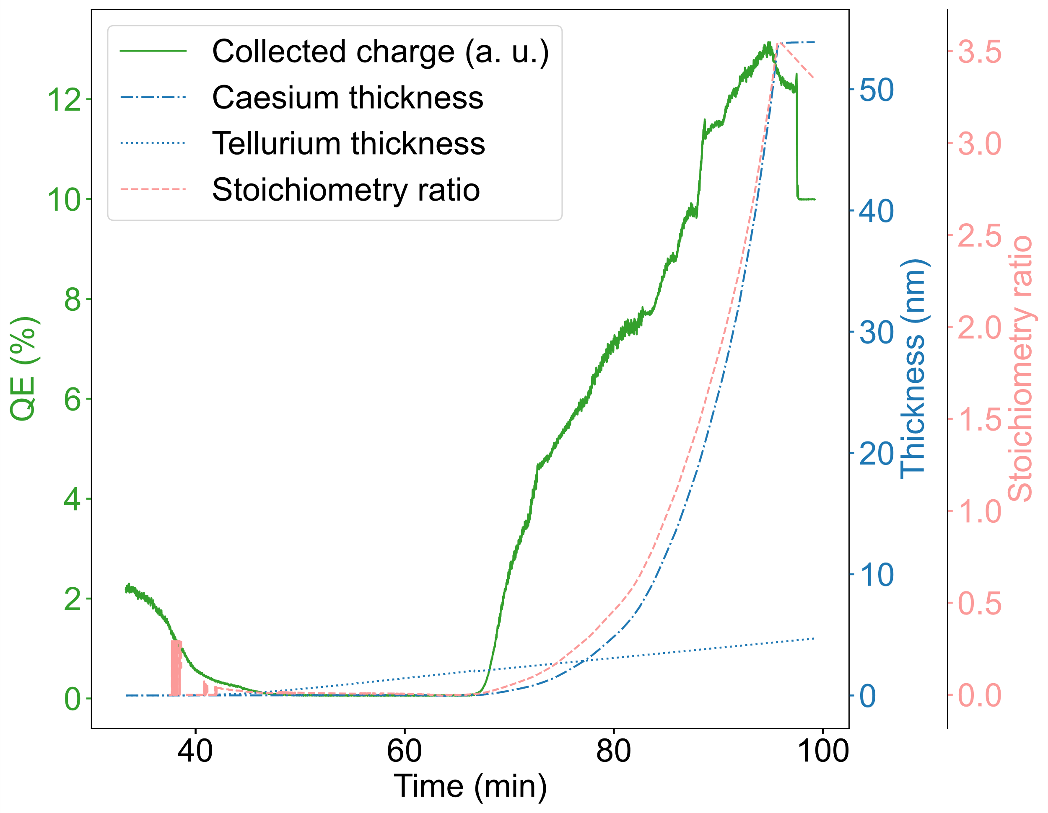
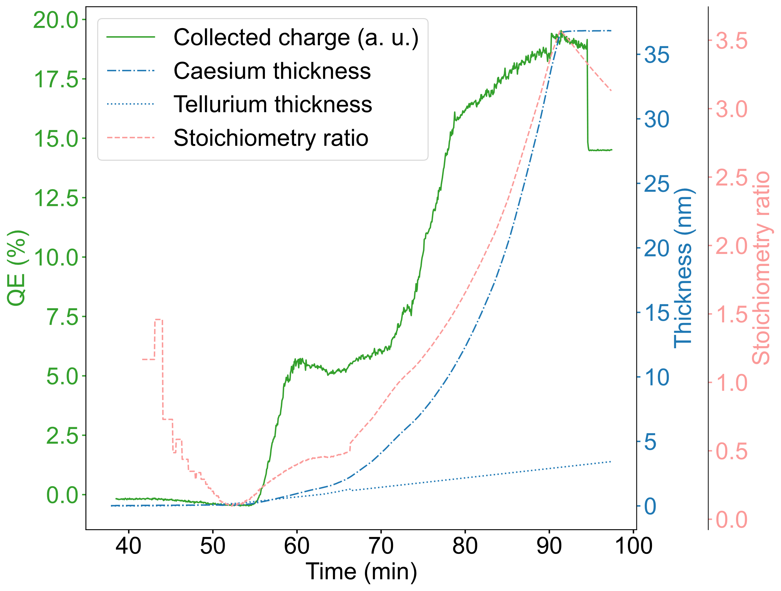
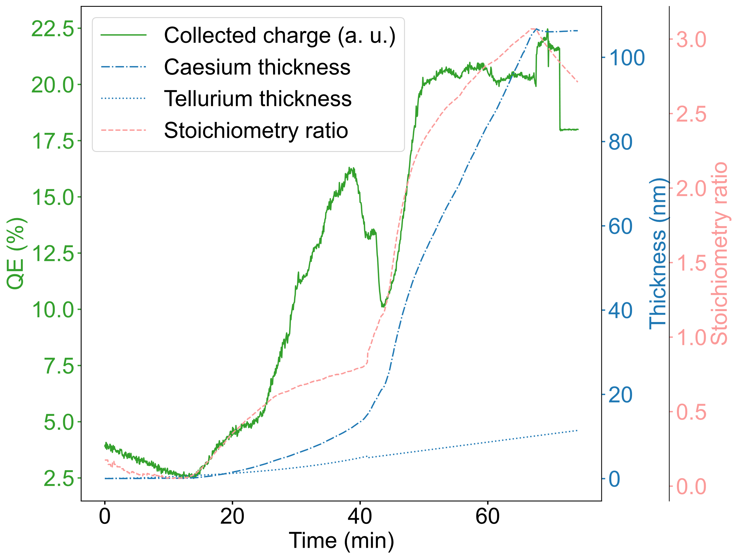
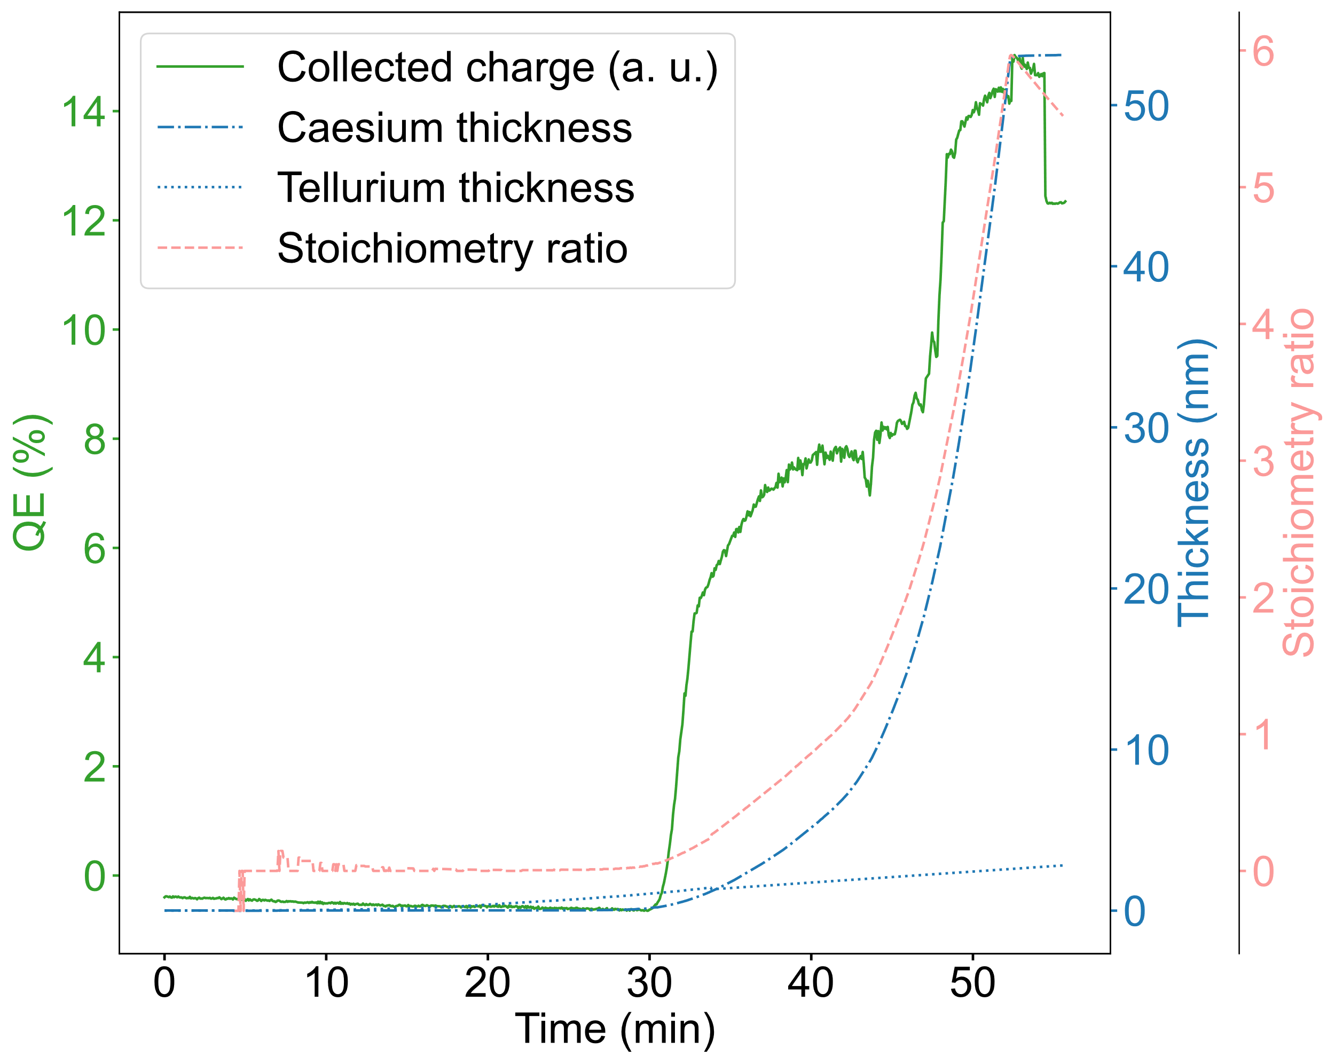
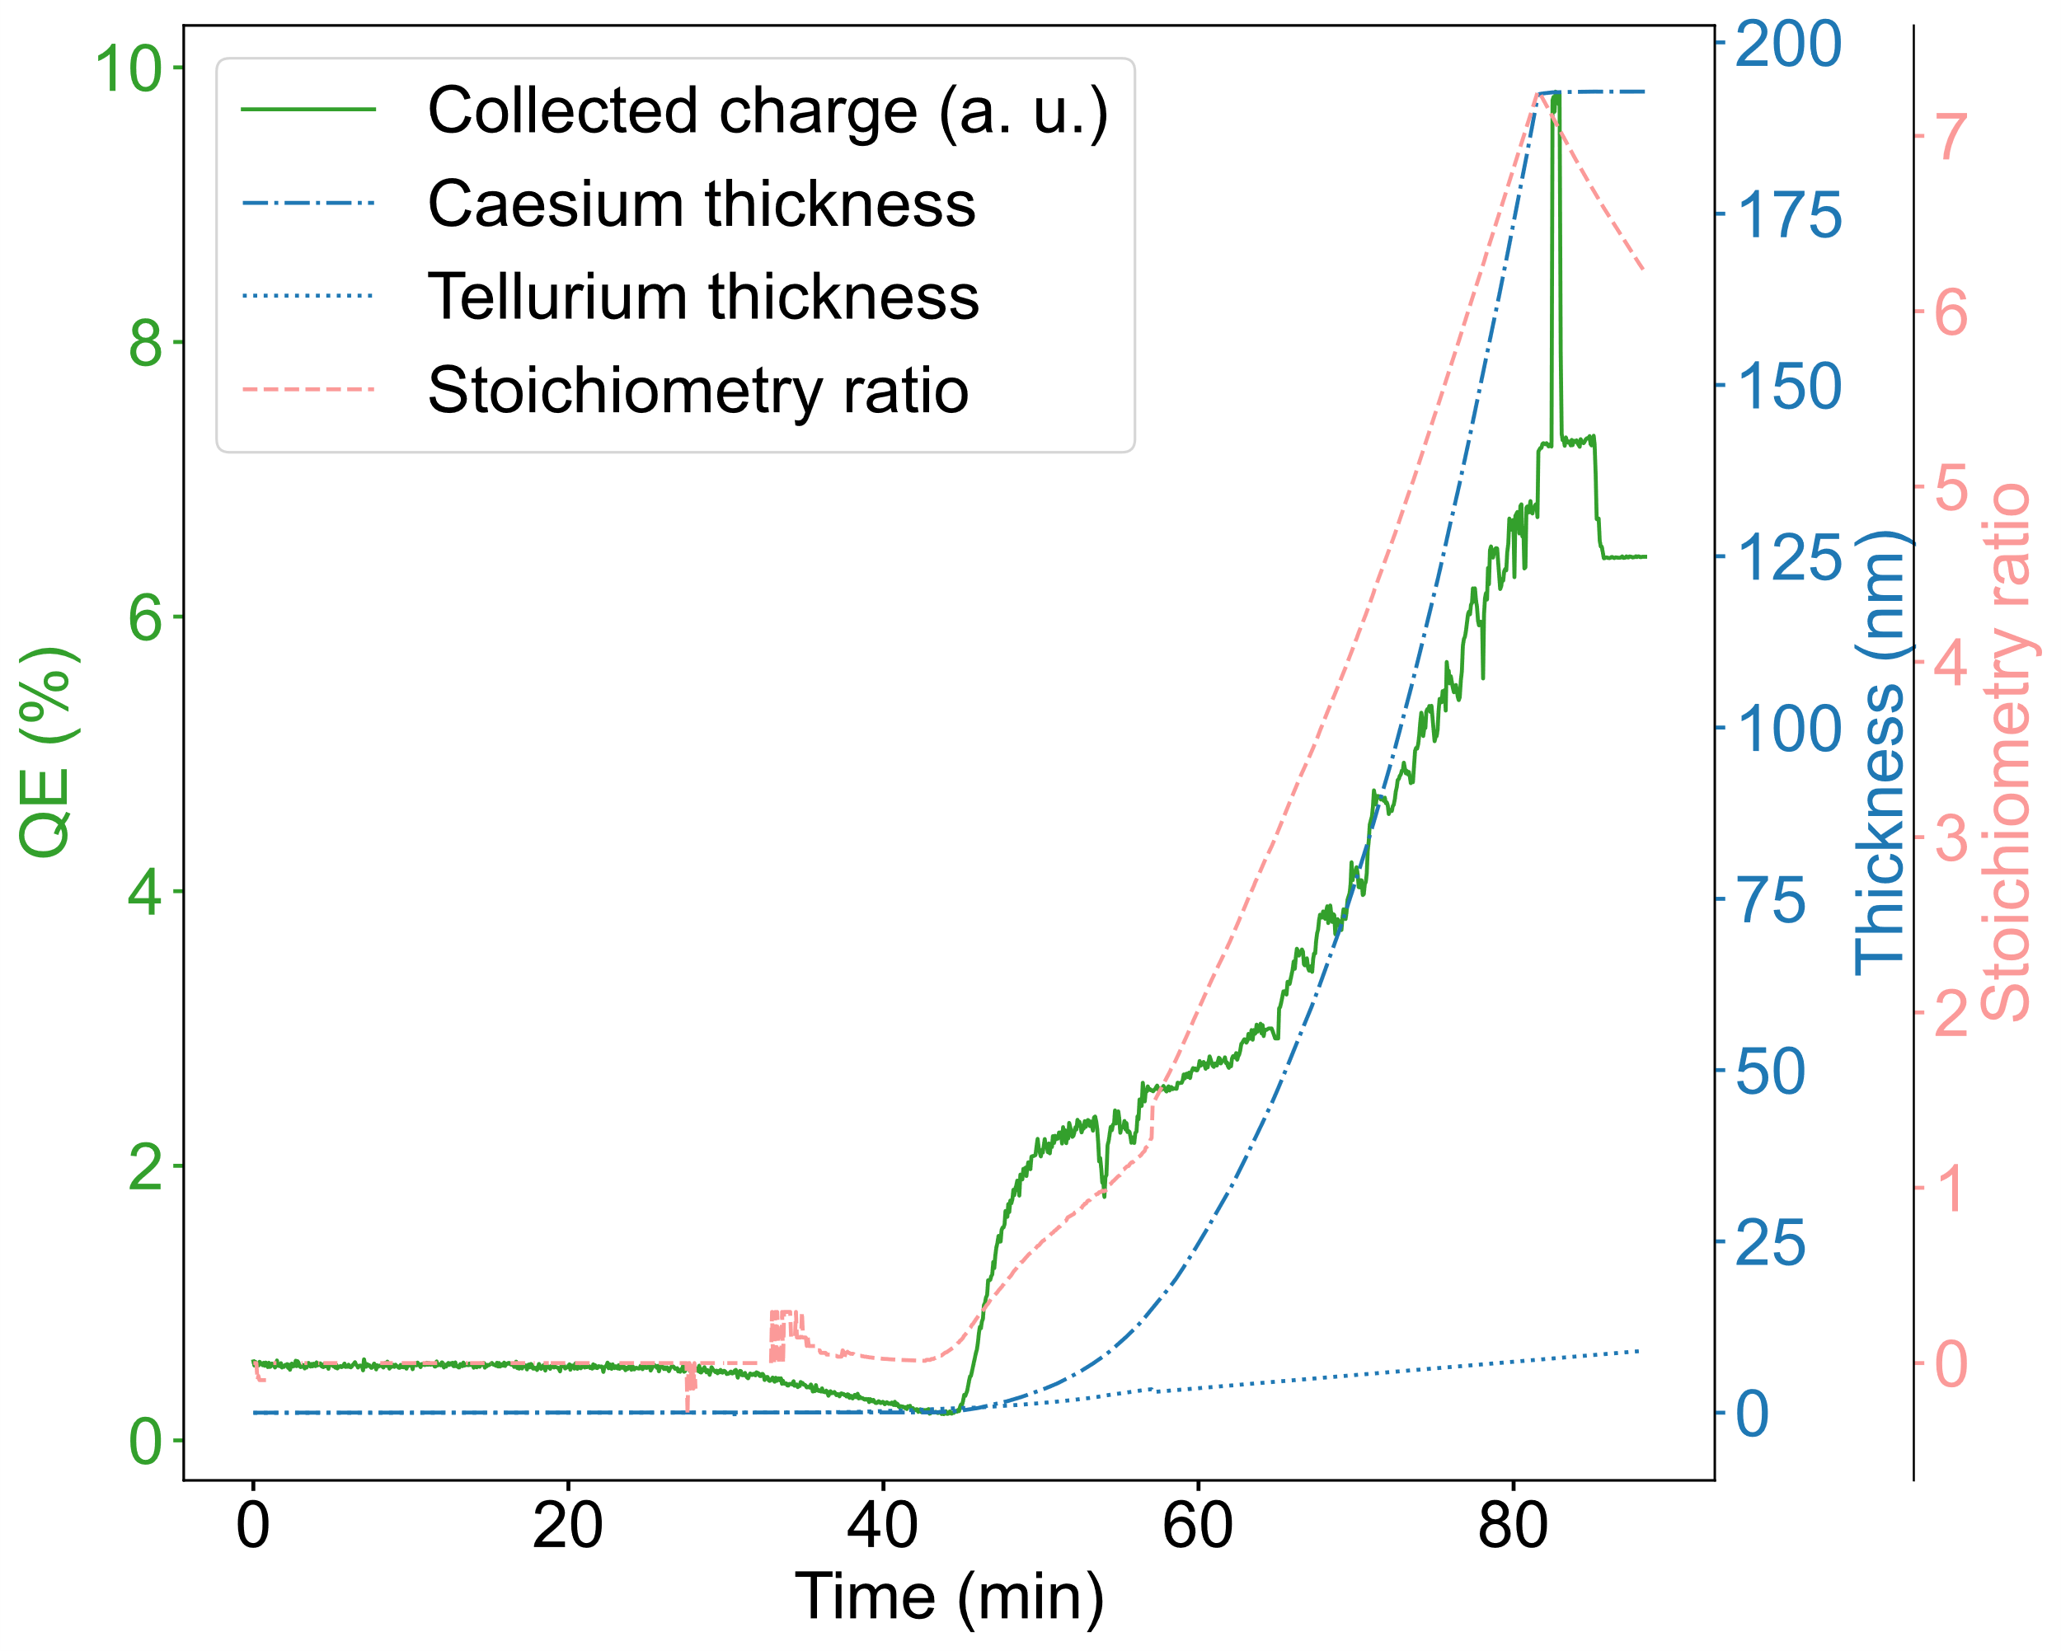
Cs₂Te Photocathode Production Data Analysis
Courtesy of M. Martinez Calderon

Slide 19
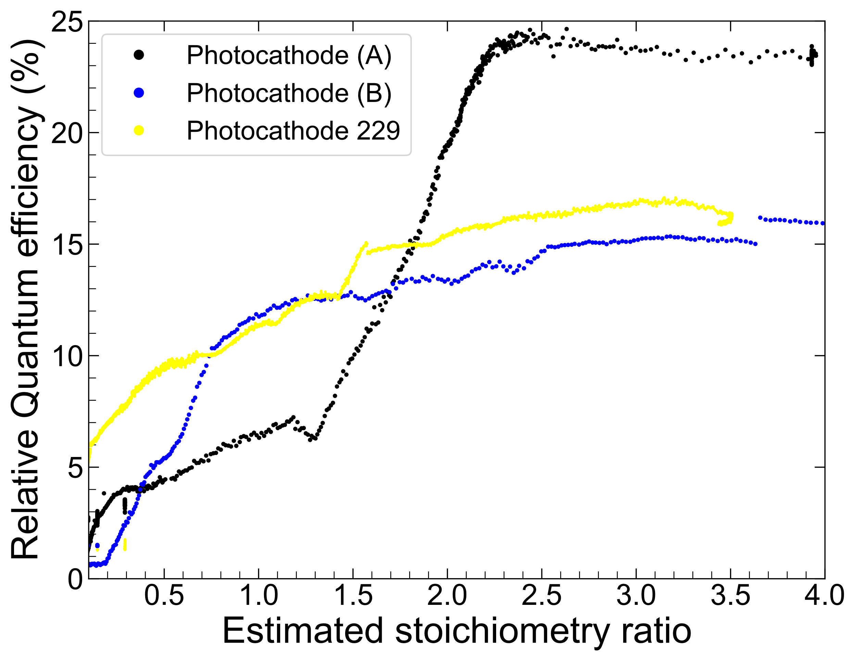
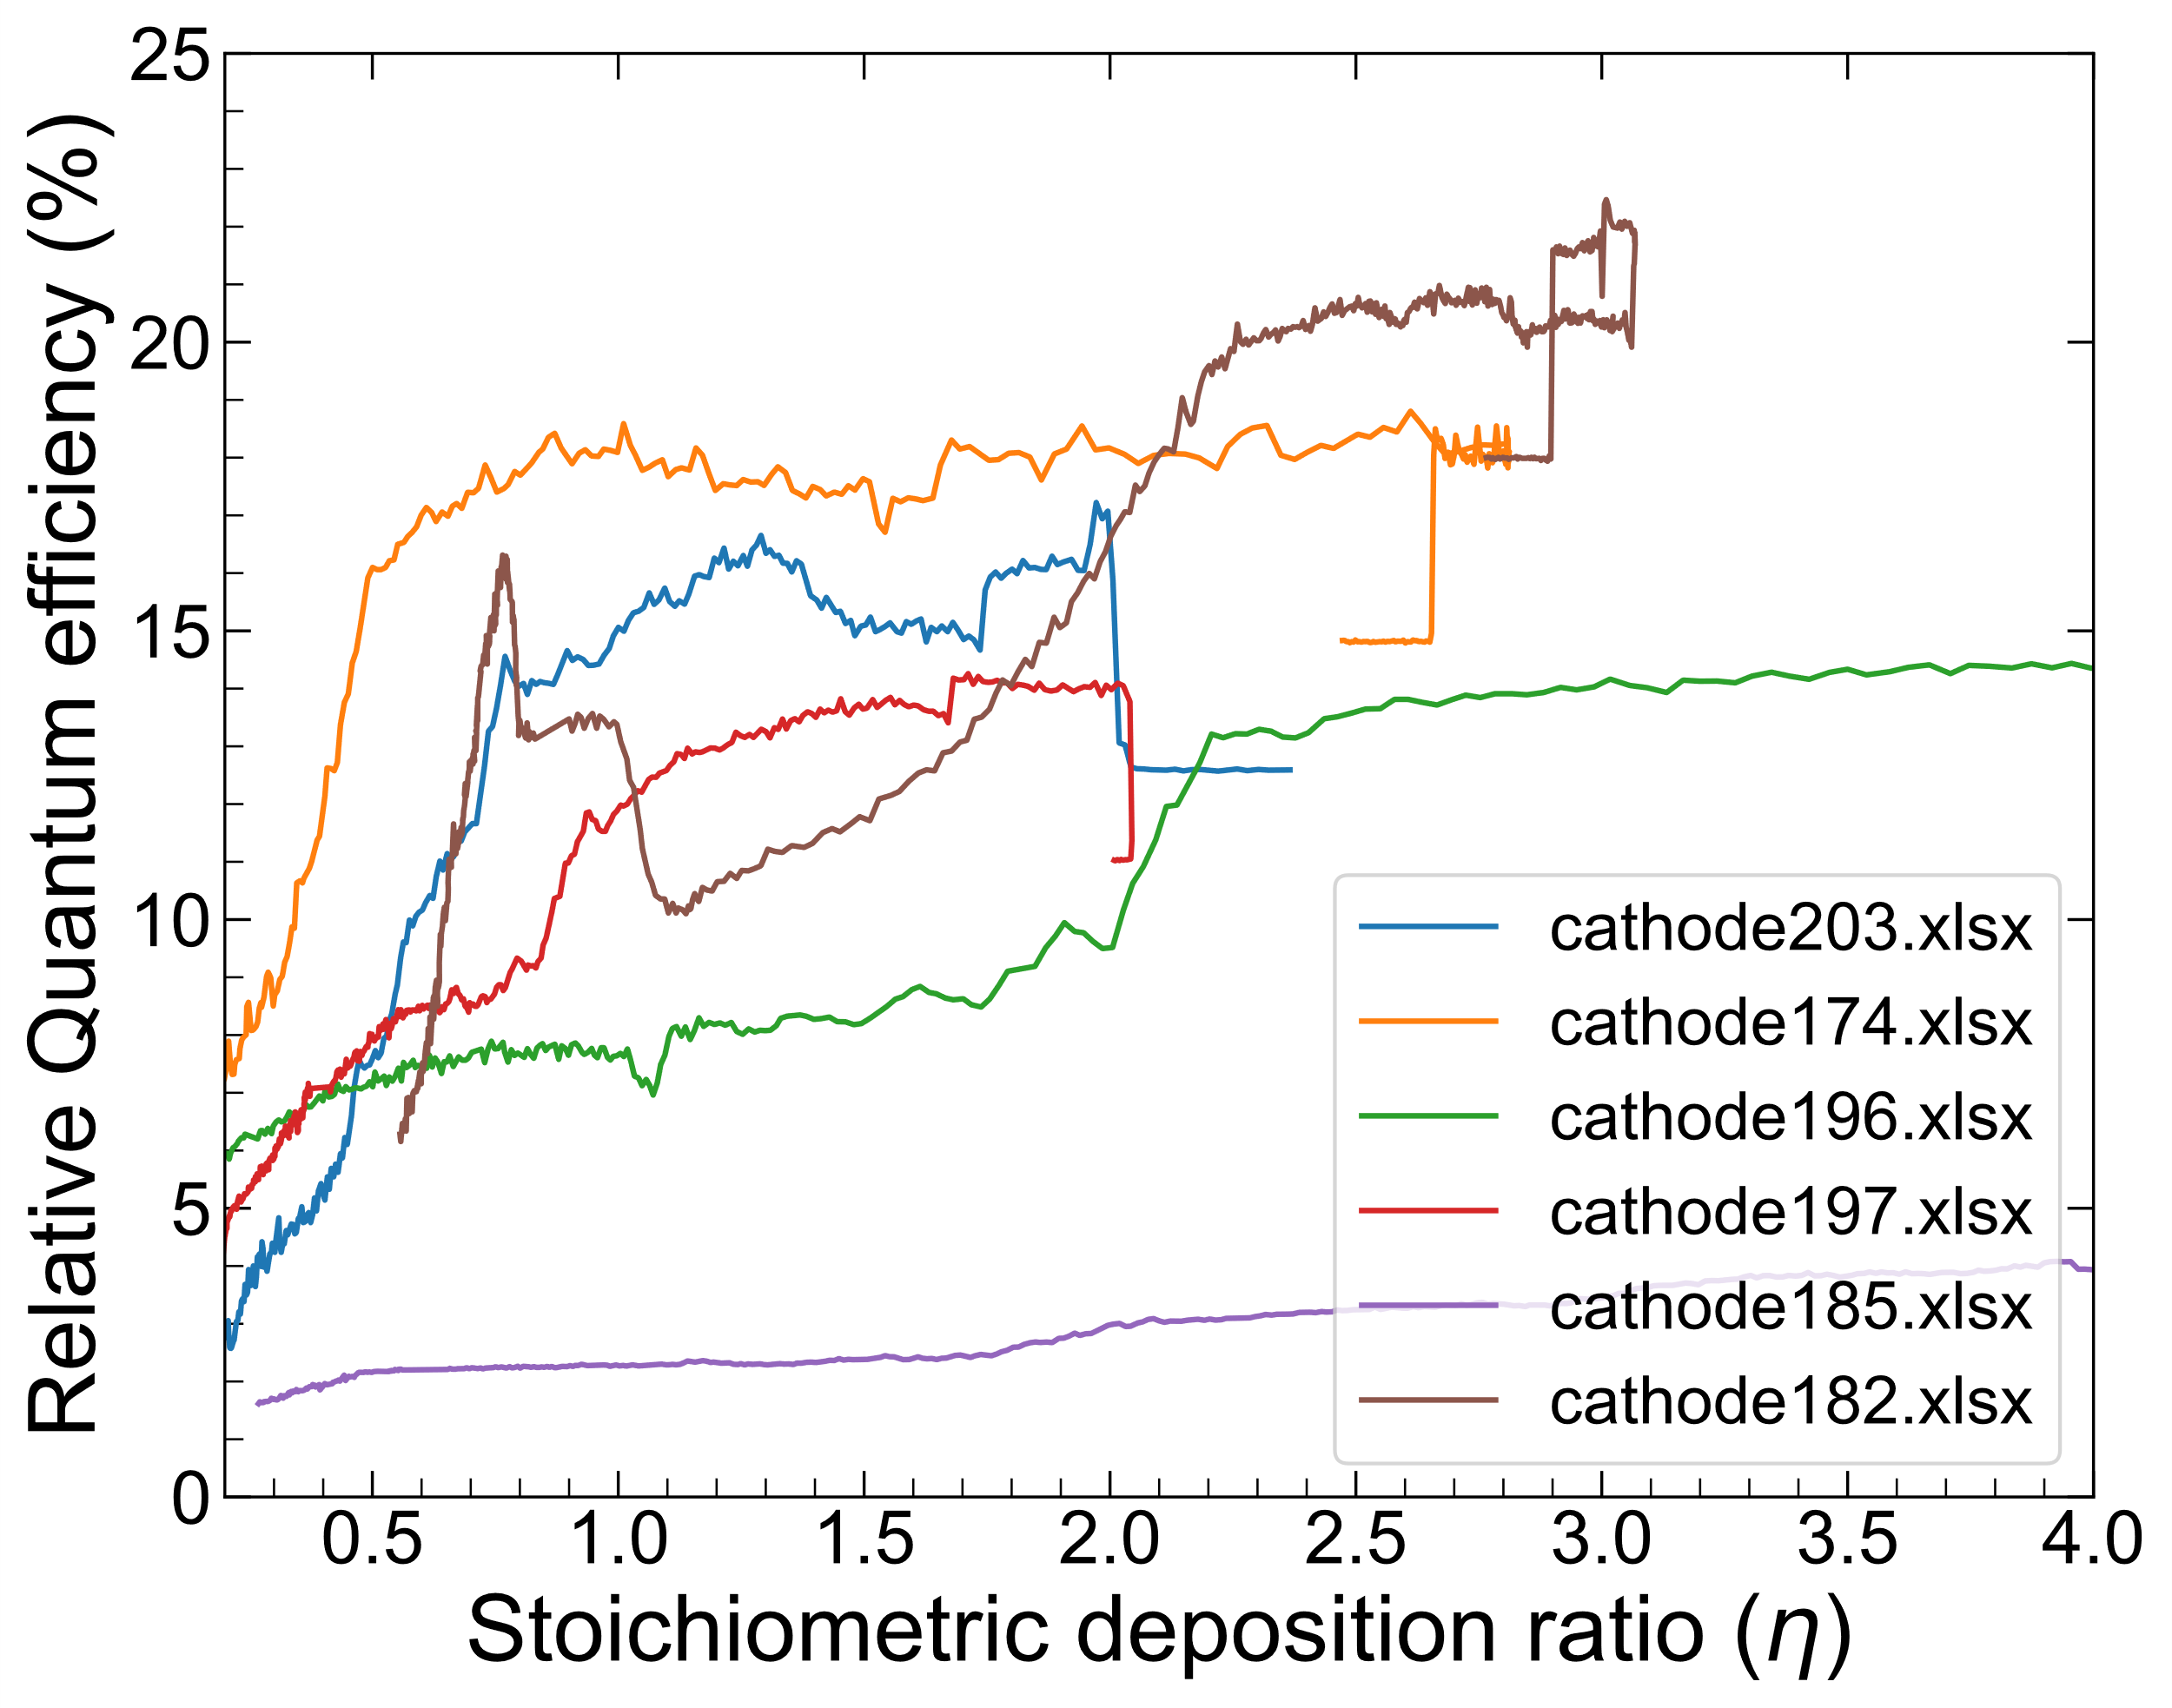
CsTe photocathodes analysis
From the previous study that we just published it seems to be an optimum window for stoichiometry ratio
Courtesy of M. Martinez Calderon

Slide 20
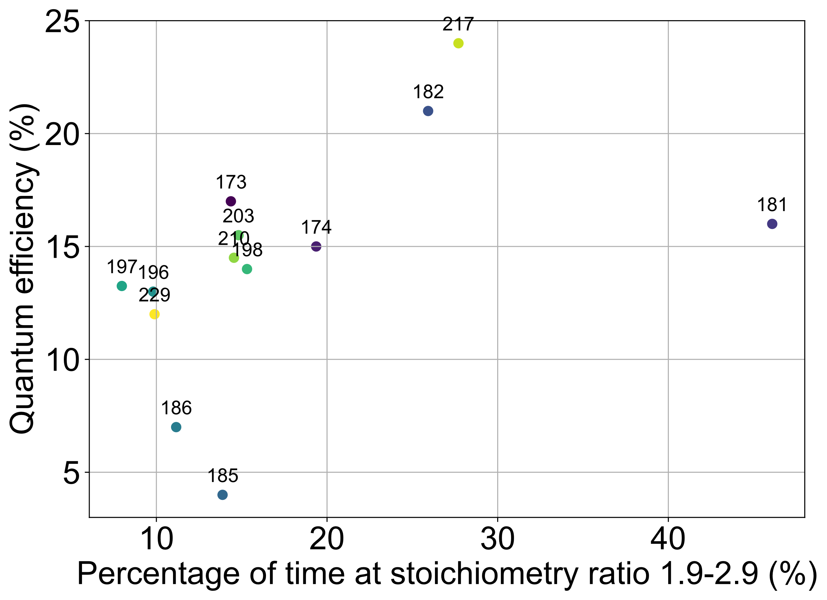
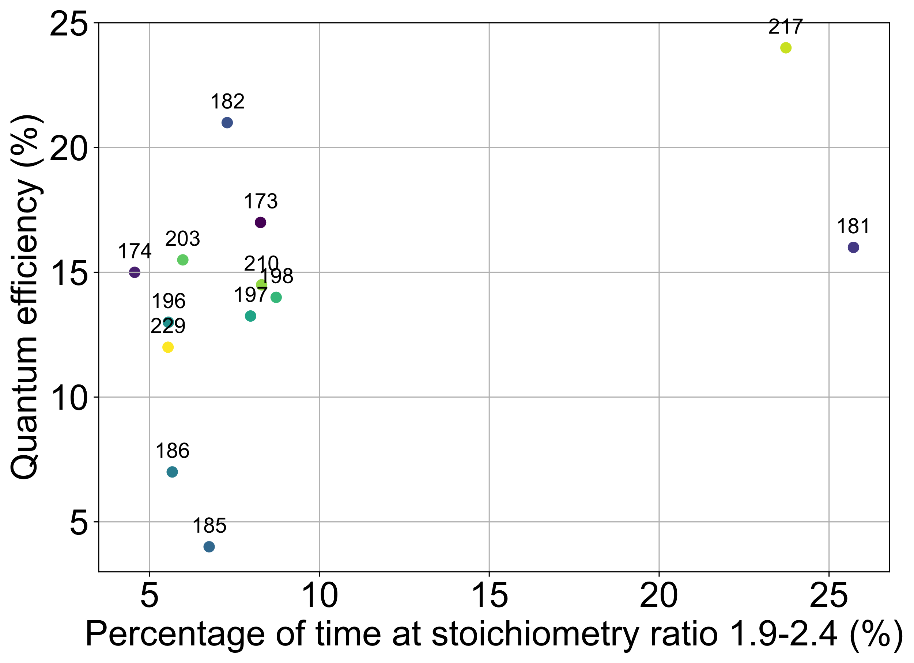
CsTe photocathodes analysis
So, we wanted to further characterize the window which seems to be crucial for achieving high QE
First, the time spent at different “windows” of optimum stoichiometry ratio
Window 1: st_ratio = 1.9 – 2.9; Window 2: st_ratio = 1.9 - 2.4
Window 1
Window 2
Courtesy of M. Martinez Calderon

Slide 21
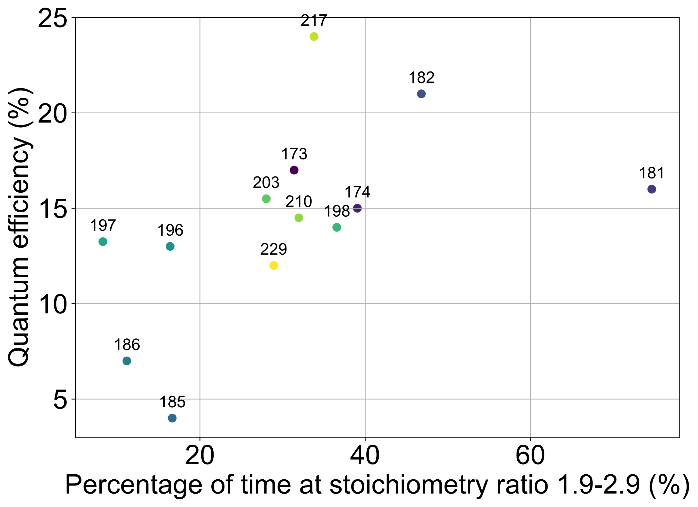
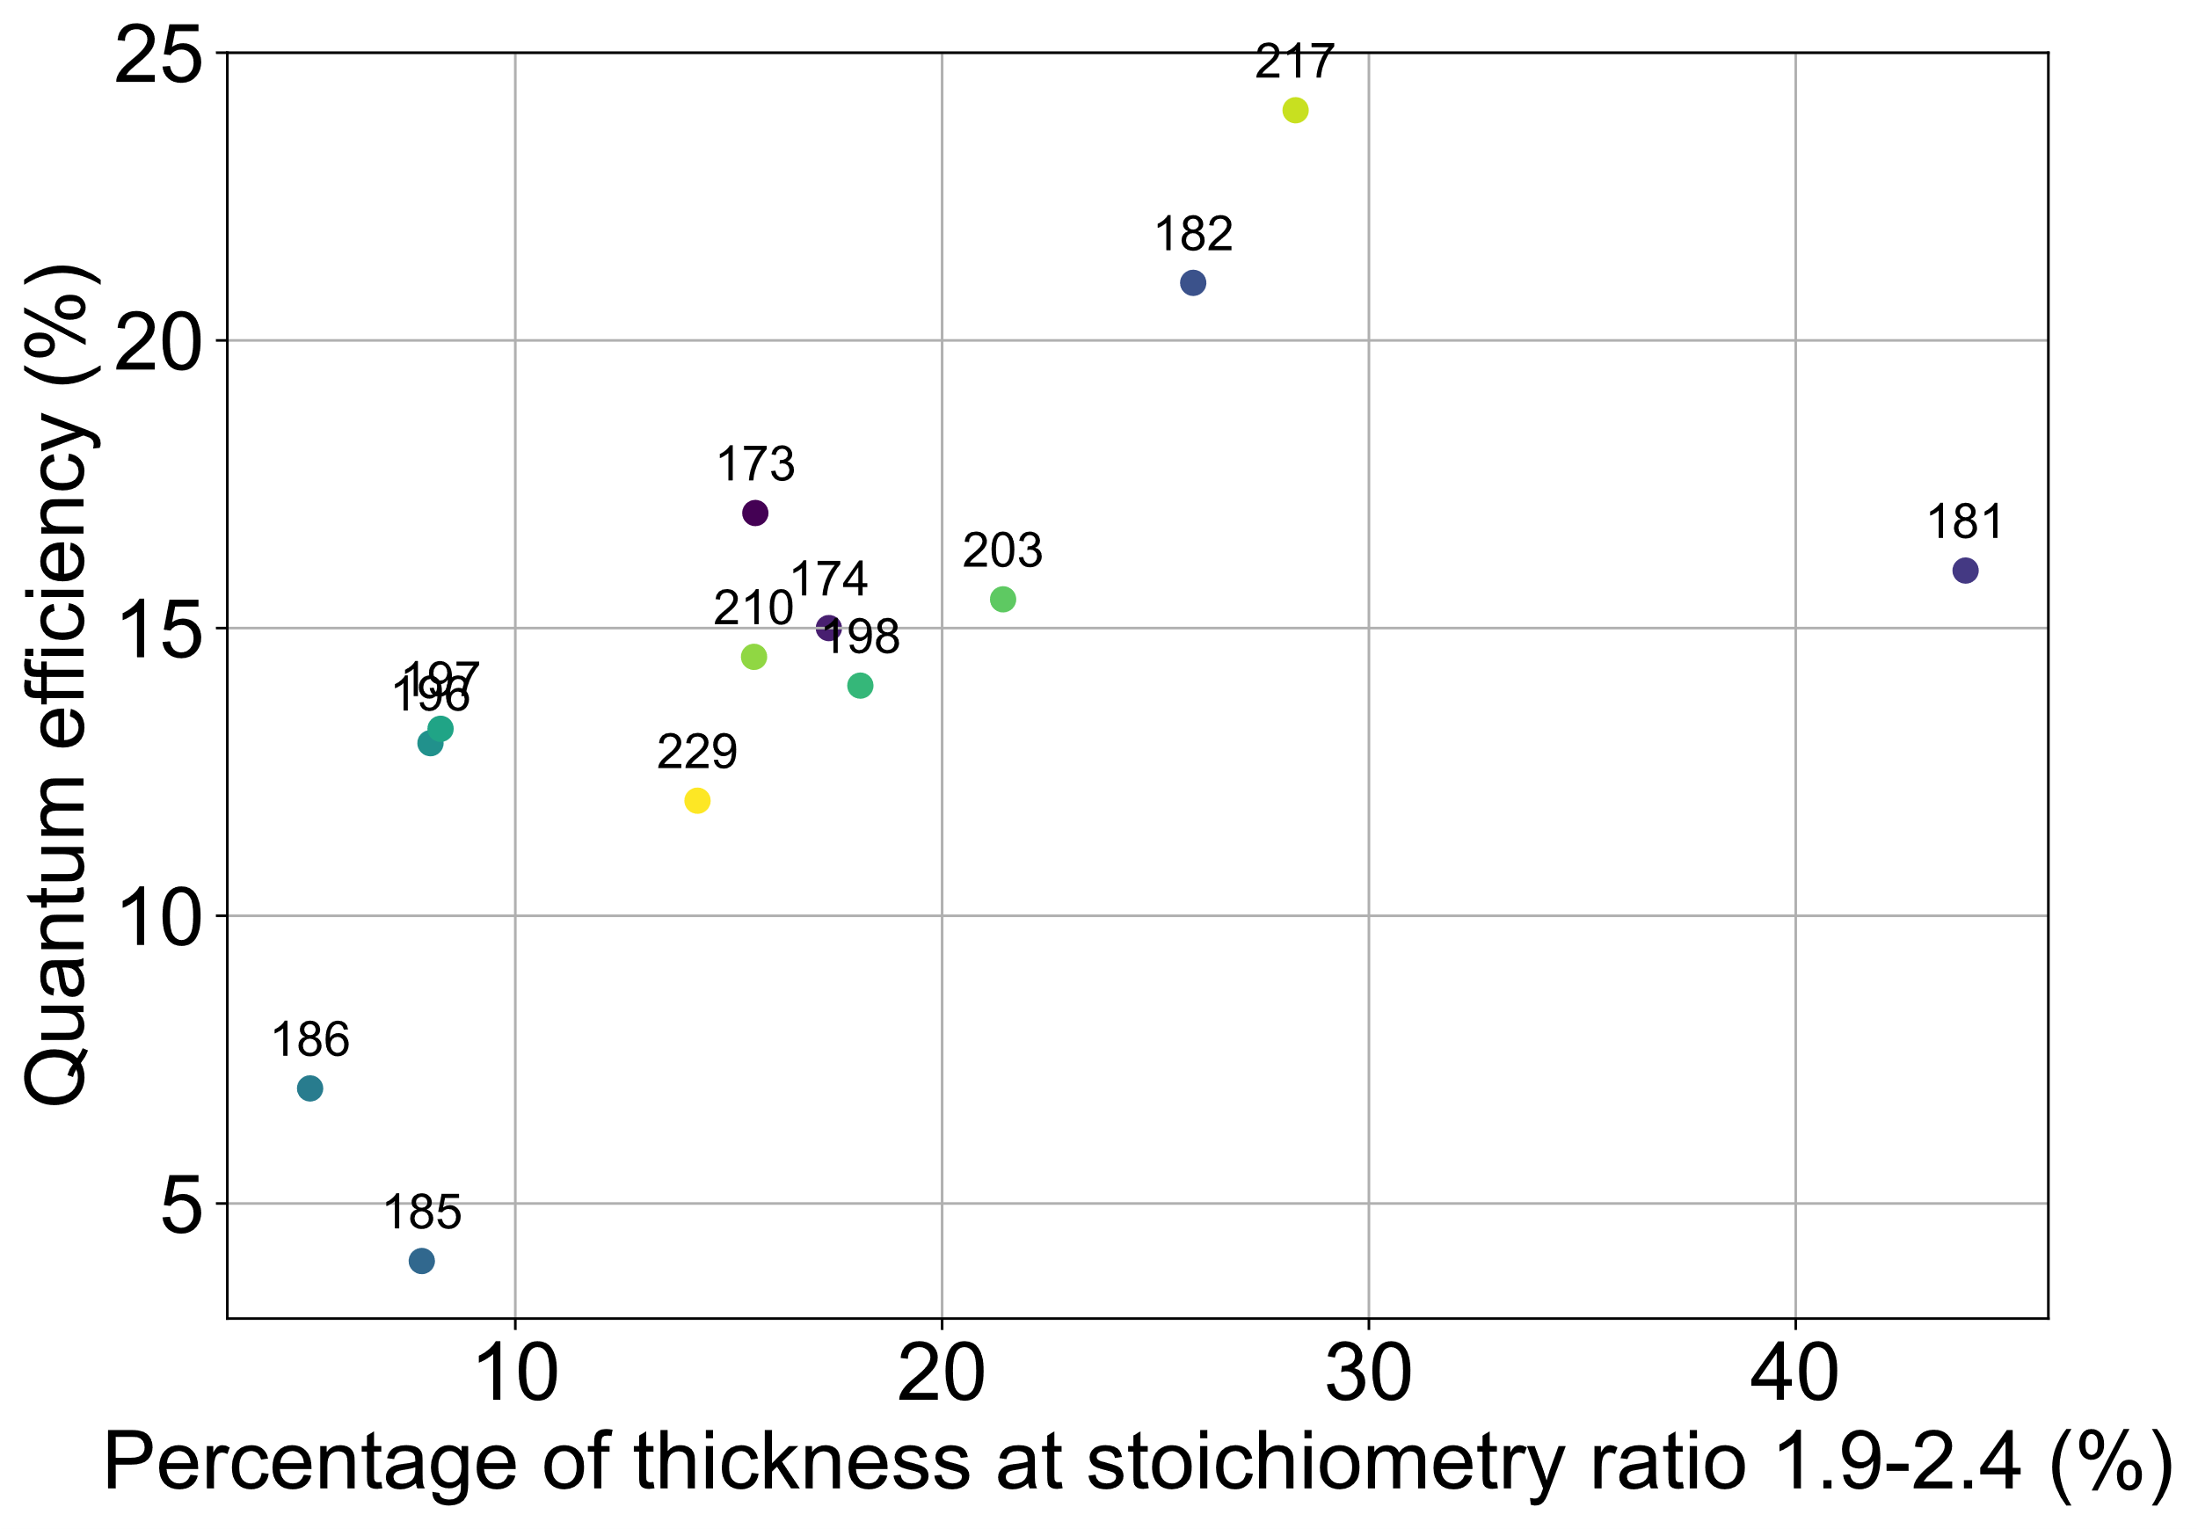
CsTe photocathodes analysis
Second, the % of thickness at different “windows” of optimum stoichiometry ratio
Window 1: st_ratio = 1.9 – 2.9; Window 2: st_ratio = 1.9 - 2.4
Window 1
Window 2
Courtesy of M. Martinez Calderon

Slide 22
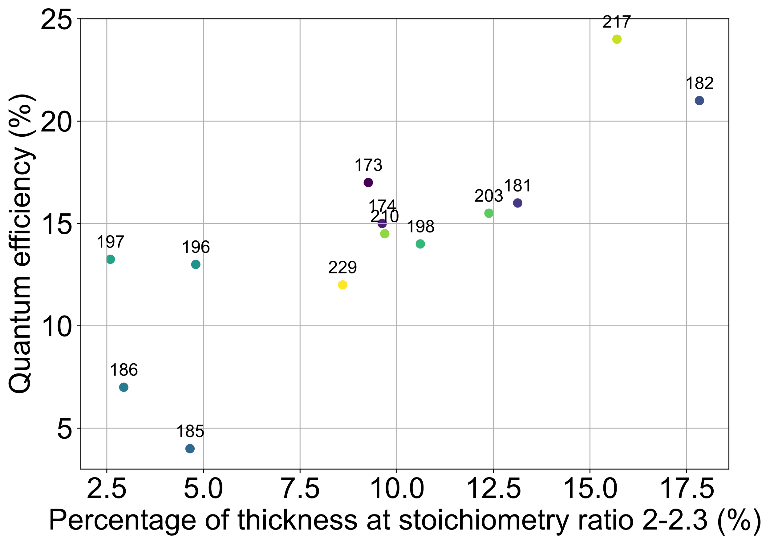
CsTe photocathodes analysis
Second, the % of thickness at different “windows” of optimum stoichiometry ratio
Window 3: st_ratio = 1.9 – 2.2; Window 4: st_ratio = 2 - 2.3
Window 3
Window 4
Courtesy of M. Martinez Calderon

