Slide 1


Slide 2
What was that? Did you see that??
Project made by:
Danciu Eduard-Florin
Matei Stefan

Slide 3

Table of contents:
Introduction: Why is particle detection important?
History of particle detection
How does modern particle detection work?
Types of particle detectors
How can we improve modern particle detectors and why

Slide 4

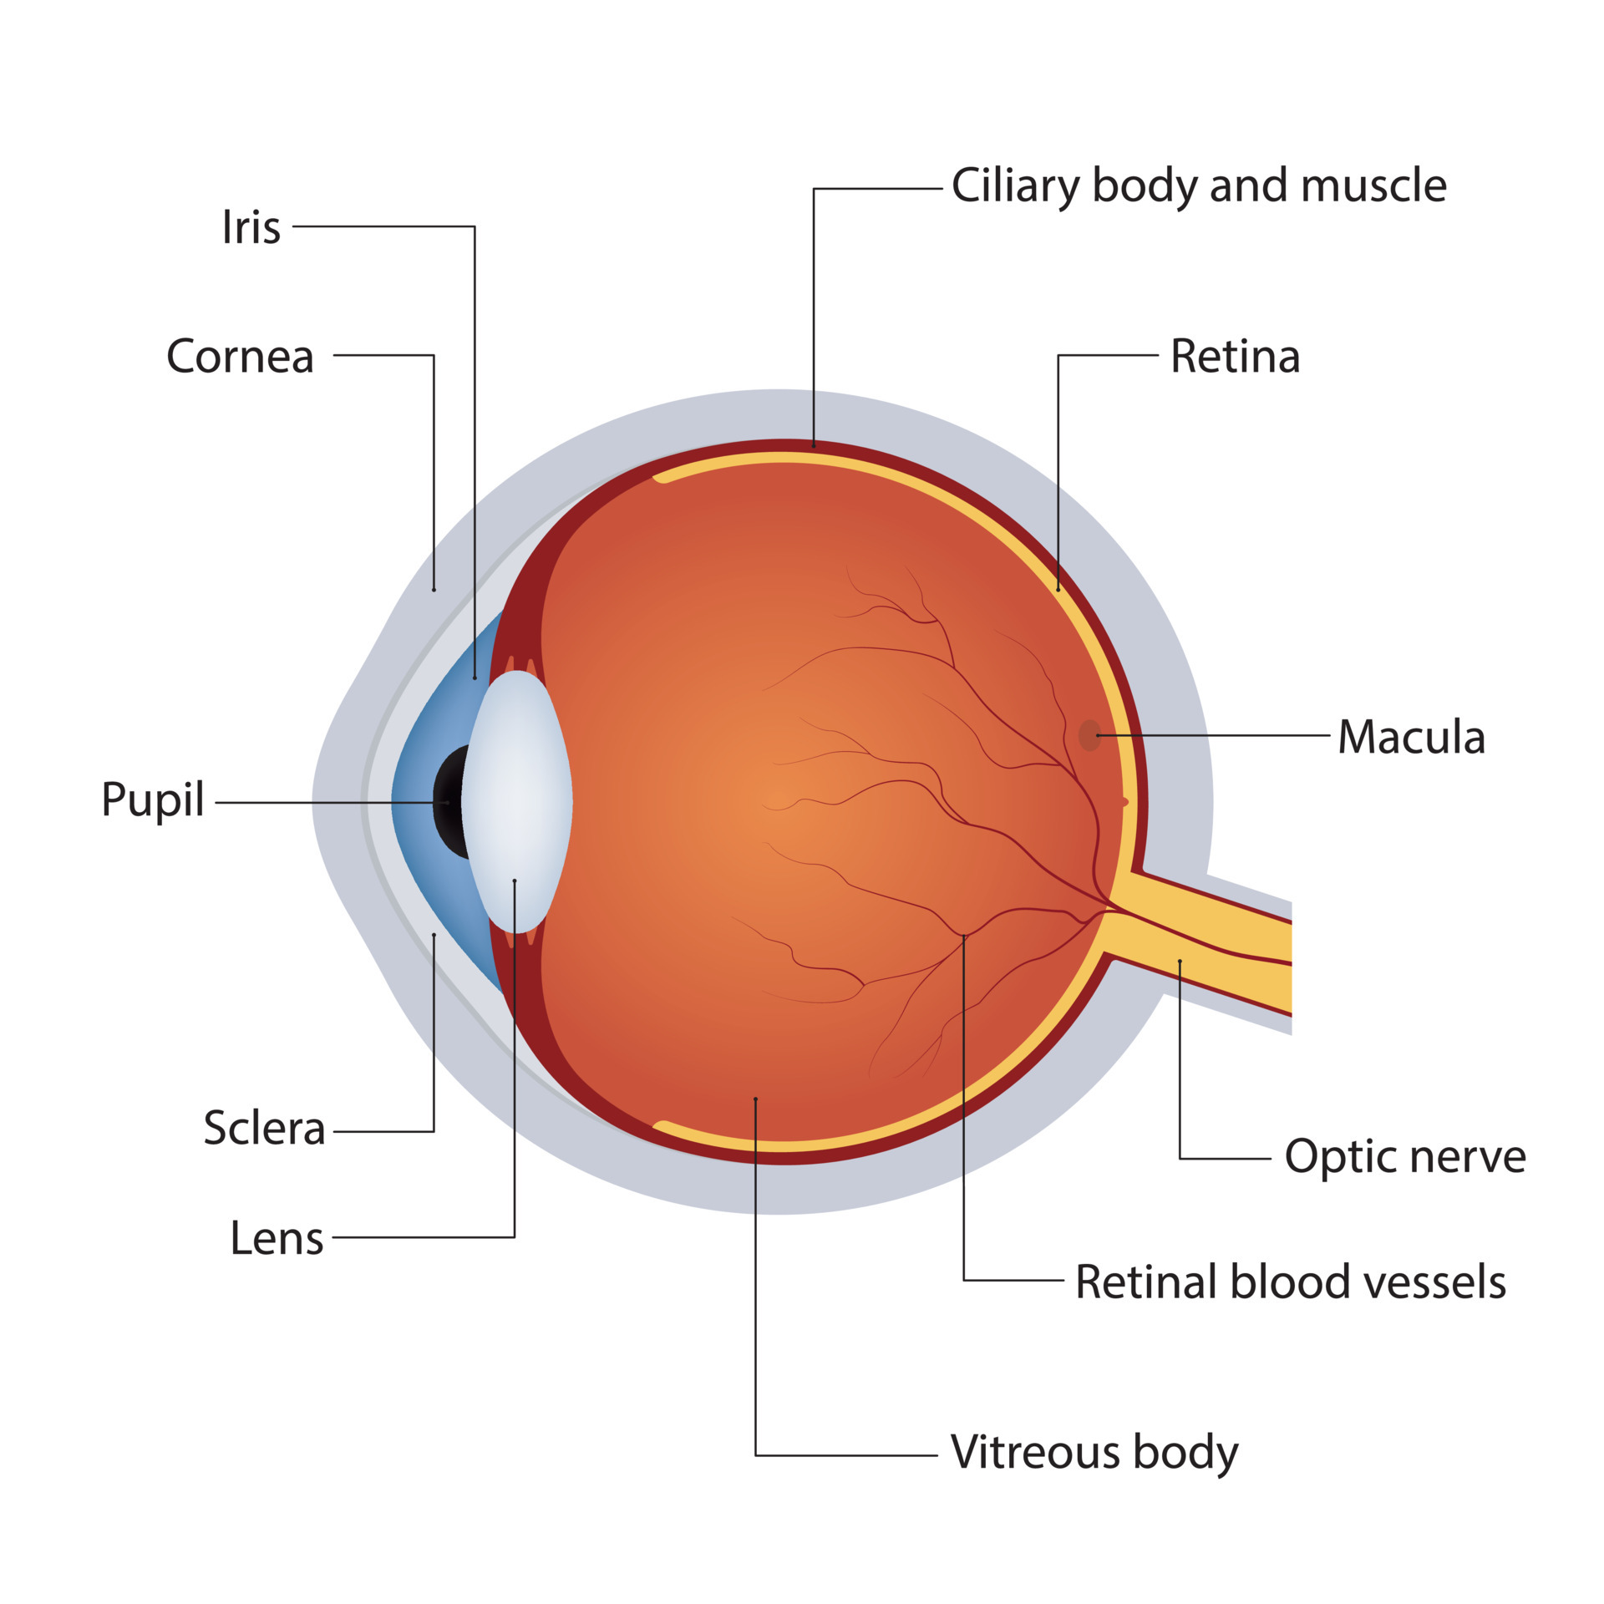
Why do we need particle detection?
The human eye is a particle detector, capable of detecting photons of certain energies.
As a result of the Cherenkov effect, we can also detect other particles with our eyes, but not without inflicting serious damage.
Thus, we study the way particles interact with different materials such that we can detect their existence by observing their effect on a certain material.

Slide 5
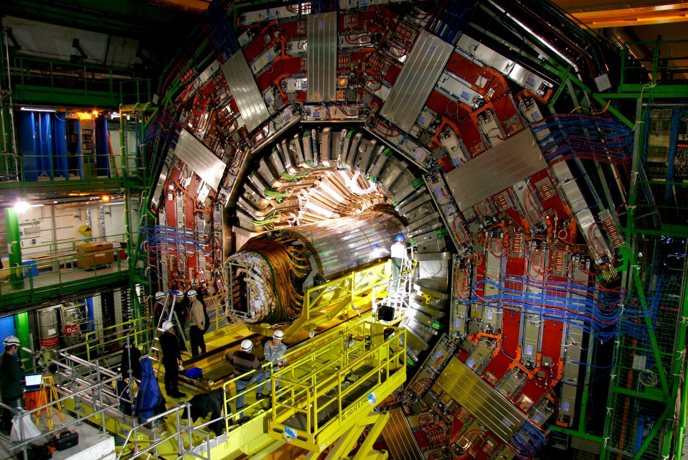
Why do we need particle detection?
An important application of particle detection is in Particle Physics.
Particle Physics is concerned with discovering and studying fundamental particles and interactions and obtaining a unified theory that explains everything in the Universe.
However, a theory can’t be verified without experimental confirmation of it’s predictions. This is where particle detectors come in.
By colliding high-energy particle beams, we allow the creation of new particles whose properties we study using particle detectors, who track their trajectories, measure their energy, momentum and charge.

Slide 6
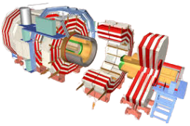
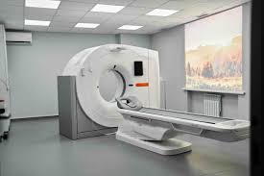
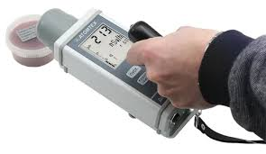
What are the applications of particle detection?
Fundamental Research
Medical Imaging
Environmental Monitoring
CMS Detector
MRI
Dosimeter

Slide 7
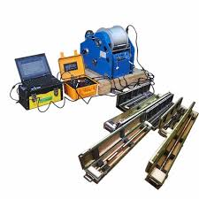
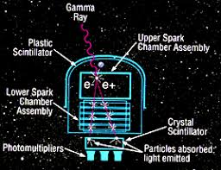
What are the applications of particle detection?
Geological exploration
Astrophysics and Cosmology
Geophysical Logging
Gamma-Ray Astronomy

Slide 8
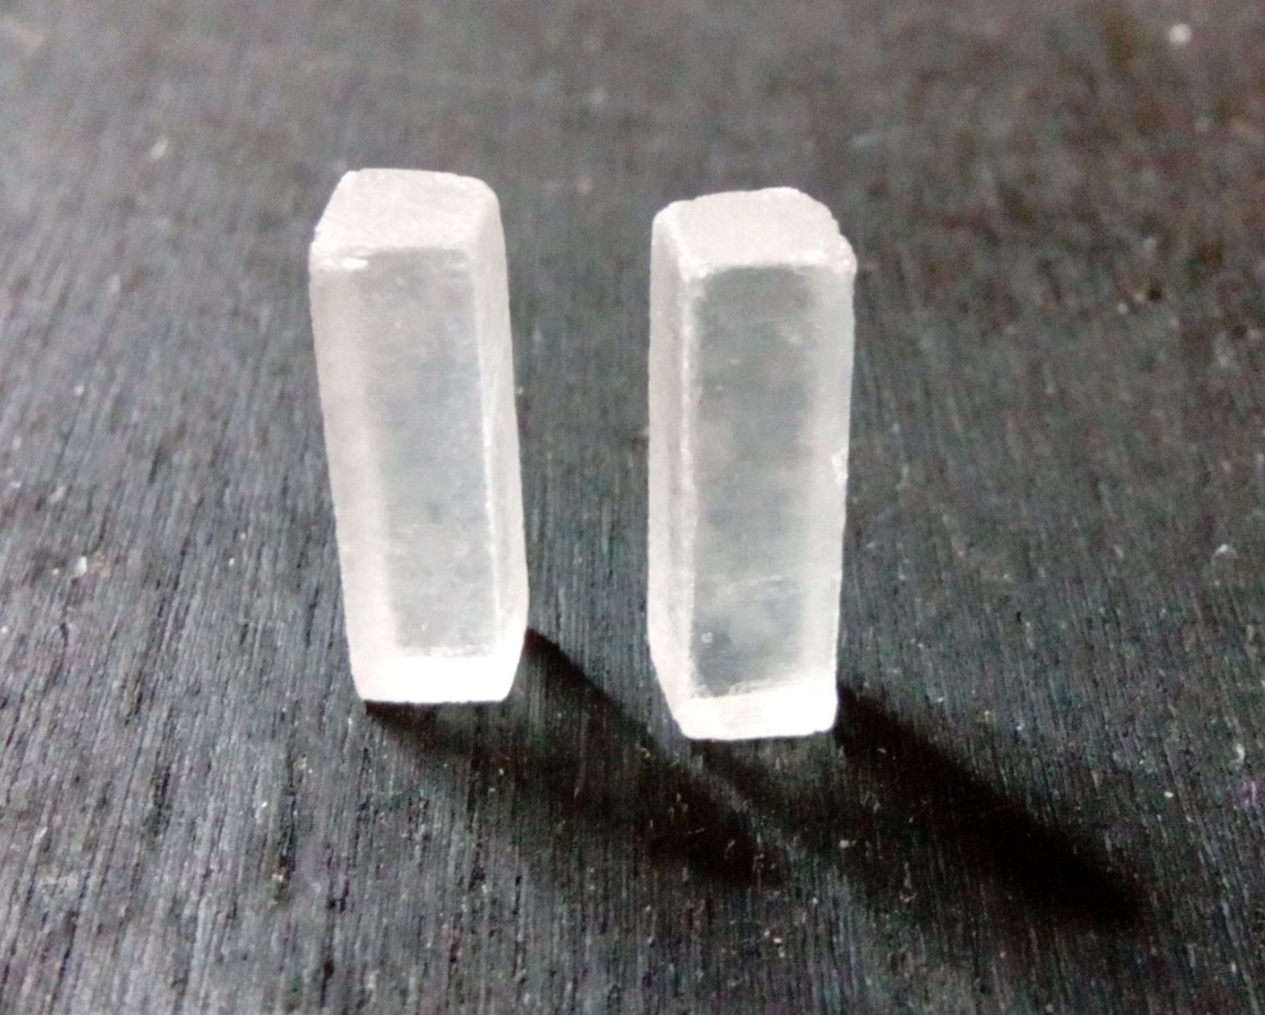
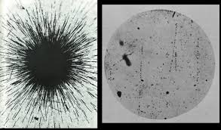
How it was achieved in the past?
Early Methods:
Photographic Plates
Scintillator material

Slide 9
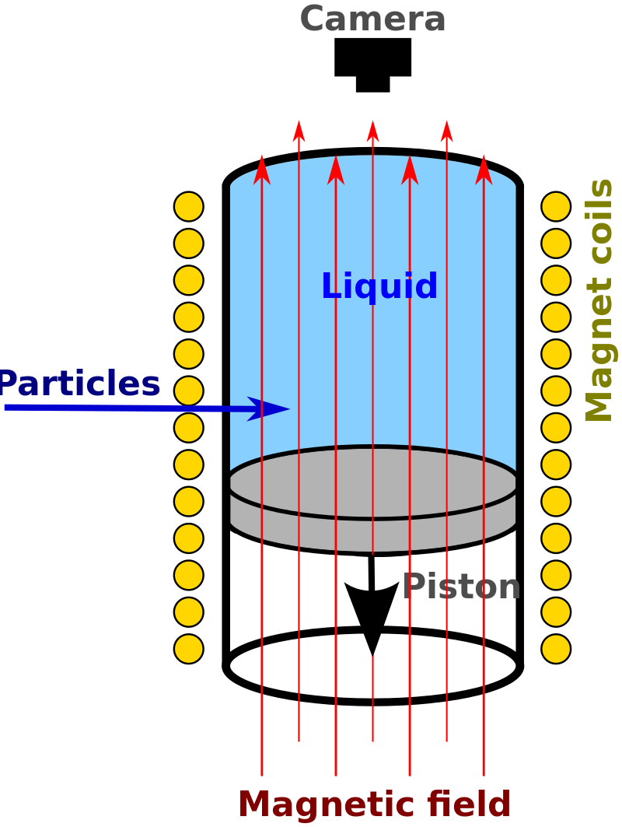
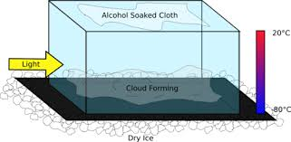
How it was achieved in the past?
2. Mid 20th Century Methods
Cloud Chambers
Bubble Chambers

Slide 10
History of Particle Detection
Particle detectors have evolved over the past century from simple photographic films and scintillation screens to advanced electronic and semiconductor devices. Early detectors, like cloud and bubble chambers, made particle tracks visible and led to key discoveries like the positron and pion.
The development of electronic detectors began with the Geiger-Müller tube and advanced to scintillation counters with photomultiplier tubes (PMTs), which increased sensitivity. Semiconductors later became high-precision tracking detectors.
Today, hybrid systems like Silicon PMTs and Micropattern Gas Detectors are used, combining various technologies to enhance performance. This evolution supports future high-energy colliders and advances in particle physics.

Slide 11
How does modern particle detection work?
Basic detection principle:
Electrical signal
(which can be detected)
electrons need to be freed
moving electrons
Lots of electrons need to be freed in order to detect them. Thus, we use the Avalanche effect: by applying a strong electric field, the already freed electrons gain kinetic energy which they use to free other subsequent electrons.

Slide 12
Neutral particles (e.g. neutrons, photons)
Nuclear reactions
Scintillation
Charged particles
Scintillation, Bremsstrahlung, Cherenkov radiation
Ionisation
Photons
Avalanche effect
Electrons
Photoelectric effect,
Compton effect,
Pair production
More electrons
Electrical signal

Slide 13
Detection of charged particles
Ionisation: some of its kinetic energy is transferred to an electron of the gas detector, thus freeing it.
By creating photons:
  Scintillation: the process where a material emits ultraviolet or visible light under excitation from high-energy photons or energetic particles like electrons, alpha particles, neutrons and ions.
  Bremsstrahlung: is the electromagnetic radiation (i.e. photon) emitted as a result of the deceleration of a charged particle when deflected by another charged particle.
  Cherenkov radiation: is the electromagnetic radiation (i.e. photon) emitted when a charged particle passes through a medium at a speed greater than the phase velocity of light in that medium.

Slide 14

Detection of neutral particles
Photon: frees electrons as a result of the:
  Photoelectric effect: the photon (around 1 keV) transfers its entire energy to an atom that emits a shell electron.
  Compton effect: the photon (around 1 MeV) is scattered following the transfer of some of its energy to an electron, which is released from the outer valence shells.
  Pair production: conversion of a photon into a positron-electron pair near a nucleus.

Slide 15

Detection of neutral particles
Neutron: Using gases of large reaction cross section, the interaction between the neutron and the atomic nucleus results in charged particles.
Neutrino: only via weak interaction (gravitational force caused by neutrinos is too weak).
  By transferring energy to a target particle that subsequently emits Cherenkov radiation (no flavor information unfortunately)
  By coupling with a W boson and as a result converting into a charged lepton which can be detected (flavor information)
  By finding the decays in which the detected particles don’t seem to respect energy conservation (the difference is the energy of the neutrino)

Slide 16
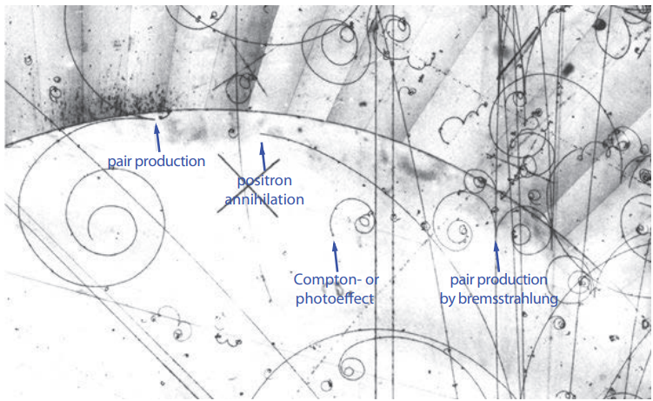
15-feet bubble chamber, Fermilab
Source: Hermann Kolanoski & Norbert Wermes, Particle Detectors

Slide 17
How many types of particles detectors exist?
The basic principle of particle detection can be implemented in machinery called particle detectors:
Gaseous Detectors
Semiconductor Detectors
Scintillation Detectors
Calorimeters

Slide 18
The Gaseous detector
Consists in: a cathode and anode surrounded by a carefully selected gas.
Mechanism:
  Charged particles ionise the gas atoms.
  The released electrons are attracted by the anode and the positive ions by the cathode.
  The electrical signal is detected.
Usually the anode is a wire and the cathode is a tube surrounding it. By multiplying these straw chambers we can effectively detect the points the charged particle has passed through, with a certain error margin (in this case the tube’s radius).
By connecting the dots we can determine the particle’s trajectory.

Slide 19
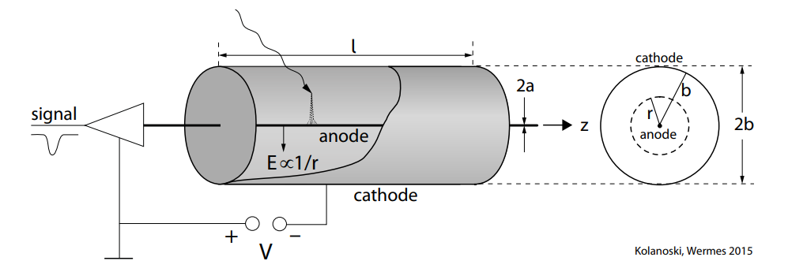
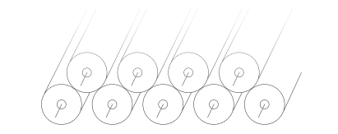

Slide 20
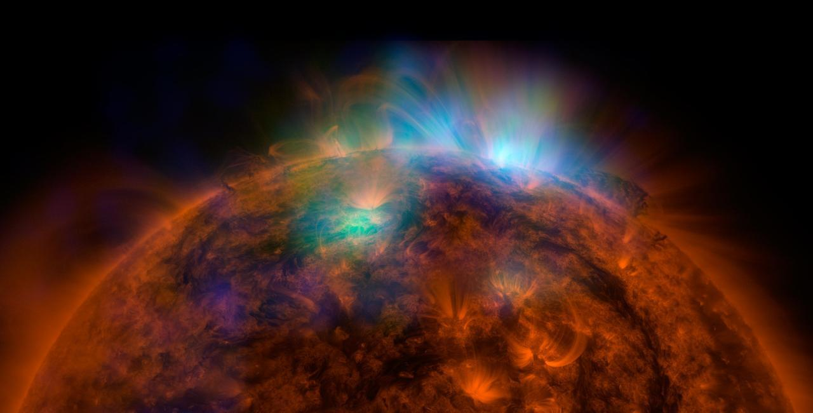
The Gaseous detector
Other layouts exist:
  Multiwire proportional chamber (the tube being replaced by two parallel planar cathodes on each side of the wires)
  Drift chambers (By measuring the drift time of the electron, a more precise measurement of the position of the charged particle is determined)
By alternating the directions of the wires on multiple levels, a more precise tridimensional trajectory can be obtained.

Slide 21
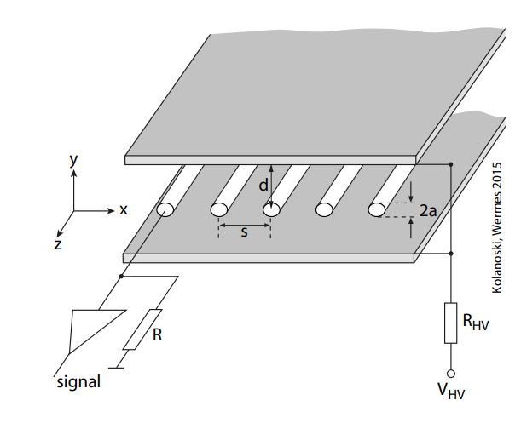
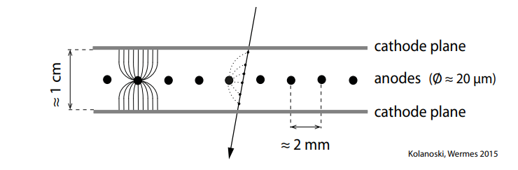
Multiwire proportional chamber

Slide 22
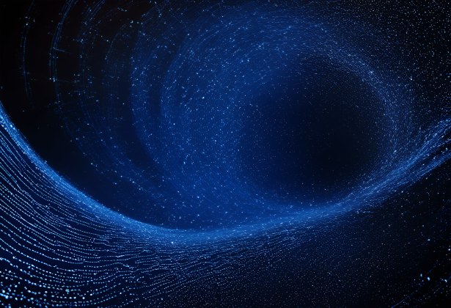
The semiconductor detector
Is based on a similar principle used in the gaseous detector.
Mechanism:
  The material is arranged between two electrodes.
  The charged particles or photons hit the material (usually silicone), creating electron-hole pairs.
  The electrons and holes travel to the electrodes, which results in an electrical signal that can be measured.
  The energy of the particle can be determined by measuring the number of electron-hole pairs.
This detector is more efficient than the gaseous detector because the energy necessary for the generation of an electron-hole pair is five times smaller than for the generation of an electron-ion pair in a gas.
Therefore, a higher resolution can be achieved. The drawback is that silicone detectors are more expensive and require sophisticated cooling to reduce leakage currents.

Slide 23

Scintillation detector
use scintillators, a material which emits photons when struck by an incoming particle, absorbing its energy.
The scintillator is coupled with a photomultiplier tube (PMT), that absorbs the photons and re-emits them as electrons (photoelectric effect, compton effect, pair production)
The multiplication of the electrons results in an electrical signal that can be measured, giving valuable information about the particle.

Slide 24
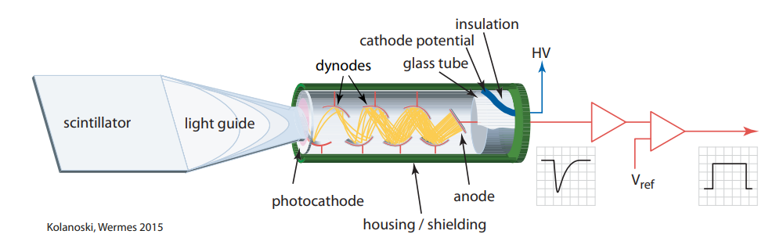
Scintillation detector

Slide 25
Calorimeter
As their name suggests (“calorie”), they measure a particle’s energy as it passes through the detector.
To measure a particle’s full energy, it needs to deposit its entire energy in the calorimeter (this way stopping it).
To do this, the calorimeter consists in alternating absorbing material (e.g. lead) and scintillation detectors or gaseous detectors.
Two types: electromagnetic and hadronic.

Slide 26
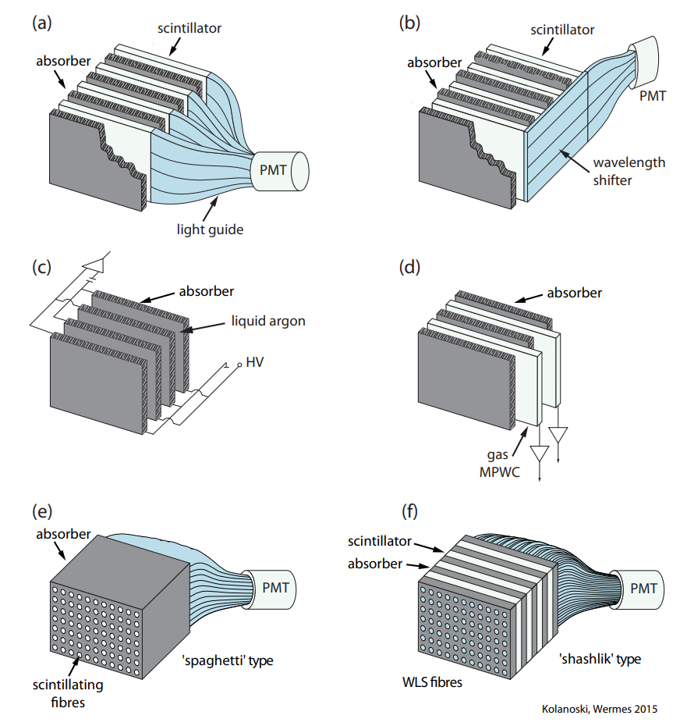
Different calorimeter arrangements

Slide 27
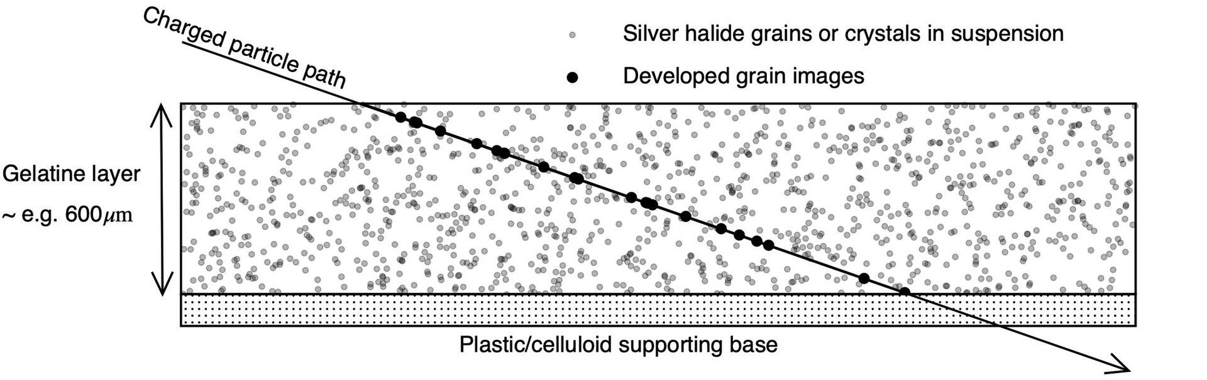
Nuclear Emulsion
It uses photographic plates coated with a thick layer of gelatine sensitive to charged particles. When a particle passes through the emulsion, it creates a visible track of silver grains that can be examined under a microscope

Slide 28
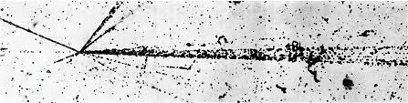
Nuclear Emulsion
Nuclear emulsions have been used historically to discover particles like the pion. They are valued for their high resolution.
Although they are less common now due to the advent of electronic detectors, nuclear emulsions are still used in some experiments where high resolution is critical, such as in studying rare interactions or in astroparticle physics.

Slide 29
Where are these particle detectors used? (Examples)
Mostly used in colliders at CERN, Fermilab, SLAC, Cornell
For example:
  ATLAS
  CMS
  ALICE
  LHCb

Slide 30
Why do we need more powerful particle detectors?
Advancing Fundamental Physics
  To deepen our understanding of the fundamental building blocks of the universe and the forces governing them.
Probing Extreme Conditions
  To recreate and study conditions similar to those just after the Big Bang, providing insights into the early universe.

Slide 31
Why do we need more powerful particle detectors?
Precision Measurements
  To make highly accurate measurements of particle properties and interactions
Technological Advancements
  To drive innovation and development in technology, benefiting both science and society

Slide 32
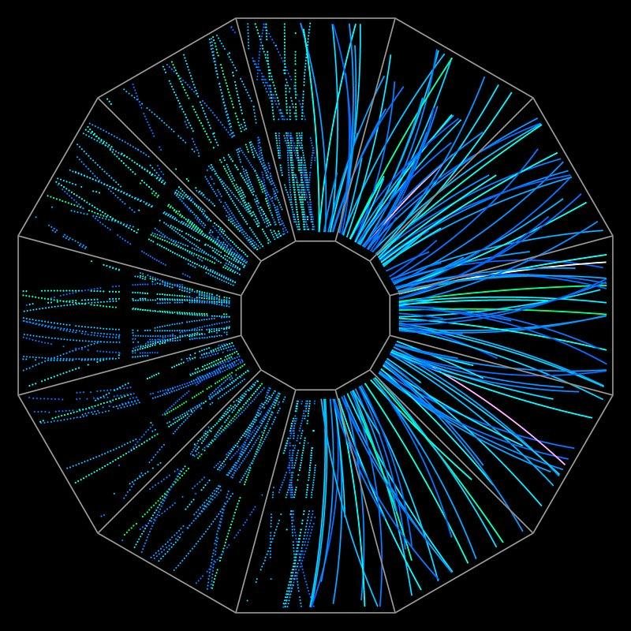
How could we improve particle detectors?
Higher Energy Colliders
Improved Detector Materials
Enhanced Resolution and Precision
Advanced Data Processing
Miniaturization
Cooling and Stability

Slide 33
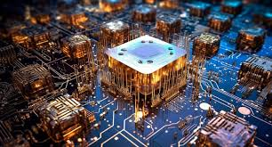
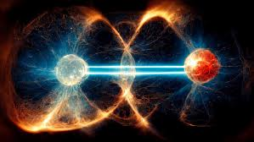
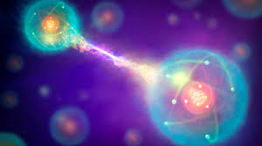
What new technologies could we use?
QUANTUM-ENHANCED PARTICLE DETECTOR
Quantum Sensors
  Much better sensitivity for weak signals
  Smaller size but even better performance
  Accuracy of measurements
Quantum entanglement
  Much higher sensitivity
  Enhanced resolution.
  More reliable

Slide 34
What new technologies could we use?
Quantum Computing for Data Analysis
  Faster data processing
  Complex simulation
  Machine learning integration
Graphene based detectors components
  Higher conductivity
  Better durability
  Thermal management

Slide 35
What new technologies could we use?
Adaptive Self Healing materials
  Longer operational life
  Reduced Maintenance time and cost
Integrated Photonic Circuits
  Transmitting signals faster
  Smaller size
  Low energy consumption

Slide 36
Thanks for watching
and hope you enjoyed!
And let’s not forget the people who helped us:
  Roxana Zus
  Sarah Zoechling
  Calin Alexa
  Elena Firu
🥰🥰🥰

Slide 37
Discoveries
Early 20th Century:
  Electron (1897) - J.J. Thomson
  Proton (1917) - Ernest Rutherford
  Neutron (1932) - James Chadwick
Mid 20th Century:
  Positron (1932) - Carl Anderson using a cloud chamber
  Muon (1936) - Carn Anderson and Seth Neddermeyer
  Pion (1947) - Cecil Powell, César Lattes, and Giuseppe Occhialini using photographic emulsions
  Kaon (1947) - George Rochester and Clifford Butler using a cloud chamber
  Lambda Baryon (1950) - Manchester group (Butler, Rochester, and others)
Late 20th Century:
  Antiproton (1955) - Emilio Segrè and Owen Chamberlain
  Neutrion (1956) - Clyde Cowan and Frederick Reines
  Omega Baryon (1964) - Brookhaven National Laboratory team
  J/ψ Meson (1974) - teams led by Burton Richter and Samuel Ting, marking the "November Revolution."
  Bottom quark (1977) - Leon Lederman’s team at Fermilab
  Top quark (1995) - CDF and D0 collaborations at Fermilab
21st Century:
  Tau Neutrino (2000) - DONUT experiment at Fermilab
  Higgs Boson (2012) - ATLAS and CMS collaborations at CERN’s Large Hadron Collider

