Slide 1


How Does an Onion-like Topology Aid in Particle Identification?
Case study: ATLAS detector
Darius CHIȚU
George CHITA

Slide 2
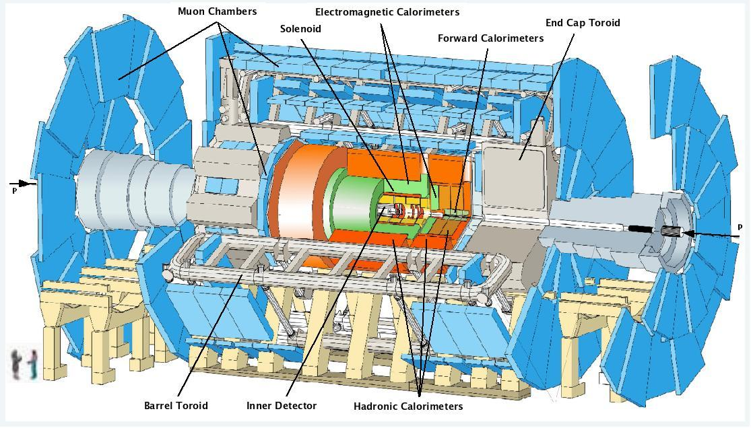
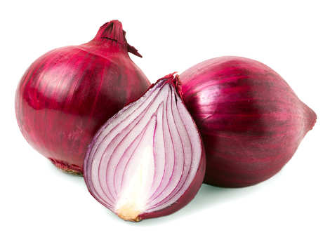

So… why DO they look like ONIONS?
Each particle has a different charge (+/-/0) and extremely different energy intervals. Consequently, each particle deposits its energy at a different radius relative to the beam axis (line) and is stopped by different density materials.
Therefore, a cylindrical design is needed. Detectors, specialized in sensing one specific category of particles, are placed at optimal radii from the beam axis, so that particles stop and deposit most of their energy in those layers, making them easier to be detected. The order in which these layers are constructed is such that each particle signature and calculated parameters are unique.

Slide 3
Topology of Particle Detectors

Slide 4
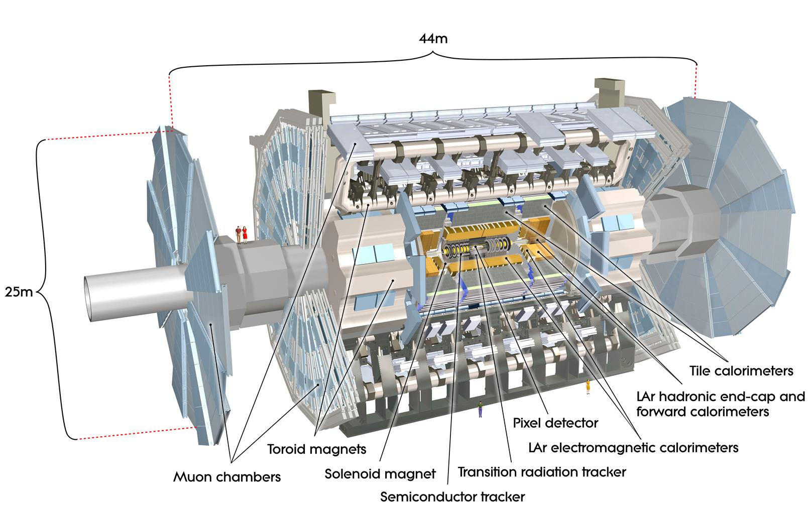
Layers of ATLAS Particle Detector
As we have seen before the ATLAS particle detector consists of several sensor layers, divided in two categories, with different functions:
-Tracking sensors (measure particle trajectory)
-Pixel Detector (layer 1)
-SCT (semiconductor tracker) (layer 2)
-TRT (transition radiation tracker) (layer 3)
-Calorimeters (measure particle energy and momentum)
-LAr Electromagnetic Calorimeter (layer 4)
-Tile Calorimeters (layer 5)
-Muon Spectrometer (layer 6)

Slide 5
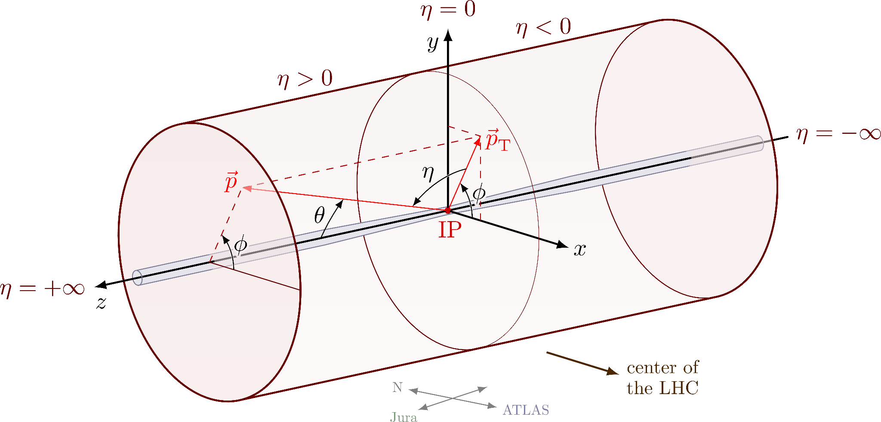
Coordinate System of ATLAS Detector
The ATLAS particle detection system makes use of 6 coordinates, of which, for the purpose of this presentation, we will only be interested in Φ,R and z which respectively correspond to azimuth, radius and distance from the center point (point of collision).

Slide 6
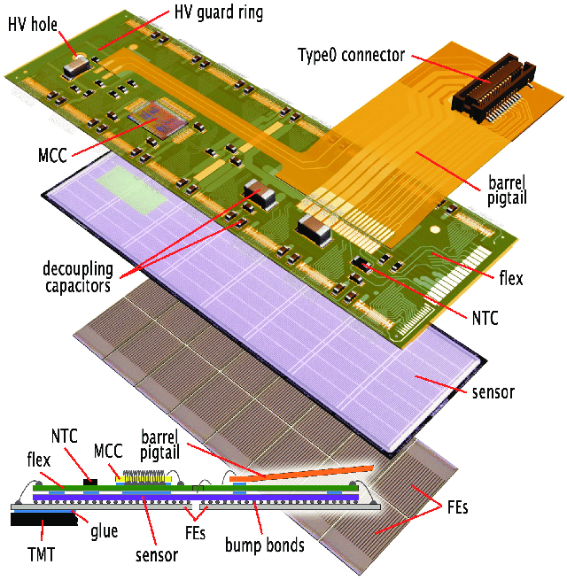
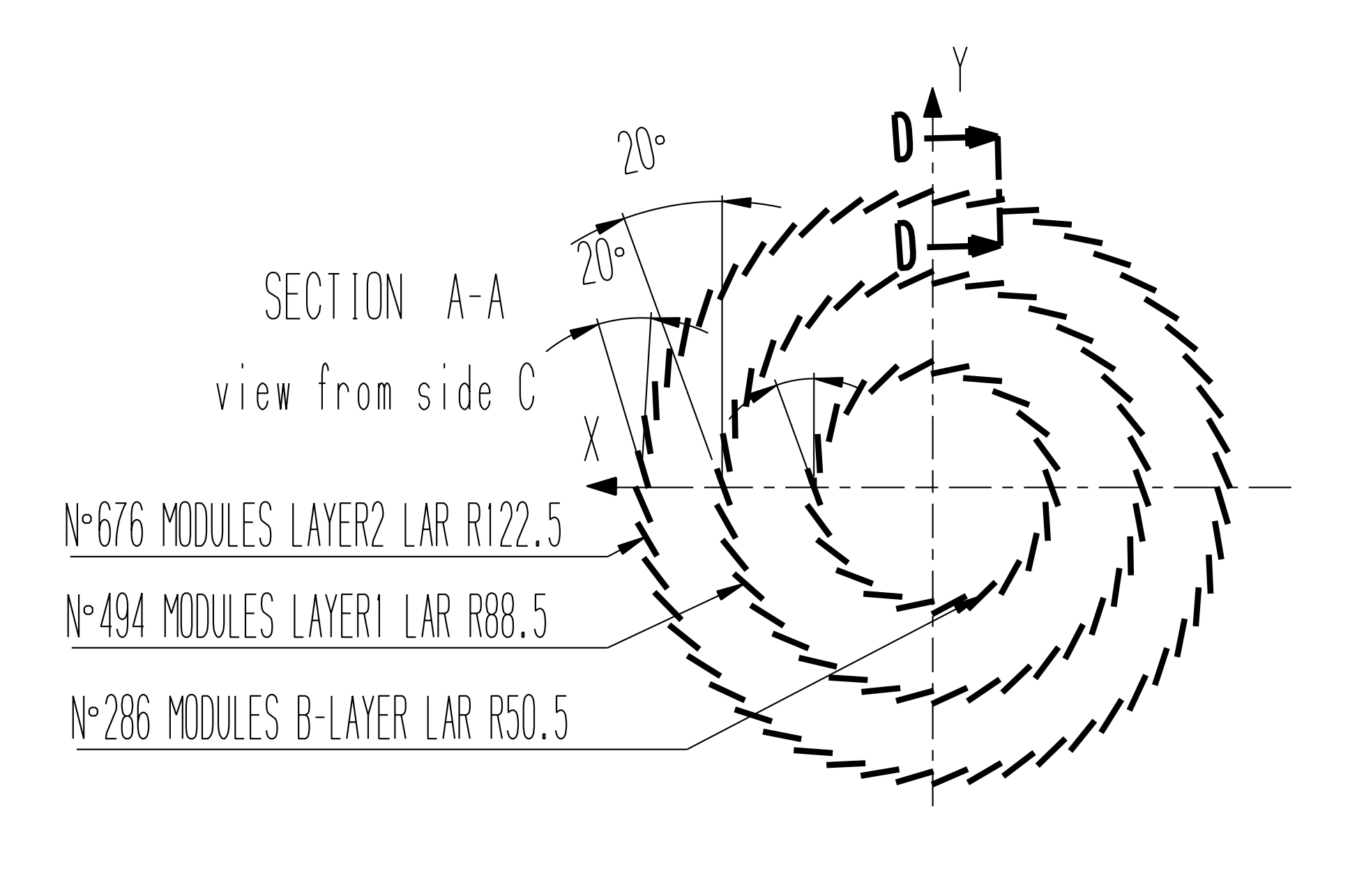
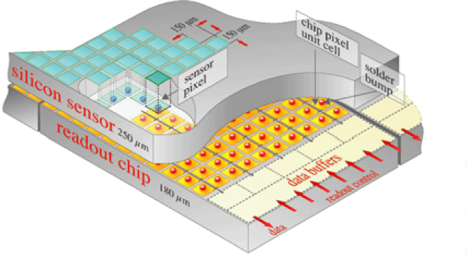
Pixel Detector
The pixel detector represents the innermost layer of the ATLAS detector. It is mainly comprised of rectangular modules, each 62.4x22.4 mm, containing 61440 (for each module) individual microscopic pixels. The modules are arranged in 3 layer as follows:
Layer 1 PD - R=50.5 mm, 22 modules
Layer 2 PD - R=88.5 mm, 32 modules
Layer 3 PD - R=122.5 mm, 52 modules
There is a 20° angle between any two neighbouring modules.
It gives R,Φ and z coordinates.

Slide 7
How Does the Pixel Detector Work?
For each pixel, a silicon wafer doped with p and n type semiconductors is used.
Quick explanation:
-p doping means introducing a boron impurity into the crystal lattice of silicon atoms. These boron atoms are missing an electron relative to the silicon. These so called “holes” imitate the existence of a free positive charge carrier.
-n doping means introducing a phosphorus impurity to the crystal lattice which carries with it an extra electron. This extra electron acts like a negative free charge carrier.
In a semiconductor, a depletion layer is formed at the junction between these two materials. What is a depletion layer?
Keep in mind that the material is electrically neutral from a global point of view, as the number of protons in the nucleus is equal to the number of electrons around it, for all three elements. Still, a positive “hole”, from the p-type gets attracted to the electrons in the n-type as its position is more favorable there. Vice-versa for electrons in n-type. The particles migrate until the electric force (created by their electric field) is equal to their attraction to the opposite side. (Usually 0.7V for silicon)

Slide 8
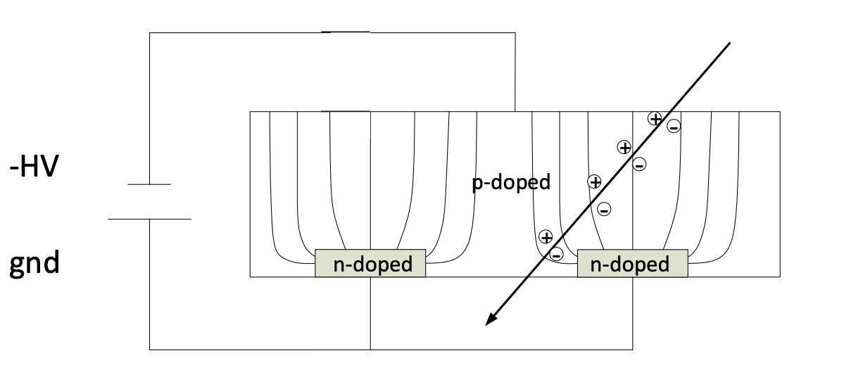
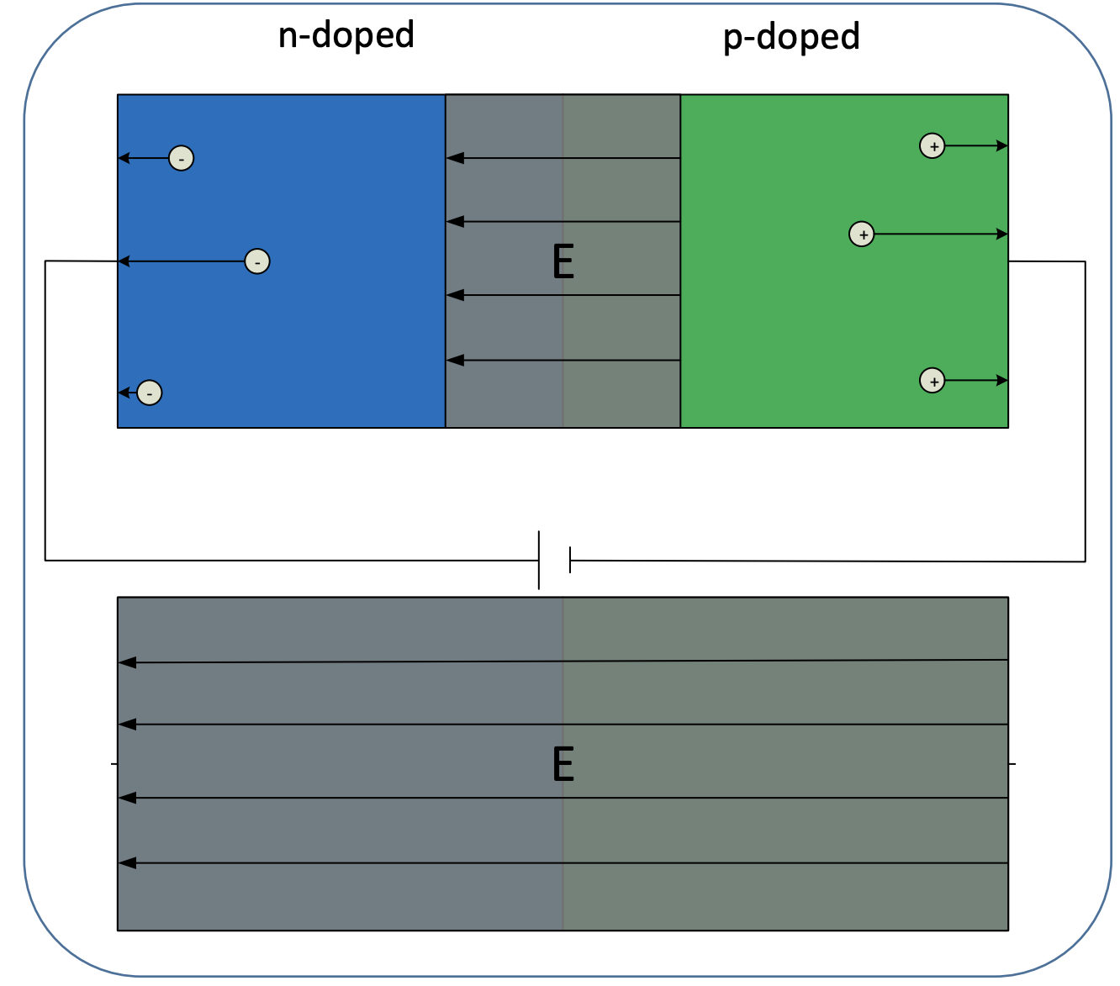
How Does the Pixel Detector Work?
This is the basic working principle of a diode. If a voltage is applied that creates an electric field in the direction of the depletion region electric field, the depletion region will grow until the voltage potential of the layer will be equal and opposite to the potential that is applied, and no current will flow. Still, this is a conductor, so when a particle hits and knocks off some electrons from the atoms, a current will flow to replace those electrons. This current can be easily measured and analyzed further. The ingenuity of this design is that even though the detector is a conductor, it doesn’t allow current to pass until a particle is detected.

Slide 9
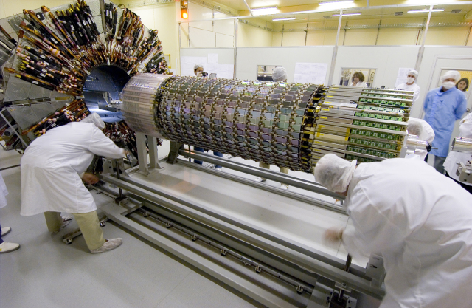
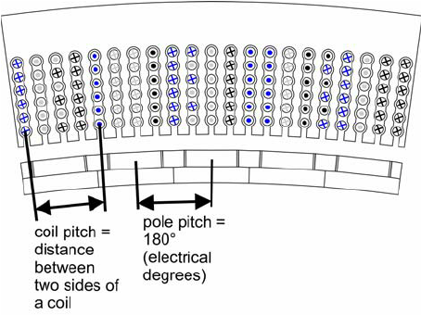
Semiconductor Tracker
The semiconductor tracker is the 2’nd major layer of the ATLAS detector, comprised of sublayers 4,5 and 6, each consisting of detector sensors sized 63.4x64 mm. Each of the sensors consists of 768 silicon strips spaced out equally, with a pitch of 80um.
One module contains two sensors daisy-chained back to back, with a total length of 128mm.
To ensure that all particles cross at least one module, the main detector barrel, has several circular end caps built with different trapezoidal sensors, but having the same working principle.
It gives R,Φ coordinates.

Slide 10
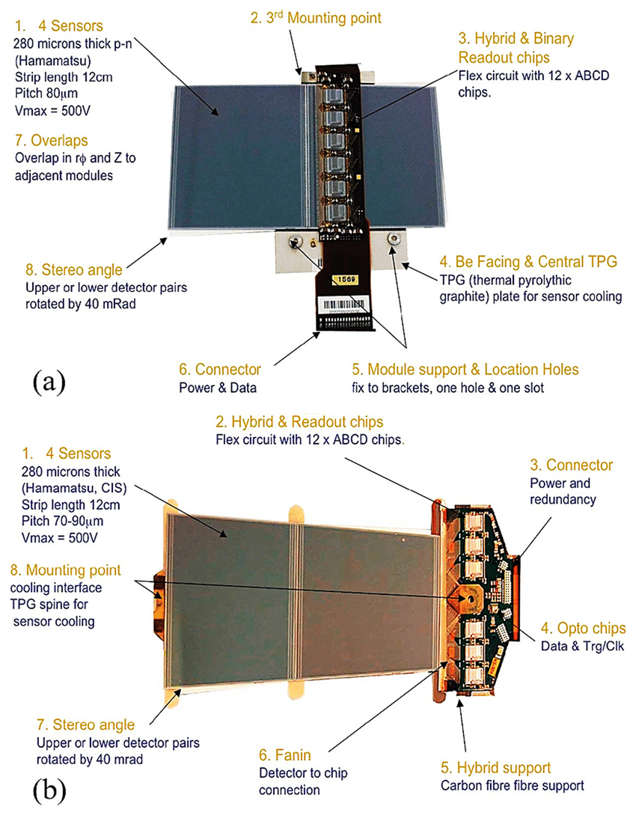
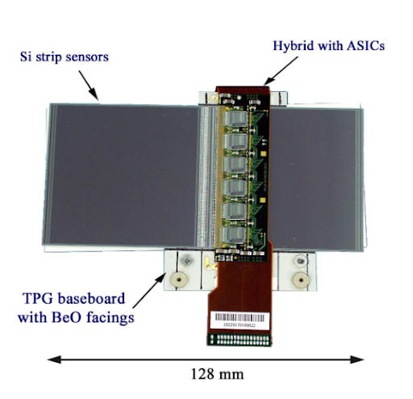

Slide 11

How does a SCT sensor work?
Huaraaayyy! No more boring explanations!
It works exactly the same as the pixel detector, except that the sensors are strips, and the p-type is inside the n-type conductor. Here is a cat for your relaxation:

Slide 12
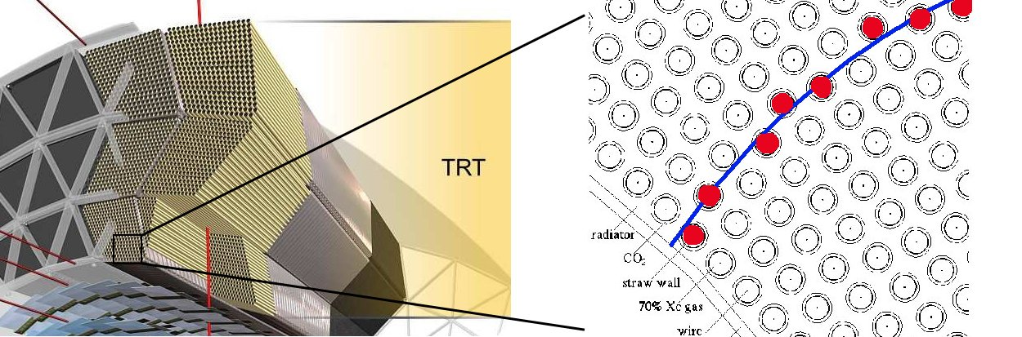
Transition Radiation Tracker
The TRT is based on the use of parallel metal straws, each 1440 mm long (along the beam axis), with a thin gold-plated tungsten wire at the middle, surrounded by a mixture of gases (70% Xe 27% CO2 3%O2). There are 96 trapezoidal modules, which in total contain about 50,000 parallel straws, and, as we have seen in the case of the SCT, the TRT also makes use circular end caps comprised primarily of 320,000 radial straws starting from an inner radius of 640 mm to an outer radius of 1040mm, with the exception of the last four caps, which have an inner radius of 480mm (overlapping with the SCT endcaps and not allowing any particles to escape). In total the TRT has 420,000 readout channels, as each straw is divided in half and only has one output cable.
It gives R,Φ coordinates.

Slide 13
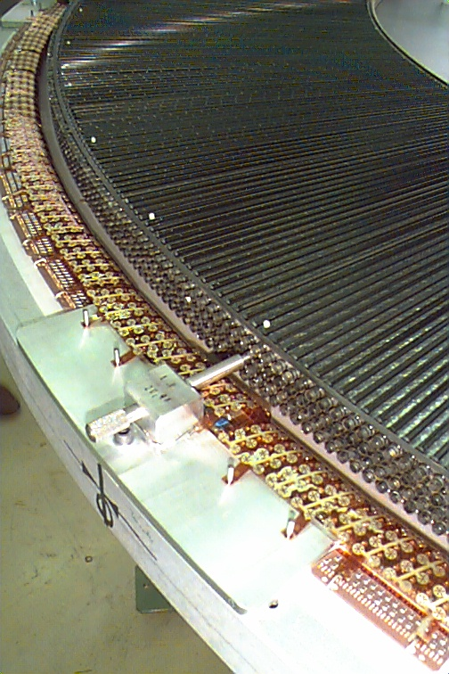
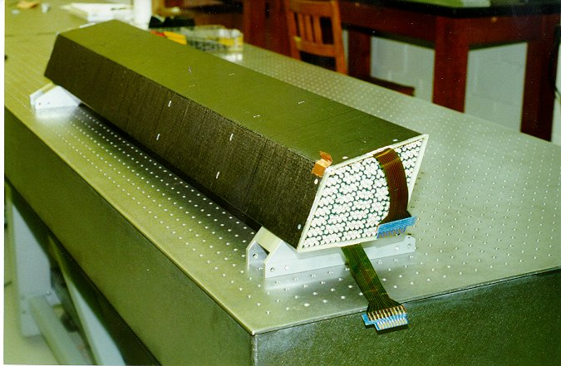
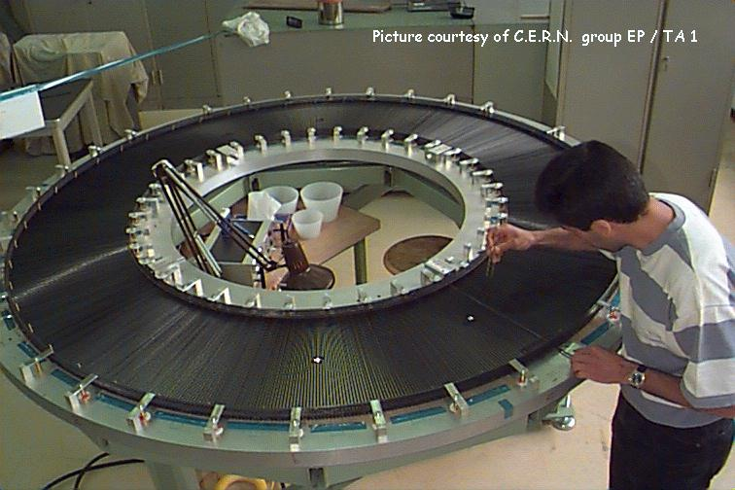

Slide 14
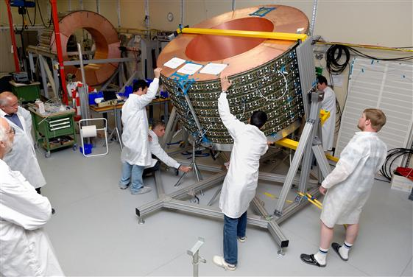
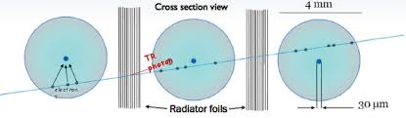
How does a TRT detector work?
In simple terms, an energetic particle that passes through the detector ionizes, a combination of gases inside of the straws (70% Xe; 27% CO2; 3%O2), creating charge carriers (gas ions and free electrons) that get attracted and deposit their charge on the different electrodes (outer pipe, and inner wire) outputting an electrical pulse. This is very similar to how all basic geiger tubes work.

Slide 15
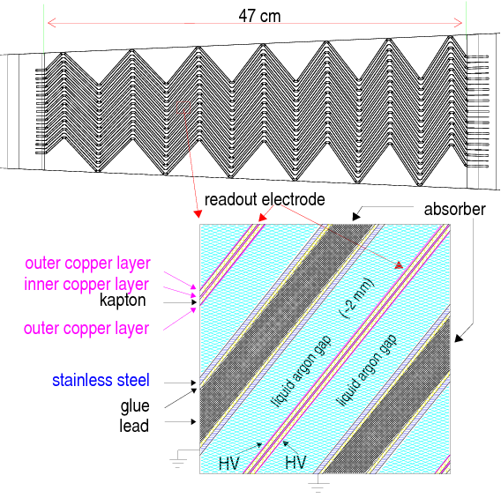
Liquid Argon Electromagnetic Calorimeter
The LAr electromagnetic calorimeter consists of several layers of copper coated in a thin layer of lead in between layers of readout copper electrodes held at a high voltage potential. In between these two layers, sits a 2 mm thick layer of liquid argon at a temperature of about -186°C. The layers of lead plated copper are bent in a zig-zag pattern (with sides of 43.76mm), such that the tight angles do not permit the passing of a particle without it depositing its energy in one of the layers. The central barrel of the calorimeter is 6.4 m long and with 53 cm thick walls.
Particle

Slide 16
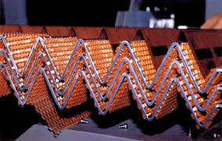
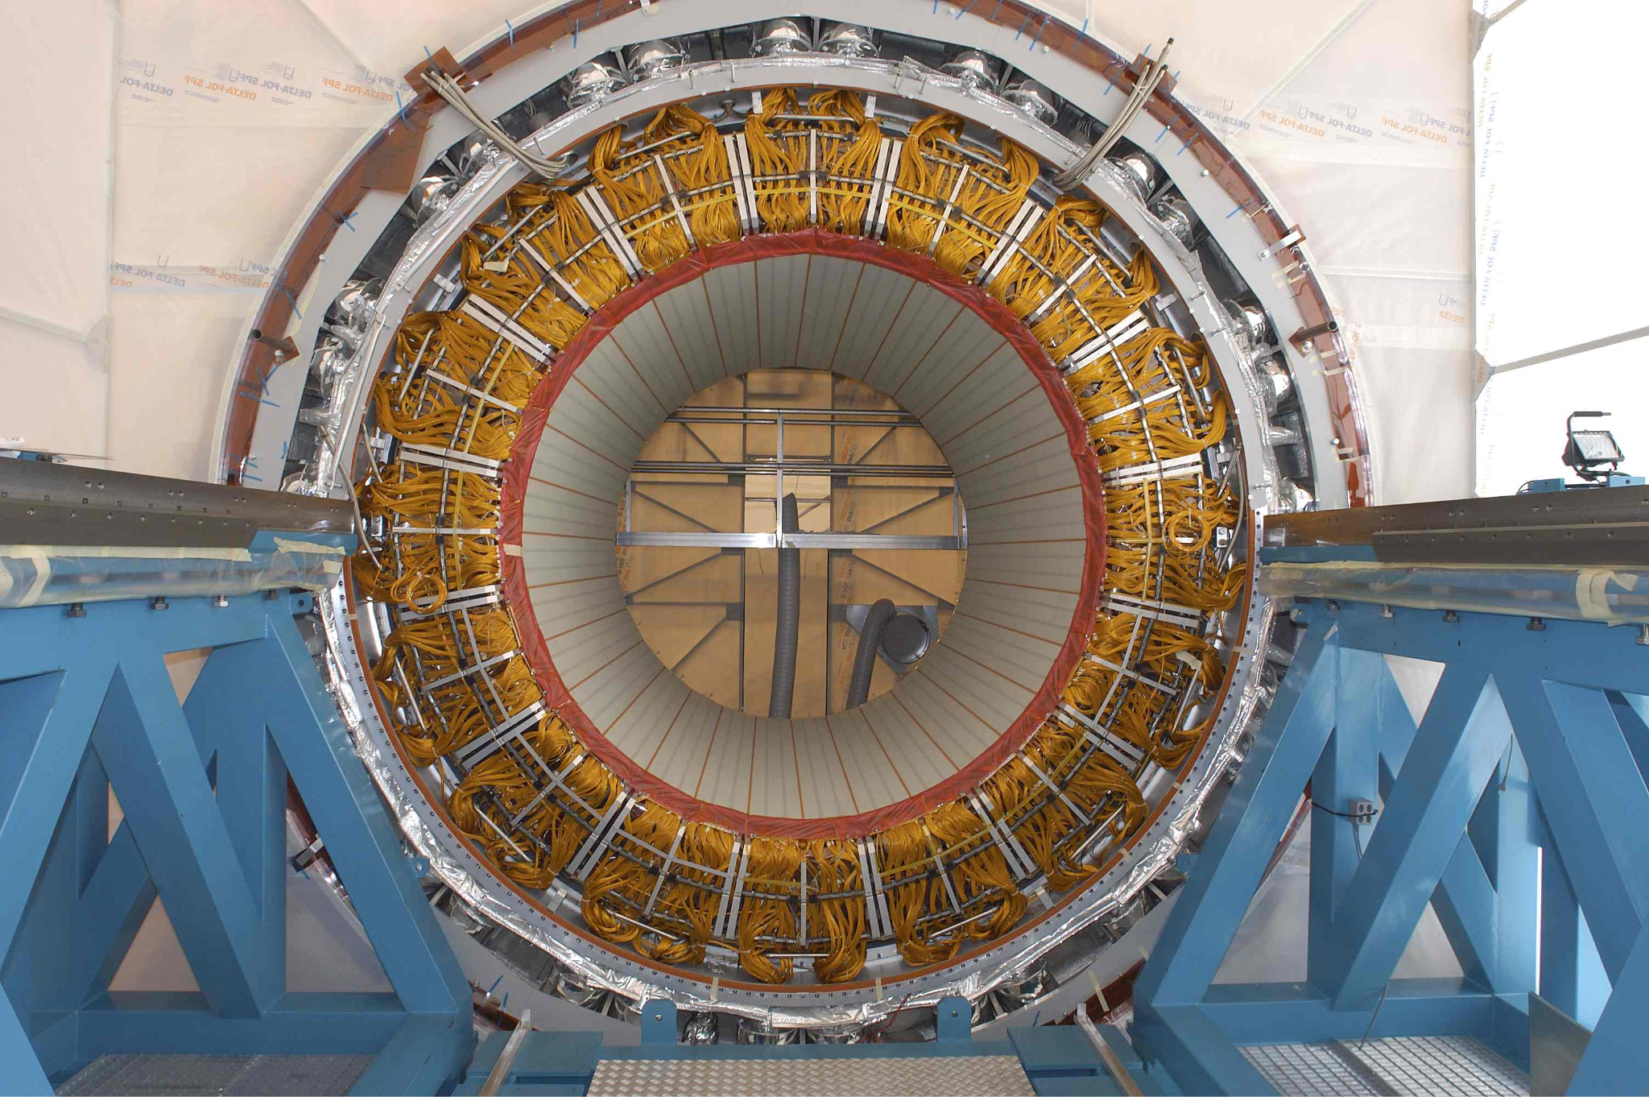
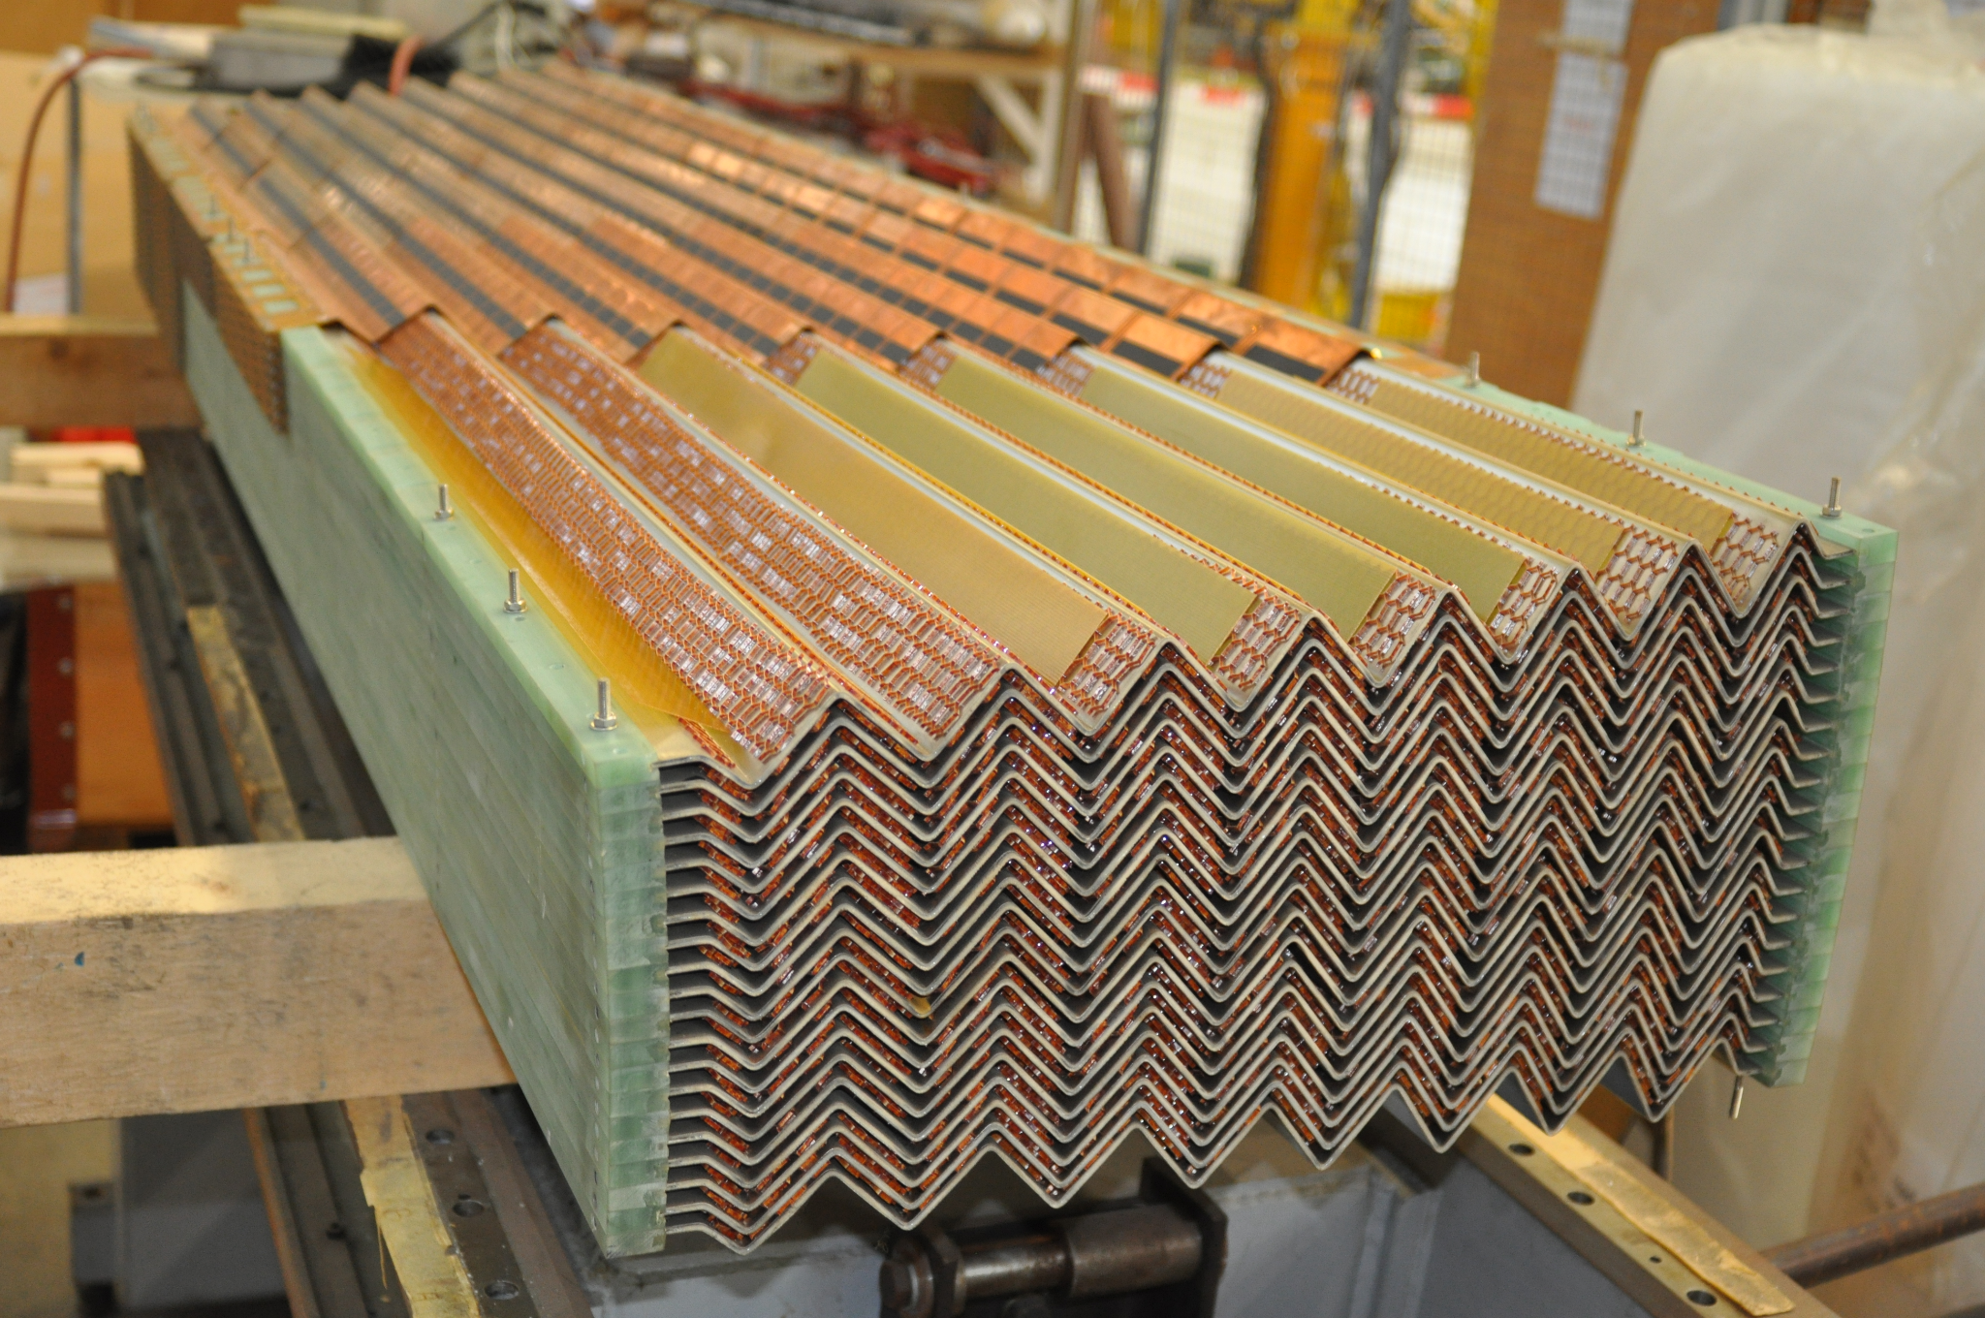

Slide 17
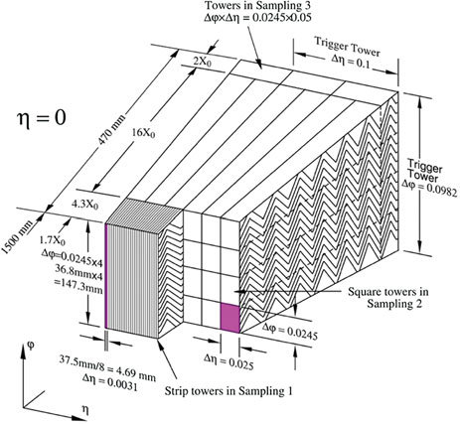

Slide 18
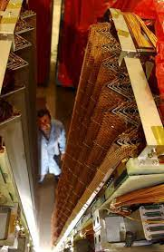
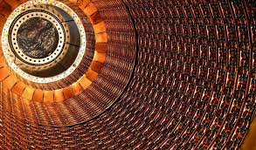
How does the LAr Electromagnetic Calorimeter Work?
When a particle passes through the different layers of the detector it ionizes the argon atoms and creates freely moving charge carriers that get attracted to the anode/cathode where they deposit their charge and create an electrical signal.(In other words it creates a slightly conductive path) The voltage difference between the different detector layers is around 2000V. Argon is optimal as it has a very low ionization energy of just 26eV per atom, per first electron.

Slide 19
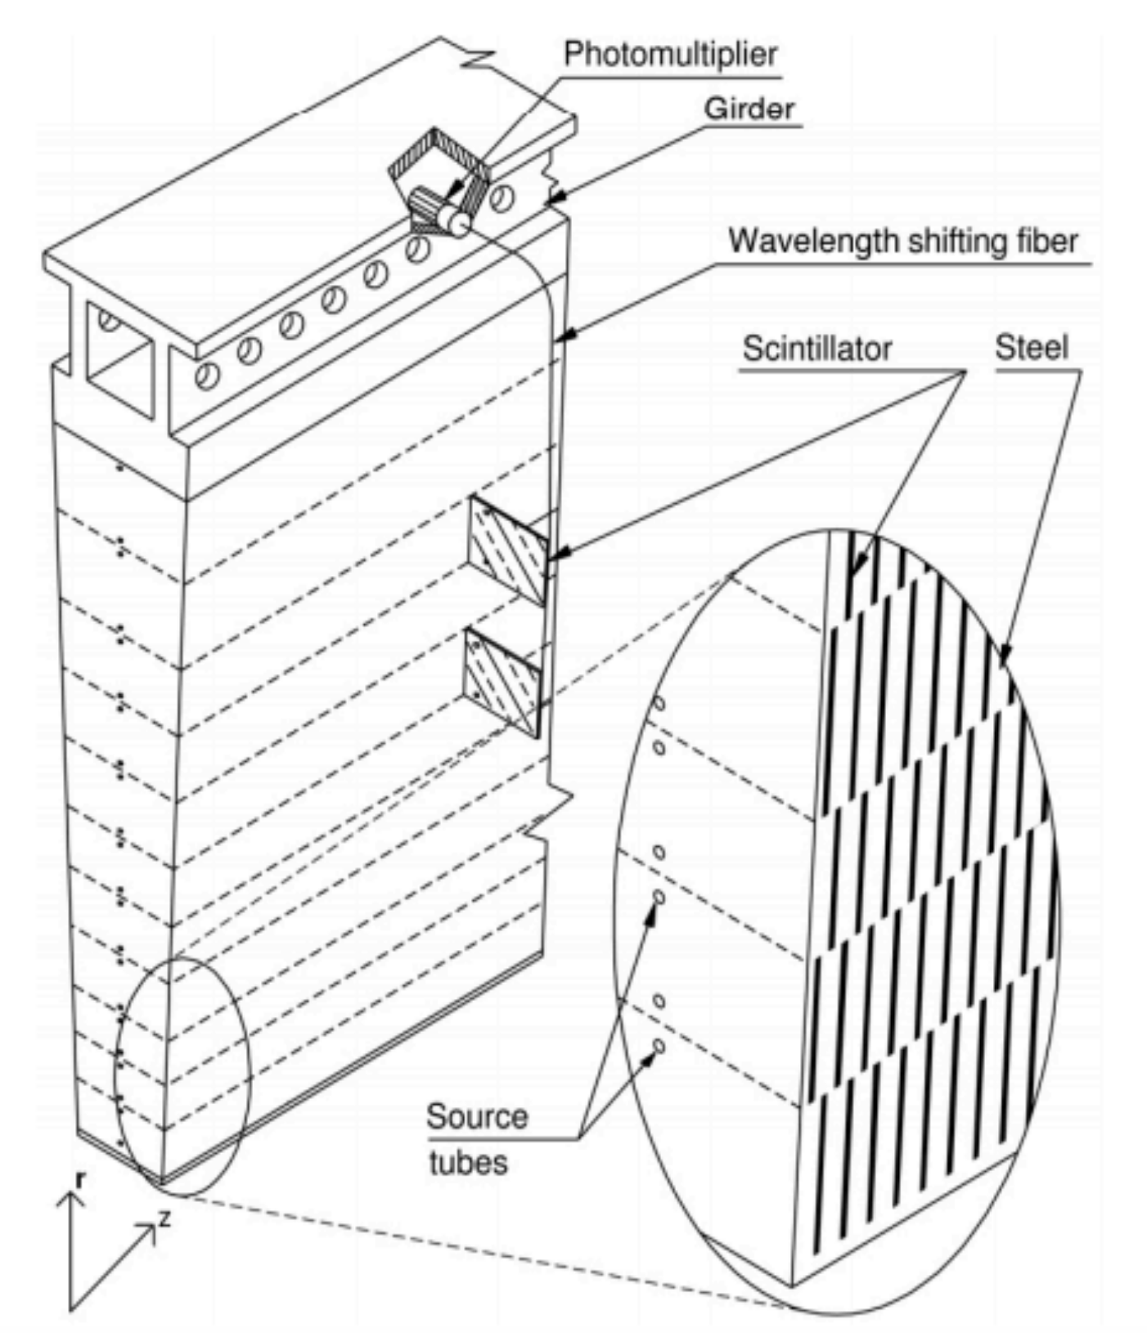
Tile Calorimeter
The tile calorimeter is comprised of 64 modules per a 360° slice, each covering an angle of approximately 5.62°, starting from an inner radius of 2280mm to an outer radius of 4230m.
A module consists of 576 alternating iron plates sandwiched between a scintillator 3 mm thick polymeric material (polystyrene), with a ratio of iron to scintillator of 4.7 to 1. There are 11 such layers on top of each other, shifted by a slight amount. The photons can reach the multiplier ,even if the layers of iron are shifted and there is no free path to the tube, by means of WLS fibers. (The ends are silver coated as not to allow light to escape)

Slide 20
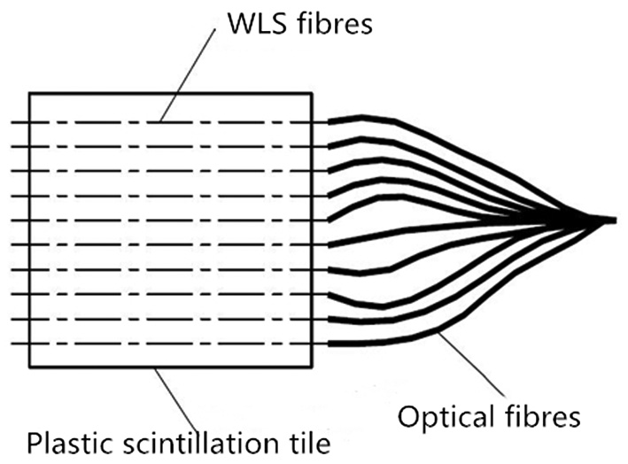
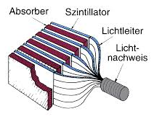
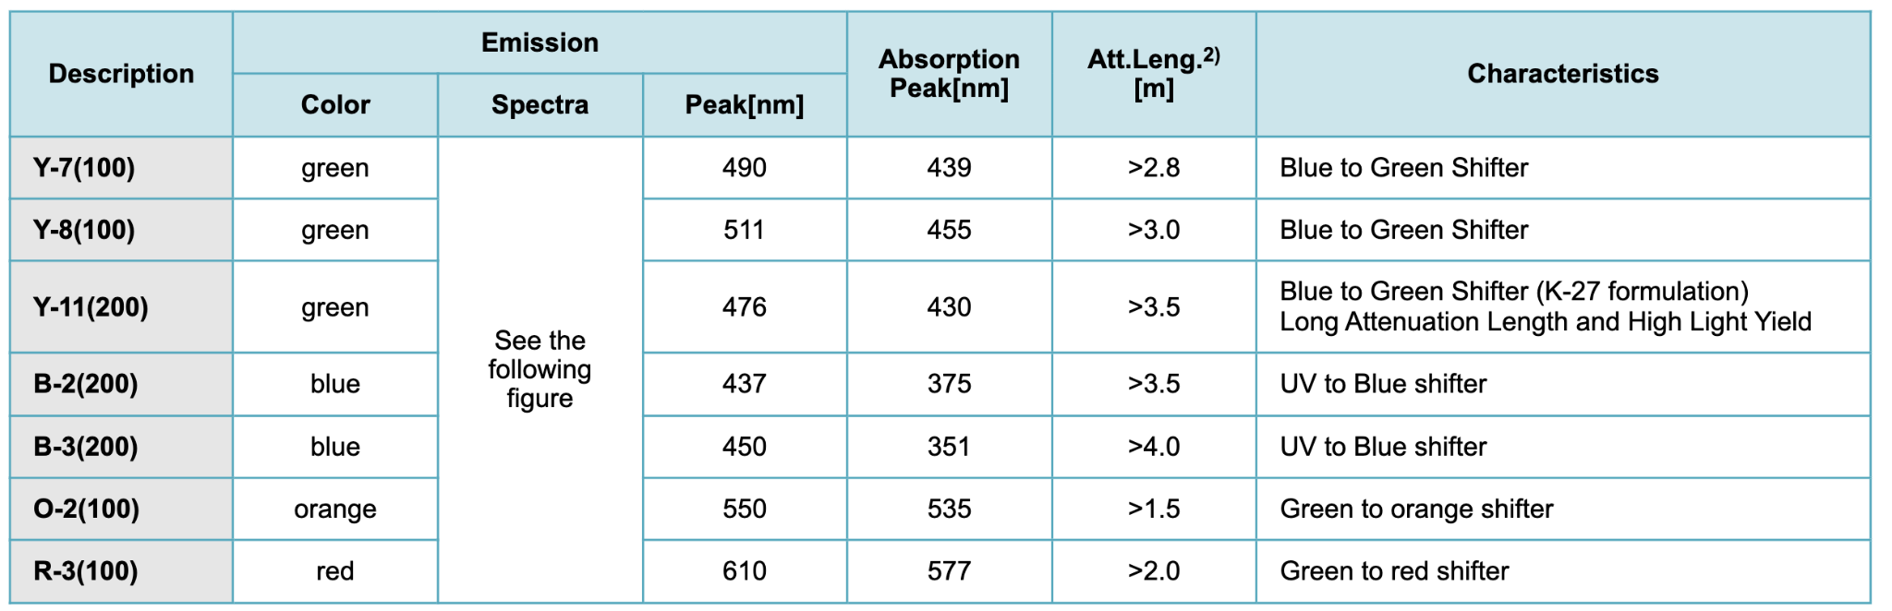
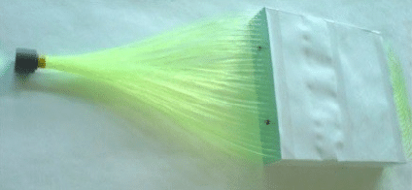
Quick explanation of what WLS fibers are (wavelength shifting)
Wave-Length Shifting (WLS) optical fibers are used to collect the light produced in the scintillator tiles. The plastic in these fibers have been doped with special dyes that absorb the predominantly blue photons from the scintillator and re-emit even more green ones, allowing the PMT to better detect the particles.

Slide 21
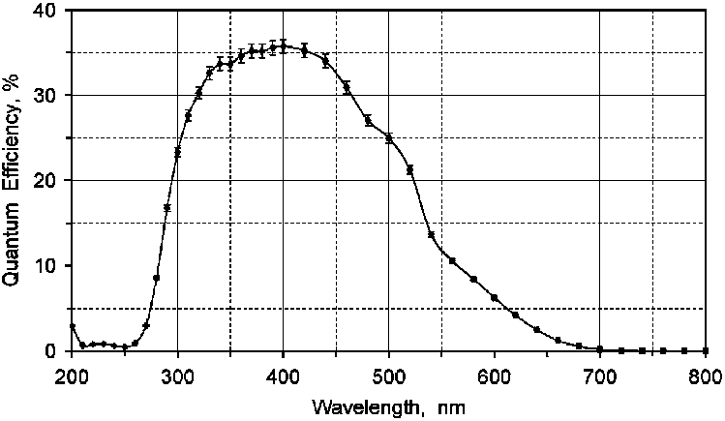

Slide 22
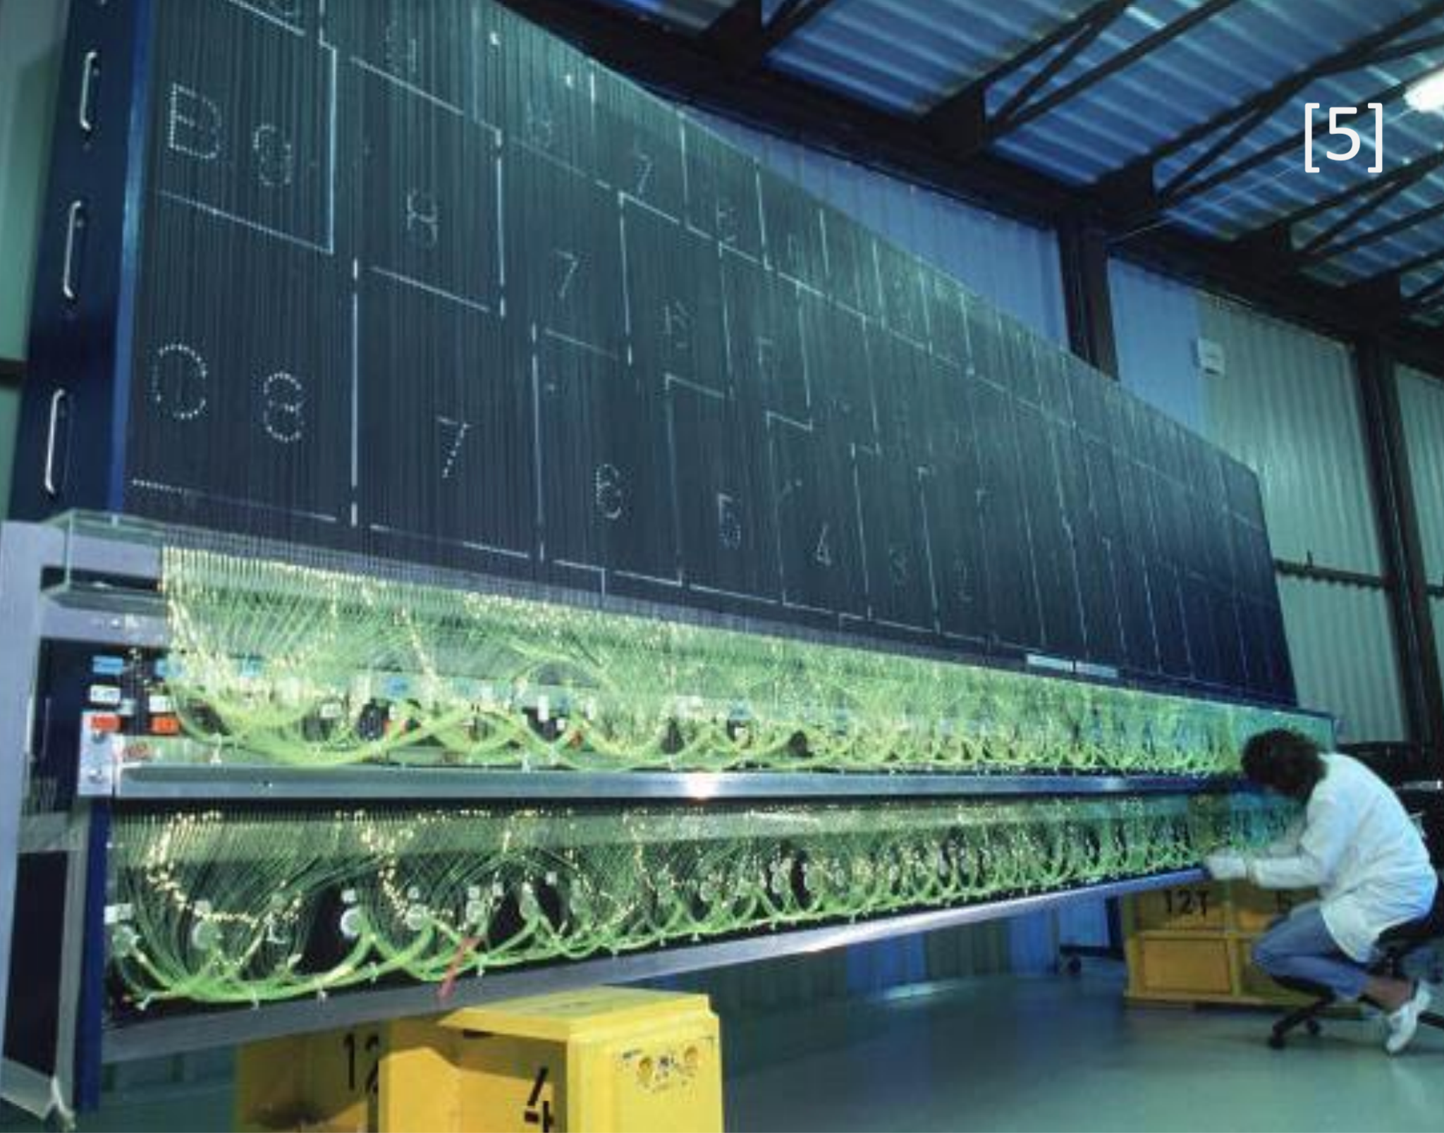

Slide 23
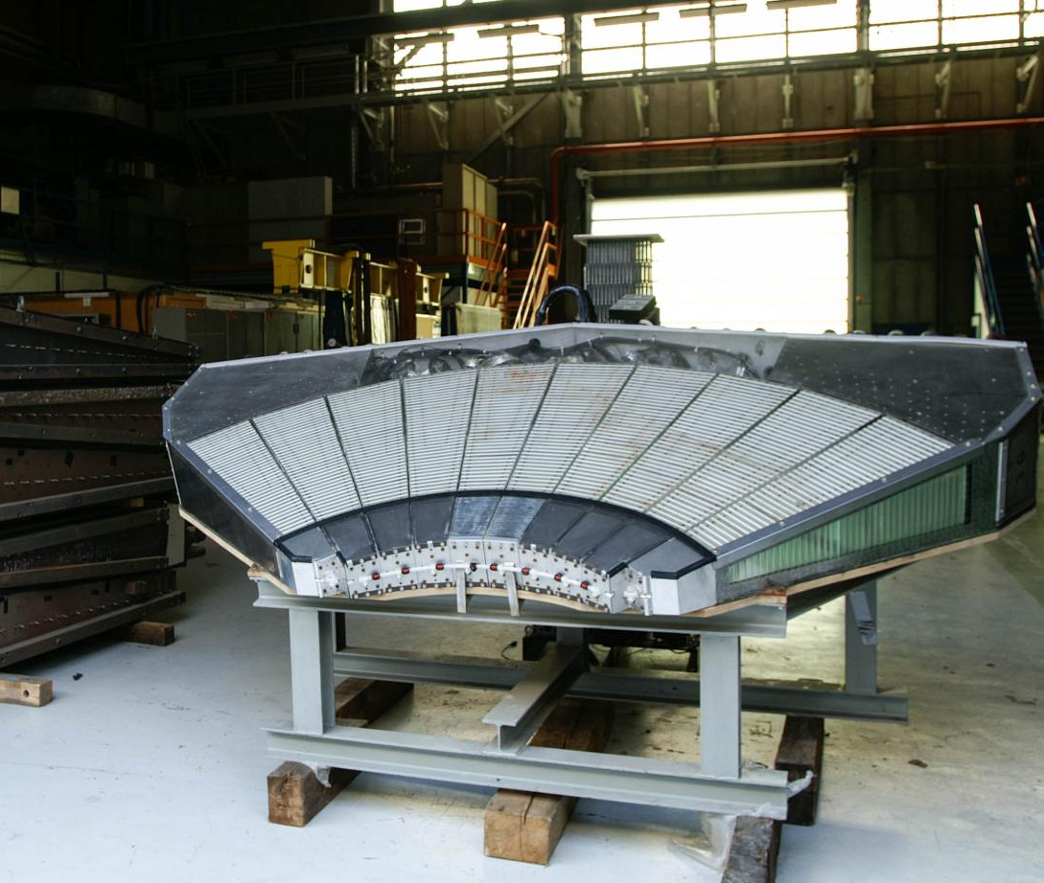
Tile Calorimeter
The plane of the scintillator and iron plates is parallel to the plane of the beam axis, in order to allow incoming particles to pass in between these layers, and not intersect them directly, which would slow down the particles much quicker. At the end of each module sits a photomultiplier tube, which transforms the incoming photons into a stronger electrical pulse, that then gets amplified and analyzed. The topmost layer has a width of 369mm while the bottom one is only 231mm and a radial height ranging from 97 to 187mm (from bottom to top).

Slide 24
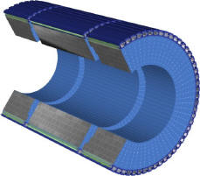
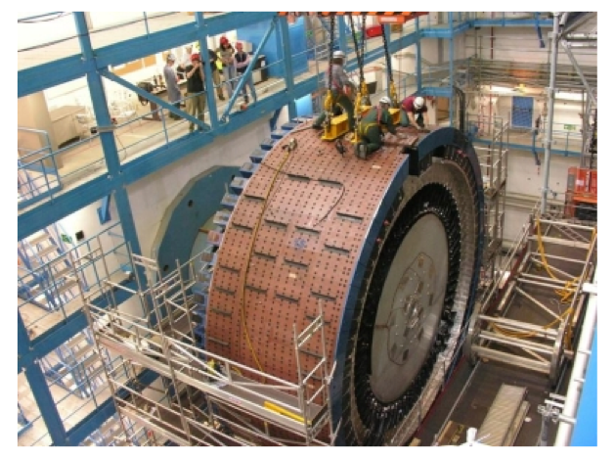

Slide 25
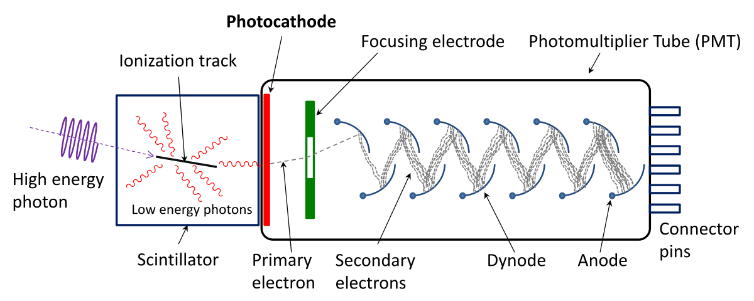
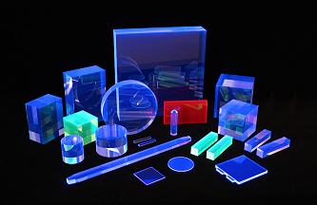
How do Scintillators Work?
When a high energy photon hits an electron in the region of a nucleus, the electron absorbs the photon’s energy and gets raised to a higher energy level. After a short amount of time, the electron starts re-emitting lower energy photons until it drops down to the energy level it started from. Quantization of energy (Bohr’s postulate). The combined energy of the re-emitted photons equals the initial energy, so energy is conserved.
The photons emitted get directed into the PMT and get amplified.

Slide 26
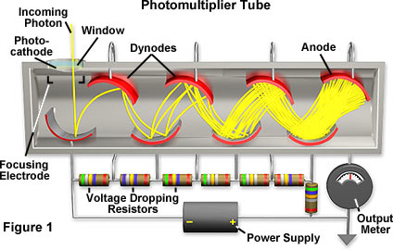
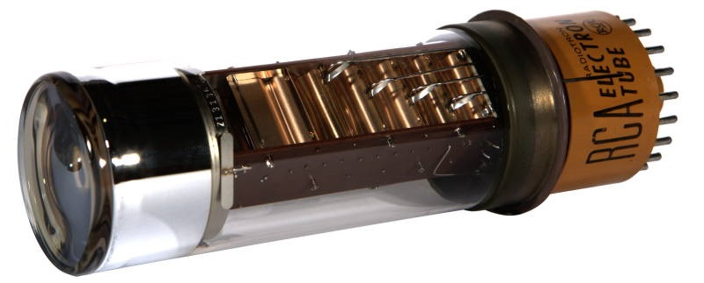
How does a Photomultiplier Tube Work? (In general-Not ATLAS)
The photomultiplier tube consists of multiple photo-emitting cathodes, held at a voltage difference of about 100V from each other, in a very good vacuum (10uPa). When a photon strikes the first cathode, via the photoelectric effect, it emits a few electrons that get accelerated to the neighbouring cathode, where the process repeats, and, in the end, a strong electrical signal can be measured. This process happens generally with semiconductors (bialkali antimonides) as they have the valence band very close to their conduction band, needing a very low energy to raise an electron into the conduction band.

Slide 27
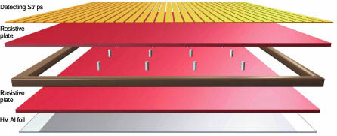
Muon Spectrometer
The muon spectrometer is composed of four different types of detectors: MDT (monitored drift tube), RPC (resistive plate chambers), TGC (thin gap chambers) and CSC (cathode strip chambers).
-Monitored Drift Chambers (MDT) are used in the ATLAS Detector to measure the momentum of high energy muons. They consist of aluminum tubes (3 cm in diameter), which are filled with an Ar-CO2 gas mixture at 3 bar of pressure and additionally contain a thin metal wire at the center (anode). About 1200 drift chambers are required for ATLAS. They are up to 6 m long, and are primarily found in the barrel and end cap region.
-RPCs consist of two parallel plates, a positively-charged anode and a negatively-charged cathode, both made of a very high resistivity plastic material and separated by a thin gas volume, sandwiched between copper strips and thin layer of aluminum foil (charged to a high potential). When a muon passes through the chamber, electrons are knocked out of the atoms of the gas. These electrons in turn hit other atoms causing an avalanche of electrons. The electrodes are transparent to the signal (the electrons), which are instead picked up by external metallic strips after a small but precise time delay. These detectors build up a large section of ATLAS’s main barrel.

Slide 28
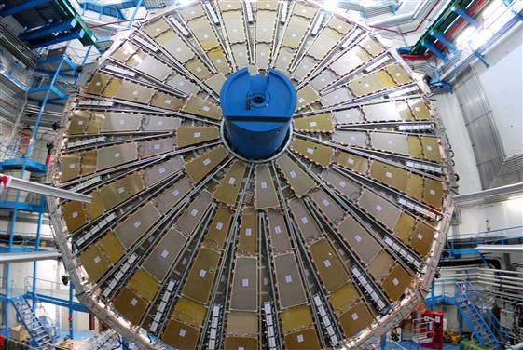
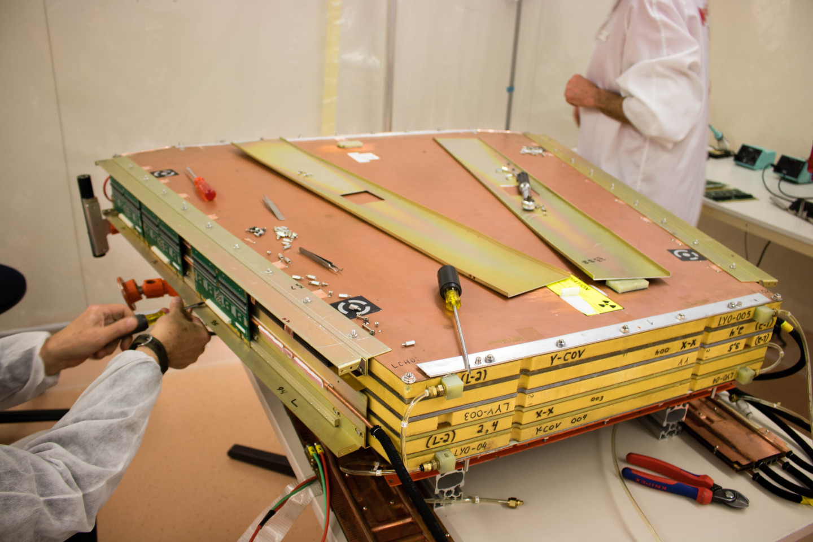
Muon Spectrometer
-Thin gap chambers are made by sandwiching 50um gold plated tungsten wire with a pitch of 1.8 mm at a 1.4 mm distance from a bottom resistive graphite epoxy plate and top copper pads with a pitch of only 80mm. Under the resistive plate there are placed very fine 3.2 mm pitch, plated, copper strips. The chamber is filled with a gas mixture of 55% CO2 and 45% n-pentane to which a 2.9kV/cm electric field is applied (in order to direct ionized particles). The TGC comprise most of the detector’s end caps.
-Cathode strip chambers consist of arrays of positively-charged anode wires crossed with negatively-charged copper cathode strips within a gas volume. When muons pass through, they knock electrons off the gas atoms, which flock to the anode wires creating an avalanche of electrons. Positive ions move away from the wire and towards the copper cathode, also inducing a charge pulse in the strips, at right angles to the wire direction.

Slide 29
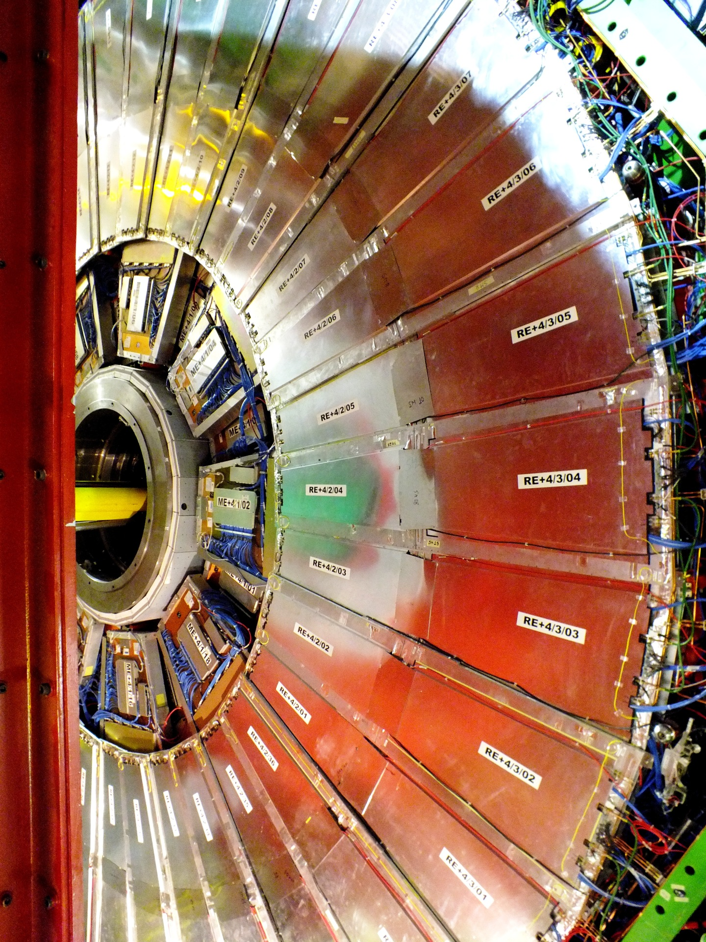
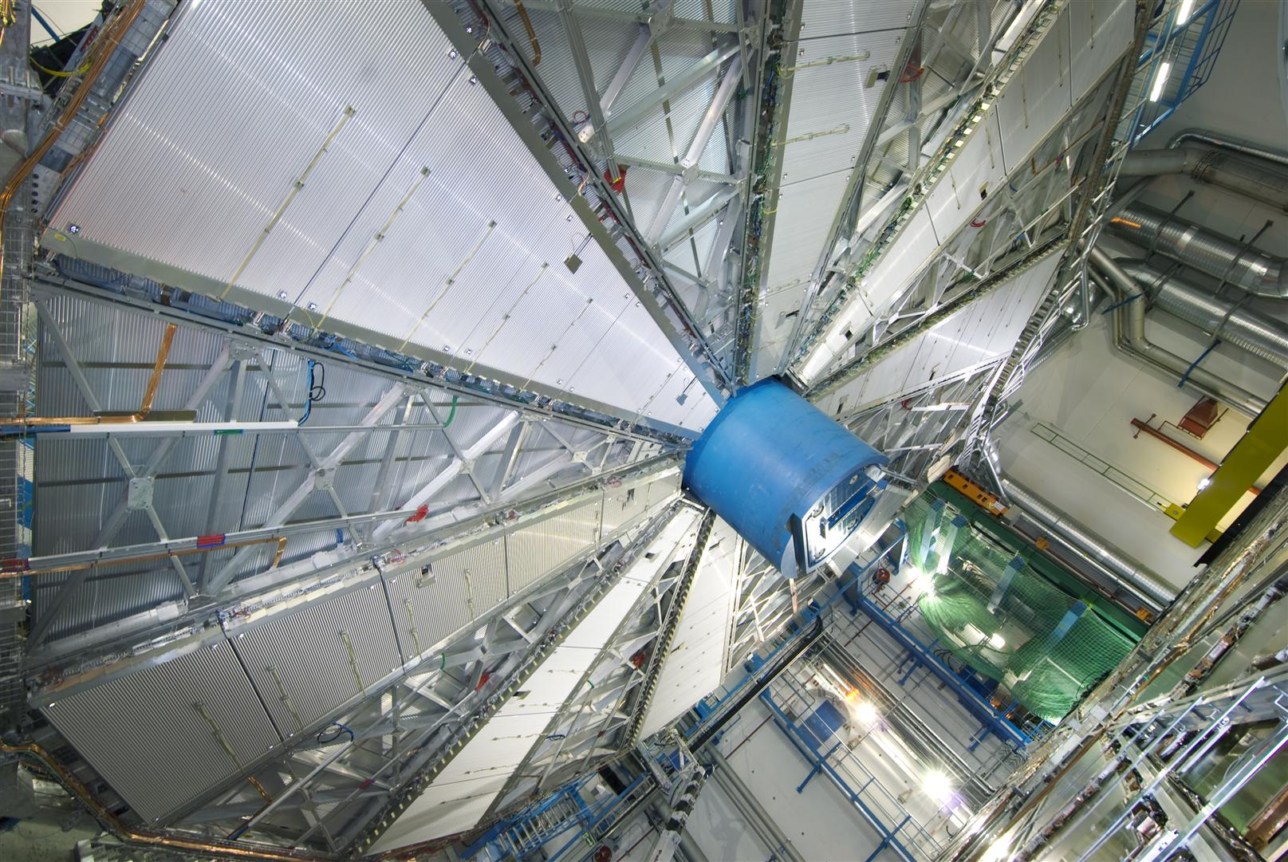
RPC
MDT

Slide 30

How does a Muon Spectrometer Work?
Huraaaaay again! The same explanation as for TRT and LAr calorimeters!
Now here’s another kitty for you:

Slide 31
Particle Identification
(PID)

Slide 32
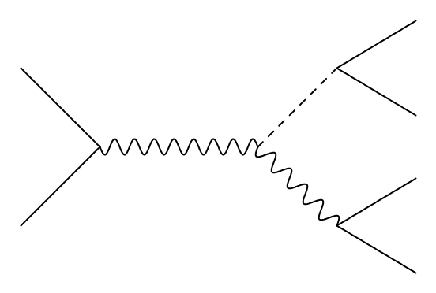




Particle Identification (PID)
final state (observable particles)
Energy of particles is recorded as hits in the:
trackers
calorimeters
muon spectrometers
Objects are reconstructed from the hit information:
reconstruct low-level objects
reconstruct physics objects using tracks and clusters, and measure momentum
[1]
Fig. 1. Example of collision event
[1] Georg VIEHHAUSER, Tony WEIDBERG; Detectors in Particle Physics: A Modern Introduction, 2024 (CRC Press)

Slide 33
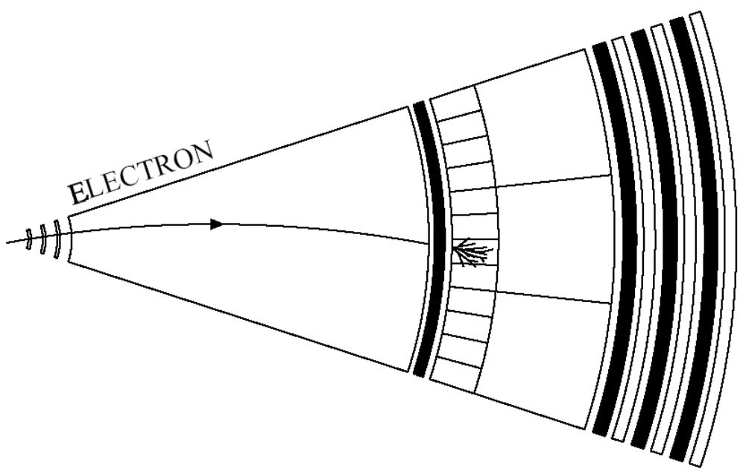
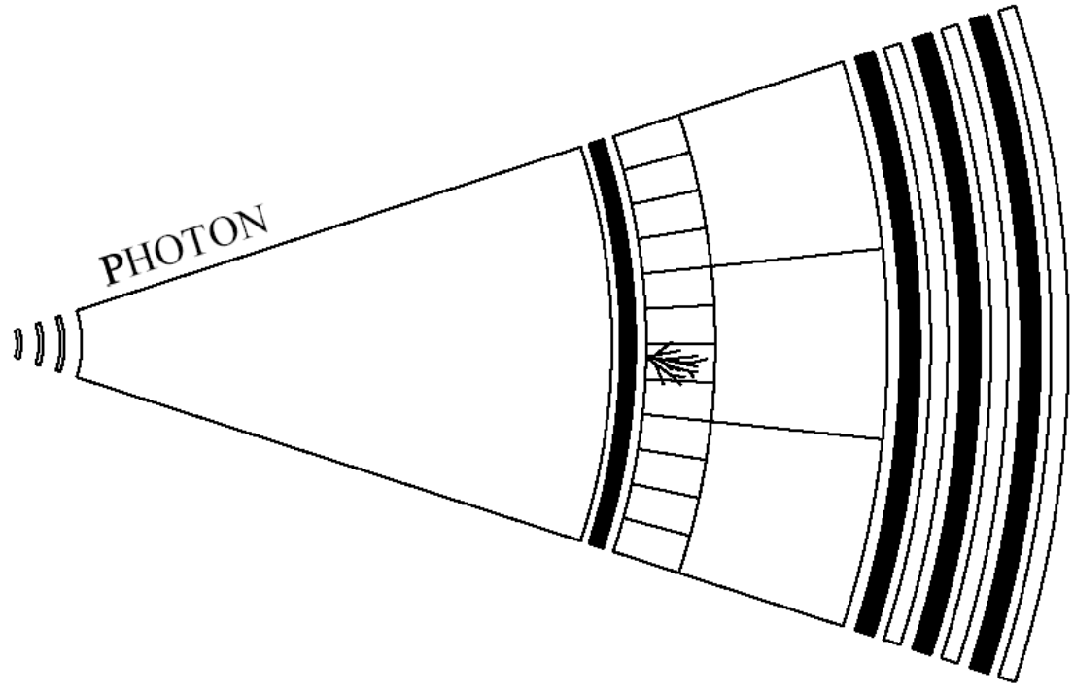
Electron & Photon – Particle signatures
[2]
[2]
Fig. 2. Schematic view of e– signature
Fig. 3. Schematic view of γ signature
leave a bent track (with a magnetic field)
stopped in first layer (EM calorimeter)
no track
stopped in first layer (EM calorimeter)
[2] Saikat BISWAS; Particle Identification in High Energy Physics, 2020.

Slide 34
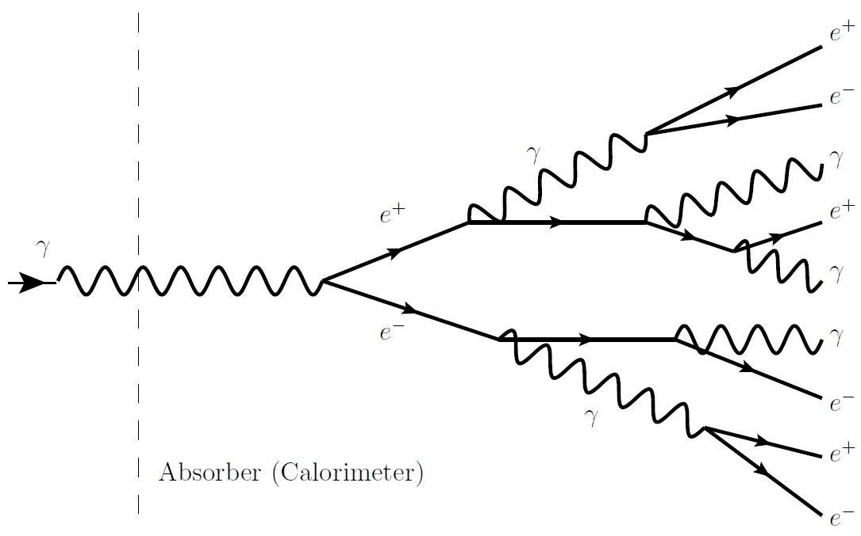
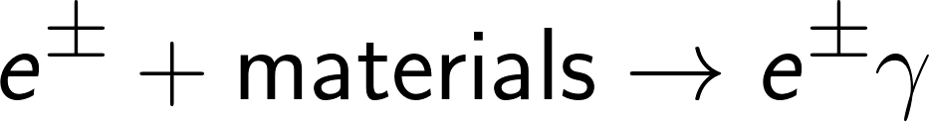

Electron & Photon – Interactions with materials
Bremsstrahlung radiation:
Pair production:
incident on matter at high energy
energy of incident particle is used up
[1]
Fig. 4. Schematic view of EM shower(photon injection)
[1] Georg VIEHHAUSER, Tony WEIDBERG; Detectors in Particle Physics: A Modern Introduction, 2024 (CRC Press)

Slide 35

Electron & Photon – PID
[2]
[2]
Fig. 2’. Recap of e– signature
Fig. 3’. Recap of γ signature
[2] Saikat BISWAS; Particle Identification in High Energy Physics, 2020.

Slide 36

Muon – Particle signatures
[2]
Fig. 5. Schematic view of muon signature
leave a bent track (with a magnetic field)
not stopped in calorimeter
tracked in muon detectors
[2] Saikat BISWAS; Particle Identification in High Energy Physics, 2020.

Slide 37

Muon – PID
[3]
Standalone MS track
Reconstruct local tracks in ID and MS separately;
Combine MS and ID tracks;
Global fit based on ID & MS hits, taking into account energy loss in the calorimeters;
ID
track
[2]
Fig. 5’. Recap of muon signature
[3] Roger FORTY; Particle Identification (CERN); ICFA Instrumentation School, 1-2 December 2017

Slide 38

Muon – PID: reconstruction efficiencies
gap in the MS
Fig. 6. Muon reconstruction efficiencies for events
𝐽/𝜓 → 𝜇𝜇
Fig. 7. Muon reconstruction efficiencies for events
Z → 𝜇𝜇
[4]
[4]
[4] The ATLAS Collaboration, CERN; Muon reconstruction and identification efficiency in ATLAS using the full Run 2 pp collision data set at √s = 13 TeV, Eur. Phys. J. C 81 (2021) 578

Slide 39


Hadron – Particle signatures
[2]
[2]
Fig. 8. View of charged hadron signature
Fig. 9. View of neutral hadron signature
„
„
leave a bent track (with a magnetic field)
stopped deep in second layer (hadronic calorimeter)
no track
stopped deep in second layer (hadronic calorimeter)
[2] Saikat BISWAS; Particle Identification in High Energy Physics, 2020.

Slide 40

Hadron – Interactions with materials
energy measured similar to EM calo
energy of incident particle is used up
[1]
Fig. 10. Schematic view of hadronic shower (hadron injection)
[1] Georg VIEHHAUSER, Tony WEIDBERG; Detectors in Particle Physics: A Modern Introduction, 2024 (CRC Press)

Slide 41







Neutrino – Missing Transverse Energy (MET)
Neutrinos don’t interact with detectors Missing Transverse Energy:
Conservation of momentum:
Missing
Reconstruct the visible objects:
[5]
Fig. 11. Transversal section of detector
[5] The ATLAS Collaboration, CERN; Performance of missing transverse momentum reconstruction with the ATLAS detector using proton-proton collisions at √s = 13 TeV, Eur. Phys. J. C 78 (2018) 903.

Slide 42




PID methods – Mass determination
Relativistic momentum:
Rest mass:
momentum can be measured thanks to the magnetic field [charged particle]
Lorentz variables can be determined:
Time-of-flight (TOF)
Energy loss by ionisation (dE/dx)
Cherenkov radiation
Transition radiation
[6] Edwin F. TAYLOR, John Archibald WHEELER; Spacetime Physics: Introduction to Special Relativity. 1992, W. H. Freeman.

Slide 43




PID methods – Time-of-flight (TOF) measurements
Difference in arrival time:
Relativistic momentum:
Fig. 12. Typical TOF set-up (diagram & specific)
Calculated mass:
[7]
[7] Roger FORTY; Time-of-flight technologies (CERN); ECFA R&D Roadmap Symposium, 6 May 2021.

Slide 44




TOF – Flight-time plots for different particles
Flight-time:
Difference in flight-times:
Relativistic approximation:
Fig. 13. TOF differences for pairs of pairs of particles at flight distance L = 1 m.
[8]
[8] Hermann KOLANOSKI, Norbert WERMES; Particle Detectors, 2022 (ed princeps 2020), Oxford University Press.

Slide 45

TOF – Separation of π,K,p (Mark III experiment, SLAC)
Fig. 14. Type separation w.r.t particle velocity
[8]
Fig. 15. Separation using TOF mass
[8]
[8] Hermann KOLANOSKI, Norbert WERMES; Particle Detectors, 2022 (ed princeps 2020), Oxford University Press.

Slide 46





PID methods – Energy deposit by ionisation
[1’]
Fig. 16. Diagram of energy deposit by ionisation
[1] Georg VIEHHAUSER, Tony WEIDBERG; Detectors in Particle Physics: A Modern Introduction, 2024 (CRC Press)

Slide 47







Ionisation – Bethe-Bloch formula for heavy particles
Energy loss for heavy charged particles:
Interaction dominated by elastic collisions with electrons
high E
low E
maximum energy transfer in single collision
mean excitation energy of medium
density-effect correction
[transverse extension of electric field]
shell-effect correction
[correct neglection of atomic binding]
Non-relativistic region
[9] Particle Data Group PDG 2010; 27. Passage of particles through matter; Revised January 2010 by H. Bichsel (University of Washington), D.E. Groom (LBNL), and S.R. Klein (LBNL).

Slide 48



Ionisation – Stopping power w.r.t. parameter βγ (1)
saturation at large (βγ) due to density-effect (correction δ)
[polarization of medium]
Fig. 17.
Stopping power development (log-log graph)
[9]
Fermi plateau
log rise
[relative extension of transversal electric field]
[9] Particle Data Group PDG 2010; 27. Passage of particles through matter; Revised January 2010 by H. Bichsel (University of Washington), D.E. Groom (LBNL), and S.R. Klein (LBNL).

Slide 49


Ionisation – Minimum ionization for materials
`
Fig. 18. Behaviour of stopping power for different materials
[10]
[10] Particle Data Group PDG 2019; 33. Passage of particles through matter; Revised August 2019 by D.E. Groom (LBNL) and S.R. Klein (NSD LBNL).

Slide 50


Ionisation – Bethe-Bloch formula for electrons
Incident and target electrons have the same mass:
scattering of identical, indistinguishable particles
mean excitation energy of medium
kinetic energy
of electron
independent term univariately dependent on Lorentz factor
Positrons are not identical with electrons, i.e. different treatment!
[9] Particle Data Group PDG 2010; 27. Passage of particles through matter; Revised January 2010 by H. Bichsel (University of Washington), D.E. Groom (LBNL), and S.R. Klein (LBNL).

Slide 51


Ionisation – Identification: specific ionization plots
[11]
[11]
pions
kaons
Bethe-Bloch
axis to create distinguishable signatures
protons
Fig. 19. Distribution of MPV_{dE/dx} with parametric expression derived from MC simulated tracks
Fig. 20. Charged, low momentum particle ID (ATLAS)
[11] G. AAD, et al.; Searches for heavy long-lived sleptons and R-hadrons with the ATLAS detector in pp collisions at √s = 7 TeV. In: Phys. Lett. B 720 (2013)

Slide 52


PID methods – Detection of Cherenkov radiation
Occurs when a charged particle traverses a medium in which its velocity is greater than the phase velocity of light in that medium: ,
emitting electromagnetic radiation.
Fig. 21. Cherenkov radiation, as caused by an asymmetry in the polarisation of the dielectric medium
[8]
[8] Hermann KOLANOSKI, Norbert WERMES; Particle Detectors, 2022 (ed princeps 2020), Oxford University Press.

Slide 53




Cherenkov radiation – General characteristics
[8]
Fig. 22. Geometry of the outgoing wave front for Cherenkov radiation
Cherenkov angle:
[8] Hermann KOLANOSKI, Norbert WERMES; Particle Detectors, 2022 (ed princeps 2020), Oxford University Press.

Slide 54




Cherenkov radiation – Mass calculation
Relativistic momentum:
Mass calculation:
Remember:
Mass calculation using
Cherenkov angle:

Slide 55

Cherenkov radiation – Identification: angle (ALICE)
Fig. 23. Cherenkov angle w.r.t. momentum create distinct plots
[8]
[8] Hermann KOLANOSKI, Norbert WERMES; Particle Detectors, 2022 (ed princeps 2020), Oxford University Press.

Slide 56



PID methods – Detection of Transition radiation
Occurs when a relativistic particle traverses the boundary between two media with different electric permittivities , emitting photons with energies up to the high-energy X-ray regime.
Fig. 24.
Transition radiation and possible angles TR photons can take
[8]
[8] Hermann KOLANOSKI, Norbert WERMES; Particle Detectors, 2022 (ed princeps 2020), Oxford University Press.

Slide 57






Transition radiation – General characteristics
Intensity:
Emission
angle:
Emission
energy:
low photon emission probability per transition
[8]
gas with high photon absorption (high Z) required
[12]
Fig. 24’. Recap of TR radiation geometry
[12] Marco DELMASTRO, 3. Particle interactions in particle detectors, European School of Instrumentation in Particle & Astroparticle Physics

Slide 58



Transition radiation – High threshold hit fraction
`
`
Fig. 25 & 26. TRT High Threshold hit fraction defined by: provides
electron/hadron discrimination over the momentum range between [1,150] GeV/c
[13]
[13] Ahmet BINGUL (On behalf of ATLAS TRT Collaboration); The ATLAS TRT and its Performance art LHC, ICPP-II, 2011

Slide 59


Transition radiation – Identification: fraction of hits
Fig. 27. Phase spaces for particle types
Fig. 28. High-threshold fraction distribution
[12]
[12] Marco DELMASTRO, 3. Particle interactions in particle detectors, European School of Instrumentation in Particle & Astroparticle Physics

Slide 60


Particle reconstruction – V⁰s (example)
K_{S}⁰ and Λ are collectively known as V⁰s, due to their characteristic two-prong decay vertex:
Fig. 29. Reconstruction example
Fig. 30. Decay of V⁰s
[2]
[2] Saikat BISWAS; Particle Identification in High Energy Physics, 2020.

Slide 61

Mass reconstruction – Higgs boson
Fig. 31. Mass reconstruction for pion
Fig. 32. Mass reconstruction for Higgs

Slide 62
Bibliography
-[1] ATLAS Pixel Collaboration, ATLAS Pixel Detector Technical Design Report, CERN/LHCC/98-13 (1998).
-[2] ATLAS Collaboration, ATLAS TDR-5, CERN/LHCC/97-17 (1997).
-[3] ATLAS Inner Detector Volume I Technical Design Report
-[4] The ATLAS Experiment at the CERN Large Hadron Collider, PUBLISHED BY INSTITUTE OF PHYSICS PUBLISHING AND SISSA
-[5] ATLAS Experiment at CERN
-[1]-[13](P) All references and citations are given at the footer of each slide in detail. Consult references there!

