Slide 1
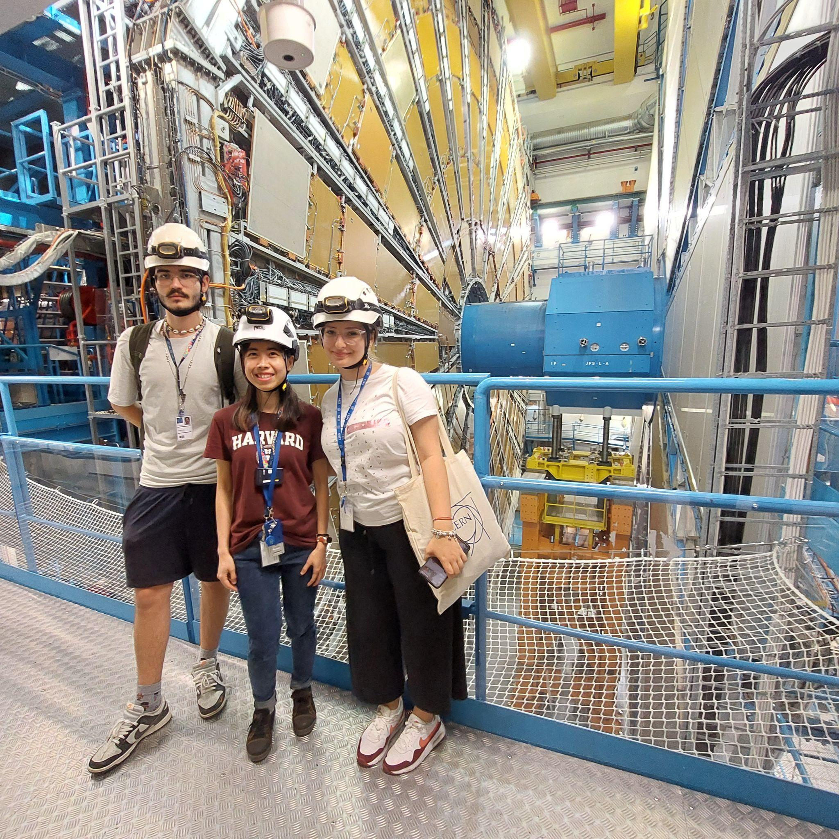
Applications of fundamental particles in medical imaging
students : Ana Andrei & Georgescu Daria
coordinated by Joni Pham

Slide 2
Positron Emission Tomography (PET)
Radiation Therapy
Ionizing Techniques
Magnetic Resonance Imaging (MRI)
X-ray Imaging
Computed Tomography (CT)
Non-Ionizing Techniques
Infrared Spectroscopy
Ultrasonography

Slide 3
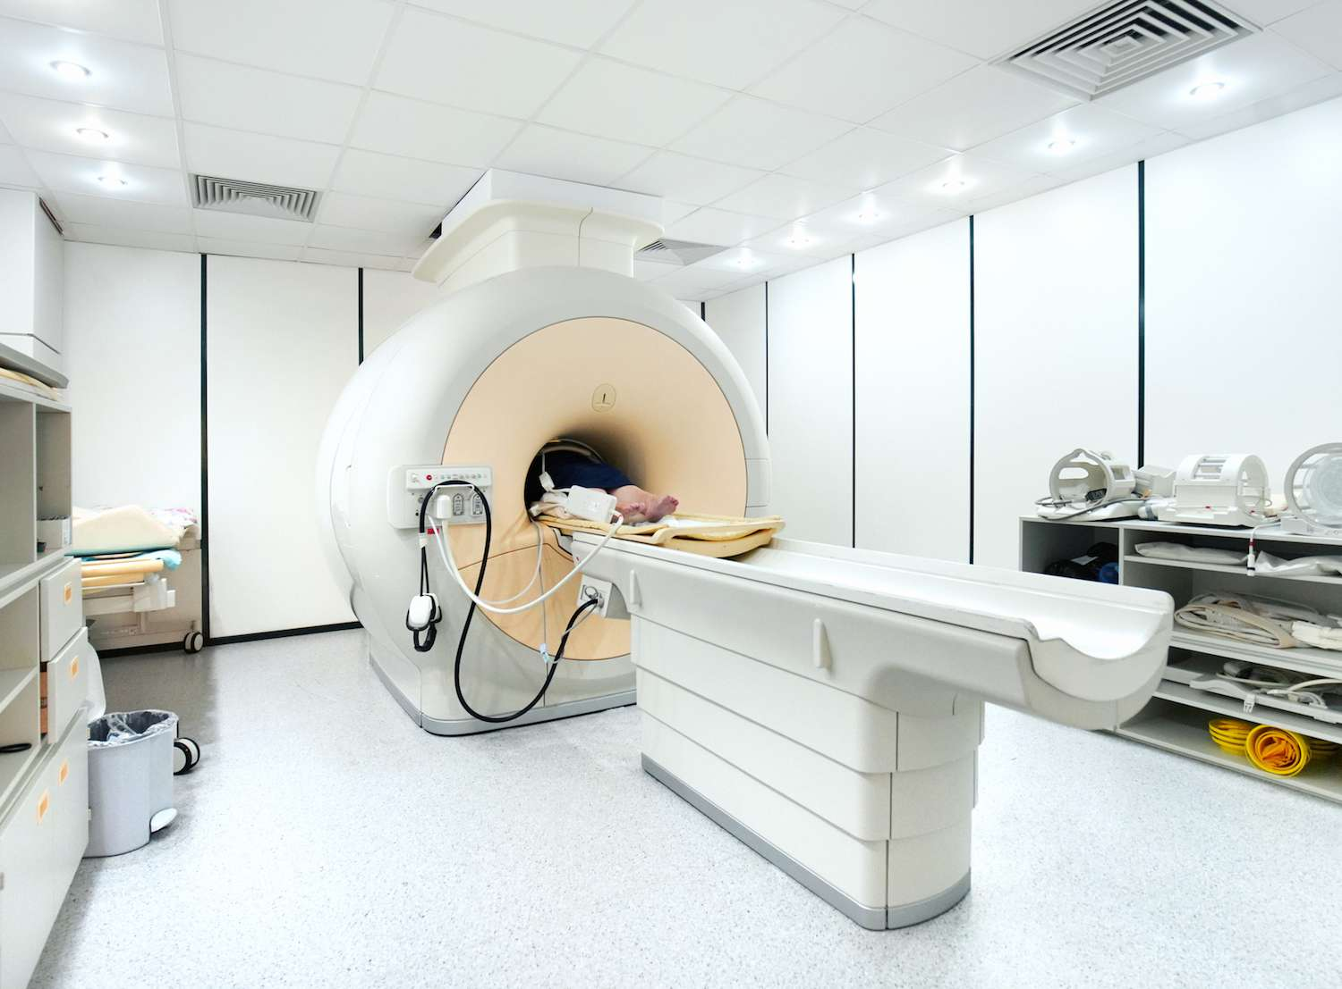
Non-ionization imaging methods
MRI - Magnetic Resonance Imaging

Slide 4
HOW DOES IT WORK?

Slide 5
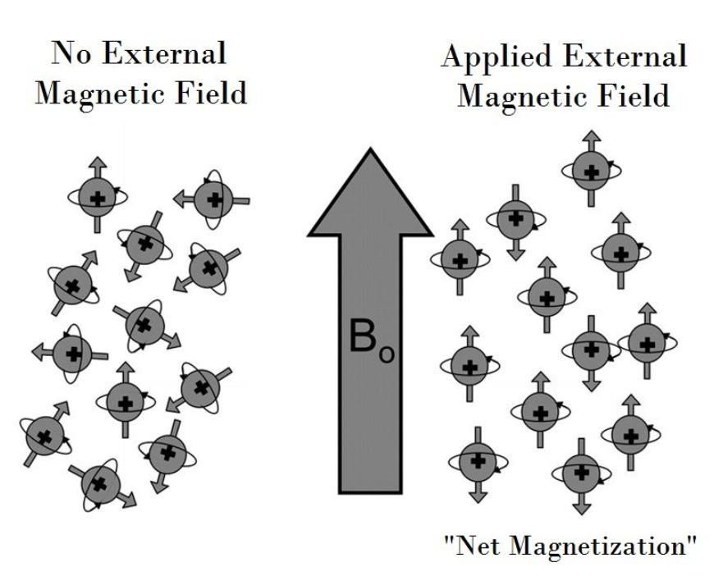
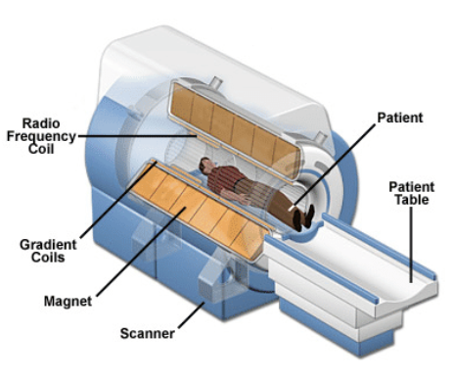

Slide 6
But how do we create these images?

Slide 7
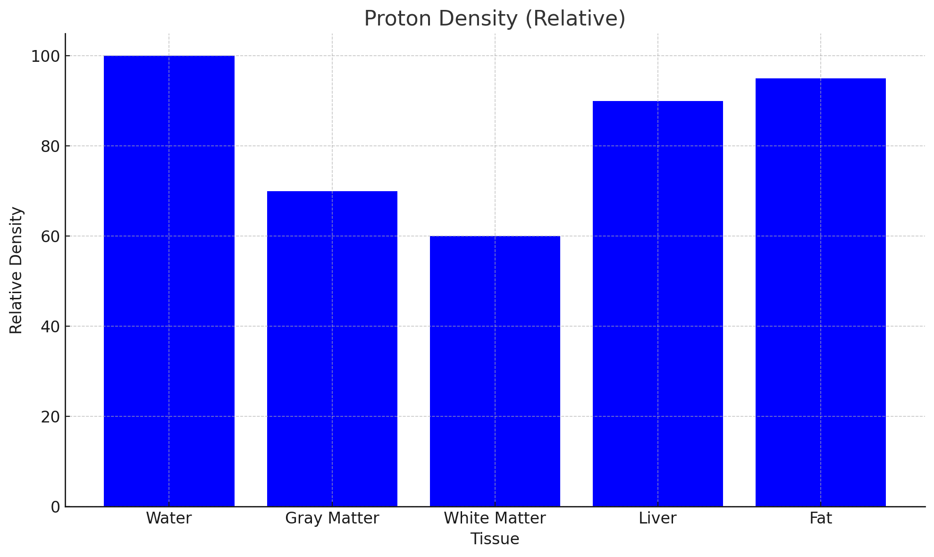

Slide 8
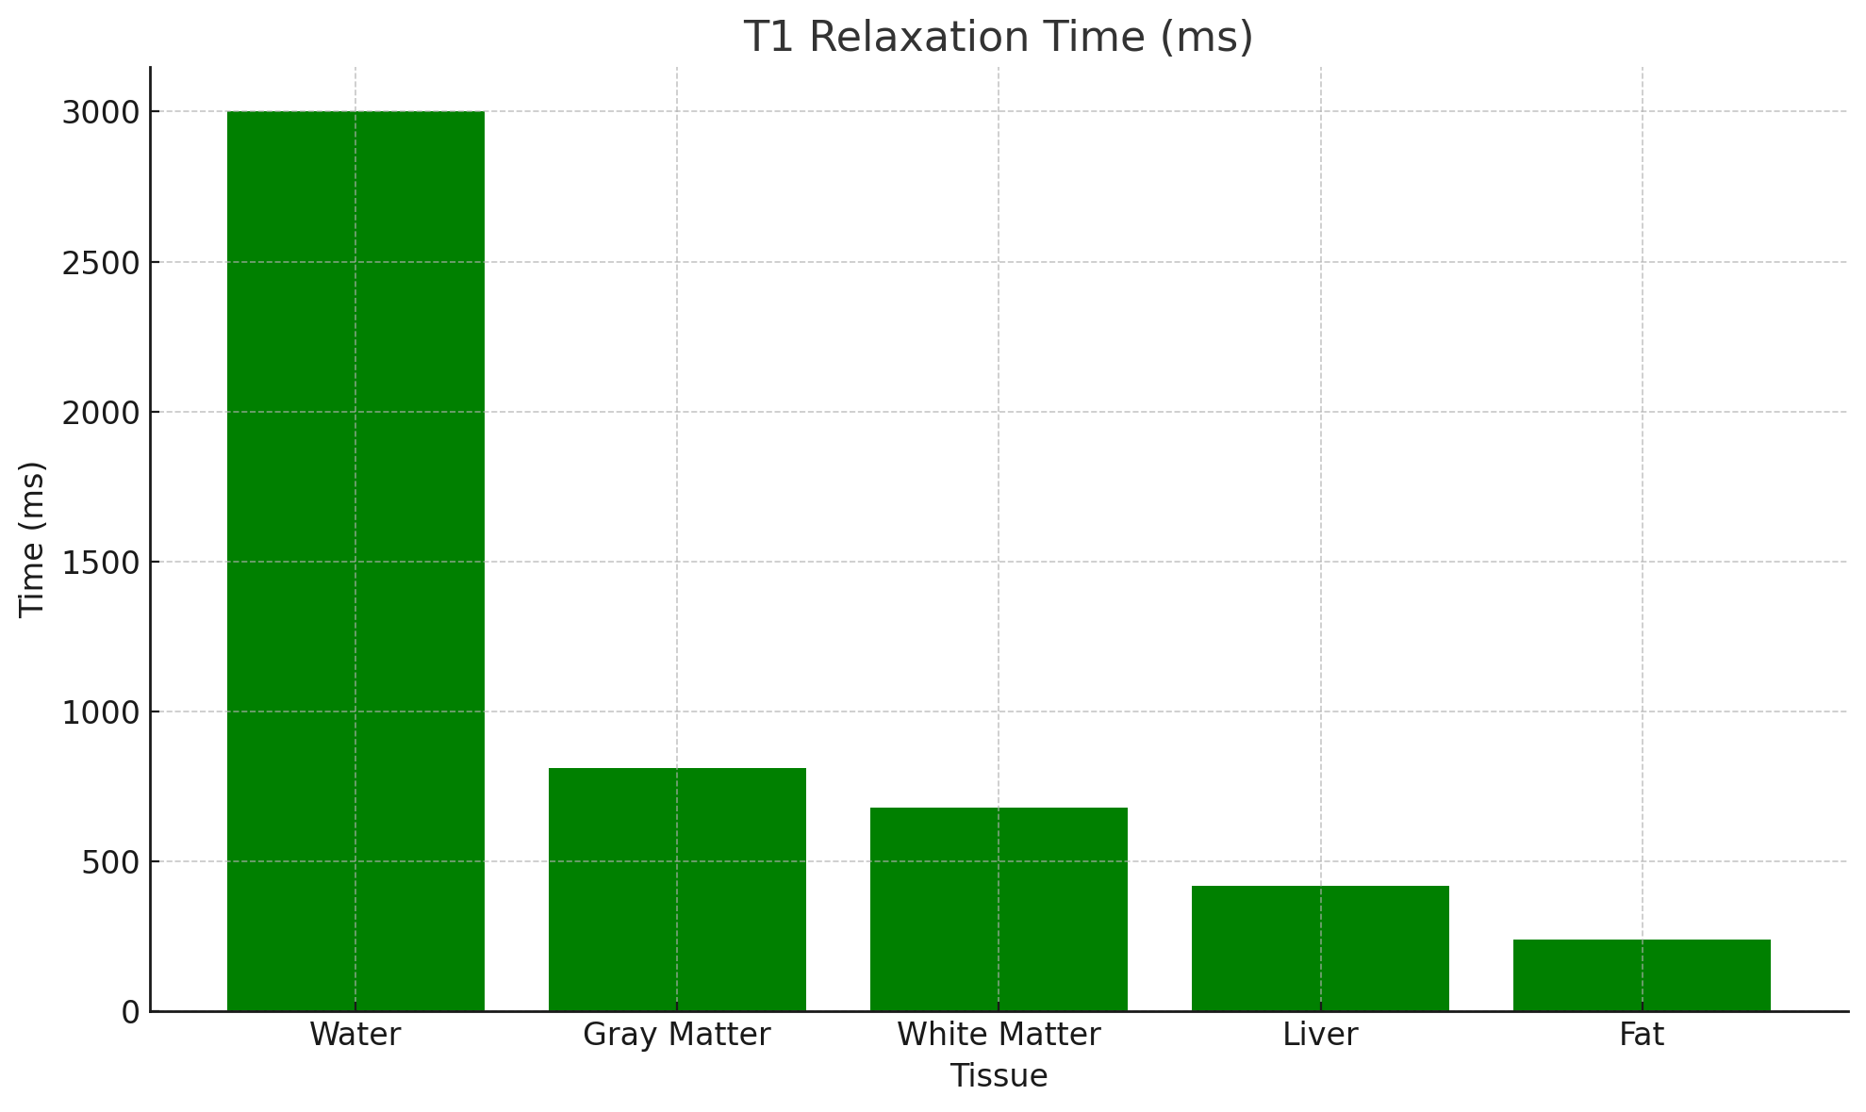

Slide 9
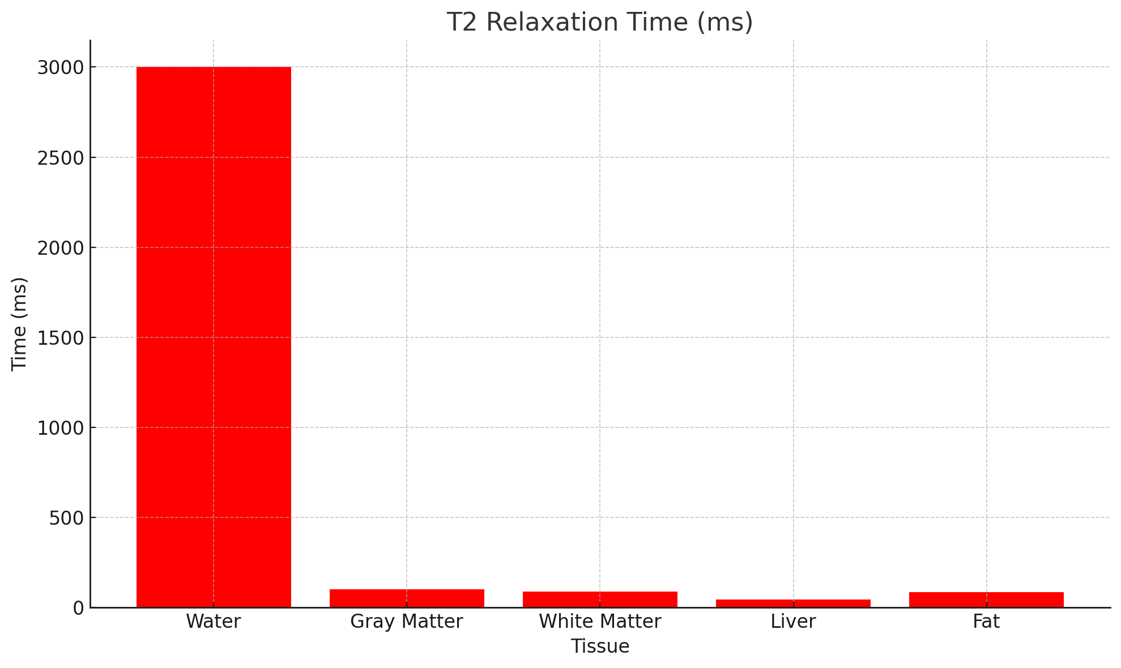

Slide 10
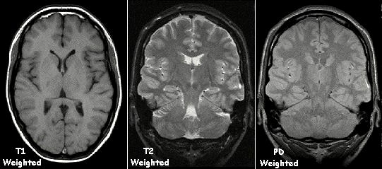

Slide 11
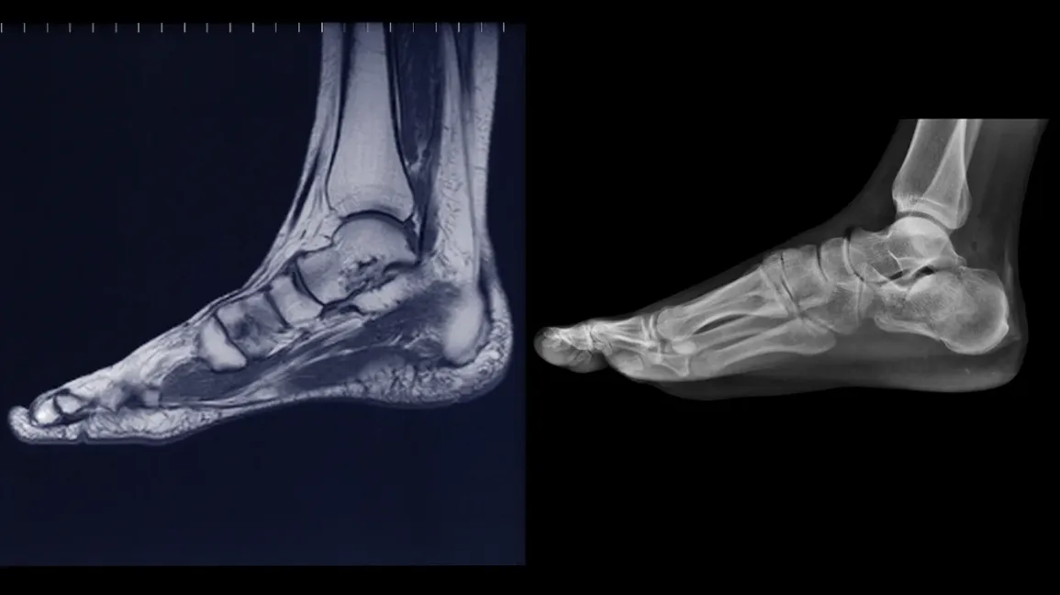
MRI
X-ray

Slide 12
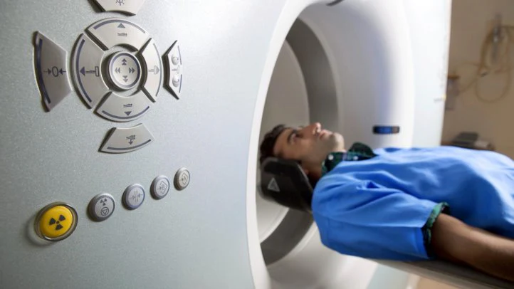
Advantages & Risks

Slide 13

Why does the MRI have this funny-looking shape?

Slide 14
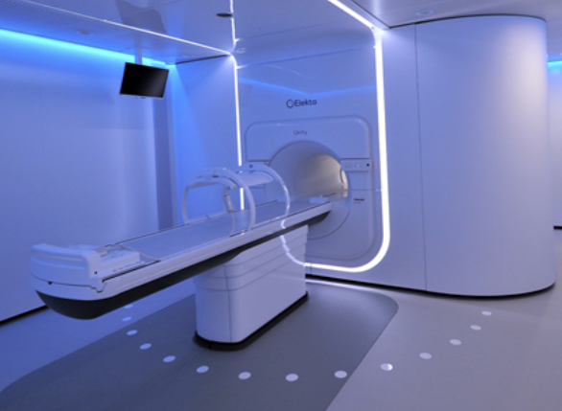
MRI Linac for Advanced Radiation Therapy Cancer Treatment

Slide 15
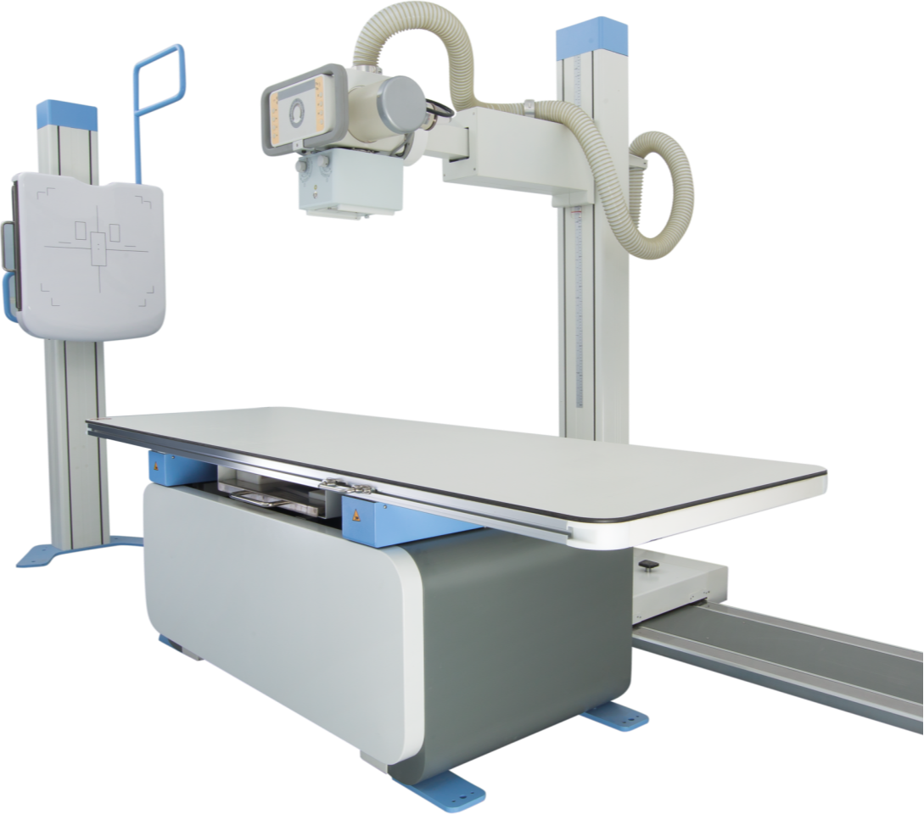
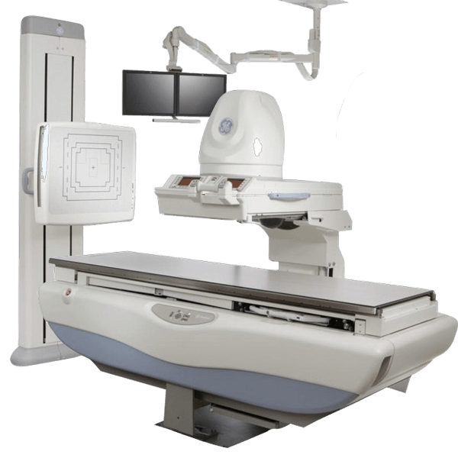
X-Rays

Slide 16
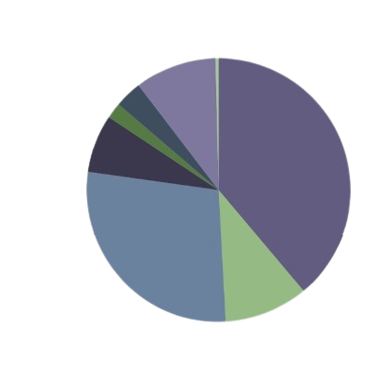
USES
REMAINDER(0,4%)
ANGIOGRAPHY & VASC INTERVENTION(3%)
CT
(10%)
GASTROINTESTINAL AND UROGENITAL TRACT (2%)
MAMOGRAPHY (7%)
DENTAL (39%)
SKELETON (28%)
THORAX (10%)

Slide 17
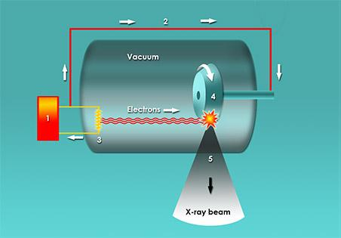
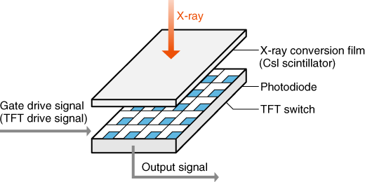
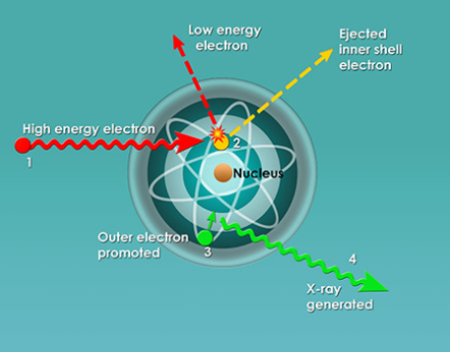
COMPONENTS AND FUNCTIONING
Main components :
– X-Ray generator
– Image detection system

Slide 18
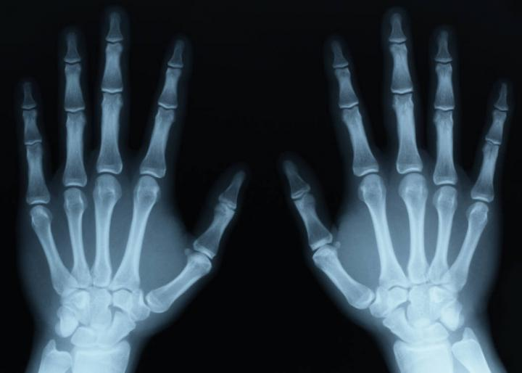
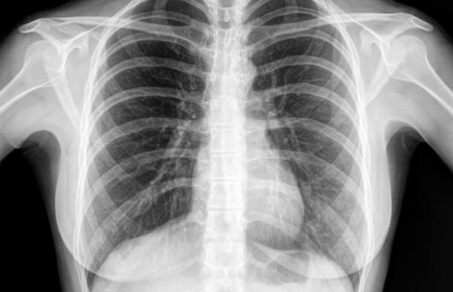
applications & shortcomings

Slide 19
wavelengths : 0.01 to 10 nanometers,
frequency : 30 petahertz to 30 exahertz (31016 Hz to 31019 Hz)
energy: 100 eV to 150 keV.

Slide 20
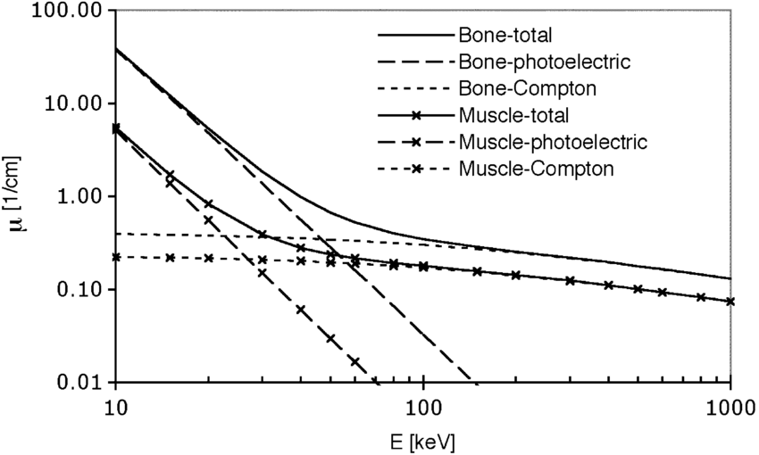
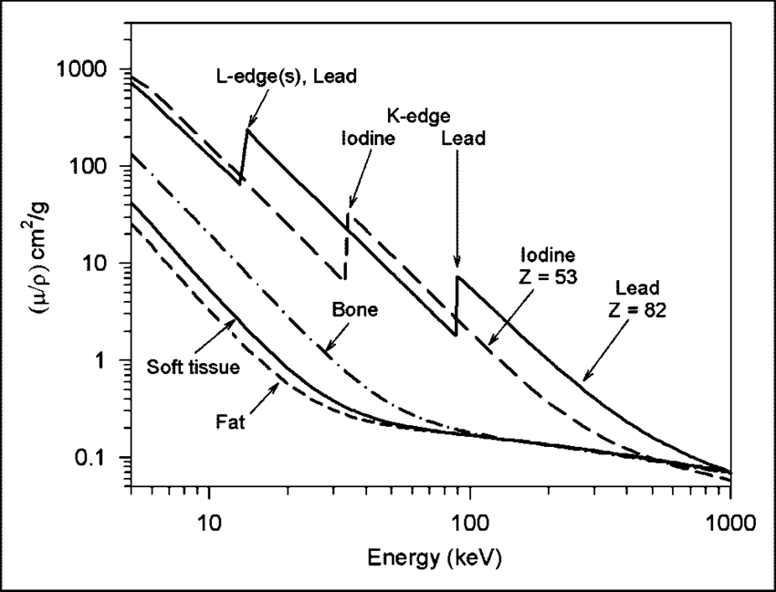

Slide 21
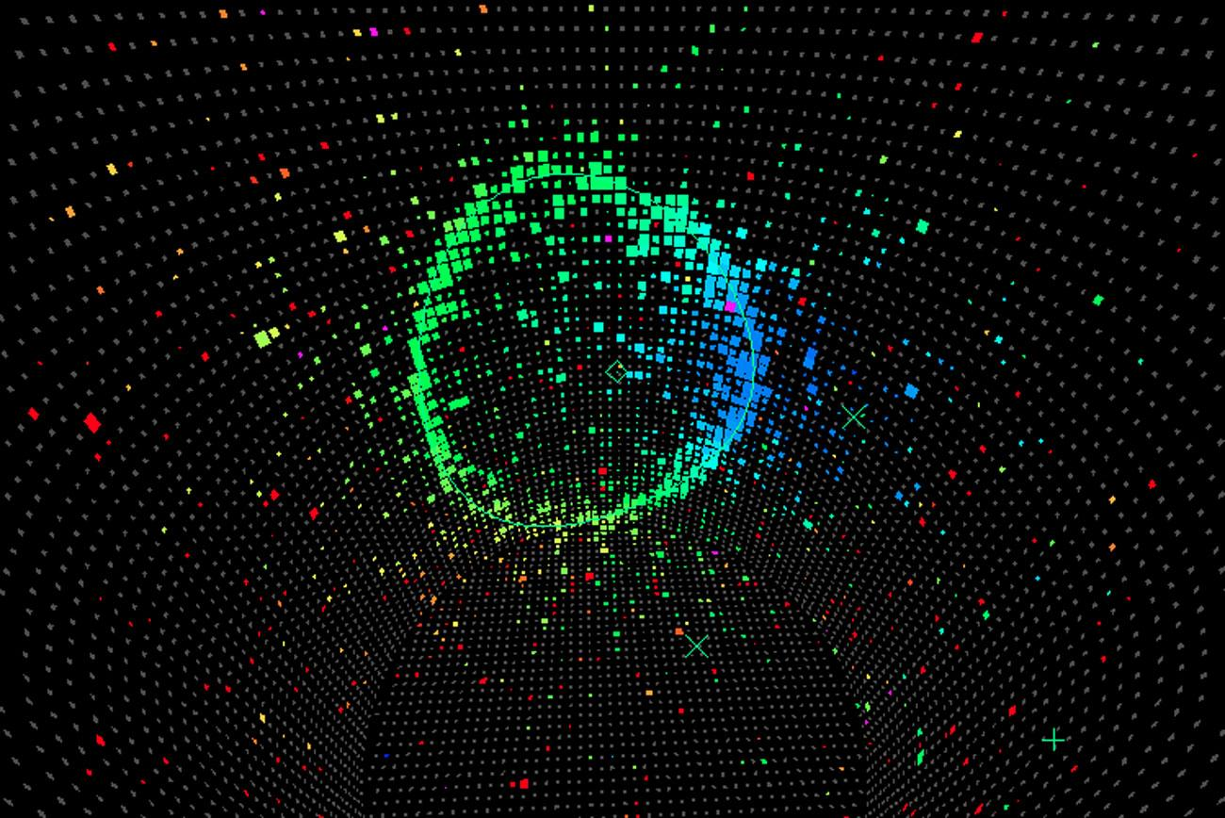
If not electrons then what ?

Slide 22
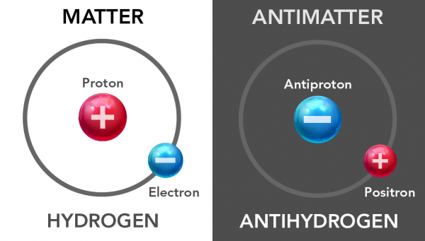

Slide 23
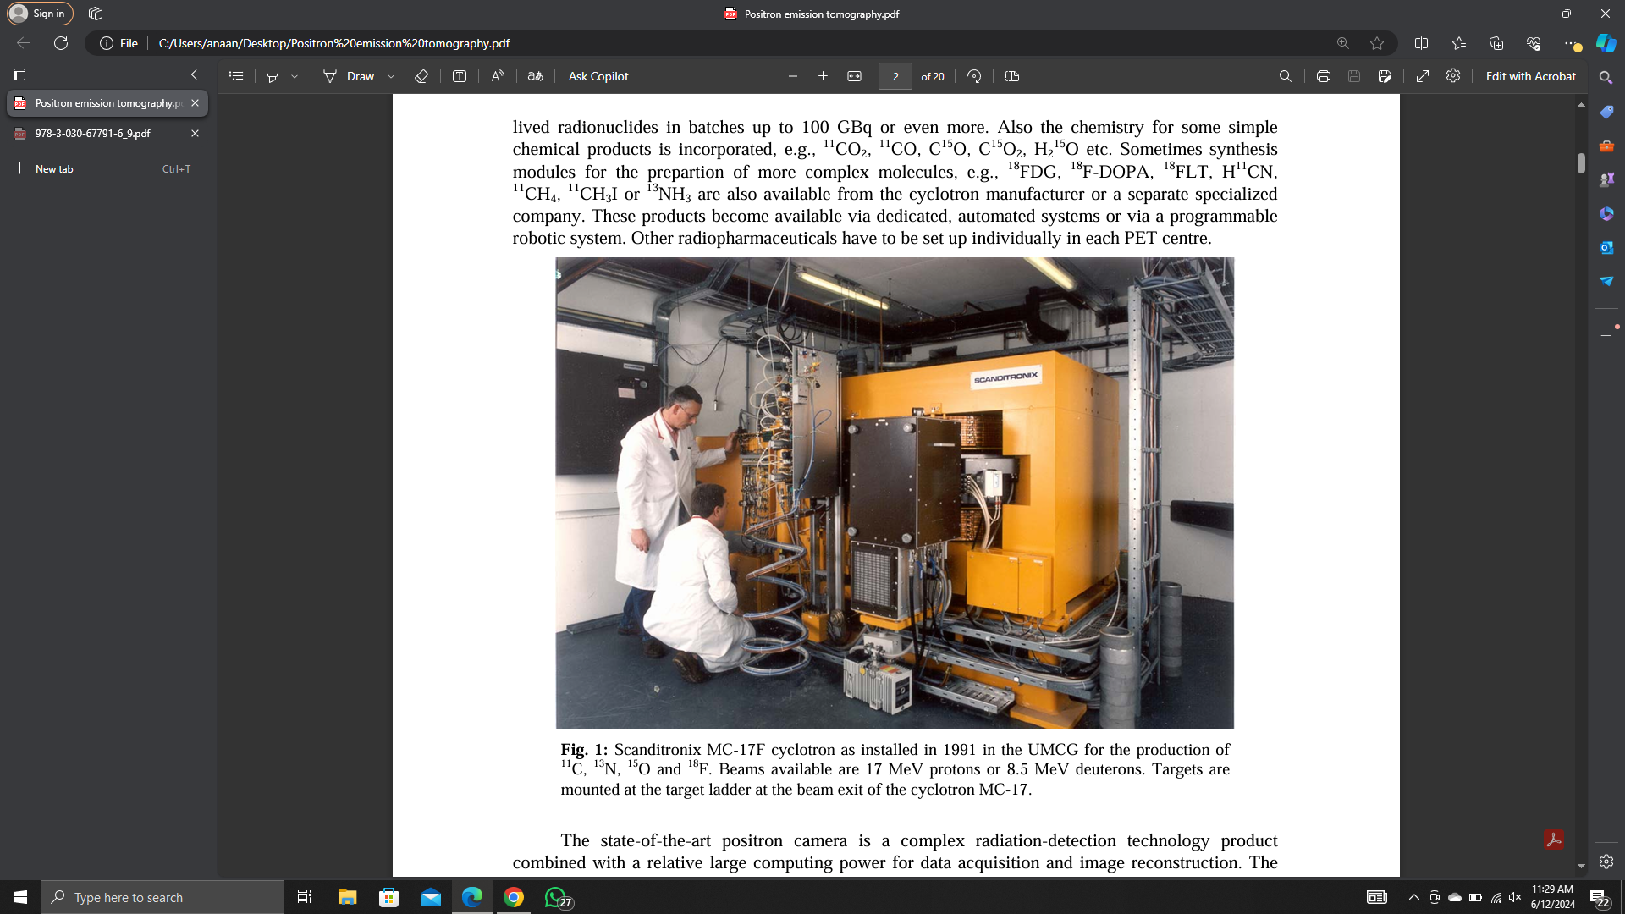
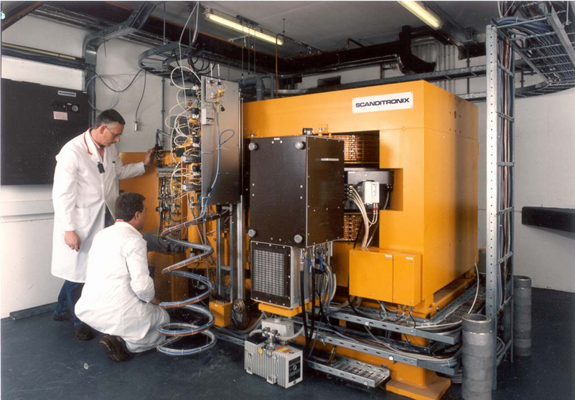
POSITRON EMISSION TOMOGRAPHY

Slide 24
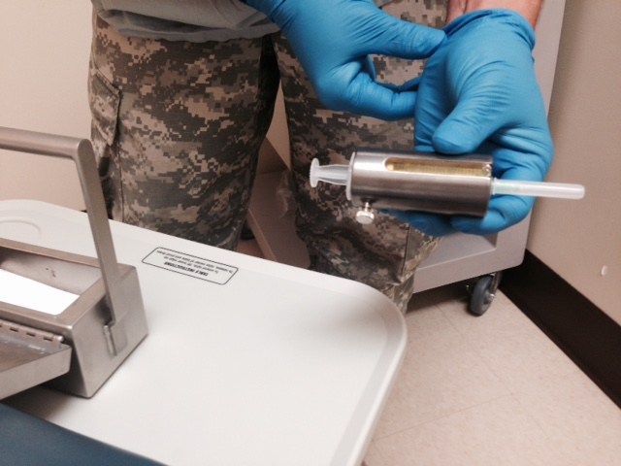
The Radioactive solution(<0,01 SIEVERTS)
It will get absorbed by the areas with hyper-metabolic activity
usually contains the Na22 isotope
goes through a decaying process

Slide 25
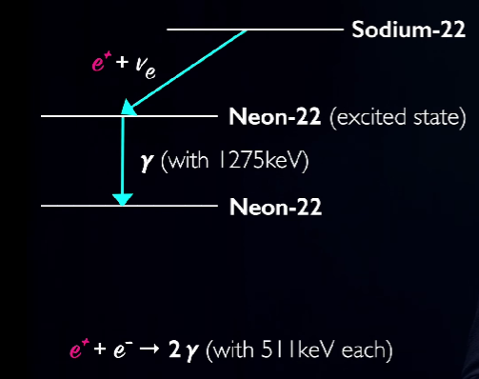
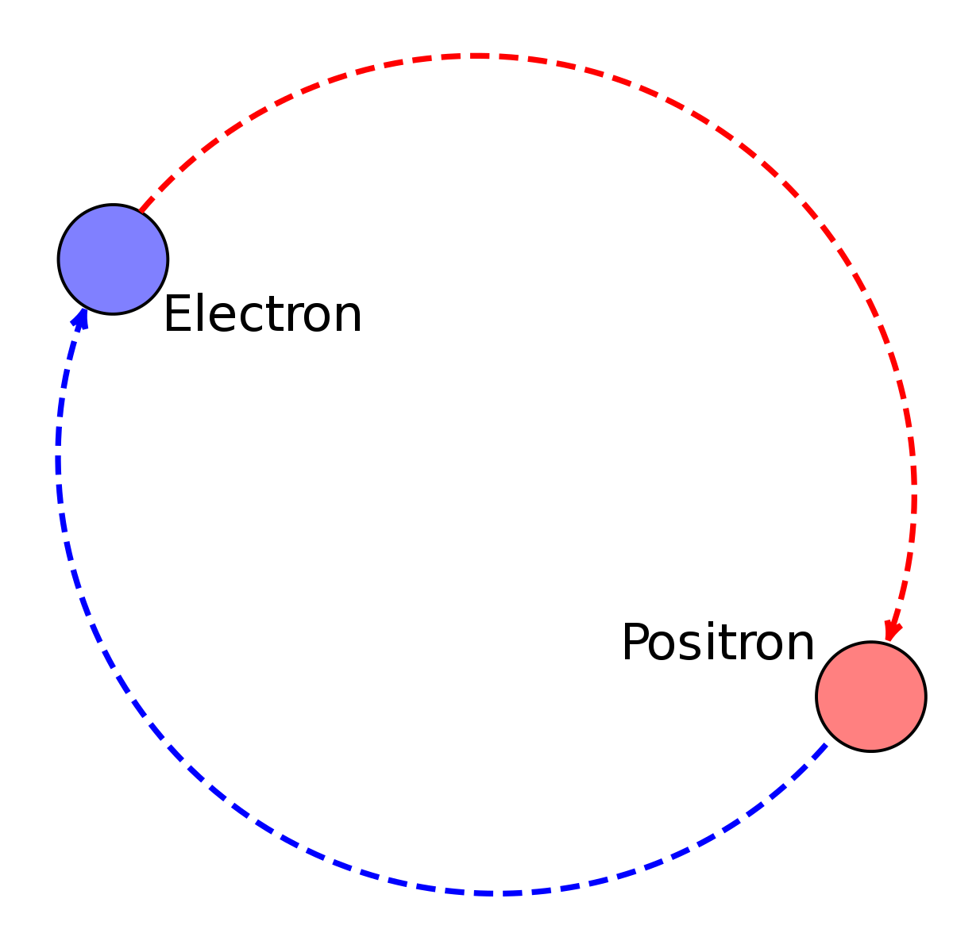
The positron is slowed down in the tissue (collisions) => positronium, (atom formed by the positron and an electron).
Anti particles => annihilation => 2 photons of 511 keV back to-back or co-linear are generated.
CONSERVATION LAWS: cons. energy / momentum
electron
THE DECAYING PROCESS
POSITRONIUM
positron

Slide 26
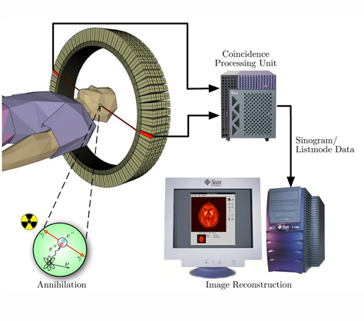
Coincidence measurements : energetic photons → scintilator crystals → photomultiplyer → electric current → multichannel analyzer
Coincidence
2 signals with maximum 4𝜇s between them

Slide 27
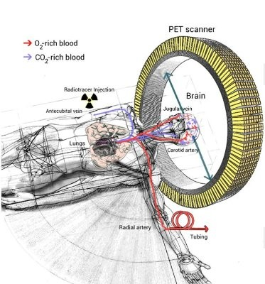
THE SCINTILLATION DETECTORS / POSITRON CAMERA
Ring formed from ≅ 70 blocks
4 rings added => axial field of view (15–16 cm)
31–63 planes are imaged simultaneously with a spatial resolution of 4–7 mm FWHM
(full width at half maximum)

Slide 28
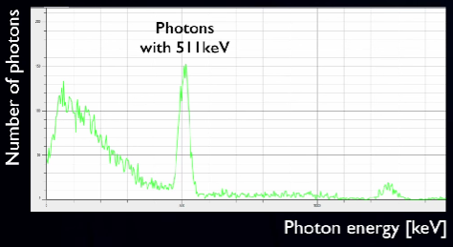
THE ENERGETIC SPECTRE
PEAK : 511 KeV (ANIHILTION)
SMALL PEAK : 1275 KeV (Na22 excited → Na22 + 𝜸)

Slide 29
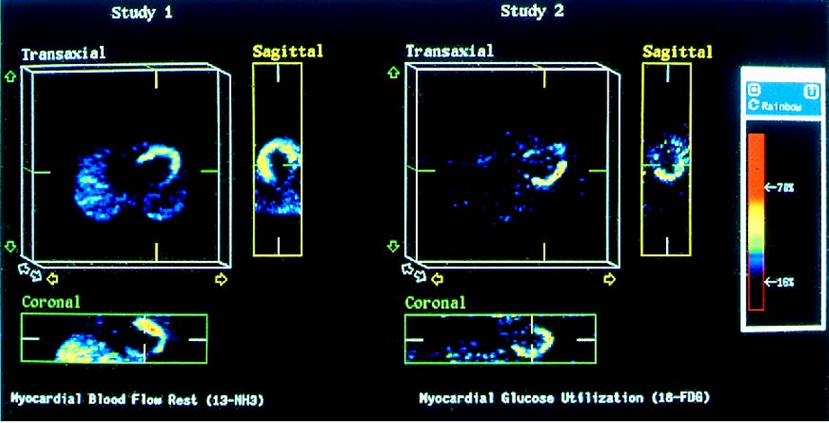
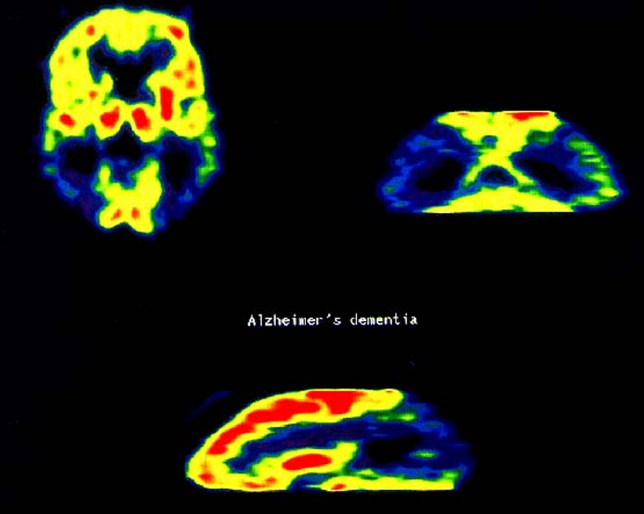
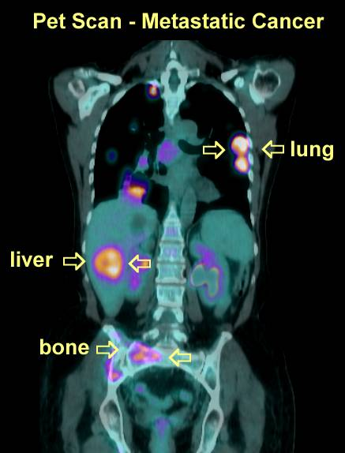
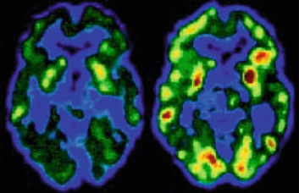
USE IN MEDICAL FIELD
ALCOHOOLISM - ABSTINENCE CURE
ALZHEIMER’S DEMENTIA (GLUCOSE CONSUMPTION)

Slide 30
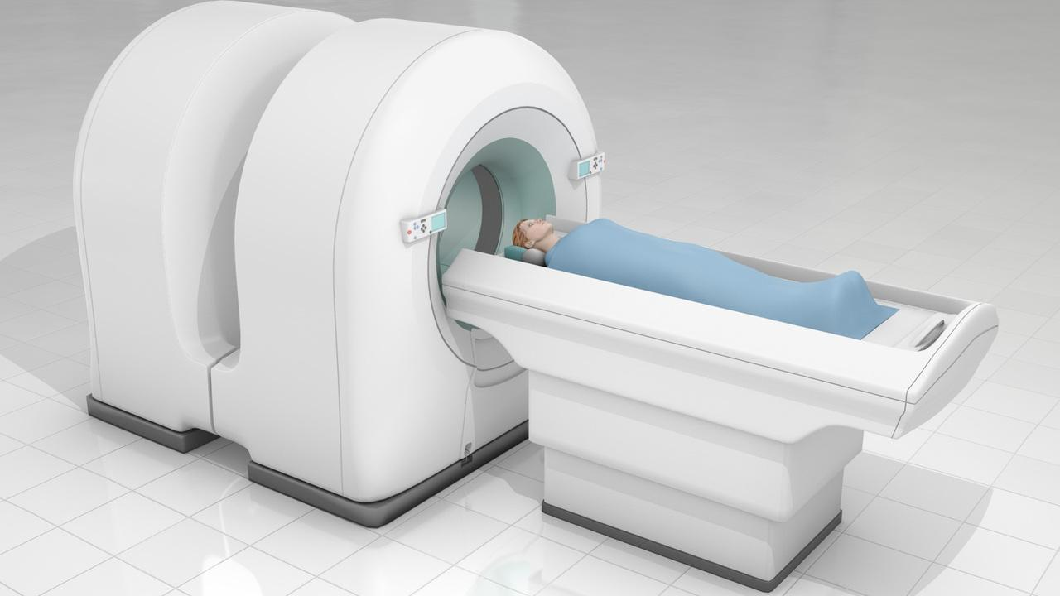
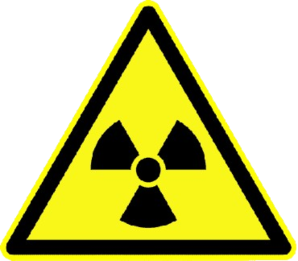
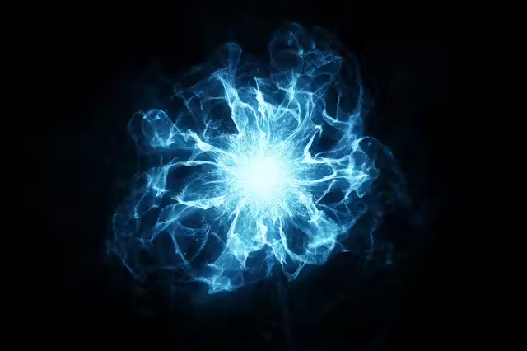
ADVANTAGES AND SHORTCOMINGS
RISKY
LIMITED
🐌 SLOW
💰💰EXPENSIVE
ACCURACY ✅✅
EFFICIENT⏳⏳
HIGH PRECISSION🔍🔍

Slide 31
bibliography
https://www.nibib.nih.gov/science-education/science-topics/magnetic-resonance-imaging-mri#pid-946
https://www.mayoclinic.org/tests-procedures/mri/about/pac-20384768
https://www.youtube.com/watch?v=HUUvBICd6QI
https://www.youtube.com/watch?v=Ok9ILIYzmaY
https://www.imaios.com/en/e-mri/nmr-signal-and-mri-contrast/signal-weighting-and-sequences-parameters
https://www.researchgate.net/figure/Alignment-of-protons-due-to-an-external-magnetic-field_fig3_299512554
https://www.healthline.com/health/mri-vs-xray#pros

Slide 32
Thank you for your attention !

