Slide 1
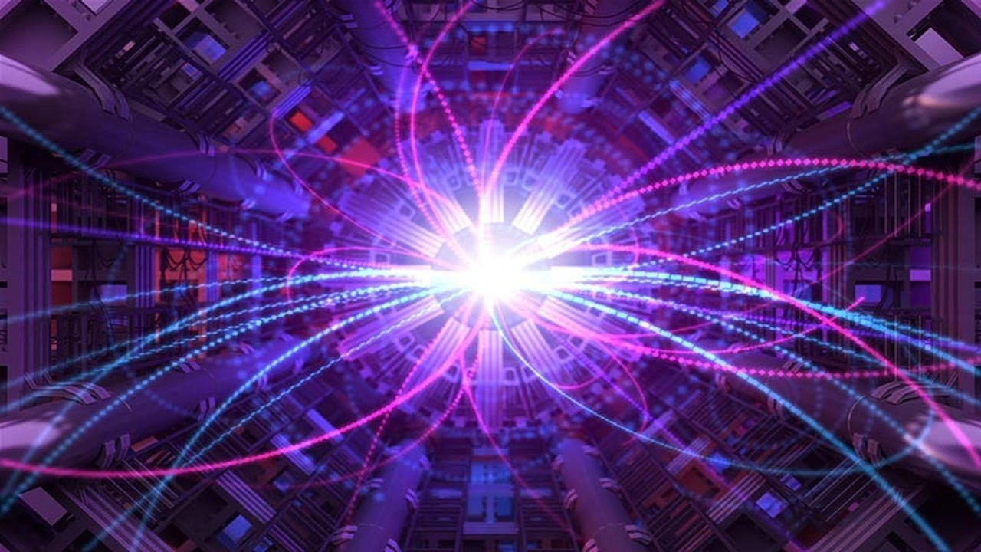
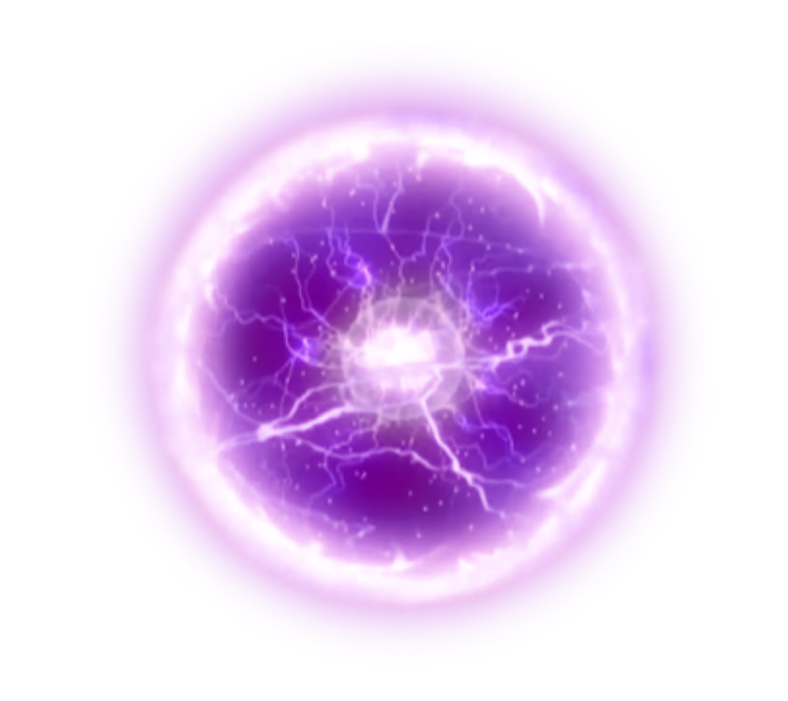


What's the matter with antimatter?
HSSIP-RO 2024
Luca Mihai Vasiu, Munteanu David-Ioan​

Slide 2

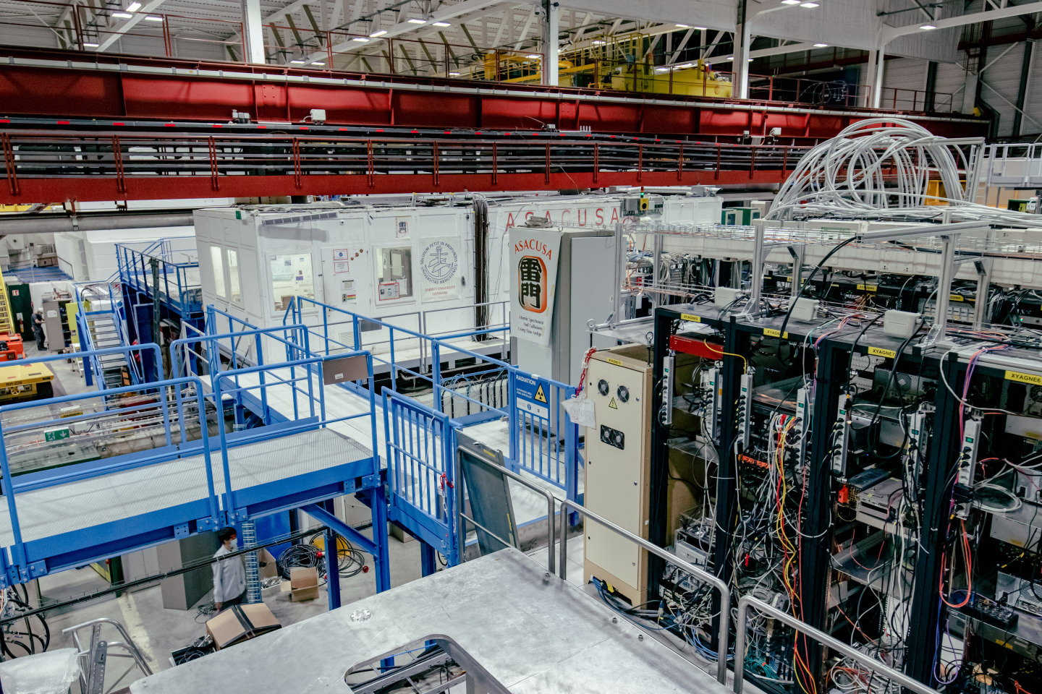
1
What is Antimatter?
1.1
What is it?
1.2
How was it discovered
1.3
Where can we find it
1.4
The Big (and problematic) Bang
2
Antimatter studies @CERN
https://cds.cern.ch/record/2790882

Slide 3
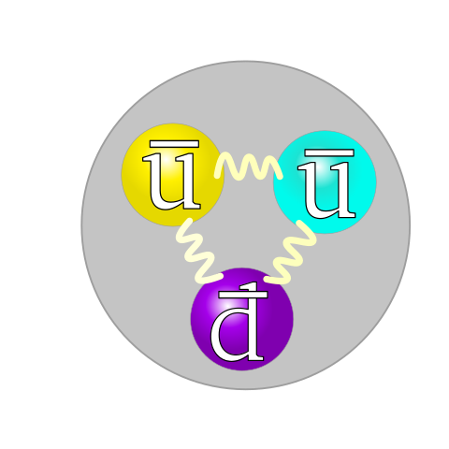
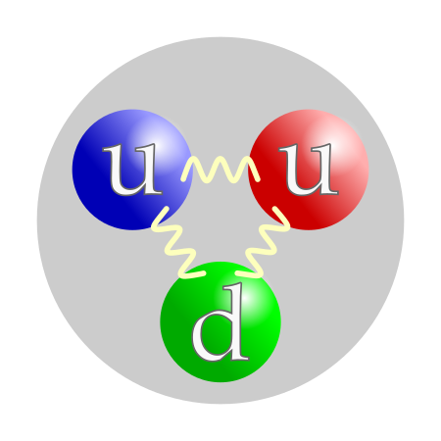
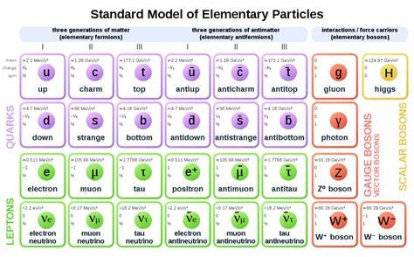
1.1 What is Antimatter?
All fermions have a corresponding antiparticle, sharing all of the particle's characteristics and a fliped charge. If the two touch, they anihilate each other releasing energy

Slide 4
1.1 What is Antimatter?

Slide 5
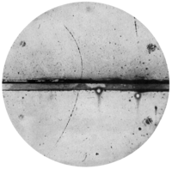
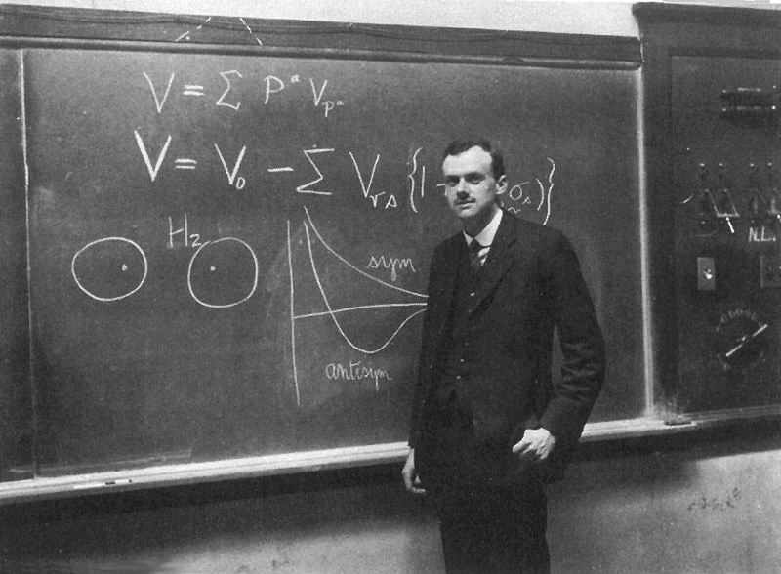
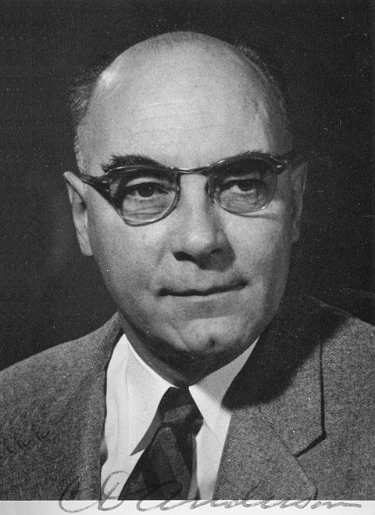
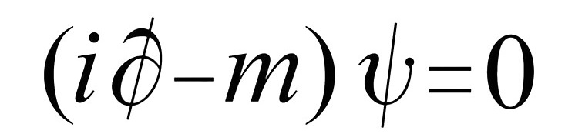
1.2 How was it discovered?
In 1928, Cambridge mathematician Paul Dirac proposed the idea of antimatter. He observed that an equation used to describe particles had two posible solutions, one with positive, one with negative charge:
https://citacoes.in/autores/carl-david-anderson/
https://wallpapercave.com/paul-dirac-wallpapers

Slide 6
1.2 How was it discovered?
Observations by Carl David Anderson in a cloud chamber led to the official recognition of the positron as the first antiparticle, thereby validating Dirac's claim. Anderson would later discover the muon also using the cloud chamber.
https://citacoes.in/autores/carl-david-anderson/

Slide 7

1.3 Where can we find it?
As science fiction as antimatter might seem, we do actually encounter it in our daily lives:
Certain natural phenomena, like thunder, produce antimatter
Neutrinos are speculated to be their own antiparticle, and about 100 trillion of them pass through your body every second.
Cosmic background radiation produces antimatter when colliding with particles
Bananas
Wait.... WHAT?

Slide 8

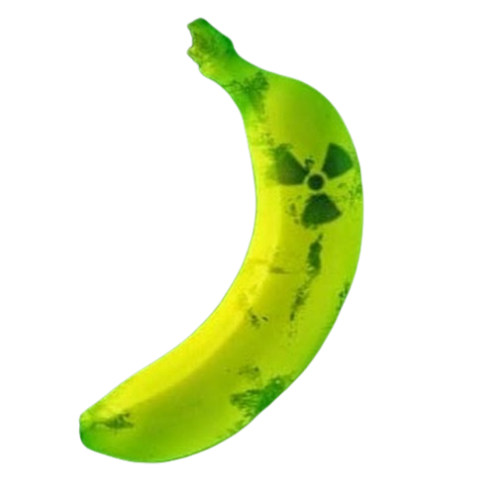
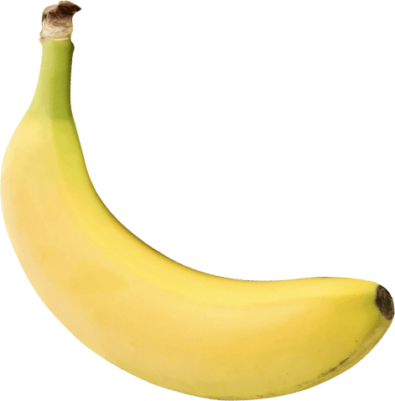
BANANAS!?
Bananas are radioactive; actually, the potassium in them is (actually, only the 0.01% K-40 isotope is).
On average, a K-40 atom in a banana undergoes positron decay every 75 minutes.
If we harvested all the antimatter from all the bananas in the world, we would produce approximately around 1.2 picograms (about $80 worth) of antimatter each year.

Slide 9

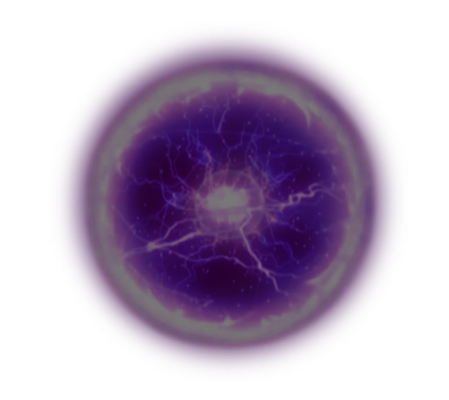
But there is a problem...

Slide 10
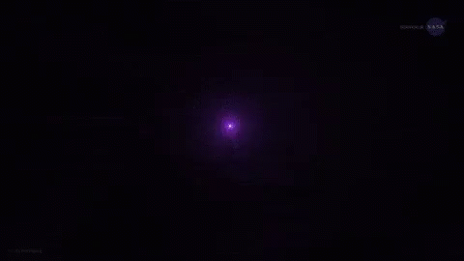

Slide 11
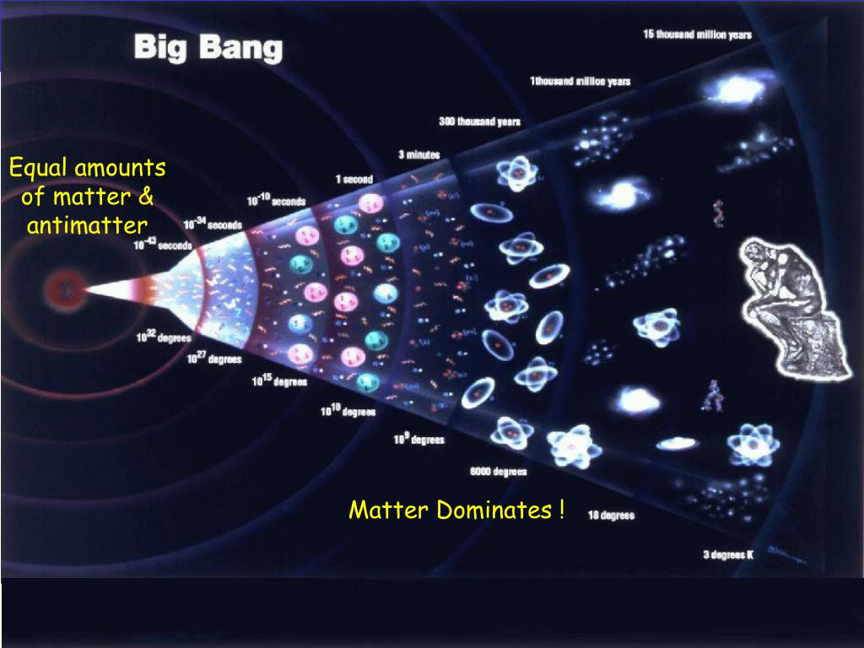
1.4 The Big (and problematic) Bang
The universe came into existence around 14 bilion years ago, producing both matter and antimatter
Most matter and antimatter was anihilated, producing backround radiation
Given the present amount of radiation, the matter/antimatter ratio should have been just slightly above 1
https://quizlet.com/237833274/the-big-bang-theory-diagram/

Slide 12
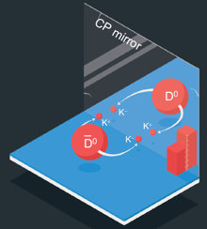
1.4 The Big Problem
Charge Parity
Charge parity is a quantum number that describes how particles behave under the symmetry operation of charge conjugation
The Weak Force has been shown to violate CP, but not enough as to justify the discrepancy we see
The Big Bang producing more matter than antimatter violates Charge Parity, therefore our model must be adapted to explain this

Slide 13

ANTIMATTER STUDIES @CERN, THE FIRST (KNOWN) ANTIMATTER FACTORY
Ch.1 Does antimatter matter?
Ch.2 Journey to the antimatter factory
Ch.3 The antimatter factory – deceleration
Ch.4 The antimatter factory – experiments

Slide 14


Ch.1 Does antimatter matter?
positron per gram
$25,000,000,000
antiproton per gram
$3,000,000,000,000,000
https://www.abc.net.au/news/science/2023-02-19/antimatter-factory-physics-most-expensive-explosive-substance/101948092

Slide 15
Ch.1 Does antimatter matter?
ANNIHILATION
WHY IS IT SO EXPENSIVE?

Slide 16
Ch.1 Does antimatter matter?
WAIT... WHY ARE WE REALLY DOING THIS?
1)
2)
3)
Why is antimatter so rare?
​
What are the properties of antimatter?
Are there any more differences between antimatter and normal matter?

Slide 17
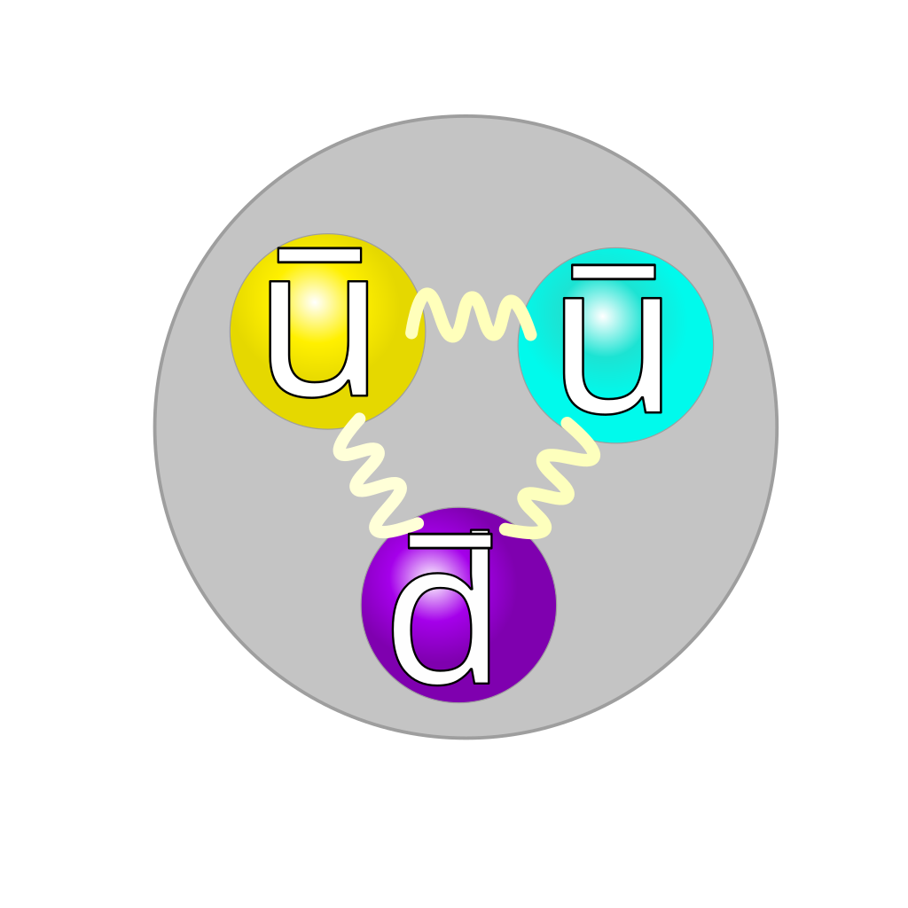
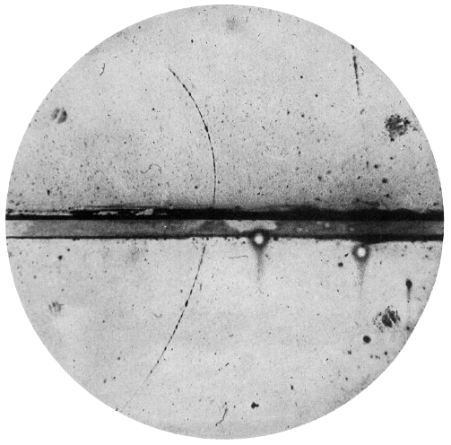
Ch.1 Does antimatter matter?
ANTIPARTICLES WE NEED
Antiproton
(collision)
Positron
(emmited by radioactive Na-22)
Antihydrogen(antimatter)
https://scienceblog.com/491440/improved-measurements-antiprotons-magnetic-moment-deepen-mystery-baryonic-asymmetry/
https://www.vedantu.com/chemistry/positron

Slide 18
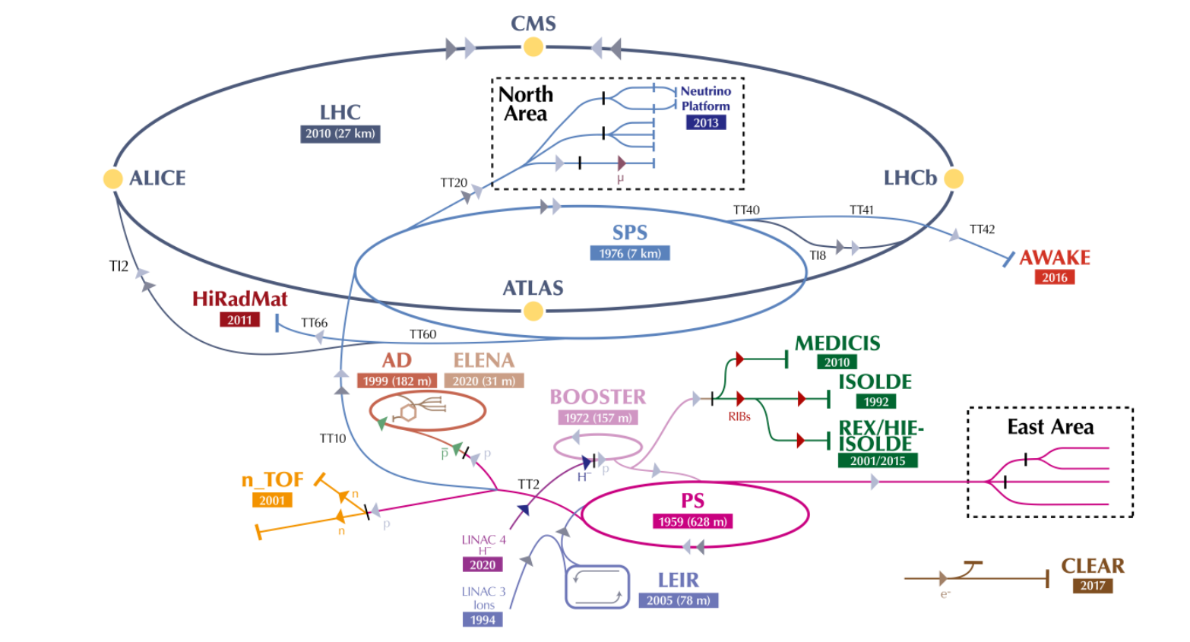
Ch. 2: Journey to the Antimatter Factory
https://home.cern/science/accelerators/accelerator-complex

Slide 19
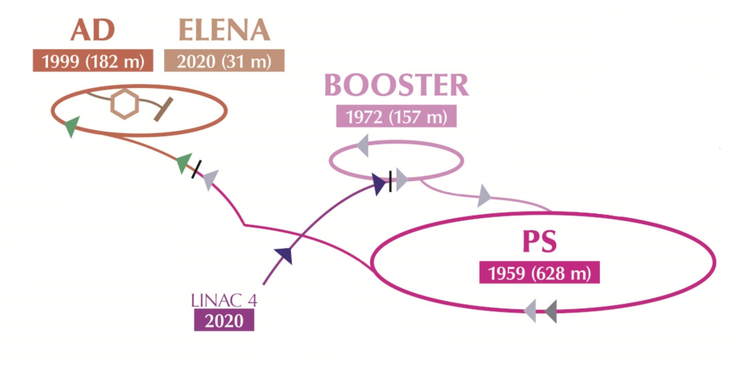
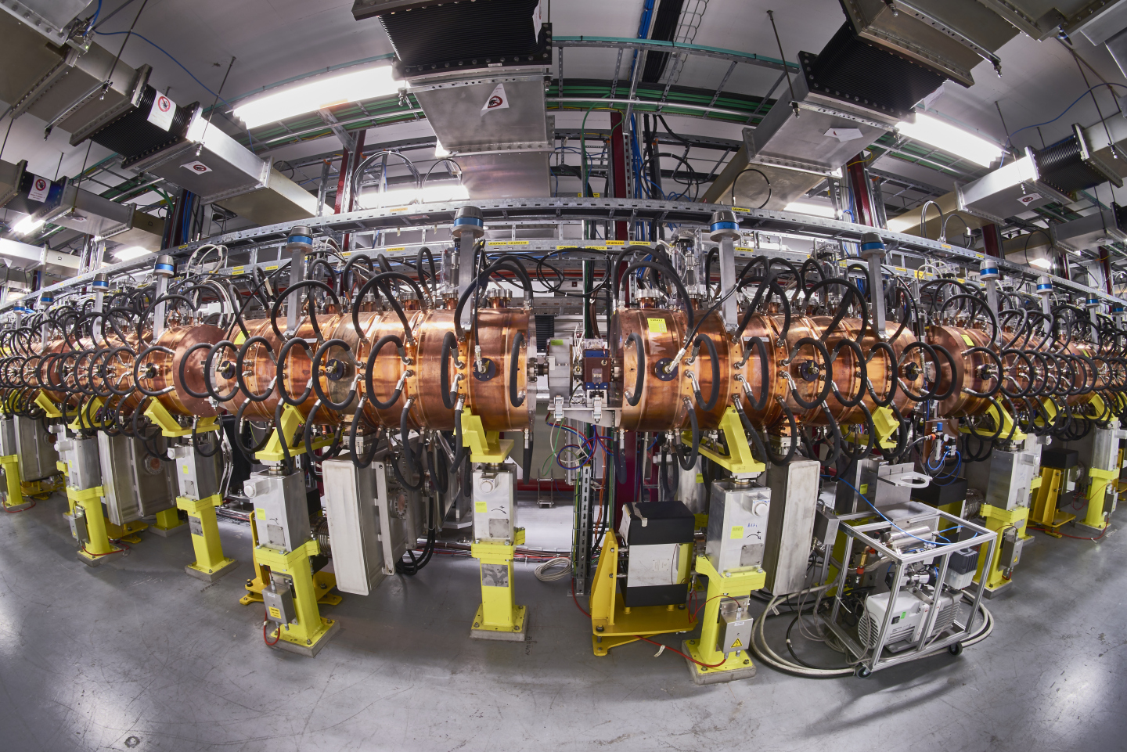
Ch. 2: Journey to the Antimatter Factory

Slide 20
Ch. 2: Journey to the Antimatter Factory
THE LINEAR ACCELERATOR 4
Accelerates negative hydrogen ions (H-);
Conductors behind them push, conductors in front of them pull;
During injection to the Booster, they are stripped of their two electrons to leave only protons;
https://www.jinr.ru/posts/a-brand-new-linear-accelerator-for-cern/

Slide 21
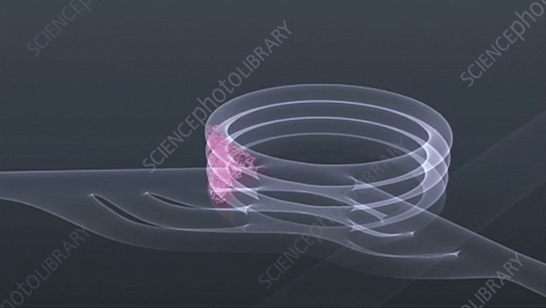
Ch. 2: Journey to the Antimatter Factory

Slide 22
Ch. 2: Journey to the Antimatter Factory
Made of four synchotron rings;
Receives protons at 160 MeV, accelerates them at 2 GeV and squeezez them together;
Allows the PS to accept 100 times more protons.
https://www.sciencephoto.com/media/410785/view/proton-synchrotron-booster-cern
THE PROTON SYNCOTHRON BOOSTER

Slide 23
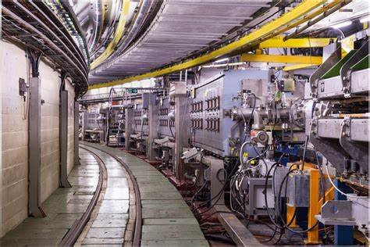
Ch. 2: Journey to the Antimatter Factory

Slide 24
Ch. 2: Journey to the Antimatter Factory
THE PROTON SYNCHROTRON
Accelerates protons to 26 Gev;
Sends the accelerated protons to:
  East Area;
  n_TOF;
  SPS;
  AD;
https://home.cern/science/accelerators/proton-synchrotron

Slide 25
Ch. 2: Journey to the Antimatter Factory

Slide 26

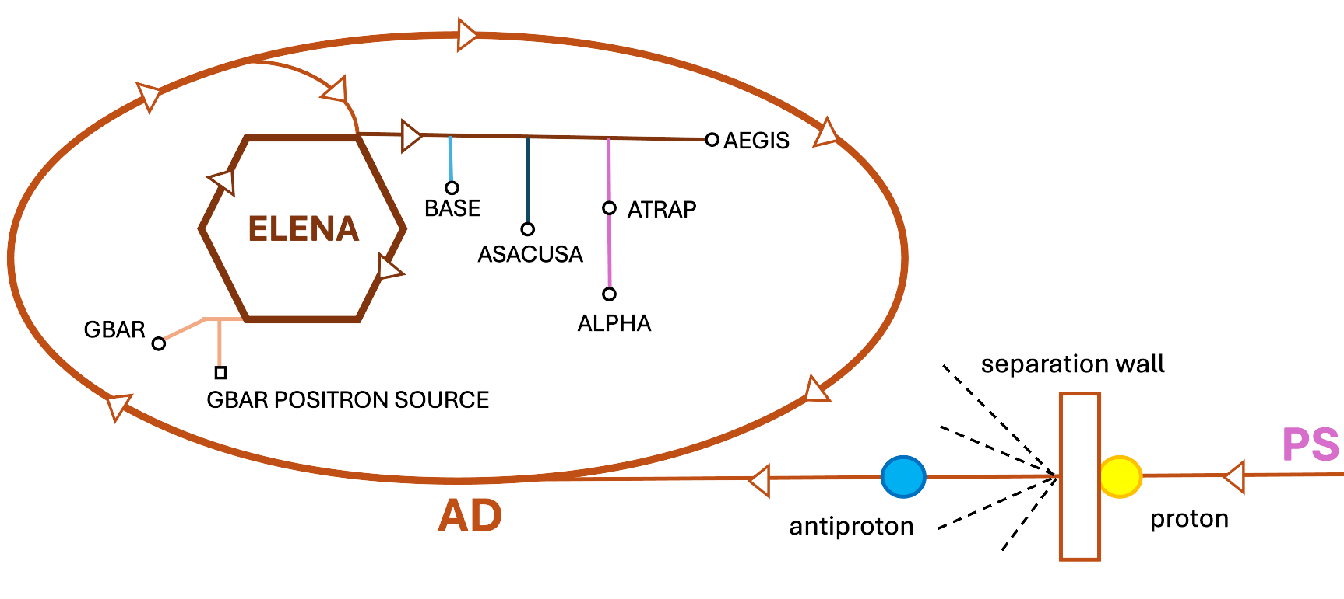
Ch. 3: The Antimatter Factory - Deceleration
THE ANTIMATTER FACTORY

Slide 27
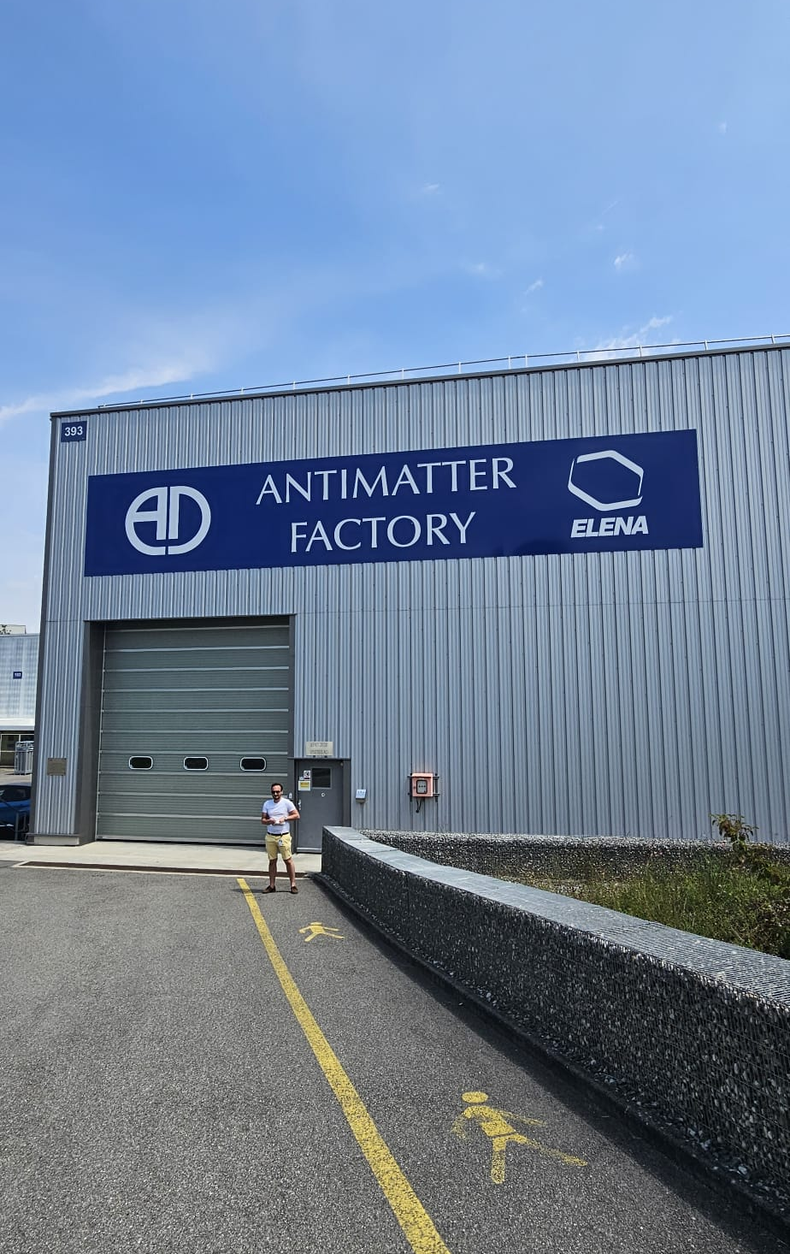


Ch. 3: The Antimatter Factory - Deceleration
INTO THE ANTIMATTER FACTORY!!
The proton beam is fired into a metal wall;
These collisions create secondary particles, including antiprotons;
Antiprotons are separated from the other particles and focused using a different charge magnetic field;
Problems:
  Too much energy to be bound;
  Different energies and random movement.

Slide 28
Ch. 3: The Antimatter Factory - Deceleration
INTO THE ANTIMATTER FACTORY!!
The proton beam is fired into a metal wall;
These collisions create secondary particles, including antiprotons;
Antiprotons are separated from the other particles and focused using a different charge magnetic field;
Problems:
  Too much energy to be bound;
  Different energies and random movement.

Slide 29

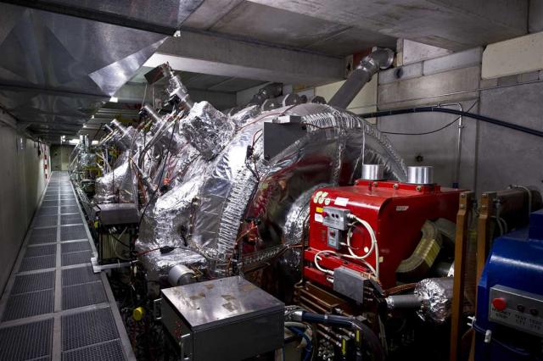
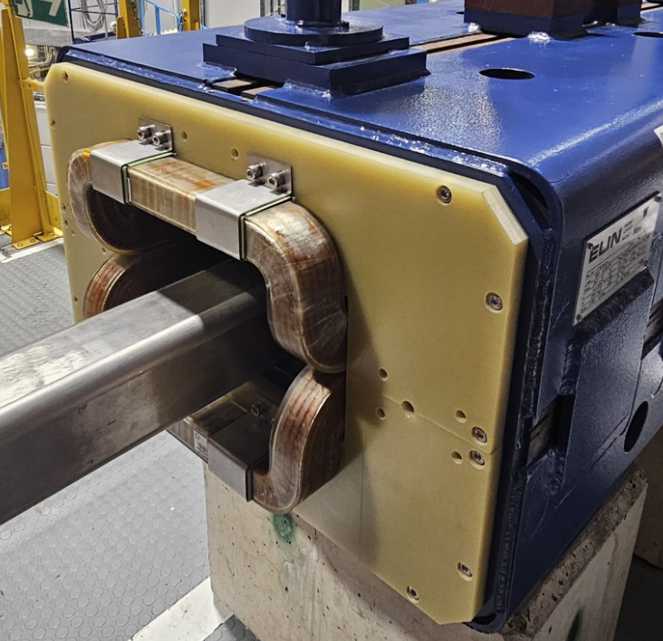
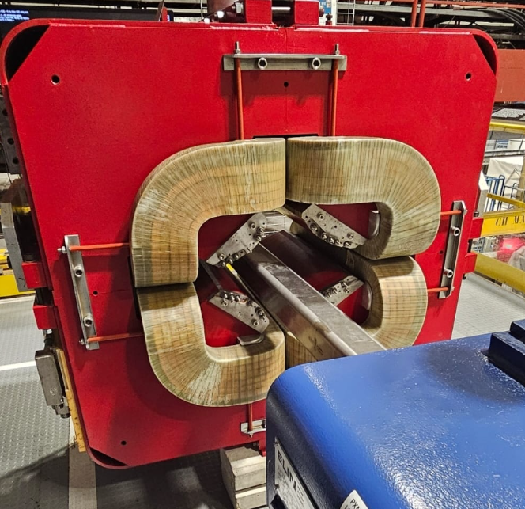
Ch. 3: The Antimatter Factory - Deceleration
THE ANTIPROTON DEACCELERATOR
The AD tames these particles into a low-energy beam that can be used to produce antimatter.
Composed of two magnets:
The magnets keep the antiprotons on the same track, while slowing them down to around a tenth of the speed of light with strong electric fields.
dipole magnets
Bends the beam
quadrupole magnets
Focuses the beam
https://home.cern/science/accelerators/antiproton-decelerator

Slide 30

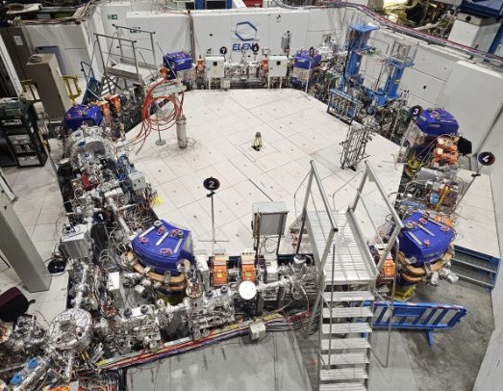
Ch. 3: The Antimatter Factory - Deceleration
EXTRA LOW ENERGY ANTIPROTONS
ELENA slows the antiprotons even more, reducing the energy from 5.3 Mev to 0.1 MeV.
The two magnet systems are also present here;
An electron cooling system also increases the beam density;
The antiproton trapper efficiency increases by a factor of 10 to 100.

Slide 31
Ch. 4: The Antimatter Factory - Experiments

Slide 32


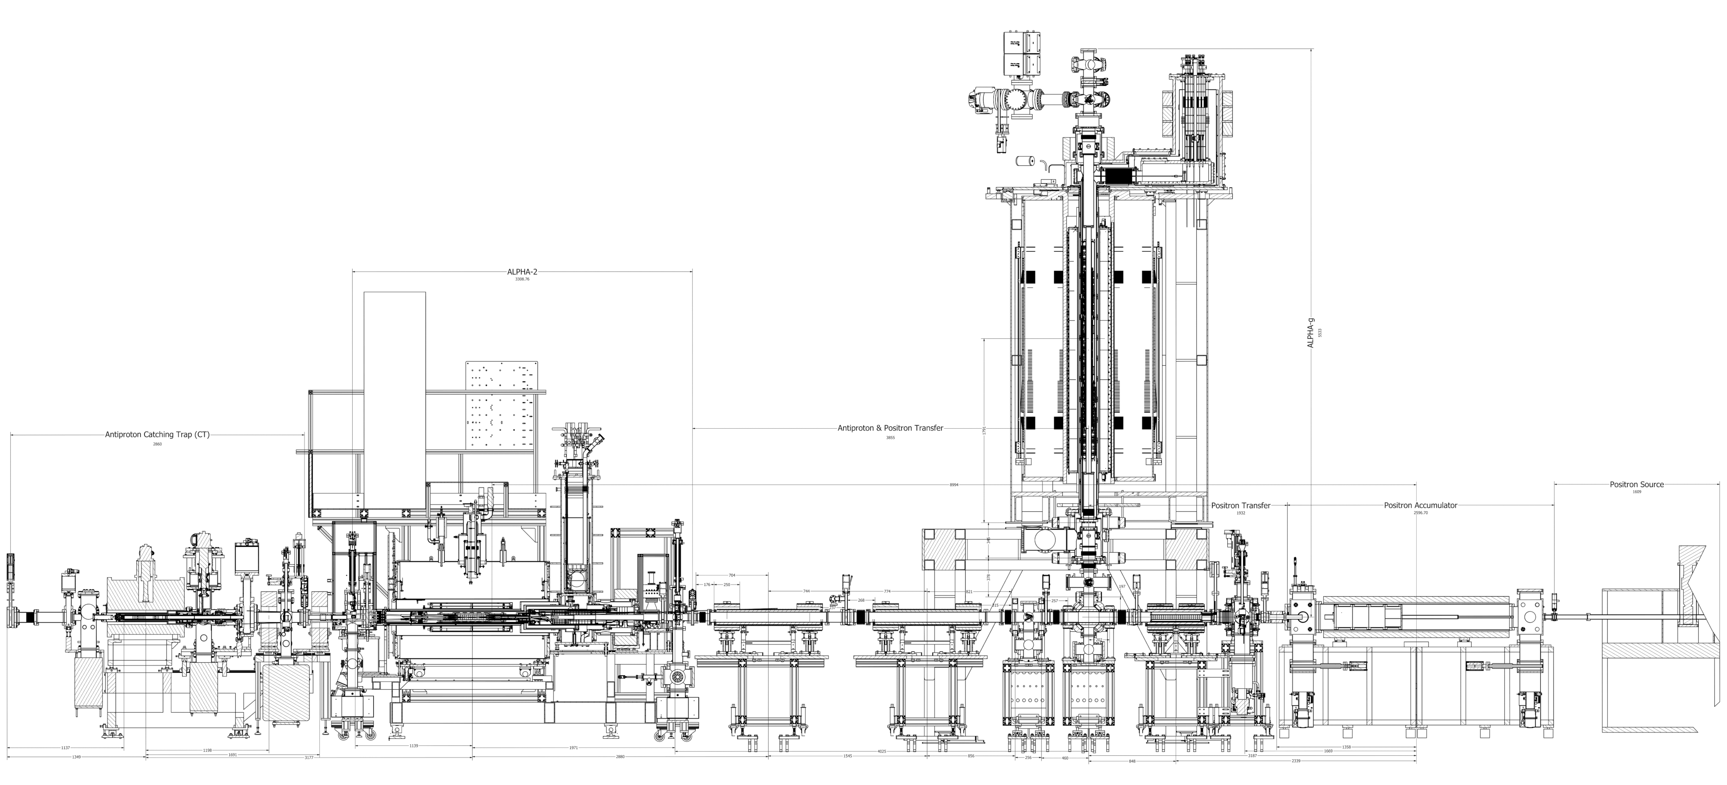
Ch. 4: The Antimatter Factory - Experiments
ANTIHYDROGEN LASER PHYSICS APPARATUS
Alpha works with trapped antihydrogen and hydrogen atoms by comparing them. These experiments study fundamental symmetries between matter and antimatter.
In the case of the ALPHA-g, we are studying how gravity affects antihydrogen compared
to hydrogen.
Atom Trap
antiproton
positron
https://alpha.web.cern.ch/experimental-cycle

Slide 33
Ch. 4: The Antimatter Factory - Experiments
ANTIHYDROGEN LASER PHYSICS APPARATUS
Alpha works with trapped antihydrogen and hydrogen atoms by comparing them. These experiments study fundamental symmetries between matter and antimatter.
In the case of the ALPHA-g, we are studying how gravity affects antihydrogen compared
to hydrogen.
Atom Trap
antiproton
positron
https://alpha.web.cern.ch/experimental-cycle

Slide 34
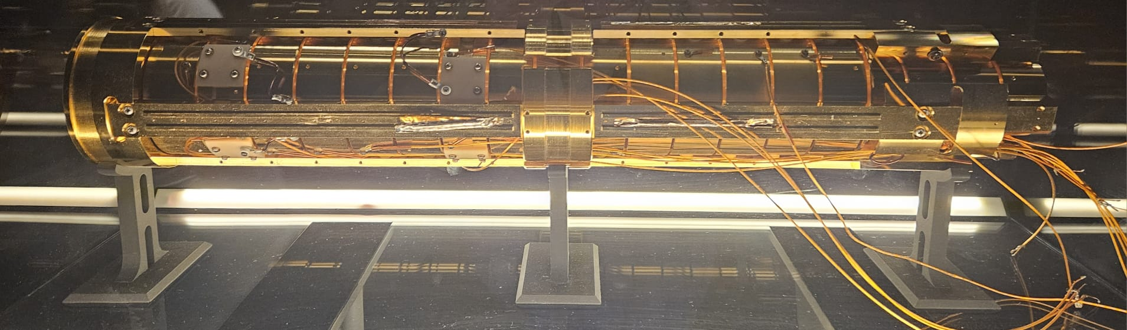
Ch. 4: The Antimatter Factory - Experiments
TRAPPING ANTIMATTER
For antiprotons, they are trapped between two negative potentials of the electrodes. Magnets also generate a magnetic fields to keep the antiprotons in a spiral trap.
For antihydrogen, even with no electrical charges, we can use its magnetic properties to trap it with very powerful magnetic fields.
In 2021, an experiment succeeded in storing antihydrogen atoms for 16 minutes.
Most antihydrogen atoms escape and get annyhilated, so the process is repeated many times.

Slide 35
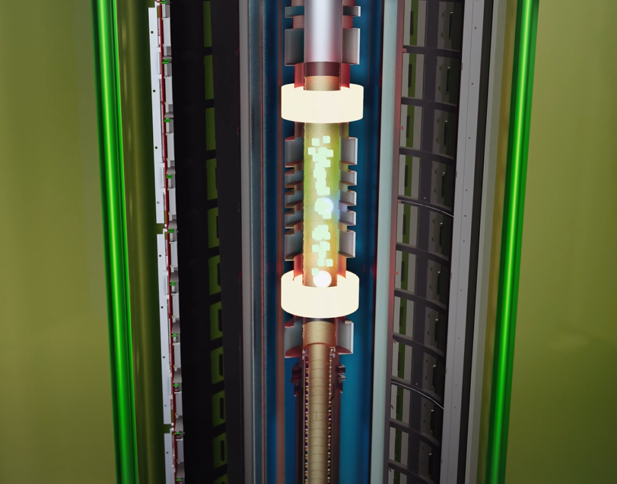
Ch. 4: The Antimatter Factory - Experiments
CONDUCTING THE EXPERIMENT
The two barriers in the top and bottom are slowly opened;
Their path will be determined by the point of annihilation (light detection);
This experiment proves that the antihydrogen behavior is consistent with the behavior of the hydrogen atoms under the same conditions.
https://www.youtube.com/watch?v=prhmw9CavR0

Slide 36
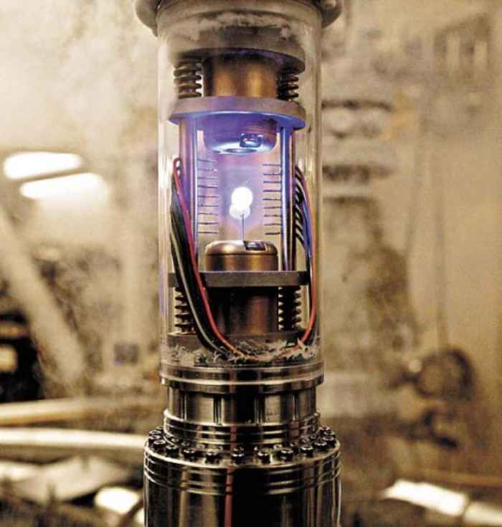
In conclusion
Antimatter is an exotic, mysterious doppelganger of matter, that anihilates violently in contact with regular matter
Matter and antimatter should have been created in equal amounts at the big bang, but now matter dominates the universe
Antimatter research is crucial in bettering our understanding of the origin of the universe and has potential future aplications
Matter-Antimatter coliders are superior to regular coliders, their only drawback being obtaining the antimatter
Banana antimatter mining is maybe not a profitable business avenue

Slide 37
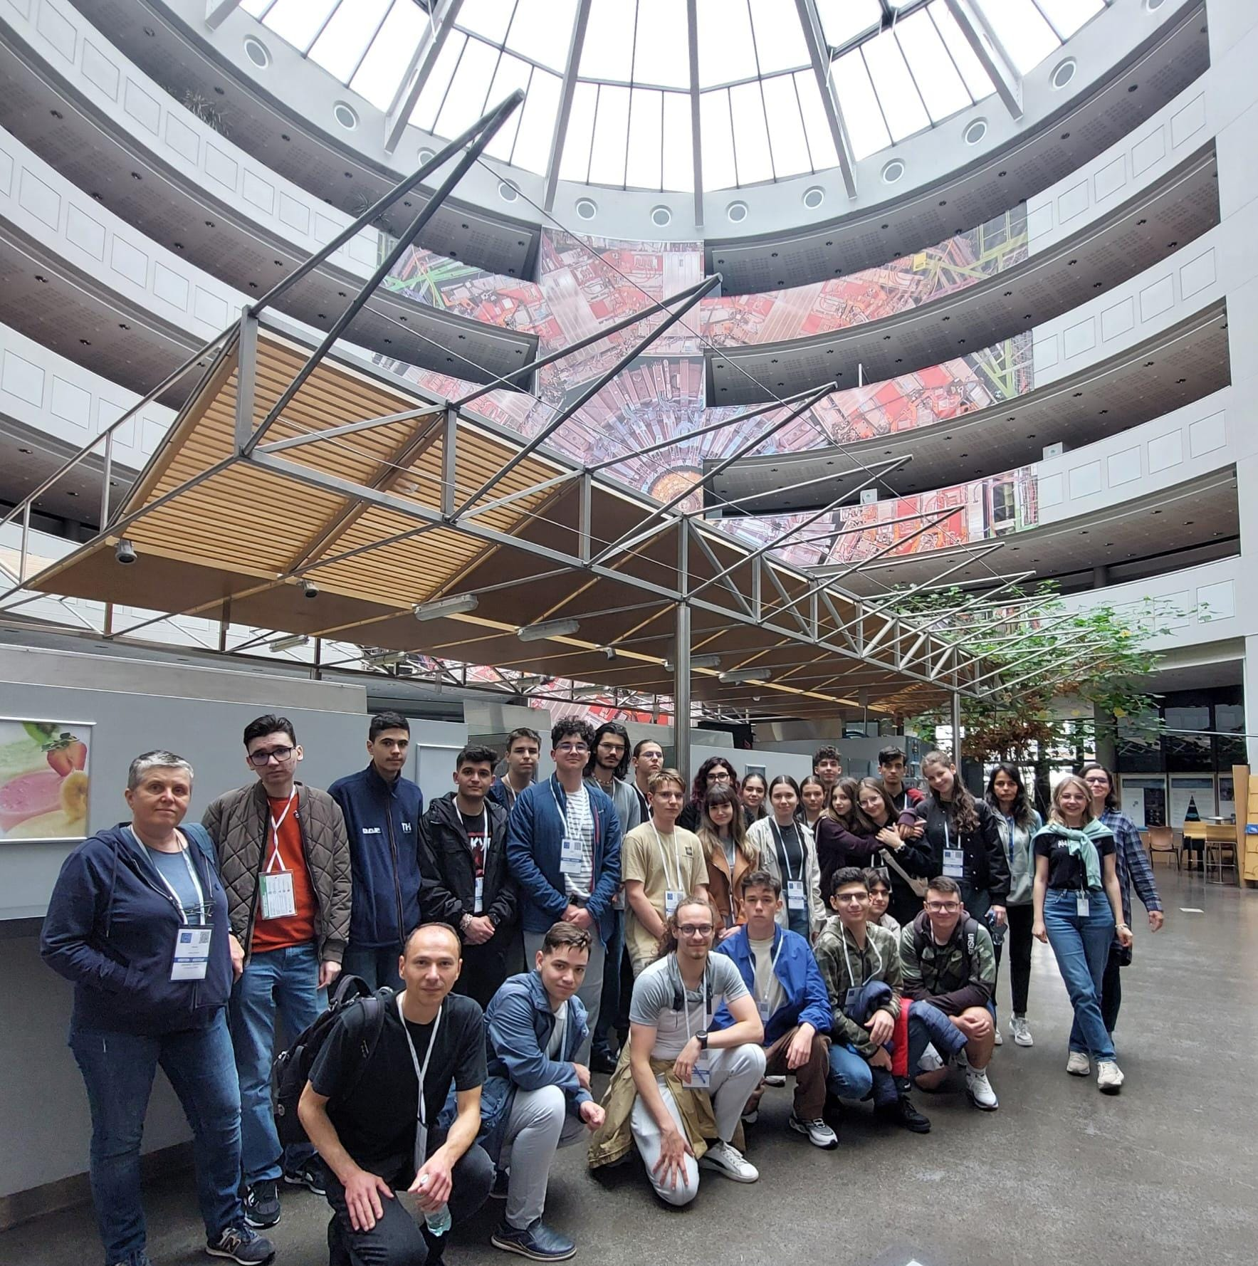

THANK YOU FOR YOUR ATENTION!
AND THANK YOU FOR THE AMAZING MEMORIES!<3

Slide 38

References
Antimatter | CERN (home.cern)
New clues to why there’s so little antimatter in the universe | MIT News | Massachusetts Institute of Technology
Fermilab | Science | Inquiring Minds | Questions About Physics (fnal.gov)
Storing antihydrogen | CERN (home.cern)
Antimatter-Frank Close
https://www.youtube.com/watch?v=wX9UbhEK_bM
https://blog.richmond.edu/heroes/tag/sherlock-holmes-hero/
https://www.pngplay.com/fr/image/tag/energy
https://forum.philosophynow.org/viewtopic.php?t=41591&start=45
The first evidence for CP violation in a specific charm hadron decay (cern.ch)
https://knovhov.com/most-dangerous-and-expensive-thing-in-the-world/

