Slide 1
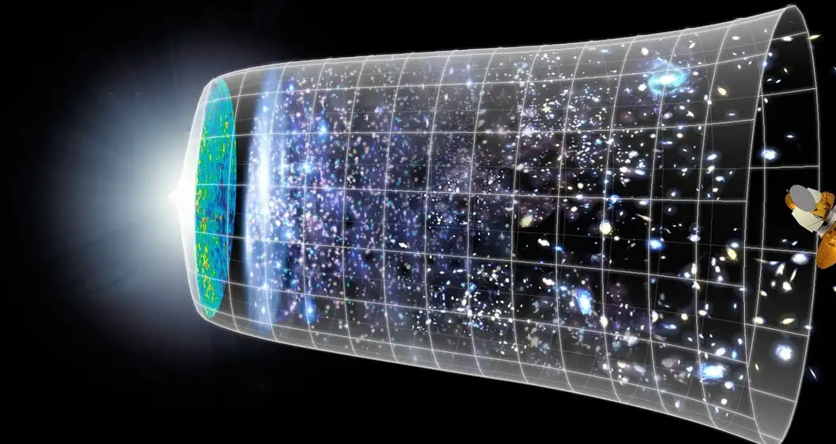

Cosmallogy
Boldureanu Andreea
Bratan Maia

Slide 2

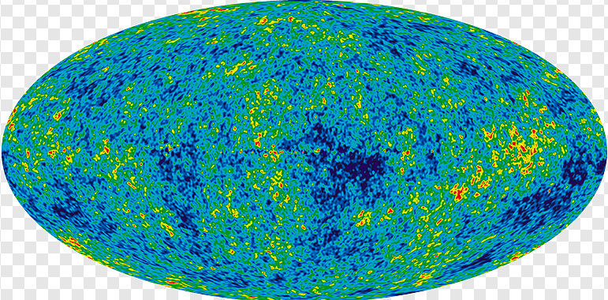
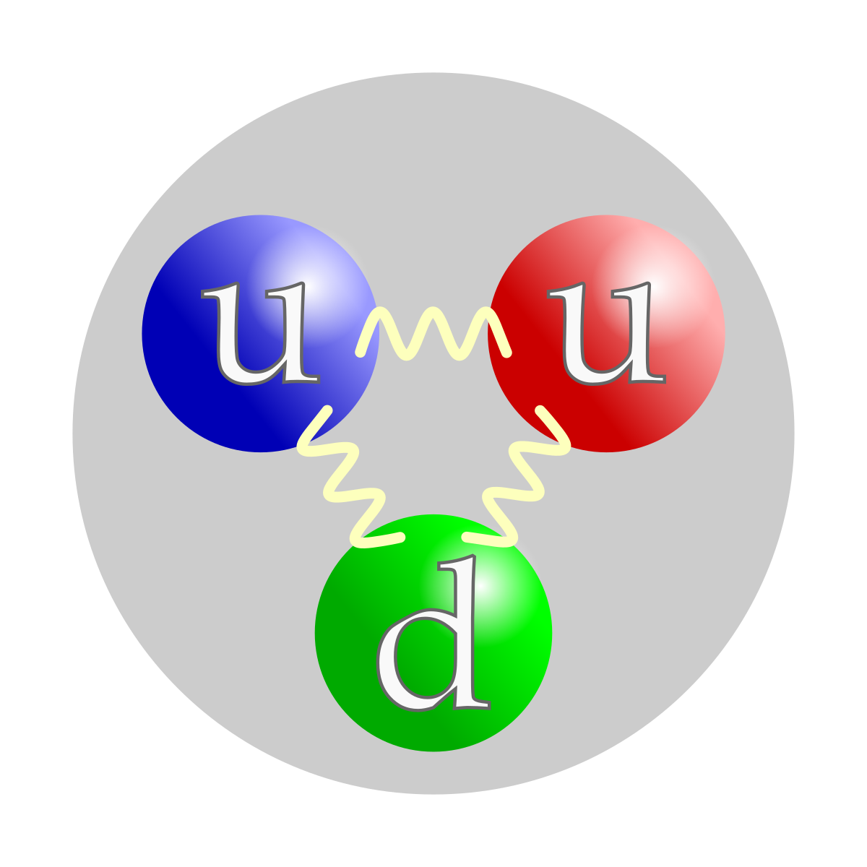

Slide 3
Main connections between cosmology & particle physics
01
02
The early universe
ΛCDM
model
Cosmic Microwave Background
03
04
CERN EXPERIMENTS

Slide 4
1
The Early universe

Slide 5
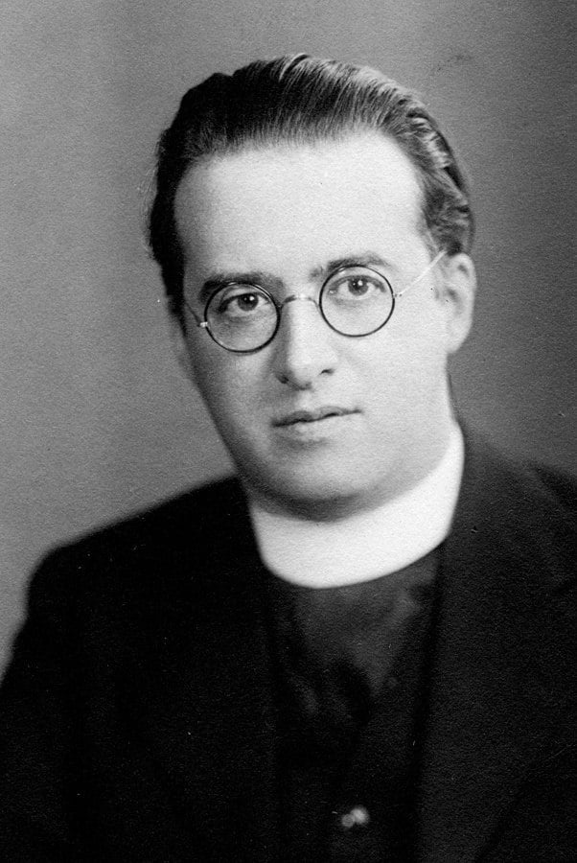
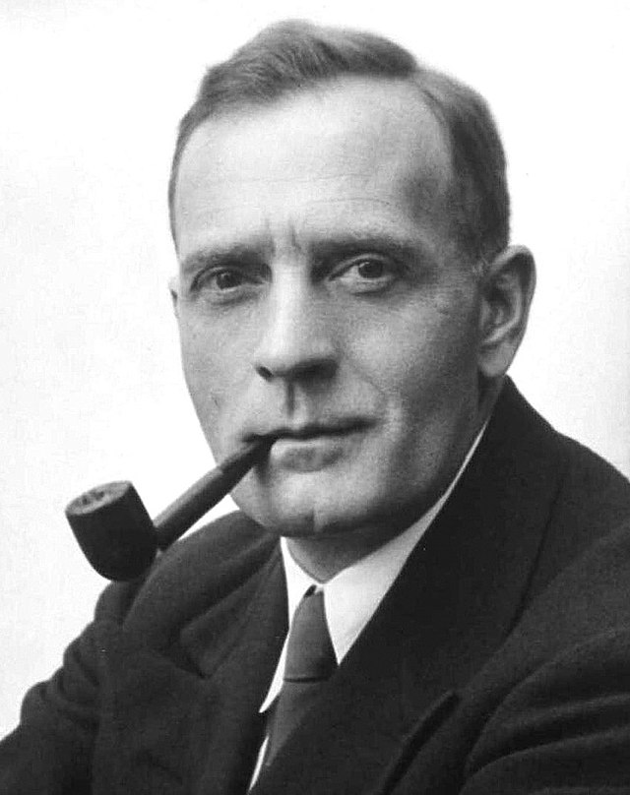
Georges Lemaître
1927
Hypothesis of the Primeval Atom
Edwin Hubble

Slide 6
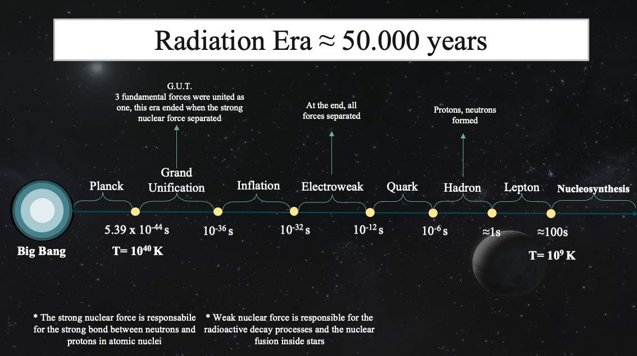
Source:
Author's own graph

Slide 7
I. particle behavior in the epochs
I. ELECTROWEAK
Quark-gluon plasma
Large numbers of exotic particles (W, Z, Higgs Bosons)
II. between electroweak-quark
Baryogenesis (baryon asymmetry problem—- quarks dominate)
III. QUARK
Quarks, electrons, neutrinos form
Quarks not bound in Hadrons!
IV. Hadron
Protons, neutrons formed

Slide 8
I. particle behavior in the epochs
V. LEPTON
Leptogenesis (dominance of leptons over anti-leptons)
VI. nuclear
Atomic nuclei formed
Energy dominated by photons

Slide 9
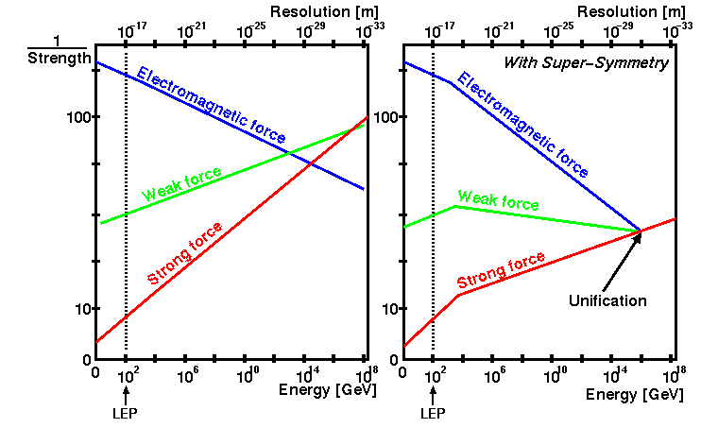
II. FUNDAMENTAL FORCES
Figure 1: Strength reciprocal vs. energy graph not taking into account SUSY (left) and taking it (right)
Source: CERN, „Particle Physics Education CD-ROM,” 1999.

Slide 10
2
ΛCDM
model

Slide 11

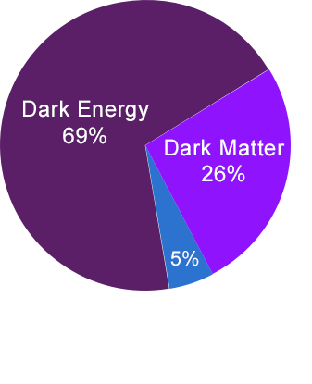
What are these particles?
How do they work?
Figure 2: Content of the universe
Source: https://chandra.harvard.edu/darkuniverse/

Slide 12
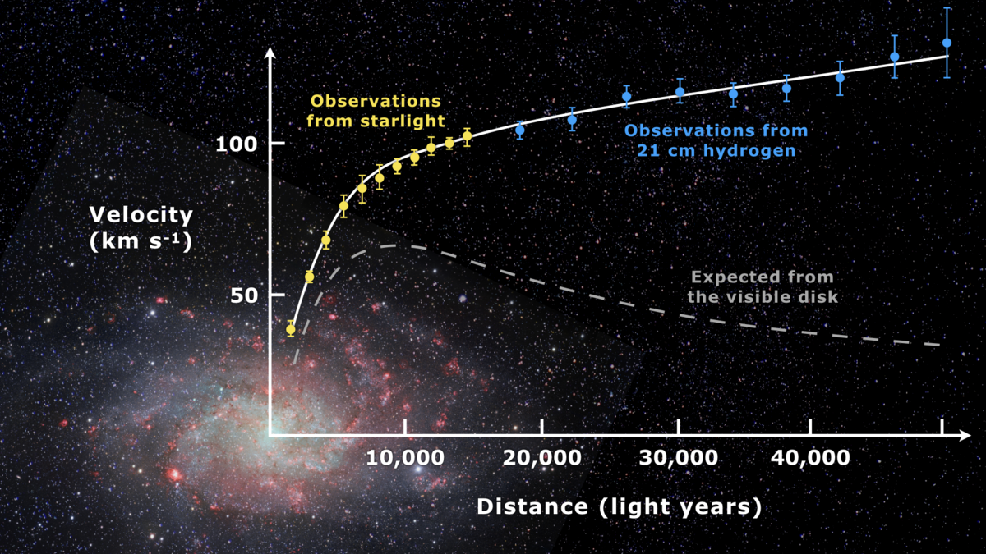
Figure 3: Observed vs expected galaxy velocities Source:https://commons.wikimedia.org/wiki/File:Rotation_curve_of_spiral_galaxy_Messier_33_(Triangulum).png

Slide 13
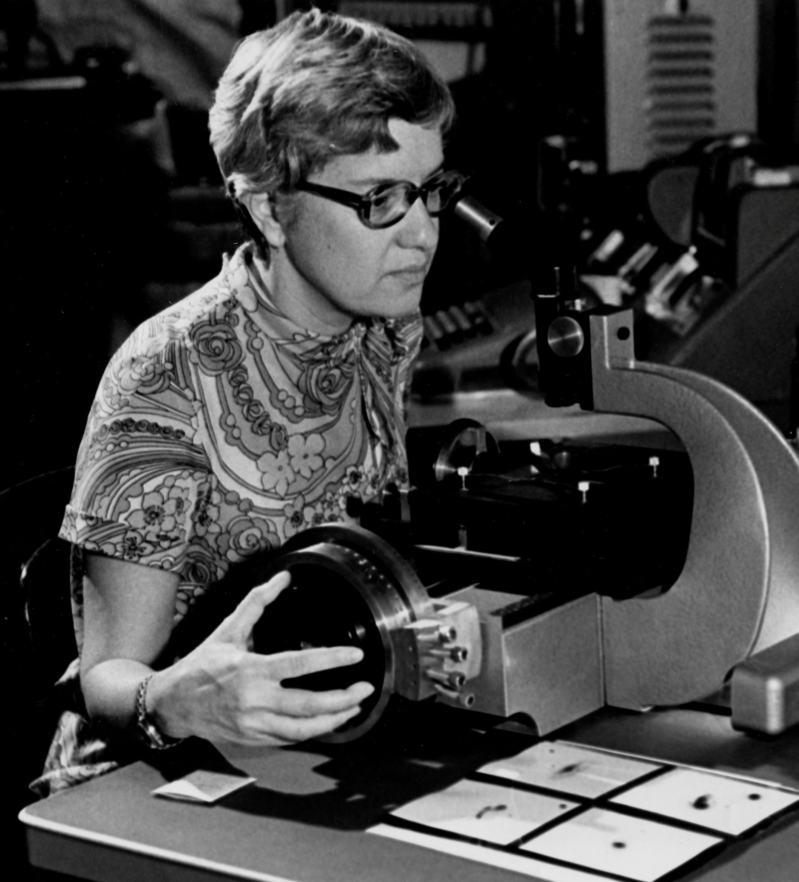
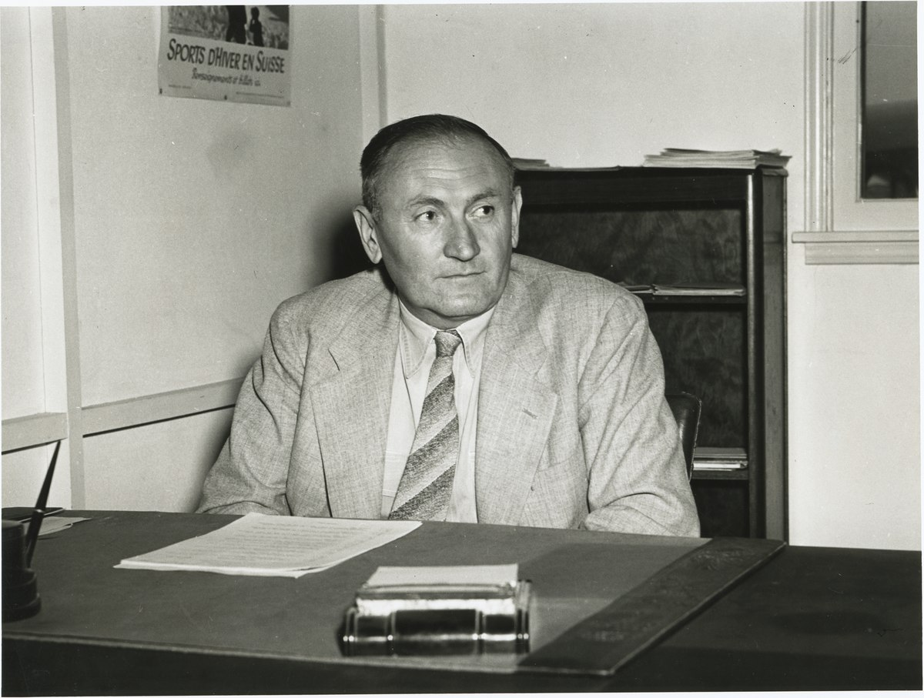
Vera Rubin
Fritz Zwicki

Slide 14
Possible candidates
WIMPs
Axions
Sterile Neutrinos
DARK MATTER
I.
(Weakly interacting massive particle)
II.
III.

Slide 15
The WIMPs
Heavy, electromagnetically neutral subatomic particle that is hypothesized to make up most dark matter and therefore some 22% of the universe
Characteristics:
They don’t absorb/emit light
They don’t interact strongly with other particles

Slide 16
AXIONS
Axions are another well-motivated dark matter candidate. They were proposed to resolve the strong CP problem.
Characteristics:
No electric charge
Very small mass
Very low interaction for strong and weak forces

Slide 17
CP Problem
PARTICLE
C
CHARGE CONJUGATION SYMMETRY
ANTIPARTICLE
+
P
PARITY SYMMETRY
-
Source:
Author's own graph

Slide 18
Sterile
neutrinos
A special kind of neutrino that has been proposed to explain some unexpected experimental results, but they have not been definitively discovered. Scientists are looking hard for them in many different experiments.
Characteristics:
No electric charge
Very small mass
Very low interaction for strong and weak forces

Slide 19
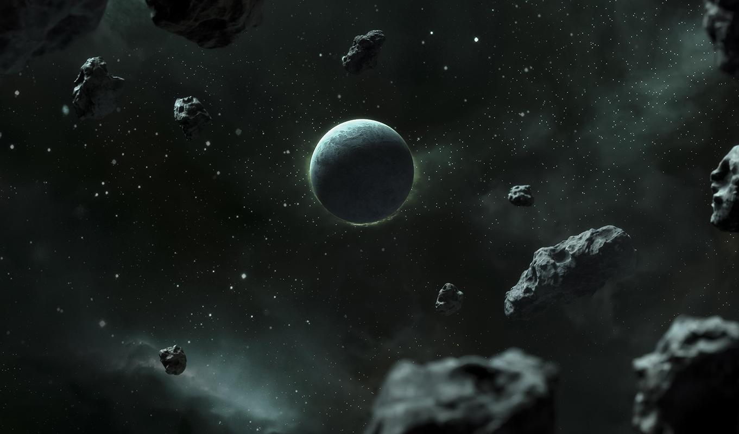
QUINTESSENCE
EXPANSION OF THE UNIVERSE

Slide 20
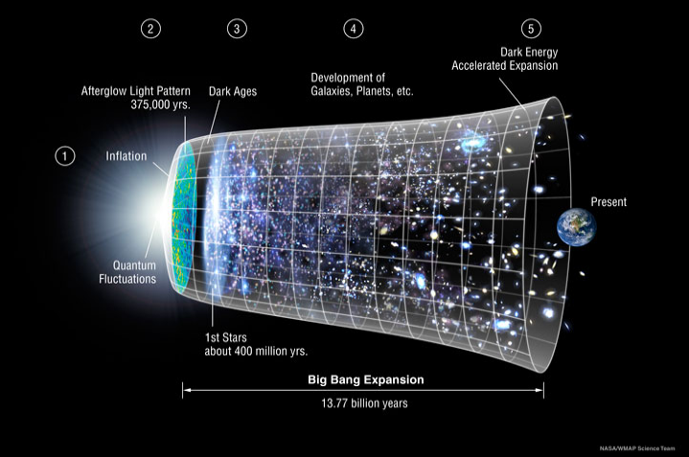
ΛCDM Model of Cosmology
This model proposes specifically cold matter, such as:
Non - baryonic
Cold
Dissipationless
Collisionless
Figure 4: Big Bang Expansion
https://lambda.gsfc.nasa.gov/education/graphic_history/univ_evol.html

Slide 21
3
Cosmic
microwave background

Slide 22
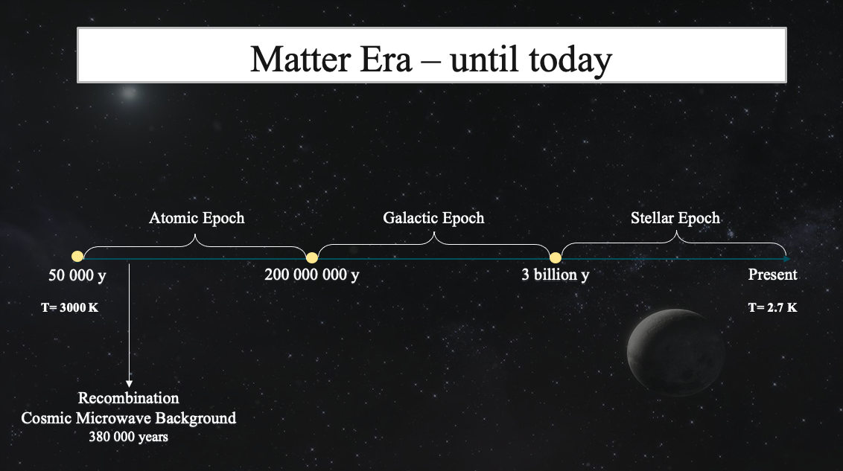
Source:
Author's own graph

Slide 23
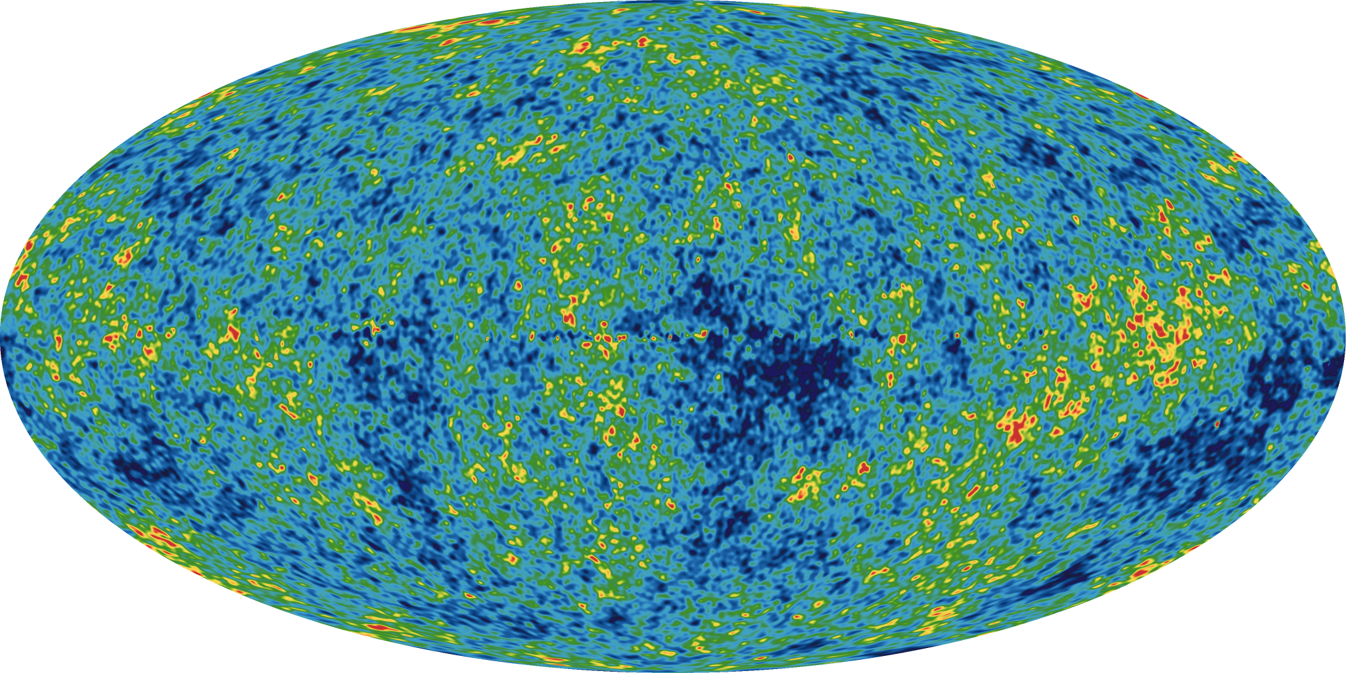
COSMIC MICROWAVE BACKGROUND
Isotropic photon background with a blackbody spectrum (T=2.725 K)
Before recombination: hot, dense plasma of particles (photons scattered off , Thomson scattering)
Proves that photons/baryons must have existed in a highly interacting thermal state
Small irregularities: Random quantum fluctuations before recombination
Figure 5: Cosmic Microwave Background (blue spots colder than red spots)
Source: WMAP

Slide 24
4
CERN EXPERIMENTS

Slide 25
I.
LHCb / LHCf
II.
ALICE
III.
Others (ATLAS, CMS, ELENA/AD)

Slide 26
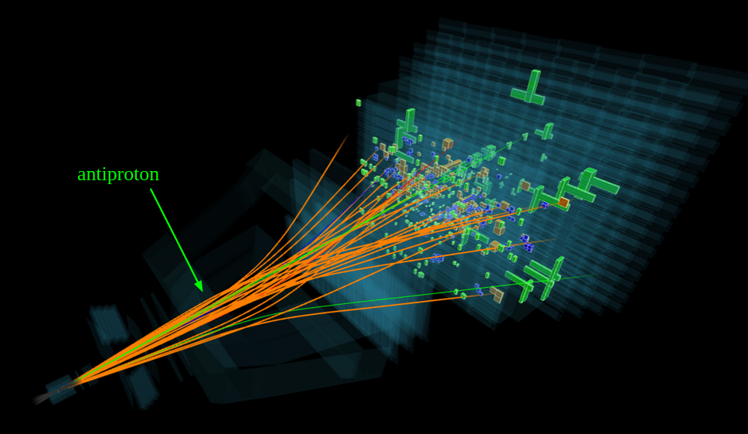
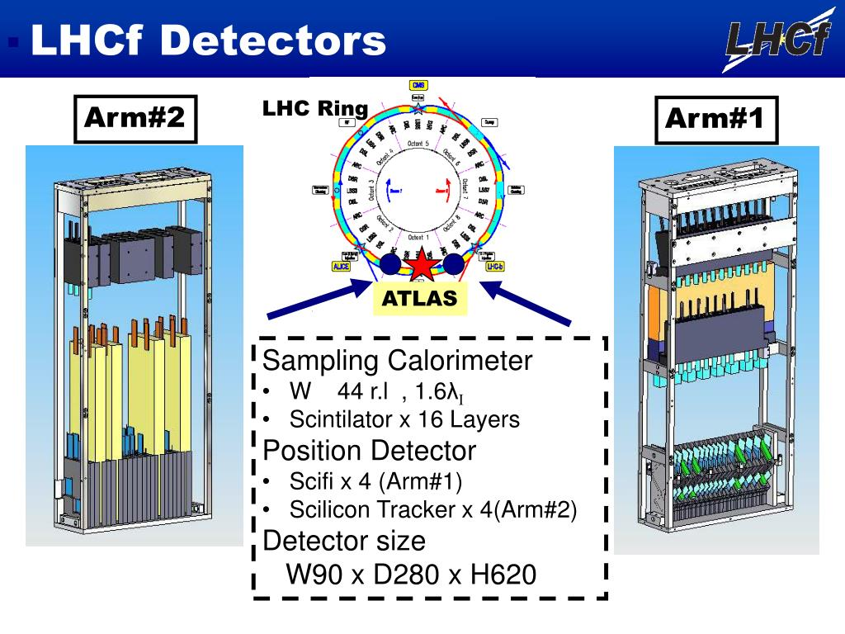
Large Hadron Collider beauty
Large Hadron Collider forward
Figure 6: proton-proton collision at LHCb
https://home.web.cern.ch/news/news/physics/lhcb-reveals-secret-antimatter-creation-cosmic-collisions
Figure 7: LHCf Detectors
https://www.slideserve.com/varick/lhcf-detectors

Slide 27
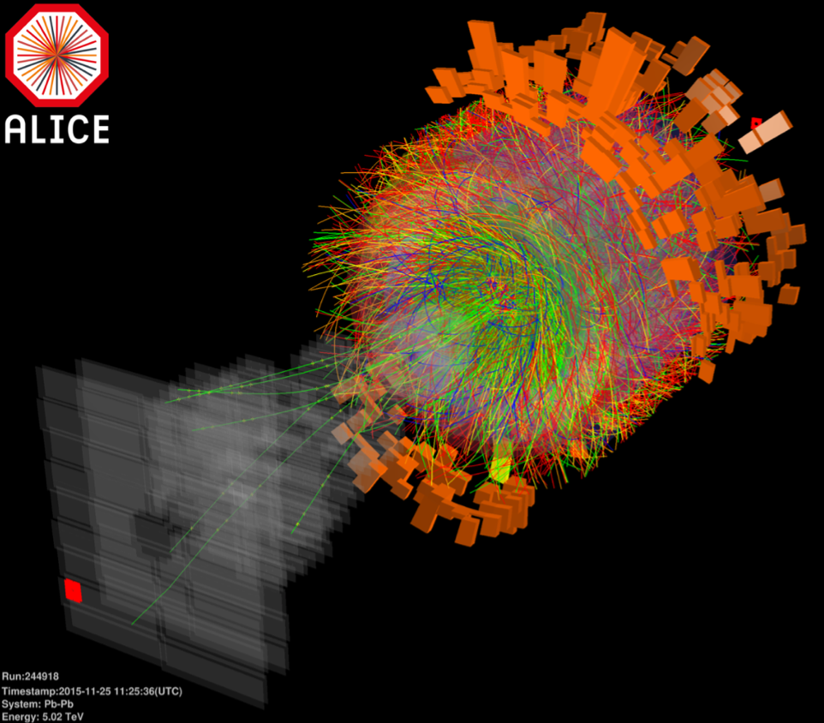
What is the quark-gluon plasma state?
What happens at ALICE?
https://home.cern/news/news/physics/alice-explores-hidden-charm-quark-gluon-plasma

Slide 28
Resources
Aretz, S.; Borowski, A.; Schmeling, S. (2017), "Development and Evaluation of a Construct Map for the Understanding of the Expansion of the Universe". Science Education Review Letters
Auriemma, G. (2014), "LHC, Astrophysics and Cosmology", Acta Polytechnica CTU Proceedings 1(1): 42–48
Bambi, C.; Dolgov, A. (2016), "Introduction to Particle Cosmology", Springer-Verlag Berlin Heidelberg
Bergstrom, L.; Goobar, A. (2004), "Cosmology and Particle Astrophysics", Springer
Pettini, M.; "Introduction to cosmology", Cambridge University
https://cfa.harvard.edu/research/topic/dark-energy-and-dark-matter
https://pages.uoregon.edu/jimbrau/astr123/Notes/Chapter27.html
https://www.osti.gov/servlets/purl/6260191
https://neutrinos.fnal.gov/types/sterile-neutrinos/
https://en.wikipedia.org/wiki/Axion
https://www.astro.caltech.edu/~george/ay20/eaa-wimps-machos.pdf
https://physicsworld.com/a/quintessence/
https://home.web.cern.ch/news/news/physics/lhcb-reveals-secret-antimatter-creation-cosmic-collisions
https://www.slideserve.com/varick/lhcf-detectors
https://www.physicsoftheuniverse.com/topics_bigbang_timeline.html

Slide 29
