Slide 1
The Future of
Particle Accelerators
Rădneanțu Maria, Vizitiu Andrei

Slide 2
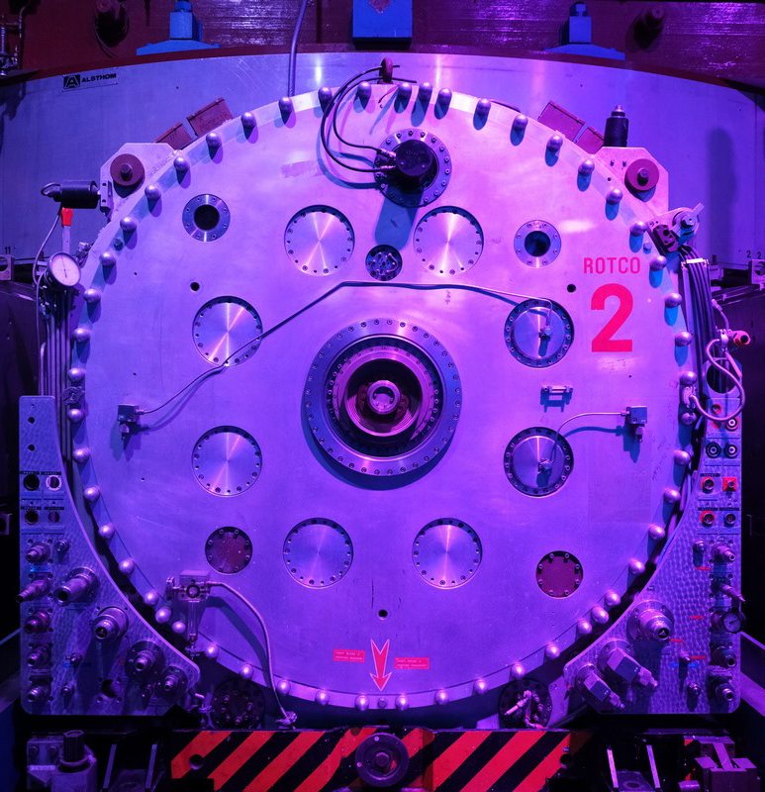
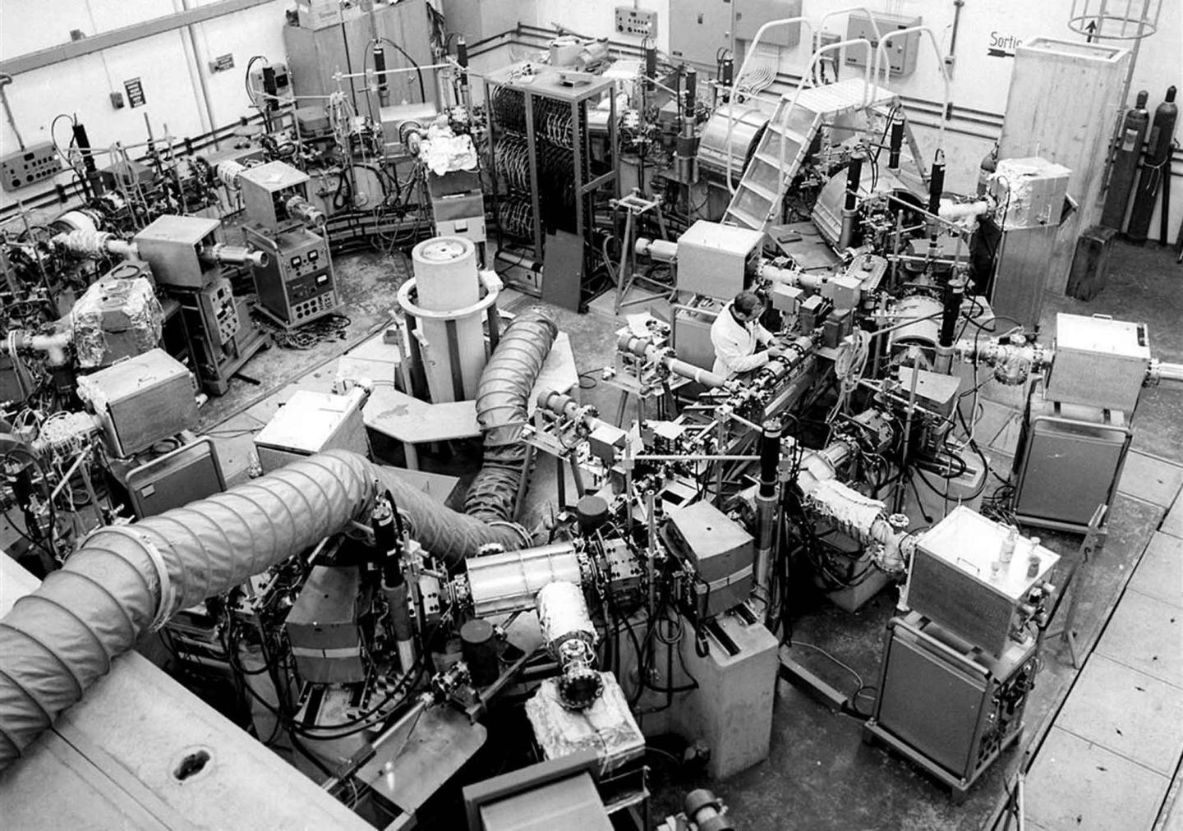
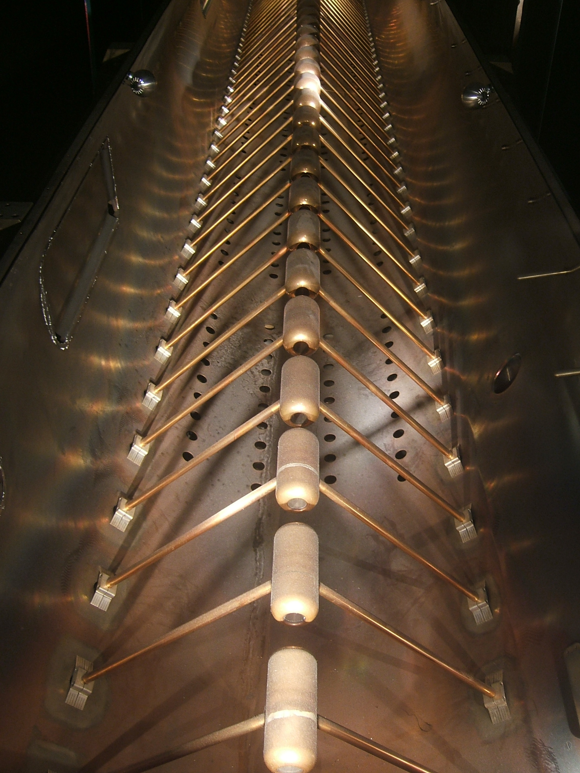
But first… A quick recap

Slide 3
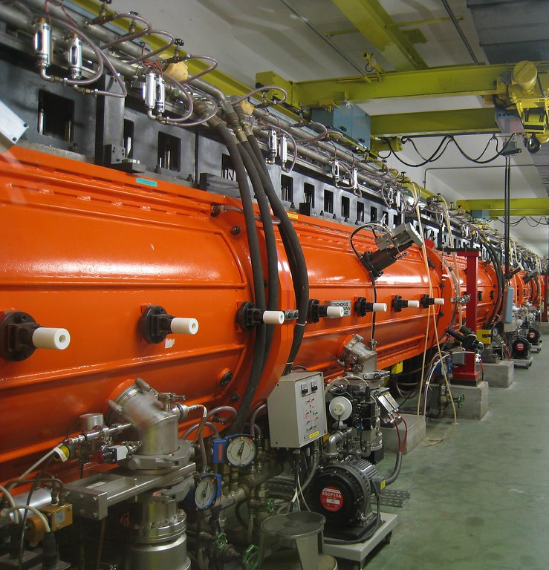
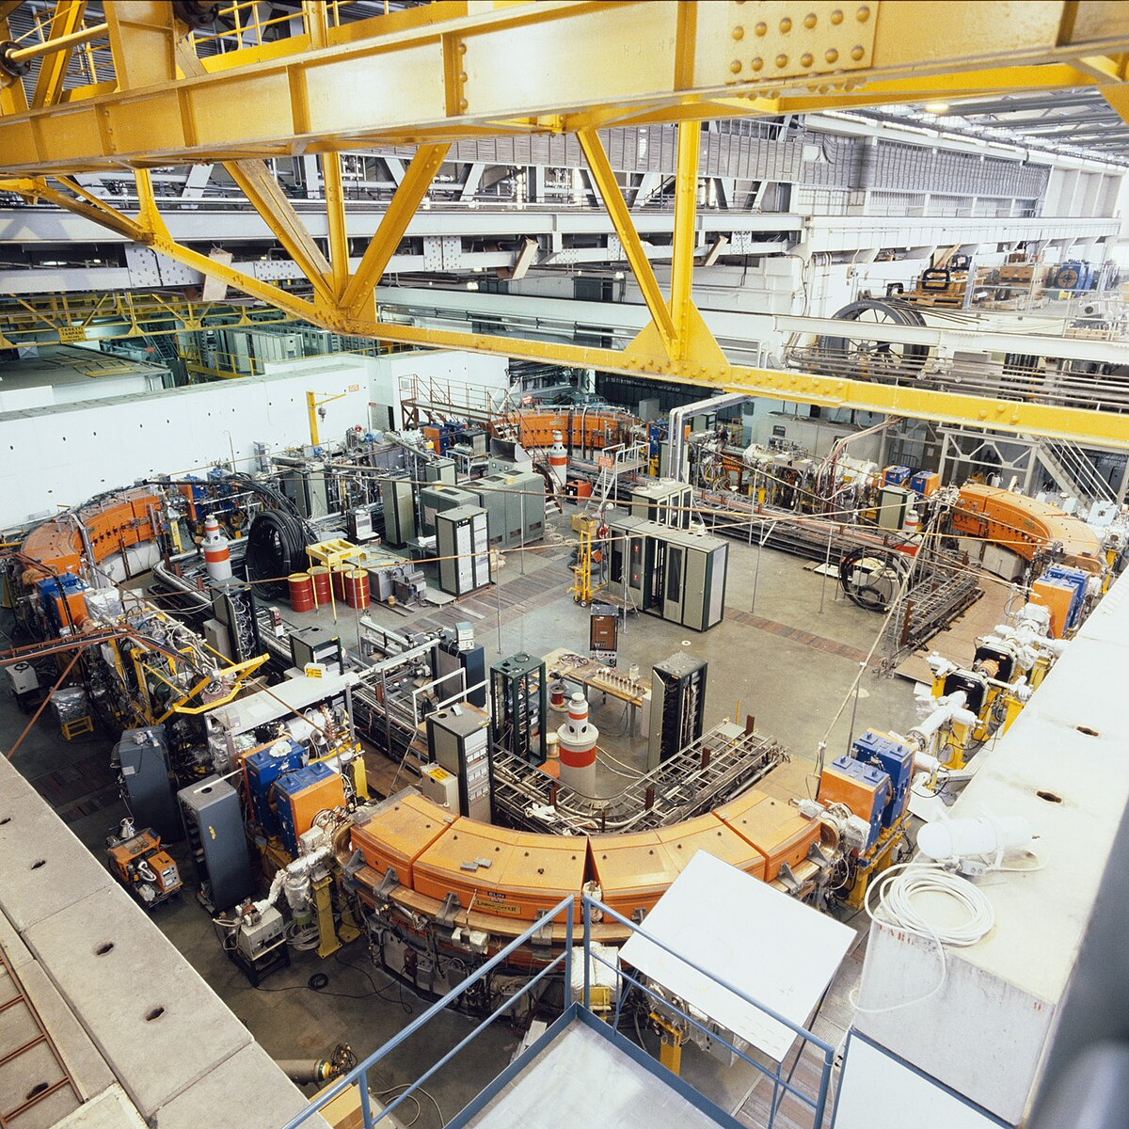
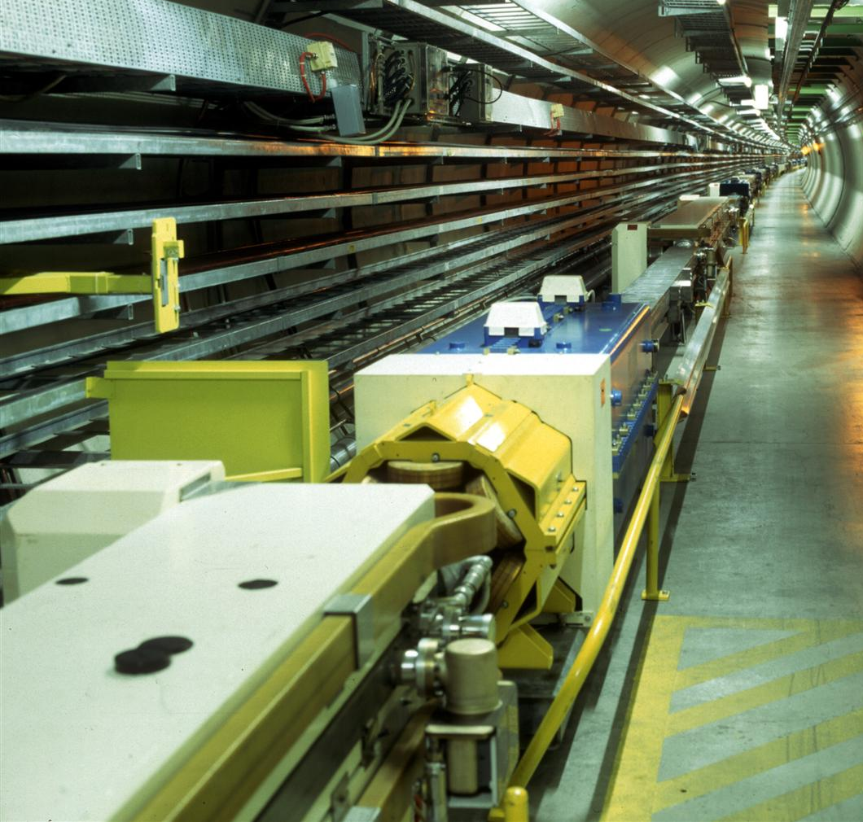
Past accelerators
Synchrocyclotron
Linear Accelerator 1
Intersecting Storage Rings
1957 - 1990
1959 - 1992
1971 - 1984

Slide 4
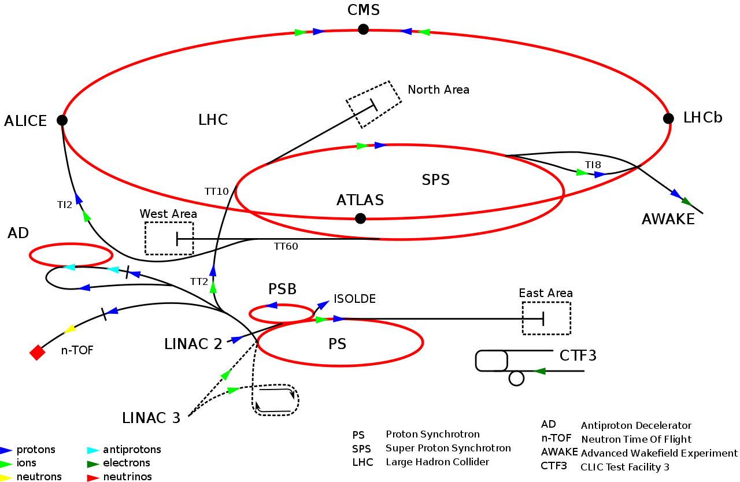
Past accelerators
Linear Accelerator 2
Low Energy Antiproton Ring
Large Electron-Positron Collider
1978 - 2018
1982 - 1996
1989 - 2000

Slide 5
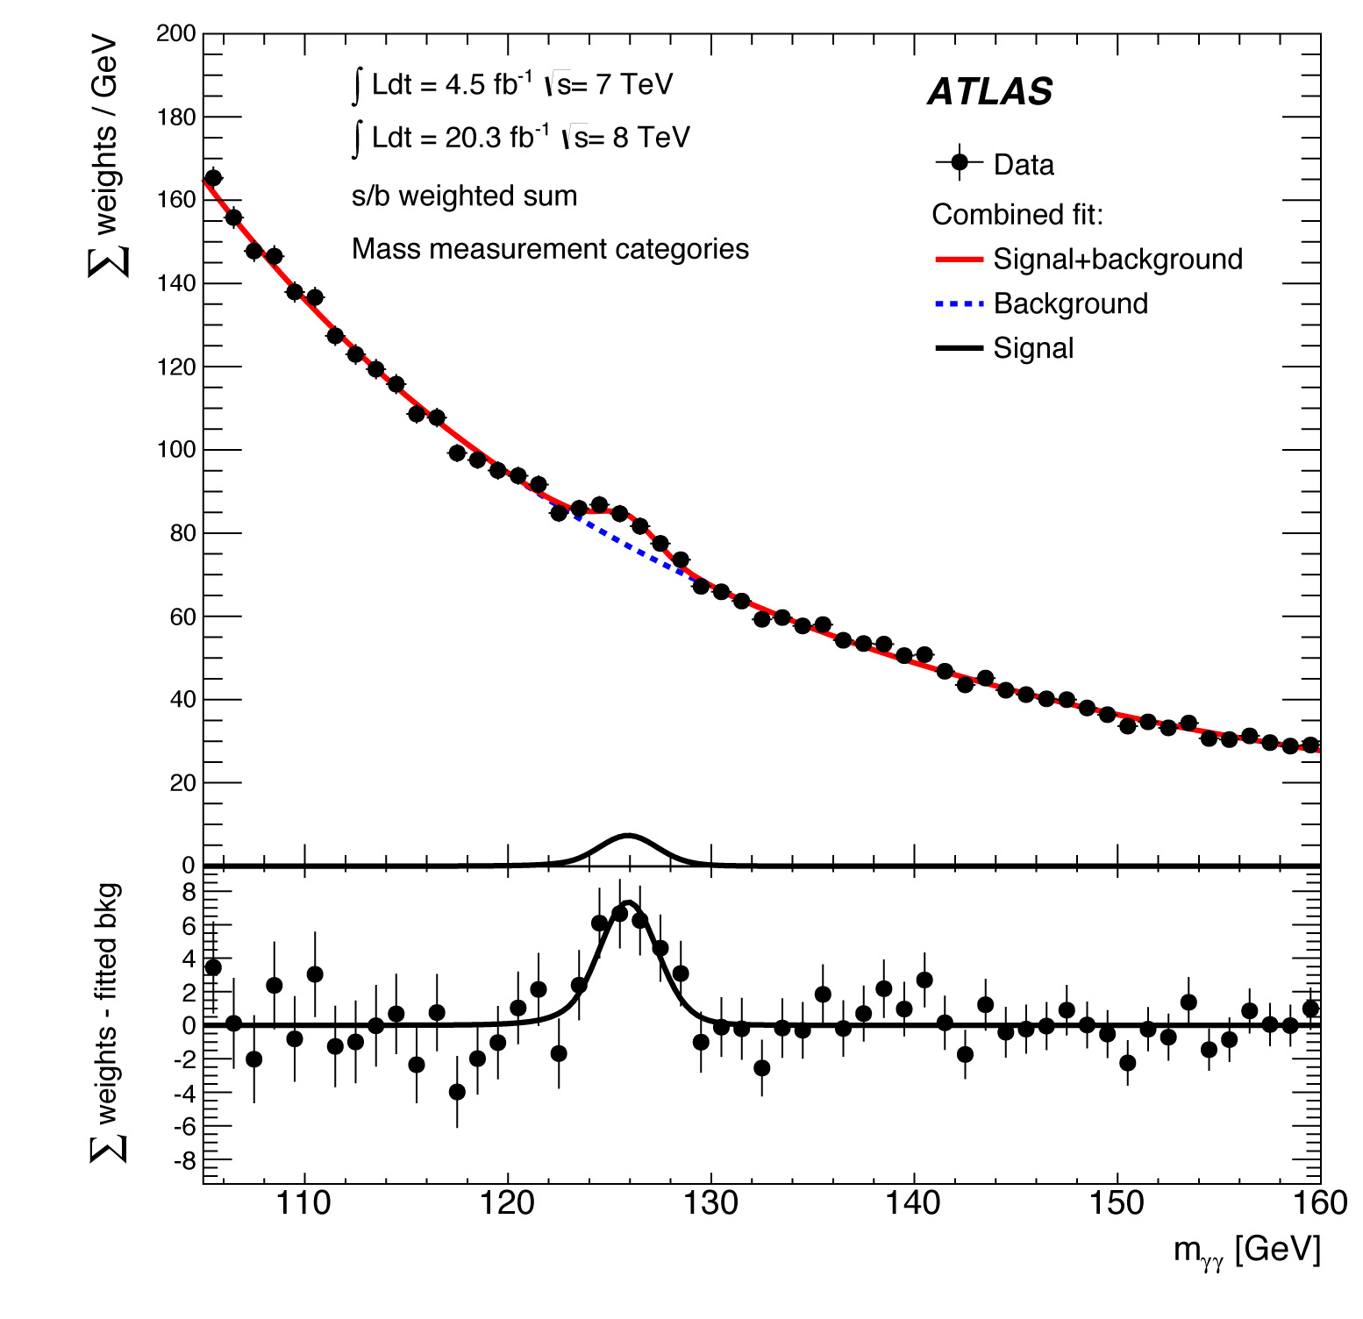
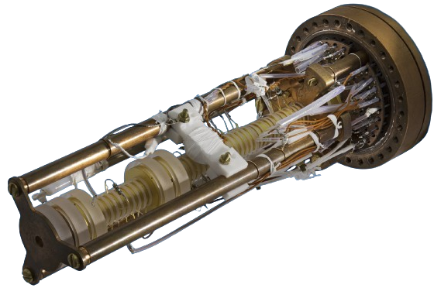
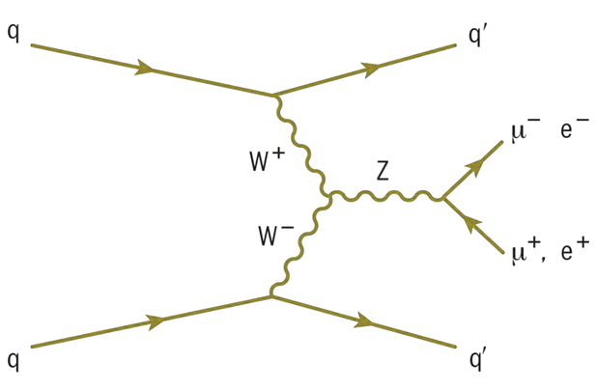
Present accelerators
Large Hadron Collider (LHC)
Super Proton Synchrotron (SPS)
Proton Synchrotron (PS)
LINAC 4
PS Booster
Antiproton Decelerator (AD)
LINAC 3
Low Energy Ion Ring (LEIR)

Slide 6
CERN’s scientific achievements so far:
W and Z bosons – the Super Proton Synchrotron (1983)
The Higgs boson (2012) and exotic hadrons (the tetraquark, the pentaquark) – the LHC
Antimatter research – the Low Energy Antiproton Ring (LEAR), Antiproton Decelerator (AD), ELENA

Slide 7
Future accelerators
Why do we need better accelerators? What is not explained by the SM?
-Discovery of new particles
-Matter/Antimatter asymmetry
-CP violations
-Mass of neutrino particles
-Quark and lepton flavour puzzle
-Dark matter studies
-Higher resolution readings
-Other candidates for physics beyond the SM (such as heavy axions, dark photons, long-lived particles)

Slide 8
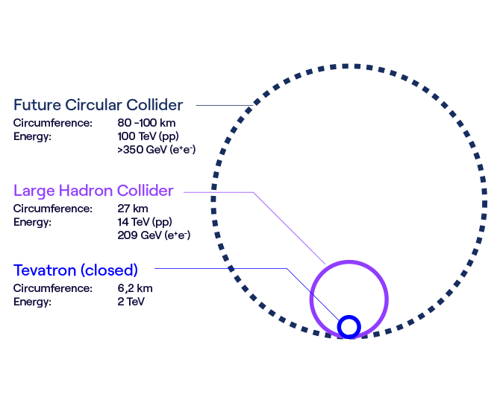
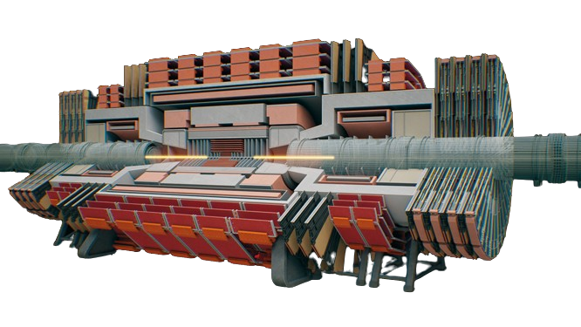
The Future Circular Collider

Slide 9
The Future Circular Collider
The Future Circular Collider (FCC) study is developing designs for the next generation of higher performance particle colliders that could follow on from the Large Hadron Collider (LHC) once it reaches the end of its High-Luminosity Phase.

Slide 10
FCC in a nutshell
Timeline
-2025: Completion of the FCC Feasibility Study
-2027–2028: Decision by CERN Member States and international partners
Tunnel
-90.7 km circumference
-200 m average depth
-8 surface points (7 in France, 1 in Switzerland)
Two stages:
-FCC-ee (precision measurements) about 15 years from the mid-2040s. The FCC-hh, would then be installed in the same tunnel, reusing the existing infrastructure, similar to when the LHC replaced LEP
-FCC-hh (high energy) about 25 years from the 2070s
Costs/benefits
-15 billion CHF, spread over at least 15 years for FCC-ee with four experiments
-Estimated benefit–cost ratio of 1.66
-About 800 000 person-years of employment created

Slide 11
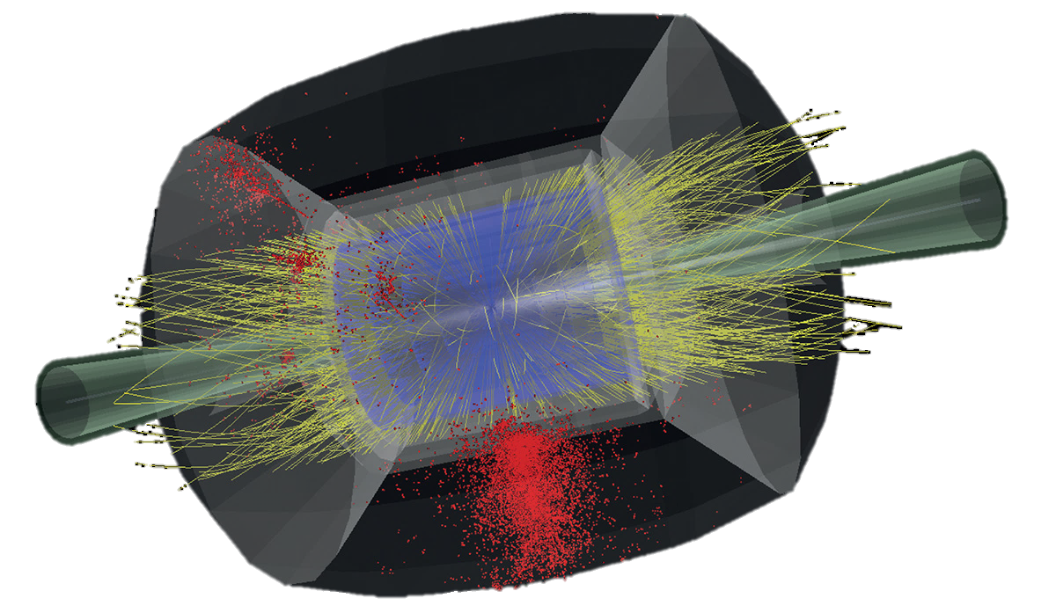
The Muon Collider

Slide 12
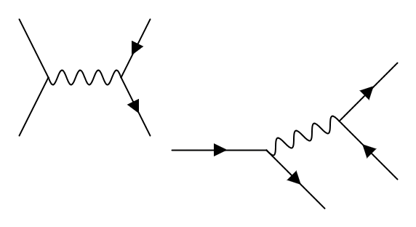
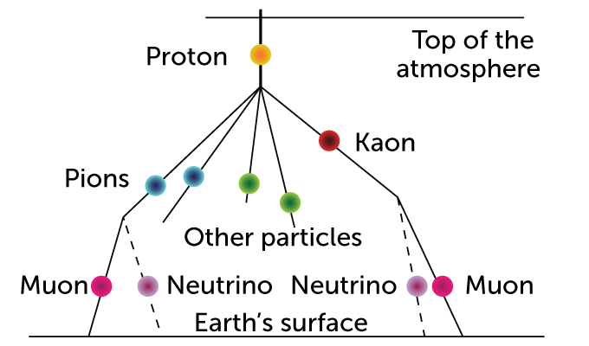







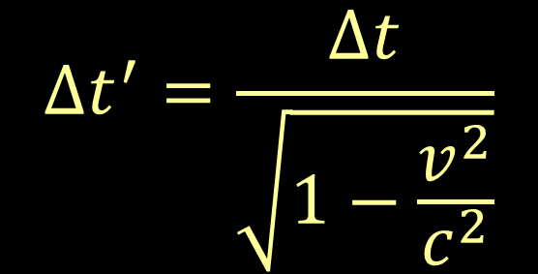



The problem with muons
$$\overline{u}$$
$$\overline{ν_{μ}}$$
Electron
$$Δt^{′}=\frac{Δt}{\sqrt{1−\frac{v^{2}}{c^{2}}}}$$
$$W^{−}$$
$$ⅇ^{−}$$
$$π^{−}$$
Anti-Pion
$$W^{−}$$
d
$$μ^{−}$$
Muon
$$\overline{ν_{e}}$$
$$\overline{u}$$
d
$$ν_{μ}$$

Slide 13

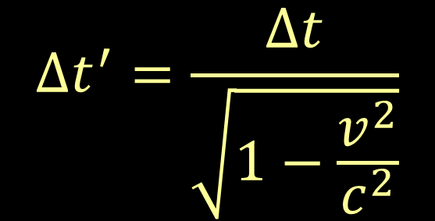
What makes this possible?
$$Δt^{′}=\frac{Δt}{\sqrt{1−\frac{v^{2}}{c^{2}}}}$$

Slide 14
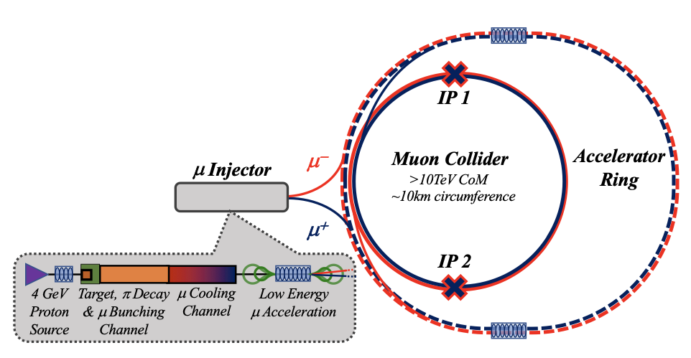
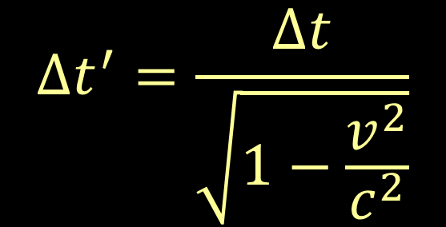
The Muon Collider
$$Δt^{′}=\frac{Δt}{\sqrt{1−\frac{v^{2}}{c^{2}}}}$$

Slide 15
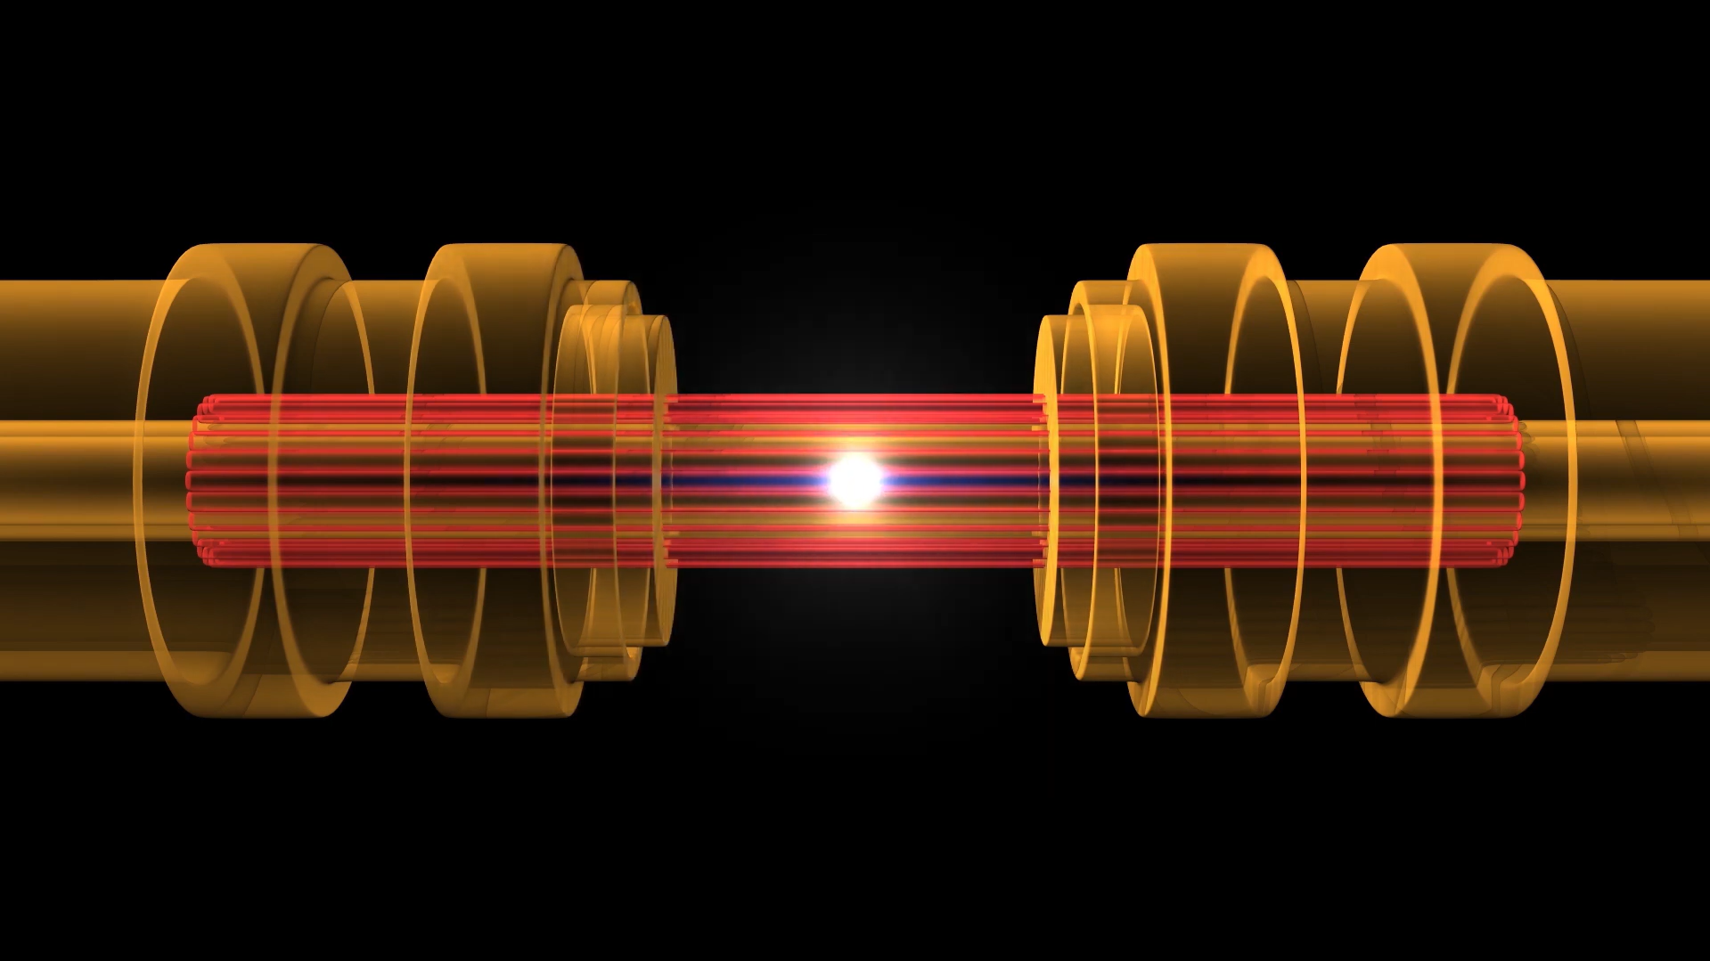
The Muon Collider

Slide 16


THANK YOU!

