Slide 1

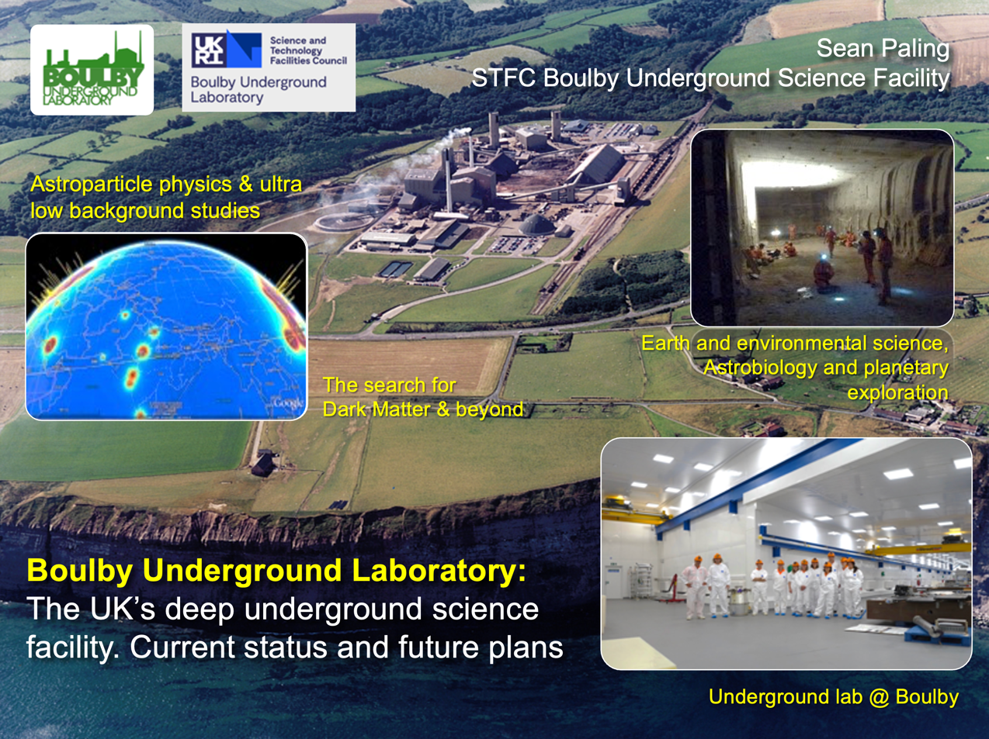
Boulby Underground
Laboratory:
Status and plans for the UK’s deep underground science facility.
Sean Paling
Boulby Underground Laboratory, UK
Sean Paling. Boulby Underground Lab. 2024

Slide 2

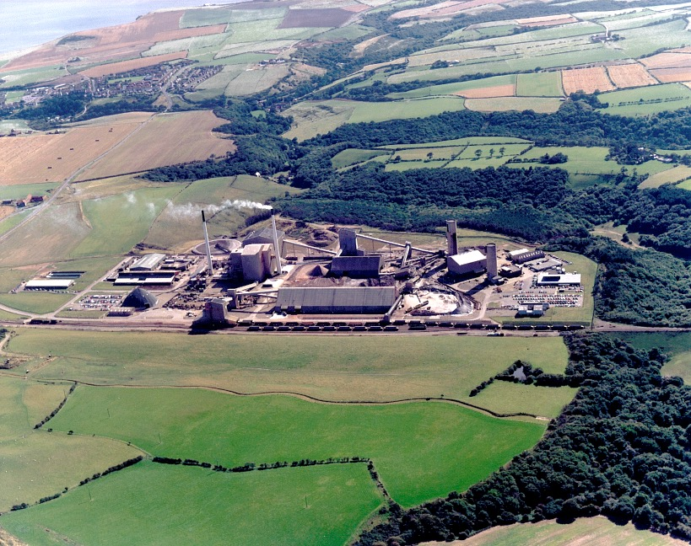



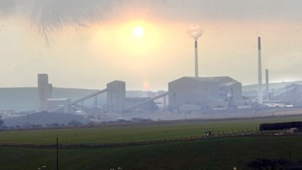
Boulby Mine
A working polyhalite and rock-salt mine on the North East coast of England.
Owned by Israel Chemicals Ltd. (ICL-UK). Locally operated as Cleveland Potash Ltd.
Major local employer: ~500 direct staff and 2000 indirect employment.
Polyhalite: K₂Ca₂Mg(SO₄)
Middlesborough
Ships worldwide for agricultural fertiliser
Staithes
Whitby
York
Deepest mine in Britain: 1300km
The world’s first polyhalite mine
12 miles North of Whitby, N. Yorks
View from Staithes

Slide 3
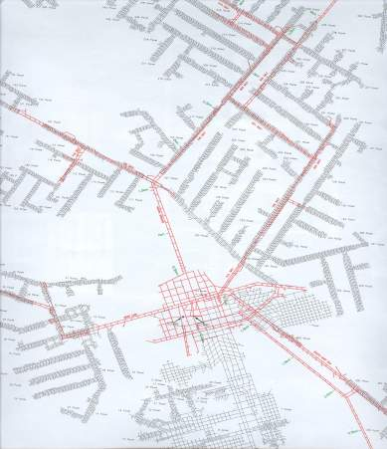
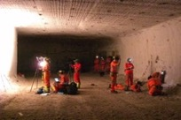
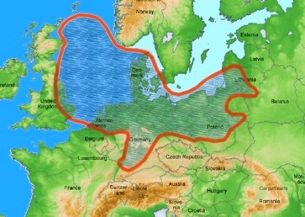
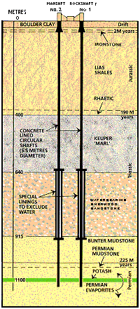



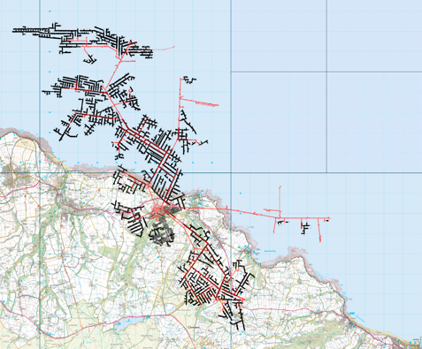

Boulby Geology & Mining
Excavations are in Salt (NaCl), Potash (KCl) and Polyhalite (K₂Ca₂Mg(SO₄)). Permian evaporite layers left over from the Zechstein Sea (250m.yrs past).
Over 40 kms of tunnel mined each year (now >1,000kms in total), the long-lived roadways being cut in the lower NaCl layer.
Typical Boulby Salt Roadway
Polyhalite
Potash
Zechstein Sea
Rock-Salt
Low activity salt
U ~67 ppb,
Th ~125 ppb
Mine Shafts
>1000kms of tunnel mined in 50 years
Current Lab
(2017)
Boulby Geology

Slide 4
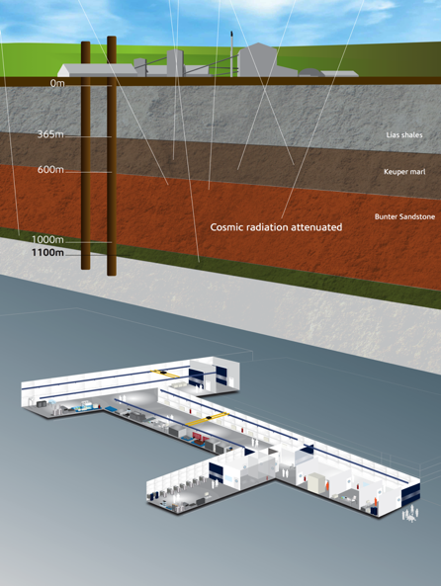
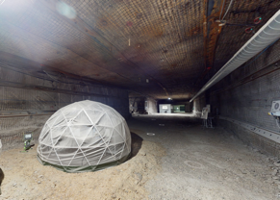
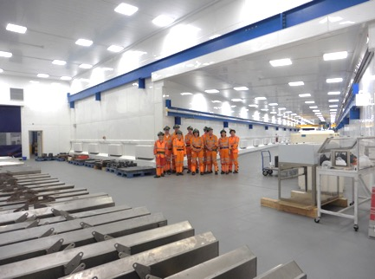
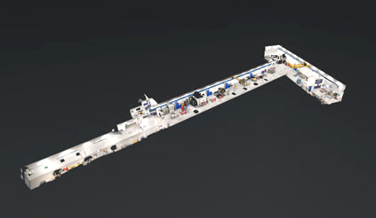
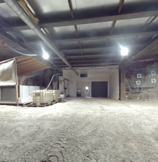


Boulby Underground Laboratory
The UK’s deep underground science facility operating in a working potash and salt mine.
1.1km depth (2805 mwe). With low background surrounding rock-salt
Operated by the UK’s Science & Technology Facilities Council (STFC) in partnership with the mine operators ICL-UK
Outside Experimentation Area (OEA)
4000m³ class 10k and 1k clean lab space
Permian Evaporites
Factor ~10⁶ reduction in cosmic ray flux
vs. surface
A QUIET place in the Universe
Lab entrance

Slide 5
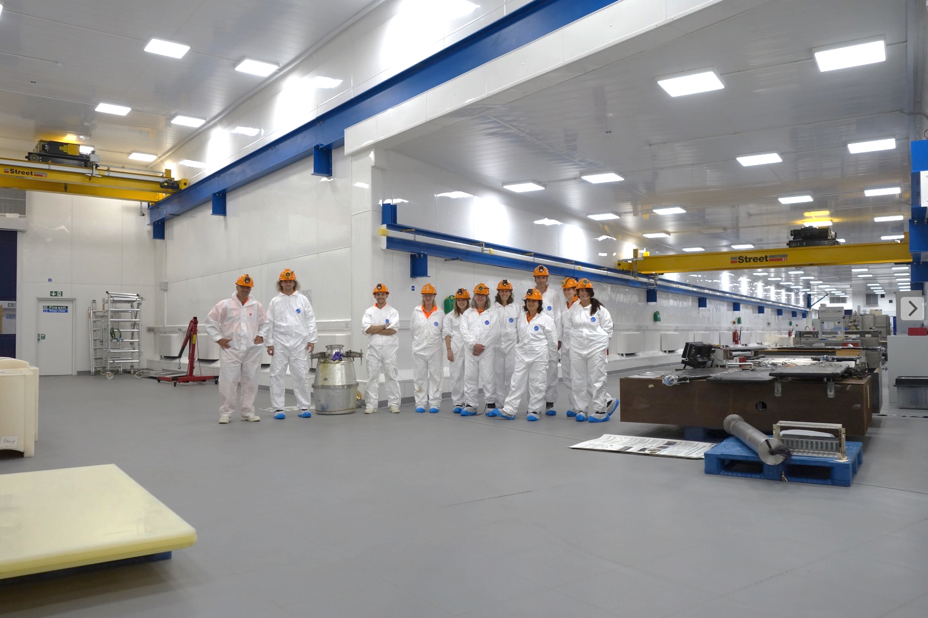
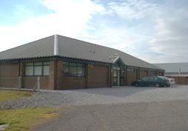
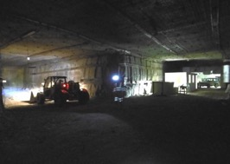


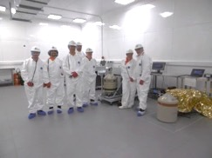
Office space, chemistry & clean prep lab, storage and staging space, IT room, conference room,
Supported access to surrounding geology & UG environs. Power, wifi/internet.
Surface support and staging building
3000m³ Outside Experimentation Area
Boulby Underground Lab Facilities 2023: >4000m³ class 1k & 10k (ISO 6 & 7) clean room lab space. 10Gb Internet. AC, air filtration, 5T & 10T lifting, LN generation, fume hood & clean prep space. 3000m³ Outside Experimentation Area (OEA) with power & internet. Supported access to wider mine environs.
BUGS Material screening

Slide 6

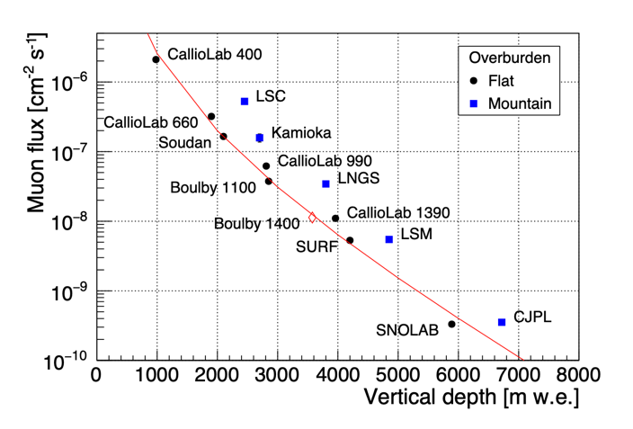
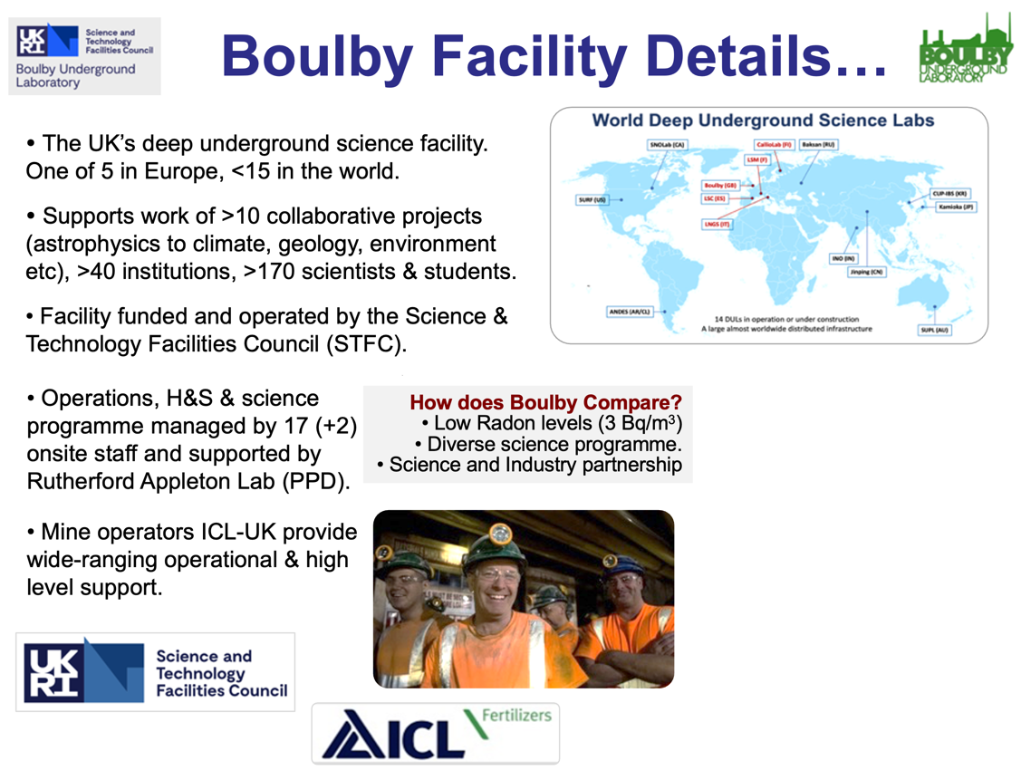


Boulby Underground Laboratory (UK)

Slide 7
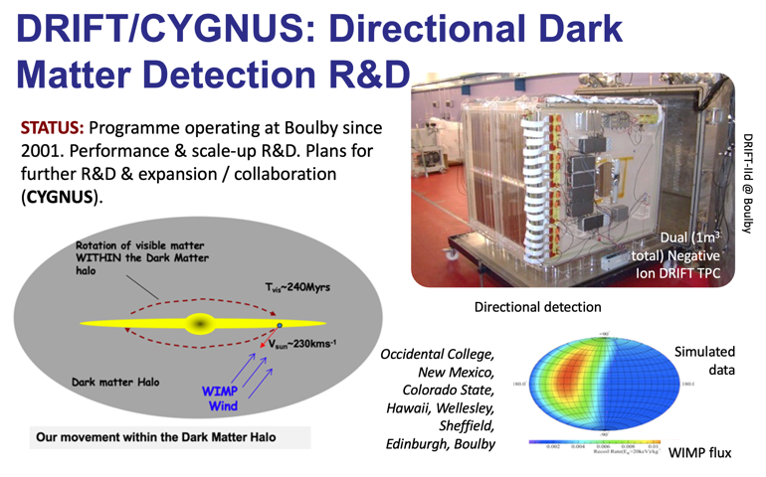
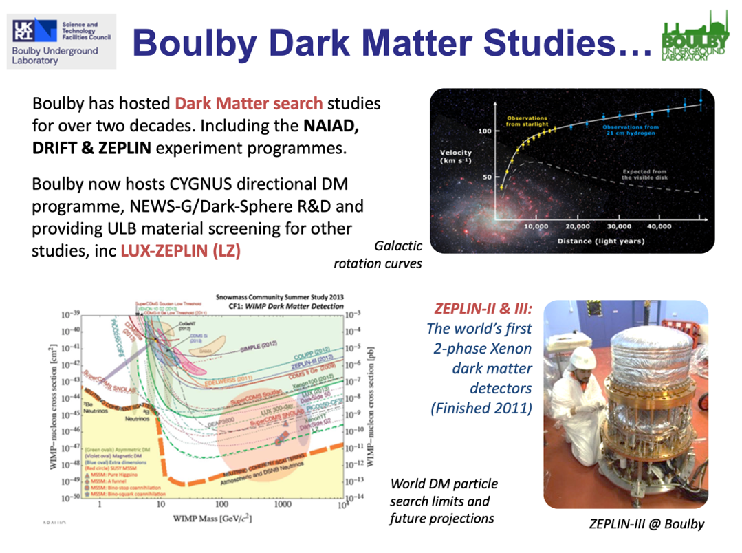
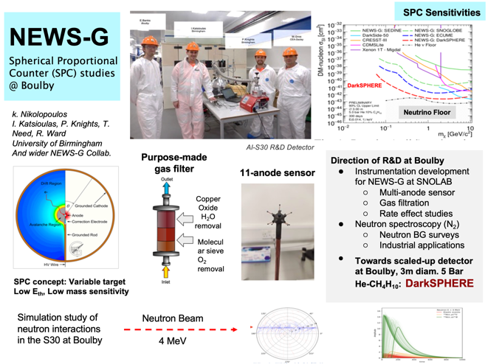
Boulby Science Now & Future
Particle physics and ultra-low background studies

Slide 8
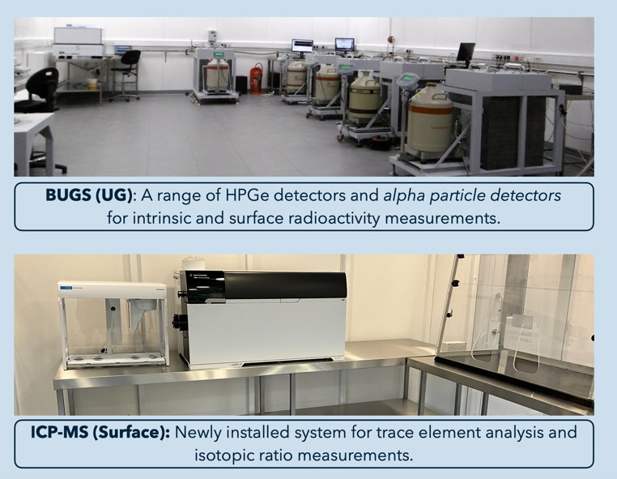
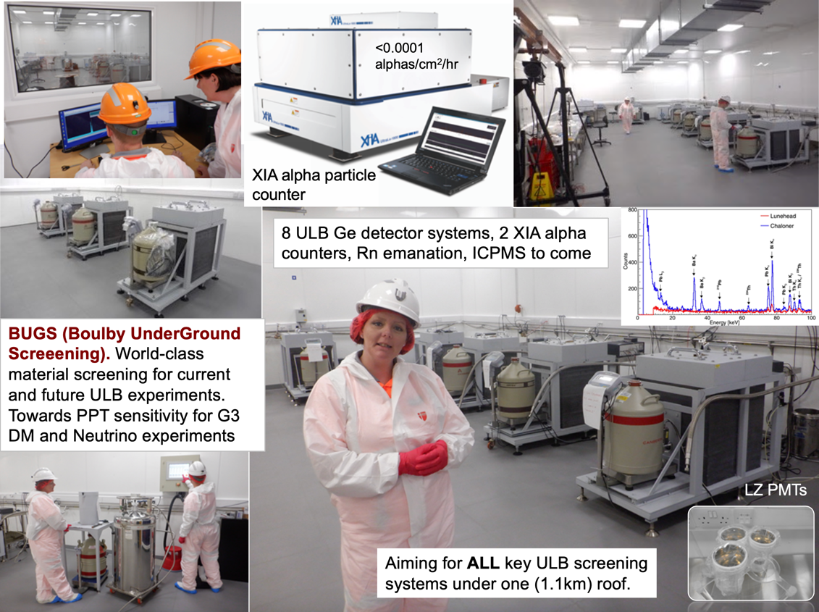
Boulby Science Now & Future
Particle physics and ultra-low background studies
BUGS Facility: (Boulby Under-Ground Screening)
  ULB Germanium (8)
  XIA: Surface alphas (2)
  Radon Emanation *
  ICPMS * * Commissioning

Slide 9
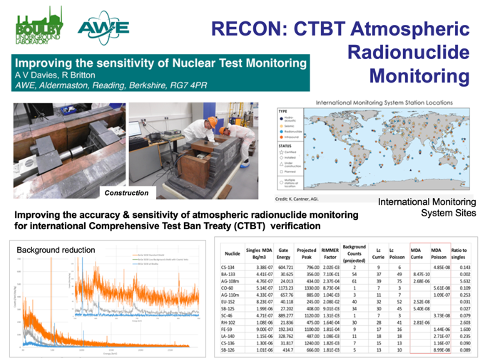
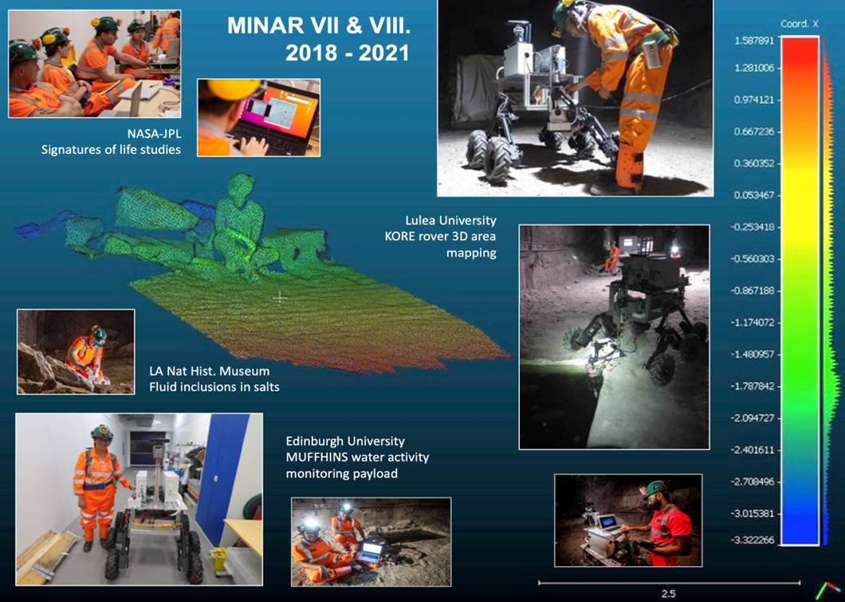
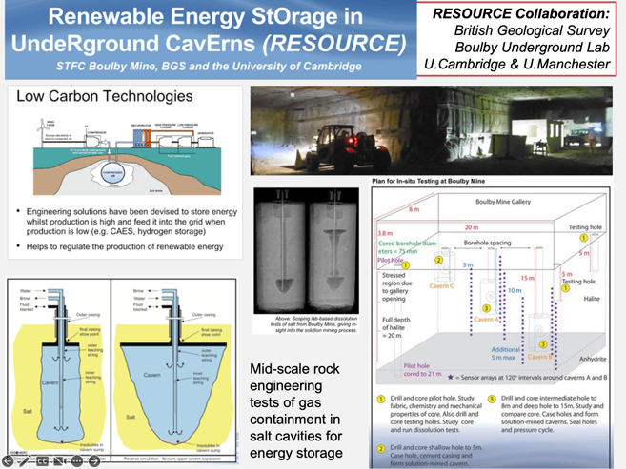
Multidisciplinary Science
RECON:
Atmospheric monitoring for nuclear
security
Applied low background particle physics, Earth and Environmental science, Astrobiology & Planetary Exploration Technology Development.
MINAR:
Astrobiology and planetary exploration technology development
RESOURCE:
Compressed gas energy storage R&D

Slide 10
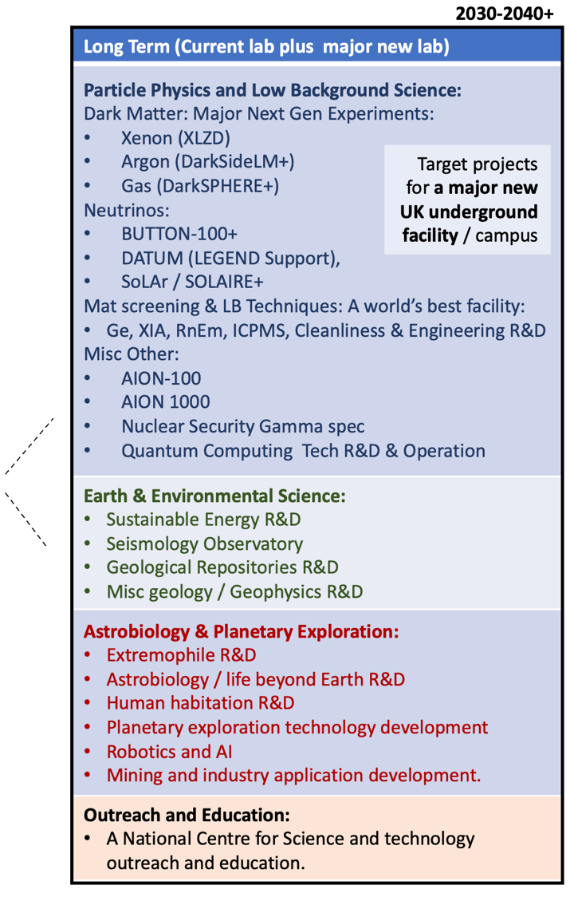
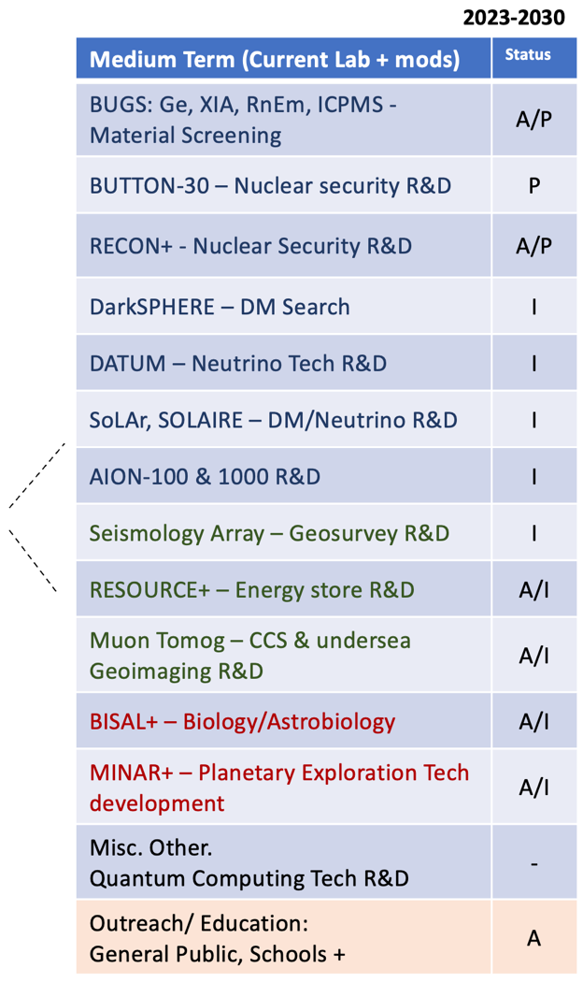
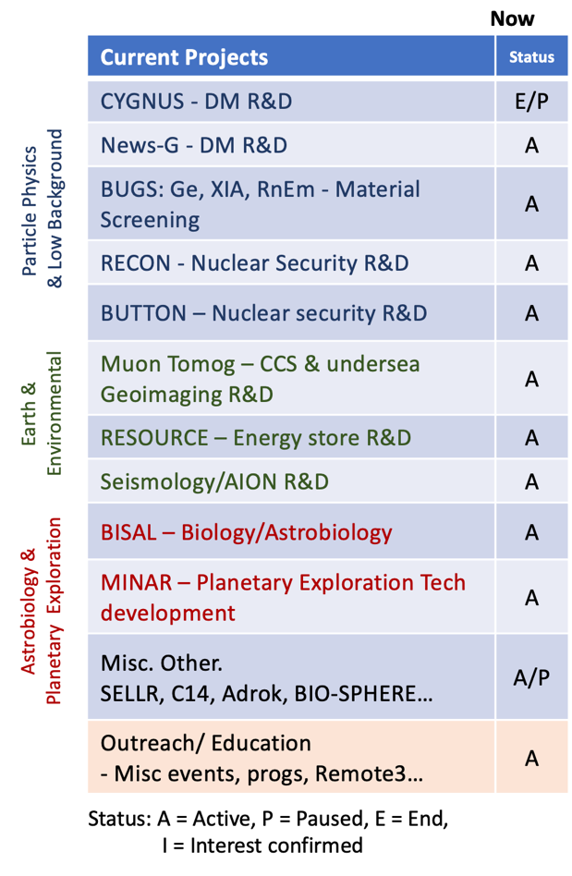


Boulby Activities Now and Potential Future
(Not comprehensive)

Slide 11


UK Underground Science Facilities. Now and the Future…
What Boulby Is:
An internationally-important centre for pure & applied multi-disciplinary science.
A local (North East) and national asset for science, technology and outreach/education.
A successful and proud example of science and industry partnership
A UKRI/UK facility with potential, opportunity and support for wide-ranging growth.
STFC/Boulby now looking to: continue to develop the UK underground science facilities to further enable truly internationally-important astro-particle physics and pure and applied multi-disciplinary science.
Short term: Maximally exploit the current Boulby facility to host world class Underground Science:
Medium-to long term: Prepare to build a major new deep underground science facility in the UK to host next-generation world-leading science projects coming 2030+
UKRI’s Future Underground Dark Matter Experiments Fund - 2024
Boulby Development Project:
Plans & preparations for a major new multi-disciplinary Deep Underground Science Facility in the UK

Slide 12

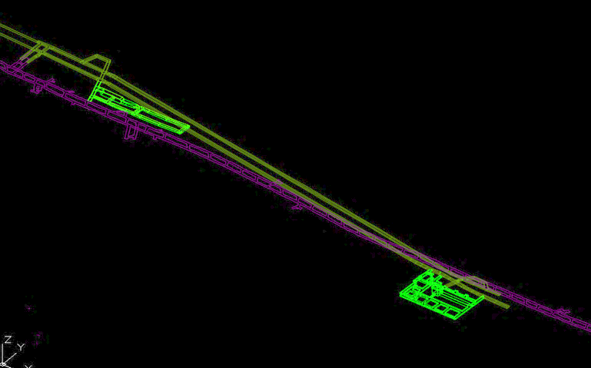
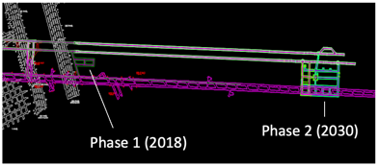
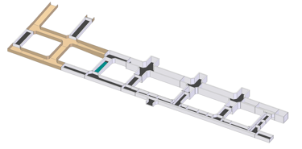
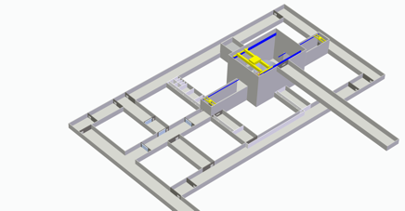
Boulby Development Project
Task 1: Site and design Development.
Stage 1: Clean manufacturing and multi-science lab in salt (1.1km) - 2028
Stage 1 (2028)
Stage 2 (2030)
Stage 2: Full depth science lab in Polyhalite (1.3km) ~2030+
A new lab @ Boulby
Stage 1 (Salt)
DRAFT: 2-stage Designs
~(30m)³ main cavity
Total volume
(Stage 1 + stage 2) ~120,000m³
Stage 2
(Polyhalite)
Stage 2 Polyhalite)
Excavations for stage 1 of expansion currently expected to begin mid-2024.
Phase 1 lab (salt 1.1km)

Slide 13

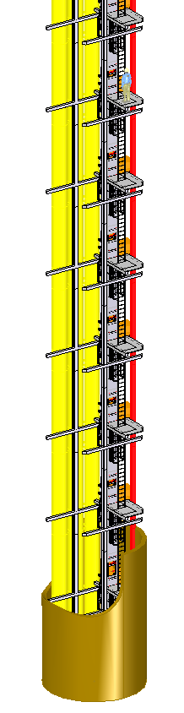
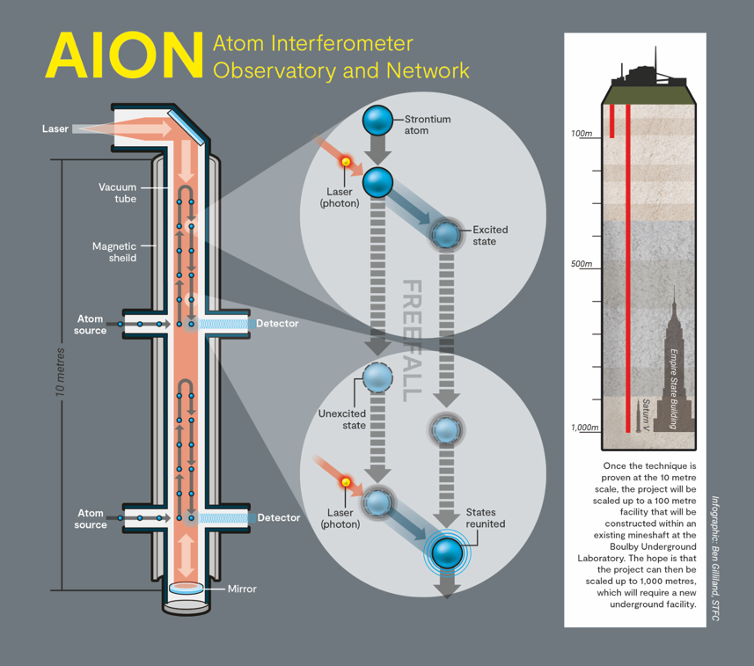
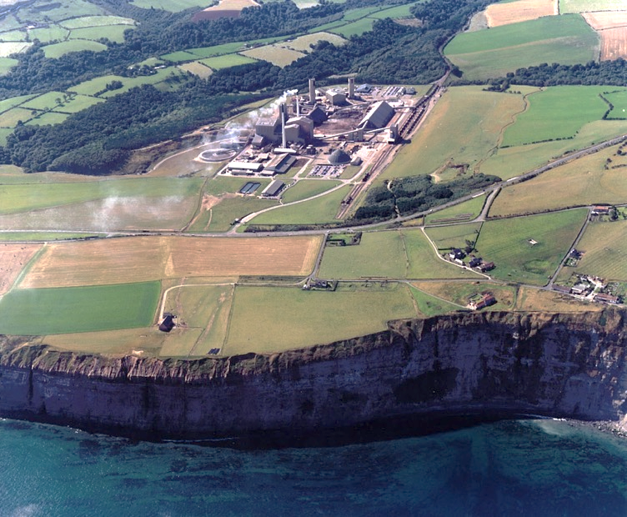
Prospects for Atomic Interferometry at Boulby…
ALONGSIDE new underground laboratories to be excavated, there is user interest and STFC support for hosting atomic interferometry projects (AION 100 & 1000) in existing or new commercial shafts at or near Boulby Lab in NE England.
Shaft 3
Tailings Shaft
180m
Shaft 2
Personnel
1.1km
Shaft 1
Rock Shaft
1.1km

Slide 14
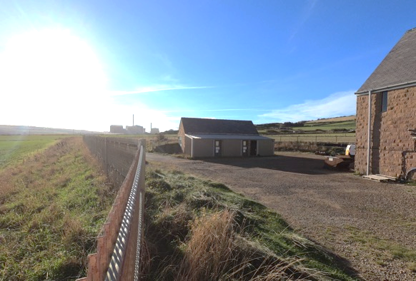
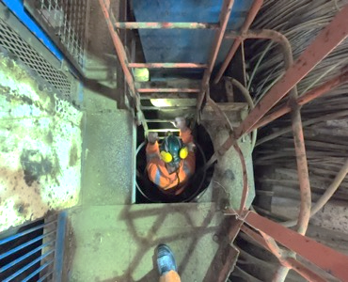
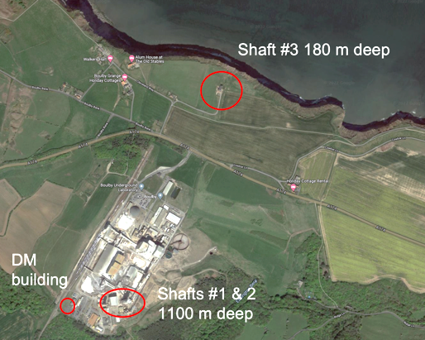
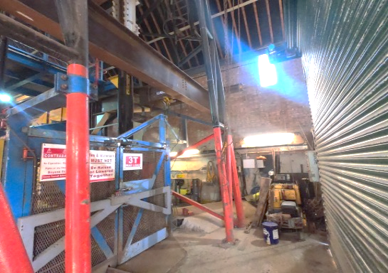
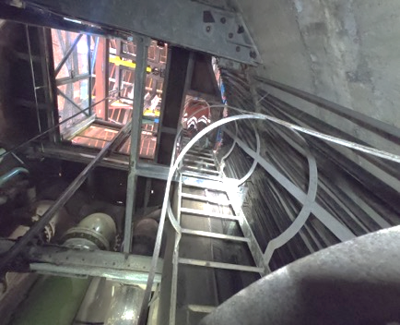

Prospects for Atomic Interferometry at Boulby…
Boulby SHAFT 3: Tailings shaft. Possible location for AION-100 @ Boulby
Tailings (no. 3) shaft specs:
180m vertical shaft
~50m from coastal cliffs.
5m diameter shaft with 3T capacity crane.
Personnel Cage (used few times/day), water & ventilation pipes, access stairs/ladders

Slide 15
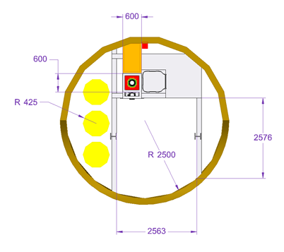
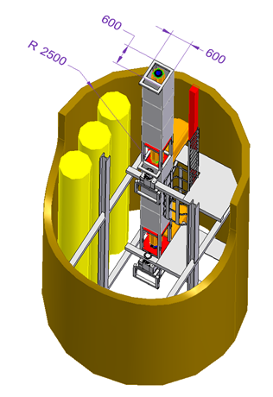
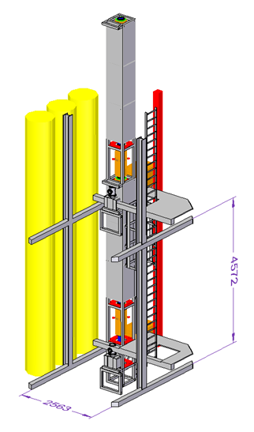
Prospects for Atomic Interferometry at Boulby…
Boulby SHAFT 3: Tailings shaft. Possible location for AION-100 @ Boulby
Proposed AION Interferometer tube
Sidearm Footprint
Ladder access
Water Pipes
Lift cage space
Existing steel framework
DRAFT schematics of AION-100 in Boulby No. 3 shaft.
It DOES look practicable from a local engineering perspective. More detailed engineering(+) work now to be done…

Slide 16
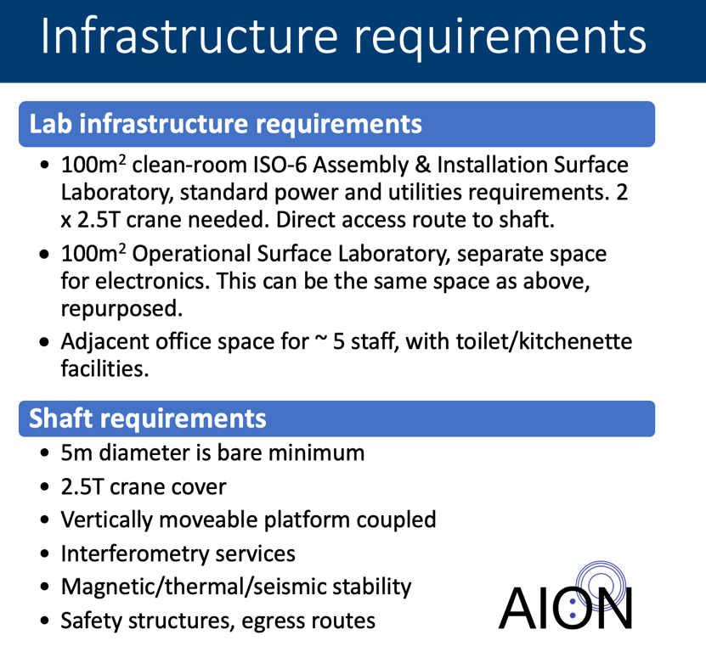
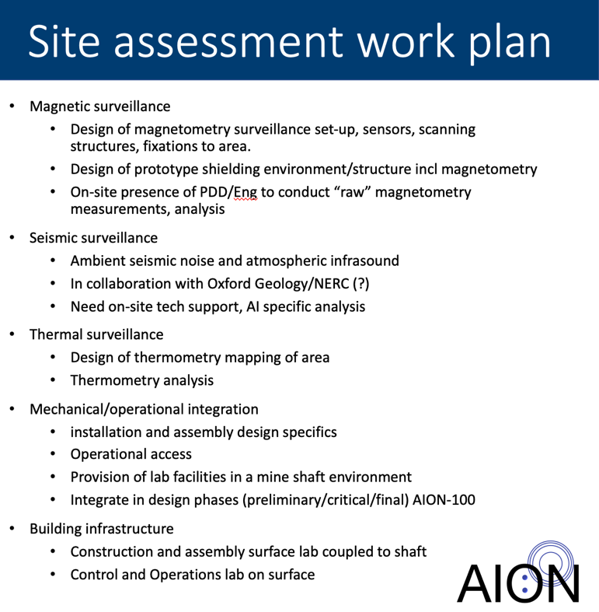
Prospects for Atomic Interferometry at Boulby…
Boulby SHAFT 3: Tailings shaft. Possible location for AION-100 @ Boulby
Next-level
site evaluation & preparation studies underway
(Mar 24)
Mitchell, Kettlety
et al.
(Initial evaluations)
?

Slide 17
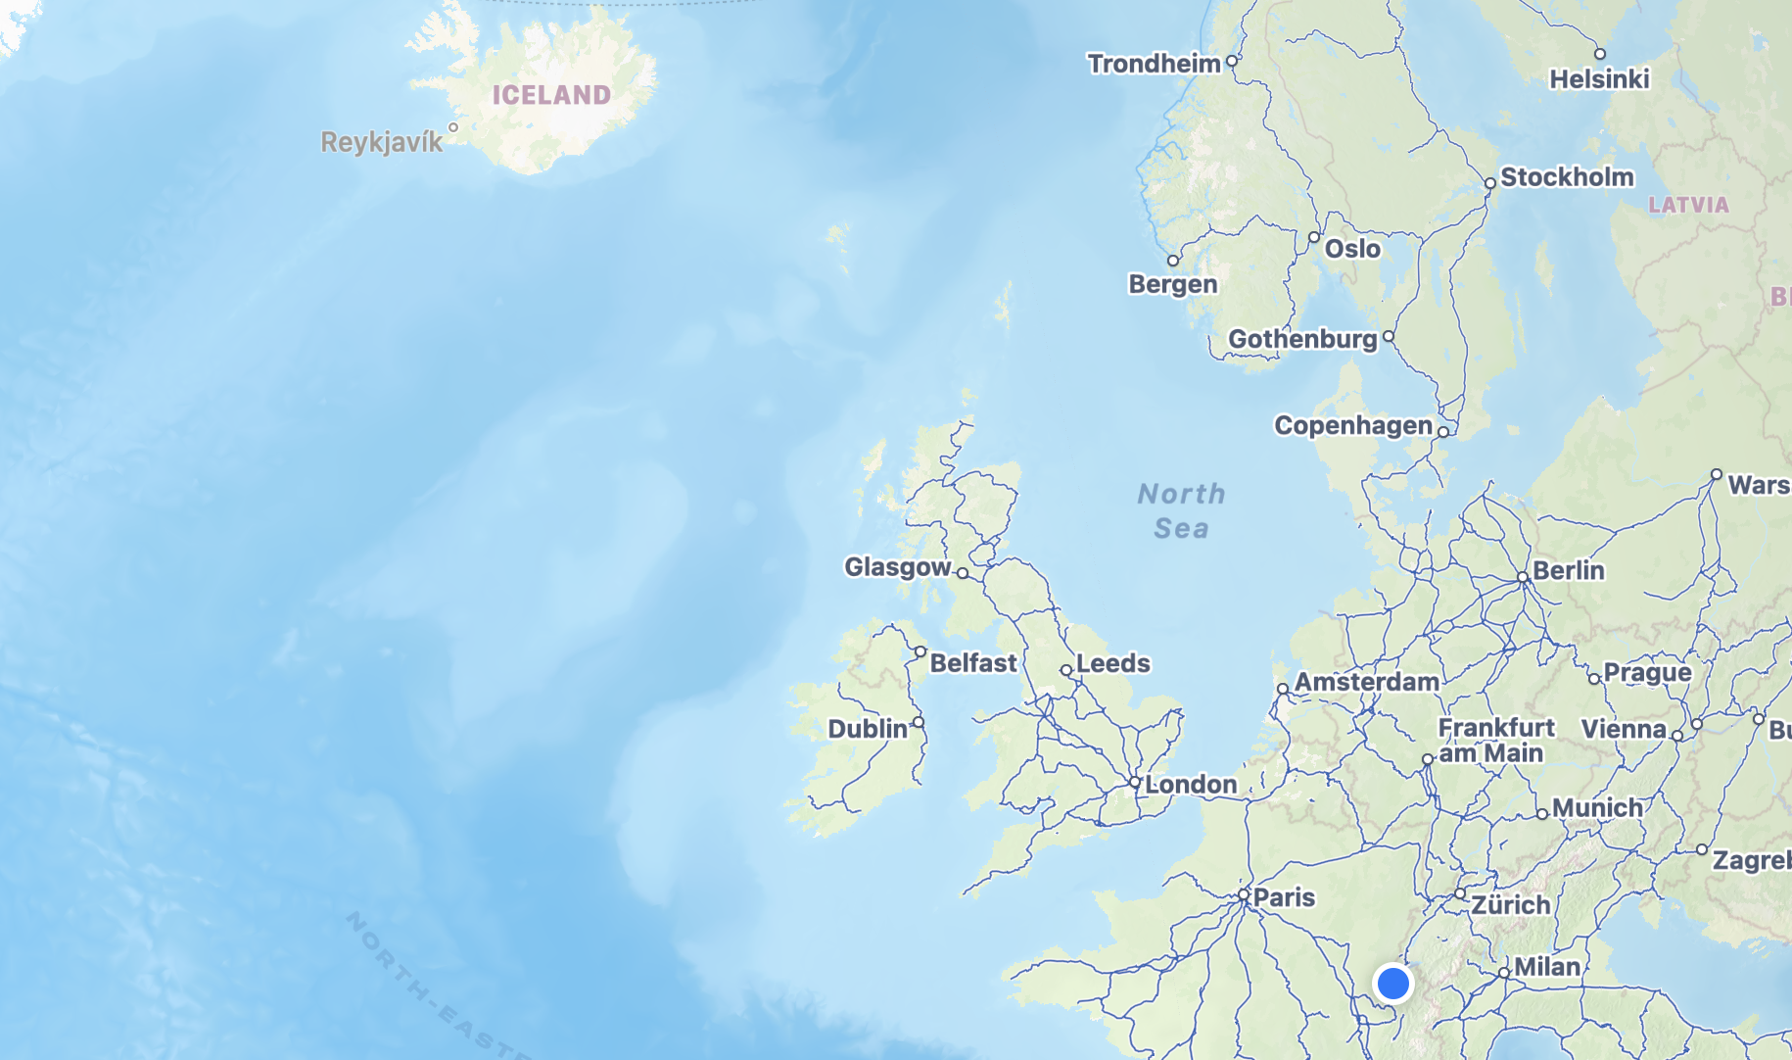
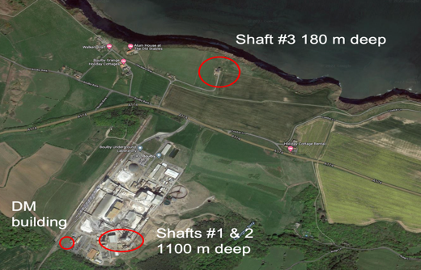
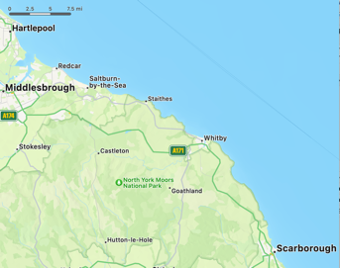







Prospects for Atomic Interferometry at / near Boulby…
Boulby & NE UK region site possibilities / opportunities for AION-1000.
Boulby Mine
Woodsmith Mine
(Construction - Eta 2030):
2 x 1.5km depth shafts
7m diameter
37km Material Transport System ( MTS) tunnel with misc. >100m access shafts
Woodsmith Mine
Boulby Mine (existing):
Shafts 1 & 2
2 x 1.1km depth shafts
5m diameter
Current use:
Shaft 1: Rock transport
Shaft 2: Personnel
Discussions re: hosting AION-1000 at both sites underway. Detailed engineering, logistics & background studies planned

Slide 18




New: Potential for Atomic Interferometry in new (Stage 1) Underground Lab.
Quantum Campus
Opportunity for an AION-10 or AION-20 system to be operated in the new stage 1 underground facility ‘Quantum Campus’.
Stage 1: Clean manufacturing and multi-science lab in salt (1.1km) - 2028
Space for an AION-20 in possible stage 1 ‘Quantum Campus’
DRAFT
DRAFT
Quantum Campus
Barnaby Matthews 2024
Quantum Campus
Stage 1 Main Lab
Stage 1 Main Lab
Towards a world-leading low background Quantum Technology facility for fundamental science, seismic monitoring and more
Space for an AION-10 in stage 1 experimental hall
Stage 1 excavations to begin mid-2024. Outfitting completed ~2028

Slide 19

Boulby Underground
Laboratory: Status, plans and opportunities for growth.
Summary…
Boulby Underground Lab status
The UK’s deep underground science facility
A rich and varied current science programme in astroparticle physics and low background science, Earth and environmental science, astrobiology and planetary exploration studies.
Future plans:
UKRI/STFC are now looking to maximally exploit the current facilities at Boulby, in addition we are working toward a major expansion of facilities to enable the UK to host major international next-generation science projects from 2028+
STFC is keen to consider proposals for siting future Atomic Interferometry studies of varying sizes in Boulby shafts, or in the new Boulby Underground Laboratory
Sean Paling. Boulby Underground Lab. 2024

