Slide 1
Multi-photon clock atom interferometry
2nd Terrestrial Very-Long-Baseline Atom Interferometry Workshop
Jason Hogan
April 3, 2024

Slide 2
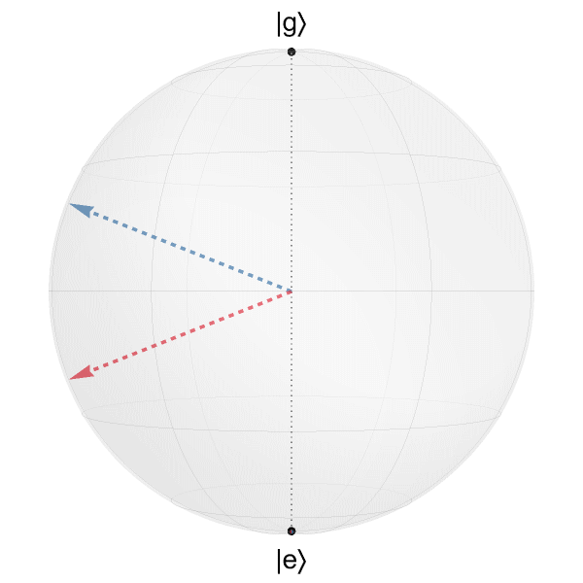


Broadband LMT Clock Atom Interferometry
¹P₁
Sr
³P_{J}
689 nm
7.4 kHz
461 nm
30.5 MHz
$$(Ω\left(t\right),0,{+δω}_{D})$$
698 nm
1 mHz (⁸⁷Sr)
¹S₀
$$(Ω\left(t\right),0,{−δω}_{D})$$
⁸⁸Sr, ¹S₀ → ³P₁ transition (689 nm)
Broadband: laser cooled atoms (red MOT)
Fast: 601 ħk splitting in ~20 μs
Floquet modulation technique to symmetrically drive both arms
Conventional pulses
Floquet pulses
Ω = 2π × 12 MHz

Slide 3
Narrowband LMT Clock AI Limits
For gravitational wave detection in MAGIS, need the ¹S₀ → ³P₀ transition (698 nm)
Full scale MAGIS detector (on Earth) requires extreme LMT, beyond state-of-the-art
Simulation effort to understand future limits
Constrained optimization includes:
Spontaneous emission decay
Off-resonant scattering
Detuning errors (Doppler, laser noise)
Intensity inhomogeneities
Timing jitter
Laser: 5W, 1 Hz linewidth
⁸⁷Sr DFG, matter wave lens
Interferometer enhancement factors >10⁴ theoretically possible, but transitions are too slow (at this power)

Slide 4
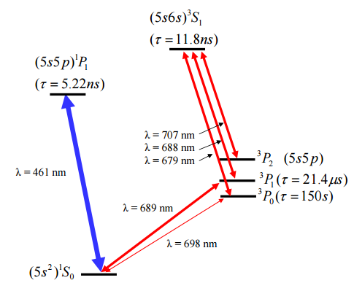
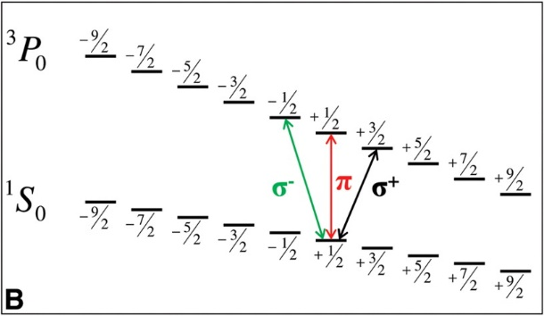
Multiphoton Clock Atom Interferometry Motivation
¹S₀ → ³P₀ clock transition in Sr at 698 nm is only naturally allowed in fermionic ⁸⁷Sr
Bosons have interesting properties:
Scalar polarizability of clock states
Zero linear Zeeman shift in ground state
High natural abundance
Reduced interaction strength (e.g., ⁸⁸Sr)
Easier state preparation (I=0)
Possible to make BEC (e.g., ⁸⁴Sr)
⁸⁷Sr only
Proposal: Use multi-photon excitation to populate ³P₀ state for atom interferometry
⁸⁷Sr
Potential to engineer the effective coupling strength for faster pulses, better LMT
Boyd et al., Science (2006).

Slide 5
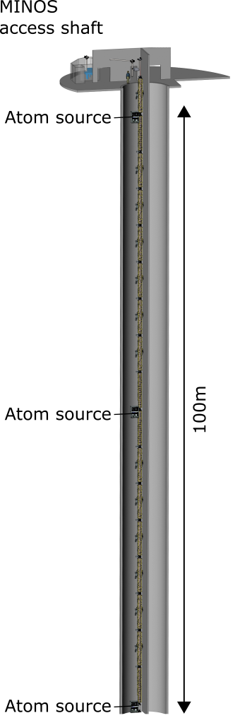

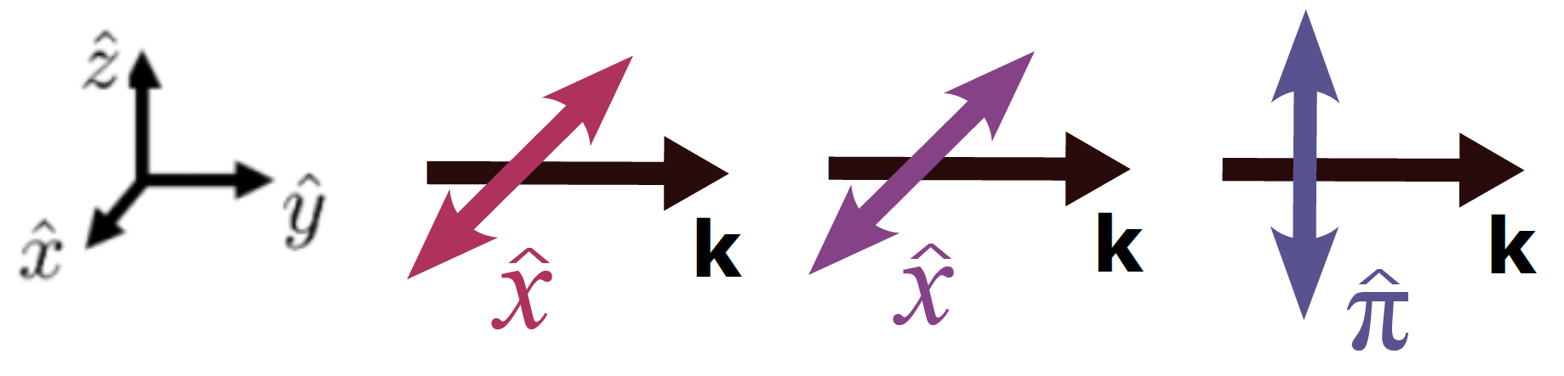
Gradiometer configuration requires collinear light
Long baseline gradiometry for gravitational wave, dark mater detection
Light pulses from alternating directions (LMT enhancement)
For single photon single direction transitions, laser noise is common
For three photon gradiometer, all light must be collinear.
For example: x – x – z

Slide 6
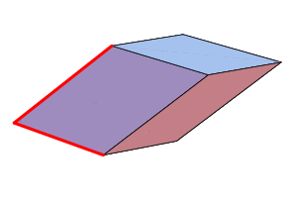
Polarization requirements
Coupling
For x-x-z polarization, there is destructive interference between two paths:
Zeeman shift
Solution: Small magnetic field breaks the symmetry and results in a non-zero coupling

Slide 7
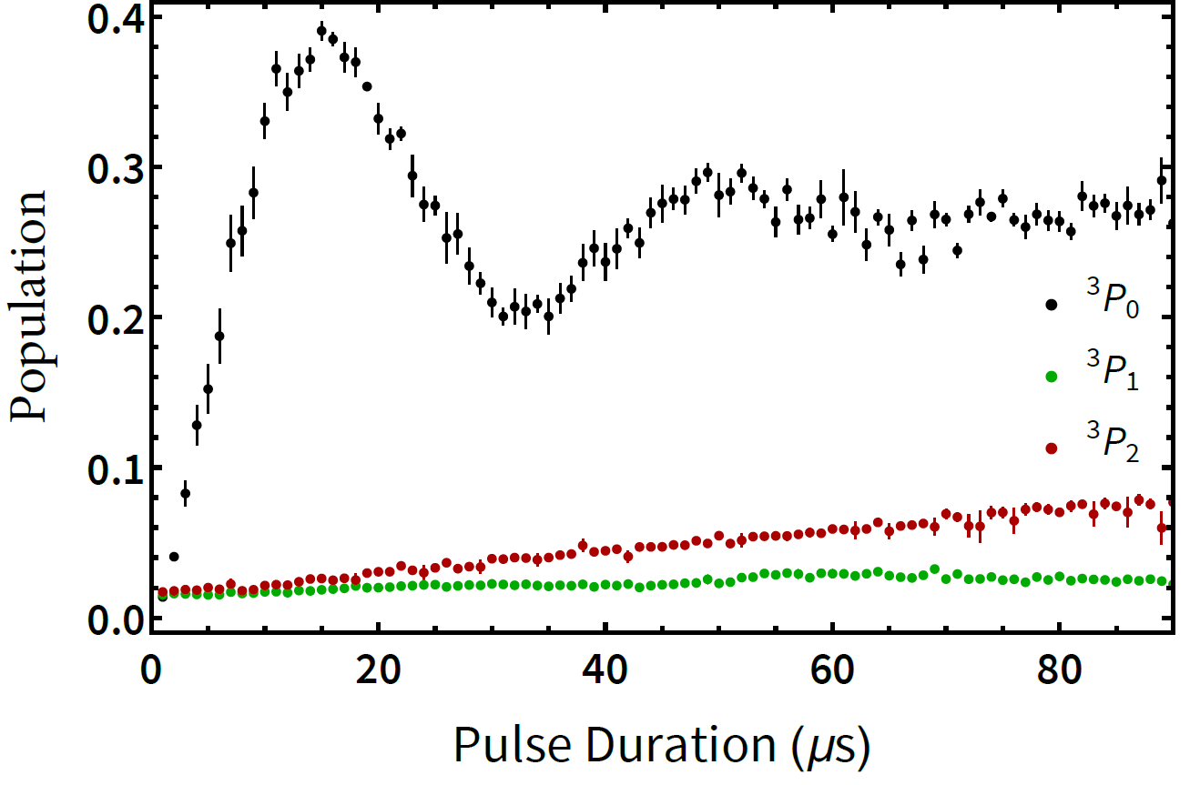
Three photon Rabi oscillations
689 nm, 688 nm, 678 nm lasers locked to frequency comb; scan three photon resonance
Detection using state-selective repump followed by 461 nm push pulse
Verified that transition requires all four fields
We observe minimal decay to unwanted states, consistent with density matrix simulation
Here: 29 kHz Rabi frequency with 10 Gauss field, 5 W/cm² (360 micron beam)
2.5 GHz detuning of 688 nm, 9.9 MHz detuning of 689 nm
Peak transfer limited by intensity inhomogeneity in this proof of principle

Slide 8
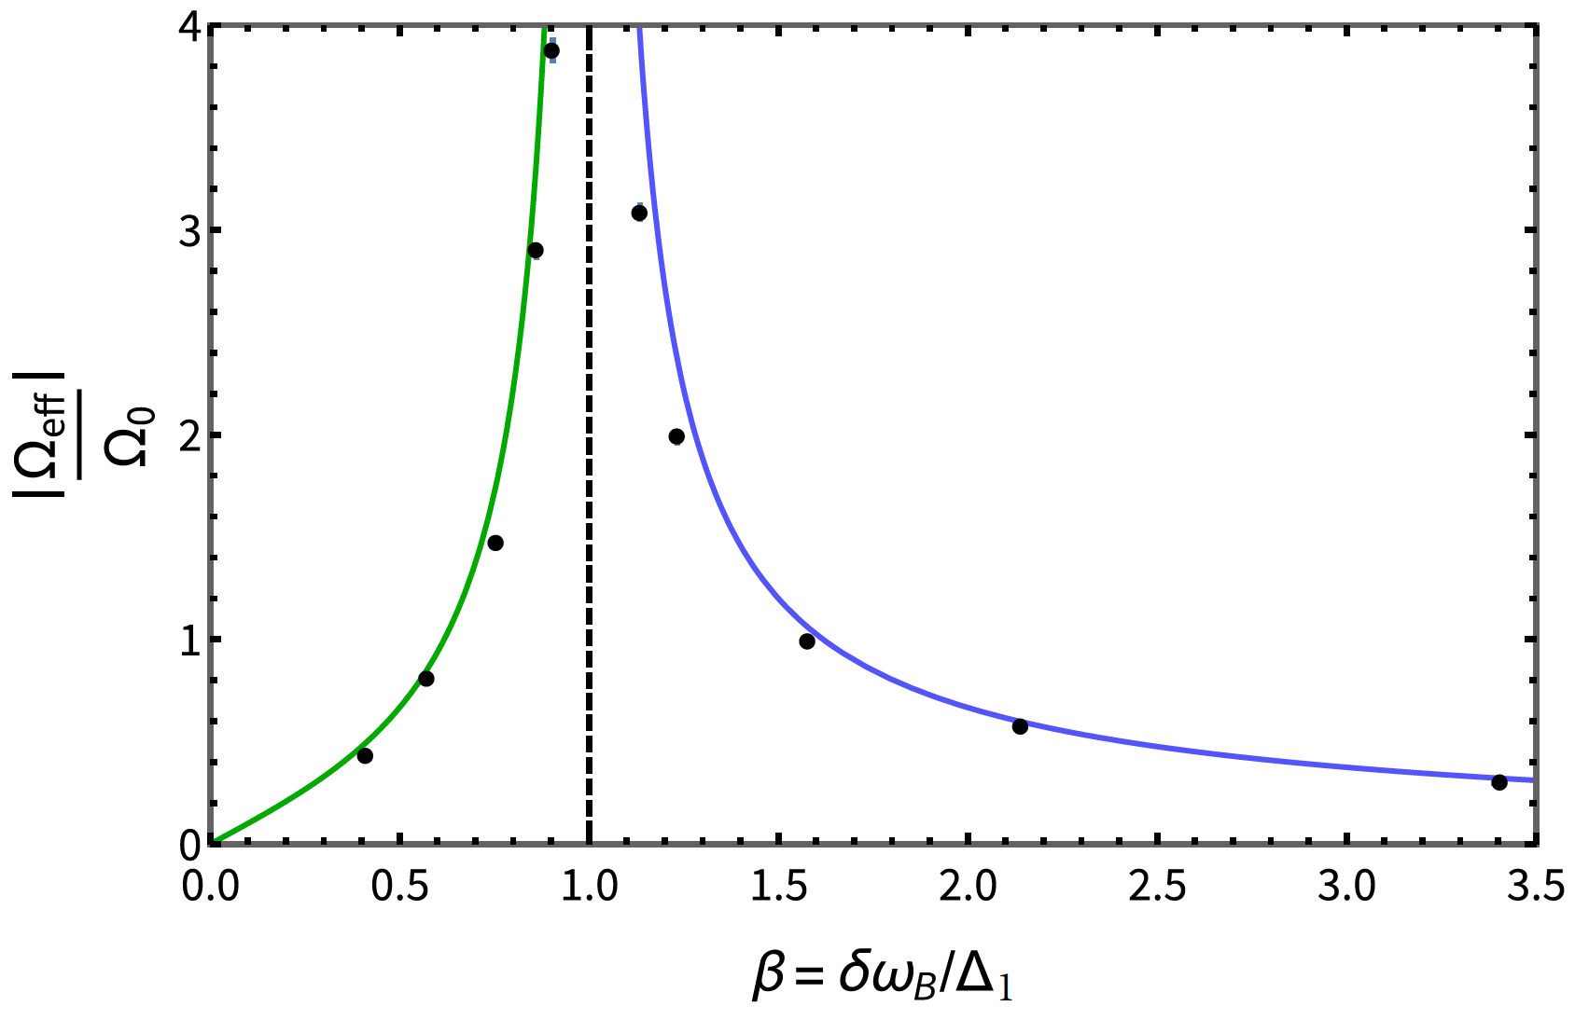
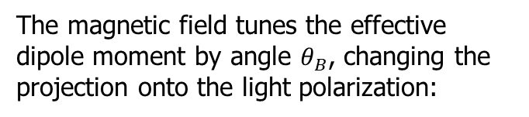


Magnetic tuning of three photon Rabi coupling
Three photon coupling depends on:
(ratio of Zeeman shift to 689 nm detuning)
Two regimes:
$$β<1$$
$$β>1$$
Some examples:
12 kHz Rabi frequency at 4 Gauss field
49 kHz Rabi frequency at 19 Gauss field
The magnetic field tunes the effective dipole moment by angle $θ_{B}$, changing the projection onto the light polarization:
High Rabi frequency with modest magnetic fields, intensities

Slide 9
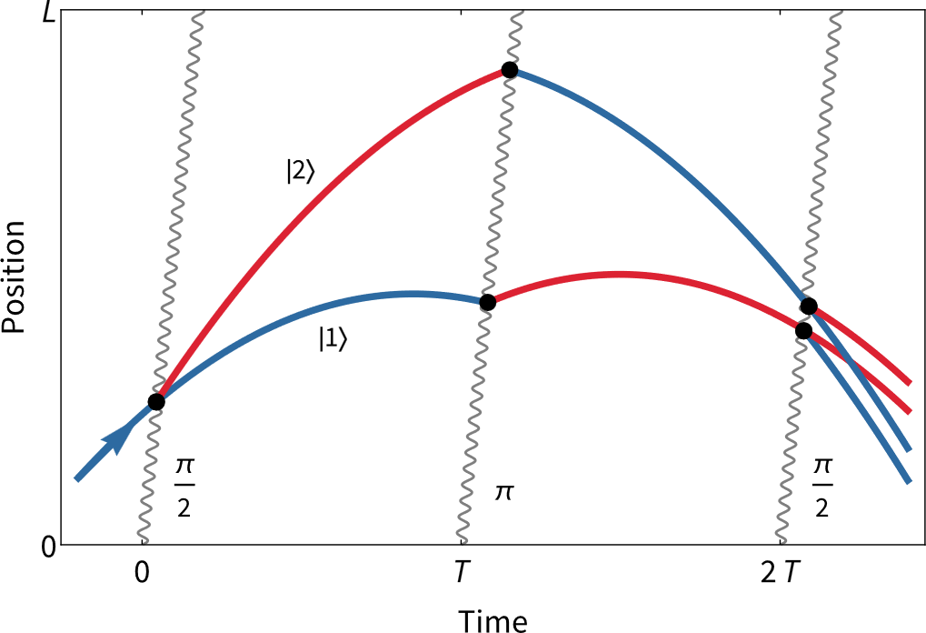
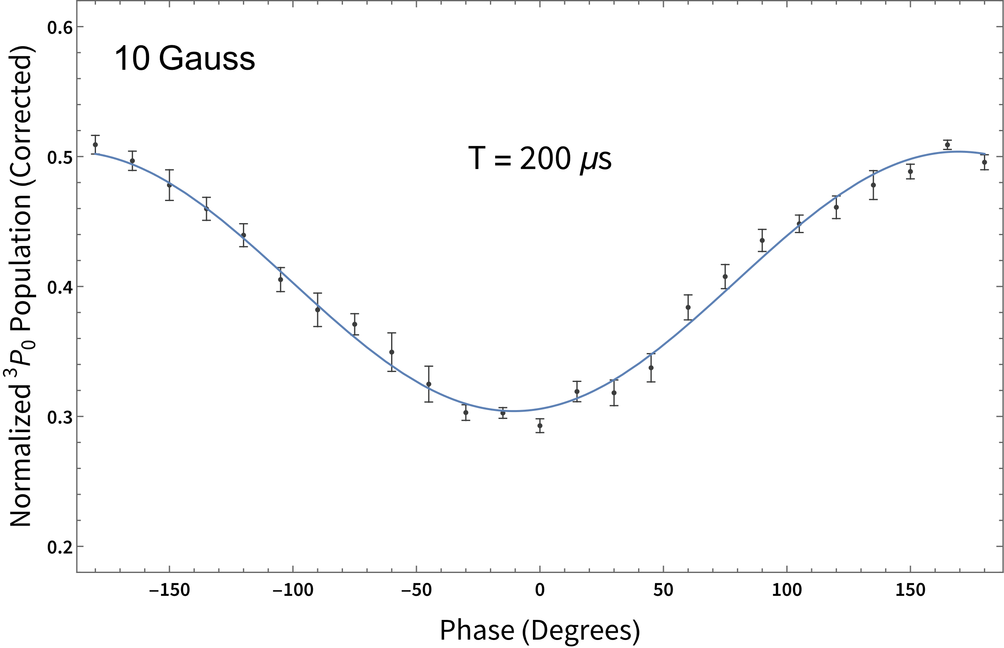
Atom interferometry demonstration
Mach-Zehnder sequence
Shows phase coherence over longer times
Proof of concept for future long-baseline atom interferometer applications
Atom interferometry between ¹S₀ → ³P₀ levels of ⁸⁸Sr using the three photon transition

Slide 10
Summary
Three photon transition opens up the use of bosons for atom interferometry and clocks
Small magnetic field allows for collinear light, otherwise forbidden by selection rules
  → Semi-classically, the magnetic field adds a torque that “rotates” the atomic state on a timescale faster than the natural lifetime
Demonstrated proof of concept atom interferometer
Next steps
Higher power laser, bigger beams to reduce inhomogeneous loss
Optimize parameters (magnetic field, 689 detuning) to minimize spontaneous emission – ultimate limits?
Possible alternative to ⁸⁷Sr 698 nm transition for MAGIS-100 (?)
  → May offer an advantage for LMT atom optics by engineering an effective transition with strong coupling but long excited state lifetime

