Slide 2
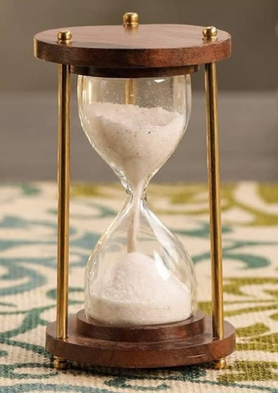
TE-MPE Annual Meeting
25 January 2024
Welcome and General Information
Jan Uythoven
Many thanks to the Section Leaders and group members for their input
Special thanks to Daniel Wollmann, Daniel Calcoen and Claudia Dupraz
15 min

Slide 3
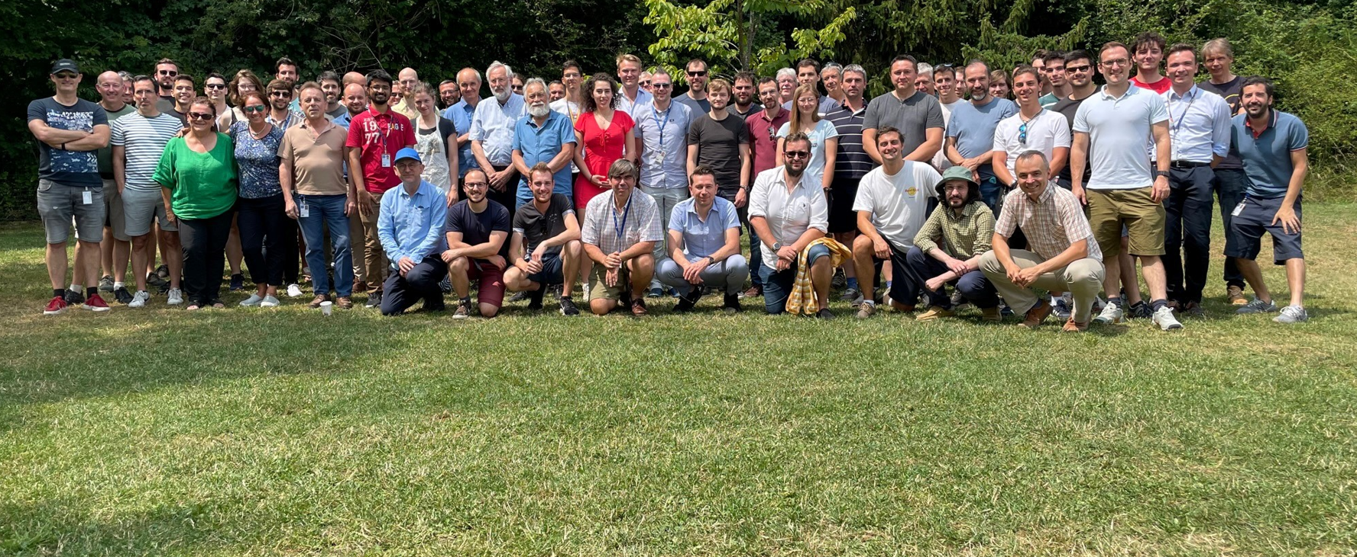
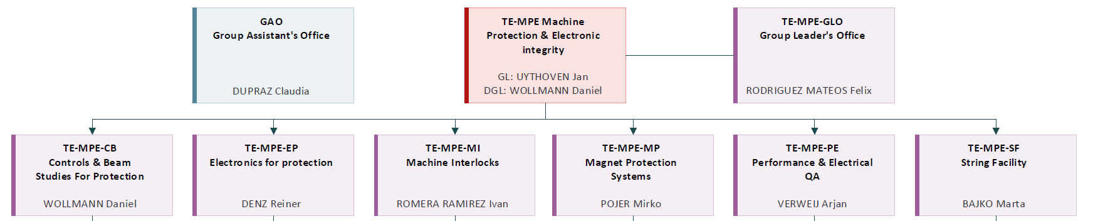
Machine Protection and Electrical Integrity

Slide 4
Machine Protection and Electrical Integrity

Slide 5
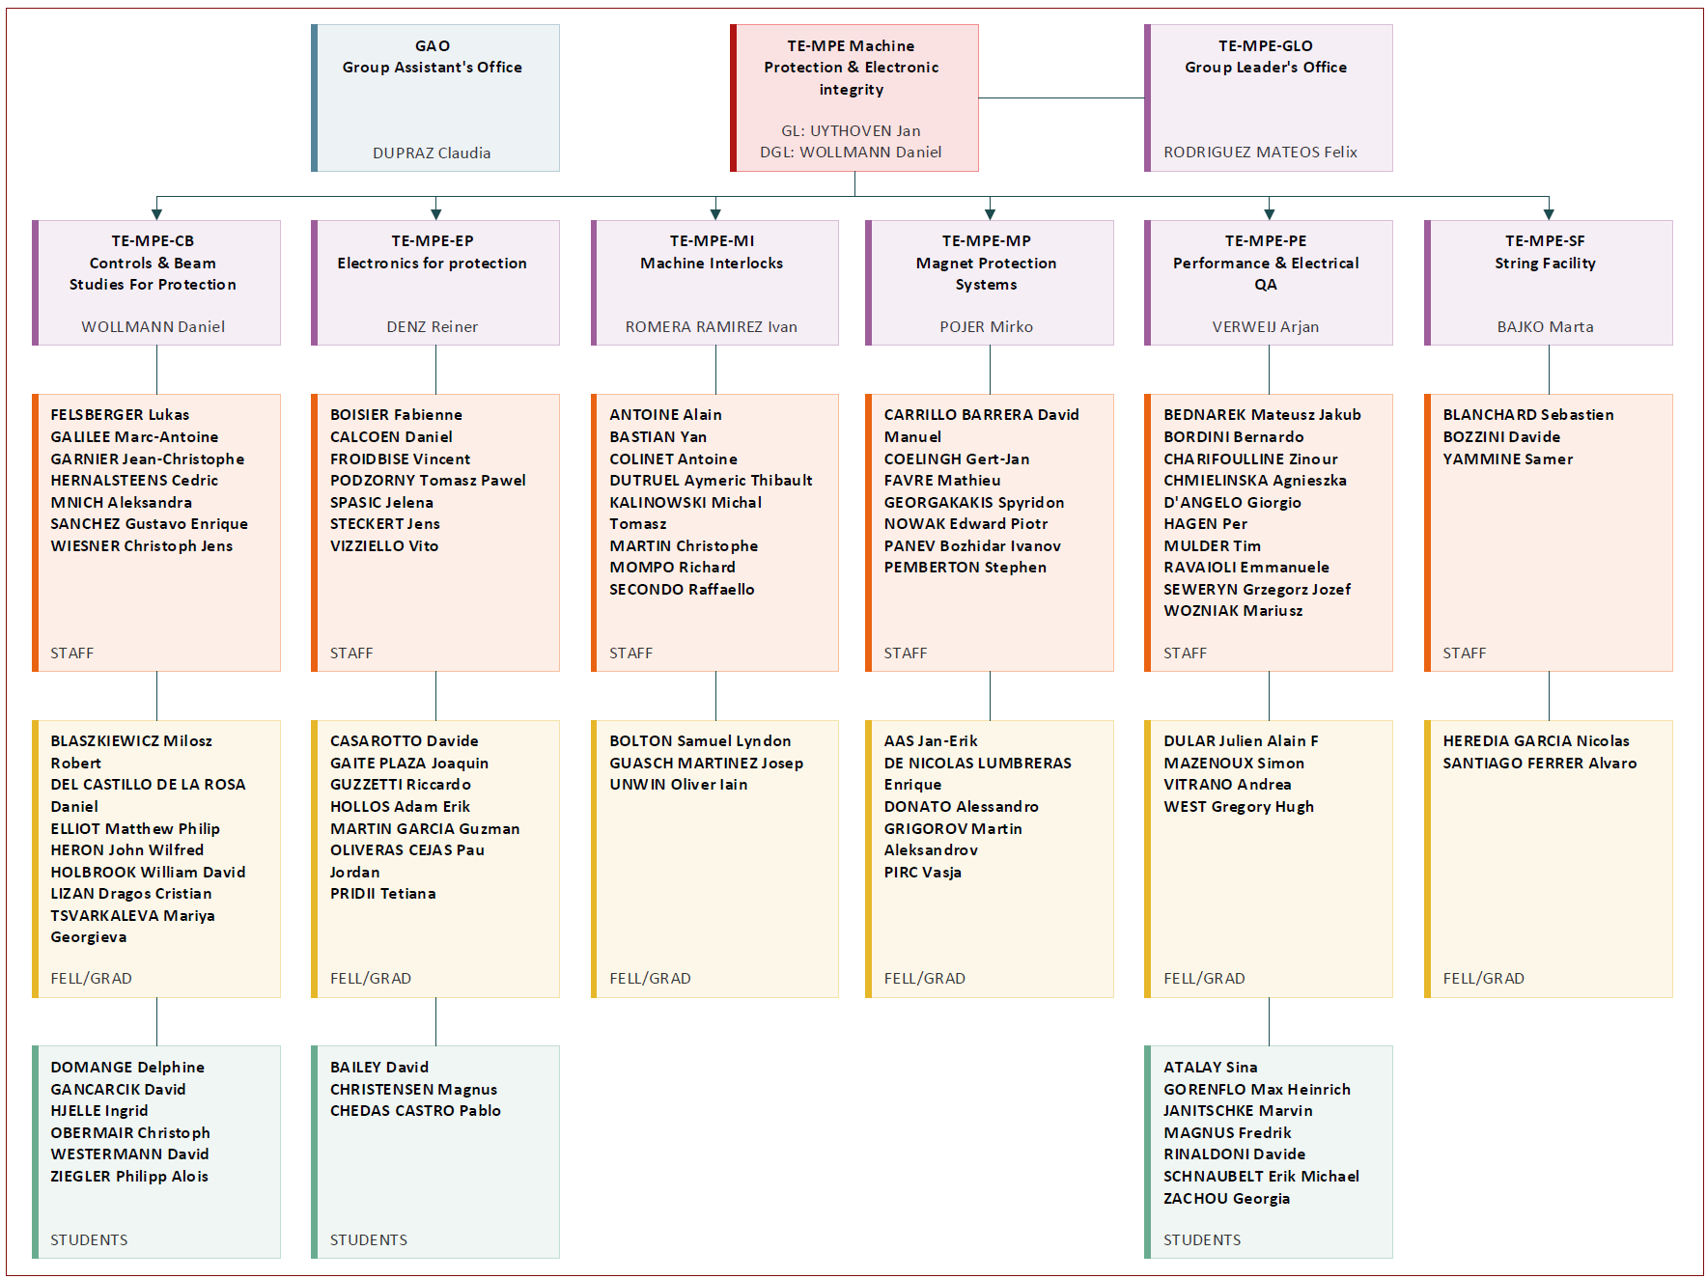
Machine Protection and Electrical Integrity

Slide 6

Arrivals in 2023: Welcome !
Staff
Graduates
CHMIELINSKA Agnieszka PE
DUTRUEL Aymeric MI
FELSBERGER Lukas CB
HERNALSTEENS Cedric CB
MNICH Aleksandra CB
AAS Jan-Erik MP
DEL CASTILLO
DE LA ROSA Daniel CB
DONATO Alessandro MP
DULAR Julien PE
ELLIOT Matthew CB
GAITE PLAZA Joaquin EP
GUZZETTI Riccardo EP
HOLBROOK William CB
LIZAN Dragos CB
MAZENOUX Simon PE
OLIVERAS CEJAS Pa EP
PIRC Vasja MP
UNWIN Oliver MI
WEST Gregory PE
Students
ATALAY Sina PE
BAILEY David EP
CHEDAS
CASTRO Pablo EP
GORENFLO Max PE
HJELLE Ingrid CB
MAGNUS Fredrik PE
RINALDONI Davide PE
ZACHOU Georgia PE
WESTERMANN David CB
ZIEGLER Philipp CB

Slide 7
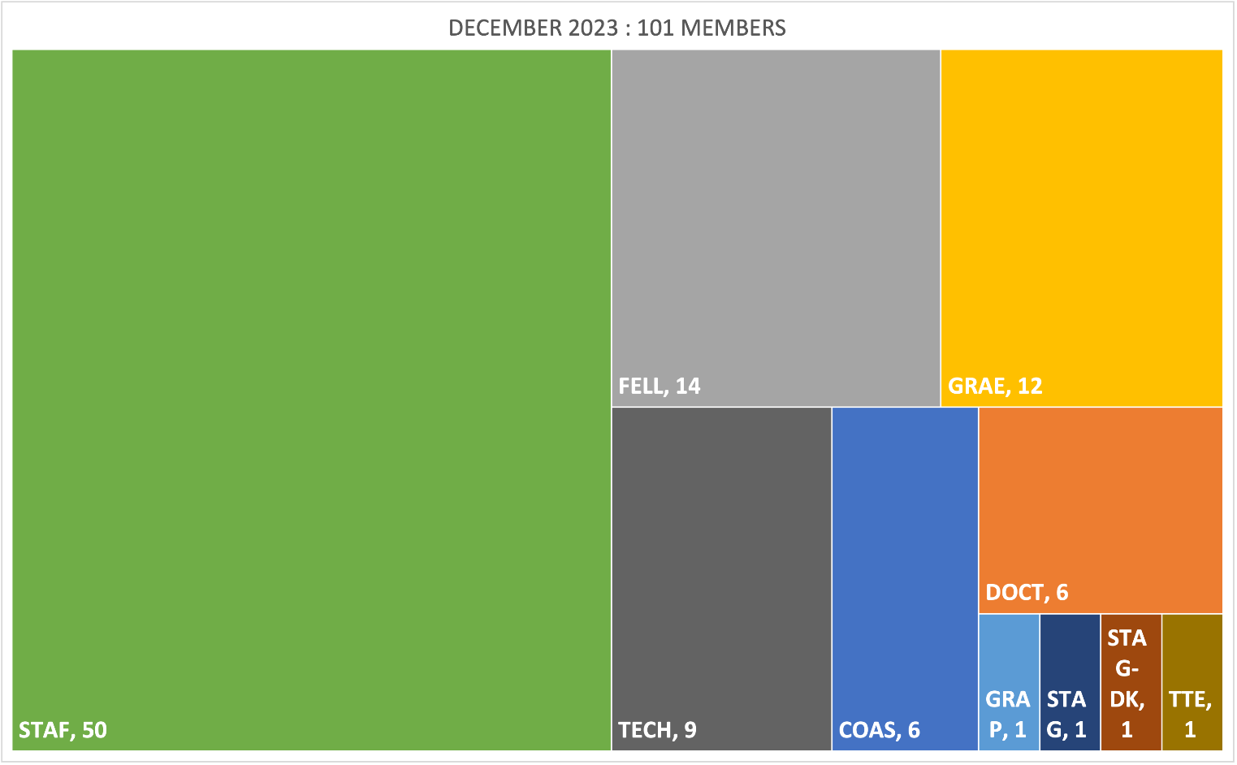
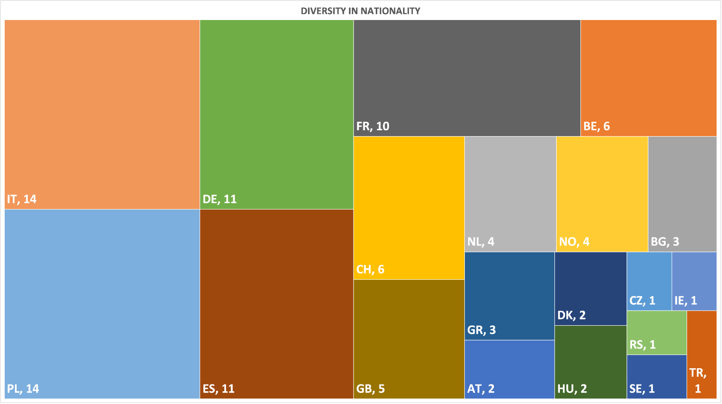
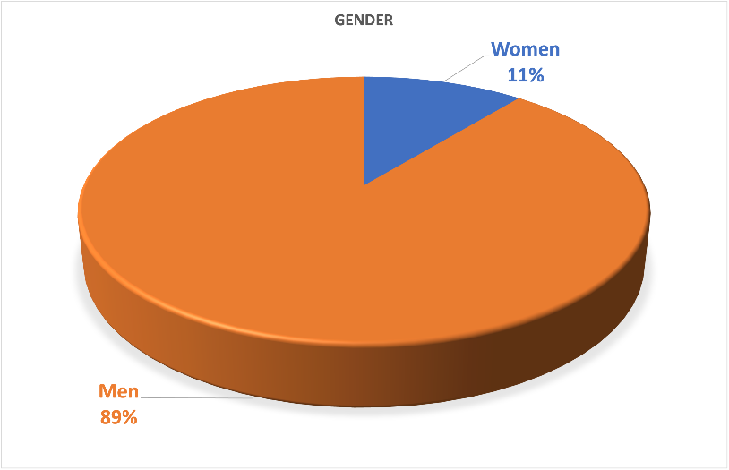
MPE Statistics 2023
December 2023 : 101 members
December 2022 : 92 members
December 2021 : 89 members
20 nationalities
But only 11 % women, something to be worked on!

Slide 8
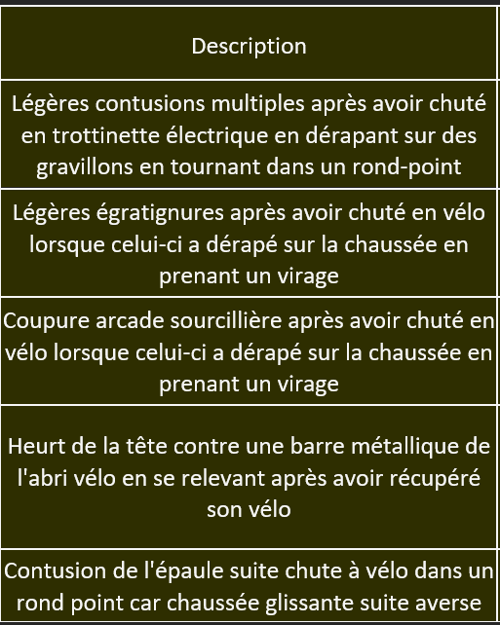

Safety, our highest priority
2023 MPE declared accidents
No accident-related absences in 2023
No major accidents in 2023:
  All declared accidents are related to transport by bike or e-scooter
  We had one near miss related to electrical safety … !
Keep on taking care of your and other people’s safety
Drive a bit more slowly on your bike or e-scooter in the bends !!
  Keep on riding and be visible!

Slide 9
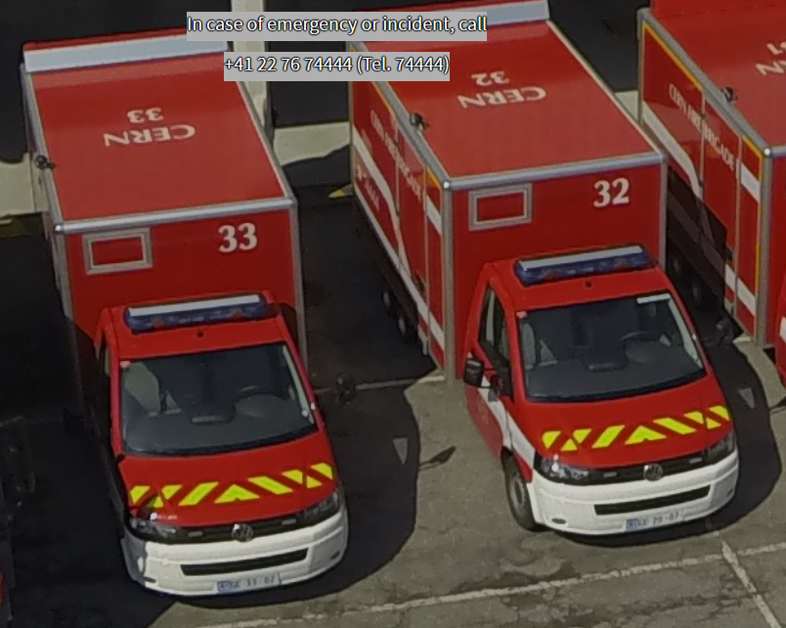
(022 76) 7 44 44

Slide 10
One quick slide per Section
Not covering the work done by the section or claiming to be complete in any sense
The aim is to give newcomers a taste of what else we are doing in the group
More complete overviews to be schedules at the MPE Technical Meetings

Slide 11
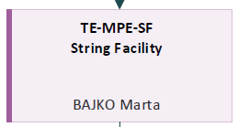
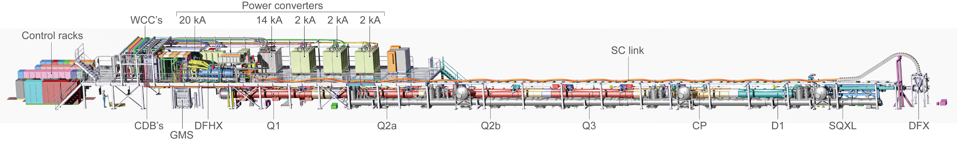
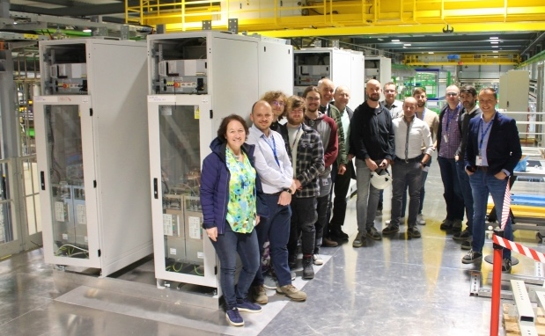
High Luminosity LHC Inner Triplet String Facility
Hardware Commissioning
Operation

Slide 12
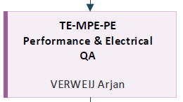
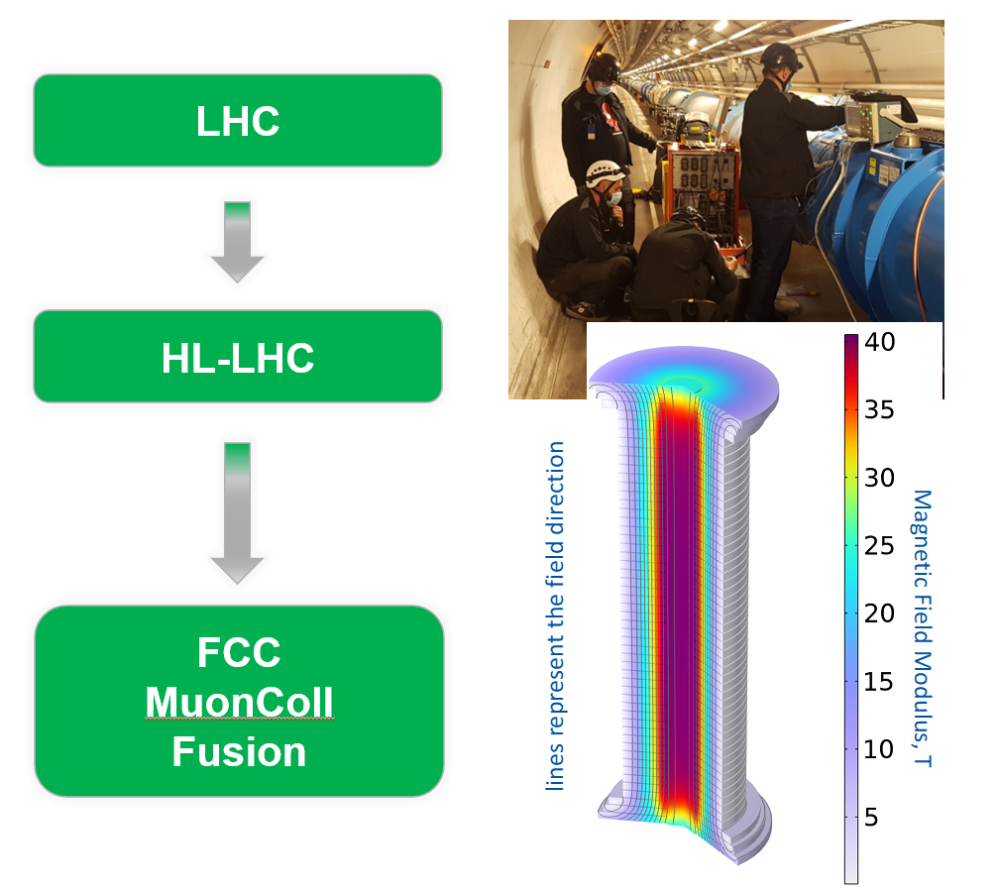
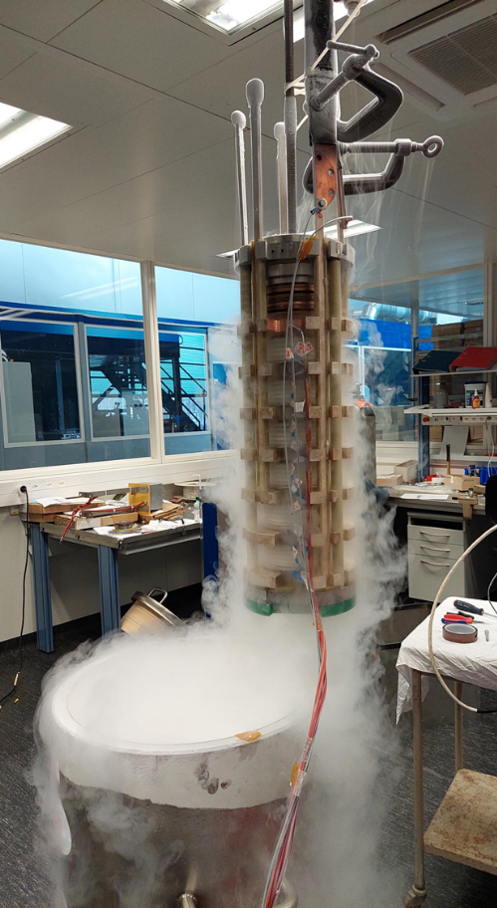
Superconducting Magnets Hardware Commissioning
Operation, MP3, SigMon, cold diodes, …
Electrical Quality Assurance
STEAM framework:
Simulation of Transient Effects in Accelerator Magnets
Simulation and protection of sc magnets for future applications
HL-LHC cold diodes under test at LN2

Slide 13
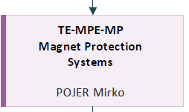
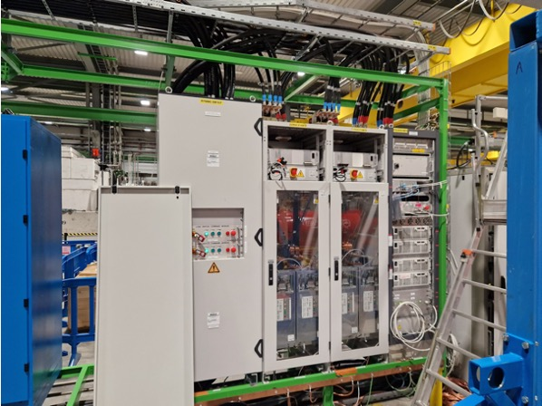
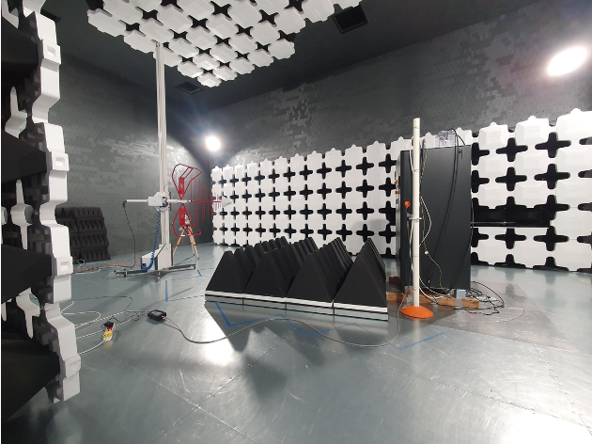
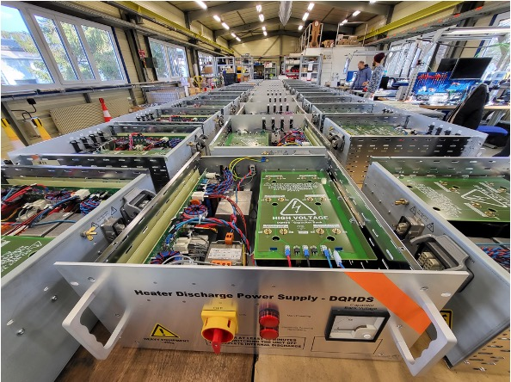
Quench Protection Energy Extraction Systems
Circuit breakers / switches / DC contactors
CLIQ
Quench Heater Power Supplies
Universal Control Electronics for EE systems
2 x 2 kA systems in cluster F1 in SM18
CLIQ pre-series unit during
CE marking
DQHDS for the STRING

Slide 14
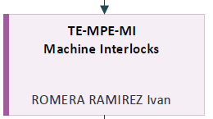
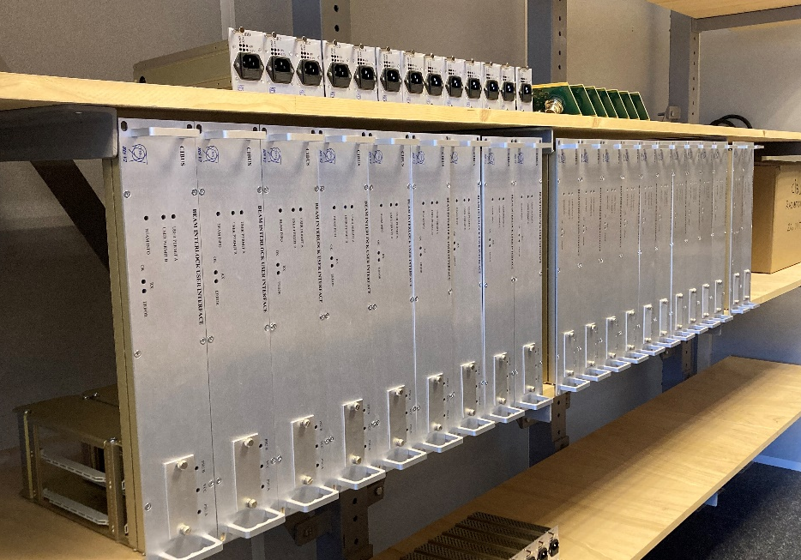
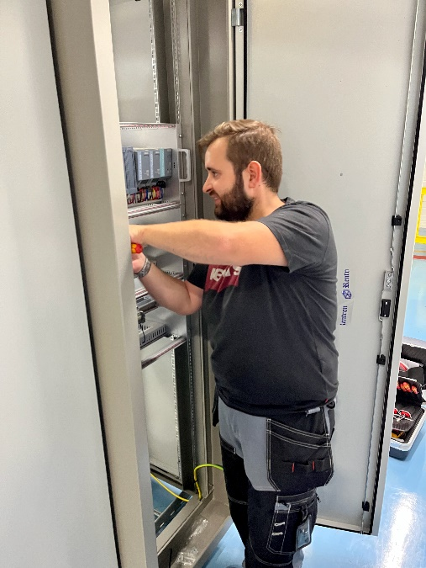
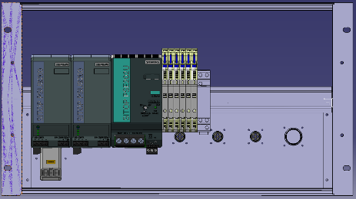
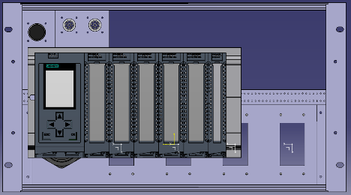
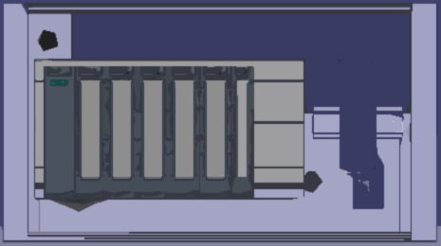
Beam Interlock System BIS
Safe Machine Parameters SMP
Warm magnet Interlock Controller WIC
Power Interlock Controller PIC
Fast Magnet Current change Monitor FMCM
…
WICv2 generic crate and patch panel design
CIBU v2 – Series production hardware
PICv2 Prototype in the IT-String

Slide 15
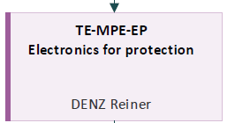
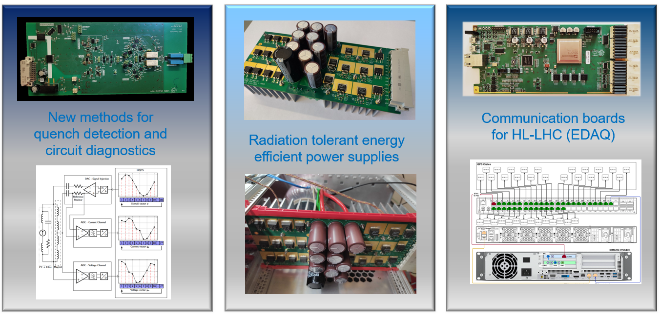
Quench Detection System (QDS) & Consolidation
  UQDS, PDSU, EDAQ
DAQs for test benches (SM18, IT String)
Research and Development

Slide 16
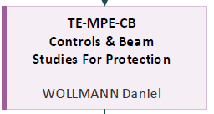
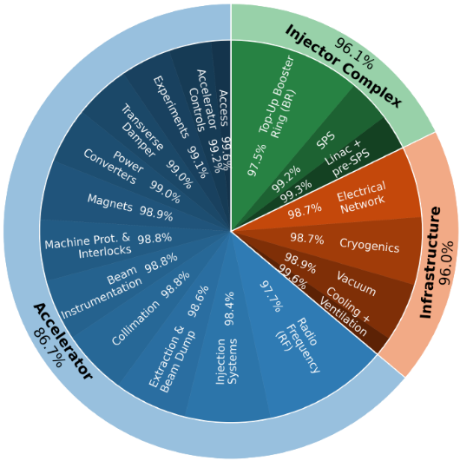
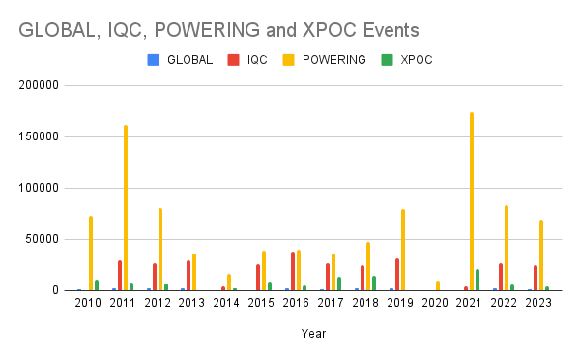
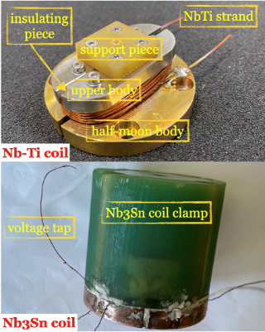
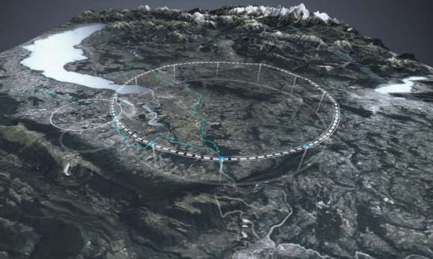
Controls and software systems
Post Mortem, SigMon, AccTesting
Dependability studies for protection systems and accelerators
Failure case and beam induced damage studies
UFOs
Machine Protection Panel

Slide 17

The Future – 2024 and beyond
Safety
Operation of our accelerator complex
HL-LHC
  All sections involved
  Owner of HL workpackages (7 and 16)
Consolidation of existing systems
Future accelerators and R&D

Slide 18

Next:
8 min
They are not:
  The highlights of the section
  Covering the most important topic of the section
They are aimed to be:
  Speed (7 – 8 minutes)
  Interesting

