Slide 1
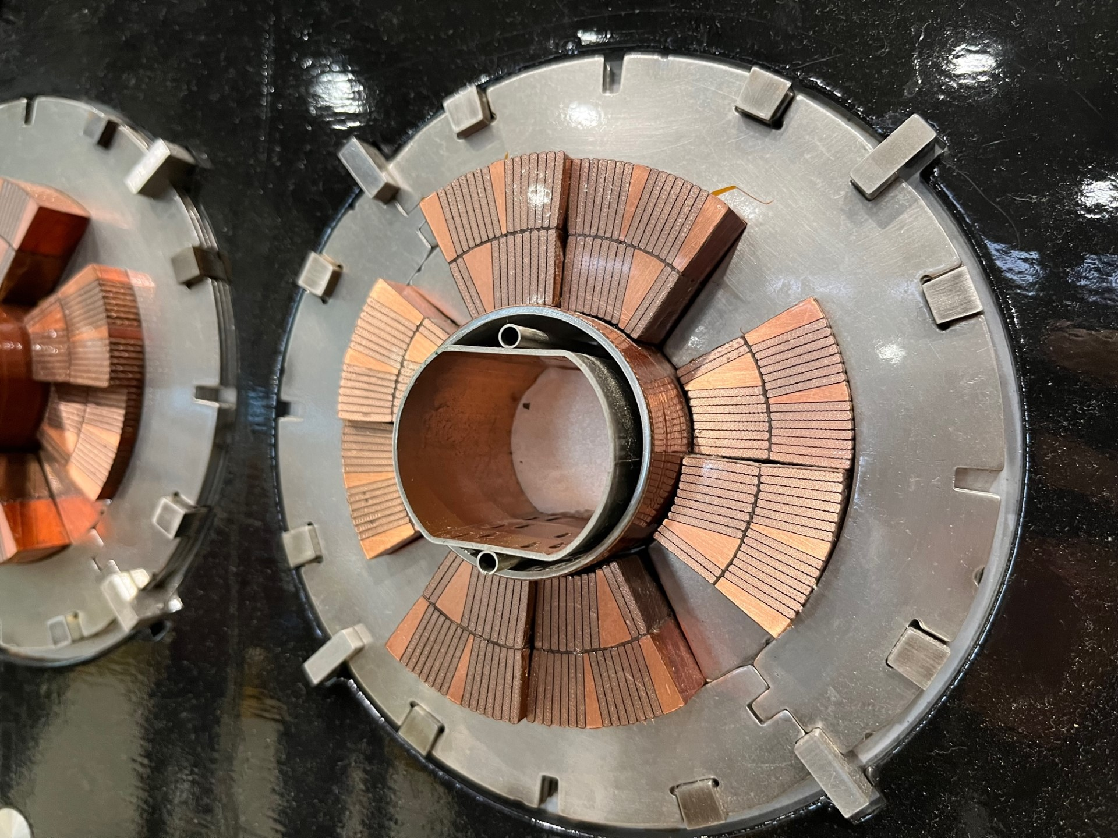



New Finite Element Models for SC Accelerator Magnets
HFM
TE-MPE-PE
Julien Dular
on behalf on the PE section

Slide 2
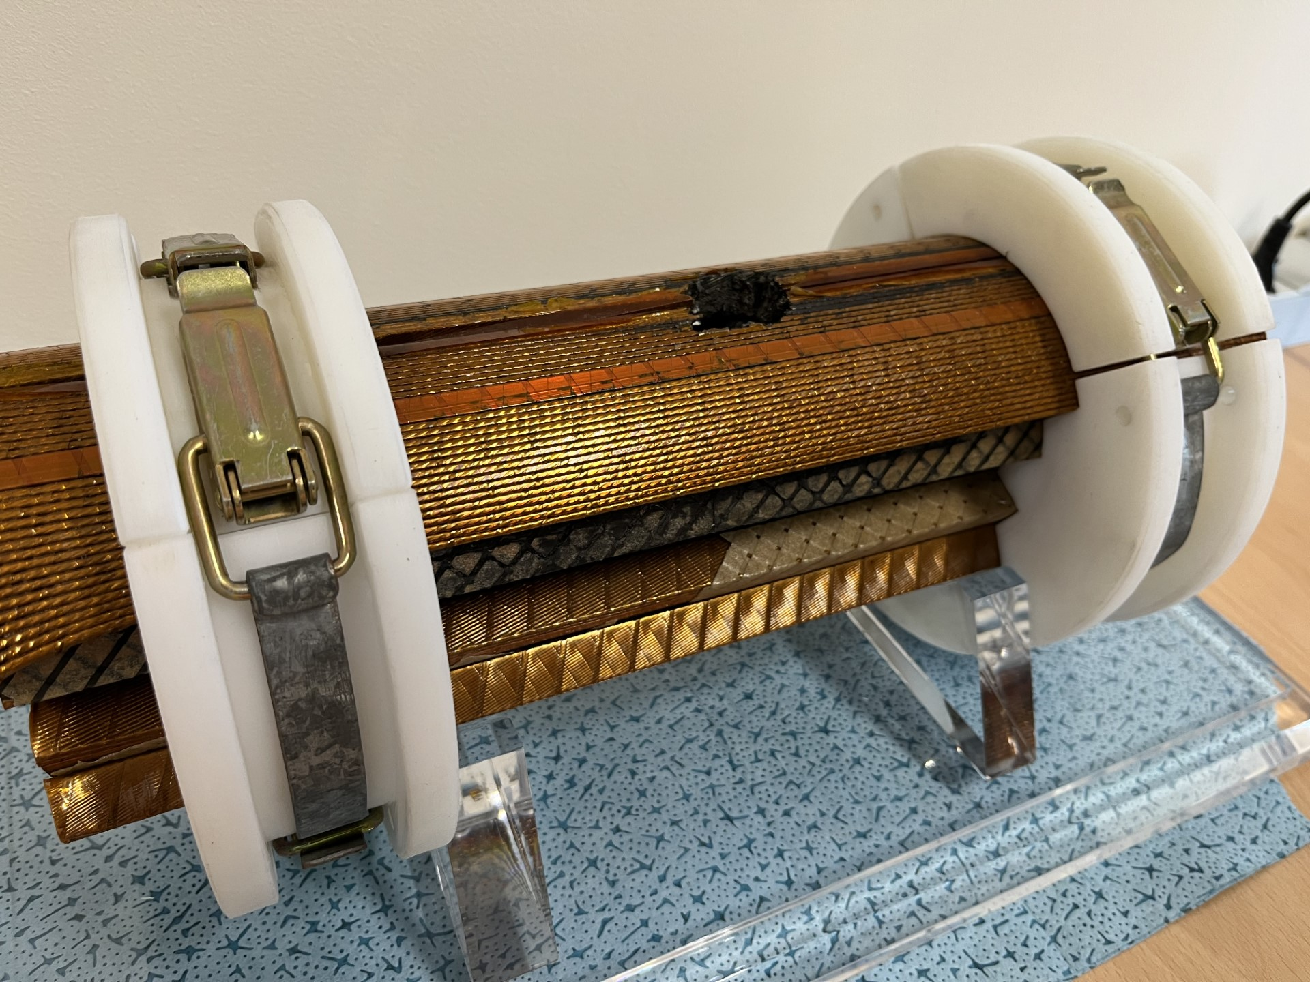
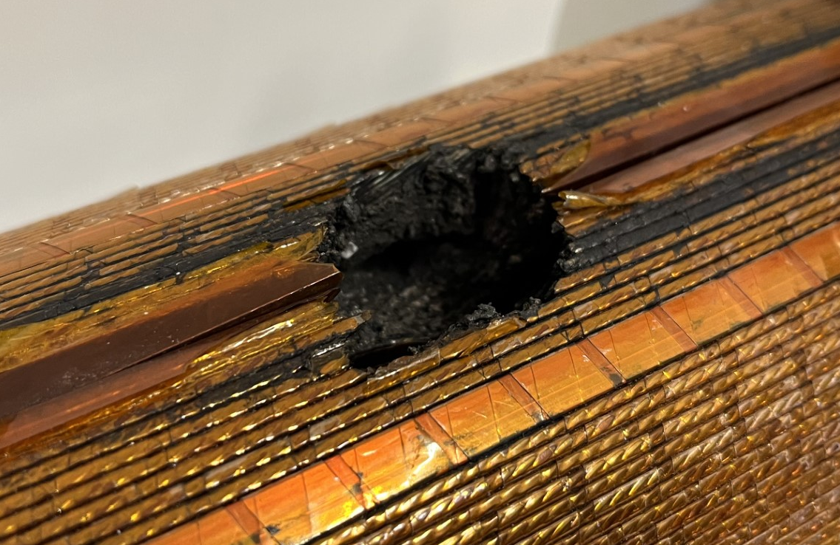
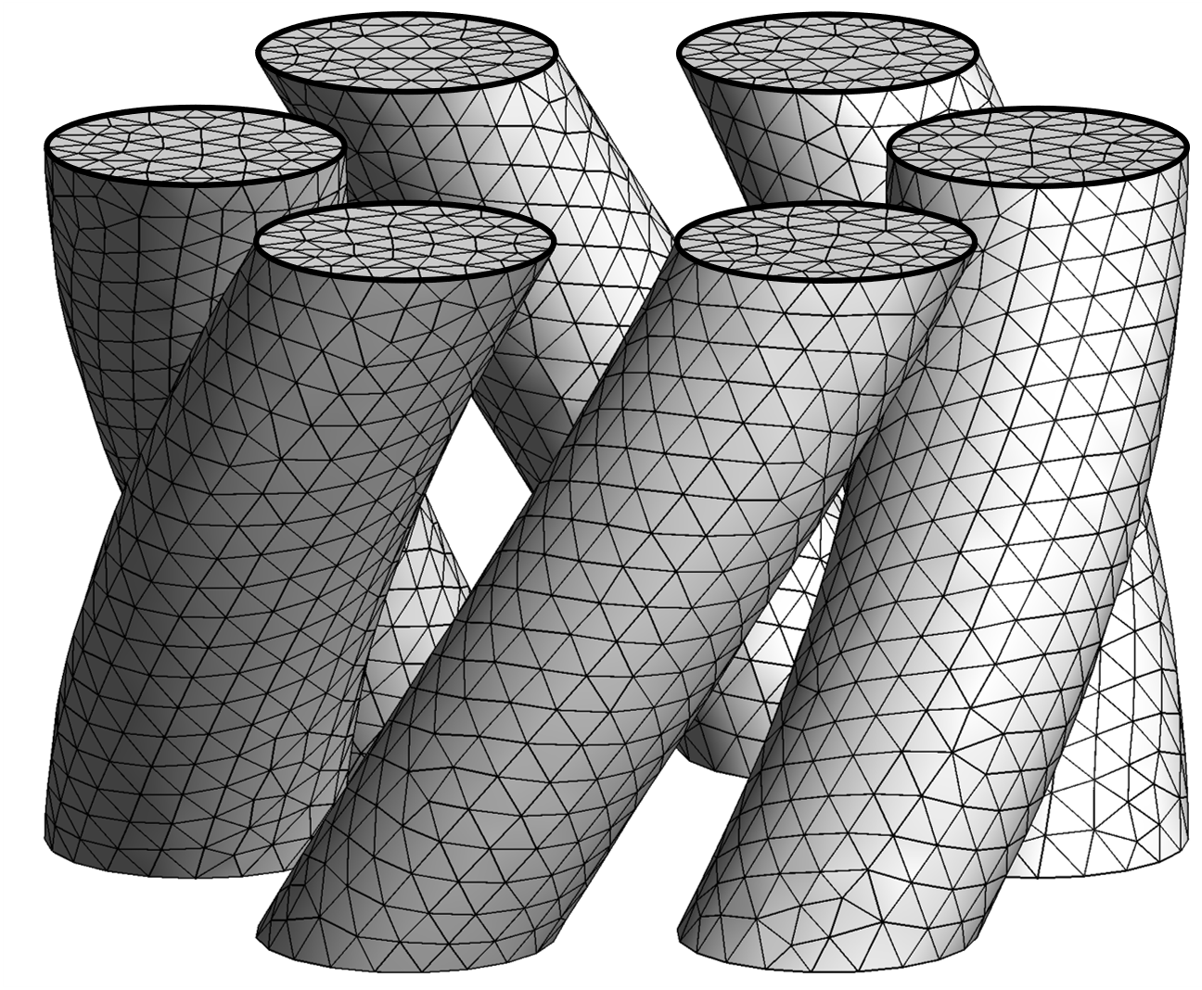
Numerical modelling for magnet protection
Need for efficient protection techniques on future high-field magnets (e.g. E-CLIQ).
Numerical modelling is a powerful tool for design.
Finite Element Quench Simulator
  Open-source and free to use
  Based on GetDP/Gmsh, chosen for their flexibility
  Part of framework
Finite Element Method
Arbitrary mesh
Variational equations
Series of matrix systems: Ax = b

Slide 3
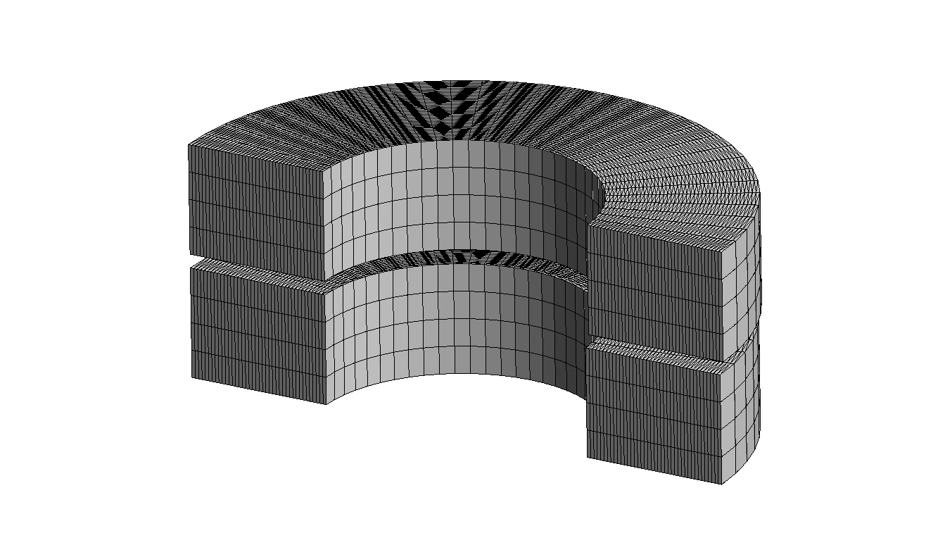
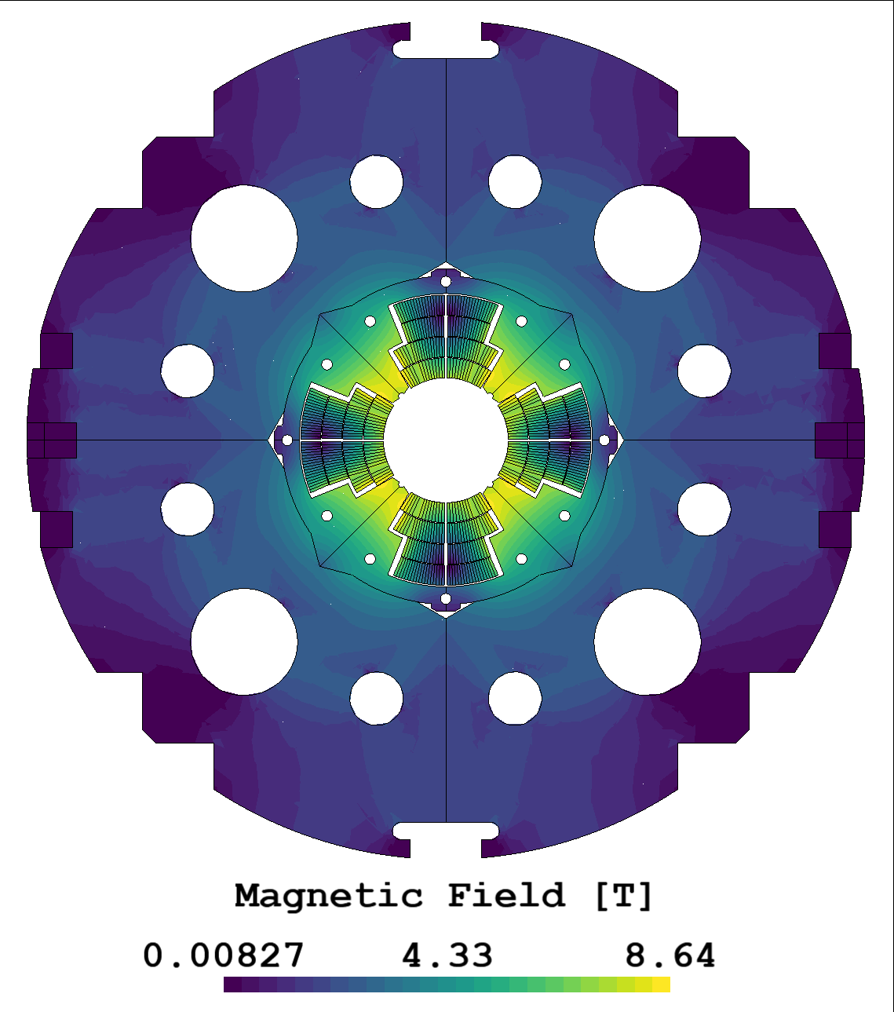
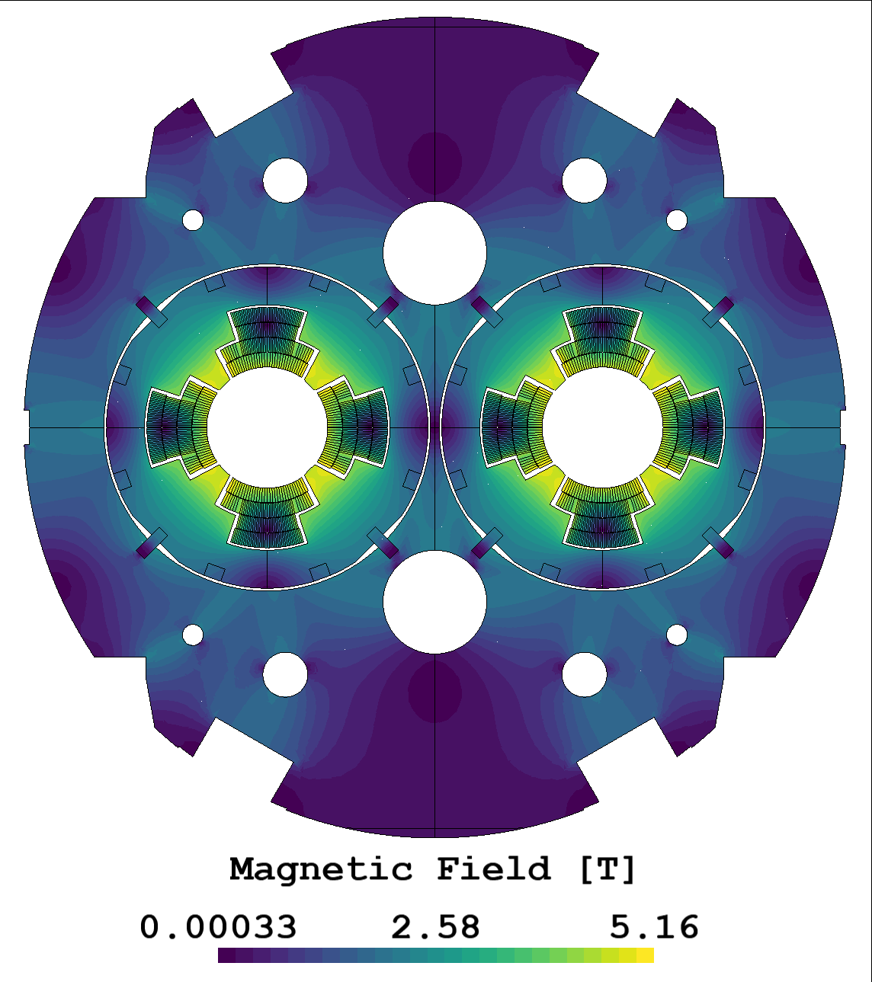
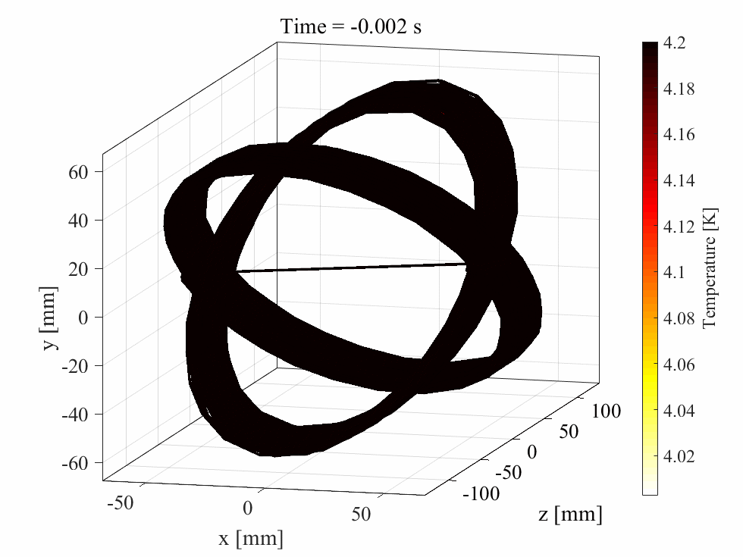
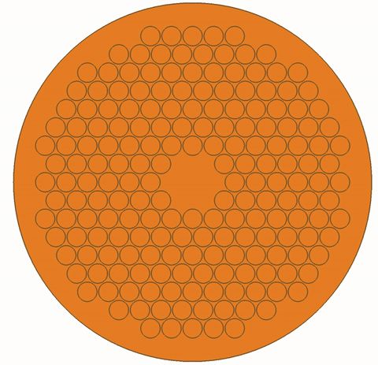
- An open-source FE tool
Multipole magnets (MQXA & MQY)
No-Insulation HTS Pancake coils
…and more…
CCT magnet
Co-simulation with LEDET
Conductors (wires, cables)
Courtesy of A. Vitrano, E. Schnaubelt, S. Atalay, M. Wozniak, E. Ravaioli, F. Magnus

Slide 4

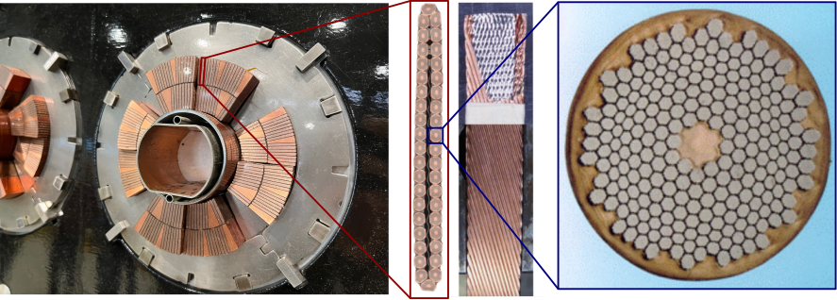
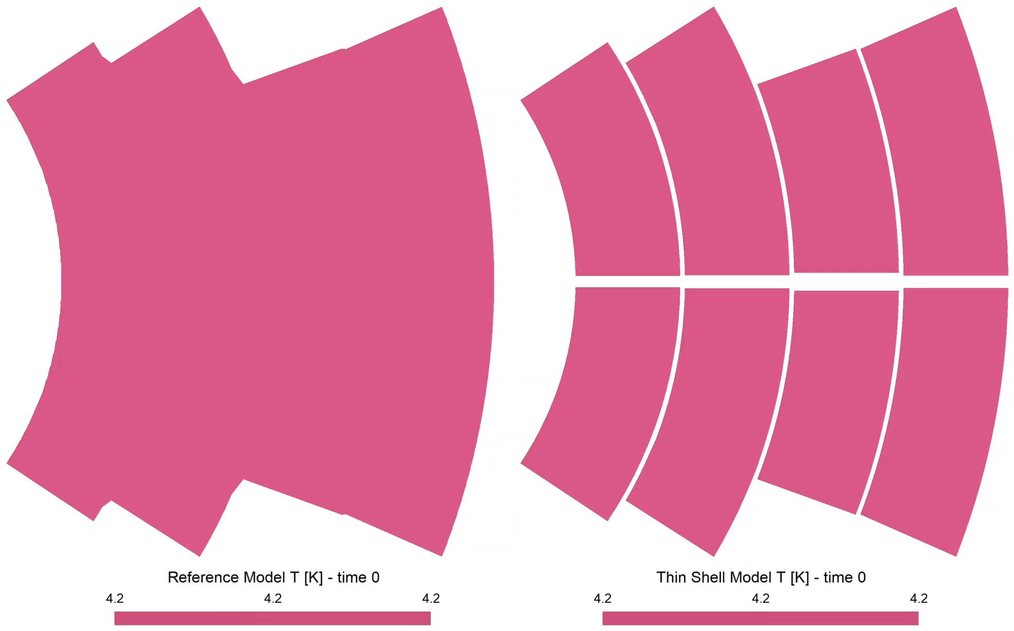
Magneto-thermal transients in magnets
Magnets are multi-scale structures.
Macroscopic response (e.g. Quench) depends on small-scale dynamics.
Full models would be too big to solve.
Need for lighter models:
3D→2D*, homogenization, thin-shell approx…
1 mm
~1h CPU per strand → ~40×200 strands in magnet → ~1 year for one simulation!
Courtesy of A. Vitrano, E. Schnaubelt, F. Magnus

Slide 5
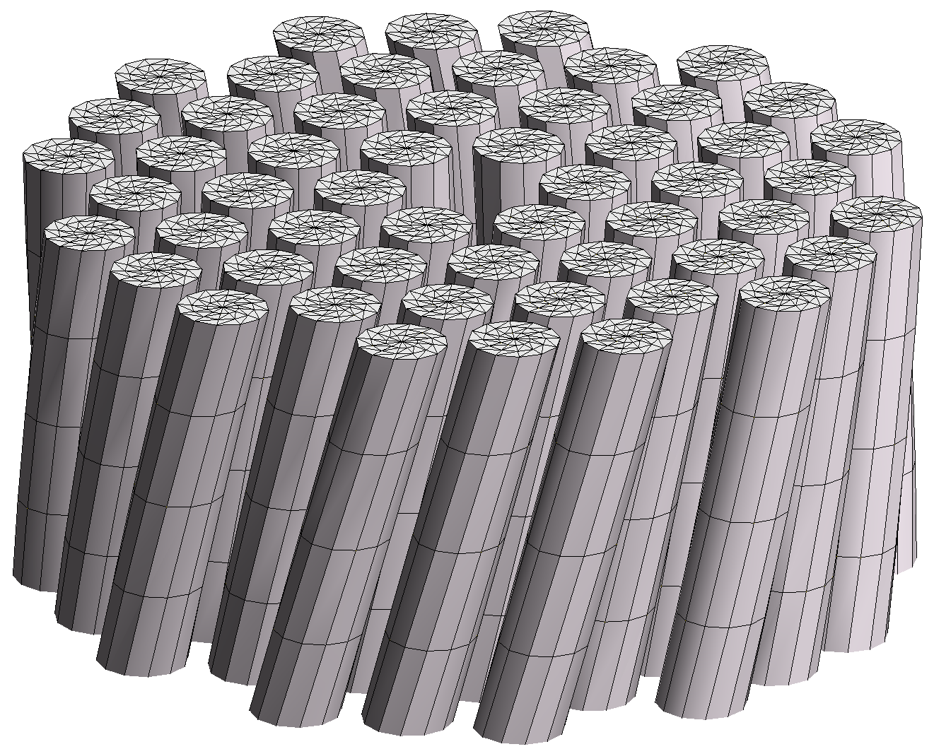
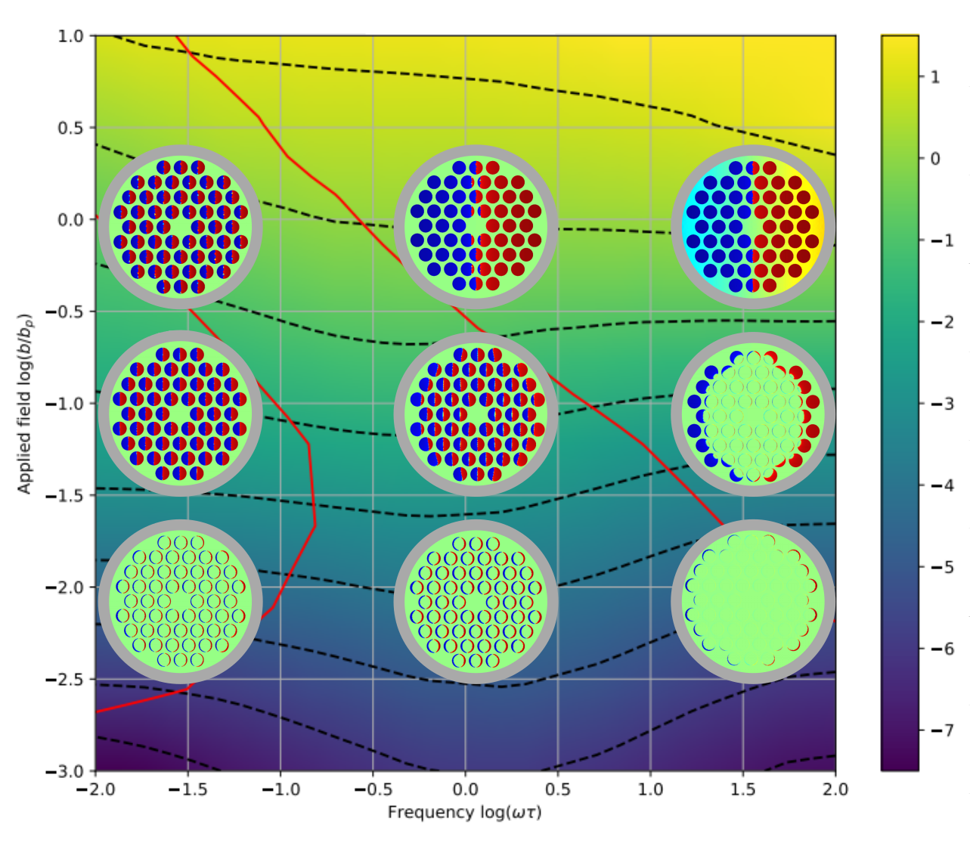
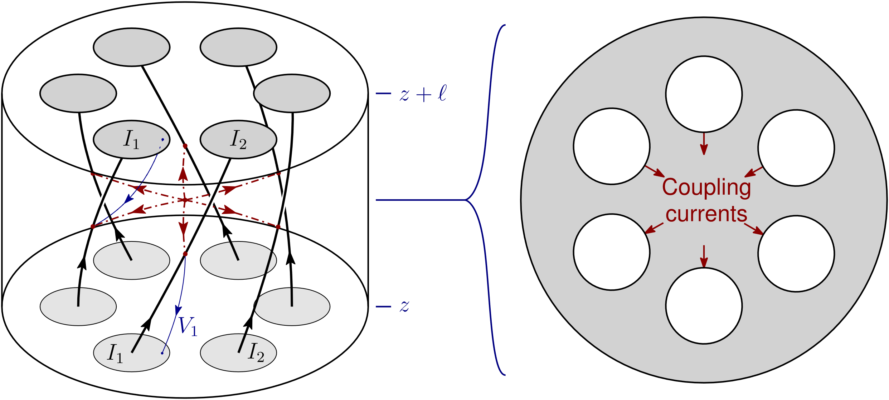









Linked-flux FE method
Objective: describe the response of composite superconducting conductors,
  AC loss, magnetization, inductance.
Linked-flux method - 2D model:
  One problem for out-of-plane currents,
  One problem for in-plane currents,
  Coupling via circuit equations.
Example - AC loss w.r.t. field and frequency:
Loss per cycle (J/m)
$${10}^{2}$$
10 T
$${10}^{1}$$
$${10}^{0}$$
1 T
$${10}^{−1}$$
$${10}^{−2}$$
0.1 T
$${10}^{−3}$$
$${10}^{−4}$$
0.01 T
$${10}^{−5}$$
$${10}^{−6}$$
b
0.02 Hz
0.2 Hz
2 Hz
20 Hz
200 Hz
f

Slide 6
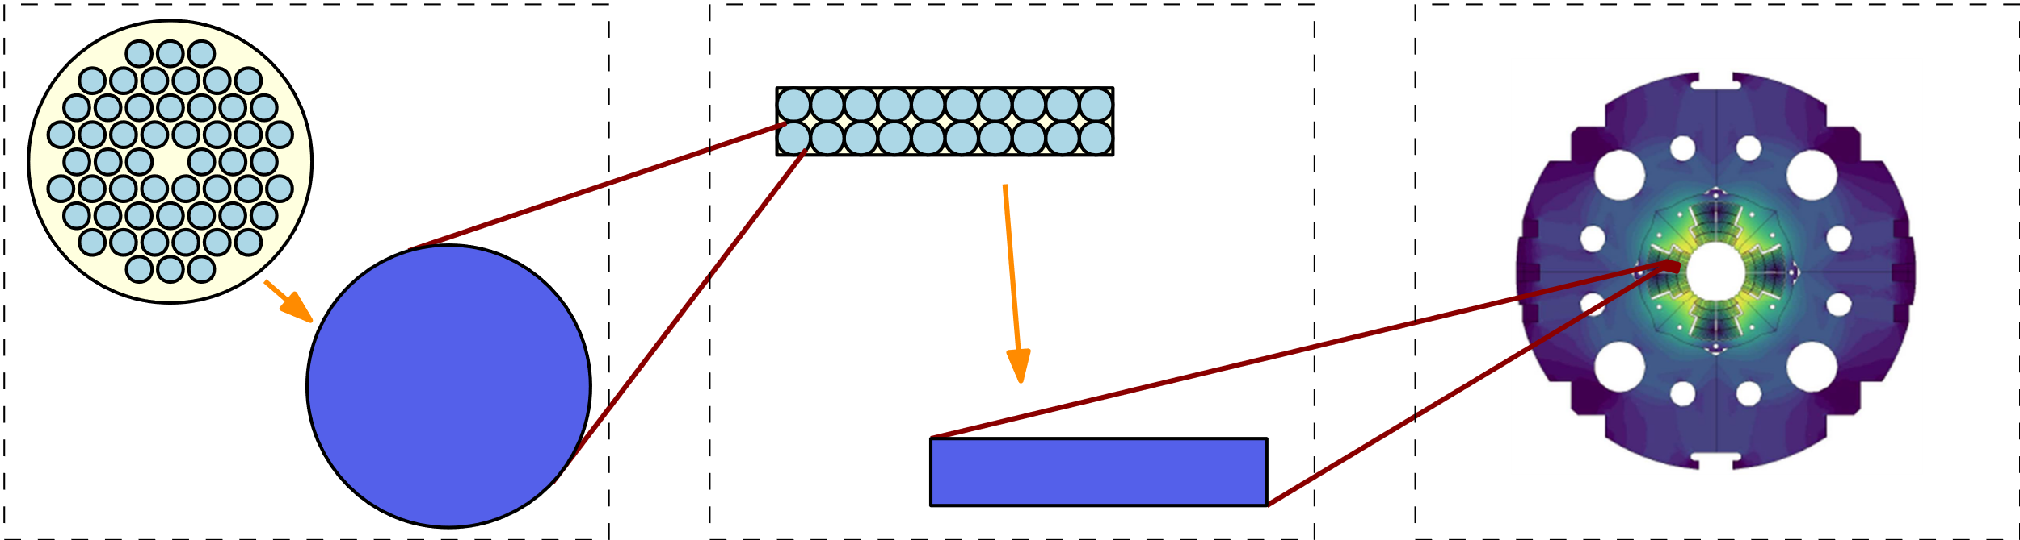
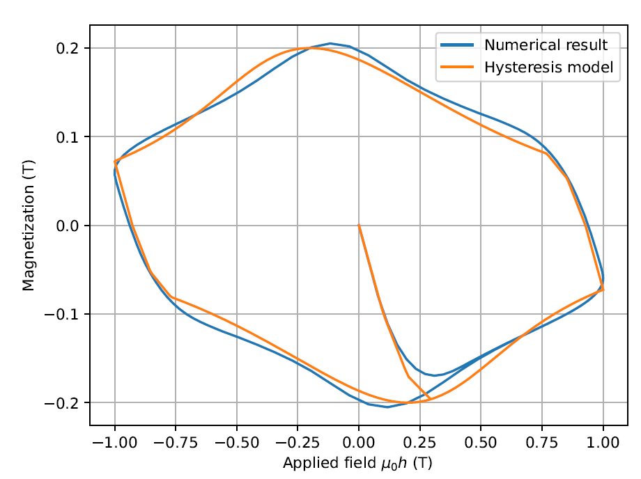
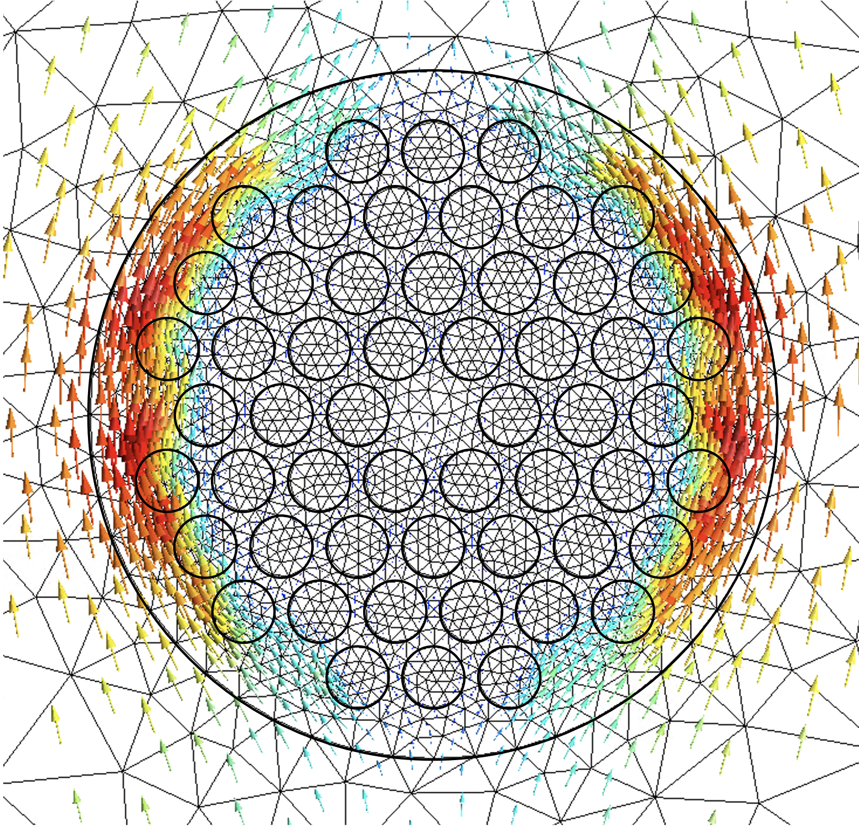
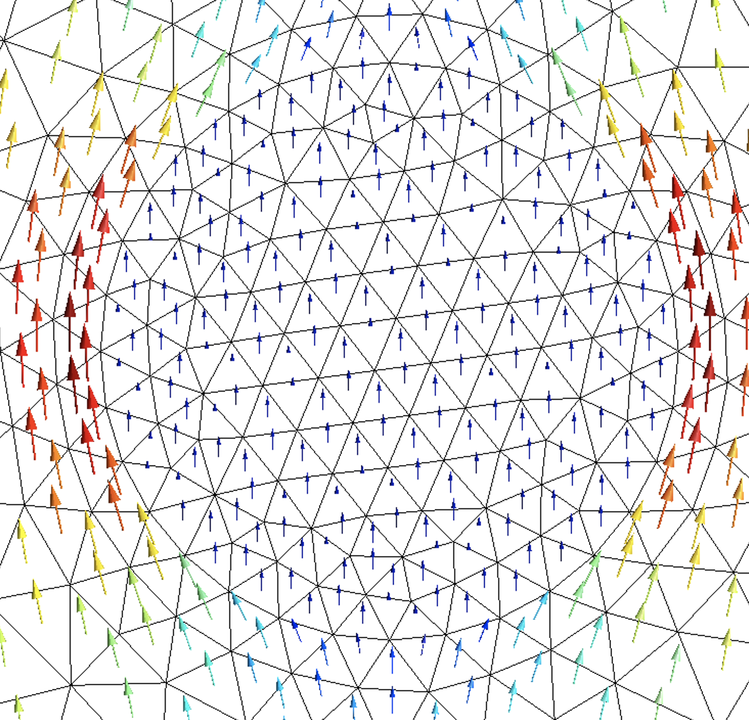
Magnet model with homogenization
Upscaling macroscopic response without describing small-scales explicitly.
This requires dedicated modelling tools:
  Light-weight dynamic vector hysteresis model,
  Equivalent resistance and inductance.
10 min CPU
5 sec CPU

Slide 7
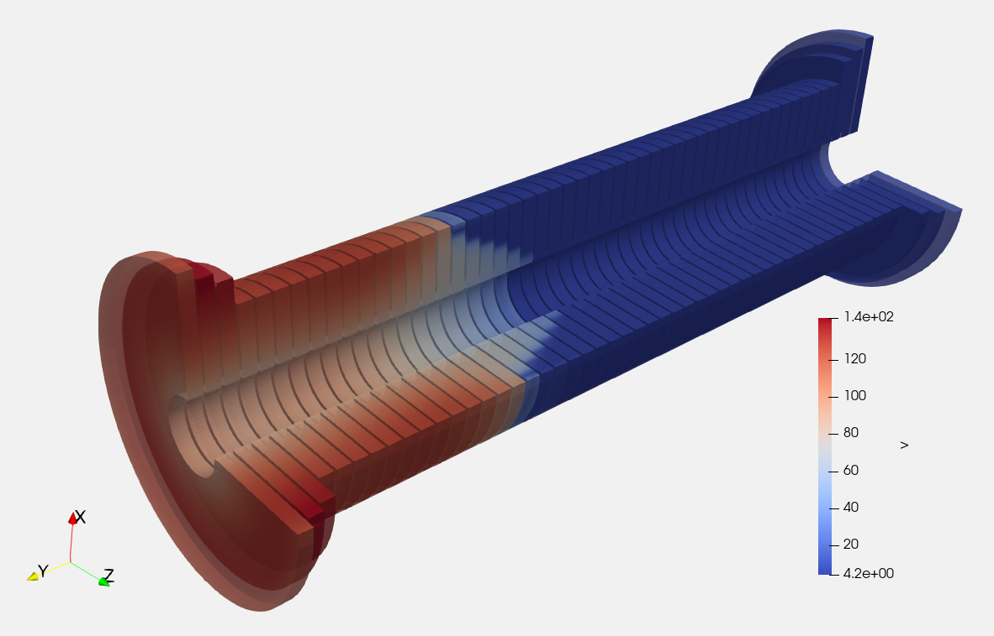
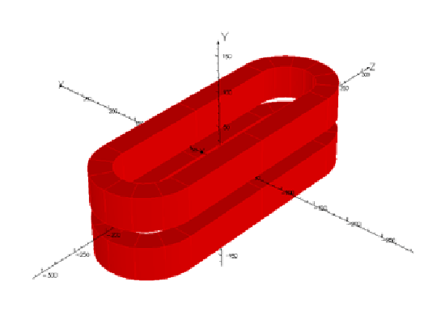
Outlook and conclusions
We investigate new finite element approaches for magneto-thermal transient simulations of accelerator magnets.
They are first validated on LTS magnets and cables.
As a next step, they will be extended to HTS magnets:
NI HTS solenoid
3D Racetrack coils
Homogenized
pancake coils
Courtesy of T. Mulder, S. Atalay, E. Schnaubelt, M. Wozniak
Thank you!

