Slide 1
CERN theme directions and subtheming
Dan Noyes, ENTICE 25 May 2011

Slide 2
Overview of web strategy
Graphic charter (recommendation)
CERN Drupal theme
How to subtheme

Slide 3
A vision for the CERN web
cern.ch
Department websites
Experiments
Groups
Services
Directories
Collaborative content
Personal websites
Scientific data
Organisational data
Metadata
Old stuff
…

Slide 4
A vision for the CERN web
cern.ch
Press office
Bulletin
Users’ site
Public website

Slide 5
A vision for the CERN web
cern.ch
CERN’s official website

Slide 6
‘Give me a template’
Backwards design
Degrade quickly
Conflicts with co-branding

Slide 7
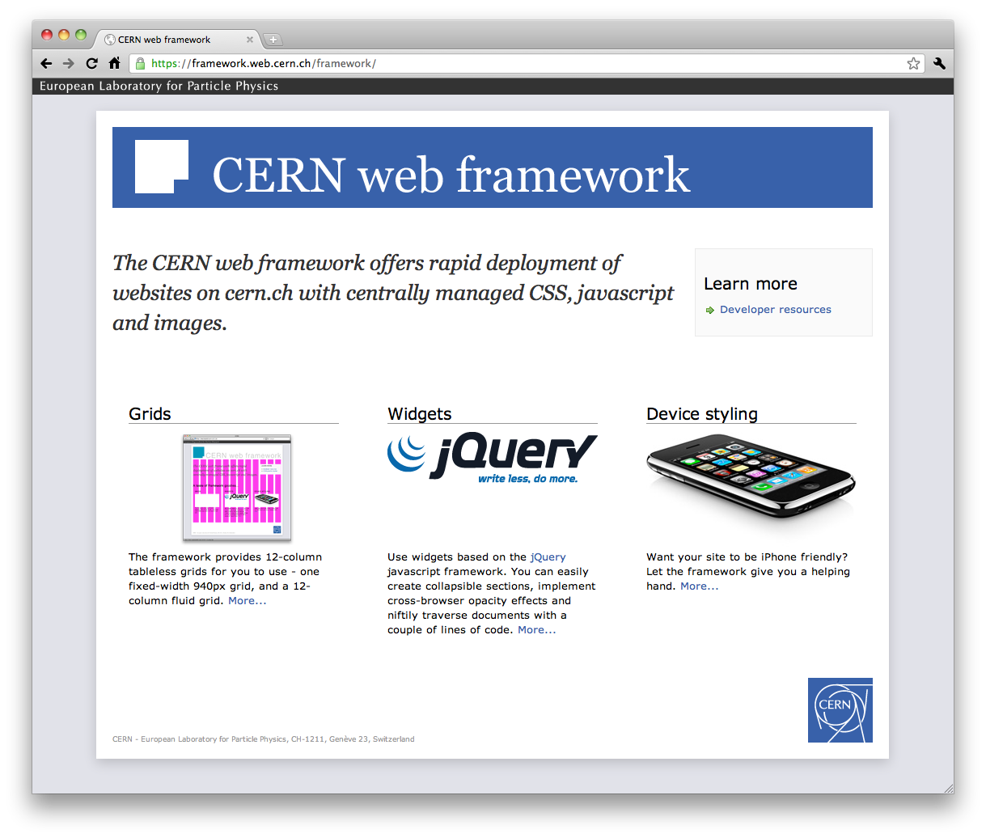
cern.ch/framework

Slide 8
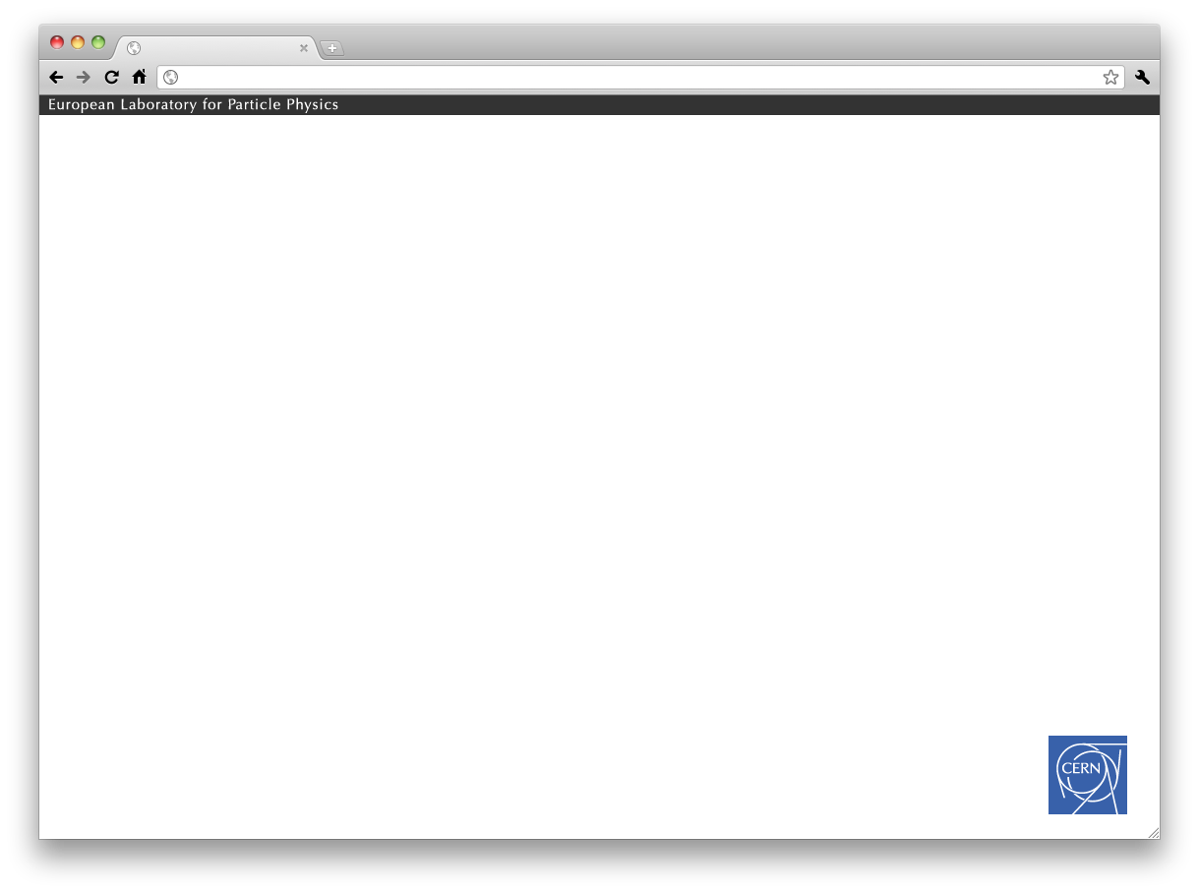
‘Strip and logo’ branding

Slide 9
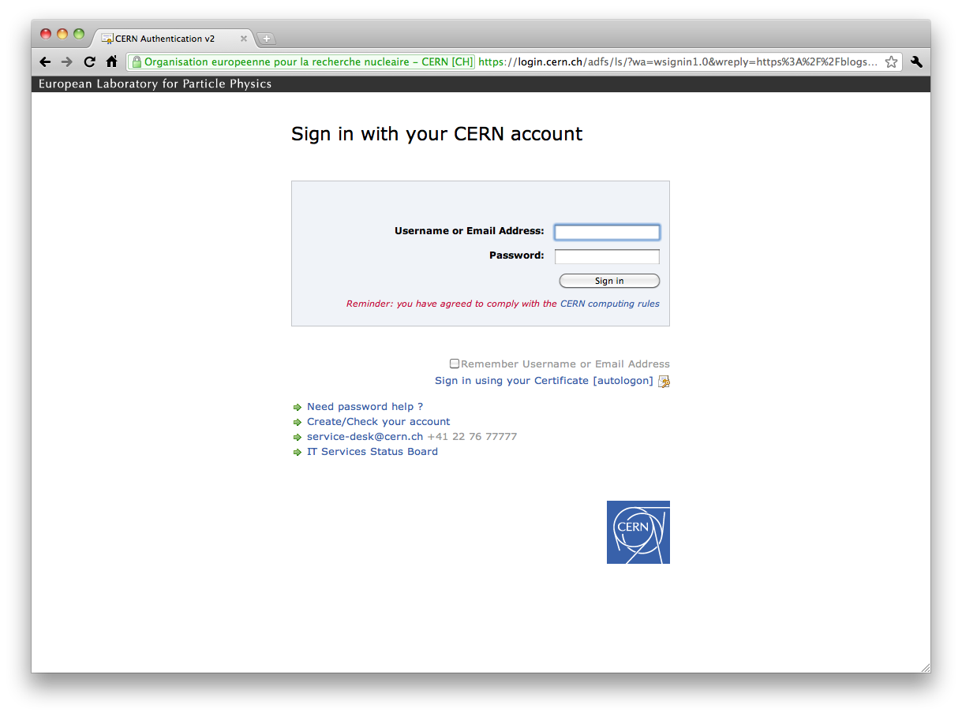

Slide 10
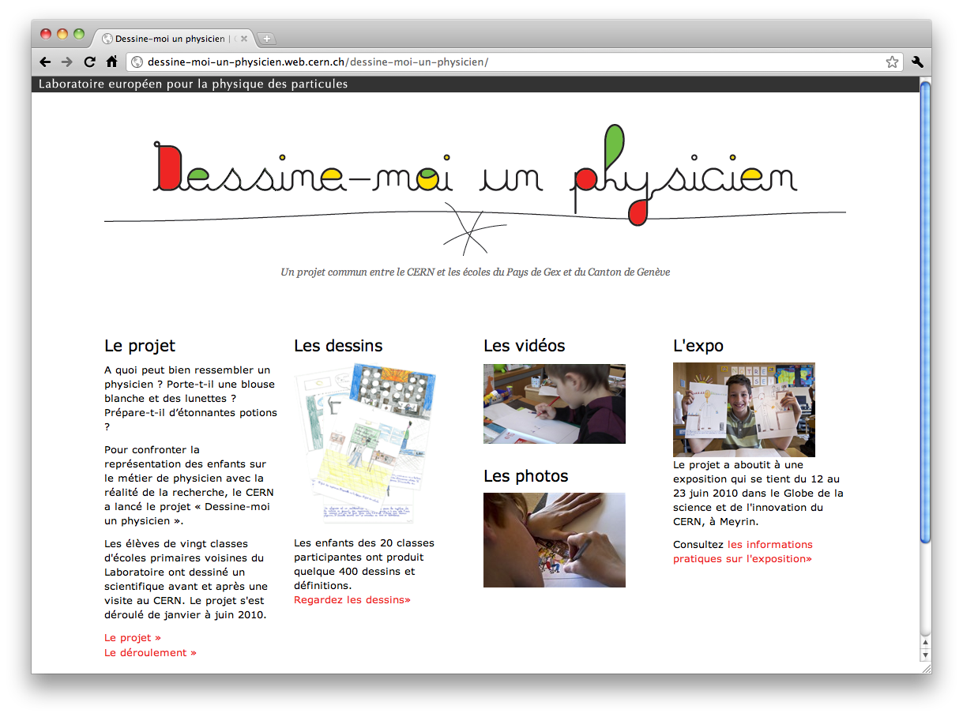

Slide 11
Working with designers
Strip and logo
CERN Drupal theme
New CERN website

Slide 12
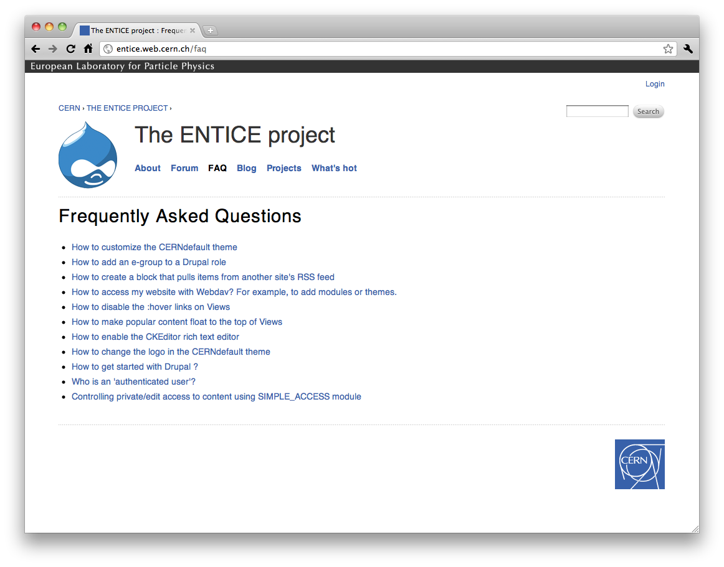
A Drupal theme for CERN

Slide 13
Subtheming - warnings
Not easy
Use a sandbox
Do you really need to subtheme?

Slide 14
How to subtheme the CERN theme
read http://drupal.org/node/225125
enable CERN default theme
download and enable cern_subtheme_base
customize

Slide 15
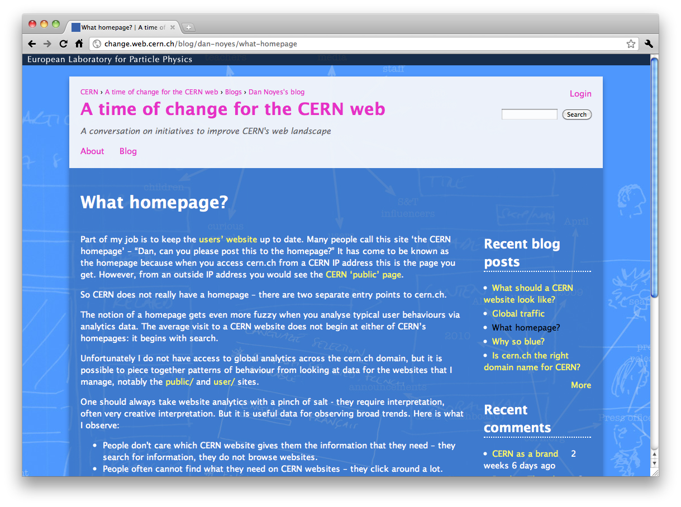
Subtheme examples

Slide 16
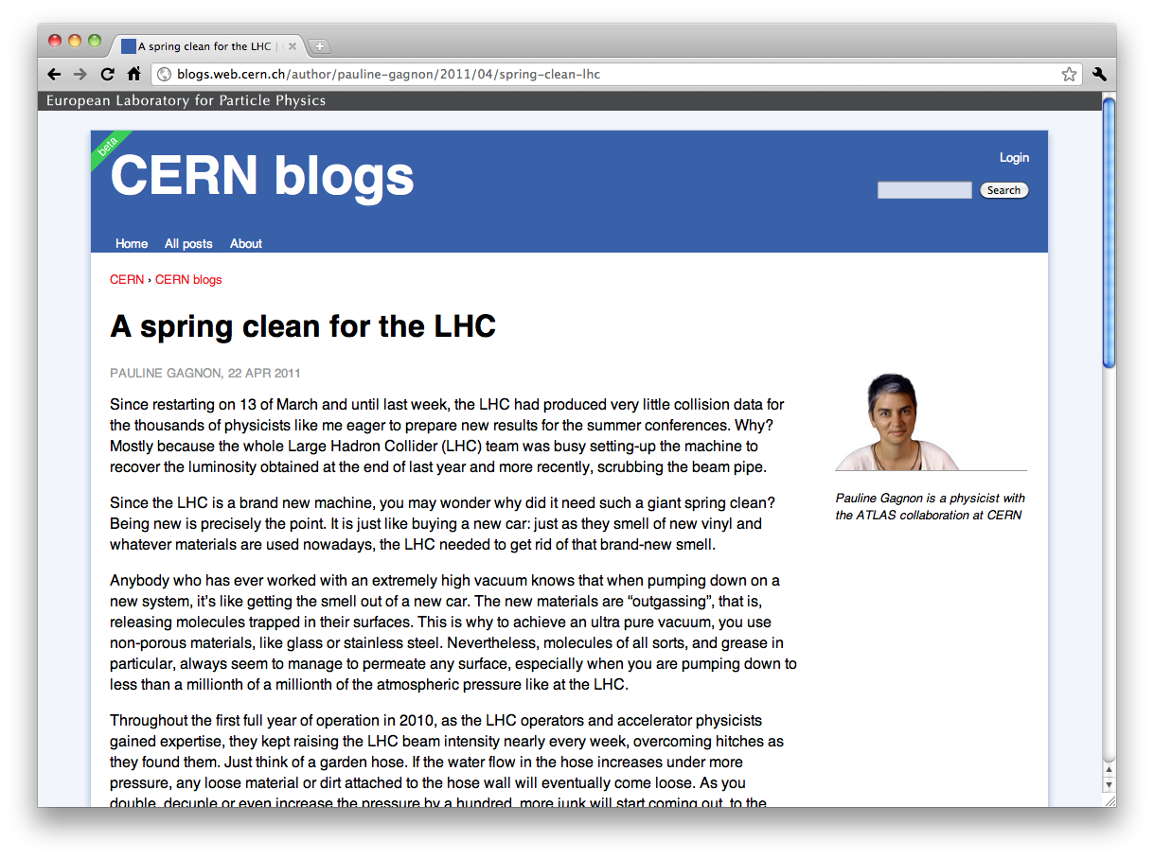
Subtheme examples

Slide 17
Using subversion
svn export [path-to-repository] [path-to-local]
svn export https://svn.cern.ch/reps/d7theme/cern_subtheme_base/
/Volumes/blogs.cern.ch/themes/cern_subtheme_base/

