Slide 1
Technology WG activities: status and plans
Calatroni / Döbrich (CERN / MPP)
27.3.2024

Slide 2
Brief report from Technology Working Group
Experiments list and updates
News from selected experiments
Mini-workshops

Slide 3
The PBC Technology Working Group
Mandate (highlights):
  …explore and evaluate possible technological contributions of CERN primarily to non-accelerator-related experimental physics initiatives and projects that may also be hosted elsewhere
  …survey technologies that could become relevant to CERN accelerator and non-accelerator projects
  …favour the exchange of experience and expertise in technological domains such as superconducting and normal conducting magnet and RF technology, cryogenics, optics, vacuum and surface technology
  …support the development of new physics experiments and detection methods like quantum sensing and new (accelerator and non-accelerator) experiment proposals
Objectives:
  Contribution to advancing conceptual designs where appropriate
  Identification and promotion of synergies with Quantum Sensing Initiatives at CERN and with other PBC Working Groups
  Documentation of identified and undertaken initiatives and benefits for the experimental community

Slide 4
All experiments & proposals linked with Tech WG
List from 2022 PBC Workshop
ALPS-II -> axion search light-shining-through-wall with lasers -> DESY
BabyIAXO -> axion search from the sun -> DESY
VMB@CERN -> QED birefringence with lasers
Grenoble Haloscope (GrAHal) -> axion search with RF cavities
RADES/HTS -> axion search with HTS RF cavities
DarkSide -> direct detection of WIMPS with liquid Ar TPC -> CERN REC
Ptolemy -> Carbon NanoTubes for cosmological neutrino background
STAX -> axion search light-shining-through-wall with RF cavities
Advanced-KWISP -> search for Short Range Interactions
New: Axion Heterodyne Detection -> axion search with two-mode RF cavities
New: AION-100 @ CERN -> vertical atom interferometer

Slide 5
All experiments & proposals linked with Tech WG
Updated list after reaching out to all experiments
ALPS-II (Joern Schaffran) -> axion search light-shining-through-wall with lasers
BabyIAXO (Matthias Mentink, Igor Garcia Irastorza) -> axion search from the sun
GrAHal (Pierre Pugnat) -> axion search with RF cavities
RADES/HTS (Jessica Golm) -> axion search with HTS RF cavities
Advanced-KWISP (Giovanni Cantatore) -> search for Short Range Interactions
Axion Heterodyne Detection (TBC) -> axion search with two-mode RF cavities
AION-100 @ CERN (Oliver Buchmuller, Richard Hobson) -> vertical atom interferometer
NEW: FLASH (Claudio Gatti) - > axion search with RF cavities

Slide 6
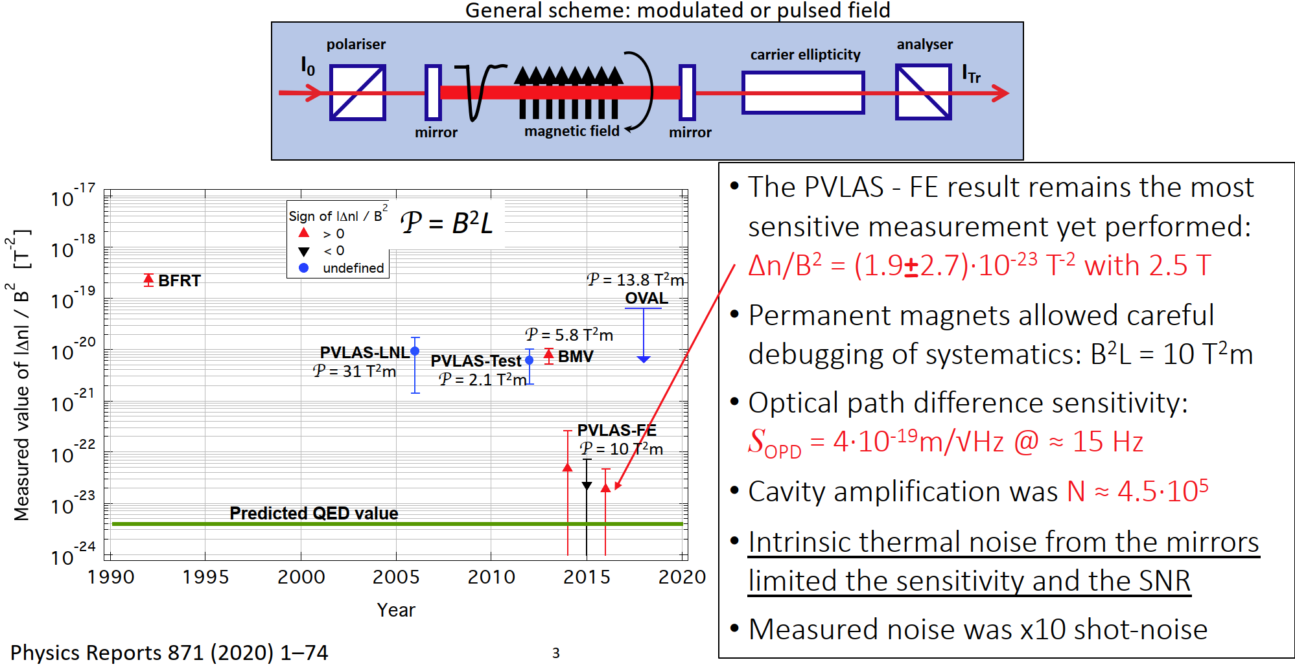
VMB@CERN status
Mostly taken from presentation of Guido Zavattini to SPSC and PBC Tech WG
State of the art
PVLAS @ Ferrara U.

Slide 7
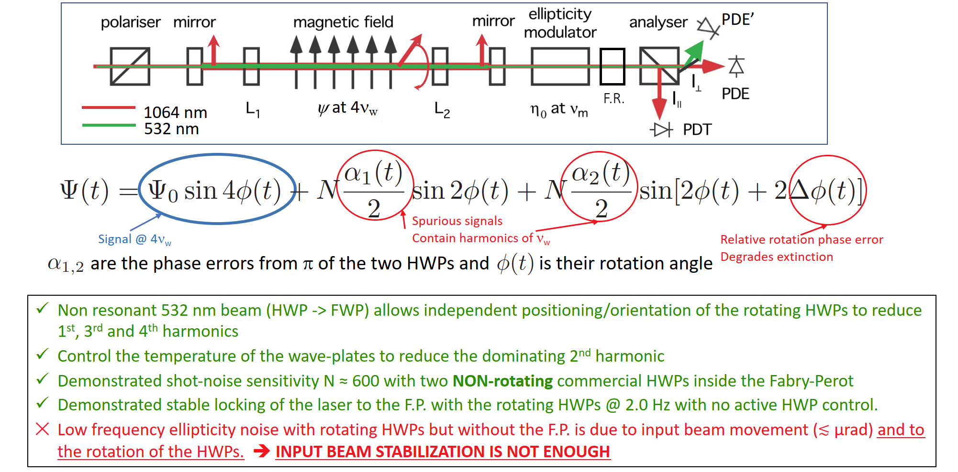
VMB@CERN status
Mostly taken from presentation of Guido Zavattini to SPSC and PBC Tech WG
Scheme: two co-rotating Half-Wave Plates inside the Fabry-Perot
Baseline scheme for VMB@CERN
LHC dipole field (B_{ext}² L ≈ 1000 T²m) low-frequency modulation might help improving SNR (suppression of HWPs 4th harmonic)

Slide 8
VMB@CERN status
Mostly taken from presentation of Guido Zavattini to SPSC and PBC Tech WG
Technical issues:
  We don’t know how to stabilize the beam to 1 nm/√Hz on each optical element in Ferrara on an isolated monolithic 4.8 m optical bench. How could this, in principle, be done in SM18 on the hall floor using twoseparate optical benches 20 m apart?
  Is SM18 really adequate? Mechanical stability, thermal stability, cleanliness etc.
  Extra noise, not associated to beam pointing noise, is induced by the rotating HWPs without the F.P. which we don’t know at present how to reduce
  Dust on rotating HWPs generate intensity modulation. Is beam centering enough? Probably also modulates the polarisation generating more noise.

Slide 9
VMB@CERN status
Mostly taken from presentation of Guido Zavattini to SPSC and PBC Tech WG
Remaining work
  2023 is the last R&D year financed by INFN. References to our LoI to SPSC
  initiative paper: (https://cds.cern.ch/record/2649744/files/SPSC-I-249.pdf)
  In 2022 our results led us to write a Conceptual Design Report for the INFN - CSN2.
  ✕ In early 2023 we aimed at submitting a proposal to the SPSC at CERN. We also aimed at presenting a proposal to INFN
  During 2023
    Implement alignment and temperature feedbacks on rotating wave plates
    Possibility to rotate at ≈ 10 Hz (?)
    Install F.P. low finesse cavity (mirrors will arrive in May)
  Presented this status report to INFN on April 17th
  Report these findings to SPSC in May.
  ✕ Due to these studies and related results, we are postponing a proposal for VMB@CERN to SPSC until further notice.

Slide 10
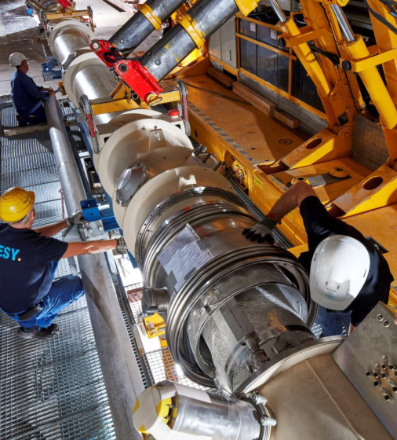
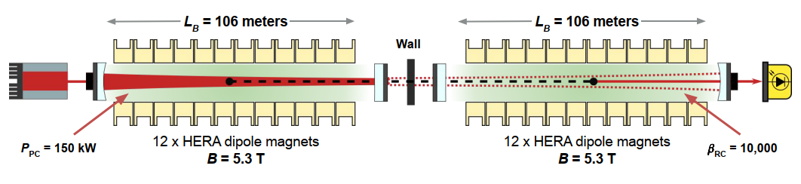
Some updates: ALPS-II
ALPS-II, now data-taking in DESY
Axion search light-shining-through-wall with lasers (“successor” to OSQAR)

Slide 11
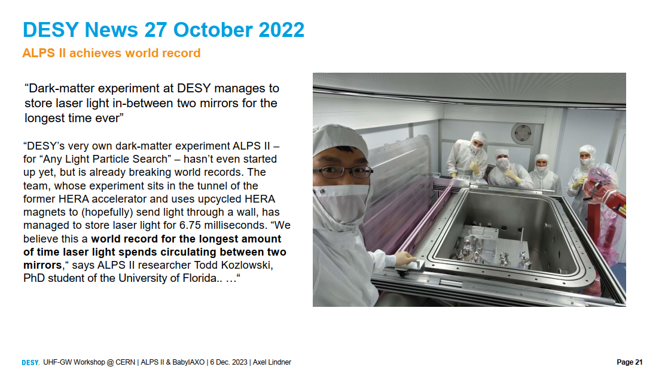

Slide 12
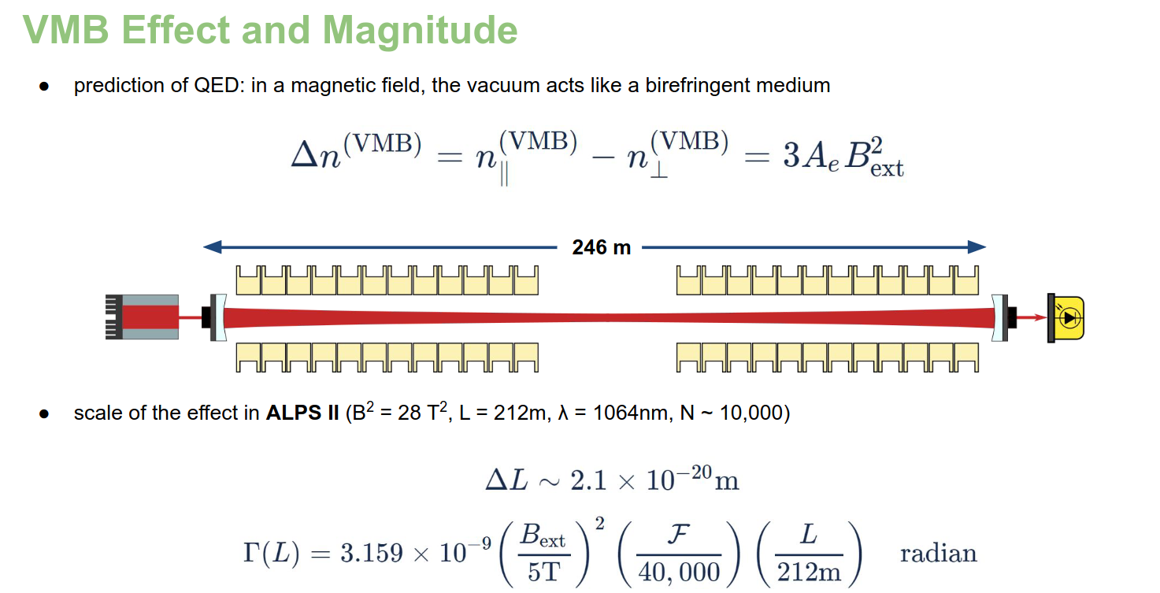
ALPS-II and VMB
Mostly taken from presentation of Todd Kozlowski @Technology WG meeting in June
B_{ext}² L ≈ 6000 T²m
for VMB@CERN with one LHC dipole it was ≈ 1000 T²m

Slide 13
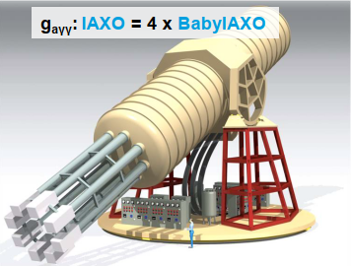
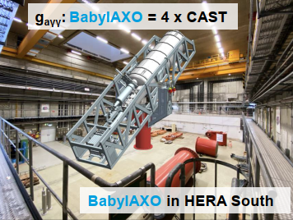
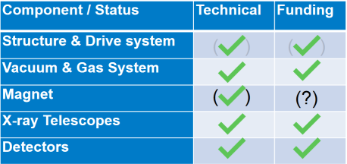
Some updates: BabyIAXO
BabyIAXO, now under construction in DESY
Axion helioscope + option as haloscope (RADES) (“successor” to CAST)

Slide 14
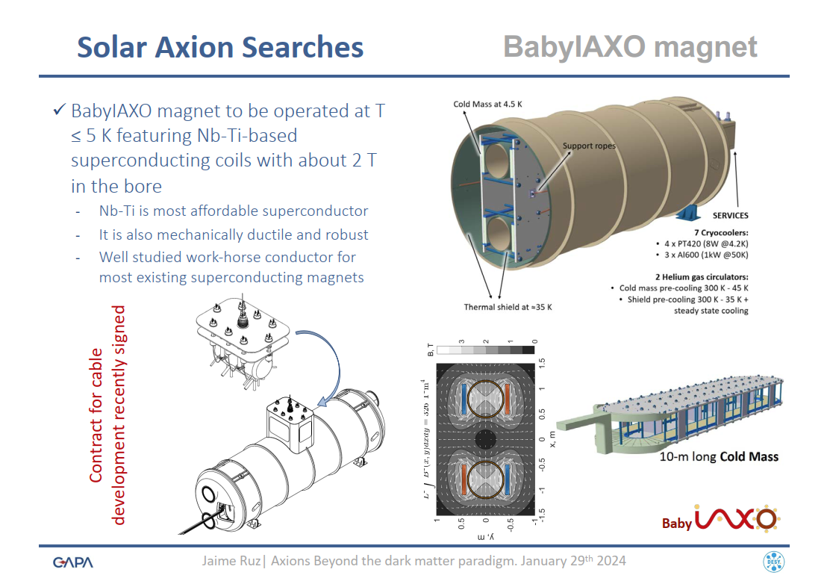
BabyIAXO
Magnet design and quench studies performed within PBC.
Presently, effect of quenches (eddy current stresses) on objects inside magnet bores are underway within PBC.

Slide 15

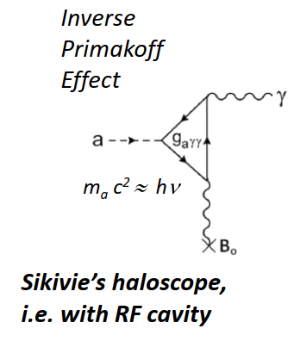
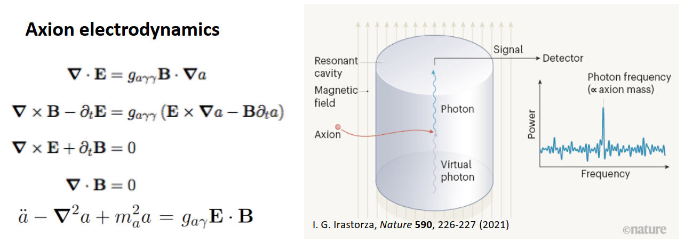
GrAHal status
Mostly taken from presentation of Pierre Pugnat for CERN REC Committee and Tech WG

Slide 16
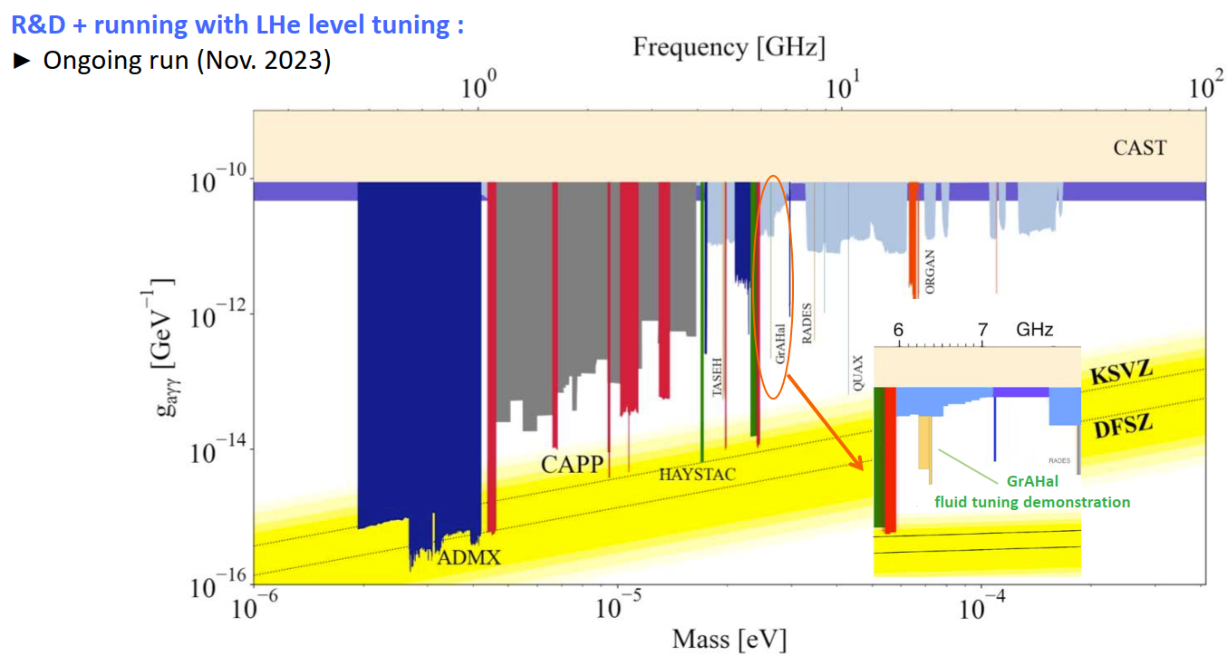
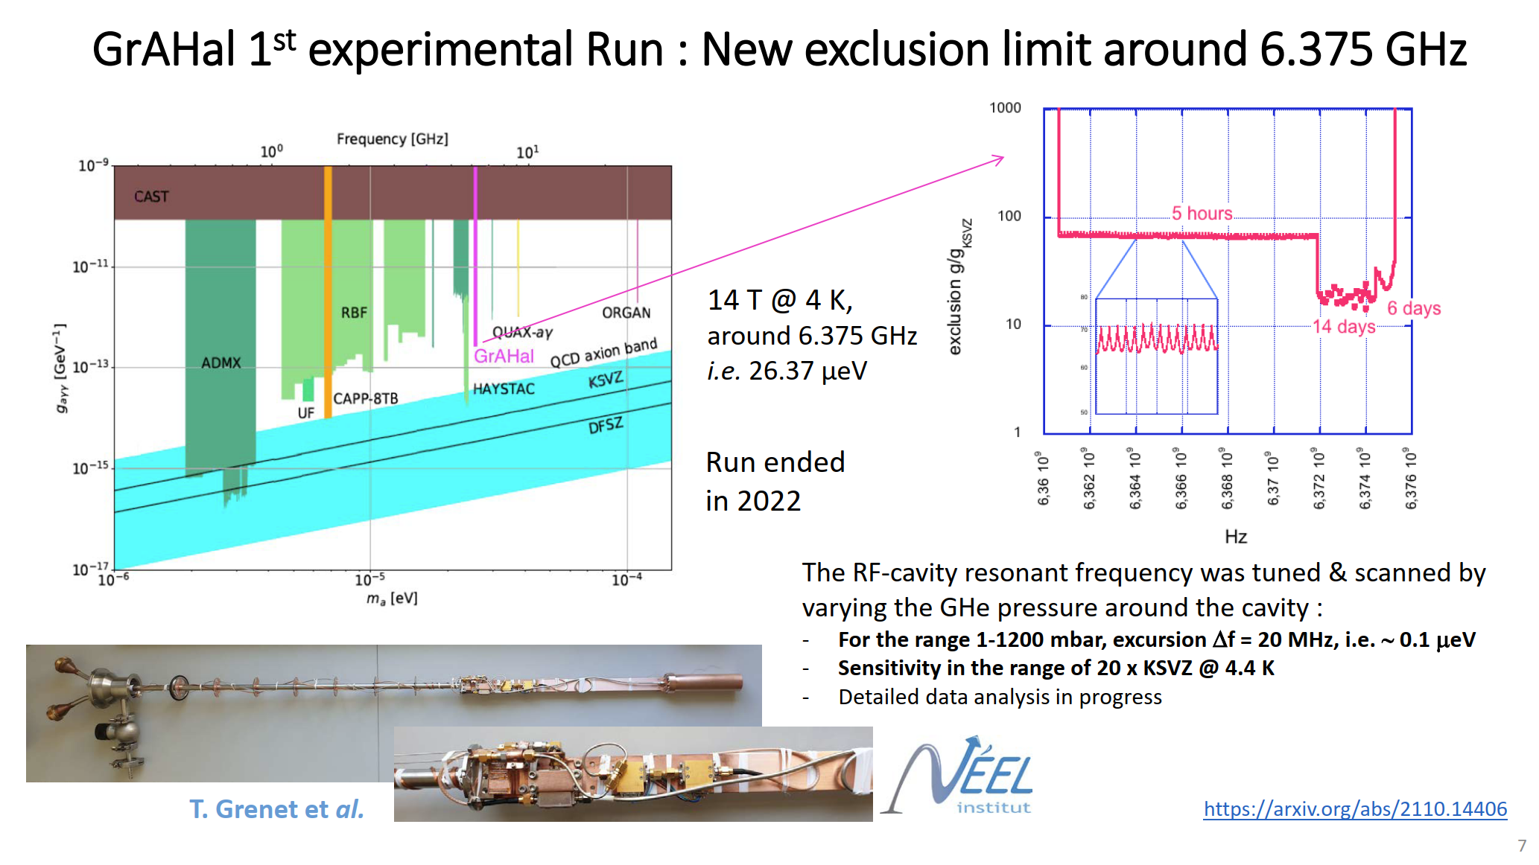
GrAHal status
Mostly taken from presentation of Pierre Pugnat for CERN REC Committee and Tech WG
https://arxiv.org/abs/2110.14406

Slide 17
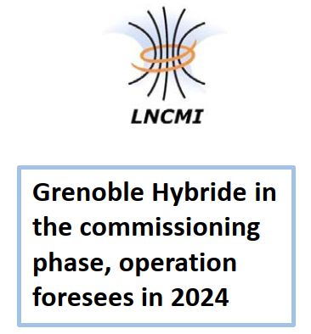
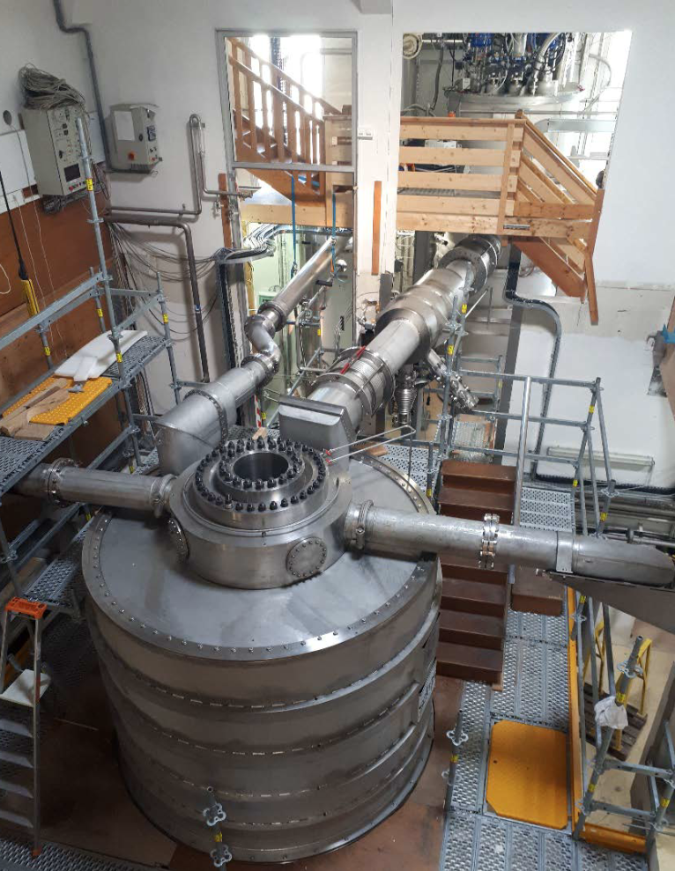
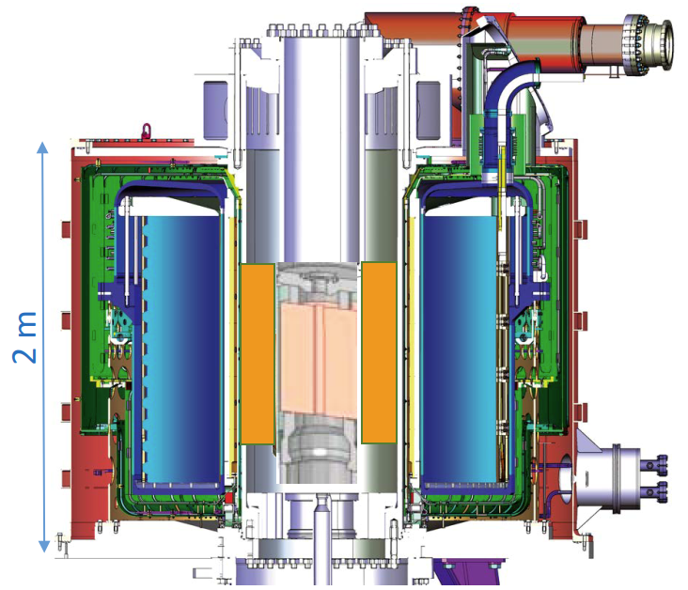
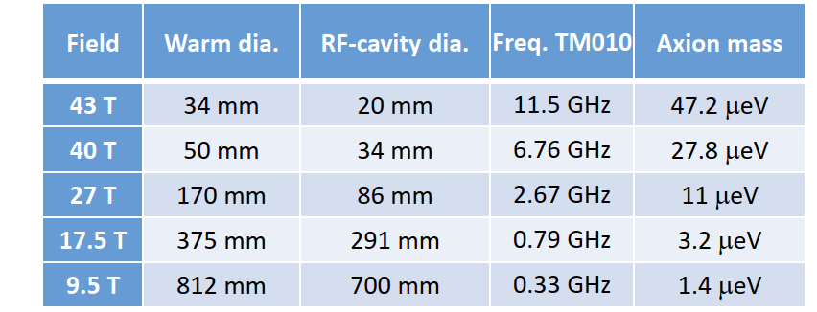
GrAHal status
Mostly taken from presentation of Pierre Pugnat for CERN REC Committee and Tech WG
Next steps, approved by ANR (Agence Nationale pour la Recherche) for the run of GrAHal @ 43 T & 11.5 GHz
(before 31st December 2024 – funding for operation at 24 MW secured…)
Within available 4.4 K LHe Cryostat @ LNCMI

Slide 18
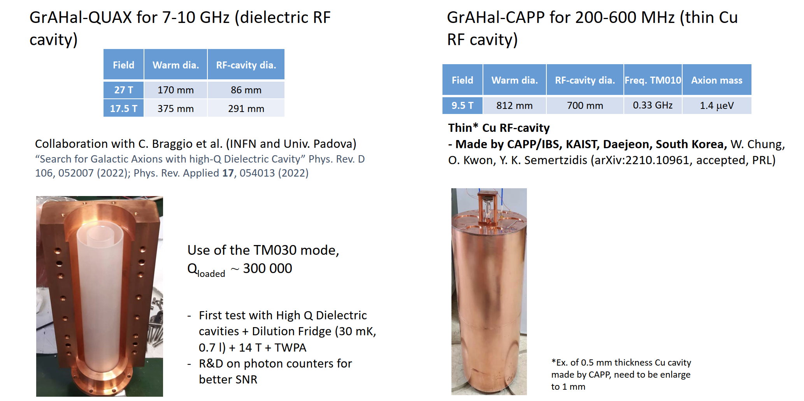
GrAHal status
Mostly taken from presentation of Pierre Pugnat for CERN REC Committee and Tech WG

Slide 19
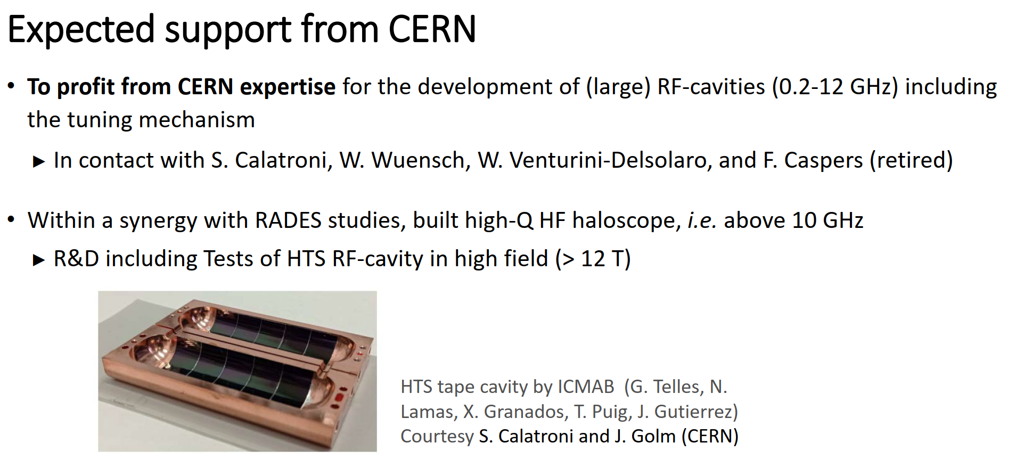
GrAHal status
Mostly taken from presentation of Pierre Pugnat for CERN REC Committee and Tech WG

Slide 20
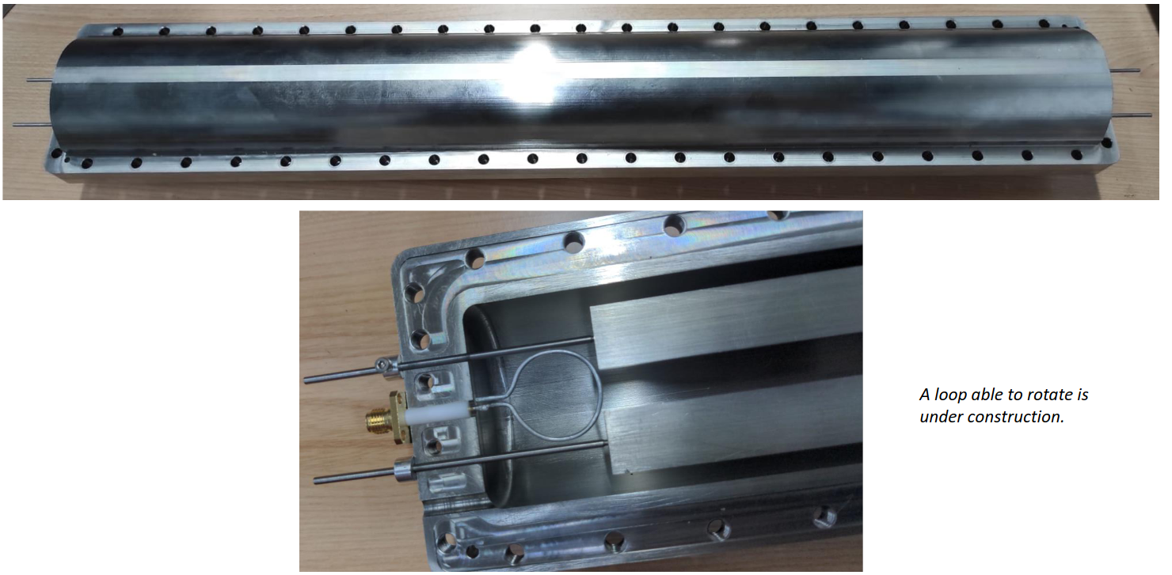


News from RADES
RADES (Relic Axion Dark matter Exploratory Set-up): R&D effort with long-term idea to operate babyIAXO (also) as a haloscope
However RADES activities independent of babyIAXO:
Many different R&D directions
One R&D partially supported by PBC: HTS cavity studies (Jessica Golm)
R&D also starting towards Single Photon detection
Prototype to test tuning concept
© Bildnachweis

Slide 21
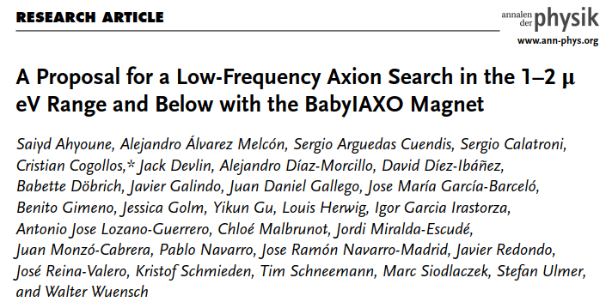
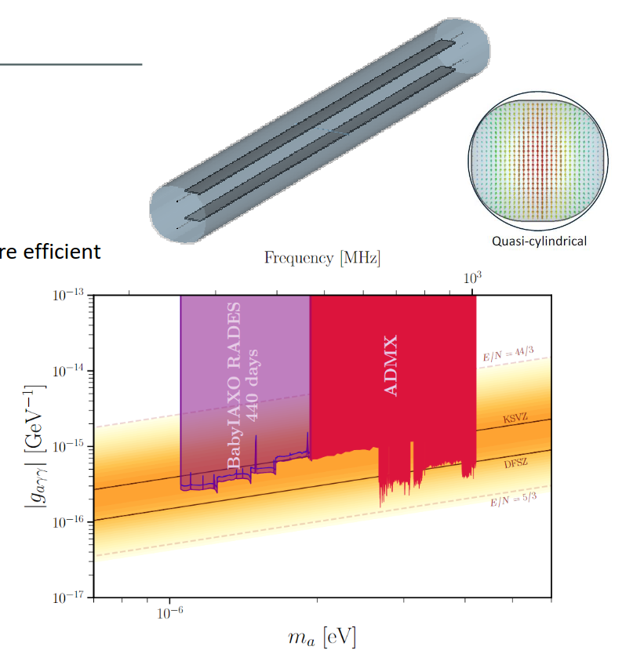
News from RADES
Published concept for a haloscope option for babyIAXO
Proposal also contains BASE-like concept for search of ultra-light ALPS (0.1-1000 neV)
-> Devlin/Ulmer
© Bildnachweis

Slide 22
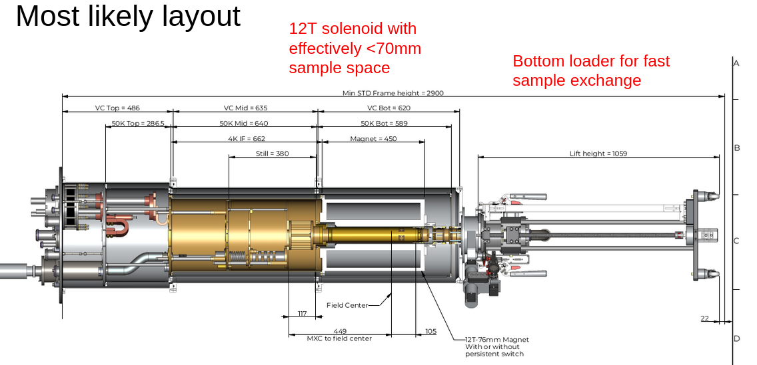
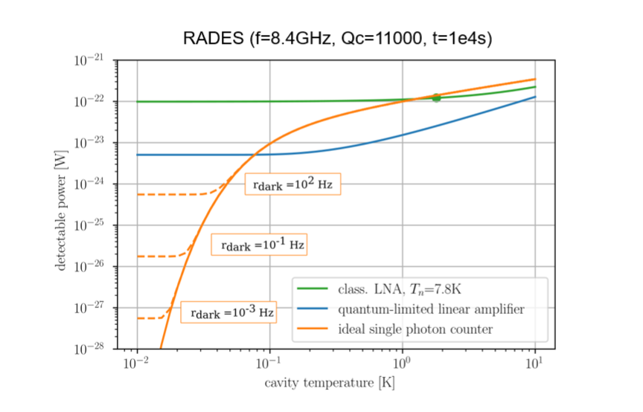
News from RADES
Studying different R&D strains for SPD, ultimate handle to improve sensitivity (shown in plot)
Ordered a dil-fridge incl magnet for the group, to arrive ~ mid 2024 at MPI
Possible technologies:
nano-TES, QBIT
© Bildnachweis

Slide 23
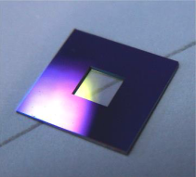
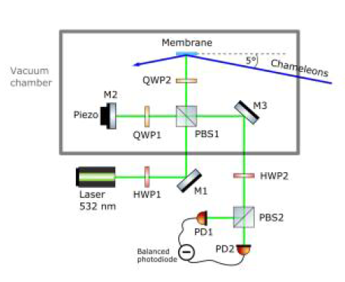
A-KWISP status
Dark matter sensors based on room-temperature membranes, read-out by a Michelson interferometer
Three sensor-network, one in Rijeka (Croatia) operating, two in Trieste and Camerino (Italy) under construction
Temperature measurement and control system being finalized, soon implemented on all three sensors.
CERN ideal place for further expanding the network of sensors, and studying technological development for bringing the membranes to cryogenic temperatures
Giovanni Cantatore aims at presenting ideas and status (and possible requests for support to PBC) towards the end 2024

Slide 24
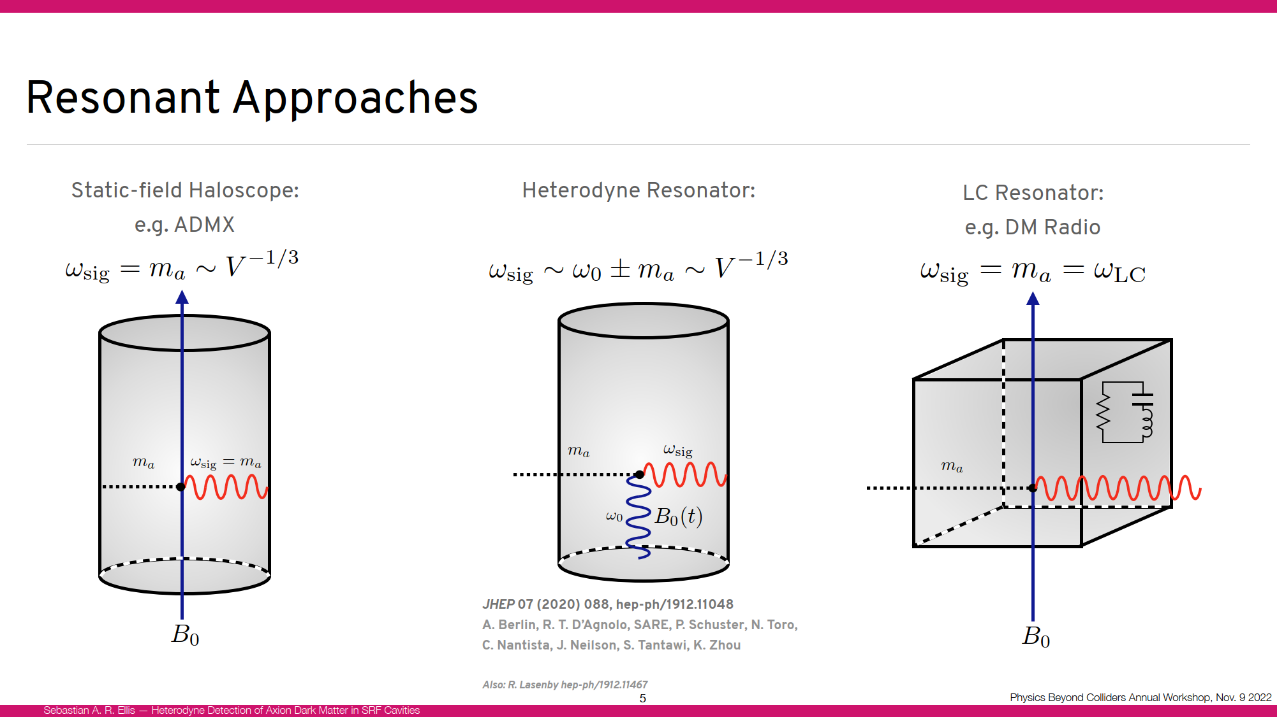
Axion Heterodyne detection status
Mostly taken from presentation of R.-T. D’Agnolo and S. Ellis at PBC meetings
Talk by Raffaele-Tito D’Agnolo this afternoon

Slide 25
Axion Heterodyne detection status
Presented to PBC management in 2021
  Experiment based on superconducting cavities of high performance
  Concept received high praise, but some preliminary experiments were deemed necessary (intermodulation levels in standard RF measurement chain)
  SRF section in RF group interested, but no much progress since
  SLAC has received an LDRD grant for a preliminary design (corrugated HE11 cavity)
  During investigation they moved for $$$ reasons from a SC prototype to NC prototype
  FNAL is also building a bulk niobium SC cavity tailored for this purpose
  They made preliminary background signal measurements on an existing cavity https://arxiv.org/abs/2207.11346 a bit inconclusive for the time being

Slide 26
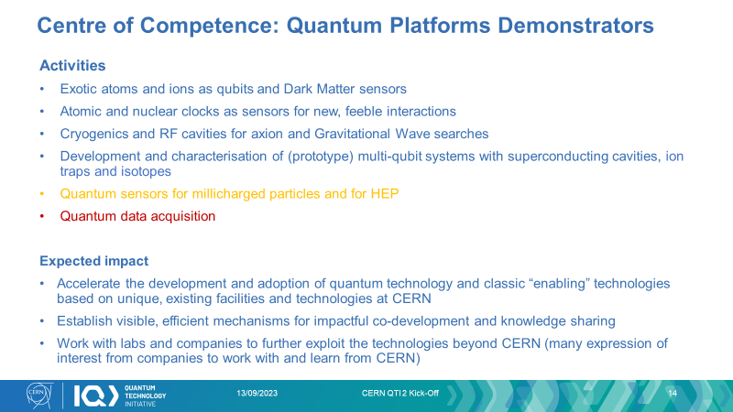
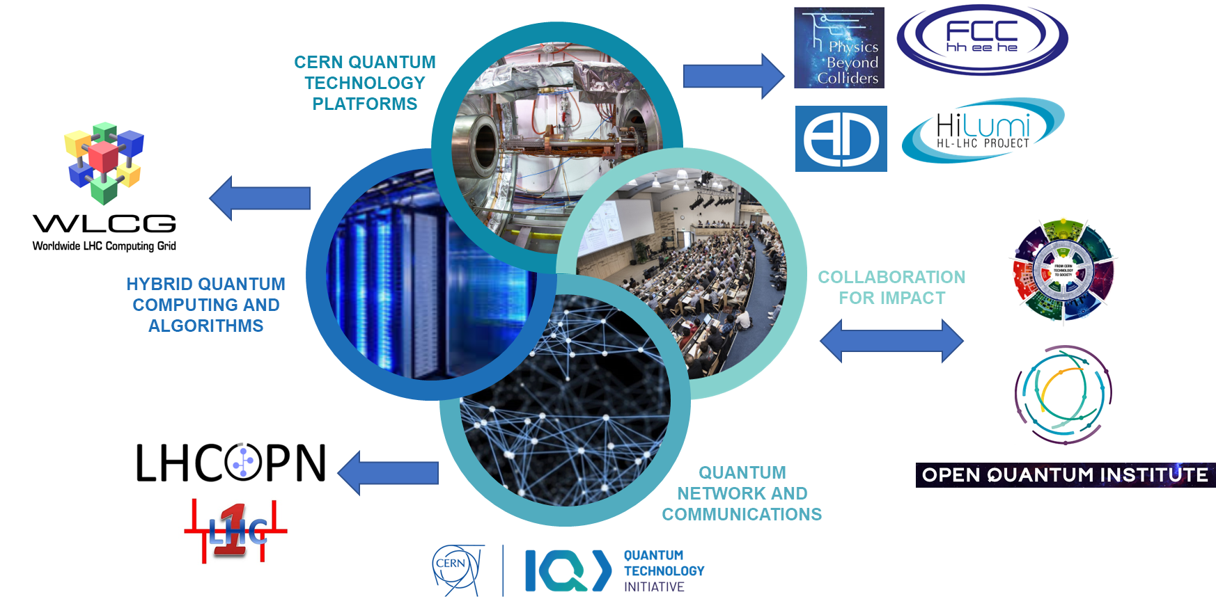
Axion Heterodyne detection status
CERN QTI v2.0 approved by Management and Council for the period 2024-2028
A. Di Meglio, S. Vallecorsa, M. Doser

Slide 27
Axion Heterodyne detection status
Dedicated Staff and Fellows both in TE and SY departments, and funds for investments have been allocated by QTI
  Staff (5y) in SY/RF, for supervision of cavity design and measurements
  Staff (5y) in TE/CRG, for design and construction of sub-K cryogenics
  GRAD (3y) in TE/VSC for cavity surface treatments
  Allocated funds in SY/RF for cavity fabrication and in TE/CRG for cryogenics
PBC management agreed to contribute one GRAD (3y) for cavity design
Program is in synergy with PBC <-> ideal platform for quantum sensing technologies

Slide 28
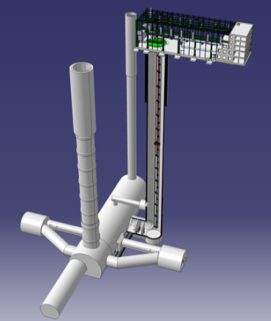
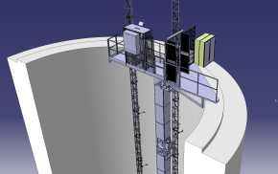
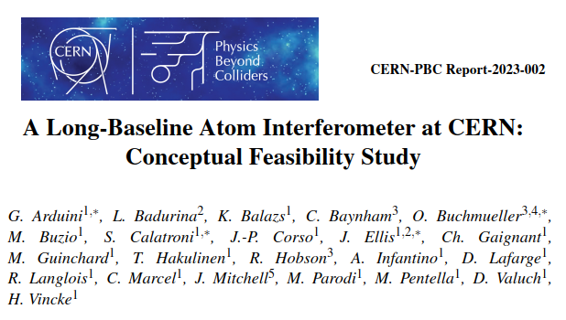
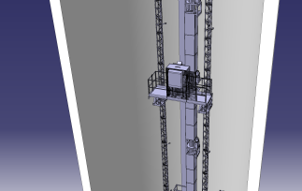
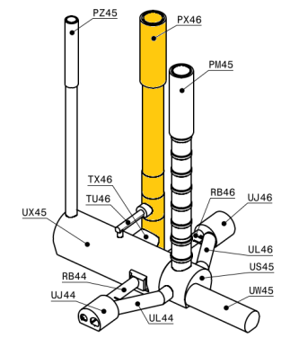
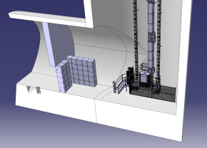
AION-100 @ CERN status
Mostly taken from my presentations and feasibility study report https://arxiv.org/abs/2304.00614
Talk by Oliver Buchmuller this morning

Slide 29
AION-100 @ CERN status
Conceptual feasibility study for AION-100 like vertical atom interferometer at LHC point 4 https://arxiv.org/abs/2304.00614
Presented at Terrestrial Very-Long-Baseline Atom Interferometry Workshop https://indico.cern.ch/event/1208783/
“Community Roadmap” (workshop summary) document is prepared, accepted for publication in AVS Quantum Science, arXiv:2310.08183
Discussed with CERN management (Mike Lamont), who agreed to support the formation of a “Proto-Collaboration”. Memorandum of Cooperation being finalized by CERN legal service.
Will be presented and discussed at 2nd Terrestrial Very-Long-Baseline Atom Interferometry Workshop https://indico.cern.ch/event/1369392/ (Next week)
Future (ideal) step: if a Collaboration is formed, CERN management must be requested to prepare site during LS3 for subsequent installation of an experiment.

Slide 30
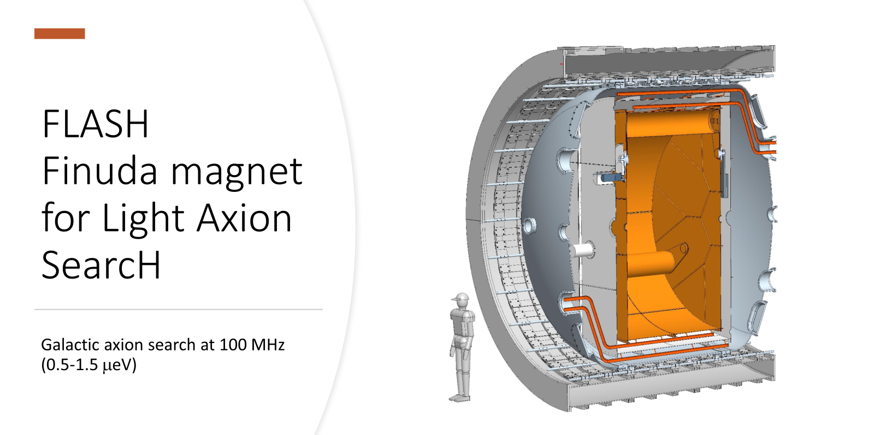
New entry: FLASH
Talk by Claudio Gatti this morning

Slide 31
Mini-workshops
Tech WG aims at supporting initiatives in the PBC requiring CERN expertise in technology
The mix of technologies considered is very varied: magnets, optics, coatings…
The technology WG mini-workshop series is aimed at providing users with an overview of possibilities/expertise at CERN and – in turn – providing CERN with an overview of ideas “out there”
The first four workshops were well received:
  1st PBC technology mini workshop: superconducting RF
  2nd PBC technology mini workshop: lasers & optics
  3rd PBC technology mini workshop: vacuum, coating and surface technologies
  4th PBC technology mini workshop: cryogenics technologies
Last workshop was >1 year ago: we were absorbed by other activities and organization of future workshops lagged behind
Date for new workshop is fixed 26.9.2024: (Superconducting) magnet technologies, measurements and shielding, in presence at CERN Building 30
Initially foreseen as remote-only in June, but was re-scheduled upon request of several speakers to have it in-presence
Next workshops (hopefully at shorter interval)
  Mechanical, design and fabrication technologies
  PBC meets QTI

Slide 33
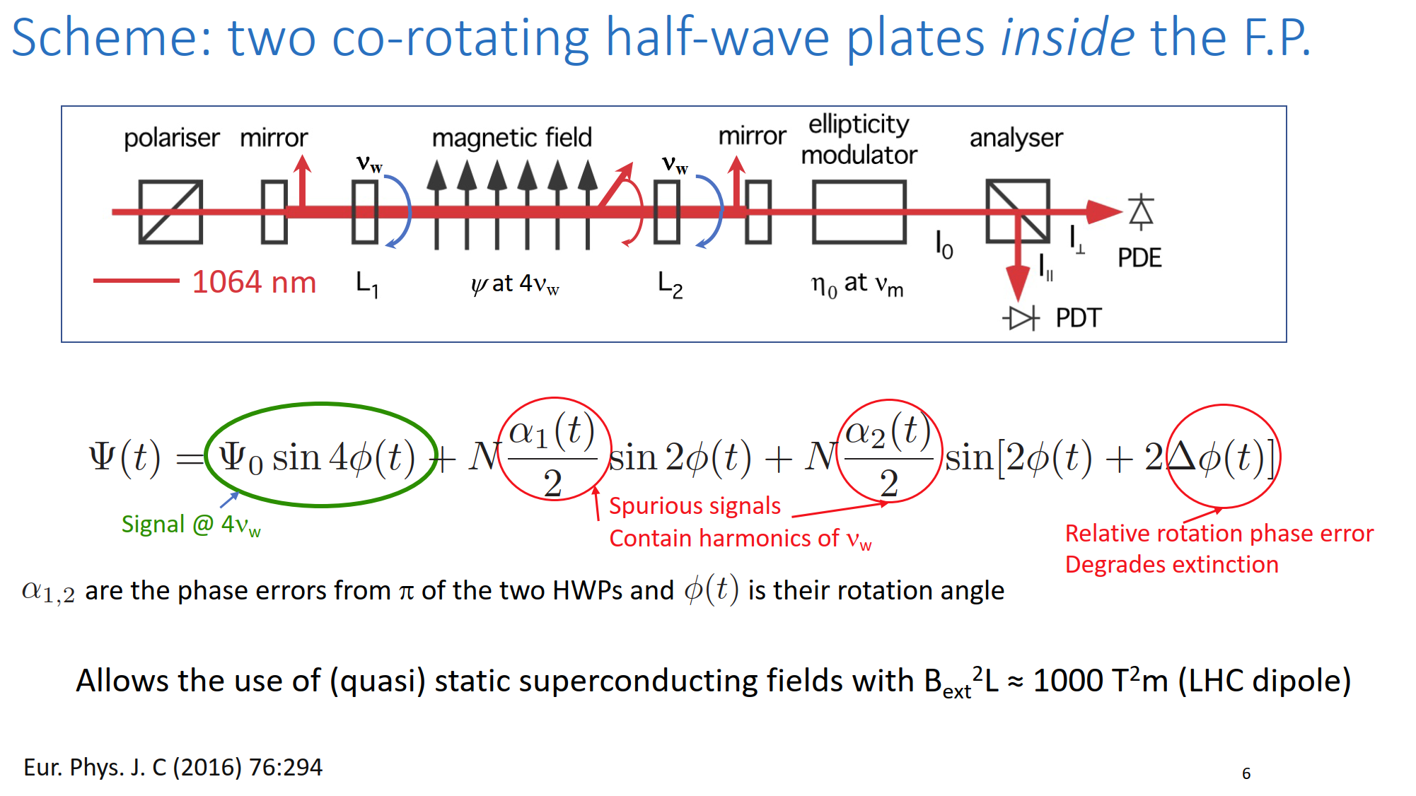
VMB status
Mostly taken from presentation of Guido Zavattini to SPSC and PBC Tech WG

Slide 34
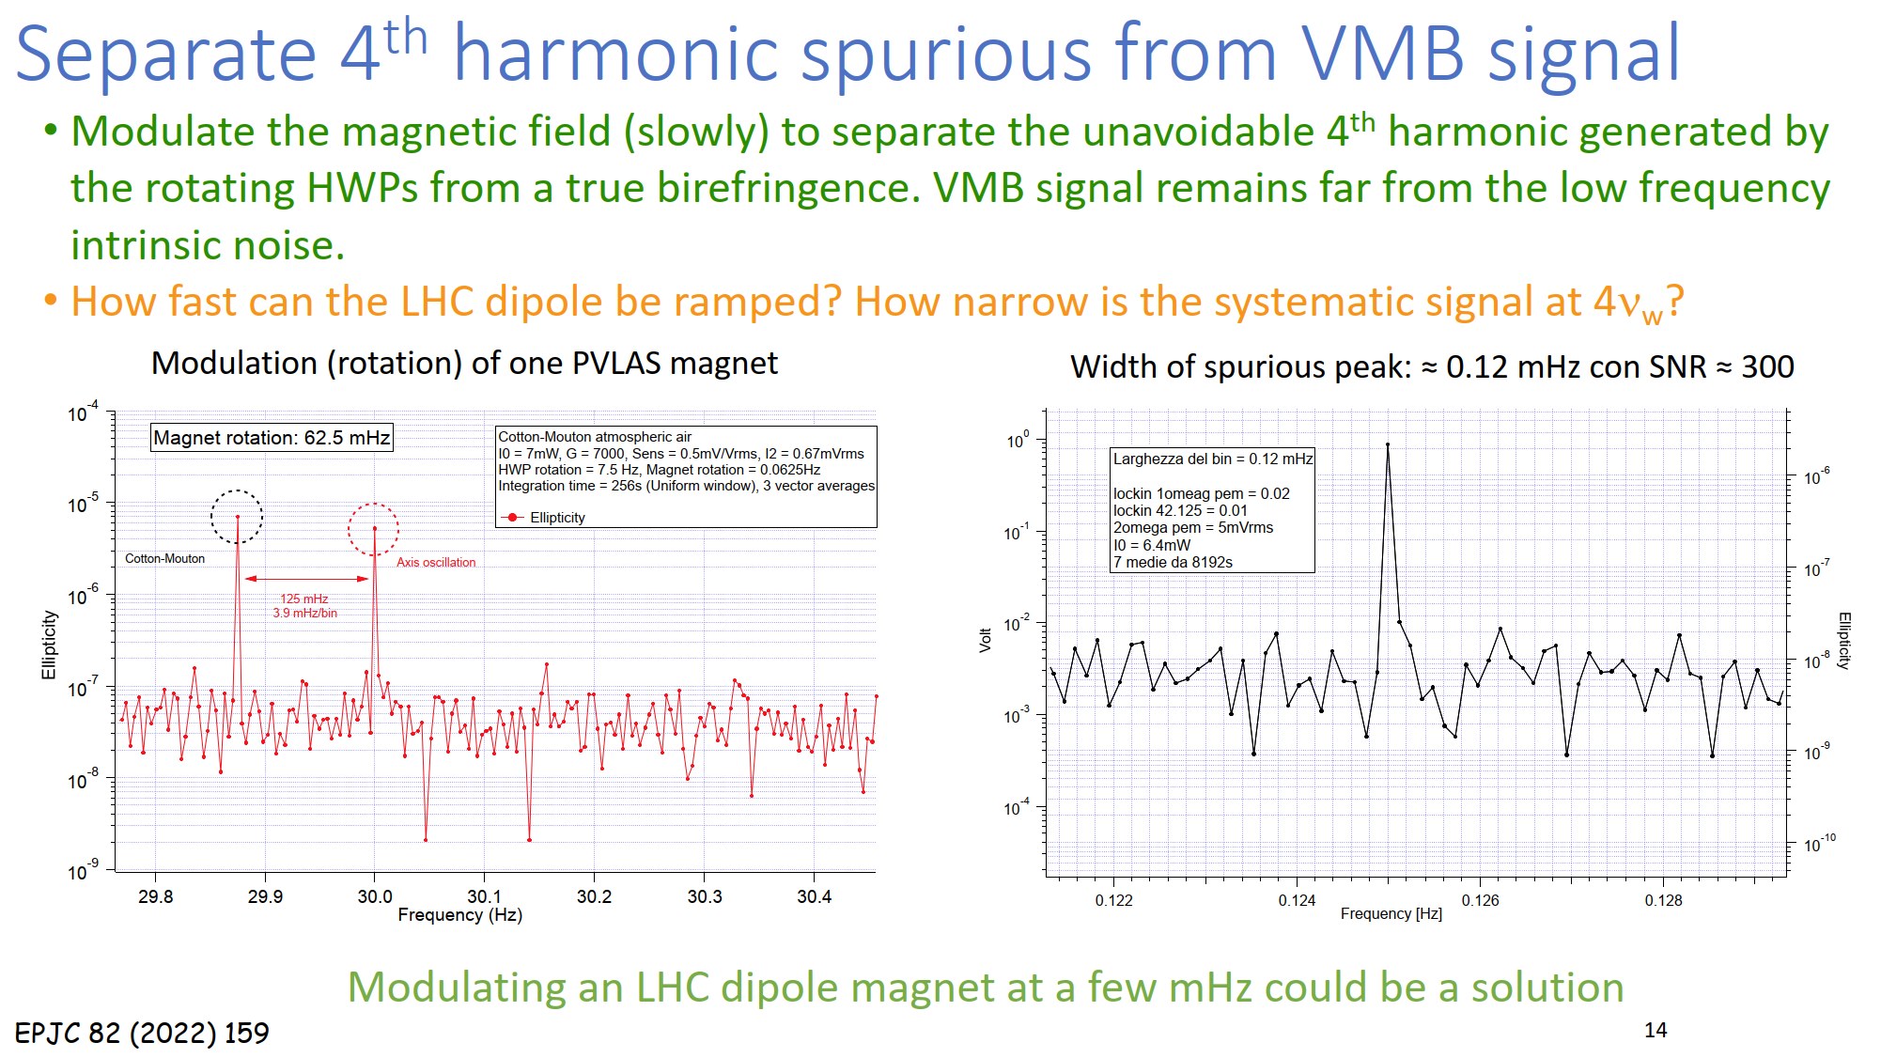
VMB status
Mostly taken from presentation of Guido Zavattini to SPSC and PBC Tech WG
Preliminary at PVLAS without Fabry-Perot
LHC dipole modulation frequency (7 mHz) must be >> than width of spurious peak

Slide 35
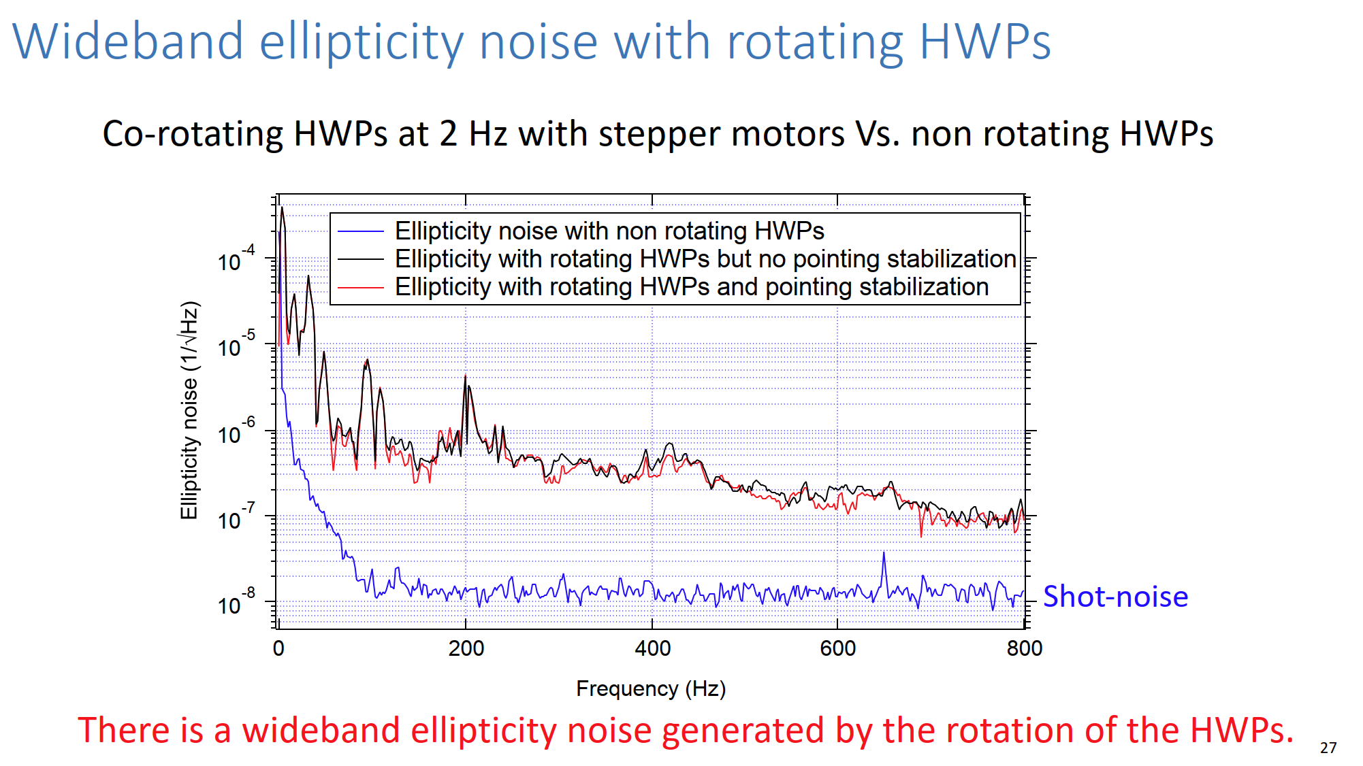
VMB status
Mostly taken from presentation of Guido Zavattini to SPSC and PBC Tech WG

Slide 36
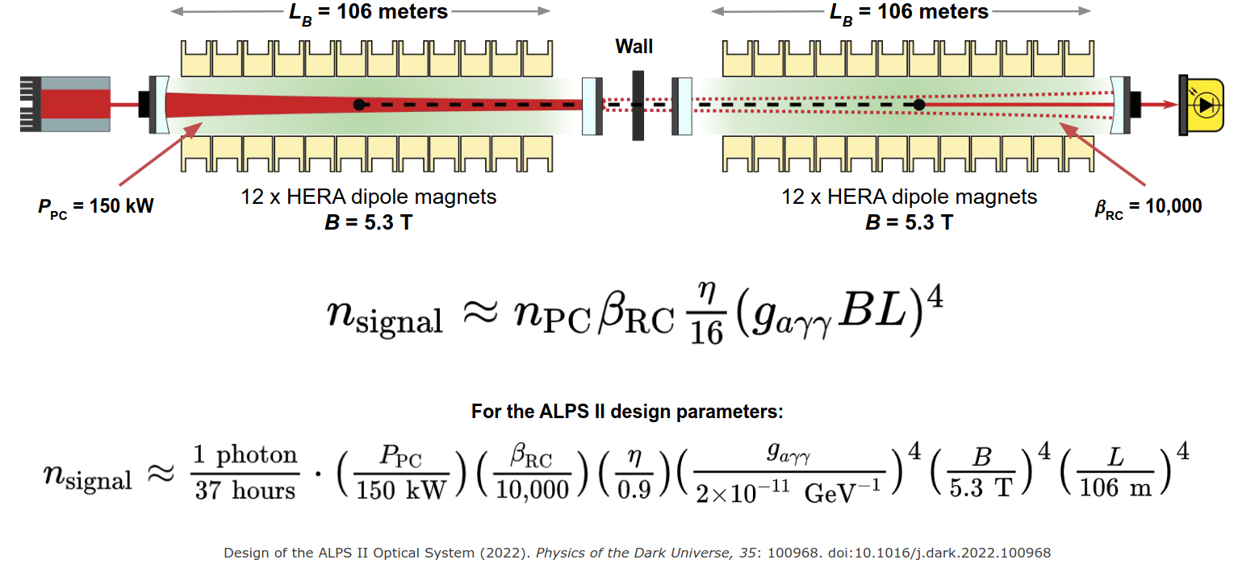
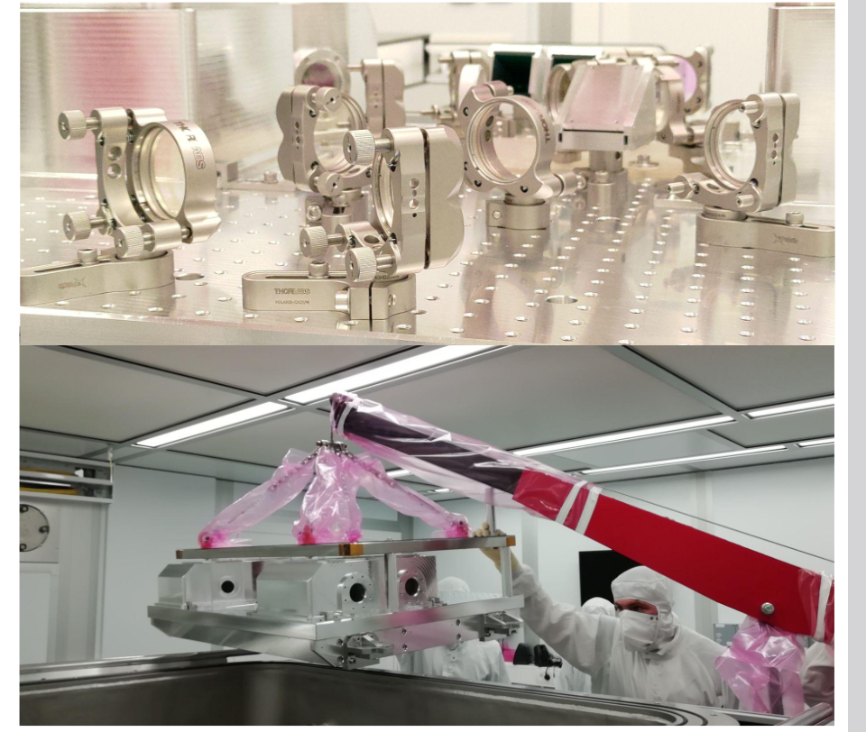
News from ALPS-II
Mostly taken from presentation of Todd Kozlowski @Technology WG meeting in June
© Bildnachweis

Slide 37
News from ALPS-II
Mostly taken from presentation of Todd Kozlowski @Technology WG meeting in June 2023
> 35 W of stable 1064 nm laser light
injected through the Production Area
Optics on COB must be pre-aligned
before insertion into vacuum
Heterodyne Interferometry:
measurement of the interference beat-note between an ultra-weak signal field and a strong local oscillator on a shot-noise-limited photodetector
© Bildnachweis

Slide 38
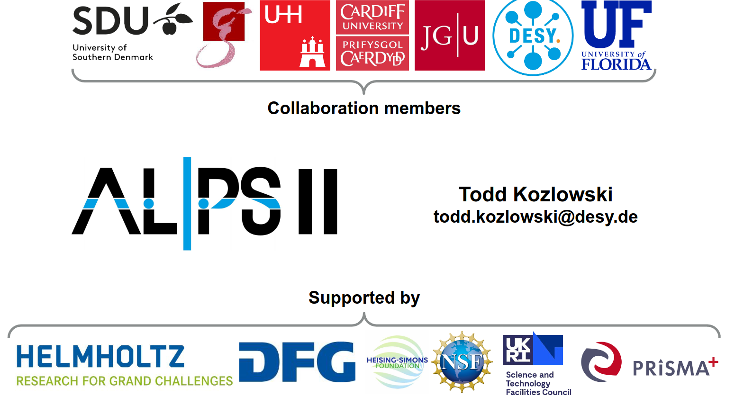
News from ALPS-II
Mostly taken from presentation of Todd Kozlowski @Technology WG meeting in June
ALPS-II started smooth data taking (except when Metallica plays in nearby concert venue)
Different concepts for future VMB measurement under study
The ALPS II experiment, with its 24 HERA dipole magnets (B2 L = 6000) can produce the largest magnitude VMB effect of any contemporary experiment
VMB will not be implemented into the ALPS II program until after all experimental goals achieved - outlook 3-4 years
© Bildnachweis

Slide 39
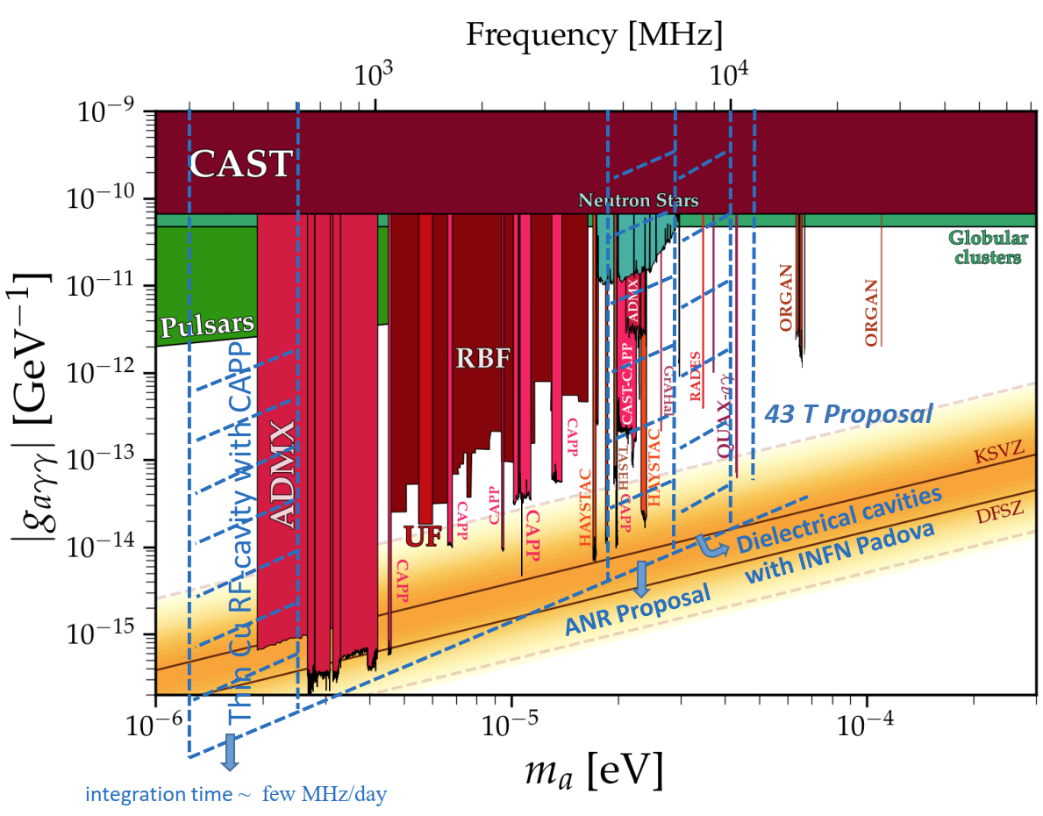
GrAHal status
Mostly taken from presentation of Pierre Pugnat for CERN REC Committee

Slide 40
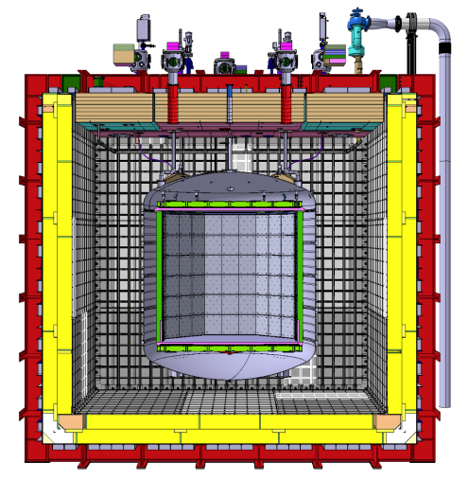
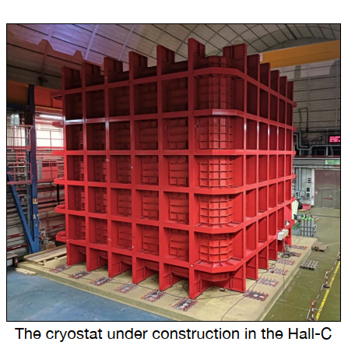
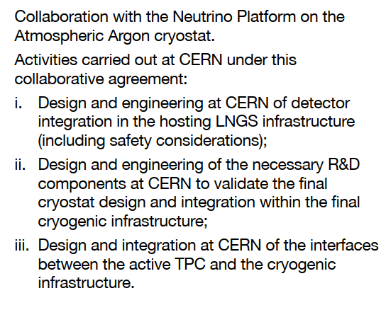
Some Updates: DarkSide-20K
DarkSide, under construction at INFN-LNGS, formal collaboration with CERN
Direct detection of WIMPS with liquid Ar TPC
From: G. Fiorillo

Slide 41
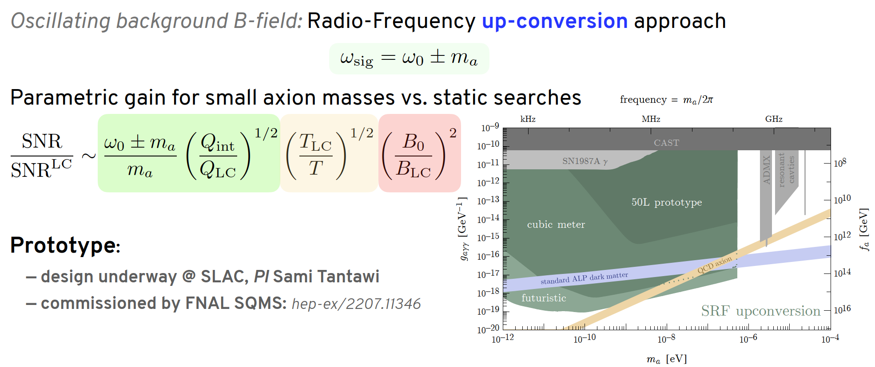
Axion Heterodyne detection status
Mostly taken from presentation of R.-T. D’Agnolo and S. Ellis at PBC meetings

Slide 42
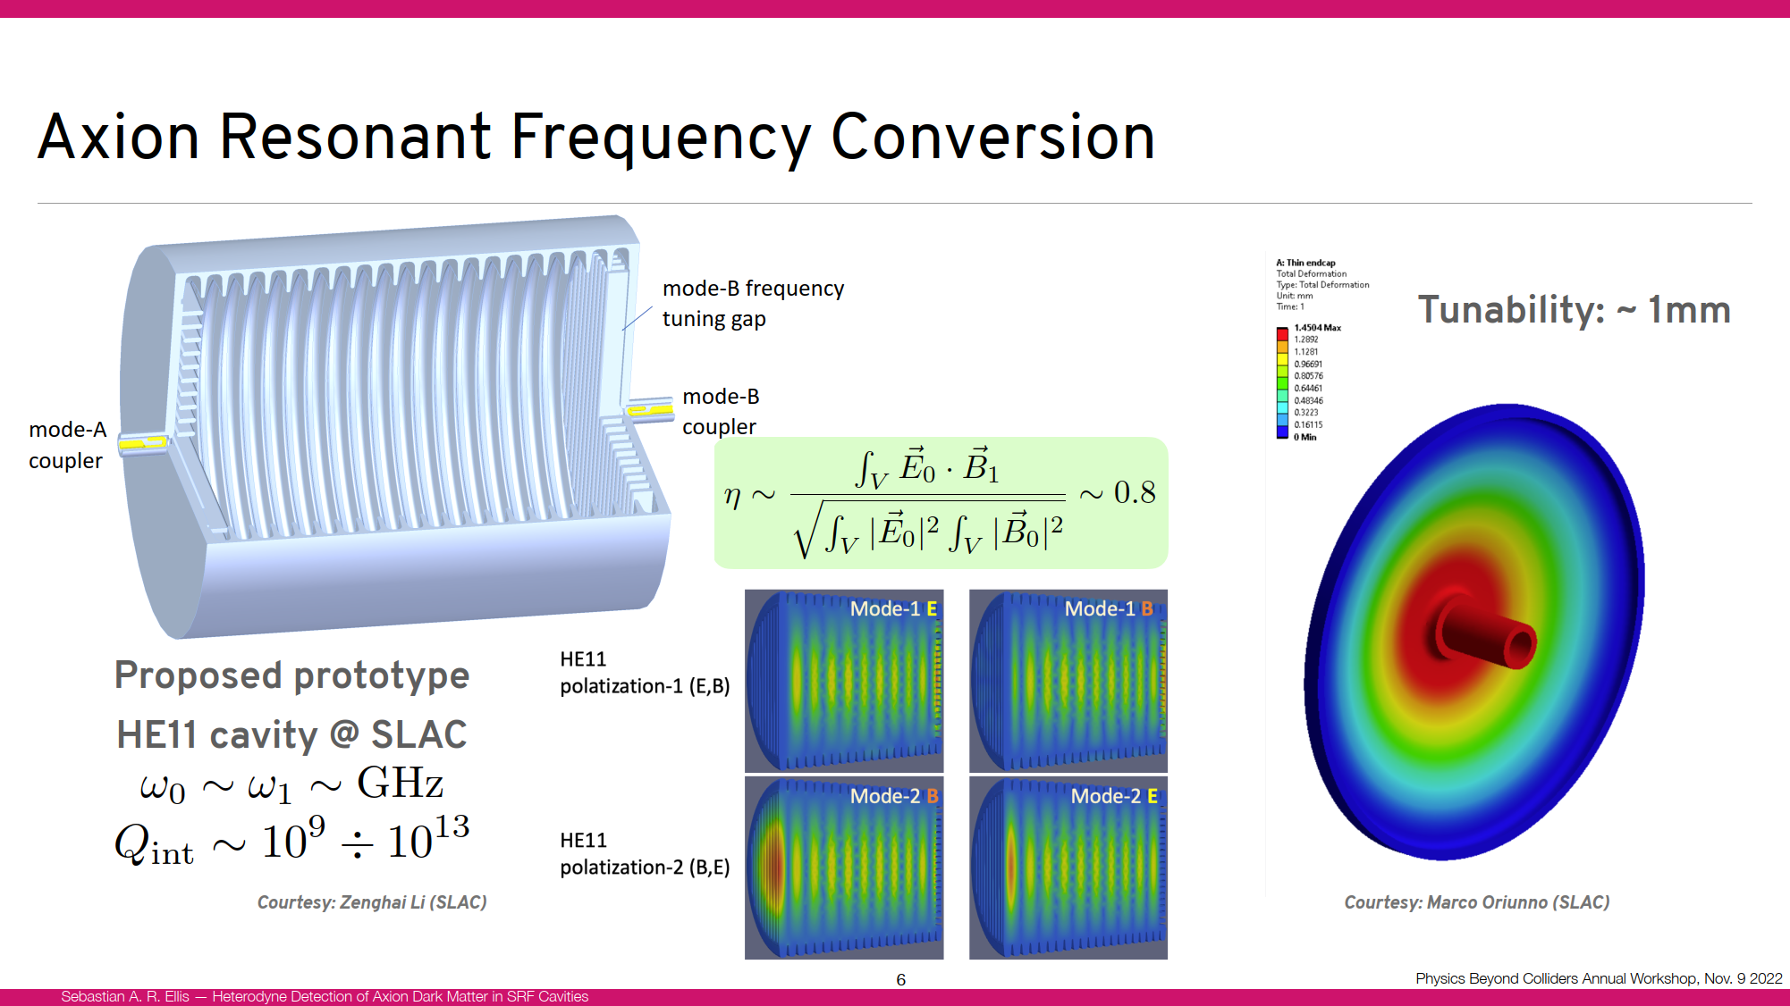
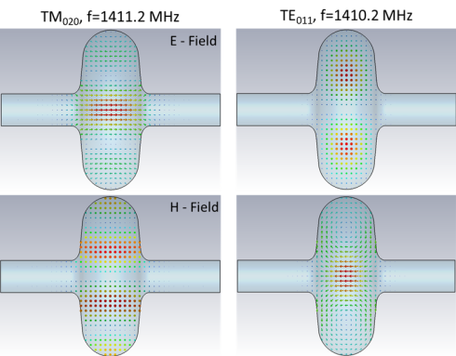

Axion Heterodyne detection status
Mostly taken from presentation of R.-T. D’Agnolo and S. Ellis at PBC meetings
FNAL design https://arxiv.org/abs/2207.11346

