Slide 1
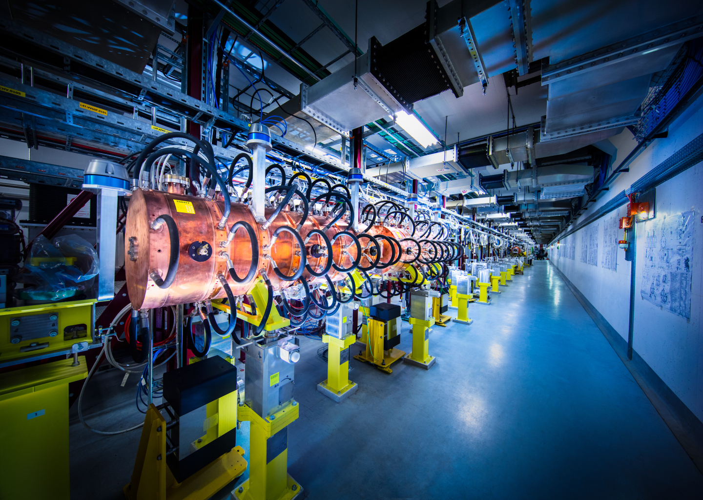
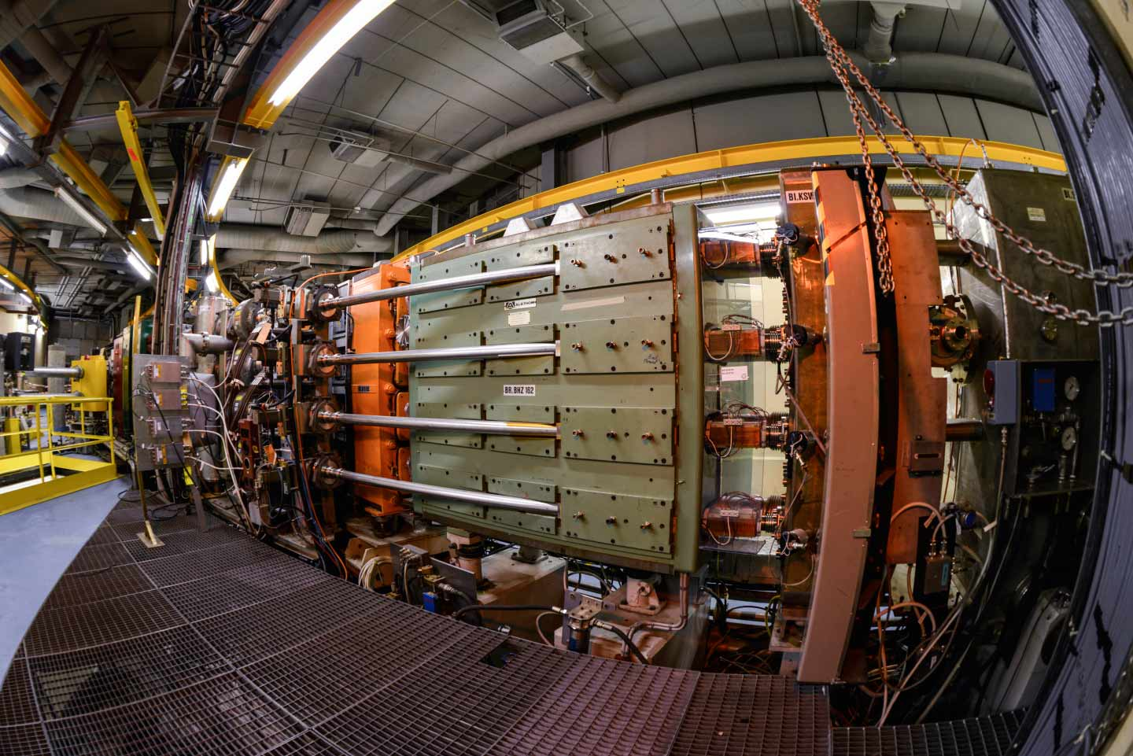
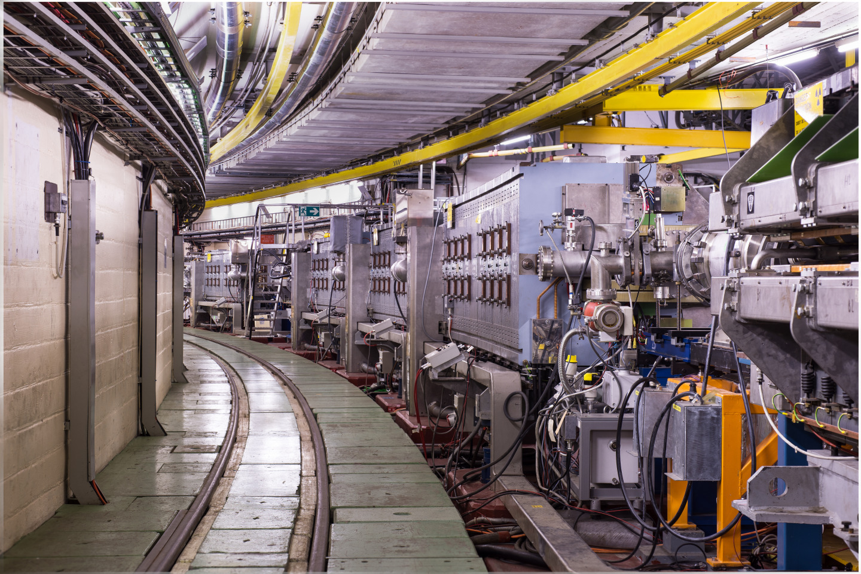
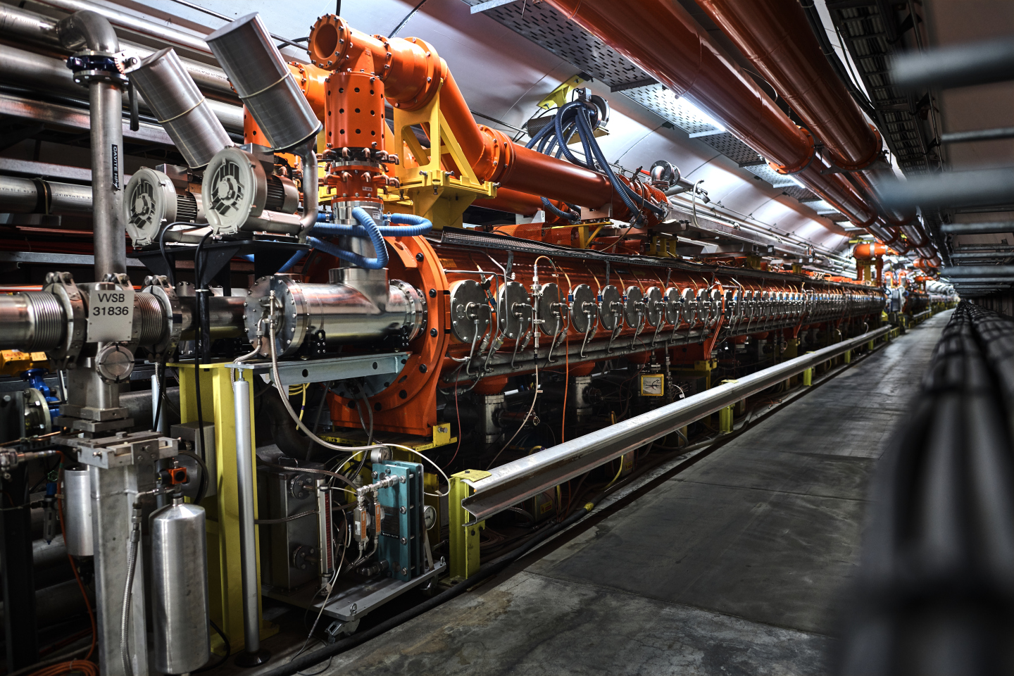
Performance of the injectors after LIU: status and prospects
T. Prebibaj, S. Albright, R. Alemany, C. Antuono, G. Arduini, T. Argyropoulos, P. Arrutia, F. Asvesta, H. Bartosik, G. Bellodi, C. Bracco, S. Cettour-Cave, N. Charitonidis, H. Damerau, L. Feliciano, A. Findlay, M. A. Fraser, D. Gamba, G. P. Di Giovanni, A. Huschauer, A. Lasheen, J. B. Lallement, K. Li, I. Mases Sole, M. Marchi, B. Mikulec, F. Roncarolo, G. Rumolo, E. Sargsyan, P. Skowronski, M. Schenk, F. M. Velotti, C. Zannini, PSB-PS-SPS OP
25-27/03/2024
PBC Annual Workshop

Slide 2
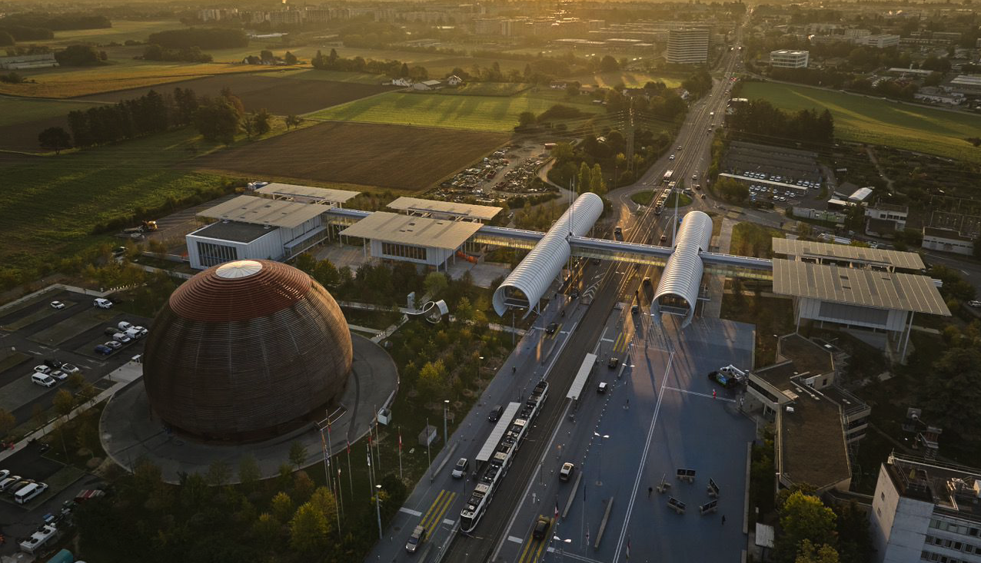

Outline
Overview & LIU upgrades
Status & prospects: protons
Status & prospects: ions
Summary & Outlook

Slide 3
Outline
Overview & LIU upgrades
Status & prospects: protons
Status & prospects: ions
Summary & Outlook

Slide 4
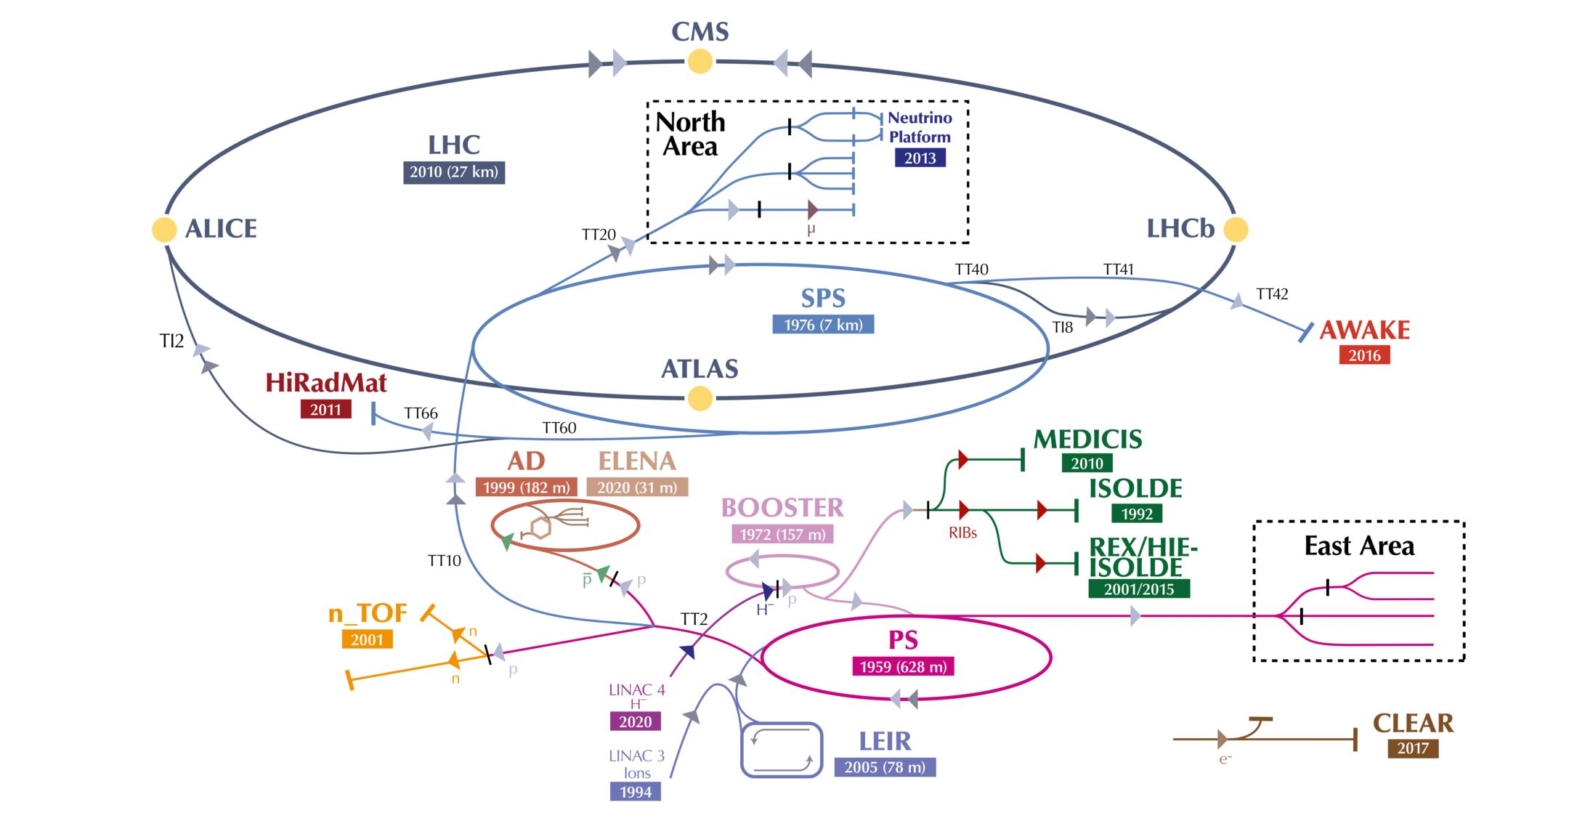
Injectors complex & facilities
PBC Workshop 2024
tirsi.prebibaj@cern.ch

Slide 5
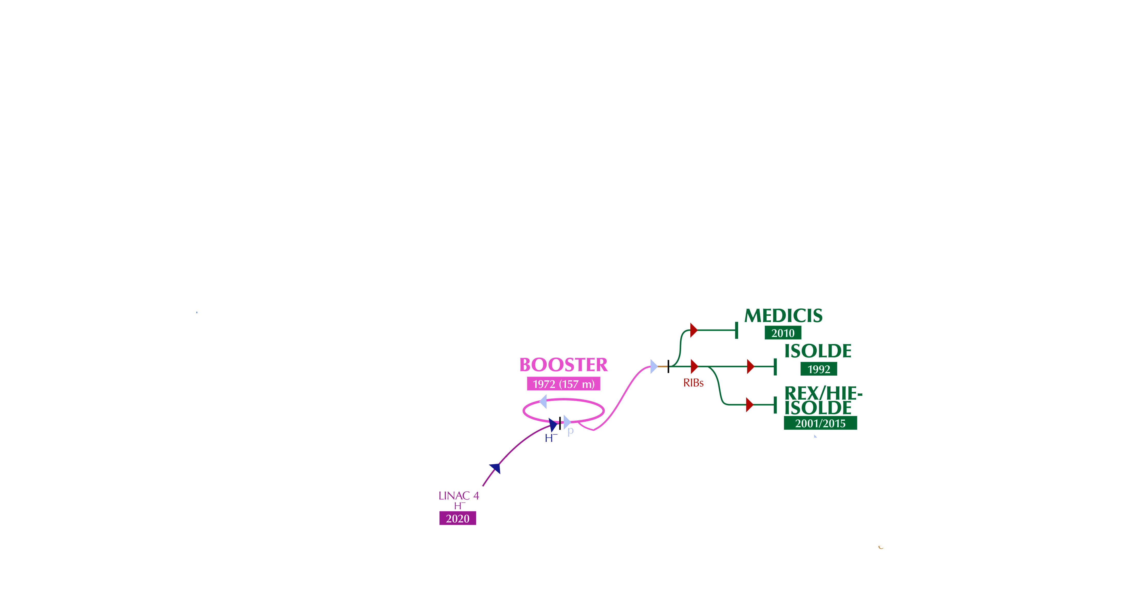
Injectors complex & facilities
PBC Workshop 2024
tirsi.prebibaj@cern.ch

Slide 6
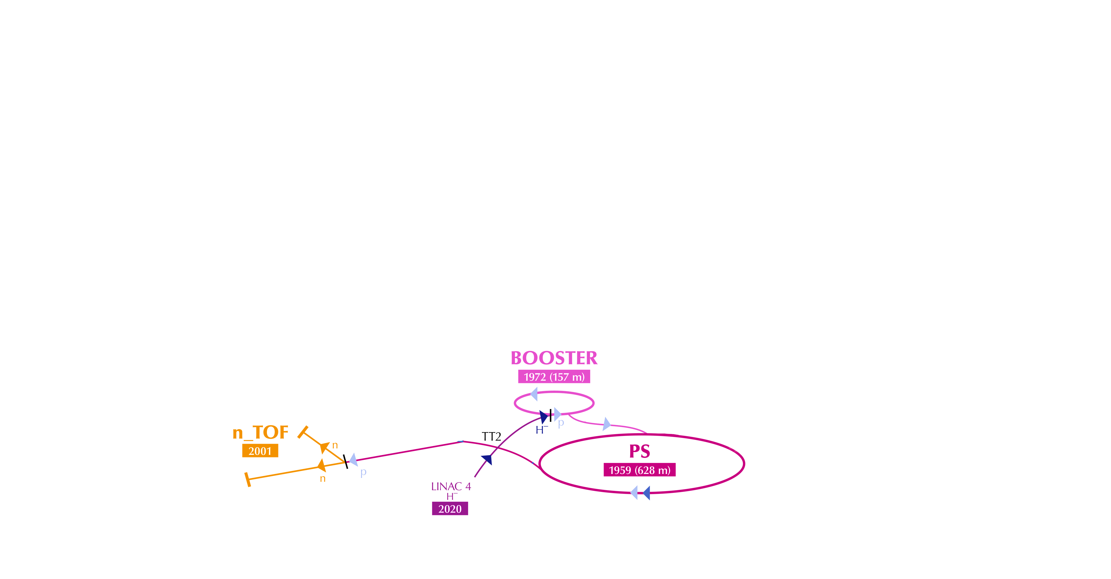
Injectors complex & facilities
PBC Workshop 2024
tirsi.prebibaj@cern.ch

Slide 7
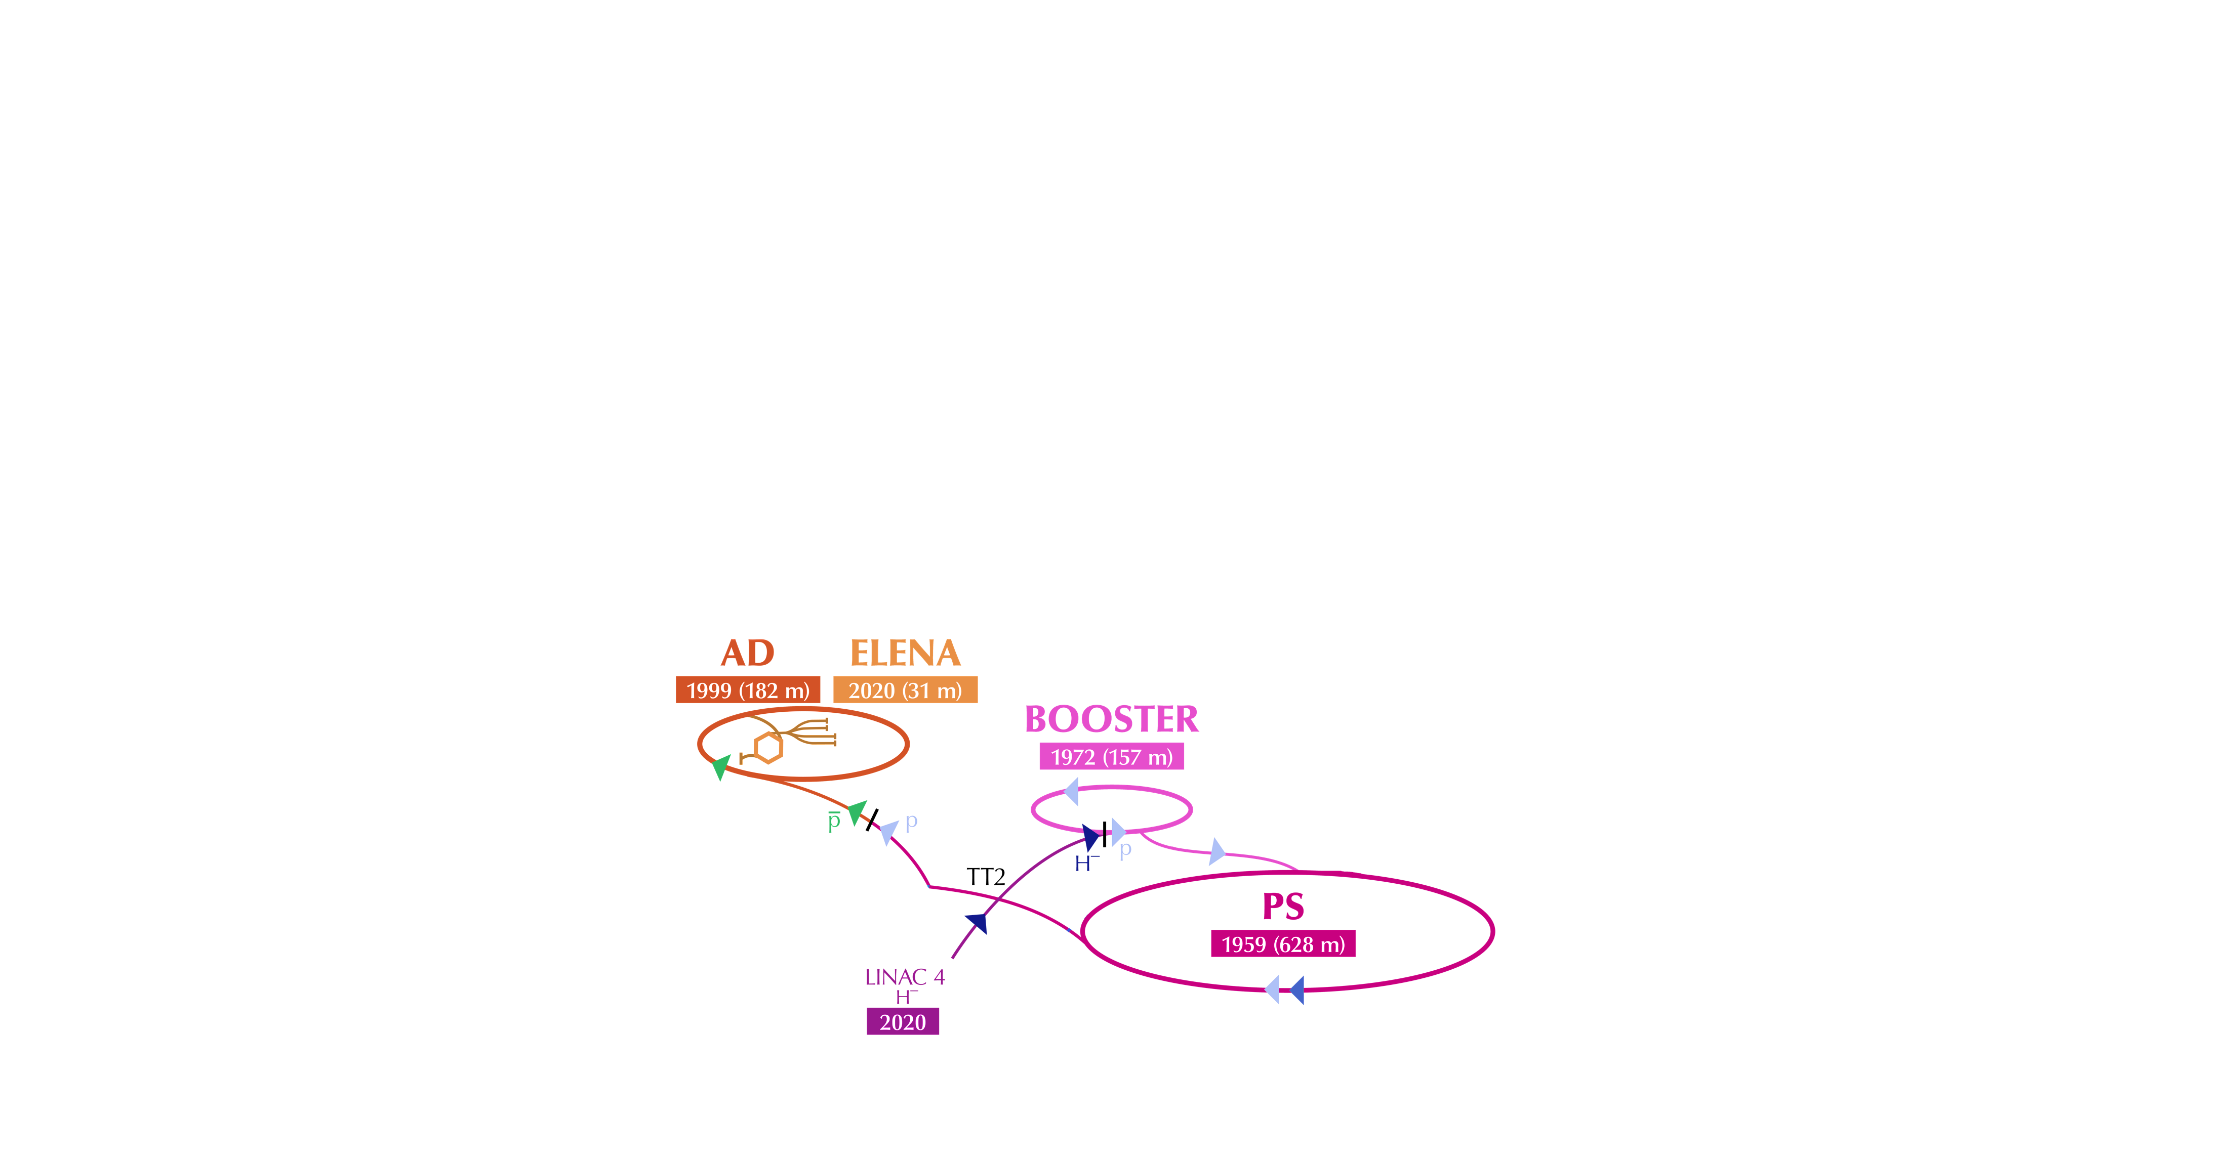
Injectors complex & facilities
PBC Workshop 2024
tirsi.prebibaj@cern.ch

Slide 8
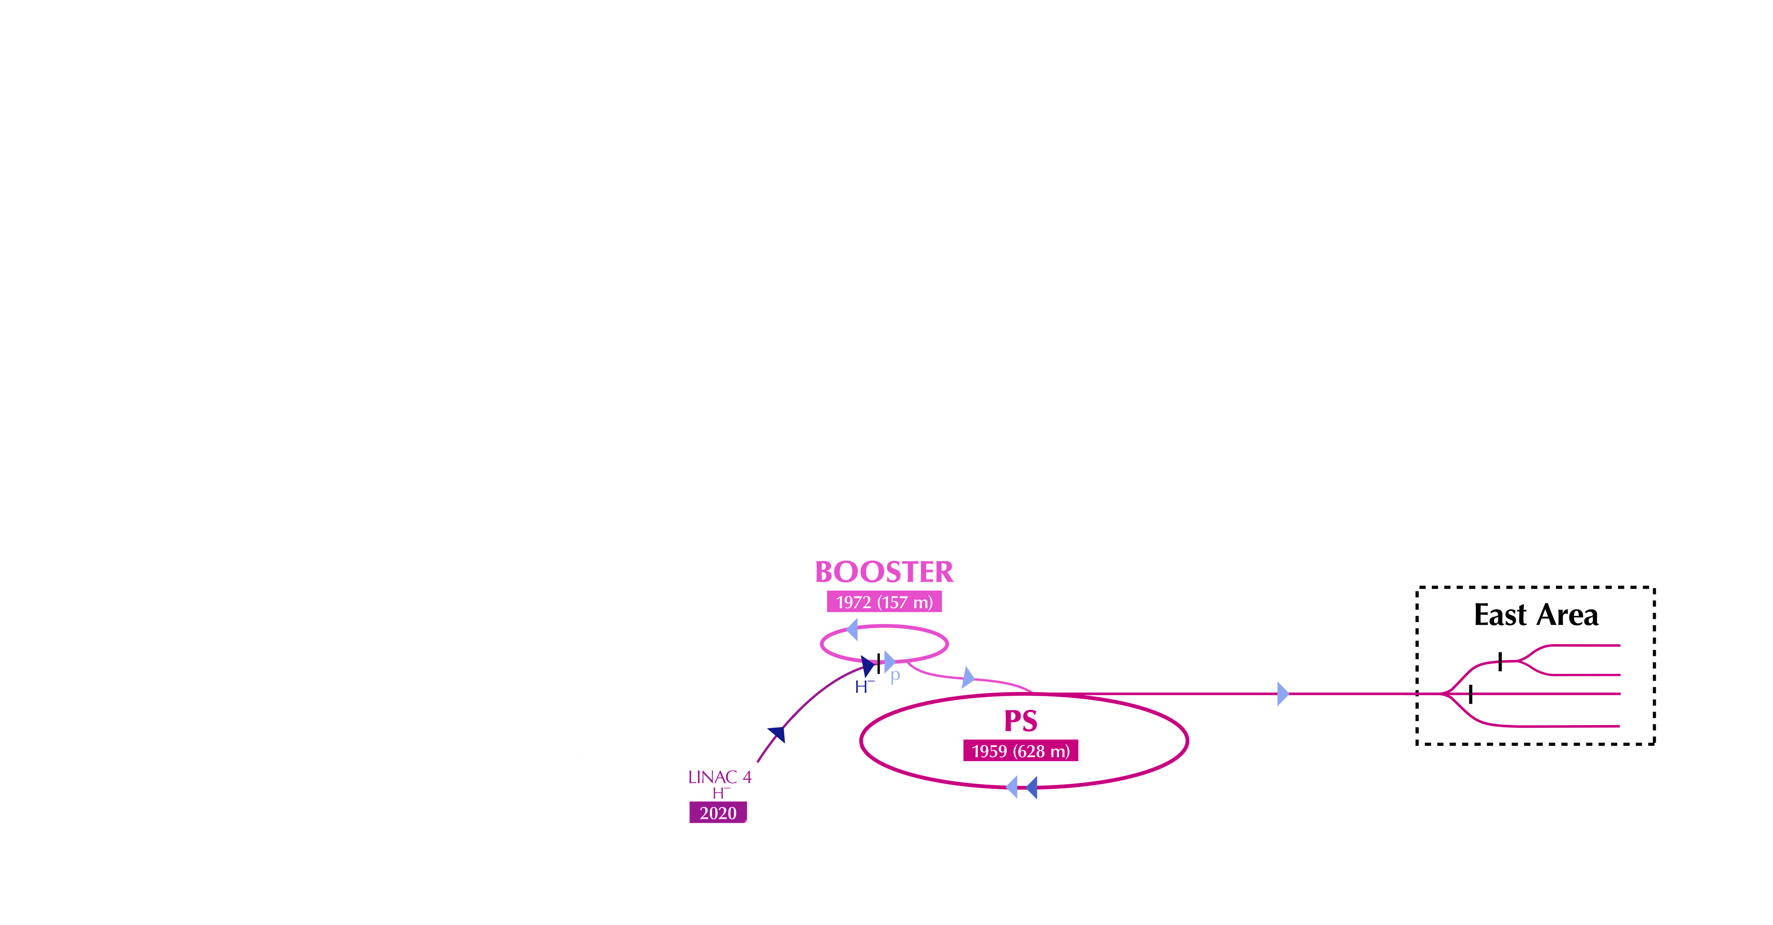
Injectors complex & facilities
PBC Workshop 2024
tirsi.prebibaj@cern.ch

Slide 9
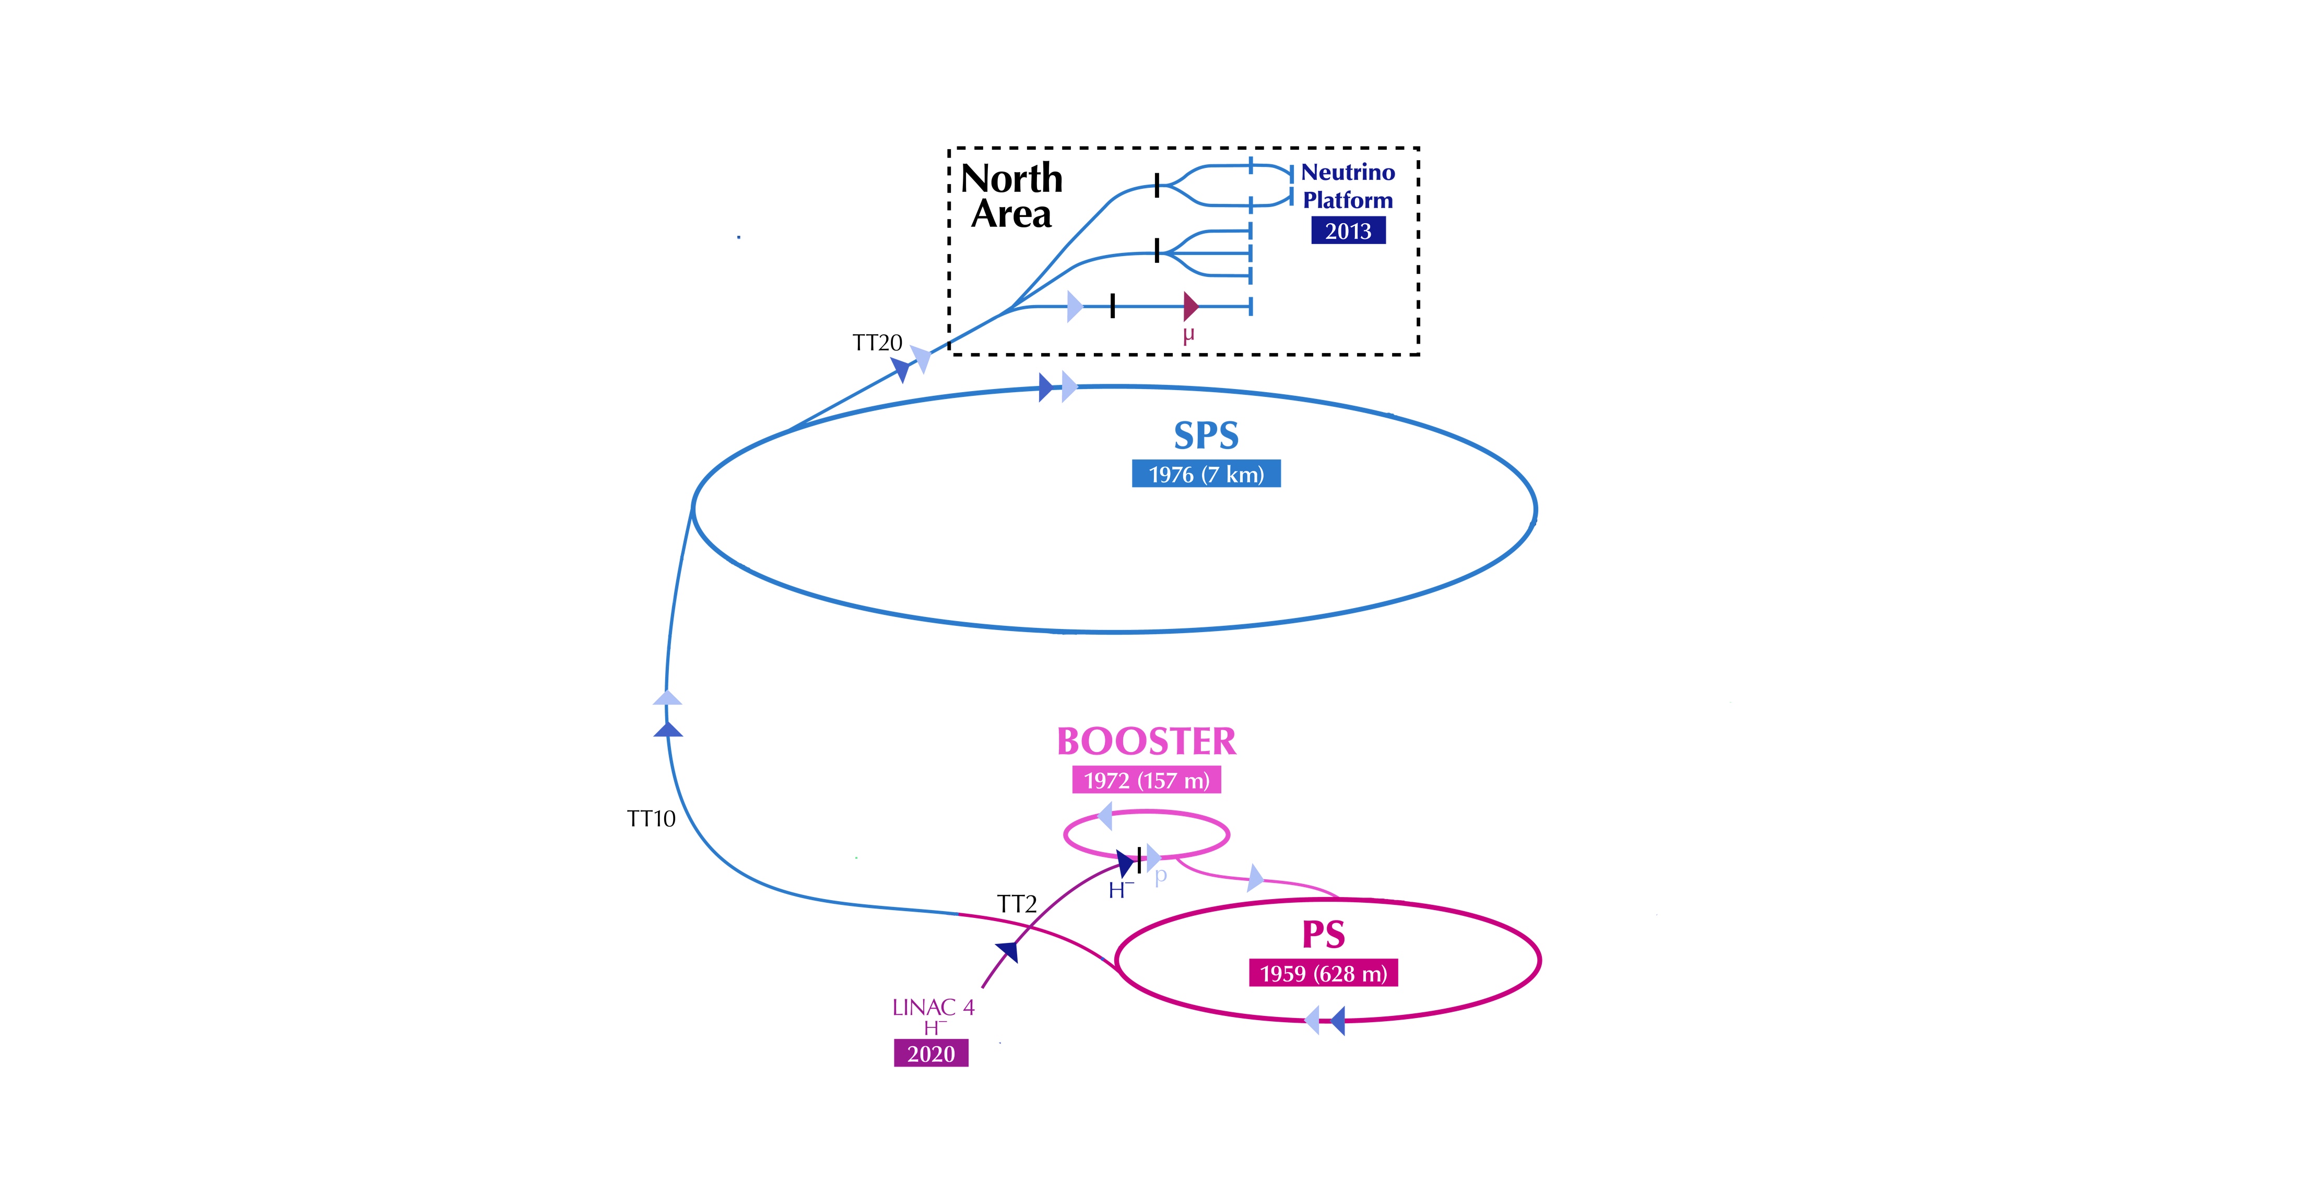
Injectors complex & facilities
PBC Workshop 2024
tirsi.prebibaj@cern.ch

Slide 10
Injectors complex & facilities
PBC Workshop 2024
tirsi.prebibaj@cern.ch

Slide 11
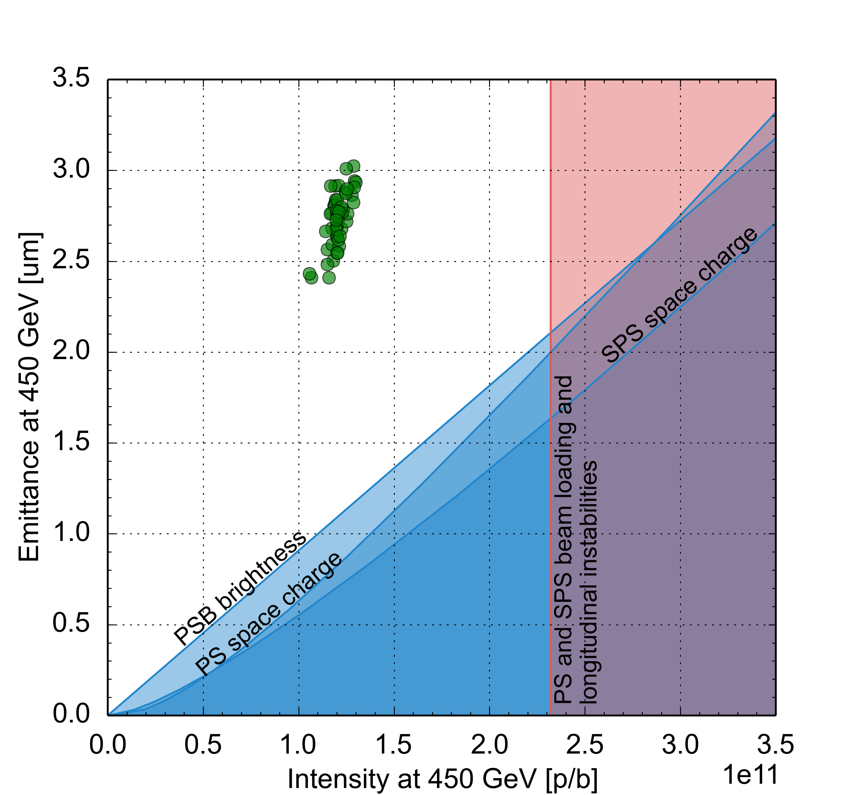
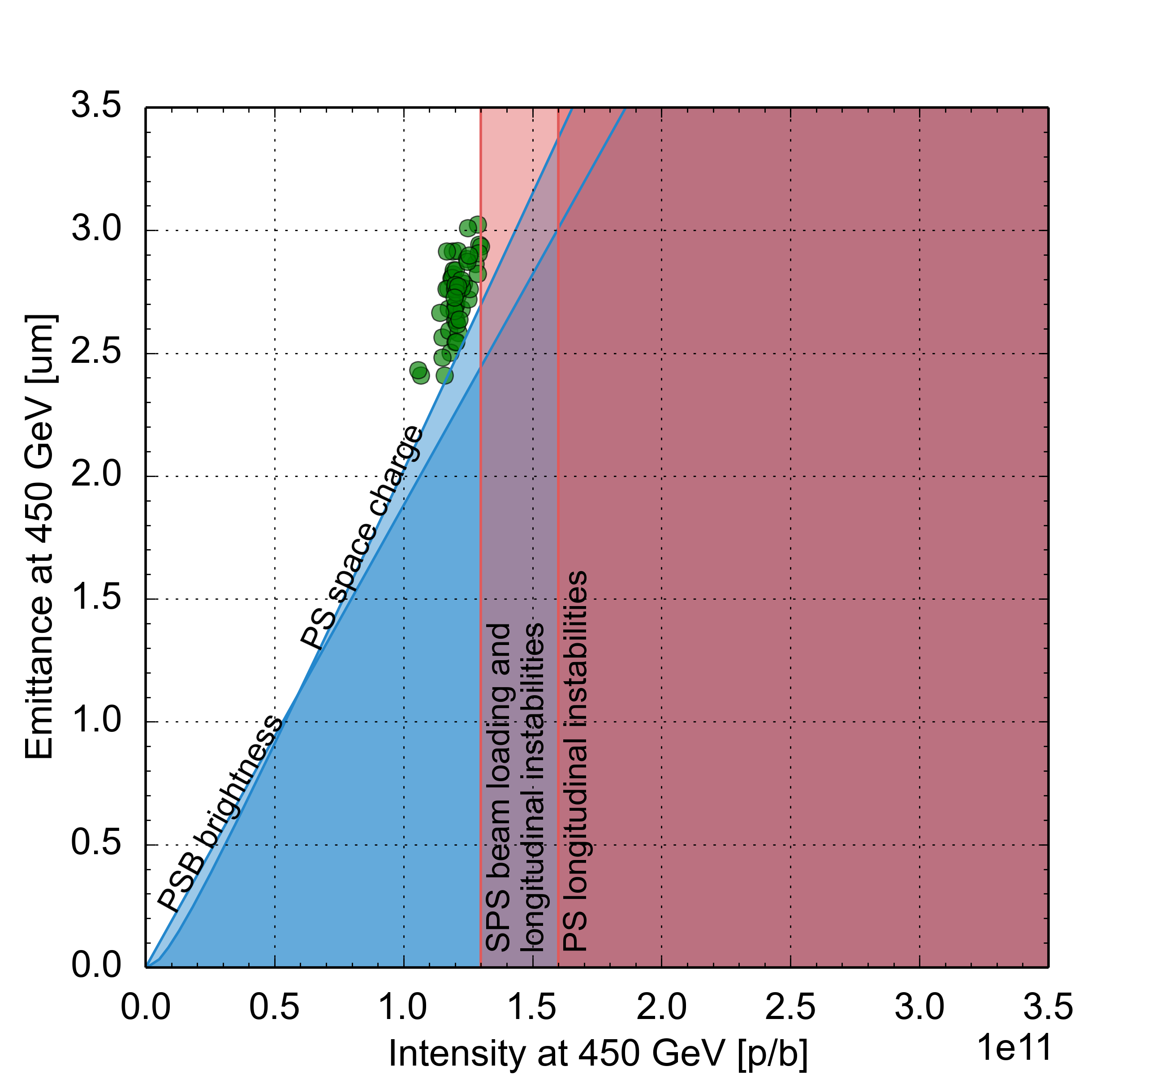
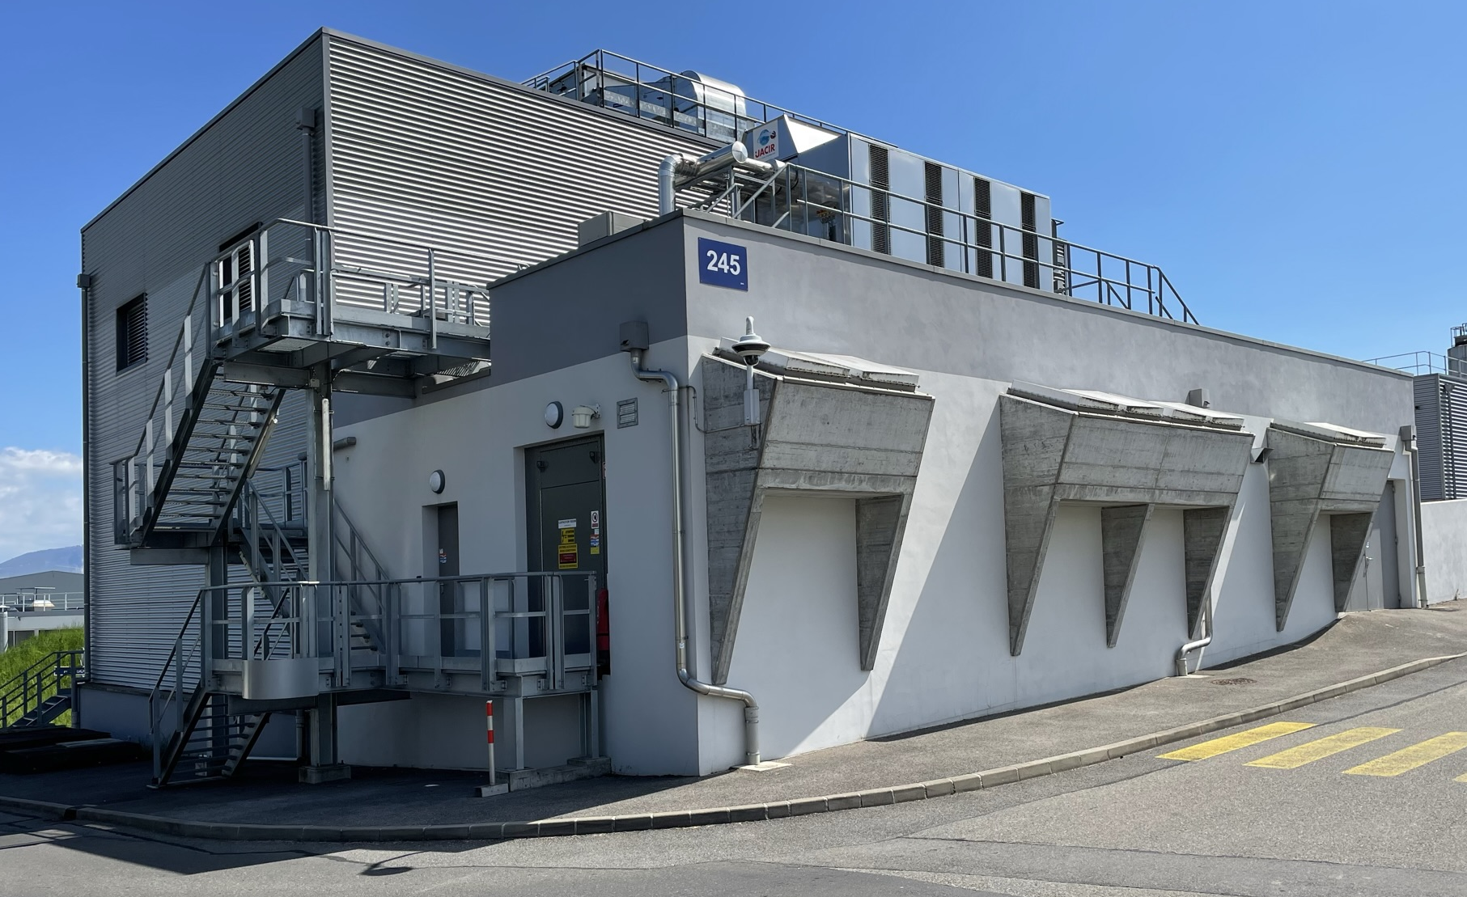
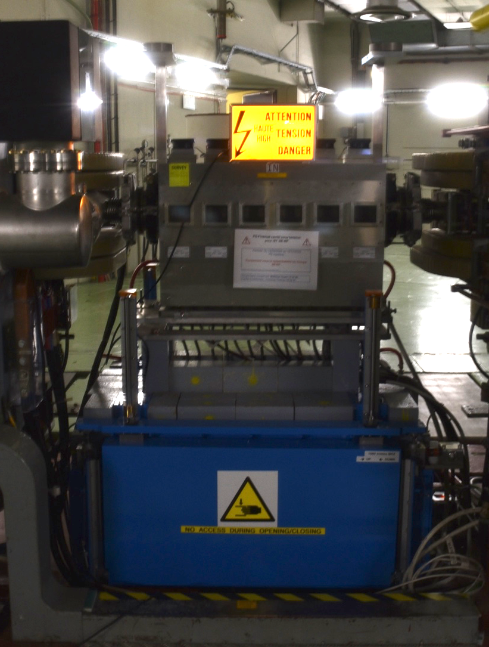
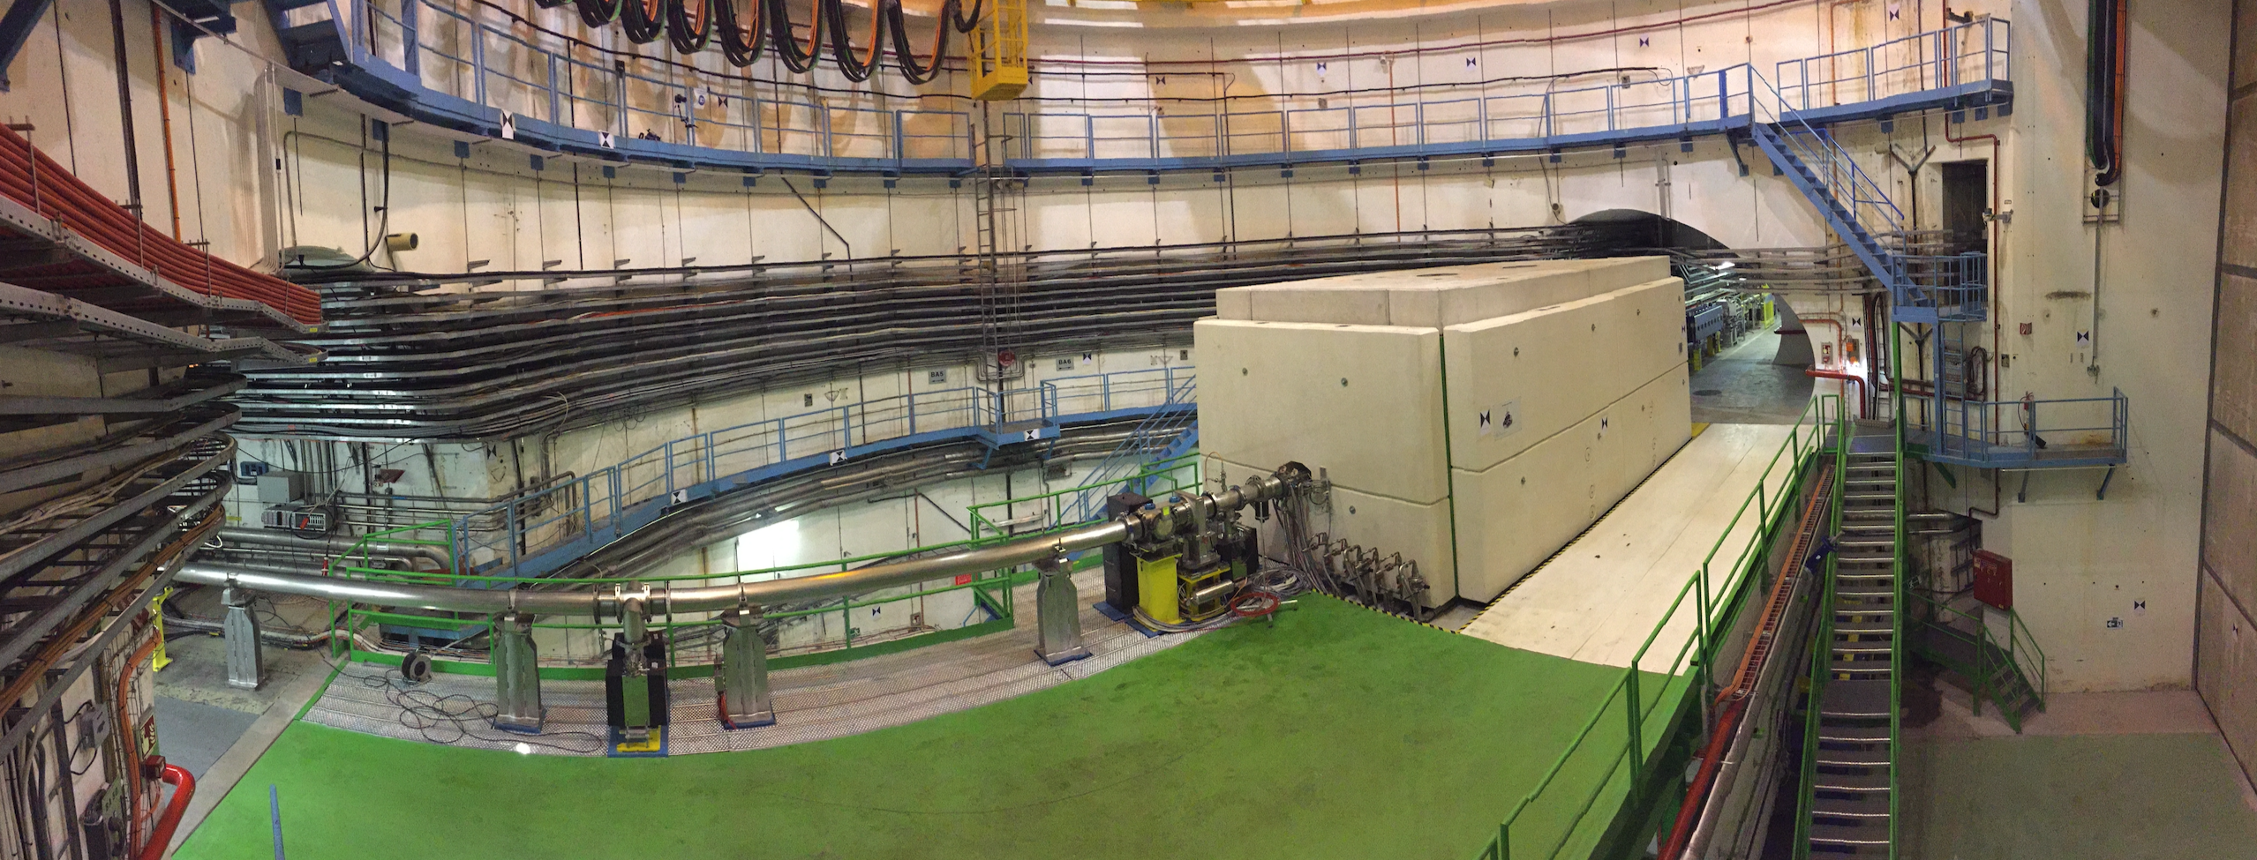
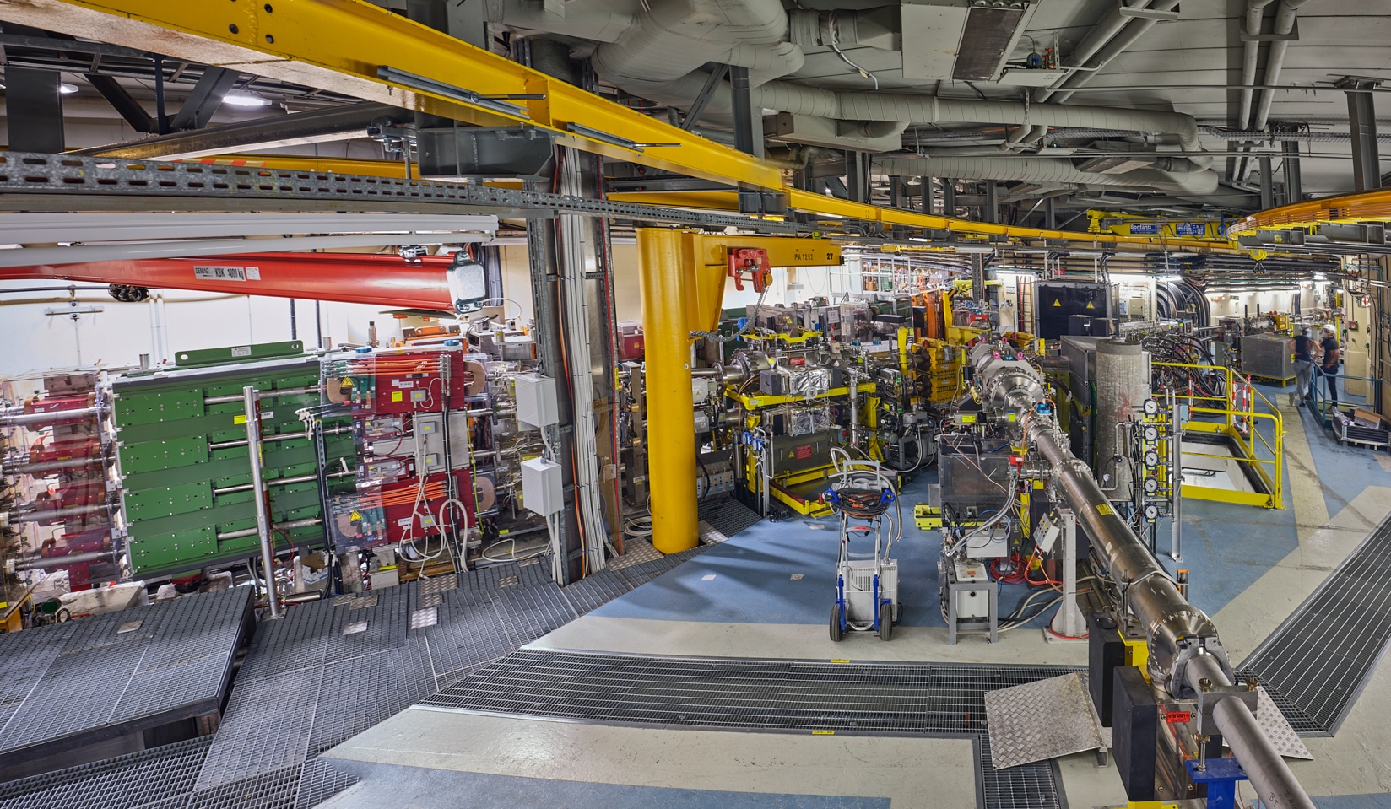
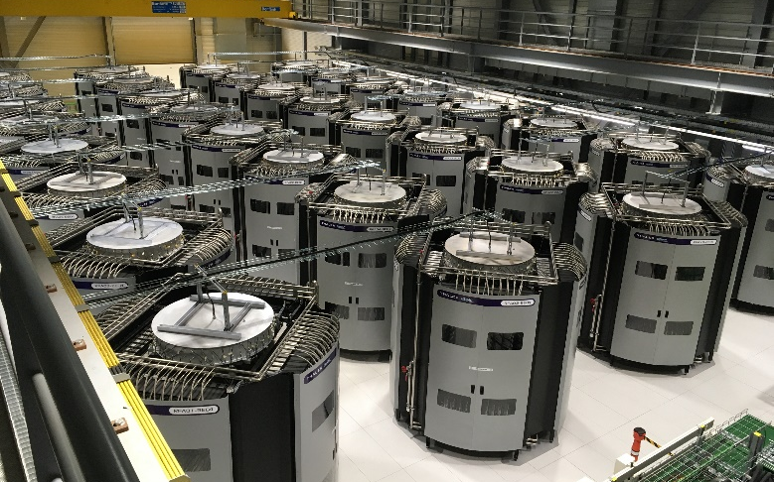
LHC Injectors Upgrade (LIU) project
Upgrades for injectors to satisfy HL-LHC requirements.
PS Finemet cavity ( damper)
Pre-LIU performance:
N_{b}=1.1 – 1.3 x 10¹¹ p/b
ε_{x,y}=2.5 – 3.0 μm
New SPS beam dump
HL-LHC target
N_{b}=2.3 x 10¹¹ p/b
ε_{x,y}=2.1 μm
PSB new power supply building
PSB injection Line from Linac4
New SPS RF amplifier towers
PBC Workshop 2024
tirsi.prebibaj@cern.ch
Notes:
Most of the LIU upgrades were implemented during LS2, but for example the PS Finemet cavity already came during LS1. One further major upgrade during LS2 were the Finemet cavities for the PSB.

Slide 12
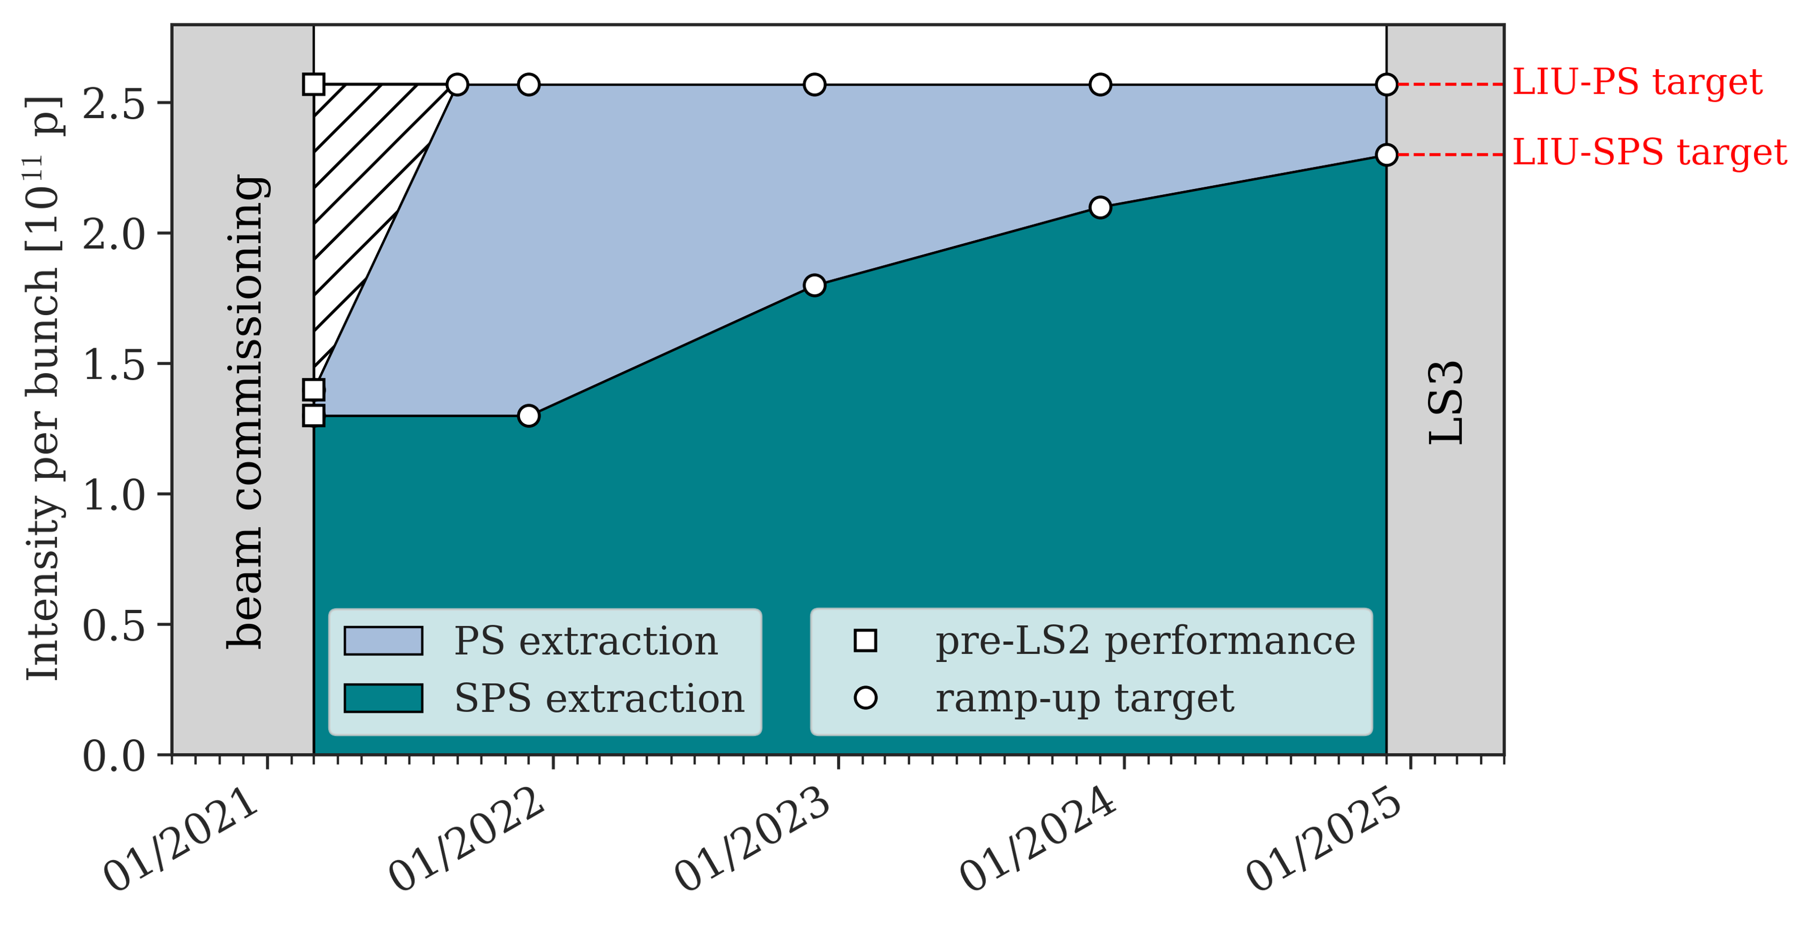
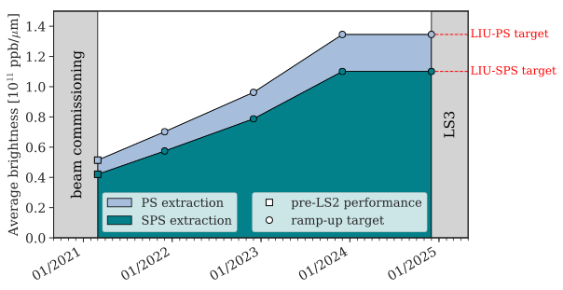
LHC beams
LIU parameter ramp-up is ongoing.
PSB brightness exceeded already in 2021.
PS LIU brightness & intensity as of 2022 (ahead of schedule).
SPS intensity reached already in 2023, brightness on LIU target (at the end of flat bottom).
Fixed Target beams also benefiting from LIU upgrades.
PBC Workshop 2024
tirsi.prebibaj@cern.ch
A. Huschauer et al., LIU Workshop 2020
Notes:
SPS measurements conducted at the end of flat bottom – last point that can be measured with present instrumentation (WS).

Slide 13
Outline
Overview & LIU upgrades
Status & prospects: protons
Status & prospects: ions
Summary & Outlook

Slide 14
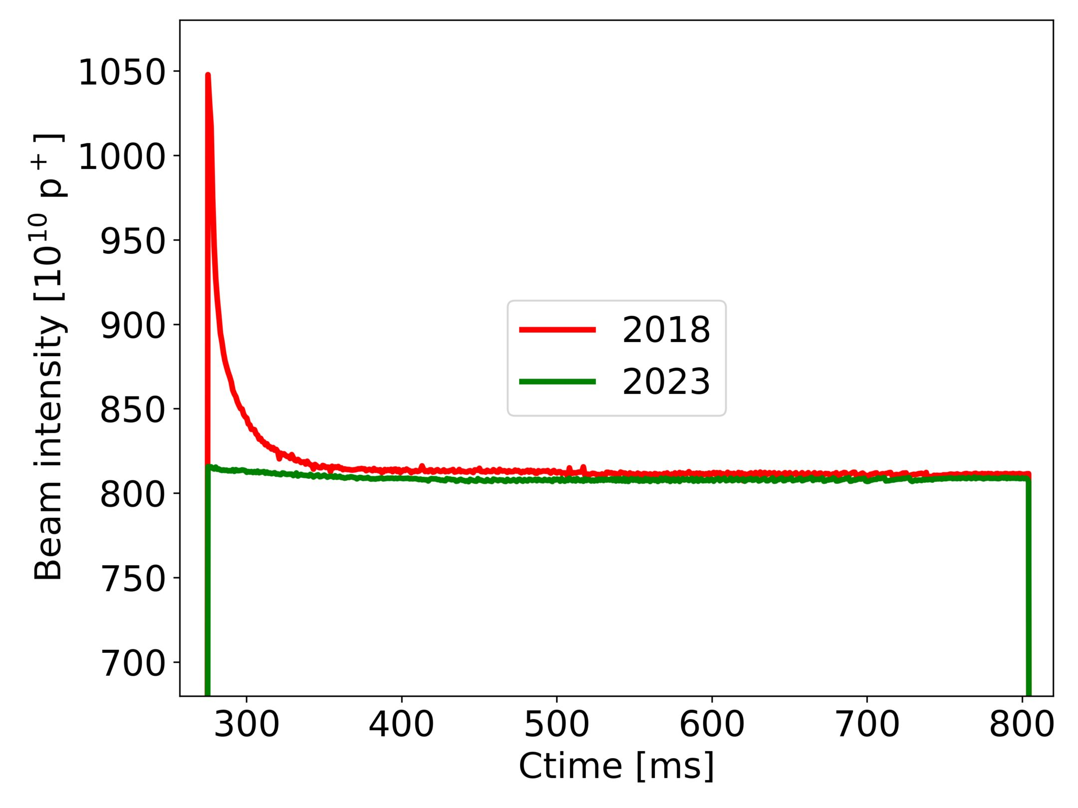
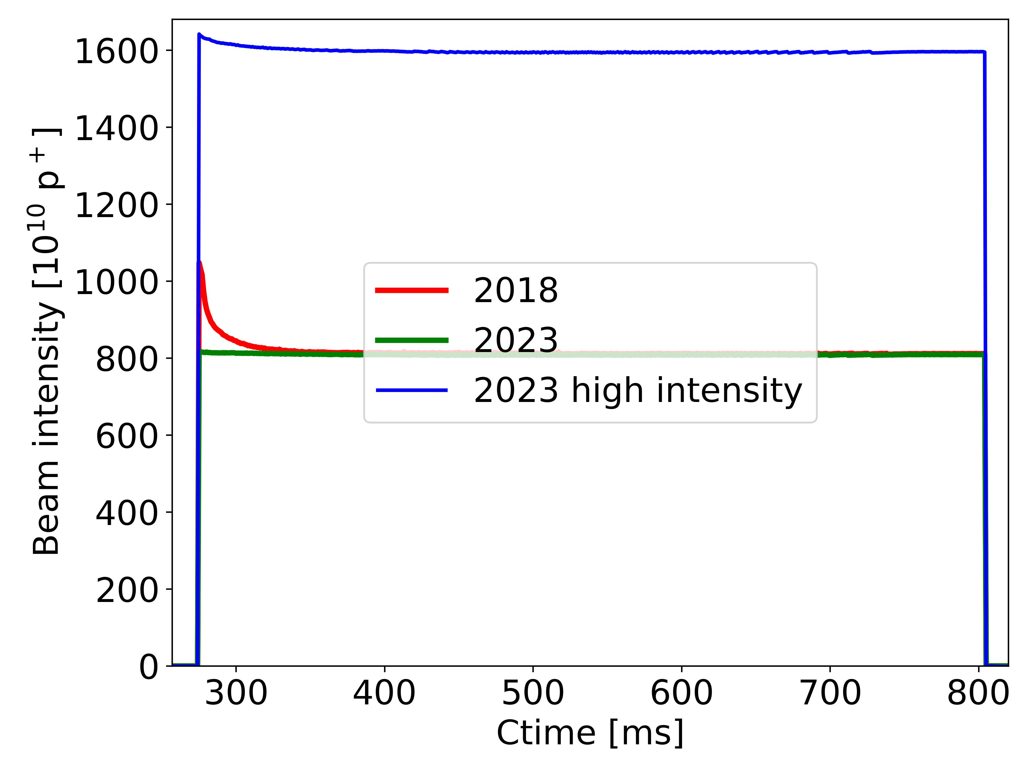
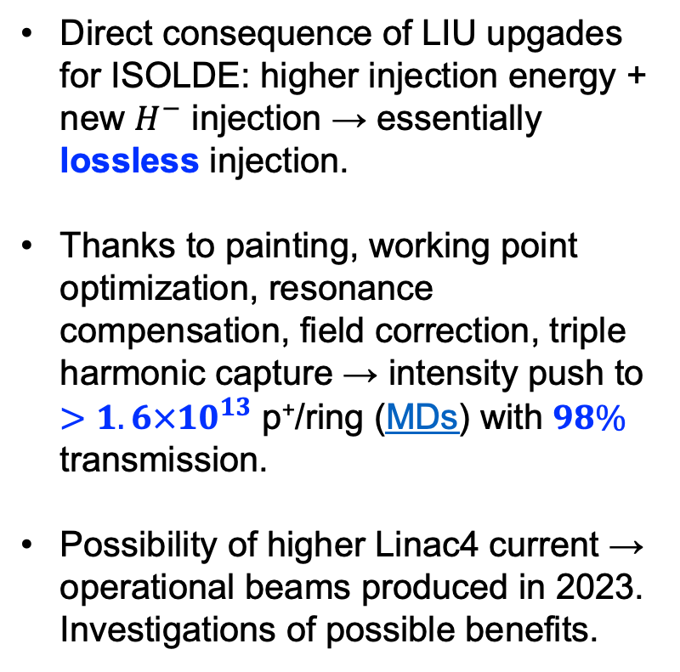
PSB intensity reach
Higher intensity & energy for ISOLDE.
Direct consequence of LIU upgades for ISOLDE: higher injection energy + new $H^{−}$ injection → essentially lossless injection.
Thanks to painting, working point optimization, resonance compensation, field correction, triple harmonic capture → intensity push to $>1.6×{10}^{13}$ p⁺/ring (MDs) with $98\%$ transmission.
Possibility of higher Linac4 current → operational beams produced in 2023. Investigations of possible benefits.
PBC Workshop 2024
tirsi.prebibaj@cern.ch

Slide 15
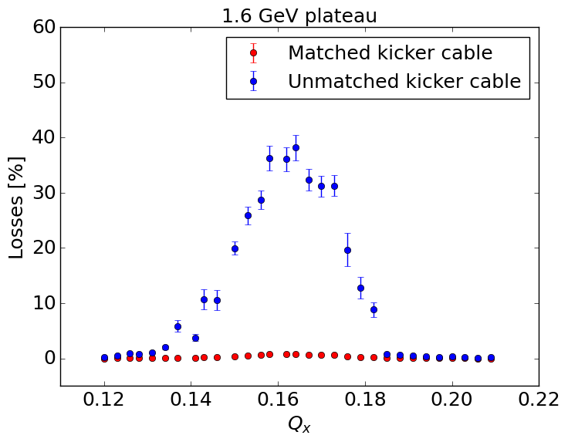
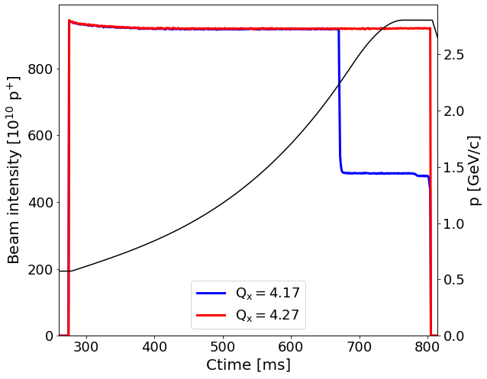
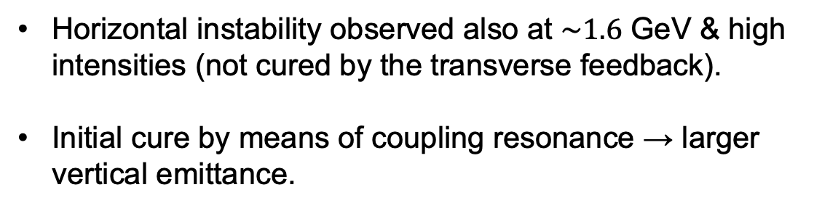
PSB instabilities at high energies
Horizontal instability observed also at $\sim 1.6$ GeV & high intensities (not cured by the transverse feedback).
Initial cure by means of coupling resonance → larger vertical emittance.
Extensive studies identified instability source (unmatched termination of extraction kicker cables).
Recent improvements: working point adjustemnts at extraction → improved transmission and reduced emittances.
PBC Workshop 2024
tirsi.prebibaj@cern.ch
Notes:
Kicker doesn’t pulse when matched – beam cannot be extracted.

Slide 16
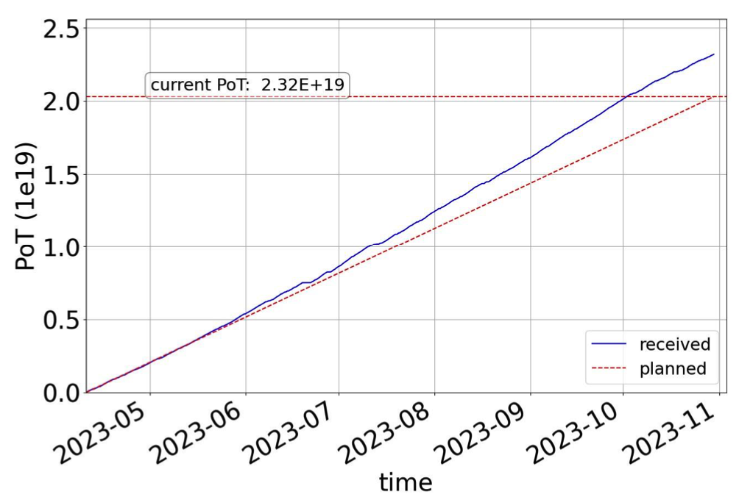
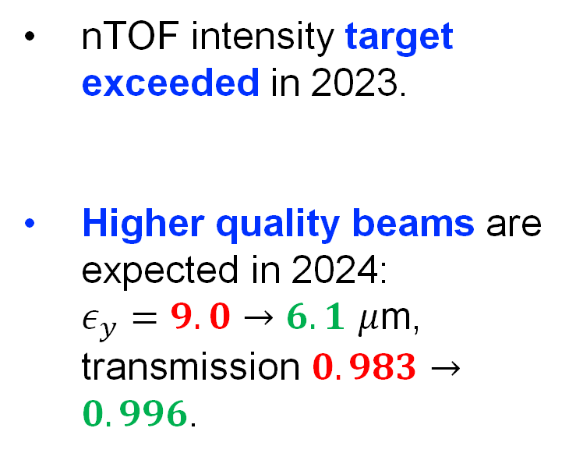
PSB instabilities at high energies
The cure of instabilities allows production of high intensity beams without considerable emittance constraints.
nTOF intensity target exceeded in 2023.
Higher quality beams are expected in 2024:
$ε_{y}=9.0→6.1$ $μ$m, transmission $0.983→0.996$.
PBC Workshop 2024
F. Asvesta et al., IPP 15/03/2024
tirsi.prebibaj@cern.ch
Follow-up points for TOF
Notes:
Give numbers (transmission emittance) for 2024

Slide 17
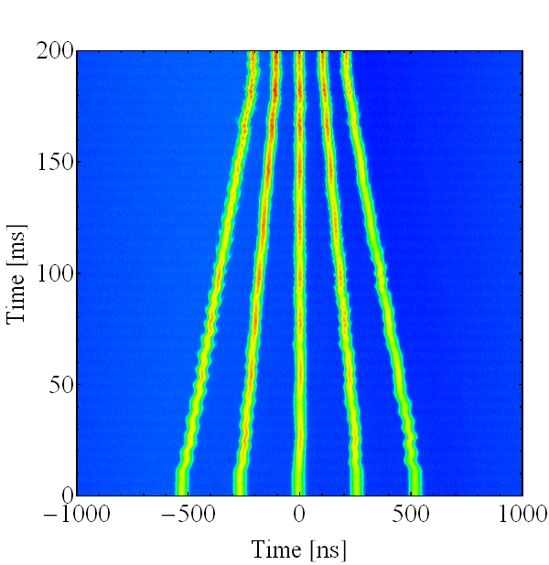
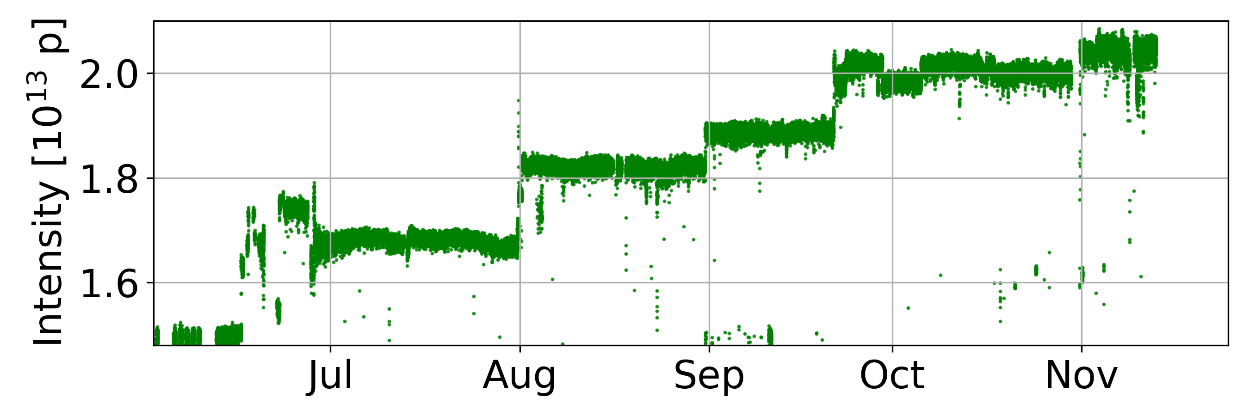
High-intensity for AD
Thanks to LIU upgrades, one PSB ring can deliver two bunches with sufficient brightness to AD.
Longitudinal stability achieved with batch compression
at high intensities in the PS (5 bunches).
Increasingly higher intensities to AD in 2023.
PS batch compression
Significant beam loss in PS-AD transfer line – radiation hot spot. Ongoing studies to improve (lack of instrumentation).
PBC Workshop 2024
tirsi.prebibaj@cern.ch
Notes:
The batch compression was reworked to achieve the high intensity with five bunches.

Slide 18
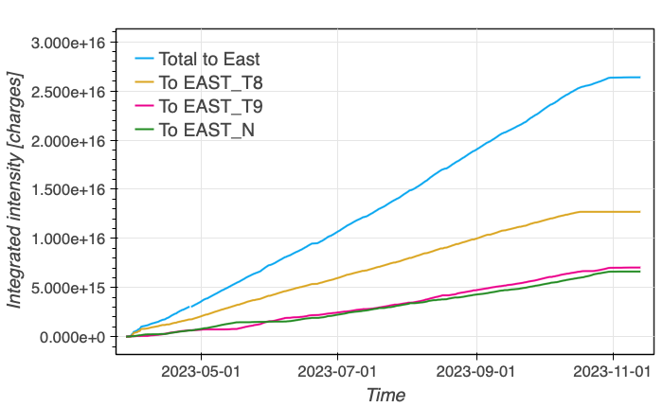
Beam production for EAST
Straightforward beam production in PSB-PS.
From accelerators’ perspective: possibility to increase beam intensity in case it is requested by experiments.
PBC Workshop 2024
tirsi.prebibaj@cern.ch

Slide 19
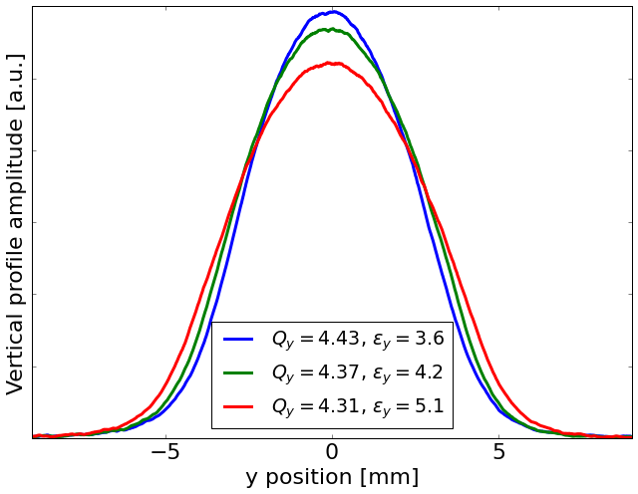
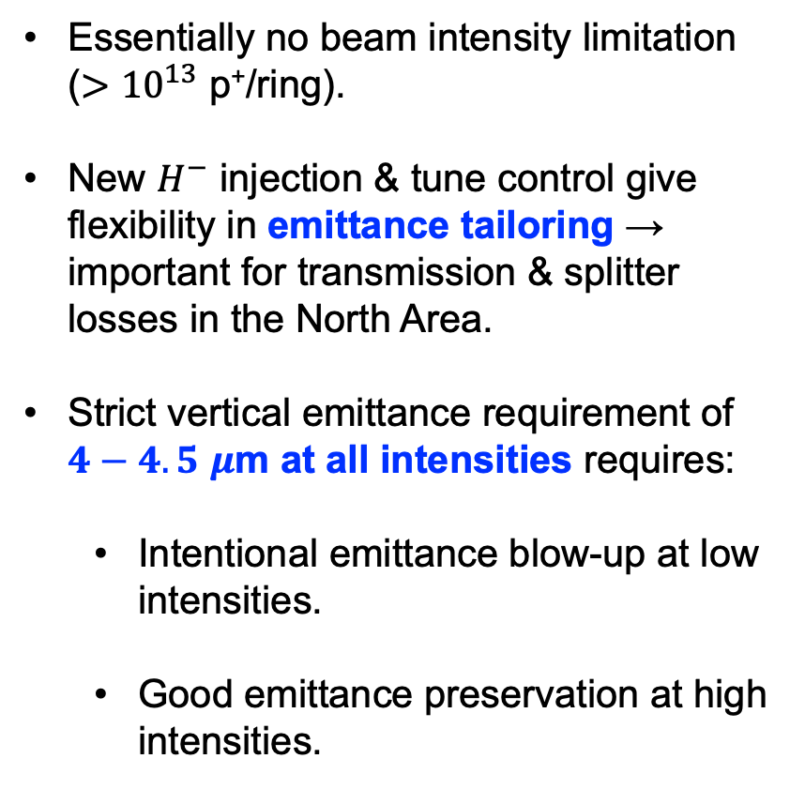
Status of SFTPRO in the PSB
Essentially no beam intensity limitation
($>{10}^{13}$ p⁺/ring).
New $H^{−}$ injection & tune control give flexibility in emittance tailoring → important for transmission & splitter losses in the North Area.
Strict vertical emittance requirement of $4−4.5$ $μ$m at all intensities requires:
  Intentional emittance blow-up at low intensities.
  Good emittance preservation at high intensities.
PBC Workshop 2024
tirsi.prebibaj@cern.ch
Notes:
Essentially there is not beam limitation
& tune control
Splitter losses in the NA

Slide 20
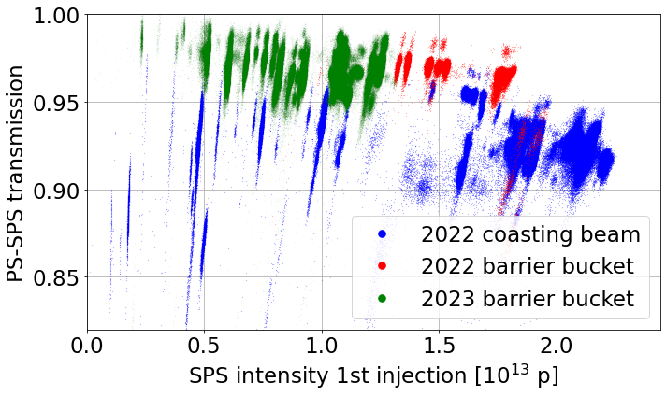
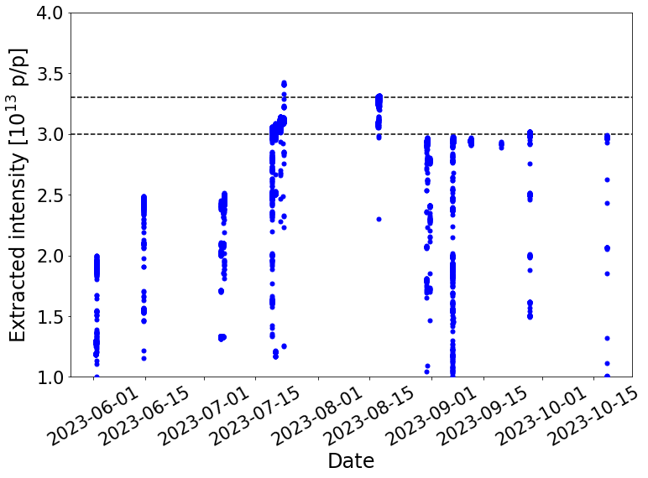
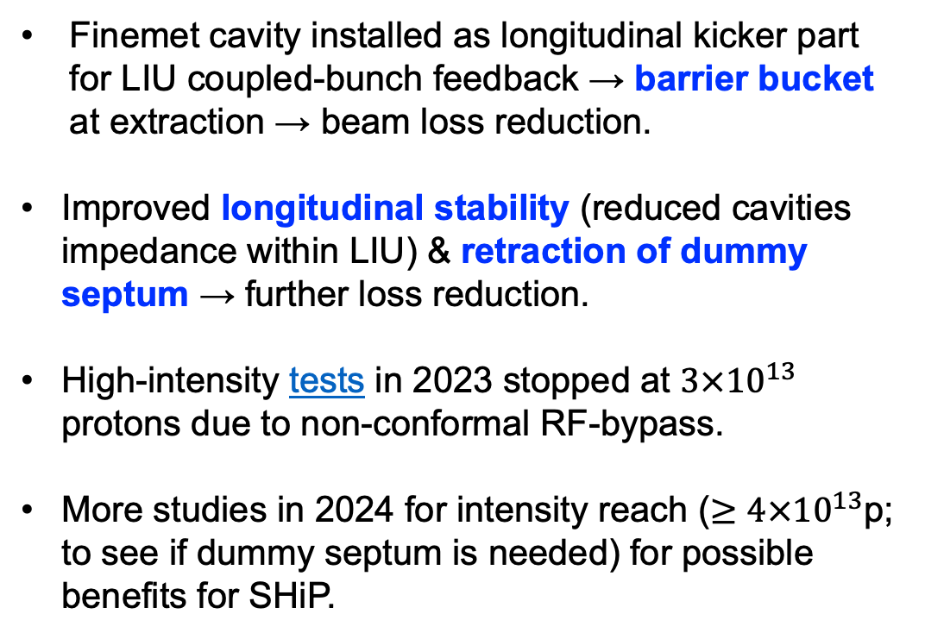
Status of SFTPRO in the PS
MTE/SFTPRO almost lossless up to PS extraction.
Finemet cavity installed as longitudinal kicker part for LIU coupled-bunch feedback → barrier bucket at extraction → beam loss reduction.
Improved longitudinal stability (reduced cavities impedance within LIU) & retraction of dummy septum → further loss reduction.
High-intensity tests in 2023 stopped at $3×{10}^{13}$ protons due to non-conformal RF-bypass.
More studies in 2024 for intensity reach ($≥4×{10}^{13}$p; to see if dummy septum is needed) for possible benefits for SHiP.
2023
PBC Workshop 2024
tirsi.prebibaj@cern.ch
Notes:
2 RF bypasses, one broke and was changed; both were checked during YETS.
4E13 p/p at PS-SPS transfer is actually the limit of the SPS (e.g. beam dump are all designed for LIU intensity, order slightly above 7E13 p/p). Even with the dummy septum 4E13 p/p would probably not work.

Slide 21
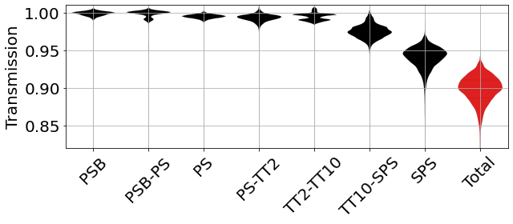
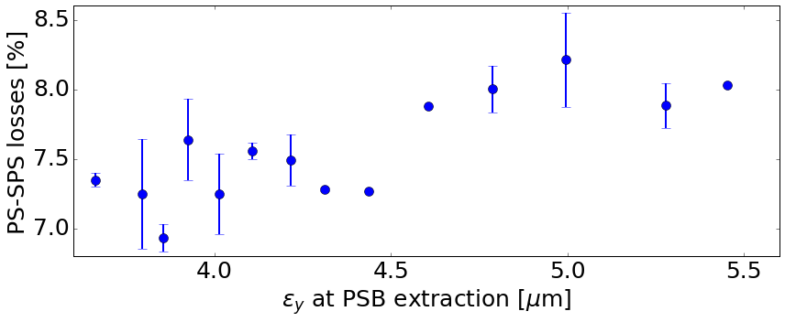
Status of SFTPRO in the SPS
Ongoing PSB-PS-SPS MDs to understand transmission bottlenecks.
Tailoring emittances in PSB to determine:
  Impact of beam size (emittance)
  Impact of beam shape (tails)
  Emittance preservation between accelerators
Planned studies to optimize TFB & tune in PS to improve NA spill structure.
PBC Workshop 2024
tirsi.prebibaj@cern.ch
Notes:
Plan is to study TFB etc in the PS.

Slide 22
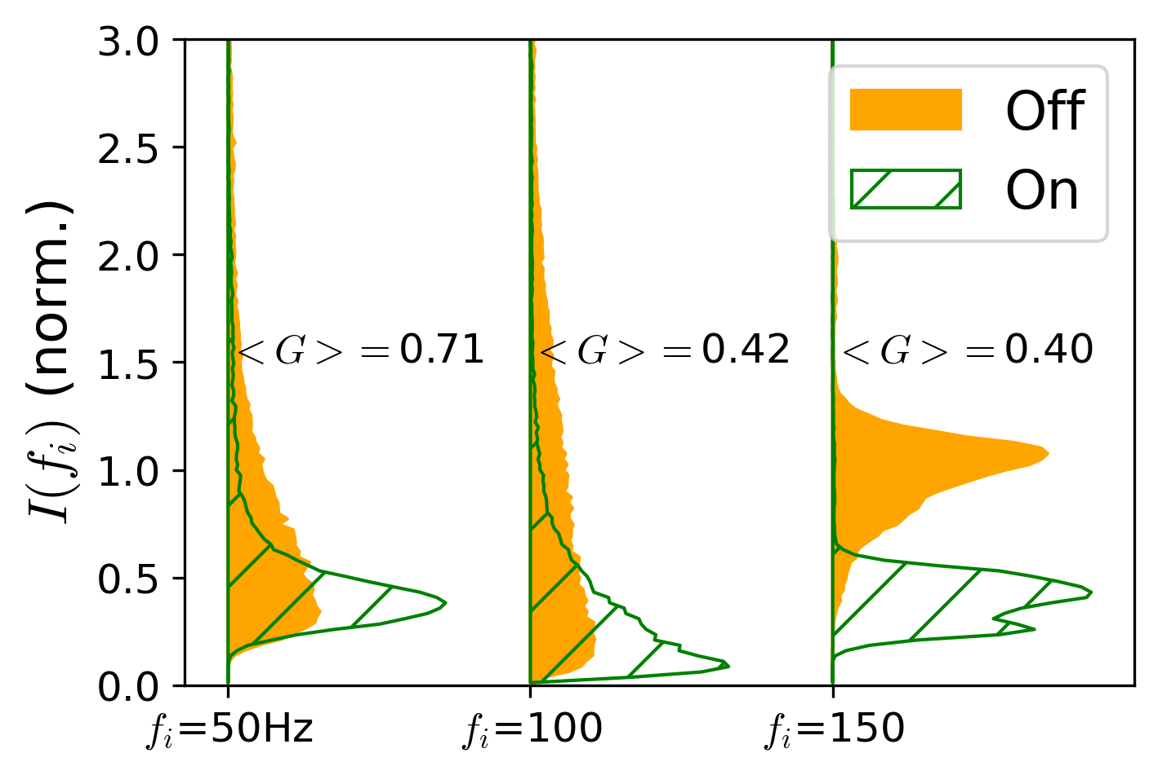
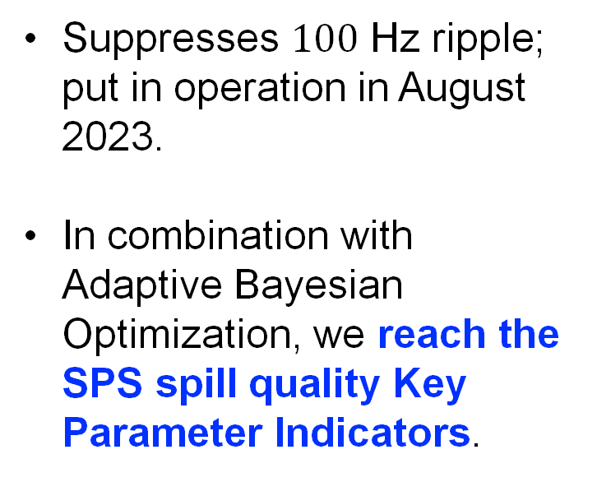
Status of SFTPRO in the SPS
  Empty-bucket channelling to improve spill strucutre.
Spill ripple (6 days of data)
Suppresses $100$ Hz ripple; put in operation in August 2023.
In combination with Adaptive Bayesian Optimization, we reach the SPS spill quality Key Parameter Indicators.
Ripple amplitude
  Slow extraction R&D has achieved 50% loss reduction, with another factor of at least 2 being targeted with new crystal technology.
PBC Workshop 2024
tirsi.prebibaj@cern.ch
P. Arrutia et al., JAP23 Workshop
Notes:
Pablo plot from JAP, shows how spill noise was reduced.
Empty-bucket channelling (EBC) is an RF manipulation pursued in the SPS due to difficulties to suppress 100Hz spill ripple.
In 2023, new RF feature implemented to add frequency offset between 200MHz and 800MHz frequency programs at SFT flattop. In 2022, EBC with 800MHz cav. was in conflict with 200MHz compensation during SFT extraction. RF team exploited slip-stacking controls to solve issue.

Slide 23
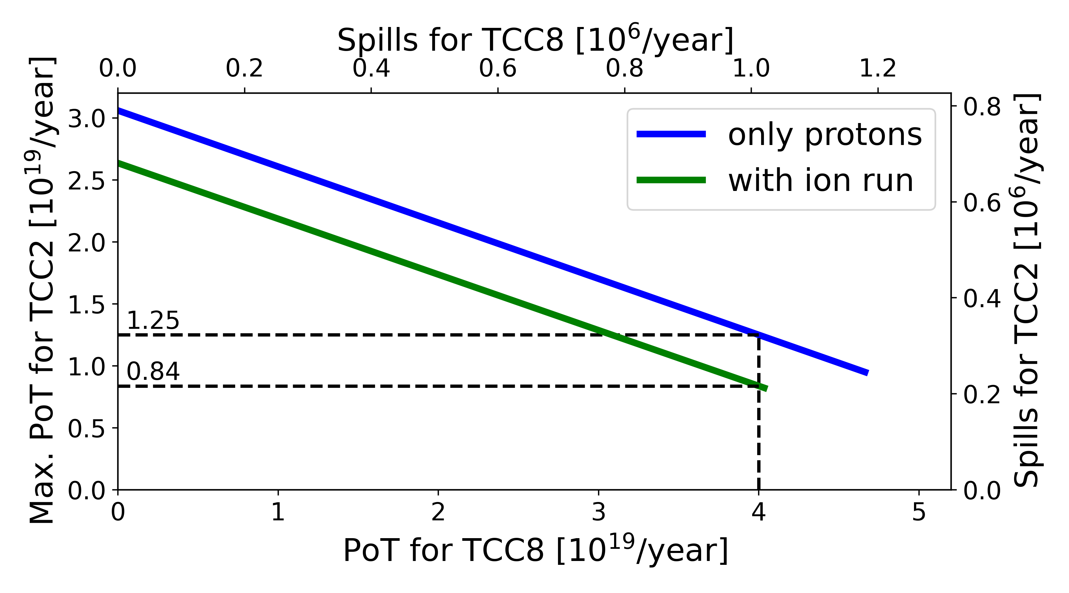
Future proton sharing for ECN3
SHiP will require high number of Protons on Target (PoT), through many high-intensity cycles with short slow extraction (1.2s).
Studies to address proton sharing scenarios based on post-LIU SPS performance, existing limitations and other SPS users.
Impact of high-duty SHiP supercycles to PSB & PS Fixed Target users is under investigation.
PBC Workshop 2024
tirsi.prebibaj@cern.ch
Notes:
Assumed protons per spill is 4.2e13.

Slide 24
Outline
Overview & LIU upgrades
Status & prospects: protons
Status & prospects: ions
Summary & Outlook

Slide 25
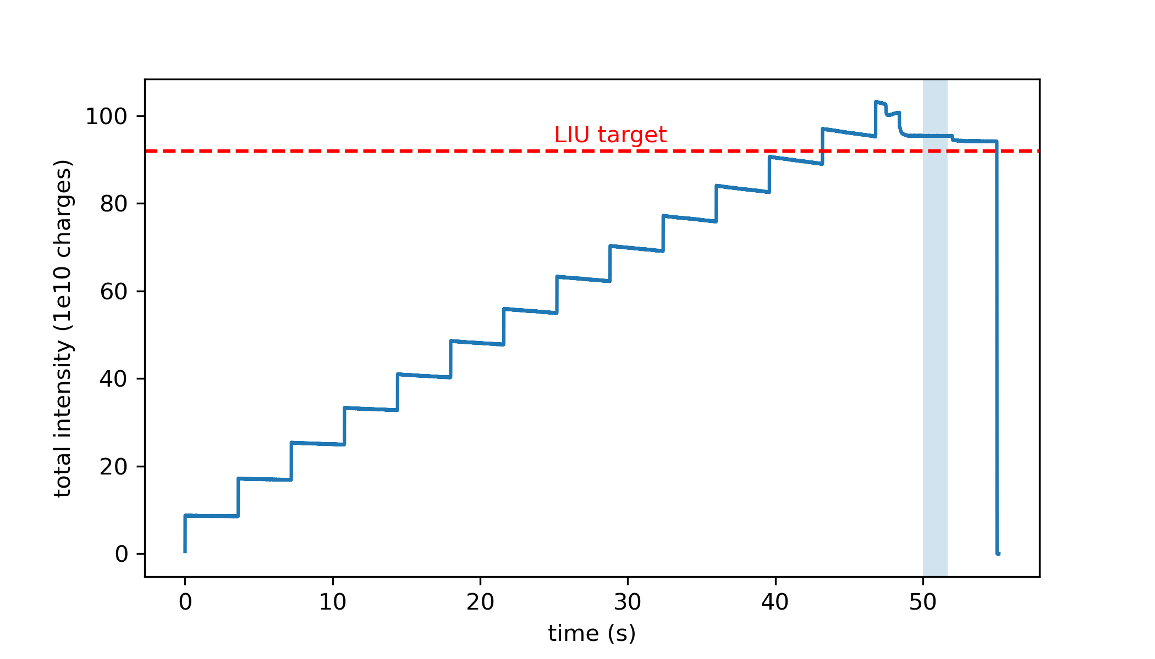
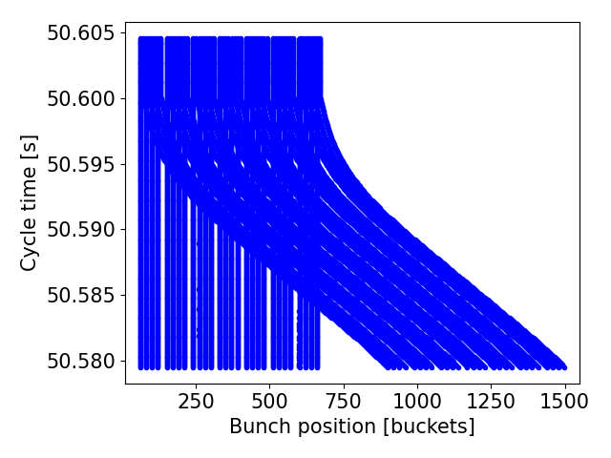
LIU ions for the LHC
LIU intensity demonstrated in 2023.
Successful commissioning of the SPS momentum slip-stacking (14 injections).
Two ion species to run in 2024 for the injectors (Mg & Pb).
PBC Workshop 2024
tirsi.prebibaj@cern.ch
T. Argyropoulos et al., JAP23 Workshop
Notes:
EAST area for ions more interesting compared to protons (Elliot).

Slide 26
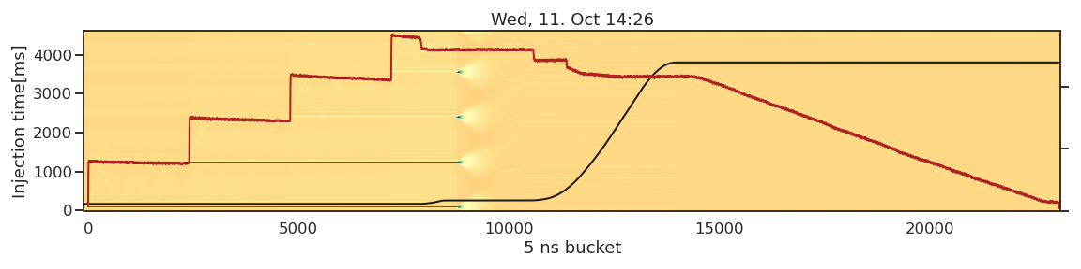
LIU ions for the Fixed Target experiments
Not direct impact of LIU to ions for Fixed Target, but:
Successful ion operation for NA & EAST in 2023, demonstrated HEARTS beam & facility readiness.
Status & plans for 2024 & beyond:
    Source tests in 2024 (to address drops of Pb intensity).
    Re-evaluating missing spare situation in ion chain for long term availability.
    NA CONS to review risk of equipment failure.
Studies with new ions in the complex (Future Ions WG):
    Krypton tests in 2023.
    Magnesium run up to PS in 2024.
    Oxygen and Pb⁷⁹⁺ run in 2025 for NA, LHC, HEARTS, SPS Gamma Factory.
    Potential B³⁺ tests.
A. Huschauer et al., Chamonix Workshop 2024
PBC Workshop 2024
tirsi.prebibaj@cern.ch
R. Alemany et al., PBC Workshop 2024
Notes:
Add reference to presentation of Reyes

Slide 27
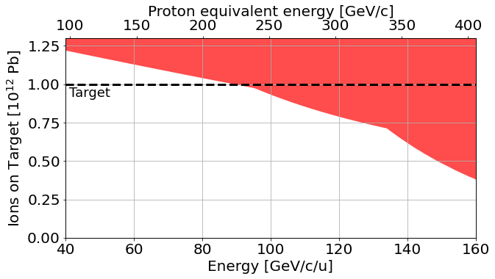
Future ion sharing
Operation & expected performance for future North Area experiments considering accelerator capabilities & other ion users.
PRELIMINARY
Example: Ions on Target estimations for NA60+ using Pb at different energies, assuming a 4-week run.
PBC Workshop 2024
tirsi.prebibaj@cern.ch

Slide 28
Outline
Overview & LIU upgrades
Status & prospects: protons
Status & prospects: ions
Summary & Outlook

Slide 29
Summary & Outlook
3 years of post-LIU accelerators:
    LIU brightness reached.
    LIU intensity is almost reached.
    Preparing fine tuned parameters and reproducibility for HL-LHC era.
Fixed Target beams benefiting from LIU upgrades:
    Higher intensity & higher energy for PSB/ISOLDE.
    Record intensity for AD.
    Exceeding Protons on Target goals for nTOF.
Ions after LIU upgrades:
    LIU intensity reached in 2023.
    Rich program in ion species and parameters for FT experiments.
Addressing challenges in transmission, monitoring & beam quality:
    Assessing intensity reach in PSB & PS for the future of Fixed Target beams.
    Ongoing studies for higher intensity and loss reduction for SFTPRO.
    Ongoing studies for future proton & ion sharing scenarios, including physics users of PSB & PS.
PBC Workshop 2024
tirsi.prebibaj@cern.ch

Slide 30
Thank you for your attention

