Slide 1
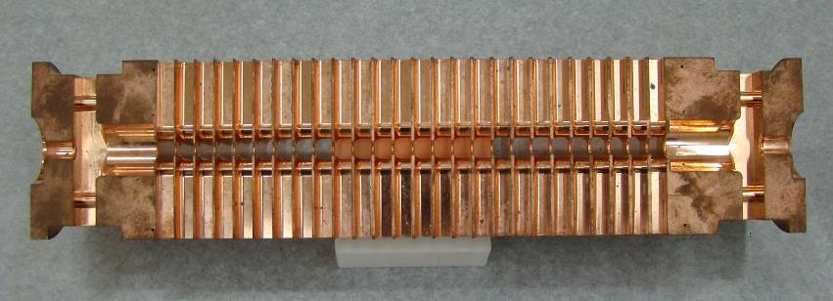
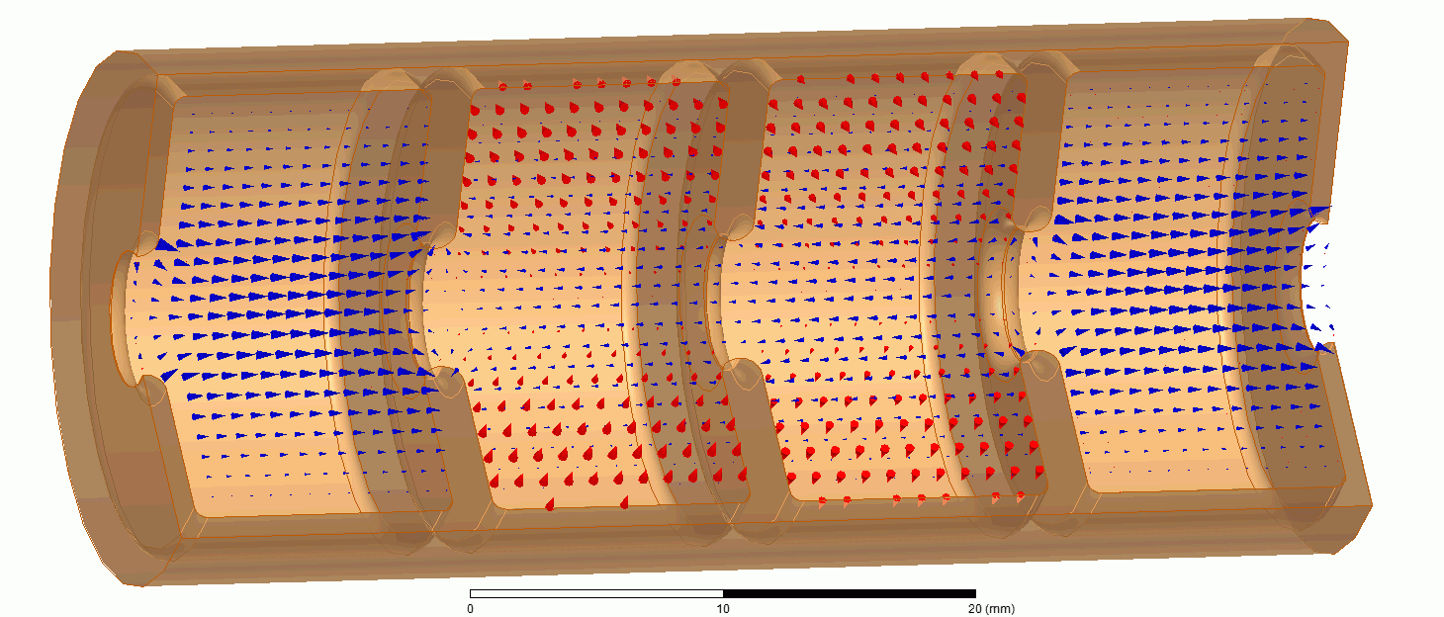
Beam accelerated from right to left
Cut away view of CLIC travelling wave RF cavity
An accelerator system for the FLASH treatment of large deep-seated tumors. Walter Wuensch, CERN Accademic Training Program https://indico.cern.ch/event/1131207/

Slide 2
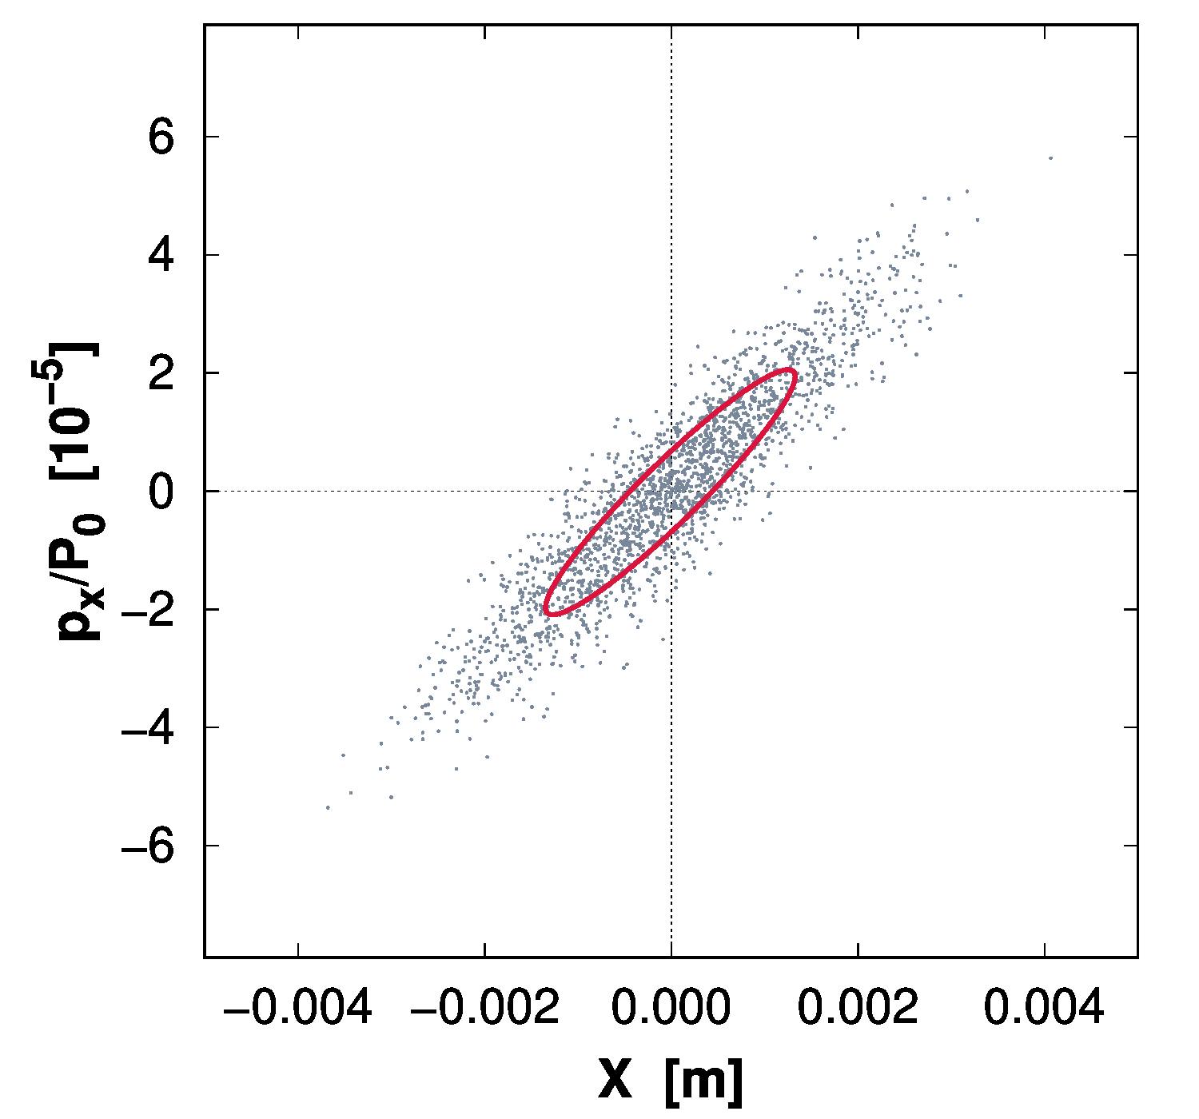

Slide 3
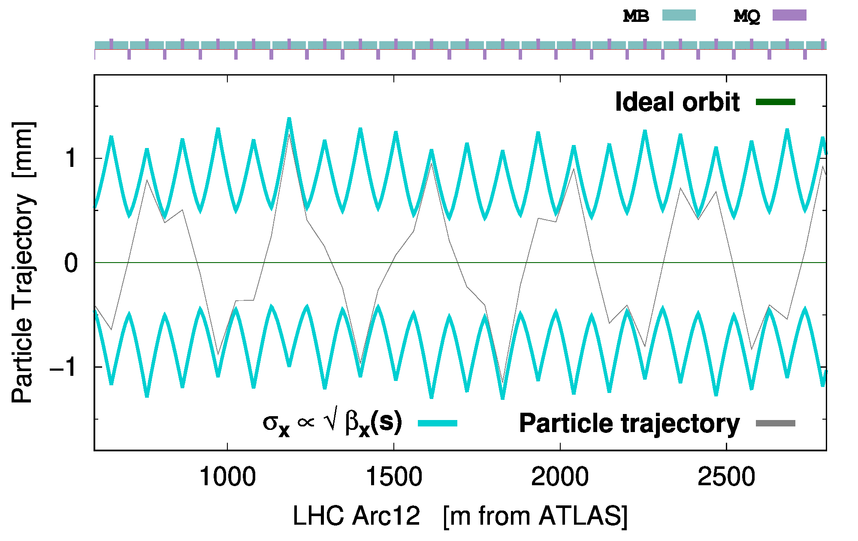

Slide 4
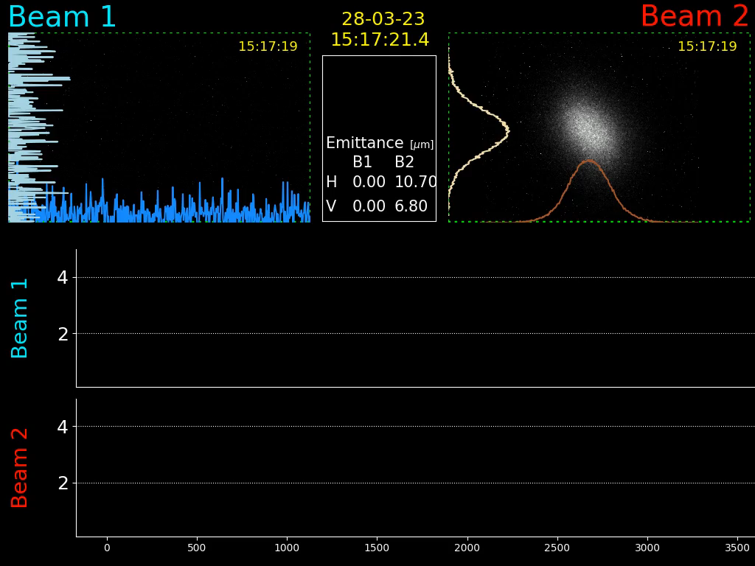
Impact of linear coupling correction on LHC Beam2 bunch shape measured with the synchrotron radiation monitor
Linear coupling was changed between 15:17:45 and 15:18:05

