Slide 2
LHCb detector upgrade Cryogenics
T. Koettig, C. Fabre, J. Bremer

Slide 3
Content
Part 1
General PID of Proximity cryogenics
Points for discussion – agenda
Part 2
Cryolab R&D support options
Part 3
Knowledge database and existing experience

Slide 4
PID
Surface
Cryoplant

Slide 5
PID
Test facility?
Surface
Interface
Cryoplant
Questions:
Operation modes
Number of circuits
Max. system pressure
Operational pressure and temperature => n. slide
Interface Proximity cryogenics vs. Detector cryogenics

Slide 6
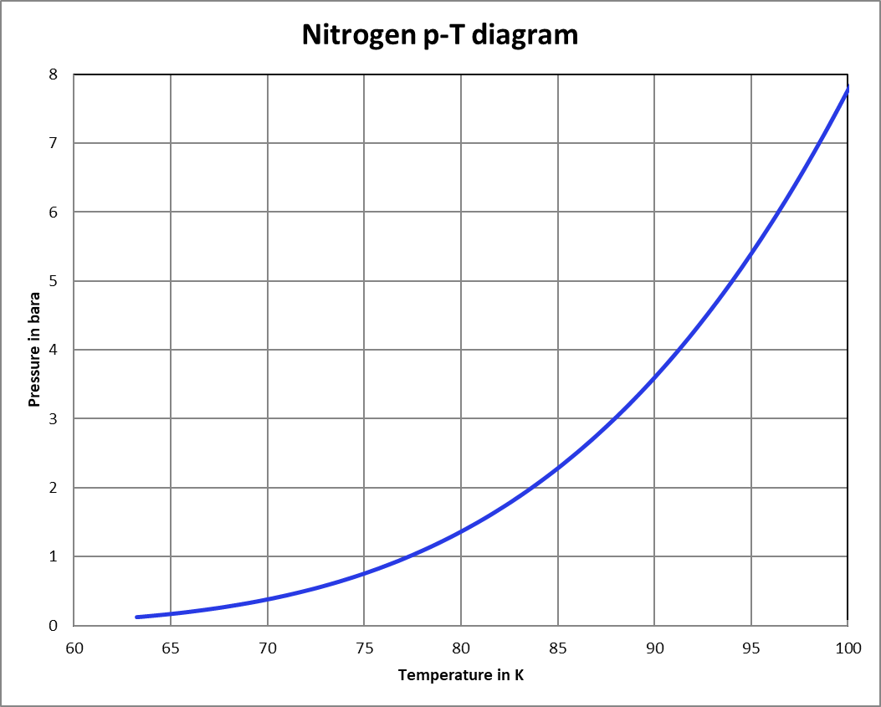
Two-phase flow nitrogen as a technical coolant
Temperature stability vs. time in the N₂ supply line
Mass flow rate depending on:
heat load,
vapor quality x
orientation dependency: dp as fct. (x)
static height difference in circuits
Cooldown and warm-up procedure
…

Slide 7
Testing options at 80 K in the Cryolab

Slide 8
Cryolab LN₂ test infrastructure
Two-phase nitrogen cooled sample environment in vacuum
Pressure test at cold up to 5 bara for feedthroughs, interfaces etc.
Leak test under the same conditions with He to vacuum

Slide 9
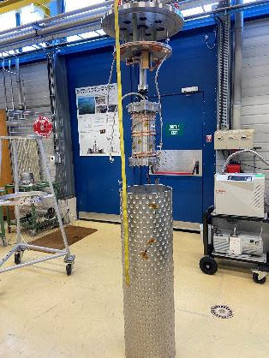
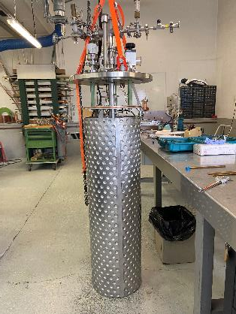
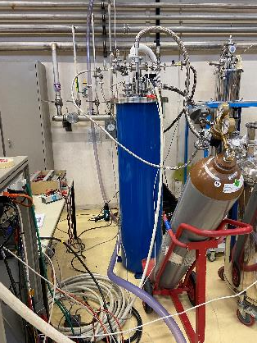
Test stand features
Sample He leak test to vacuum up to 5 bara at cold
Sample environment at 80 K, actively cooled
Thermal shield actively or passively cooled

Slide 10
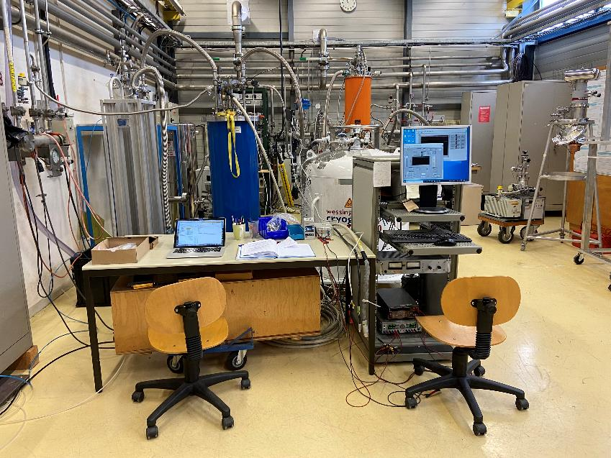
Full tests stand, LN₂ supply at 78 K from 500 l Dewar

Slide 11
Pressure Drop and Heat Transfer in Two-phase flow N₂
T. Koettig, C. Fabre, J. Bremer

Slide 12
Content
Two-phase flow pressure drop
Test stand geometry and features
Pressure drop: measurement results in horizontal, vertical up- and downward orientation N₂
Verification of the test set-up by starting in subcooled liquid
Summary

Slide 13
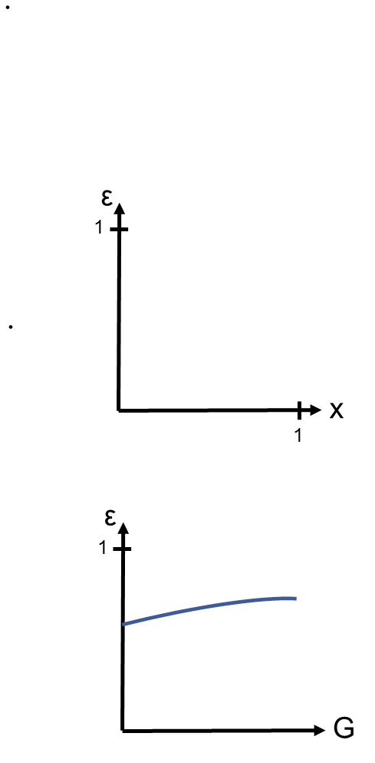
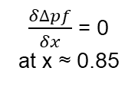

Two-phase Flow Pressure Drop
Void fraction:
Frictional pressure drop:
Void fraction versus vapor quality
Frict. press. drop versus vapor quality
x↑ ➔ ε↑
∆p_{f}
$\frac{δ∆pf}{δx}$ = 0
at x ≈ 0.85
0
Void fraction versus mass velocity
x
0
0.85
1
G↑ ➔ ε↑
in kg/(m²s)

Slide 14
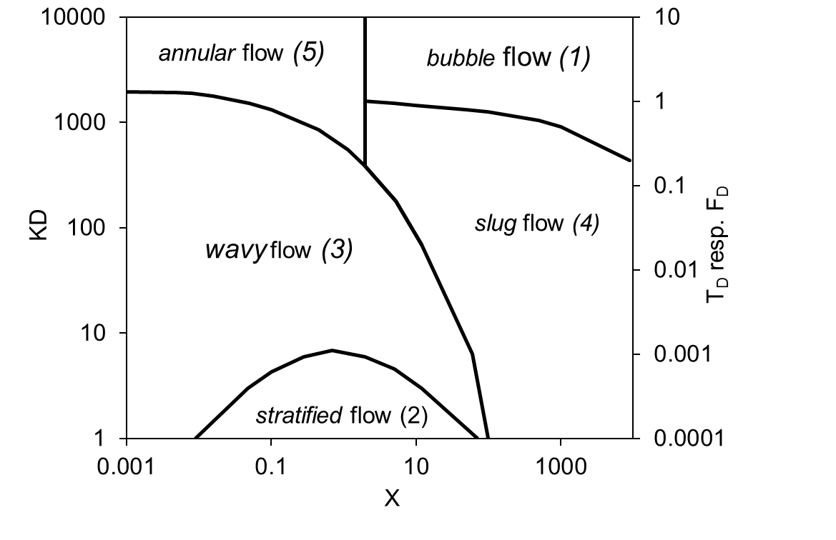
Flow pattern map I
Fig.: Flow pattern for horizontal flow
VDI Heat Atlas
Fig.: Flow pattern map according to Taitel and Dukler
VDI Heat Atlas
Source: H. Kirsch, Cooling Circuit Design for the Large-scale Liquid Argon Detectors in the ICARUS Experiment, CERN-THESIS-2016-438

Slide 15
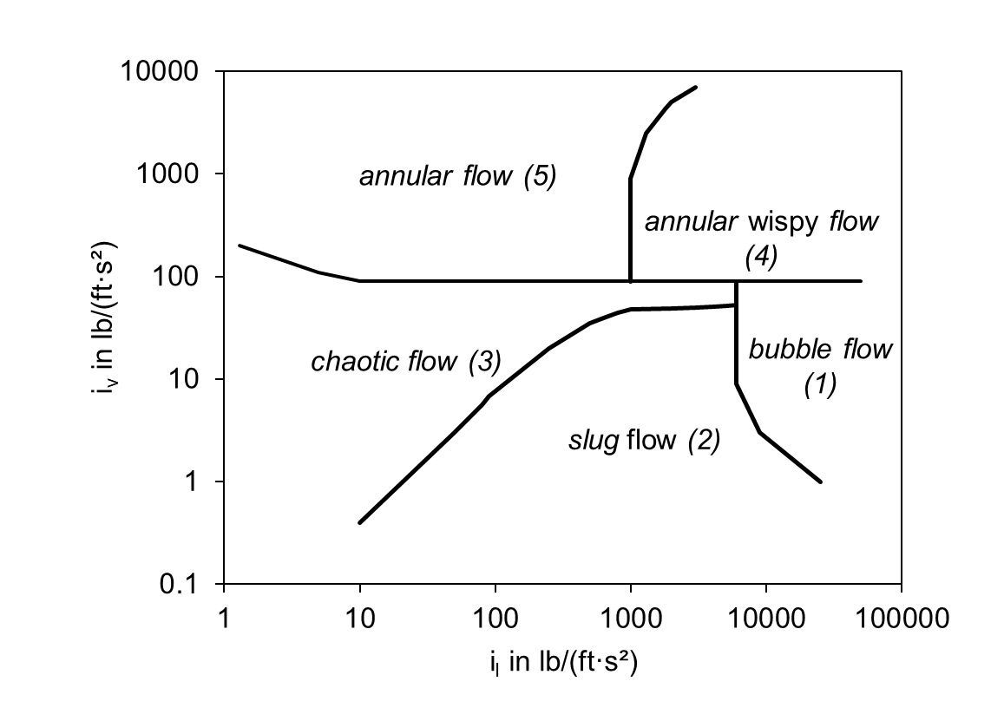
Flow pattern map II
Fig.: Flow pattern for vertical flow
VDI Heat Atlas
Fig.: Flow pattern map according to Hewitt and Roberts
VDI Heat Atlas

Slide 16
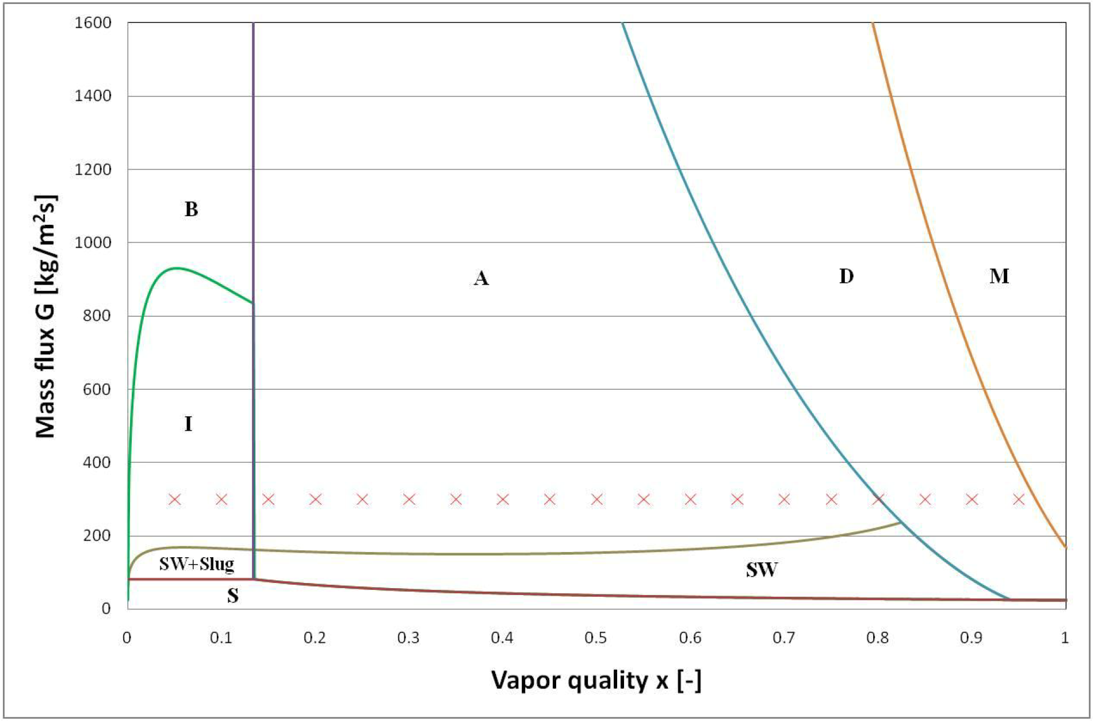
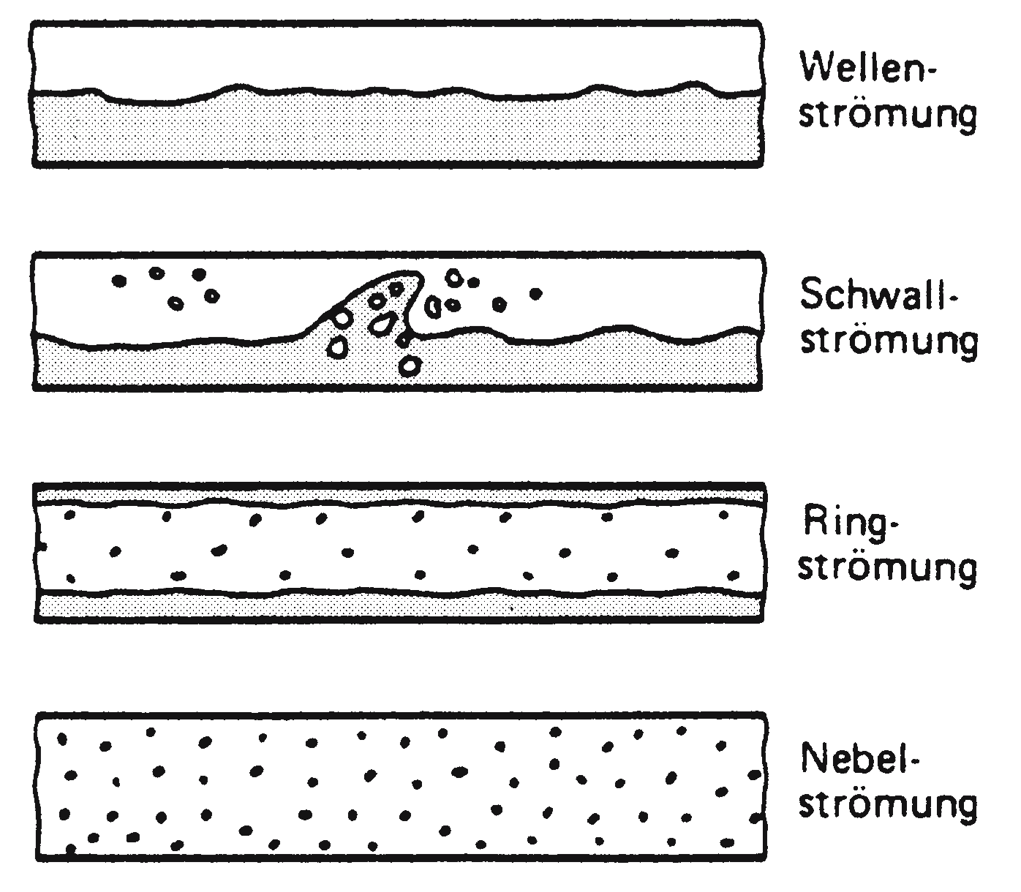
Flow pattern map III
S => SW
Intermitt.
Annular
Dry-out
Mist
From: VDI Waermeatlas Hbb4, 2006

Slide 17
Experimental Set-up
LN₂
1 bar
TT
PT
PT
TT
FT
EH 1
EH 2
EH 3
2
3
4
5
6
Sample
Precooler
Joule-Thomson expansion
Cryostat with thermal shield
p
1
LN₂ Dewar
4 bar
EH 1
Test conditions d_{i}=6 mm
Pressure (bar abs.) | 2.8
Internal diameter (mm) | 6.0
Mass flow (g/s) | 0.6 – 2.0
Mass velocity (kg/m²s) | 22 - 72
1
EH 2
3
4
2
Test
5
6
h

Slide 18
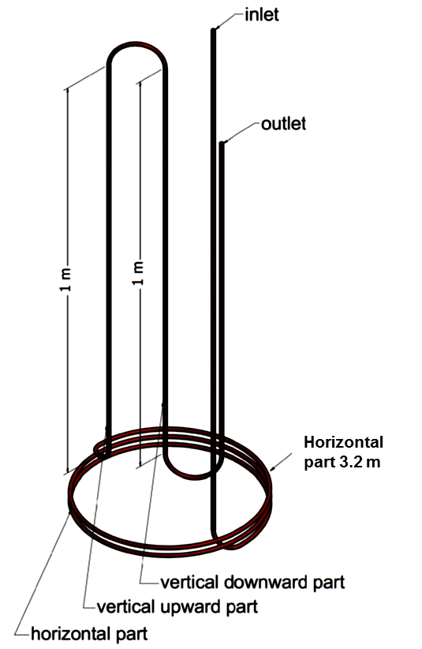
Experimental Set-up
LN₂
1 bar
TT
PT
PT
TT
FT
EH 1
EH 2
EH 3
2
3
4
5
6
Sample
Precooler
Joule-Thomson expansion
Cryostat with thermal shield
p
1
LN₂ Dewar
4 bar
EH 1
1
EH 2
3
4
2
Test
5
6
h

Slide 19
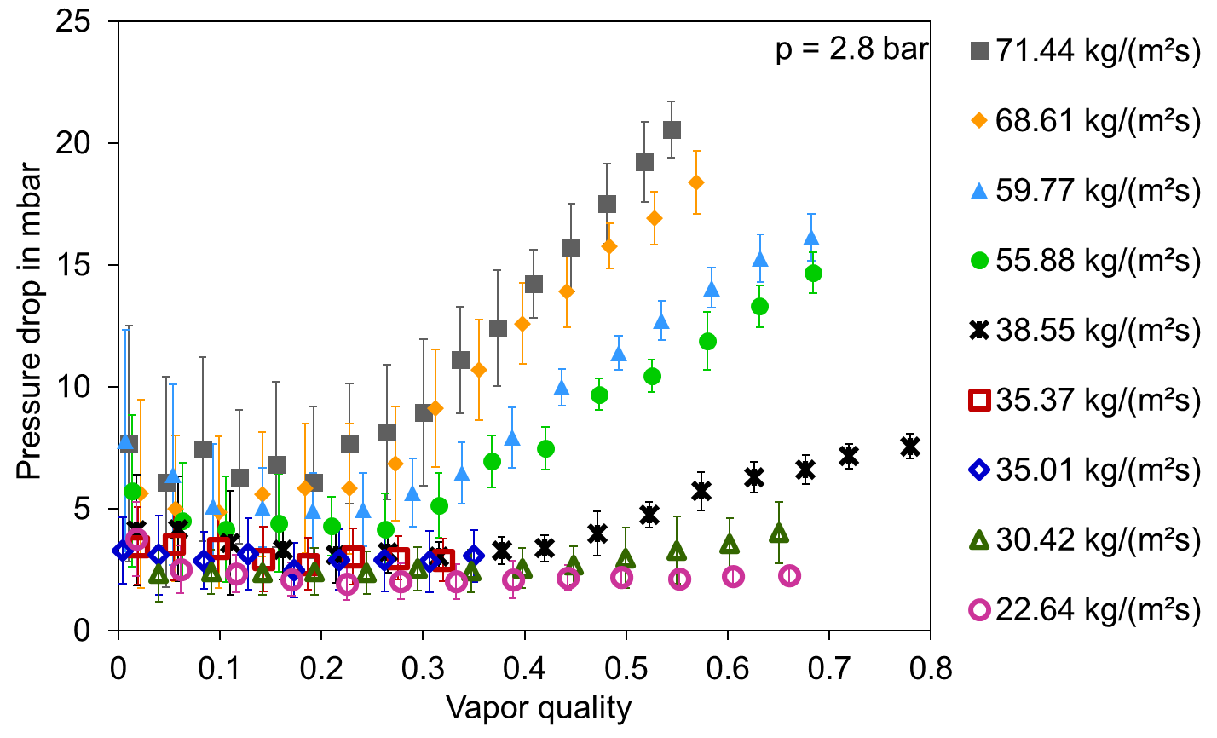
Results – Horizontal Orientation
Source: H. Kirsch, Cooling Circuit Design for the Large-scale Liquid Argon Detectors in the ICARUS Experiment, CERN-THESIS-2016-438

Slide 20
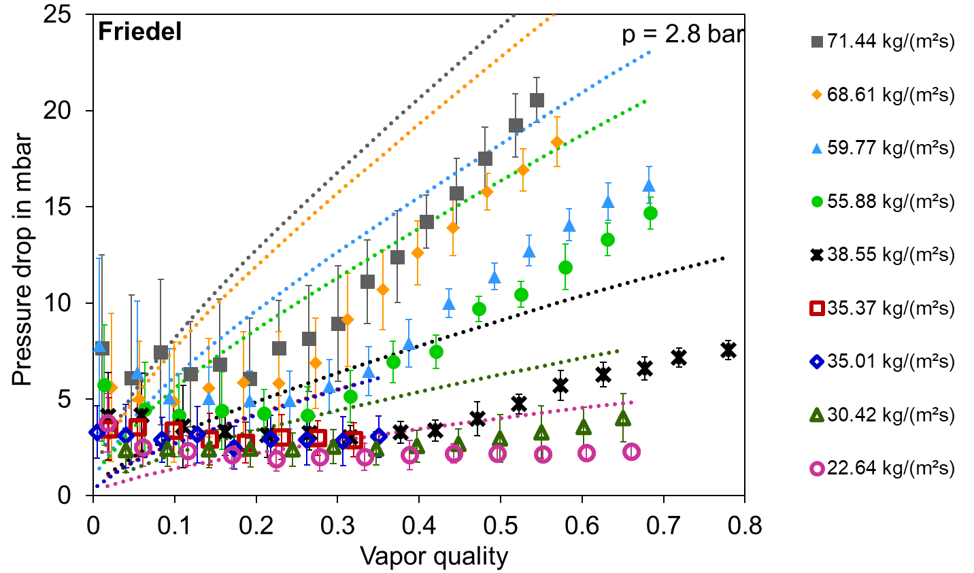
Results – Horizontal Orientation
Source: H. Kirsch, Cooling Circuit Design for the Large-scale Liquid Argon Detectors in the ICARUS Experiment, CERN-THESIS-2016-438

Slide 21
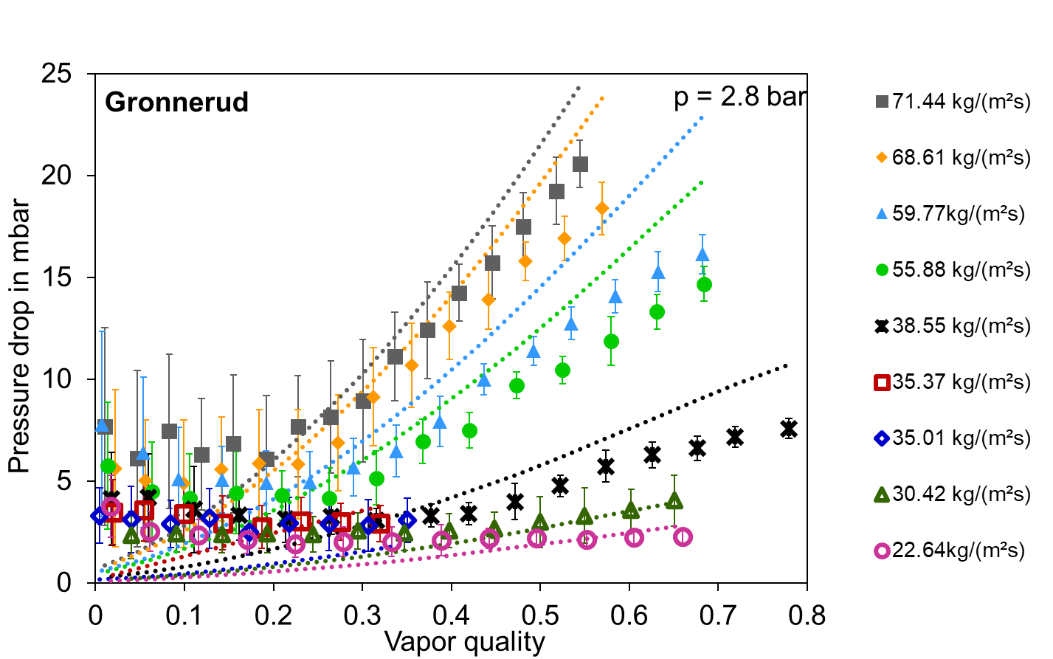
Results – Horizontal Orientation
Source: H. Kirsch, Cooling Circuit Design for the Large-scale Liquid Argon Detectors in the ICARUS Experiment, CERN-THESIS-2016-438

Slide 22
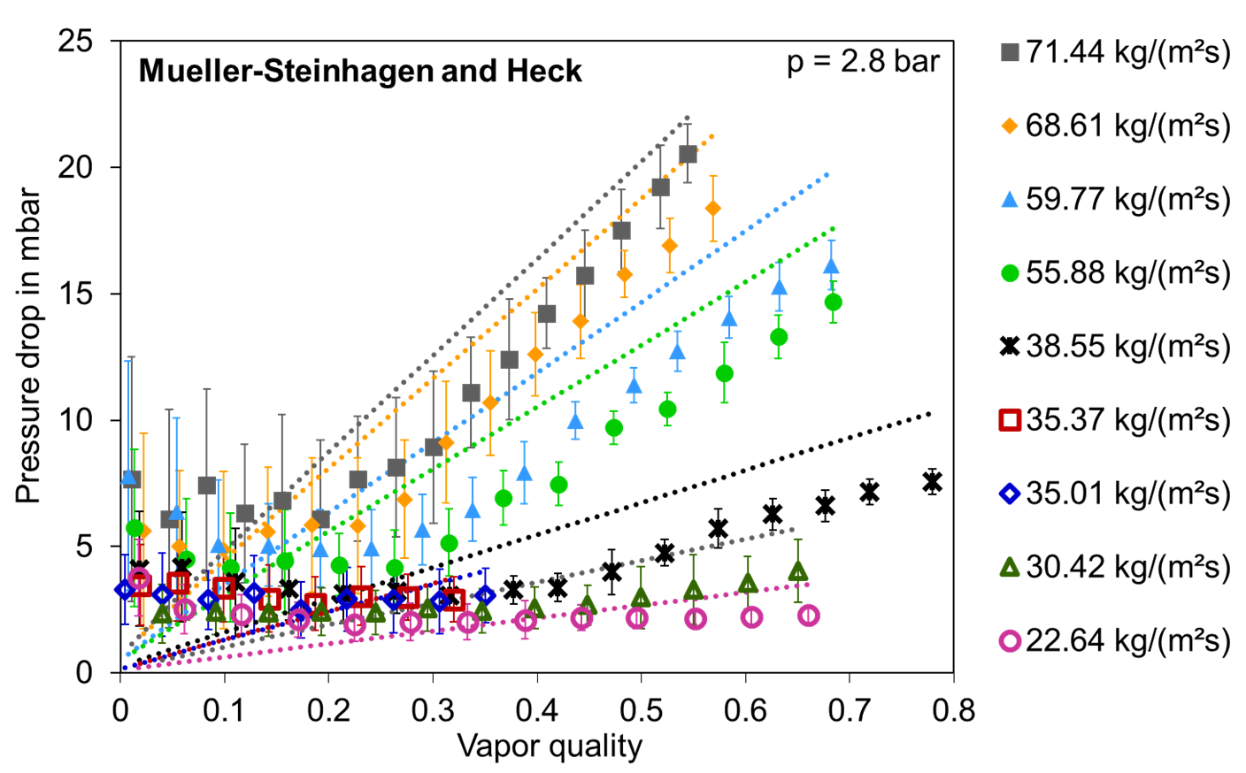
Results – Horizontal Orientation
Source: H. Kirsch, Cooling Circuit Design for the Large-scale Liquid Argon Detectors in the ICARUS Experiment, CERN-THESIS-2016-438

Slide 23
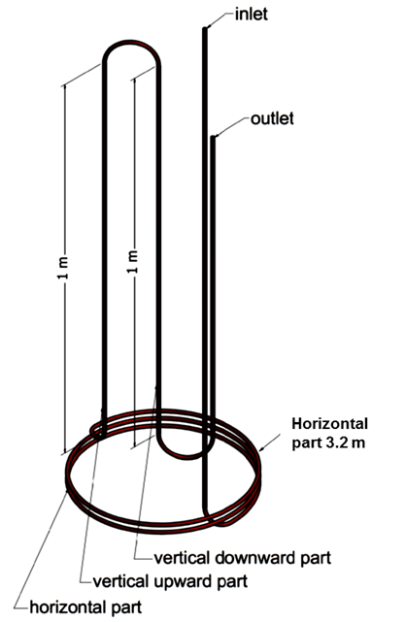
Vertical Upward Orientation

Slide 24
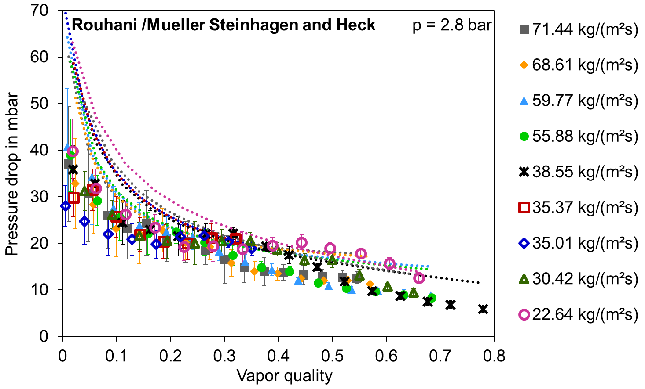
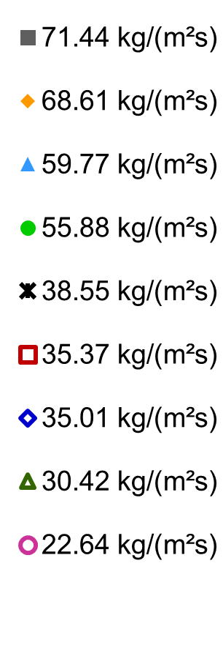
Results – Vertical Upward Orientation
Flow is always in chaotic regime
Source: H. Kirsch, Cooling Circuit Design for the Large-scale Liquid Argon Detectors in the ICARUS Experiment, CERN-THESIS-2016-438

Slide 25
Vertical Downward Orientation

Slide 26
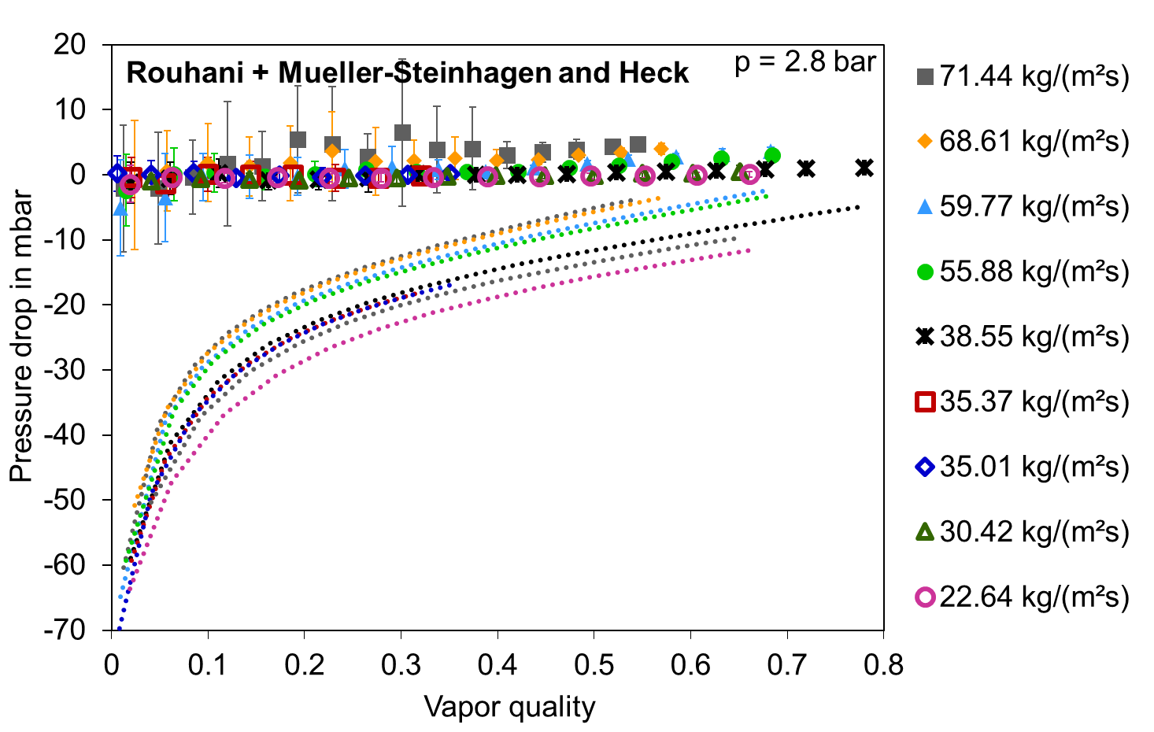
Results – Vertical Downward Orientation
Source: H. Kirsch, Cooling Circuit Design for the Large-scale Liquid Argon Detectors in the ICARUS Experiment, CERN-THESIS-2016-438

Slide 27
Verification of the set-up
Enter the two-phase range from the liquid phase (subcooled)
Monitor the change in pressure drop
Monitor the temperature behaviour single phase to saturation conditions

Slide 28
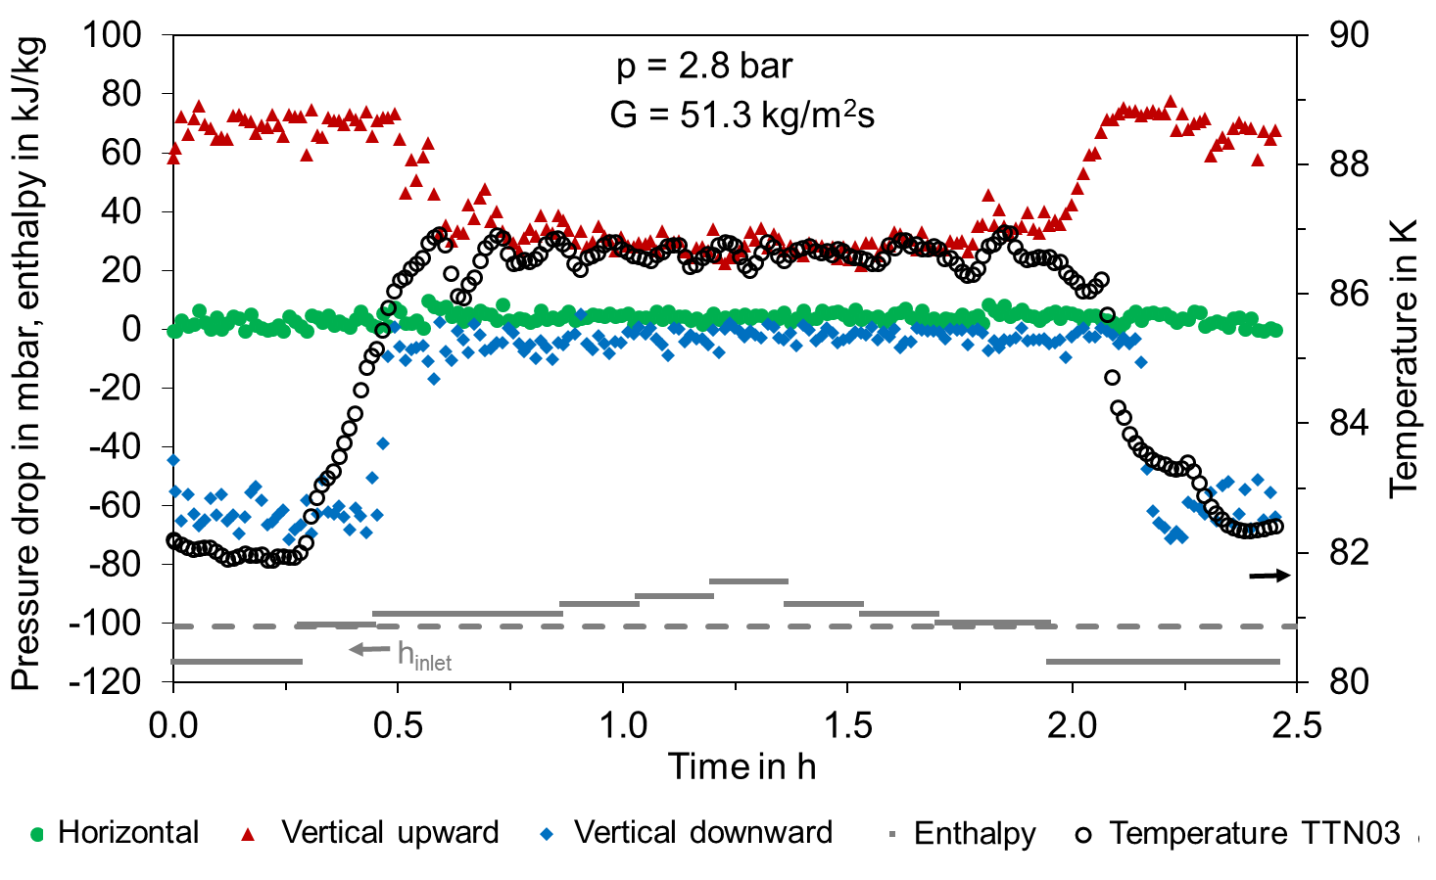
Results – Verification Test
Temperature inlet

Slide 29
Summary
Two phase flow is special, remember the cooling effect by Δp(G) or Δp(q)!
Pressure drop at x~0.5-0.85 can be much higher than in gas or liquid phase
Deviation in vertical upward orientation of the models for small vapor quality
Models fail to predict pressure drop for vertical downward direction
First bubbles create buoyancy effect that overcomes gravitational influence
Consider the dry out and the sudden decrease in heat transfer for x>~ 0.7
Design for sufficient flow speed to avoid phase separation => syphons/instabilities
Parallel channels => tuning of the inlet restriction to 100 % pressure drop of the heated section

Slide 30
Thank you for your attention

Slide 31

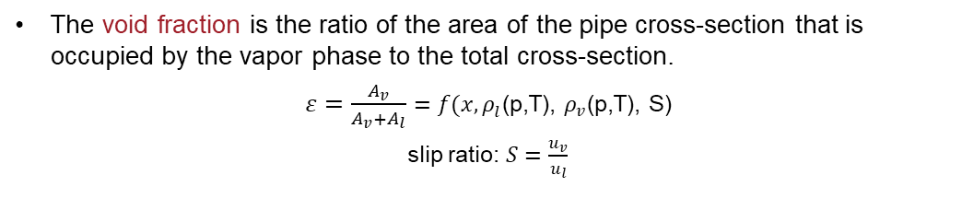
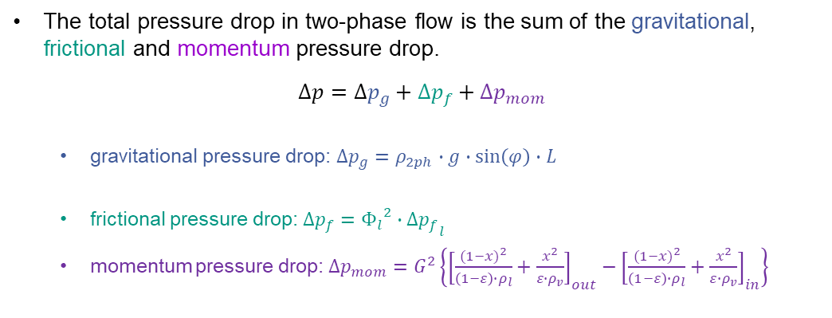
Two-phase flow pressure drop
The total pressure drop in two-phase flow is the sum of the gravitational, frictional and momentum pressure drop.
$$∆p=∆p_{g}+∆p_{f}+∆p_{mom}$$
gravitational pressure drop: $∆p_{g}=ρ_{2ph}∙g∙\sin\left(φ\right)∙L$
frictional pressure drop: $∆p_{f}={Φ_{l}}^{2}{∙∆p_{f}}_{l}$
momentum pressure drop: $∆p_{mom}=G^{2}\left\{{\left[\frac{{(1−x)}^{2}}{\left(1−ε\right)∙ρ_{l}}+\frac{x^{2}}{ε∙ρ_{v}}\right]}_{out}−{\left[\frac{{(1−x)}^{2}}{\left(1−ε\right)∙ρ_{l}}+\frac{x^{2}}{ε∙ρ_{v}}\right]}_{in}\right\}$
$ρ_{2ph}={(1−ε)∙ρ}_{l}$+${ε∙ρ}_{v}$
The void fraction is the ratio of the area of the pipe cross-section that is occupied by the vapor phase to the total cross-section.
$ε=\frac{A_{v}}{A_{v}+A_{l}}=f(x,ρ_{l}$(p,T), $ρ_{v}$(p,T), S)
slip ratio: $S=\frac{u_{v}}{u_{l}}$
Source: H. Kirsch, Cooling Circuit Design for the Large-scale Liquid Argon Detectors in the ICARUS Experiment, CERN-THESIS-2016-438

Slide 32
Experimental Set-up
LN₂
1 bar
TT
PT
PT
TT
FT
EH 1
EH 2
EH 3
2
3
4
5
6
Sample
Precooler
Joule-Thomson expansion
p
Cryostat with thermal shield
1
LN₂ Dewar
4 bar
EH 1
Test conditions
Pressure (bar abs.) | 2.8
Internal diameter (mm) | 6.0
Mass flow (g/s) | 1.44
Mass velocity (kg/m²s) | 51
1
3
4
2
5
6
Test
EH 2
h

Slide 33
Appendix
Two-phase flow CO₂ in mini-channels

Slide 34
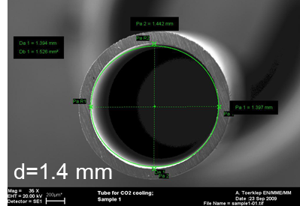
CO₂ two-phase flow in mini channels
Pressure drop and heat transfer study in a horizontal mini-channel as a function of:
vapor quality
mass flux
heat flux
p_{sat} and T_{sat}

Slide 35
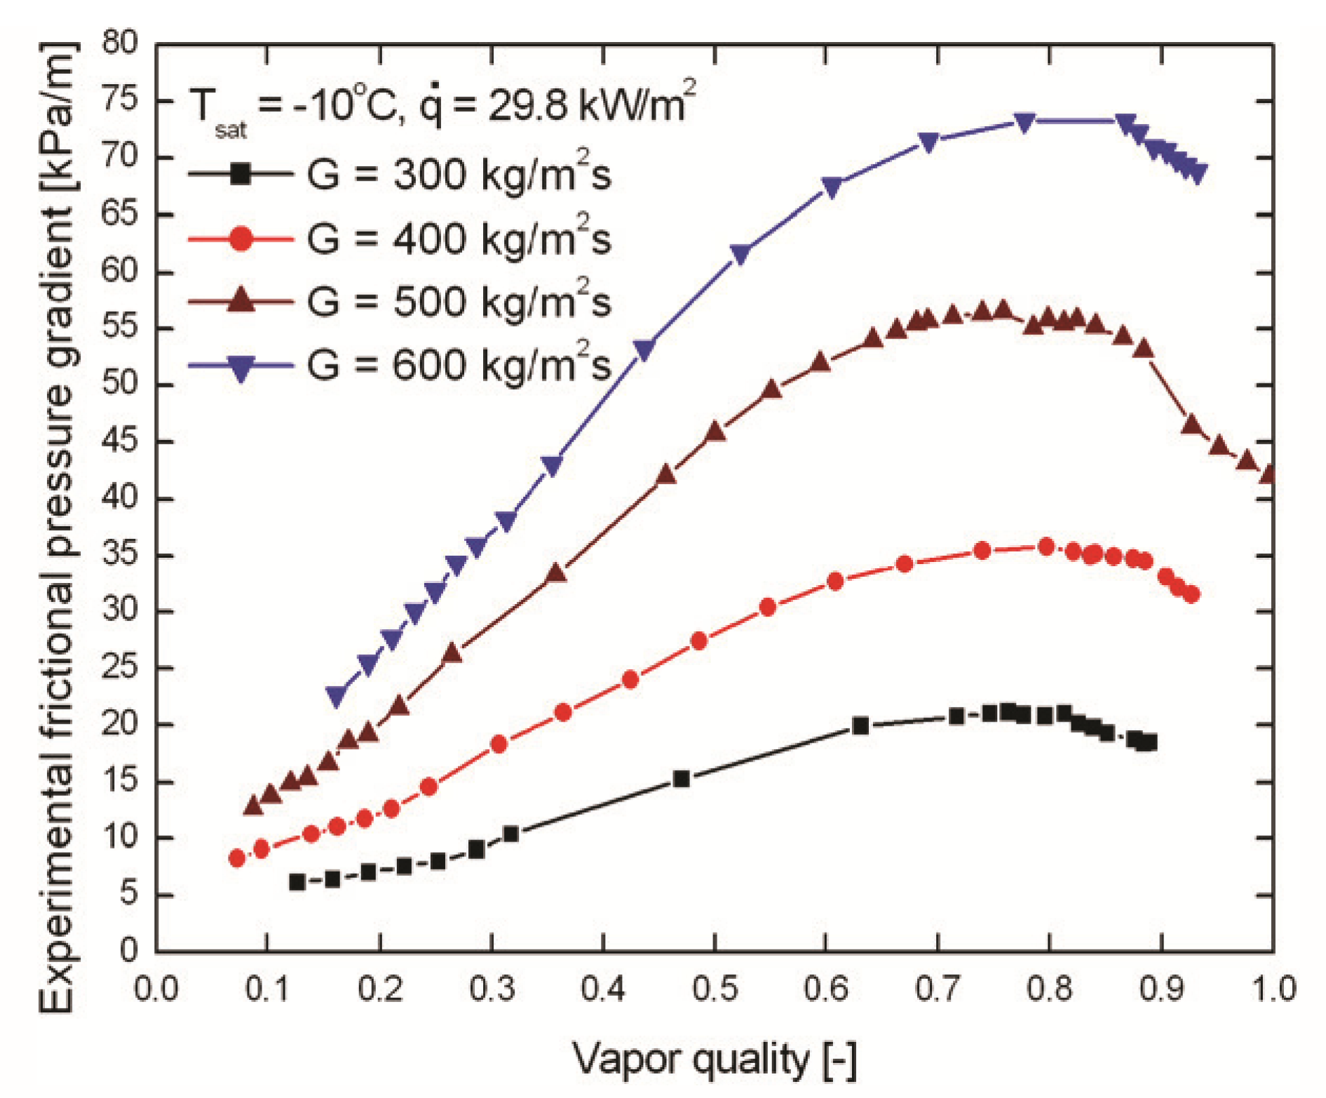
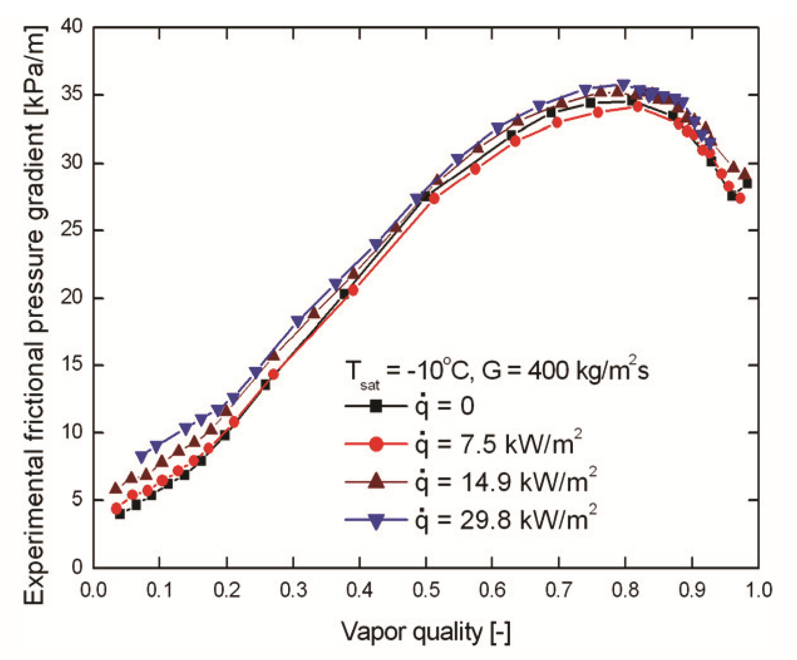


CO₂ two-phase flow - Pressure drop
$$Δp \text{= }\text{fct}\text{.}(G)$$
$$Δp≠\text{fct}\text{.}(\dot{q})$$

Slide 36
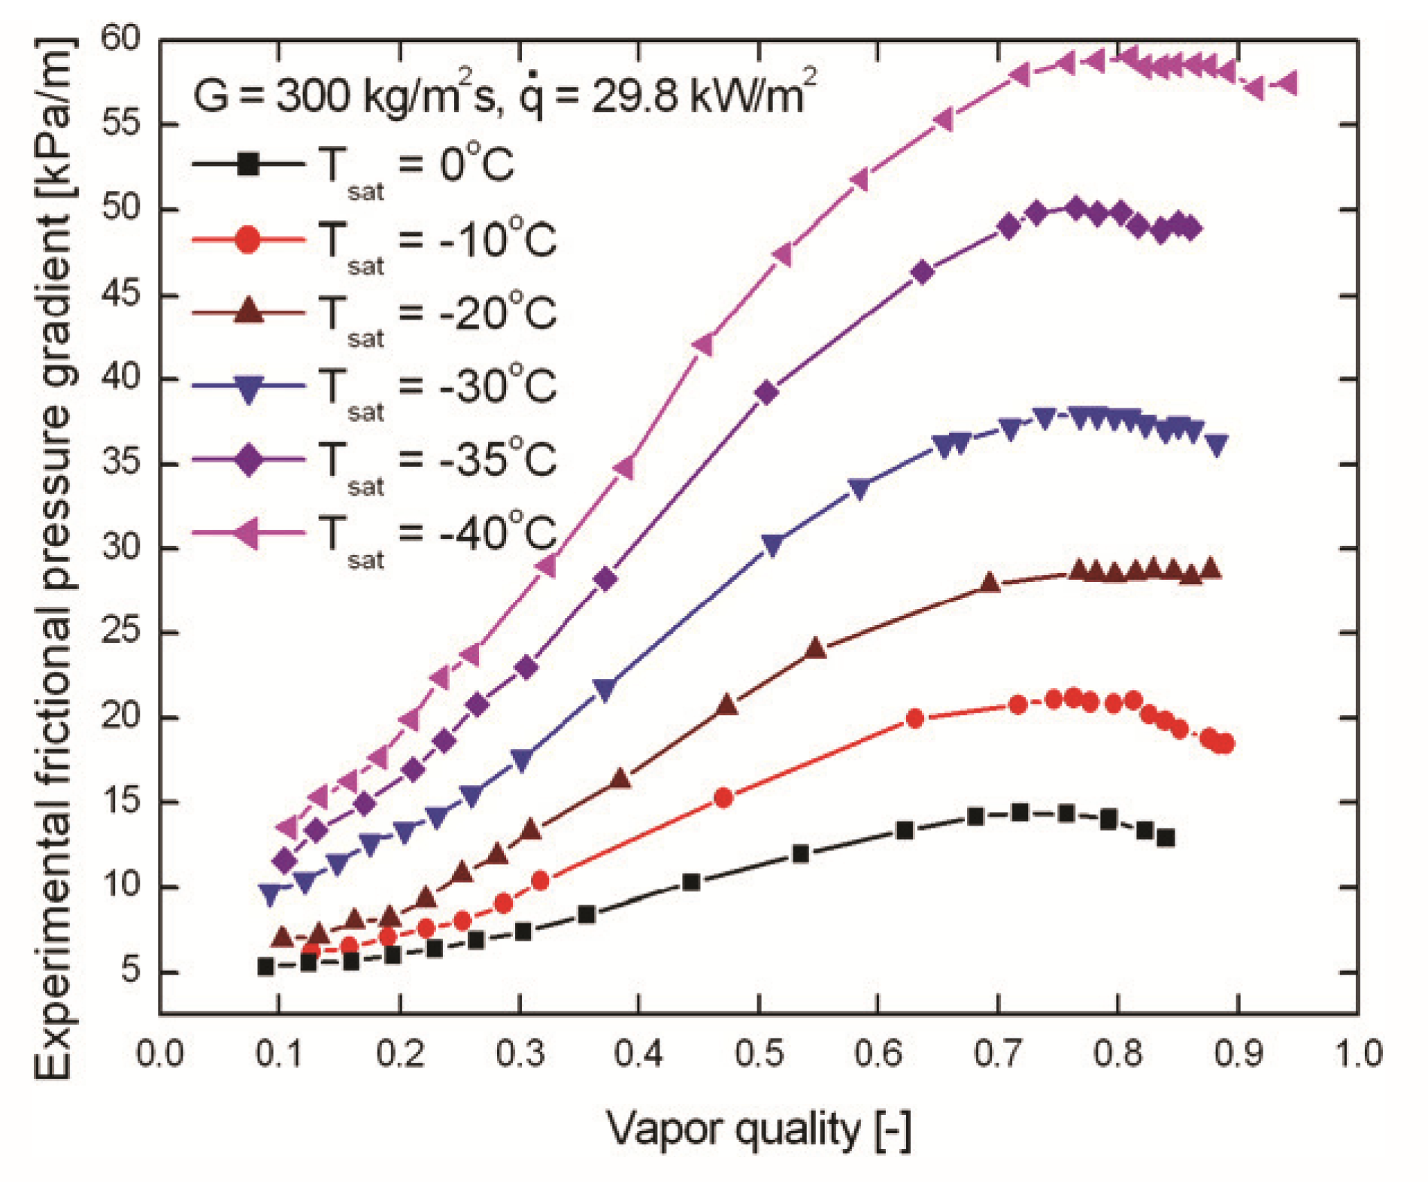
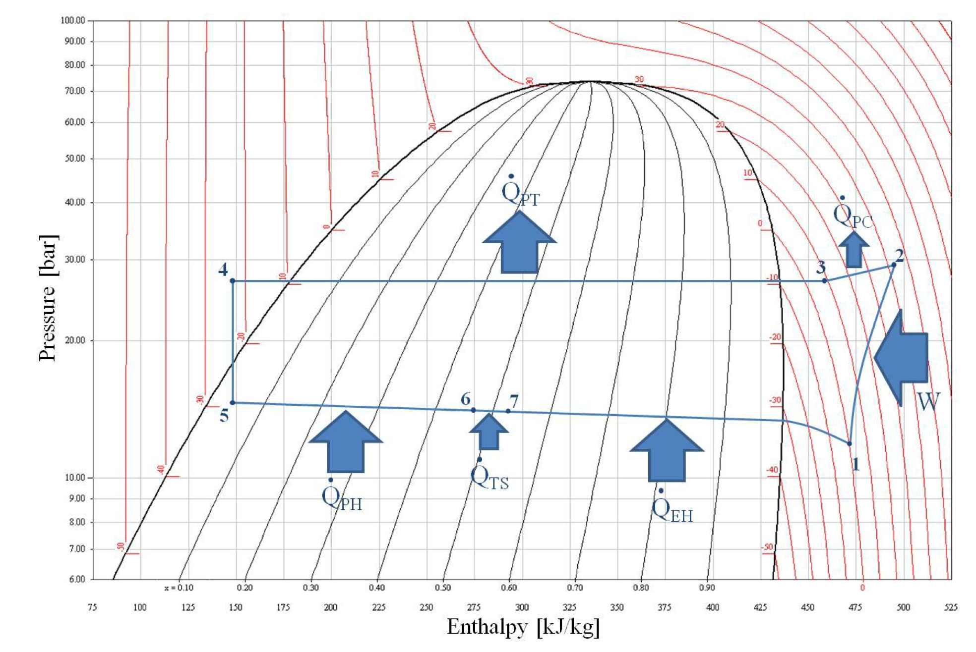

CO₂ two-phase flow - Pressure drop
$$Δp\text{ = }\text{fct}\text{.}\left(Tsat\right)⇒ fct. (p_{sat})$$
Pressure drop and or heating two-phase flow is cooling!
100
10
From: D. Helmer, Investigation of Heat Transfer and Pressure Drop Phenomena of CO₂ in Two Phase Flow

Slide 37
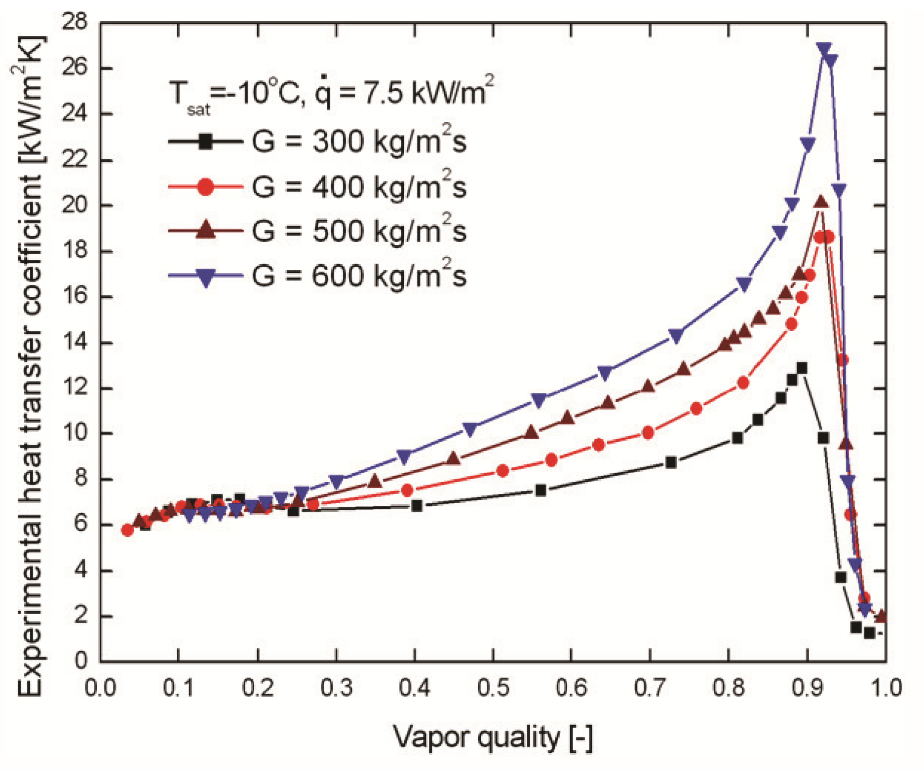
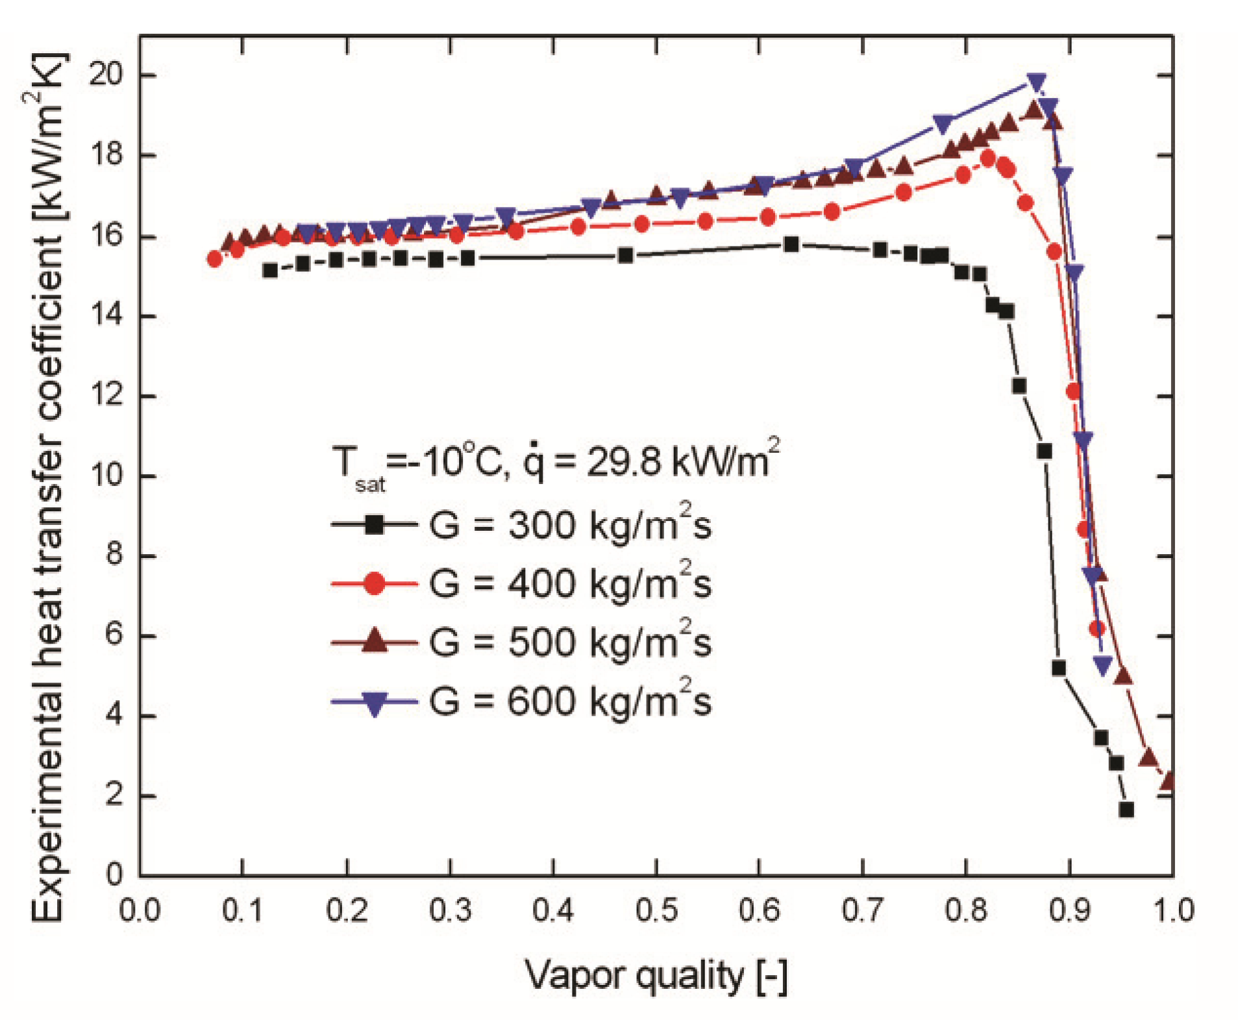
CO₂ two-phase flow - Heat transfer (heat and mass flux dep.)
Mass flux dep. at low heat flux
Mass flux dep. at high heat flux
d=1.4 mm

Slide 38
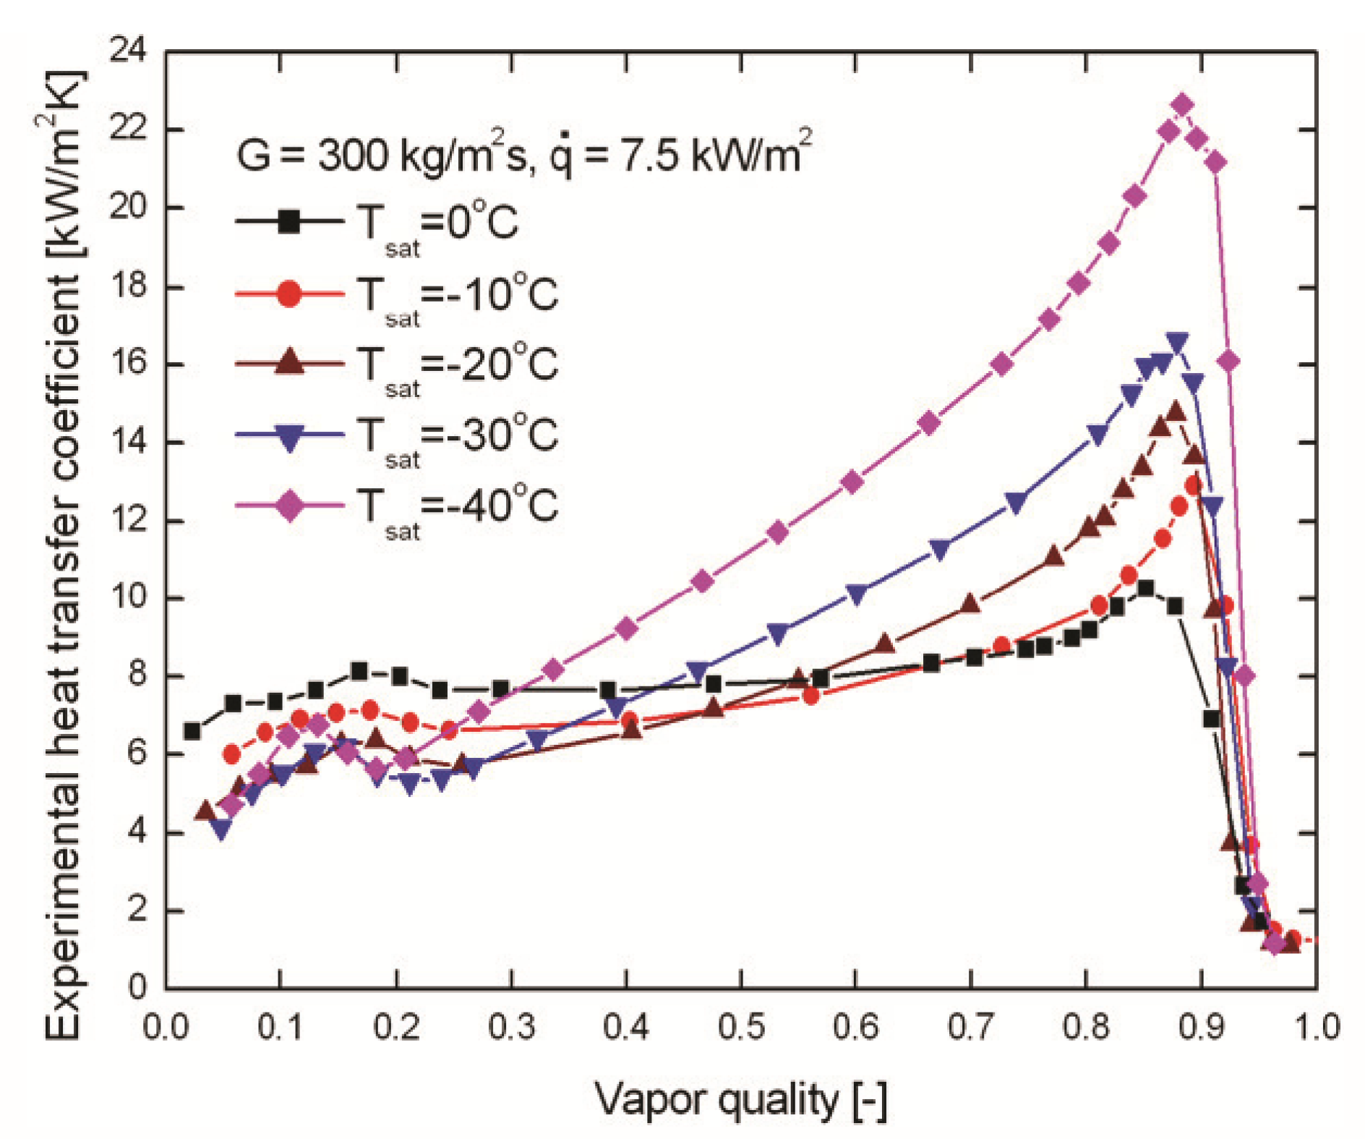
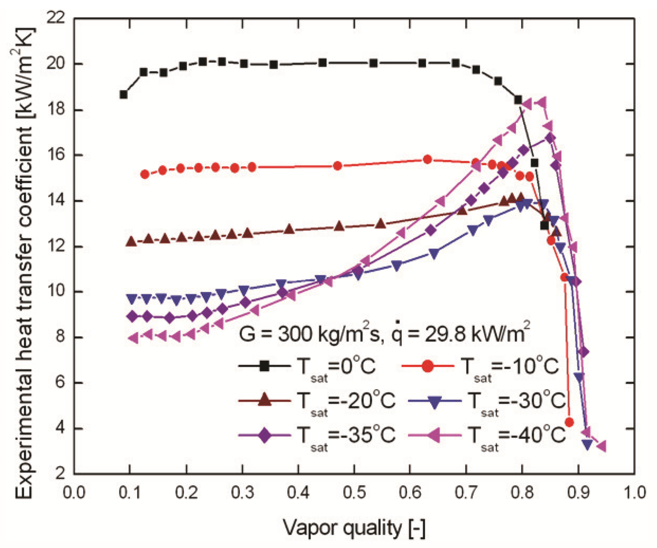
CO₂ two-phase flow - Heat transfer (temperature dependency)
Temperature dep. at low heat flux
Temperature dep. at high heat flux
d=1.4 mm

