Slide 1
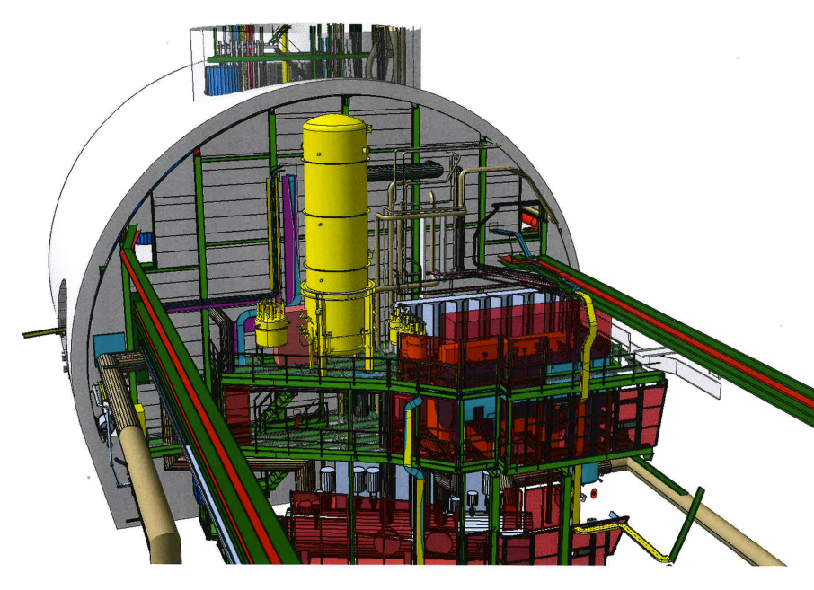
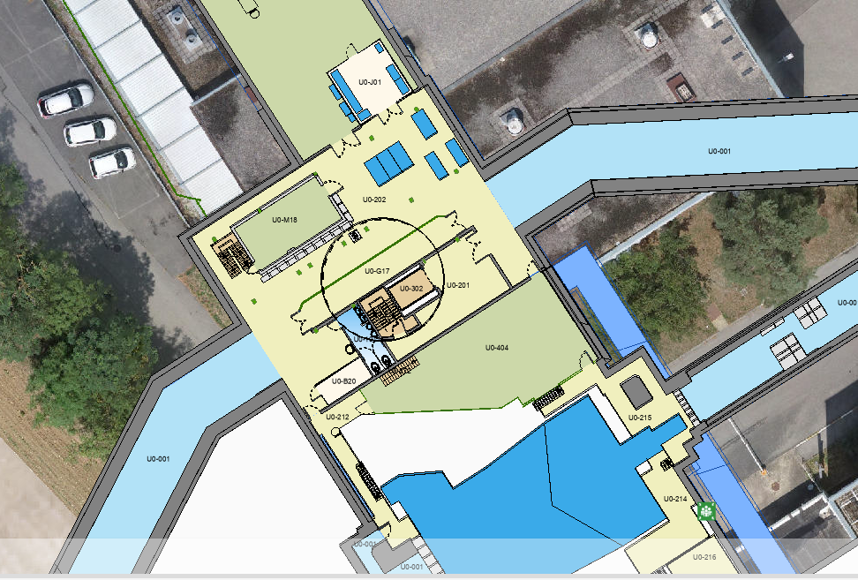
System position proposal – C side
UX85B – Phase Separator , Pumps, Distribution Box
O.Jamet

Slide 2
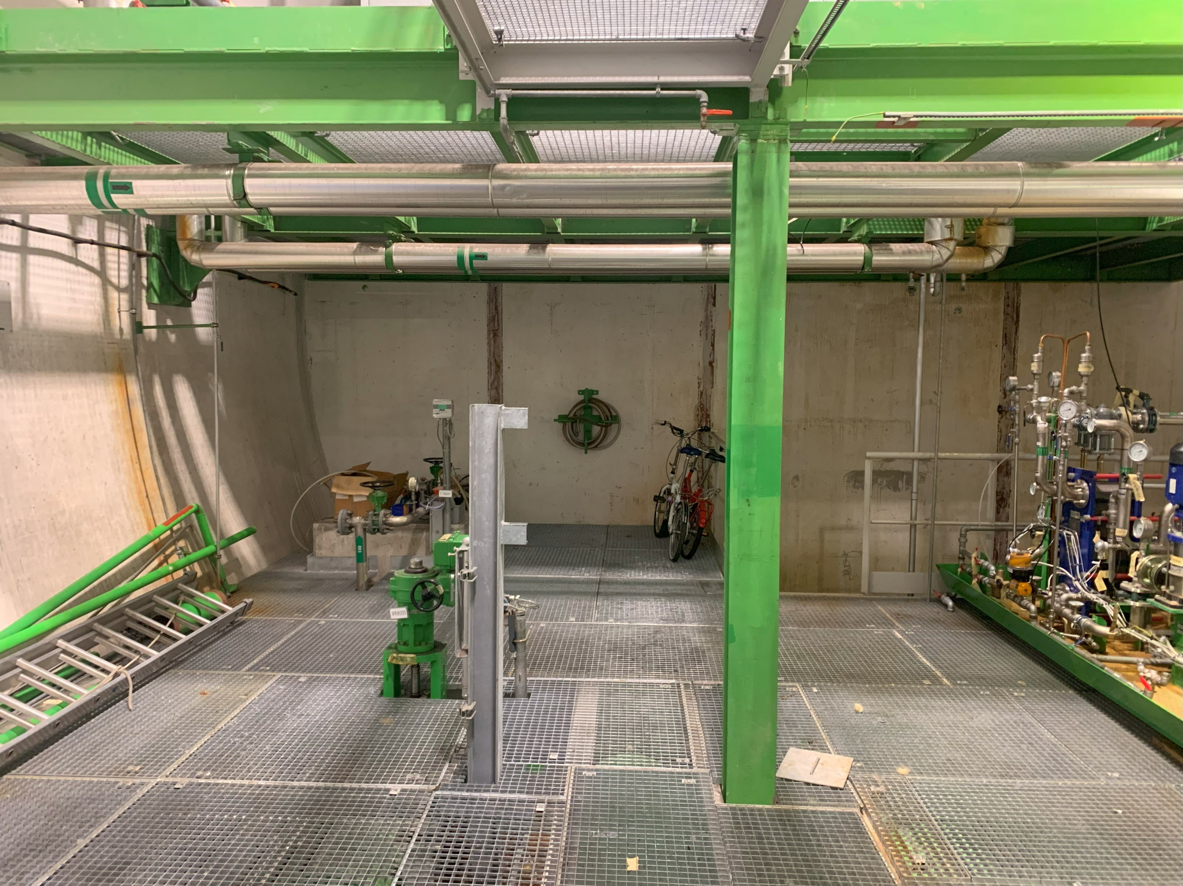
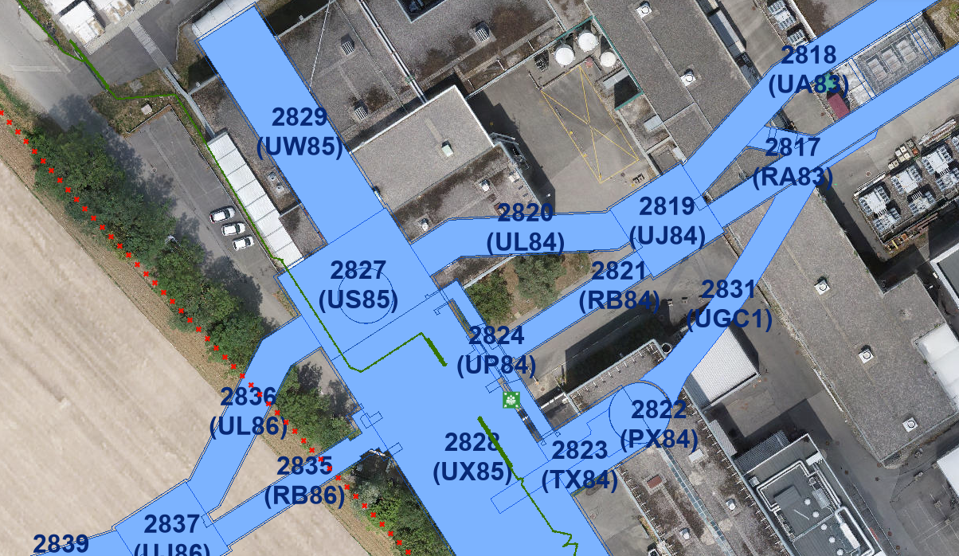
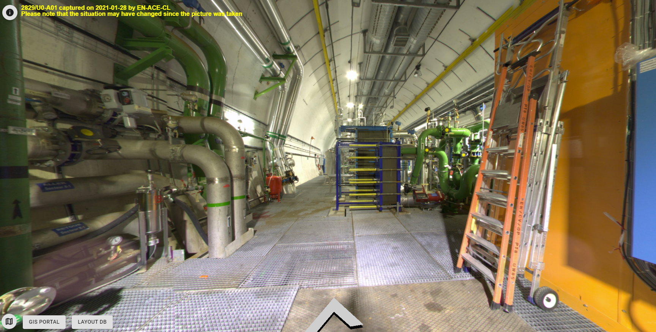
System position proposal – C side
UW85 – Turbo-Brayton Subcooler position

Slide 3
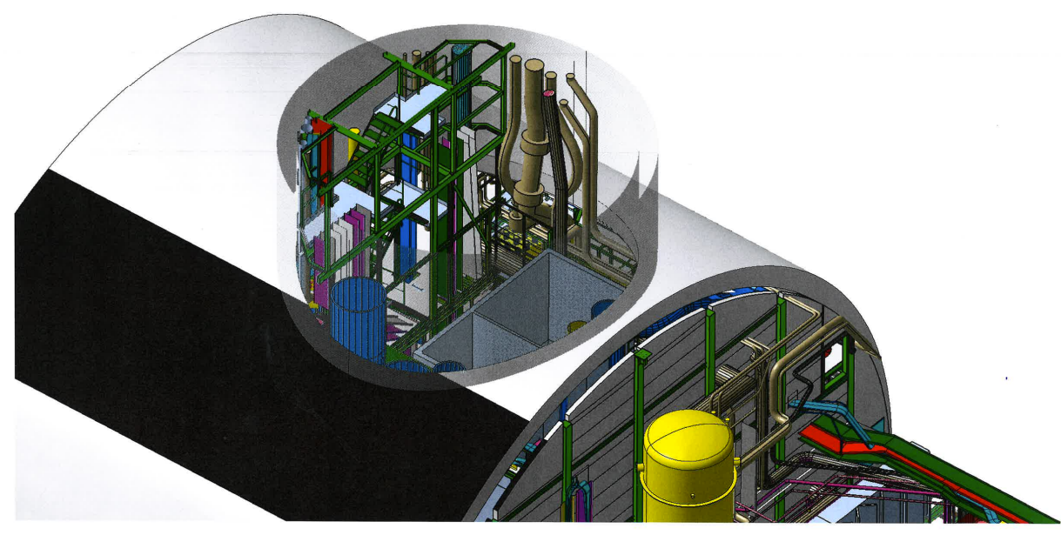
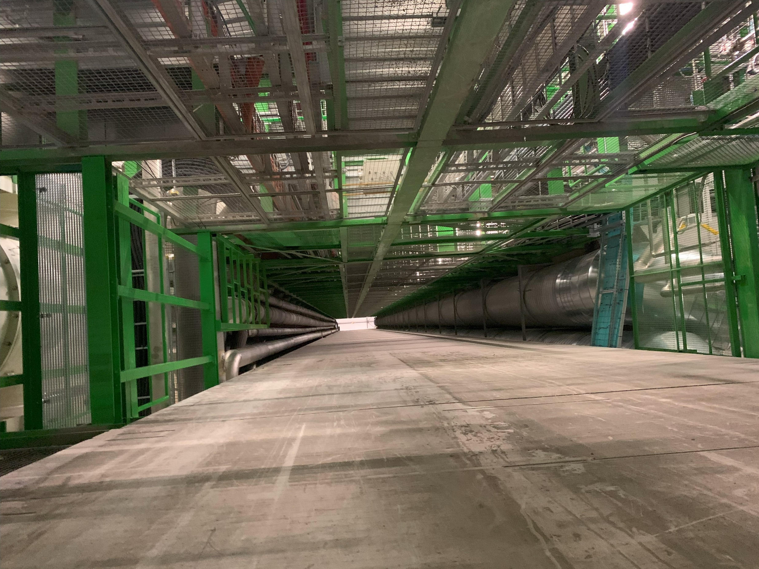
System position proposal – C side
PM85 shaft – Cryoline & Venting Line path ?
O.Jamet

Slide 4
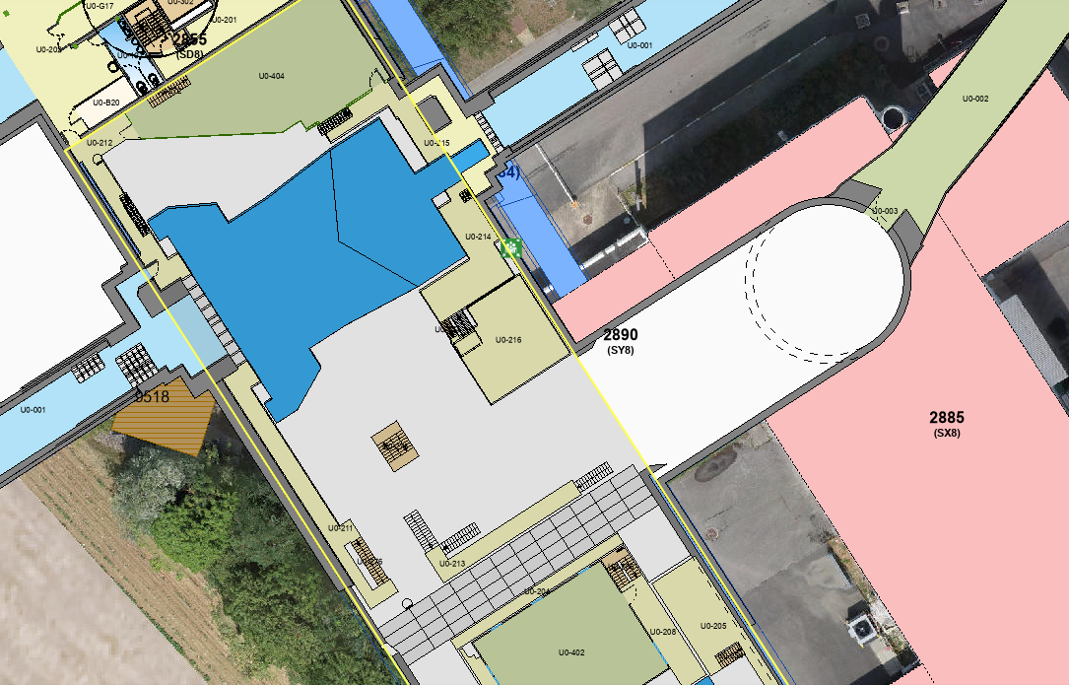
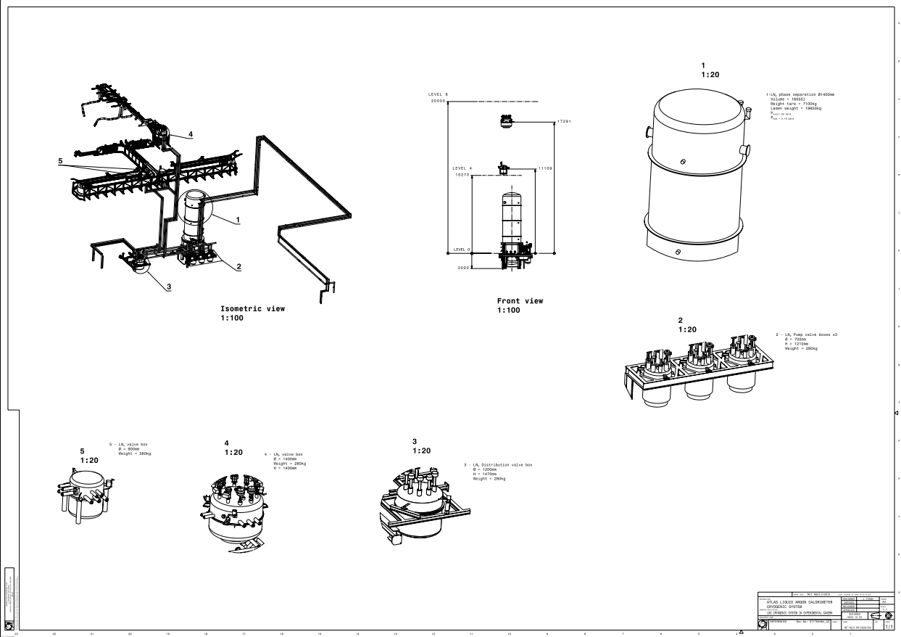
System position proposal – A side
PX84 shaft – Cryoline & Venting Line path
UX85B – Phase Separator , Pumps, Distribution Box

Slide 5
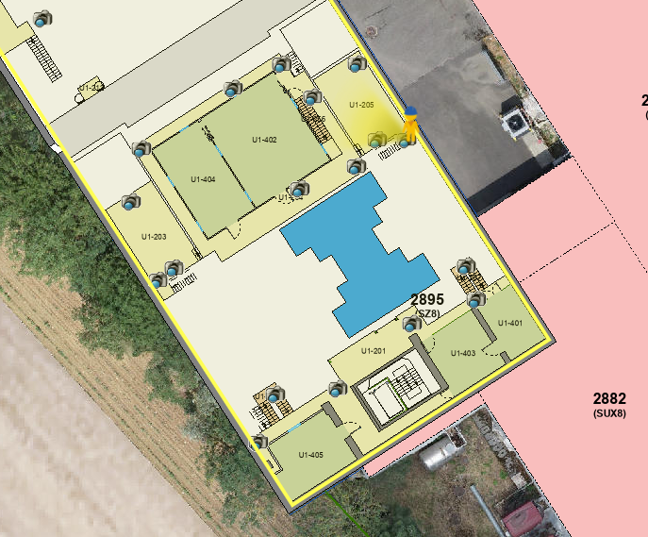
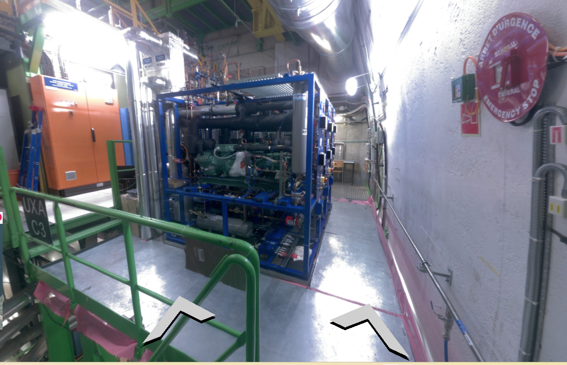
System position proposal – A side
UX85A – Turbo-Brayton Subcooler position

