Slide 1
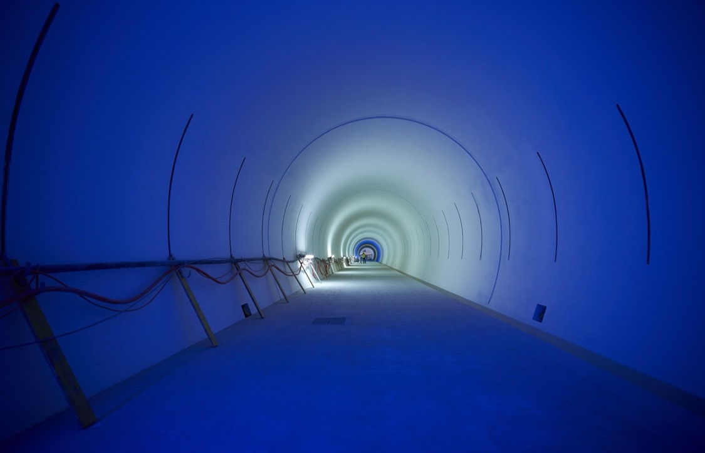
HL-LHC Upgrade Project
ENEA Visit to CERN, February 2024
O.Brüning, on Behalf of the HL-LHC Project

Slide 2
Outline
HL-LHC Introduction: Goals, Schedule and Collaborations
Status of key technologies towards the HL upgrade
  Civil engineering
  New Superconducting Insertion Magnets
  Superconducting Link
  Crab Cavity System
  Collimation: Crystal & Low impedance collimators
Inner Triplet String in SM18 @ CERN
Conclusions

Slide 3
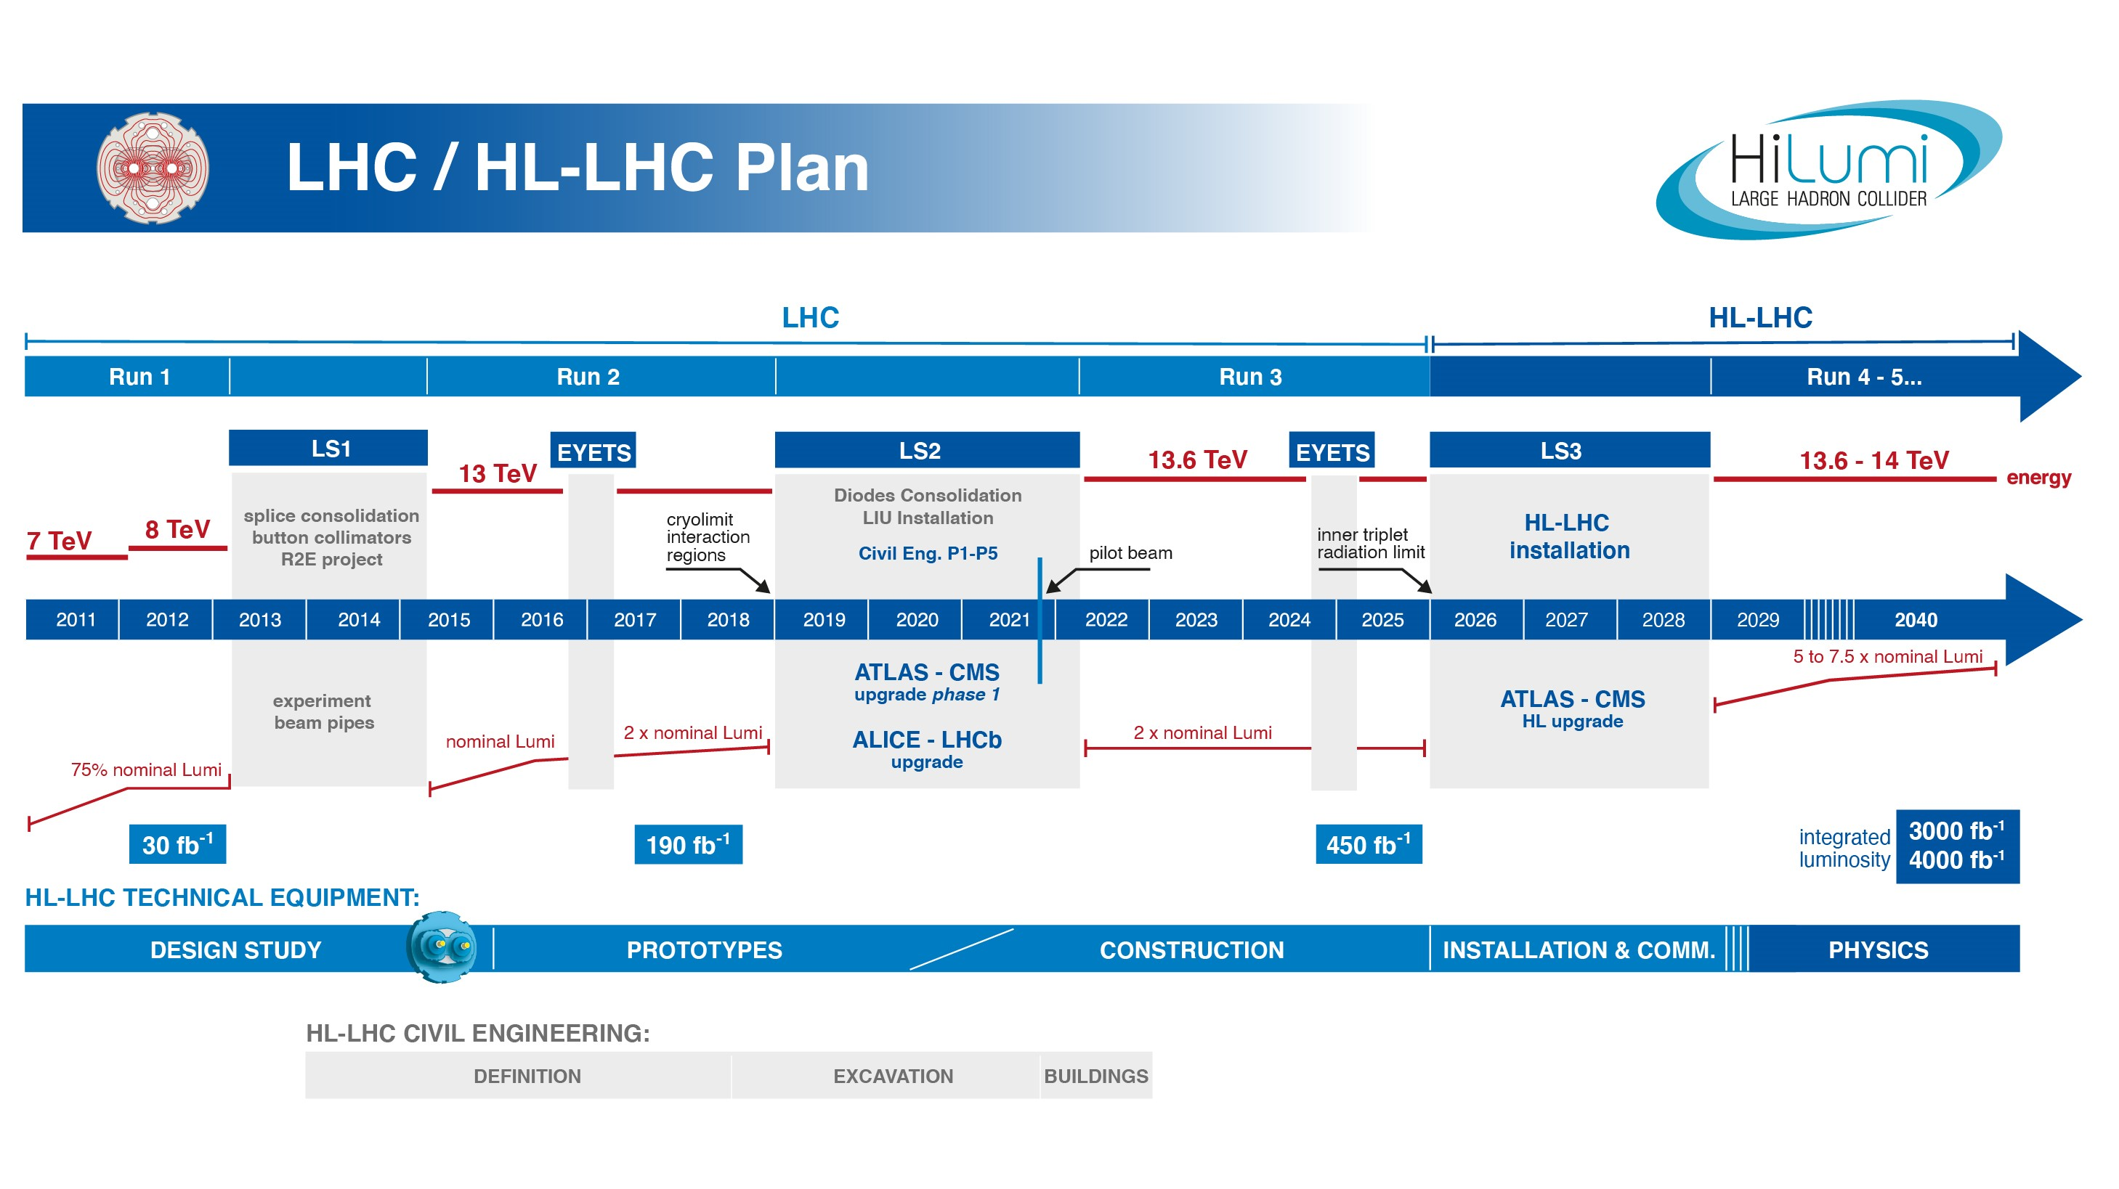
EU funded HiLumi
Design Study
Approval of
HL-LHC Project
We are here
HL-LHC Operation
Run3 operation
< 2 years until start of Long Shutdown 3
The project is ready for installation start in 2026! ➔ endorsed by 2023 C&SR

Slide 4
Goal of HL-LHC upgrade project
The main objective of the HL-LHC is to determine and build a hardware configuration and a set of beam parameters that will allow the LHC to reach the following targets:
Prepare machine for operation beyond 2025 and up to 2040
Devise beam parameters and operational scenarios for:
# enabling at total integrated luminosity of 3000 fb⁻¹
# implying an integrated luminosity of 250 fb⁻¹ per year,
# design oper. for μ ≤ 140 (➔ peak luminosity 5 x 10³⁴ cm⁻² s⁻¹)
➔ A challenge as well for the experiments!
➔ Operation with levelled luminosity!

Slide 5
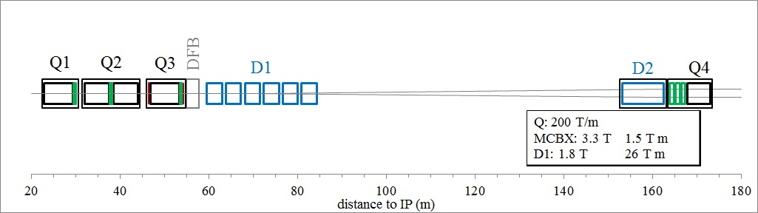
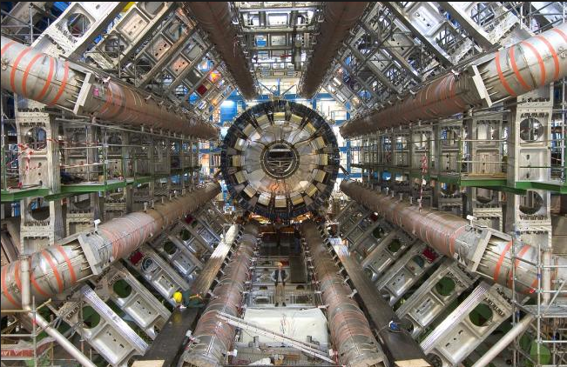
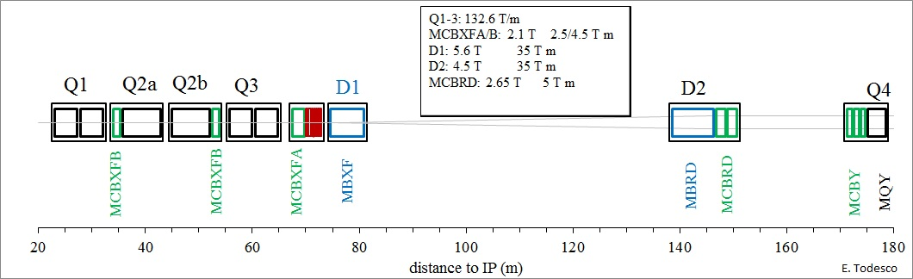
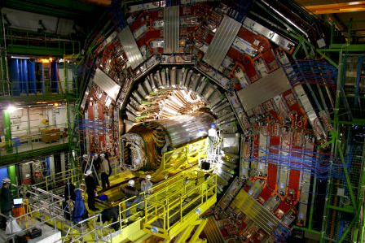
New HL-LHC Triplet Layout:
70mm ➔ 8T peak ➔ Nb-Ti
150mm ➔ 12T peak ➔ Nb₃Sn

Slide 6
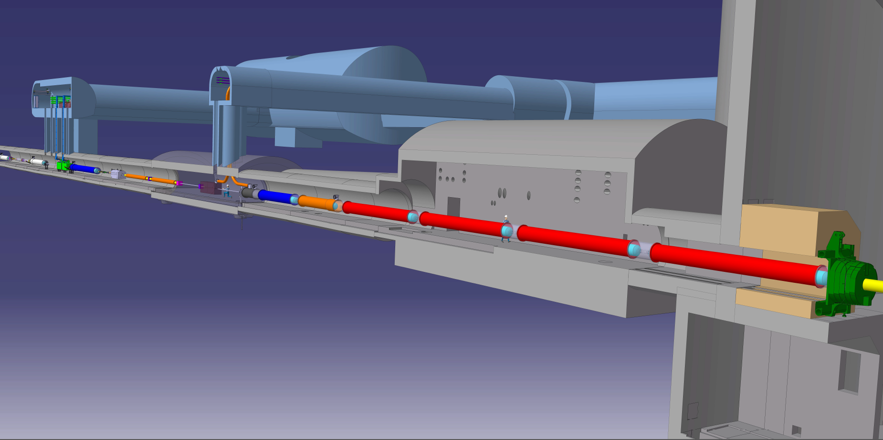







The Insertion Region (up to Q4)
Connection to LHC (UL)
Service gallery (UR)
UA Gallery
Service cavern
SC Links
Q4
Collimators
D2
Crab cavities
D1
CP
Q3
TAXN
DFM
DFX
Q2b
Q2a
Q1
TAXS

Slide 7
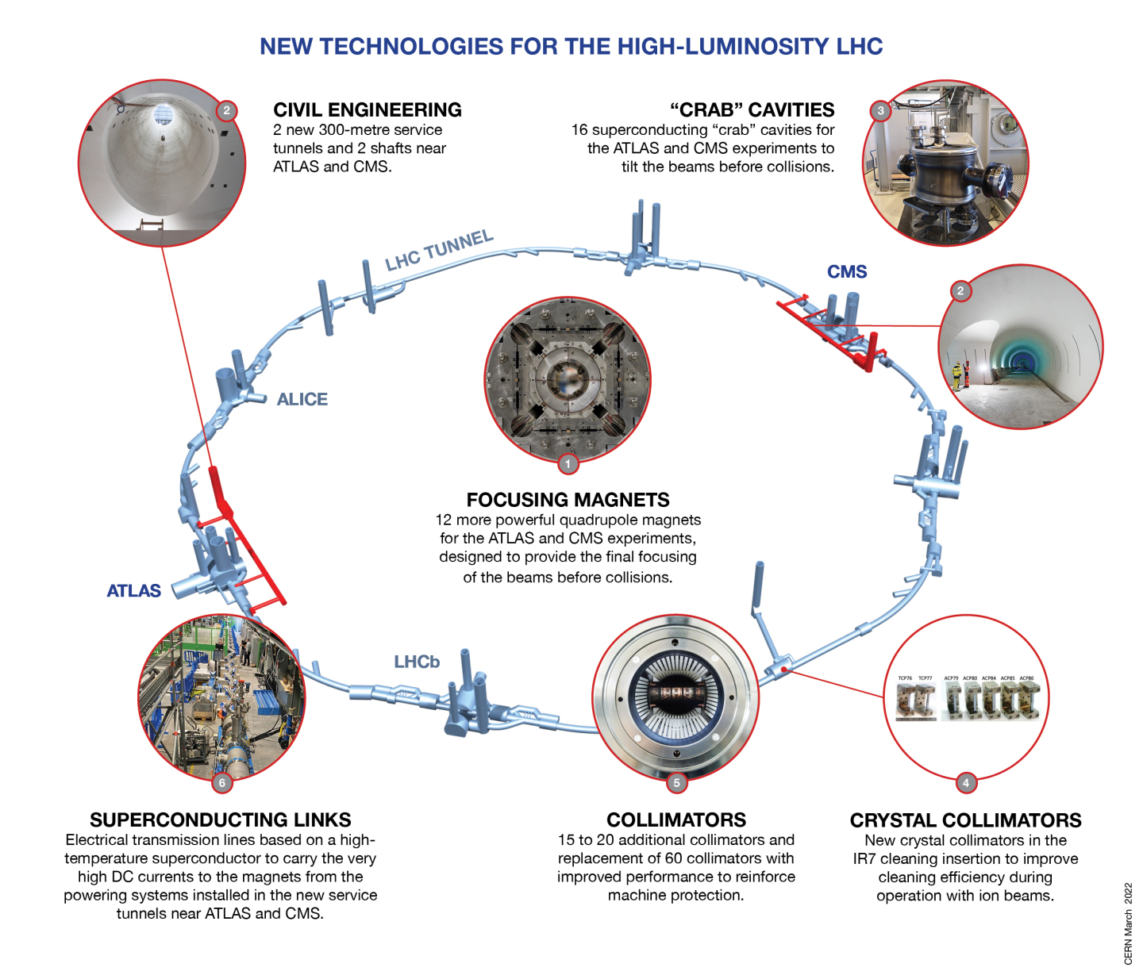
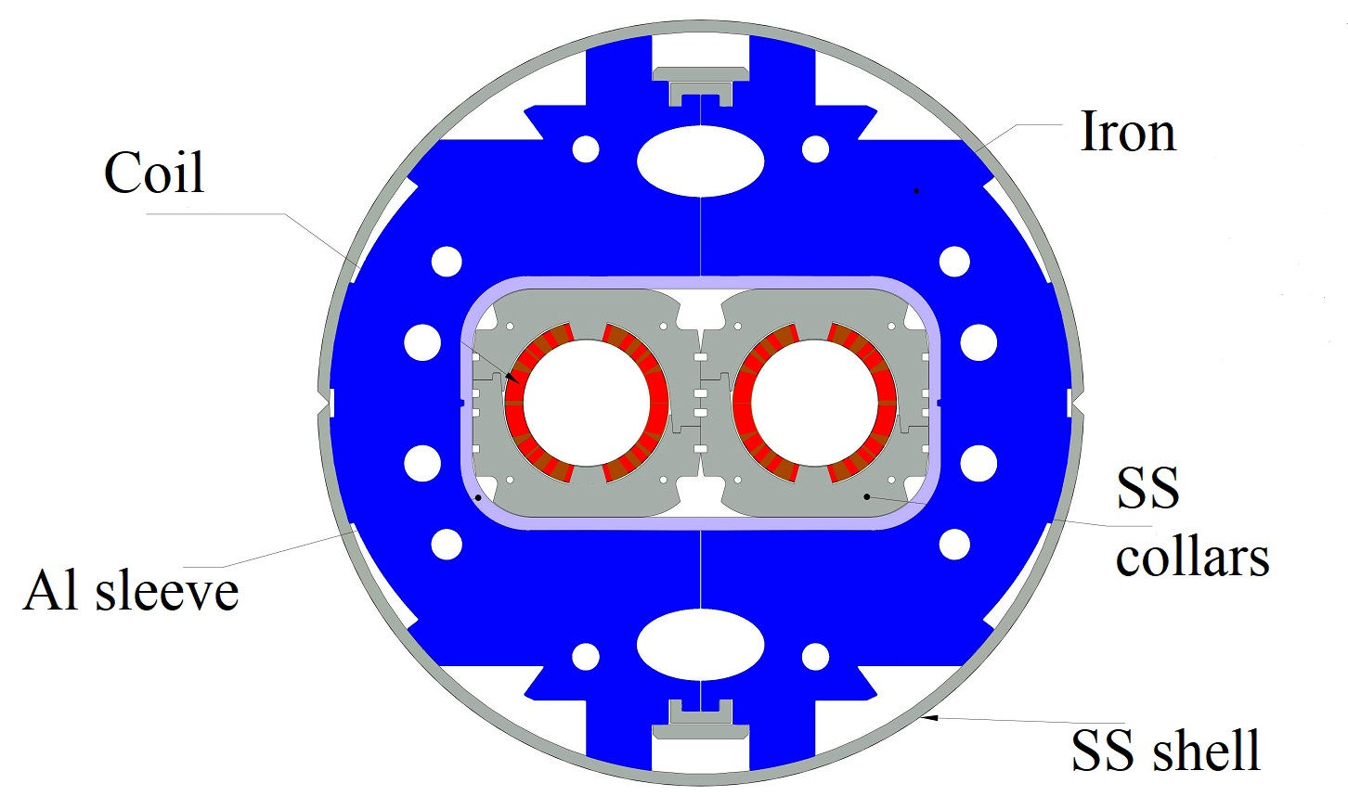
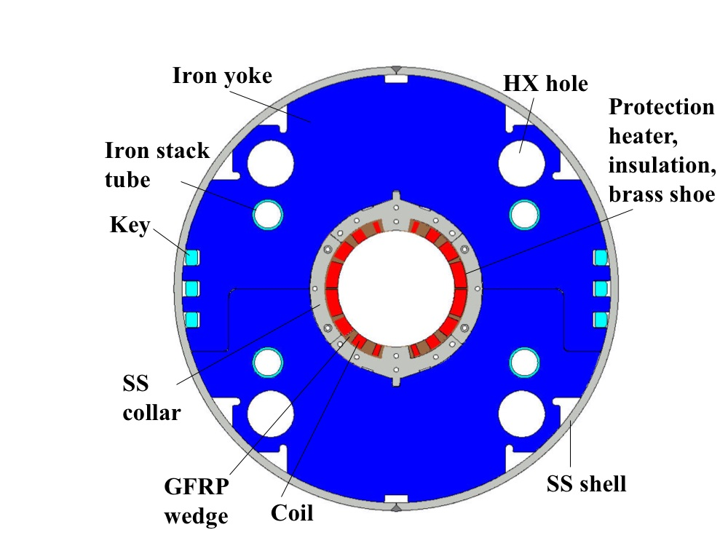
Technology
Landmarks
Series production in Industry well underway
Prototype and first series delivered to CERN
Separation / Recombination
dipole magnets: D1 & D2
Finished in 2023
Finished in 2023
Fully validated in 2023 and first magnets ready for installation
Complete Prototype System installed in SM18 and under testing
½ system already installed for Run3
Successfully deployed in 2023 Pb-Pb run
Prototype cryostated @ CERN

Slide 8
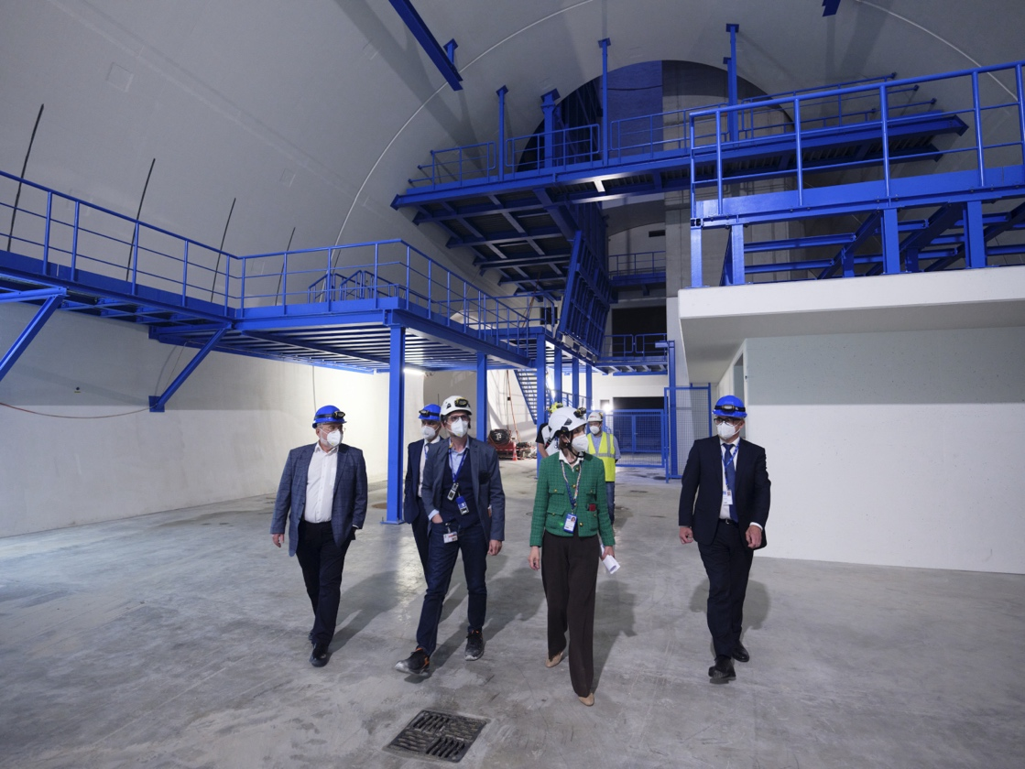
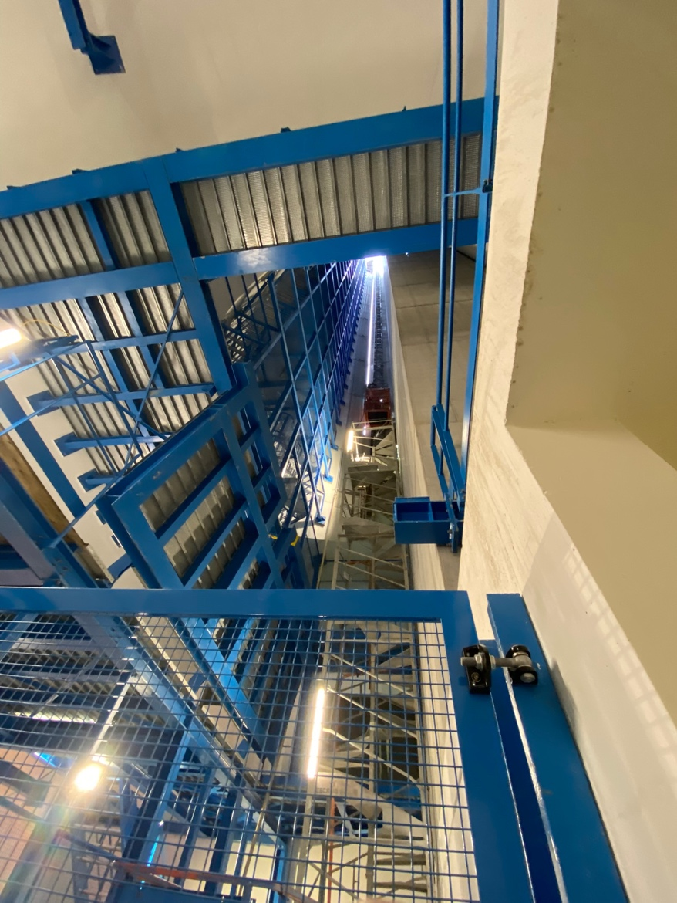
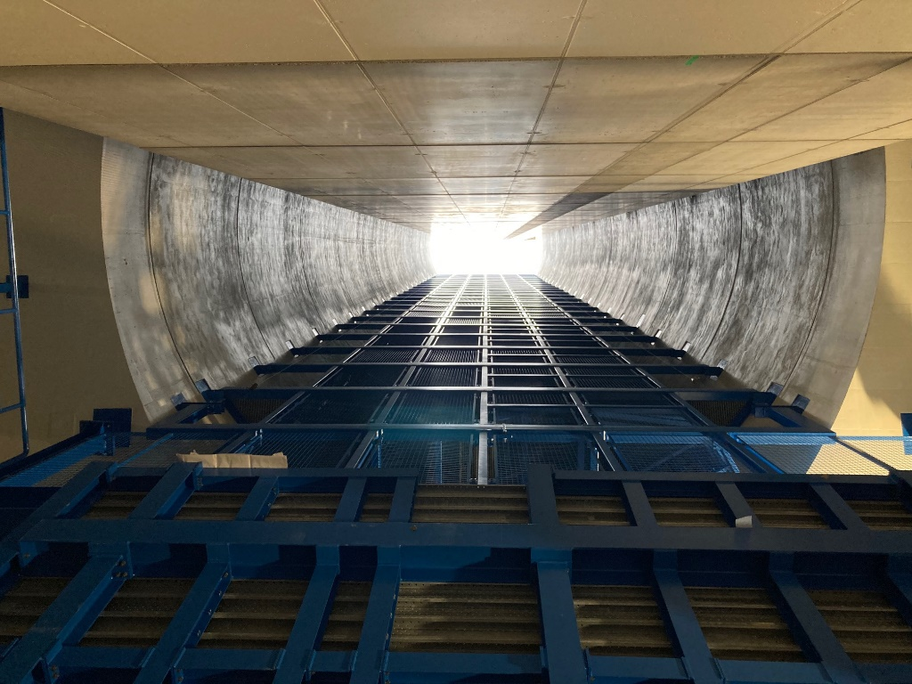
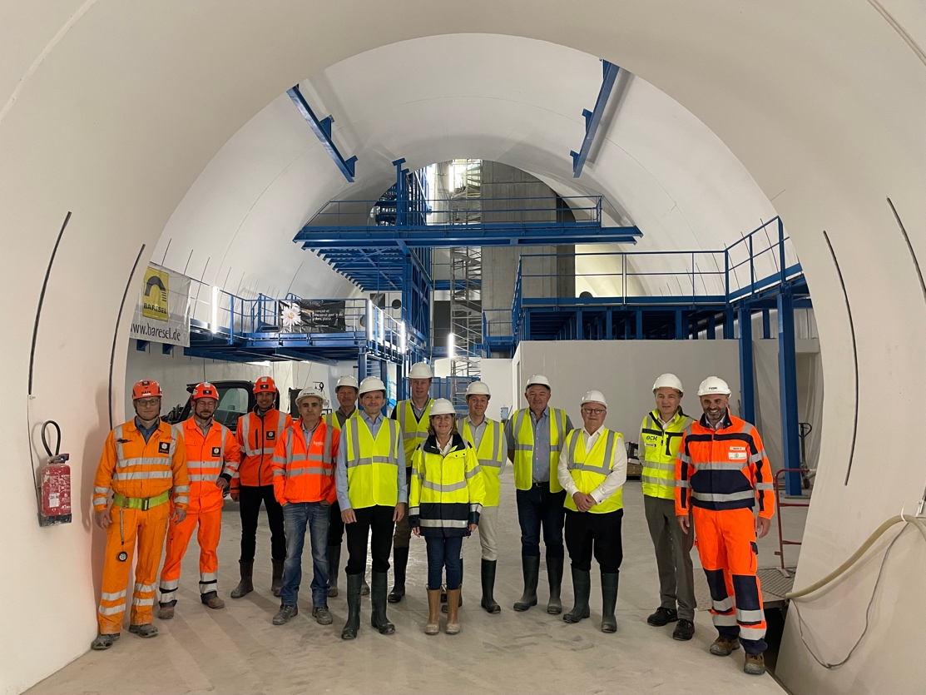
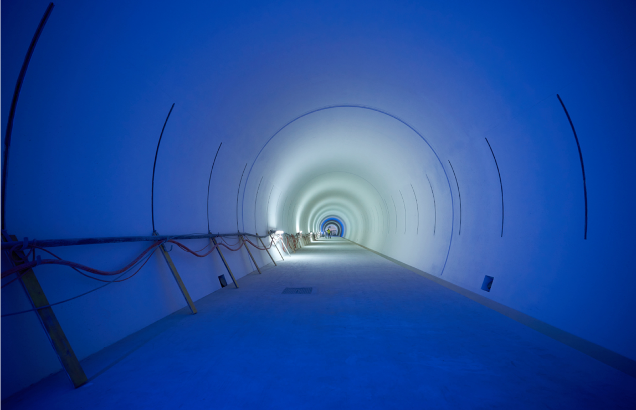
New Underground construction: Ceremony for completion of CE 2023
Notes:
To be updated with latest plans for Ceremony

Slide 9
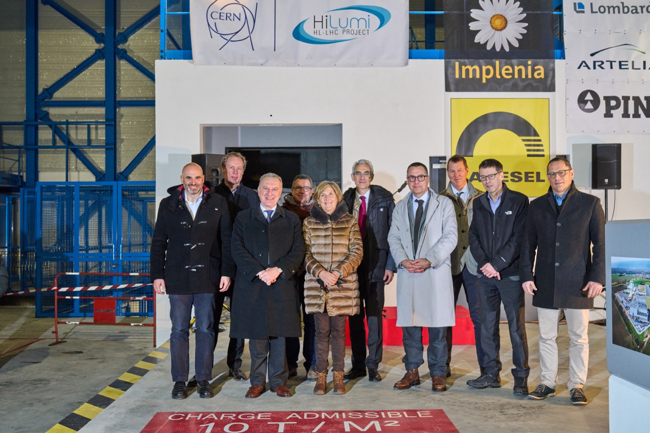
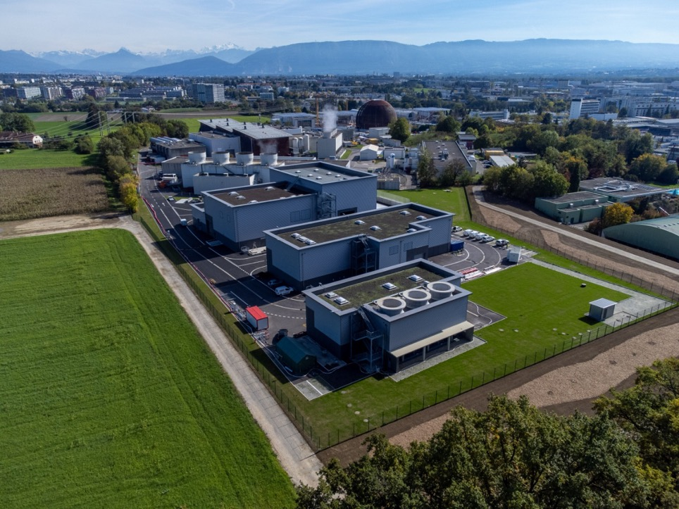
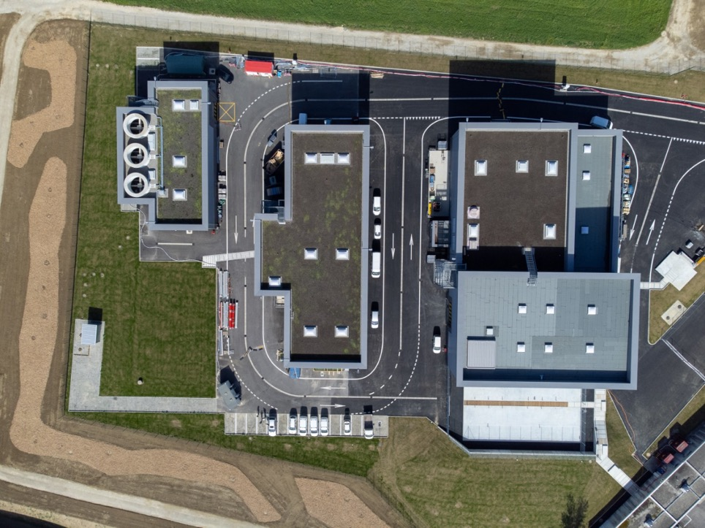
Completion of Surface buildings in 2023
Work Ended Spring 2023
SF17
SU17
SE17
SHM17
SD17
Example Point 1
20th January 2023
Celebration Ceremony: Point 5

Slide 10
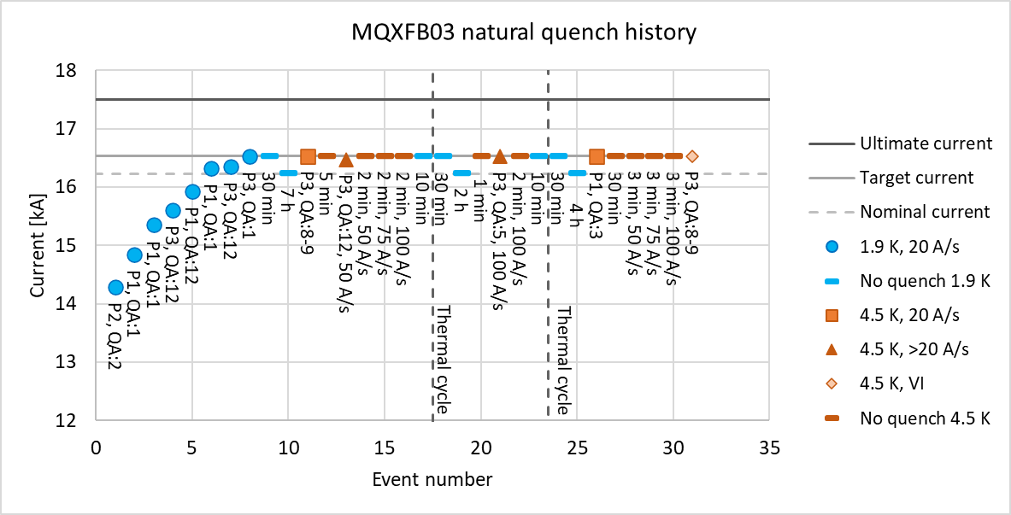
Status MQXFB – Q2 - Assemblies at CERN
Magnets produced ➔ None showing degradation!
3 [last 3] consecutive Magnets passed acceptance criterial!!!
MQXFBP1: test at CERN in 2020
  Failed to reach nominal current @ 1.9K But:
    Reached 6.4TeV equivalent without Quench; limitation only in one coil, all concepts validated @ 15.15kA
    ➔ Plan to exchange the limiting coil ➔ procedure test for 4+1 ➔ MQXFBMT4 July 2023 ✓
    MQXFBP2: test at CERN in 2021
        Limited at around nominal current and eventually reached nominal current at 1.9K at lower ramp rates
        ➔ review of assembly ➔ 3 Phase Improvement plan
        1) Stainless Steel prestress; 2) Assembly procedure of Cold-Mass; 3) Coil production
MQXFBP3: test at CERN in 2022 – Lower shell pre-stress ➔ 1) but after disassembling 01
  Nominal +300A @ 1.9K and 3 TC ✓
  Still limited at 4.5K ➔ but compatible with powering at ultimate current at 1.9K
MQXFB02 test at CERN in 2023 – 1) plus New Magnet Assembly procedure ➔ 1) & 2)
  nominal +300A @ 1.9K and 3 TC ✓ Still limited at 4.5K but compatible with ultimate at 1.9K!
MQXFB03 test at CERN in 2023 – New coil production ➔ 1) & 2) & 3)
  Nominal + 300A @ 1.9K and 4.5K and after TC! ➔ Full validation of magnet concept!
Decision to use P2 and P3 for the IT-String in SM18 @ CERN even though they are limited @ 4.5K
Re-cryostating of the cold-masses in final cryostat configuration
Lost one coil during preparation for cold-test in final cryostat configuration
➔ Plan to exchange the damaged coil and keep 02 as a spare
First Magnet that will go into the machine!
10
Notes:
Simplify for ENEA!

Slide 11

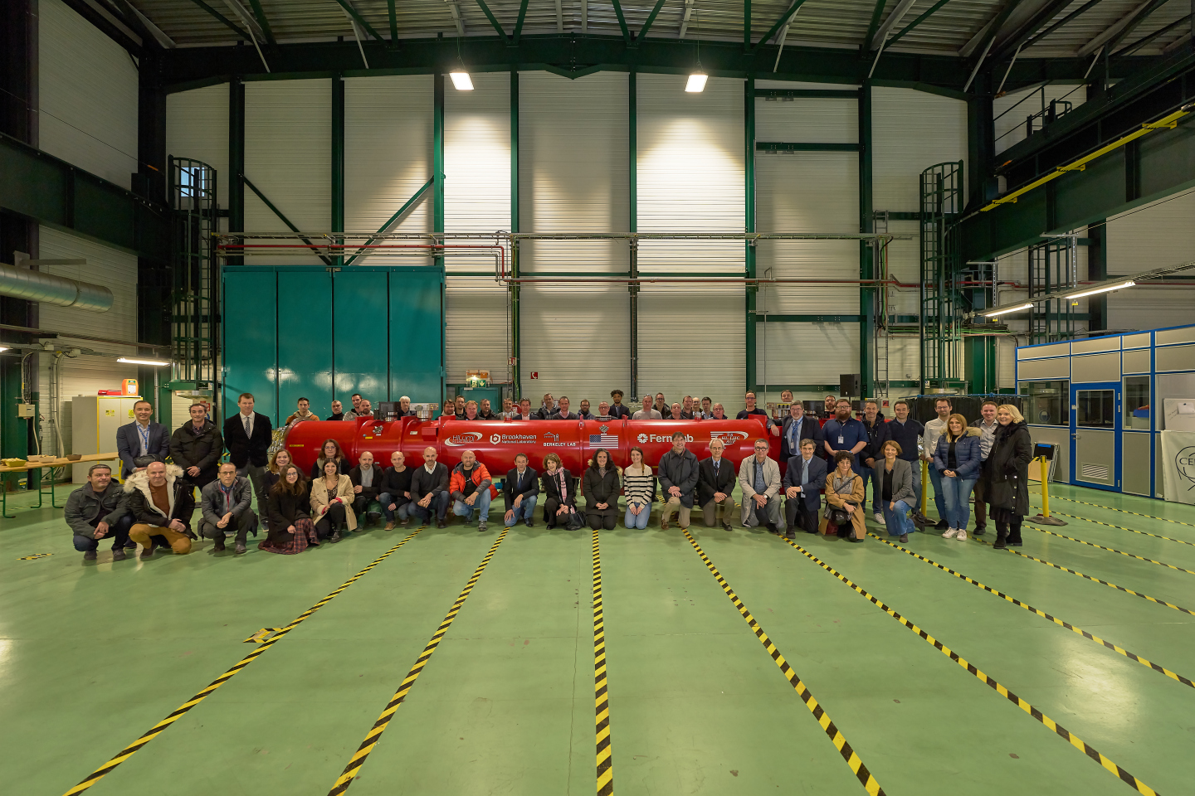
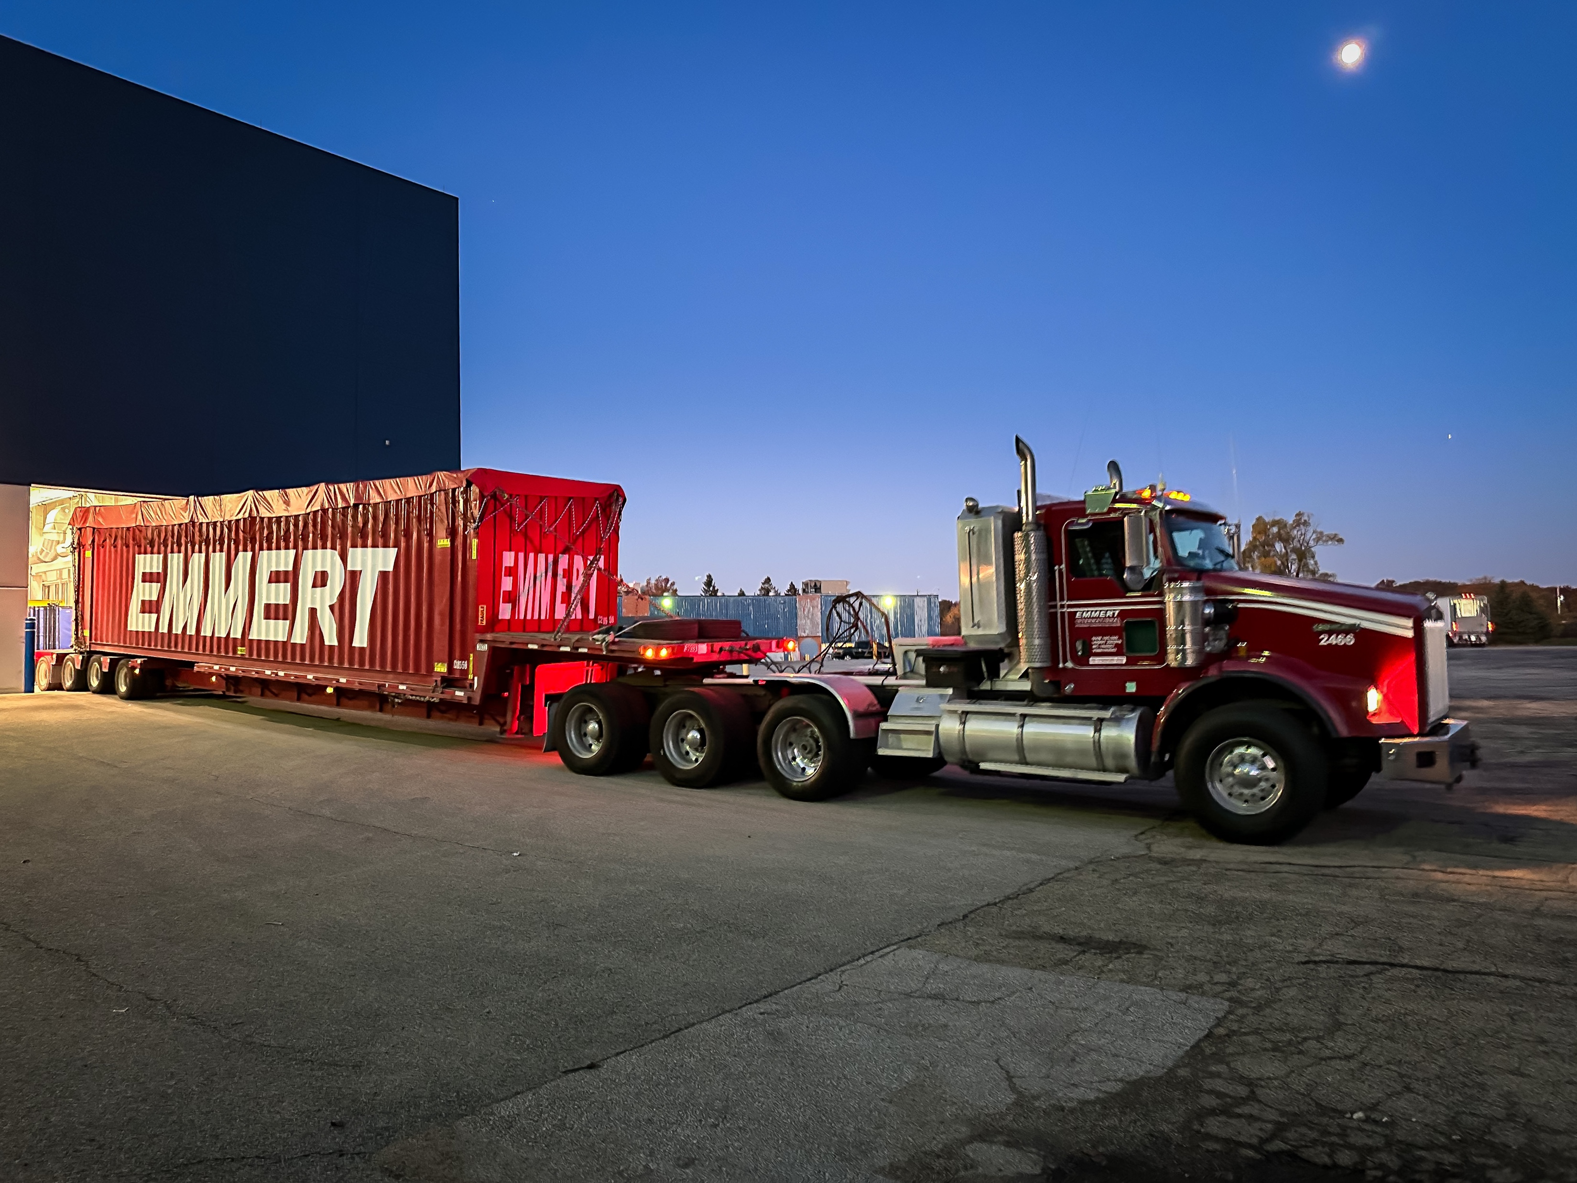
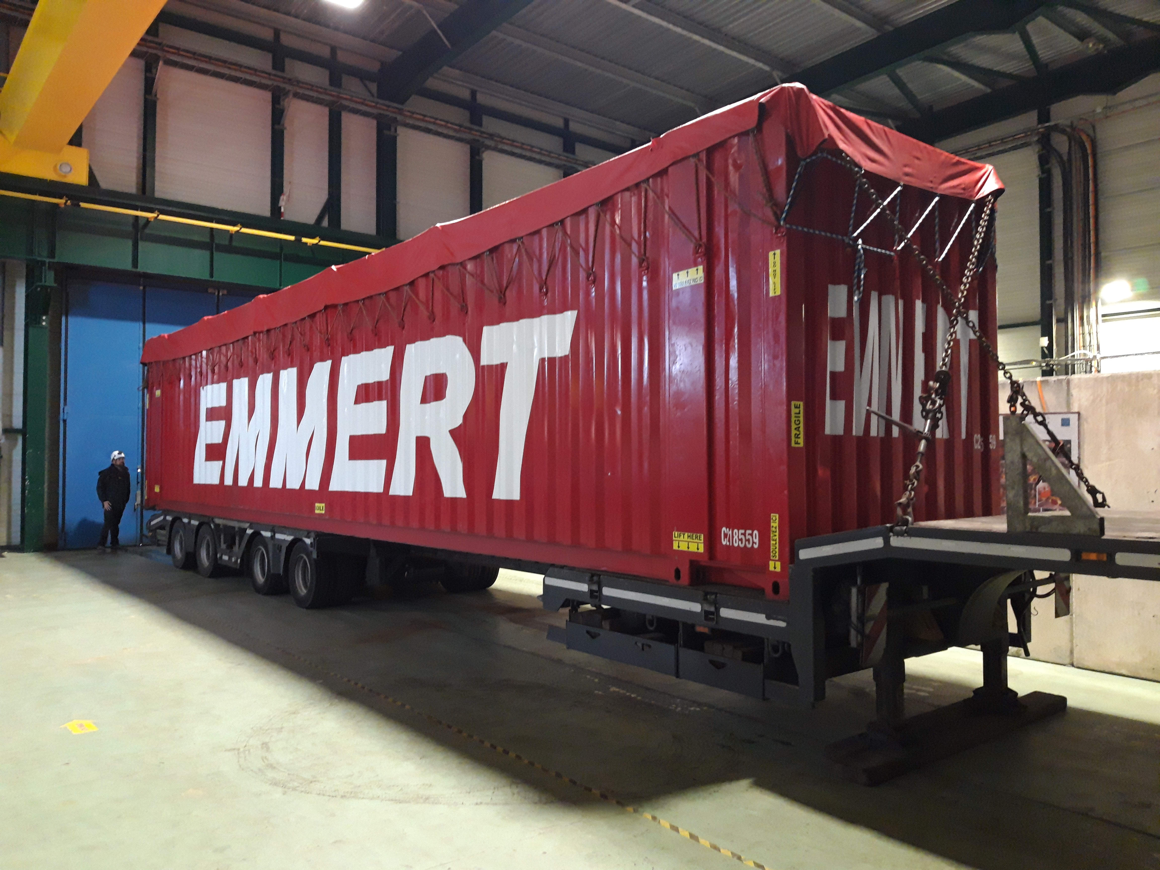

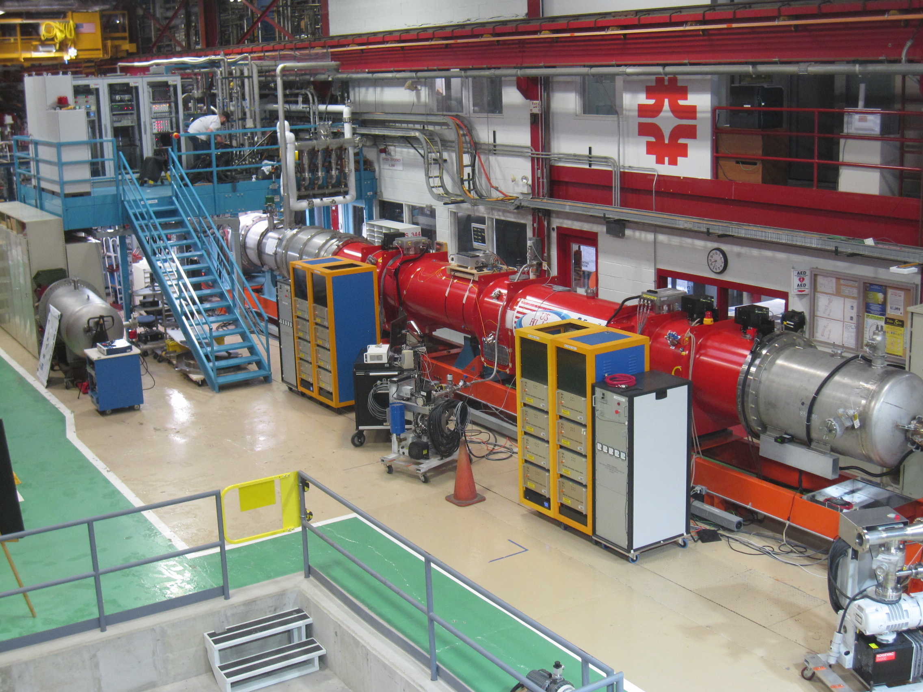
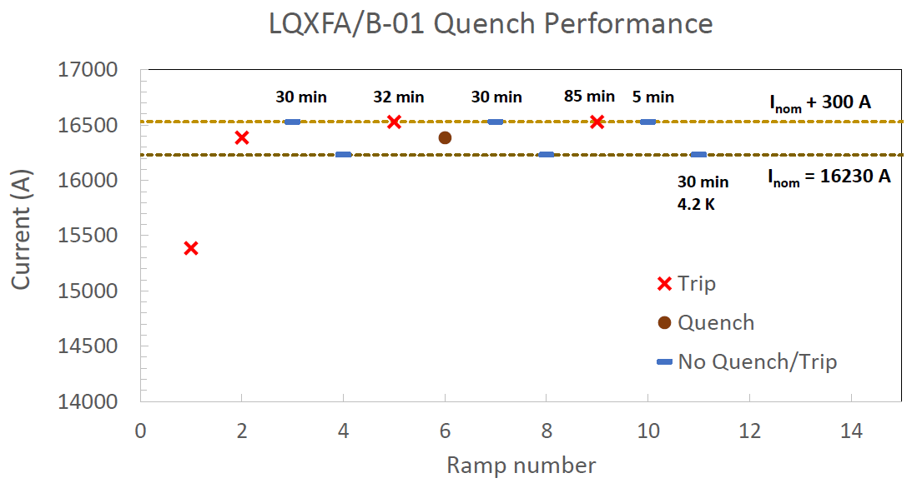

Status MQXFA – Q1 & Q3- Assemblies at AUP
8 out of 20 magnets build, tested and validated!
From 15 that were produced – 3 during COVID ➔ all non-conformed being repaired ➔ 2 repaired validated
MQXFA08b & MQXFA14b repaired and validating coil replacement procedure and coil production planning
Endurance test on MQXFA05: 50 quenches, 5 TC ➔ magnet remains @ nominal! ✓
Unscheduled mechanical robustness test for MQXFA11 ➔ road accident ✓
Magnet passed acceptance criteria at vertical test station ✓
CA-01: First cold mass reaching nominal performance – no retraining after thermal cycle
Nonconformities but accepted in close collaboration with AUP to assure in-time delivery for IT-String
➔ Shipped in November ➔ Arrived @ CERN in December [acceptable for IT-String, not yet for machine]
Cabling completed: https://newscenter.lbl.gov/2023/08/30/cabling-for-lhc-upgrade-wraps-up/
Second Cold-Mass Assembly being prepared for testing at FNAL ➔ second out of 10 CMA
CA01 Arriving @ CERN November 28th 2023
CA01 Leaving FNAL October 30th 2023
Notes:
Simplify for ENEA!

Slide 12
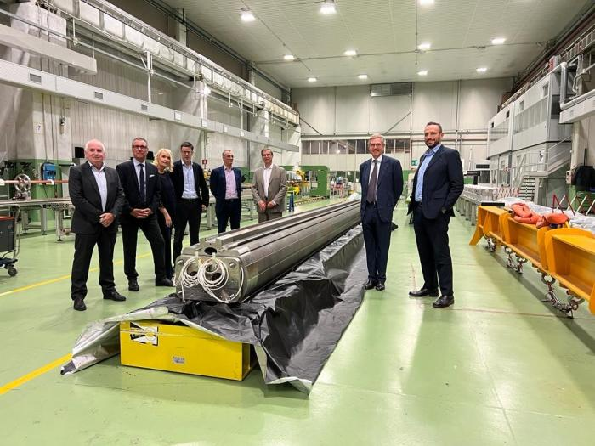
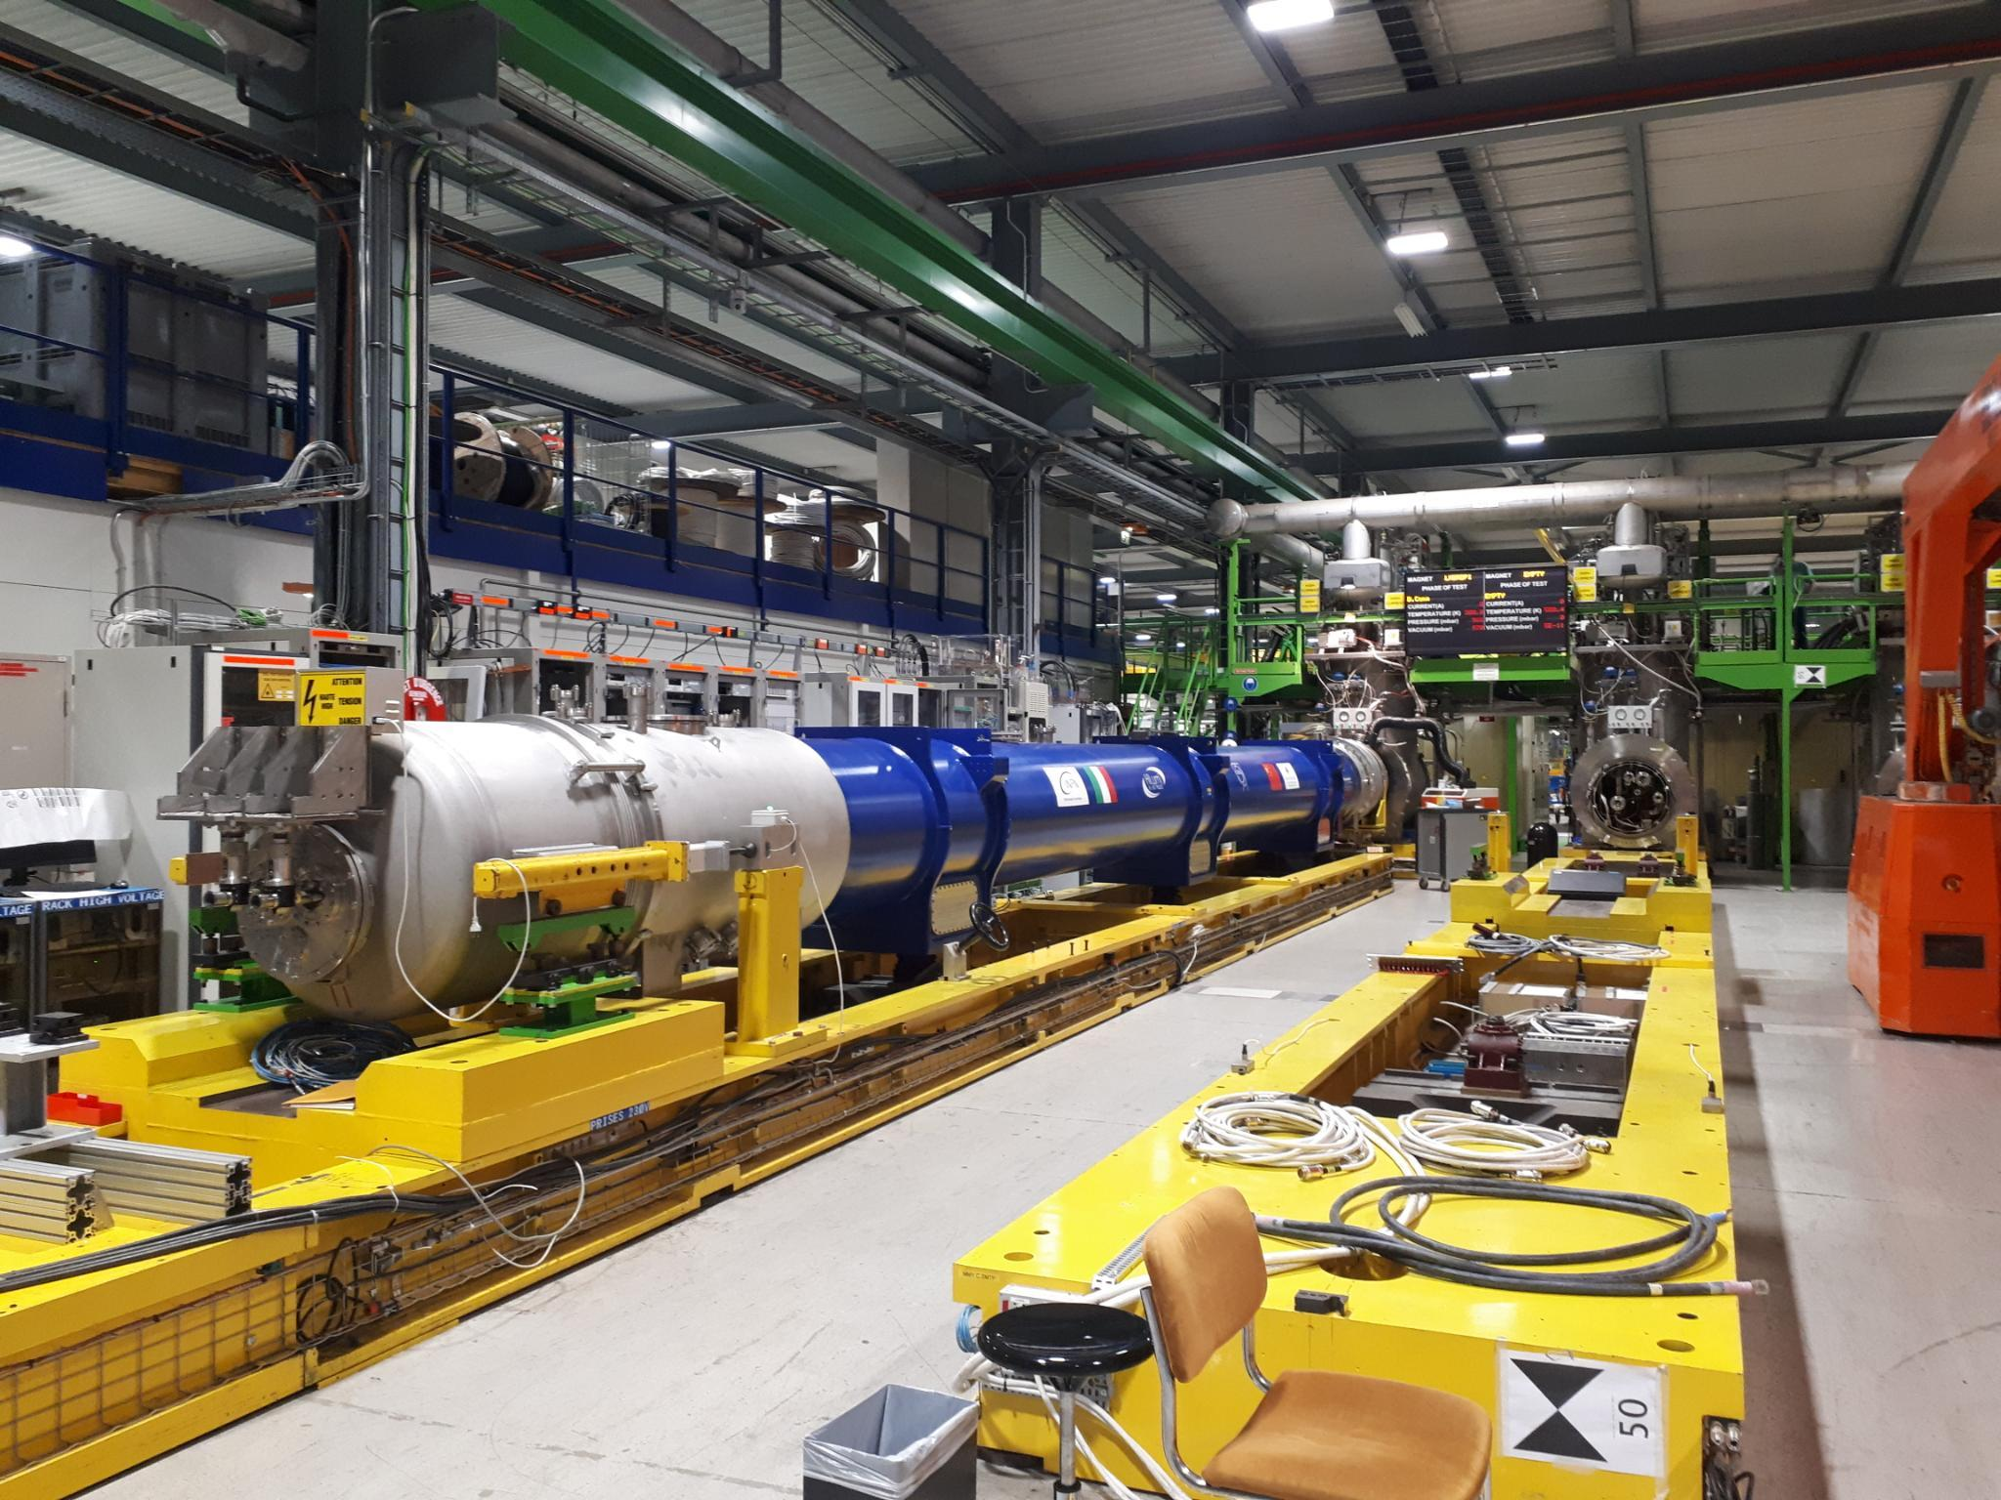
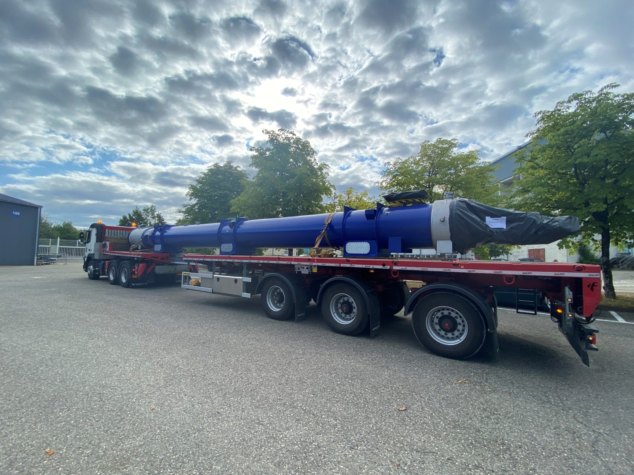
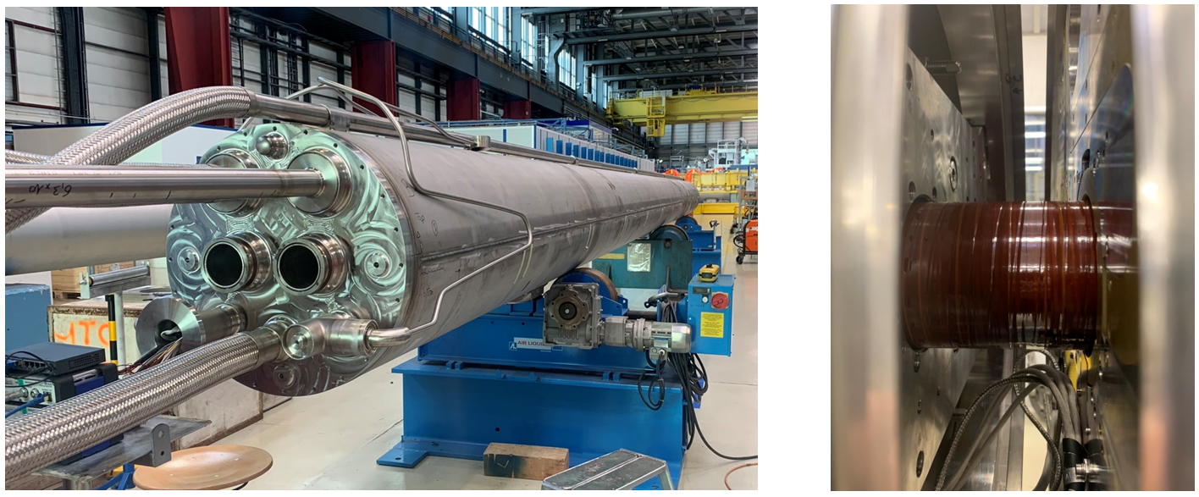
D2 Cold-Mass Assembly
D2 Prototype on the test bench in SM18: reached ultimate current after TC without quench
First D2 series magnet at ASG factory in Genoa, 2023
Cryogenics by-pass
D2 Prototype Cold-Mass @ CERN in Hall 180

Slide 13
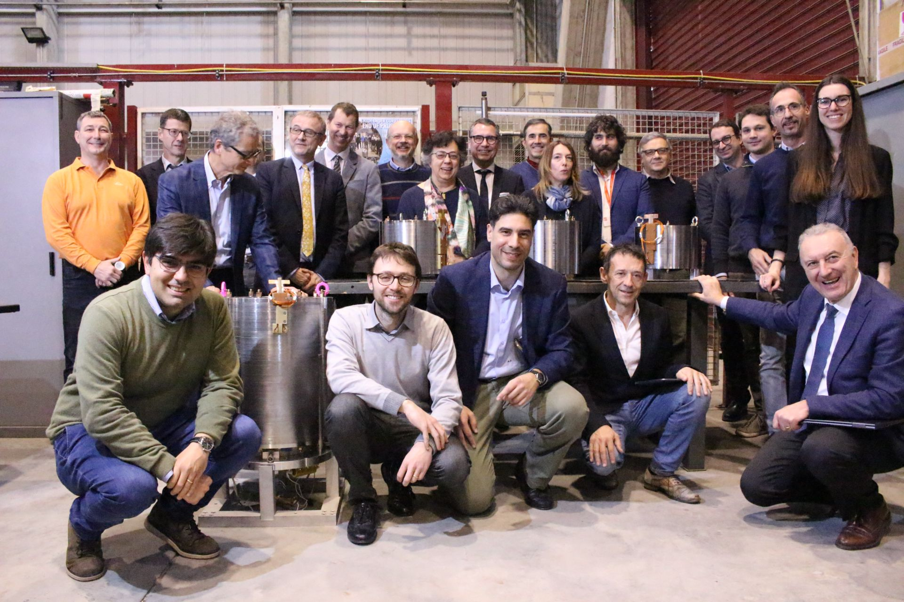
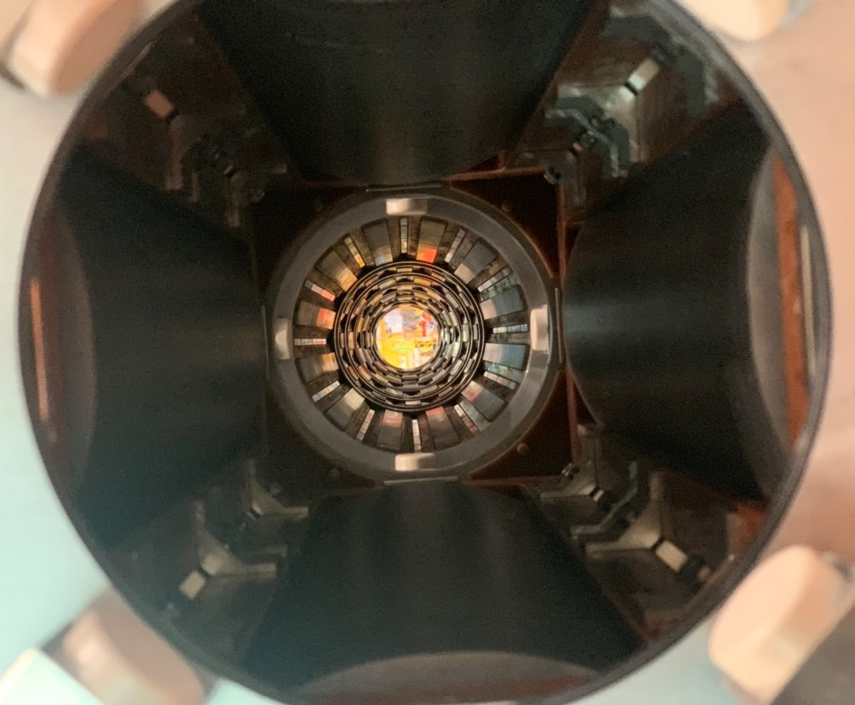
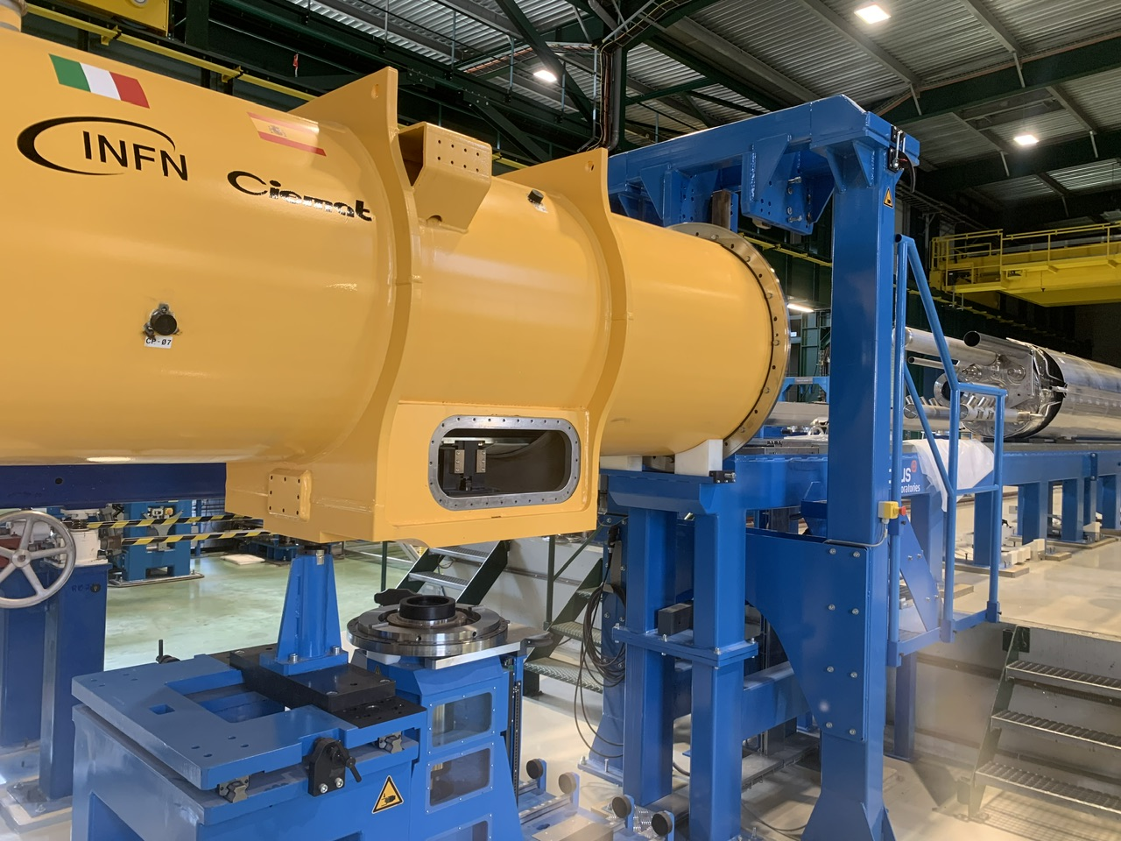
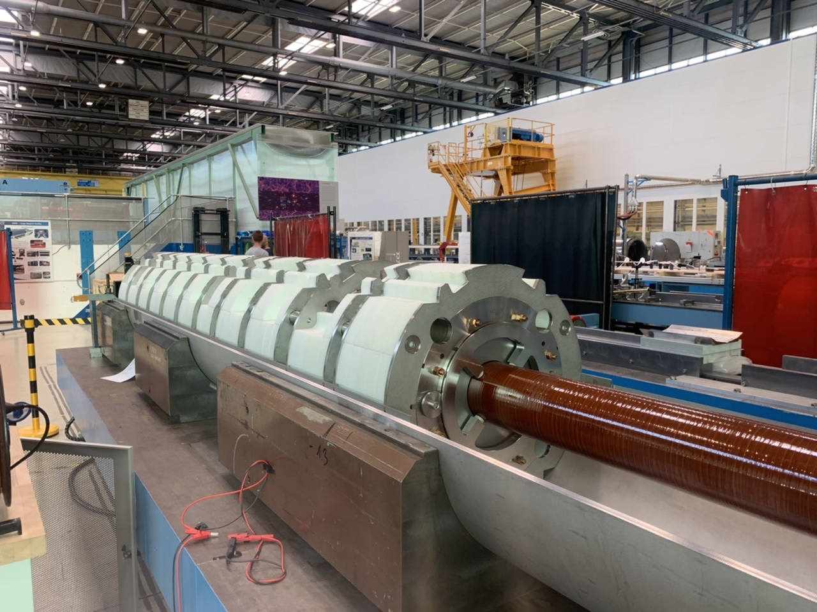
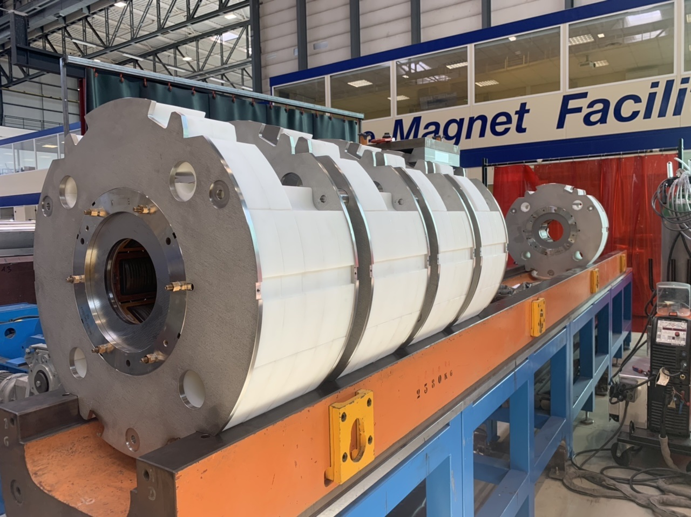
Non-Linear Corrector Package Production by LASA in Milan
SAES RIAL Vacuum
as Industrial partner
Production already completed!
Excellent performance of the delivered magnets!!!

Slide 14
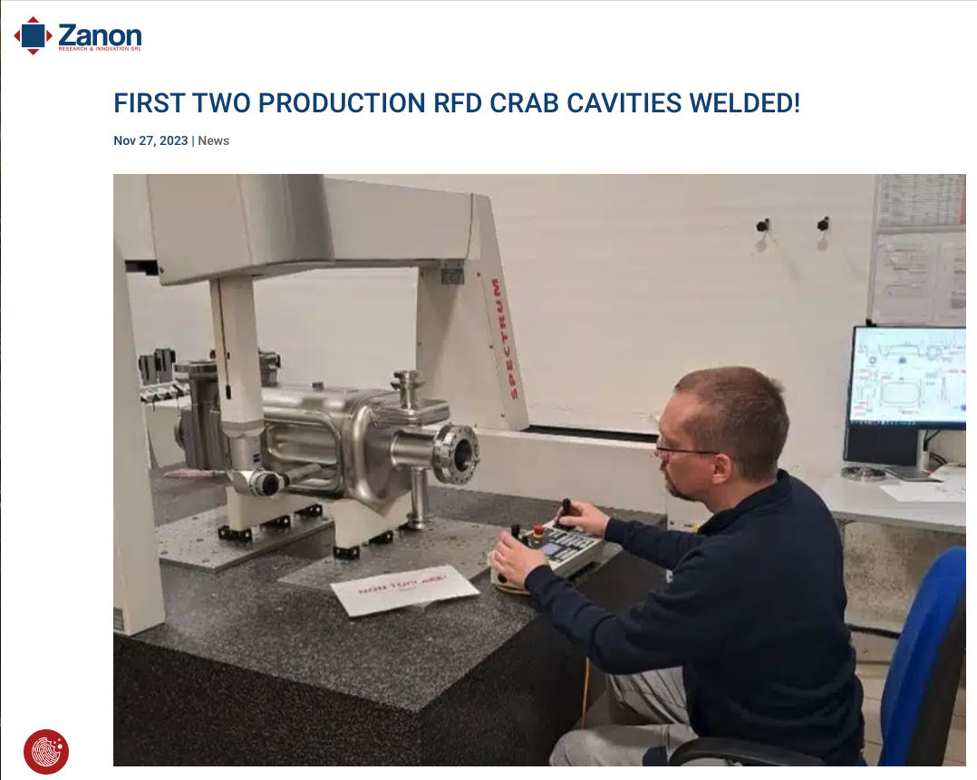
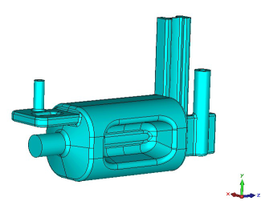
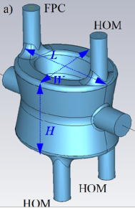
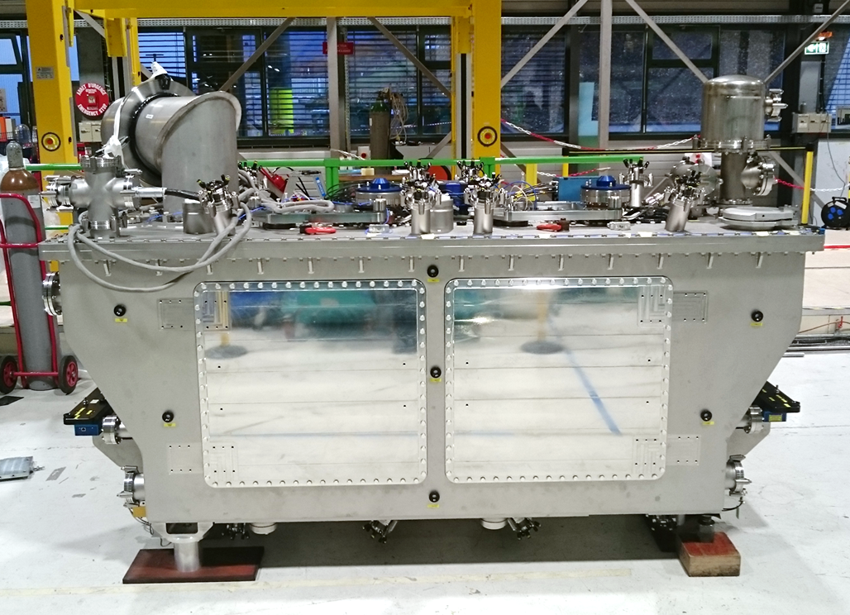
HL-LHC cavity designs
Produced by CERN with RI
as industrial partner
Produced by AUP with Zanon
as industrial partner
2 Designs with
Different Coupler concepts and
Deflection planes
RF Dipole: Waveguide or
waveguide-coax couplers
Double ¼-wave: Coaxial couplers with
hook-type antenna
Crab-Cavity
Cryomodule containing
2 Crab Cavities
Present baseline: 4 cavities / IP / side ➔ 16 total

Slide 15
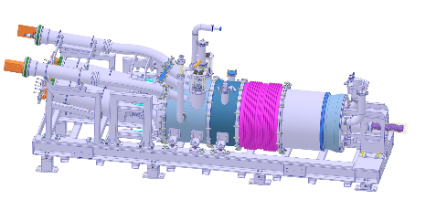
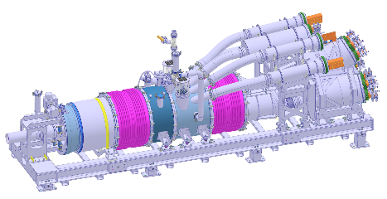
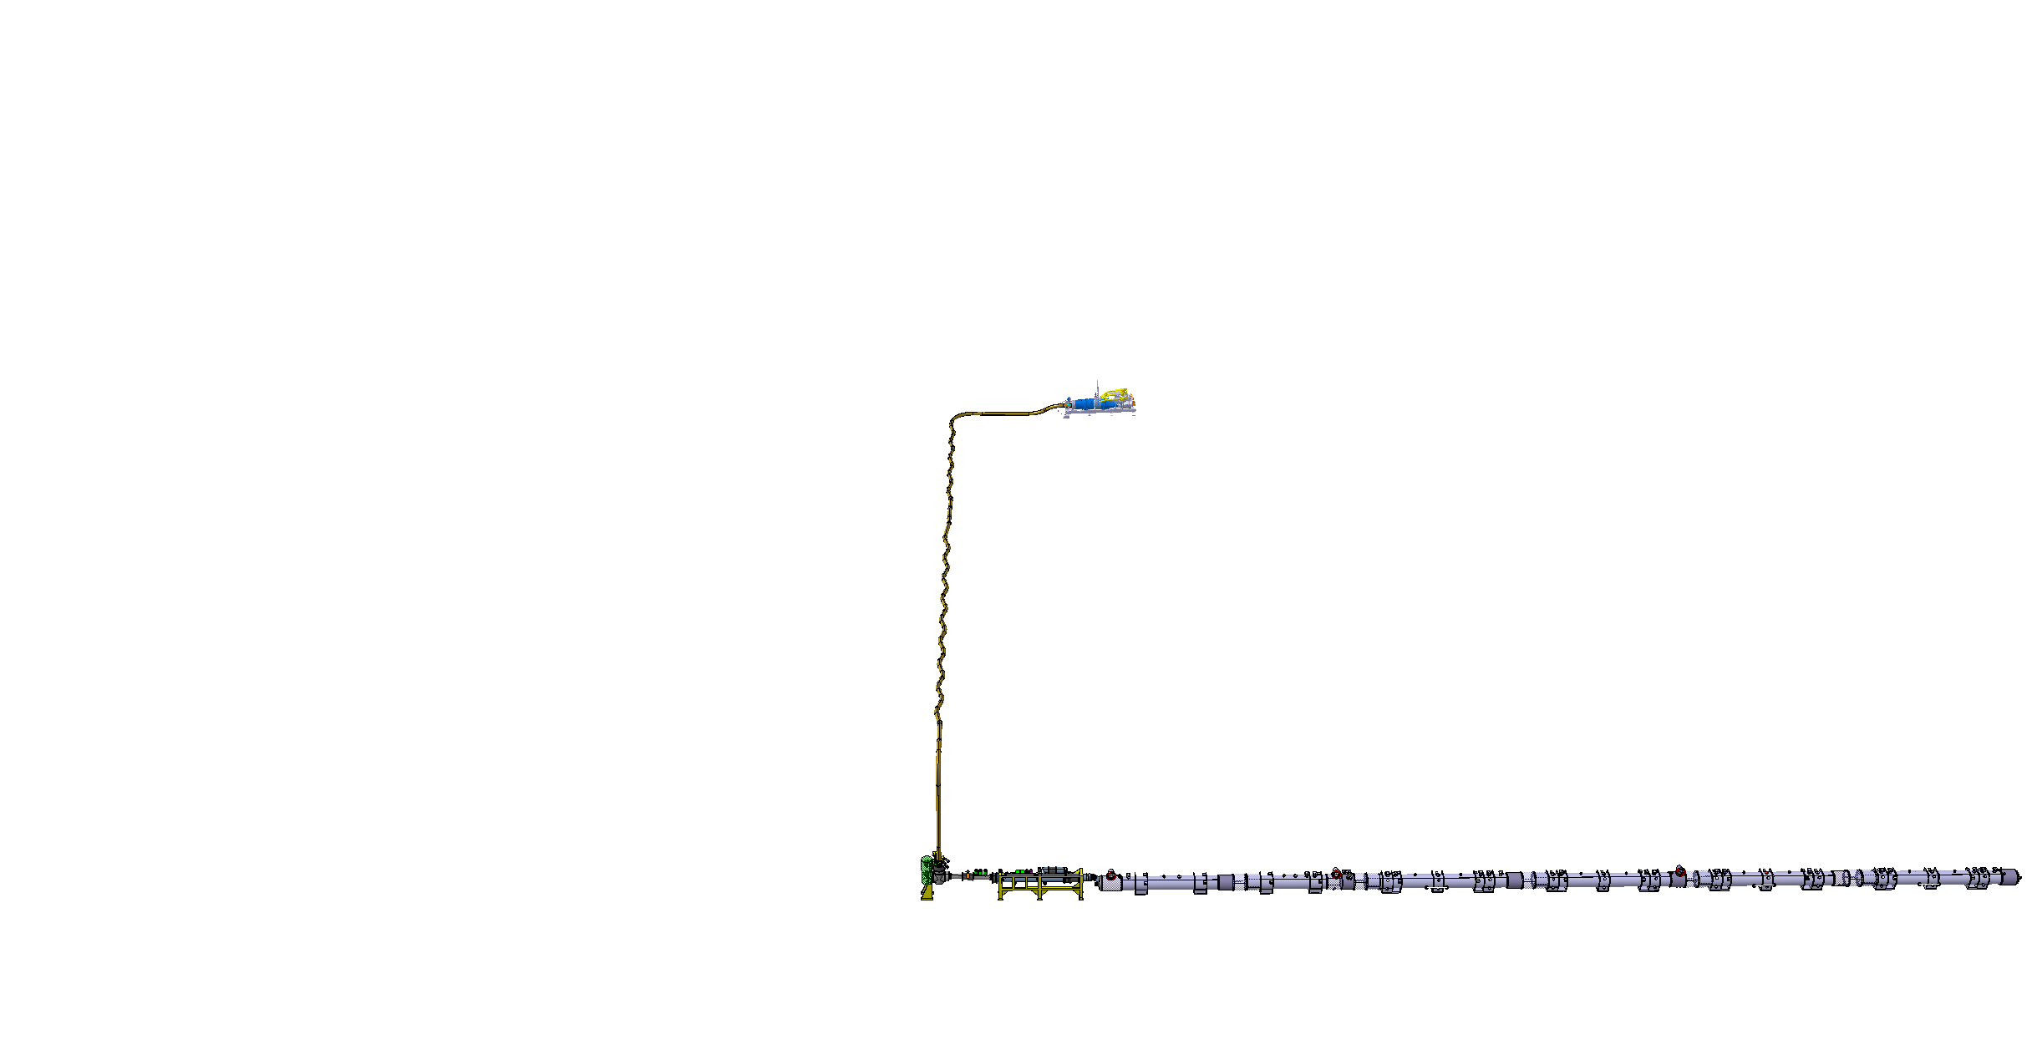
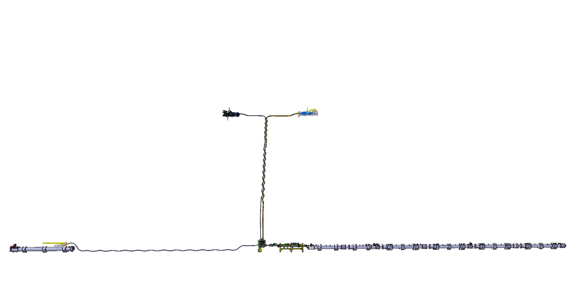
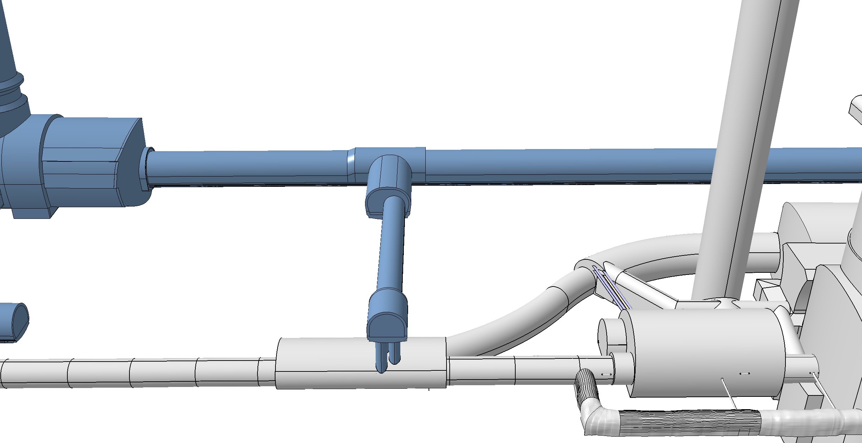
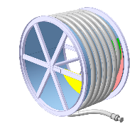
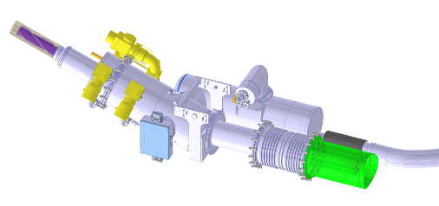
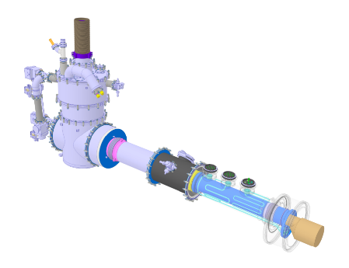
Cold Powering System
DFHM
DFHX
Power converters: (18, 0.6) kA
Power converters: (18, 7, 2) kA
DSHM
DSHX
140 m
89.5 m
Power converters: (60, 120, 200) A
D2
DCM
D1
CP
Q3
Q2B
Q2A
Q1
DFM
DFX

Slide 16
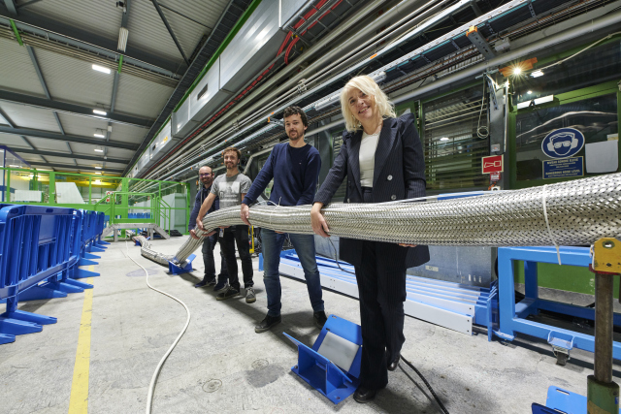
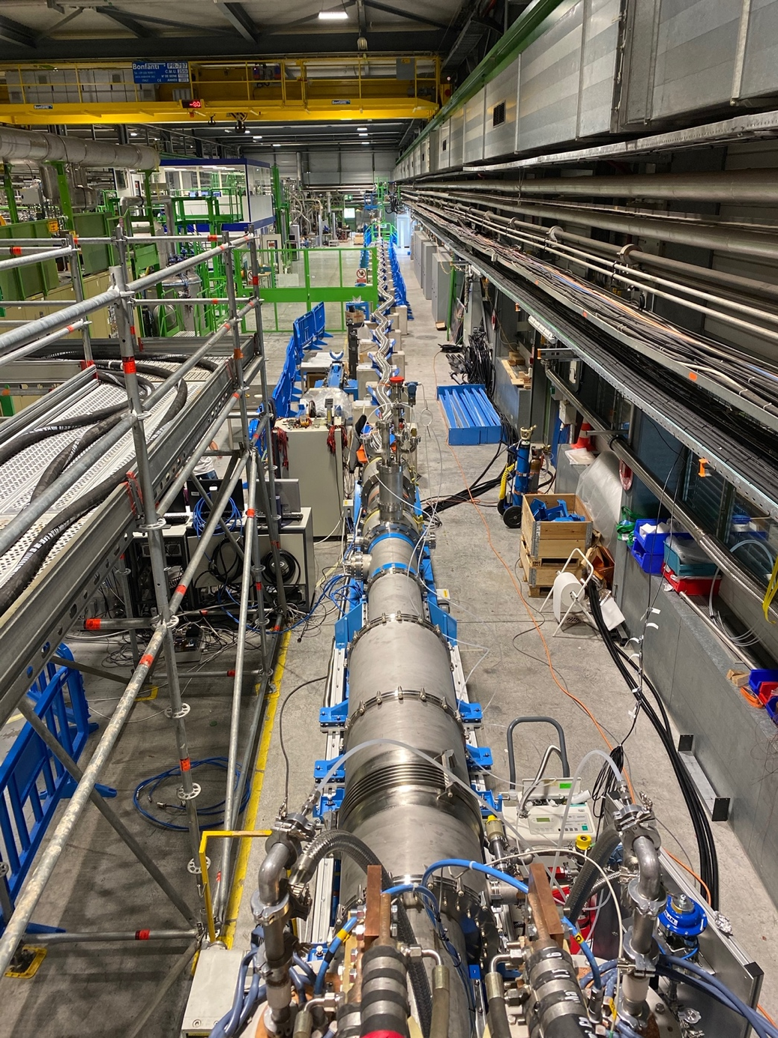
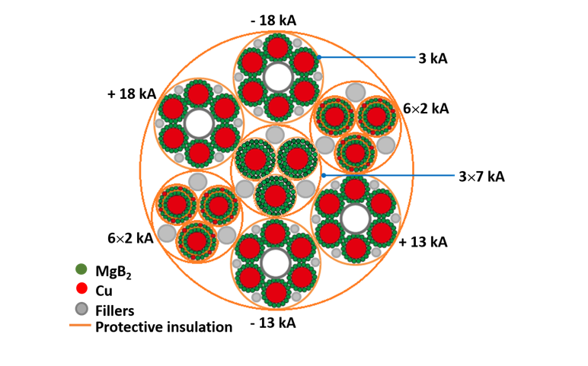
MgB₂ Superconductor and Superconducting link
Cable production complete !
Assembly of the first complete
system incl. flexible cryostats
is ongoing
Demo-3 in SM18
Successfully Demonstrated
Concept between 2020 / 22
with > 120kA @ 30K
16

Slide 17
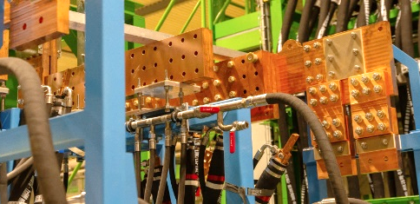
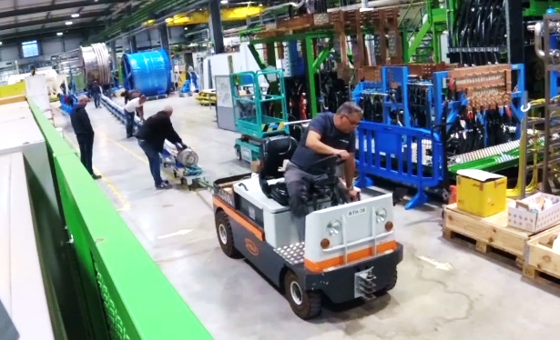









Complete System Test planned for Q1 2024 in SM18 @ CERN
Industrial partners in Italy: ASG and TRATOS
SC-Link-DFHX assembly in pictures

Slide 18









Collimation upgrades
SAES CINEL
as Industrial partner for the LS1 and LS2 production
Completely new layouts
Novel materials.
IR1+IR5, per beam:
4 tertiary collimators
3 physics debris collimators
fixed masks
Cleaning: Crystal collimators for Pb ion beam operation
Over 100 Collimators and absorbers to protect the SC magnets!!!
56 new collimators to be produced by LS3!
Ion physics debris:
DS collimation
Low-impedance, high robustness secondary collimators

Slide 19



Xray machine for crystal characterization
Bent crystal produced by PNPI and by INFN (Ferrara)
Crystal primary collimator in the LHC tunnel
X-ray characterization at CERN
Four primary crystal collimators installed in the LHC for ion beam collimation
First operational deployment in the LHC lead ion run 2023 ➔ Factor 5 to 6 beam loss
improvement!

Slide 20




HL-LHC IT STRING: P5L
P4
P5
P5
P3
P2
HL-LHC
P6
P5R
SPS
P7
P1
P5L
P8

Slide 21




HL-LHC testing facilities in SM18
Magnet Testbenches
IT Test Area
SRF Section
Cold-powering Test Area

Slide 22






IT String Status in pictures
PC and Energy Extraction racks installed on the metallic structure
Cryo Distribution
On top of the empty metallic structure
Under the metallic structure
Q4 2024
Q1’25
Q2-Q4 2025
Q1’26
Q2’26

Slide 23





THE IT-STRING INGREDIENTS ARE GETTING READY
Dates given in schedule change request, EDMS 2898265
  Q1: magnet cold mass being welded → Available in September 2024
  Q2a: MQXFBP3b completed → Available for Testbench Jan. → April 2024
  Q2b: MQXFBP2b completed → On SM18 Testbench → Available April 2024
  Q3: arrived at CERN December 2023 → Available July 2024
  CP cryostating Phase II ongoing → Available August 2024
  D1 cryostating completed → On SM18 Testbench → Available March 2024
D1
(in SMI2)
CP
CP
(SMI2)
Q2b
In SM18
Q2a
(in SMI2)
Q2b
(in SM18)
Q3
(in FNAL)
Notes:
To be updated by Ezio’s PSM presentation

Slide 24



HL-LHC Highlights
Available beginning of 2024
Open Access Publication
https://doi.org/10.1142/13487
ISBN: 978-981-127-894-5

Slide 26









Bent crystal for particle accelerators
Crystal collimation scheme
Pure crystals with regular lattices
If the protons have p_{T} < U_{max}
Critical angle
LHC 450 GeV = 9.4 μrad
LHC 6.5 TeV = 2.4 μrad
FCC-hh 50 TeV = 0.9 μrad
Straight crystal: hadron oscillate, “trapped” between planes
LHC design parameters for Silicon crystals
4mm
Mechanical bending of crystal produces a net kick of trajectories of the particles trapped between planes.
50μrad at 7 TeV proton
(4mm length, curvature r = 80m)
50mm
1mm
Bent crystal
Beam
Bending 50μrad
Crystal collimation: Needed at the HL-LHC for the collimation of lead ion beams!
TCP = primary collimator
TCSG = secondary collimator
TCLA = shower absorber

Slide 27



1st CERN-DQW Series, Qualified
3rd test beyond the specification with $100 μm$ additional chemistry of HOMs & ${120}^{0}$deg vacuum bake

Slide 28


Industrial DQW Series (RI)
1st pre-series jacketed cavity with excellent results, metrology to be finalized before acceptance
2nd cavity in metrology and cold tests soon

Slide 29

RFD Cold Mass Assembly – UK1 Collaboration
Lowering of Top plate to Cavity String successful !!
Since last PSM (July), important alignment issue between top plate and cavity string corrected with some non-conformities (not ideal but ok)
Delivered to CERN in time in October for installation deadline in the SPS Test-facility!
Unfortunately observed major Nonconformities following reception tests @ CERN
Electrical Short of coupler to ground / housing & vacuum leak
Will NOT be installed in the SPS in YETS 23 / 24
But important lessons learned for series production with UK and AUP / TRIUMF!!!!!!

Slide 30
AUP Crab Cavity production with Zanon as Industrial partner

