Slide 1
Visit of ENEA delegation at CERN
Wrap-up
M. Calviani (SY/STI, Systems Department)

Slide 2
https://cds.cern.ch/record/2889126

Slide 3
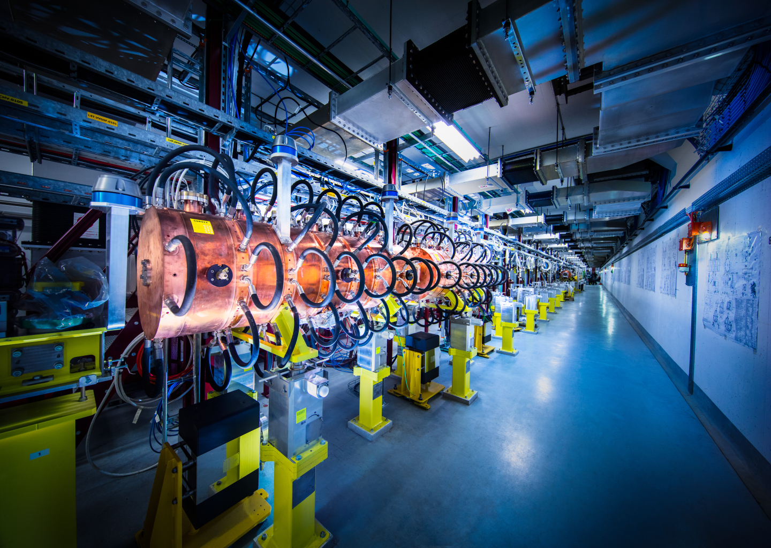
Thanks a lot for the productive and excellent discussions

Slide 4
Some key outcomes
(my takes, so please excuse me!)
”Core” development on circulating HLM loop central in the development program – clear interest from FCCee, Muon Collider & FT Targetry
  Conceptual design of a test loop (Stage pre-0, S1 2023)
  Realization of a proof-of-principle loop (Stage 0 – 2025-2028?)
  Proposal for a larger “prototypical” system for FCCee BS dump (Stage 1 – 2028-2032)
  In parallel, redaction of white paper for strategic development of HLM systems at CERN currently being envisaged (Marco)
CERN/ENEA interest in further exploring the expertise of each of the respective institutions
CERN/ENEA to explore possibilities/mechanisms for in-kind contributions and collaborations for FCCee (Marco/Mariano/Alessandro to cross-check with FCCee)

Slide 5
Some key outcomes
(my takes, so please excuse me!)
CERN/ENEA interest in FTCU (Marco to provide contacts for Luca)
ENEA interest in further enhancing discussion with radioactive isotope beam production team (Marco to provide contact of RBS colleagues)
ENEA interest in Procurement rules and CERN experience
ENEA interested in KT activities (Marco to provide contacts for Giovanni’s team)
Continuous development & support for n_TOF
  Further collaboration on HLM systems for Target #4 on the backdrop of FCCee/Muon Collider developments?
Yearly regular discussion forum (presential or remote) to be setup?

Slide 6
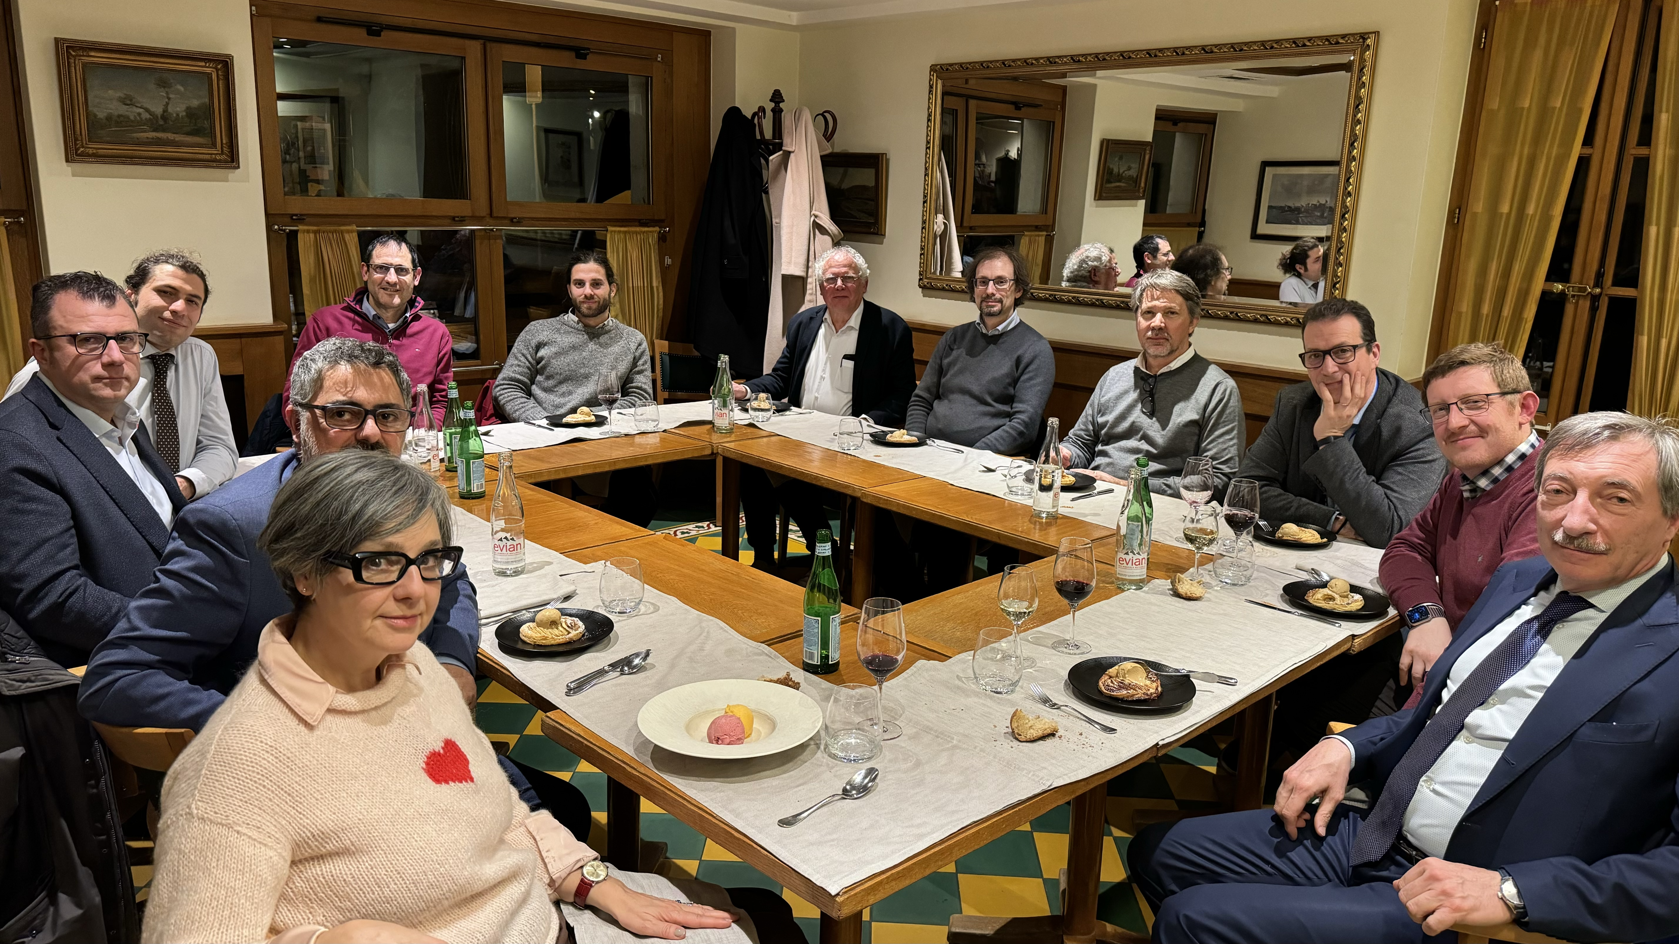

Slide 7
Looking forward to a productive collaboration and to the next event!

