Slide 2
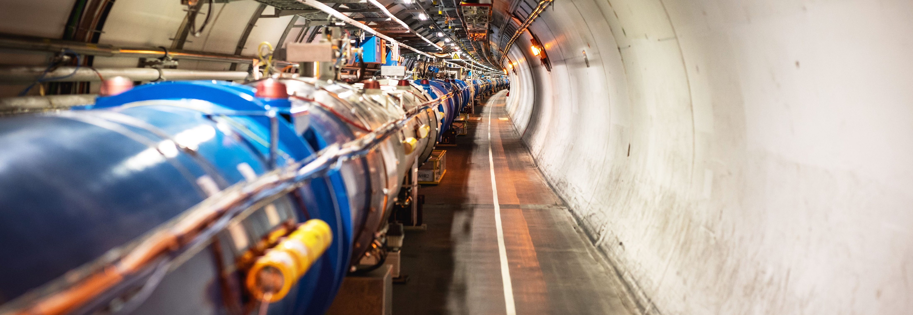
Accelerating Innovation
Knowledge Transfer @ CERN
Giovanni Anelli, Head of Knowledge Transfer Group, CERN

Slide 3
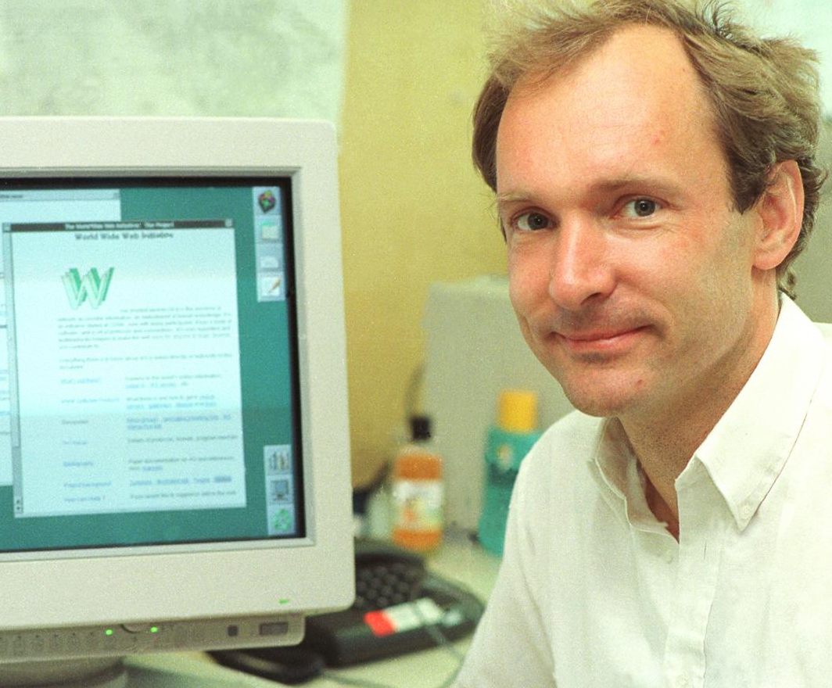
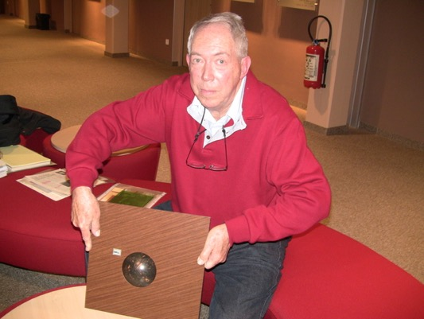
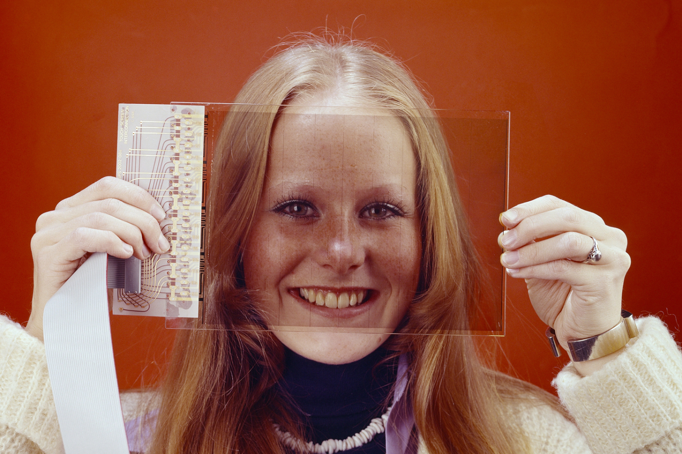
Some historic examples
WWW
TRACKERBALL
TOUCHSCREEN

Slide 4
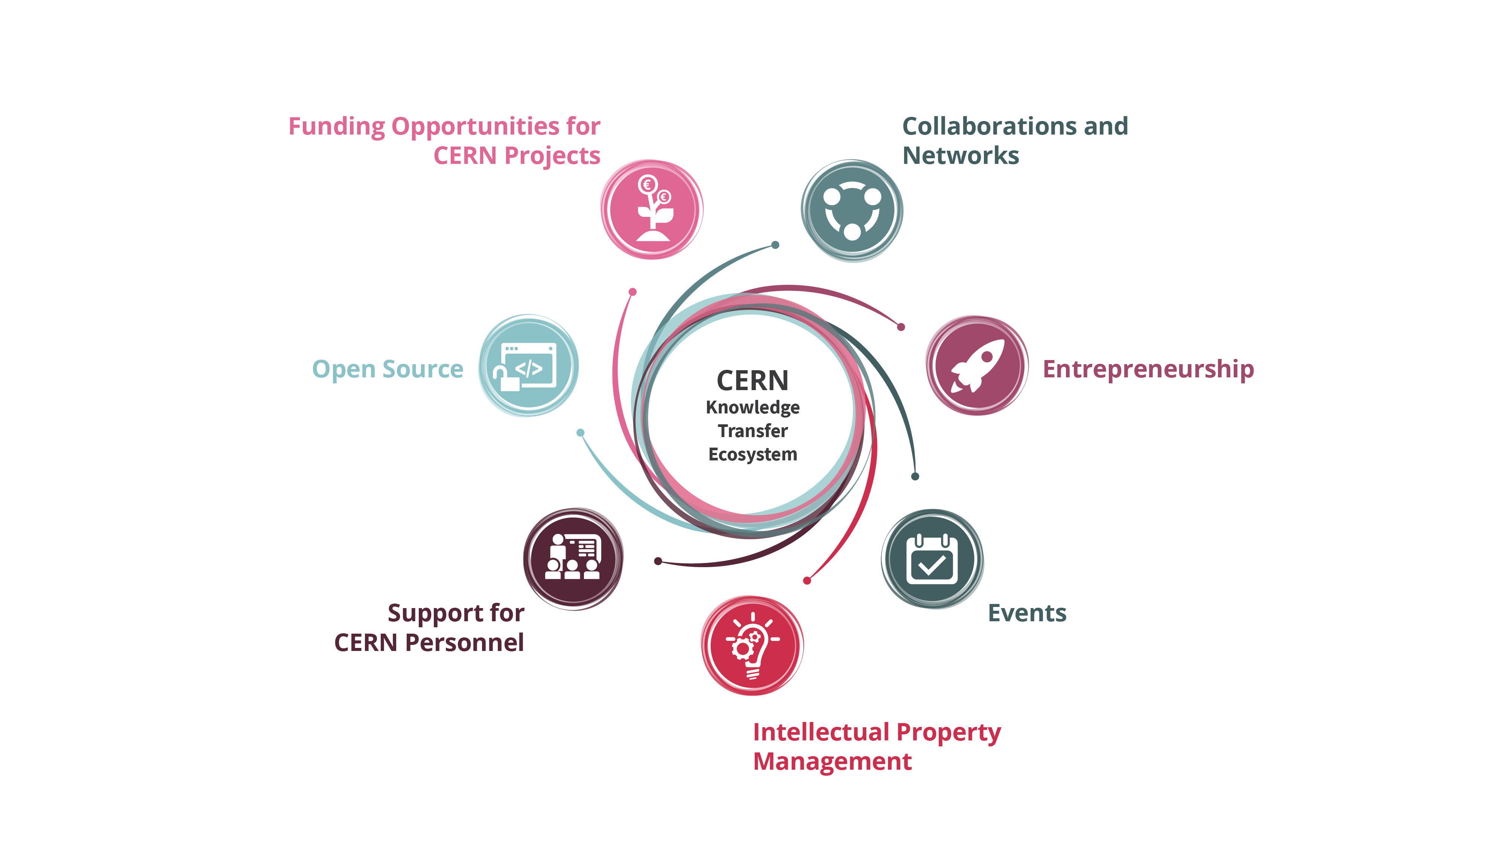
Our toolbox to accelerate innovation

Slide 5
Hybrid strategy: tech push & market pull
Scout for technologies
Search unmet needs
Mobilize tech experts
Mobilize innovation partners
Create tech and IP dossiers
Create value propositions

Slide 6
Shaping innovation partnerships
Discover
Discussion with Innovation / R&D management
Discovery day program at CERN
Shape
Define innovation ambitions and technical needs
Discuss expertise contributed by partners
Execute
Formalize partnership:
- Collaborative R&D
- License
- Consultancy
- Contract Research
Find mutual interest
Timeline, resources, IP

Slide 7

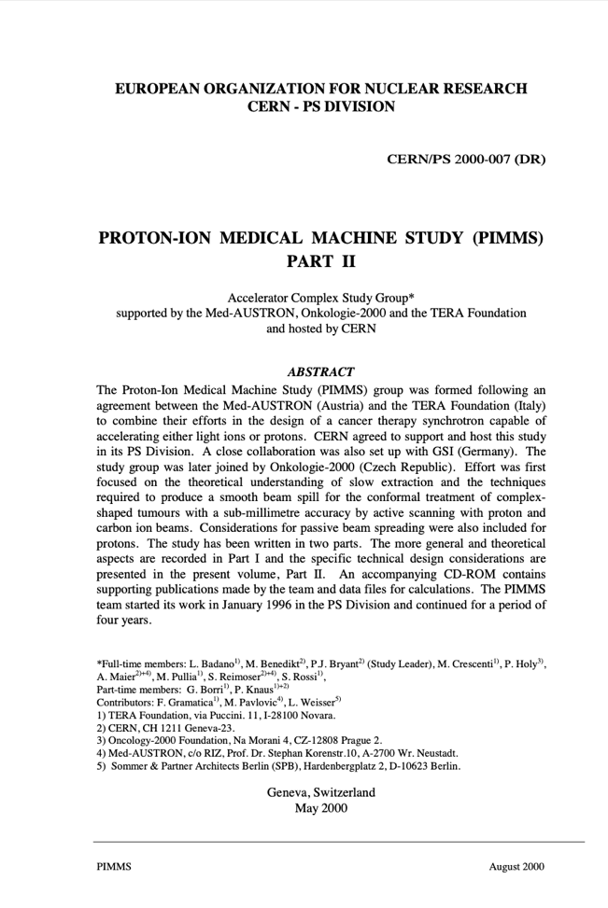
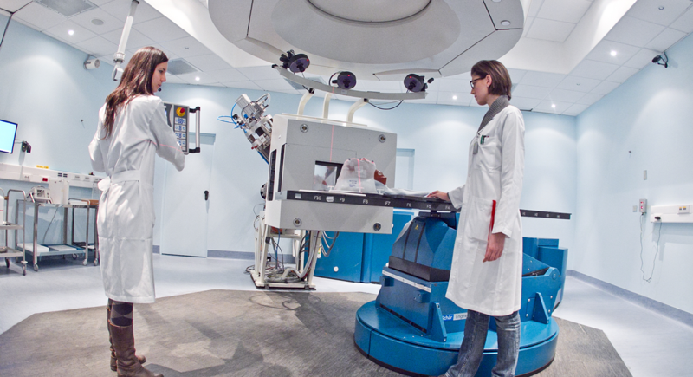

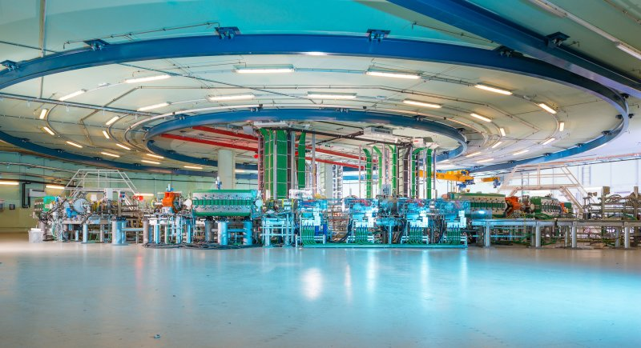

From the
PIMMS Study @

Slide 8
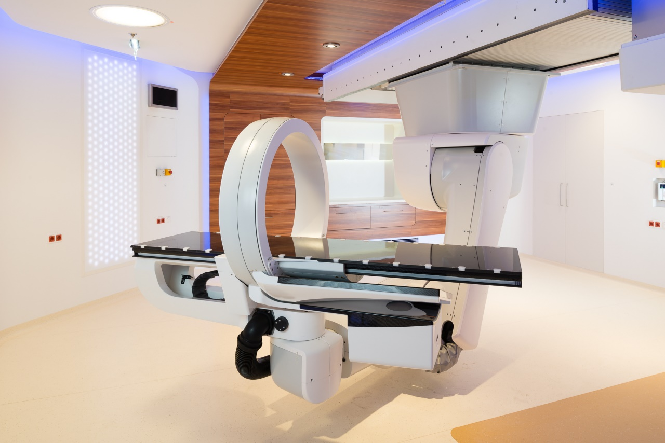
MedAustron and CNAO offer hadron therapy using CERN technology.
Collaborative R&D

Slide 9
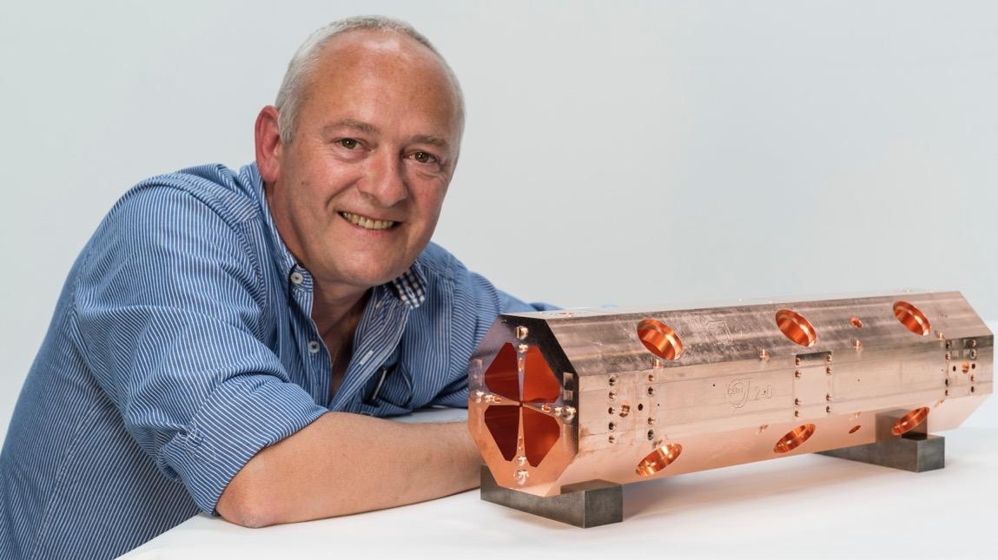
Make
hadron therapy machines smaller

Slide 10
Construction of a compact, transportable accelerator based on the HF-RFQ developed at CERN
In collaboration with INFN-CHNet (Cultural Heritage Network)
MACHINA
Movable Accelerator for Cultural Heritage In-situ Non-destructive Analysis
Photo: INFN

Slide 11
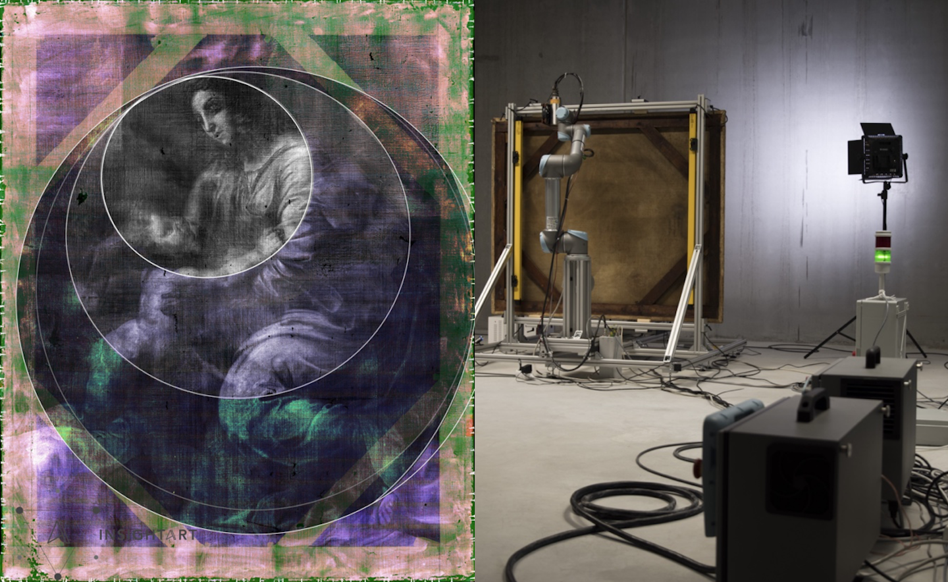
InsightArt
Start-up using Medipix
X-ray eyes for cultural heritage
Notes:
For a long time, it was thought that The Madonna and Child, a painting on canvas from a private collection, was not created directly by the master himself. Property of Popes and later part of Napoleon's war treasure, the painting changed hands several times before arriving in Prague during the 1930’s. Due to its history and numerous inconclusive examinations, its authenticity was questioned for a long time. It has now been attributed to Raphael by a group of independent experts. One of the technologies that provided them with key information, was a robotic x-ray scanner using CERN-designed chips.

Slide 12

Bundesdruckerei (Berlin) works with CERN on next generation ideas for identity management and cryptography and data handling.
Consultancy

Slide 13
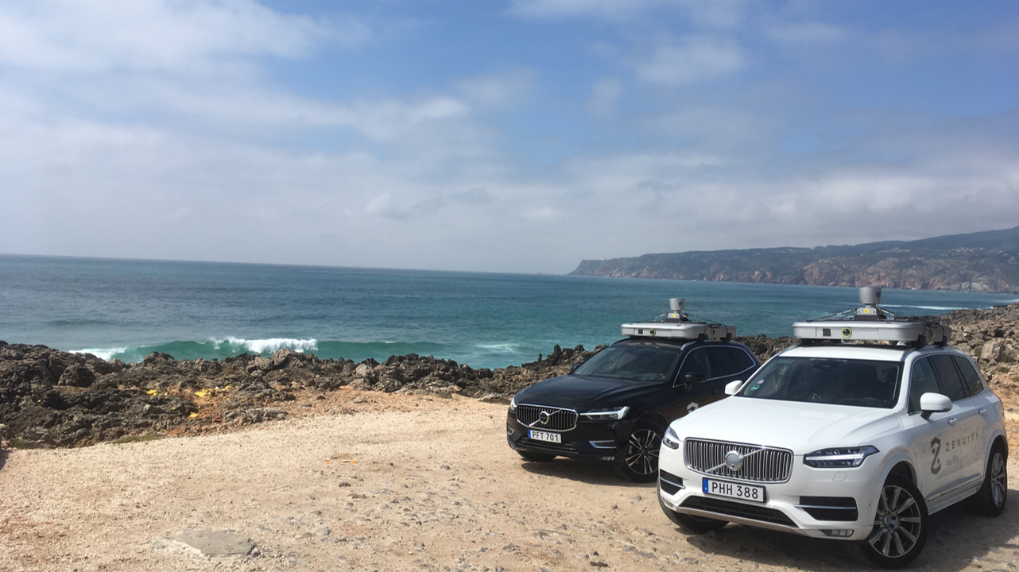
ZENSEACT (Volvo Cars Company) teams up with CERN on extremely fast machine learning using FPGAs.
Collaborative R&D

Slide 14
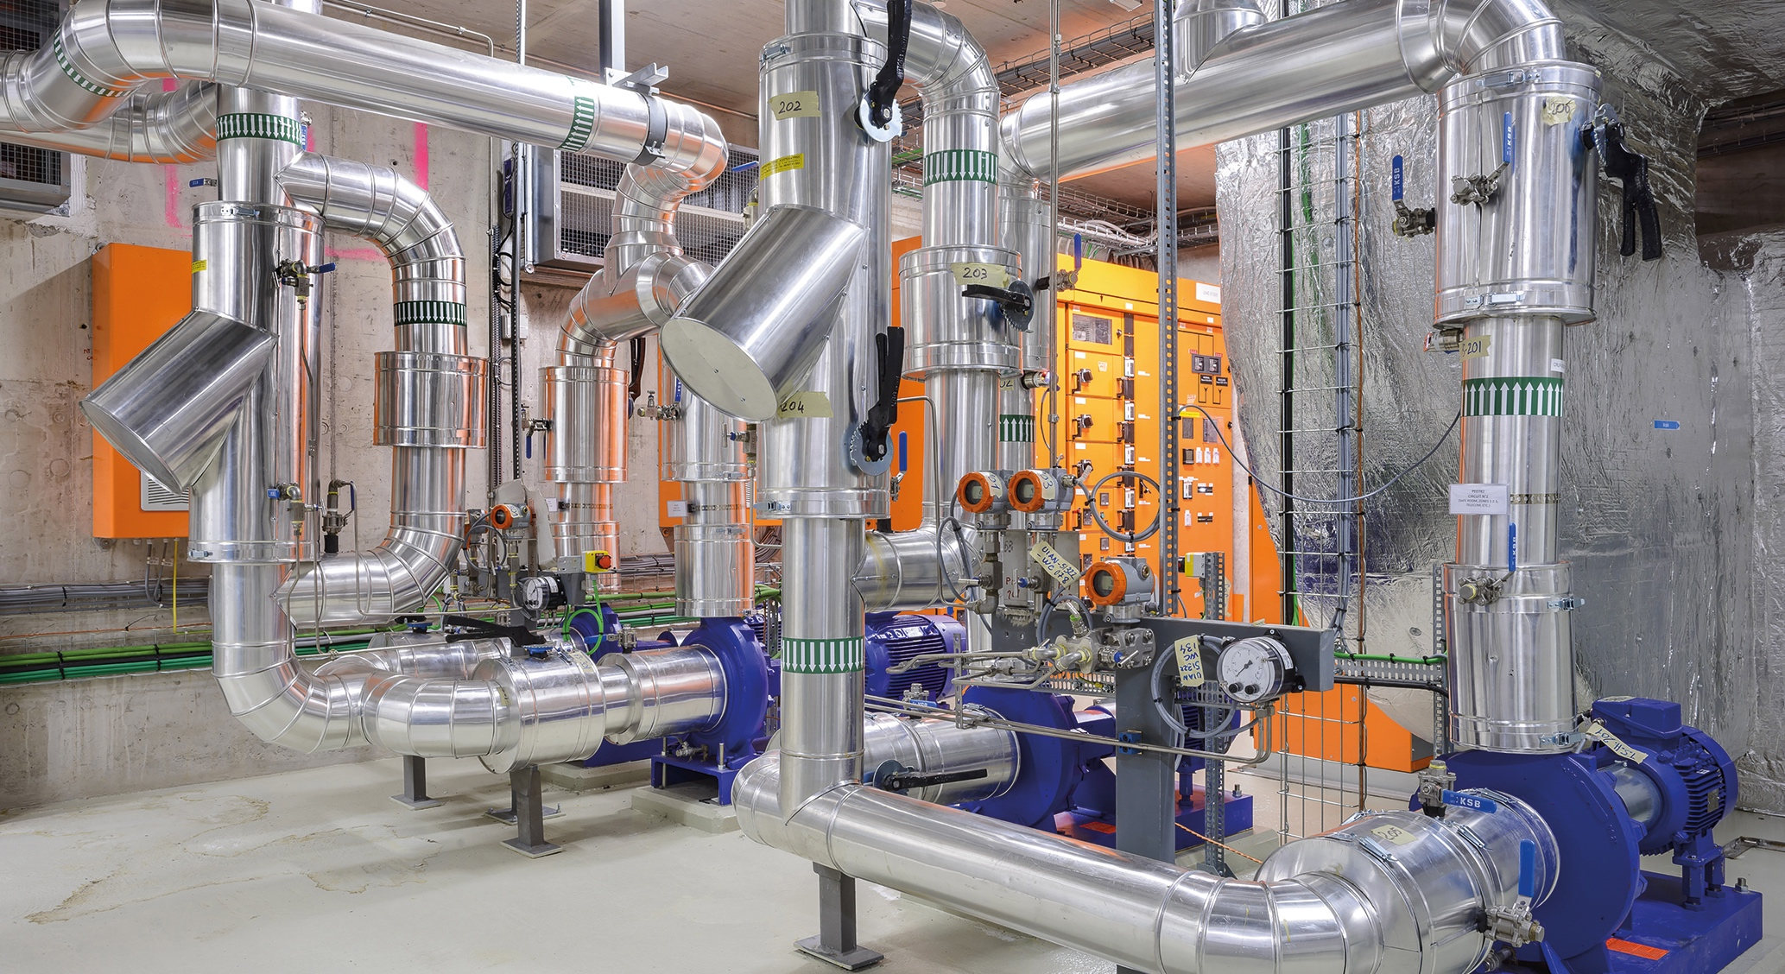
ZENSEACT (Volvo Cars Company) teams up with CERN on fast machine learning using FPGAs.
Collaborative R&D
Collaborative R&D
CERN and ABB team up on reducing electricity in cooling and ventilation.

Slide 15

Collaborative R&D
Collaboration with CORMEC and WUR to support national banks and regulators to detect trading anomalies in stock market.

Slide 16
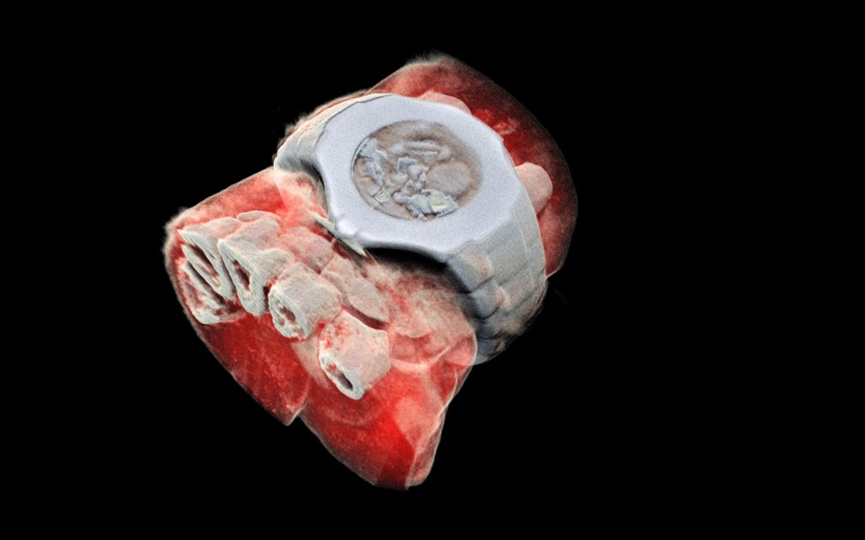
License
MARS Bio Imaging: next generation X ray finally in color using CERN chips

Slide 17
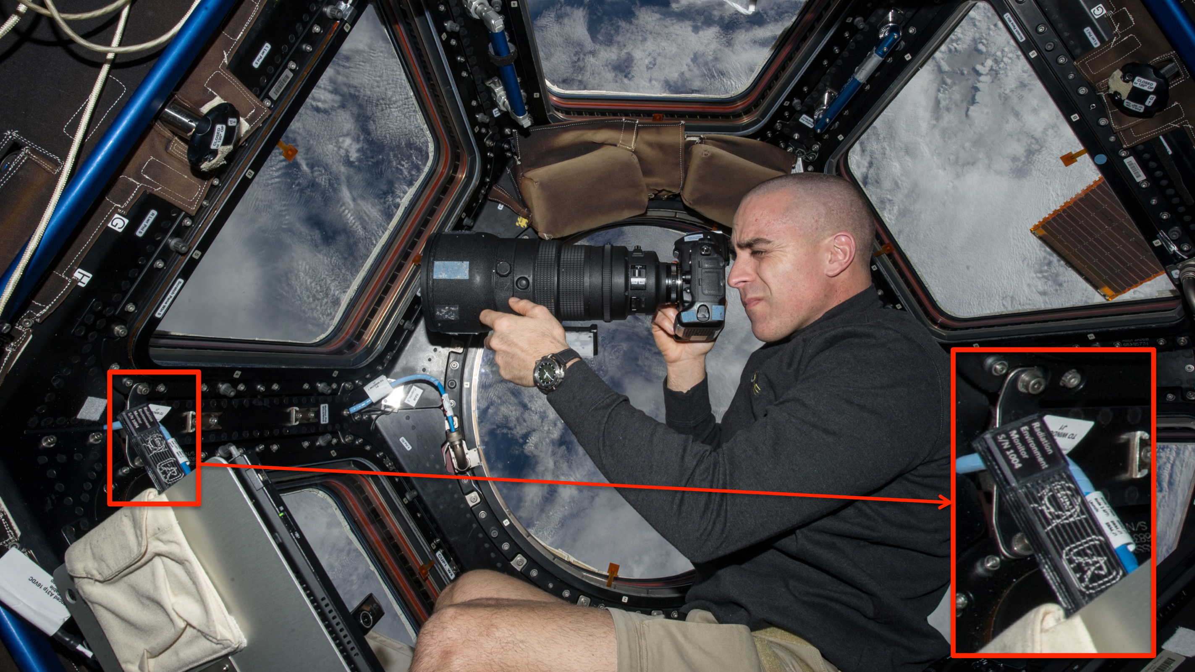
Timepix on the ISS
Courtesy of NASA, photo ref. no. iss036e006175

Slide 18
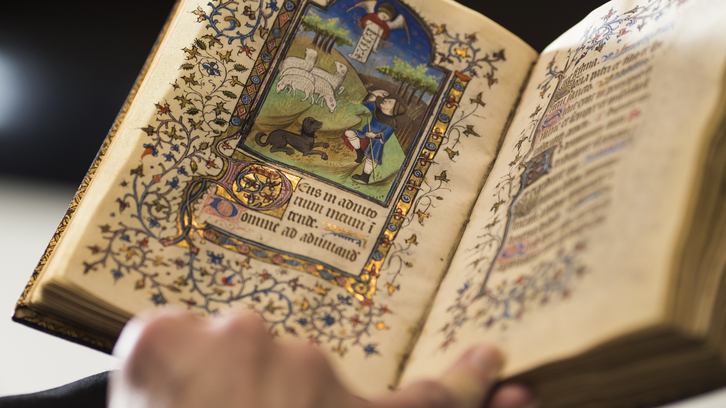
TIND: a CERN spin-off providing solutions for library management and data preservation based on the CERN open source software Invenio
Digital Preservation
Photo: Renee Jones Schneider, Star Tribune

Slide 19
Molte grazie per l’attenzione

