Slide 1

Alberto Mengoni
spokesperson of the n_TOF Collaboration
Visit of ENEA delegation, 13-14 February 2024

Slide 2

n_TOF @ CERN

Slide 3
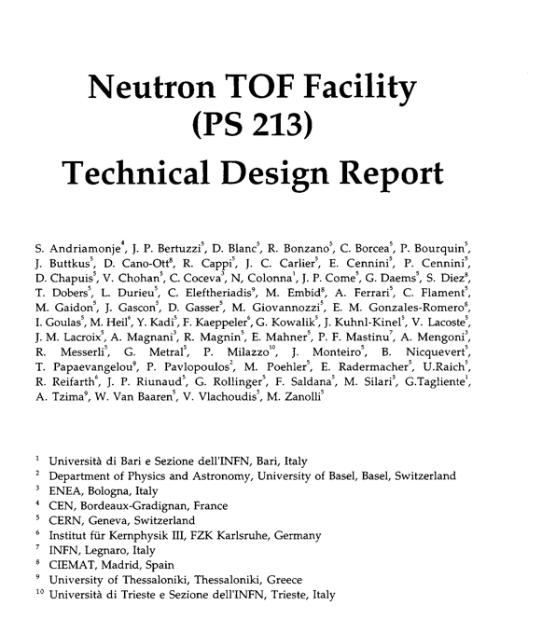

n_TOF @ CERN

Slide 4
n_TOF @ CERN
Based on an idea by Carlo Rubbia, n_TOF is a pulsed spallation neutron source, driven by the CERN PS, coupled to two flight paths (at 20 and at 186 meters) designed to study neutron-nucleus interactions for neutron kinetic energies ranging from a few milli-eV to several GeV. The neutron kinetic energy is determined by time-of-flight, hence the name n_TOF
The study of neutron-induced reactions is of paramount importance in a variety of research fields, ranging from big bang to stellar nucleosynthesis, symmetry breaking effects in compound nuclei, investigation of nuclear level densities, to applications to advanced nuclear technology, including the transmutation of nuclear waste, accelerator driven systems and nuclear fuel cycle investigations.

Slide 5
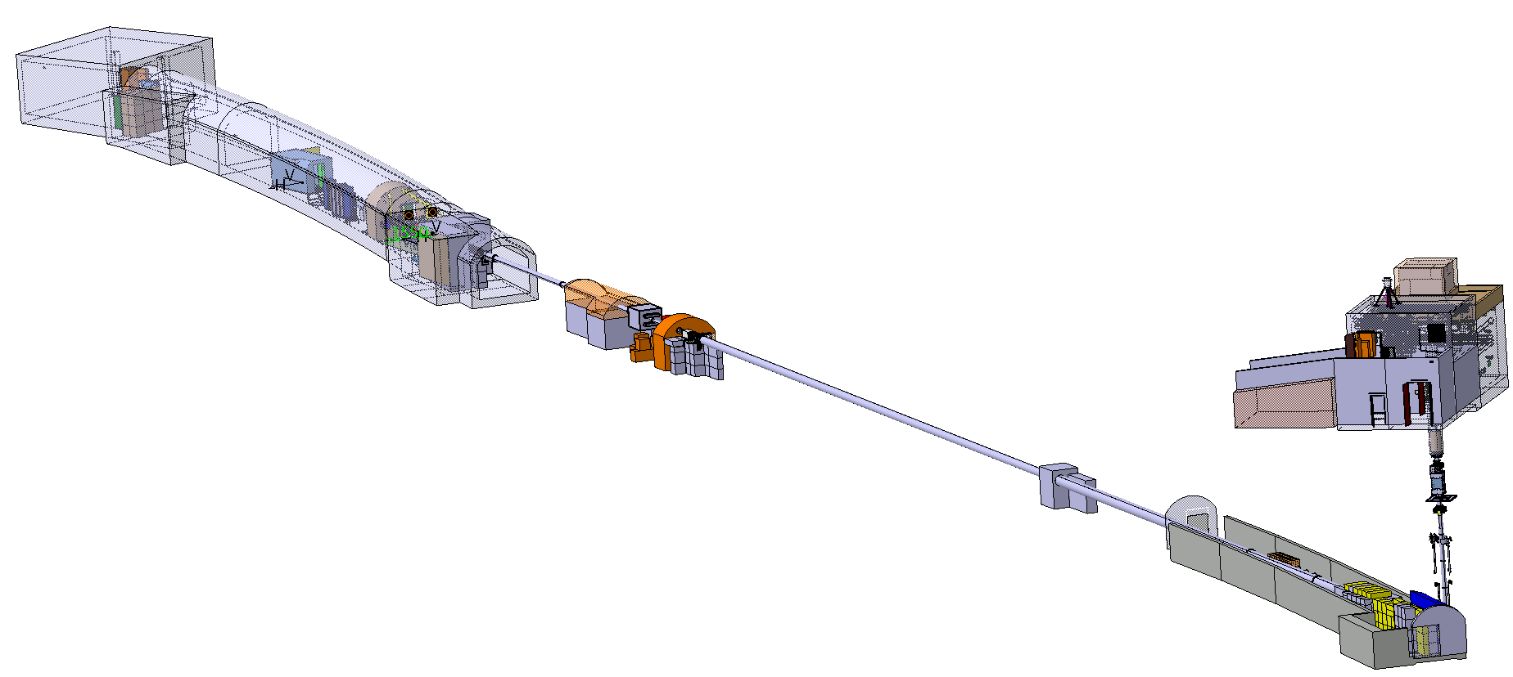
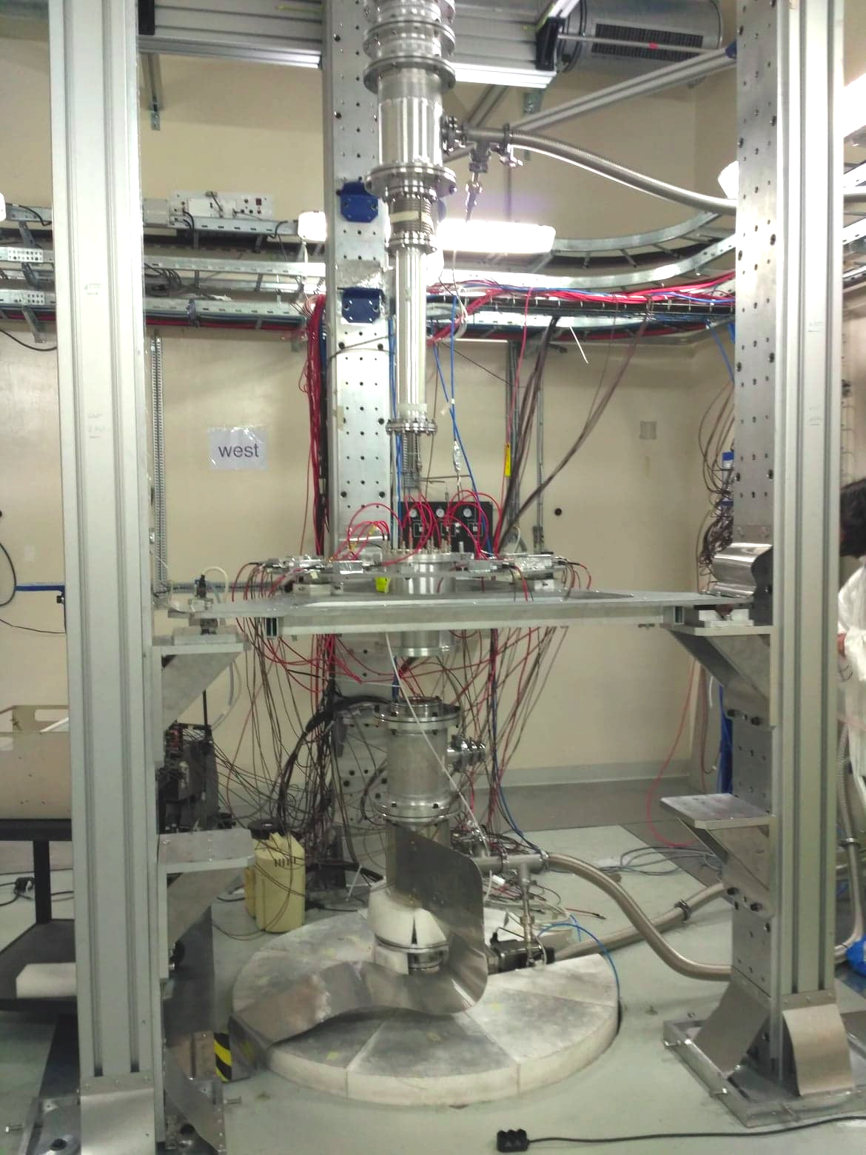
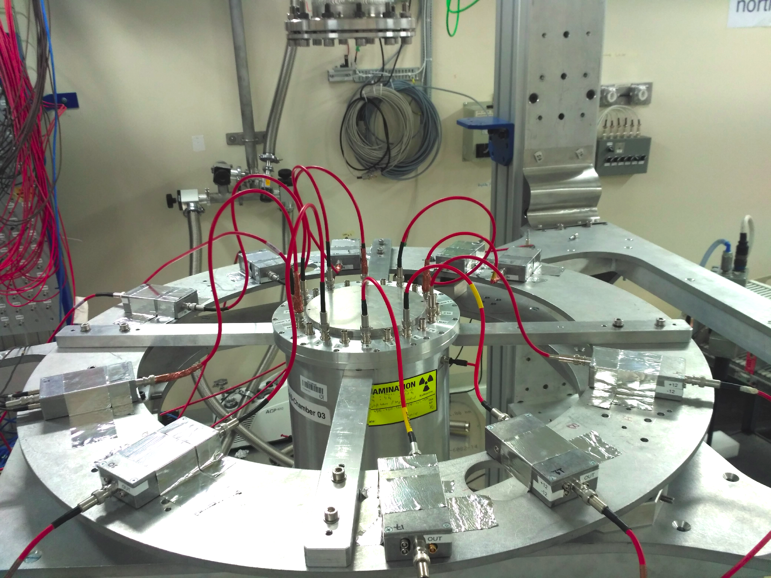
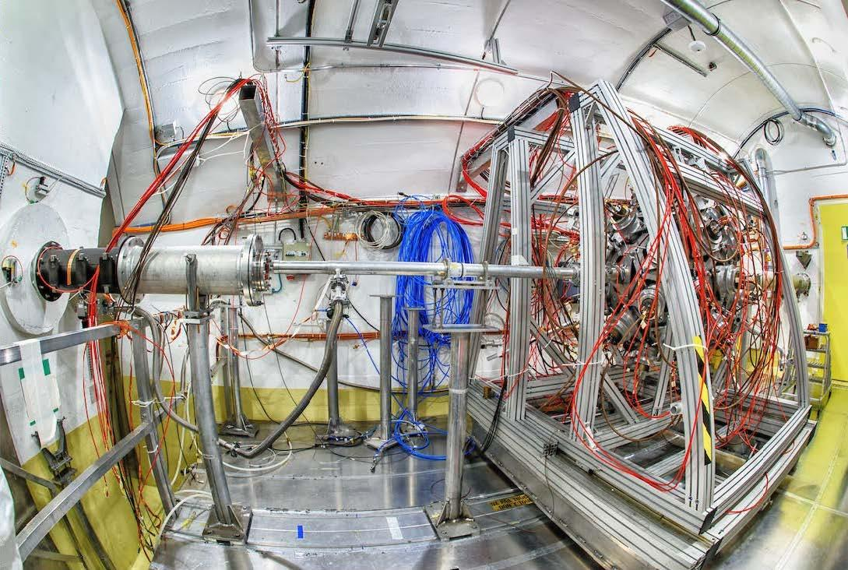
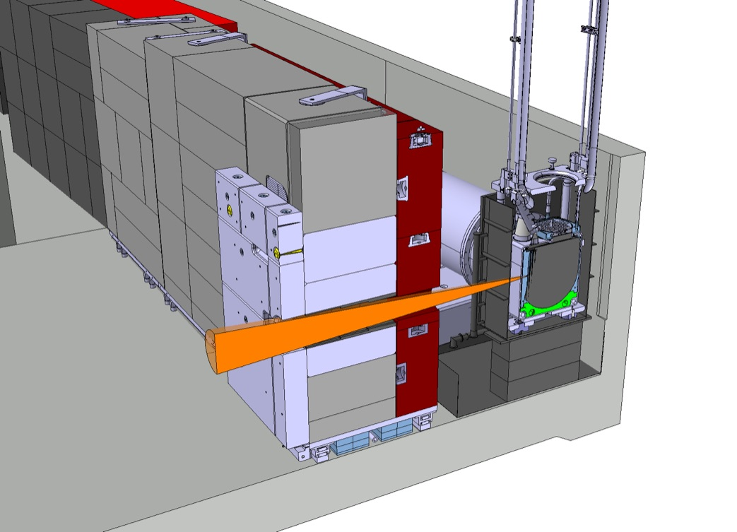
The n_TOF facility
EAR2
@186 m
@20 m
EAR1
NEAR
20 GeV/c proton beam from the PS

Slide 6
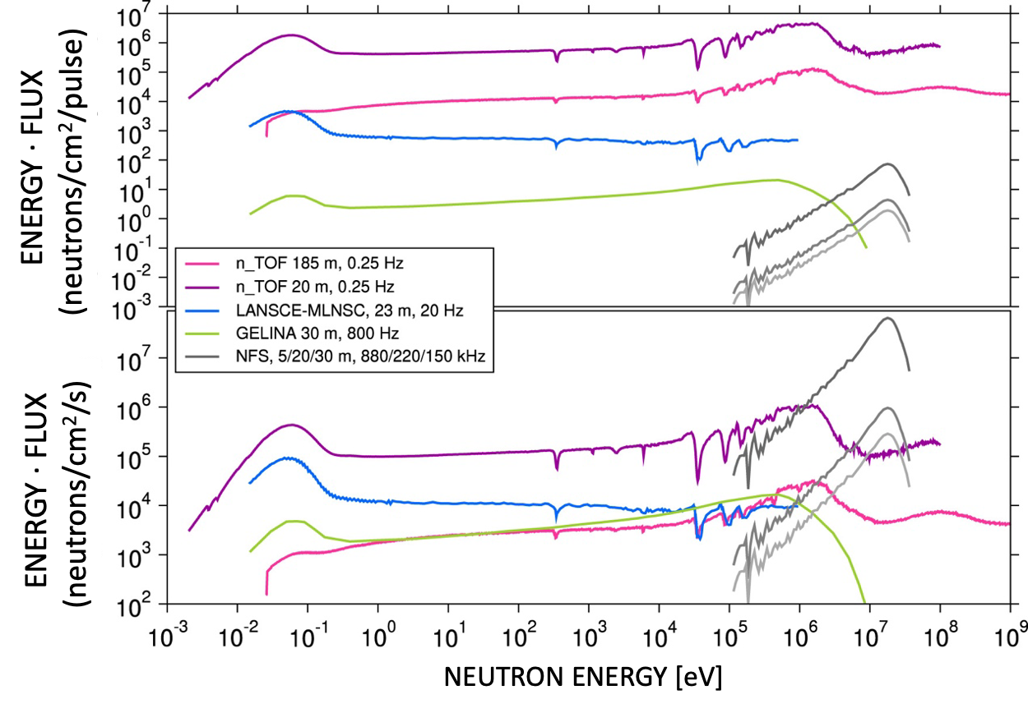
Uniqueness of n_TOF
Neutron Physics with particle accelerators
N. Colonna, F. Gunsing, and F. Käppeler
Progress in Particle and Nuclear Physics, 101, 177 (2018)
instantaneous intensity and energy distribution
repetition rate of the proton driver
time/neutron-energy resolution (long flight-path)
background conditions
energy range covered by other
spallation sources (ESS, SNS and others)
completely different science cases covered
(no nuclear physics at ESS, SNS and others)

Slide 7
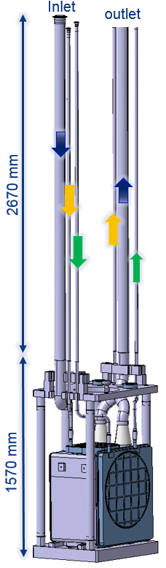
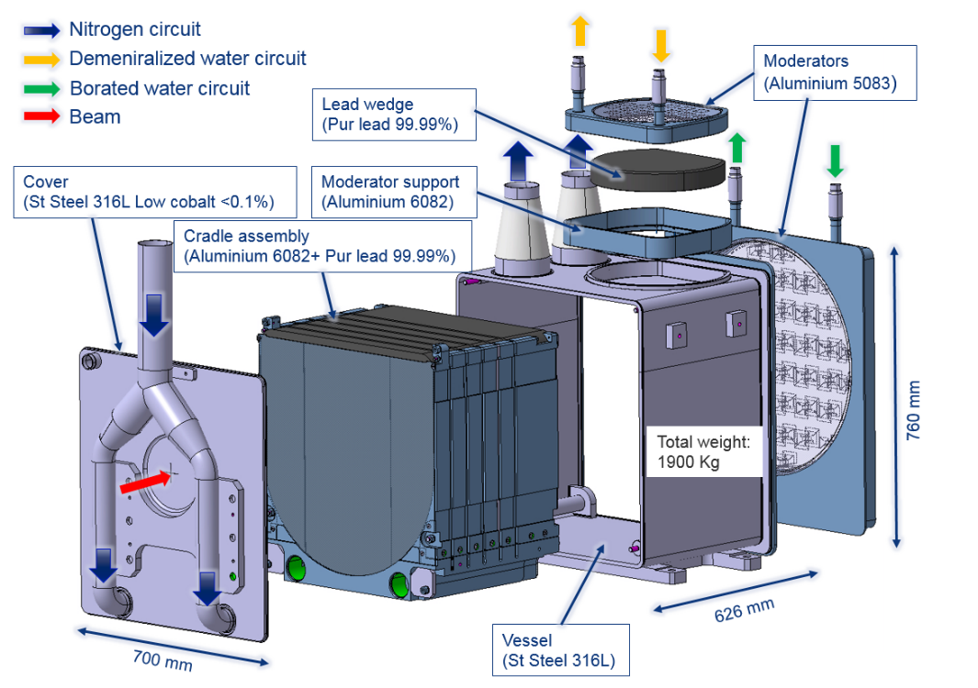


Uniqueness of n_TOF: 3rd generation target
Design of the third-generation lead-based neutron spallation target
for the neutron time-of-flight facility at CERN
R. Esposito, M. Calviani, O. Aberle et al. (2021)
Phys. Rev. Accel. Beams 24, 093001 – 7 September 2021
commissioning started on 19 July 2021
all systems working properly
results on neutron flux, resolution and
background conditions in full agreement
with expectations
courtesy of Oliver Aberle, CERN

Slide 8
Advanced nuclear technologies

Slide 9
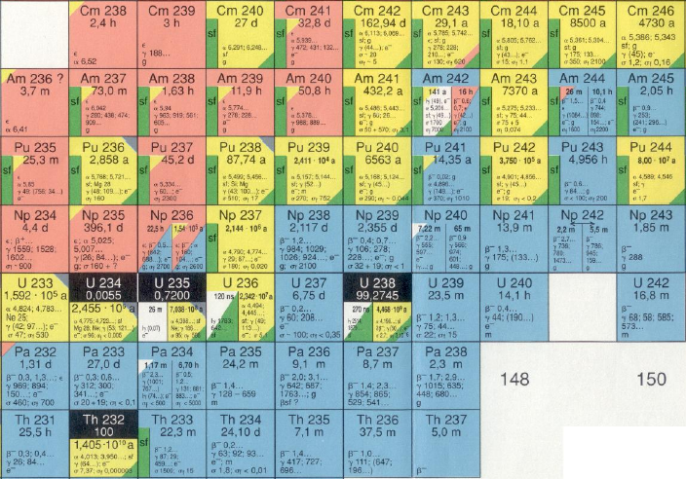
Nuclear waste: TRU 1000 MWe LWR
²⁴⁴Cm
1.5 Kg/yr
²⁴¹Am:11.6 Kg/yr
²⁴³Am: 4.8 Kg/yr
²³⁹Pu: 125 Kg/yr
²³⁷Np: 16 Kg/yr
LLFP
76.2 Kg/yr
LLFP
source: Actinide and Fission Product Partitioning and Transmutation – NEA (1999)

Slide 10
Fast neutrons
source: C Rubbia (2001)

Slide 11
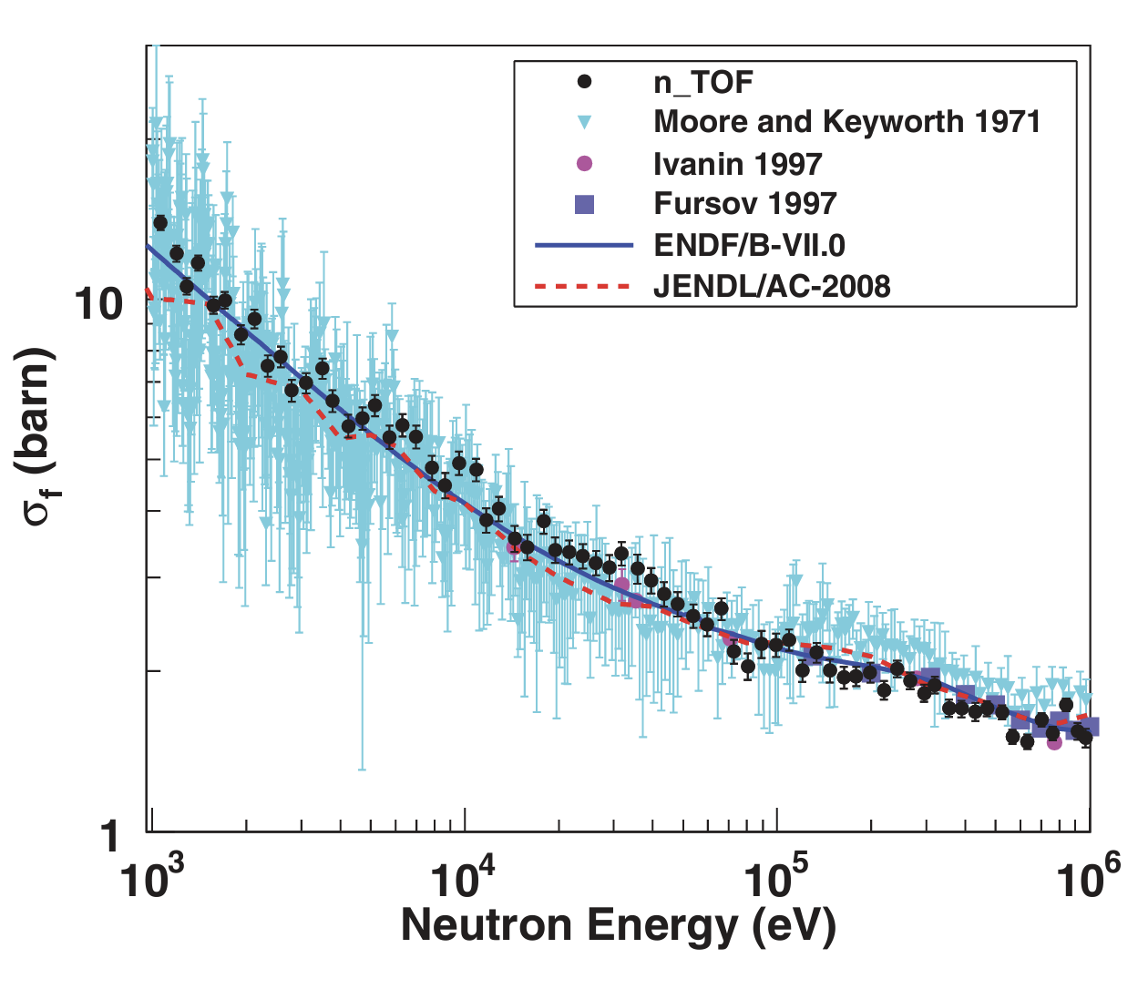
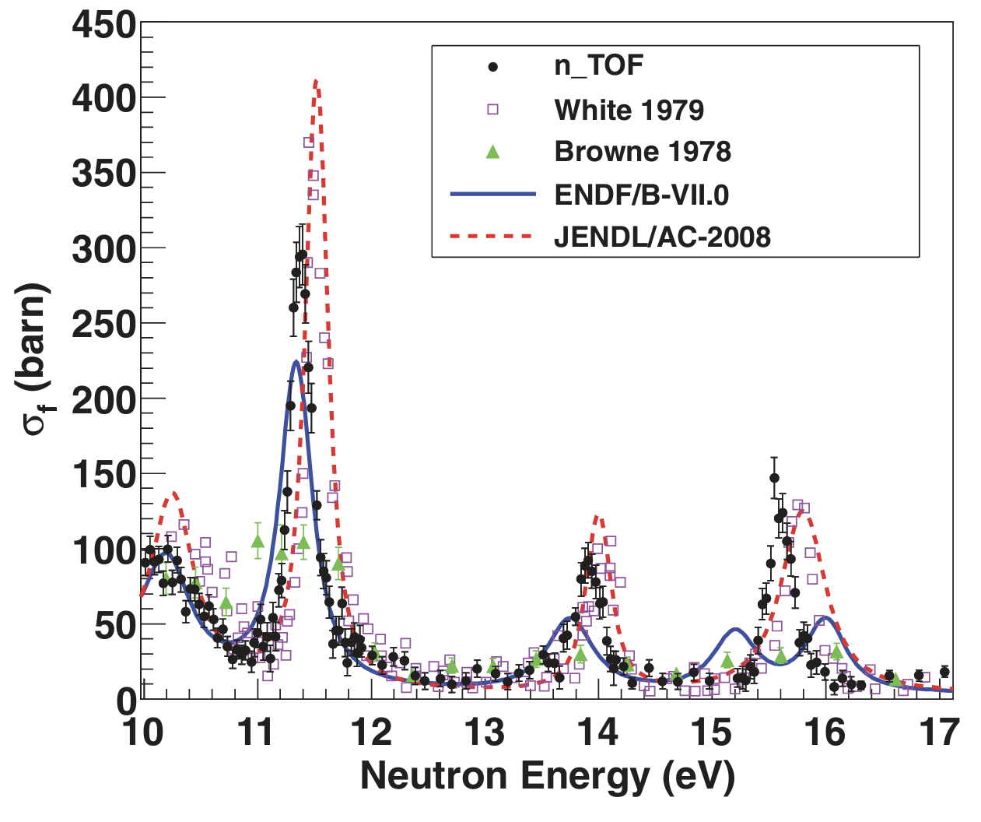

²⁴⁵Cm(n,f)
Previously available data obtained only
with low-resolution experiments…
… or with nuclear explosions!

Slide 12
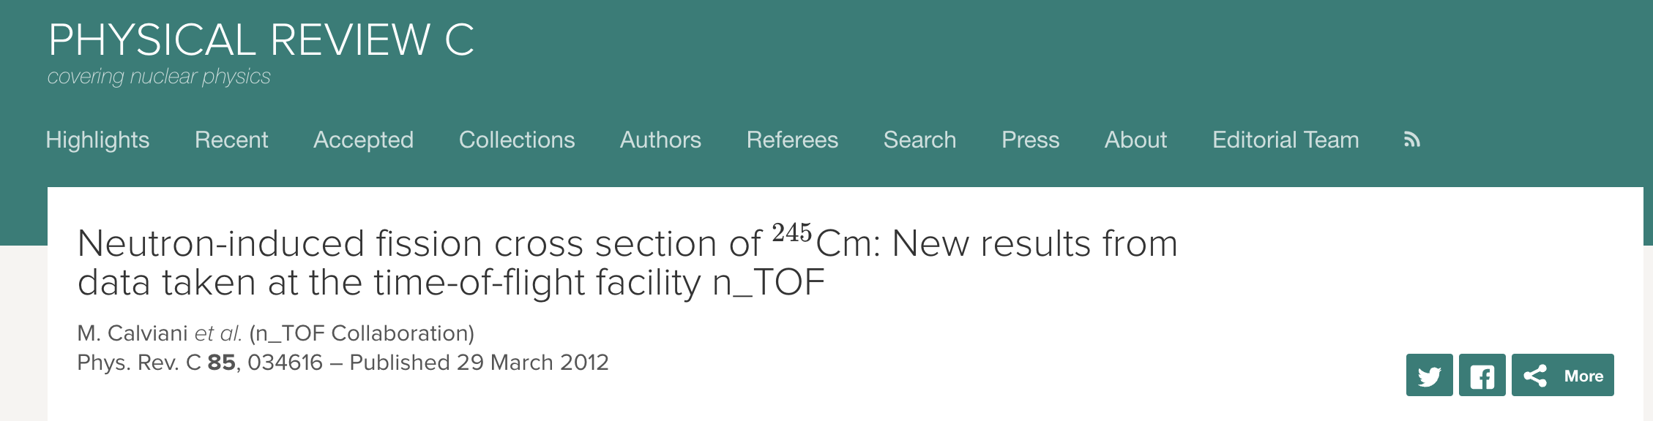
²⁴⁵Cm(n,f)
Previously available data obtained only
with low-resolution experiments…
… or with nuclear explosions!

Slide 13
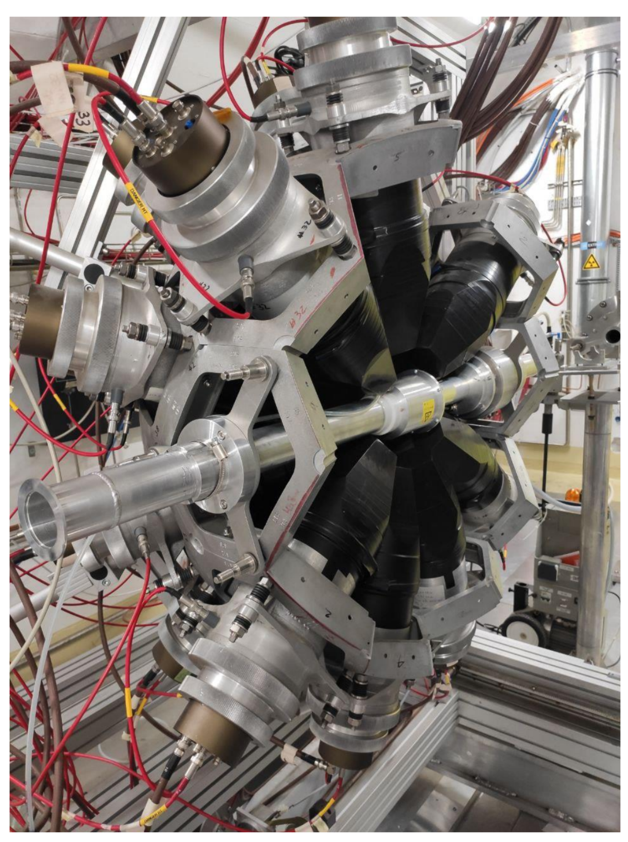
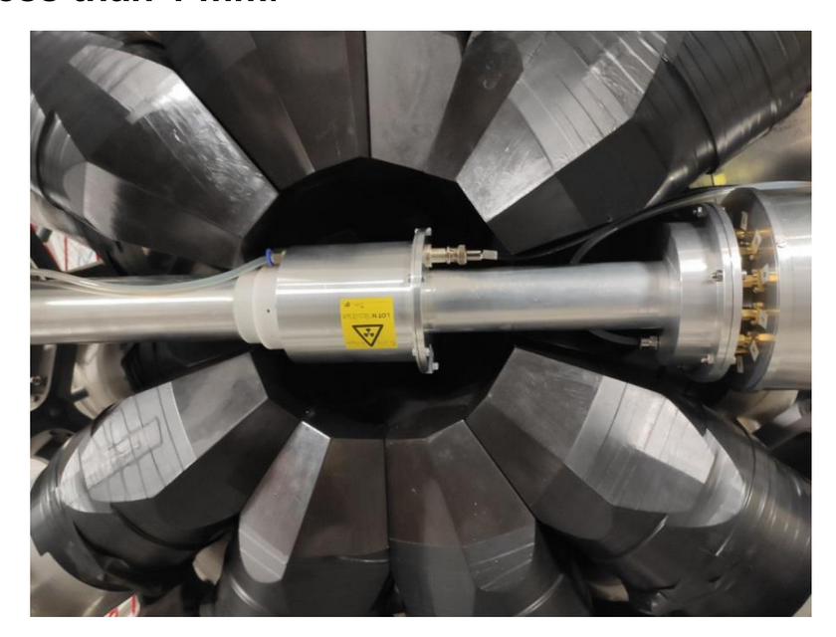
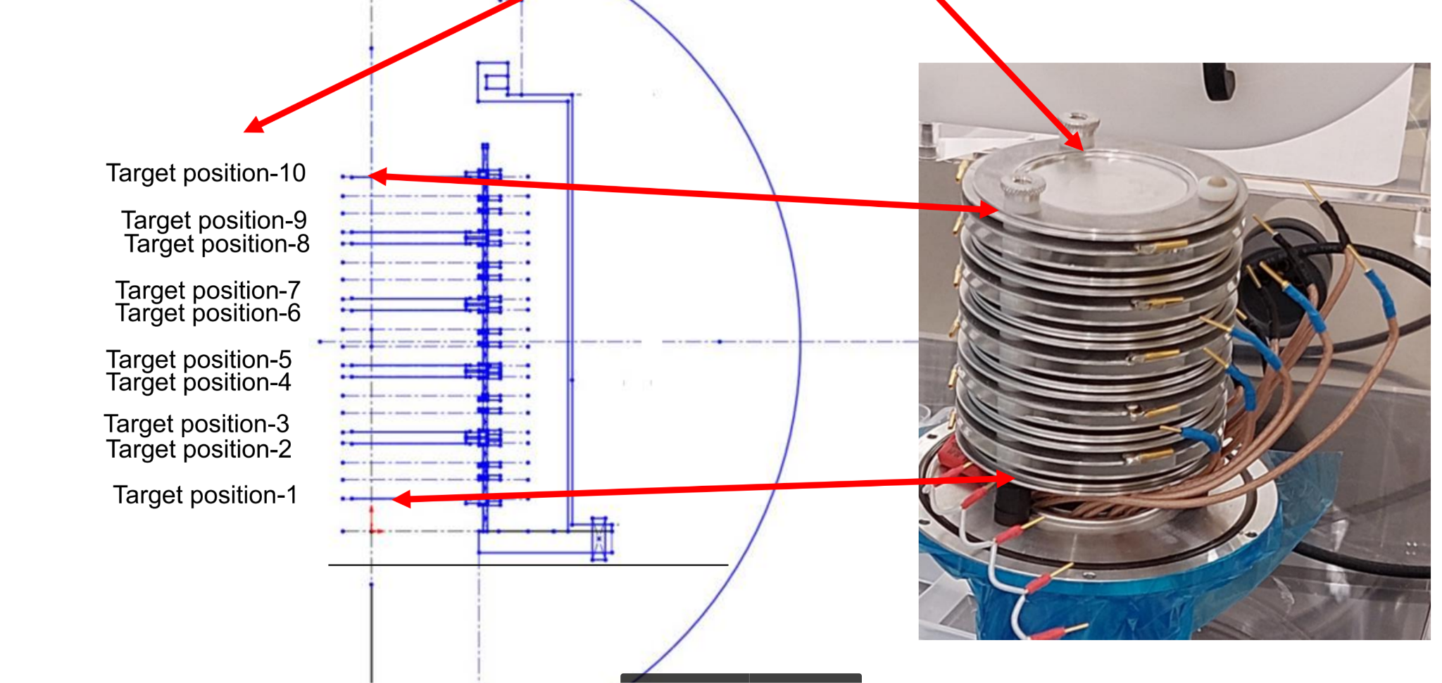


²³⁹Pu(n,𝛾) with fission tagging
fission events recorded with ~92% efficiency in the fission chamber
Recording singles, coincidence and anticoincidence events between TAC and fission chamber we can determine the α-ratio = (n,γ) and (n,f) cross section ratio
challenging measurement: ~2MBq/mg, data flow: 1TB/h
Two targets 330 MBq and 33 MBq

Slide 14
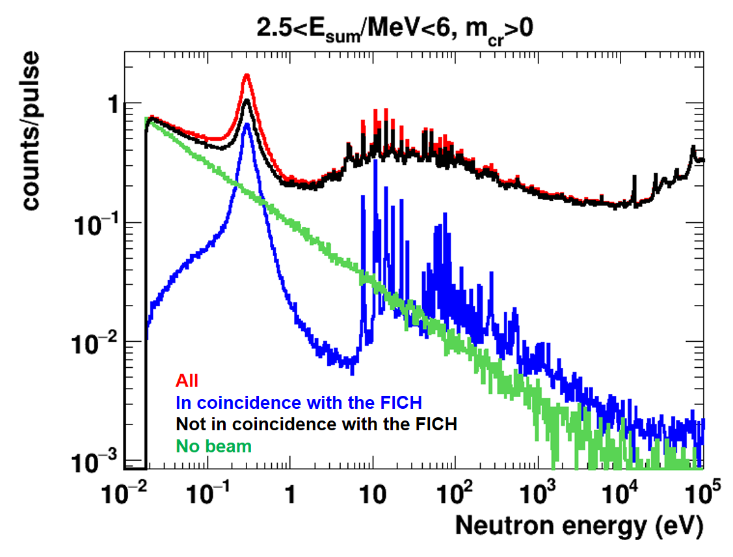
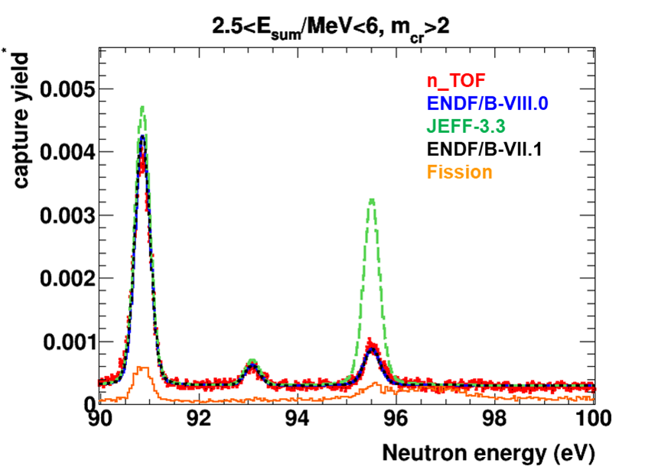
²³⁹Pu(n,𝛾) with fission tagging

Slide 15
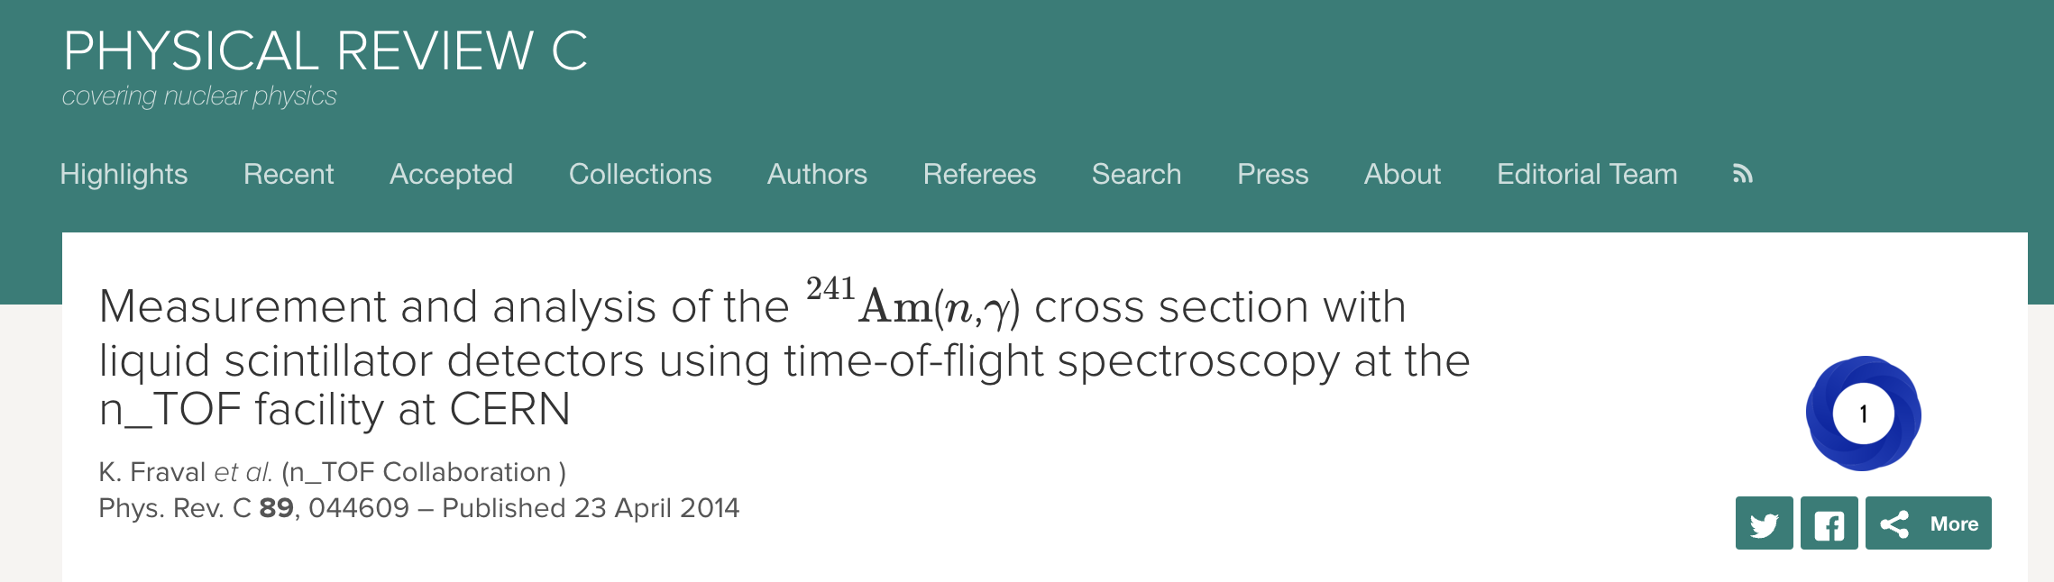
²³⁹Pu(n,𝛾) with fission tagging
Measurement performed in the 2022 run. Analysis underway and paper(s) in preparation

Slide 16
Th/U fuel cycle
www.cern.ch/n_TOF

Slide 17
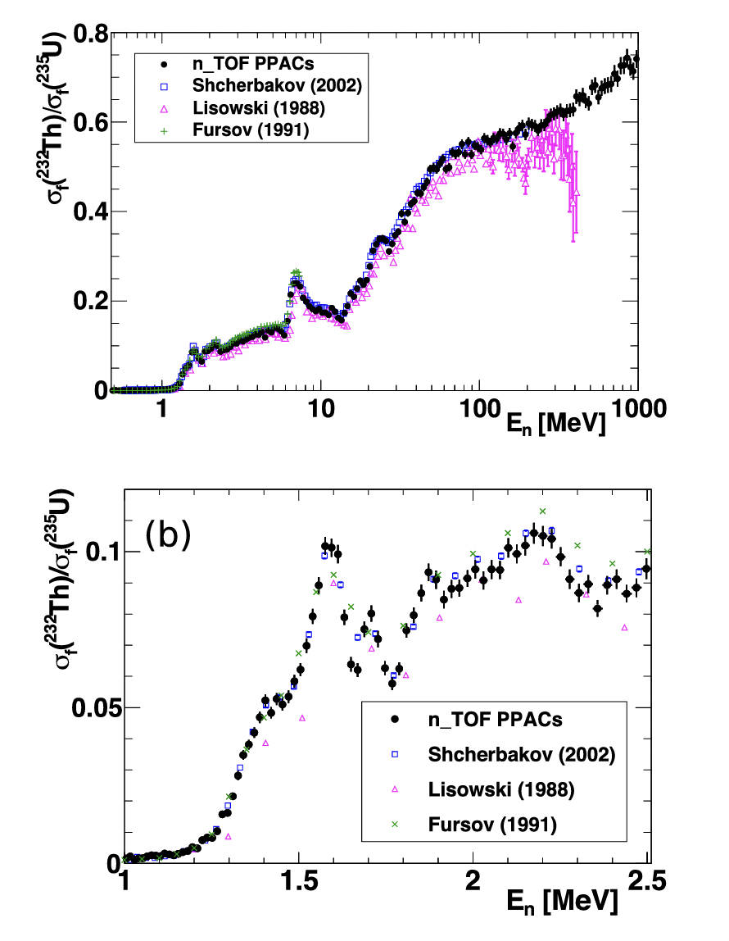
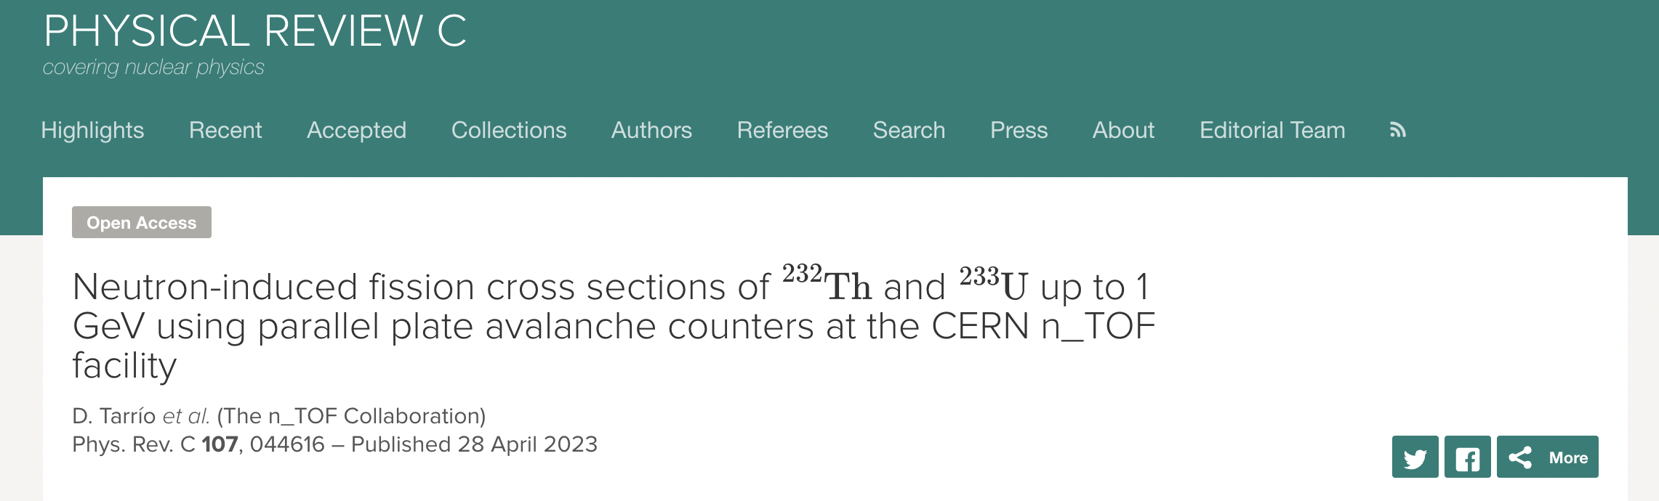
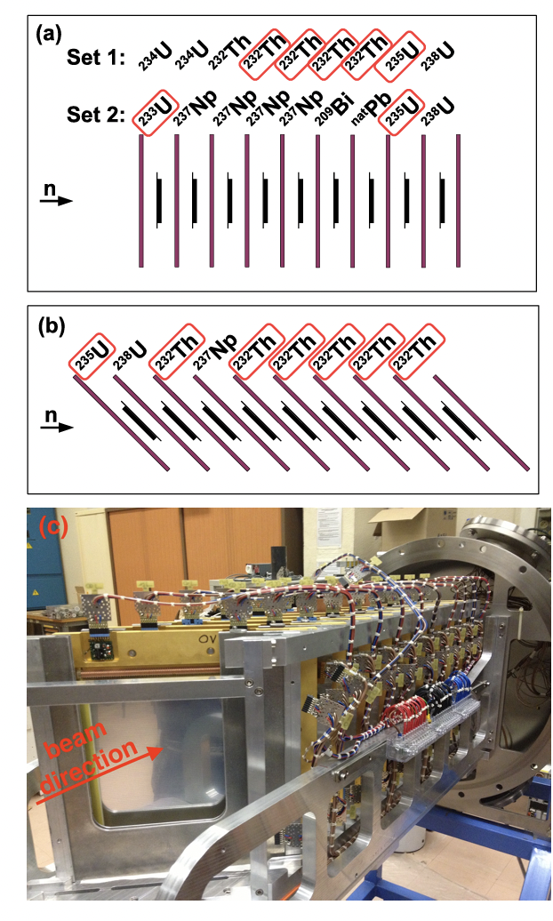
Th/U fuel cycle: ²³²Th(n,f)

Slide 18
Done at n_TOF
Radiative capture reactions (n,γ) (89)
Fission reactions (n,f) (37)
EAR2
Light particle emission reactions (n,lcp) (11)
EAR2
²³⁹Pu
Detector developments (7)
EAR2
Imaging
STEFF
²³⁵U
EAR2
²⁴¹Am
²⁴⁶Cm
²⁴⁴Cm
STEFF
²³⁵U
C6D6
²³⁰Th
²⁴¹Am
NEAR
²³⁴U
²³⁶U
²³²Th
²³⁷Np
STEFF
MGAS
EAR1
⁷⁶Ge
⁹⁴Zr
¹⁴⁰Ce
¹⁹⁷Au
⁸⁹Y
FIC0
³³S
²³⁷Np
³⁵Cl
¹⁴N
DDX
Hpge
Trans
MGAS
MGAS
Si + MGAS
EAR1
HPGe
²⁴⁵Cm
²³³U
²⁴¹Am
²⁴³Am
FIC0
²³⁶U
¹⁶O
²⁴³Am
Si
⁷Be
²⁶Al
⁷Be
DFGIC
MGAS
FIC1
³³S
Si
EAR1
EAR2
²³⁵U
²³⁸U
MGAS
¹⁴⁷Pm
¹⁷¹Tm
²³⁵U
¹²C
²³⁴U
FIC2
²⁴⁰Pu
²⁴²Pu
C6D6
EAR1
RPT
Si
⁷⁹Se
DFGC
TARAT
X17
FIC0
¹⁸⁶Os
¹⁸⁷Os
¹⁸⁸Os
⁹⁰Zr
⁹¹Zr
⁹²Zr
⁹⁴Zr
⁹⁶Zr
²⁴Mg
²⁶Mg
²⁰⁸Pb
¹³⁹La
MGAS
²³⁵U
iTED
²³⁷Np
²³³U
²³⁴U
²⁰⁹Bi
^{nat}Pb
²³²Th
⁵⁹Ni
Si
²³⁵U
²⁴⁴Cm
RPT
²³²Th
²³⁴U
CVD
²³⁸U
EAR1
TAC
²³⁹Pu
²⁴³Am
PPAC
PPAC
TAC
EAR2
²³⁷Np
²³⁷Np
²³⁰Th
TAC
MGAS
⁸⁷Sr
²³²Th
PPAC
PPAC
¹⁵⁴Gd
⁷⁷Se
⁷⁸Se
⁶⁹Ga
⁷¹Ga
⁸⁹Yr
⁸⁸Sr
MGAS
¹⁵¹Sm
²⁰⁴Pb
²⁰⁶Pb
²⁰⁷Pb
²⁰⁹Bi
²³²Th
TAC
¹²C
MGAS
⁷⁹Se
⁹⁴Mo
⁹⁵Mo
⁹⁶Mo
¹⁶⁰Gd
⁵⁰Cr
⁵³Cr
⁷⁹Se
⁹⁴Nb
C6D6
²³⁵U
¹⁴⁷Pm
²⁴²Pu
²⁰⁴Tl
⁷⁶Ge
⁷⁴Ge
⁷⁰Ge
TAC
²³³U
²⁰⁵Tl
³⁵Cl
¹⁴⁰Ce
⁸⁰Se
⁶⁸Zn
sTED
²⁴⁰Pu
²³⁷Np
²⁴³Am
²³³U
TAC
²³⁶U
⁶³Ni
⁶²Ni
⁵⁸Ni
⁵⁷Fe
²³⁸U
²⁵Mg
⁹²Zr
⁹³Zr
C6D6
C6D6
C6D6
EAR1
C6D6
⁷⁹Se
⁹⁴Nb
¹⁶⁰Gd
C6D6
C6D6
¹⁵⁷Gd
¹⁵⁵Gd
⁷²Ge
C6D6
TAC
⁶²Ni
⁵⁶Fe
⁵⁶Fe
²⁴¹Am
¹⁷¹Tm
⁷³Ge
C6D6
C6D6
C6D6
C6D6
C6D6
2001 - 2004
2009 - 2012
2014
2015
2016
2017
2018
2021-2023
Phase 1
Phase 2
Phase 3
Phase 4

Slide 19
Publications and experimental data dissemination
overall 250+ papers published
135 in peer-reviewed journals, 52 in Phys. Rev. C, 32 in NIMA
over 90% in Open Access in the last 5 years
121 data sets included in the Experimental Nuclear Reaction
Database (EXFOR @ IAEA), 92% of all measurements performed
https://twiki.cern.ch/NTOFPublic/ListOfPublications

Slide 20
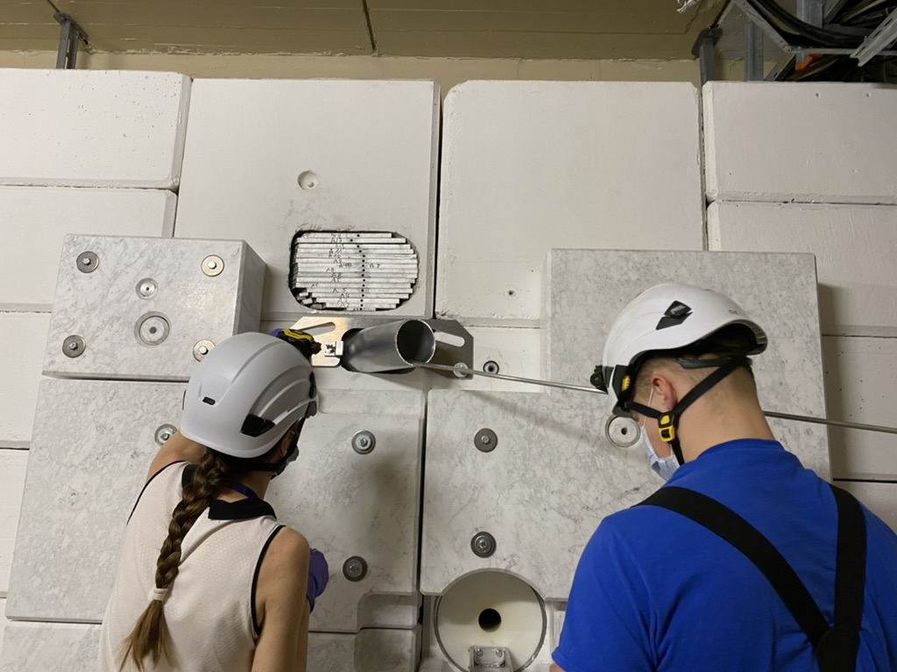
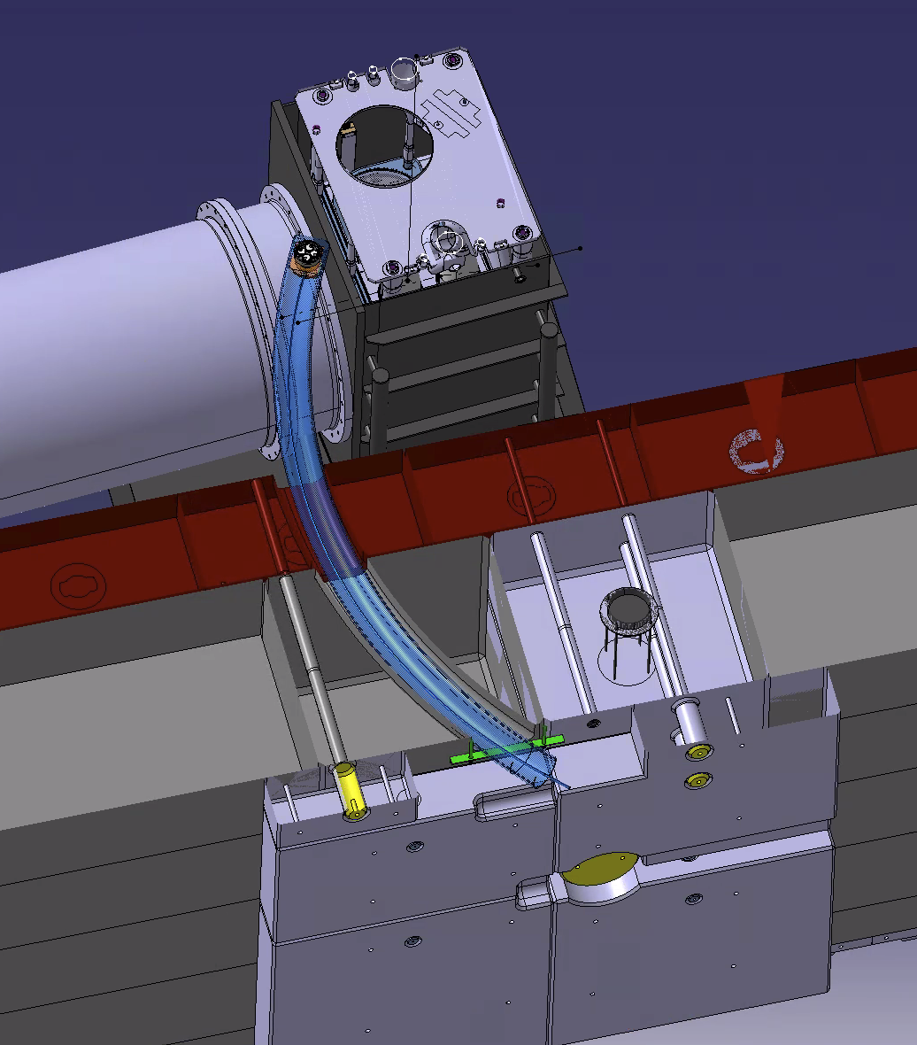
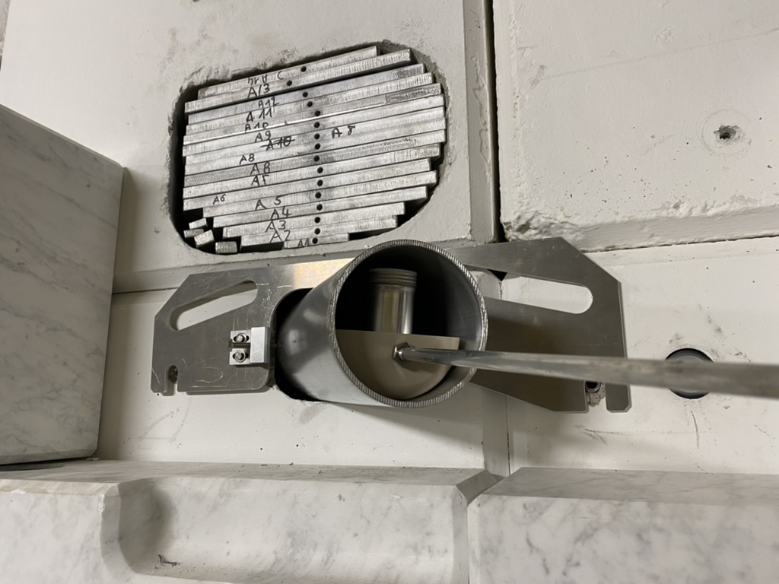
R2M activities
Irradiation shelf on target pool
24 sample positions
New in 2022
UNIQUE IRRADIATION CONDITIONS

Slide 21
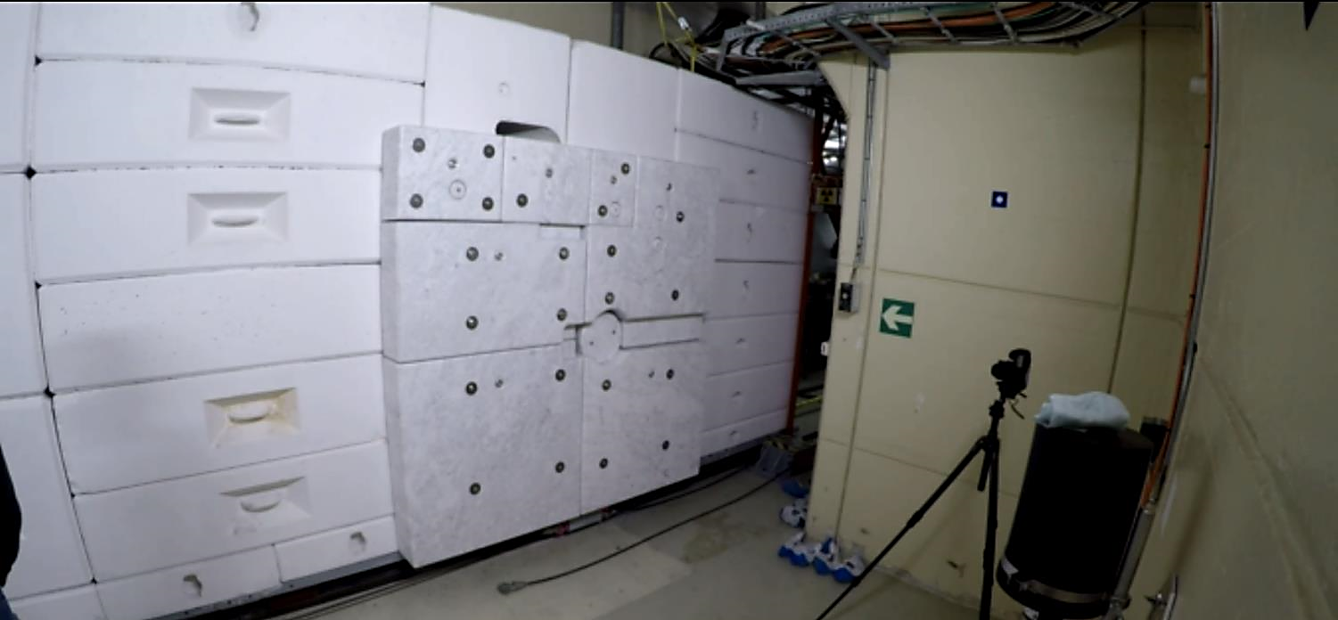
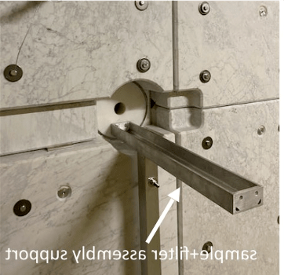

NEAR Station (outer area)
n_TOF target area shielding CLOSED
neutrons
Sample + filter assembly support

Slide 22
Nuclear Astrophysics

Slide 23
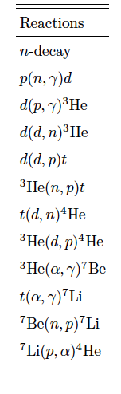
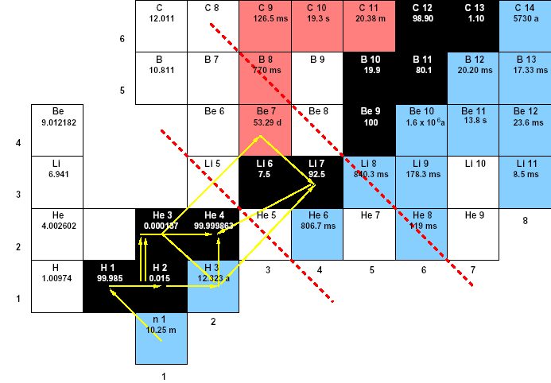
Neutrons during Big Bang Nucleosynthesis
and the Cosmological Lithium Problem
⁷Be
sample mass: 80 ng
t_{1/2} 53 d
activity 1 GBq
main result:
a reduction (~15%) of the CLiP,
but not a solution
⁷Be(n,α)⁴He

Slide 24
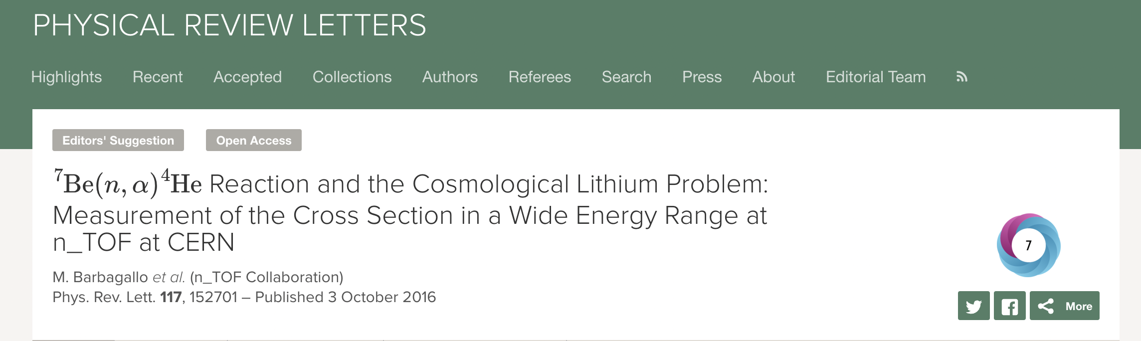
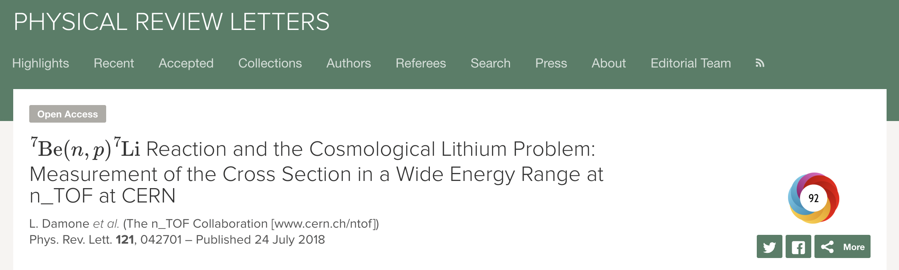
Neutrons during Big Bang Nucleosynthesis
and the Cosmological Lithium Problem
⁷Be
sample mass: 80 ng
t_{1/2} 53 d
activity 1 GBq
main result:
a reduction (~15%) of the CLiP,
but not a solution
⁷Be(n,α)⁴He

Slide 25



Present
All experimental activities at n_TOF are evaluated by the ISOLDE and n_TOF Experiments Committee (INTC) and approved by the Research Board
29 new experiments and 14 LOI for tests and detectors’ development approved in the 2021-23 period, since new target commissioning
Experimental program - up to LS3 - ready to go
Direct participation in EURO-LABS and involvement in several other EU-funded projects: SANDA, ARIEL(TA), several ERC projects
Fully embedded in the nuclear physics community in Europe (participation in the preparation of the NuPECC LRP-2024)

Slide 26
Future
All experimental activities at n_TOF are evaluated by the ISOLDE and n_TOF Experiments Committee (INTC) and approved by the Research Board
Several improvements and extensions of the facility capabilities envisaged and ready to be evaluated for technical implementation and resource provisions, up to LS4 and beyond
LOI submitted, evaluated and endorsed by the INTC with physics cases for activities at n_TOF beyond LS3 (document here >>)

Slide 27
Future 1
Target #4
neutron flux, resolution and
background conditions tbc
in the adopted technology
To be installed in LS4 (2032/33)
Project must start in 2025/26

Slide 28
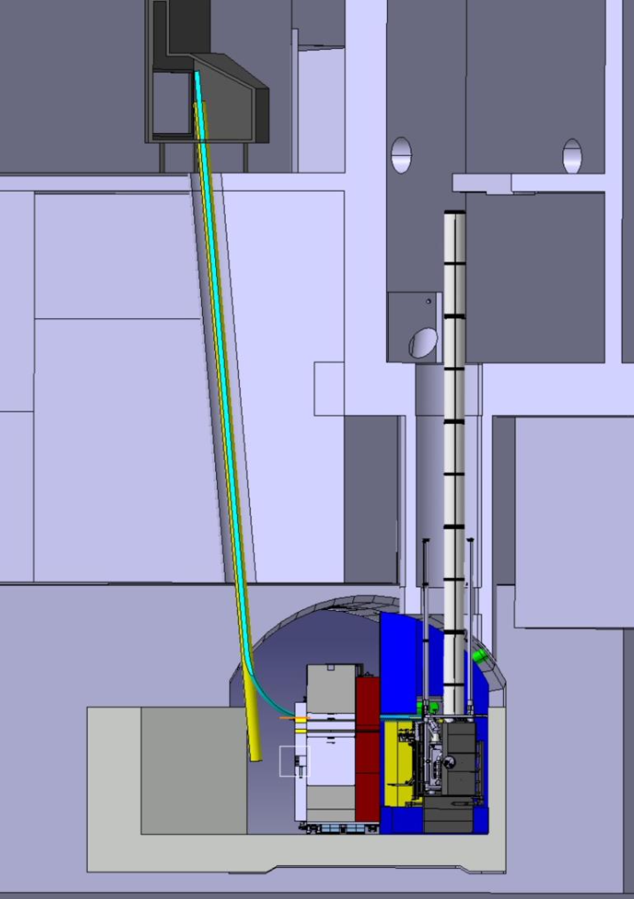
Future 2
An initiative for the improvement of the infrastructure is certainly the realization of a mechanical or pneumatic rabbit system that could allow irradiation of samples very close to the spallation target for low-background measurement in a dedicated area.
This action would include the realization of a counting station in the ISR8 area, about 20 meters from the spallation target, which could receive the samples within tens of seconds from the end of irradiation. This station could operate independently from EAR1 and EAR2 activities.

Slide 29
The n_TOF Collaboration
Established in the year 2000 (Phase-2 MoU signed in 2008)
130 researchers, mostly from Europe (+ Japan and the USA)
40+ research institutions involved
typically, 20 PhD students/year (3-year cycle)
management: Collaboration Board, Executive Committee, Editorial Board, various working groups

Slide 30
The n_TOF
Collaboration

Slide 31
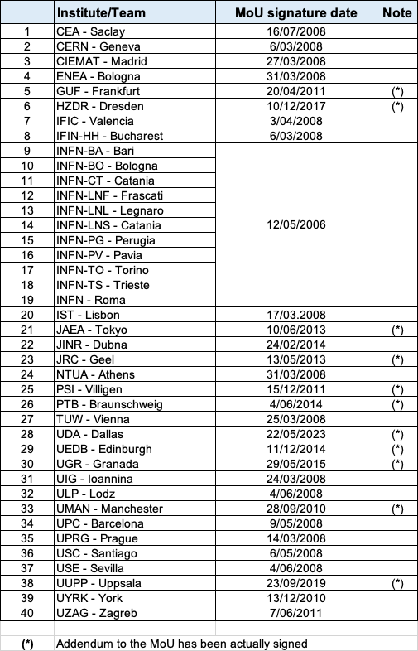
The n_TOF Collaboration
The Executive Committee
A Mengoni, ENEA and INFN, Bologna – Spokesperson
E Gonzales, CIEMAT, Madrid
R Vlastou, NTUA, Athens
F Gunsing, CEA, Saclay
N Colonna, INFN Bari
R Reifarth, Goethe-Universität, Frankfurt
E Chiaveri, CERN and University of Manchester (former SP)

Slide 32
The n_TOF
Collaboration

Slide 33
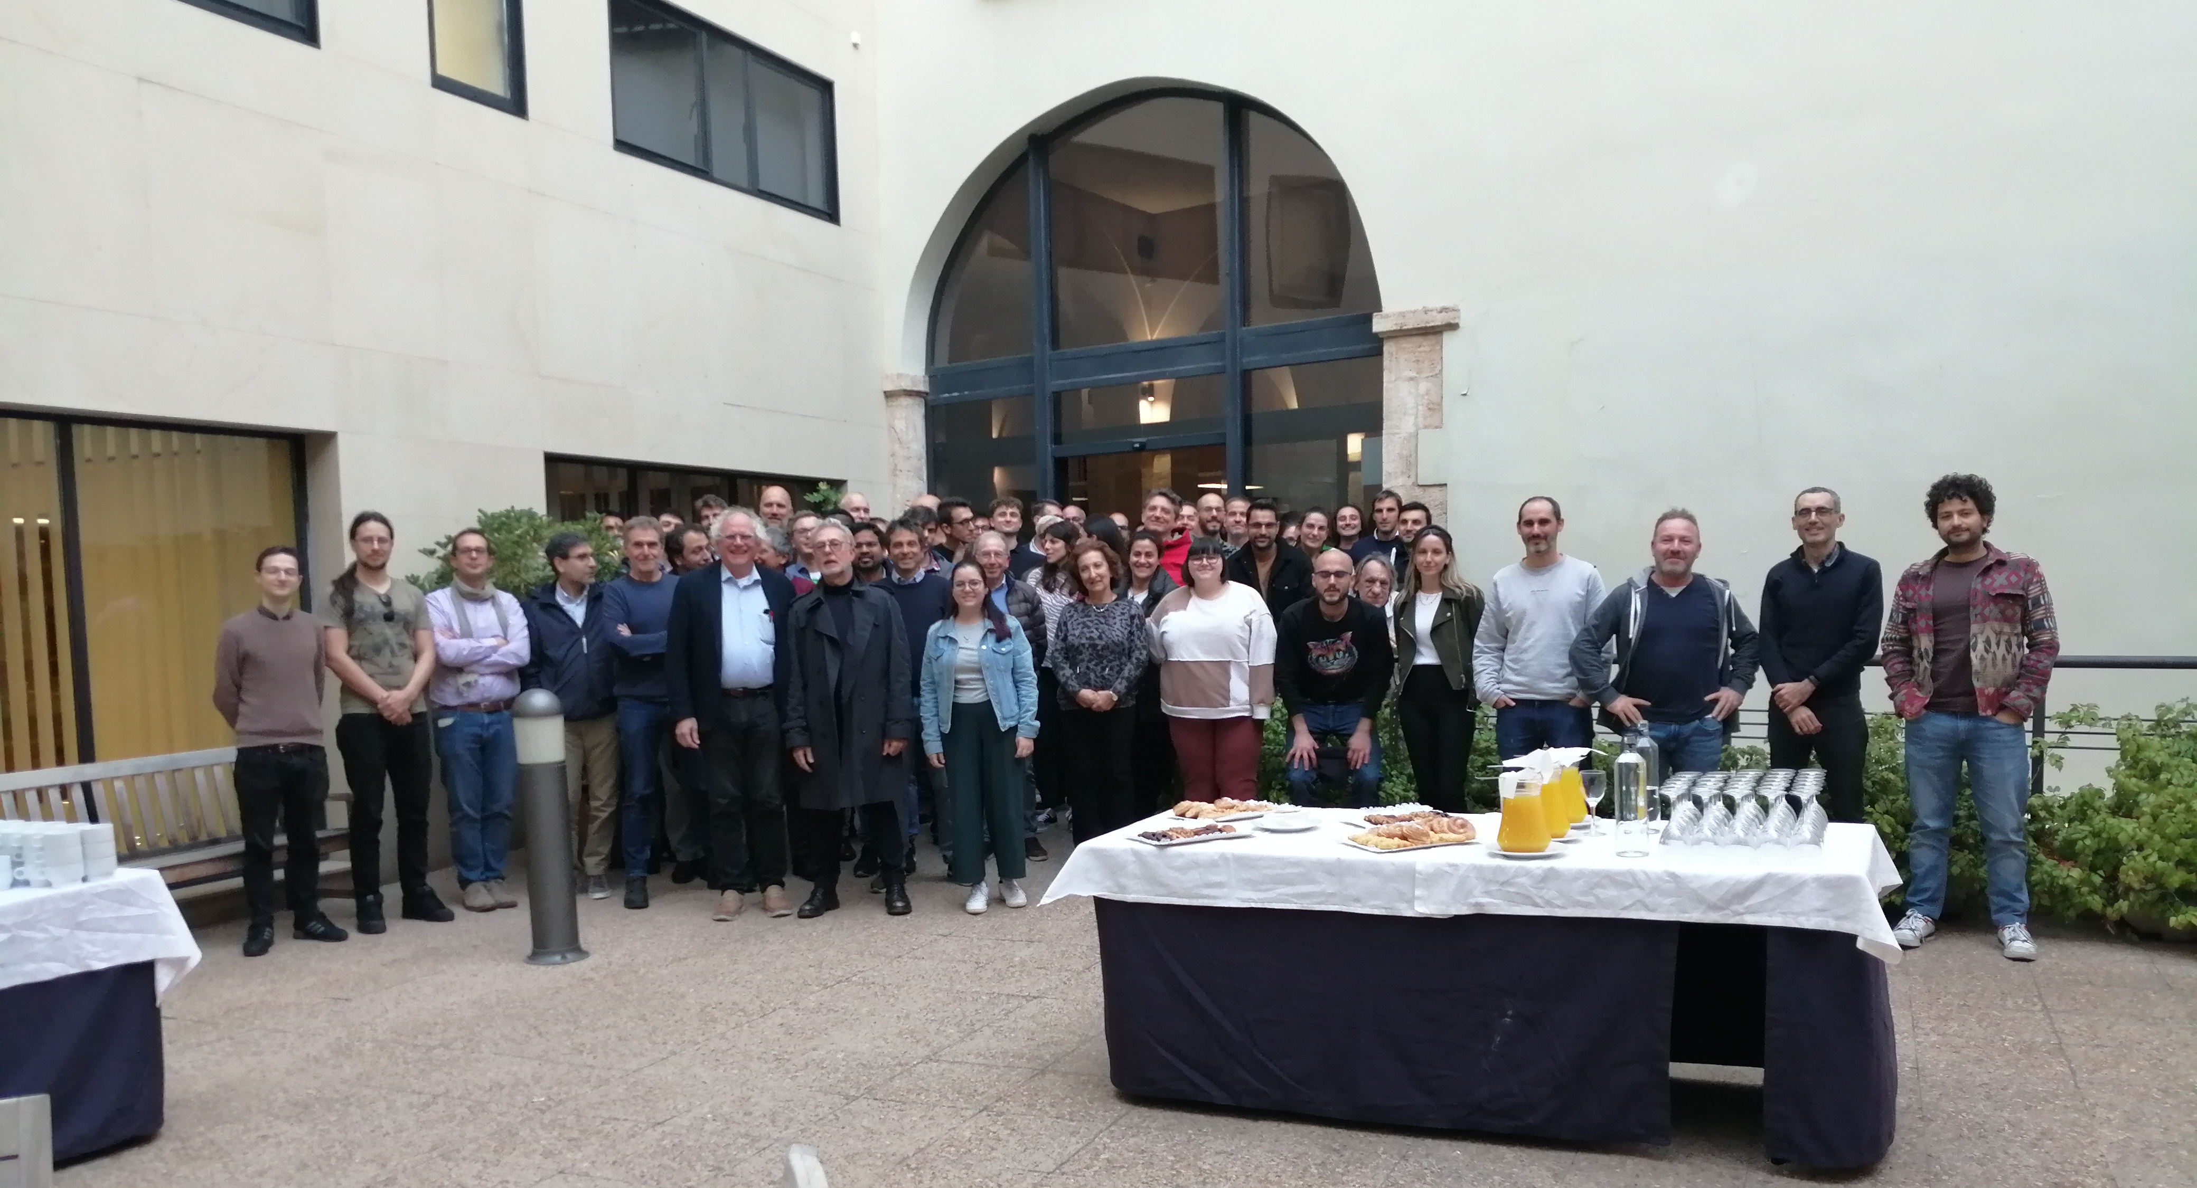
The end
Valencia, 22-24 November 2023
www.cern.ch/n_TOF

Slide 35
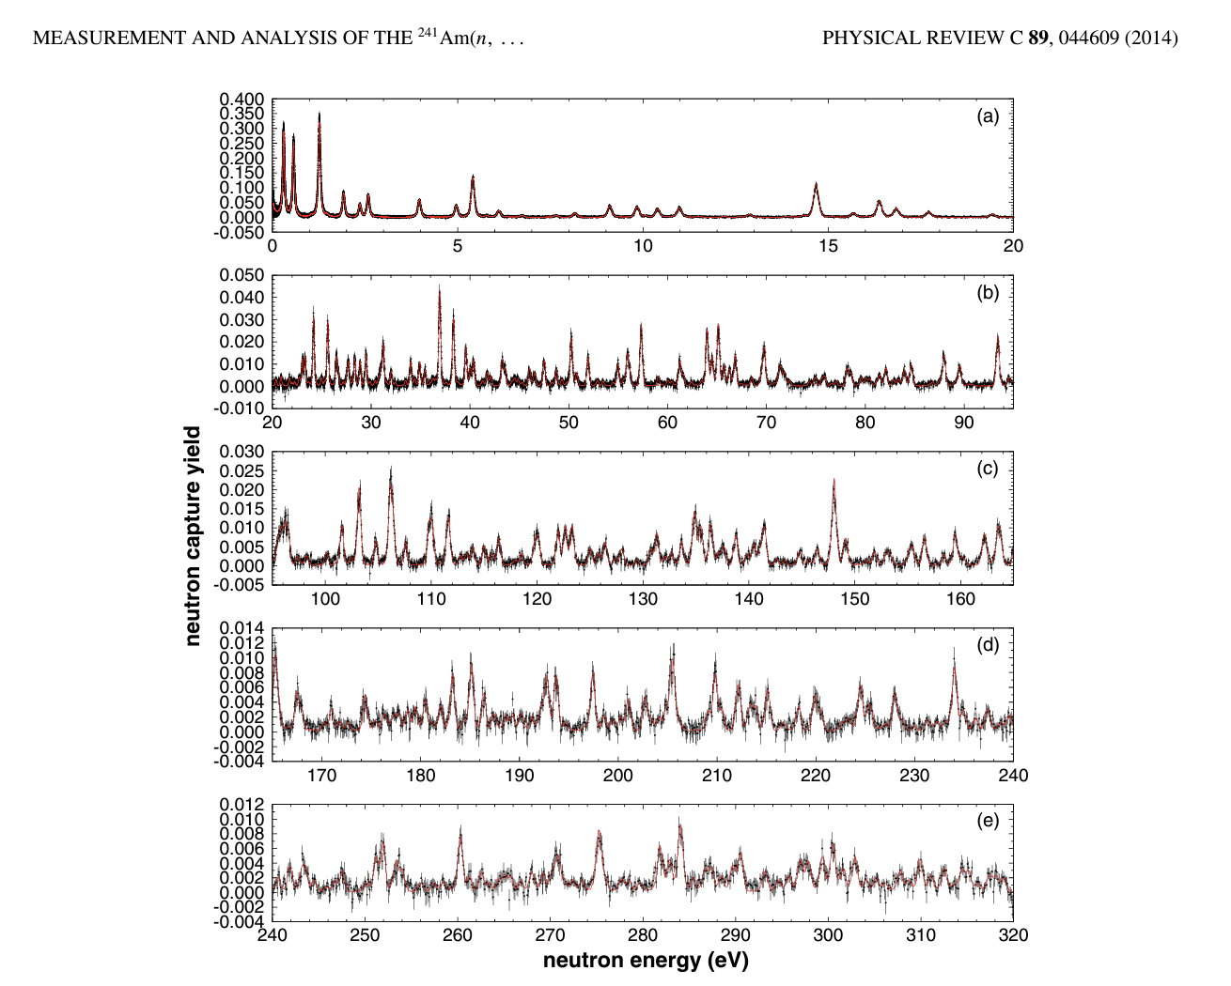

²⁴¹Am(n,𝛾)
The results in the resolved resonance range bring new constraints to evaluations below 150 eV and the energy upper limit was extended from 150 to 320 eV with a total of 172 new resonances not present in current evaluations.
The thermal capture cross section was found to be σ_{th}= 678 ± 68 b, which is in good agreement with evaluations and most previous measurements.
The capture cross section in the unresolved resonance region was extracted in the remaining energy range up to 150 keV and found to be larger than current evaluations and previous measurements.

Slide 36
²⁴¹Am(n,𝛾)
The results in the resolved resonance range bring new constraints to evaluations below 150 eV and the energy upper limit was extended from 150 to 320 eV with a total of 172 new resonances not present in current evaluations.
The thermal capture cross section was found to be σ_{th}= 678 ± 68 b, which is in good agreement with evaluations and most previous measurements.
The capture cross section in the unresolved resonance region was extracted in the remaining energy range up to 150 keV and found to be larger than current evaluations and previous measurements.

Slide 37
<< back

Slide 38
The Re/Os clock
BANG!
?
4.6 Ga
Now
s-only
Os
Os 184
0.02
Os 185
94 d
Os 186
1.58
Os 187
1.6
Os 188
13.3
Os 189
16.1
Os 190
26.4
Os 191
15.4 d
Os 192
41.0
Re
Re 183
71 d
Re 184
38 d
Re 185
37.4
Re 186
90.64 h
Re 187
62.6
Re 188
16.98 h
Re 189
24.3 h
Re 190
3.1 m
42.3x10⁹ a
W
W 182
26.3
W 183
14.3
W 184
30.67
W 185
75.1 d
W 186
28.6
W 187
23.8 h
W 188
69 d
s-process
r-only
r-process
(*) DD Clayton, ApJ 139 (1964) 637

Slide 39
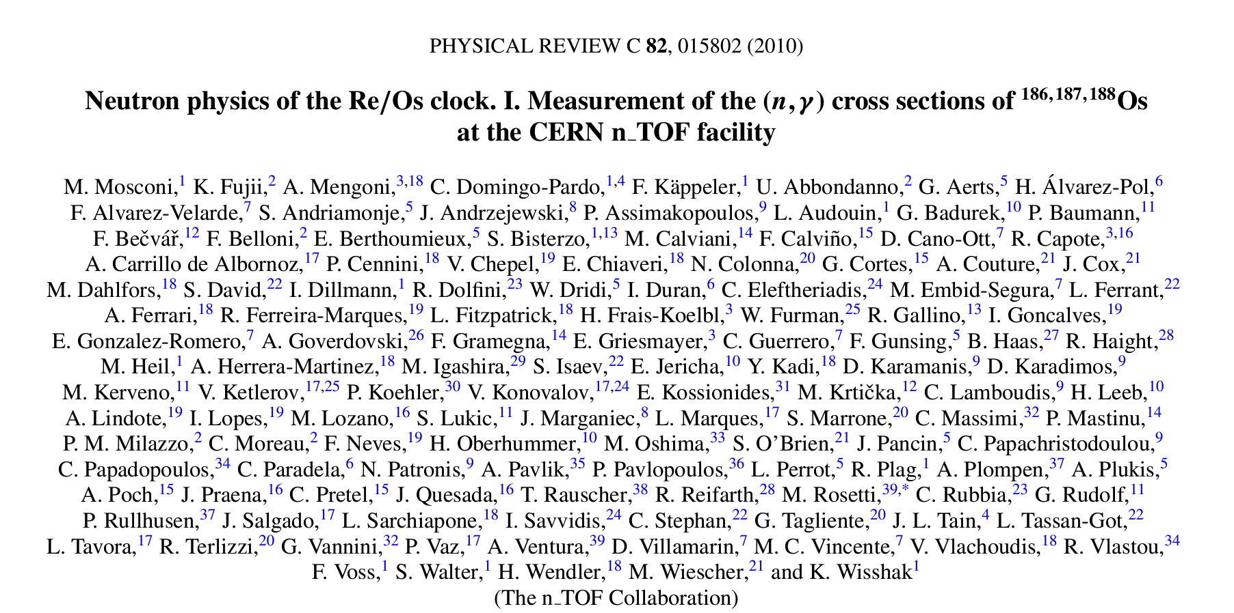
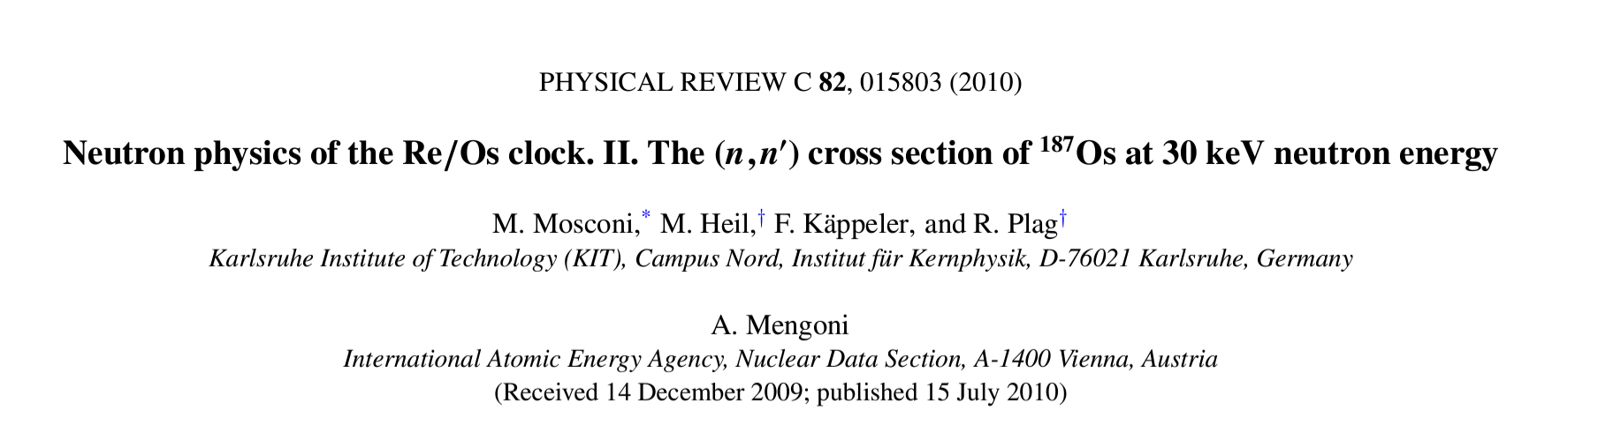
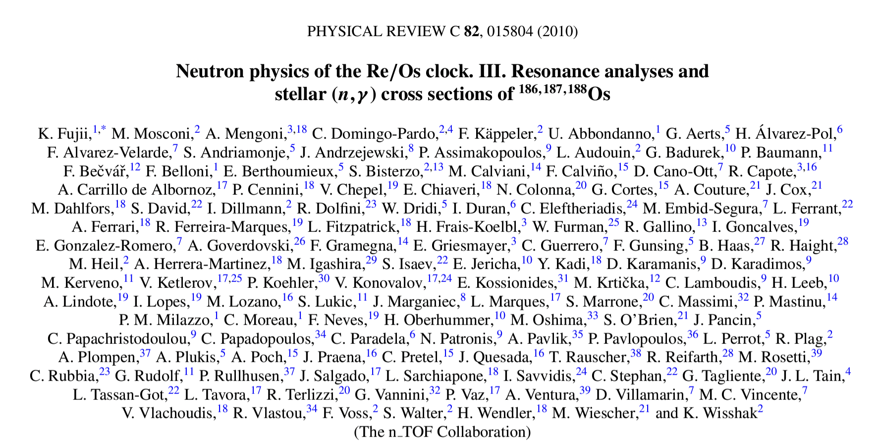
The Re/Os clock
BANG!
?
4.6 Ga
Now
s-only
Os
Os 184
0.02
Os 185
94 d
Os 186
1.58
Os 187
1.6
Os 188
13.3
Os 189
16.1
Os 190
26.4
Os 191
15.4 d
Os 192
41.0
Re
Re 183
71 d
Re 184
38 d
Re 185
37.4
Re 186
90.64 h
Re 187
62.6
Re 188
16.98 h
Re 189
24.3 h
Re 190
3.1 m
42.3x10⁹ a
W
W 182
26.3
W 183
14.3
W 184
30.67
W 185
75.1 d
W 186
28.6
W 187
23.8 h
W 188
69 d
s-process
r-only
r-process
(*) DD Clayton, ApJ 139 (1964) 637

Slide 40
<< back

Slide 41
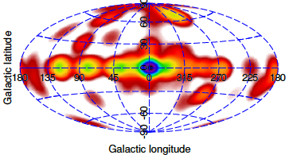
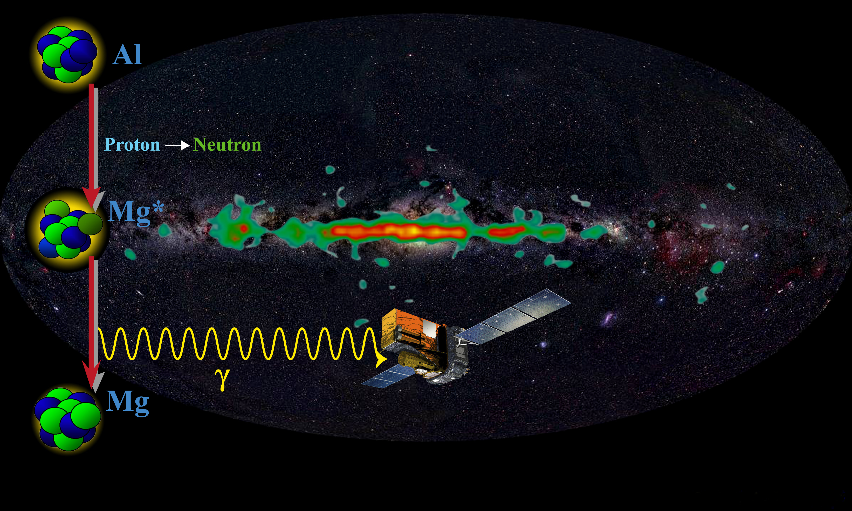
²⁶Al and the chemical elements production in our Galaxy
²⁶Al is a radioactive nucleus produced in massive stars
The ²⁶Al half-life, 720 thousand years, very short
with respect to the age of Universe of 13.8 billion years
Each ²⁶Al nucleus decay produces one highly energetic
γ-ray of 1.8 MeV. The interstellar medium is transparent to this ”light”
By recording these γ-rays we have a ”snapshot” of the
on-going nucleosynthesis in our Galaxy. Accordingly, we can trace the dynamics of the Milky Way (rotational speed, expansion, star-formation rates, etc.)
From the total production and destruction of ²⁶Al, we can understand how the cosmo-chemical element factories (stars) are producing energy and matter
The distribution of the ²⁶A “light “(1.8 MeV γ-rays) across the Milky Way. This is a “snapshot” of the ongoing chemical elements production in our Galaxy
Nuclear reaction data are necessary to quantify
the ²⁶Al net yield: production & destruction
measurement performed with 11 μg of ²⁶Al
ESA INTEGRAL mission detects ²⁶Al γ-rays

Slide 42
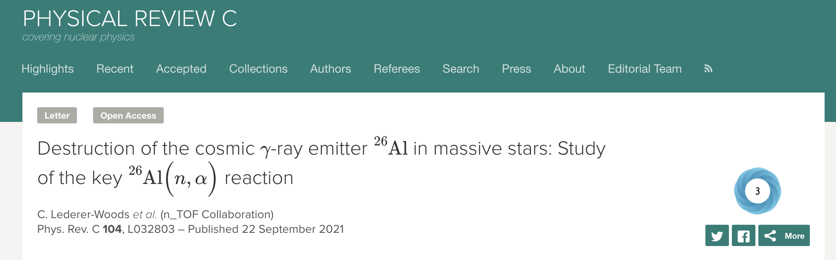
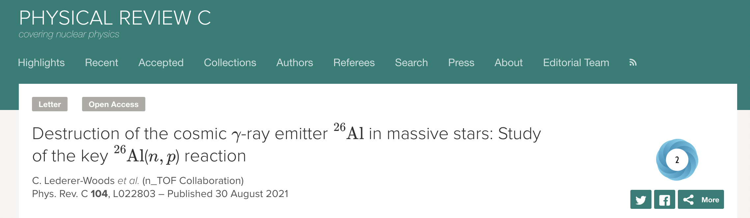
²⁶Al and the chemical elements production in our Galaxy
²⁶Al is a radioactive nucleus produced in massive stars
The ²⁶Al half-life, 720 thousand years, very short
with respect to the age of Universe of 13.8 billion years
Each ²⁶Al nucleus decay produces one highly energetic
γ-ray of 1.8 MeV. The interstellar medium is transparent to this ”light”
By recording these γ-rays we have a ”snapshot” of the
on-going nucleosynthesis in our Galaxy. Accordingly, we can trace the dynamics of the Milky Way (rotational speed, expansion, star-formation rates, etc.)
From the total production and destruction of ²⁶Al, we can understand how the cosmo-chemical element factories (stars) are producing energy and matter
The distribution of the ²⁶A “light “(1.8 MeV γ-rays) across the Milky Way. This is a “snapshot” of the ongoing chemical elements production in our Galaxy
Nuclear reaction data are necessary to quantify
the ²⁶Al net yield: production & destruction
measurement performed with 11 μg of ²⁶Al
ESA INTEGRAL mission detects ²⁶Al γ-rays

Slide 43
Basic science at n_TOF
Explored
Cosmochronology (nuclear clocks) : Re/Os clock
BBN : the cosmological lithium problem (CLiP)
Planned
NN-scattering length : charge-symmetry breaking in QCD
To be explored
X17 (n+³He, n+⁷Be) : dark photons/fifth force (?)

Slide 45
NEAR Station (outer area)
n_TOF target area shielding CLOSED
neutrons
Sample + filter assembly support

Slide 46
NEAR Station (outer area)

Slide 47
NEAR Station (outer area)

