Slide 1
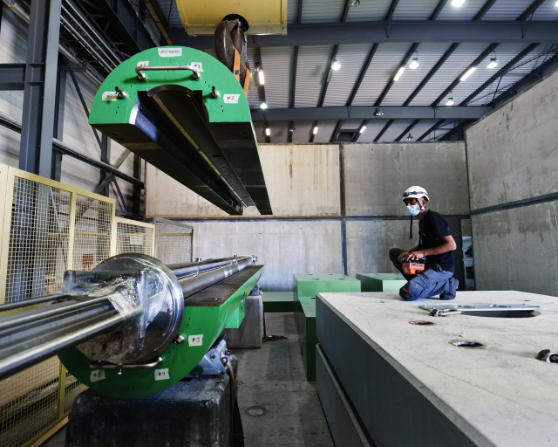
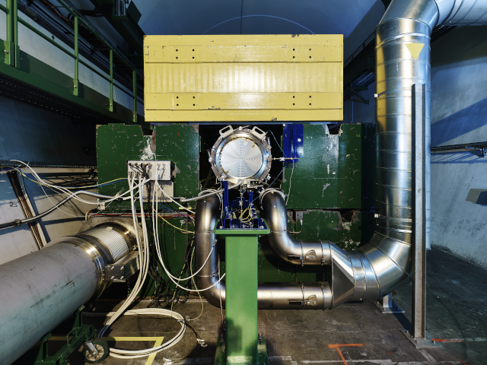
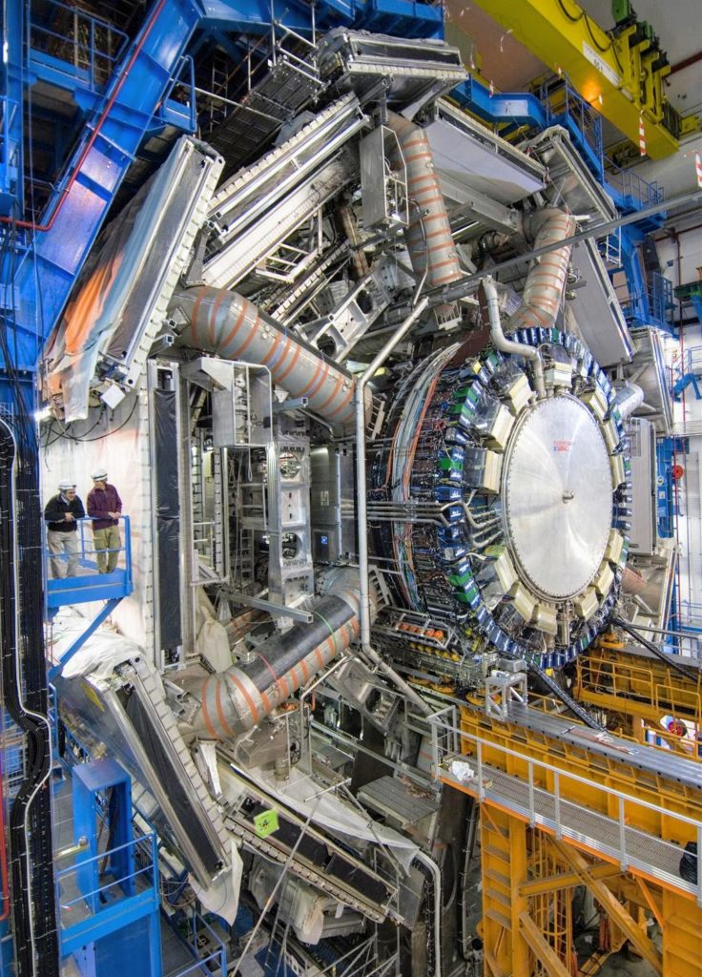
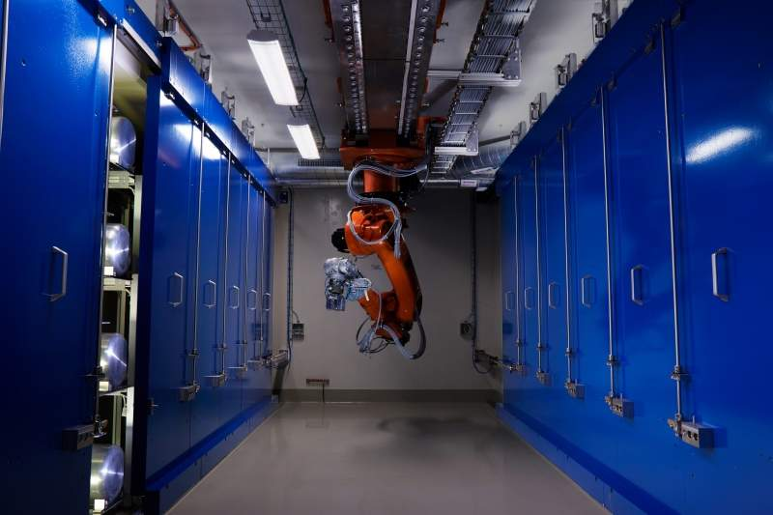
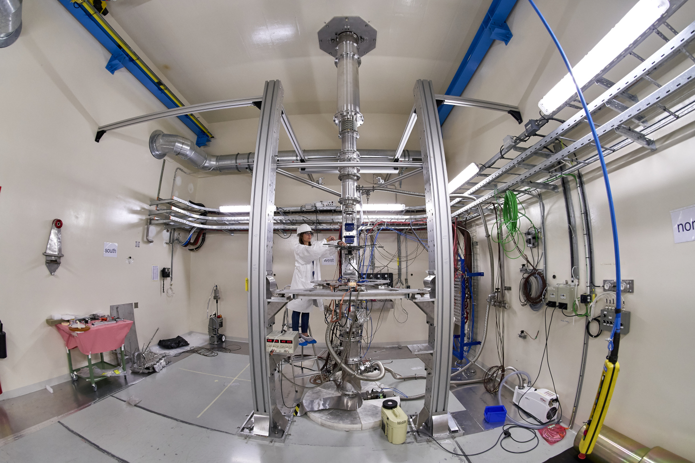
Point 6
BB5

Slide 2
Safety measures during CERN underground visit
Forbidden
Pregnant women, minors under the age of 16
Persons with reduced mobility (e.g. wheelchair, walking stick, difficulty to walk)
Persons carrying cardiac pacemaker and implantable defibrillator bearers
Persons suffering from claustrophobia or vertigo
Eating and drinking underground
Bags bigger than 10 litres
Safety recommendations
Closed and flat shoes are mandatory for the visit
Helmets with chinstraps will be provided to each visitor
Guide will use a dosimeter to ascertain that the dose received during your visit is negligible
Always follow the instructions of your guide and stay with the guide and the group
Do not touch any equipment
In the unlikely event of an alarm, please follow the instructions given by your guide

