Slide 1
Noble-Liquid Calorimeter General News

Slide 2
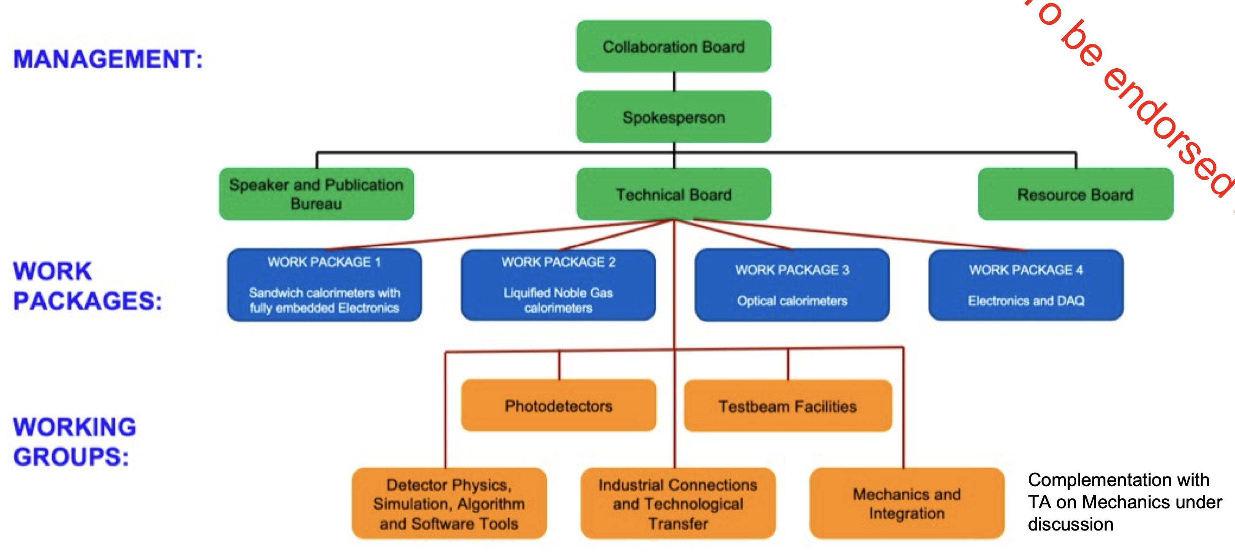
Status of DRD Calo
From input proposals the DRD Calo Proposal was compiled
  https://drive.google.com/file/d/1jMUBHSVcI0Ak-ZL0GO8q_qhzKa9XKTzn/view?usp=sharing
DRD on calorimetry was approved in December 2023.
The first proto Collaboration Board (CB) Meeting took place in January 2024
  https://indico.cern.ch/event/1359299/
Next step is to propose candidates and then elect a CB chair
DRD Collaboration Meeting
  https://indico.cern.ch/event/1368231/
DRD governance will be put in place and DRD Spokesperson and Deputies will be elected.

Slide 3
Conferences – FCC Week
FCC WS Annecy (29.1.-2.2.)
FCC US WS at MIT (end of March)
CALOR 2024 (20.5.-24.5.)
  Should submit 2 abstracts
Pisa Meeting 2024 (26.5.-1.6.)
  Could submit 1 (or 2) abstracts
FCC Week (10.6.-14.6.)
ICHEP 2024 (18.6.-24.6.)
  Likely one oral presentation in a parallel session

