Slide 1

Collective phenomena in jets – a new window into the ultimate quark-gluon droplet
Xiaoyu Liu
for the CMS Collaboration
Rice University
Based on the work: PRL 133 (2024) 142301, CMS-PAS-HIN-24-024
Notes:
doe logo, qm logo
footnote

Slide 2
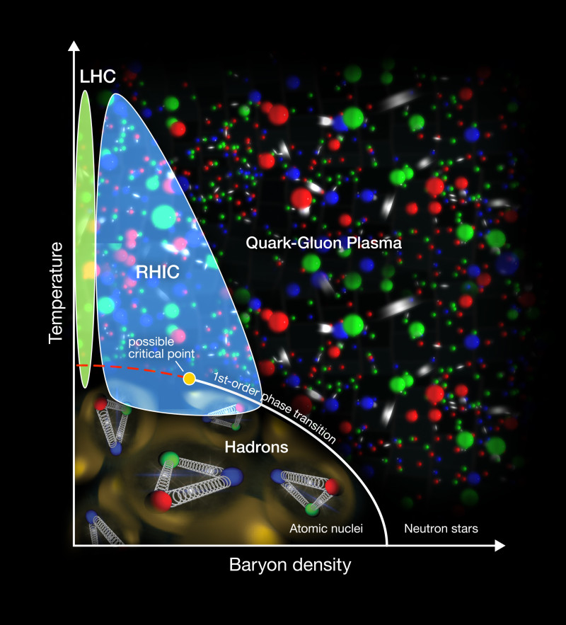
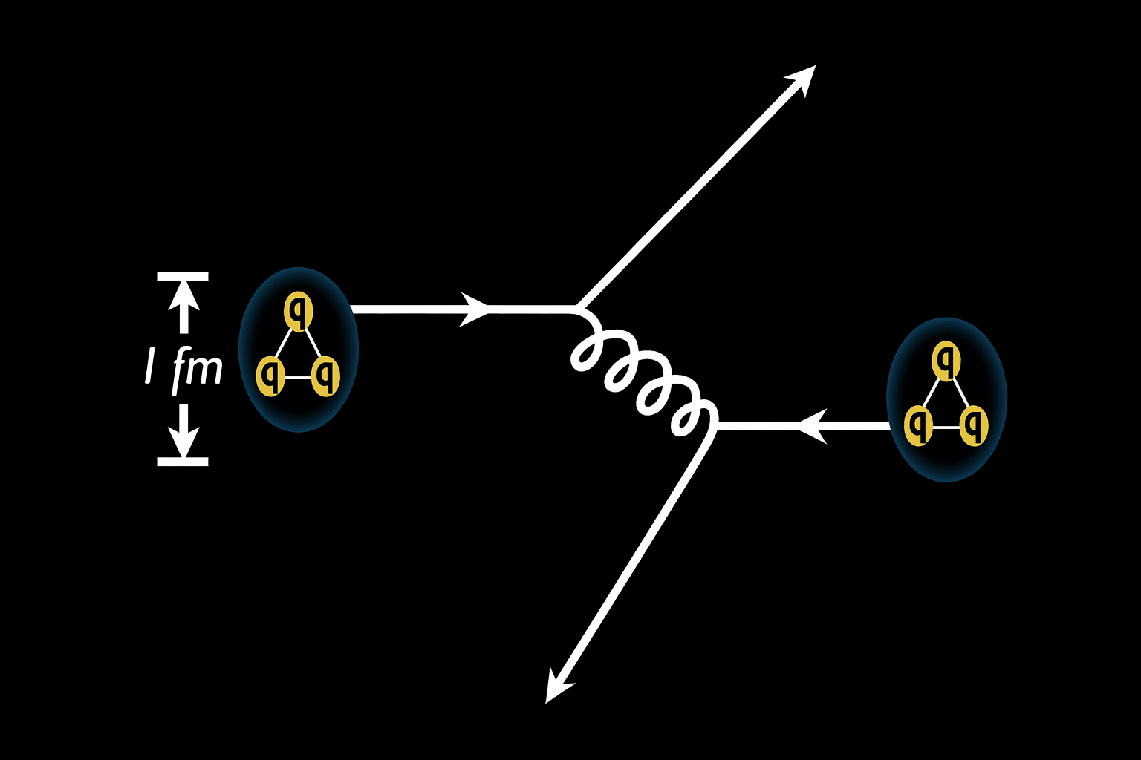
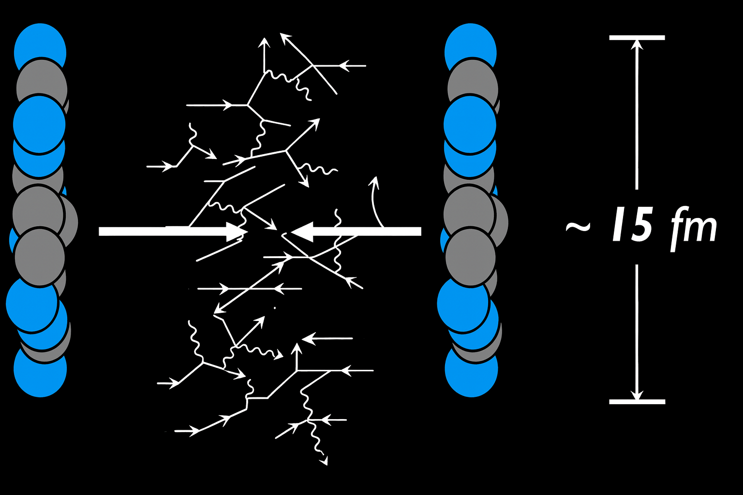
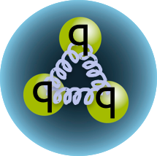
Matter in extreme conditions
QCD predicts a color deconfined matter: Quark Gluon Plasma, at extreme energy densities.
Produced in relativistic heavy-ion collisions.
vs.
Baryon chemical potential
Point-like, too small for partonic rescattering.
Notes:
Just to begin with a brief introduction to what we do in high-energy nuclear experiments: in general, we are interested in matter under extreme conditions.
Quantum Chromodynamics predicts the existence of a deconfined state of matter — the quark–gluon plasma, or QGP — at very high energy densities. We are able to reach such conditions through relativistic heavy-ion collisions.
In these collisions, the temperature at the center can reach trillions of degrees, hot enough to melt protons and neutrons, creating a small droplet of QGP.
As a comparison, in minimum-bias proton–proton collisions, the protons are effectively point-like, the system is too small for significant partonic rescattering, and therefore no QGP is expected to form.
QGP: Deconfined matter over large distances, interact and evolve (~10 fm/c) nonperturbatively

Slide 3
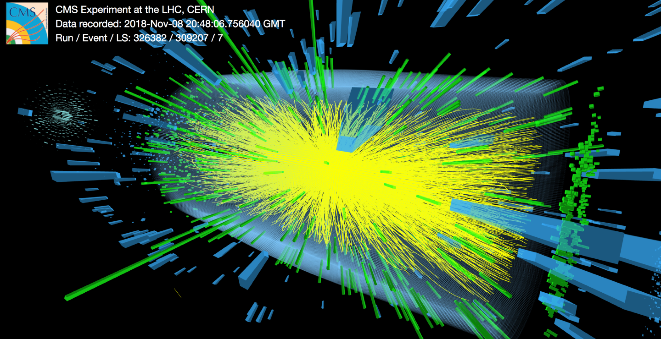
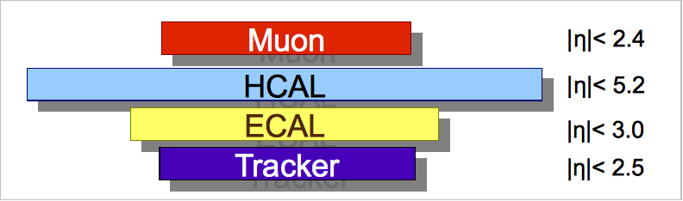
Central PbPb event
Up to 20,000 particles produced
QGP?
ZDC
ZDC
Notes:
CMS has a large fiducial coverage

Slide 4

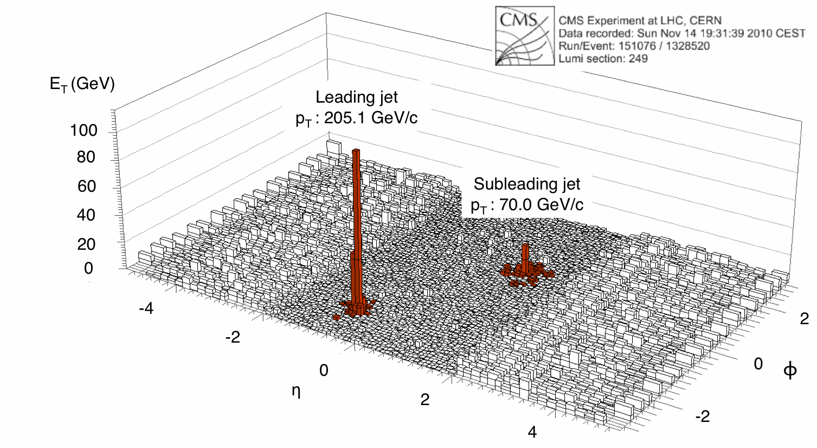
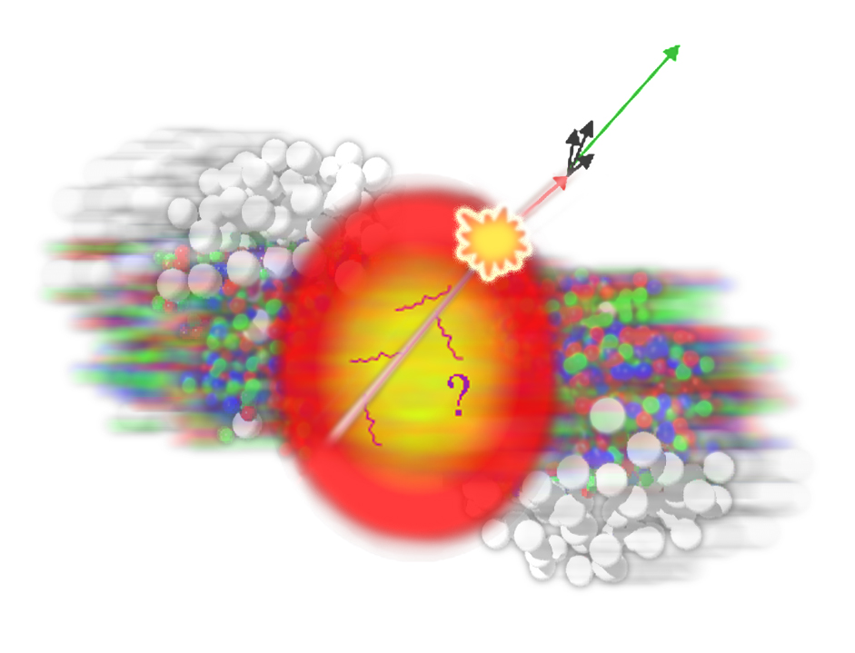
deconfined
PbPb
Speed of sound
Quarkonia melting
Rep. Prog. Phys. 87 (2024) 077801
T_{c}
Direct evidence for deconfined QCD state
Strong collective behavior
Jet quenching
Notes:
For example, we have measured the speed of sound in the medium. We have observed quarkonium melting, jet quenching, and, most relevant for today’s talk, strong collective behavior.
For the rest of my presentation, I’m going to focus on this collective behavior.

Slide 5
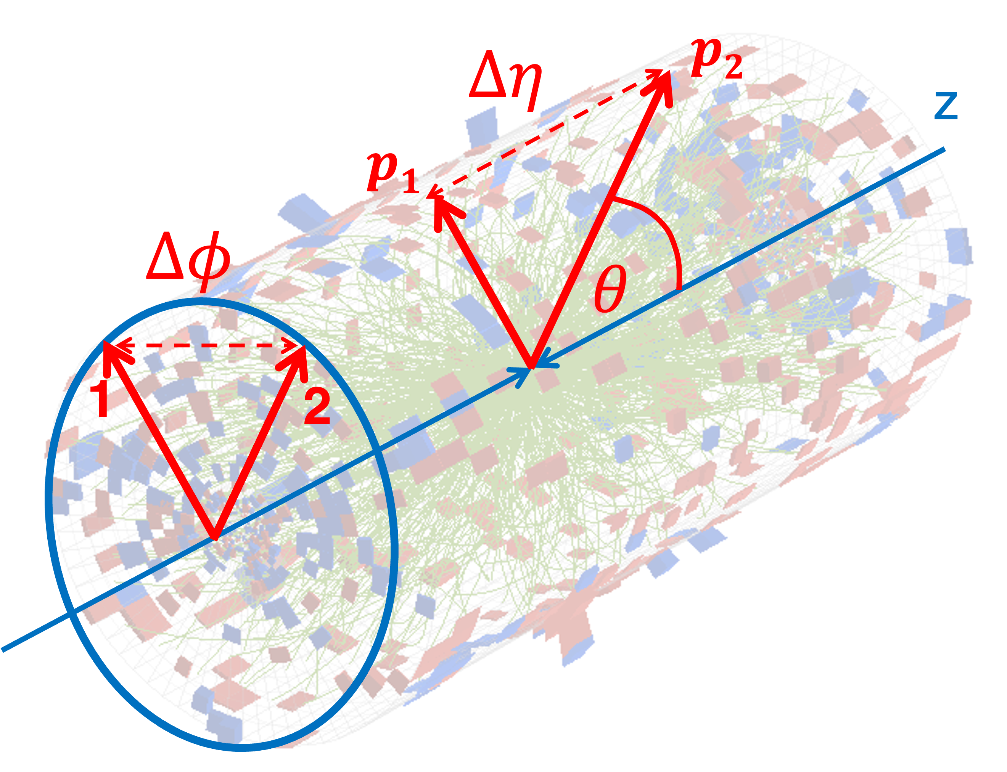
Two particle correlations
2D distribution of pairs in: $Δη=η_{1}−η_{2}, Δφ=φ_{1}−φ_{2}.$
35-40%
Notes:
A common observable to study collectivity in heavy-ion collisions is the two-particle correlation function.
The distribution you see on the right is typical of heavy-ion collisions. While it may look familiar now, when it was first observed it was quite surprising — because of the long-range near-side ridge.

Slide 6
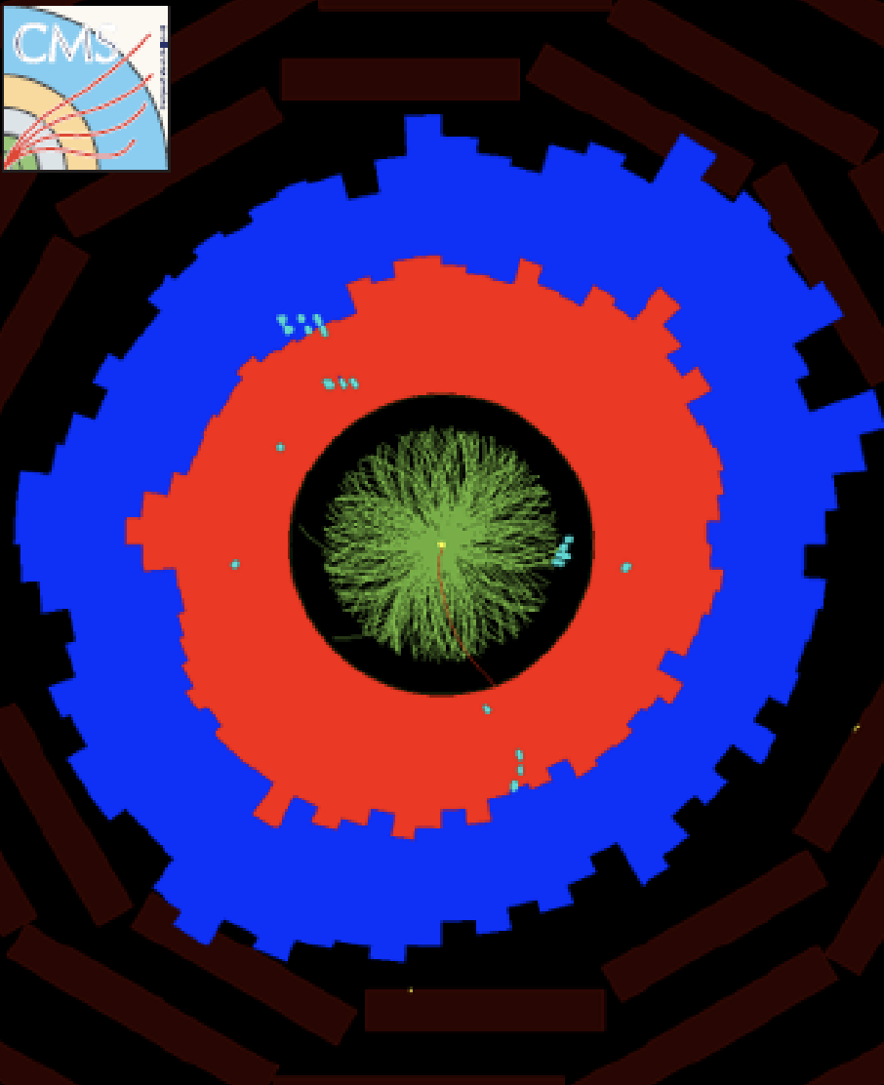
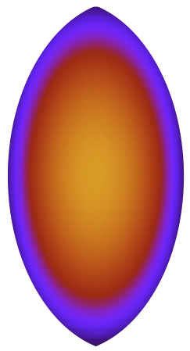
Long-range near-side ridge
A hallmark signature for QGP
35-40%
Short-range
“Ridge”
Long-range
Notes:
They all share a preferred emission angle, as illustrated in the event display on the right.

Slide 7
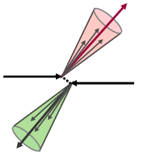
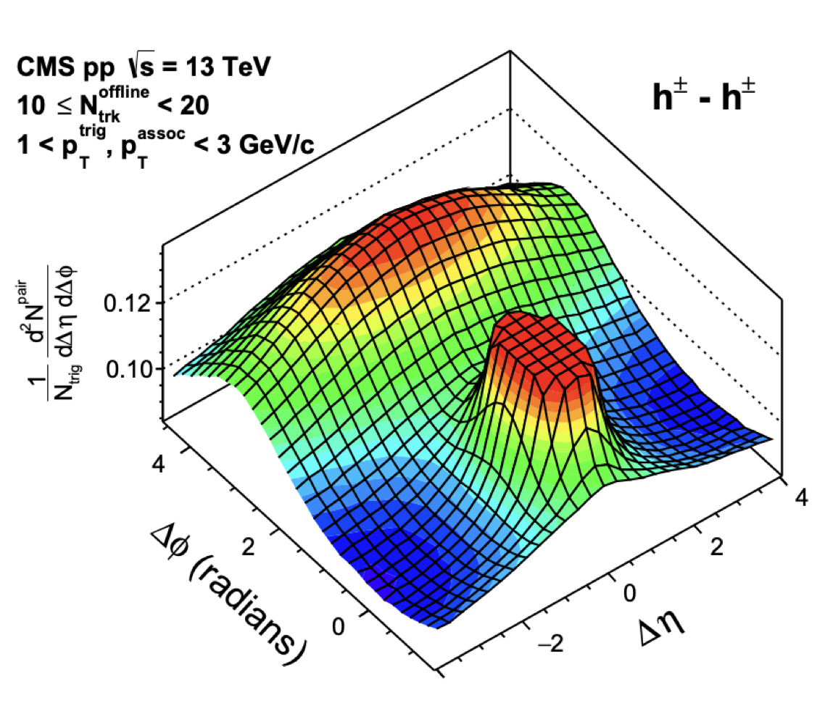
Long-range near-side ridge
A hallmark signature for QGP
35-40%
pp MinBias
Short-range
“Ridge”
Long-range
No near-side ridge in MB pp
Notes:
We now understand that this ridge originates from flow, an important property of QGP

Slide 8
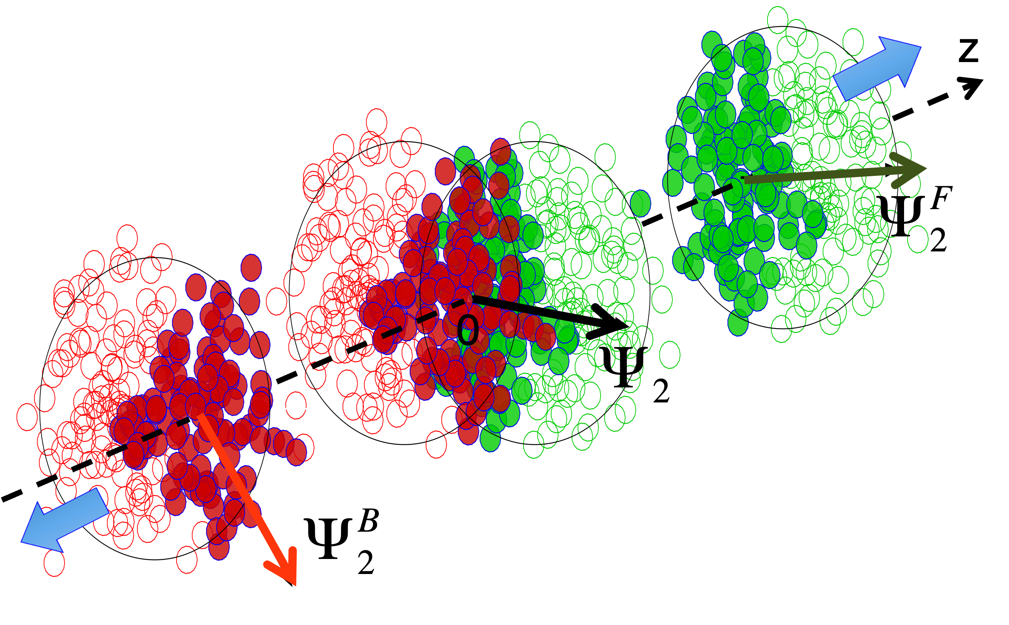



Flow
Initial State Geometry:
Final State Anisotropy:
$$ε_{2}^{F}$$
$$ε_{2}$$
Pressure-driven
expansion
$$ε_{2}^{B}$$
Notes:
As a result, the final-state particle distribution is anisotropic. All particles are correlated via this short axis at the initial stage. This collective behavior is called flow

Slide 9
Flow
Initial State Geometry:
Final State Anisotropy:
$$ε_{2}^{F}$$
$$ε_{2}$$
Pressure-driven
expansion
$$ε_{2}^{B}$$
QGP is a strongly coupled, nearly perfect fluid!
Notes:
Flow tells us that QGP is extremely efficient in converting the initial-state anisotropy into the final-state anisotropy. It also tells us that QGP behaves as a strongly coupled, nearly perfect fluid.
k2: hydrodynamic response

Slide 10
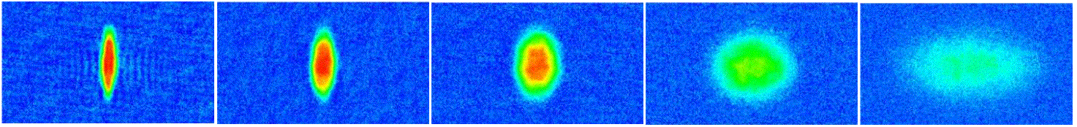

Flow
Initial State Geometry:
Final State Anisotropy:
$$ε_{2}^{F}$$
$$ε_{2}$$
Pressure-driven
expansion
$$ε_{2}^{B}$$
QGP is a strongly coupled, nearly perfect fluid!
“Elliptic flow”
⁶Li gas T=10⁻⁷K
Time
$$v_{2}≅κ_{2}ε_{2}$$
Notes:
k2: hydrodynamic response
Here is a nice analogy with the expansion of a lithium gas cloud, where one can also clearly see elliptic flow.

Slide 11
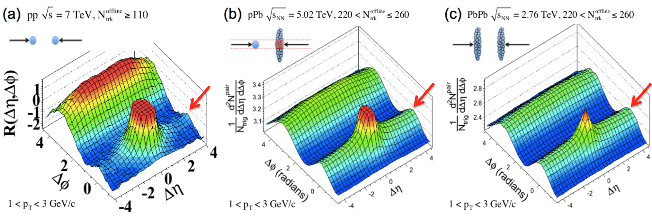
QGP signatures in small systems
Near-side ridge discovered in high-multiplicity pp and pPb collisions.
JHEP 09 (2010) 091
PLB 718 (2013) 795
EPJC 72 (2012) 2012
Also see a review: K. Dusling, WL, B. Schenke, Int.J.Mod.Phys. E25 (2016) 01, 1630002
Notes:
As our understanding of heavy-ion collisions has deepened, something unexpected emerged in much smaller systems.

Slide 12
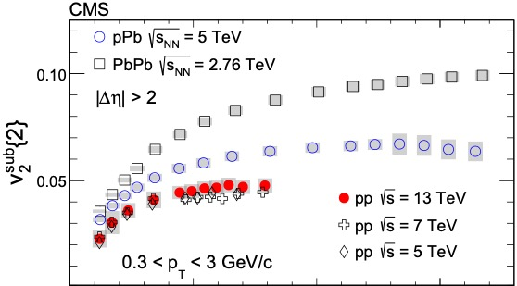
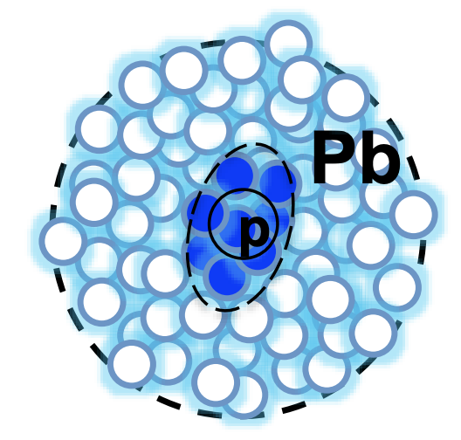
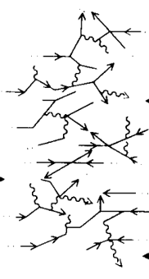
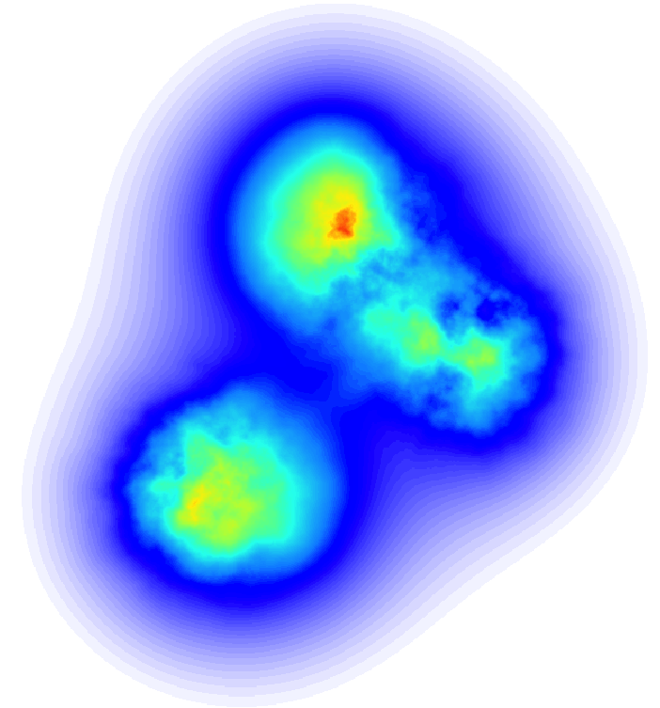
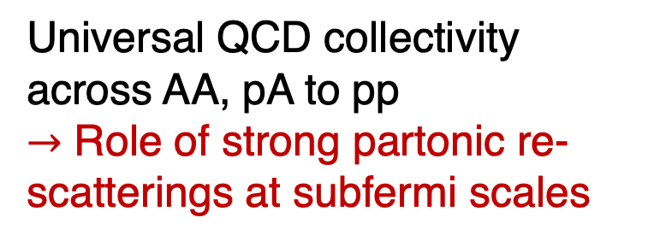
QGP signatures in small systems
Flow: Initial geometry + partonic rescattering
PLB 765 (2017) 193
Universal QCD collectivity across AA, pA to pp
$→$ Role of strong partonic re-scatterings at subfermi scales
PbPb
pPb
pp
p/A
p/A
“QGP” everywhere!?
Ordered roughly by expected initial geometry
Diminishing toward low multiplicity
Notes:
We extracted v₂ from two-particle correlations for all three systems and compared them on the same plot.
The results align with the expected origin of v₂:
Initial geometry is present in all three systems.
The measured v₂ roughly follows the ordering set by that geometry.
As we move to lower multiplicities, the amount of partonic rescattering decreases, and correspondingly v₂ diminishes.

Slide 13
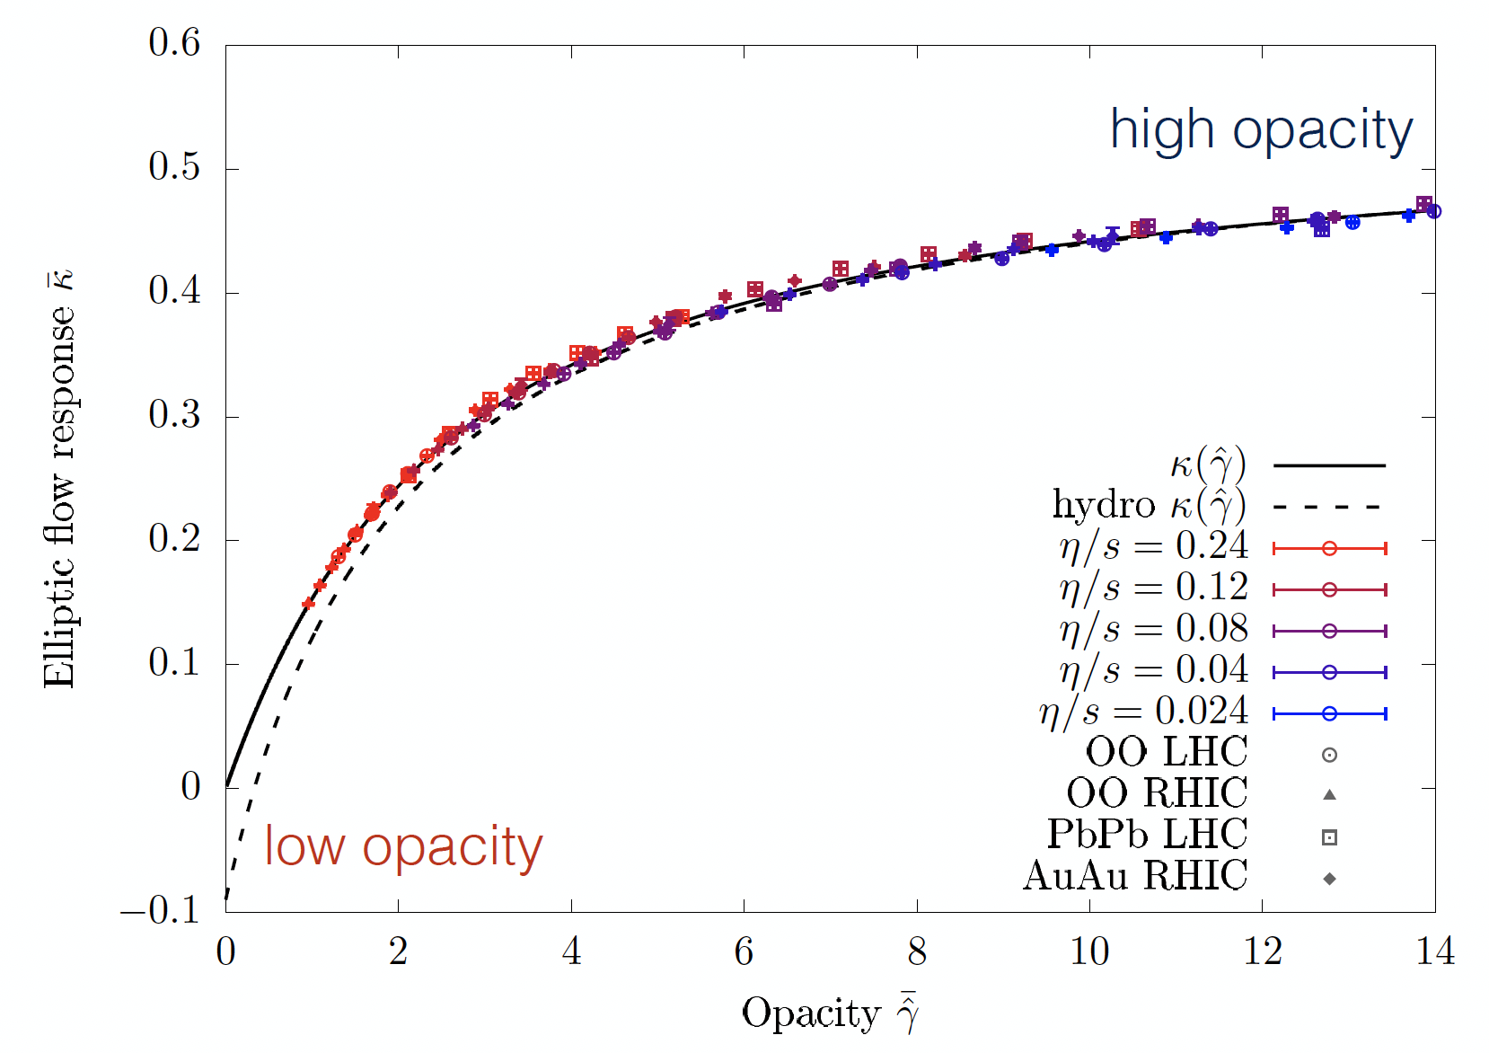

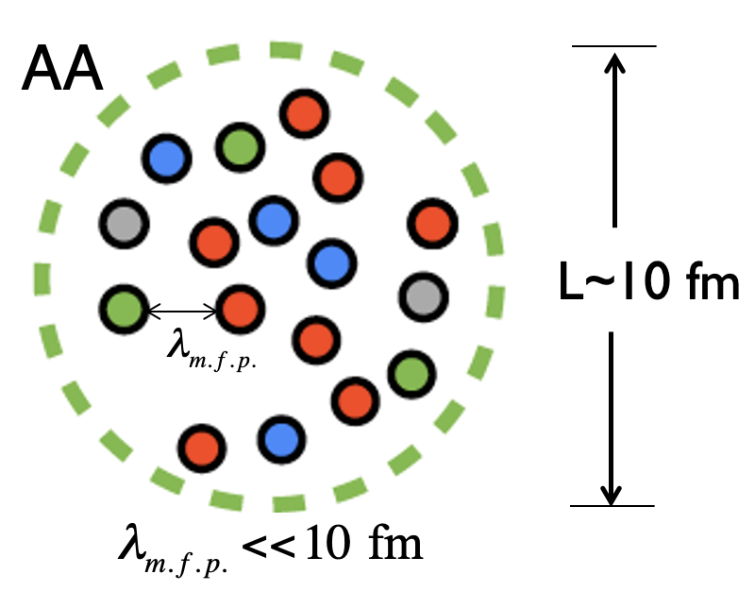
A new paradigm - Universal QGP across systems
Sören Schlichting
$$κ_{2}≅\frac{v_{2}}{ε_{2}}$$
Elliptic flow response
Opacity $\overline{\hat{γ}}≡\frac{L}{ℓ_{mfp}}\sim {{(N}_{ch})}^{\frac{1}{3}}$
Notes:
A kinetic and hydrodynamic calculations predict that v₂ divided by the eccentricity depends only on the system’s opacity.
the model suggest add backup
https://indico.cern.ch/event/1334113/contributions/6291369/attachments/3045615/5390548/QM_2025_Poster_bullet.pdf

Slide 14

How small a QGP droplet can be ?
p
Pb
p
p
Pb
Pb
ultimate limit
A single q or g
Can a QGP droplet be initiated by a “single parton” in the vacuum?
A. Baty, P. Gardner, WL, PRC 107 (2023) 064908
Notes:
All these discoveries in small systems naturally lead us to ask: how small a QGP droplet can be created?
To push the boundaries even further, it has been postulated that a QGP droplet could be initiated by a single parton propagating through the vacuum.

Slide 15
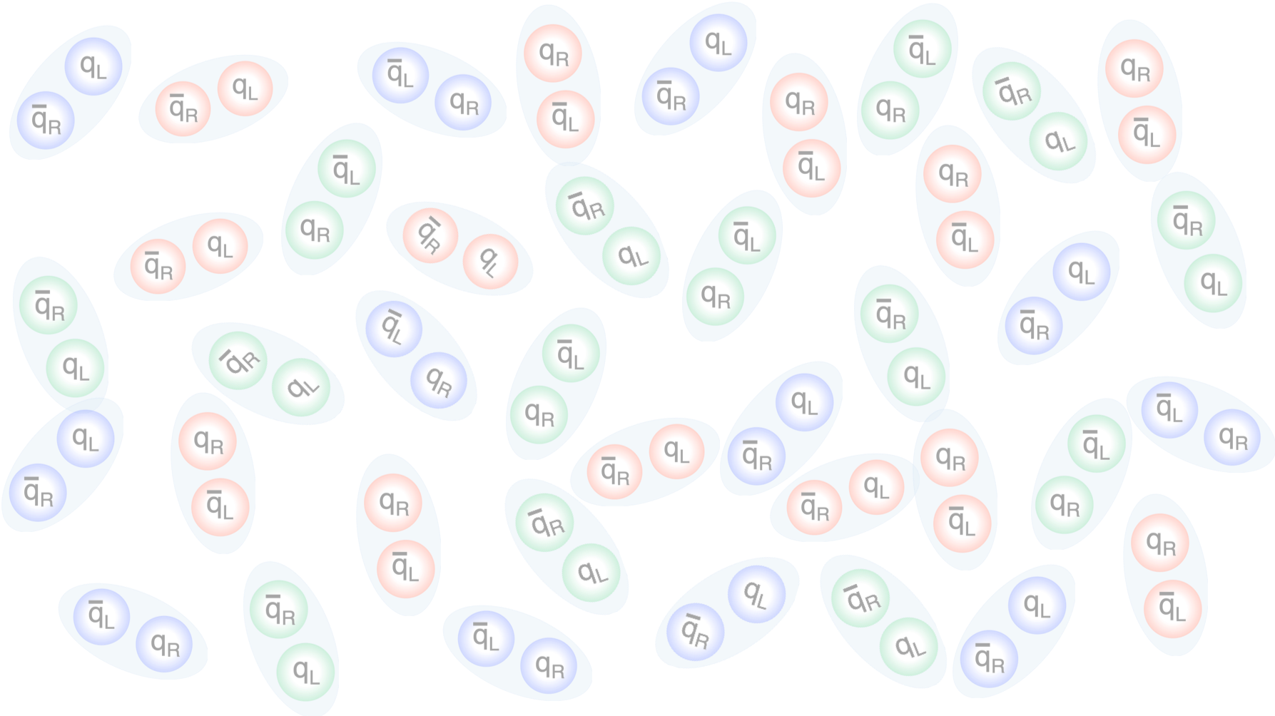
Jet: a proxy for system initiated by a parton
“Jet”
e/p
e/p
Beam axis

Slide 16
Jet: a proxy for system initiated by a parton
“Jet”
e/p
e/p
Beam axis
Filled with virtual color charges – chiral condensates

Slide 17
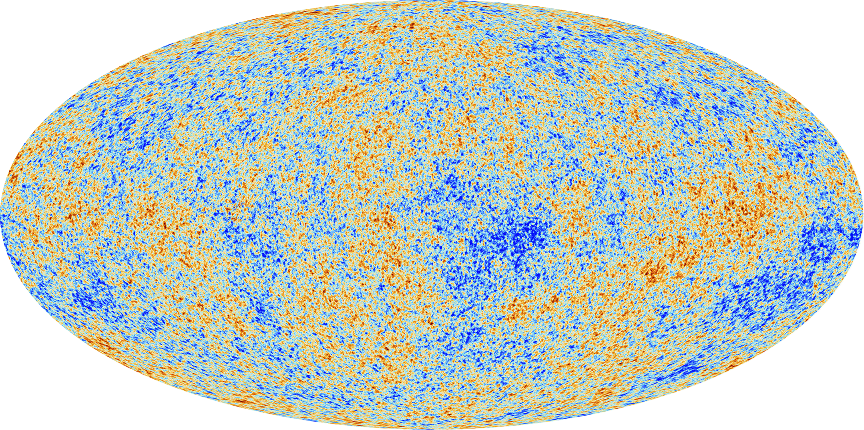



Jet: a proxy for system initiated by a parton
High-multiplicity jets
$$π$$
“Jet”
$$K$$
q/g
e/p
e/p
Hadronization
p
Beam axis
$$γ$$
…
Notes:
A particularly interesting case is high-multiplicity jets: systems that are small but very dense. If the energy density is high enough, they may become highly non-perturbative, perhaps even reach a regime that can be described by hydrodynamics

Slide 18
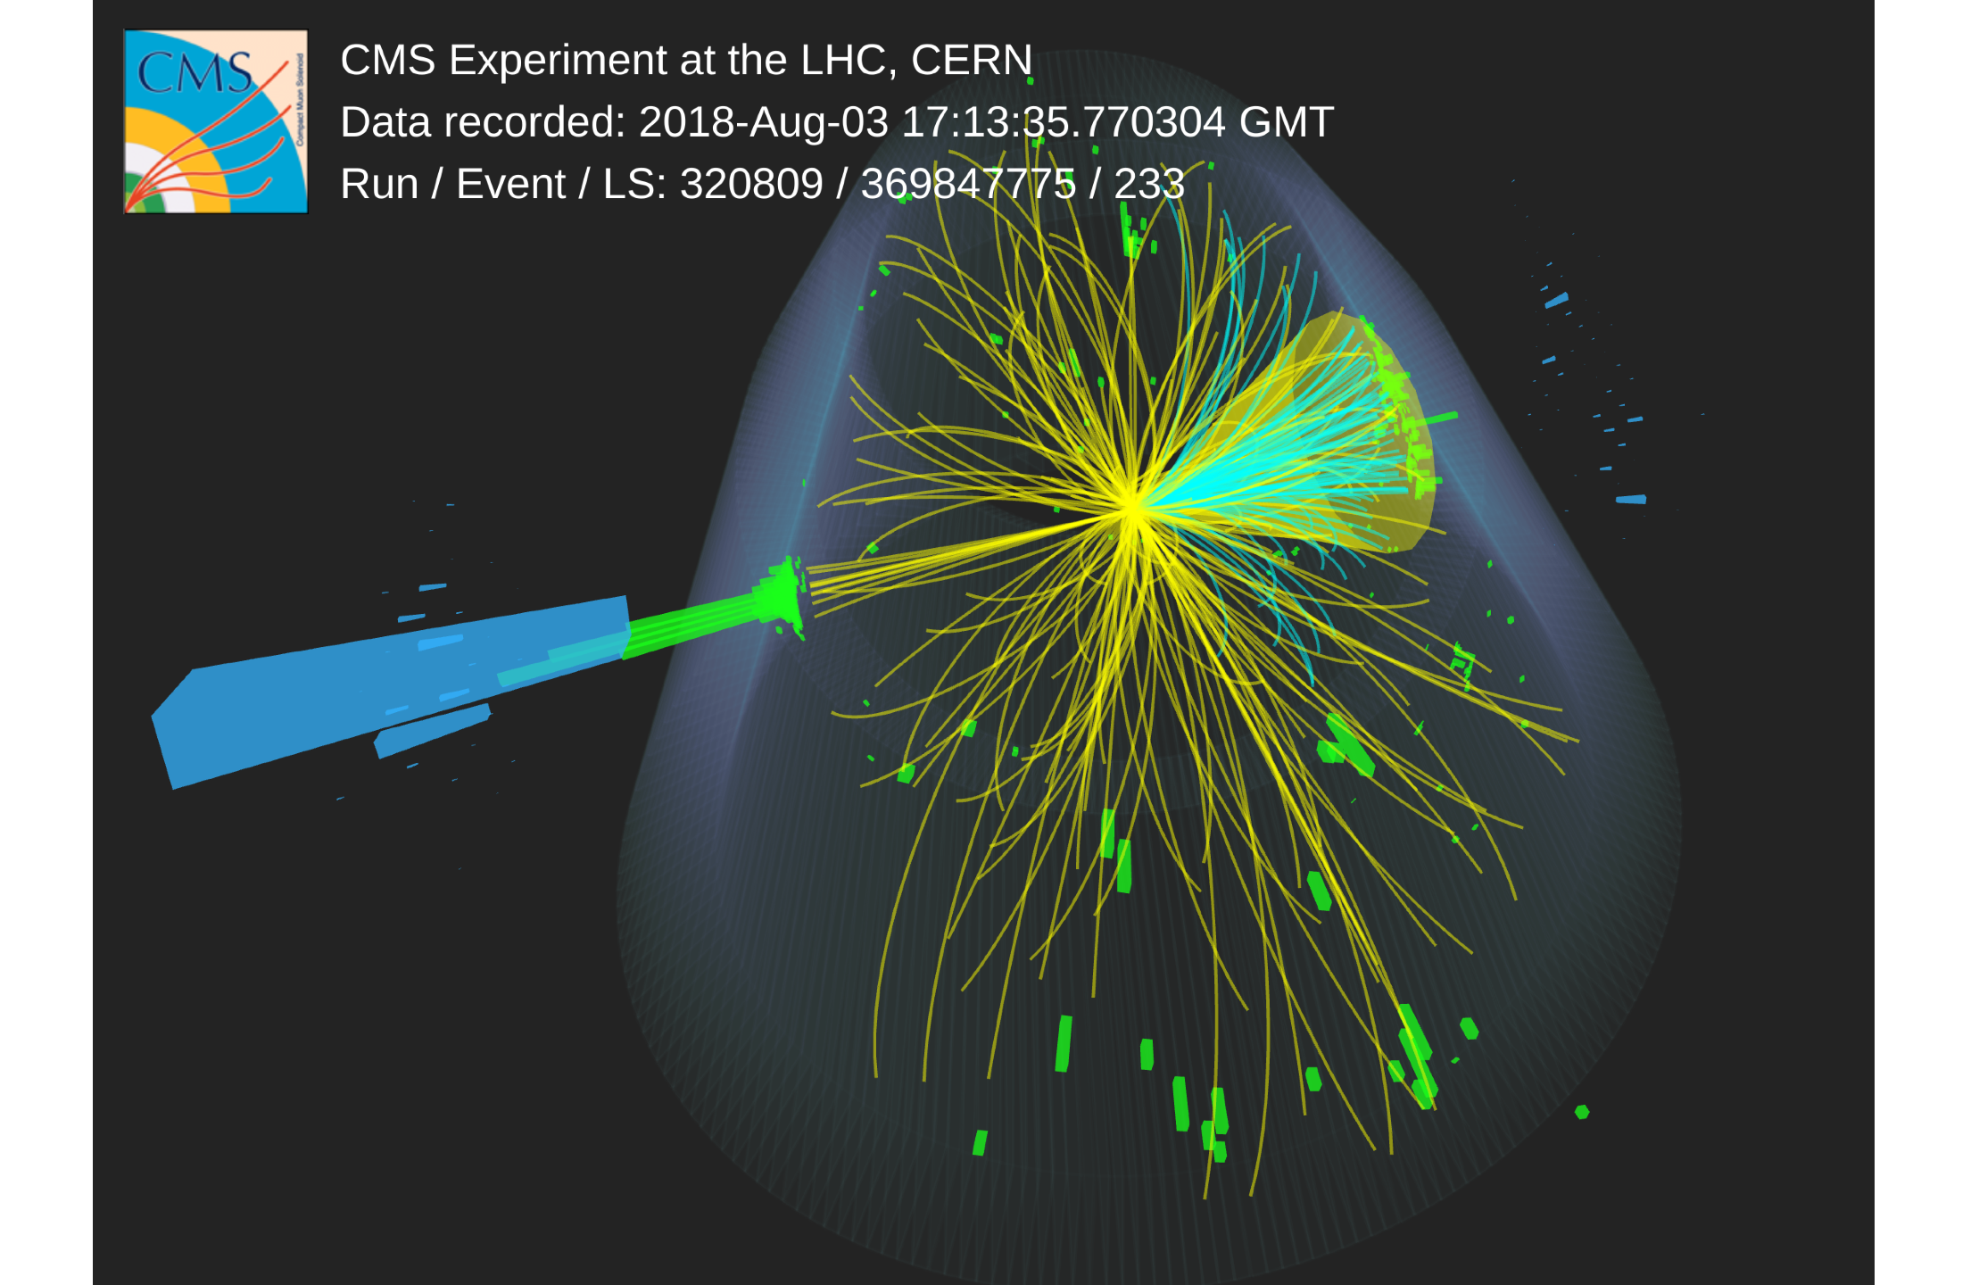
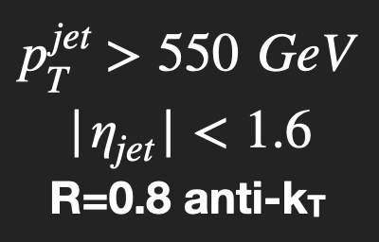
Full nominal pp data
from Run 2 (138/fb)
Full nominal pp data
from Run 2 (138/fb)
Pileups (~ 40) mitigate
Select top ~2,500 jets in N_{ch} out of 10⁸ jets analyzed
Analyzing only particles clustered into a jet
Notes:
These high-multiplicity jets are extremely rare, but they do exist. With all the Run-2 data, CMS recorded about 2,500 jets with Nch > 95, enabling us to study this ultimate small system.
standard cms procedure for pileup mitigation called puppi what is vn
transverse anisotropy
comes from initial geometry
the fact it converts initial anisotropy to the final state extremely efficient suggests it is strongly coupled and low viscosity (viscosity will smear out the fine strucure of flow )
the cartoon we have in mind

Slide 19
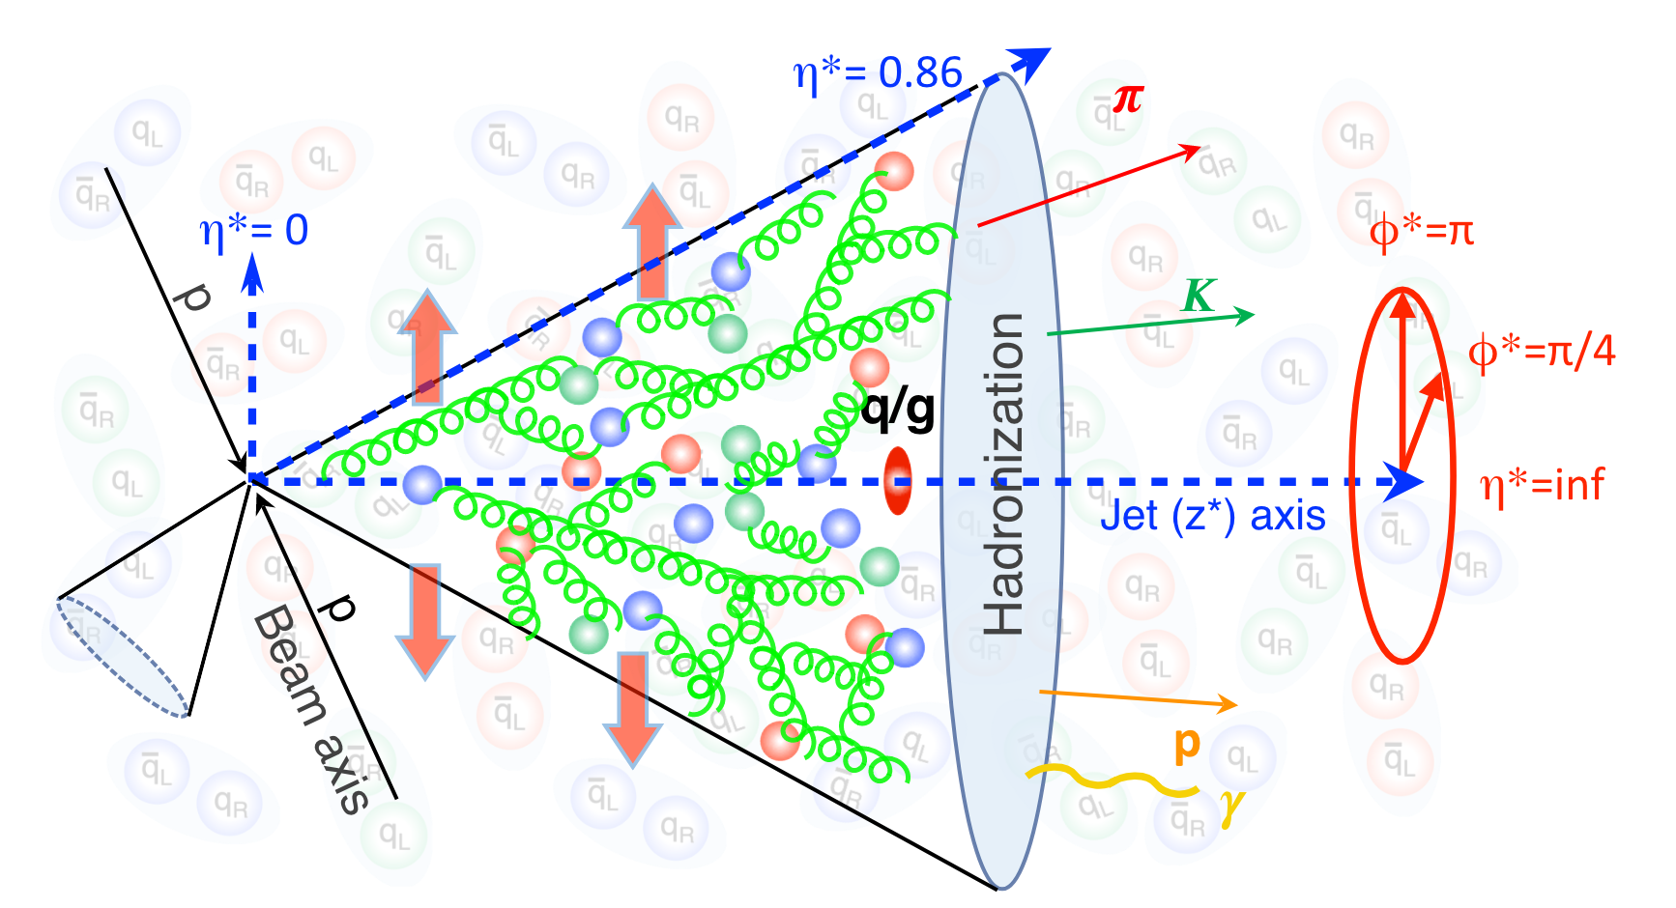
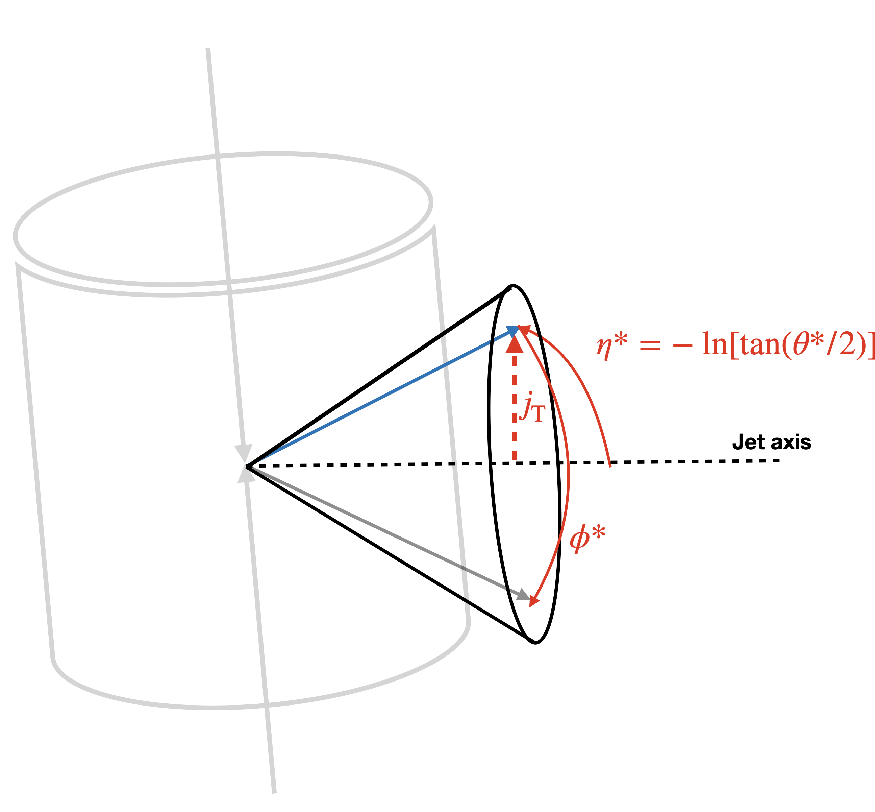
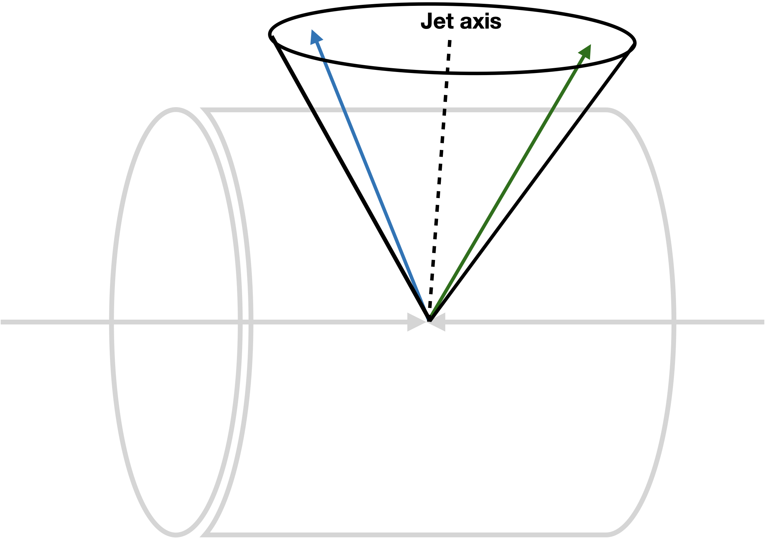

Rotation to the Jet Frame
Jet axis
Jet axis
beam axis
$$φ^{∗}=0$$
beam axis
Rotation is done for every jet individually.
$p=\left(p_{T},η, φ\right)$ ➜ $p^{∗}=\left(j_{T},η^{∗},φ^{∗}\right)$
Notes:
Before showing results, let me emphasize an important aspect of any measurement within a jet.
When a jet propagates, all transverse activity happens relative to the jet axis. Therefore, any azimuthal correlations we measure should also be defined with respect to the jet axis, not the beam axis.

Slide 20
Rotation to the Jet Frame
70
Jet axis
$$φ^{∗}=0$$
beam axis
Rotation is done for every jet individually.
$p=\left(p_{T},η, φ\right)$ ➜ $p^{∗}=\left(j_{T},η^{∗},φ^{∗}\right)$
Notes:
shift towards smaller eta, high Nch gluon radiation, large angle
reach peripheral Heavy ion collisions (rhic energy)

Slide 21
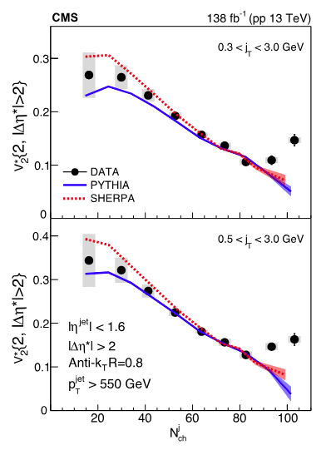

Elliptic flow $v_{2}^{∗}$
Enhanced elliptic anisotropies at high multiplicities.
Onset of collectivity?
PRL 133 (2024) 142301
Notes:
Now let’s take a look at v₂ in the jet frame.
A surprising v₂ enhancement is observed at high Nch.
This enhancement cannot be explained by models such as Pythia8 or Sherpa.
This result is intriguing, because it may indicate the onset of collectivity within jets.

Slide 22
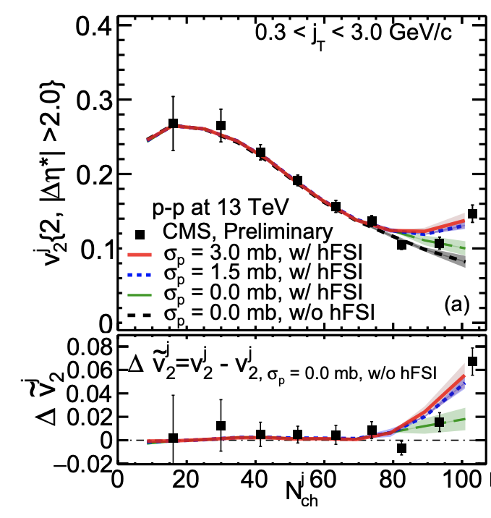
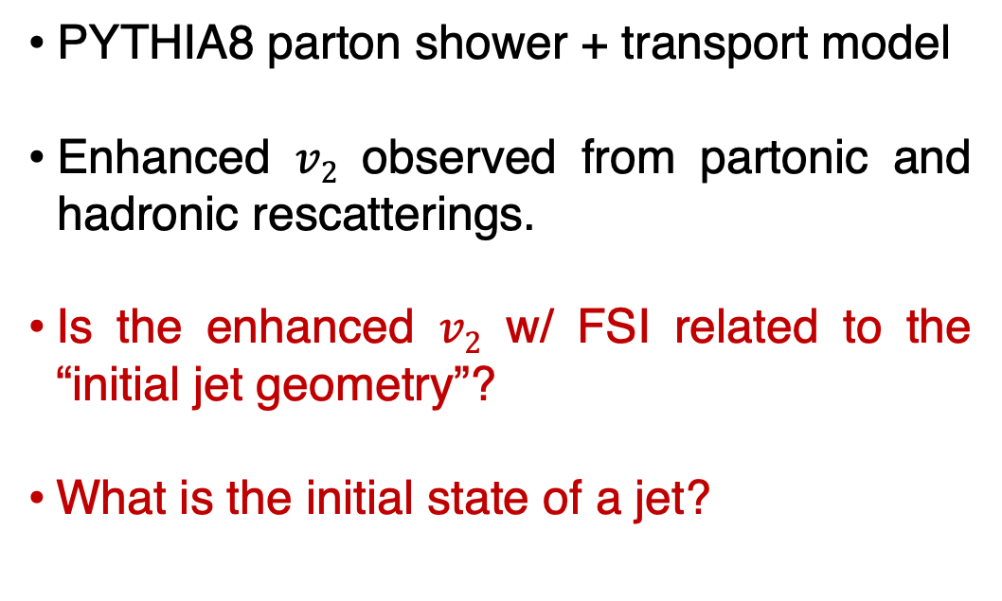
Recent theoretical developments
W. Zhao et. al.,arXiv:2401.13137
PYTHIA8 parton shower + transport model
Enhanced $v2$ observed from partonic and hadronic rescatterings.
Is the enhanced $v2$ w/ FSI related to the “initial jet geometry”?
What is the initial state of a jet?
Notes:
About three months after CMS published these results, a theoretical model combining Pythia parton showers with a transport model was able to reproduce the CMS measurement.
The enhanced v₂ arises from partonic and hadronic rescatterings — but importantly, hadronic rescattering alone is not sufficient.
Besides rescattering, another essential ingredient for v₂ is the initial geometry.
So, a natural question is: is the enhanced v₂ related to the initial jet geometry?

Slide 23
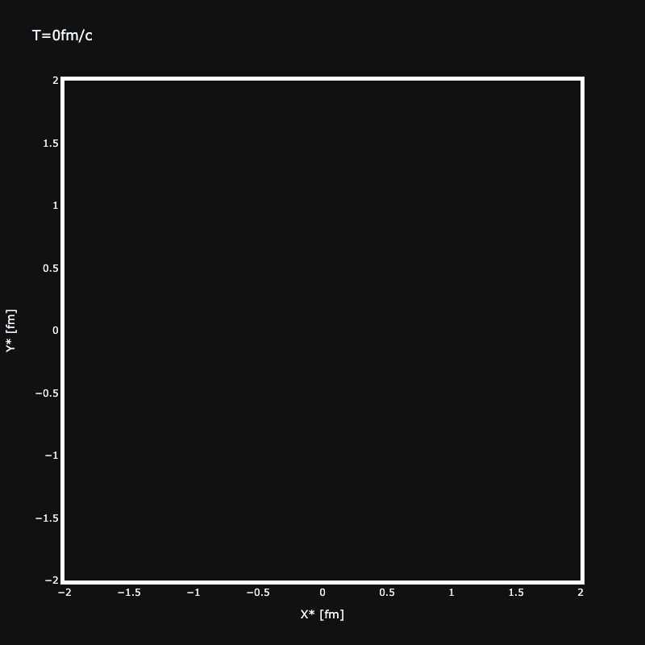
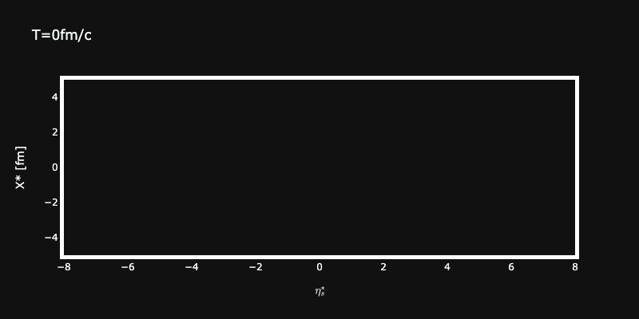

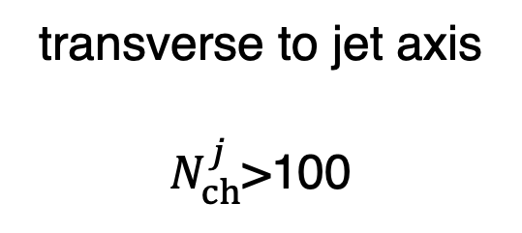



Initial stages of a jet
Space-time evolution of parton showers
PYTHIA8
MUSIC
PYTHIA
PYTHIA8
jet axis
$$y^{∗} [fm]$$
$$x^{∗} [fm]$$
$$x^{∗} [fm]$$
$$η_{s} [fm]$$
transverse to jet axis
$N_{ch}^{j}$>100
Notes:
Here we look at the space-time evolution of parton showers from Pythia8, in the jet frame.
Focusing on the transverse direction, we can quantify the initial jet geometry by the eccentricity of the partons.
The plot on the right shows the time evolution of eccentricity for low-, high-, and inclusive jets. You see that a sizable initial eccentricity exists for all of them.

Slide 24
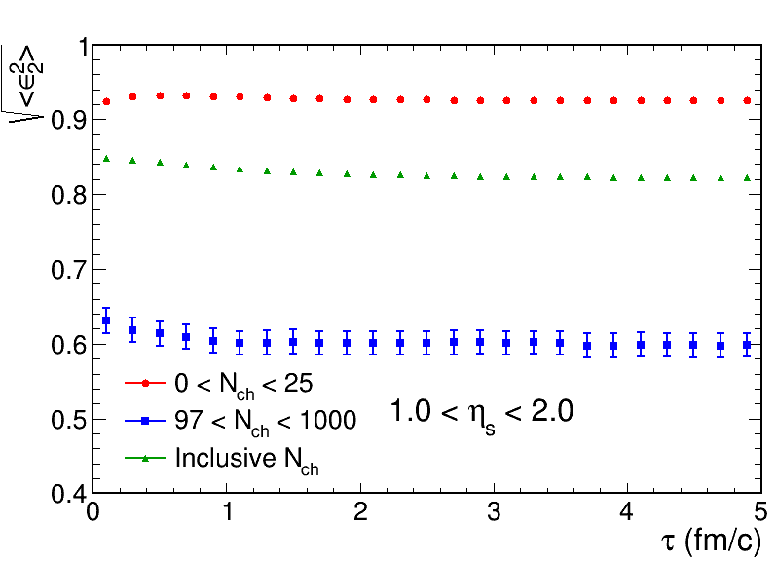
Initial stages of a jet
Jet frame
Transverse “jet geometry”
PYTHIA8
$$y^{∗} [fm]$$
$$x^{∗} [fm]$$
Sizable initial-state eccentricity
Notes:
Focusing on the transverse direction, we can quantify the initial jet geometry by the eccentricity of the partons.
The plot on the right shows the time evolution of eccentricity for low-, high-, and inclusive jets. You see that a sizable initial eccentricity exists for all of them.
\boldsymbol{\varepsilon}_n = \varepsilon_n e^{i n \Phi_n} \equiv \frac{\sum_j w_j e^{i n \phi^{*,\mathrm{coord}}_j}}{\sum_j w_j}, \qquad \phi^{*,\mathrm{coord}}_j = \arctan\!\left(\frac{y^*_j - \langle y^* \rangle_p}{x^*_j - \langle x^* \rangle_p}\right)

Slide 25
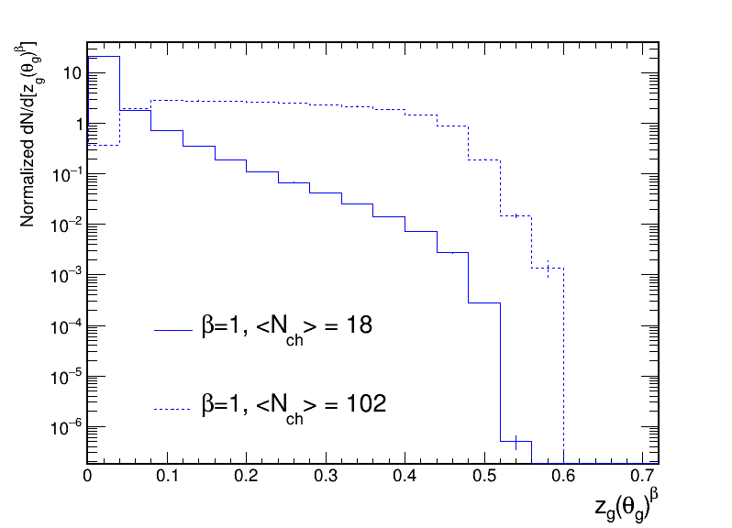
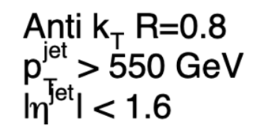
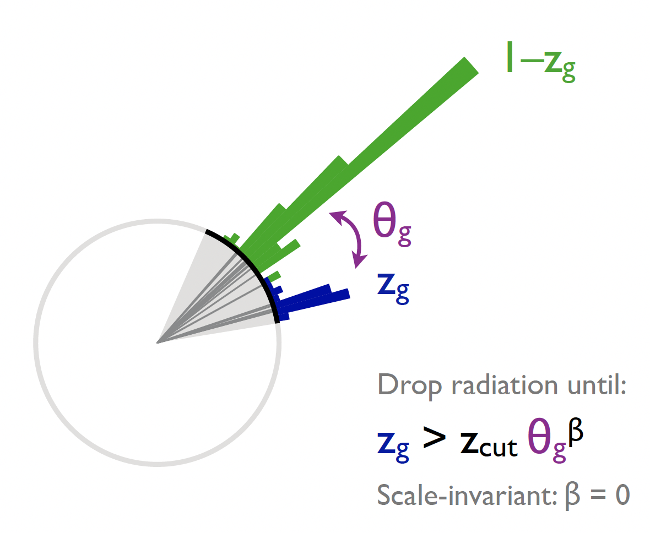

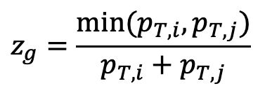
Does final-state $v_{2}$ correlate with initial $ε_{2}$?
PYTHIA 8 pp 13 TeV
Jet substructure engineering (JSE)
$$z_{g}=\frac{min⁡(p_{T,i},p_{T,j})}{p_{T,i}+p_{T,j}}$$
z_{cut}=0.1
J. Thaler
Notes:
We use the combination, z<sub>g</sub>·θ<sub>g</sub>, to characterize the jet’s substructure shape.
This distribution shows z<sub>g</sub>·θ<sub>g</sub> for low- and high-multiplicity jets in Pythia8.
The larger this observable is, the more prominent the two-prong substructure within the jet.

Slide 26

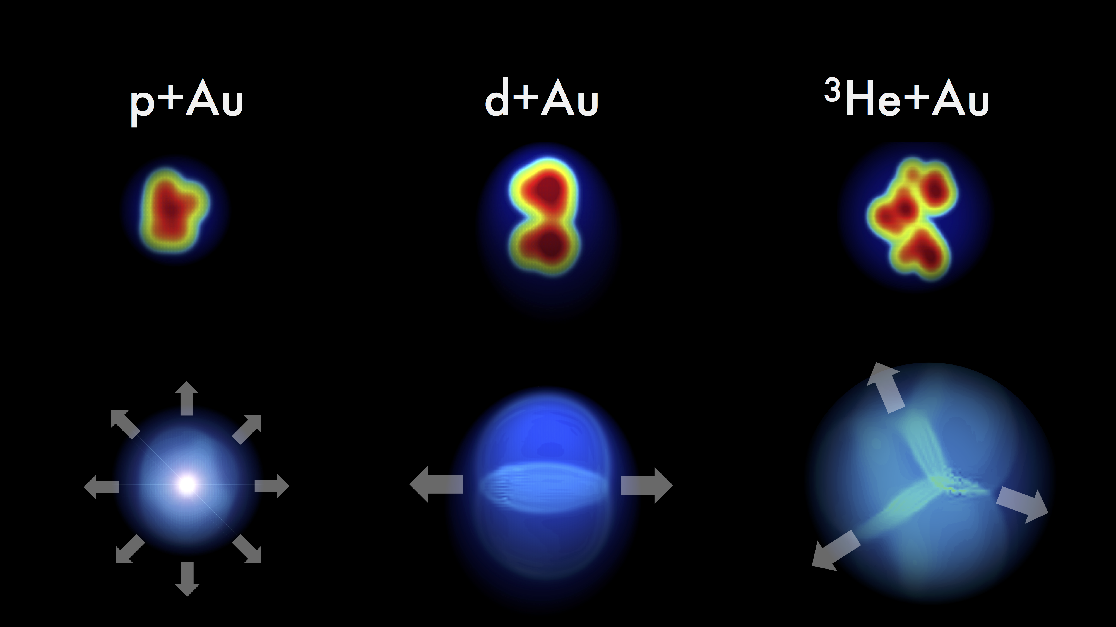
Jet substructure engineering
PYTHIA 8 pp 13 TeV
z_{cut}=0.1
Increasing eccentricity?
Notes:
Two-prong jets are particularly interesting, because they may correspond to larger eccentricities at the early stage of the parton shower — somewhat like comparing d–Au to p–Au collisions.

Slide 27
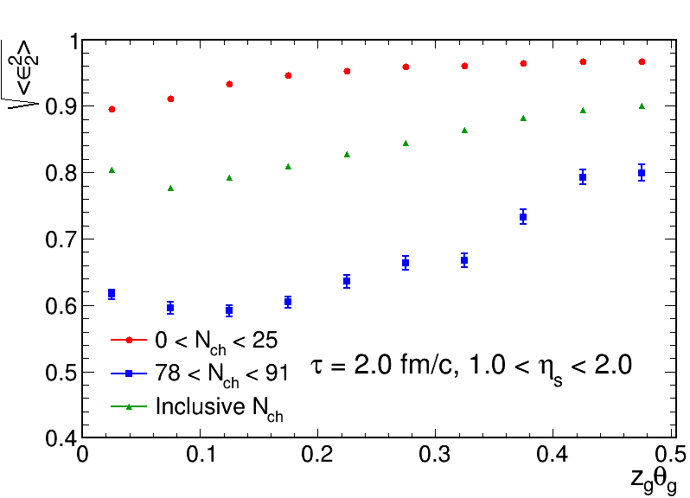
Jet substructure engineering
PYTHIA8 + transport model
Engineering the substructure does vary the “initial jet geometry”
Will $v2$ in jets be correlated with the jet substructure?
Notes:
Model studies confirm this: eccentricity strongly correlates with z<sub>g</sub>·θ<sub>g</sub>.

Slide 28


Jet substructure classified $v_{2}^{∗}(N_{ch}^{j})$
CMS-PAS-HIN-24-024
Enhancement of $v_{2}^{∗}$ relative to MC mainly for two-prone jets – Geometry driven?
Notes:
suggesting possible connections to the initial jet geometry

Slide 29
Jet substructure classified $v_{2}^{∗}(N_{ch}^{j})$
CMS-PAS-HIN-24-024
Average jet substructure data
well described by PYTHIA8
- No room for exotic configurations
Enhancement of $v_{2}^{∗}$ relative to MC mainly for two-prone jets – Geometry driven?
Notes:
It is also worth mentioning that the average z<sub>g</sub>·θ<sub>g</sub> across all multiplicities is well described by Pythia, leaving no room for exotic configurations present in data but missing in simulation.

Slide 30

Jet substructure classified $v_{2}^{∗}(N_{ch}^{j})$
CMS-PAS-HIN-24-024
Only $\sim 5\%$ data explored (pp), more HM jets in HL-LHC era!
Enhancement of $v_{2}^{∗}$ relative to MC mainly for two-prone jets – Geometry driven?

Slide 31

Summary
p/A
p/A
?
q/g
$$⟺$$
Collectivity is universal across QCD systems?
Jets provide a new femto-lab to probe the smallest scales.
Open question: is collectivity a generic property of excited QCD vacuum?
A very rich program ahead at the LHC. Stay tuned!
Notes:
just beginning, future plan

Slide 32
Thank you

Slide 33
Backup

Slide 34
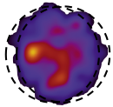
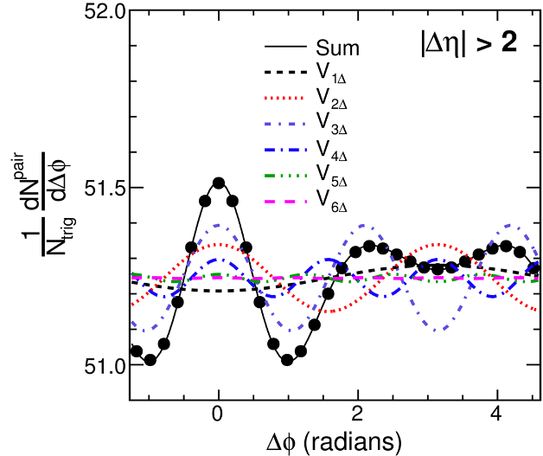
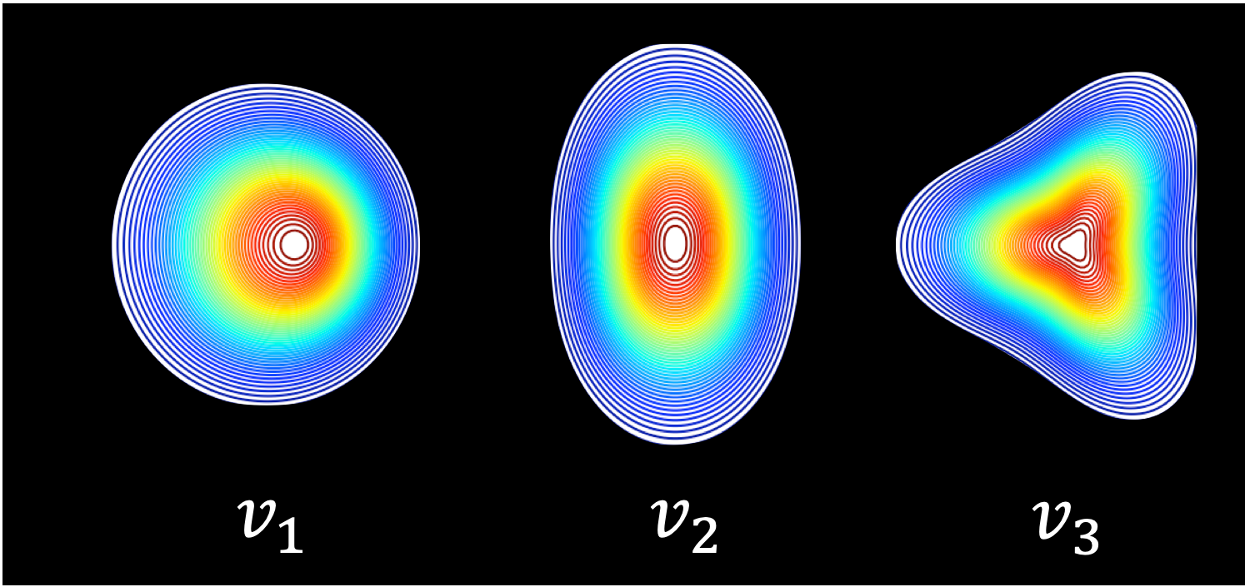
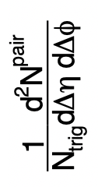


Anisotropic flow ($v_{n}$)
Two particle correlation method:
PbPb 2.76 TeV
Head-on (top 0.2%)
$$V_{nΔ}=v_{n}^{2}$$
y
1 < p_{T}ª, p_{T}^{b} < 3 GeV
x
Notes:
v1: there is a displacement along the x axis
what is vn
transverse anisotropy
comes from initial geometry
the fact it converts initial anisotropy to the final state extremely efficient suggests it is strongly coupled and low viscosity (viscosity will smear out the fine strucure of flow )
\frac{\mathrm{d}N^{\mathrm{pairs}}}{\mathrm{d}\Delta\phi}=\frac{N^{\mathrm{pairs}}}{2\pi}[1+\sum_{n}2v_n^2\cos{(n\Delta\phi)}].

Slide 35
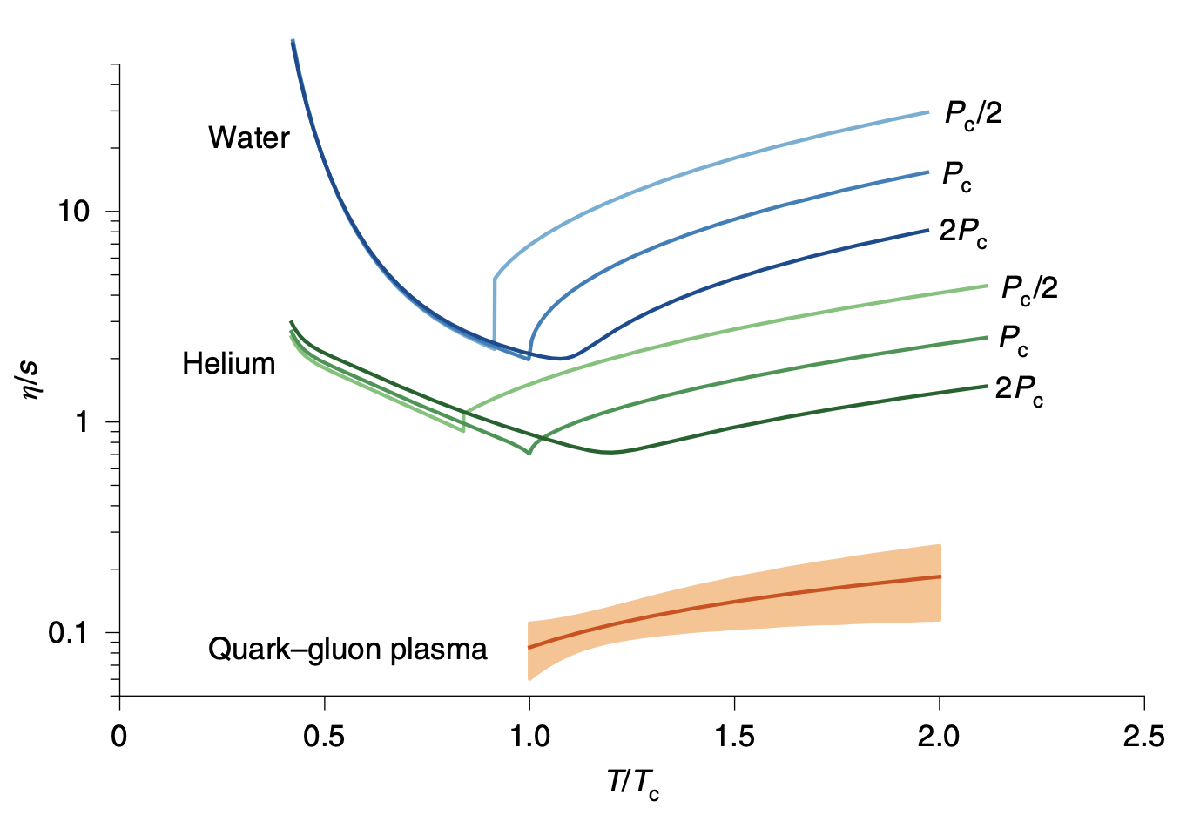
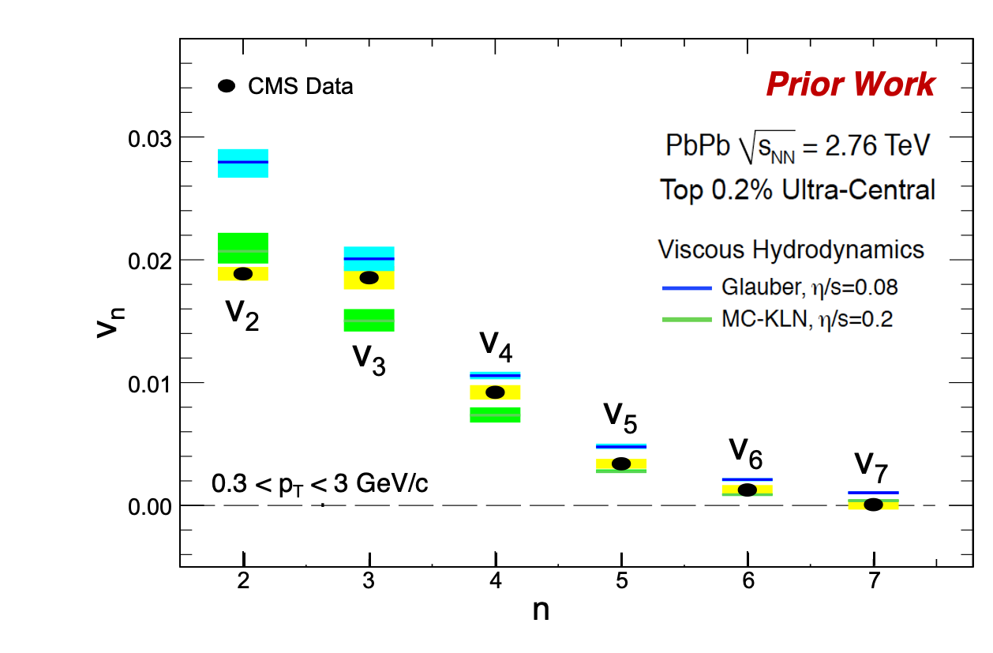


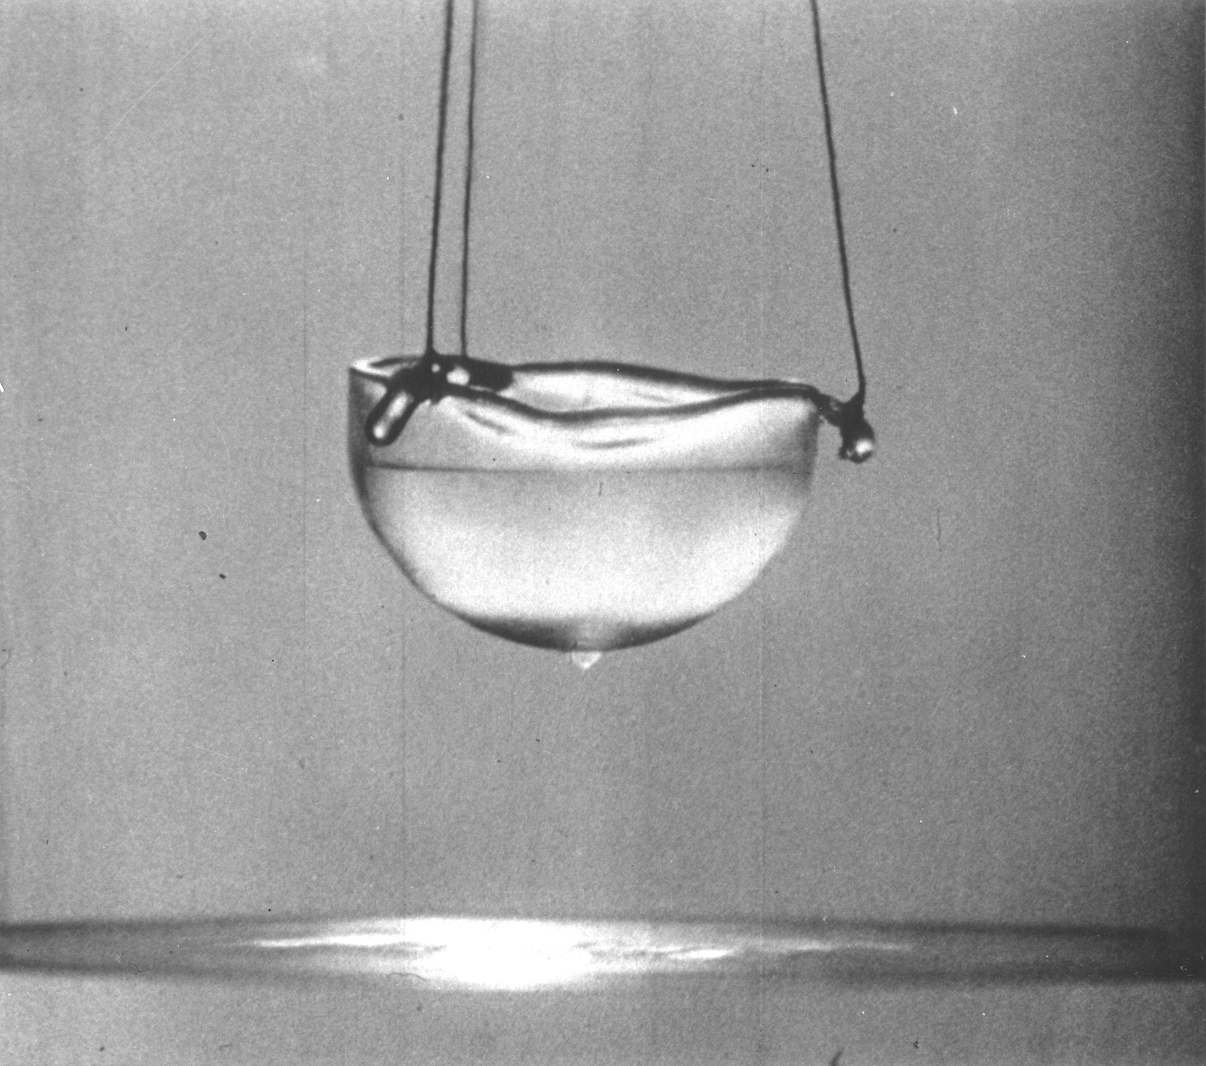





Discovery of ideal fluid
Shear viscosity to entropy density ($η$/s)
from Bayesian analysis of $vn$ data
Elliptic ($v2$) and high-order ($vn$) flow
Nature Physics 15, 1113 (2019)
CMS Flow Data
Theoretical limit from
ADS/CFT calculations
JHEP 02 (2014) 088
QGP is a strongly coupled, nearly “perfect” liquid ($η$/s ~ 0), and extremely efficient in converting initial anisotropy to the final state.
Notes:
Hydrodynamics can effectively describe QGP.
Provide access to equation of state (EoS) and transport coefficient of QGP.
[6] C. Gale, S. Jeon, and B. Schenke, Hydrodynamic Mod- eling of Heavy-Ion Collisions, Int. J. Mod. Phys. A 28, 1340011 (2013), arXiv:1301.5893 [nucl-th].
The QGP created at RHIC can be understood remarkably well when modeled as a hydrodynamic system [6], providing access to the equation of state (EoS) and transport coefficients [7, 8] of the QCD matter under extreme conditions.
shear viscosity ($η$): resistance to deformation

Slide 36
Opacity and multiplicity
Total entropy: $S\sim N_{ch}$
Entropy density: $\frac{S}{L^{3}}\sim T^{3}$
$\frac{N_{ch}}{L^{3}}\sim T^{3}$
Mean free path: $ℓ_{mfp}\sim \frac{1}{T}$
$\frac{L^{3}}{ℓ_{mfp}^{3}}\sim N_{ch}$
$\frac{L}{ℓ_{mfp}}\sim {{(N}_{ch})}^{\frac{1}{3}}$

Slide 37

Rotation to the Jet Frame
Jet axis
$$φ^{∗}=0$$
beam axis
Rotation is done for every jet individually.
$p=\left(p_{T},η, φ\right)$ ➜ $p^{∗}=\left(j_{T},η^{∗},φ^{∗}\right)$
Notes:
shift towards smaller eta, high Nch gluon radiation, large angle
reach peripheral Heavy ion collisions (rhic energy)

Slide 38

Two-particle correlation
Charged jet constituents
Notes:
S(\Delta\eta^*,\Delta\phi^*)=\frac{1}{N_{\mathrm{ch}}^{\mathrm{trg}}}\frac{\mathrm{d}^2N^{\mathrm{sig}}}{\mathrm{d}\Delta\eta^*\mathrm{d}\Delta\phi^*},
B(\Delta\eta^*,\Delta\phi^*)=\frac{1}{N_{\mathrm{ch}}^{\mathrm{trg}}}\frac{d^2N^{\mathrm{combin}}}{\mathrm{d}\Delta\eta^*\mathrm{d}\Delta\phi^*},

Slide 39


Two-particle correlation
PRL 133 (2024) 142301
(HIN-21-013)
Notes:
\frac{1}{N_{\mathrm{ch}}^{\mathrm{trg}}}\frac{\mathrm{d}^2N^{\mathrm{pair}}}{\mathrm{d}\Delta\eta^*\mathrm{d}\Delta\phi^*}=B(0,0)\frac{S(\Delta\eta^*,\Delta\phi^*)}{B(\Delta\eta^*,\Delta\phi^*)}
\frac{1}{N_{\mathrm{ch}}^{\mathrm{trg}}}\frac{\mathrm{d}^2N^{\mathrm{pair}}}{\mathrm{d}\Delta\phi^*} \propto 1+2\sum_{\mathrm{n}=1}^{\infty}V_{\mathrm{n}\Delta}^{*}\cos{(\mathrm{n}\Delta\phi^{*})}

Slide 40


Elliptic flow $v_{2}^{∗}$
PRL 133 (2024) 142301
A rising trend of $v_{2}^{∗}$ at high $N_{ch}^{j}$ $>80$ , cannot be explained by MC models.
Onset of collectivity?
Notes:
this study trigger us to think if it is onset of col... in this talk i WILL show you soem NEW studies.

Slide 41
Jet substructure observables

Slide 42
$z_{g}θ_{g}$ classified 2D CF
$$z_{g}θ_{g}$$
All charged particles are used
$$N_{ch}^{j}$$
long-range near-side pattern emerges in high $N_{ch}^{j}$ jets with two-prong structures?!
Notes:
mention all charged particles are included

Slide 43




Origin of $v_{2}^{∗}$ enhancement
Energy density evolution in HI
Spatial distribution of partons in a jet
?
MUSIC
$⊥$ to jet axis
jet axis
Is the observed $v_{2}^{∗}$ enhancement related to the “initial parton geometry”?
Notes:
explain the right plots, how did you knwo parton position -> derived from momentum and virtuality. The illustration shows the evolving energy density of the QGP created in a non-central collision. Pressure gradients act on the initial geometrical anisotropy to create a final velocity field (arrows), which may be decomposed into elliptic (yellow), triangular (teal) and higher order components. (Image: MUSIC/arXiv:1209.6330) spatial distribution

Slide 44


Future – exploit the full potential of LHC
5%
Data used so far
15%
HL-LHC
PbPb 5/nb, OO
PbPb 7/nb, pPb
Lighter ions?
O(10⁵) HM jets w/ $N_{ch}^{j}>100$ to explore a multitude of QGP signatures!
3000 fb⁻¹

Slide 45

Underlying event injection: random phase

Slide 46

Underlying event injection: phase locked with jet

Slide 47

Pileup removal

Slide 48


