Slide 1
In Memoriam László Jenkovszky member of ISMD Board of Elders
Tamás Csörgő ^{1,2}
¹HUN-REN Wigner FK, Budapest, and
² MATE Institute of Technology, KRC, Gyöngyös, Hungary
Bio, Scientometrics
Initiator of collaborations
Training of a new generation
Initiator of conference series
School in Hungary, heritage

Slide 2
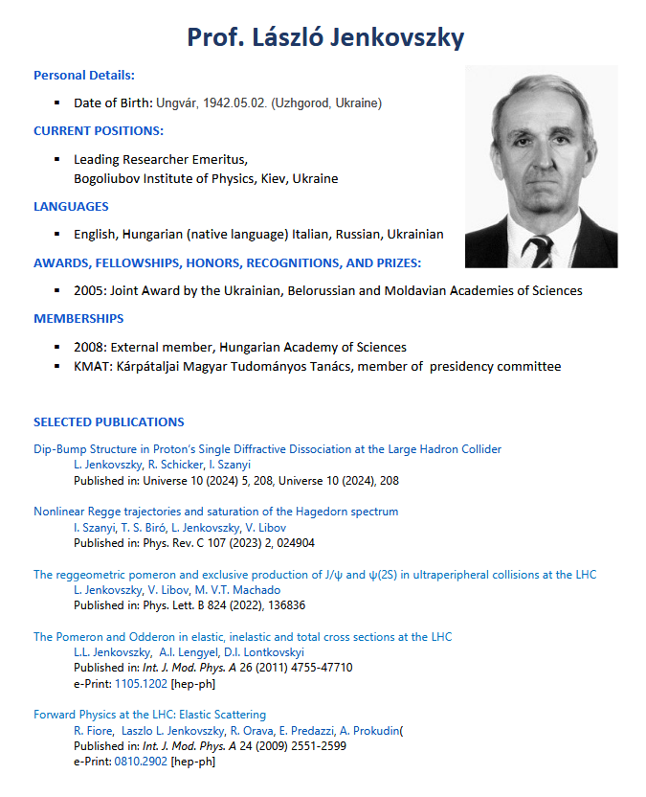
CV of László Jenkovszky
* May 2, 1942
In Ungvár, Hungary
Primary school (1948-56):
In Perecseny, USSR
University (1959-64):
In UZHGOROD, USSR
Ph.D (cand. Sci, 1964-67):
At JINR, DUBNA, USSR
leading Researcher
1967-2013 In BITP, kiev, ukraine
6 languages: English, Hungarian,
Italian, Russian, spanish, Ukrainian
retired (2013) as leading researcher:
Bogoliubov Institute, Kiev, Ukraine
CV From a joint grant proposal,
08/2024, MATE, GYÖNGYÖS, HUNGARY
† August 16, 2025
In kiev, ukraine
2

Slide 3
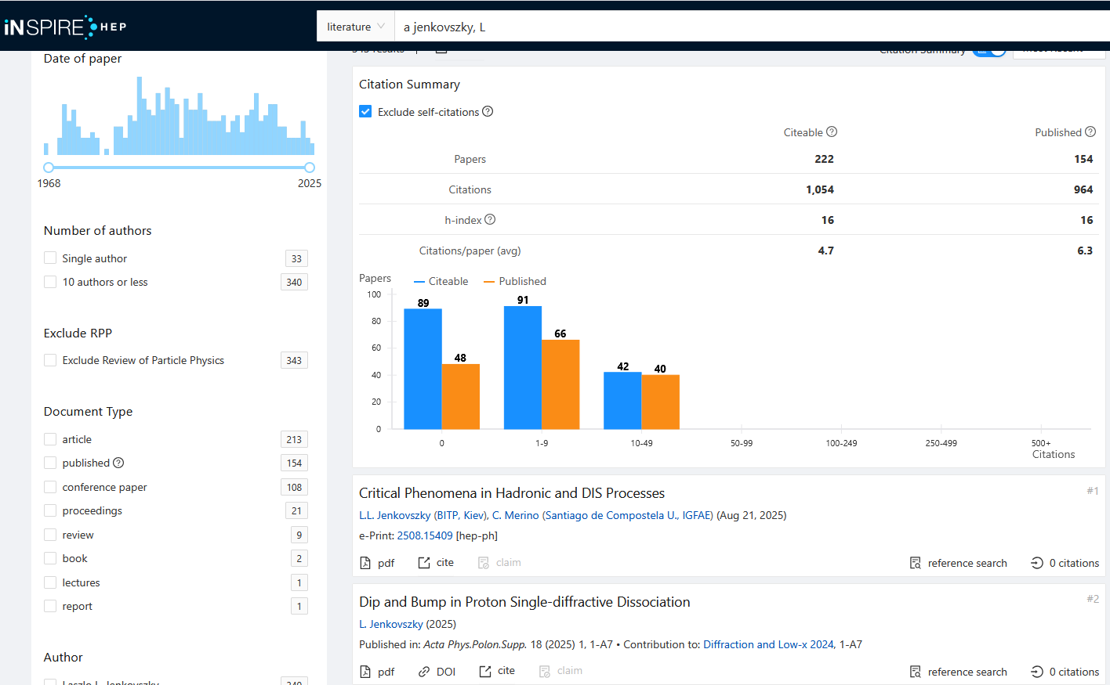
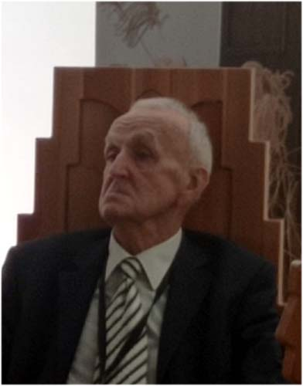
Scientometrics
† Aug. 16, 2025
kiev, ukraine
Two papers
From 2025
At age of 83
Last CONF.:
BGL 2025
In MOROCCO
3

Slide 4
HONORS AND PRIZES
2005: Joint Award by the Ukrainian, Belorussian and Moldavian Academies of Sciences
2008: External member,
Hungarian Academy of Sciences
Member of presidency committee
Hungarian science council of subcarpathia
Member of iAC / PAC of several conference series, eg.
Bolyai-Gauss-Lobachevskii,
Diffraction,
DUBNA JINR PARTICLE PHYSICS,
International Symposium on Multiparticle Dynamics,
Kruger: Discovery physics at the LHC,
NEW TRENDS in HEP, ...
4

Slide 5
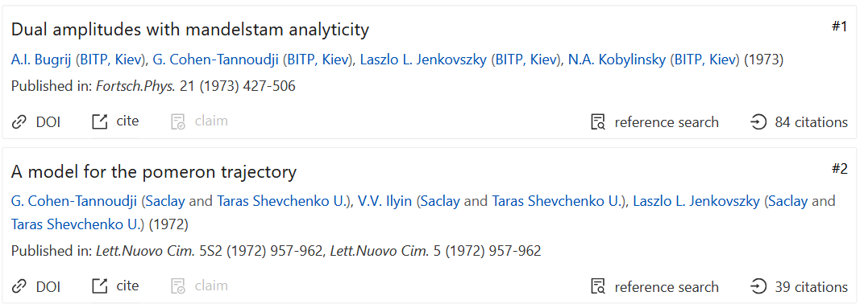
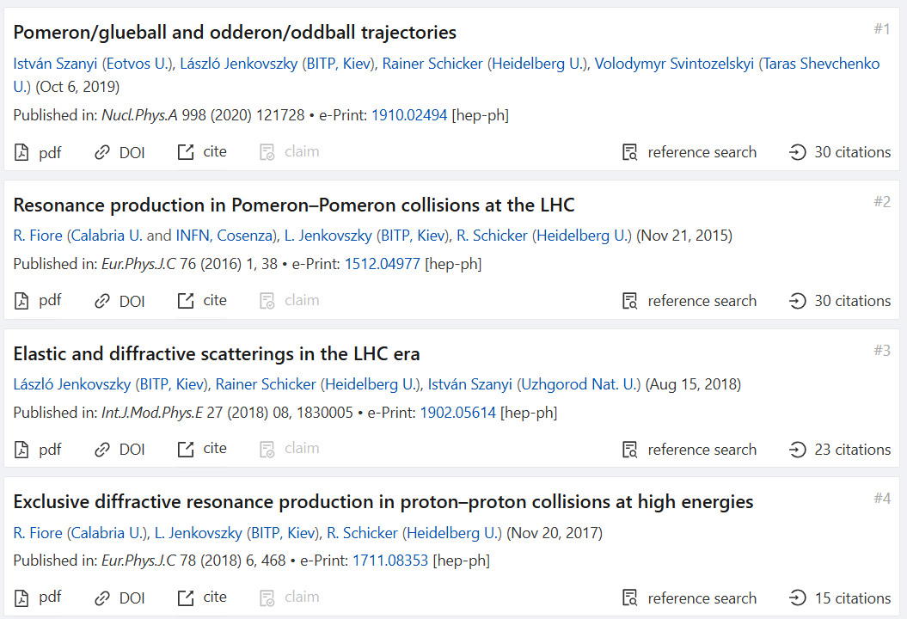
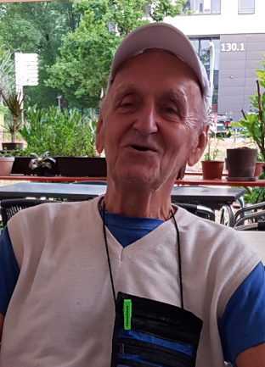
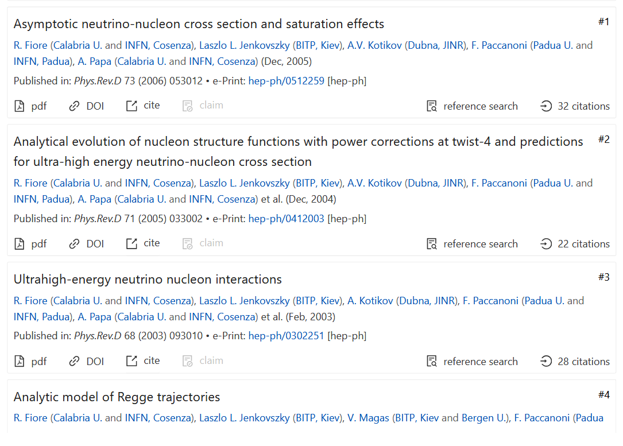
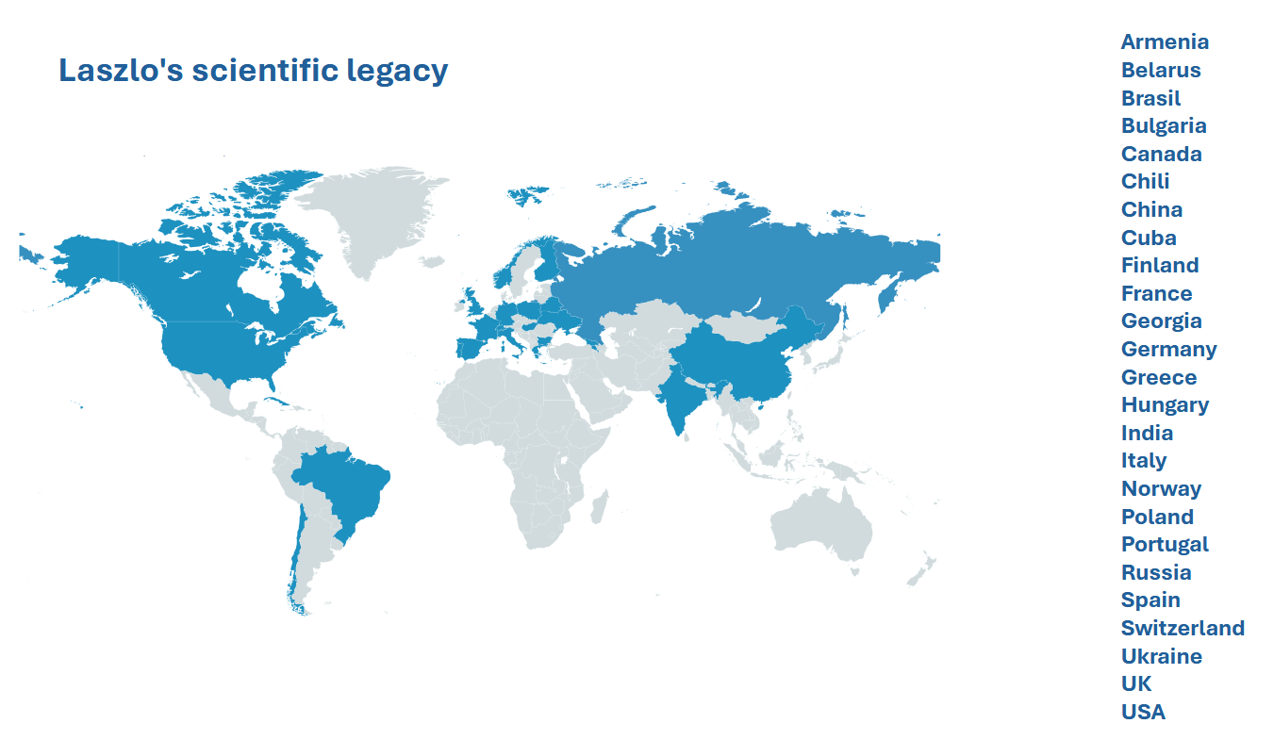
Collaborators: G. Cohen-Tannoudji, R. Fiore, A. Papa,
R. Schicker, …
FROM A. CHEPLAKOV’S
TALK AT NEW Trends IN HEP’25
5

Slide 6
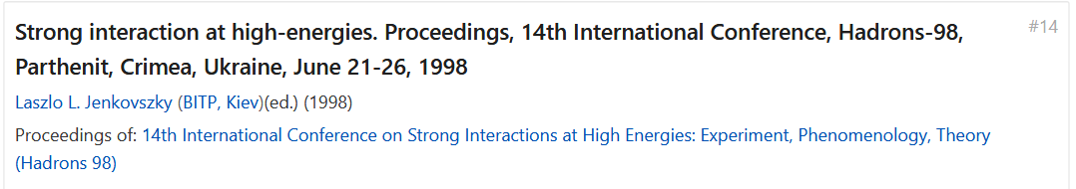
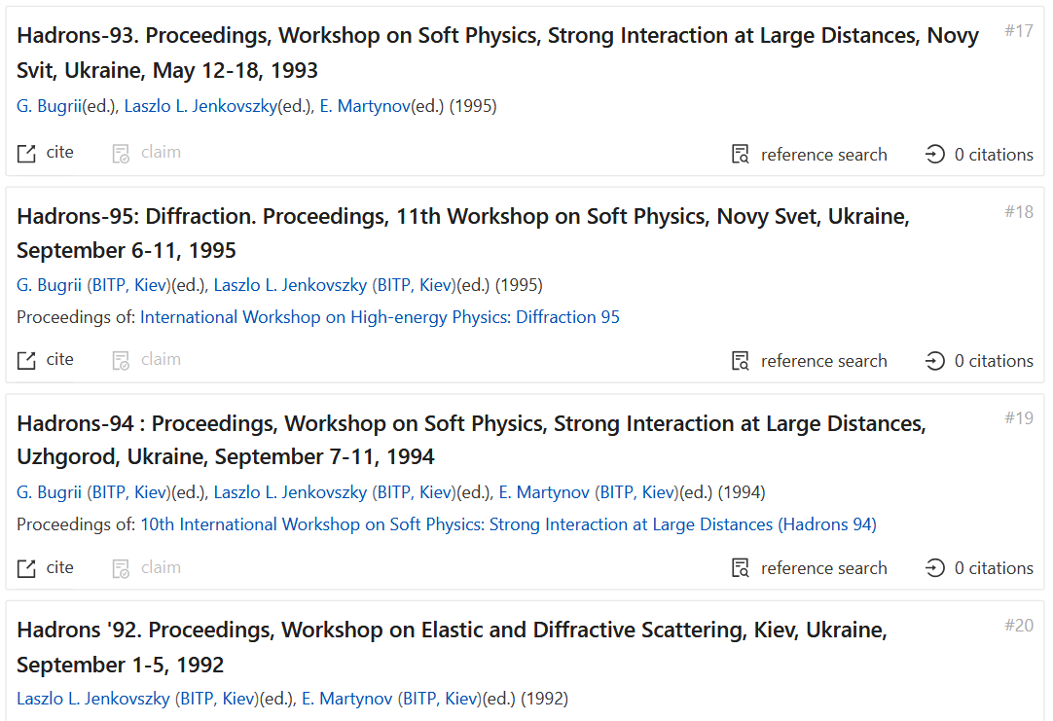
HADRONS (14 CONFERENCES)
Also IN MEMORIAM
E. MARTYNOV
BITP, Kiev, †2025
6

Slide 7
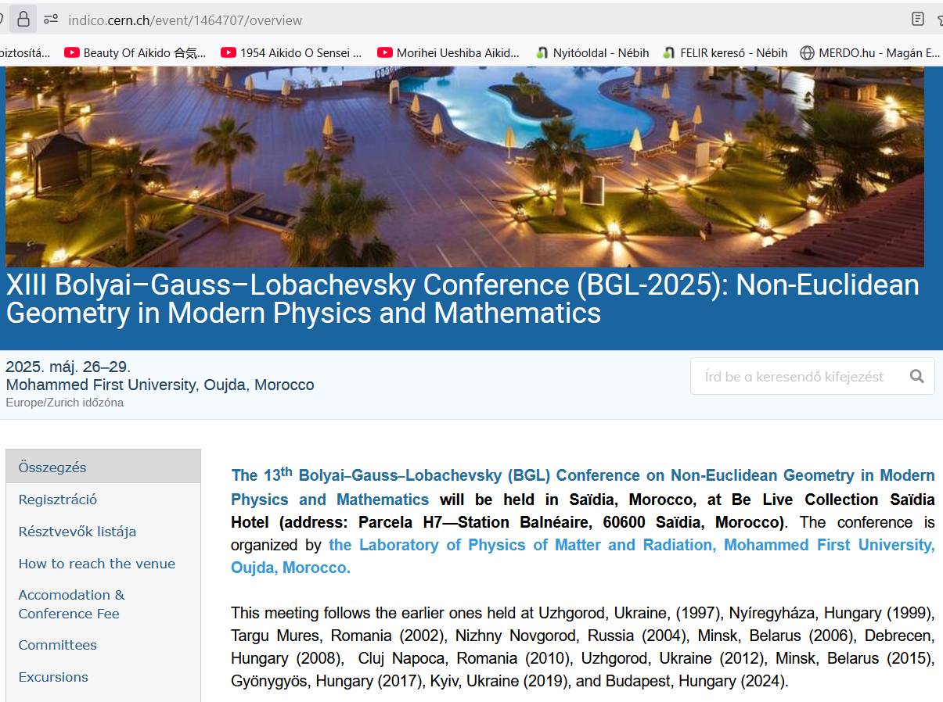
BOLYAI-GAUSS-LOBACHEVSKII (13 CONFERENCES, 1997-2025)
LAST CONFERENCE
Of László
As far
As I know…
7

Slide 8
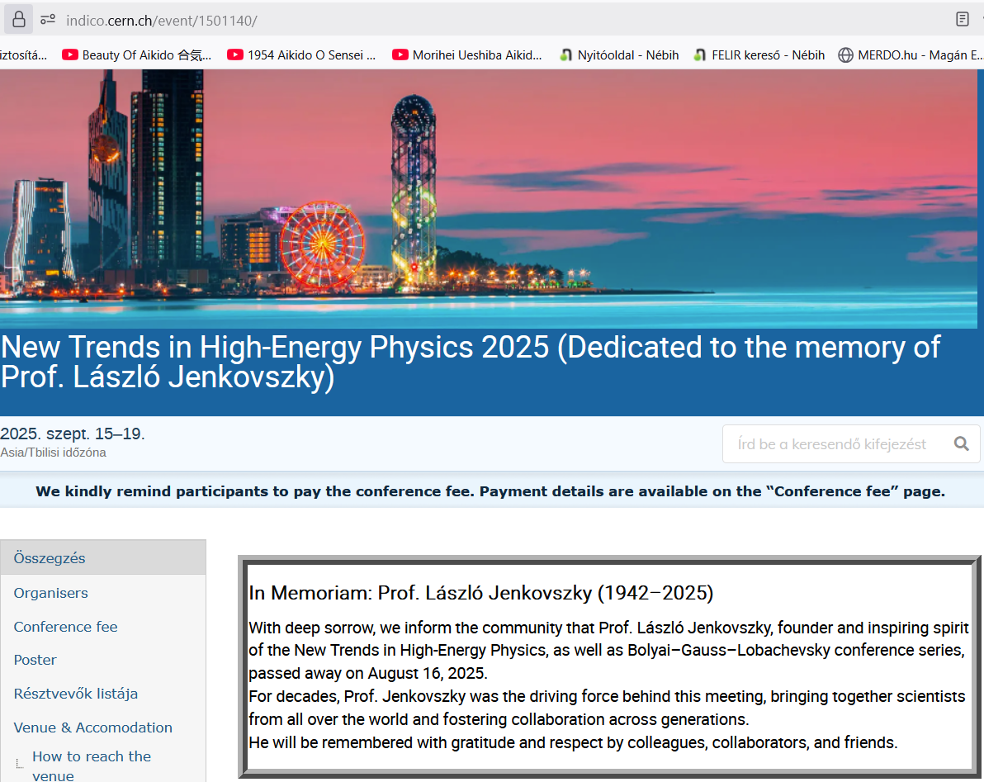
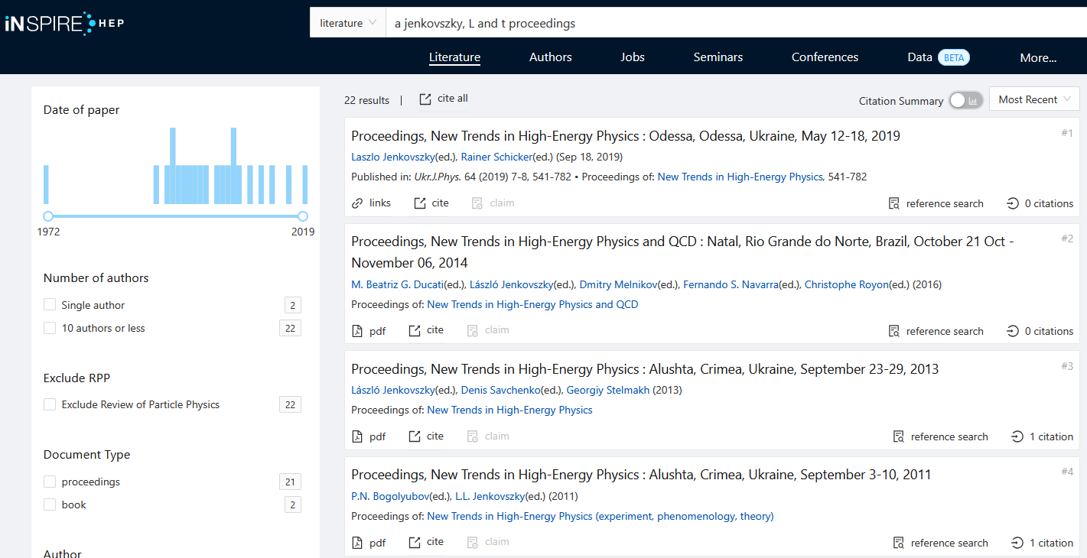
NEW TRENDS IN HEP (2000-25, ~ 20 CONFERENCES)
With R. Schicker, D. Savchenko, Ch. Royon, Sorina Popescu, F. Navarra, P.N. Bogoliubov …
Collaboration across Borders and generations.
Colleagues, collaborators And friends …
8

Slide 9
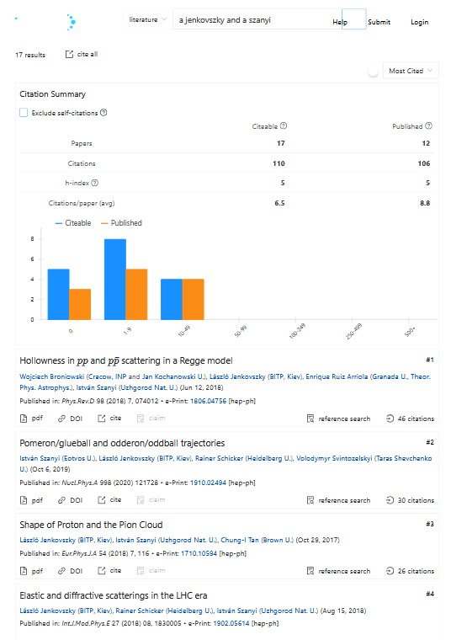
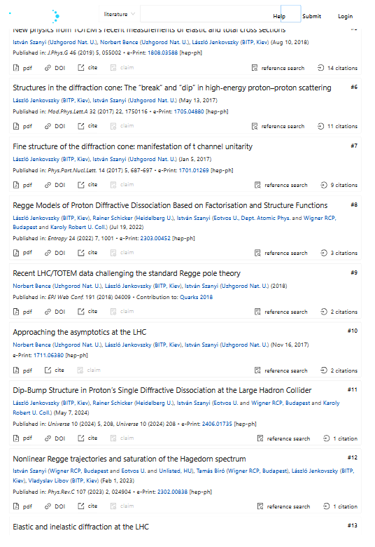
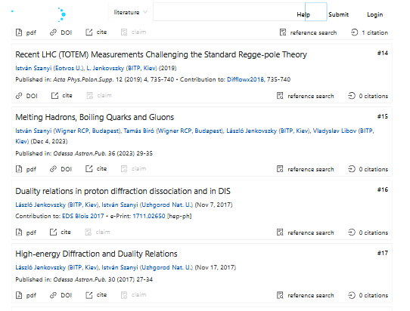
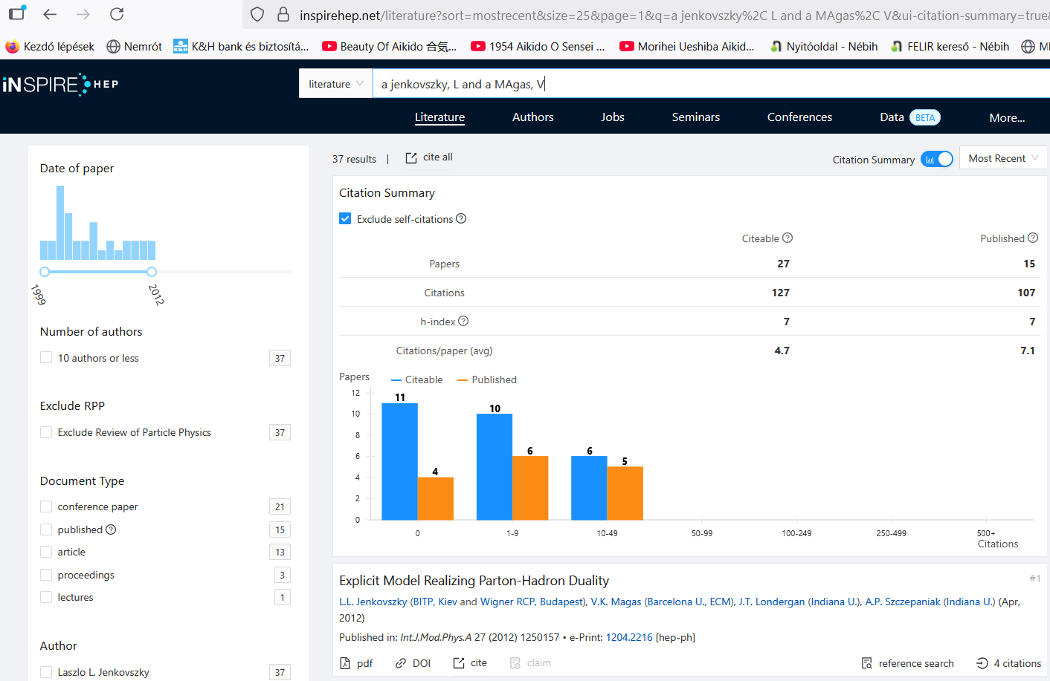
TRAINING TALENTS (SZANYI, MAGAS, BENCE, …)
9

Slide 10
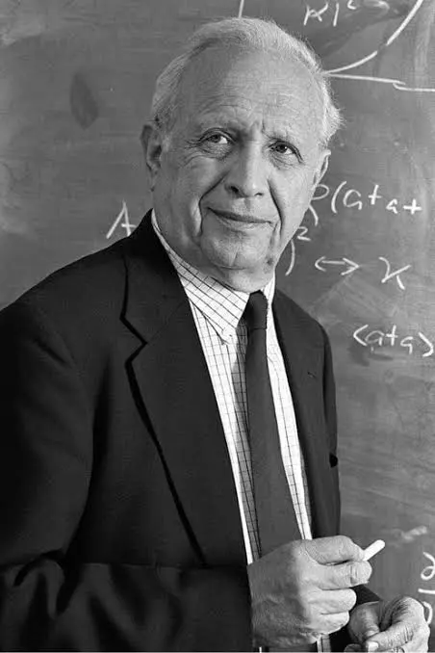
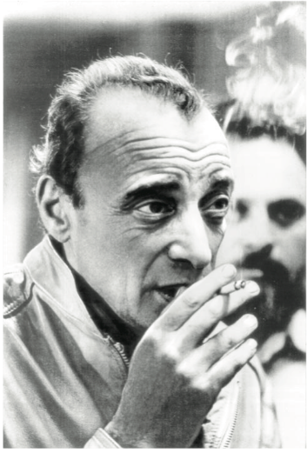
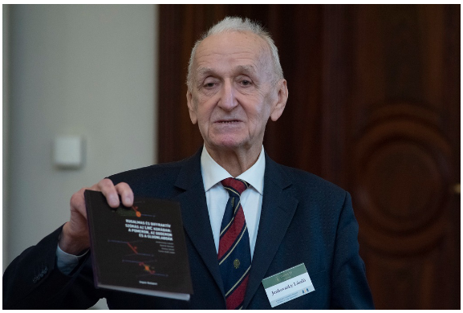
FORWARDING PHYSICS WORLDWIDE, IN HUNGARY
OUR MENTORS
V.N. Gribov (1930-1997)
R. J. Glauber (1925-2018)
L. Jenkovszky (1942-2025)
László sprouted a school on forward physics in Hungary
10

Slide 11
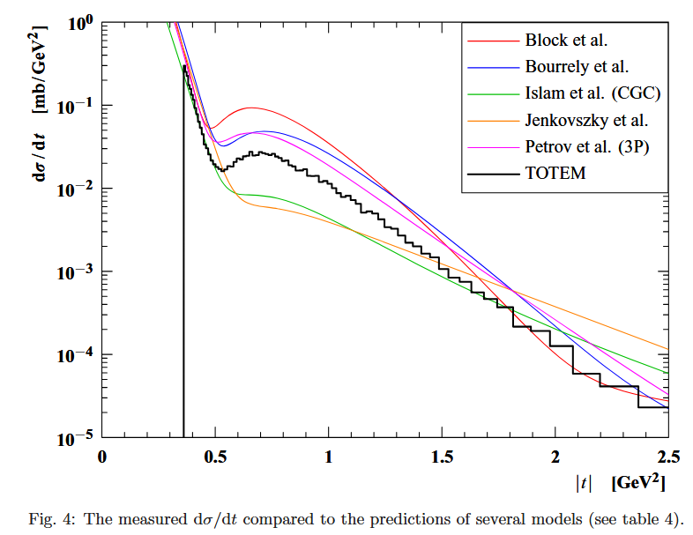
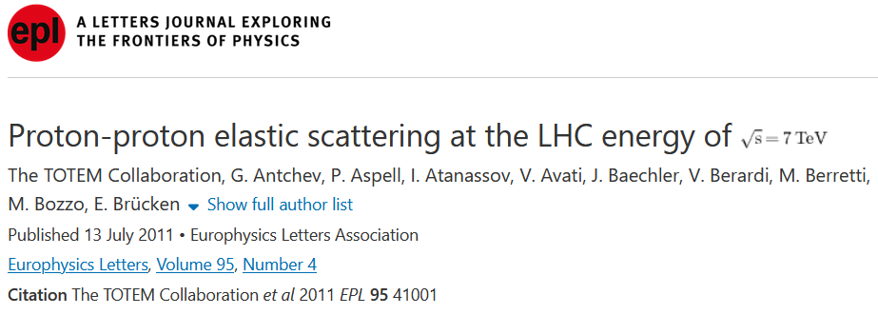
FAMOUS PREDICTIONS I: ELASTIC pp @ LHC 7 TeV
11

Slide 12
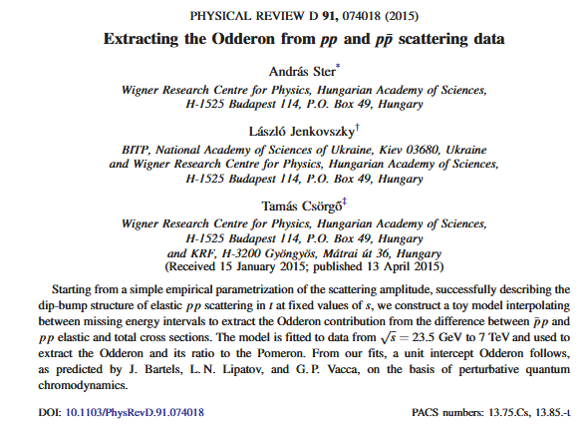
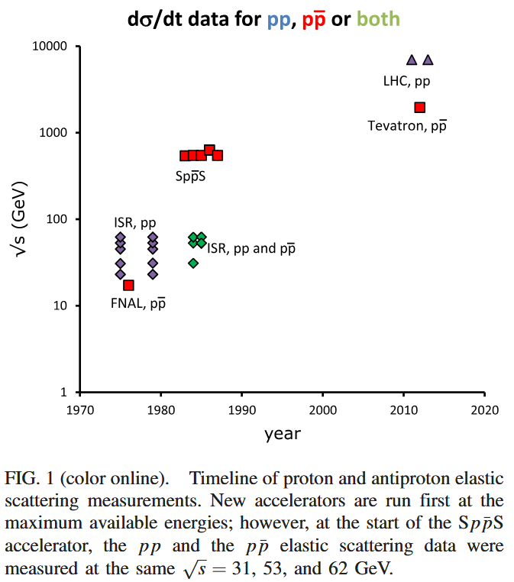
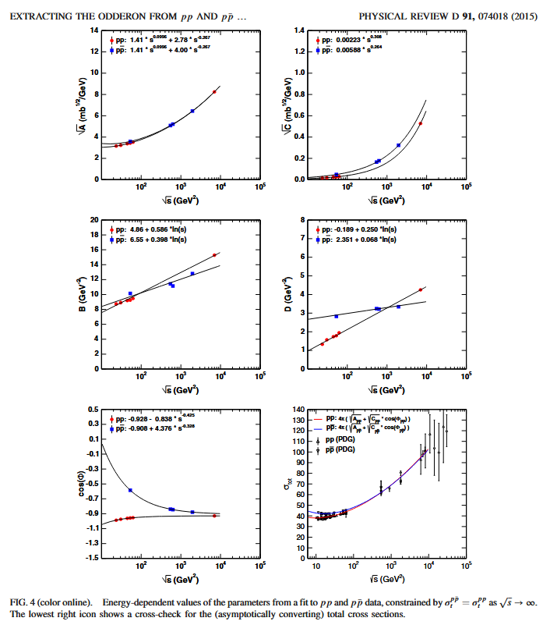
PREDICTION II: ODDERON DISCOVERIES AT LHC
12

Slide 13
13

