Slide 1
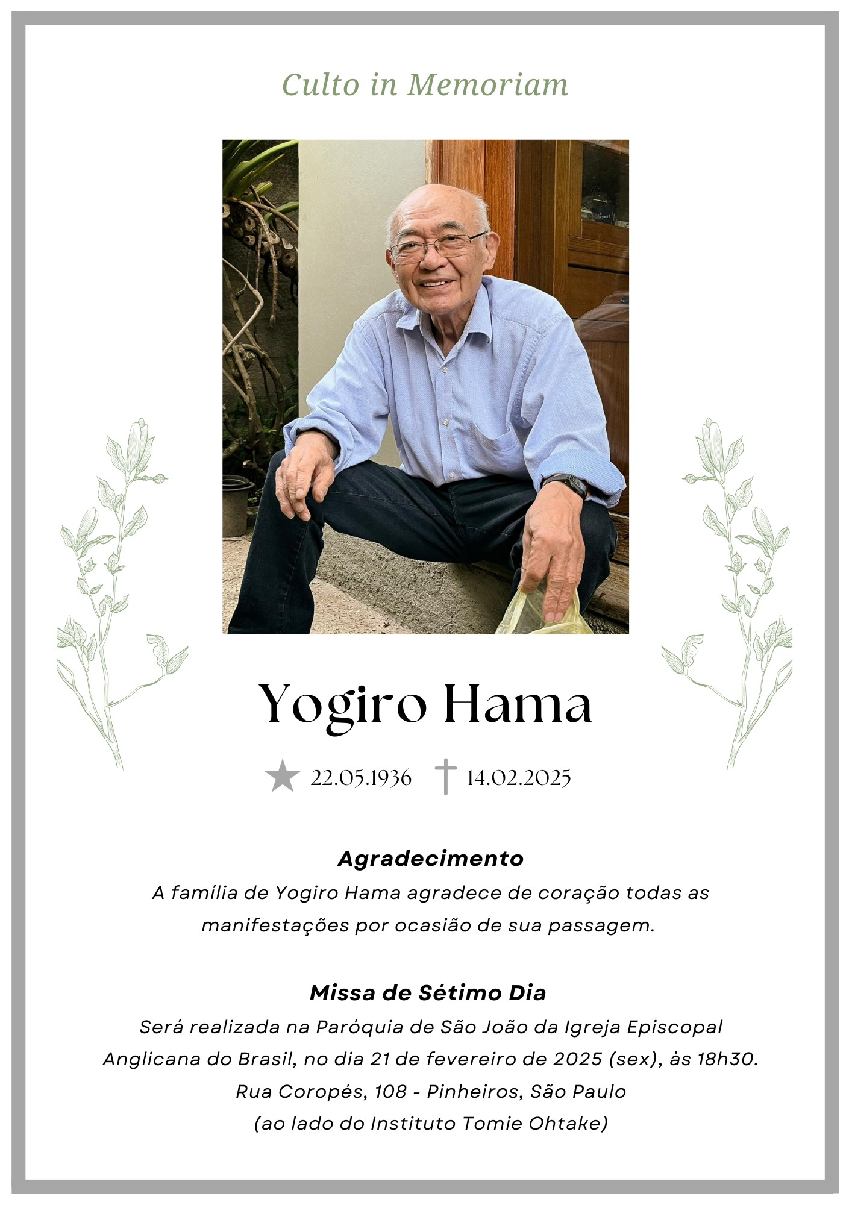
In memoriam Yogiro Hama
In our heart, we shall not forget you.
In our mind, we’ll remember you, too.
In the next world, someone was waiting for you.
Good Yogiro, farewell, may God bless you!
Tamás Csörgő
September 26, 2026

