Slide 1
Status of 14T+ magnet design
Gloria Bellini
14T+ weekly meeting
23rd of January 2024

Slide 2
Contents
40 mm Aperture:
Magnetic optimization
EM modeling in ANSYS
Mechanical optimization
50 mm Aperture:
Magnetic analysis and optimization

Slide 3
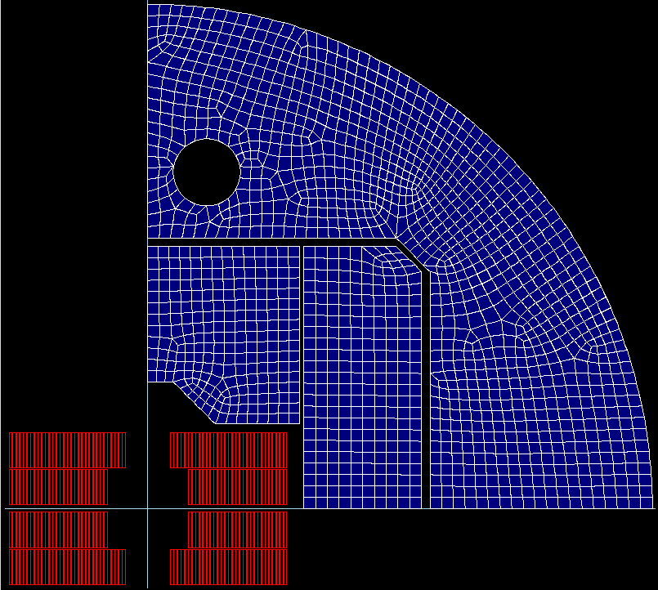
40mm aperture
Magnetic optimization in Roxie
Parameters:
2 objectives:
Harmonics below 10 units
Peak field over bore field ratio as little as possible
Link to the analysis: C:\Users\gbellini\14T ANSYS_test\v301ap40mm\Roxie
Reference model:
Strand diameter | 1 mm
Cu/SC | 0.9
# strands/cable | 40
# turns/quadrant | 59
Eq. coil width | 55 mm
I_nom | 15757 A
J_overall | 338 A/mm2

Slide 4
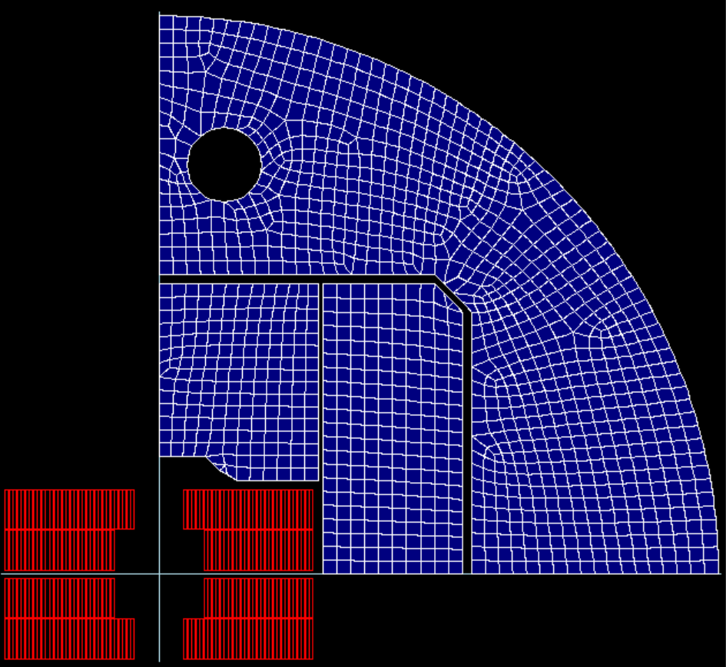
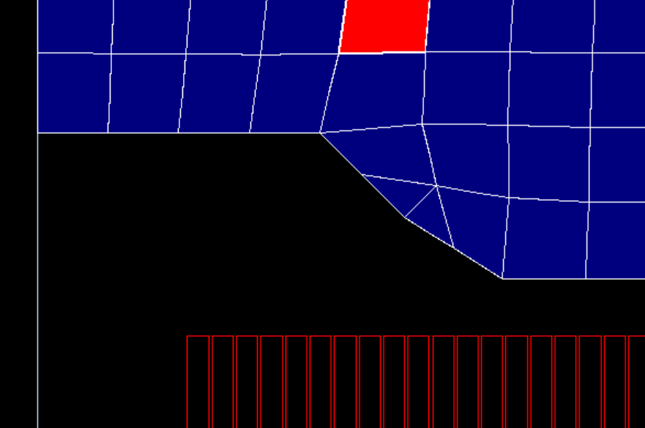
40mm aperture
Magnetic optimization in Roxie
Design 1:

Slide 5
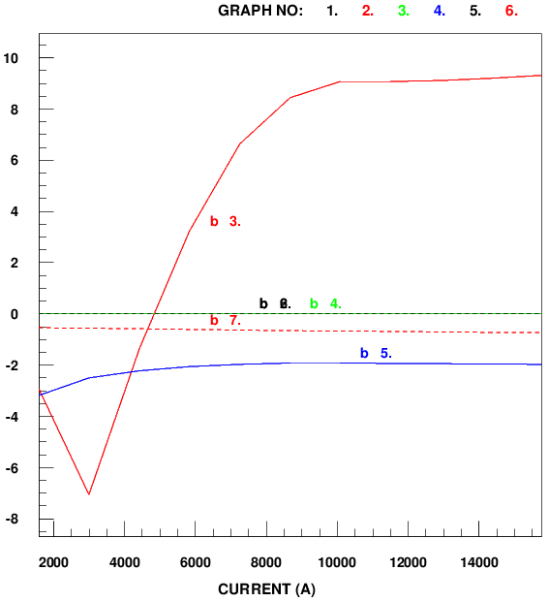

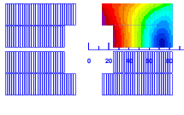
40mm aperture
Magnetic optimization in Roxie
Design 1:
FOTO ARMONICHE FOTO CAMPO MAGNETICO
Bp/Bap = 1.042 FOTO CAMPO MAGNETICO

Slide 6
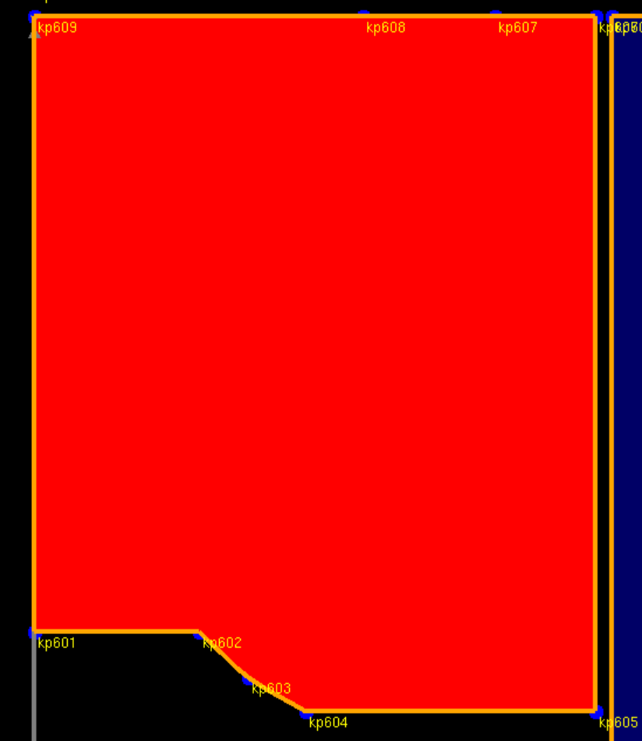
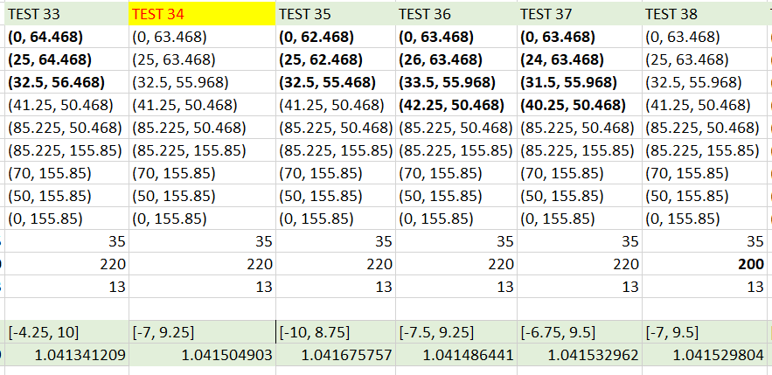
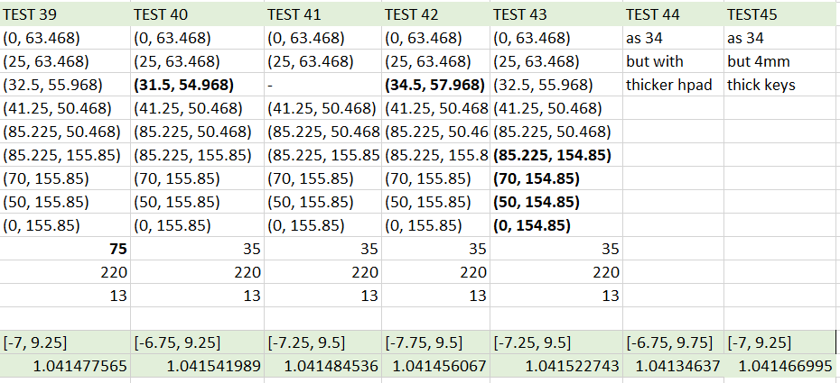
40mm aperture
Magnetic optimization in Roxie
Design 1:

Slide 7
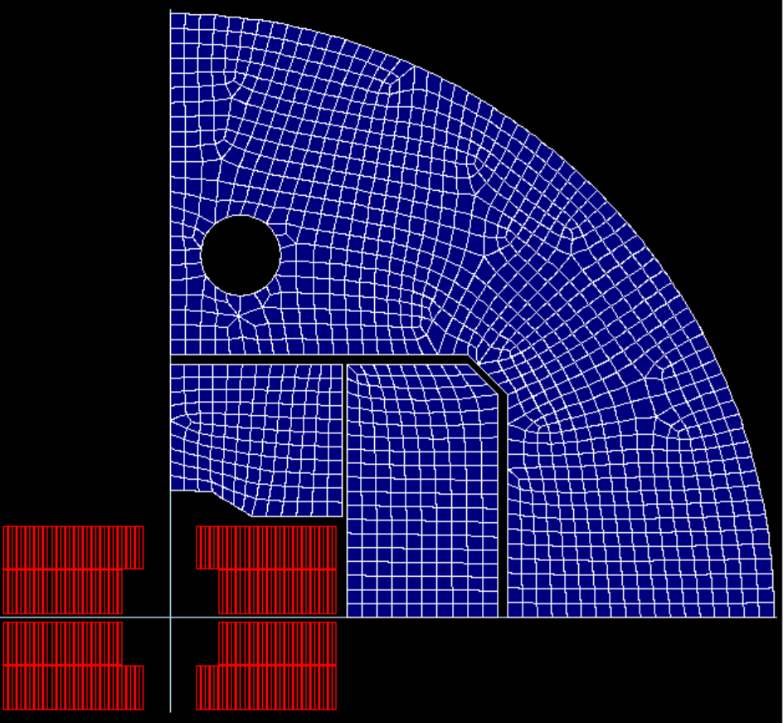
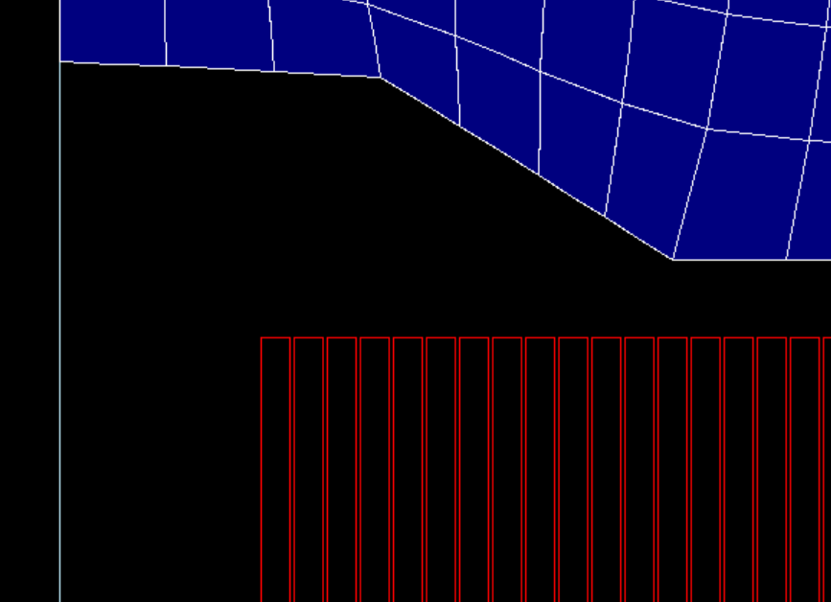
40mm aperture
Magnetic optimization in Roxie
Design 2:

Slide 8
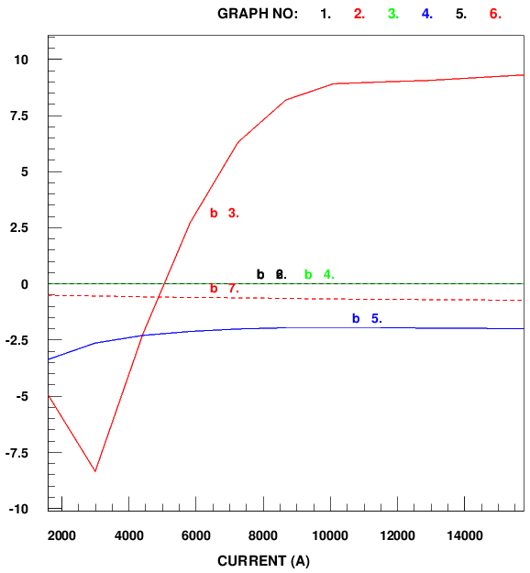

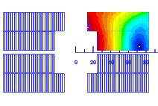
40mm aperture
Magnetic optimization in Roxie
Design 2:
FOTO ARMONICHE FOTO CAMPO MAGNETICO
Bp/Bap = 1.042

Slide 9
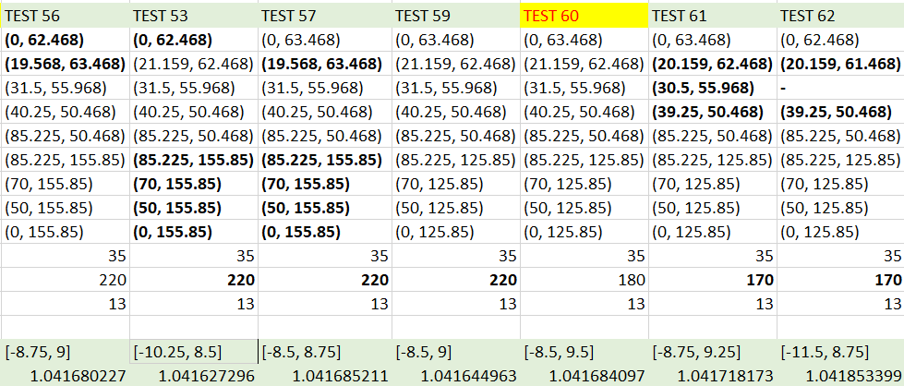
40mm aperture
Magnetic optimization in Roxie
Desing of choice for the mechanical analysis
Design 2:

Slide 10
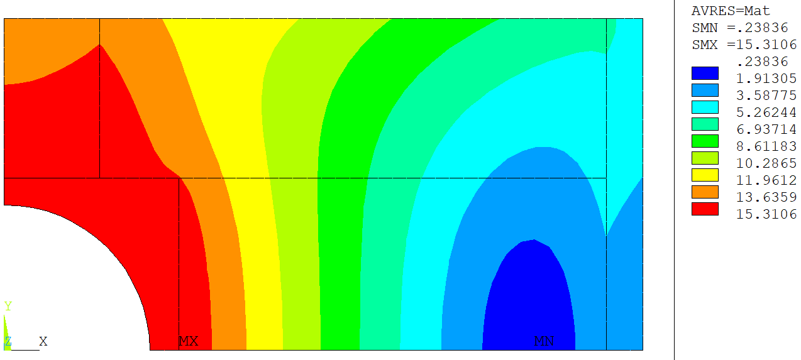
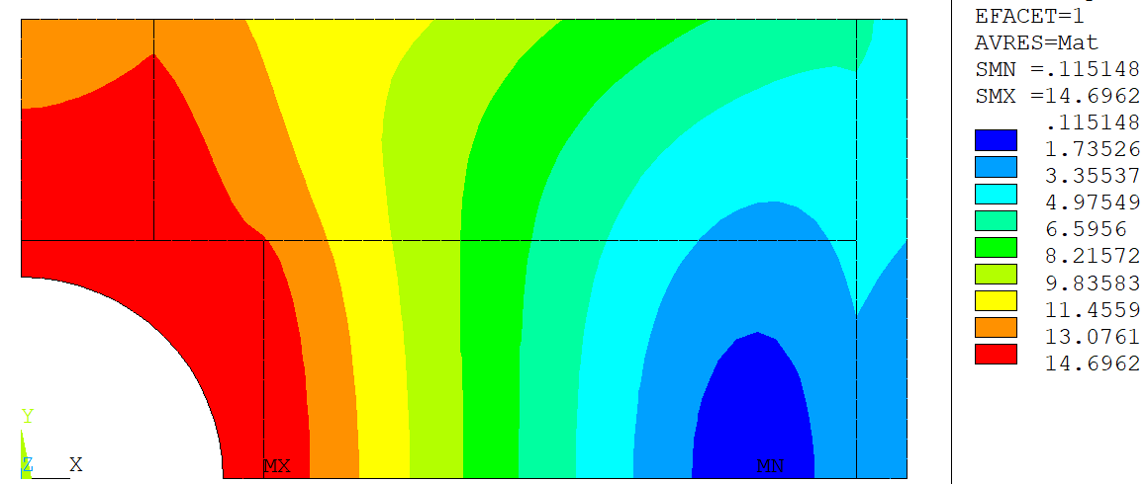

Bore field = 14.92 T
Peak field = 15.31 T
Total current = 334 A/mm2
Magnetic modeling in ANSYS
Correction of total current:
Bore field = 14.20T
Peak field = 14.79 T
FOTO CAMPO MAGNETICO ROXIE
Bore field = 14.32T
Peak field = 14.70 T
Current density = 318 A/mm^2
$$I_{ansys}=0.95⋅15757 A$$

Slide 11
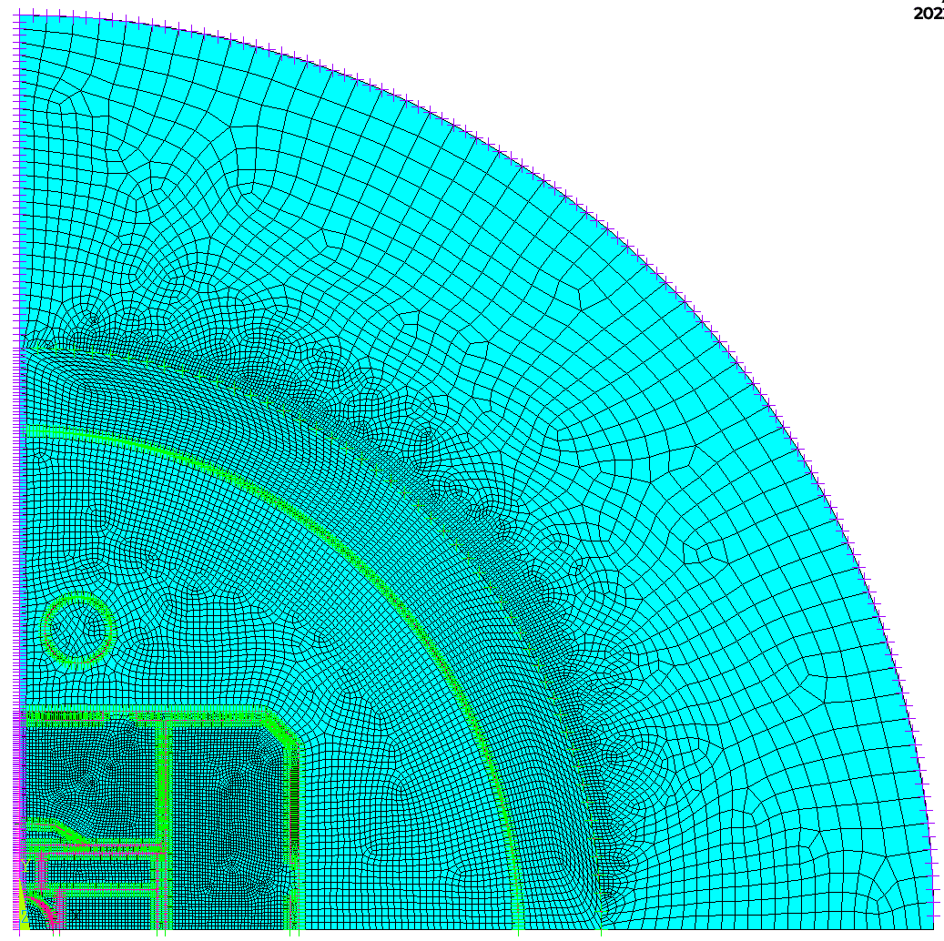
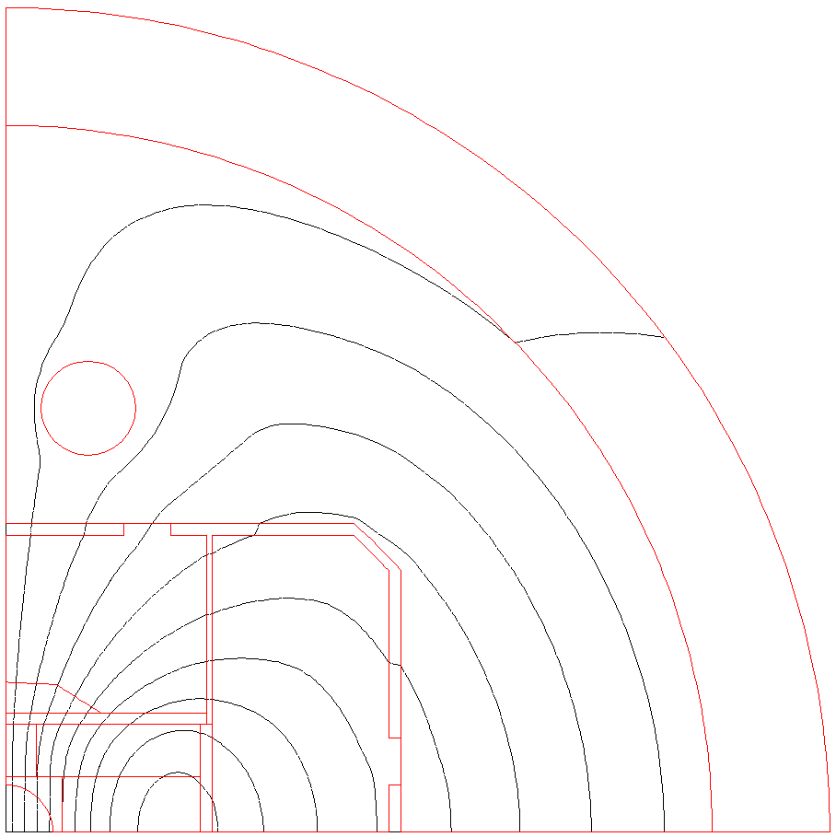
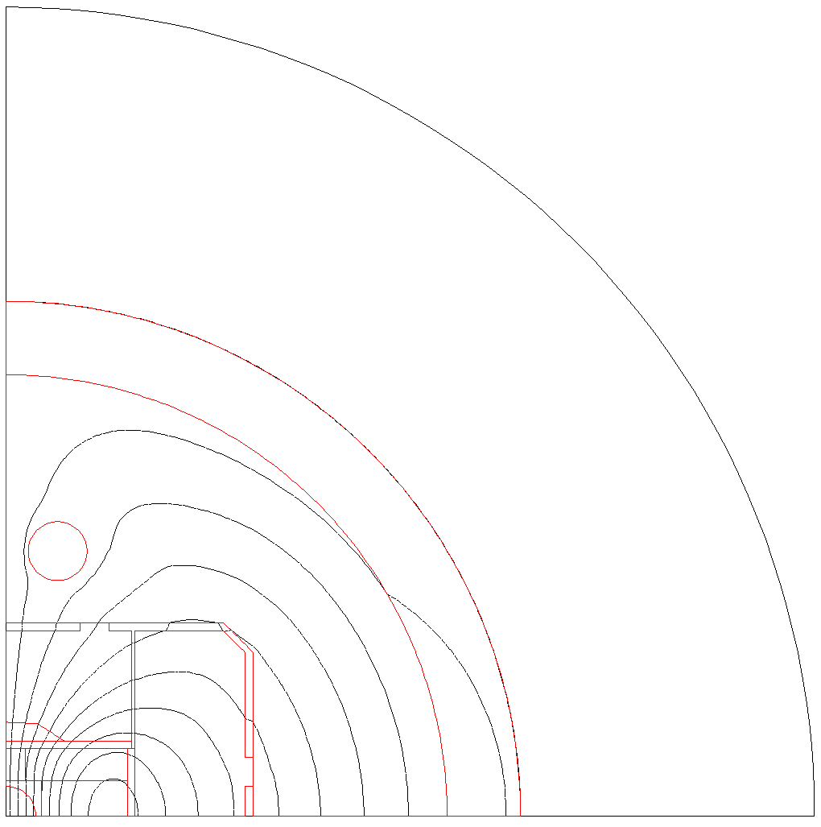
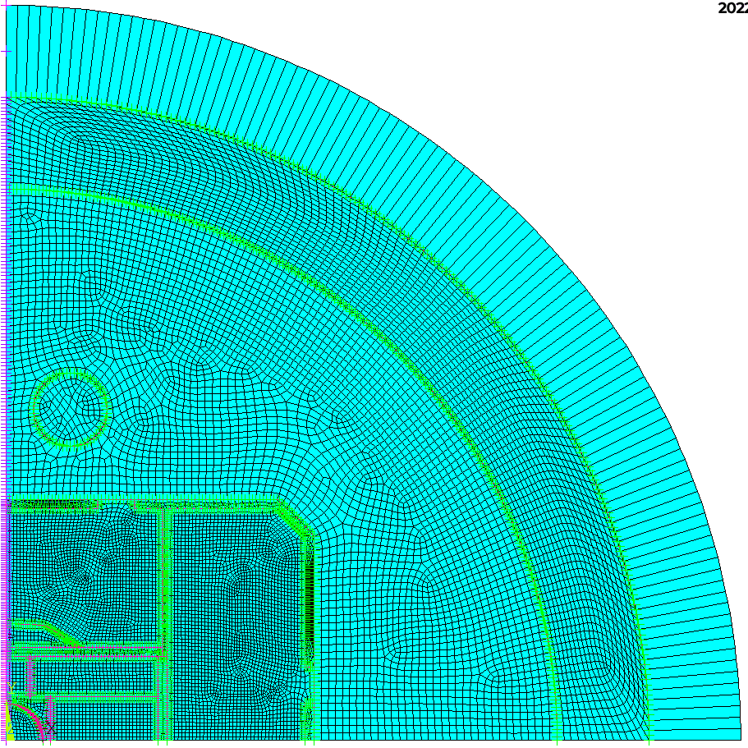
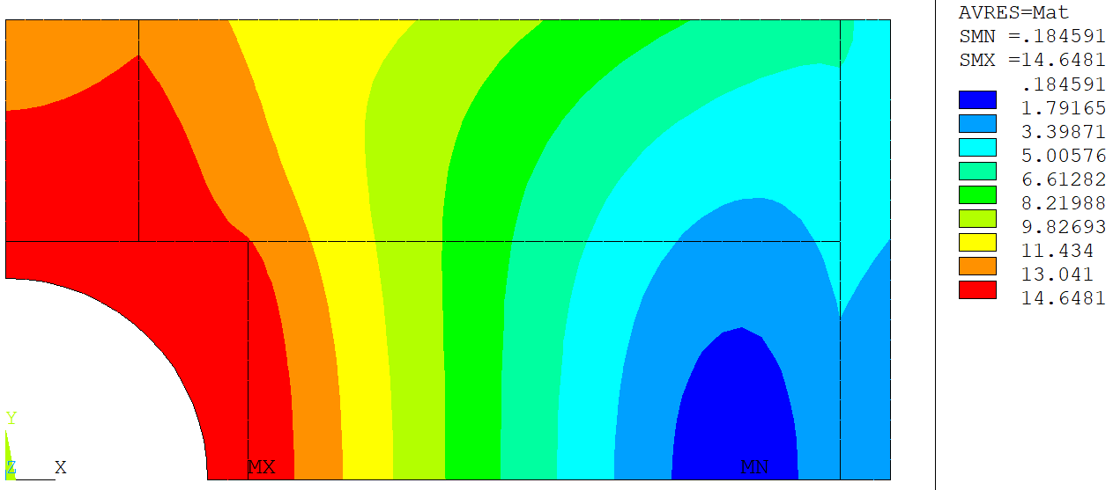
40mm aperture
Magnetic modeling in ANSYS
Analysis of Boundary Conditions:

Slide 12
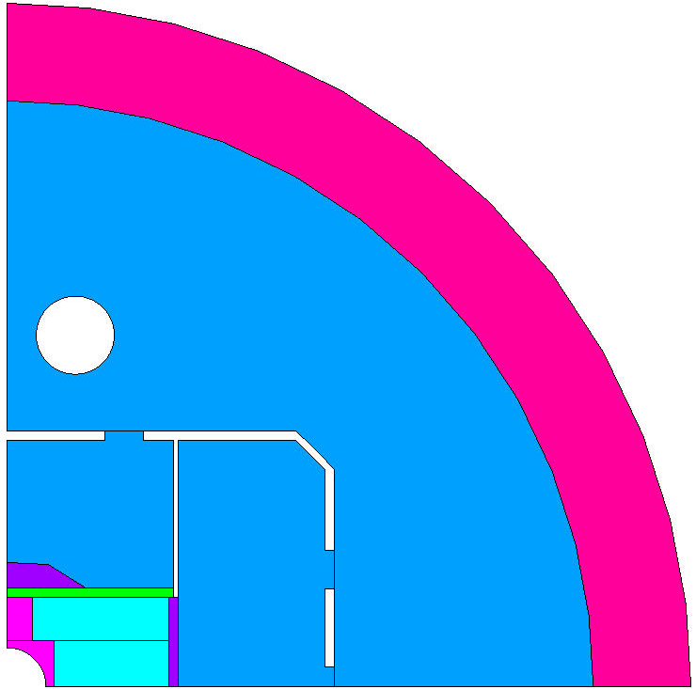
40mm aperture
Mechanical optimization
54 mm
Yoke bladders | 50 MPa
Hpad bladders | 50 MPa
Vpad bladder | 50 MPa
Key interference hpad | 0.7 mm
Key interference vpad | 0.05 mm
Yoke gap | 5 mm
54 mm
108 mm
27 mm
37 mm
37 mm

Slide 13
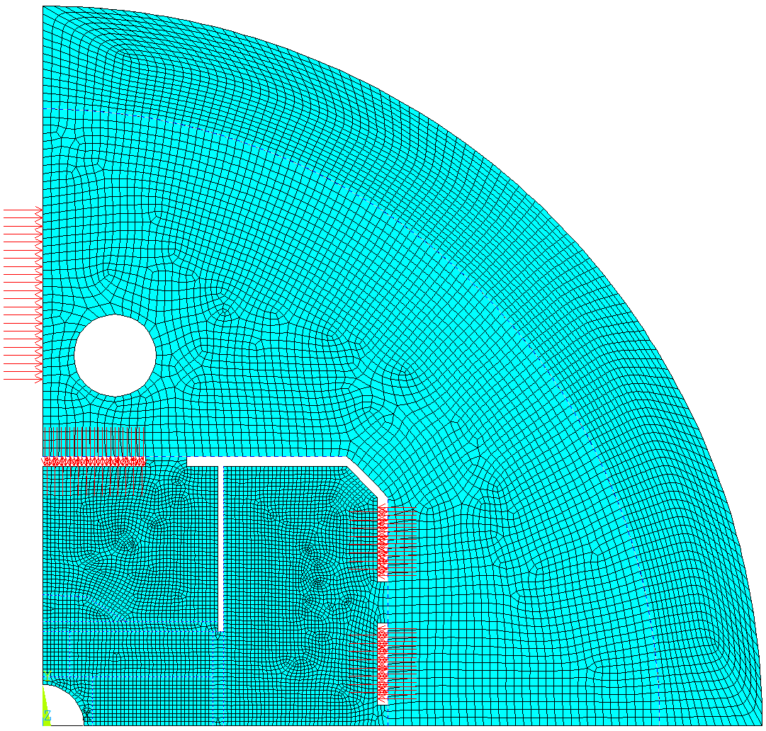
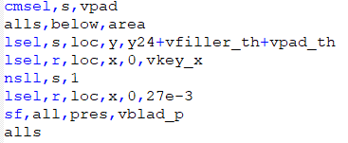
40mm aperture
Mechanical optimization
In a unique model:
Bladder inflation
Key inserted
Cool-down
Powering of the magnet
By the definition of 2 sets of contact
108 mm
Numerical issue: problem with the definition of the
bladder between vertical pad and yoke
50 mm
37 mm
37 mm

Slide 14
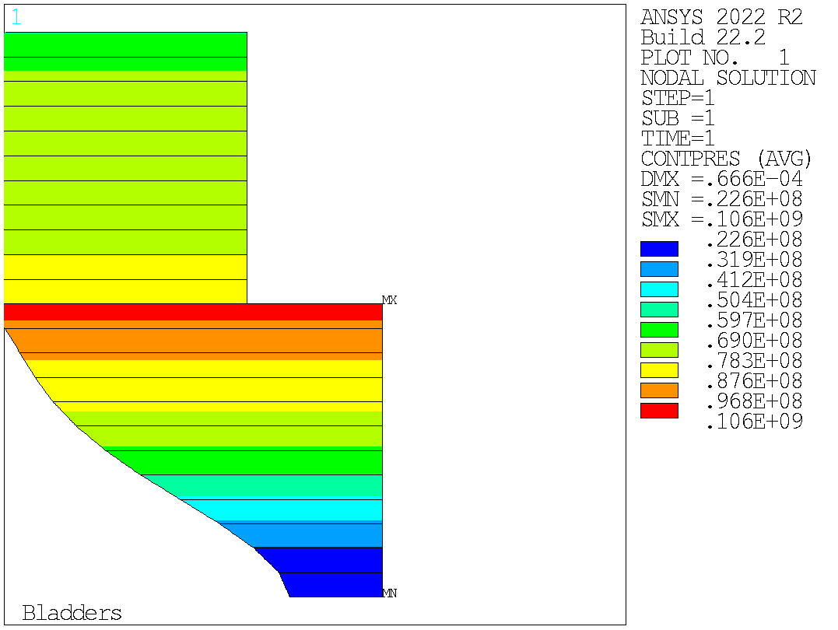
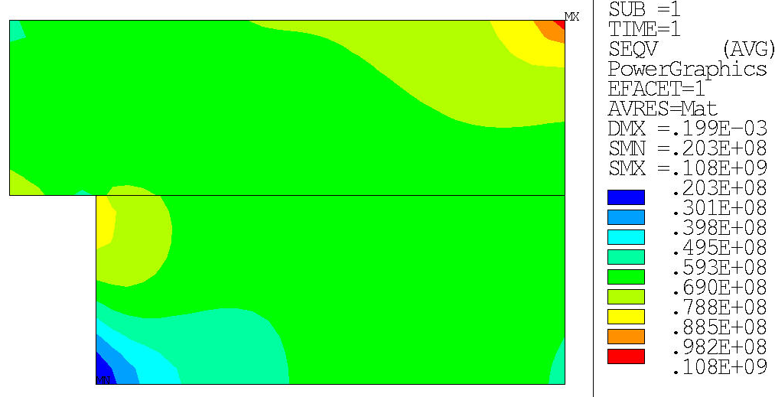
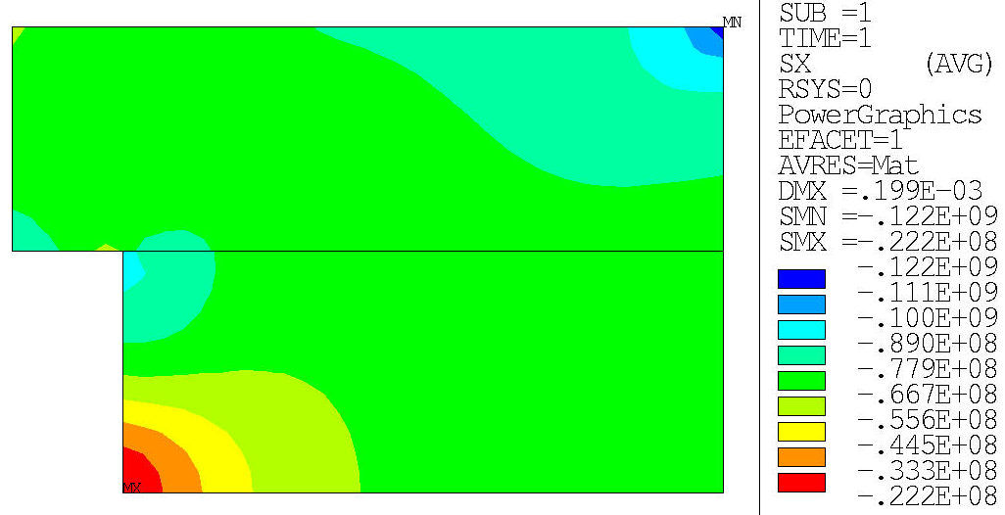
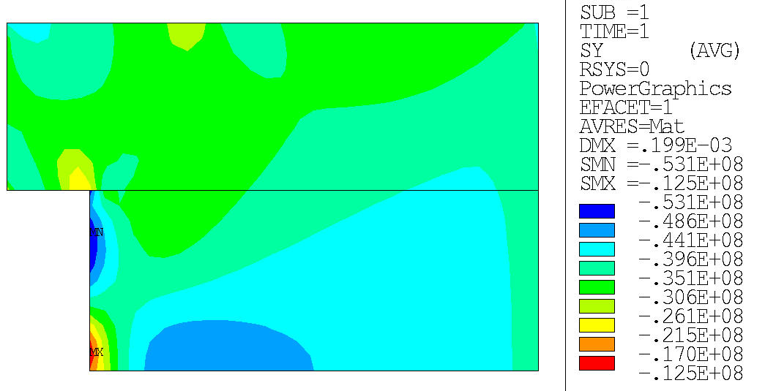
40mm aperture
Criteria: Seqv < 110 MPa
Mechanical optimization
Seqv
Contact pole-coil
criteria: Min 5MPa
SX
SY
Bladder insertion

Slide 15
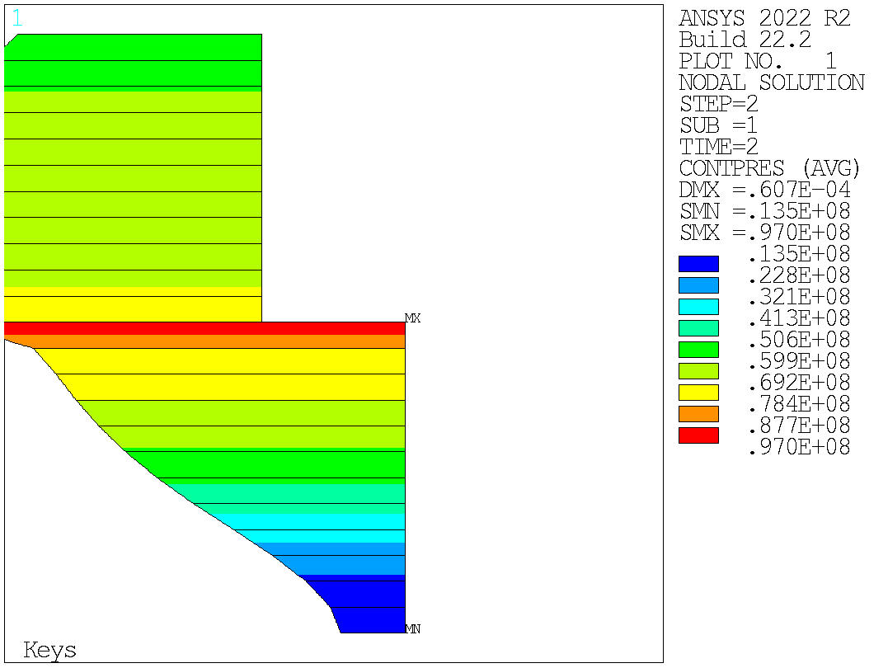
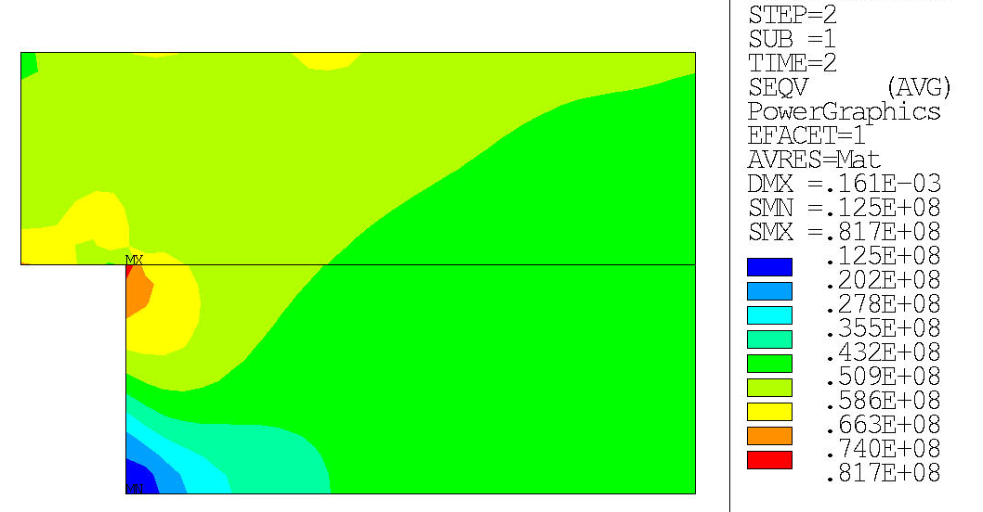
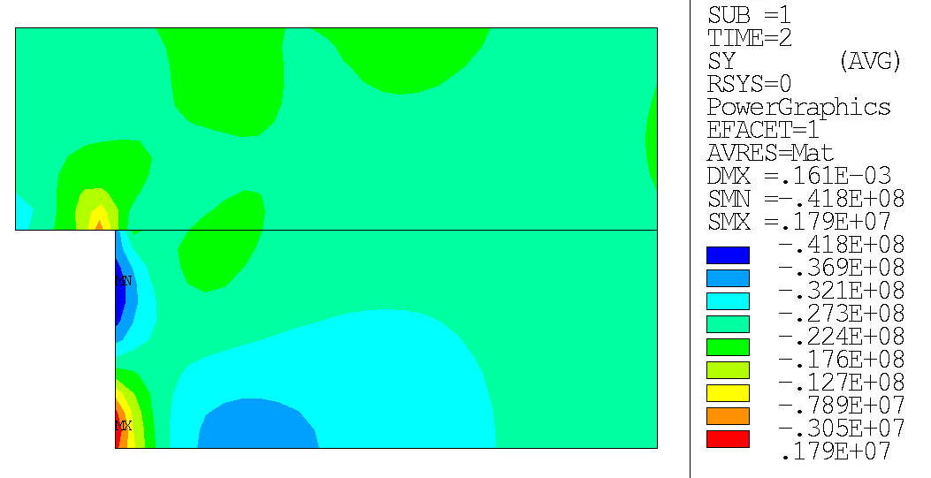
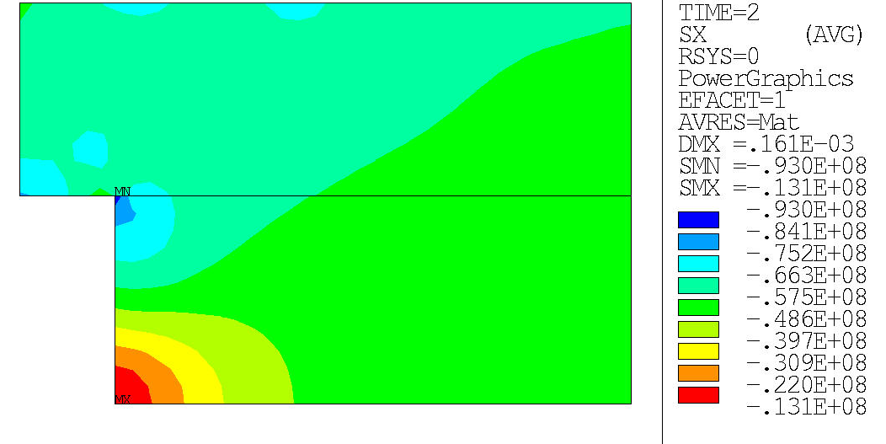
40mm aperture
Criteria: Seqv < 110 MPa
Mechanical optimization
Seqv
Contact pole-coil
criteria: Min 5MPa
SX
SY
Key inserted

Slide 16
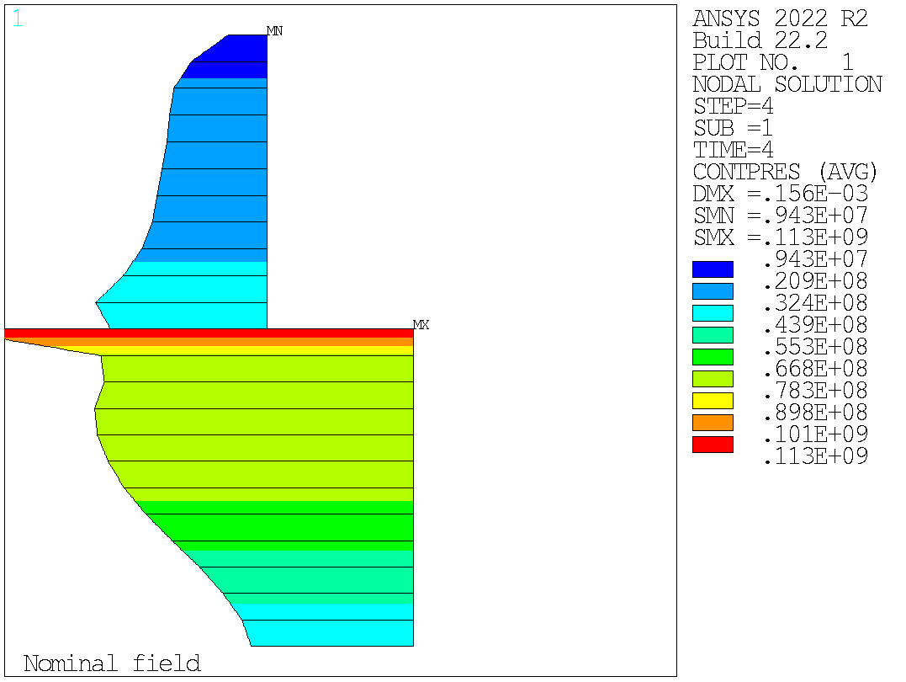
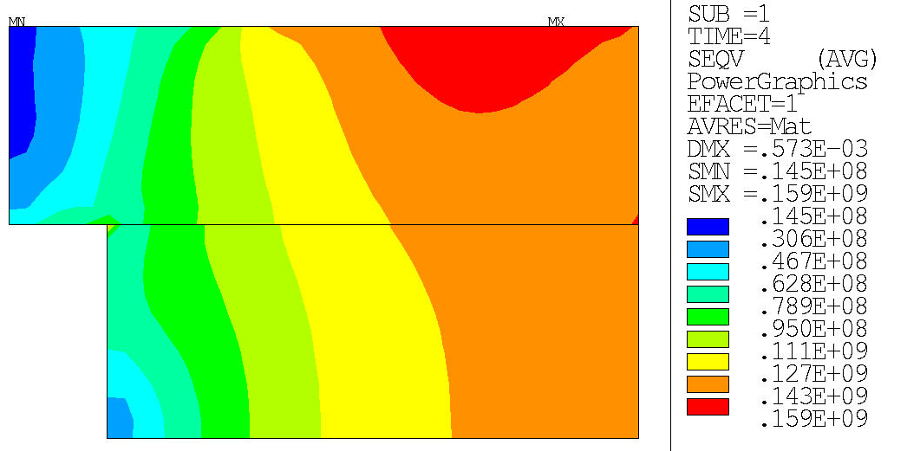
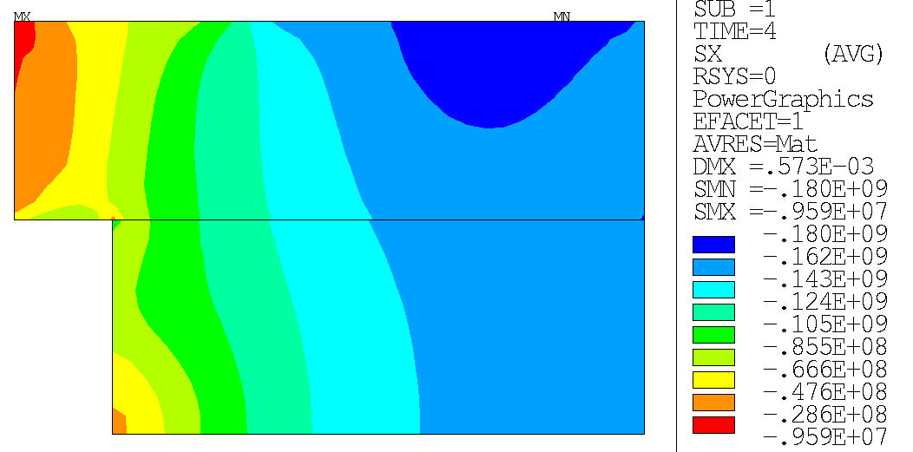
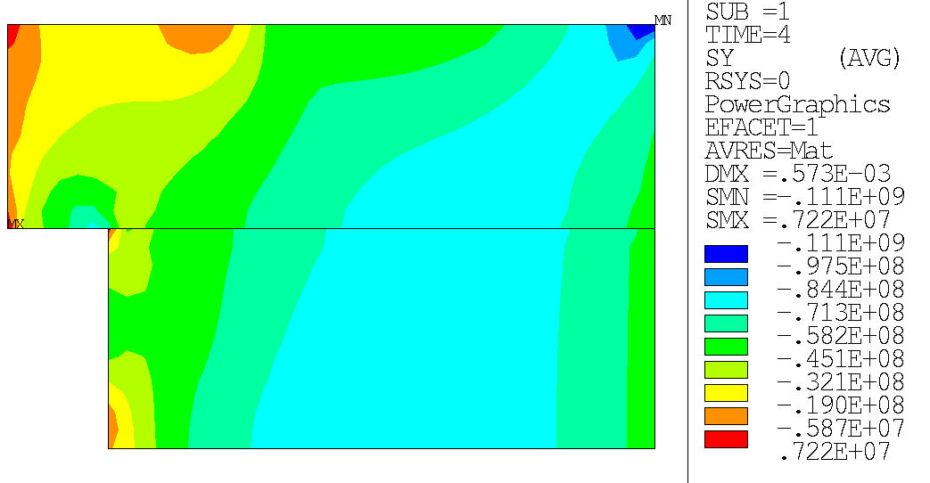
40mm aperture
Criteria: Seqv < 150 MPa
Mechanical optimization
Seqv
Contact pole-coil
criteria: Min 5MPa
SX
SY
Cool-down

Slide 17
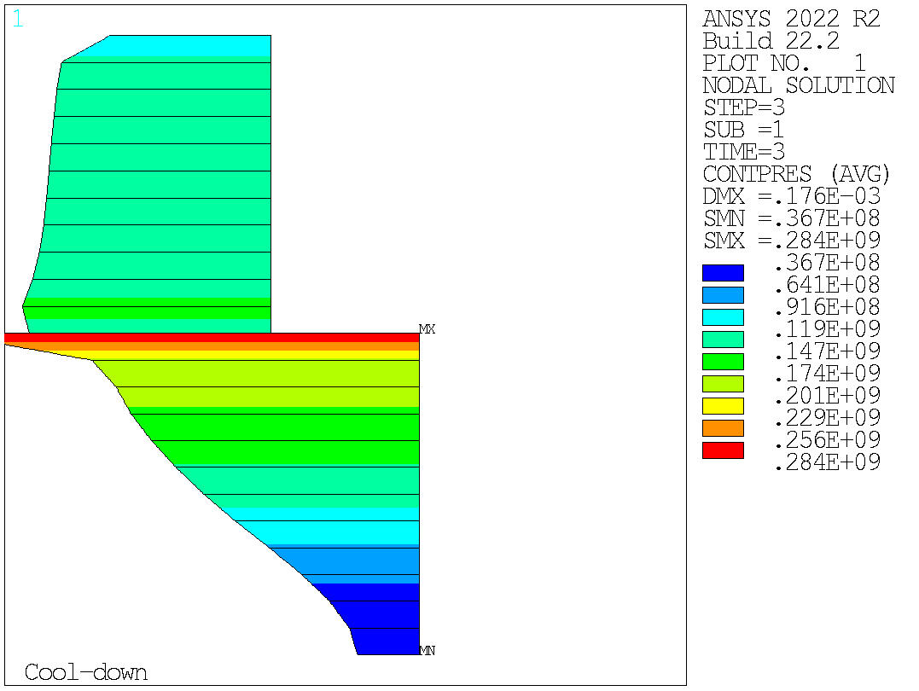
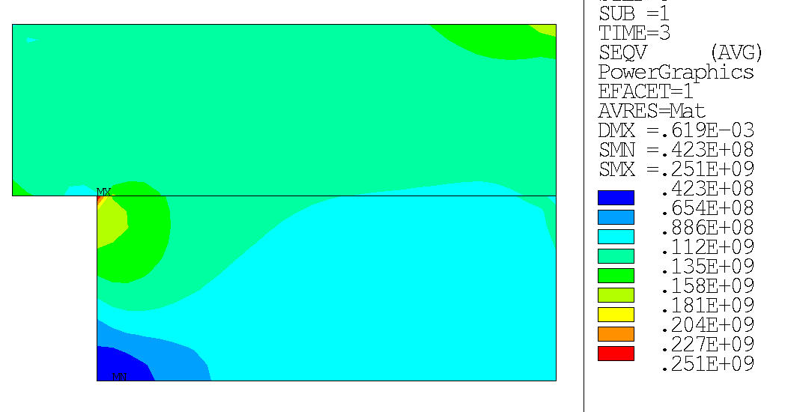
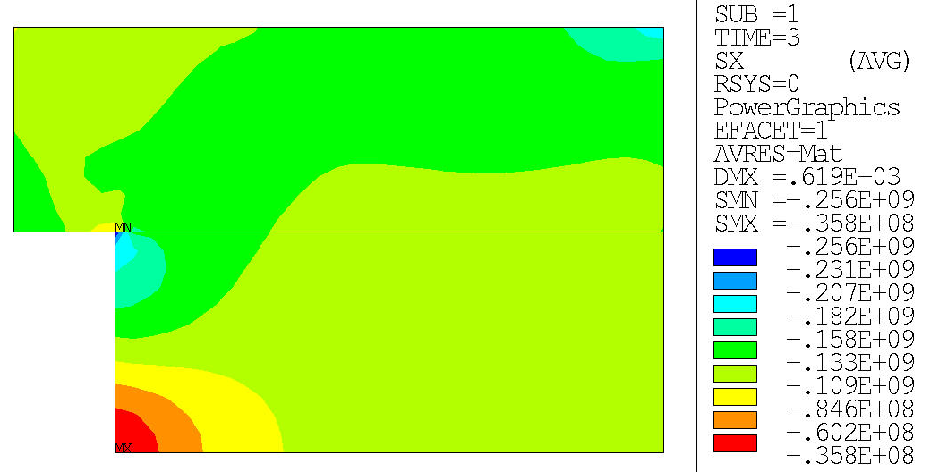
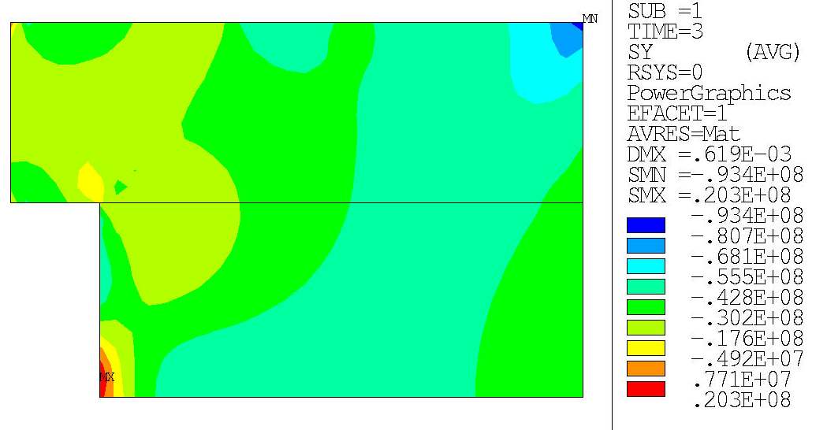
40mm aperture
Criteria: Seqv < 150 MPa
Mechanical optimization
Seqv
Contact pole-coil
criteria: Min 5MPa
SX
SY
Powering

Slide 18
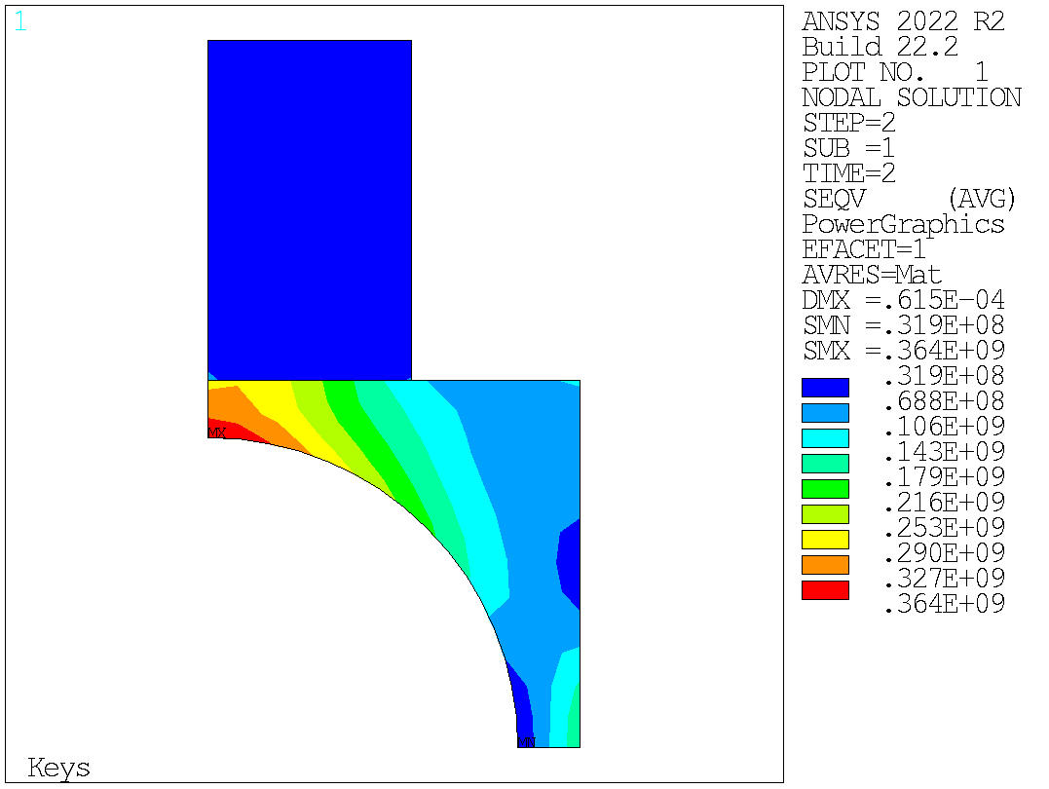
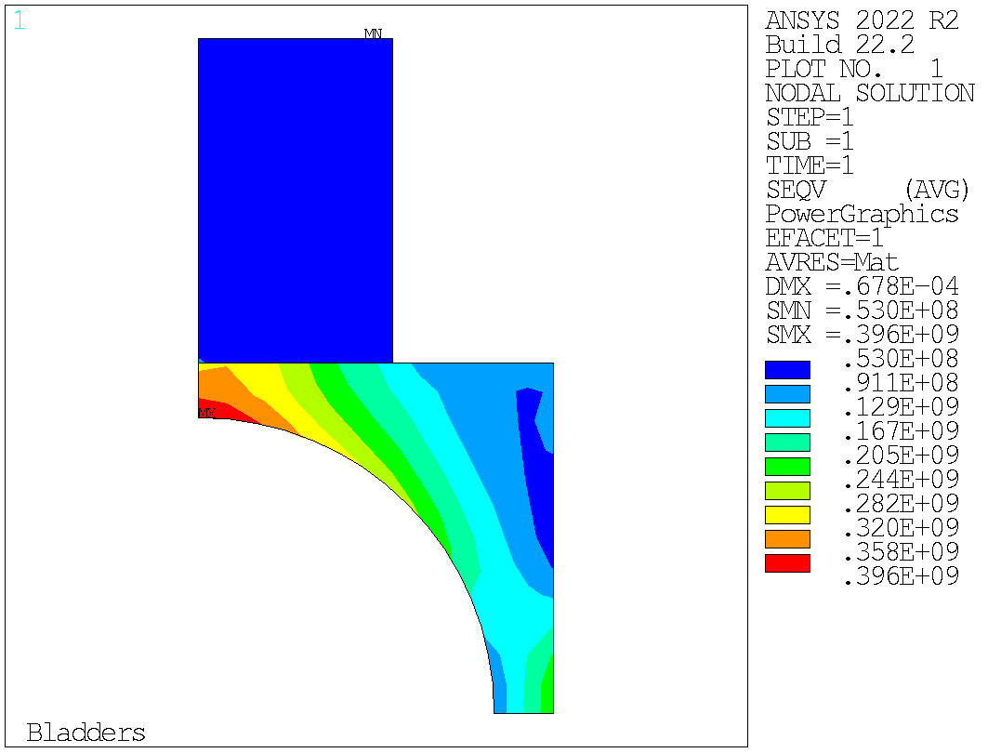
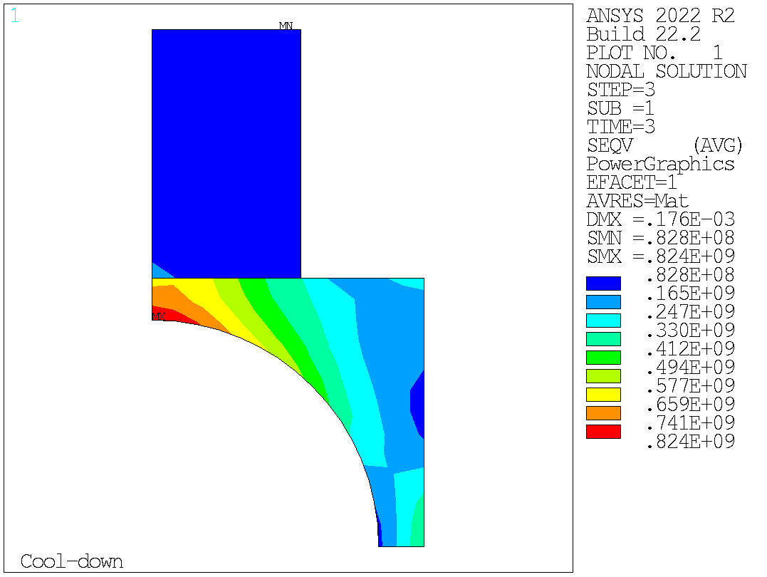
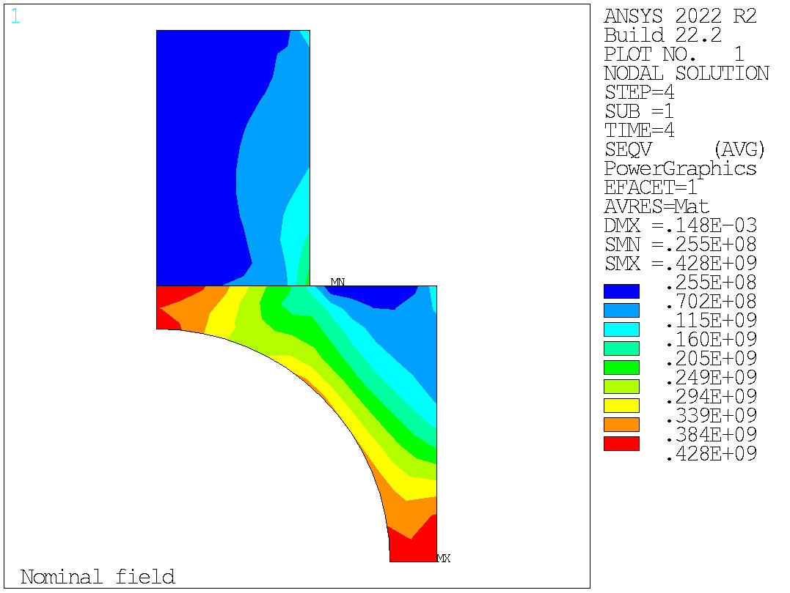
40mm aperture
Mechanical optimization

Slide 19
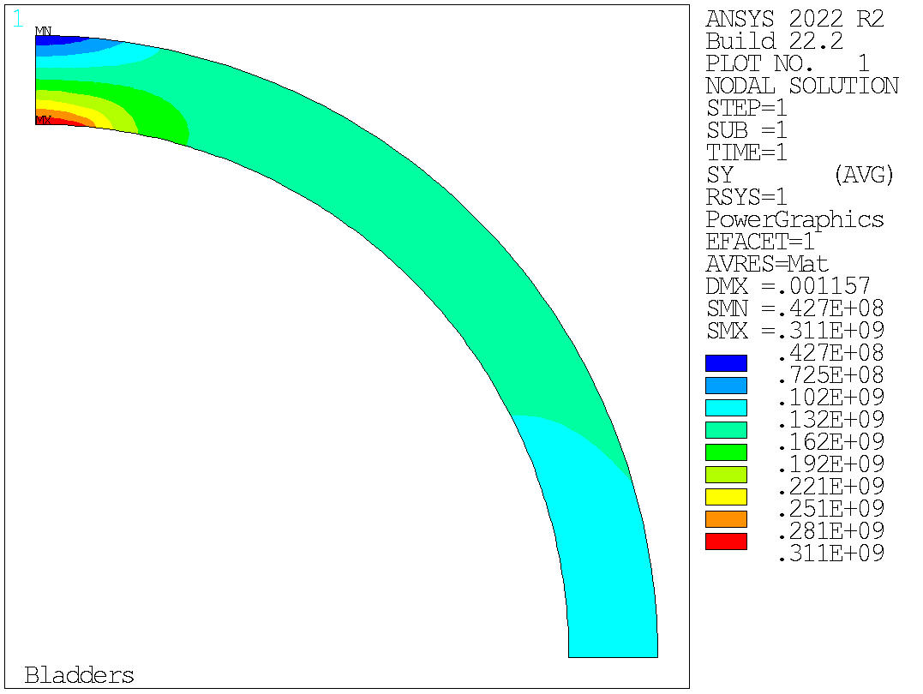
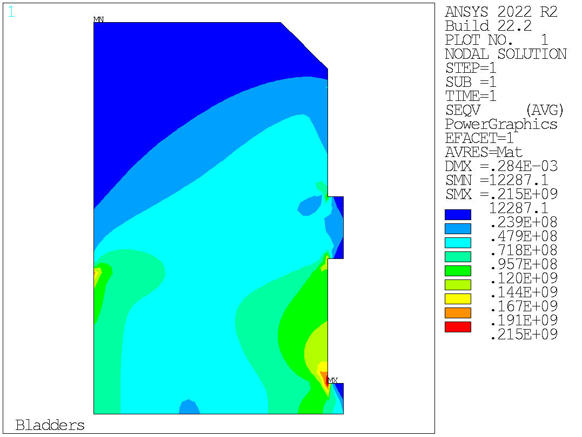
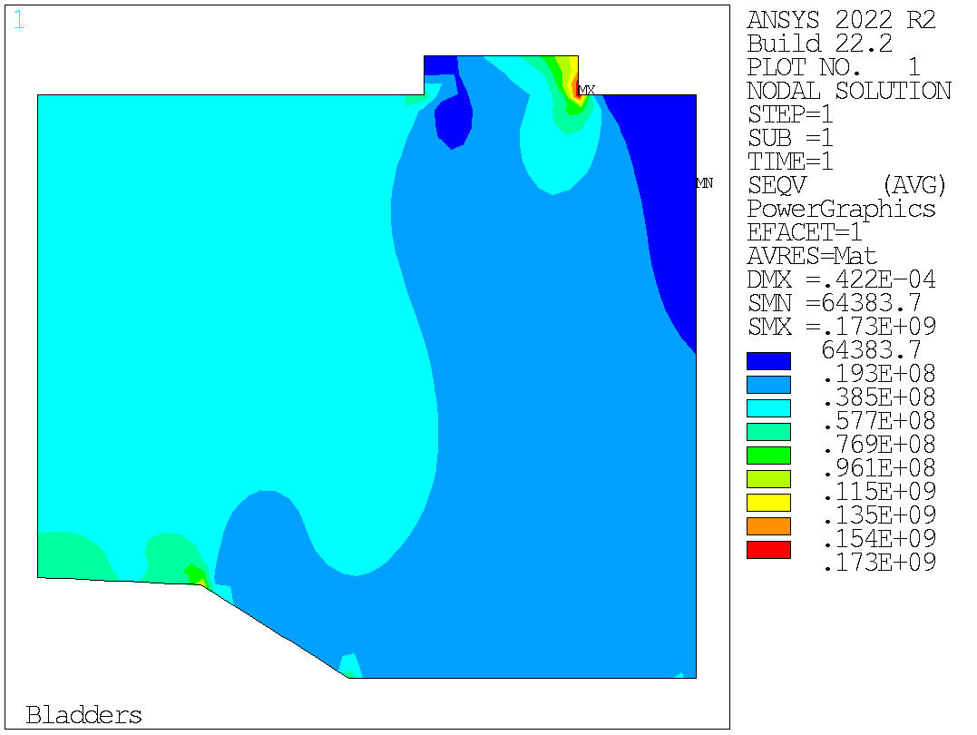
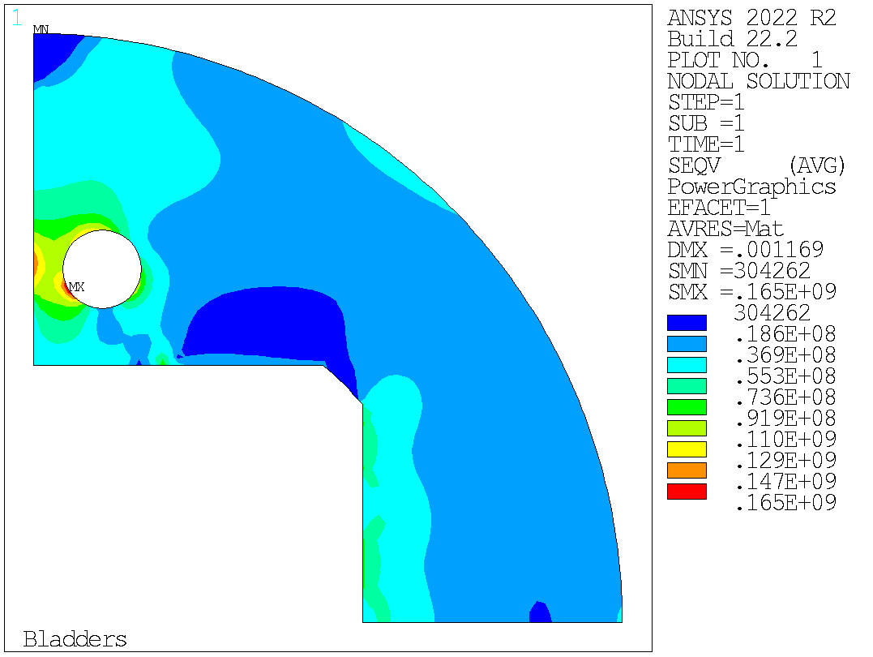
40mm aperture
Mechanical optimization
Bladder inflation

Slide 20
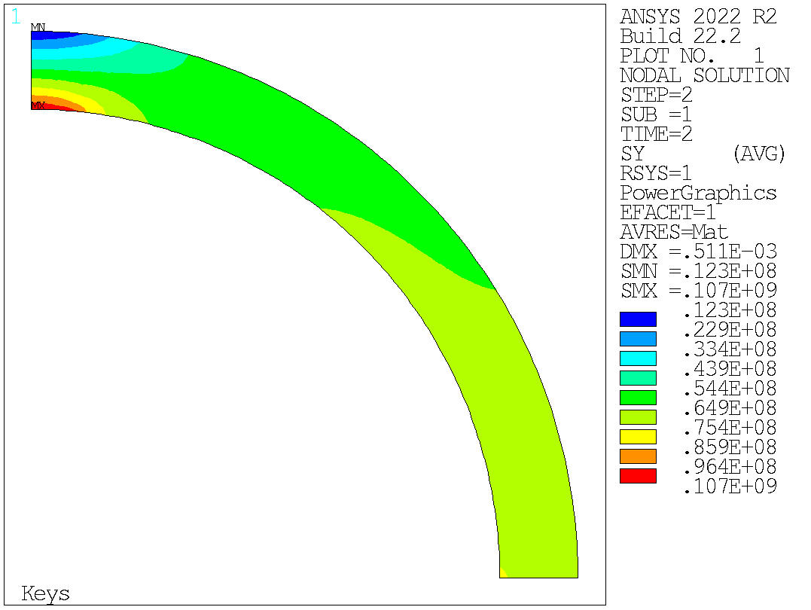
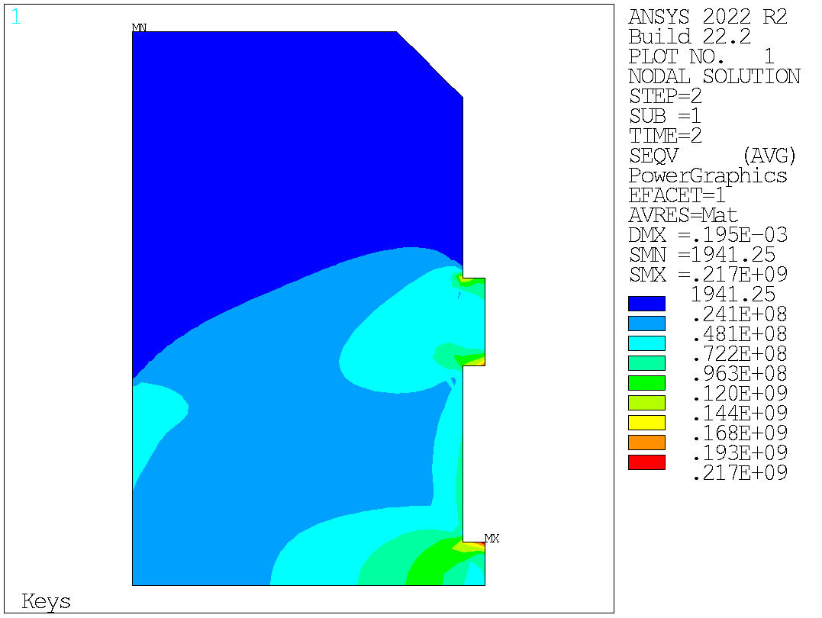
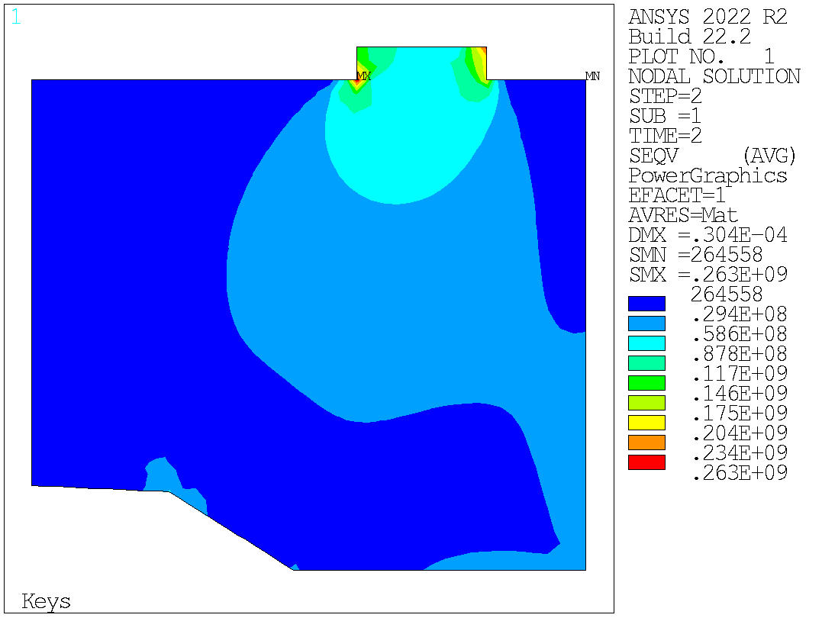

40mm aperture
Mechanical optimization
Key inserted

Slide 21




40mm aperture
Mechanical optimization
Cool-down

Slide 22




40mm aperture
Mechanical optimization
Powering

Slide 23

50mm aperture
Magnetic optimization in Roxie
Parameters:
Link to the analysis: C:\Users\gbellini\14T ANSYS_test\v301ap50mm\Roxie
 | Cable #1 | Cable #2 | Cable #3
Strand diameter | 1.1 mm | 1 mm | 0.85 mm
Cu/SC | 0.9 | 0.9 | 1.2
# strands/cable | 44 | 48 | 56
I_nom | 22374 A | 28000 A | 17986 A
Ncab coil 1 | 23 | 25 | 29
Ncab coil 2 | 27 | 29 | 33

Slide 24






50mm aperture
Cable #1 (44 x 1.1 mm)
Magnetic optimization in Roxie
Parameters:
Bp/Bap = 1.052
 | Cable #1 | Cable #2 | Cable #3
Cable in Roxie | 14TV01 | 14TV02 | 14TV03
I_nom | 22374 A | 28000 A | 17986 A
I @ 14 T | 21074 A | 19300 A | 16986 A
Cable #2 (48 x 1.0 mm)
Cable #3 (56 x 0.85 mm)
Bp/Bap = 1.046
Bp/Bap = 1.047

Slide 25






50mm aperture
Cable #1 (44 x 1.1 mm)
Magnetic optimization in Roxie
Parameters:
Bp/Bap = 1.0533
 | Cable #1 | Cable #2 | Cable #3
Cable in Roxie | 14TV01 | 14TV02 | 14TV03
I_nom | 22374 A | 28000 A | 17986 A
I @ 14 T | 21074 A | 19300 A | 16986 A
Cable #2 (48 x 1.0 mm)
Cable #3 (56 x 0.85 mm)
Bp/Bap = 1.046
Bp/Bap = 1.047

Slide 26



50mm aperture
2 objectives:
Harmonics below 10 units
Peak field over bore field ratio as little as possible
Magnetic optimization in Roxie
Cable #1 (44 x 1.1mm):
Ncab coil 1 = 21
Ncab coil 2 = 29
Current = 21074 A
Peak Field = 14.84 T
Bore Field = 14.09 T
Peak Field/Bore field = 1.0533

