Slide 1
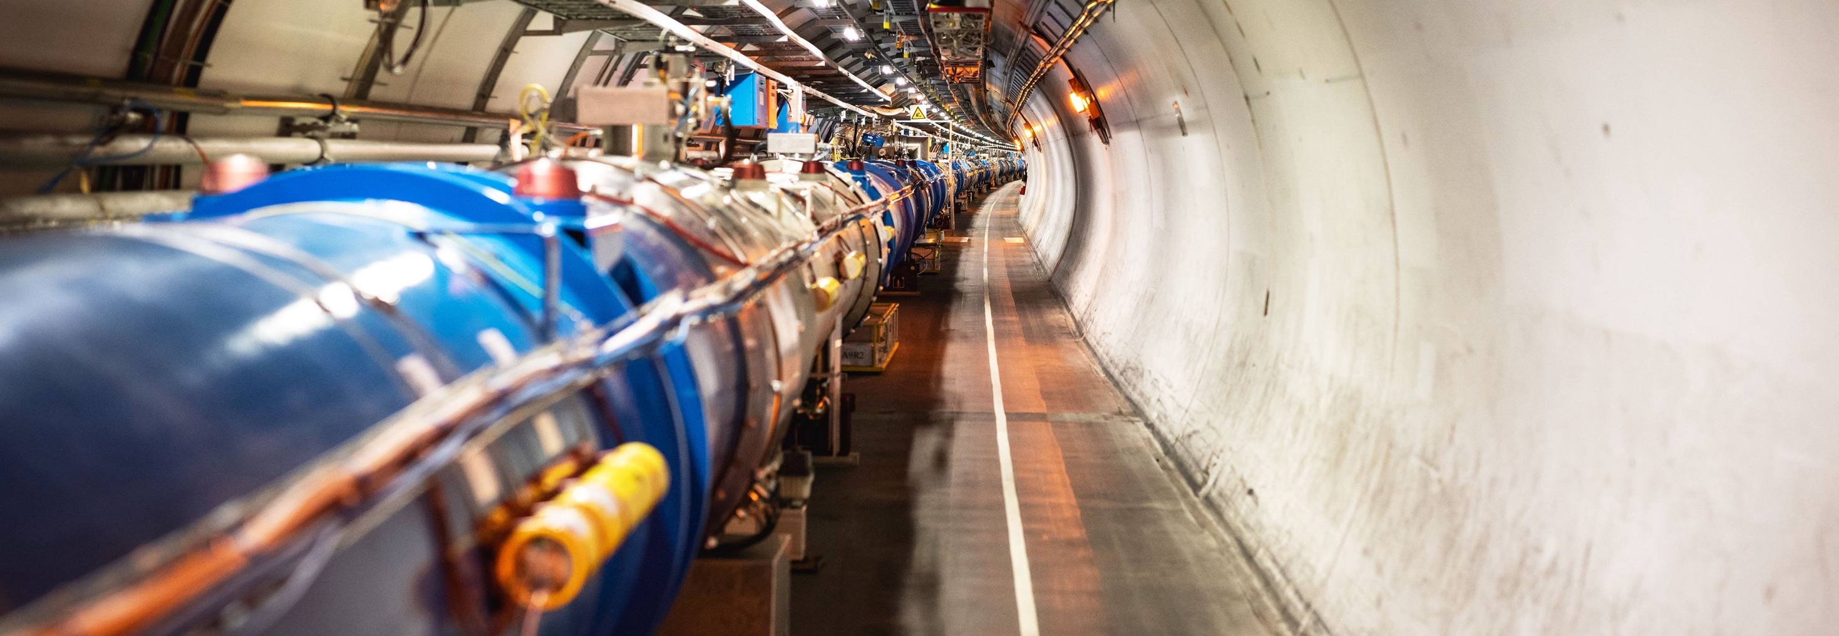
WELCOME TO CERN
CDSE Lab

Slide 2
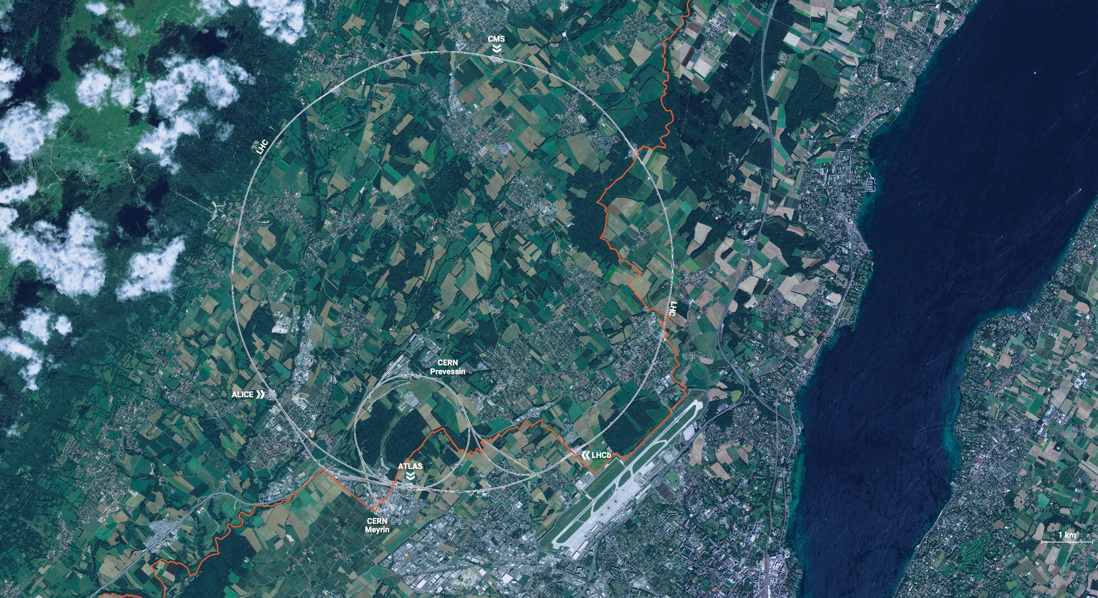
CERN is the world’s biggest laboratory
for particle physics.
Our goal is to understand the most fundamental particles and laws
of the universe.

Slide 3

Four pillars underpin CERN’s mission
RESEARCH
EDUCATION
& TRAINING
COLLABORATION
TECHNOLOGY
& INNOVATION

Slide 4
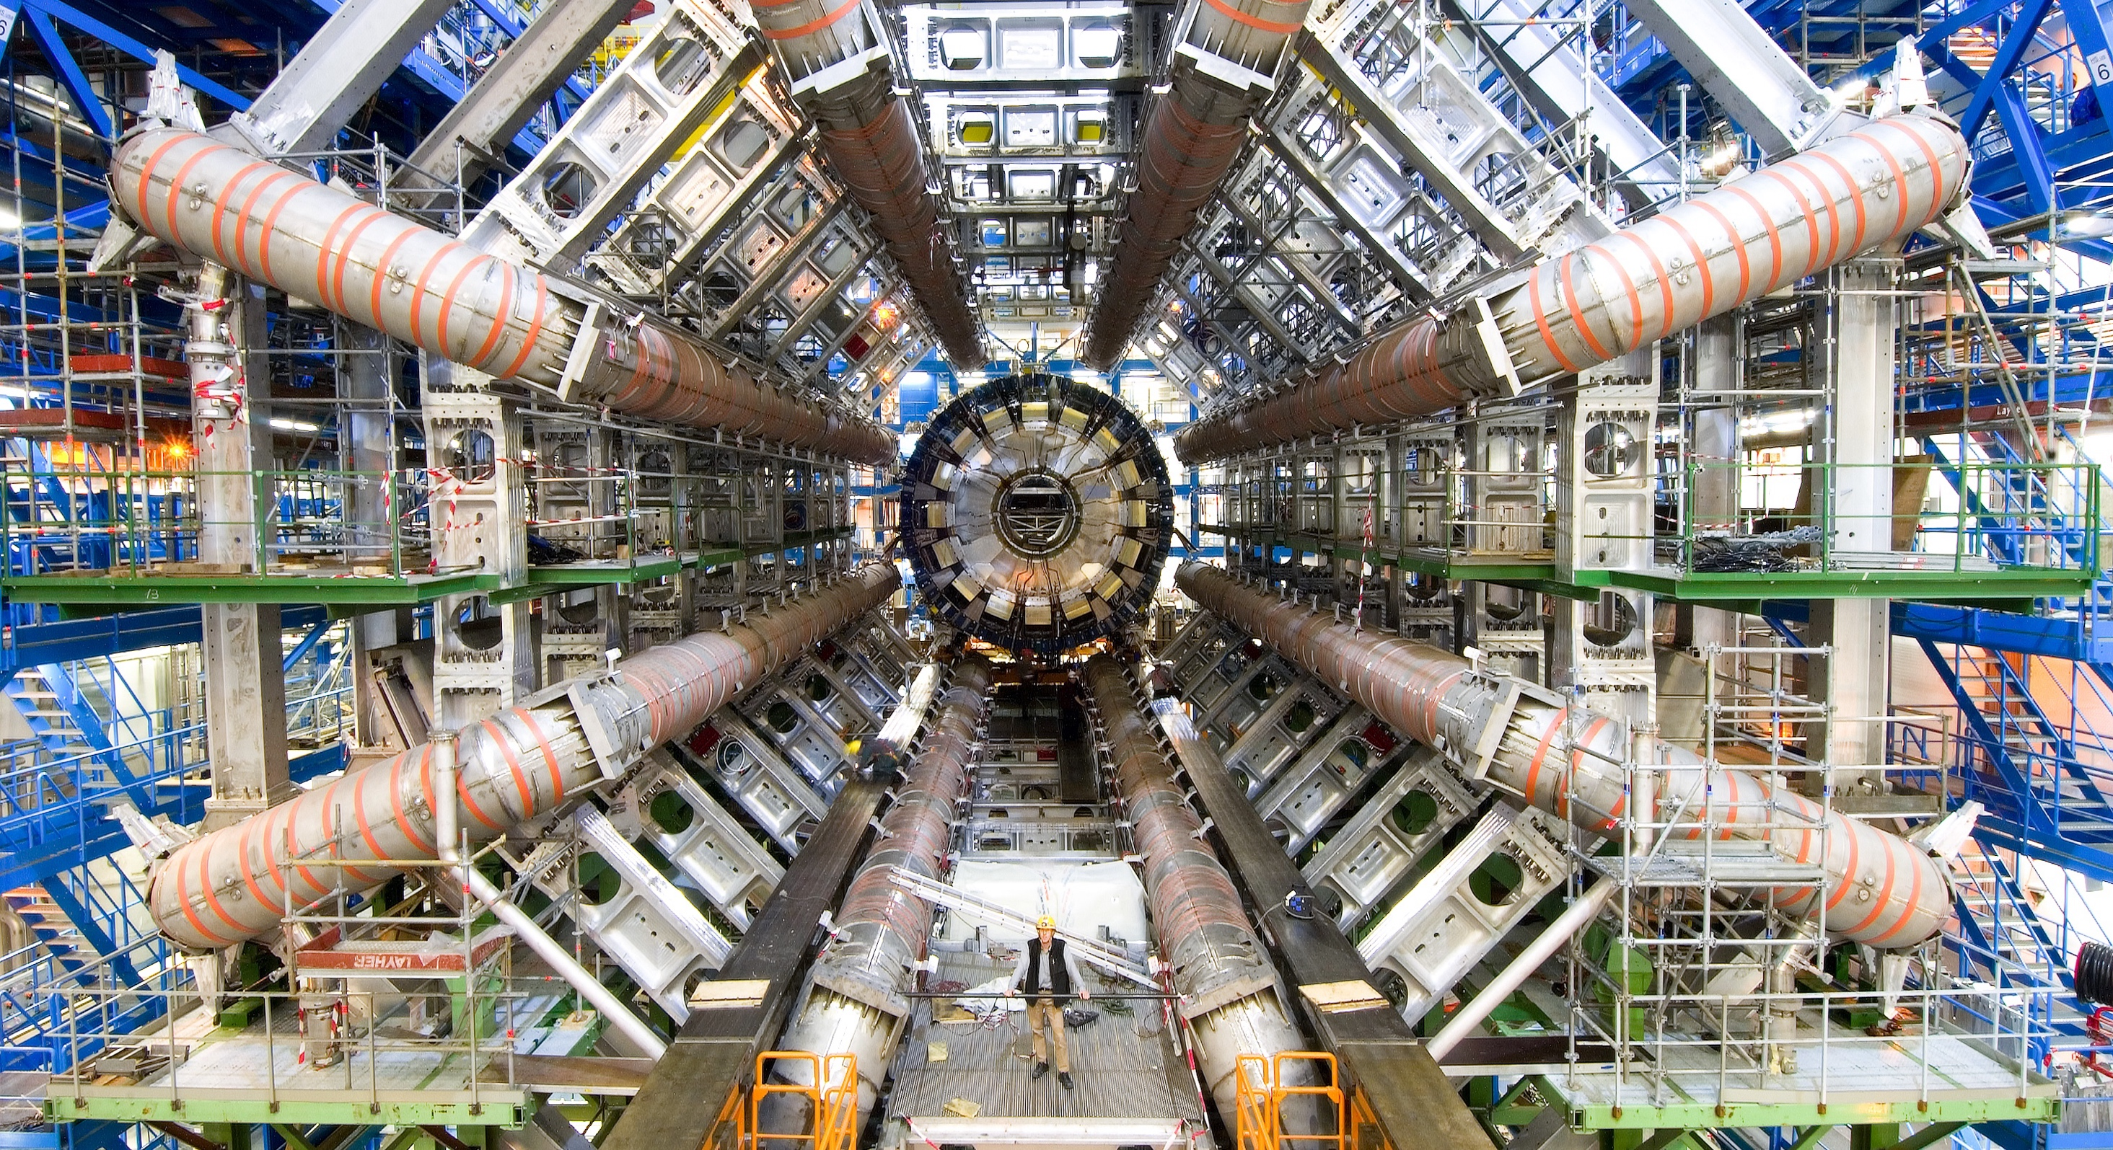
RESEARCH

Slide 5
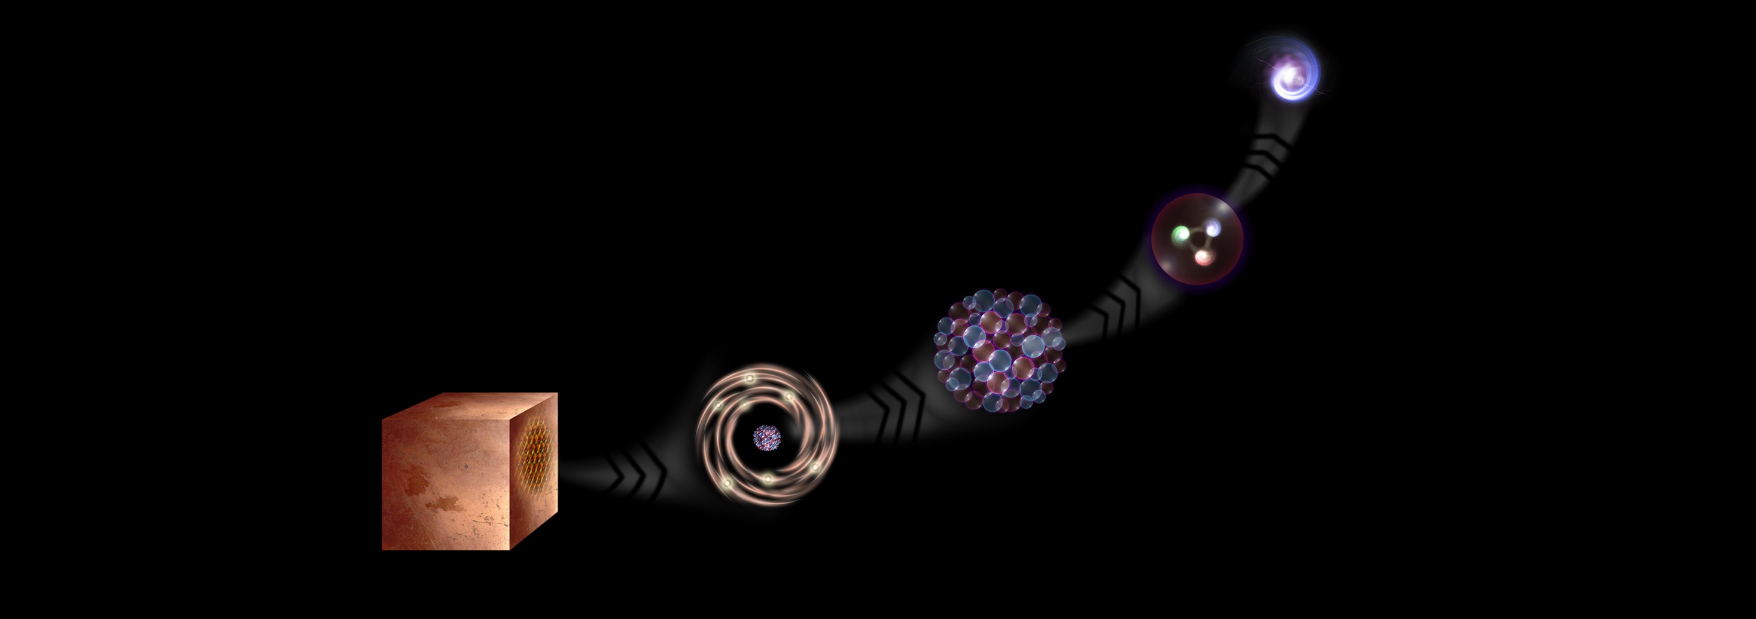
What is the universe made of?
We study the elementary building blocks of matter and the forces that control their behaviour
Quark
<10⁻¹⁸ m
Proton
~10⁻¹⁵ m
Nucleus
~10⁻¹⁴ m
Electron
Matter
0,1 m
Atom
~10⁻¹⁰ m

Slide 6
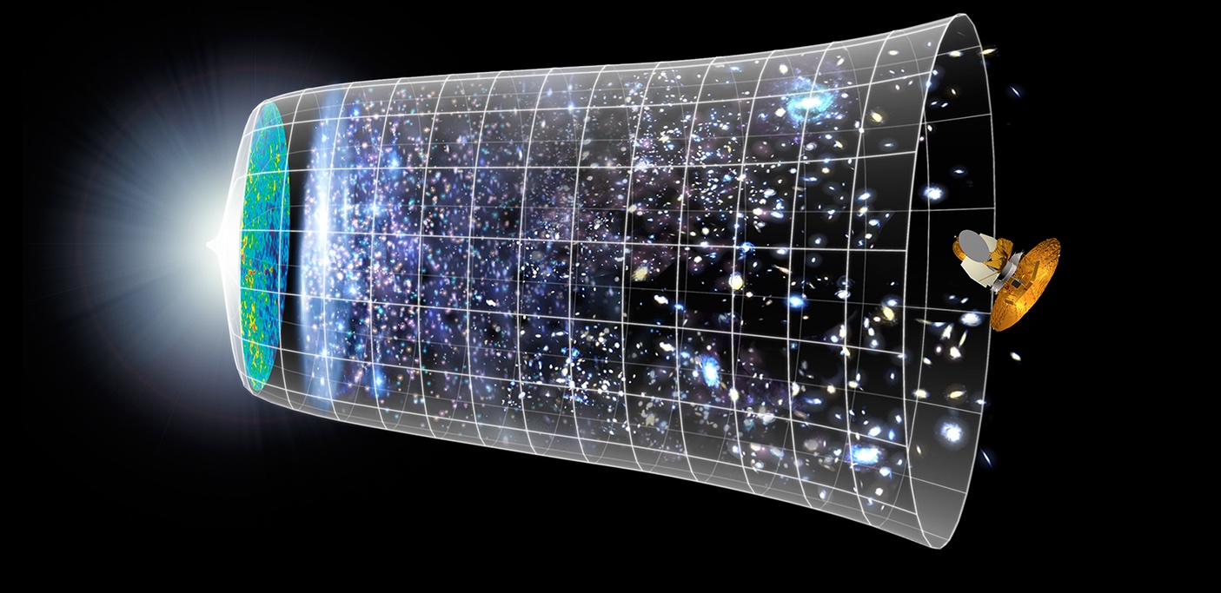

How did the universe begin?
Big Bang
We reproduce the conditions a fraction of
a second after the Big Bang, to gain insight into the structure and evolution
of the universe.
Telescopes
Accelerators
380 000 years
13.8 Billion Years
Today
10²⁸ cm
Notes:
“How did the Universe begin?”
We gain insight into the structure and evolution of the UniversThe other question that underpins research in particle physics is e, from the first billionth of a second (10⁻¹²s) after the Big Bang.
From the very small (particle physics at modern accelerators allows us to study the fundamental laws of nature on scales down to smaller than 10⁻¹⁸ m) to the very big (telescope-based astrophysics), we gain knowledge about the laws and evolution of the universe.

Slide 7
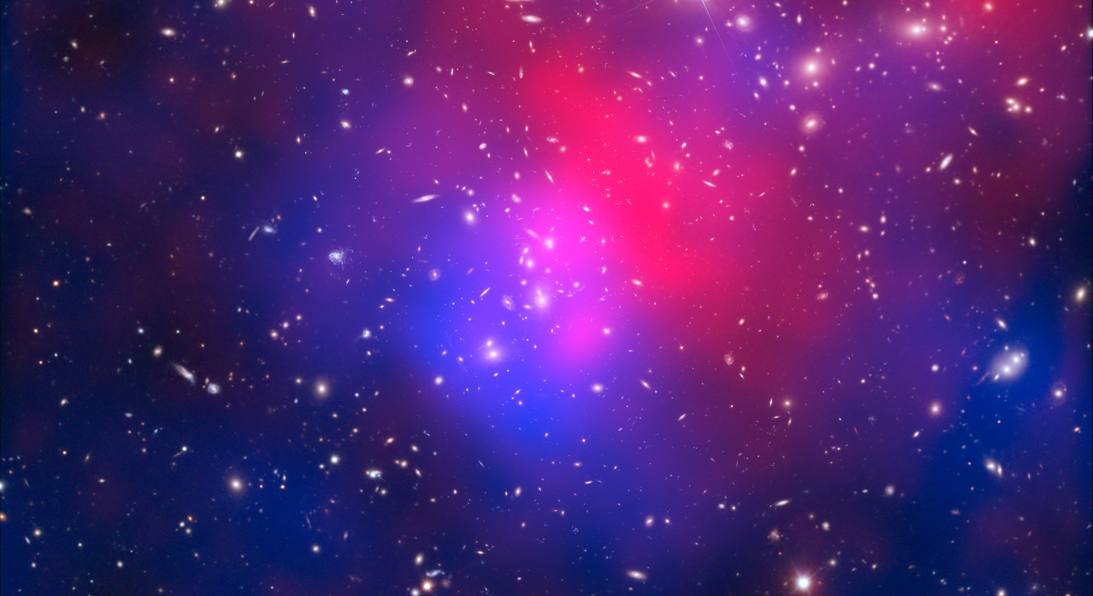
There are many unanswered questions in fundamental physics
Including
95% of the mass
and energy
of the universe is unknown.
Is there only one Higgs boson, and does it behave exactly as expected?
Why is the universe made only of matter, with hardly any antimatter?
Why is gravity so weak compared to the other forces?

Slide 8
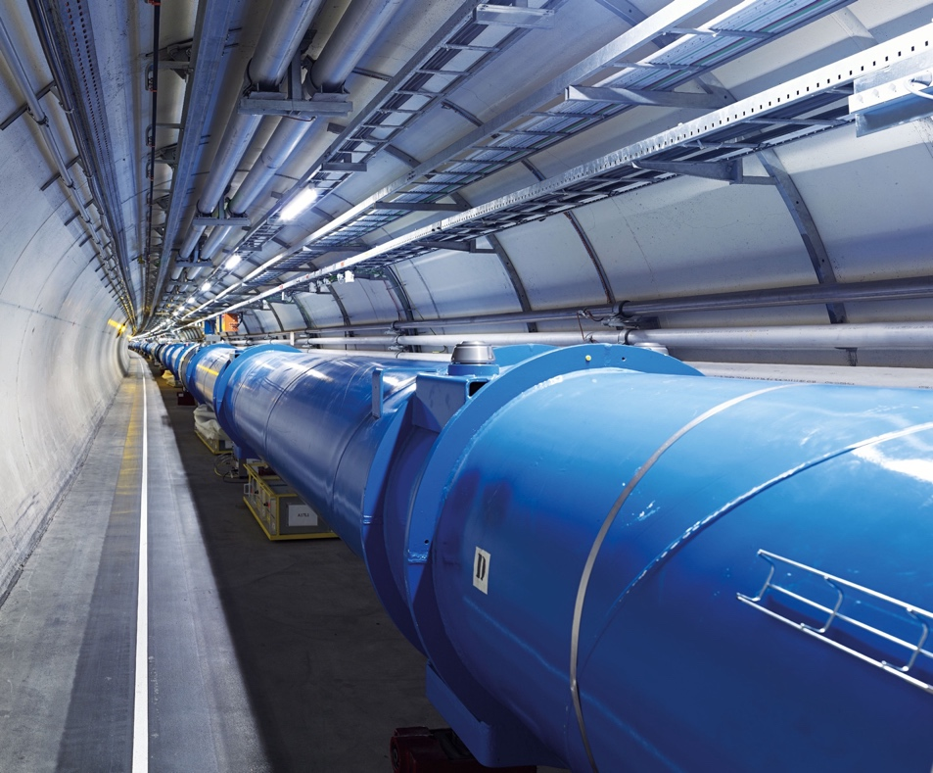
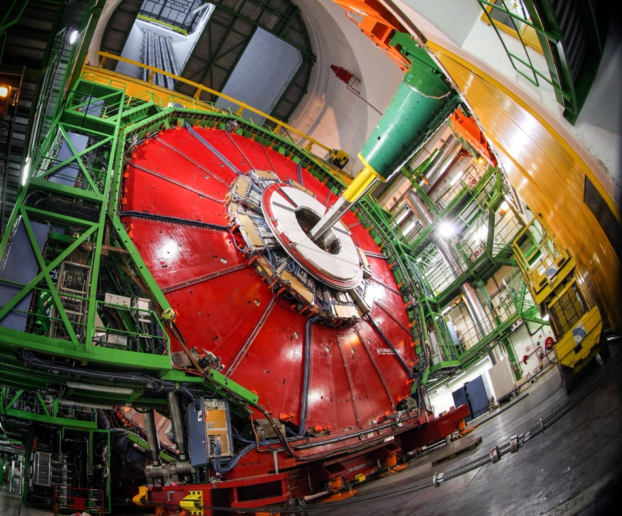
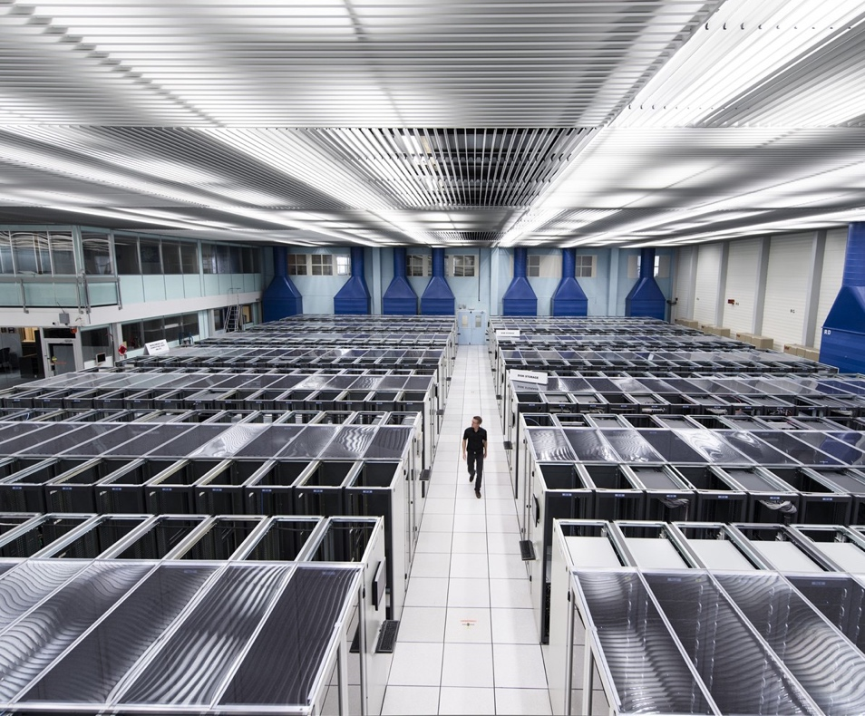
How do we do it?
We build the largest machines to study the smallest particles in the universe
We develop technology to advance the limits of what is possible
We perform world-class research in theoretical and experimental particle physics
ACCELERATORS
DETECTORS
COMPUTING

Slide 9
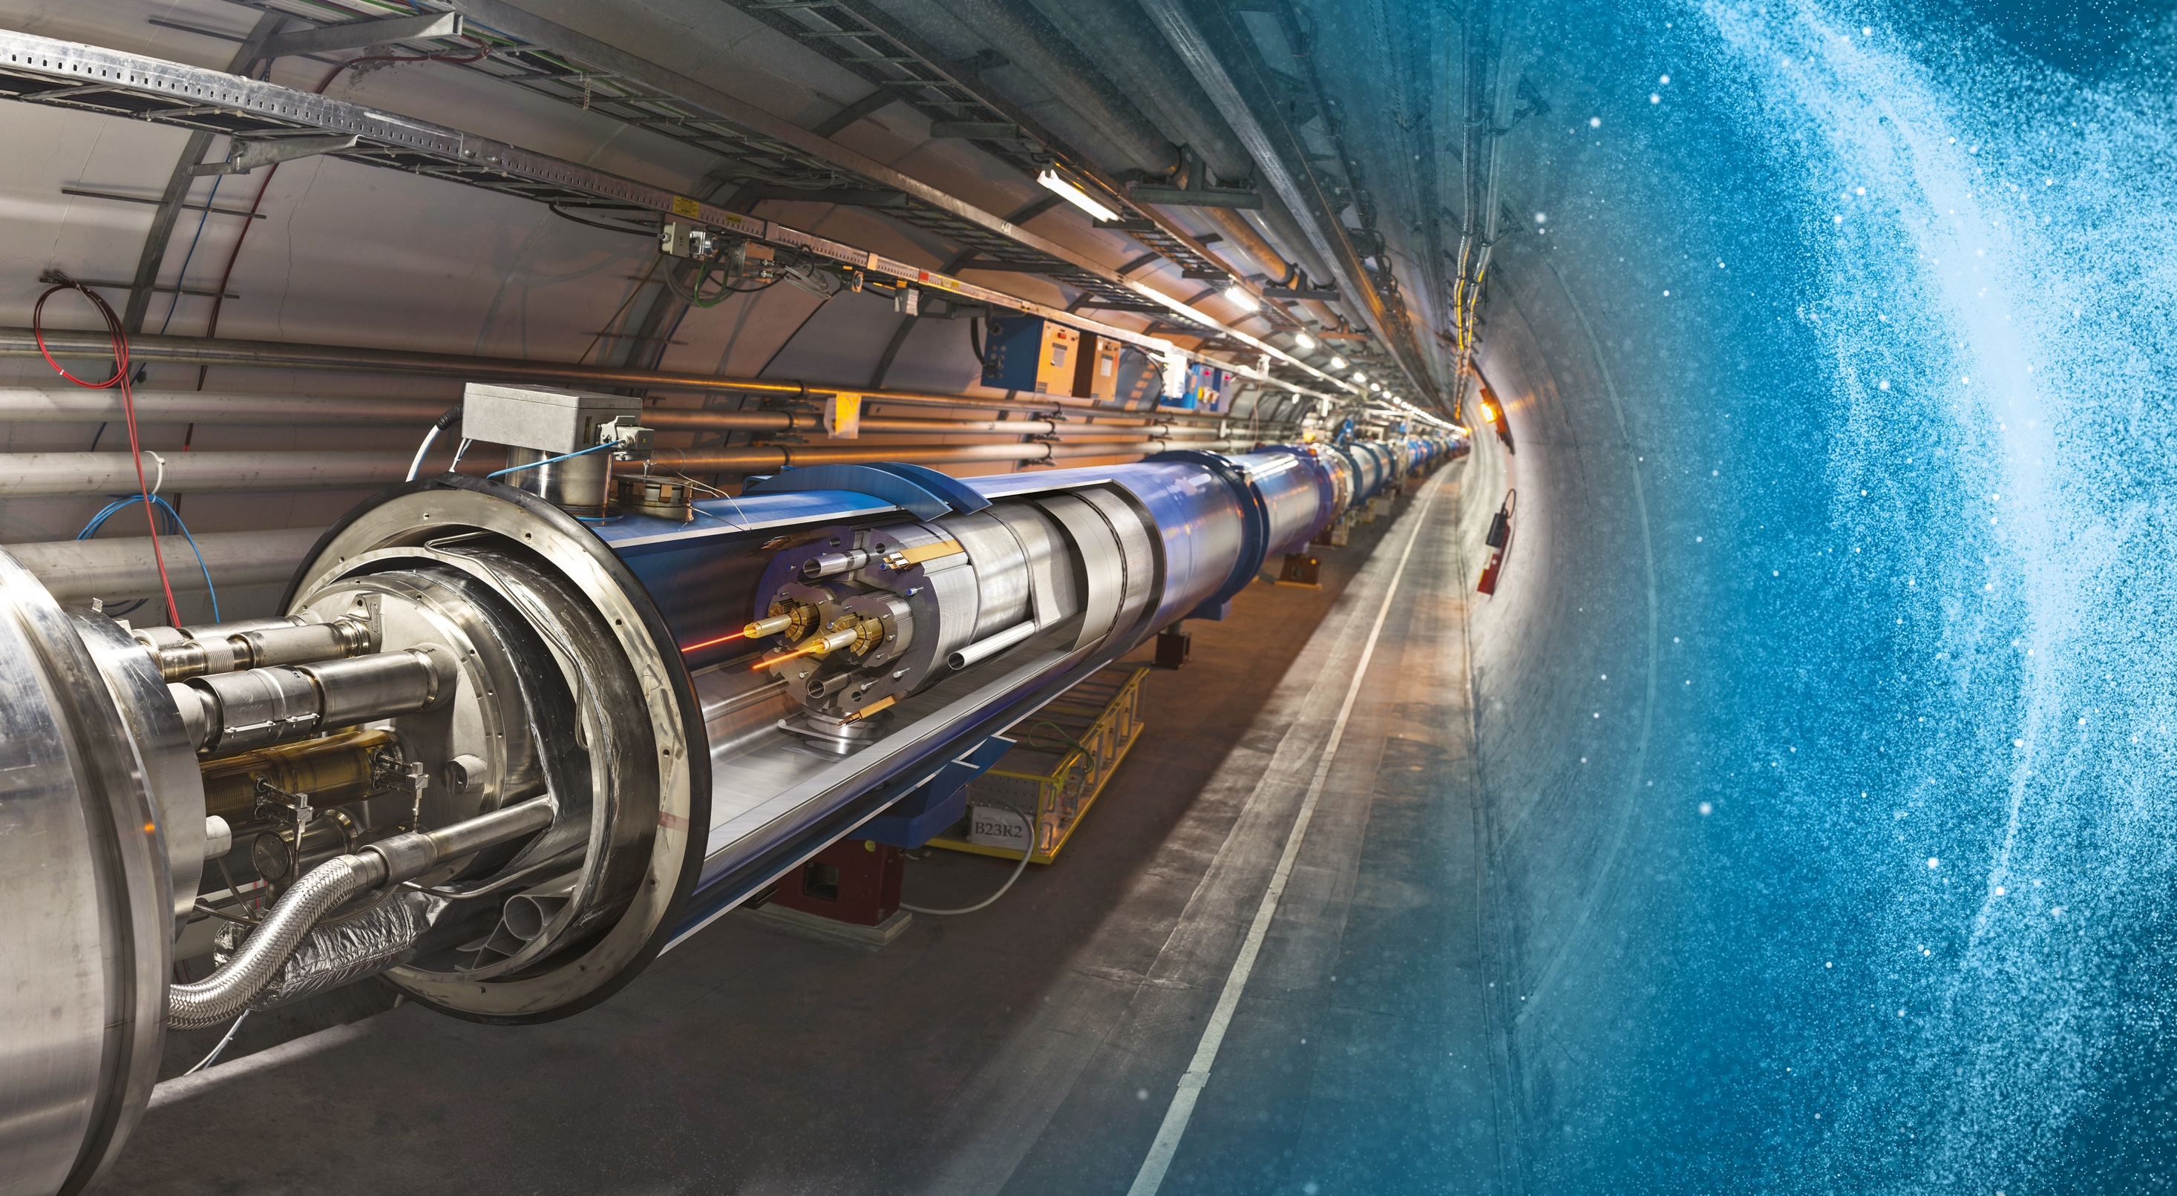
Large Hadron Collider (LHC)
27 km in circumference
About 100 m underground
Superconducting magnets steer the particles around the ring
Particles are accelerated
to close to the speed
of light
Notes:
The LHC is CERN’s flagship accelerator.
Possible additional information to complement what is on the slide (TIME PERMITTING):
It is the world’s largest and most powerful particle accelerator
Protons (and lead ions) circulate in two beams, which travel in opposite directions in two separate beam pipes
Protons are accelerated to 99.9999991% the speed of light (11 245 turns/second)
The beam pipes are under ultrahigh vacuum, to avoid collisions between the particles and gas molecules. The vacuum in the beam pipes is 10⁻¹³ atm – similar to the atmosphere on the moon (10⁻¹⁵ atm)
It is one of the coldest places in the Universe (1.9K; -271.3°C)
Superconducting magnets are used to focus the beam (quadrupole magnets) and bend the beam around the circular accelerator (dipole magnets)
The LHC is built in the same tunnel where CERN’s previous flagship accelerator was located – LEP, which accelerated electrons

Slide 10
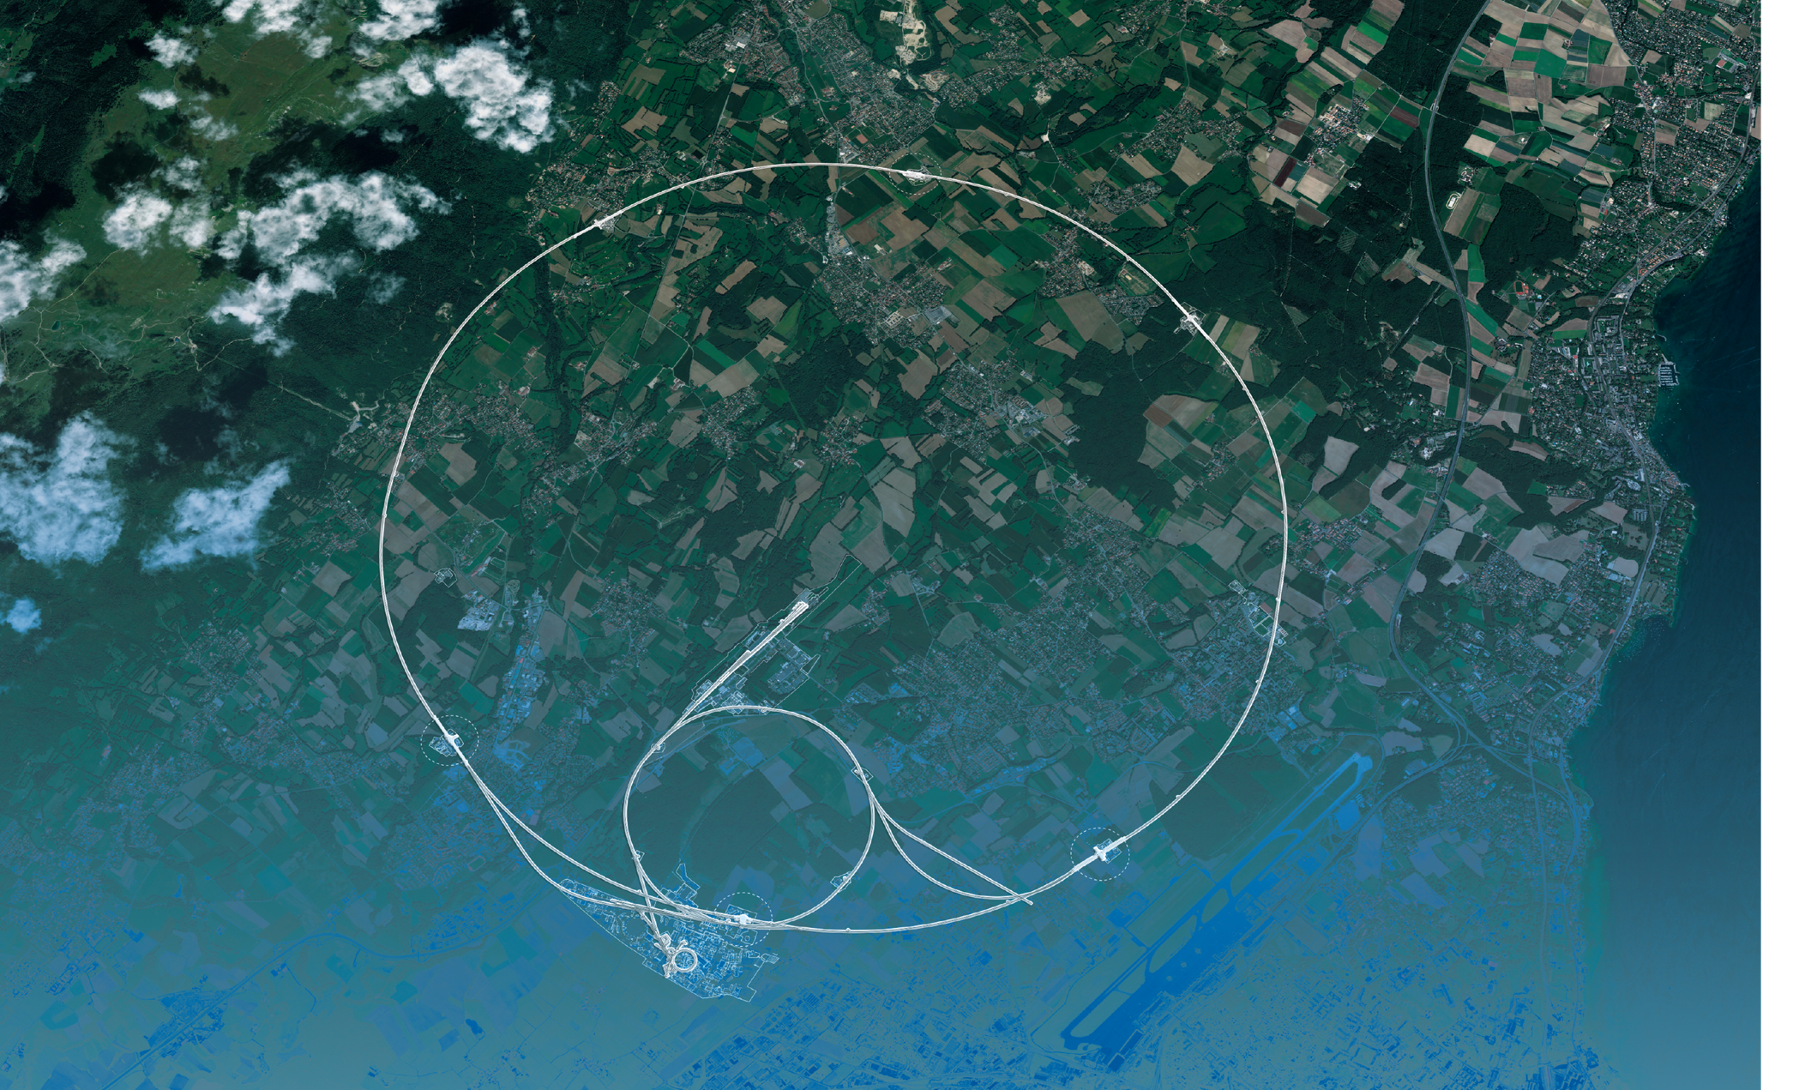
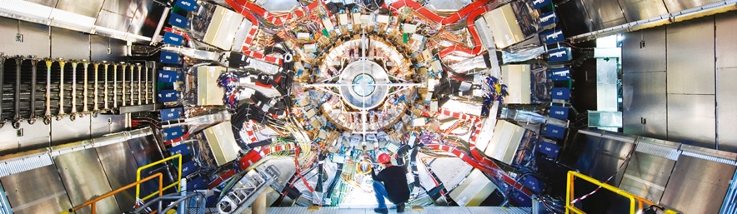
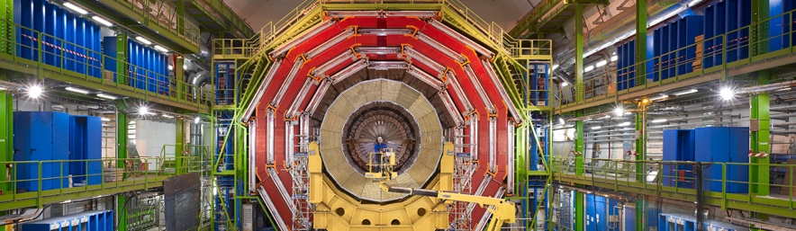
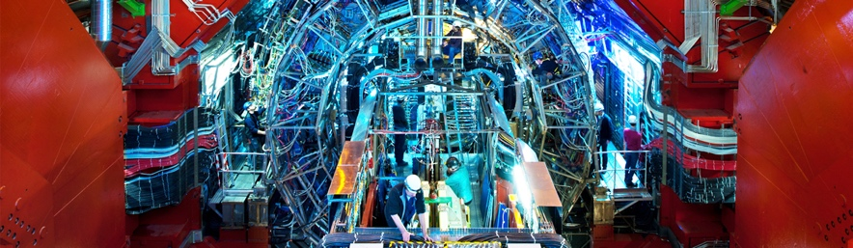
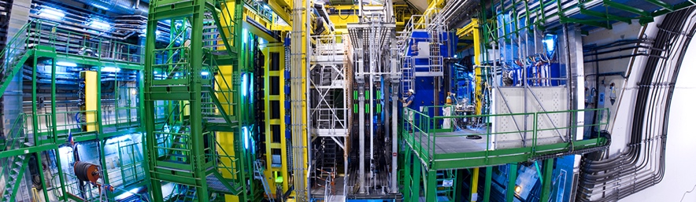
Giant detectors record the particles formed at the four collision points
ATLAS
CMS
CMS
ALICE
ALICE
ATLAS
LHCb
LHCb
Notes:
ATLAS – is a general-purpose detector, designed to carry out research ranging from precise measurements of the Higgs boson to searches for new physics beyond the Standard Model, similar to CMS. It is the largest collider-detector ever built (44m in length and 25m in diameter).
CMS - is a general-purpose detector, similar to ATLAS. It is one of the detectors, with ATLAS, where evidence for the Higgs boson was discovered and announced in 2012. It is the heaviest collider-detector (12.5 tonnes).
ALICE – studies the properties of the so-called quark-gluon plasma, a state of matter that probably existed just after the Big Bang, before protons and neutrons were formed.
LHCb – studies the asymmetry between matter and antimatter in interactions of particles containing the so-called b quark. This may help understand why our Universe is made up of only matter.

Slide 11




The LHC detectors are analogous to
3D cameras
The detectors measure the energy, direction and charge of new
particles formed.
They take 40 million pictures
a second. Only 1000 are
recorded and stored.
The LHC detectors have been built by international collaborations covering all regions of the Globe.

Slide 12
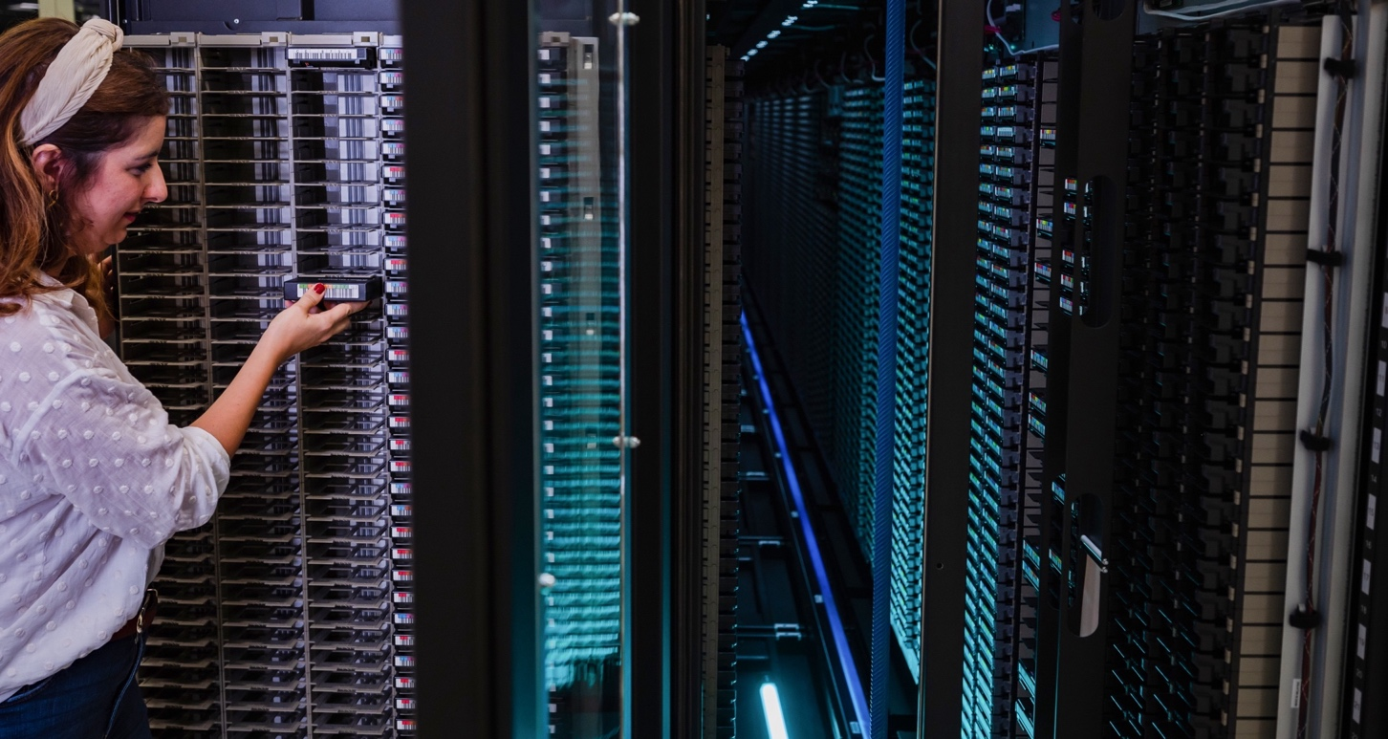
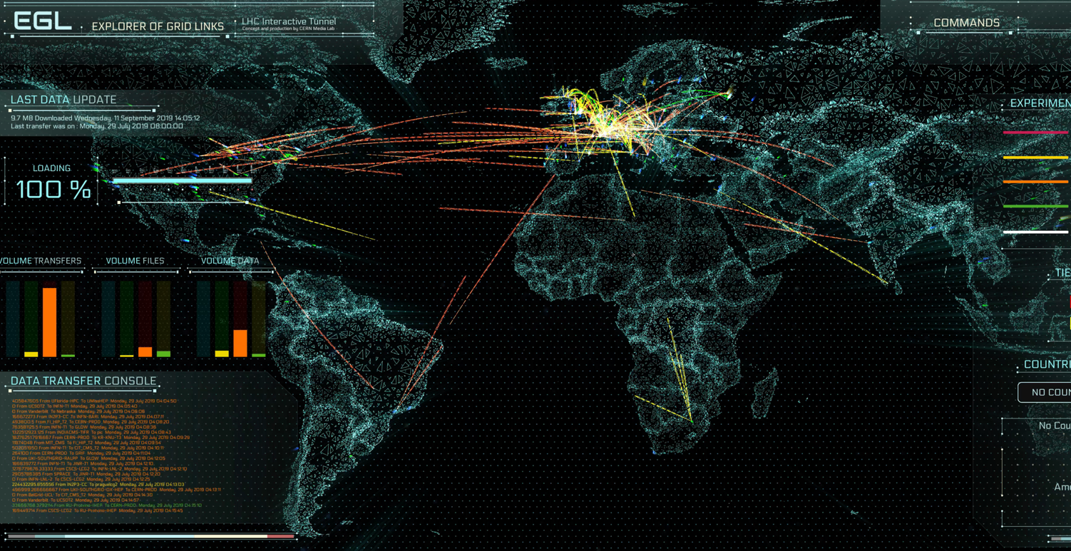
The Worldwide LHC Computing Grid (WLCG)
Used to store, distribute, process and analyse data.
1 million processing cores in about 170 data centres
and 42 countries.
More than 1000 Petabytes of CERN data stored world-wide.

Slide 13

COLLABORATION

Slide 14

Science for peace
CERN was founded in 1954 with 12 European Member States
CERN’s annual budget
is 1200 MCHF (equivalent
to a medium-sized European university)
23 Member States
Austria – Belgium – Bulgaria – Czech Republic
Denmark – Finland – France – Germany – Greece Hungary – Israel – Italy – Netherlands – Norway
Poland – Portugal – Romania – Serbia – Slovakia Spain – Sweden – Switzerland – United Kingdom
As of 31 December 2022
Employees:
2658 staff, 900 fellows
Associates:
11 860 users, 1516 others
3 Associate Member States
in the pre-stage to membership
Cyprus – Estonia – Slovenia
7 Associate Member States
Croatia – India – Latvia – Lithuania – Pakistan
Türkiye – Ukraine
6 Observers
Japan – Russia (suspended) – USA
European Union – JINR (suspended) – UNESCO
Around 50 Cooperation Agreements
with non-Member States and Territories
Albania – Algeria – Argentina – Armenia – Australia – Azerbaijan – Bangladesh – Belarus – Bolivia
Bosnia and Herzegovina – Brazil – Canada – Chile – Colombia – Costa Rica – Ecuador – Egypt – Georgia – Honduras
Iceland – Iran – Jordan – Kazakhstan – Lebanon – Malta – Mexico – Mongolia – Montenegro – Morocco – Nepal
New Zealand – North Macedonia – Palestine – Paraguay – People's Republic of China – Peru – Philippines – Qatar
Republic of Korea – Saudi Arabia – Sri Lanka – South Africa – Thailand – Tunisia – United Arab Emirates – Vietnam
Notes:
More than 40% of CERN’s budget is returned to industry through materials, utilities and services

Slide 15
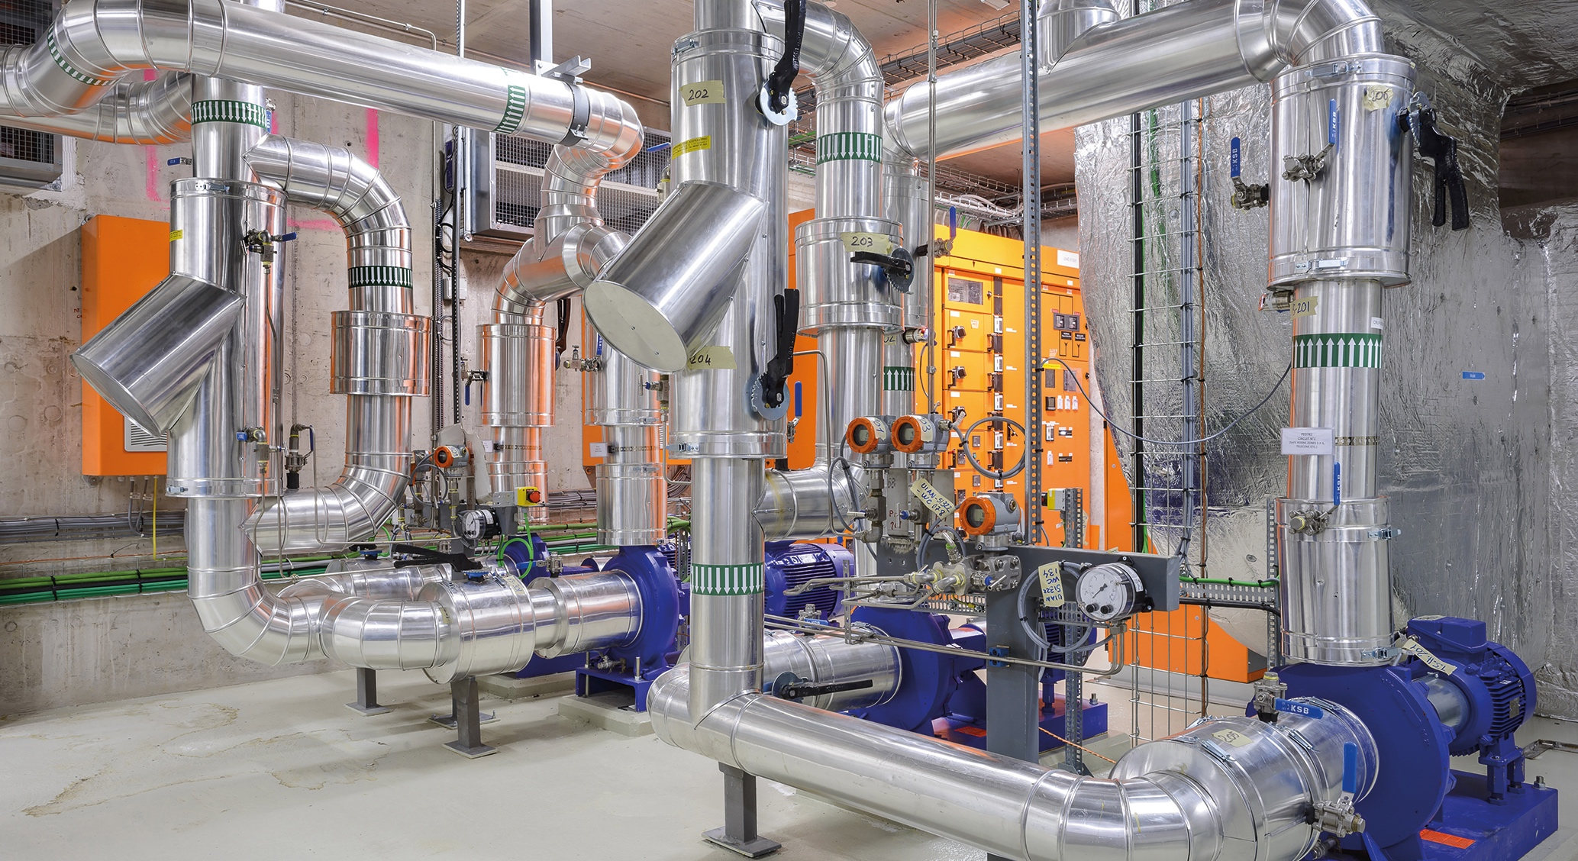
TECHNOLOGY & INNOVATION

Slide 16

CERN’s technological innovations have applications in many fields
CERN is the birthplace of the World Wide Web
And there are many more examples
Medical imaging, cancer therapy, material science, cultural heritage, aerospace, automotive, environment, health & safety, industrial processes.

Slide 17
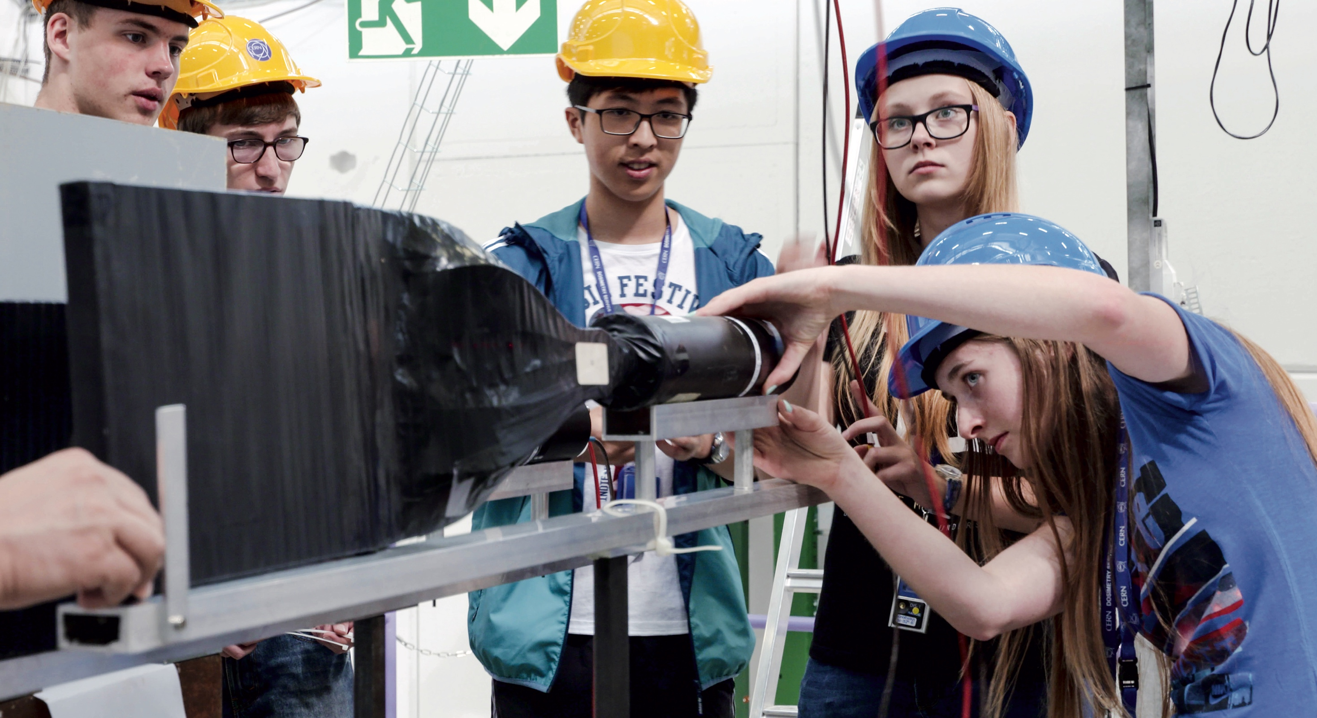
EDUCATION
& TRAINING

Slide 18
CERN opens a world of career opportunities
Number
of Persons
19%
Other fields, including
government organisations
27
45%
Industry
36%
Academia or Research
65
age
Age Distribution of Scientists working at CERN
Source: CERN Alumni survey (2014)
PhD and Technical students leaving CERN

Slide 19

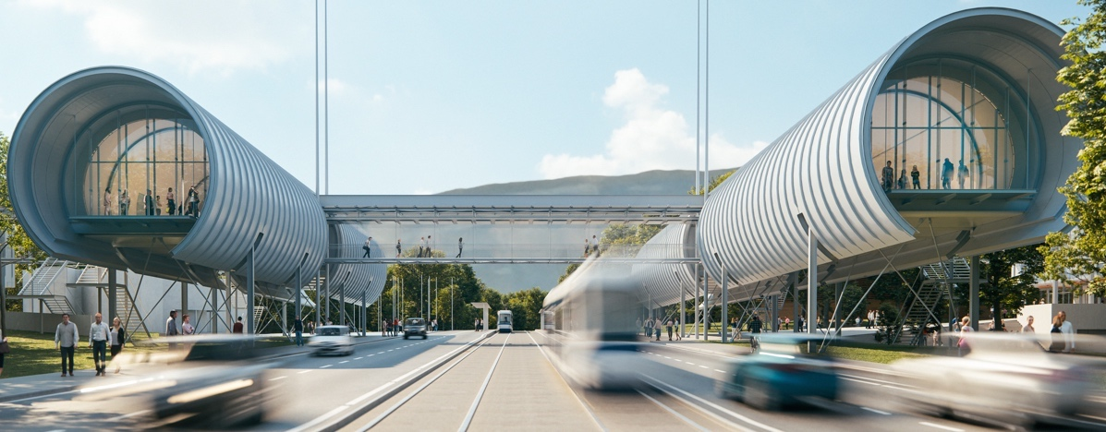
CERN’s training, education and outreach programmes
300 Undergraduate students in
Summer programmes
>3000 registered PhD students.
>1000 Fellows, Technical and Doctoral Students in research and applied physics, engineering and computing.
13 304 teachers since 1998 and 2000 participants in the webinar since 2020.
151 000 visitors on guided tours of CERN in 2019, from 95 countries.
CERN engages with citizens
across the globe:
on-site and travelling exhibitions
in 15 countries, > 1 million visitors
Science Gateway expands CERN’s outreach reach and impact, locally and globally.

Slide 20
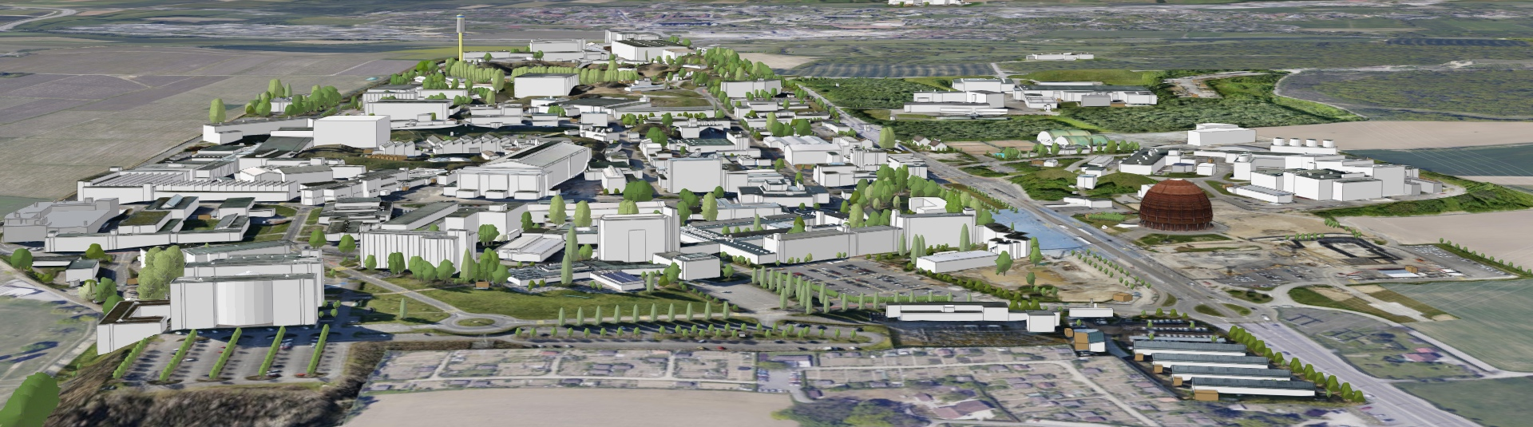
CERN SITE FIGURES
590 ha (220 fenced)
2 main sites and 15 satellite sites
670 buildings from 10 m² to 20.000 m²
65% built before the 70’s
70 km tunnels and 80 caverns
30 km roads
1000 km technical galleries and trenches
9000 persons/daily
490 hostel rooms
8500 working places
4300 parking places in Meyrin, 1400 in Prévessin
25000 daily movements to- and inter-sites
Public transport links in CH, not in FR

Slide 21
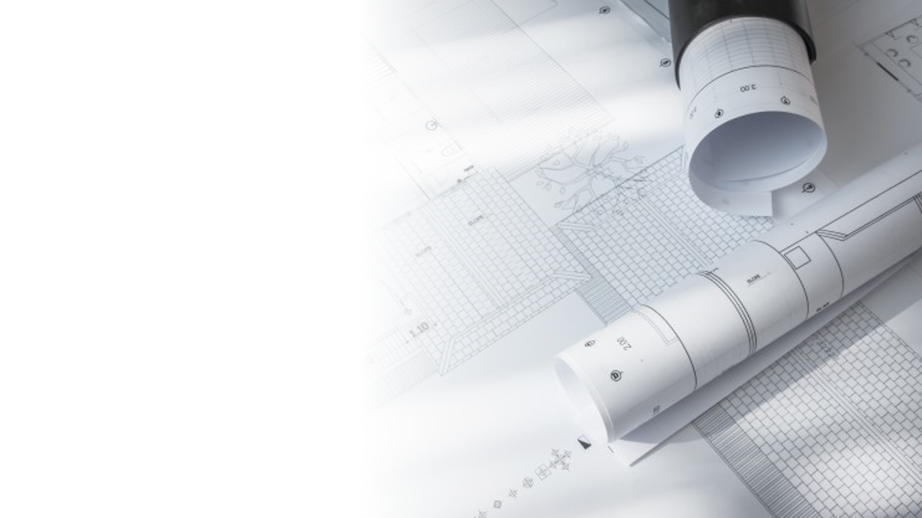
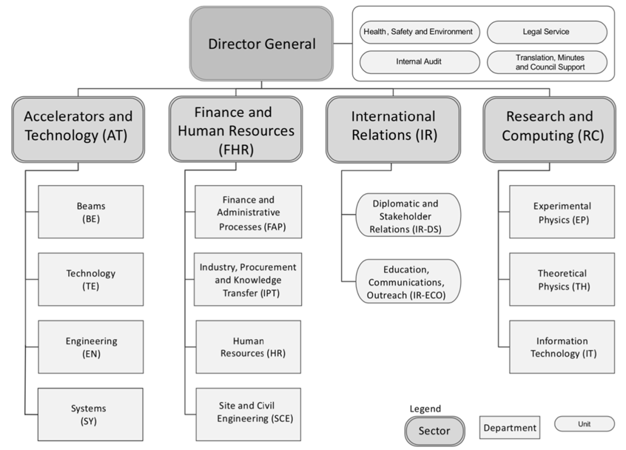
Site and Civil Engineering (SCE) Department
The Site and Civil Engineering (SCE) Department manages and develops CERN’s real estate assets and infrastructures in agreement with CERN’s scientific strategy, as well as all the services related to the caretaking and operation of the CERN site.

Slide 22
Site and Civil Engineering
(SCE)
Departmental Operation and Development
(DOD)
DH: Mar Capeans
DDH: Cedric Garino
Strategic cross-​sectional projects, management of resources, admin hub, Safety, Site Security.
Project Portfolio
Management
(PPM)
Site Asset
Management
(SAM)
Services
and Supply Chain
(SSC)
Service Management
and Support
(SMS)
GL: Natacha Lopez
DGL: Pieter Mattelaer
GL: Pierre Cardon
DGL: Michael Poehler
GL: Cedric Garino
DGL: Laetitia Lejeune
GL: Gyorgy Balazs
DGL: Isabel Fernandez
Responsible for the major developments of CERN in the field of civil engineering. It consists of project managers and specialists developing, monitoring and managing the major civil engineering projects during the execution phase.
Responsible for monitoring the condition of current buildings and infrastructure on campus, and conducting relevant renovation projects. Study and early support of user-​initiated construction projects (IPP lead).
Responsible for providing the CERN community with high standard campus experience and optimal industrial logistics by offering rationalized, efficient, and controlled services.
Responsible for the clear and coherent implementation and monitoring of service management. Business analytics.

Slide 23
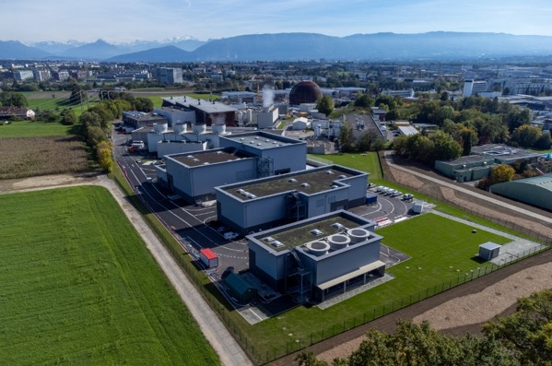
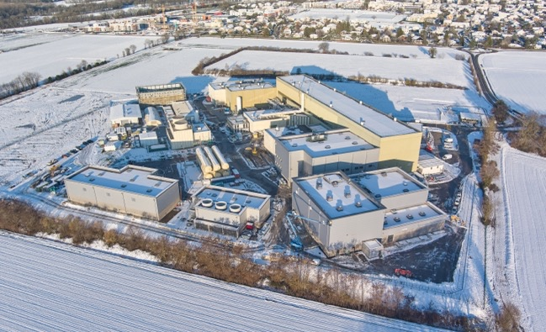
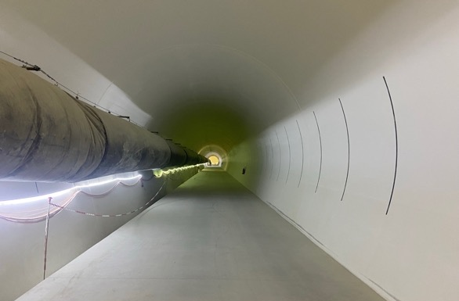
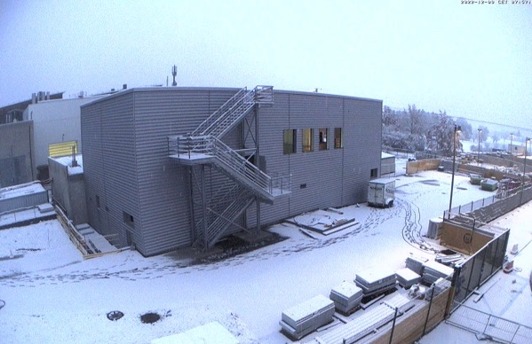
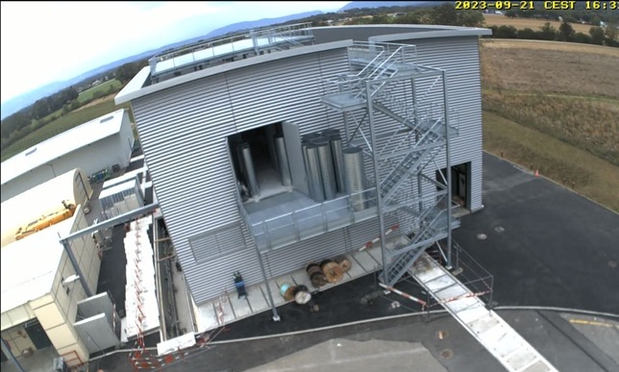
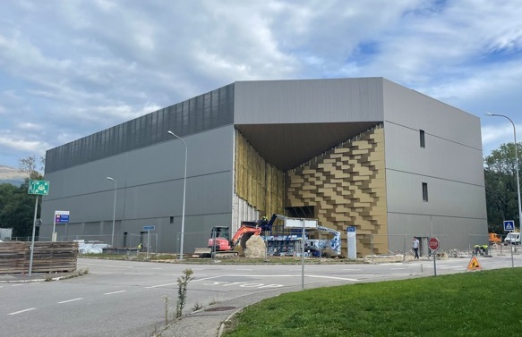
Examples of recent constructions
HL-LHC P1
HL-LHC P5
HL-LHC underground structures
CO₂ cooling building ATLAS
CO₂ cooling building CMS
PCC
Reference Design

Slide 24
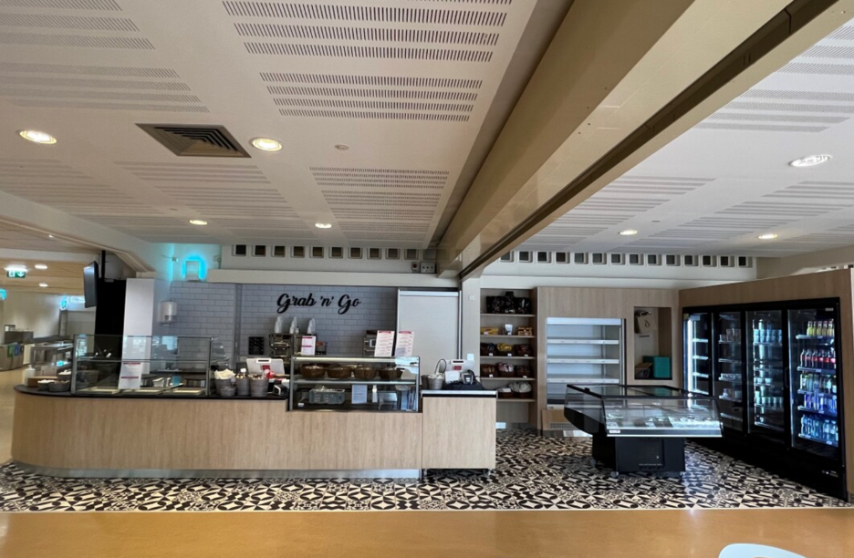
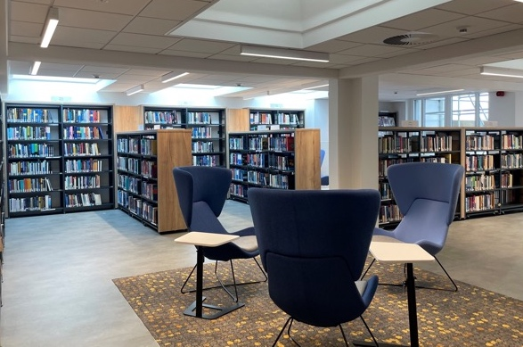
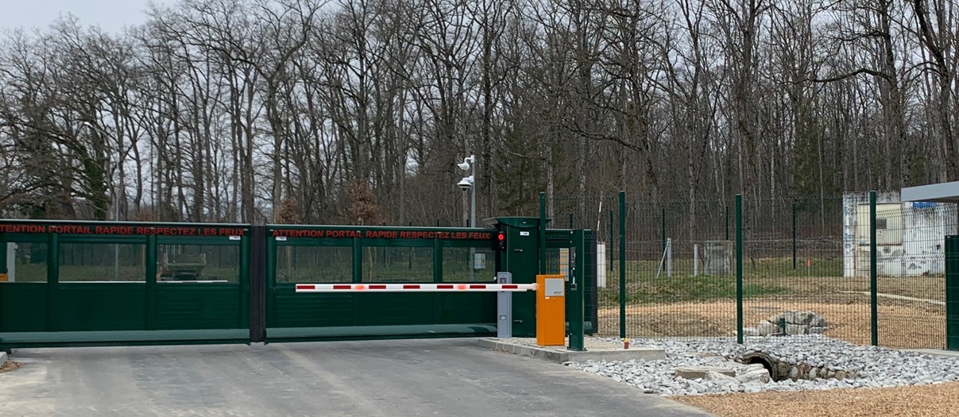
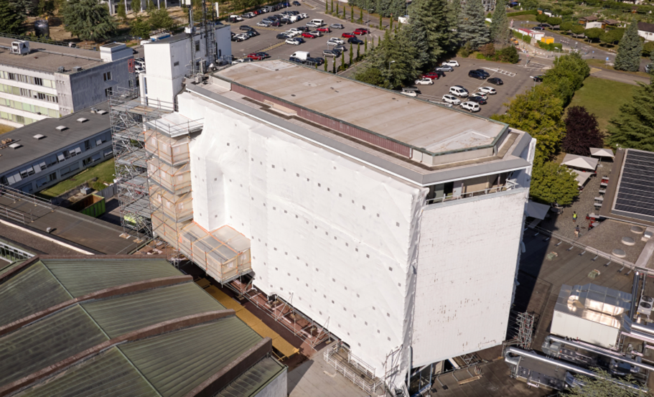
Examples of recent renovations
R1
B52/CERN Library
ADD ENERGY GAIN
CERN Library
Recovered the original and protected architectural essence of Steiger’s design
New contemporary interior in terms of functionality, technical installations and aesthetics
Energy performance improved by 75%.
  Low energy lighting: 50% less power, 40% lower consumption, automatic regulation
  HVAC E-recovery up to 80%: heat exchangers, automatic regulation depending on occupancy, sleep mode
  Improved building insulation
Site periphery
B60
Reference Design

Slide 25





To increase the positive impact on CERN’s community & the environment
Sustainable
Services
Gradual replacement of Internal Combustion Engine (ICE) cars by Battery Electric Vehicles (BEV) for car sharing, campus logistics, shuttles
Working with all Departments to reduce CERN’s car fleet by 25% in 2024
New car sharing service: 600 users registered, 8,500 reservations in the year
Central collectors of office waste in 8 buildings
Released CERN’s Waste Management Roadmap
Completed the inventory of storage buildings and migration to EAM (15 buildings, ~10k assets)
Released CERN’s Storage Roadmap
E-bike & e-scooters station-to-station service consolidated: 3600 registered users, 44,000 reservations in the year
Laboratory waste sorting pilot for metals in 2 buildings and biowaste pilot for R3 and 2 office buildings
Active standardization committees and sub-committees
2-phase renovation of R1, vegan offer, catering survey
Renovation of all bathrooms at hotel B39, private market integrated in CERN market, renovation of an apartment

Slide 26

