Slide 1
Grid Sites in China
On Behalf of IHEP-CC
Jingyan Shi
shijy@ihep.ac.cn

Slide 2
Outline
1
Overview of WLCG Sites in China
2
Beijing LHCb Tier-1 Site
3
WLCG Tier-2 Site at IHEP
4
Grid Site of Other Experiments
5
Summary

Slide 3
Overview of Grid Sites in China (1/2)
Chinese WLCG site history
  2006: IHEP signs the Memorandum of Cooperation with WLCG for ATLAS and CMS Tier-2 sites
  2018: LHCb Beijing Tier-2 site deployed at IHEP
  2020: BelleII Tier-2 site was built at IHEP
  2023: Construction starts for LHCb Tier-1 site and Alice Tier-2 sites at IHEP
  2024: LHCb Beijing Tier-1 goes into production
  2024: Alice Tier-2 goes into production

Slide 4
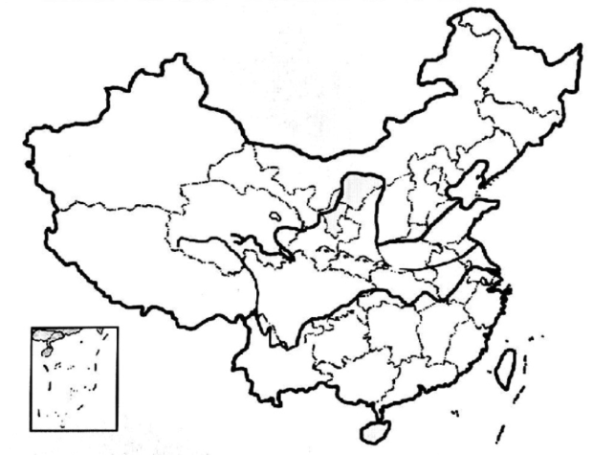
Overview of WLCG Sites in China (2/2)
PKU-T3
(CMS)
BEIJING-T1
Tier1(LHCb)
BEIJING-LCG2
Tier2(ATLAS,CMS,LHCb,BelleII)
Lanzhou-T2
(LHCb)
USTC-T3
(ATLAS)
Beijing-T2
(Alice)
HK-LCG2
(ATLAS)

Slide 5
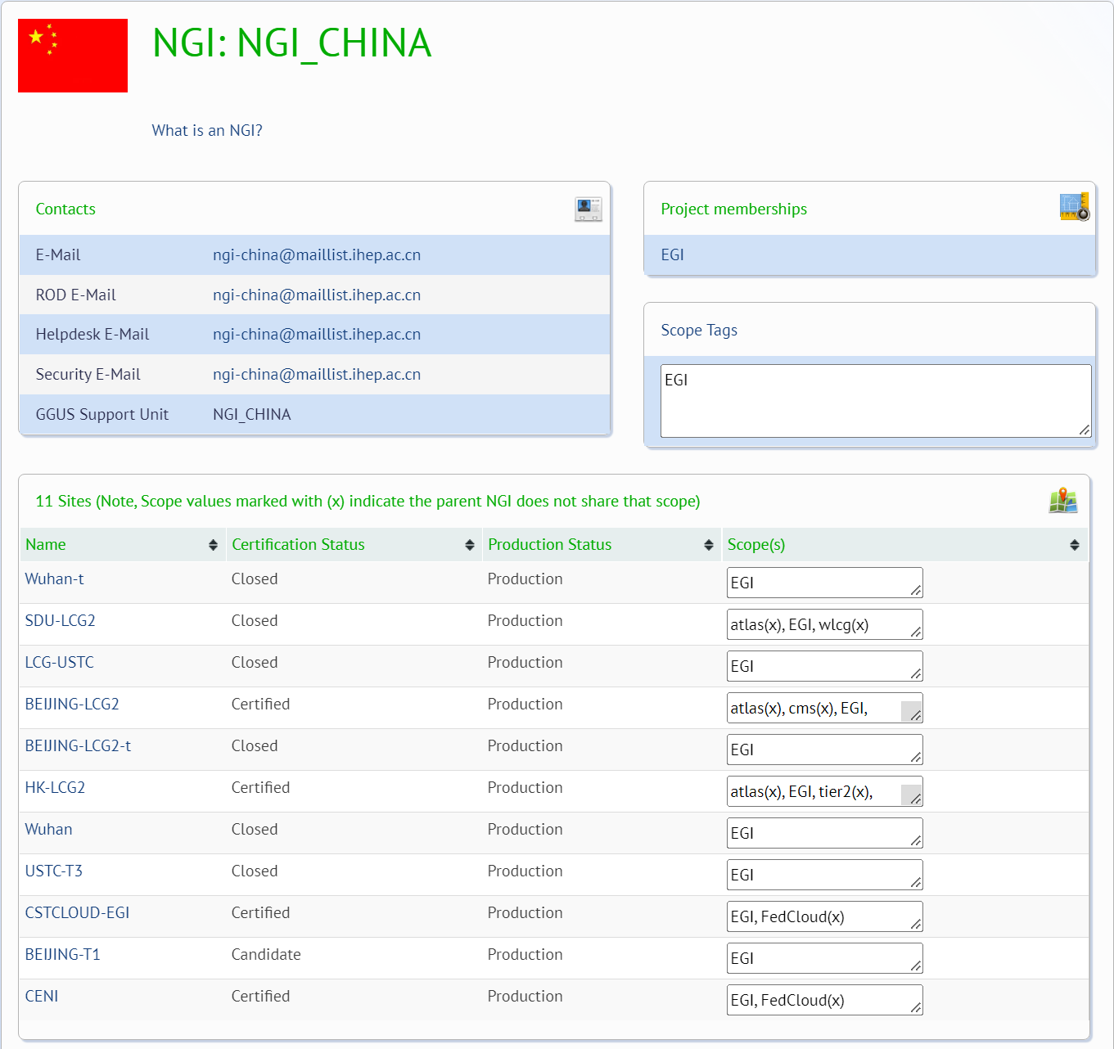
EGI - NGI_CHINA
NGI_CHINA was founded in 2014
Resource Centers involved in NGI_CHINA
  BEIJING-T1 (WLCG Tier-1)
  BEIJING-LCG2 (WLCG Tier-2)
  HK-LCG2 (WLCG Tier-2)
  CSTCLOUD-EGI (EGI)
  CENI (EGI)
Webpage of NGI_CHINA

Slide 6
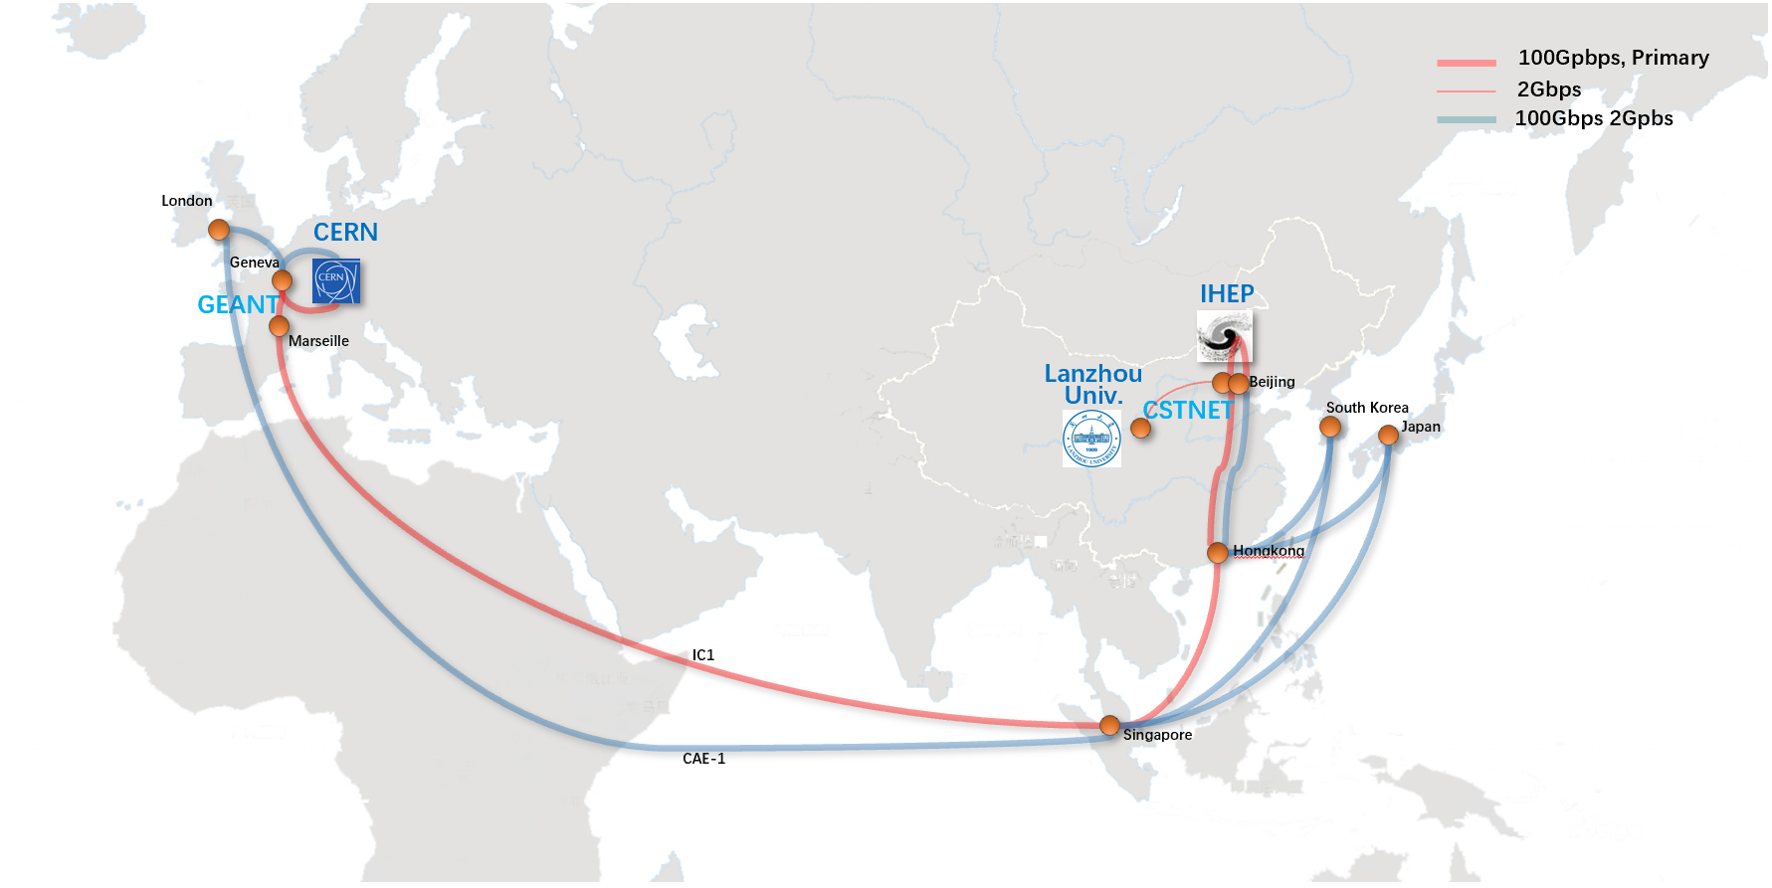
International Network Upgrade
International network link is upgraded to 100Gbps in 2023
  CSTNET (CNIC), GEANT, CERN and CN-IHEP collaborated on the upgrade
  LHCOPN: not less than 20Gbps
    CSTNET：20Gbps
    GEANT：more than 20Gbps promised
  LHCONE: more than 20Gbps
    IHEP is the main network user of CSTNET
International network connection of IHEP

Slide 7
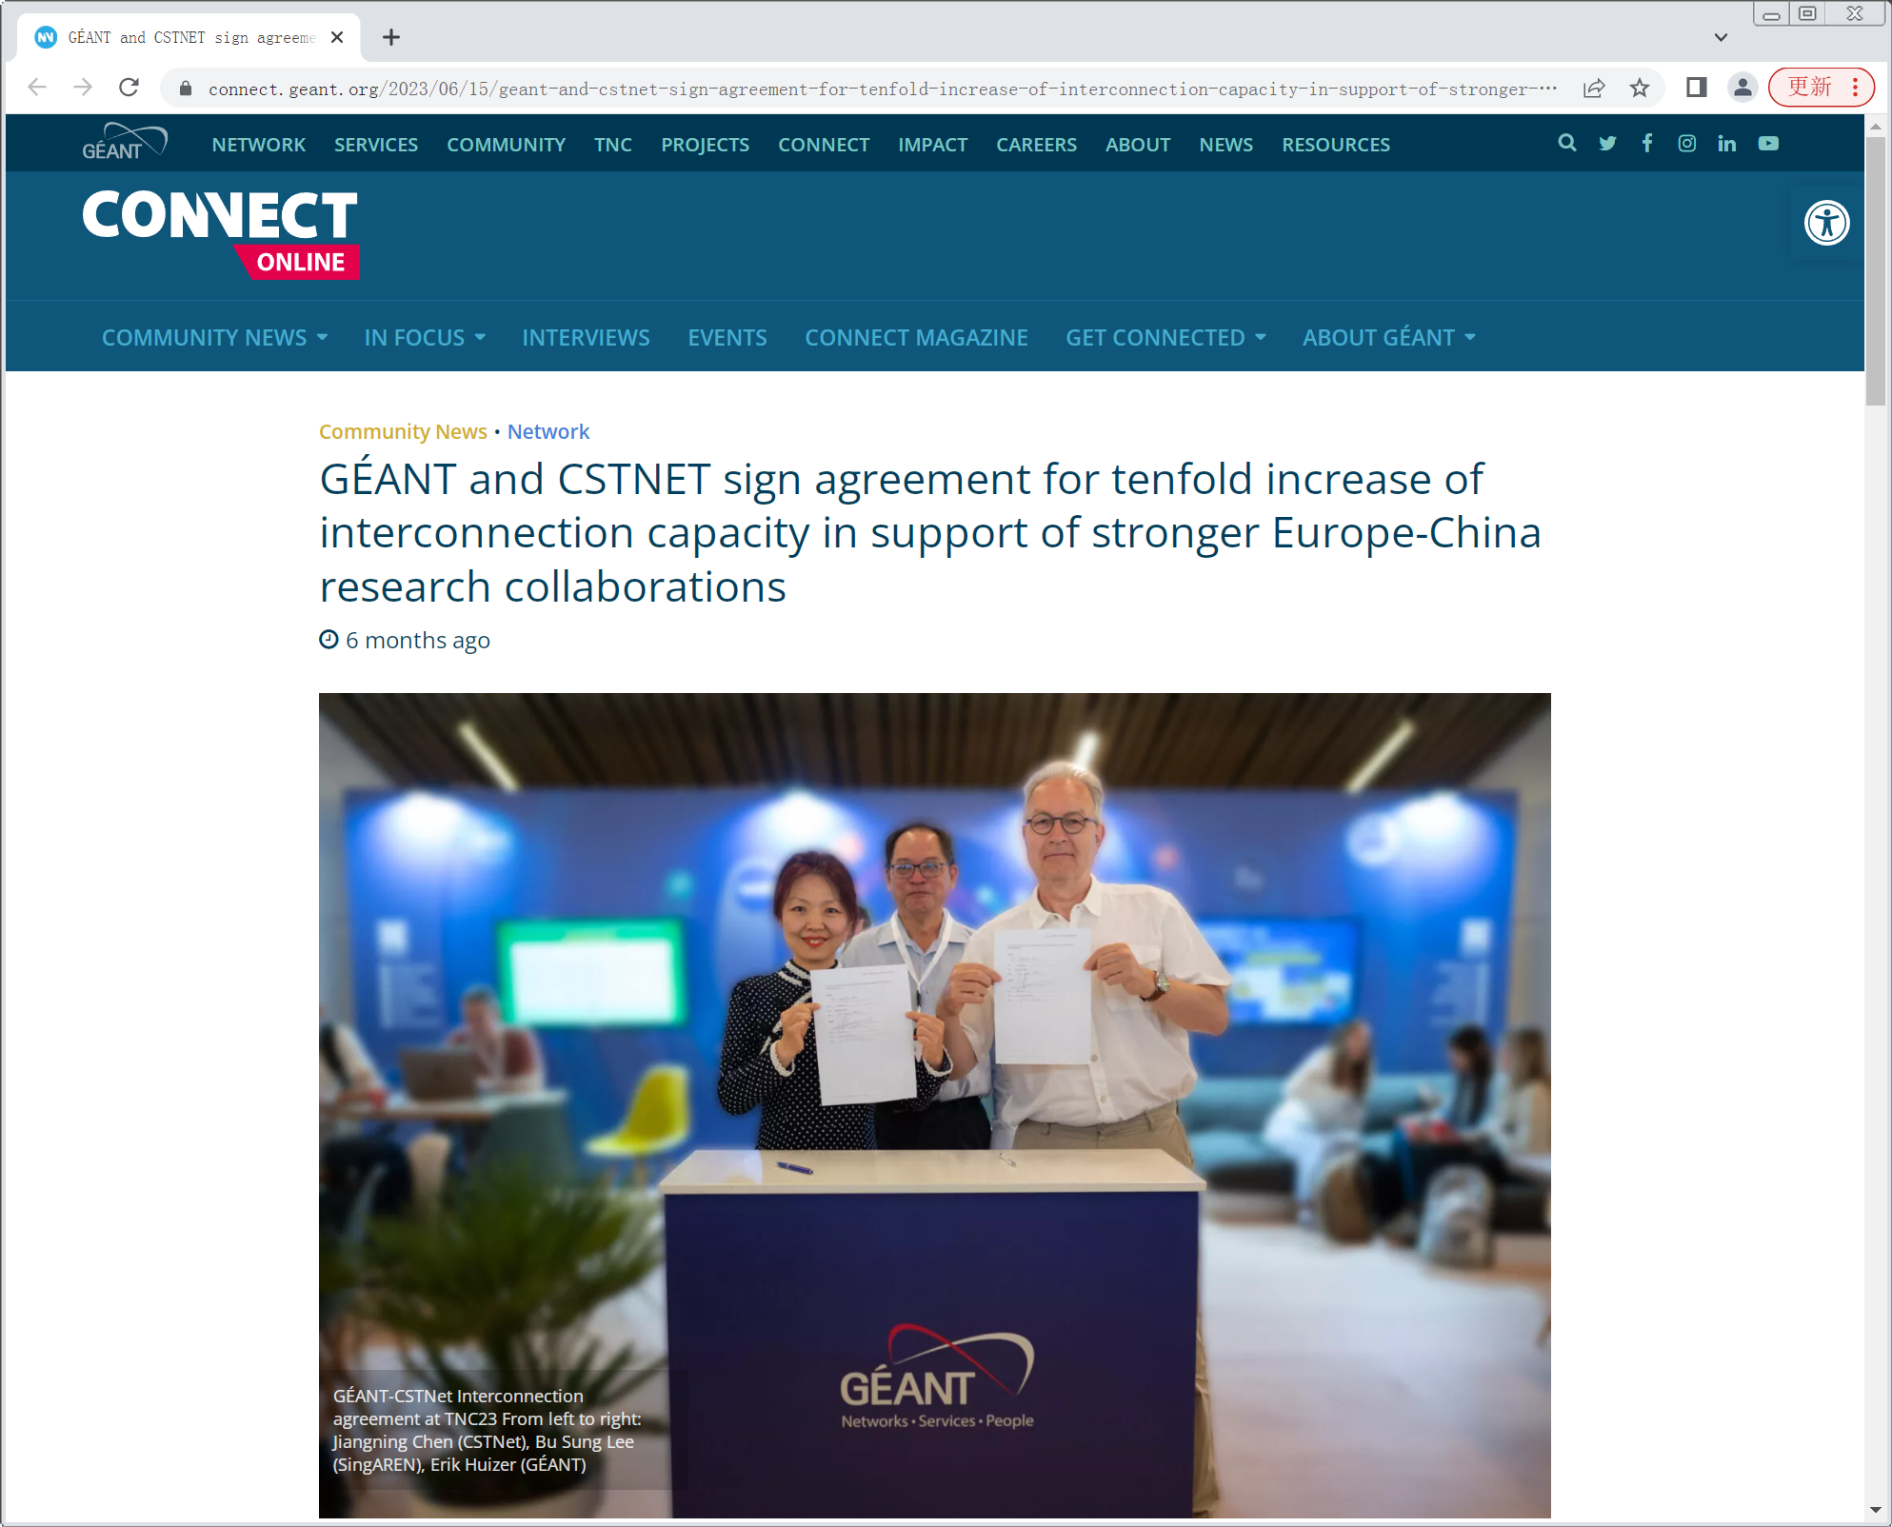
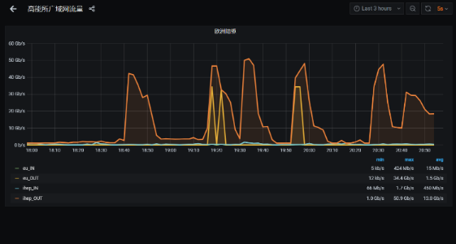
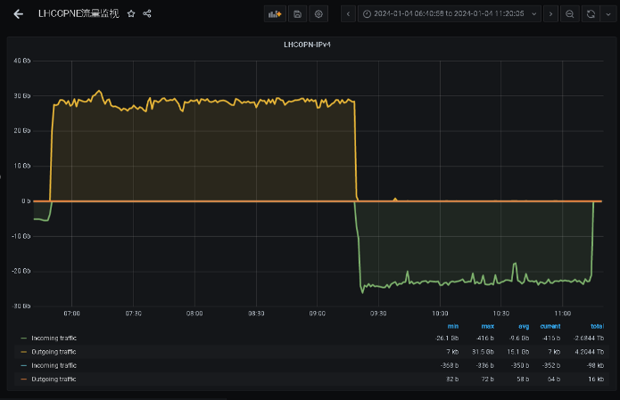
Network Performance Test
Time line of the 100Gbps network link creation for IHEP
  07/06/2023： CSTNET and GEANT signed an agreement to increase the interconnection capacity by tenfold
  13/07/2023: CSTNET 100G Europe Link became operational
  15/12/2023: IHEP-LHCOPN was ready
Network Performance Test
  JUNO data transferred
    Data transferred between IHEP and INFN, IN2P3 based on LHCONE
    Max speed reached to 50.9Gbps
  Iperf3 test
    Iperf3 test conducted between IHEP and CERN based on LHCOPN
    Max speed reached to 30Gbps
  Network Latency: ~210ms
50.9Gpbs
In: 30Gpbs
Out: 30Gpbs
Juno data transfer between IHEP and INFN, IN2P3
Iper3 Test between IHEP and CERN
Agreement signed between CSTNET and GEANT
Notes:
50.9G 是无任何限制的情况下，裸100G测试，为的是验证能跑多少，但张玄同提供的JUNO测试资源有限，因此只跑了50.9Gbps, 走LHCOPN
30Gbps这张图，是利用CERN iperf3服务器长期稳定的测试，无限制,走LHCONE

Slide 8
Outline
1
Overview of WLCG Sites in China
2
Beijing LHCb Tier-1 Site
3
WLCG Tier-2 Site at IHEP
4
Grid Site of Other Experiments
5
Summary

Slide 9
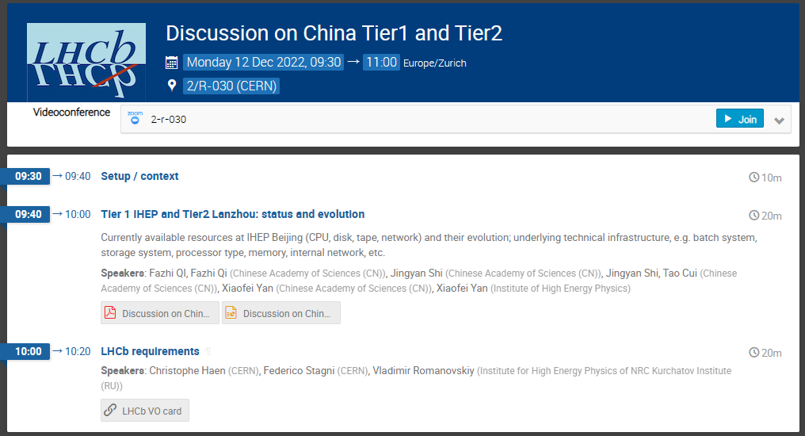
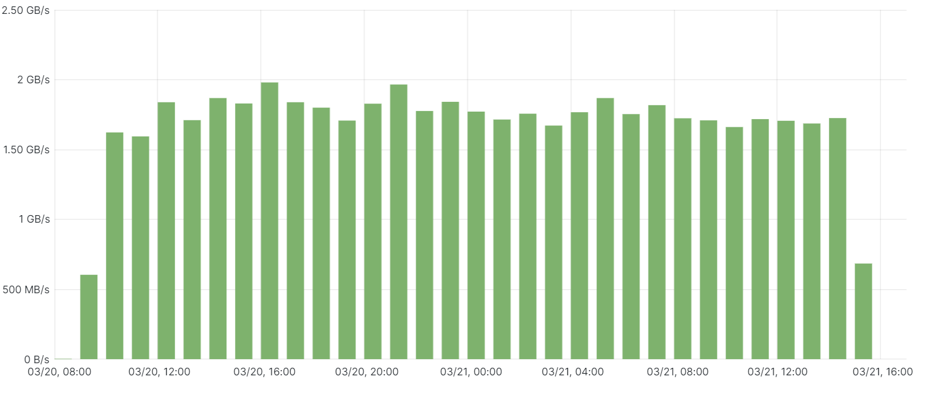
Construction and Resource of LHCb Beijing Tier-1 Site
Construction
  Oct. 2023: Chinese LHCb collaboration and CC-IHEP decided to construct Tier-1 Site for LHCb
  Dec. 2023: Discussed and received the approval from WLCG
  Feb. 2024: Construction completed
Resource provided for LHCb Beijing Tier-1
  Computing:
    40 worker nodes (Intel & AMD) with 3216 CPU cores: 67,000 HepScore
  Disk storage
    4 sets of storage array provide 3.2 PB
  Tape storage:
    4 drivers (IBM) and 170 tapes with 3PB
  Network equipment and management server:
    6 switches, 1 router, 2 band cards and 10 servers
First data challenge has been done
  189TB data was transferred into IHEP Site in ~2 days
  Average transfer speed is about 1.55GB/s (Max is 1.98)
  Transfer efficiency is close to 100%
International network connection of IHEP
Network traffic of the first data challenge

Slide 10
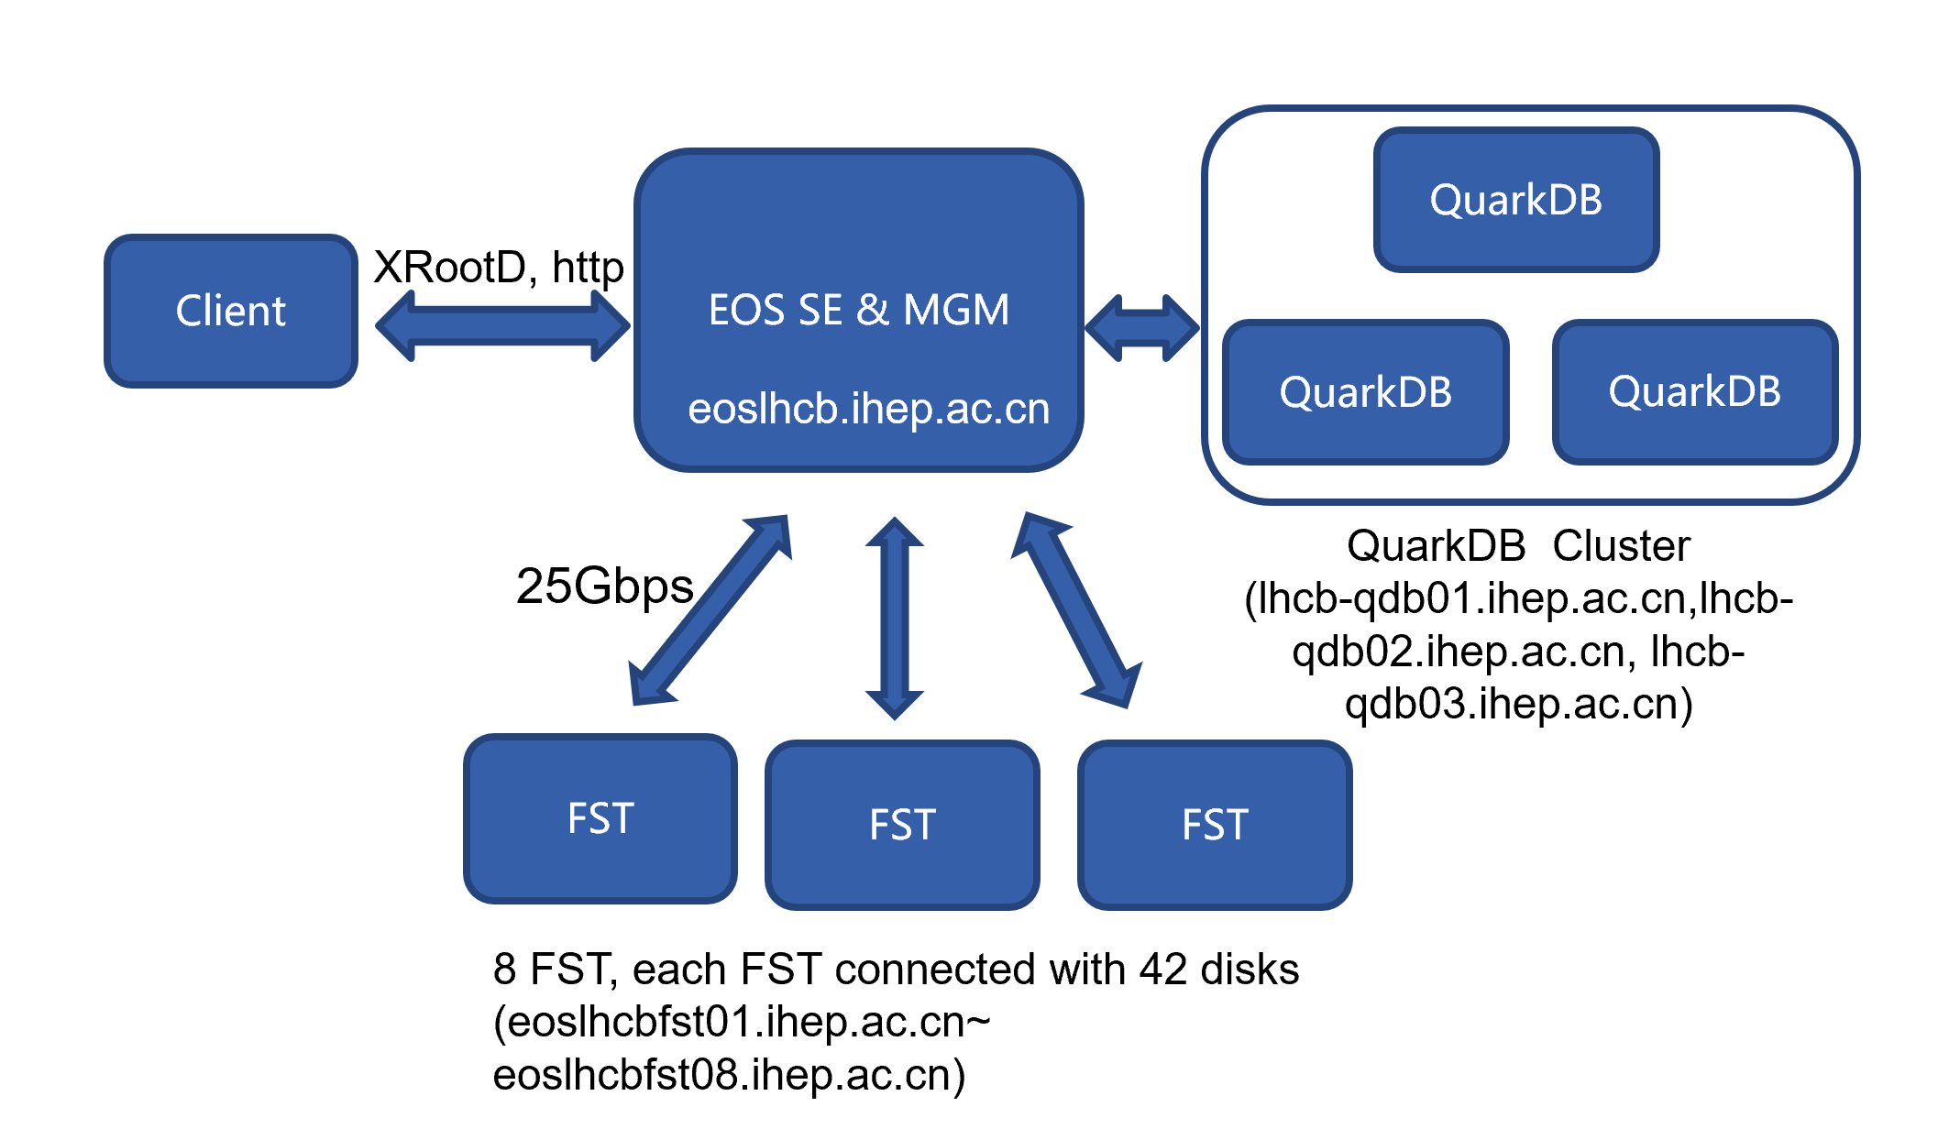
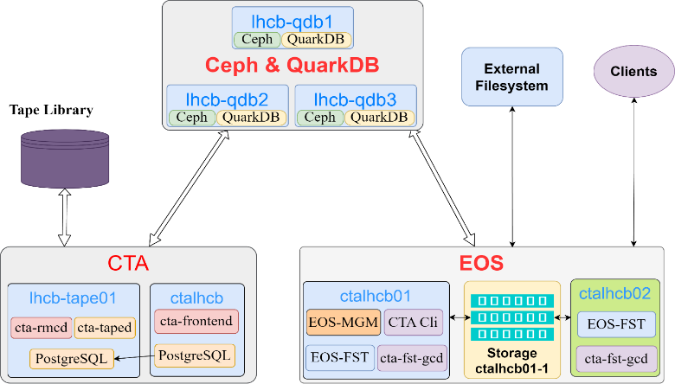
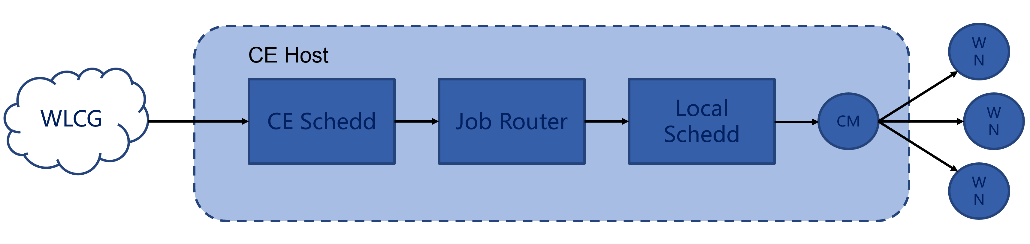
Software of LHCb Beijing Tier-1 Site
Disk storage: EOS
  services: QuarkDB, MGM, FST
  protocol: xrootd and http
Tape storage: EOS & EOS-CTA
  Protocols: xrootd and http(s)
  Authentication: SCI-Token and GSI
CE: HTCondor-CE & HTCondor
  Support for SCIToken and GSI
Other middle software
  Argus, BDII, APEL
Software of LHCb BEIJING Tier-1
Notes:
biyj: protocols and authentication

Slide 11
Outline
1
Overview of WLCG Sites in China
2
Beijing LHCb Tier-1 Site
3
WLCG Tier-2 Site at IHEP
4
Grid Site of Other Experiments
5
Summary

Slide 12
Chinese Tier-2 Site Federation
CPU: 4472 cores with 95,000 HepScore
  AMD 9654: 1152 Cores
  Intel Golden 6338: 1280 Cores
  Intel Golden 6140: 1152 Cores
  Intel E5-2680V3: 696 Cores
  Intel X5650: 192 Cores
CE & Batch: HTCondorCE & HTCondor
VO: ATLAS, CMS, LHCb, BELLEII, JUNO, CEPC
Storage: 1050TB
  4TB * 24 slots with Raid 6, 5 Array boxes
  DELL MD3860 8TB * 60 slots
  DELL ME4084 10TB * 42 slots
  DELL ME4084 12TB * 84 slots
Computing and Storage Pledge of BEIJING LCG Tier- 2

Slide 13
New Budget for ATLAS and CMS
New budget for ATLAS and CMS Beijing Tier-2 site
  Total budget: RMB 3Milliion
  Allocation:
    CPU：60,000 HepScore
    Disk storage：2.5PB
Upgrade timeline
  The upgrade of ATLAS and CMS Beijing Tier-2 will be completed in 2024

Slide 14
New Tier-2 Site for LHCb at Lanzhou University
Construction started in Oct. 2023
  ~3500 CPU cores with 77,000 HepScore
  ~3PB Disk Storage
  Dedicated 2Gbps link between IHEP and Lanzhou Univ.
Progress
  Hardware installation completed
  Network link established
  Software deployment will be started in April
Jointly maintained by CC-IHEP and Lanzhou Univ.
  Hardware maintenance: Lanzhou Univ.
  Software deployment and maintenance: CC-IHEP
WLCG
Beijing-T1
Lanzhou-T2
Lanzhou Univ. LHCb Tier-2 Site

Slide 15
New Tier-2 Site for Alice is Under construction
Chinse Alice collaboration would like to build Tier-2
  Discussed with CC-IHEP in Dec. 2023
    The Alice Tier-2 to be built at IHEP
    CC-IHEP to be responsible for the overall maintenance
Current Status
  Hardware procurement in progress
    1152 CPU cores with 30,600 HepScore
    840TB disk storage
Expected Production: Aim for production in 2024

Slide 16
Outline
1
Overview of WLCG Sites in China
2
Beijing LHCb Tier-1 Site
3
WLCG Tier-2 Site at IHEP
4
Grid Site of Other Experiments
5
Summary

Slide 17
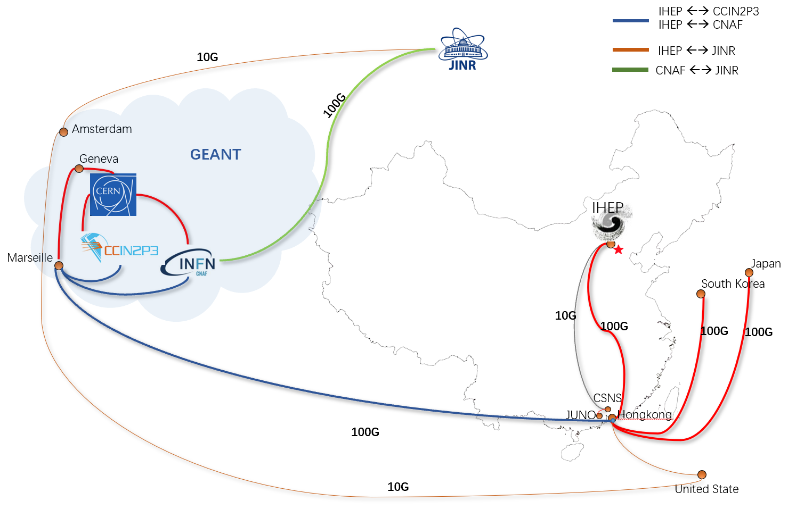
JUNO at IHEP
JUNO: Jiangmen Underground Neutrino Observatory
  To be in production in 2024
Grid Computing started since 2018,
  Includes INFN, CC-IN2P3, JINR, IHEP, for JUNO Production and raw
  data transfer.
Grid computing platform at IHEP:
  DIRAC system with IHEP-extensions
    monitoring, production system and job-submission API
  Shared middleware and infrastructures: FTS3, VOMS, TPC, etc.
Software deployed at IHEP:
  Storage: EOS, Lustre on disk, EOS-CTA on tape.
  Computing: HTCondor on x86, Slurm on ARM and GPU.
  Network: 10Gbps(From JUNO-onsite to IHEP),
  100Gbs(From IHEP to GEANT).
Data Challenge 1:
  12th ~ 26th Feb 2024, corresponding to WLCG DC24.
  Pressure transfer (500-1000 Mbps) with 4-8 times throughput than JUNO design.
  IHEP -> CNAF/IN2P3 transfer worked well, almost no failure.
  IHEP->JINR is bad and always get stuck.
Sites | Resources in 2024
 | CPU (KHS06) | Disk (PB) | Tape (PB)
IHEP | 180 | 8 | 4
CNAF | 20 | 3 | 1
IN2P3 | 15 | 0.2 | 2
JINR | 120 | 10 | 10
JUNO International Link

Slide 18
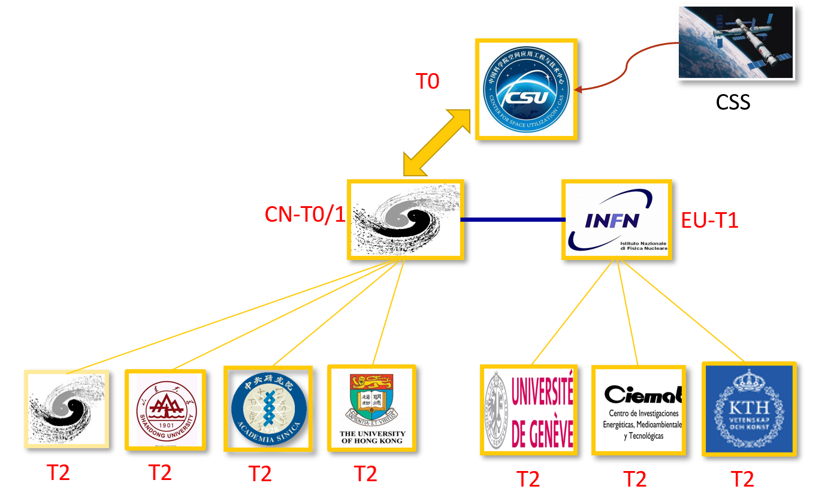
HERD & CEPC Plan at IHEP
HERD and CEPC is under construction
  HERD: High Energy Radiation Detection Facility
  CEPC: Circular Electron Positron Collider
HERD: To be in production in 2027
  Storage requirements: 45.5 PB in 10 year
  Computing requirement: >13000 CPUs in 10 years
  Computing model:
    Two Tier-1 sites run at China and Europe
    Several Tier-2 sites disperse across China and Europe
    Computing system: DIRAC + dHTC(HTC&HPC)
    Data storage and transfer management: Rucio.
CEPC: At the very beginning, everything is in design
  Distributed Computing System: DIRAC + Rucio integration in developing.
  Infrastructure and middleware: IAM, FTS3, etc.
Computing Model of HERD

Slide 19
Summary
The establishment of WLCG sites in China started in 2006 and has since undergone continuous upgrade
The construction of LHCb Beijing Tier-1 sites is progressing smoothly
CC-IHEP takes responsibility of most of the LHC experiments grid sites in China
Grid computing is utilized for the experiments led by IHEP

Slide 20
Thank you ！
Question?

