Slide 1
LHC BWS CONS project team meeting #11
BI-ML: William Andreazza, Morad Hamani, Lucas Limonet, Chiara Pasquino,
Harry Sullivan, Maria Teresa Ramos Garcia, Raymond Veness
BI-SW: Ana Guerrero Ollacarizqueta, Stephen Jackson, Steen Jensen
BI-PM: David Belohrad, Daniele Butti, Nabil El-Kassem, Aurelie Noelle Goldblatt,
Jean Tassan-Viol, Federico Roncarolo, Vishnu Varadan

Slide 2
2024 Introduction
Today’s first meeting of the year and good time to look to 2023 work done.
(But still a busy time with EYETS, some people could not make it today)
We had in 2023:
- 5 regular meetings
- 1 kick-off Bellows & Hybrid+
- 1 kick-off new design
- Meeting with compagnies
(UHVD, LINMOT, ETEL)
- lots of ad-hoc meetings
=> More follow-up & actions tracking this year

Slide 3
2024 Introduction
2023 achievements
Priorities
- Hybrids validated with beam (dedicated MD)
- Hybrids test with new laser calibration bench
- MCA extensively tested
- Many R&D investigations
- 4 Hybrid+ installed with new bellows in LHC
Plan for 2024
Push Hybrid+ for operation (LMC recommendation)
Test MCA with extended range (133mm!)
Test linear motor bench as candidate for actuator
R&D for in-vacuum parts and actuator
Prototype to test for run2025 ?
Continuity of service to OP before/after LS3
Test a suitable prototype before LS3 to validate the consolidation candidate.
Deploy the new devices during LS3, probably in // to Hybrid+ (requires additional infrastructure)
Agree with stakeholders of switch strategy parallel operation with Hybrid+ post-LS3?
Hybrid+ is just an intermediate system to ensure operation post LS3 with a proven system tested with beam.

Slide 4
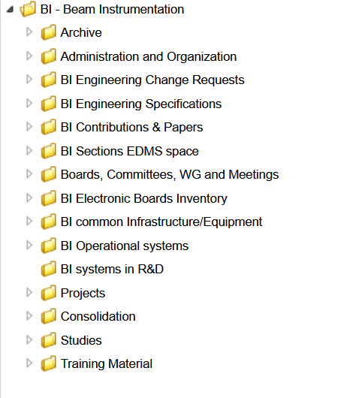
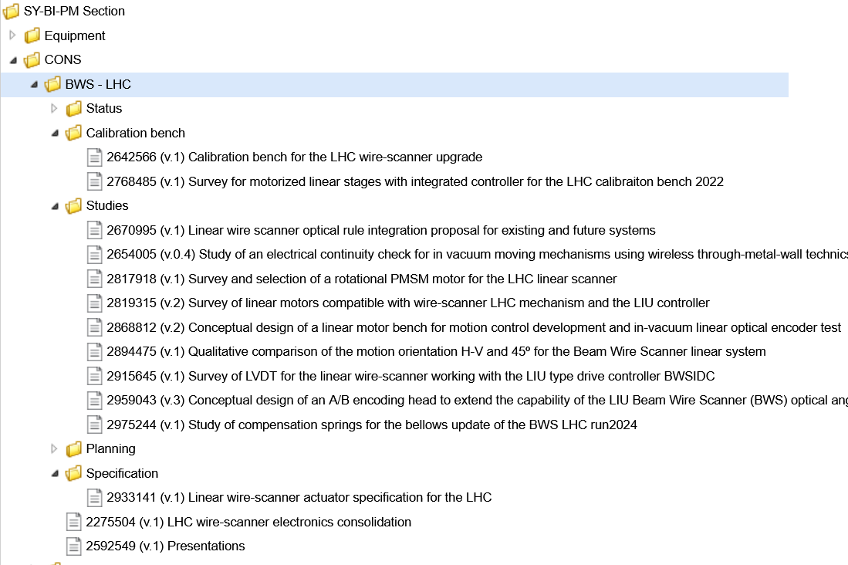
Documentations and follow-up
Move doc to official BI CONS structure
(from BI-PM and BI-ML sources)
Use JIRA to follow-up actions (if you like)

