Slide 1


Pablo Garcia Tello
IdeaSquare
CERN

Slide 2
Today's purpose is listening to all and each one of you

Slide 3

Although, given the circumstances…

Slide 4
Please, allow me sharing some thoughts

Slide 5
Fitting on Markus’ shoes
First, it is impossible…even if I would try, no matter how hard.
Second, it is absurd for me to pretend it: Therefore, I would do my best, with your help.
I owe everything @ CERN (and some other things) to: Markus, Thierry, Mar and Sergio.

Slide 6
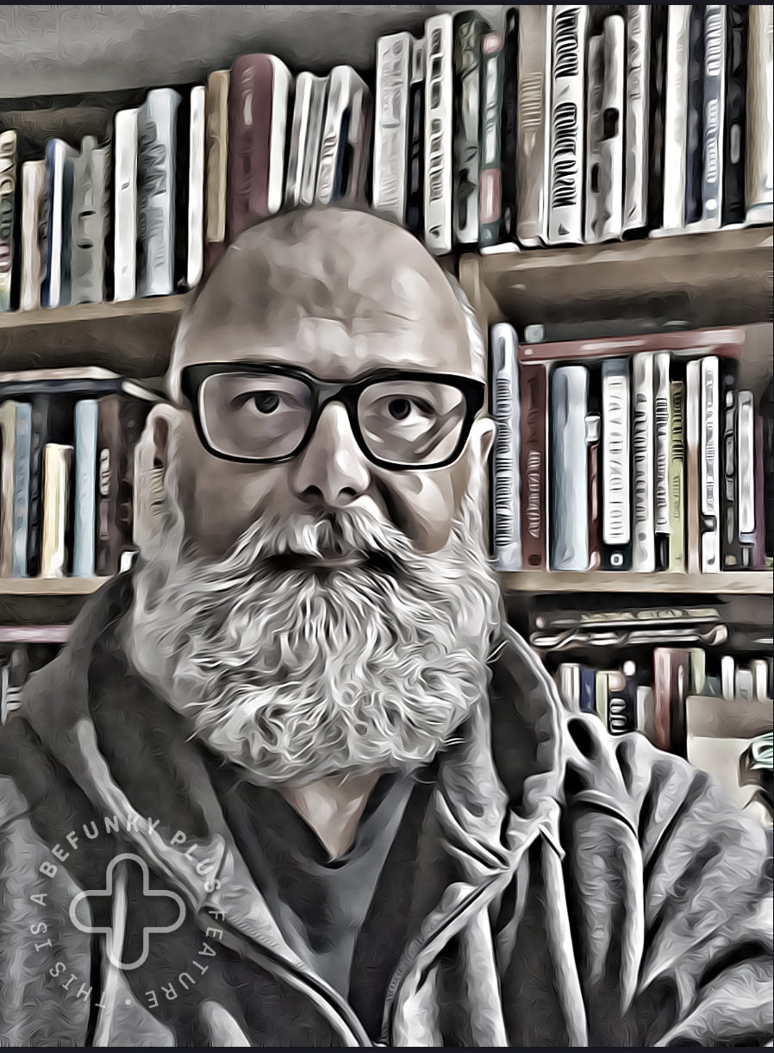
Let’s go…a bit of pants down
Personality type: ENTP
(consistent after 75 tests in different websites)

Slide 7
A bit of pants down
What do I like most from any individual? Commitment, team loyalty and being forward looking.
What I dislike most about any individual? Lame excuses, incompetence on purpose and idiots (*)
What am I really bad at? Interpreting feelings, “having a monthly talk” and telling anyone what to do.
I am a maniac about…font types (please don’t use Arial and/or Times New Roman).
(*) An idiot is a person causing an intentional damage to others without even obtaining a personal benefit.

Slide 8
What is IdeaSquare for me?
People over Things.
The embodiment of what each of you and all, as a team, would like it to become.
A team that constantly struggles for reinventing itself.

Slide 9
“People over Things”
That means ANYTHING.
IdeaSquare without anyone of you is plainly and simply an empty useless space.
I will fight relentlessly to attain the best possible contractual conditions for each one of you.
It won't be happening tomorrow, because we need to get the money for doing so.
And we must do it together.

Slide 10
“The embodiment of what each of you and all as a team would like it to become”
Propose and take the lead.
Don’t expect to be proposed and/or acting systematically (by default) only as a team player.
Everything fits…and if it doesn’t, we make it fit.
I don’t read minds and/or interpret people feelings: talk to me in direct terms anytime.
Support each other: If you don’t have time for it…find the time.

Slide 11
A team that constantly struggles for reinventing itself
If we claim we are unique, we must struggle to be so.
It means that when undertaking new paths 99.99 % of the time we will not know what we are doing.
If we become a “me too”, we better shut off the light.

Slide 12
How do I see our short-midterm future?
With rational optimism (*)
(*) Rational optimism: Accepting the reality of a situation while remaining confident that we can make things better.

Slide 13
How the IdeaSquare I dream about looks like?
The space with the best possible working conditions for each one.
A global reference for truly novel thinking pathways and ideas.
A place where people want to come and develop, and we have the money to make it possible.

Slide 14
Thanks, and Questions

